Slide 1
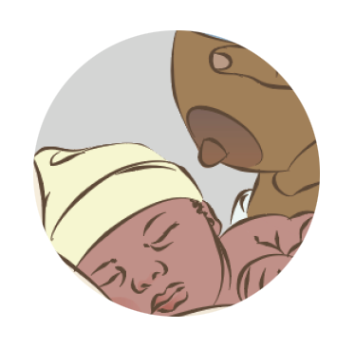

Breastfeeding:
Overcoming difficulties
Notes:
© World Health Organization 2024. All rights reserved.
Materials for demonstrations, practice, and simulations
Organise one set per group of 3 participants and a set for the facilitator (as available).
Newborn mannequin, small newborn mannequin, breastfeeding doll (wide-open mouth)
Breast models or breast simulator filled with water (as available)
Cloth or shawl to cover mother while breastfeeding
Local newborn clinical notes and monitoring forms
Local breastfeeding assessment forms/observation checklists

Slide 2
Content
Goal and learning outcomes
The situation
Preventing difficulties
Common breastfeeding problems
Maternal illness and newborn conditions
Summary
Clinical practice
Quality improvement
References and additional resources

Slide 3

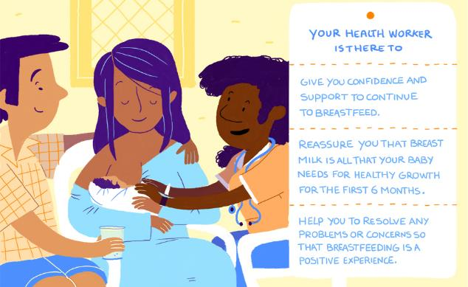
Goal and learning outcomes
All mothers are supported to
prevent and resolve breast-
feeding difficulties.
Assess and classify breastfeeding
difficulties.
Counsel and give practical support
to mothers to prevent and resolve
breastfeeding problems.
Notes:
Breastfeeding difficulties include:
Beliefs about size and shape of breasts or nipples
Beliefs about inadequate milk production
Lack of support or lack of confidence
Flat or inverted nipples
Sore or cracked nipples
Engorgement
Blocked ducts
Mastitis
Babies with specific problems (small, hypotonic, or with clefts)
Maternal illness or use of medications

Slide 4
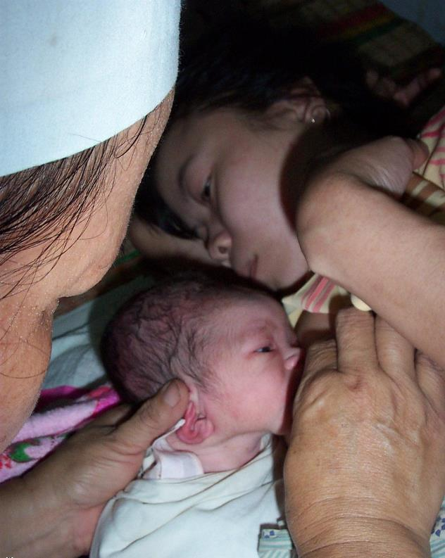
The situation
Baby Hoang has just been born.
The nurse knows it is important that she should breastfeed soon after birth.
Describe what you see.
© WHO/Dr Helenlouise Taylor
Notes:
The nurse is squeezing the mother’s breast and pushing Hoa onto the breast.
Hoang’s mother is not participating.
It is not clear if Hoang is ready to feed.
Is this respectful care?
How can you ensure that Hoang and her mother do not develop breastfeeding difficulties?

Slide 5
Overcoming breastfeeding difficulties
Form groups (mother, midwife, companion).
Examine, counsel and give practical support to Nitu.
Debrief with your team and facilitator.
Nitu complains of swollen red breasts.
She has no fever.
Notes:
Baseline simulation
Skills and performance – participants demonstrate examining, counseling and giving practical support for a breastfeeding problem.
Asking mother’s permission to observe a breastfeed and examine her breasts
Assessing a breastfeed
Examining the breasts for specific signs
Defining the breastfeeding difficulty
Counselling for the relevant problem, using effective and respectful communication
Giving practical support for the breastfeeding difficulty including:
- Positioning and attachment
- Massage of breast
- Expression of breastmilk
Debriefing – participants self-reflect and give feedback in their roles.
Provision of care (performance objectives)
What was done well?
What could have been done better?
What will you change the next time?
Experience of care
Was the communication respectful and the language appropriate?
Was handling of the baby gentle?
Were infection prevention practices followed?
Did the health worker ask for consent before touching mother or baby?
Did the health worker demonstrate positions using a mannequin?
Did the health worker use hand-on-hand technique to guide mother?

Slide 6
Preventing difficulties

Slide 7

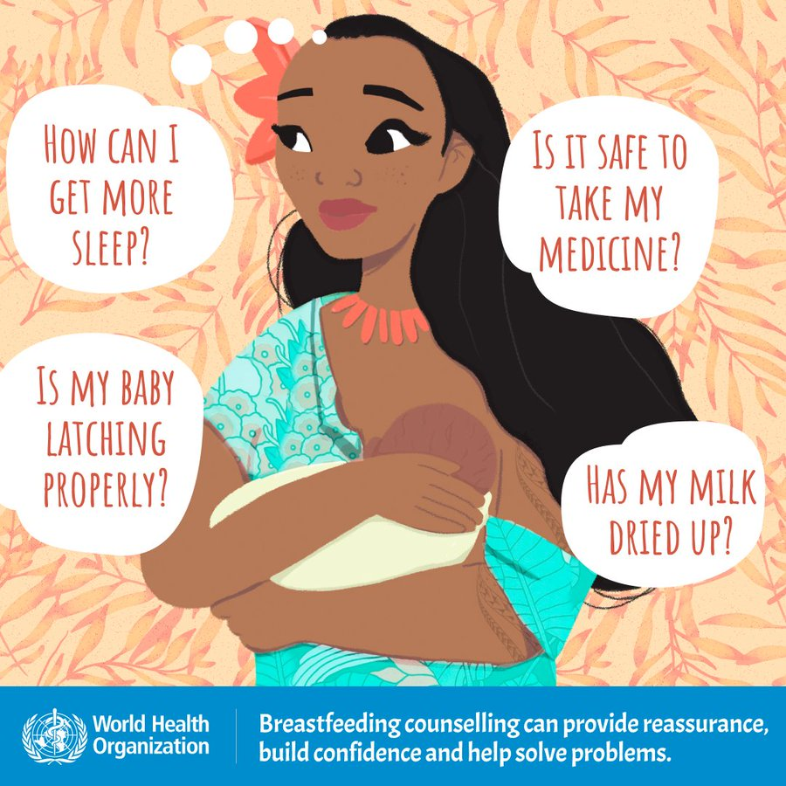
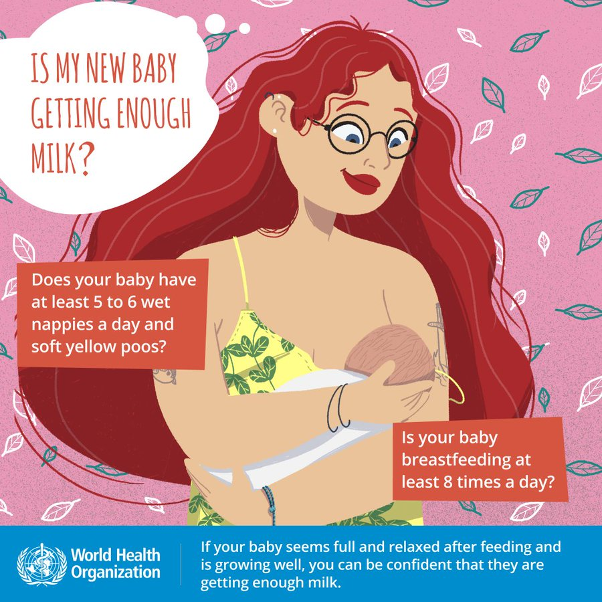
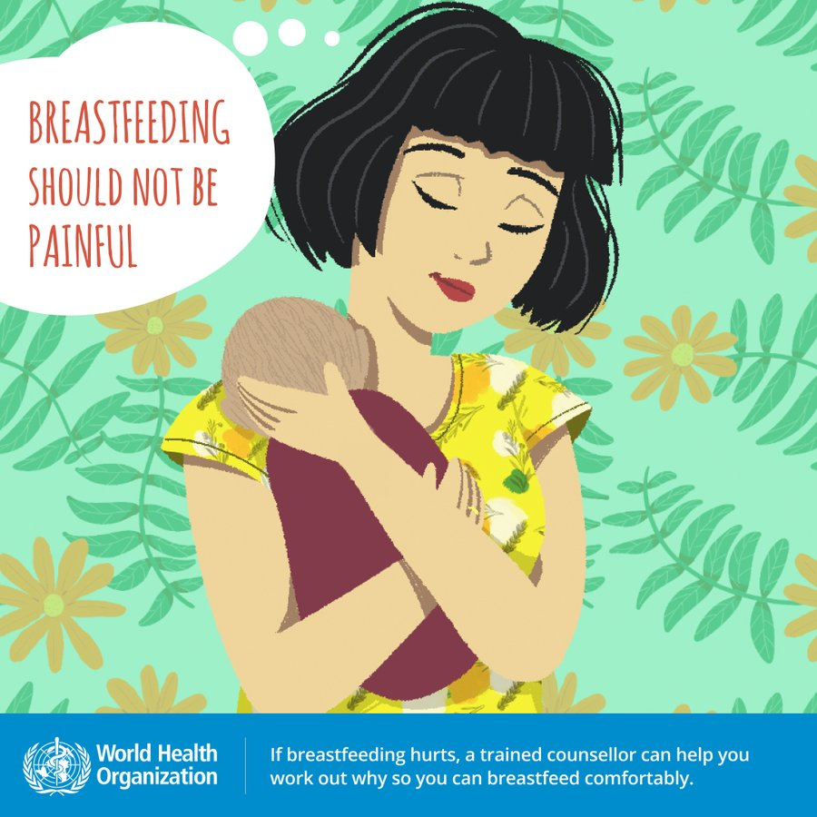
What concerns do mothers have about breastfeeding?
Notes:
What are the most common concerns of mothers in your health facility?
Addressing common concerns can prevent problems.
Supportive health workers help mothers build their confidence.
To learn more
Helping a breastfeeding mother

Slide 8
What are the most common breastfeeding problems?
Beliefs about size and shape of breasts or nipples
Beliefs about inadequate milk production
Lack of support or lack of confidence
Flat or inverted nipples
Sore or cracked nipples
Engorgement
Blocked ducts
Mastitis
Maternal illness or use of medications
Newborn conditions that affect feeding behaviour
Notes:
How common are these problems in your health facility?

Slide 9
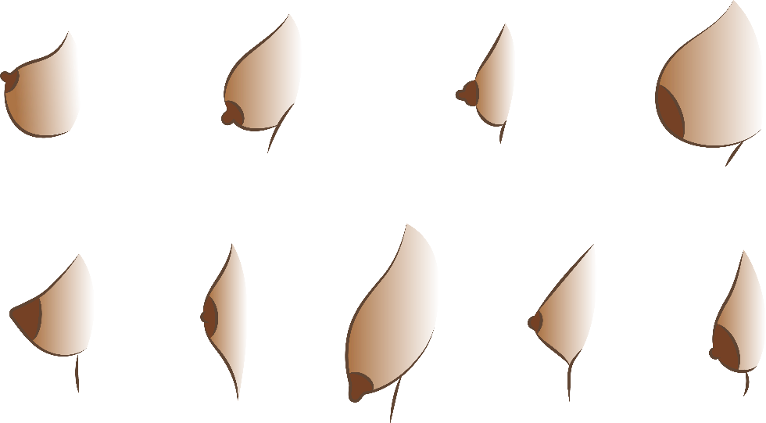
Which of these breast or nipple shapes cause feeding difficulties?
1
2
3
4
5
6
7
8
9
Notes:
None of these breast or nipple shapes cause feeding problems.
Breasts and nipples come in all shapes and sizes. All are good for breastfeeding. Mother and baby will learn together. Comfortable positioning will depend on the size of the baby and the size of the breast.
During pregnancy avoid telling a mother that she will not be able to breastfeed successfully. Do not “diagnose” or treat a nipple that looks flat or inverted.
A baby may have difficulty attaching if the nipple is large. Skin-to-skin contact and self-attachment can help. The mother can lean over her baby, on a bed or table, so that her breast falls towards the baby’s mouth. This may make it easier for the baby to attach.
Some mothers think their breasts are too small to make enough milk.
Small breasts do not mean inadequate milk production. All breasts can make adequate milk.
Small breasts and large breasts both contain about the same amount of glandular tissue, Fat and other tissue give the breast its shape and make difference in size. Small breasts may have less milk storage between feeds than larger breasts. Babies of mothers with small breasts may need to feed more often. The quantity of milk produced in a day is no different.

Slide 10

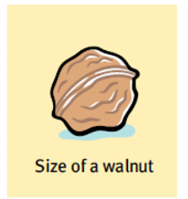

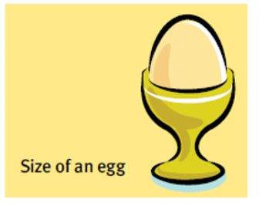
What is the size and volume of a newborn’s stomach?
Day 1
5–7 mL
Day 2
22–27 mL
1 Week
45–60 mL
1 Month
80–150 mL
Adapted from WHO 2020 BFHI training modules
Notes:
A newborn’s stomach is much smaller than many people imagine.
Size and volume also depend on gestational age and weight of the newborn.
Knowing the size of the stomach can help when counselling mothers who think they do not have enough milk.
To learn more
Bergman NJ. Neonatal stomach volume and physiology. Acta Paediatrica. 2013;102:773–7.
Zangen S, DiLorenzo C, Zangen T, Mertz H, Schwankovsky L, Hyman PE. Rapid maturation of gastric relaxation in newborn infants. Pediatr Res. 2001;50:629–32.

Slide 11

How often does the newborn feed?
First 24 hours
First feeding may be followed by a long
sleep, then 5–12 breastfeeds.
Newborns vary. Skin-to-skin contact,
rooming-in, and mother’s responsiveness to cues also influence frequency of feeds.
After day 3
Frequency of 10–12 times daily may decrease to an average of 8 times daily as milk volume increases.
© WHO/Yoshi Shimizu
Adapted from WHO 2020 BFHI training modules
Notes:
Understanding the changes in frequency of feeding is important when assessing for feeding difficulties.
To learn more
Holmes AV, McLeod AY, Bunik M. (2013). ABM clinical protocol #5: peripartum breastfeeding management for the healthy mother and infant at term. Breastfeeding Medicine, 8(6), 469–473. DOI:10.1089/bfm.2013.9979.

Slide 12
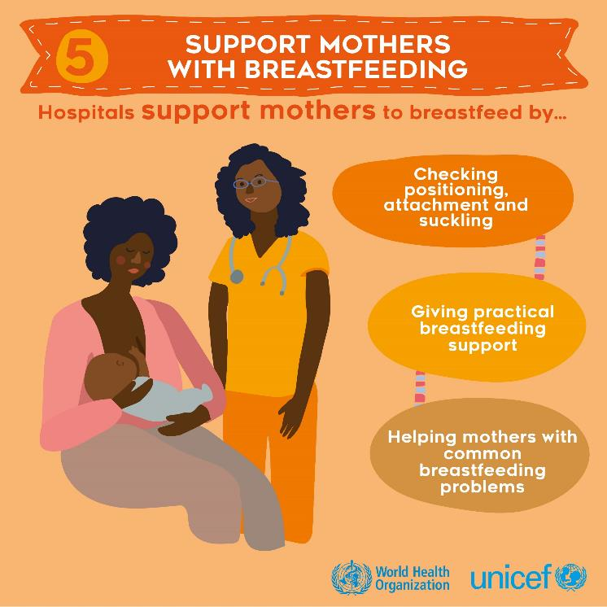
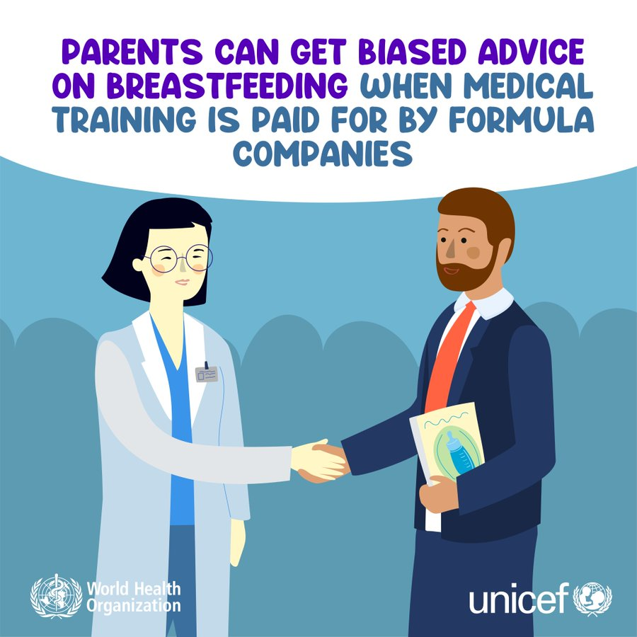
What is your role in preventing difficulties?
Notes:
Build mothers’ confidence and give unbiased advice.

Slide 13
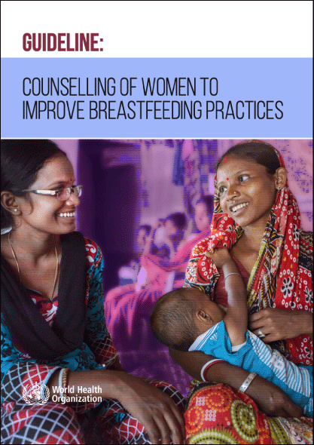
How can breastfeeding counselling prevent difficulties?
Find the guideline on pages 32–37, then go to page 5.
Notes:
Use a printed or digital copy (pdf) of the document.

Slide 14
Recommendation
Breastfeeding counselling should anticipate and address important
challenges and contexts for breastfeeding, in addition to establishing
skills, competencies and confidence among mothers.
Reasons
Benefits of breastfeeding counselling for primiparous women:
    Promote exclusive breastfeeding
    Reduce the using of artificial teats and bottles
Some women would like to have more information about:
    What to expect
    How to deal with common feeding problems
Notes:
Is this recommendation currently applied in your place of work?
If yes, what enabling factors support the application of this recommendation?
If no, what are the barriers to applying this recommendation?

Slide 15
Recommendation
A minimum of six breastfeeding counselling contacts take place:
    Before birth (antenatal period)
    During and immediately after birth (perinatal period
    up to the first 2–3 days after birth)
    At 1–2 weeks after birth (neonatal period)
    In the first 3–4 months (early infancy)
    At 6 months (at the start of complementary feeding)
    After 6 months (late infancy and early childhood).
Additional contacts as necessary for
    Primiparous women, adolescent women, after caesarean section,
    multiple pregnancies, women who plan to return to school or work,
    women who are obese
Notes:
Are all mothers counselled in your health facility?
When does counselling occur?
To learn more
Implementation guidance on counselling women to improve breastfeeding practices UNICEF & WHO, 2021.

Slide 16




How can you prevent problems for this mother and her newborn?
Antenatal counselling
Skin-to-skin contact
at delivery and early initiation
Support for good positioning and attachment
Rooming-in to promote responsive feeding
No supplementation
© WHO/Yoshi Shimizu
  Breastfeeding attachment
Notes:
View video
What new knowledge is presented in this video?
Are there any skills or practices that differ from your current practice?
What provider behaviours differ from your current practice?
Does this video highlight any quality gaps in your facility?
Note: Scissoring is no longer recommended for the normal newborn.
To learn more
BFHI medical indications for supplementary feeding
Antenatal counselling

Slide 17

Practise hand-expression of breast milk
Wash hands thoroughly.
Find a comfortable position.
Massage the breast and/or back and neck.
Hold a clean wide-necked container under the nipple and
areola to collect the milk.
Place thumb and first finger behind the nipple (at least 4 cm
from the tip of the nipple) in a “C” shape.
Press the breast toward the chest wall.
Compress the breast between finger and thumb, then release.
Press, compress and release all the way around the breast.
© Da Nang hospital for women & children Vietnam
Hand expression
Notes:
Practise the technique of hand expression with a breast model.
View video
Which mothers do you teach how to express their breast milk?
All mothers should be taught hand‐expression, not only those with babies who are unable to breastfeed. Mothers may need to relieve their breast or leave milk for their baby when they go back to work.
All health care workers who care for breastfeeding mothers should be able to teach mothers how to express their breast milk.
It is not necessary for the health worker to touch a mother’s breasts when teaching hand expression. Using a breast model is an effective way to demonstrate for the mother.
Expressing should not hurt. If it does hurt, check technique.
If a baby is not able to breastfeed, a mother should begin expressing her milk as soon as possible after delivery, ideally, within one hour, and not later than six hours after birth. This includes mothers who have delivered by caesarean section. The newborn can receive mother’s milk by an alternative method of feeding if unable to feed at the breast.
How often should the mother express breast milk?
Express six or more times in 24 hours, day and night , approximately every three hours.
A mother might need to express for five to 10 minutes to get a teaspoon of colostrum. She can express for longer to store colostrum for later.
It is easier to hand-express when the breasts are soft.. Teach a mother how to express her milk in the first and second day after delivery. Do not wait until the third day, when her breasts are full.
She should express as much milk as she can, each time. When expressing to relieve symptoms, such as engorgement, or softening the areola to help the baby attach, she should express only as much as necessary.
Freshly expressed milk be given to the baby immediately.
If this is not possible, follow milk storage guidelines.

Slide 18

Practise demonstrating and supporting a mother for hand expression
© WHO/Gato Borrero
  How to express breast milk
Notes:
Use model breast or your own breast
Support the mother to express milk herself.
Do not squeeze her breasts.
View video 00:50–04:12.
Preparing the container
Choose a small cup, jug or jar with a wide mouth.
Wash the cup in soap and water. (She can do this the day before.)
Pour boiling water into the cup and leave it for a few minutes. Boiling water will kill most of the germs.
When ready to express milk, pour the water out of the cup.
If colostrum is being expressed, Use a small syringe (without a needle) or a spoon. If a mother can express only a few drops, it can be difficult to collect in a cup. A helper can collect the milk with a syringe directly from the nipple, and it can be given to the baby directly from the syringe.
A mother will need to practice before much milk is expressed. Encourage her not to give up if she gets little milk or no milk on the first attempt.
The amount of milk obtained increases with practice:
Remind the mother that colostrum is expressed in the first two to four days. Because it is thicker, she will notice that it does not spurt or spray.
Expect about a teaspoon of colostrum at each expression.
After Day 2 or 3, she should find expression easier. The milk will come more quickly and in spurts.
To learn more
Assessment-of-breastmilk-expression-checklist

Slide 19
How long can breast milk be stored?
 | STORAGE LOCATIONS AND TEMPERATURES
TYPE OF BREAST MILK | Countertop 77 °F /25 °C or colder (room temperature) | Refrigerator 40 °F /4 °C | Freezer 0 °F or ≤18 °C or colder
Freshly expressed or pumped | Up to 4 Hours | Up to 4 Days | Within 6 months is best. Up to 12 months is acceptable.
Thawed, previously frozen | 1–2 Hours | Up to 1 Day (24 hours) | NEVER refreeze human milk after it has been thawed.
Leftover from a feed | Use within 2 hours after the baby is finished feeding.
Is this good technique?
  Expressing and storing breast milk, 6.30–7.54
Notes:
View video
How do you store expressed breast milk in your health facility?
To learn more
Hand expression and safe storage

Slide 20
Common breastfeeding problems

Slide 21
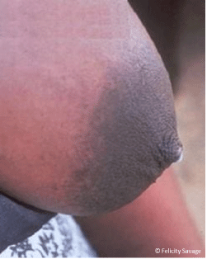
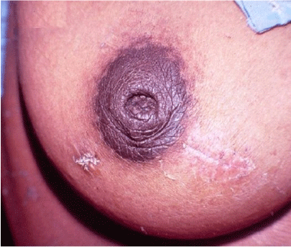
What is the appearance of flat or inverted nipples?
Notes:
Photograph 1: What do you observe?
Nipple look flat.
Photograph 2 :What do you observe?
Nipple inverted.
Can a mother with flat or inverted nipples breastfeed?
Yes.
Babies do not suckle from the nipple. They take the nipple and the breast tissue underlying the areola into their mouths to form a “teat”.

Slide 22
When and how will you support mothers with flat or inverted nipples?
Time period | Practical support
Antenatal | Build mother’s confidence. Reassure. Explain.
Soon after delivery | Build the mother’s confidence. Her breasts will change. Explain that the baby suckles the breast, not the nipple. Let the baby explore the breast skin-to-skin. Help to position her baby on the first day. Try different positions, ensuring the mother is comfortable. Help her to make the nipple stand out more. Consider use of syringe
First weeks (only if necessary) | Express breast milk and feed with a cup. Express breast milk into the baby’s mouth.
Adapted from WHO 2020 BFHI training module
Notes:
Review table on slide:
The most important time to help a mother is soon after delivery.
If a mother is worried about inverted nipples, explain that they will improve. Explain about how a baby suckles from the breast behind the nipple, not from the nipple itself.
If a mother has a problem with her breasts that you are unsure about, such as previous breast surgery or burns, refer to a counsellor or someone more experienced.
Support the mother for good attachment and build her confidence

Slide 23
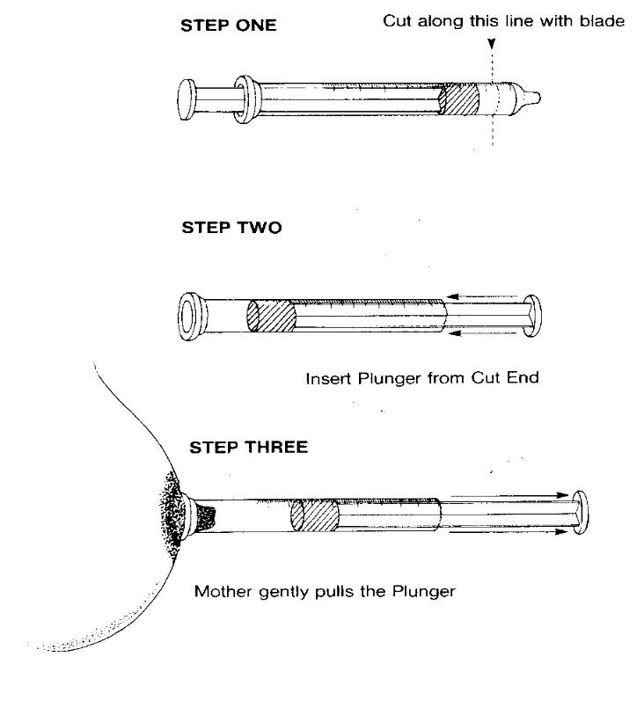
Flat or inverted nipples syringe treatment
© Felicity Savage
Notes:
Optional practice
The baby feeds from the breast and NOT from the nipple. If the baby is well attached, the nipple will often respond over days, and this technique will NOT be needed. When the baby is well attached, milk will pass through the nipple. Mothers with inverted nipples successfully breastfeed their babies.

Slide 24
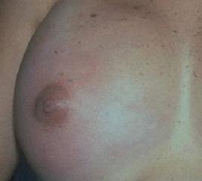
What are the signs of engorgement?
2
Engorged
Painful
Oedematous
Tight, especially nipple
Shiny
Red
Milk NOT flowing
Fever may occur for 24 hours
© UNICEF/UNI51384/Press
Adapted from WHO 2020 BFHI training modules
Notes:
The signs of engorgement are clues to why it causes breastfeeding difficulties.
The breasts are over full and swollen, partly with milk and partly with increased tissue fluid and blood.
The breasts looks shiny and hard because of oedema (increased tissue fluid).
Swelling and oedema block the flow of milk, which builds up and causes stasis.
The nipple is flat because the skin is stretched tight, which can lead to difficulties in attachment.
When breasts are engorged, the skin looks red. Fever can raise concern for mastitis; however, the fever often resolves in 24 hours.

Slide 25
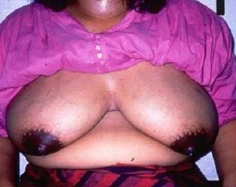
What are the signs of milk volume increasing normally?
1
Full Breast
Hot
Heavy
Hard
Milk flowing
No fever
© UNICEF/UNI51384/Press
Adapted from WHO 2020 BFHI training modules
Notes:
The normal increase in milk production a few days after delivery can produce discomfort.
The breasts are large because they are filled with milk.
Breasts may feel hot, heavy and hard when milk production is increasing rapidly.
Milk flowing well and absence of any fever distinguish normal fullness from engorgement.
Full breasts may feel lumpy.
The only treatment needed is to breastfeed frequently and remove the milk.
The heaviness, hardness or lumpiness decreases after a feed, and the breasts feel softer and more comfortable.
In a few days, the breasts adjust to the baby’s needs and will feel less full.

Slide 26
What are the causes of engorgement and how can it be prevented?
Causes
Plenty of milk
Delayed start to breastfeeding
Poor attachment to breast
Infrequent removal of milk
Restriction of length of feeds
Prevention
Remove milk frequently, start
breastfeeding early
Start breastfeeding soon after delivery
Ensure good attachment
Encourage unrestricted breastfeeding
Notes:
What causes of engorgement do you see in your health facility?
How do you prevent engorgement when working with mothers?
Ensure good attachment and frequent responsive feeding.

Slide 27
How do you manage engorgement?
Do not “rest the breast.”
If baby is able to suckle:
Hold baby skin-to-skin, help with attachment and allow to suckle frequently. This stimulates oxytocin.
If baby is not able to suckle:
Express milk by hand or with a pump.
To stimulate oxytocin reflex, before feed: Use warm compress or take warm shower. Massage neck and back. Lightly massage the breast. Stimulate nipple skin. Help mother to relax. Support her and build her confidence.
To reduce oedema, after feed: Use cold compress
Adapted from WHO 2020 BFHI training modules
Notes:
How do you manage engorgement in your health facility?
In the past midwives and family members would recommend to rest the breast.
If milk is not removed, milk production will decrease.
Support mothers with engorgement:
Keep the baby in skin‐to‐skin contact.
Encourage rooming-in in 24/7.
Help to express breast milk.
Counsel mothers on the risks of pacifiers, artificial teats or bottles, so that they do not replace suckling at the breast.
Teach how to massage breasts.
Reduce oedema with cold compress.
To learn more
Breast pain
Breast engorgement

Slide 28
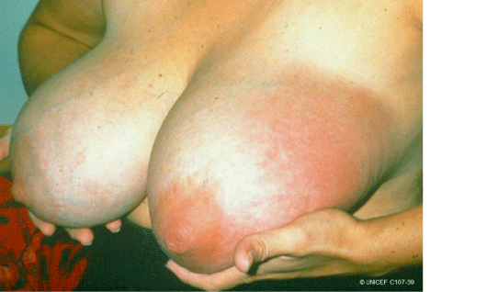
What are the signs of blocked ducts and ?
Notes:
What do you observe in this mother with mastitis?
Part of the breast is swollen and hard, with redness of the overlying skin.
This mother has severe pain, fever, and feels ill, with headache and nausea.
Blocked ducts and milk stasis lead to mastitis.
Approximately one of every four breastfeeding women experiences mastitis during the first 26 weeks postpartum.

Slide 29
How do you prevent and manage blocked ducts and mastitis?
Supporting mother to improve milk removal
Look for cause and correct
Poor attachment?
Pressure from clothes?
Large breasts draining poorly?
Advising and supporting
Frequent breastfeeds
Gentle massage towards nipple
Warm compress
Pain relief analgesics (ibuprofen)
Vary positioning
If these symptoms continue:
Symptoms severe
(high fever, large area affected, fissure,
no improvement in 24 hours)
Pain relief and support
Refer to an appropriate medical
provider for antibiotic treatment
Adapted from WHO 2020 BFHI training modules
Notes:
What causes blocked ducts?
Inadequate removal of the milk from all or part of a breast
Infrequent or short breastfeeds
Not responding to feeding cues
In your practice, how do you prevent mastitis ?
Counsel and support to practice responsive breastfeeding, good positioning and attachment hand-expression of breast milk and use of warm or cold compress, based on a woman’s preferences. (WHO Recommendation).
In your health facility how do you manage mastitis?
Support mothers with empathy and kindness. Mastitis is very painful, and the mother needs pain relief and sensitive practical support
Improve milk removal, positioning and attachment, and give massage.
If high fever, large area affected, fissure, no improvement in 24 hours, refer to an appropriate health worker for antibiotic treatment
Give cloxacillin 500 mg every 6 hours for 10 days
Give paracetamol for severe pain
Re-assess in 2 days
Refer if no improvement.
To learn more
UNICEF Breastfeeding problems

Slide 30
What are newborn signs of inadequate milk intake?
Clinical evidence of dehydration
    Dry mucous membranes, poor skin turgor, sunken fontanelle not improved after assessment and management of breastfeeding
Weight loss
Low urine output
Delayed bowel movements, delayed transition in stools
from meconium to transitional
Adapted from WHO 2020 BFHI training modules
Notes:
Do you routinely assess a newborn for adequacy of feeding in the health facility?
Sometimes a baby is getting enough milk, but the mother thinks her milk supply is low.
Support the mother to breastfeed with confidence.
Explain the signs that milk volume is adequate to the family, so they will not pressure mother to bottle feed.
Counsel mothers when and where to seek medical advice and support:
Baby apathetic
Irritable or weak cry
Inability to suck or no signs of swallowing
More than 12 feeds per day and never seeming satisfied
Most feeds lasting more than 30 minutes
Scant urine
No stools

Slide 31

What are the factors underlying not enough milk?
Breastfeeding factors
Delayed initiation
No or little skin-to-skin contact
Milk “coming in” delayed due to:
    Complications of delivery
    Maternal illness
    Diabetes
Poor attachment and ineffective
suckling
Feeding at fixed times
Short or infrequent feeds
Supplementary feeding
No night-time feeding
Behavioural factors
Lack of support from health workers or
family
Lack of confidence
Worry and stress
Dislike of breast-
feeding
Tiredness
Lack of bonding
Rejection of newborn
© WHO/Yoshi Shimizu
Notes:
To learn more
Is your baby getting enough Milk?
Increasing your milk supply

Slide 32
How will you assess if milk supply is adequate?
Meena’s mother-in-law says Meena does not have enough milk.
Listen carefully to the mother and take a detailed history.
Use effective and empathic communication.
Assess the infant’s health.
Assess the big picture (pressure from family, etc).
Assess the mother’s health (physical and psychological health).
Observe one or more feeds.
Not enough milk
Notes:
In the history, find out if the mother is breastfeeding exclusively or giving supplementation.
When assessing the infant, ask:
Is the baby removing milk from the breast?
What is the baby’s output (urine and stooling pattern)?
Is the baby’s weight within the expected range (on a growth chart)?
View video
What is new knowledge for you in this video?

Slide 33
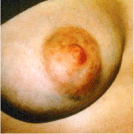
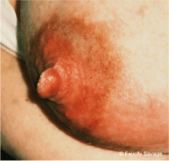
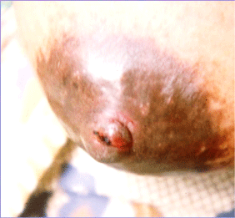
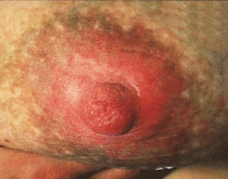
What are the signs of sore nipples?
© UNICEF C107-32
© Felicity Savage
© Felicity Savage
© Chloe Fisher
Notes:
Describe each clinical photograph.
Sore nipple with bruising on the bottom of the areola and dilated blood vessels
Poor attachment causes the skin of the breast to rub against the baby’s mouth with sucking.
Fissure across the tip of the nipple, tight and shiny breast (oedema)
This mother waited to put her baby to her breast until day 3. The overly full breast prevented good attachment, and the baby sucked only on the nipple, damaging the skin.
Ridged line across the tip of the nipple (compression stripe)
Pressure from poor attached has deformed the nipple.
Red, shiny area of skin on the nipple and areola and loss of pigmentation
This mother has Candida infection, or thrush. She also describes burning pain that continues after a feed and becomes worse than during the feed.
What is appropriate management for Candida?
Check the baby for thrush - white patches inside the cheeks or on the tongue or a red rash on the buttocks.
Refer both mother and baby for treatment with a topical antifungal. If treatment is not effective, fluconazole, given orally, is recommended.
Advise the mother to stop using pacifiers (dummies).
In women living with HIV, treat breast thrush and oral thrush in the infant promptly to prevent systemic infection.
To learn more
Nipple pain

Slide 34
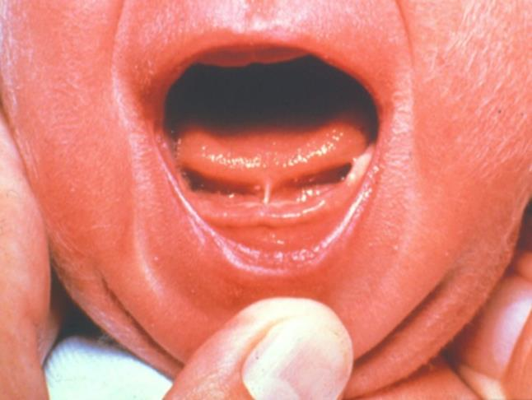
What are common causes and management of sore or cracked nipples?
Causes
Poor attachment
Candidiasis
Tongue tie (less common)
Management
Improve attachment
Identify and address underlying cause – engorgement, fissure, Candida, tongue tie
Protect skin to promote wound healing
© Felicity Savage
Adapted from WHO 2020 BFHI training modules
Notes:
What are the most common causes and how do you manage mothers with sore or cracked nipples in your health facility?
What do you see and what do you do?
Tongue tie in a newborn may occur when the fold of skin under the tongue (lingual frenulum) that attaches the bottom of the tongue to the floor of the mouth is unusually short, thick or tight.
The baby is usually able to breastfeed. Reassure parents that the tongue will grow normally as the baby gets older.
Surgery is not routinely needed.
If there is difficulty with feeding because the tie is restricting the tongue’s movement and the baby does not gain weight, refer the baby for evaluation and management

Slide 35
Maternal illness and newborn conditions

Slide 36
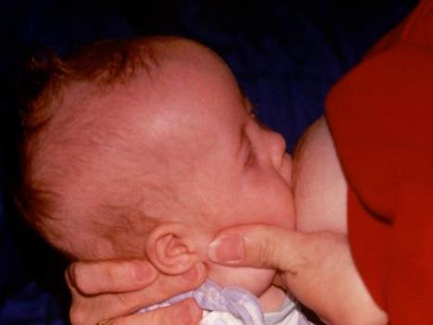
What newborn conditions affect breastfeeding?
© WHO
Notes:
What do you see and what do you do?
Harry has trisomy 21 (Down syndrome) and low muscle tone.
Mother is giving firm support of head, neck and chin with the baby in an upright position (“dancer” position for breastfeeding).
She supports her breast and her baby’s chin to maintain good attachment.
What techniques do you use to make feeding easier for a hypotonic baby?
Feeding may take a long time regardless of technique.
Wake for breastfeeds and stimulate to remain alert during feeding.
Mother may also need to express her milk and feed by cup.
Some babies gain weight slowly even if they receive enough breast milk. They may have other health problems, for example, a cardiac problem. Ensure relevant follow-up.
To learn more
Dancer position, Massage techniques to help babies with low tone breastfeed better 14.52–15.22
Can babies with other special needs or neurological syndromes breastfeed?
Many babies with apparent barriers to breastfeeding manage better than expected.
Support early and prolonged skin-to-skin contact and responsive care to build confidence.
Encourage the mother to begin breastfeeding as soon as possible after birth.
Let a baby explore the breast and try to attach in his or her own way.

Slide 37
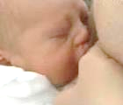
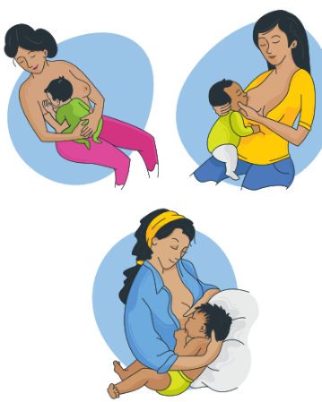

Position a baby with cleft
© Smile Train
Unilateral cleft
© Smile Train
©smiletrain 2021
Bilateral cleft
Notes:
View videos
Why do these babies have saturation monitors?
What is new knowledge for you in these videos?
Are there any skills or practices that are different from your current practice?
Do the videos highlight a quality gap?
Practise techniques useful for breastfeeding a baby with a cleft.
Express milk to increase flow before attaching the baby.
Use alternative positions that help the baby self-attach and make mother comfortable.
Modified underarm position
Straddle position, with baby sitting upright facing mother with legs to either side, back supported with arm and head with hand
Help babies with frequent burping/winding as they swallow air.
Assess need for alternative feeding methods: special cup, spoon or other system.
To learn more
Breastfeeding for newborns with cleft 0-3.28
What difficulties may these babies have?
Poor attachment – baby tiring easily, breast problems for mother
Nasal regurgitation – desaturation or aspiration (pneumonia)
Poor growth – malnutrition if inadequate feeding support
How else can you support mothers and families?
Maintain skin-to-skin contact and encourage responsive, nurturing care from birth.
Refer early for surgical treatment and expert feeding support.
Support the parents to overcome possible stigma related to cleft.
Link mothers and families to support groups and appropriate psychosocial support as needed.

Slide 38
Should mothers taking medications stop breastfeeding?
Type of medication | Breastfeeding management
Most commonly used drugs | Safe in usual dosages for breastfeeding Check LactMed database
Estrogen-containing contraceptives Thiazide diuretics | Use alternative drug May decrease milk supply
Chloramphenicol, tetracycline, metronidazole, sulfonamides, co-trimoxazole, dapsone | Use alternative drug if possible Monitor baby for jaundice
Psychiatric drugs Anticonvulsants | Continue breastfeeding Side-effects possible Monitor baby for drowsiness
Some anticancer drugs Radioactive substances (temporarily) | Breastfeeding contraindicated
Adapted from WHO 2020 BFHI training modules
Notes:
In your health facility which mothers do you advise to stop breastfeeding?
If mothers are taking medications during breastfeeding, understand if those medications can affect the baby.
Most drugs pass into breast milk only in small amounts. Very few affect the baby.
It is rarely necessary to stop breastfeeding because of a mother’s medication.
It is harmful to stop breastfeeding just because the mother is taking a medication and no one has checked whether it is contraindicated or not.
Contraindicated medications are few. They include anticancer drugs and radioactive substances.
Consultation with a doctor or breastfeeding/lactation specialist can help answer difficult questions.
To learn more
LactMed
This is a database of drugs and other chemicals to which breastfeeding mothers may be exposed. It includes information on the levels of such substances in breast milk and infant blood and the possible adverse effects in the nursing infant. Suggested therapeutic alternatives to those drugs are provided where appropriate. All data are derived from the scientific literature and fully referenced.
Breastfeeding and maternal medication: recommendations for drugs in the Eleventh WHO Model List of Essential Drugs.

Slide 39
How should you support breastfeeding when a mother is sick?
Any ill woman
If admitted to health care facility, admit baby with her.
Reassure her that she can continue to breastfeed, and you will support and help her.
Encourage her to continue.
Fever
Give her plenty to drink. Treat underlying cause.
Feels too unwell or unwilling to breastfeed
Help her to express her breast milk and feed by cup.
Extremely ill and unable to express herself
Consider expressing her breast milk and feeding by cup.
Psychiatrically ill
Care for mother and baby together. Allow companion.
When mother recovers
Help her to increase her breast milk supply or re-lactate.
Notes:
In your health facility do mothers who are sick continue to breastfeed?
It is rarely necessary for a sick mother to stop breastfeeding.
With most common infections, antibodies in breast milk protect the baby.
A mother may fear that her baby will catch her illness, or someone may have advised her to stop, or she may have been admitted to hospital and separated from her baby.
Alternatives to breastfeeding include wet nursing and human donor breastmilk, with bovine breast milk substitute as a last resort.

Slide 40
How should you support a mother to restart breastfeeding?
Take a breastfeeding history and review reasons for supplementation.
Revisit positioning, attachment and responsive feeding.
Encourage ongoing skin-to-skin contact to boost hormonal response.
Monitor baby’s stool and urine output.
Consider breast milk expression by hand or pump.
Explain importance of night feeds, keeping baby close and the impact of
dummies/pacifiers.
Counsel regarding variable time needed (easier in the first few months and
if breastfeeding was well-established initially).
Notes:
Do you practice re-lactation in your health facility?
Re-lactation takes time, motivation, patience and experienced health workers as support.
Re-lactation is especially important, in cultures where it is acceptable, if the mother has died during childbirth and another mother or family member will feed the orphaned infant.
Re-lactation can be important during humanitarian emergencies and when a newborn has been sick.
Mothers adopting a newborn can breastfeed with support
To learn more
UNICEF guidance on relactation 2020
Relactation: review of experience and recommendations for practice
Relactation in infant feeding in emergencies (IFE), Module 2, Version 1.1

Slide 41
Overcoming breastfeeding difficulties
Form groups (mother, midwife, companion).
Examine, counsel and give practical support to Nitu.
Debrief with your team and facilitator.
Nitu complains of swollen red breasts.
She has no fever.
Notes:
Repeat simulation
Skills and performance – participants demonstrate examining, counseling and giving practical support for a breastfeeding problem.
Asking mother’s permission to observe a breastfeed and examine her breasts
Assessing a breastfeed
Examining the breasts for specific signs
Defining the breastfeeding difficulty
Counselling for the relevant problem, using effective and respectful communication
Giving practical support for the breastfeeding difficulty including:
- Positioning and attachment
- Massage of breast
- Expression of breastmilk
Debriefing – participants self-reflect and give feedback in their roles.
Provision of care (performance objectives)
What was done well?
What could have been done better?
What will you change the next time?
Experience of care
Was the communication respectful and the language appropriate?
Was handling of the baby gentle?
Were infection prevention practices followed?
Did the health worker ask for consent before touching mother or baby?
Did the health worker demonstrate positions using a mannequin?
Did the health worker use hand-on-hand technique to guide mother?

Slide 42
Summary
In this module, you have:
Assessed mothers and newborns for breastfeeding difficulties
and special situations.
Demonstrated giving practical support to a mother to resolve difficulties.

Slide 43

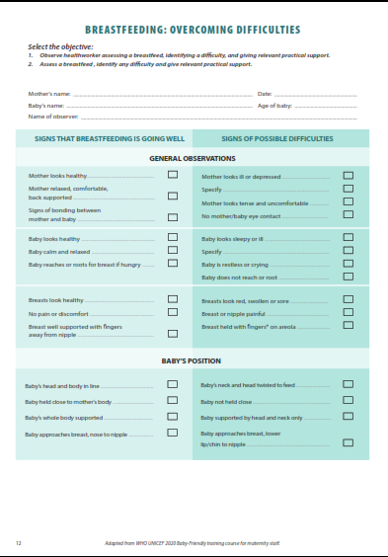
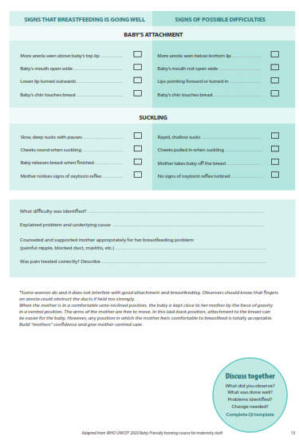
Clinical practice
Notes:
Review the Clinical practice checklist before observing or practicing in the clinical area.

Slide 44

Quality improvement
  POCQI example: support mothers to express breast milk
Notes:
After the clinical practice, discuss the observations made, possible reasons for practices, and changes needed to improve the quality of essential newborn care.
What new things will you do?
What old things will you not do?
How will you make a change?

Slide 45
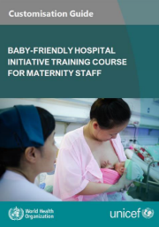



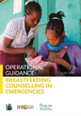
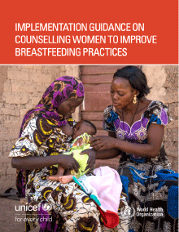

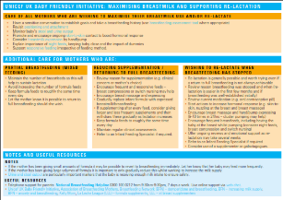
References and additional resources
  Overview Overcoming difficulties
  Breastfeeding master class
  The cost of not breastfeeding

Slide 46
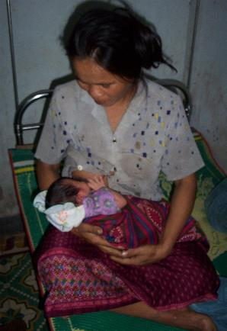
Support Thu to breast feed her first baby
Form groups (mother, midwife, and companion).
Support Thu for positioning and attachment.
Give her practical tips for successfully breast feeding
her baby.
Debrief with your team and facilitator.
Thu is blind.
Huong is her first child. Thu wants to breastfeed her
baby to ensure he gets off to a good start in life.
The baby is showing feeding cues.
© WHO/Dr Helenlouise Taylor
Notes:
Simulation
Skills and performance – participants demonstrate supporting positioning and attachment with a mother who needs adapted methods of learning.
Communicating respectfully with a mother with a visual impairment
Demonstrating with hand-on-hand technique using touch for positioning and attachment and listening for effective latch and feeding
Explaining what to do if attachment does not feel right
Exploring which position Thu and her baby prefer – reclined or side-lying, football hold with pillow
Referring appropriately (lactation consultant if available).
Debriefing – participants self-reflect and give feedback in their roles.
Provision of care (performance objectives)
What was done well?
What could have been done better?
What will you change the next time?
Experience of care
Was the communication respectful and the language appropriate?
Did the health worker ask for consent?
Did the health worker use hand-on-hand technique for trying different positions?
Were infection prevention practices followed?

Slide 47
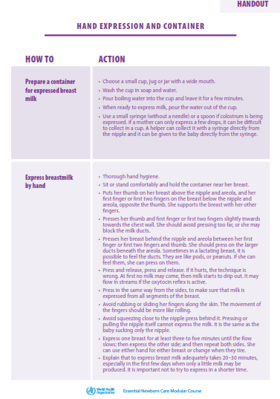
Breastfeeding after caesarean section
Form groups (mother, companion, neonatal nurse).
Support Bobby’s mother to express her breast milk.
Counsel her on breastfeeding after caesarean section.
Debrief with your team and facilitator.
Bobby was born 2 hours ago by caesarean section.
He weighs 2000 g and is under a radiant warmer.
He has not yet breastfed and now is too sleepy to feed.
He has no other problems and examination was normal.
Notes:
Simulation
Skills and performance – participants demonstrate supporting expression of breast milk after caesarean section.
Communicating the importance of skin-to-skin contact to feeding reflexes
Recognizing feeding cues
Providing responsive feeding – including gently stimulating to wake and feed
Expressing breastmilk as soon as possible after birth if baby does not feed
Storing breast milk safely
Supporting Betty to establish skin-to-skin contact and initiate breastfeeding
Debriefing – participants self-reflect and give feedback in their roles.
Provision of care
What was done well?
What could have been done better?
What will you change the next time?
Experience of care
Was the communication respectful and the language appropriate?
Was handling of the baby gentle?
Were infection prevention practices followed?
Was it necessary for the newborn to be under a radiant warmer?

Slide 48
Overcoming breastfeeding difficulties
Form groups (mother, midwife, companion).
Counsel and give practical support to Meena.
Examine, counsel and give practical support to Nitu.
Support and counsel Grace.
Debrief with your team and facilitator.
Meena has cracked nipples.
She is in discomfort.
Nitu complains of swollen red breasts.
She has no fever.
Grace has stopped breastfeeding and has no milk.
Notes:
Simulation
Select 1, 2 or 3
Use local breastfeeding observation checklist.
Skills and performance – participants demonstrate:
Assessing a breastfeed and defining the breastfeeding difficulty
Counselling for the relevant problem, using effective and respectful communication.
Giving practical support for the breastfeeding difficulty including
- Positioning and attachment
- Massage of breast
- Expression of breastmilk
Debriefing – participants self-reflect and give feedback in their roles.
Provision of care (performance objectives)
What was done well?
What could have been done better?
What will you change the next time?
Experience of care
Was the communication respectful and the language appropriate?
Was handling of the baby gentle?
Was the baby swaddled or tightly wrapped?
Were infection prevention practices followed?
Did the health worker ask for consent before touching mother or baby?
Did the health worker demonstrate positions using a mannequin?
What technique did the health worker use? (direct touch or hand on hand)

Slide 49
Re-lactation
Form groups (mother, midwife and companion).
Counsel and give practical support to Tatiana.
Debrief with your team and facilitator.
Tatiana delivered her first born a healthy baby boy, Igor 6 days ago.
She chose to bottle-feed and was discharged home after 24 hours.
Water supplies are irregular so she has decided to breastfeed her
baby to protect his health. She arrives asking for your support.
Tatiana was not breast fed by her mother, and her sister bottle fed
her baby.
Notes:
Simulation
Skills and performance – participants demonstrate counseling and practical support for re-lactation.
Explaining the process of re-lactation
Giving practical support for positioning, attachment, frequency of feeding and expression
Setting realistic targets for decreasing bottle feeds
Debriefing – participants self-reflect and give feedback in their roles.
Provision of care (performance objectives):
What was done well?
What could have been done better?
What will you change the next time?
Was data recorded and used? - frequency and volume of feeds, setting targets
Experience of care:
Was the communication respectful and the language appropriate?
Were infection prevention practices followed?
To learn more
UNICEF guidance on relactation 2020

Slide 50
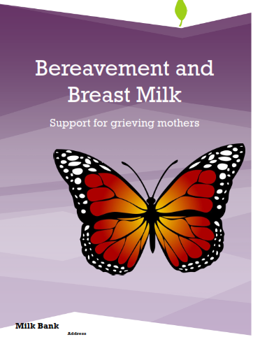
Miriam wants to donate her breastmilk
Form groups (mother, neonatal-nurse, and companion).
Communicate with Miriam about breastmilk options
with compassion and sensitivity.
Teach her how to express and store her breast
milk safely.
Debrief with your team and facilitator.
Mariam lost her baby Nat early this morning,
Resuscitation was not successful.
She wants to donate her milk in memory of Nat.
Notes:
Simulation
Skills and performance – participants demonstrate the use of supplemental resources for breastfeeding counselling after newborn death.
Counselling on options for breast milk donation
Demonstrating expression and storage of breast milk
Supporting Miriam to start expressing and safely storing her breast milk
Linking with support groups and referral to psychological counselling as needed.
Debriefing – participants self-reflect and give feedback in their roles.
Provision of care (performance objectives)
What was done well?
What could have been done better?
What will you change next time?
Experience of care
Was the language clear and appropriate?
Was the communication respectful and sensitive?
To learn more
Bereavement and Breast milk ”I want to donate my milk”

Slide 51
Suppress breastmilk production after stillbirth
Form groups (mother, midwife and companion).
Counsel and give practical support to Donna.
Debrief with your team and facilitator.
Donna delivered a baby boy by spontaneous vaginal delivery at 28 weeks
gestation 2 hours ago. He was a stillbirth.
She wants to suppress her milk production as she finds the idea of producing milk distressing.
Notes:
Simulation
Skills and performance – participants demonstrate counselling and practical support for suppression of breast milk after stillbirth.
Counselling on the available options for suppressing breastmilk production and managing engorgement.
Explaining or demonstrating methods for management
- Expression
- Hot shower
- Use of support bra, cabbage leaves or other local recommendations
Providing connections to bereavement support groups and psychological consultation as needed
Debriefing – participants self-reflect and give feedback in their roles.
Provision of care (performance objectives)
What was done well?
What could have been done better?
What will you change the next time?
Experience of care
Was the communication compassionate and sensitive and the language appropriate?
To learn more
Bereavement and Breast milk ”I want to suppress my milk”

