Slide 1
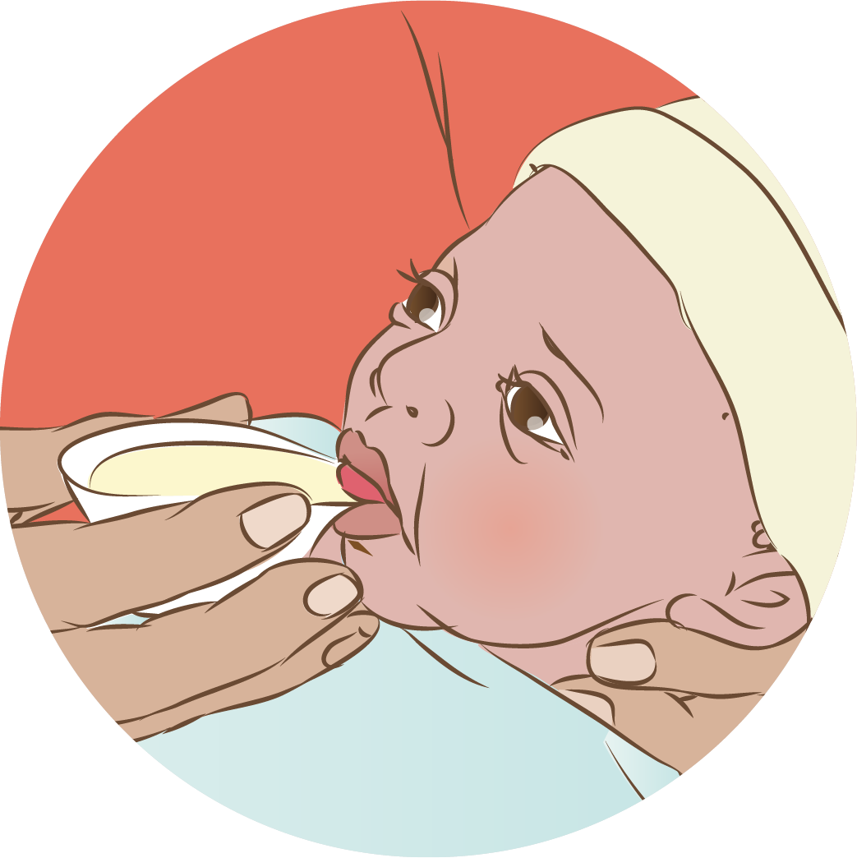

Breast milk feeding:
Alternative methods
Notes:
© World Health Organization 2024. All rights reserved.
Materials for demonstrations, practice, and simulations
Organise one set per group of 3 participants and a set for facilitator demonstration (as available).
Small newborn mannequin, newborn mannequin, model breasts/simulators (filled with water)
Shawl or shirt for mother
Wrap and hat for baby
Local examples of cups and spoons used for feeding
Locally available containers suitable for expressed milk and safe storage
Examples of safe feeding devices for newborns with cleft
Intragastric tubes sizes 5, 6 and 8; 20 mL syringes; adhesive tape; scissors; pH strips (optional); water to simulate breast milk

Slide 2
Content
Goal and learning outcomes
The situation
Need for alternative feeding methods
Expression of breast milk
Alternative feeding methods
Transition to breastfeeding
Alternatives to mother’s own milk
Summary
Clinical practice
Quality improvement
References and additional resources

Slide 3

Goal and learning outcomes
Newborns unable to breastfeed receive breast
milk by appropriate alternative feeding methods.
Assess feeding difficulties to select the appropriate
feeding method.
Support mothers to express and store breast milk.
Provide feeds safely by cup and nasogastric tube.
Counsel mothers on feeding their own baby with
alternative methods.
Support the transition to full breastfeeding.
Use alternatives to mother’s own milk appropriately.

Slide 4

The situation
Some newborn babies cannot breastfeed.
© WHO/Yoshi Shimizu
Notes:
Have you observed this where you work?
Why could this newborn not breastfeed?
The most common reasons that babies cannot breastfeed include prematurity, cleft palate and lip, neurological syndromes (asphyxia or hypotonia).
If either mother or baby is sick, alternative feeding of breast milk may be needed.
Separation of mother and newborn, for intensive care or referral to another hospital, are other situations when alternative methods may be used.
In most cases babies have no difficulty feeding at the breast after birth.
A small number of babies may not be able to suckle and may need to be temporarily or permanently fed their mother’s milk using alternative methods of feeding.
Mother’s own breast milk is the milk of choice when using any alternative methods of feeding.
The need for alternative methods of feeding and the most suitable method should be individually assessed for each mother and baby pair.

Slide 5
Need for alternative feeding methods

Slide 6
What feeding methods can be used to give expressed breast milk?
Cup or paladai (beaked cup)
Spoon, syringe or dropper
Tube feeding (nasogastric or orogastric)
Supplemental nursing system
Feeding bottle and teat
Which alternative methods are used in your health facility?
The most common methods of alternative feeding are cup or paladai and tube feeding.
The supplemental nursing system is a reservoir for breast milk that hangs between the breasts with a small tube running to the nipple. This allows the baby to receive additional milk while suckling at the breast.
Special feeding bottles and teats have been developed for babies with cleft lip and palate and other swallowing difficulties.
What are the advantages and disadvantages of each method?
To learn more Alternative feeding methods handout
Notes:
Which alternative methods are used in your health facility?
The most common methods of alternative feeding are cup or paladai and tube feeding.
The supplemental nursing system is a reservoir for breast milk that hangs between the breasts with a small tube running to the nipple. This allows the baby to receive additional milk while suckling at the breast.
Special feeding bottles and teats have been developed for babies with cleft lip and palate and other swallowing difficulties.
What are the advantages and disadvantages of each method?
To learn more (INSERT LINK to Alternative feeding methods handout GEORGE)
Direct expression requires no additional equipment and is most useful to begin a feeding at breast. Later the flow of milk may become too fast and cause the baby to choke.
Spoon, syringe or dropper do not regulate the flow of milk as well as cup or paladai; syringe or dropper are difficult to clean adequately.
Tube feeding requires special supplies and skills for placement.
The supplemental nursing system and specialized cleft feeders may not be widely available and need special skills for use.

Slide 7
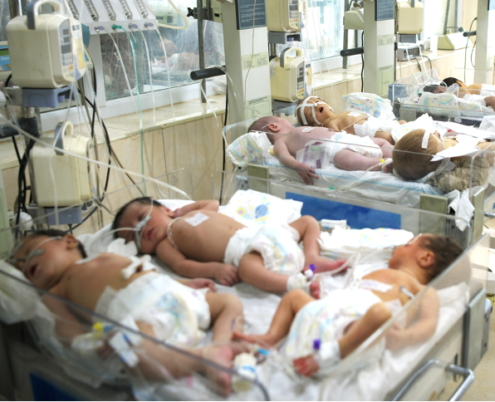
How should you assess which alternative feeding method is needed?
If the baby can swallow, but cannot suck
provide cup feeding.
If the baby cannot swallow safely
provide nasogastric tube feeding.
Only if the baby cannot tolerate
any feeding or there is a contraindication
begin intravenous fluids and nutrition.
© UNICEF/Afghanistan/Aziz Karimi
Notes:
How do you assess which method to use in your health facility?
Most babies can tolerate breast milk feedings beginning immediately after birth.
Receiving colostrum early helps mother establish her milk production and helps the baby maintain a normal blood glucose level.
Beginning colostrum feedings also contributes to a healthy microbiome.
Which babies may need cup feeding, nasogastric feeding or intravenous fluids?
Cup feeding:
Moderately preterm or late preterm newborns
Newborns with cleft palate
Extremely preterm infants transitioning from nasogastric feeding
Nasogastric tube feeding:
Newborns with respiratory distress (fast breathing, grunting)
Extremely or moderately preterm infants who cannot coordinate swallowing safely
Infants with congenital malformations or neurologic conditions who cannot coordinate swallowing
Infants who are too ill to feed by mouth, but who can still tolerate milk feeds
Newborns who have abdominal conditions that need gastric drainage (instead of feedings)
Intravenous fluids/nutrition:
Critically ill newborns (shock, sepsis)
Newborns with congenital malformations of the intestine (gastroschisis, omphalocoele)
Newborns with abdominal conditions such as obstruction, necrotizing enterocolitis

Slide 8

Which newborns may not be able to swallow safely?
Preterm or term newborns with immature or
impaired suck/swallow reflex
Respiratory distress
    Tachypnoea/grunting with risk of aspiration
    Nasal CPAP and supplemental oxygen
Birth trauma
Neurological dysfunction
Congenital abnormalities including clefts,
choanal atresia, obstruction of gastro-
intestinal tract
Notes:
What are common situations when there may be a problem with swallowing?
Many preterm and some term infants may need an intragastric tube (IGT) for feeding, administration of medication, following a surgical procedure or for gastric decompression.
Newborns who have danger signs or need surgery need to be referred urgently for advanced care. A nasogastric tube may need to be placed before safe referral and left on open drainage.
Nasogastric tubes are preferred over orogastric tubes.
Use an orogastric tube for the following indications:
Nasal prong CPAP (continuous positive airway pressure)
Nasal trauma
Cranio‐facial anomalies
Choanal atresia

Slide 9
Expression of breast milk

Slide 10
Hand expression of breast milk after preterm delivery
Form groups (mother, grandmother and neonatal nurse).
Support Yeti’s mother to express her breast milk.
Debrief with your team and facilitator.
Yeti was born 2 hours ago at 31 weeks and 1600 grams.
He is breathing well in skin-to-skin contact with his mother.
He has not yet fed.
Notes:
Baseline simulation
Skills and performance – supporting the mother of a preterm newborn to express breast milk.
Explaining feeding reflexes and the importance of starting of expression of breastmilk as soon as possible after birth
Recognizing feeding cues
Demonstrating on self or breast model how to express breastmilk
Explaining and answering questions on the process, frequency and duration
Supporting mother to express her breast milk
Debriefing – participants self-reflect and give feedback to one another in their roles.
Provision of care (performance objectives)
What was done well?
What could have been done better?
What will you change the next time?
Experience of care
Was the communication respectful and the language appropriate?
Was there adequate privacy?
Did the health worker ask for consent before touching mother or baby?
Was handling of the baby gentle?
Were infection prevention practices followed?
Detailed steps in assisting mother to hand express milk.
Show mother how to massage the whole breast gently.
Shape a “C” around the breast with fingers.
Press back toward the chest wall away from the areola.
Compress fingers together around the breast, then release.
Repeat the sequence of press, compress, release rhythmically while moving the hand around the areola. Ensure all segments of breast are emptied.
Express milk from both breasts into a clean bowl or container until the milk flow gradually decreases.
Expect that a session will last 10-20 minutes.

Slide 11
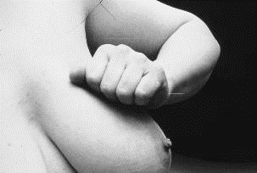
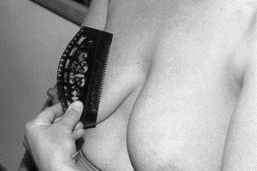
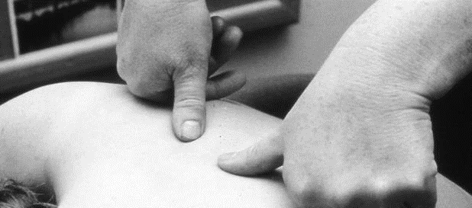
Help a mother relax to improve milk flow
All photos © WHO/ Sandra Lang
Notes:
What do you suggest to help a mother relax so that her milk flows more easily?
Apply warm compresses to the breast (for example, warm towels).
Massage back and neck before expressing.
Massage breast and nipples.
What do local mothers do?
Demonstrate any methods of massage you have observed using the breast model.
Always ask the mother if she or her family know of any ways to help her milk to flow.
It is easy to teach a mother how to massage her breasts and to teach her family to massage her back and neck.
1. Practise demonstrating breast massage to a mother
Use your own breast or a breast model to show the different ways that a mother can massage her breasts.
Massage or stroke the breasts lightly and very gently. Some mothers find that it helps if they roll a closed fist over the breast towards the nipple.
Stroke the nipple and areola gently with her fingertips or with a comb or anything else that gives a pleasant sensation.
2. Practise teaching a family member back massage
Ask the mother to sit down, lean forward, fold her arms on a table in front of her and rest her head on her arms. Her breasts should hang loose and unclothed.
Place a towel or piece of cloth on her lap.
Work down both sides of the spine at the same time, from the neck to just below the shoulder blades, using a closed fist with thumbs pointing forwards.
Press firmly, making small, slow circular movements with thumbs for two or three minutes.

Slide 12


Help a mother to hand-express breast milk
  Wash hands thoroughly.
  Find a comfortable position.
  Massage the breast and/or back and neck.
  Hold a clean wide-necked container under the nipple and
  areola to collect the milk.
  Place thumb and first finger behind the nipple
  (at least 4 cm from the tip of the nipple) in a “C” shape.
  Press the breast toward the chest wall.
  Compress the breast between finger and thumb,
  then release.
  Press, compress and release all the way around the breast.
© WHO-MCA-DaNang
Expressing the first milk
Notes:
Practise using a breast model in the role of health worker and mother.
Do not touch mother’s breast without consent
If using a breast simulator, massage the breasts, ensure that they are adequately filled with water and that the tap is open.
View video
Are there any skills or practices that differ from your current practice?
Does this video highlight any quality gaps in your facility?
To learn more
Assessment-of-breastmilk-expression-checklist

Slide 13

How can you support mother’s breast milk production?
  Begin hand expression shortly after birth.
  Express one breast until the milk just drips, then express the other breast until
  the milk just drips.
  Alternate between breasts 5 or 6 times, for at least 20 to 30 minutes.
  Stop expressing when the milk no longer flows.
  Express as often as a newborn would feed.
Making enough milk
Notes:
What is the practice in your health facility?
View video
What new knowledge is presented in this video?
Are there any skills or practices that differ from your current practice?
What provider behaviours differ from your current practice?
Does this video highlight any quality gaps in your facility?

Slide 14
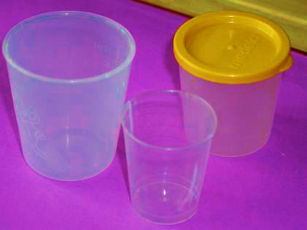
Select a container for collection and measurement of feeding volume
Capacity 50 – 90 mL.
Glass or plastic that can be washed easily.
Volume markings (graduated) for measurement.
A graduated container with a lid can also
be used to store expressed breast milk
safely.
© WHO/Sandra Lang
Notes:
Examine the containers used in your facility. Do they fit this description?
How are milk collection and storage containers kept clean and ready for use in your health facility?
Washing with soap and clean water and thorough drying after use are important ways to prevent infection.

Slide 15
How should expressed breast milk be stored safely?
 | STORAGE LOCATIONS AND TEMPERATURES
TYPE OF BREAST MILK | Countertop or colder 77 °F /25 °C (room temperature) | Refrigerator 40 °F /4 °C | Freezer 0 °F or ≤18 °C
Freshly expressed or pumped | Up to 4 Hours | Up to 4 Days | Within 6 months is best. Up to 12 months is acceptable.
Thawed, previously frozen | 1–2 Hours | Up to 1 Day (24 hours) | NEVER refreeze human milk after it has been thawed.
Leftover from a feed | Use within 2 hours after the baby is finished feeding.
Notes:
How long can you store breastmilk safely under different conditions?

Slide 16
Alternative feeding methods

Slide 17
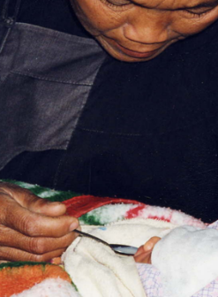
When is spoon feeding used?
Spoon feeding is used in limited situations.
Hoang’s mother expressed colostrum immediately after birth before undergoing an emergency procedure.
Grandmother feeds colostrum to the baby.
Express colostrum and feed by spoon
© WHO/Sandra Lang
Notes:
What are the disadvantages of spoon feeding?
What is the optimal use of spoon feeding?
Spoons are readily available and easy to clean.
It is a useful method for capturing and feeding colostrum.
View video
Special adapted spoons are used for some babies with clefts.
To learn more
Feeding baby with cleft

Slide 18
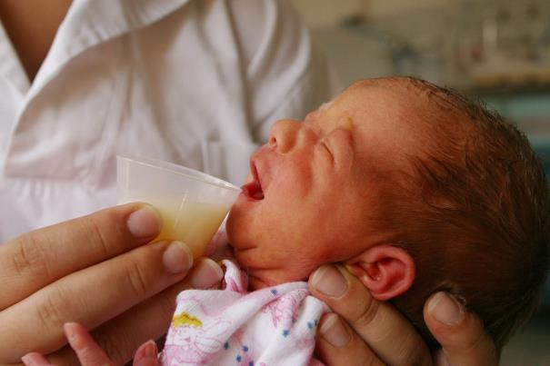
Cup feeding
© UNICEF/UNI11841/Pirozzi
Cup feeding
Notes:
Do you practice cup feeding in your health facility?
Which babies are cup fed?
What are the benefits and optimal use of cup feeding?
Cups are readily available and easy to clean.
Volume measurement is possible with a cup.
Mothers can safely give cup feeds.
View video
What new knowledge is presented in this video?
Are there any skills or practices that differ from your current practice?
What provider behaviours differ from your current practice?
Does this video highlight any quality gaps in your facility?

Slide 19
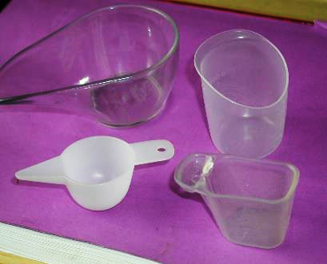
Select a feeding cup
Smooth, rounded rim
Plastic or silicone that can
be washed easily
Lip or spout to help give
small volumes slowly
© WHO/Sandra Lang
Notes:
Examine the cup(s) used in your facility. Do they fit this description?
How are feeding cups kept clean and ready for use?

Slide 20

Help a mother to give expressed breast milk by cup or paladai
Measure the correct volume of milk for the feed.
Pour a small amount of milk into the cup or paladai.
Support the baby’s head and neck in sitting position.
Bring the cup or paladai to the lip at the corner of
the mouth.
Tip the cup or paladai so the milk touches the lip and
allow the baby to swallow the milk.
Do not pour the milk into the mouth.
Continue to offer milk until the full volume is given
or the baby gives cues to stop:
    Closing the eyes
    Pushing the cup away
    Becoming very relaxed or limp
    Hold the baby upright and wind/burp
© UNICEF/Frank DEJONGH
Notes:
Practise the steps in cup feeding in the role of a health worker and a mother.
What does responsive, baby-led feeding mean?
Initiating a feeding when the baby is showing feeding cues improves the success of cup feeding.
It may sometimes be necessary to awaken a sleepy baby by stimulating around the mouth and cheek or gently rubbing the feet.
Mother will help her baby feed most effectively, by responding to her baby’s cues including when the baby is ready to stop feeding.
Encourage the mother to observe her infant’s signs of interest in feeding.
Ensure that the baby is fully awake, alert and interested in feeding, showing cues.
Let the baby lap the milk at his or her own pace.
Stop when the baby has had enough.
Do you practice baby-led feeding in your health facility?
To learn more
Cup feeding your small baby

Slide 21
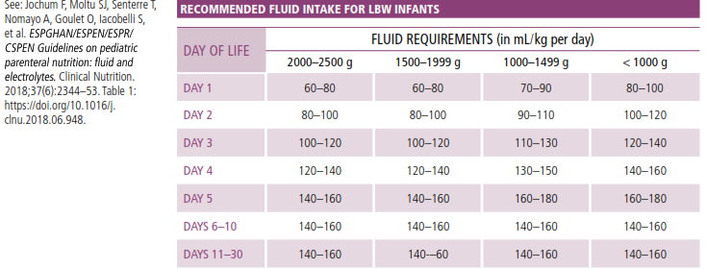
How do you calculate feeding volumes?
Notes:
How does this chart compare with volumes for starting and advancing feeds in your facility?
There are many different protocols to begin and advance feeding volumes.
The key point is to have a protocol in your facility and follow it and to monitor the baby’s growth.
In this chart, a newborn begins feeds at 60-100 mL/kg/day.
Babies between 1500 and 2000 grams advance by 20 mL/kg/day.
Babies between 1000 and 1500 grams advance by 20 mL/kg/day.
Feed volumes can be increased by 30 mLs per kg per day as tolerated.
Feed volumes should be prescribed and noted in charts and notes.
To learn more
WHO recommendations for care of the preterm or low birthweight infant

Slide 22

Calculate feeding volumes
Leo weighs 1600 grams.
His mother is expressing milk.
He is tolerating feeds.
© UNICEF/UNI11841/Pirozzi
How often should Leo be fed?
How much milk should Leo receive at each feed on days 1, 3 and 5?
Notes:
Practise calculating the feeding volume:
Use your health facility protocol and calculate mL per kg/day according to weight and age.
If 3-hourly feeds, divide the total by 8 to give the amount per feed.
If 2-hourly feeds, divide the total by 12 to give the amount per feed.
Newborns less than 1500 grams and those with unstable blood sugar may need feeding every 2 hours.
Newborns who are sick will follow other protocols. Some newborns with asphyxia will be fluid-restricted.
How often should feeds be given?
Feeding interval (every 2-3 hours)depends on gestational age of the baby and feed tolerance.
Follow medical instructions documented in notes for volumes, frequency and advancement.

Slide 23
Measure the correct amount of milk for a feed
Show mother how to measure the correct amount of breast milk:
  Use a syringe to put the right amount of milk into a feeding cup, or
  Use a plastic container marked with mLs, or
  Transfer milk with a spoon of a specific size (5 or 15 mL), or
  Mark the desired volume on the outside of the feeding cup.
Record the volume given at each feed.
Weigh the baby daily, record the weight and plot on correct growth chart.
Notes:
Practise helping mother measure and transfer the amount of milk for a feed.
What method of measurement is used in your facility?
Is this method easy for mothers to understand?

Slide 24
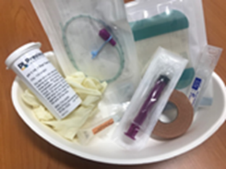
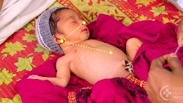
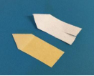

Placing a nasogastric tube safely
Inserting a nasogastric tube
Notes:
Note: Demonstration and practice is optional in facilities that do not feed by nasogastric tubes or for health workers whose scope of work does not include nasogastric tube placement.
View video
What is new knowledge for you in this video?
Are there any steps that are different from your current practice?
Does this video highlight a quality gap in your setting?

Slide 25
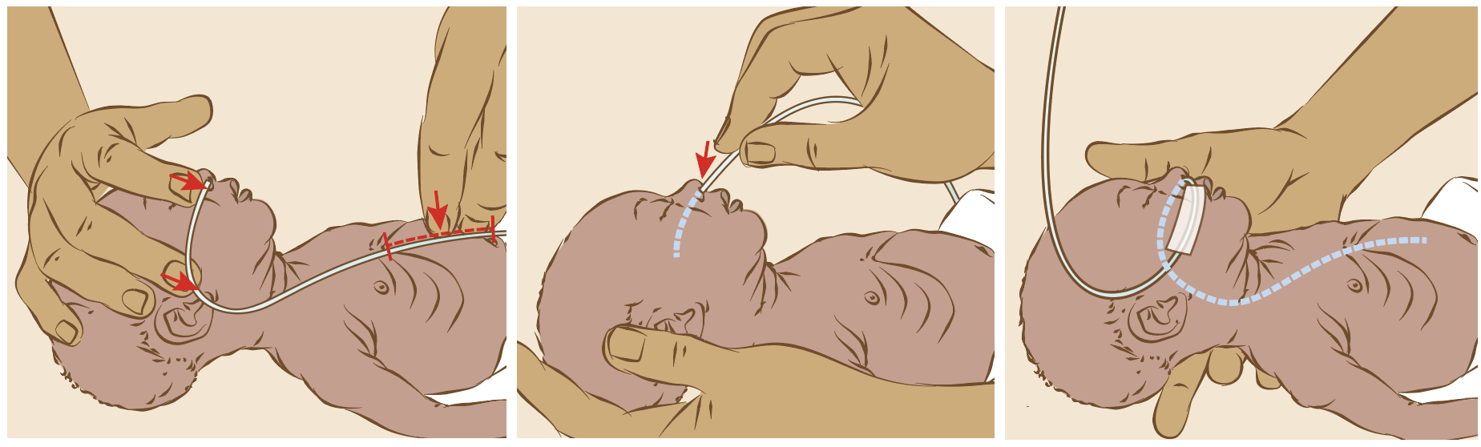
Practise safely placing a nasogastric tube
Explain to mother and obtain consent
Perform hand hygiene
Use personal protective equipment (MoH)
Select appropriate tube size
Measure length for insertion
Lubricate tube and position
Verify correct position
Secure tube in place and document the depth of insertion
Notes:
Practise nasogastric tube placement using a small newborn mannequin.
Measure the length of tube to insert with infant’s head positioned midline
Nasal tube (NGT): Distance from tip of Nose to tragus/Earlobe plus distance from ear lobe to midway between apex xiphoid and Umbilicus. Use “NEMU” to remember how to measure.
Oral tube (OGT): Distance from corner of mouth to tragus/ear lobe plus distance from ear lobe to midway between apex xiphoid and umbilicus Record measurement obtained.
Tips to facilitate nasogastric placement:
Swaddle infant to provide comfort; offer expressed breastmilk or sucrose
Gently check nostrils for patency
Select the appropriate size gastric tube - generally 6 French, but size 8 French for large infants or those requiring gut drainage
Insert the tube in a smooth, swift motion, advancing slightly down and towards the ear on the same side, to the marked length.
Do not force the tube. If resistance is felt or the tube comes back via the mouth or other nostril, stop the procedure and allow the baby to recover before any further attempts.
If a tube cannot be inserted after two attempts, a senior nurse colleague may make one further attempt. If still unsuccessful, discontinue procedure, notify medical staff - document in clinical record.
Explain to the mother when she should call staff.
How do you reduce stress and discomfort of the baby during placement of a nasogastric tube in your health facility?

Slide 26
How should you monitor intragastric tube feeding?
What should you observe and how should you respond?
Observe for excessive gagging, coughing, wheezing, apnoea or colour change
(tube in trachea?).
If incorrect position suspected, withdraw tube and re-advance once newborn is stable and comfortable.
When should you check the gastric tube?
Before feed or medication
After cough, vomit or gagging
Any clinical change in newborn’s condition
Change in tube length suspected
If milk does not flow
After routine tube change (every 3 – 7 days)
Notes:
How do you monitor tube feedings in your health facility?
What information do you record?

Slide 27
Feed via a nasogastric tube
Perform hand hygiene.
Hold the baby slightly upright.
Attach a 20 mL syringe (without plunger)
to the end of the tube.
Pinch the tube closed next to the syringe.
Pour expressed breast milk into the syringe.
Hold the syringe above the baby’s head.
Adjust the height of the syringe to make the
milk flow slower or faster.
Notes:
Practice giving a feed by nasogastric tube.
Explain to the mother as you carry out each step.

Slide 28

Support a mother to safely feed with a nasogastric tube
©WHO-MCA-DaNangKMC-VNM
Feeding with a gastric tube
Notes:
View video
Practise supporting a mother to safely feed with a nasogastric tube.
Explain and demonstrate to mother:
How to measure the correct volume of breast milk
How to hold the syringe
What information to record
When to call the health worker.

Slide 29
Placing a nasogastric tube
Form groups (mother, neonatal nurse, medical student).
Explain the situation to Peter’s mother and then place
a nasogastric tube.
Debrief with your team and facilitator.
Peter is 2 days old and weighs 1800 g at 31 weeks.
Peter cannot feed by cup. He desaturates and chokes.
The doctor has prescribed NG feeds.
Notes:
Simulation (Note: Optional in facilities that do not place nasogastric tubes and for health workers whose scope of work does not include placement of feeding tubes.
Skills and performance – participants demonstrate placement of a nasogastric tube.
Explaining why the newborn needs a gastric tube and obtaining the mother’s consent
Following the steps of placing a nasogastric tube safely
Providing measures to reduce discomfort to the baby
Debriefing – participants self-reflect and give feedback to one another in their roles.
Provision of care (performance objectives)
What was done well?
What could have been done better?
What will you change the next time?
Did you record site, and depth of tube?
Experience of care
Was the communication respectful and the language appropriate?
Was handling of the baby gentle?
What did the health worker do to reduce the baby’s discomfort?
Were infection prevention practices followed?
To learn more The effect of expressed breast milk, swaddling and facilitated tucking methods in reducing the pain caused by orogastric tube insertion in preterm infants: A randomized controlled trial

Slide 30
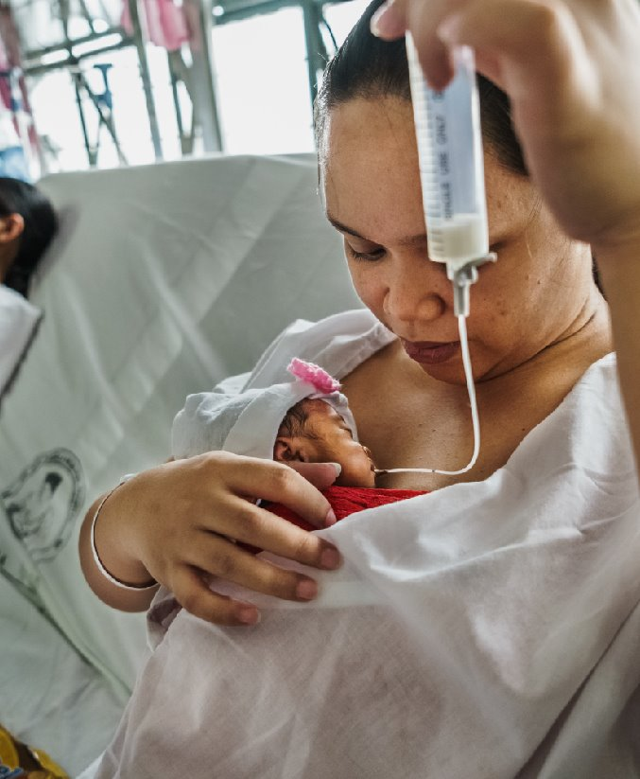
Support mother to safely feed with a nasogastric tube
In groups (mother, neonatal nurse, and nursing student).
Support Peter’s mother to safely feed her baby using
the nasogastric tube.
Debrief with your team and facilitator.
Peter cannot feed by cup. You have correctly sited
a NGT and fed him twice via the tube.
He is ready for his next feed.
© WHO/Yoshi Shimizu
Feeding with a gastric tube
Notes:
Simulation
Skills and performance – participants demonstrate supporting a mother to feed her newborn with a nasogastric tube.
Communicating to the mother what signs to observe
Explaining the steps of measuring volume, holding the syringe, recording, and reporting to health workers
Supporting mother for correct measurement of expressed breast milk and feeding baby safely herself
Debriefing – participants self-reflect and give feedback to one another in their roles.
Provision of care (performance objectives)
What was done well?
What could have been done better?
What will you change the next time?
Was data recorded and used?
Experience of care:
Was the communication respectful and the language appropriate?
Did the health worker explain what to observe and when to call a health worker?
Were infection prevention practices followed?
View video

Slide 31
Transition to breastfeeding

Slide 32
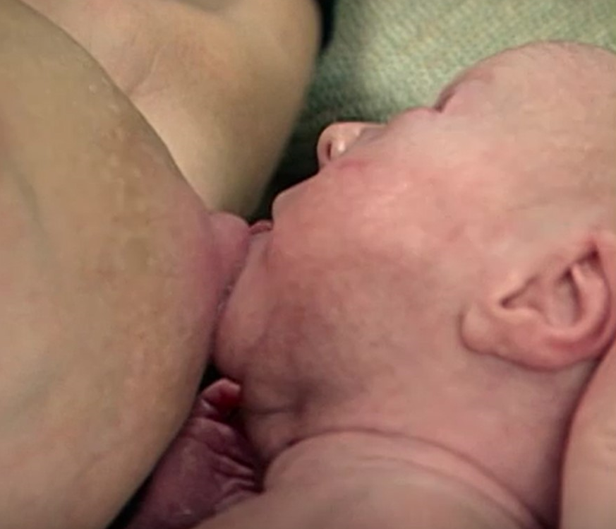
Promote practice time at the breast for small babies not yet able to attach
Support a mother to:
  Wash her hands with soap and water
  Hold her baby skin-to-skin, with mouth close to her nipple
  Express some drops of milk onto the nipple
  Wait until the baby is alert and opens the mouth wide
  Stimulate the baby if sleepy
  Let the baby smell and lick the nipple and attempt to suck
  Let some breast milk fall into the baby’s mouth
  Wait until the baby swallows before expressing more
  drops of breast milk
  Recognize when a baby has had enough - closing the mouth and taking no more milk
  Repeat this every 1 to 2 hours if the baby is very small or every 2 to 3 hours if the baby is bigger.
Notes:
Practise promoting time at the breast for stimulating feeding reflexes in preterm babies not yet able to attach.
Do you encourage preterm newborns to practise at the breast in your health facility?

Slide 33
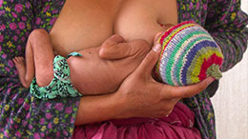
Transitioning to breastfeeding
A small baby’s feeding journey
Notes:
View video
What new knowledge is presented in this video?
Are there any skills or practices that differ from your current practice?
Does this video highlight any quality gaps in your facility?
Counsel mothers how to introduce a low- birthweight baby to the breast gradually, using the same principles of positioning and attachment learned in “Breastfeeding: ensuring a good start”.
Ensure the head and neck of the baby are supported;
Feeding at the breast is guided by the infant’s competence and stability rather than by a certain gestational/postnatal/postmenstrual age or weight.
It is important to recognize signs of the transition from deep to active sleep and waking up.
Guide the mother not to interrupt the deep sleep stage just for routine feeding.
Encourage the mother to observe her infant’s signs of interest in rooting and sucking and to breastfeed when her infant shows such signs. However, some babies will need waking or stimulating for feeding.
In many newborn units, oromotor stimulation is used to promote earlier feeding in newborns.
Non‐nutritive breastfeeding has been shown to increase milk supply and duration of breastfeeding post discharge.

Slide 34
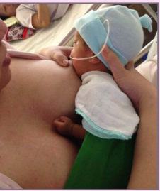
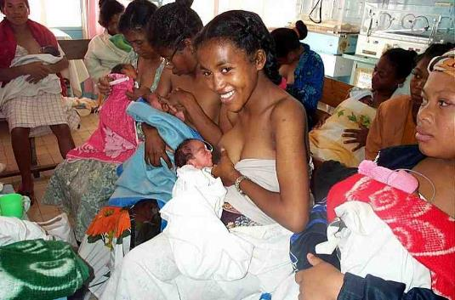
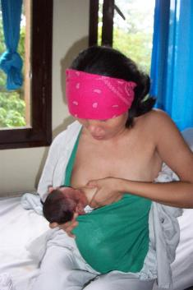
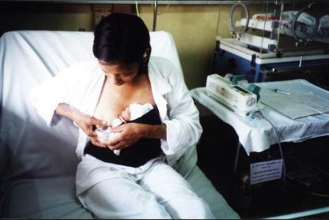
Practise positioning and attachment for the small baby
© Da Nang hospital for women & children Vietnam
© WHO/Dr Ornella Lincetto
Breastfeeding the small baby 3.24 -7
© WHO/Dr Helenlouise Taylor
© WHO/Dr Helenlouise Taylor
Notes:
View video
Practise positioning and attachment for the small baby in the role of health worker and mother.
Removing the baby from KMC position
Loosen the wrap/binder and support the head and buttocks.
Ensure that the baby remains wrapped to stay warm but has the arms and hands free.
Positioning the small baby
Cross cradle hold – allows a better view of the baby and controls the baby’s head
Dancer hold – supports baby’s chin between thumb and index finger (on cheeks) to help maintain attachment; supports the breast with thumb on top and fingers underneath so they form a ‘C’.
Returning the baby to KMC position
Support the head and buttocks while moving into and adjusting the binder or wrap.
Turn baby’s head to one side, slightly extended to keep the airway open and allow eye contact.
The top of the binder is just beneath the baby’s ear.

Slide 35
Support Lydia to breastfeed Amos while in kangaroo position
Form groups (Lydia, paediatrician and companion).
Counsel Lydia about breastfeeding Amos and support her for good positioning
and attachment of her preterm newborn.
Debrief in your group and with your facilitator.
Amos is in kangaroo position, and he is stable and warm.
He is showing feeding cues.
Breastfeeding in KMC position
Notes:
Simulation
Skills and performance – participants demonstrate counselling and supporting the mother of a preterm newborn in positioning and attachment.
Counselling on breastfeeding in KMC position
Providing practical support for good positioning and attachment - using an alternative hold with head and neck well supported.
Debriefing – participants self-reflect and give feedback to one another in their roles.
Provision of care (performance objectives)
What was done well?
What could have been done better?
What will you change the next time?
Did you use a position suitable for a preterm infant?
Experience of care
Was the communication respectful and the language appropriate?
Was the health worker sensitive to mother’s anxieties?
Did the health worker ask for consent before touching you or the baby?
Was handling of the baby gentle and supportive of head and buttocks?
Were infection prevention practices followed?
Was the baby kept warm?
View video
To learn more
Breastfeeding your small baby

Slide 36
How long does it take to transition to full breastfeeding?
© Da Nang hospital for women & children Vietnam
Notes:
What do you explain to mothers about transitioning to full breastfeeding in your health facility?
Transition to exclusive breastfeeding will depend on maturity, medical complications, and growth.
Correct attachment may be difficult for small, sick or preterm infants and should be taught and observed frequently until both the mother and the infant are comfortable.
Small or preterm infants often require additional head and neck support. The infant’s face should be visible to the mother to assess the infant’s safety and milk transfer.
Routinely use a standardized, objective breastfeeding assessments, such as the Infant Breastfeeding Assessment Tool (IBFAT), Mother–Baby Assessment (MBA), LATCH or the UNICEF b‐r‐e‐as‐t tool.
To learn more
ltuntas N, Turkyilmaz C, Yildiz H, Kulali F, Hirfanoglu I, Onal E, et al. Validity and reliability of the infant breastfeeding assessment tool, the mother baby assessment tool, and the LATCH scoring system. Breastfeed Med. 2014;9(4):191–5. doi: 10.1089/ bfm.2014.0018.
Jensen D, Wallace S, Kelsay P. LATCH: A breastfeeding charting system and documentation tool. J Obstetr Gynecol Neonatal Nurs. 1994; 23:27–32. doi: 10.1111/ j.1552‐6909.1994.tb01847.x.
Matthews MK. Developing an instrument to assess infant breastfeeding behaviour in the early neonatal period. Midwifery. 1988;4(4):154–65. doi: 10.1016/ s0266‐6138(88)80071‐8.
Mulford C. The Mother–Baby Assessment (MBA): an “Apgar score” for breastfeeding. J Hum Lact. 1992;8(2):79–82. doi: 10.1177/089033449200800216.

Slide 37
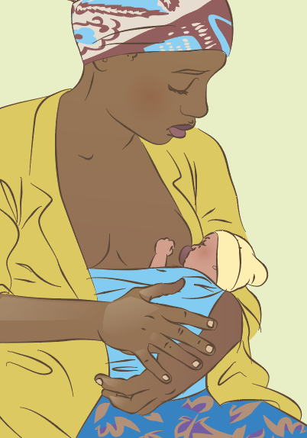
Transition to breastfeeding
Form groups (mother, midwife, companion).
Support her mother to transition to breastfeeding.
Debrief with your team and facilitator.
Esme weighs 1.9 kg. She was cup fed for 3 days.
Esme is showing feeding cues and is active and hungry.
Her mother breastfed her first born who was
born at term.
Notes:
Simulation
Skills and performance – participants demonstrate supporting mother in the transition to full breastfeeding.
Explaining how breastfeeding differs for the small baby
Identifying factors that can speed or slow transition to breastfeeding
Explaining responsive feeding and feeding cues - including when baby has finished feeding
Demonstrating positions suitable for small baby - ensuring head and neck support
Supporting mother’s actions for safe positioning and attachment
Building mother’s confidence and responding to worries or concerns of family
Debriefing – participants self-reflect and give feedback to one another in their roles.
Provision of care (performance objectives)
What was done well?
What could have been done better?
What will you change the next time?
Experience of care
Was the communication respectful and the language appropriate?
Was handling of the baby gentle?
Were infection prevention practices followed?

Slide 38
Alternatives to mother’s own milk

Slide 39

When is donor milk feeding recommended?
Find the recommendations and evidence on page 20-22.
Notes:
Use a printed or digital copy (pdf) of the document.

Slide 40
Recommendations and reasons
When mother’s own milk is not available, donor human milk may
be considered for feeding of preterm or low-birth-weight (LBW) infants, including very preterm (< 32 weeks’ gestation) or very LBW (< 1.5 kg)
infants.
Compared with infant formula, feeding with donor human milk can:
    Decrease the risk of necrotizing enterocolitis by hospital discharge
    Decrease the risk of feeding intolerance
    Increase the weight gain and growth by hospital discharge
Notes:
Is this recommendation currently applied in your place of work?
If yes, what enabling factors support the application of this recommendation?
If no, what are the barriers to applying this recommendation?

Slide 41
Why may mother’s milk not be available?
Mother/infant separation
Infant abandonment
Maternal death, disease
Delay in milk production from preterm birth, insufficient lactation support,
stress/trauma
Notes:
How are these situations handled in your health facility?
What are the systems to make mother’s milk or donor milk available?

Slide 42
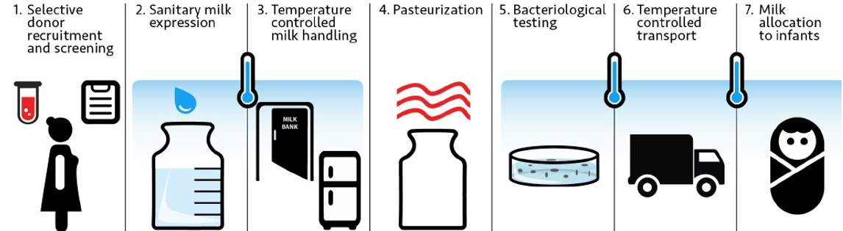
What is a human milk bank?
Human milk bank: A service established to recruit breast milk donors, collect
donated milk, and then process, screen, store, and distribute the milk to meet
infants’ specific needs for optimal heath.
Processing of donor human milk at a human milk bank
Human milk banking: Indian experience mothers own milk
Virtual tour of Da Nang Human Milk Bank
Notes:
Is there a milk bank or other means of storing mother’s own milk in your health facility?
View video

Slide 43

Donating breast milk
Form groups (mother, midwife and companion).
Explain to Felicity the process of milk donation.
Debrief with your team and facilitator.
Felicity has decided she wants to donate her breast milk to help sick newborns in memory of her son Aran, who was born yesterday but did not survive.
She asks for information on the process.
Notes:
Simulation
Skills and performance – participants demonstrate supporting a bereaved mother to donate breast milk.
Counselling on options for breast milk donation
Explaining the process of lactation during bereavement
Demonstrating expression and storage of breast milk
Supporting Felicity to start expressing and safely storing her breast milk
Linking to support groups and referral for psychological counseling as needed.
Debriefing – participants self-reflect and give feedback to one another in their roles.
Provision of care (performance objectives)
What was done well?
What could have been done better?
What will you change the next time?
Experience of care
Was the communication respectful, and the language appropriate?
Did the health worker give compassionate sensitive care?
To learn more
strengthening-human-milk-banking

Slide 44
What is supplementation?
Supplementation: food other than mother’s own milk fed to the infant following or in
place of a breastfeed (only when medically indicated)
Type | Purpose
Donor breast milk | Breast milk donated by mothers with excess to cover needs especially for low birthweight (LBW), preterm and sick infants
Formula: Ready-to-feed Concentrated Powdered | Most expensive, but does not introduce water issues More costly than powdered, but easier to mix Least expensive, commonly used, but can pose water issues
Formula: cow’s milk based | Powdered milk, cow’s milk based
Formula: soy based | Powdered milk, soy based
Formula: hypoallergenic | Powdered milk, hydrolysed for infants with allergies or health concerns
Human milk fortifiers (HMF) | Formula-based to complement breast milk, especially for LBW, preterm and sick infants
Notes:
Do health workers supplement breast feeds in your health facility?
Are the supplements prescribed by a doctor and the reason documented in the notes?
Do not provide breastfed newborns any food or fluids other than breastmilk, unless medically indicated.
WHO recommends mothers own expressed breast milk or donor breast milk.
Supplementation rates should be monitored in all newborn units and quality improvement measures introduced to ensure that newborns receive breast milk unless medically indicated.
To learn more
BFHI medical indications for supplementary feeding

Slide 45
What are medical reasons for supplementation?
Newborns
Mothers
Low birthweight (<1500 g)
Prematurity (birth before 32 weeks)
Hypoglycaemia - low blood glucose levels that do not respond to breast milk
Signs/symptoms indicating poor breast milk intake
High bilirubin associated with
poor breast milk intake
Metabolic disorders
Delayed milk production with poor
intake by the infant
Hormonal conditions
Poor milk production due to breast
pathology or breast surgery
Pain with breastfeeding unrelieved
by other interventions
Severe illness preventing a mother
from caring for her infant
Herpes simplex virus type 1 with open lesions
Maternal preferences
Kellams A, Harrel C, Omage S, Gregory C, Rosen-Carole C. ABM Clinical Protocol #3: Supplementary feedings in the healthy term breastfed neonate. Revised 2017. Breastfeed Med. 2017;12:188–98. doi:10.1089/bfm.2017.29038.ajk
Notes:
Are these medical reasons for supplementation applied in your health facility?
Mothers who have made a fully informed decision not to breastfeed exclusively, or have chosen to mixed feed, may consider supplementary feeding with infant formula.
It is important to ensure that:
All mothers are informed about the risks and management of various feeding options and have been helped to decide what is suitable in their circumstances.
All mothers have received factual information in a sensitive and respectful manner, on the importance of exclusive breastfeeding and basic management of breastfeeding related to their concerns.
To learn more
Protecting, promoting and supporting breastfeeding: the baby-friendly hospital initiative for small, sick and preterm newborns

Slide 46
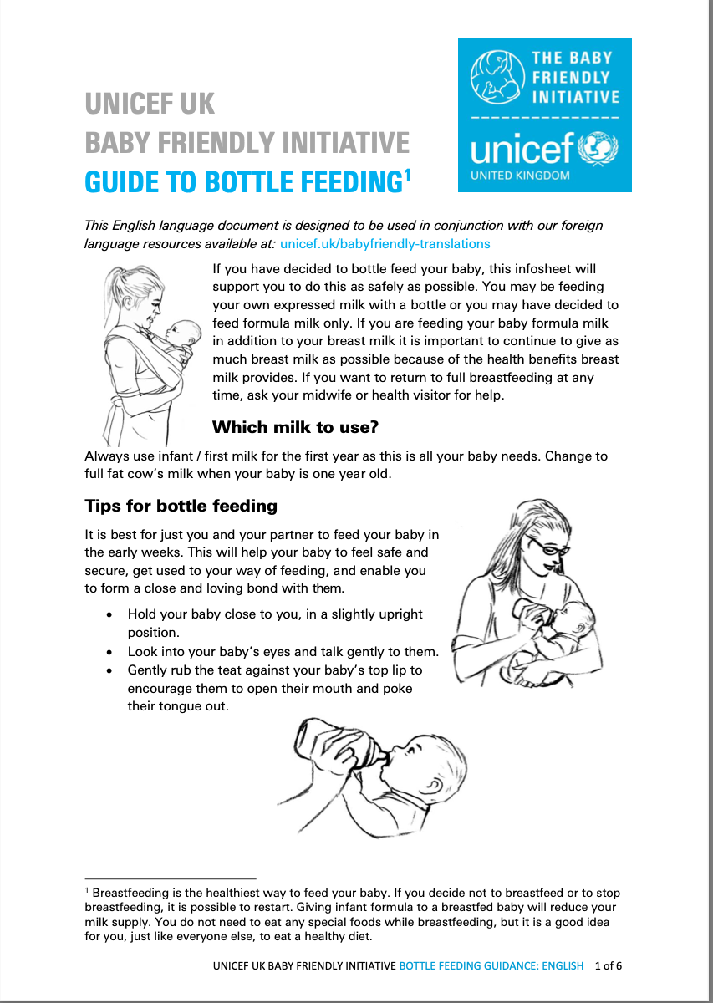
How would you support safe formula feeding if this is mother’s decision?
Encouraging the mother to feed the baby responsively
Holding baby close in a slightly upright position
Looking into baby’s eyes and talking gently
Gently rubbing the teat against baby’s top lip encouraging mouth
openingand tongue extension.
Placing the teat into the mouth, allowing the baby to draw it back
Removing the teat at intervals giving the baby a break
Not forcing baby to take all the milk if satisfied
Discarding any leftover milk if not used within one hour
Preparing formula safely
Making up bottles freshly for each feed
Not adding anything (sugar, cereals chocolate powder, tea)
Never warming in a microwave as uneven heating can burn baby’s mouth
Notes:
Is this implemented in your health facility?
Breastfeeding is the healthiest way to feed a baby.
Giving infant formula to a breastfed baby will reduce milk supply.
If a mother decides not to breastfeed or to stop breastfeeding, it is possible to restart.
If a mother decides to bottle feed, support her for safe responsive bottle-feeding, respecting her choice
WHO recommendations address the needs for infants born to HIV-infected mothers. Antiretroviral drugs allow these children to exclusively breastfeed until they are 6 months old and continue breastfeeding until at least 12 months of age with a significantly reduced risk of HIV transmission.
To learn more
Questions and answers on HIV and infant feeding
How do you support mothers to safely prepare a feed?
Clean and sterilize feeding and preparation equipment.
Use boiled water.
Add powdered formula while water is above 70 ºC.
Use exact amount of formula indicated on the label.
Cool the feed quickly to feeding temperature.
Check temperature of formula before feeding.
Discard formula not used within 2 hours.
For using liquid formula concentrate, follow manufacturer’s instructions
To learn more
BFHI Bottle-feeding-guidance

Slide 47
Hand expression of breast milk after preterm delivery
Form groups (mother, grandmother and neonatal nurse).
Support Yeti’s mother to express her breast milk.
Debrief with your team and facilitator.
Yeti was born 2 hours ago at 31 weeks and 1600 grams
He is breathing well in skin-to-skin contact with his mother
He has not yet fed
Expressing the first milk
Notes:
Repeat simulation
Skills and performance – supporting the mother of a preterm newborn to express breast milk.
Explaining feeding reflexes and the importance of starting of expression of breastmilk as soon as possible after birth
Recognizing feeding cues
Demonstrating on self or breast model how to express breastmilk
Explaining and answering questions on the process, frequency and duration
Supporting mother to express her breast milk
Debriefing – participants self-reflect and give feedback to one another in their roles.
Provision of care (performance objectives)
What was done well?
What could have been done better?
What will you change the next time?
Experience of care
Was the communication respectful and the language appropriate?
Was there adequate privacy?
Did the health worker ask for consent before touching mother or baby?
Was handling of the baby gentle?
Were infection prevention practices followed?
Detailed steps in assisting mother to hand express milk.
Show mother how to massage the whole breast gently.
Shape a “C” around the breast with fingers.
Press back toward the chest wall away from the areola.
Compress fingers together around the breast, then release.
Repeat the sequence of press, compress, release rhythmically while moving the hand around the areola. Ensure all segments of breast are emptied.
Express milk from both breasts into a clean bowl or container until the milk flow gradually decreases.
Expect that a session will last 10-20 minutes.

Slide 48
Summary
In this module, you have:
Assessed the need for alternative methods of feeding and the range of methods available for a baby who is unable to breastfeed
Demonstrated safe techniques for providing cup and nasogastric tube feeding
Demonstrated supporting a mother to feed her newborn using appropriate
alternative methods
Demonstrated giving practical support for a mother to transition to full
breastfeeding
Assessed the need for alternatives to mother’s own milk and the range of acceptable options.
Notes:
Learn more
Overview: Alternative methods of breast milk feeding

Slide 49
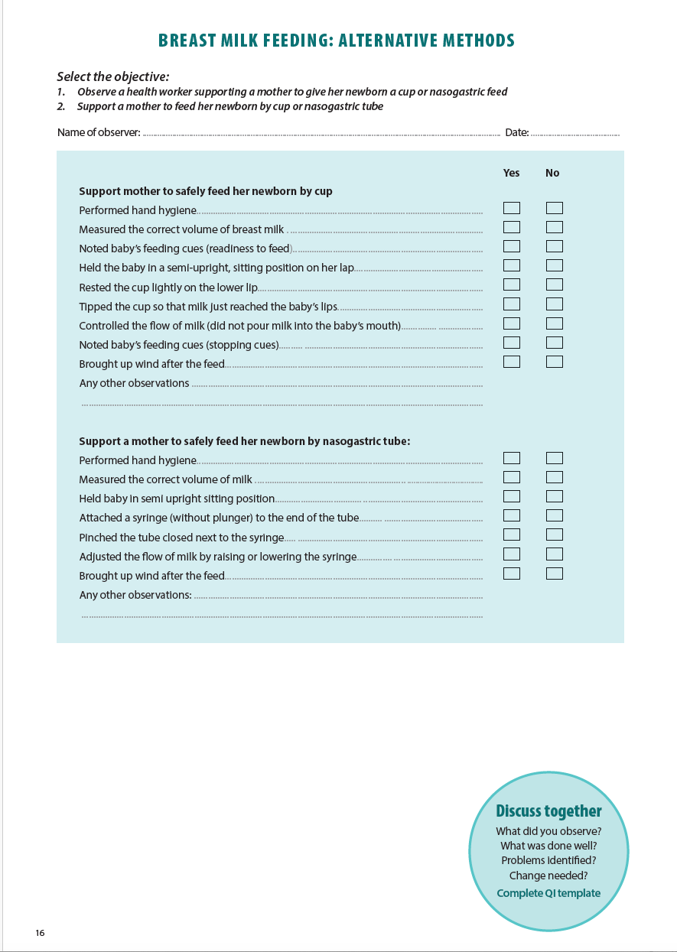
Notes:
Review the Clinical practice checklist before observing or practising in the clinical area.

Slide 50
Example of QI project to increase use of expressed breast milk
Notes:
After the clinical practice, discuss the observations made, possible reasons for practices and changes needed to improve the quality of essential newborn care.
What new things will you do?
What old things will you not do?
How will you make a change?
View video
To learn more
UNICEF examples neonatal care improvements

Slide 51








References and
additional resources
Alternative methods of feeding low birthweight baby
Breastfeeding in KMC position
Notes:
UNICEF alternative feeding resouces in multiple languages
Supporting comprehensive cleft care through nutrition and feeding. Smile Train, 2018.

Slide 52
Samuel is 3 hours old:
Calculate feeds needed
He was born at 34 weeks gestation with a birth weight of 1975 g.
He is receiving skin-to-skin care from Amy.
He is not able to breastfeed without tiring.
How will you support Amy to feed Samuel?
How much expressed breast milk will you give him per feed?
On days 1, 2, 3 and 4?
Notes:
Support Amy to feed Samuel
Stimulating milk production
Expression of breast milk
Safe cup feeding
Observe for tolerance to feeds. The medical officer will prescribe feeding volumes according to tolerance and condition of the newborn.
How many ml of expressed breast milk should be given on Days 1, 2, 3 and 4?
Use local MoH approved guidelines or the table below.
To ensure growth, volumes and advancement may be greater than the examples given here.

Slide 53
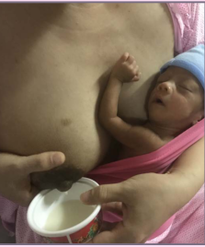
Lily 30 weeks needs EBM
Lily is 30 weeks gestation. She is 2 hours
old and weighs 1.8 kgs. Sucking and
swallowing is not well coordinated.
She is stable and pink.
She is in kangaroo position.
How will you support breast milk feeding for Lily?
What important points will you explain about
expression of breast milk to her mother?
How much expressed breast milk will her mother
give on days 1, 2 and 3?
© Da Nang hospital for women & children Vietnam
Notes:
How will you support breast milk feeding for Lily?
Safe expression of breast milk.
Safe milk storage.
Safe cup feeding or feeding with a gastric tube.
Quantity of milk should be prescribed by medical staff and charted in notes and feeding charts.
Use local MoH approved guidelines or the table below.
To ensure adequate growth, volumes and advancement may be greater than the examples given here.
Calculate ml per kg/day according to weight and age, then:
If 3 hourly feeds prescribed, divide the total by 8 to give the amount per feed.
If 2 hourly feeds prescribed, divide total by 12 to give the amount per feed.
Watch for feed tolerance.
Weigh daily.
Teach attachment and positioning in advance. Ask her observe another mother who is breastfeeding successfully or demonstrate using a mannequin.
Ask the mother to breastfeed at regular intervals, every 2 to 3 hours during the night and during the day. Continue with frequently scheduled exclusive breastfeeding until the baby shows a satisfactory growth or until the baby reaches 1800 g of weight. Then support the mother to breastfeed on demand responding to cues.
If the mother notices that the baby seems to be tired or looks blue or dusky or “his colour is not right”, then ask her to stop feeding and call a health worker and let the baby rest. Assess the baby’s breathing.

Slide 54
Lily and Marta
What important points will you explain about
cup feeding for Lily?
After 3 days she is more active and is licking
expressed breast milk from her mother’s
breast.
What do you do next?
Cup feeding your small baby
© Da Nang hospital for women & children Vietnam
Notes:
Show Marta how to safely cup feed Lily in a way that gives her confidence to do it herself.
Teach a family member such as the father or grandmother to cup feed the newborn.
Encourage Marta to put lily to the breast before cup feeding.
View video
To learn more
Breastfeeding your small baby
A small baby’s feeding journey

