Slide 1
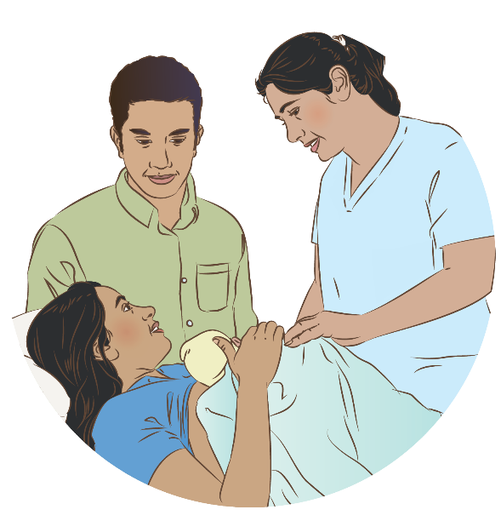

Communication and respectful care
Notes:
© World Health Organization 2024. All rights reserved.
Materials for demonstrations, practice, and simulations
One set per group of 3 participants and a set for facilitator demonstration if available.
Newborn Mannequin and clothes
Parent guide and counselling materials
Clinical practice card communication
Communication checklist
Local counselling materials

Slide 2
Content
Goal and learning outcomes
The situation
Newborns’ rights
Communication skills
Summary
Clinical practice
Quality improvement
References and additional resources

Slide 3
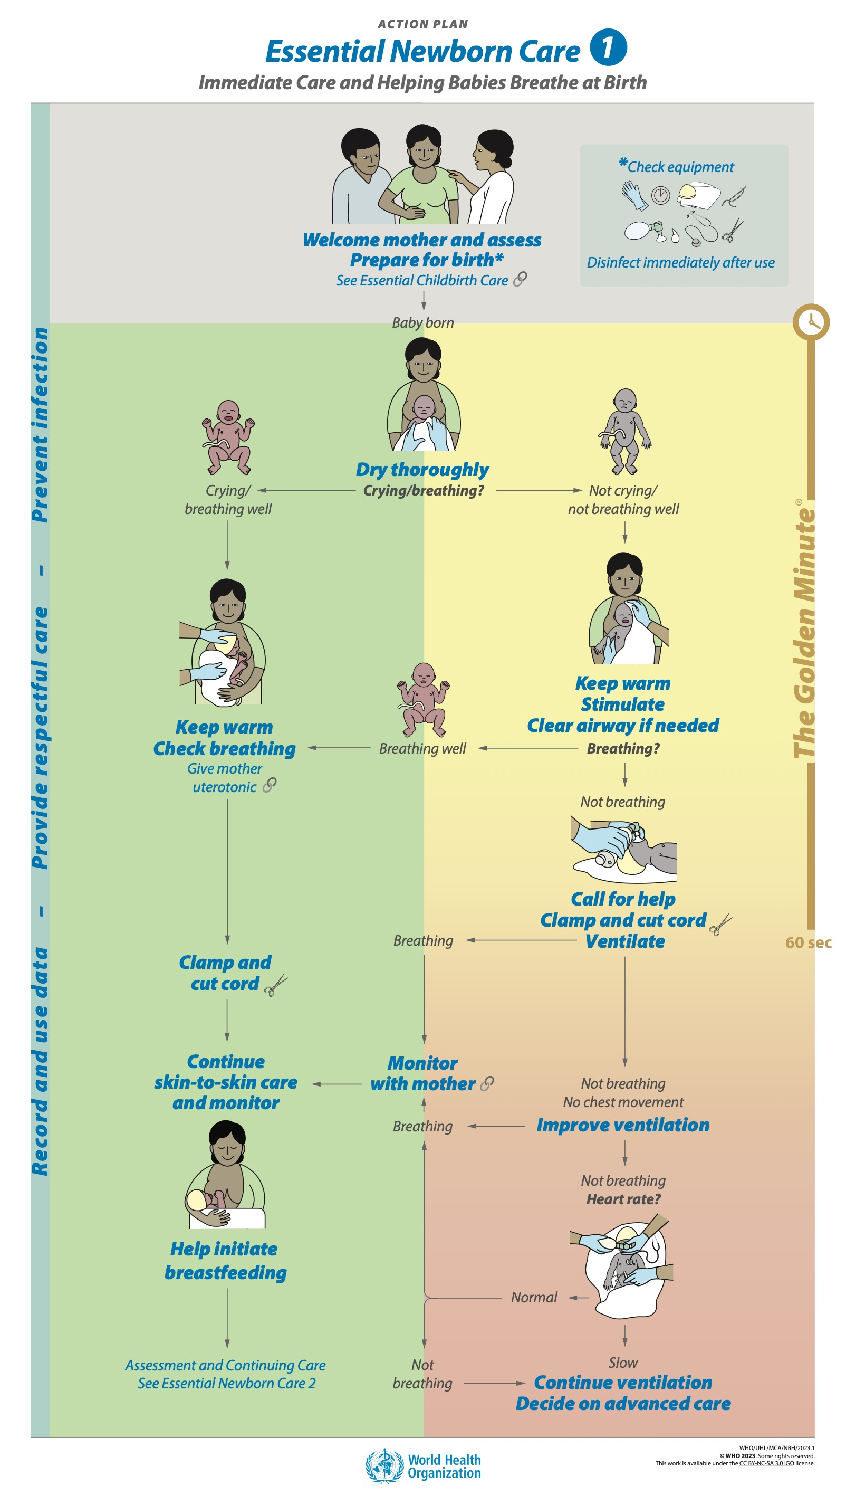
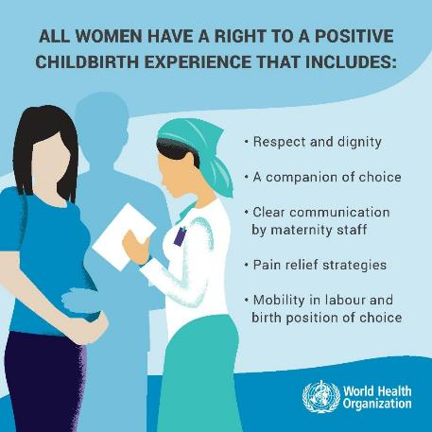
Goal and learning outcomes
Every mother and newborn receives respectful
care with effective communication.
  Communicate with mothers, fathers and families
  in an effective, respectful and responsive way.
  Interact with the newborn in a respectful and
  responsive way.

Slide 4
Communicating on the postnatal ward round
Form groups (doctor, mother and grandmother).
Ask Maya about her and her baby’s health and if she has any concerns.
Debrief with your team and your facilitator.
Maya gave birth to Ehlam yesterday morning.
Mother and baby are well.
Notes:
Baseline simulation
Skills and performance – participants demonstrate communication on the ward round.
Using the steps of good communication (Greet and Ask Listen Praise Advise and Check understanding ALPAC)
Using respectful and effective verbal communication
Showing responsive non-verbal communication
Debriefing – participants self-reflect and give feedback to one another in their roles.
Provision of care (performance objectives)
What was done well?
What could have been done better?
What will you change the next time?
Was data recorded and used?
Experience of care:
Was the communication respectful and the language appropriate?
Was the newborn referred to by name and by the correct sex?

Slide 5
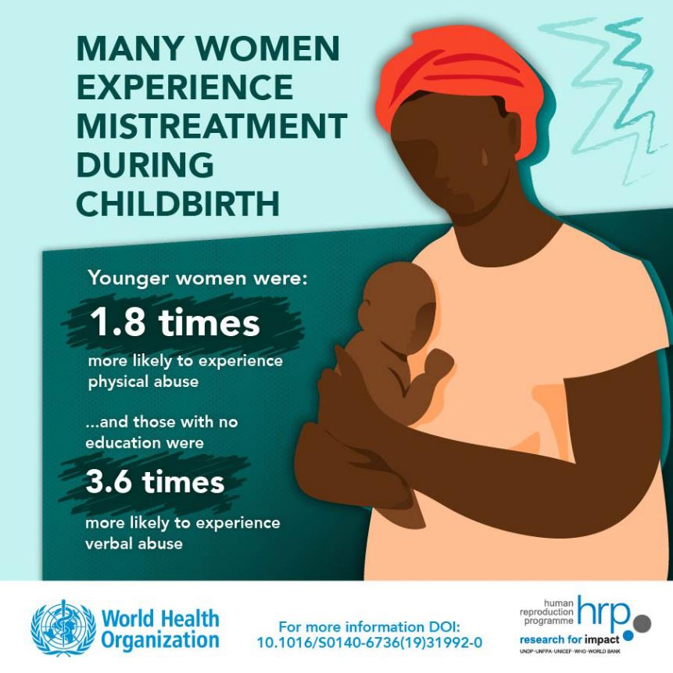
The situation
Mimi arrives at the hospital in advanced labour.
The midwife shouts at her for not coming earlier and tells Mimi that it is her fault if anything happens to the baby.
Mimi does not fully understand as her mother tongue is different.
With the next contraction Mimi cries
out in pain.
The midwife pushes her and tells her to quickly get on the bed and put her feet in the stirrups so she can deliver the baby.
Notes:
Have you ever seen or experienced such communication and behavior?
Does verbal abuse happen in your setting?
To start to address disrespectful care and mistreatment we need to understand the underlying causes. Reflect on why there is poor communication and disrespectful care in your context.
Mothers with disabilities face many difficulties in access to quality health care.
Their experience of care is often poor due to the negative attitudes of health workers.
How do you communicate with mothers with visual impairments, who are deaf, who have physical or intellectual disabilities?
There are people with disabilities in every ethnic and minority community and in other marginalized groups such as refugees, internally displaced persons and indigenous people.
For these populations, be doubly sure to remove barriers to care and ensure respectful communication.
To learn more
Diorgu FC, George AN. Broader driver of disrespectful maternity care: power dynamics. Obstet Gynecol Int J. 2021;12(3):130-133
Attitudinal barriers to communication
Understanding communication barriers and removing them
Disability inclusive communication
WHO respectful care

Slide 6
Newborns’ rights

Slide 7
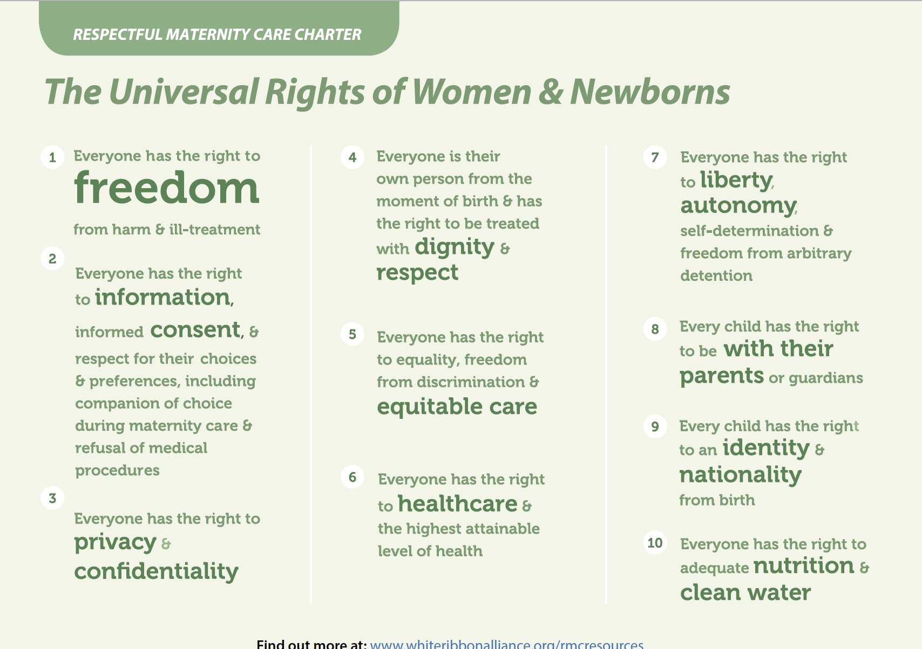
Do newborns have rights?
Freedom from harm and ill-treatment.
Right to information, informed consent, and respect for
their choices and preferences.
Right to privacy and confidentiality of medical procedures.
Everyone is their own person from the moment of birth and has
the right to be treated with dignity and respect.
Right to equality, freedom from discrimination and
equitable care.
Right to health care and the highest attainable level of health.
Right to liberty, autonomy, self-determination and freedom from
arbitrary detention.
Every child has the right to be with their parents or guardians.
Right to an identity and nationality from birth.
Right to adequate nutrition and clean water.
Notes:
Which rights are not applied in your country?
Newborns have fundamental rights and freedoms, as stipulated in international law.
These include the rights to:
survival, health and development
a legal identity from birth
be protected from harm, violence and neglect
a caring, loving and nurturing environment – even in humanitarian and fragile settings.
Newborns can be subject to harm and mistreatment. All newborns are at risk.
Sometimes there is a failure to meet standards of care, with separation of mother and baby or no consent for treatment or referral or no communication about birth registration.
There may be stigma and discrimination against girls/newborns with congenital malformations/small or preterm newborns/newborns from excluded groups ethnic/religious, etc., unmarried mothers/adolescent mothers/mothers with disabilities.
All newborns should have respectful, gentle care.
Always consider the environment noise/light.
Give pain relief, including skin-to-skin care and breast milk/sucrose for all procedures.
Avoid harmful practices (for example, routine suctioning, routine separation).
Avoid rough handling (this is more common when mother had physical abuse).
To learn more
Defining disrespect and abuse of newborns a review of the evidence

Slide 8
Communication skills

Slide 9

Empathy - what is it and why is it important?
The ability to share someone else’s feelings
or experiences by imagining what it would be like
to be in that person’s situation.
Empathy: The human connection to patient care
Notes:
Could you imagine yourself in other people´s shoes?
View video
Empathy is central to our work with mother´s families and newborns is key to effective communication.

Slide 10
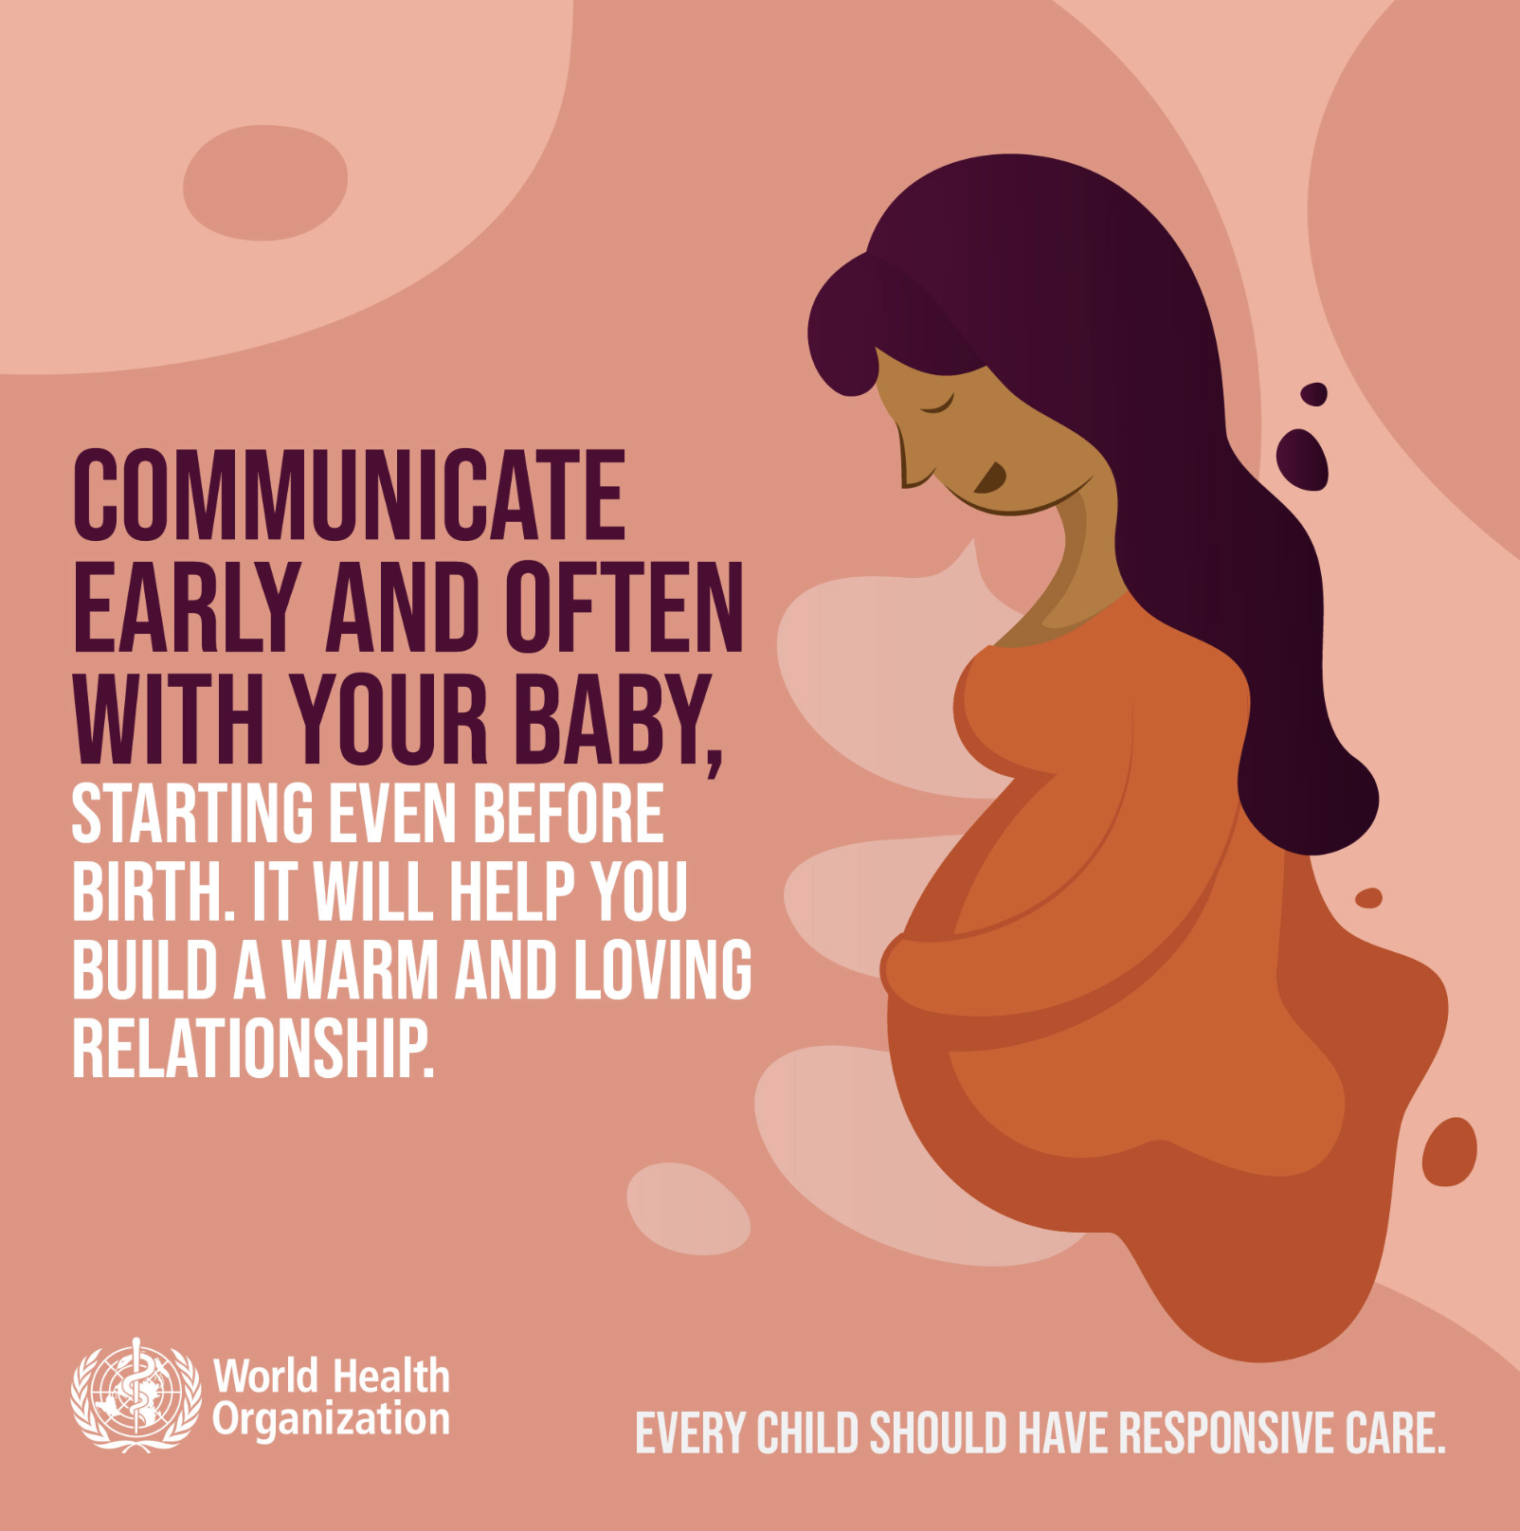
How do you use effective and respectful communication?
Communicating effectively with mothers, fathers
and families is critical. Good communication
empowers families to take an active role.
Using clear and simple language promotes the exchange
of information.
Protecting the privacy of the mother and her newborn
and the confidentiality of their data promotes trust
and collaboration.
Ensuring newborn’s behavior and cues are
recognized, respected and included in care decisions.
Notes:
What barriers to communication have you observed?
Hearing impairment: limited availability of written material or sign language interpreters at health services.
Visual impairment: health information not provided in accessible formats, including braille or large print-easy-to-follow formats
Cognitive impairment: plain language and pictures not available
Attitudinal barriers
Prejudice, stigma and discrimination by health service providers and other staff (including receptionists and security guards) at health facilities.
Women with disability face particular barriers to sexual and reproductive health services and information. Health workers often make the inaccurate assumption that women with disability are asexual or are unfit to be mothers.
To learn more
Inclusion made easy a quick guide
How do newborns communicate?
Sounds, gestures, cues and body language
gentle handling with respect, dignity and the mother’s consent
a quiet environment without noise and light pollution
To learn more
Understanding baby cues
Communicating with newborn through play
UNICEF communication and brain growth
Building-your-babys-mental-health
7-questions-about-communicating with babies-every-new-parent-asks-

Slide 11

Ask questions to obtain the information needed
Open questions often begin with words such as
“how”, “why”, “where”, “what” or “when”.
Closed questions are questions which have
“yes” or “no” answers.
Use these to obtain more detailed information.
Use these to confirm information already obtained.
Notes:
Practise using each kind of question in pairs.
Ask about hobbies.
Give feedback to each other.

Slide 12
Verbal and non-verbal communication
Verbal communication (spoken language)
can have positive and negative effects.
Non-verbal communication includes other ways of relating to people
    facial expressions
    body language
Respectful care during labor and birth
Notes:
View video
Reflect on what you have seen.
Is this something you practice in your health centre?
Are there any skills or practices that differ from your current practice?
What provider behaviours differ from your current practice?
Does this video highlight any quality gaps in your facility?

Slide 13
Use listening and learning skills
Ask open questions.
Use responses and gestures that show interest.
Listen and reflect back what the mother/parent/caregiver says.
Empathize – show you understand how the mother/parent/caregiver feels.
Avoid using judging words.
Empathy vs sympathy
Notes:
In pairs ask mother about her delivery and immediate care after birth and give feedback to each other.
What is the difference between empathy and sympathy?
View video
What new knowledge is presented in this video?
Does this video highlight any quality gaps in your facility?

Slide 14
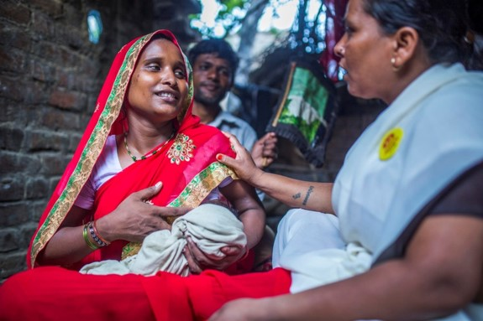
Use listening and learning skills
Posture: Sit at the same level and close
to the mother.
Eye contact: Pay attention to the
mother, avoid getting distracted and
show you are listening.
Barriers: Remove any physical barriers.
Taking time: Take time without hurrying
or looking at your watch or mobile
phone.
Touch: Only touch in an appropriate
way. Do not touch the mother, her
breasts or her baby without her consent.
© UNICEF/UN0281006/Vishwanathan
Notes:
In pairs practise using listening and learning skills.
Behave in negative way
Apply guidance for good communication
Give constructive feedback.
How did you feel as the mother when the health worker was indifferent and did not listen?
How did you feel when good listening and learning skills were applied?
Eye contact may not be appropriate in some cultural contexts.

Slide 15

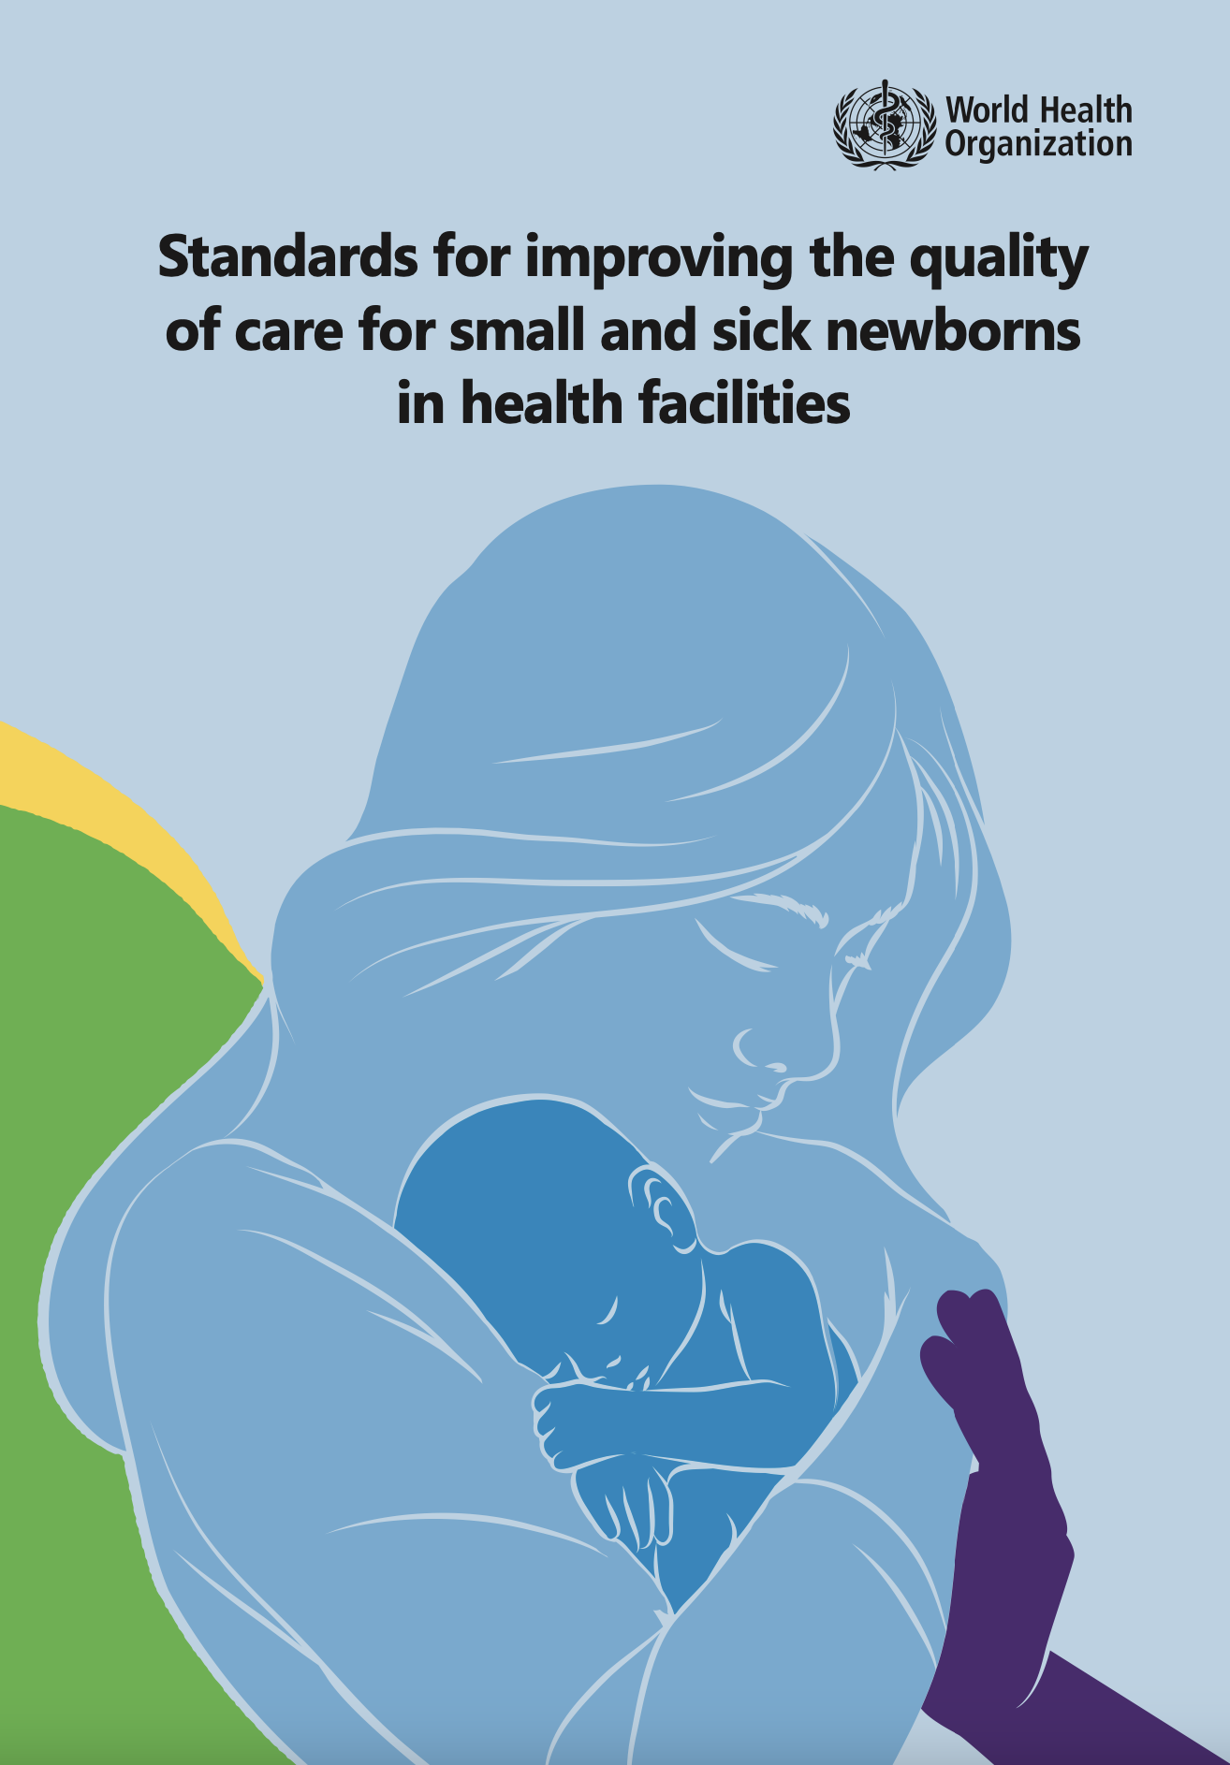
Why is effective communication important for mothers and families?
Find the standard and reasons
on pages 87-88.

Slide 16
Standard and reasons
Quality statement 4.1
All carers of small and sick newborns are given information about the
newborn’s illness and care, so that they understand the condition and the
necessary treatment.
Reasons
    Feelings of helplessness, anxiety, depression and fear may reduce caregivers’
    confidence in caring for their baby.
    Families often feel excluded from involvement in the care of their babies, especially small or sick newborns, because of lack of communication with staff and staff
    unfriendliness.
Notes:
Parents and caregivers, especially of small or sick newborns, may find the hospital experience stressful and report anxiety and loss of control.
Other factors make families feel excluded from involvement in the care of their small or sick newborn including distance from home and family and fear of technology.
Preterm birth is a traumatic event, which disrupts parents’ expectations of parenthood. They are uncertain about the newborn’s outcome, which can affect realization of their parental roles and lead to problems in interaction and attachment.
Information about their newborn should be provided with empathy and in a culturally appropriate way.
Effective communication requires access to translation and interpretation services for families who do not speak the dominant language, so that they receive appropriate information and can ask questions and participate in decision-making about their newborn.

Slide 17
Standard and reasons
Quality statement 4.4
Carers of small and sick newborns and staff understand the importance of
nurturing interaction with the newborn, recognize and respect the newborn’s
behaviour and cues and include them in care decisions.
Reasons
    Newborns are separate individuals with an identity, feelings and emotions, who can actively communicate, participate and respond, rather than being passive recipients.
    Touch, taste, smell and sight enable developing babies to learn from their
    surroundings and to adapt physiologically and psychologically.
Notes:
The fetus begins to experience the world through touch and then, later in pregnancy, through taste, sound, smell and sight.
From birth, babies can recognize their mothers’ voice, and soon after birth they respond to faces, gentle touch and holding, as well as the soothing sound of “baby talk”.
Caregivers can learn to understand how babies respond to them, which is essential for optimal development of the baby’s rapidly growing brain.

Slide 18
Which situations can be difficult?
Difficult situations include:
Communicating when a family member is upset, angry,
aggressive or confrontational or when a baby dies
Communicating with mothers or family members with a disability
(Hearing, vision, physical or intellectual disability)
Communicating with families from different cultures
Notes:
Which difficult situation have you experienced when caring for newborns?
Remember
When caring for mothers, newborns, fathers and families, always treat them as you would like to be treated yourself.
Care is not just an activity. Care involves kindness, compassion and humanity.
Practice handling difficult situations with your peers using simulations to build your confidence.
Cultural competence
Be sensitive to differences between your own cultural background and that of the mother and family. Differences in verbal and non-verbal communication can influence care.
Culture, religion and ethnicity may influence beliefs and values that people have about health and health care.
Different cultures have different views of the causes of a newborn’s condition. “Blame” may be placed on the mother or both parents, or the child’s condition may be considered an “act of God”. This is especially important if the baby has any congenital abnormalities.
Avoid overgeneralizing, stereotyping and other culturally based assumptions.
When taking a history ask questions that assess sociocultural dimensions, views of health, immigration history, identity and religion.
When there are language barriers between a family and a health professional, use an interpreter who does not transform what the mother or family says.
Cultural competence and culturally effective care are critical for improving health outcomes for mothers and babies, and their safety and satisfaction.

Slide 19
How do you give bad news?
“Bad” news depends on what it means to the person receiving the
information.
Arranging for a relative or friend to be with mother before giving bad news
Giving bad news or sensitive information in a private space
Using effective communication with sensitivity and compassion to support
mothers and families when a newborn dies or if a newborn has a
life-threatening condition or congenital abnormality
Notes:
Have you been trained to give bad news?
What techniques do you use when giving bad news?
To learn more
Standards for Improving Quality of Maternal and Newborn Care in Health Facilities. Standard #3, #4, #6

Slide 20
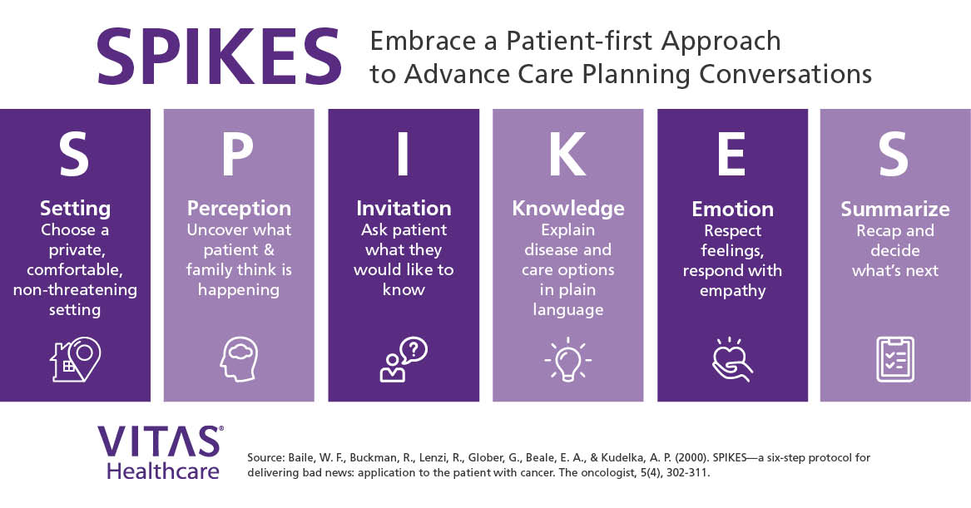
How do you approach a difficult conversation?
Notes:
Some people find mnemonics help them remember what to do in difficult situations.
SPIKES outlines the aspects to consider and include in a difficult conversation.
ALPAC reminds the content of good communication as practiced in the first simulation (Ask Listen Praise Advise Check understanding)

Slide 21
Communicating a serious diagnosis
Form groups (doctor, mother and father).
Communicate your findings with Harry’s parents.
Debrief with your team and facilitator.
On examination you find that Harry has clinical signs of Trisomy 21, Downs syndrome.
Notes:
Simulation
Skills and performance – participants demonstrate communicating a difficult diagnosis.
Using the SPIKES outline to guide the conversation
Demonstrating compassion, kindness, and respect in verbal communication
Utilising respectful non-verbal communication
Debriefing – participants self-reflect and give feedback to one another in their roles.
Provision of care (performance objectives)
What was done well?
What could have been done better?
What will you change the next time?
Experience of care
Was the communication respectful and the language appropriate?
Was the difficult news given with sensitivity?
Were Harry’s parents referred to specific services for follow up and linked with a relevant parent support group?

Slide 22
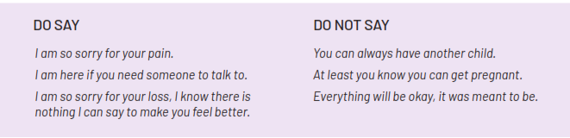
What is important when communicating with parents after their baby has died?
Acknowledge their loss directly and
sensitively.
Do not try to avoid talking about
their grief.
Use the same terminology the mother
uses to refer to her baby and her loss.
Provide culturally appropriate ways
to preserve memories.
Support parents to complete civil
registration.
Link family to ongoing psychosocial
support.
Notes:
After the death of a newborn, are mothers given privacy and sensitive compassionate care?
What are culturally appropriate steps to preserve a newborn’s memory in your context?
Taking photos
Creating footprints or handprints
Collecting locks of hair
Arranging time alone with baby
Donating breast milk (some mothers)

Slide 23
Practice verbal and non-verbal skills to communicate bad news
After a normal healthy pregnancy, Delia delivers her first baby, a girl.
She is not breathing, and she dies.
Non-verbal skills:
Verbal skills:
Be kind and gentle in actions
If the mother is sitting down, sit down
with her
Do not leave the mother alone
Touch her appropriately
Allow the mother to react in her own way
Let her touch or hold the newborn
Let the mother or father and other
members of the family be with the
newborn.
Give a simple, clear explanation of
what happened
Make sure the mother understands
what you are telling her by using “open”
questions
Give her time to ask questions
Speak softly
Respect her cultural beliefs and customs
If she is alone, ask if there is anyone near to the hospital/clinic who can be with her.
Notes:
Practise in groups explaining to Delia and her husband what has happened.
Apply verbal and non-verbal skills.
Give each other feedback.
Was the privacy of the parents ensured?
Did you communicate with the parents whether the newborn was a girl or boy?
Did you tell them how much the newborn weighed and if the newborn was premature?
Were the parents supported for birth and death certification?
Were the parents referred for counselling and support if available in your context?

Slide 24
Communicating that a baby has died
Form groups (mother, doctor, husband).
Communicate with Miriam and her husband.
Debrief with your team and facilitator.
Nat was born to Miriam. He did not breathe at birth.
After 20 minutes of ventilation there is no cord pulse and no heart beat.
You listen with your stethoscope. You hear no heart beat.
Notes:
Simulation
Skills and performance – participants demonstrate effective, compassionate and respectful communication to parents of a stillborn.
Using the SPIKES outline to guide the conversation
Providing information on resuscitation interventions, weight, gestation, diagnosis
Facilitating ways to preserve memories, complete civil registration, link with ongoing psychosocial support
Demonstrating compassion, kindness, and respect in verbal communication
Utilising respectful non-verbal communication
Debriefing - participants self-reflect and give feedback in their roles.
Provision of care (performance objectives)
What was done well?
What could have been done better?
What will you change the next time?
Was data recorded and used?
Did the health worker acknowledge the loss directly and sensitively?
Did the health worker talk about grief?
Did the health worker use the same terminology the parents used to refer to their baby and their loss?
Experience of care
How difficult was this situation for the health worker?
Was the setting private and were the parents supported by extended family or others?
Was the communication respectful and the language appropriate?

Slide 25
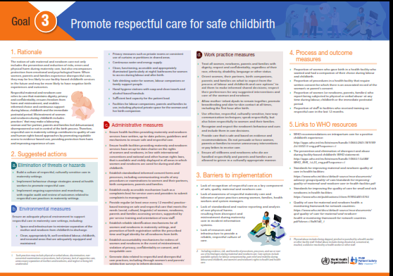
What actions promote respectful care of newborns and address disrespectful care?
Notes:
Review the poster in supplemental materials
Poster
Which actions could improve the situation where you work?

Slide 26
Disrespectful behaviour and abuse
Form groups (nurse, nurse in charge, medical officer ).
Explain what you saw and explore how this could be addressed with
your colleagues.
Debrief with your team and with your facilitator.
You are transferred to a new posting as medical officer.
You saw the midwife slapping Mimi’s baby to stimulate breathing.
This is not unusual in the hospital.
You are now in the office with the nurse in charge.
Notes:
Simulation
Skills and performance – participants demonstrate respectful communication addressing a difficult situation involving a colleague.
Explaining the actions observed in objective language
Exploring options for addressing disrespect and abuse – for example, case review, targeted education on rights of newborns and women, simulations for staff on how to intervene
Deciding on next steps and follow-up with the midwife involved
Debriefing – participants self-reflect and give feedback to one another in their roles.
What was done well?
What could have been done better?
What will you change the next time?
How difficult was this situation for the health worker (medical officer)?
Is this something you have experienced?
Review some of the measures that could be put in place “Promote respectful care for safe childbirth” poster.

Slide 27
Communicating on the postnatal ward round
Form groups (doctor, mother and grandmother).
Ask Maya about her and her baby’s health and condition.
Debrief with your team and your facilitator.
Maya gave birth to Ehlam yesterday morning.
Mother and baby are well.
Notes:
Repeat simulation
Skills and performance – participants demonstrate communication on the ward round.
Using the steps of good communication (Greet and Ask Listen Praise Advise and Check understanding ALPAC)
Using respectful and effective verbal communication
Showing responsive non-verbal communication
Debriefing – participants self-reflect and give feedback to one another in their roles.
Provision of care (performance objectives)
What was done well?
What could have been done better?
What will you change the next time?
Was data recorded and used?
Experience of care
Was the communication respectful and the language appropriate?
Was the newborn referred to by name and by the correct sex?

Slide 28
Summary
In this module, you have learned:
Learned the importance of effective communication.
Learned about the rights of women and newborns.
Demonstrated how to communicate with mothers, fathers, newborns their families and colleagues in an effective, respectful and responsive way.
You will apply what you have learned about communication skills throughout the course and whenever caring for women and newborns.
Continue to practice effective communication and managing difficult situations with your peers.

Slide 29
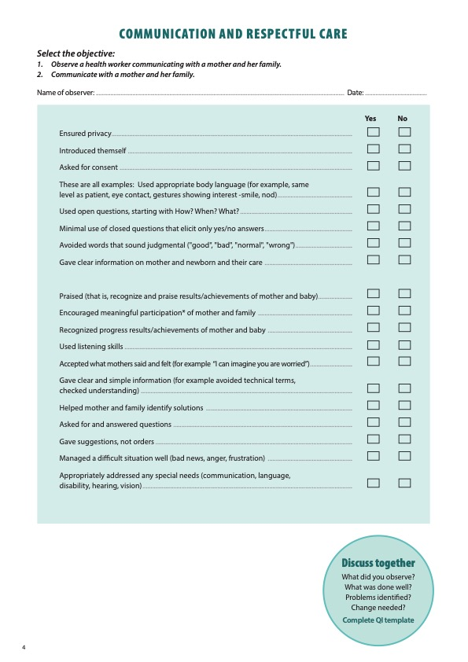
Notes:
Review the Clinical practice checklist before observing or practicing in the clinical area.

Slide 30
Notes:
After the clinical practice, discuss the observations made, possible reasons for practices, and changes needed to improve the quality of essential newborn care.
What new things will you do?
What old things will you not do?
How will you make a change?

Slide 31

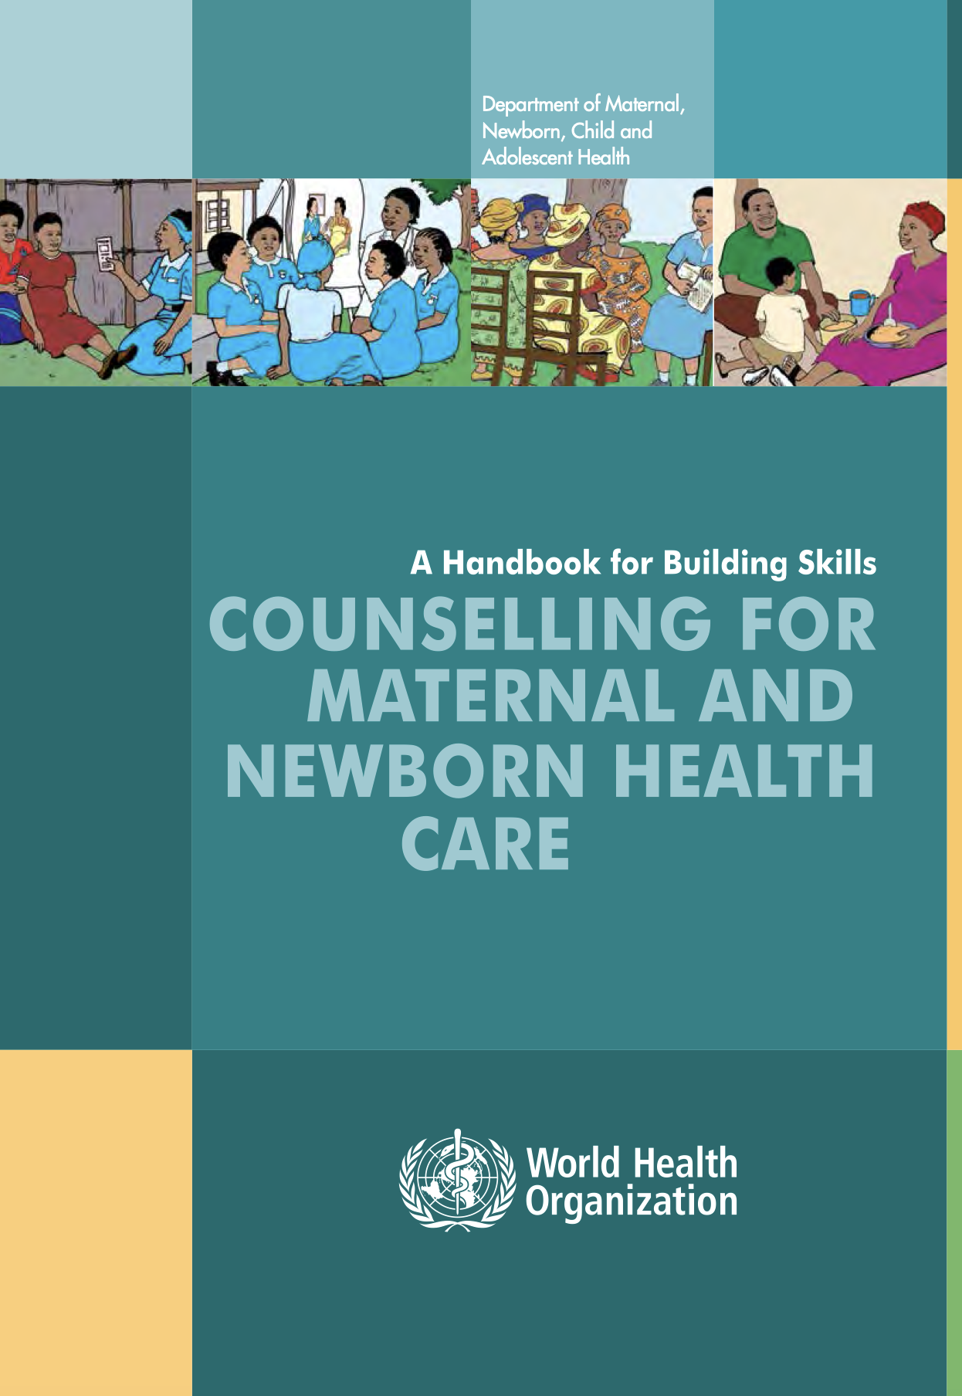

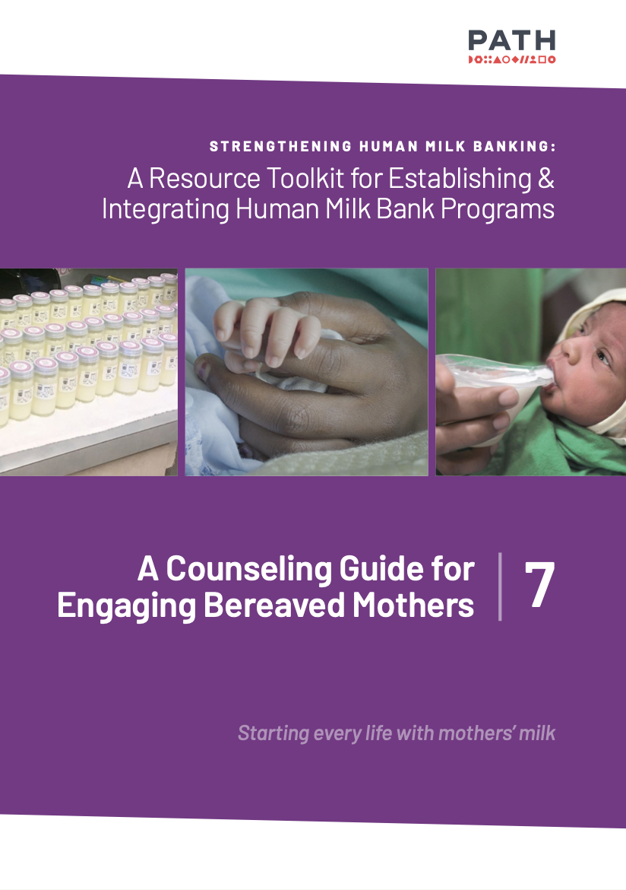


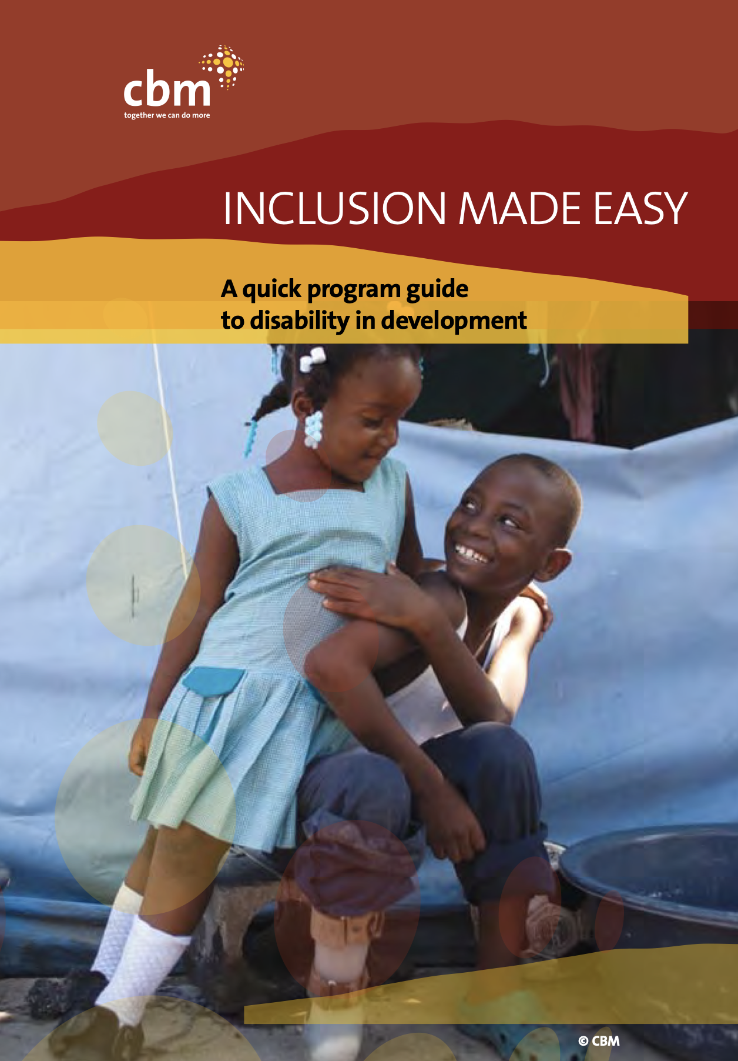
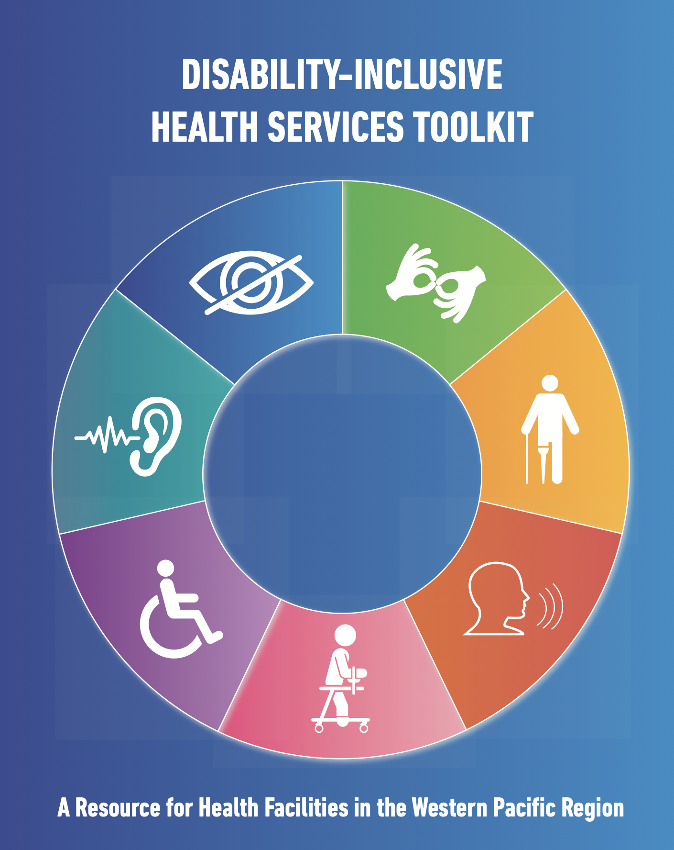
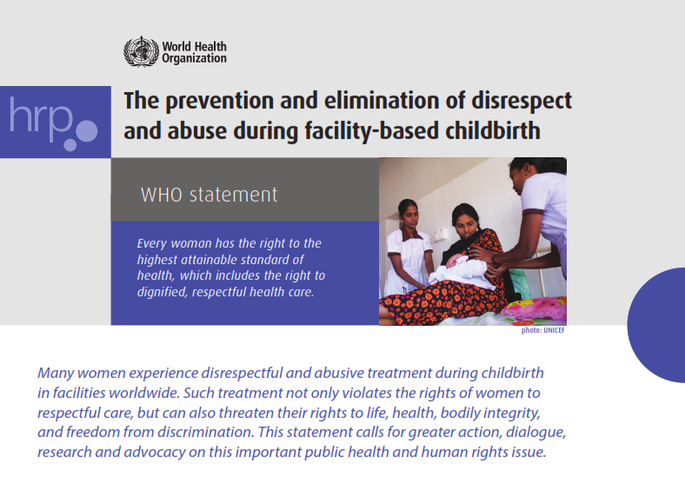
References
Respectful care communicate with respect and kindness
Communicating with newborn cues and body language
WHO WPRO inclusive communication

