Slide 1
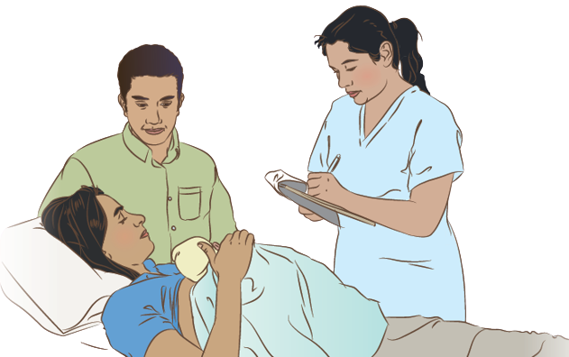

Data collection and use
Notes:
© World Health Organization 2024. All rights reserved.
Materials for demonstrations, practice, and simulations
Organise one set per group of 3 participants and a set for facilitator demonstration if available.
Blank examples of each recording form used in the facility
Antenatal clinic visits
Inpatient admissions
Labour and delivery records
Newborn record
Health care worker daily monitoring and assessment of newborn
Mother’s observations of newborn
Growth monitoring (newborn)
Newborn referral note
Newborn discharge summary
Forms used for birth/death registration, reporting of congenital anomalies, MPDSR (Maternal Perinatal Death Surveillance and Review), and any others used locally
Recording forms filled out with information for the fictitious patient Salina (see slide 3)
Flipchart to record responses to practice exercises
Quality improvement template with tips for completion

Slide 2
Content
Goal and learning outcomes
The situation
Why data is important
Using data
Summary
Clinical practice
Quality improvement
References and additional resources

Slide 3
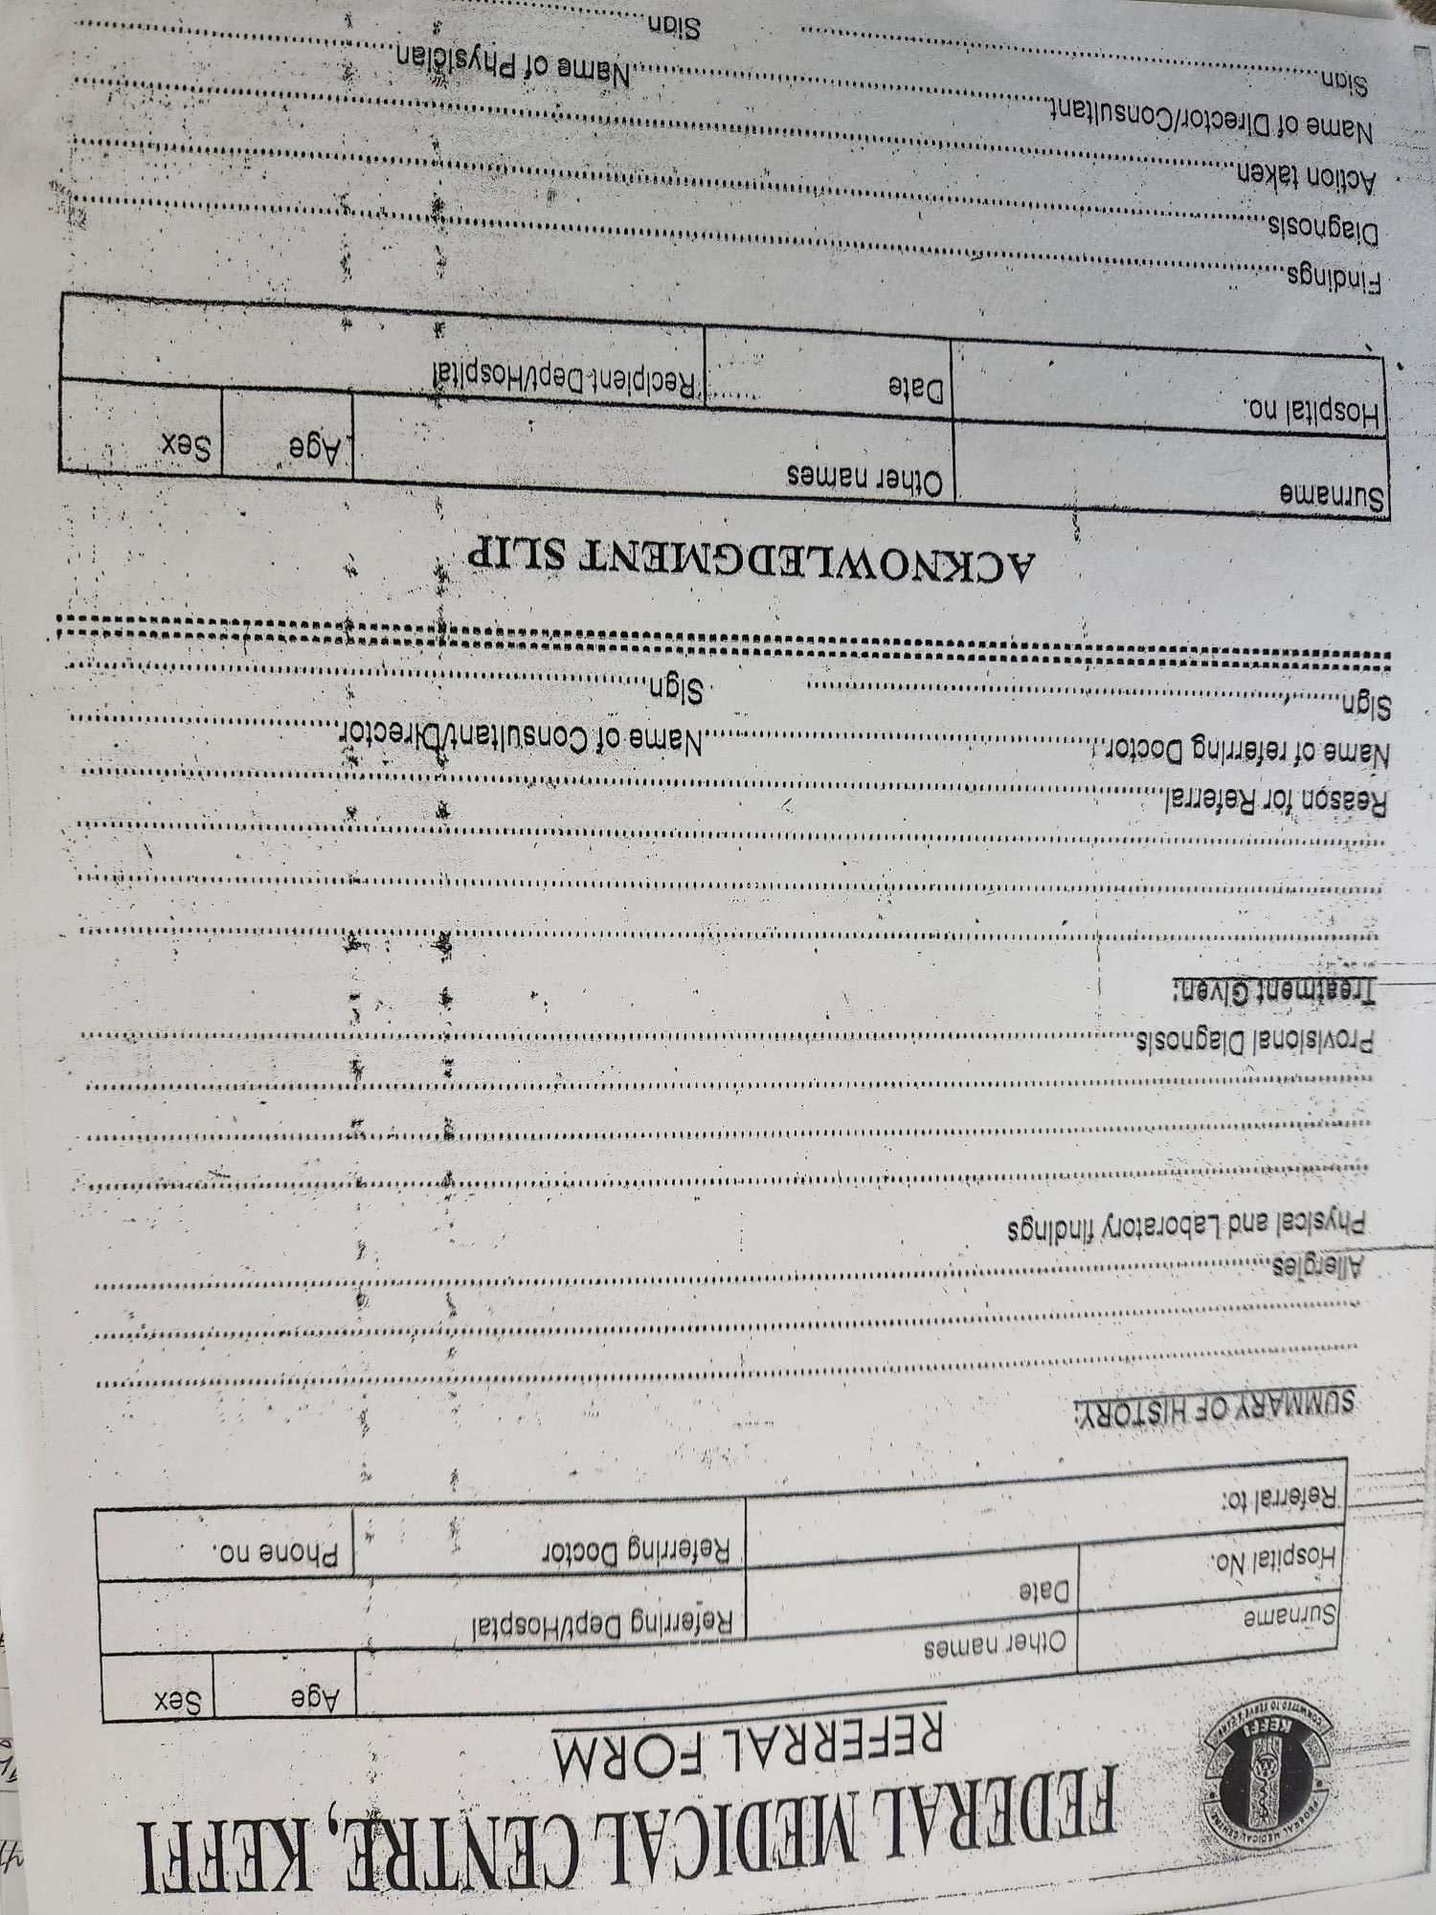
Goal and learning outcomes
Data collection and use are essential
to providing quality newborn care.
Collect data that supports essential functions
at all levels of the health system.
Ensure complete and accurate data collection.
Use data in daily care of newborns.
Use data to track processes and outcomes.
Use data at the facility level to improve the
process of care and specific outcomes.

Slide 4
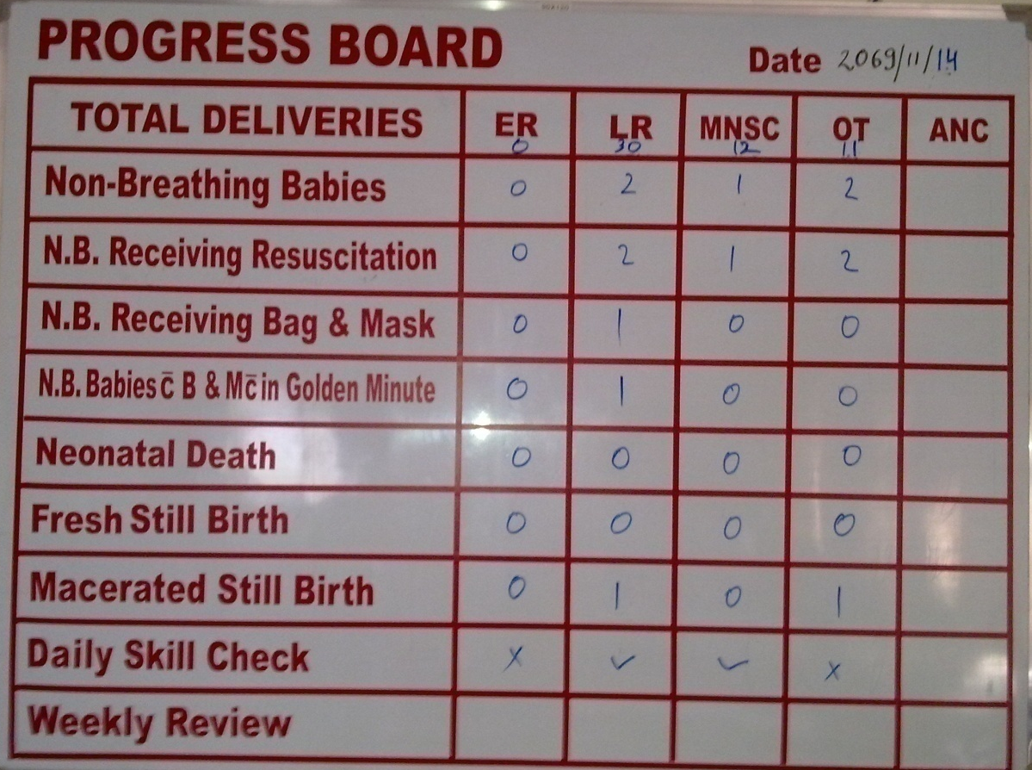
The situation
2.5 million newborns, more than
2 million stillbirths and 295 000
mothers die each year around
the time of childbirth.
The highest neonatal mortality
numbers and rates are in
humanitarian and fragile settings.
The quality of essential newborn
care can be improved everywhere.
© UNICEF-Ashish KC
Data reveals gaps in care and enables improvement.
Notes:
What can data reveal about newborn care practices?
Data is not just about counting numbers of patients or items.
Data is also about what interventions are performed and what outcomes are achieved.
Measuring important processes and outcomes draws attention to them and enables change and improvement.
The board shown tracks deliveries in every place they occur in a large metropolitan hospital.
What data track interventions?
What data track outcomes?
What indications are there of a quality improvement process?
How does the situation compare with your health facility?
Does your facility collect and use data to improve outcomes?

Slide 5
Stillbirth registration
Form groups (midwife, mother, husband).
Help the parents register the stillbirth.
Debrief with your team and facilitator.
Julie gave birth at 32 weeks gestation in the health facility.
Her son was stillborn.
Notes:
Baseline simulation
Skills and performance – participants demonstrate the steps in stillbirth registration at their facility.
Notifying the civil registration office of a stillbirth.
Encouraging parents to complete the details in the civil registration record.
Giving parents information on when and where to collect the certificate of stillbirth.
Debriefing – participants self-reflect and give feedback to one another in their roles.
Provision of care (performance objectives)
What was done well?
What could have been done better?
What will you change the next time?
Experience of care
Was the language clear and appropriate?
Was the communication respectful?

Slide 6
Why data is important

Slide 7
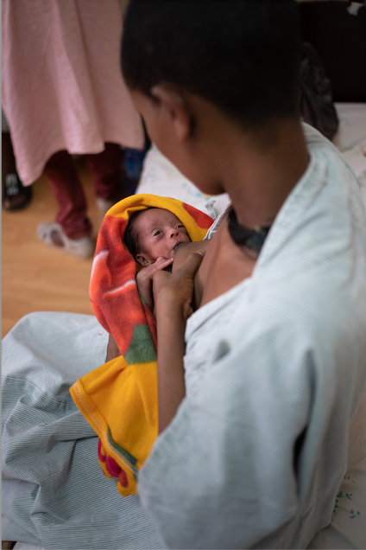
Why is data important?
Caring for the patient
    Making and documenting a care plan
    Spotting trends in condition
    Facilitating communication and handovers
    Making the health worker’s job easier and
    more rewarding
Understanding processes and showing outcomes
Improving care by making changes through
facility-based quality improvement
Learning from one another
Planning and prioritising resource use
© WHO
Notes:
Why is data important?
How can you care for a patient without data?
How can you understand the outcomes of your care without data?
How can an administrator manage ordering and show outcomes for the facility without data?
How can health workers and administrators work together to improve the experience of patients and health care workers without data?
To learn more Data for impact

Slide 8
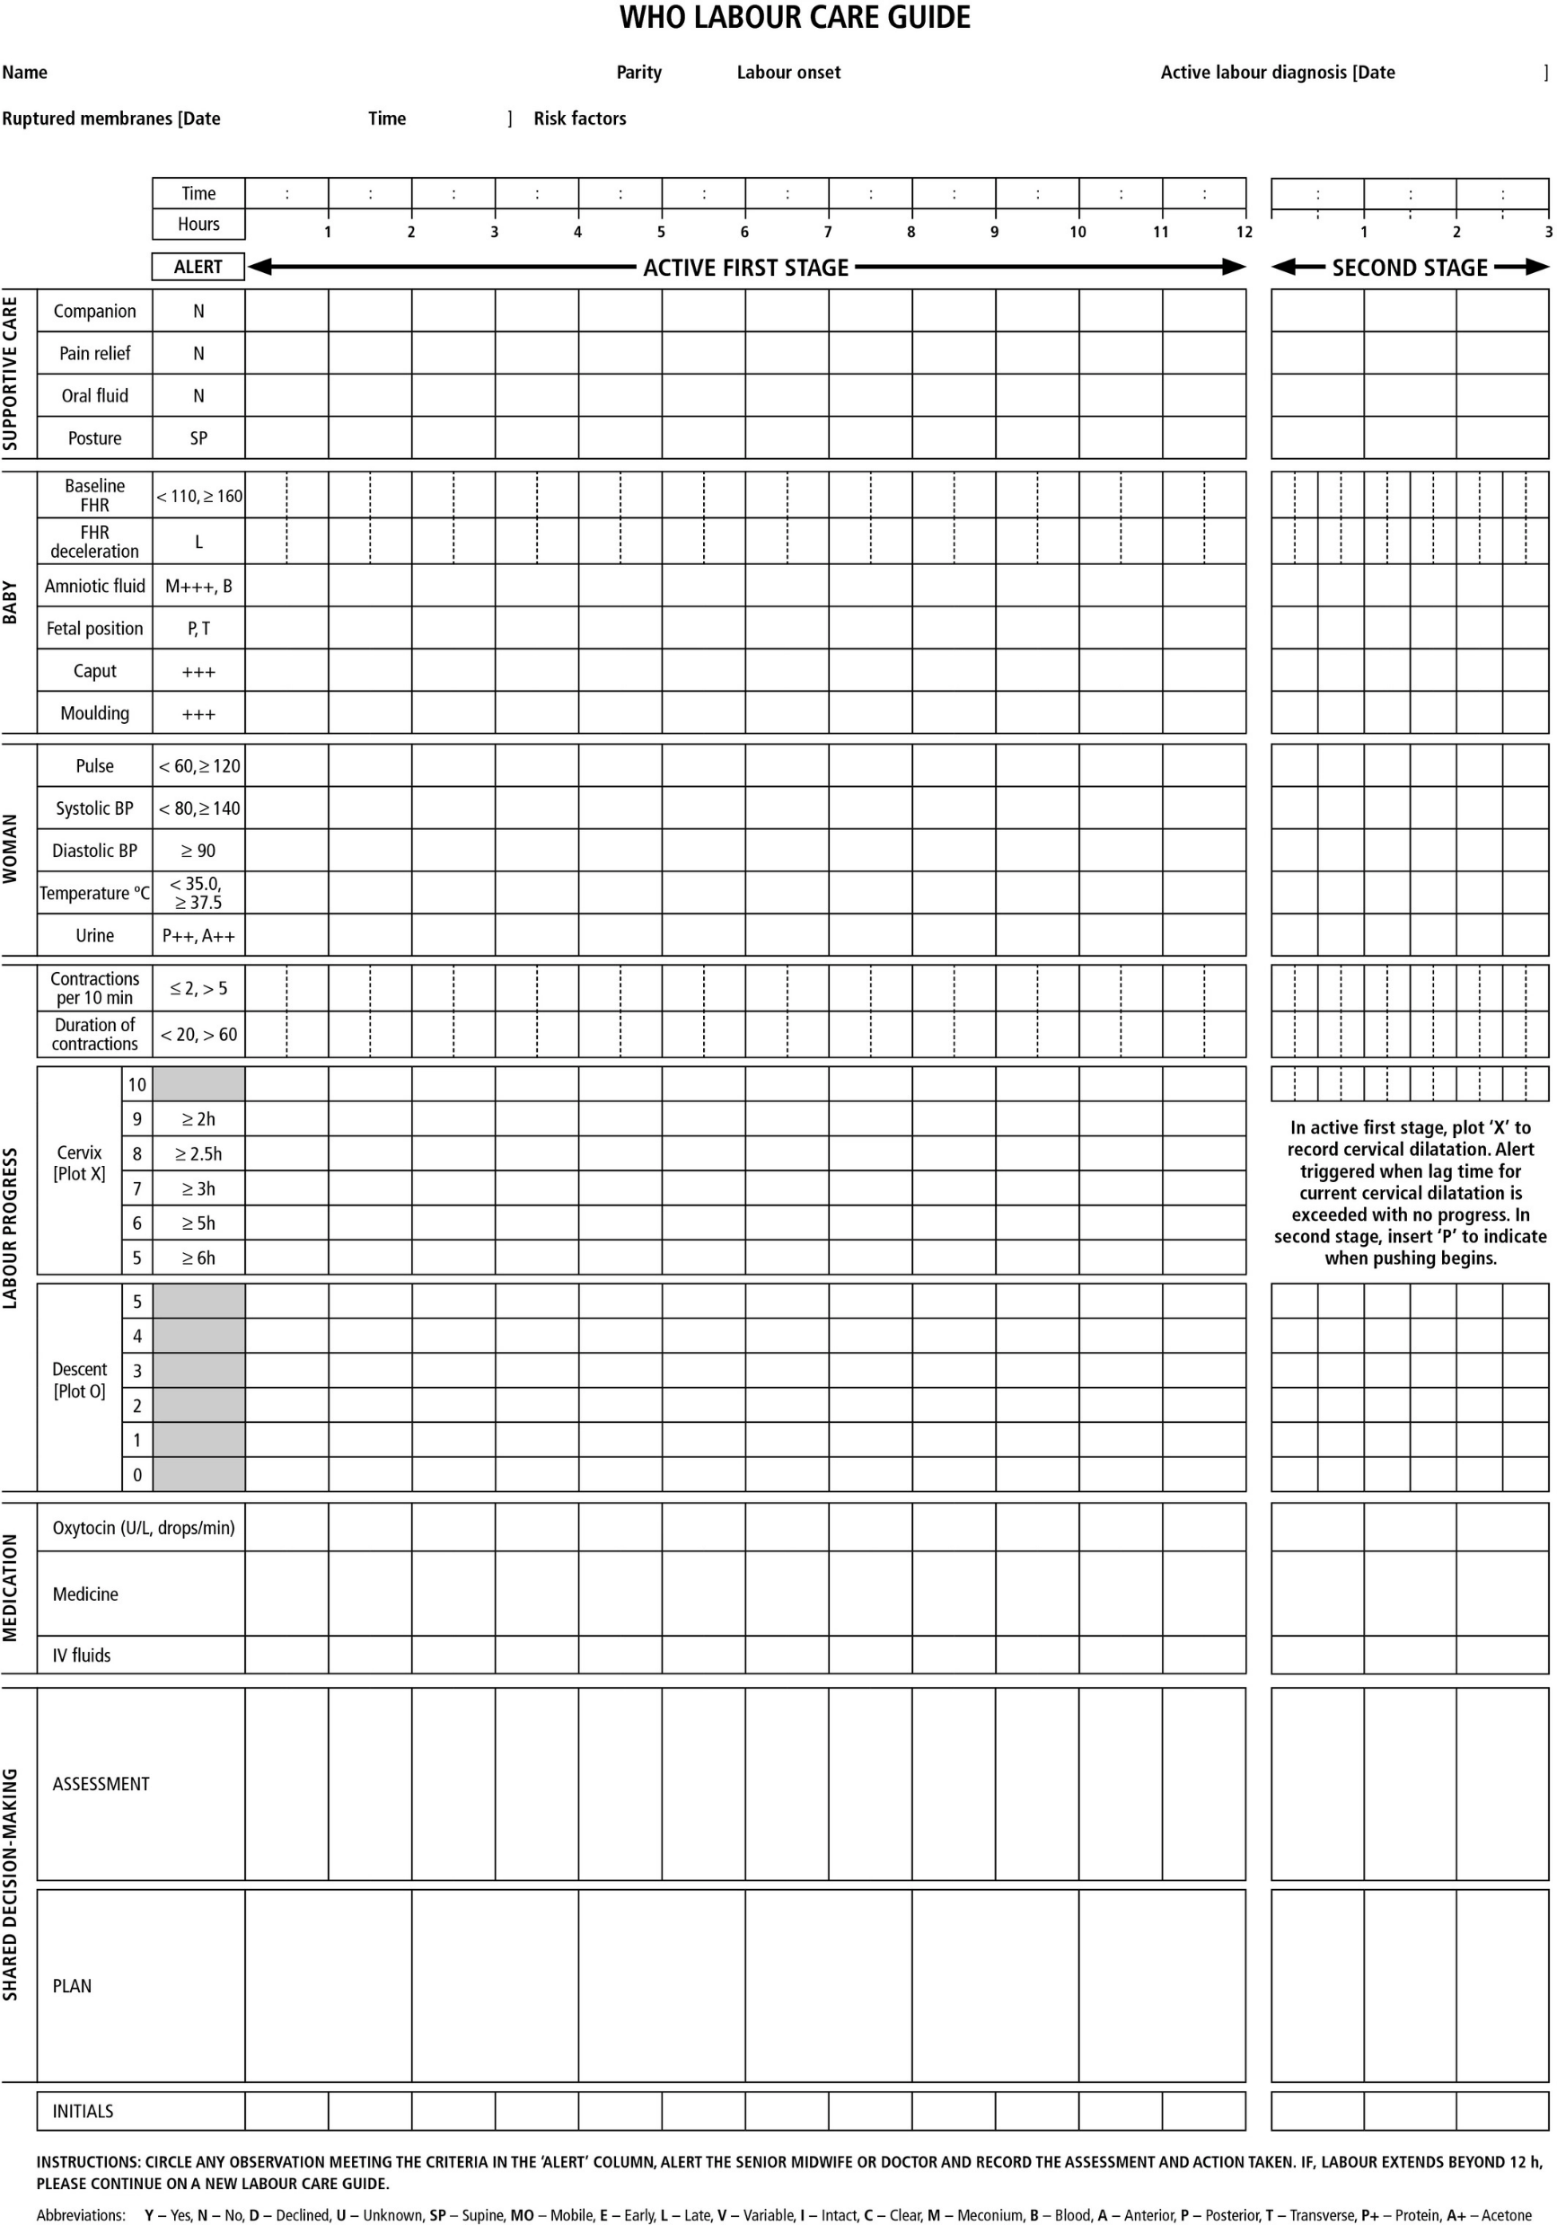
Access data in the health facility
Antenatal clinic visits
Inpatient admissions
Labour and delivery records
Newborn record
Health care worker daily monitoring and
assessment of newborn
Mother’s observations of newborn
Growth monitoring (newborn)
Newborn referral note
Newborn discharge summary
Notes:
Refer to the forms (notes or electronic records) used in the health facility to record each type of data listed.
The recording forms may be paper or electronic.
Identify each form and the type of data recorded.
If a form is not available, discuss why this may create a gap in care. For example, mother’s observations of her newborn are not commonly recorded.
A sample newborn record, newborn referral, and mother’s observations form are available in the ENC-2 Provider Guide.

Slide 9
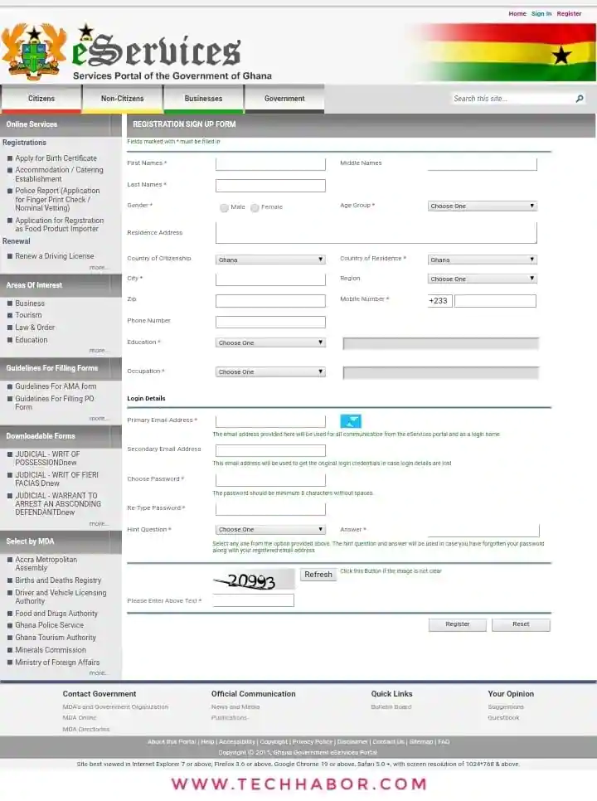
Access data in the health facility
Purpose-specific registries/reporting
    MPDSR
    Congenital anomalies
    Other?
Health Management Information System
(HMIS)
Civil registration (birth, death, stillbirth)
Notes:
Refer to the forms (notes or platforms) used in the health facility to record each type of data listed.
The recording forms may be paper or electronic.
Identify the type of information noted in each record.
Discuss how data is collected for reporting to registries and HMIS. Discuss how data is separated into categories (disaggregated – as by birth weight) for reporting and use in decision-making.
Discuss how births, deaths, and stillbirths are recorded and reported, including specific details on the national system for birth registration.

Slide 10
Collect and use complete, accurate data
Form groups (nurse, mother, companion)
Review Salina’s records to answer these questions:
Results of antenatal testing for HIV and syphilis
Hemoglobin
Tetanus immunization status
Estimated gestational age
Could you find all the information?
Salina comes to your health facility in labour. This is her first pregnancy. She had 4 antenatal visits at her local health center.
She is uncertain of her expected date of delivery.
Notes:
Review de-identified examples of recording forms used in the facility to find the information.
Indicate where the answer to each question is recorded.
If some data is not included on the facility forms, discuss how the information could be obtained.
Discuss how the answers to these questions help plan care for mother and baby and what might happen if a question goes unanswered.

Slide 11
Birth registration for every child
What benefits and protections come with birth registration?
Find the milestones on page 10.
Notes:
Use a printed or digital copy (pdf) of the document to find the benefits and protections of birth registration.

Slide 12
Recommendation and reasons
The child shall be registered immediately after birth and shall have the right from birth to a name, the right to acquire a nationality and, as far as possible, the right to know and be cared for by his or her parents.
– Convention on the Rights of the Child, 1989.
Benefits of birth registration:
A birth certificate provides proof of a child’s existence and identity as
a person before the law.
Proof of age helps prevent child labour and trafficking, child marriage and
underage recruitment into the armed forces.
Registration helps plan and access social service systems, including health,
education, and justice.
Notes:
Discuss what happens if birth registration is not completed during the birth hospitalisation.
Why is it important to support parents in completing birth registration?
At what other times can birth registration be completed?
To learn more
Improving-the-civil-registration-of-births-and-deaths-in-low-income-countries-guidance-for-the-health-sector
Birth registration health workers role

Slide 13
Using data

Slide 14
Use data in caring for patients
You are handing over care of 5 babies receiving kangaroo mother care
in your facility.
Practice in pairs to communicate to your colleague the important information
from your notes during the last shift.
Mother & baby | Temp | Feeding | Output | Comments
Salina & Bo | 36.4 | Breast x 4 | Stool, urine x4
Julia & John | 37 | Cup 30mL x4 |  | No family
Maria & Rose | 36.2 | Tube 25mL x4
Patty & Eli | 36.9 | Breast x3 | No urine | Regurgitation x3
Hafida & Omar | 37.2 | Breast x5 | Stool 2, urine 5
Notes:
Communicate to your colleague the important information from your shift.
Then, reflect on the following questions:
Do you have a system to communicate important information to your colleagues at handovers of care?
Which of these newborns needs further investigation or a change in the care plan?
What additional information do you need about each mother/baby pair (I-PASS)?
Background information – Illness severity
Patient summary - date of delivery/postnatal age, gestation, medical conditions
Care plan – Action list
Situational awareness
Summary

Slide 15
Use data to track processes and outcomes
You are attending the birth of Salina’s baby.
Where will you record the following information?
(List all if multiple places)
Information | Location/form
Birth weight
What help the baby received (if any) to breathe at birth (rubbing the back, clearing the airway, positive-pressure ventilation)
When the umbilical cord was clamped/tied and cut
How long the baby remained in skin-to-skin contact with the mother after birth
Whether the baby initiated breastfeeding in the first hour after birth
Notes:
List all the places where the data item is recorded in your facility.
Then reflect on the following questions:
Is some information recorded in multiple places?
Is some information not recorded at all?
Is some information fabricated just to fill in the blank?
Are you satisfied with the data recording tools in your health facility?
To learn more
Estifanos AS, Gezahegn R, Keraga DW et al.
The false reporter will get a praise and the one who reported a truth will be discouraged
a qualitative study on intentional data falsification by frontline maternal and newborn healthcare workers in two regions in Ethiopia.

Slide 16
What are the data for your health facility for these core indicators?
Maternal mortality ratio (or maternal deaths per month)
Stillbirth rate (or stillbirths per month)
Neonatal mortality rate (or neonatal deaths per month)
Skilled attendant at birth (inborn, outborn admissions)
Early initiation of breastfeeding (percentage in 1st hour)
Early postnatal care for mothers and babies (percentage by 48 hours)
Notes:
Do you know the data for your health facility?
These are indicators that are collected in health facilities around the world.
Some facilities may have counts (number of events, not rates or ratios) for these indicators.
The goals for the ENAP and EPMM (by 2030) are
Maternal mortality ratio < 70/100,000 live births
Stillbirth rate < 12/1000 births
Neonatal mortality rate < 12/1000 live births
Skilled attendant at birth 90% globally
Early postnatal care (within 2 days) 80% globally
How do your facility’s data compare to state and national data?
Have you ever had the opportunity to review these data?
Are these data routinely discussed with the purpose of improving quality of care?
If not, how could they be used better to improve quality of care?
To learn more
Countdown to 2030 Country profiles
WHO Toolkit for Routine Health Information Systems (RHIS) Data
WHO, UNICEF, UNFPA Improving maternal and newborn health and survival and reducing stillbirth, Progress report 2023
The Healthy Newborn (BABIES project) Count, divide, compare method for reviewing in-facility deaths

Slide 17
How can you identify problems or gaps in quality?
Clinical observations or knowledge and experience
Evidence from already collected process and outcome data (for example,
core indicators)
National or sub-national priorities and targets
What problems can you identify already based on your observations or the core indicators for your facility?
Notes:
Discuss ways that you know there are quality gaps in your facility.
What are examples of these problems?

Slide 18
How do you prioritize the problem to improve?
Importance of the outcome or process to the health of mothers and babies
Expected result of the improvement (big or little)
Impact of the improvement (how many mothers or babies will be affected)
Resources required (simple and easy to change)
Turn-around time
Notes:
Refer to the Quality improvement template with tips for completing each section.

Slide 19

Choose which problem to improve
A health facility nearby identified several
problems (gaps in care) around infection
prevention during ENCC.
No alcohol hand rub at bedside
No way to dry hands after washing
Dirty handwashing stations
Poor waste segregation
Poor waste handling/disposal
Discuss why you prioritized
the problem chosen.
Notes:
Use the tips for prioritizing a problem.

Slide 20
Form an improvement team to address this problem
Characteristic | Persons/roles
Involved in delivering care
Influential
Enthusiastic
Specialized knowledge
Notes:
Think of who needs to be included on an improvement team for the problem you selected.
Include people from every level: from administrators to cleaners
Invite persons from all involved departments
Parents often have a valuable perspective
Then, assign key roles to members of the team:
Leader
Recorder
Communicator

Slide 21
What makes a good aim statement?
SMART Aim
Specific
Measurable
Achievable (but challenging)
Relevant and recorded
Timely
Notes:
When you develop an aim statement just think of the word SMART.
Any aim you develop should meet the SMART criteria listed.

Slide 22

Is this a good aim statement?
To have handwashing facilities available for the care or every woman in the Labour Room.
To maintain two clean handwashing stations with soap and
towels during 95% of shifts within four weeks (Jan 1st to
Feb 1st) in the Labour Room.
Notes:
Discuss why the first aim statement is not good.
It is
not specific (does not define handwashing facilities)
not measurable (does not have a target)
not time-bound (does not have a timeline)
Discuss why the second aim statement is good.
It provides
a specific definition of what is meant by handwashing facilities
a measurable target – “95% of shifts”
a timeline – “within 4 weeks”

Slide 23
Write an aim statement for the problem you chose
What outcome or process needs improvement?
Who will be affected?
How much change from baseline to the desired result?
By when Time frame for change?
Notes:
Use the tips for writing an aim statement.

Slide 24
What tips help analyse a problem?
Use tools to stimulate discussion among team members.
Involve all team members in the analysis.
Analyse with the goal to identify several causes of the problem.
Try to find a few causes that account for most of the problem.
Focus on causes that are within your control and possible to remedy.
Think about how re-organization can help improve the process.
Notes:
Tools such as the Fish Bone, “Five Whys”, and Process flow chart can help identify appropriate solutions to address the main causes of the problem that you are trying to solve. (These will be discussed further.)
When analysing a problem, try to include everyone and generate a lot of ideas.
Then focus on those that account for most of the problem, causes that are under your control, and ways to change workflow and systems.

Slide 25
Draw a fishbone to analyse a problem
Fishbone: Identify all possible contributing factors
Notes:
Go through the steps to draw a fishbone with your team:
Write the problem in a box on the right-hand side of a large sheet of paper and draw a line across the paper horizontally from the box so that it looks like the head and spine of a fish.
Next, draw a line off the “spine” of the fish and write down contributing factors. These may be different levels of the health systems, or building blocks of the system, such as people (staffing), place (equipment), procedure, policies (guidelines) etc.
Next, for each of the contributing factors, identify possible causes. Show these possible causes as shorter lines coming off the "bones" of the diagram.
When a cause is large or complex, it may be best to break it down into sub-causes. Show these as lines coming off each cause line.
The completed fishbone should show several possible causes of the problem.

Slide 26

Ask 5 Whys to analyse a problem
Five whys: Understand why something is the way it is
One Scenario
There is no hand rub at bedside. Why?
No one distributes and restocks it. Why?
There are not sufficient dispensers. Why?
Hand hygiene at beside is not a priority. Why?
Protocols have not been put into action.
Notes:
Ask the Five Whys with your team.
For each answer, ask why again.
There is no one perfect answer to a Five Why’s analysis. It is not necessary to ask Why 5 times.
It can be less or more.
You might get a different chain of answers depending on the perspective of various people on the team.
The key is to understand better why things are they way they are and reach to an actionable cause for the problem.

Slide 27
Make a process flowchart to analyse a problem
Process flowchart: Locate problems in a process
Decide the beginning and end points of the process being improved.
Identify the steps of the process as done at present.
Link the steps with arrows showing direction.
Review the flowchart to see whether the steps can be improved
upon to achieve the end point efficiently.
Are some steps unnecessary?
Can the order of steps be changed to make things better or easier?
Notes:
For a complex problem with many steps, make a process flowchart with your team.
The process flow chart describes all the steps in a process - for example, how essential newborn care is provided immediately after the delivery.
Flow charts can help identify problems in the process:
Steps that are being done in the wrong order
Unnecessary or repetitive steps
Steps that are contributing the most to the problem
Creating a flow chart involves:
Deciding on the beginning and end of the process you are trying to explain. For example, delivery of a baby (start) to baby leaving the labour room (end)
All the steps between those points. For example, baby being dried, skin-to- skin care, starting breast- feeding etc.
Linking the steps together with arrows
Reviewing the whole sequence to check if this is really what happens

Slide 28
Make a process flowchart
Start
(oval)
Steps of the process (rectangles)
Steps
Yes
Steps
Steps
Option
(diamond)
No
Finish
(oval)
Steps
Step not clear (cloud)
Notes:
Different shapes are used to visualize the steps of a process (process mapping) in a flow chart:
start and finish (oval)
routine actions that always happen (rectangles)
option points (diamonds) – these are steps that lead to different options:
Either someone makes a decision about what happens next (e.g. a triage step)
Or the care in that step does not always happen (e.g. only 50% of women get oxytocin in the first minute after delivery)
unclear steps (clouds) these are used when you are not sure what happens

Slide 29
Analyse the problem using the 5 Whys or the Fishbone
Why?
Why?
Why?
Why?
Why?
Notes:
Apply one (or both) of the tools to analyse the problem selected.

Slide 30
How will you choose what causes to change?
Importance – account for most of the problem
Cost - affordable
Feasibility – within your control
Timeliness – possible to remedy fairly quickly
Notes:
This way of prioritizing a change to make is similar to prioritizing the problem to improve.

Slide 31
Decide on changes and measures of change
What changes will you make?
What measure will you use to show the change?
Example indicator name | Definition | Type | Numerator | Denominator | Data source | Report frequency
Normothermia on admission | % of newborns with an admission temperature 36.5-37.5 °C on initial assessment | Outcome | # of newborns who have a temperature 36.5-37.5 °C on initial assessment at 60-90 minutes | # of live births in the facility | RHIS patient data: patient charts/case notes, registers | Monthly
Exclusive breast milk feeding at time of discharge | % of newborns exclusively breast-milk fed at discharge | Outcome | # of newborns discharged from the postnatal unit fed exclusively with breast milk in the preceding 24 hours | # of newborns discharged from the postnatal unit | RHIS patient data: patient charts/case notes, registers | Monthly
Notes:
Decide on changes you will make and what measure(s) you will use to show the change.
Does the change address the root causes of the problem?
Is it easy and affordable?
Will the results be quickly achieved?
What measure(s) will show the change?
Process measure: numerator/denominator (number with the change divided by total number eligible for the change)
Outcome measure: numerator/denominator (number with the desired outcome divided by total number eligible for the outcome)
To learn more Examples of quality improvement indicators

Slide 32

What needs to be included in the plan for change?
PDSA cycle
What actions to take
Who is responsible for which actions
Where the actions take place
When the plan begins
What resources are needed to make
the change
Who will collect the data
Who will analyze the data and when
How to decide if the change resulted
in improvement
Plan
Do
Study
Act
Notes:
The bullet points outline the multiple steps in Planning before starting a Plan, Do, Study, Act (PDSA) cycle.
The PDSA cycle is central to making and evaluating change.
Carrying out a PDSA cycle involves the entire improvement team, and learning about these steps in detail comes through courses in quality improvement.

Slide 33
How does a PDSA cycle test change?
PLAN
Plan the change
DO
Test the change
STUDY
What did you learn?
ACT
Next steps on the basis of the test
Adopt,
Adapt,
Abandon
Notes:
What occurs in each of the steps in a PDSA cycle?
Plan – you have decided how the change will be implemented
Do – you carry out the change
Study – the team reviews whether the change was carried out as planned, what they learned from the test, and whether it was a success or a failure based on the data collected
Act – the team decides what to do next, depending on the experience and result of implementing the change idea.
They may
Adopt the change
Adapt the change – and repeat the PDSA cycle
Abandon the change – and start with a new idea
It is rare that any change will work perfectly the first time. For this reason, it is important to test new practices to learn how they work and adjust them.

Slide 34
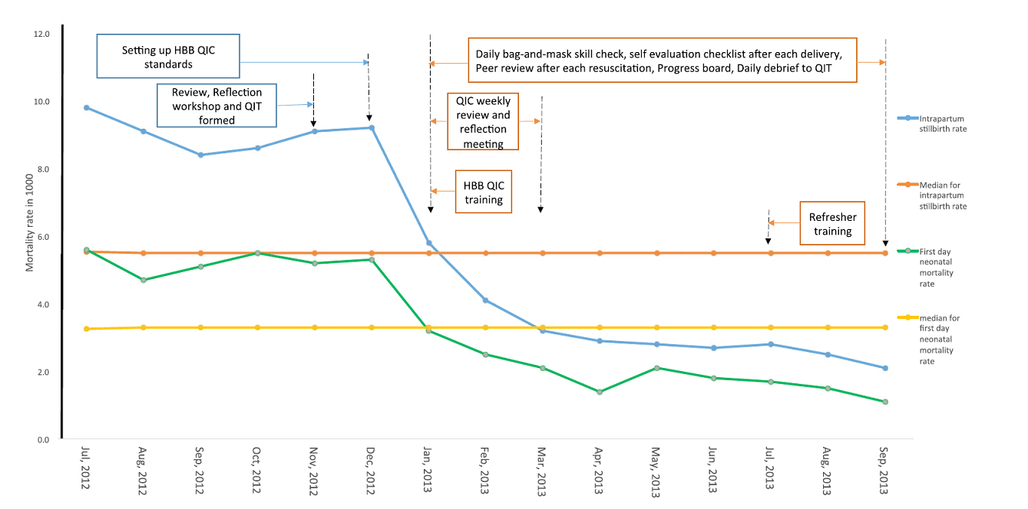
How can you show the results of change?
Impact of education, practice, and quality improvement on 1st day neonatal
death and intrapartum stillbirth - Nepal
Intrapartum stillbirth rate (ISR)
Median ISR
Mortality rate in1000
First day neonatal mortality rate (NMR)
Median for first day NMR
KC A et al. Pediatrics 2016; 137 (6):e2 0150117
Notes:
A time series chart is an effective way to show the results of change.
This time series chart from Nepal illustrates the impact of training, practice, and quality improvement in a large urban maternity hospital.
25,100 deliveries were all videotaped for review.
Along the horizontal line is time.
Along the vertical line is mortality (neonatal, stillbirth).
All the arrows represent quality improvement interventions. For example, participants practiced the bag and mask skill check daily at shift change.
The blue line shows the drop in intrapartum stillbirth and the green line first-day neonatal mortality.
Showing results of a change is important to decide if it was successful or not and to gain support for scaling up and sustaining a successful change.

Slide 35
What steps will sustain improvement?
Expand the change
Seek support for the change
Recognize and acknowledge
people who are active in making
change
Celebrate the role of health care
workers in making things better!
Make the change routine
Share the change with other
facilities
Notes:
A change that successfully brings improvement usually makes the health worker’s job easier.
These changes are the easiest to expand to other areas or health care providers.
Sometimes the change will need to be supported with new equipment or supplies.
Recognizing and celebrating the people involved in making a positive change help sustain change.
A change in recording forms or policy and procedures may be needed to make the change routine.
Several facilities working together on common problems can share their experiences and learn from one another.

Slide 36
Summary:
Data collection and use
Data collection and use are essential to providing quality care.
Health care systems depend on the routine recording and use of data.
Complete and accurate data collection is equally important for care
of an individual patient and management of an entire health system.
Data must be used for making improvements at
all levels – from local to regional and national.
Collecting and using data within facilities can improve quality in processes of care and specific outcomes.
Notes:
Throughout the Essential Newborn Care Course, you will have many opportunities to compare what you are learning to what is actually happening in your facility.
Noting possible gaps in care, prioritizing what to change and developing suggestions of what to change will bring valuable ideas to your quality improvement team for developing quality improvement projects.

Slide 37
Birth registration
Form groups (nurse, mother, husband).
Help the parents register the birth.
Debrief with your team and facilitator.
Sara gave birth to her son Yann at 32 weeks gestation in the health facility.
Sara and her husband are providing kangaroo care.
Notes:
Repeat simulation
Skills and performance – participants demonstrate the steps in birth registration in the facility.
Notifying the civil registration office of a live birth.
Encouraging parents to complete the details in the civil registration record.
Giving parents information on when and where to collect the certificate of birth.
Debriefing – participants self-reflect and give feedback to one another in their roles.
Provision of care (performance objectives)
What was done well?
What could have been done better?
What will you change the next time?
Experience of care
Was the language clear and appropriate?
Was the communication respectful?

Slide 38
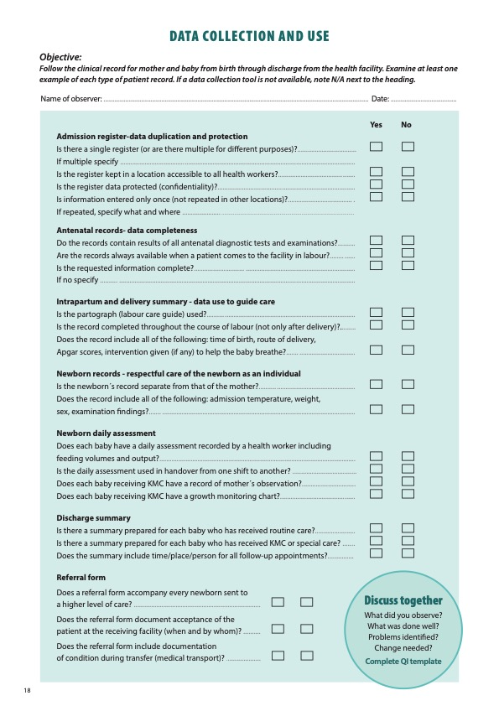
Notes:
Review the Clinical practice checklist before observing in the clinical area.

Slide 39
Notes:
After the clinical practice, discuss the observations made, possible reasons for practices, and changes needed to improve the quality of essential newborn care.
What new things will you do?
What old things will you not do?
How will you make a change?
Use your reflections to fill out the QI template.

Slide 40






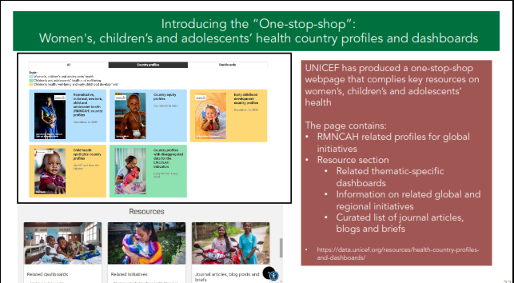


References and
additional resources
Birth registration health workers role
How and why you should collect disability data

Slide 41
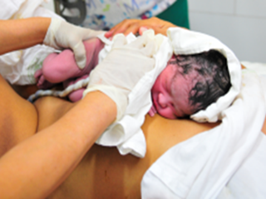
Example of QI for ENC Myanmar
  POCQI process Myanmar essential newborn care: 4.02 – 13.43
The problem: Newborns NOT receiving essential newborn care
Solutions applied:
  On-the-job training
Job-aid: Checklist for all the steps of ENC
AIM: 80% newborns receive essential
care at birth
1. Immediate drying
2. Skin-to-skin contact
3. Delayed cord clamping
4. Early initiation of breastfeeding
© Dr R Mehta WHO SEARO
Notes:
View video to see an example of applying the quality improvement process to improve essential newborn care.

Slide 42
Registration of a birth in the community
Form groups of 3 (midwife, mother, grandmother)
Register the birth and communicate with the family.
Debrief with your team and facilitator.
Lucy (16 years) delivers a son at term at home.
She came to the facility with her mother.
Notes:
Simulation
Skills and performance – participants demonstrate the steps to register a birth that took place in the community.
Notifying the civil registration office of the birth.
Encouraging family to complete the details in the civil registration record.
Giving family information on when and where to collect the certificate of birth.
Debriefing – participants self-reflect and give feedback to one another in their roles.
Provision of care (performance objectives)
What was done well?
What could have been done better?
What will you change next time?
Experience of care
Was the language clear and appropriate?
Was the communication respectful?

