Slide 1
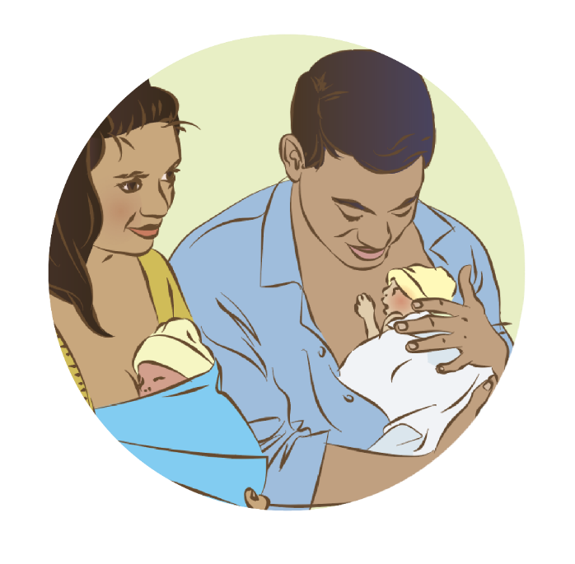

Discharge and follow-up
Notes:
© World Health Organization 2024. All rights reserved.
Materials for demonstrations, practice, and simulations
Organise one set per group of 3 participants and a set for the facilitator (as available).
Hand hygiene
Newborn mannequins (normal and small)
Warm, soft cloths/wraps or blanket, hat, socks
Model breasts and shawl (water if breast simulators used)
Materials and equipment for examination (see module Examination of the newborn)
Discharge criteria/checklists growth charts
Local newborn record
National Guidelines for newborn screening and additional materials specified therein
Counselling materials, child health cards
Ophthalmoscope or arc light

Slide 2
Content
Goal and learning outcomes
The situation
Preparation for discharge
Counselling for care at home
Postnatal care and follow-up visits
Summary
Clinical practice
Quality improvement
References and additional resources

Slide 3
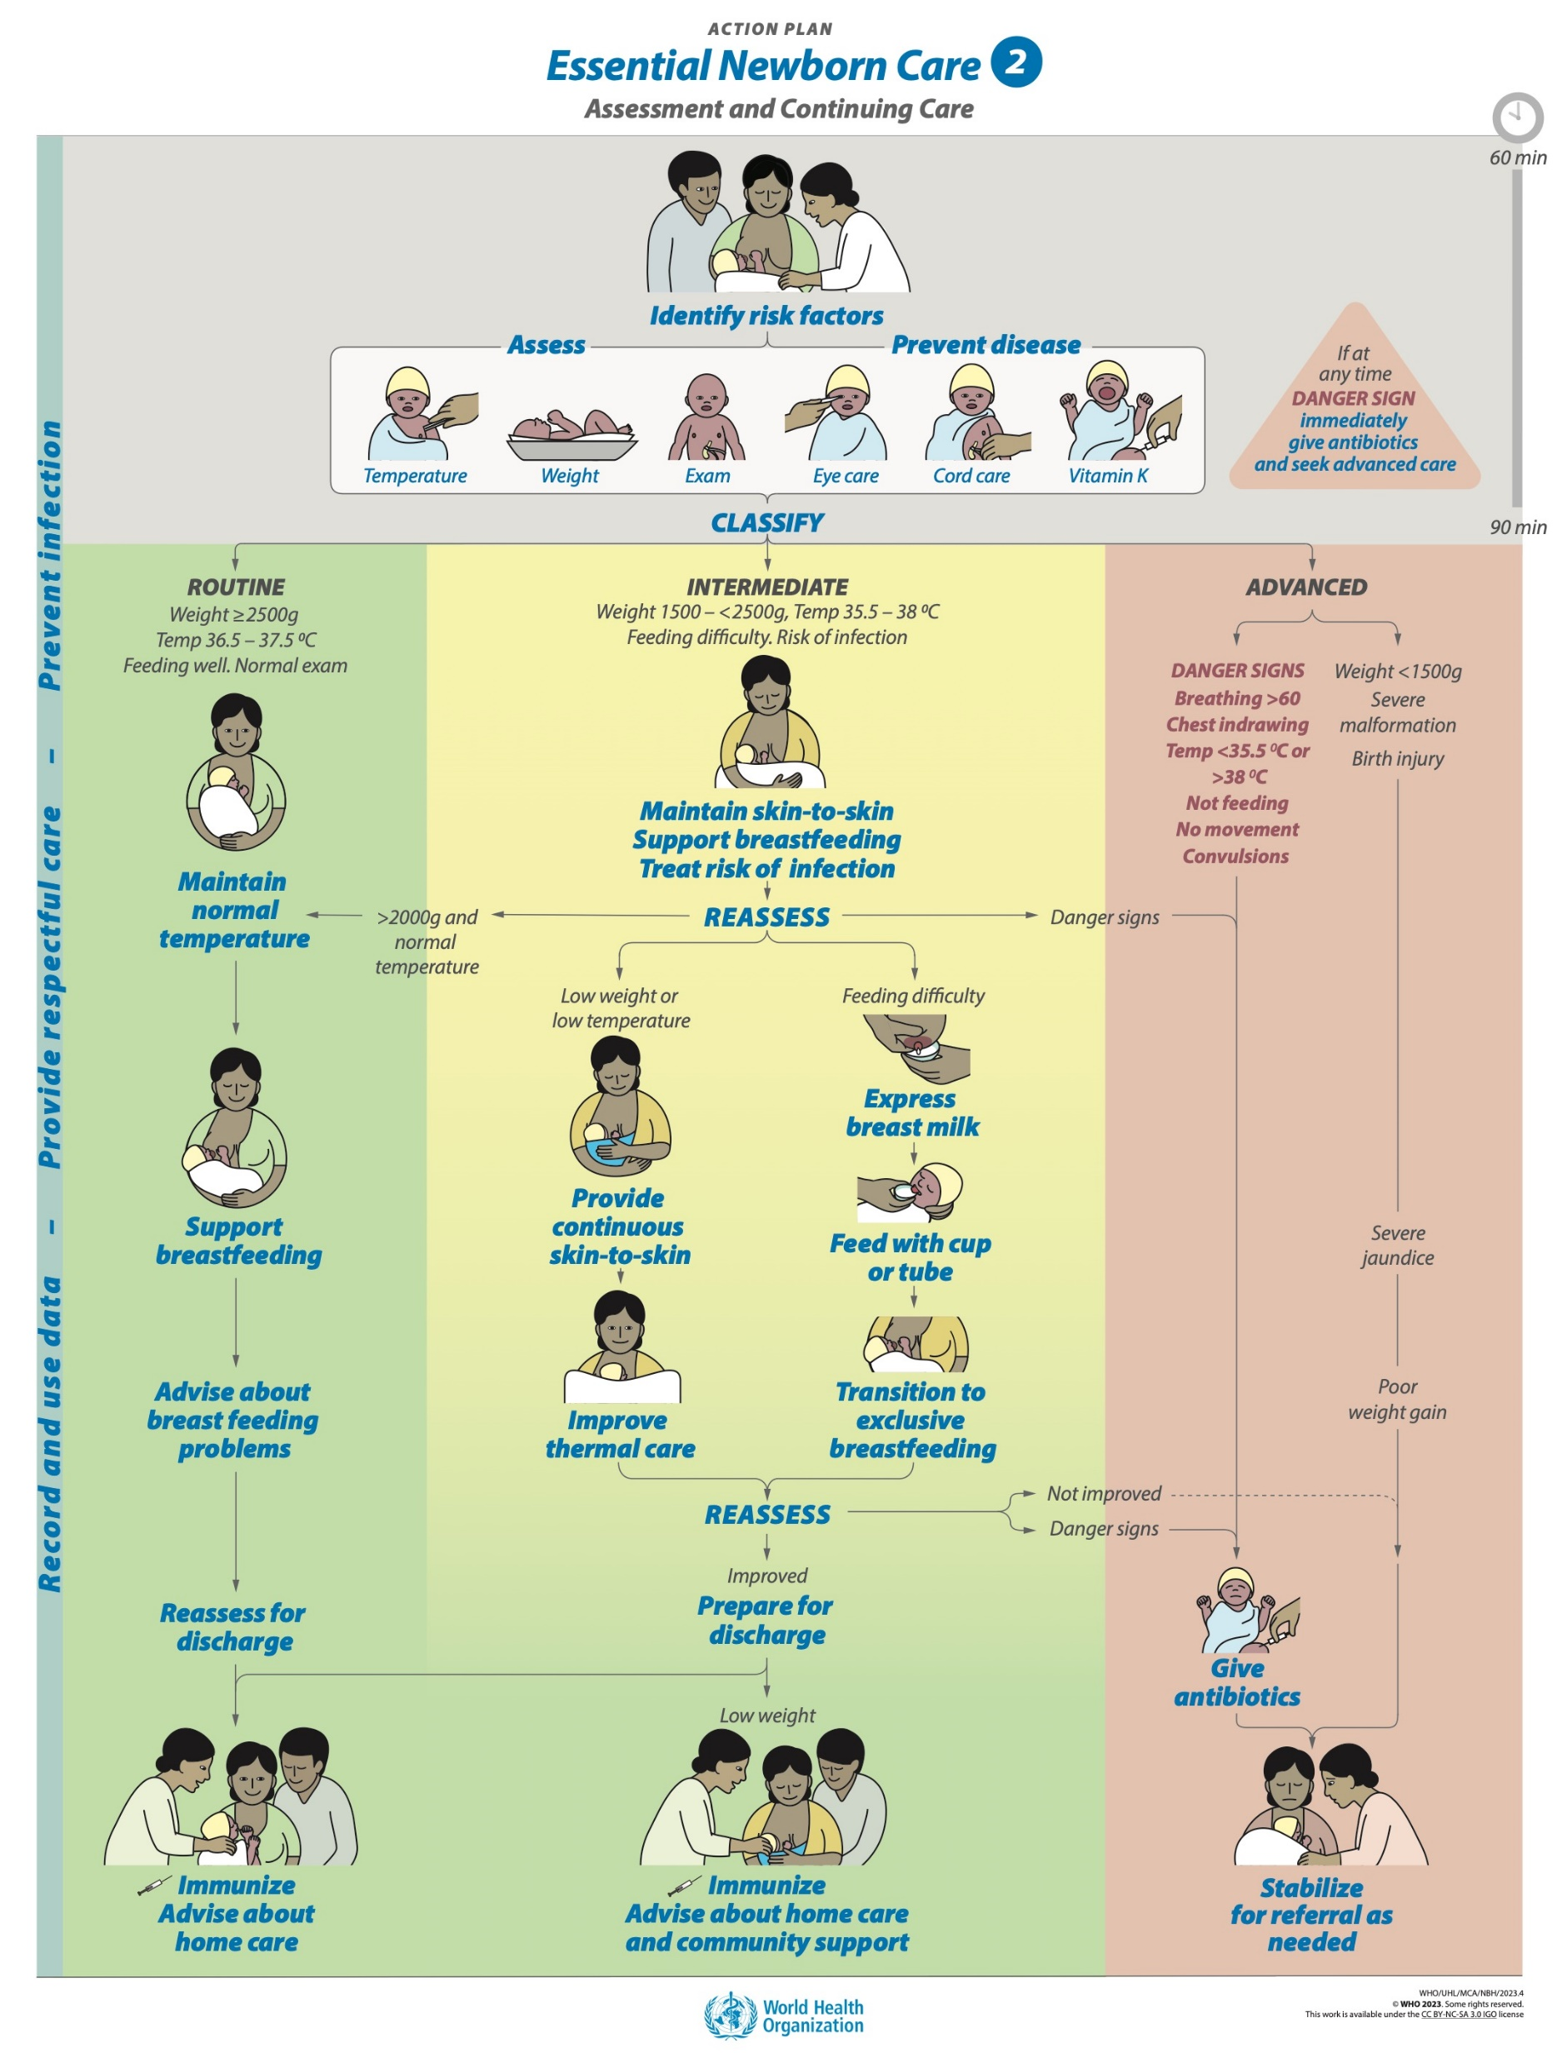
Goal and learning outcomes
All mothers and caregivers are supported to give safe, responsive and nurturing care.
Apply discharge criteria to decide if a newborn is
ready to go home
Counsel caregivers on nurturing responsive care
at home and when to return for postnatal visits
and follow-up
Counsel caregivers to identify health problems and danger signs and where and when to seek care
Notes:
Key caregivers may include grandmothers, mothers-in-law, fathers, partners other family members or foster carers.
To learn more
Standards for improving quality of care for small and sick newborns in health facilities

Slide 4

The situation
Joy gave birth to Billy 12 hours ago by
spontaneous vaginal delivery.
He weighed 3.5 kg.
The midwife has examined Joy and
asked if Billy has taken a breast feed.
Joy answered that Billy had been
to the breast twice.
The midwife explained to Joy that her
examination is normal and she is free
to go home as soon as her family arrives
to collect her.
©WHO / Yoshi Shimizu
Notes:
The midwife did not examine Billy.
Is this situation common in the health facility where you work?
What could be the consequences for Billy?

Slide 5
The situation
Few women and newborns stay in the facility for the recommended 24 hours after
birth, which is the most critical time for complications.
About 62% of the total neonatal deaths occurred during the ﬁrst 3 days of life.
Barriers to access and delays in seeking postnatal and emergency care contribute
to deaths and disabilities.
Postnatal contacts have one of the lowest levels of coverage across the continuum
of care for women and infants.
Quality of postnatal care for women and newborns can be relatively poor, and
opportunities to increase well-being and to support nurturing newborn care are lost.
Notes:
What is the length of stay in your health facility after birth?
What is the coverage of postnatal care for newborns in your context?
To learn more
Country profiles Countdown 2030
Review your country profile and coverage by subregion or district, and note where the lowest coverage occurs
Do some newborns have NO postnatal visits?
Is coverage lower for newborns than their mothers?

Slide 6
Preparation for discharge

Slide 7
Prepare for discharge
In groups (mother, nurse-midwife and companion).
Assess if Ekta is ready for discharge and counsel Leela and her
family for care at home.
Debrief with your team and facilitator.
Leela gave birth to Ekta 2 days ago by spontaneous
vaginal delivery at term.
Ekta is breastfeeding well. Leela is preparing to go home.
Notes:
Baseline simulation
Skills and performance – participants demonstrate assessing a newborn for discharge and counseling the family for care at home.
Examining Ekta and reviewing her newborn record
Assessing if discharge criteria have been met
Counseling for care at home
Feeding
Thermal care
Hygiene
Danger Signs
Responsive, nurturing care for newborns
Sleep
Explaining the plan for follow-up
What, where, when and why
Community support available
Debriefing – participants self-reflect and give feedback in their roles.
Provision of care (performance objectives)
What was done well?
What could have been done better?
What will you change the next time?
Was data recorded and used?
Was a discharge assessment checklist used?
Experience of care
Was the communication respectful and the language appropriate?
Was handling of the baby gentle?
Were infection prevention practices followed?

Slide 8
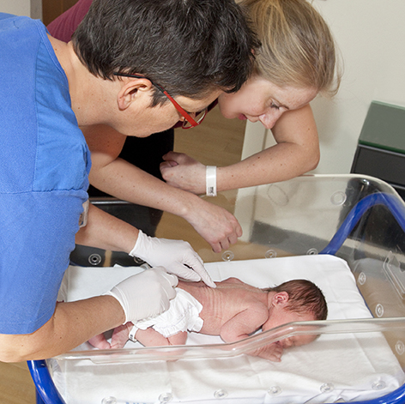
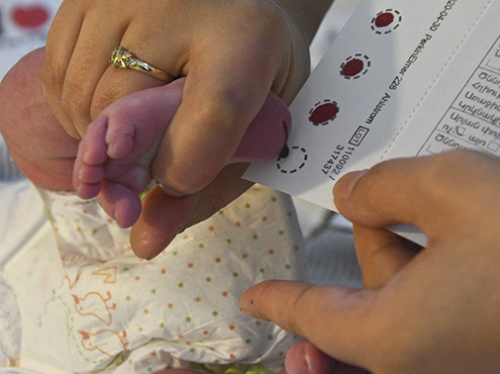
What criteria assess readiness for discharge?
Mother’s and baby’s physical, emotional and psychological
well-being
Skills and confidence of the mother to care for herself and her baby
    Breastfeeding established; counselling documented
Home environment and factors affecting ability to provide or seek care
Readiness for discharge: no earlier than 24 hours after birth
    Feeding intake; stool and urine
Complete physical examination
    No danger signs, signs of jaundice, untreated local infection or
    breastfeeding not yet established
Newborn screening following national guidelines (hearing, vision,
jaundice, metabolic, developmental dysplasia of the hip)
Immunization
© WHO / Bente Binderup
© WHO / Malin Bring
Notes:
How do you assess using discharge criteria?
Review the local discharge criteria checklist for completeness.
Do not forget about the mother.
Observe her interactions and her mood.
Mothers with depression and anxiety will be less able to provide nurturing care for their baby without support from family and services.
Identify and manage problems before discharge.
Establish links to follow-up care and additional support that may be required.
Discharging when the mother, her parents/family or the newborn are not ready places the woman and newborn at risk.
Ensure that key family members who will influence care at home (grandmothers, mother-in-law, etc.) receive the same information and actively participate in counselling and dialogue.
To learn more
Postnatal care of mother and baby
Caring-for-yourself-and-your-baby-after-birth

Slide 9
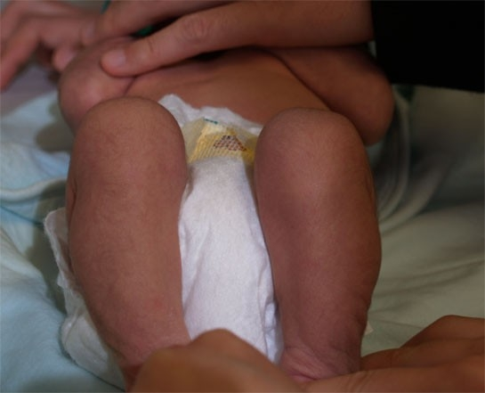


Developmental dysplasia of the hip
Barlow manoeuvre
© Stanford Newborn Nursery photo gallery
Galeazzi sign – unequal knee height
© WHO Euro
Developmental dysplasia of the hip
Ortolani manoeuvre
Notes:
View video
Is screening for developmental dysplasia of the hip carried out in your health facility?
How will a baby with a positive test be managed?
If the hip joint does not develop normally, there may be instability or even dislocation of the head of femur. Screening for this condition includes:
Galeazzi sign - unequal knee height when lying supine and abnormal movement at the joint.
Barlow manoeuvre - the hip is flexed to 90 degrees. With the fingers on the outer thigh and the thumbs on the inner thigh, a posterior force is applied at the same time as gentle outward pressure by the thumbs. If the hip can be moved out of the socket with this manoeuvre, it will be felt over the joint and the test is considered positive.
Ortolani manoeuvre - starts with the hips flexed and the hands in similar position. With one hand stabilizing the pelvis, the other hand gently abducts (opens) the hip while pushing up with the fingers on the lateral side. A palpable “clunk”, representing the return of a dislocated hip into the socket, indicates a positive test.

Slide 10
Counselling for care at home

Slide 11

How do you counsel Joy at discharge?
Do not rush. Try not to give too much information at once.
Use videos, parent cards other culturally appropriate materials.
    How to recognize danger signs and to seek care
    immediately for themselves or their newborn
    When and where to seek support for breastfeeding
    When, where and why to complete postnatal care visits
    and vaccinations
Specify any medical, surgical or developmental follow-up.
Ensure that all newborns have their births registered and have an identity.
Warning signs in newborns for mothers and caregivers
Notes:
When you counsel mothers and caregivers do you use any specific materials?
View video

Slide 12

How do you counsel for care at home?
Build confidence, support caregiving at home
and improved home environment.
Ensure additional support if:
  Small or premature newborn
  First-time parents
  Newborn or mother has a health
  condition or disability.
© Juozas Cernius / WHO
Maternal health, well-being and mental health will influence the nurturing care a mother
can give her newborn.
Notes:
Do you have a checklist of topics to cover for safe care at home?

Slide 13
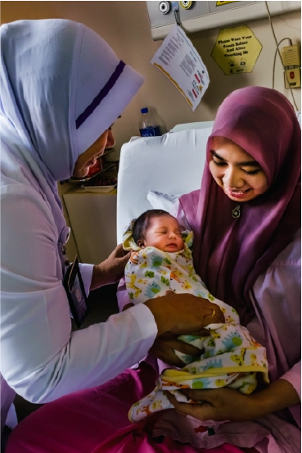
Do you counsel in the same way for every newborn?
Adapt the discharge plan to the context
and the parent’s and newborn’s needs.
Invite meaningful participation of caregivers
including grandmothers for care at home,
follow-up and care seeking.
Link with appropriate health and social
services for early interventions.
Link families with parenting support groups and community programs.
© F4_11102016_MY_3846
Notes:
How do you adjust counselling if a newborn has additional needs?
Link newborns with disabilities to targeted services and link their parents with targeted support.
What services are available for newborns needing additional care and support in your context?

Slide 14

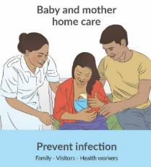
What do you discuss when counselling Joy for safe care at home?
Ensure that the baby is feeding well, warm,
clean, nurtured, and sleeping safely.
Support exclusive breastfeeding day and night.
    Responsive to the newborn’s behaviours and cues
    Seeking help for breastfeeding difficulty
  Advise on thermal care for the home environment.
  Review how the newborn and home will be kept clean.
  Encourage nurturing, responsive care.
  Review sleeping arrangements at home.
© Jonathan Hyams / Save the Children
Notes:
Ensure that the baby is feeding well, warm, clean, nurtured, and sleeping safely.

Slide 15
Advise Leela for thermal care at home
In a cold climate, keep one room or part of one room warm, but not smoky
(if there is an open fire).
Use one more layer of clothes on baby than on children or adults.
Do not leave the newborn in wet diapers.
During the day, dress or wrap the baby according to the climate.
If the temperature varies during the day, counsel caregivers accordingly.
At night let the newborn sleep with the mother or within easy reach for breastfeeding.
Ensure continuous skin-to-skin care if giving kangaroo mother care at home.
Notes:
Practise counselling on thermal care at home.
Support the family to carry out all steps to maintain normal temperature before discharge.
To learn more
Warren S et al. Effects of delayed newborn bathing on breastfeeding, hypothermia, and hypoglycemia. JOGNN. 2020;49:181–189

Slide 16
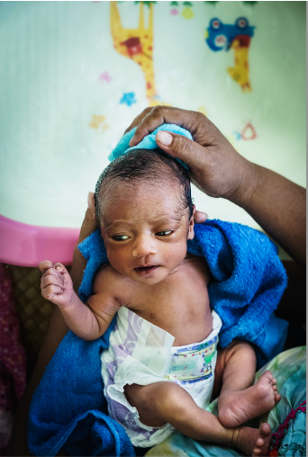
Advise Leela for hygiene at home
WASH HANDS
DO NOT put anything in the baby’s eyes or ears or on
the cord.
DO NOT bathe a baby before 24 hours of age.
Bathe when necessary
    Wash the face, neck, underarms DAILY
    Wash the buttocks when soiled
    Wash or bathe the baby in a WARM, draught-free room
    Use warm water
    Thoroughly dry the baby, dress and cover after the bath
Use a cloth or diaper to collect stool and urine.
Dispose safely to prevent infection and contamination
of water sources.
WASH HANDS
© WHO / Yoshi Shimizu
Notes:
Practise giving advice on hygiene at home and answer any questions that Leela asks.
Delay bathing for 24 hours after birth (bathing includes various methods such as tub bathing, sponge bathing, swaddled bathing and bathing under running water).
When should a caregiver practice hand hygiene?

Slide 17
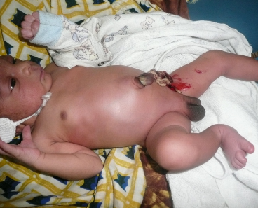
Advise Leela for cord care at home
Wash hands before and after cord care
Put nothing on the stump*
Fold the diaper below stump
Keep the stump loosely covered with
clean clothes
If the stump is wet, wash with clean
water and soap and dry with a clean cloth
If the umbilicus is red or draining pus or
blood, seek care from a health worker
© WHO / Dr Helenlouise Taylor
*Daily chlorhexidine (7.1% chlorhexidine digluconate aqueous solution or gel, delivering 4% chlorhexidine) application to the umbilical cord stump in the first week after birth is recommended only in settings where harmful traditional
substances (such as cow dung) are commonly used on the umbilical cord.
Notes:
Practise advising on safe cord care at home.

Slide 18

What sleeping position is recommended for newborns and why?
Find the recommendations on page 124.

Slide 19
Recommendation and reasons
Recommendation:
Putting the baby to sleep in the supine position during the first year is
recommended to prevent sudden infant death syndrome (SIDS) and
sudden unexpected death in infancy (SUDI).
Reason:
Compared with non-supine (prone or side) sleep position, supine (back) sleep position may decrease SUDI.
Notes:
Is this recommendation currently being applied in your place of work?
If yes, what enabling factors support the application of this recommendation?
If no, what are the barriers to applying this recommendation?
To learn more
Research on bed sharing infant sleep and SIDS
Safer-sleep-guidance
UNICEF Caring-for-your-Baby-at-Night-for Health-Professionals

Slide 20
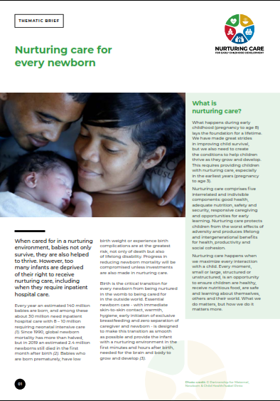
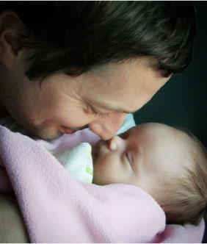
What is nurturing, responsive care for newborns?
©WHO / Sergey Volkov
Nurturing care and brain architecture
Notes:
Why do newborns need nurturing care?
View video
The early years are a critical period. The first 1000 days (from conception to 24 months) are important for all newborns for brain development and they are critical in the context of preterm birth and neonatal illness.
Every newborn’s and young child’s ability to thrive is the direct result of nurturing care and positive interaction with their environment.
An individual who thrives is able to develop his or her full potential, from conception through early childhood into adulthood.
Nurturing care is recommended for all newborns and especially for those newborns with disabilities.
Benefits of nurturing care
Benefits child development and academic outcomes, decreases hospitalizations.
Reduces parental stress levels.
Supports more positive maternal behaviour.
Improves maternal–infant interactions.
Benefits are consistent for disadvantaged children, particularly those at risk of malnutrition.
There is emerging evidence that some disabilities may be prevented/mitigated with good-quality, developmentally supportive care for small or sick newborns.
Investments in early childhood development benefit individuals, communities and countries. All newborns, especially those who have had major complications at birth and during the neonatal period, require regular developmental follow-up and nurturing care to optimize development. Those newborns at greatest risk of developmental delays, physical disabilities and poor neurodevelopmental functioning:
are small for gestational age
are premature or low birthweight
have neonatal infections
have intrapartum-related complications
have neonatal jaundice.
To learn more
Responsive parenting: interventions and outcomes. Eshel N et al. Bull World Health Organ. 2006;84(12):991–8.
A systematic mapping review of effective interventions for communicating with, supporting and providing information to parents of preterm infants. Brett J et al. BMJ Open. 2011;1(1):e000023.
Twenty-year Follow-up of Kangaroo Mother Care Versus Traditional Care. Charpak N et al. Pediatrics. 2017;139(1): pii: e20162063.
Global Health and Development in Early Childhood. Aboud FE, Yousafzai AK. Annu Rev Psychol. 2015;66(1):433–57.
Nurturing care: promoting early childhood development. Britto PR et al. Lancet. 2017;389(10064):91–102.
Massage in KMC position
UNICEF every day is fathers day

Slide 21

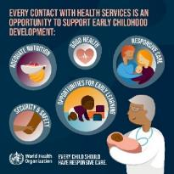
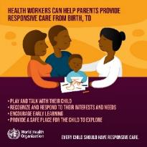
What is the health worker’s role in nurturing care?
Ensure routine follow-up, support the newborn and family by early
detection of disability or developmental delay and link to services.
Prioritize developmentally supportive care to improve
outcomes for all newborns: foster a family-centred, nurturing,
supportive environment.
Link families with early childhood development programmes with
interventions during the first 1000 days.
Support coping, parenting and early stimulation.
Encourage male involvement.
Refer mothers with anxiety or depression to appropriate services.
Notes:
Do health workers promote and support nurturing care in your health facility?
EVERY contact with health services is an opportunity to support early childhood development.
Your role is to:
Encourage and support responsiveness (care that is prompt, consistent, contingent and appropriate to the child’s cues, signals, behaviours and needs).;
Enhance parents’ and caregivers’ knowledge, attitudes, practices or skills, supporting early learning and development during the postnatal period;
Support interventions that improve parents’ and caregivers’ abilities to incorporate the child’s signals and perspective such as play and communication and feeding. For the newborn they include, but are not limited to, facilitating the caregiver to be aware and receptive and appropriately respond to the baby’s needs and wants, such as exclusive breastfeeding on demand;
Give direct support to caregivers to provide early learning opportunities for their children; or b) information, guidance and support to build caregiver capacities for healthy newborn/child development;
Support parents and family members as important partners in delivering well-timed, consistent and appropriate care with vigilant follow-up of at-risk newborns;
Support parents to take care of their own physical and mental well-being so that they can better provide nurturing care for their children;
Ensure appropriate follow-up.
To learn more
Improving early childhood development: WHO guideline. WHO, 2020.
Nurturing care practice guide
A framework for helping children survive and thrive to transform health and human potential.

Slide 22

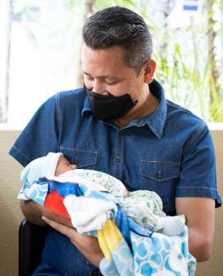
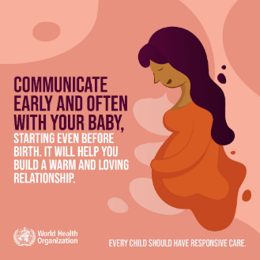


Practice responsive nurturing care
© UNICEF
© UNICEF
Serve & return
Notes:
Practise supporting a parent or caregiver to give responsive nurturing care to the newborn.
Adapt to your own context and culture (massage, singing etc)
Model and encourage caregivers to make eye contact, smile, cuddle, and talk
Help caregivers to recognize their baby’s cues and respond appropriately: signs of hunger, satiety, illness, emotional distress, interest to play, pleasure, pain or discomfort
Support caregivers to identify and use everyday moments to talk and play with their baby
View video
What is new knowledge for you in this video?
To learn more
Massage in KMC position

Slide 23
Postnatal care and follow-up visits

Slide 24
What are the recommended timings for postnatal visits?
Find the recommendations on page 152.
Notes:
Use a printed or digital copy (pdf) of the document to find the recommendations.

Slide 25
Recommendations
A minimum of four postnatal care contacts is recommended.
If birth is in a health facility, healthy women and newborns should receive postnatal
care in the facility for at least 24 hours after birth.
If birth is at home, the first postnatal contact should be as early as possible within
24 hours of birth.
At least three additional postnatal contacts are recommended for healthy women
and newborns: between 48 and 72 hours, between 7 and 14 days, and during week
six after birth.
The number, timing and content of postnatal care contacts should be tailored
to each woman’s and newborn’s health outcomes and needs and guided by
the recommendations in this guideline.

Slide 26
Recommended postnatal care visits
All mothers and newborns should have postnatal care visits.
    Small newborns need additional postnatal visits.
Newborns born at home should have the first PNC visit as soon as possible after birth.
Home visits during the first week after birth by a skilled health personnel or a trained
community health worker are recommended for postnatal care of healthy women
and newborns.
Where home visits are not feasible or not preferred, outpatient postnatal care contacts are recommended.
Home visit for the newborn
Notes:
When do newborns have postnatal visits in your health facility ?
Are home visits carried out?
At every contact:
Women, newborns, parents and caregivers should receive respectful, individualized, person-centred care.
Care should include effective clinical practices, relevant and timely information, and psychosocial and emotional support.
Care should be provided by kind, competent and motivated health workers who are working within a well-functioning health system.
View video
To learn more
Home visit for mother and newborn

Slide 27
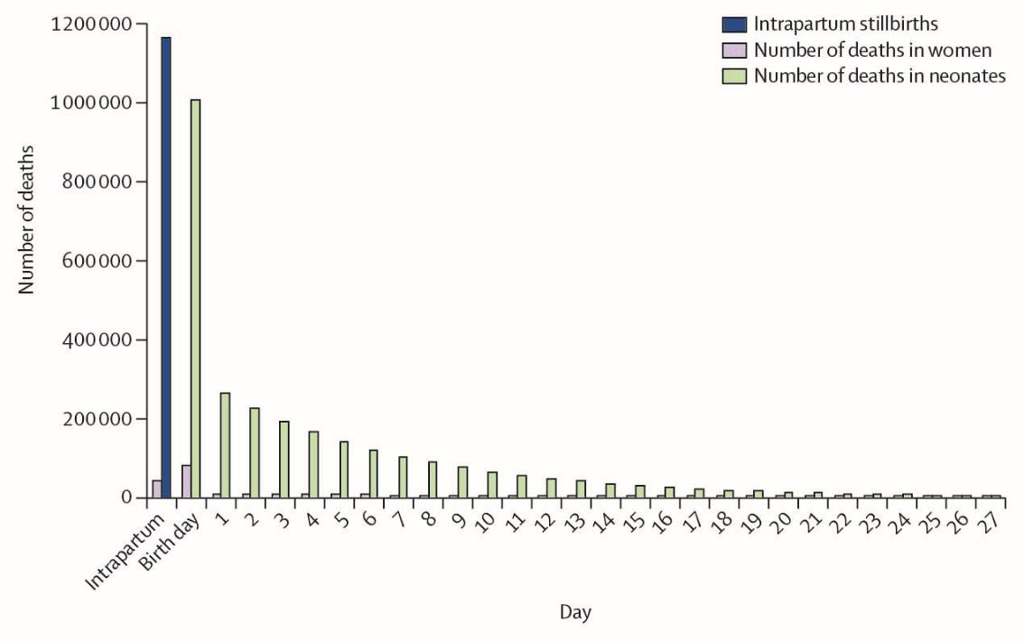
What are recommended timings for postnatal care (PNC) visits?
Birth day
WHO recommends all newborns have 4 PNC visits.
Small newborns need additional postnatal visits.
    Day 1, Day 3, Day 7-14, and at 6 weeks.
    Small newborns need additional follow-up visits.
All mothers and newborns should have post natal visits.
Newborns born at home should have the first PNC visit as
soon as possible after birth.
First PNC within 24 hours of delivery is not the same as
the standard examination after delivery.
75% of neonatal deaths
Day
1st:
Within 24 hours after birth
2nd:
48-72 hours
3rd:
Day 7-14
4th:
Week 6
Notes:
When is the first peak of newborn deaths in your context?
When do you start to see infections in newborns?
When do breastfeeding problems occur?
When should a newborn receive vaccinations?
What is the coverage of each PNC visits in your health facility?

Slide 28
How do you tailor postnatal visits to the needs of mother and newborn?
Teach parents how to recognize danger signs and seek care at any time needed.
Tailor the number, timing and content of scheduled visits to each
woman’s and newborn’s health conditions and needs:
    skills and confidence of the women to care for herself
    skills and confidence of parents/carers/family to care for the newborn
    the home environment
    other factors that may influence the ability to provide care in the home and care-seeking.
Notes:
Do you tailor postnatal visits you provide to meet the needs of mothers and newborns?
How this could be improved?

Slide 29
Assess for discharge readiness
Review newborn’s and mother’s clinical records:
    stability of vital signs
    weight gain
    stools and urine output
    medical conditions
    treatments and vaccines given
Observe mother’s mood and interaction with baby.
Perform a full examination including danger signs, assessing breastfeed.
Screen for neonatal conditions including red reflex and developmental dysplasia of hip.
Counsel for safe home care and recognition of danger signs.
Schedule postnatal visits, referrals (developmental, medical, surgical).
Link with community support and parent support groups.
Complete discharge record.
Notes:
Practice in pairs
Do you use a checklist?
What is the content of a discharge assessment in your context?
Assess and refer for further evaluation if any of the following signs are present:
not feeding well
history of convulsions
fast breathing (breathing rate > 60 per minute)
severe chest in-drawing
no spontaneous movement
fever (temperature > 37.5 °C)
low body temperature (temperature < 35.5 °C)
any jaundice in first 24 hours after birth, or yellow palms and soles at any age.
Parents and family should be encouraged to seek health care early if they identify any of the above danger signs between postnatal care visits.
To learn more
WHO recommendations on maternal and newborn care for a positive postnatal experience

Slide 30
What is the key content of the following postnatal checks?
Check 2 (48–72 hours) and Check 3 (day 7–14):
Perform a full examination, including danger signs
Check the cord
Check birth registered
Weigh, measure head circumference, record and review growth
Check breastfeeding or breast milk feeding (observe)
Check 4: week 6
Check all above
Counsel on family planning
Immunize (follow national guidelines)
Mother also needs postnatal checks – ideally together with her baby.
Notes:
The focus of each post natal check is slightly different.
A full examination and assessment is constant for all post natal checks.
Additional content, such as immunization and family planning for mother, varies with time.
Always observe the mother, her mental state and how she responds to and interacts with her baby.

Slide 31
Postnatal check for Sophie delivered at home
In groups (mother, nurse-midwife, companion).
Carry out a newborn postnatal check and counsel Ayesha for care
at home.
Debrief with your team and facilitator.
Sophie was born at home this morning at dawn.
Her mother Ayesha, after resting for a few hours, has come to the hospital for a postnatal check.
Sophie has breastfed twice since delivery.
Notes:
Simulation
Skills and performance – participants demonstrate a postnatal check and counselling for a newborn delivered at home.
Reviewing history (pregnancy, delivery, infections)
Carrying out complete examination including
Weight, temperature, breathing, colour, movement and tone; evidence of congenital anomalies, trauma or infection (danger signs)
Red reflex
Screening for development dysplasia of hip
Providing preventative treatments (vitamin K, cord care, eye care per national guidelines)
Observing a breastfeed (and providing support for positioning and attachment)
Counselling for care at home - feeding, thermal care, hygiene, danger signs, responsive care, safe sleep
Explaining plan for follow-up and community support available.
Confirming birth registration
Debriefing – participants self-reflect and give feedback in their roles.
Provision of care (performance objectives)
What was done well?
What could have been done better?
What will you change the next time?
Experience of care
Was the communication respectful and the language appropriate?
Was handling of the baby gentle?
Were infection prevention practices followed?
Did Ayesha have a postnatal check and examination?

Slide 32
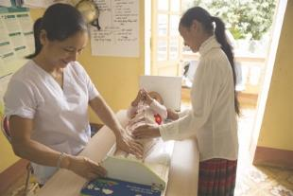
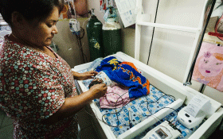
What newborn screening tests and monitoring of newborns are recommended before discharge?
Screen following national guidelines:
    Bilirubin by transcutaneous bilirubinometer
    Hearing (universal newborn hearing screening)
    Abnormalities of the eyes, including absent red reflex
    Development dysplasia of hip
Monitor health and development:
    Monitor growth
    Monitor child development using standardized tools as
    early diagnosis and interventions maximise potential.
    Connect newborns and their families to quality early
    intervention programmes and link families with
    support groups.
  Refer for specialised follow-up according to condition.
© WHO / Yoshi Shimizu
© WHO / Malin Bring
  Red reflex screening
Notes:
What screening tests are carried out in your health facility?
View video
The following screening tests are recommended by WHO 2022:
Universal screening for neonatal hyperbilirubinemia by transcutaneous bilirubinometer (TcB) at hospital discharge
Universal newborn screening for abnormalities of the eye, accompanied by diagnostic and management services for children identified with an abnormality
Universal newborn hearing screening (UNHS) with oto-acoustic emissions (OAE) or automated auditory brain stem response (AABR) for early identification of permanent bilateral hearing loss (PBHL), accompanied by diagnostic and management services for children identified with hearing loss.
To learn more
WHO recommendations on maternal and newborn care for a positive postnatal experience p 97
Red reflex using arc light

Slide 33
Prepare for discharge:
Newborn with a medical condition
In groups (mother, doctor, father).
Prepare for discharge and give appropriate counselling for care at home, including referrals and follow-up visits required.
Debrief with your team and facilitator.
Harry was born 5 days ago. He has trisomy 21 (Downs Syndrome).
At first, he was slow to feed and sleepy. His mother Ida supports him to
breastfeed using the dancer hold.
He is now taking all feeds by breast and has been gaining adequate
weight for the past 3 days.
Notes:
Simulation
Skills and performance – participants demonstrate preparation for discharge and counselling for home care of a newborn with a medical condition.
Examining Harry and reviewing his newborn record
Assessing if discharge criteria have been met
Counseling for care at home - feeding, thermal care, hygiene, danger signs, nurturing care, safe sleep
Explaining the plan for follow-up
Developmental, medical, and surgical (as needed) - where, when and why
Community support and parent support groups – how to access
Completing relevant records and forms including national congenital abnormality registry.
Debriefing – participants self-reflect and give feedback in their roles.
Provision of care (performance objectives)
What was done well?
What could have been done better?
What will you change the next time?
Experience of care
Was the communication respectful and the language appropriate.
Was the family offered specific psychosocial and emotional support ?
Was handling of the baby gentle?

Slide 34
Prepare for discharge
In groups (mother, nurse-midwife and companion).
Assess if Ekta is ready for discharge and counsel Leela and her family
for care at home.
Debrief with your team and facilitator.
Leela gave birth to Ekta 2 days ago by spontaneous vaginal
delivery at term.
Ekta is breastfeeding well. Leela is preparing to go home.
Notes:
Repeat simulation
Skills and performance – participants demonstrate assessing a newborn for discharge and counseling the family for care at home.
Examining Ekta and reviewing her newborn record
Assessing if discharge criteria have been met
Counseling for care at home
Thermal care
Hygiene
Feeding
Danger Signs
Sleep
Responsive, nurturing care for newborns
Explaining the plan for follow-up
What, where, when and why
Community support available
Debriefing – participants self-reflect and give feedback in their roles.
Provision of care (performance objectives)
What was done well?
What could have been done better?
What will you change the next time?
Was data recorded and used?
Was a discharge assessment checklist used?
Experience of care
Was the communication respectful and the language appropriate?
Was handling of the baby gentle?
Were infection prevention practices followed?

Slide 35
Summary
In this module, you have:
Applied discharge criteria to decide if a newborn is ready to go home
Counselled caregivers on
    how to care for the baby at home (including nurturing, responsive care) and when to return for postnatal visits and follow-up
    how to identify health problems and danger signs and where and
    when to seek care
    the timing and content of postnatal care visits.
Demonstrated counselling for nurturing care at home, building the
mother’s confidence and capabilities.

Slide 36
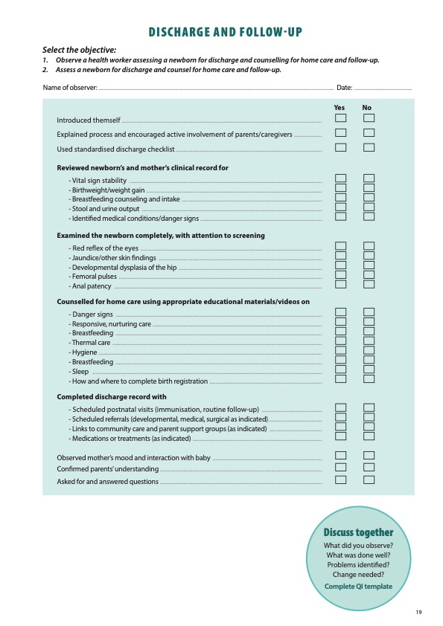
Notes:
Review the Clinical practice checklist before observing or practicing in the clinical area.

Slide 37
Notes:
After the clinical practice, discuss the observations made, possible reasons for practices, and changes needed to improve the quality of essential newborn care.
What new things will you do?
What old things will you not do?
How will you make a change?
Use your reflections to fill out the QI template.

Slide 38










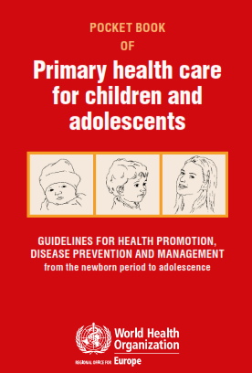






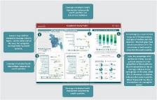
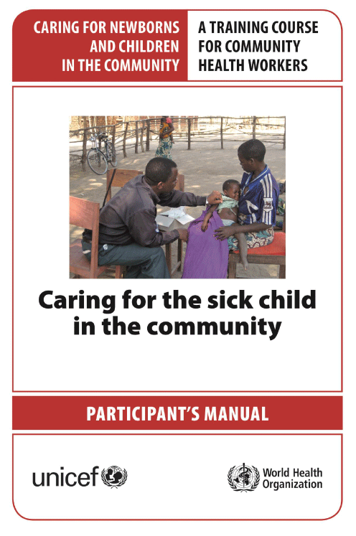
References and additional resources
UNICEF Learn ECD
Country profiles Countdown 2030.

Slide 39
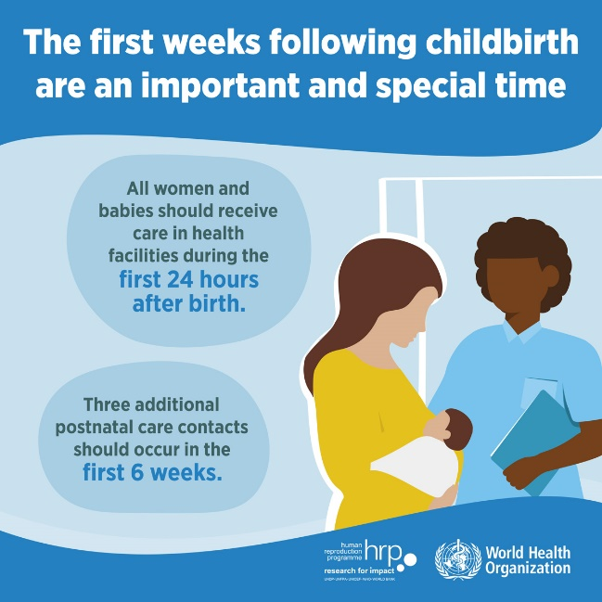
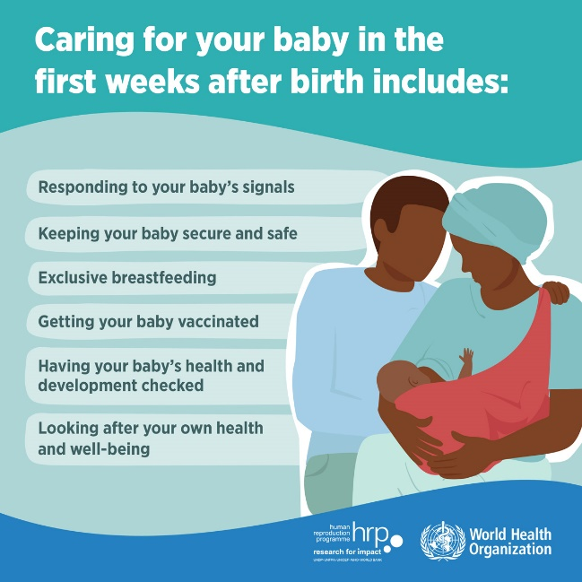
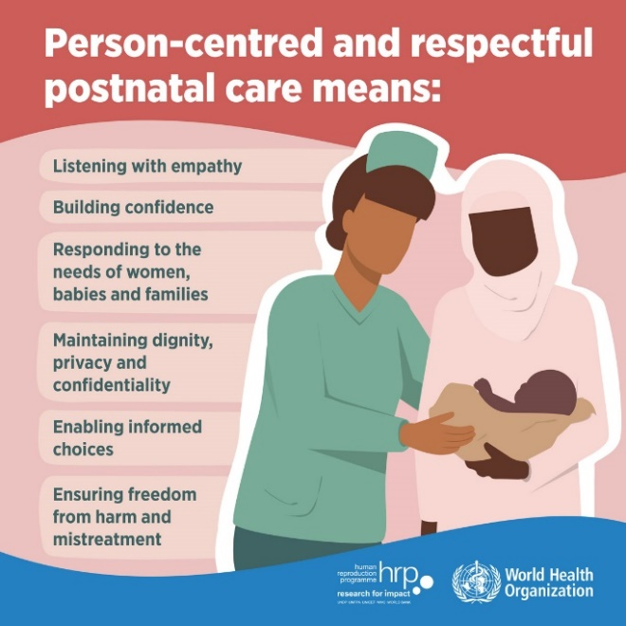
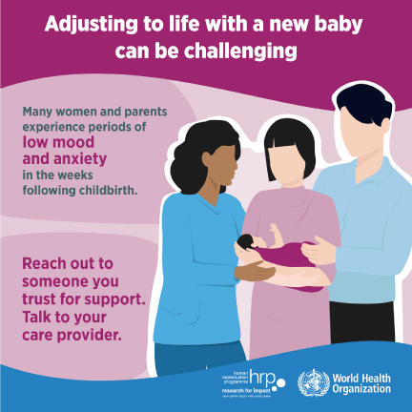
Notes:
Posters for postnatal care and responsive care

Slide 40
Prepare for discharge of a preterm newborn
Form groups (mother, neonatal nurse and grandmother).
Prepare for discharge and counsel Amy for care of Samuel at home and
follow-up visits required.
Debrief with your team and facilitator.
Amy, 15 years of age, gave birth to Samuel at 34 weeks 11 days ago.
He weighed 1975 g at birth. And now weighs 2001 g and is ready for discharge from the hospital.
He is breastfeeding well and has gained approximately 18 g/day for
the last 4 days. His examination is normal.
Notes:
Simulation
Skills and performance – participants demonstrate preparing for discharge and counselling a young mother of a preterm infant.
Examining Samuel and reviewing her newborn record
Assessing if discharge criteria have been met
Counseling for care at home – feeding, hygiene, thermal care (KMC), danger signs, nurturing care, sleep
Explaining the plan for follow-up
What, where, when and why – weekly growth checks; developmental follow-up
Community support available – young mother group
Completing discharge summary and sending to follow-up providers and community health worker
Debriefing – participant self-reflect and give feedback in their roles.
Provision of care (performance objectives)
What was done well?
What could have been done better?
What will you change the next time?
What data was used for discharge planning and communicated to follow-up providers?
Experience of care
Was the communication respectful and the language appropriate?
Was handling of the baby gentle?
Were infection prevention practices followed?

Slide 41
Concerns for child protection
In groups (mother, nurse and medical officer).
Provide postnatal care for Jean Pierre and Aimee.
Debrief with your team and facilitator.
Jean Pierre was discharged from hospital 10 days ago.
He has returned for a postnatal care visit.
He has gained no weight since birth.
On examination he looks lethargic.
He has bruises on his arms and is not moving his left leg.
His mother Aimee looks anxious and depressed.
Notes:
Simulation
Skills and performance – participants demonstrate postnatal care with concerns for child abuse.
Taking full history of pregnancy, childbirth and postnatal period - including social support and gender-based violence and feeding history for Pierre
Performing a complete examination, carefully documenting findings
Referring to appropriate senior member of staff responsible for child protection following child protection guidelines and reporting
Explaining to Aimee that Pierre has not gained weight, looks unwell and will need admission
Admitting Pierre for investigations, treatment, care and protection, following national guidelines
Referring Aimee for psychological assessment and support.
Debriefing – participant self-reflect and give feedback in their roles.
Provision of care (performance objectives)
What was done well?
What could have been done better?
What will you change the next time?
Was data recorded and used?
Did the health worker use the child protection protocol of the health facility?
Experience of care
Was the communication respectful and the language appropriate?
Was the health worker judgemental?
Was handling of the baby gentle?

Slide 42
Discharge and follow-up in a humanitarian emergency
In groups (mother, midwife and mother-in-law).
Prepare for discharge and counsel Francoise and her family for care
at home and follow-up.
Debrief with your team and facilitator.
Marie-Christine was born by spontaneous vaginal delivery to Francoise
36 hours ago in a temporary hospital structure. She has been supported throughout by Mariam, her midwife.
Marie-Christine is breastfeeding well and her examination is normal.
She weighs 3.2 kgs.
Francoise and her baby will be discharged to a tent where she is housed with her extended family.
Notes:
Simulation
Skills and performance – participants demonstrate preparing for discharge and counselling in a setting of emergency temporary housing and medical care.
Examining Marie-Christine and reviewing her newborn record
Assessing if discharge criteria have been met
Counseling for care at home – feeding, thermal care, danger signs, nurturing care, sleep and additional safety concerns in the emergency environment:
environmental factors such as cold or heat
access to water sanitation and hygiene facilities
cooking and smoke generated by cooking, heating or tobacco smoking in tent
Explaining the plan for follow-up
What, where, when and why – home visits by midwife; outpatient visits for illness
Community support available – mother-baby groups, baby-friendly spaces
Completing discharge summary for midwife and mother’s records
Debriefing – participant self-reflect and give feedback in their roles.
Provision of care (performance objectives)
What was done well?
What could have been done better?
What will you change the next time?
Experience of care
Was the communication respectful and the language appropriate?
Was handling of the baby gentle?
Were infection prevention practices followed?
Was Francoise’s health and her psychological condition considered?

Slide 43

Form groups (doctor, mother and father).
Examine Aaliyah and decide if she is ready for
discharge, then outline the follow-up plan to
the family.
Discharge of baby infected with Zika
Debrief with your team and facilitator.
Aaliyah was born to Laila 2 days ago. Laila’s blood test showed she is infected with Zika.
Notes:
Simulation
Skills and performance – participants demonstrate examination and assessment of a newborn with congenital anomalies.
Performing an examination of Aaliyah, including head circumference - severe microcephaly, congenital contractures, marked hypotonicity
Reviewing clinical record and newborn notes – poor feeding, low urine output, weight 15% below birthweight
Observing a breastfeed – poor attachment and early fatigue
Managing Aaliyah
Providing cup feedings and monitoring growth
Ensuring full neurological examination performed
Referring to neurologist and developmental follow-up clinic
Linking family to support groups and referring for psychosocial support.
Reporting to national registry of congenital disorders
Counselling Aaliyah’s family on criteria for discharge – feeding well, family confident in providing care
Debriefing – participant self-reflect and give feedback in their roles.
Provision of care (performance objectives)
What was done well?
What could have been done better?
What will you change the next time?
Experience of care
Was the communication respectful and the language appropriate?
Was handling of the baby gentle?
Were infection prevention practices followed?
Was Laila’s health and her psychological condition considered?

Slide 44
Samuel is 11 days old:
Assess him for discharge readiness
Born at 34 weeks, birthweight 1975 g
Samuel was given BCG, OPV-0 and hepatitis B (HB-1) vaccines during the week after birth. These immunizations are recorded on an immunization card and child records.
Samuel is ready for discharge from hospital on Day 11. His examination is normal.
He has been gaining approximately 30 g/day in weight for 4 days.
Amy is confident in Samuel´s care and is fully breastfeeding every 2–3 hours.
She sings and talks to him, strokes him and has even learned how to massage him.
He is very relaxed, and his grandmother observes, “He seems to be an easy baby”.
Amy wants to take Samuel home. She is not anxious or depressed. She is coping
surprisingly well.
Can Amy take Samuel home today?
Discharging the small baby, 0:00-6:00
Notes:
Is Samuel ready for discharge?
What needs to be in place?
Refer to local guidelines.
Small and sick newborns are discharged from hospital when home care is considered safe and caregivers have received a comprehensive discharge management plan and are competent in the care of their newborn.
Counsel Amy using the Baby and mother home care card, video or local materials.
Share Parent guide, Mother and baby card or Road to Health Card.
Ensure that Amy and her mother know to watch for danger signs in the newborn and feelings or signs that reflect Amy’s mental health and wellbeing.
Amy needs to know when and where follow-up visits will take place and what will happen at these visits.
Samuel is ready for discharge.
View video

Slide 45

What support should be given at postnatal visits for responsive care giving?
Find the recommendations table 3.2 on page 39.
Notes:
Use a printed or digital copy (pdf) of the document to find the recommendations.

Slide 46
Supporting caregivers during postnatal visits for responsive care giving
Support them to look closely at their child, for example:
Counsel: Coach the mother look closely at her child during an observation of breast-
feeding, and coach the father on how to hold the baby.
Ask: Will both mother and father attend the early postnatal visits together, if possible?
Support them be aware of the newborn’s signals, for example:
Discuss: How does their baby tell them that he/she is hungry, even before crying?
Counsel: With a game, help the father and mother be more responsive to their baby.
Ask: What do they do when their baby does not sleep well? Ask the caregivers show how they know their baby can see and hear. What other strategies could they try to
calm themselves and their baby?
Notes:
Is this recommendation currently being applied in your place of work?
If yes, what enabling factors support the application of this recommendation?
If no, what are the barriers to applying this recommendation?

Slide 47

Why is responsive care recommended for ALL newborns?
Find the recommendations on pages 14–15.
Notes:
Use a printed or digital copy (pdf) of the document.

Slide 48
Recommendations and reasons
All infants and children should receive responsive care during the first 3 years of life.
Parents and other caregivers should be supported to provide
responsive care.
Benefits of responsive care:
    Improves newborn’s/infant’s/children’s motor development;
    Improves newborn’s/infant’s/children’s height-for-age;
    Significantly improves caregiver–child interactions,
    Reduces caregiver’s depressive symptoms.
Notes:
Is this recommendation currently being applied in your place of work?
If yes, what enabling factors support the application of this recommendation?
If no, what are the barriers to applying this recommendation?

Slide 49
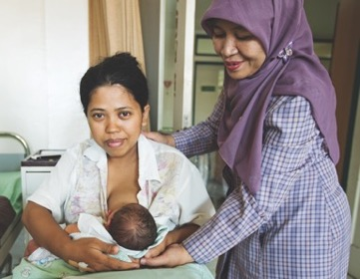
How can you ensure quality postnatal care and follow-up for all newborns?
All health workers know the content
and timing of PNC visits.
All health workers know how and
where to register births and deaths.
Build the capacity of staff to counsel
for nurturing, responsive care at home.
Support nurturing care.
Coaching, mentoring, supportive
supervision.
Support quality improvement activities.
© USAID
Notes:
What do you do in your health facility to ensure quality postnatal care and follow up ?
Policies and accountability are key.
Follow guidelines to ensure standardized quality postnatal contacts for every newborn and tailored follow-up for newborns according to their needs and condition.

