Slide 1
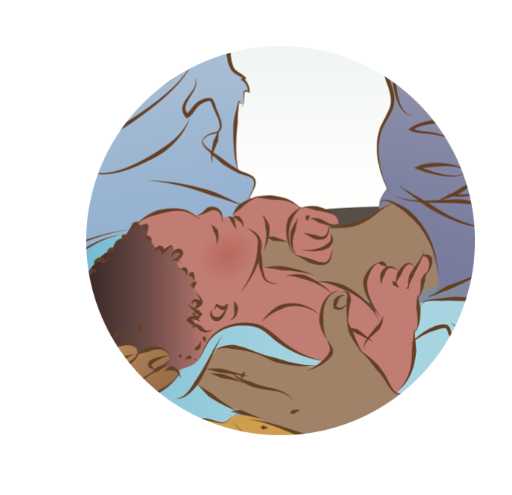

Examination of the newborn
Notes:
© World Health Organization 2024. All rights reserved.
Materials for demonstrations, practice, and simulations
Organise one set per group of 3 participants and a set for the facilitator (as available).
Alcohol handrub
Newborn mannequin and blanket or cloth to wrap
Weighing scale (model used in the facility) and cloth to cover baby during weighing
Tape measure (for head circumference)
Infant length board
Direct ophthalmoscope (to demonstrate red reflex)
Clock or watch with second hand (for respiratory rate)
Thermometer
Examples of growth charts for males and females, term and preterm
Newborn record or physical examination form used in the facility
Vitamin K, 1 or 3 mL syringe, alcohol swab
Eye prophylaxis (as used in the facility)
[Chlorhexidine only if used in the facility]

Slide 2
Content
Part 1
Goal and learning outcomes
The situation
Monitoring the newborn immediately after birth
Examination and complete assessment of the newborn
Part 2
Assessment and re-assessment to make a care plan
Summary
Clinical practice
Quality improvement
References and additional resources
Notes:
This module may be completed in two parts.
Part 1 focuses on monitoring immediately after birth, physical examination, and complete initial assessment of the newborn.
Part 2 continues with using assessment and re-assessment to make a care plan.

Slide 3
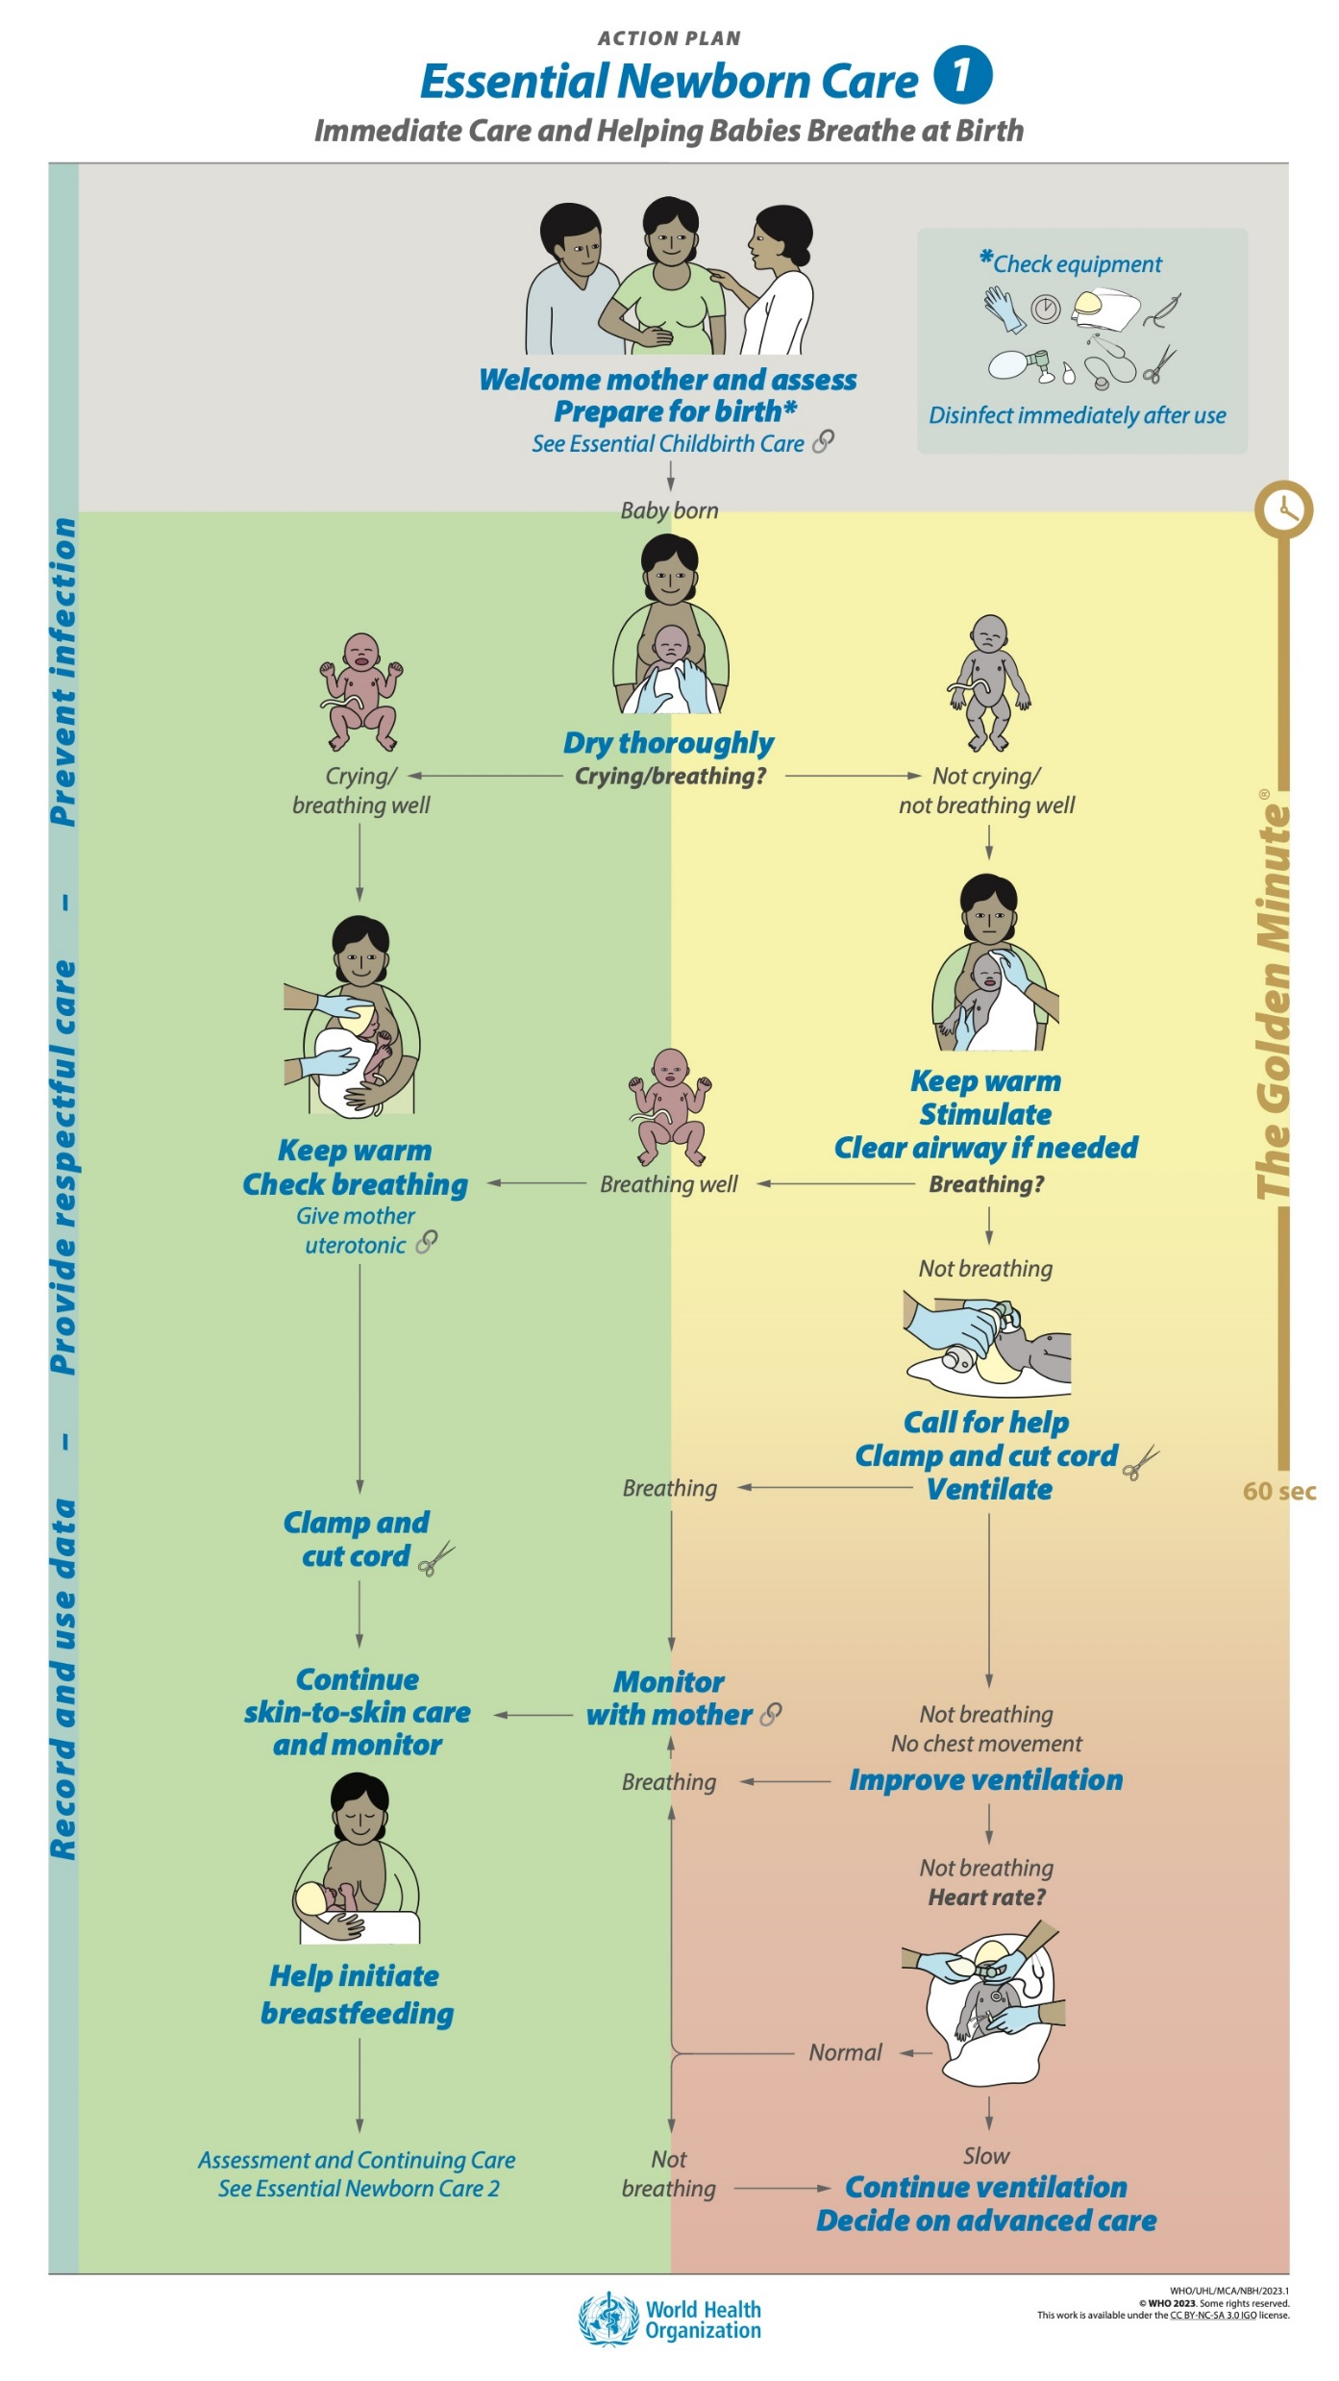
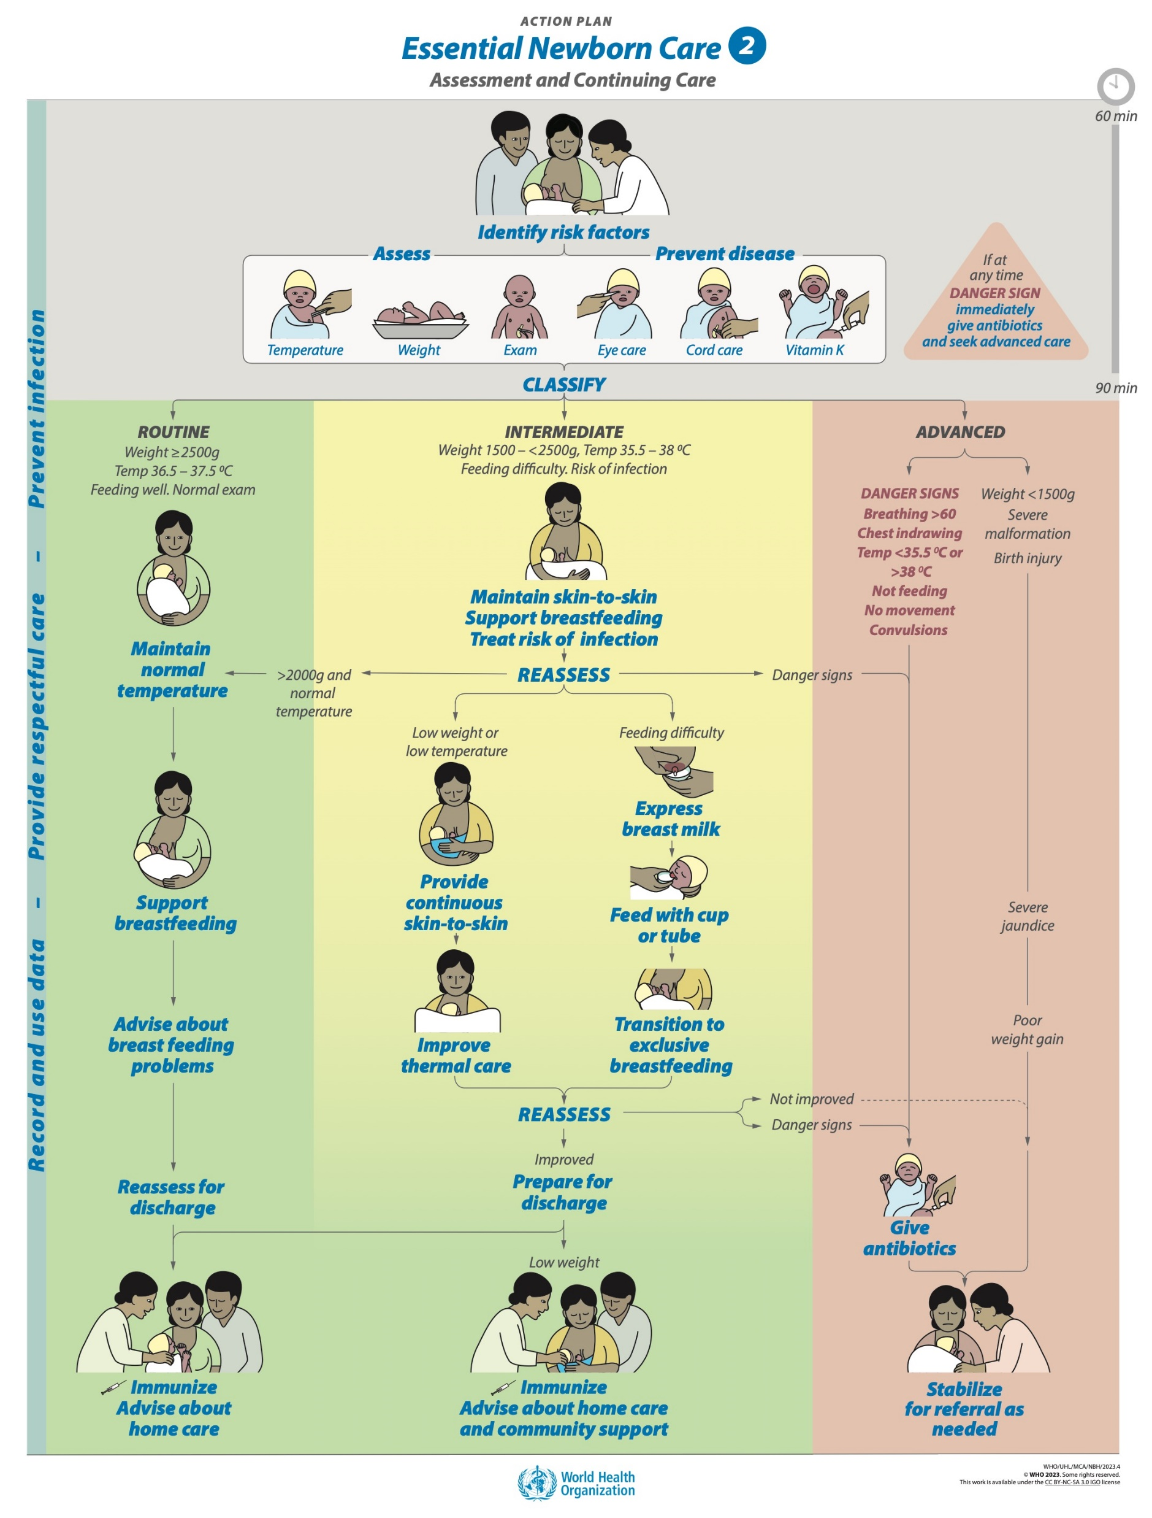
Goal and learning outcomes
All newborns will be assessed to provide individualized, evidence-based care.
Monitor
with mother
in first hour
Assess,
prevent disease
and classify
Re-assess
daily until
discharge
Notes:
Physical examination is a key part of assessment of the newborn.
Physical examination may be comprehensive or focused on certain important features, depending on when and why it is done.
This module considers physical examination as part of the assessment to make a care plan.
There are 3 important purposes for physical examination after birth:
Monitoring – the newborn is monitored with the mother for vital sign stability or signs of illness in the first hour after birth
Assessment – a detailed examination to confirm successful transition and look for congenital anomalies is performed ideally at 60-90 minutes.
Re-assessment – focussed examinations to detect changes in condition are performed in the first hours after birth and throughout the stay in the facility.

Slide 4

Goal and learning outcomes
All newborns will be assessed to provide individualized, evidence-based care.
Monitor | Breathing/color Temperature Size/maturity/abnormalities | Continue skin- to-skin care
Assess | Temperature Weight Complete examination +risk factors | Prevent disease Classify for ongoing care
Re-assess | Temperature Weight Focused examination +feeding, output | Continue or change ongoing care
Notes:
The physical examination is a key part of assessment and making a care plan throughout the facility stay.
The table shows 3 different types of assessment and how the focus of the examination changes depending upon when and why it is performed.
Monitor: Immediately after birth the examination focuses on breathing and colour, the most critical transition at birth. A rapid visual scan gives an impression of the newborn’s size and maturity, as well as any obvious malformations or signs of illness. Temperature is monitored by touch while the newborn is skin-to-skin with mother.
Assess: A full assessment at 60-90 minutes includes temperature measured with a thermometer, weight on a scale, and a complete physical examination looking especially for congenital abnormalities or signs of birth trauma. Paired with assessment of risk factors, the complete examination forms the basis for making an initial care plan. Basic steps to prevent disease (eye care, cord care, vitamin K) accompany this assessment.
Re-assess: If there is a change in the newborn’s status or routinely as part of daily care, later examinations scan for changes or any Danger Signs. Signs of possible infection can be detected early with a combination of observations by the mother and the health worker.

Slide 5
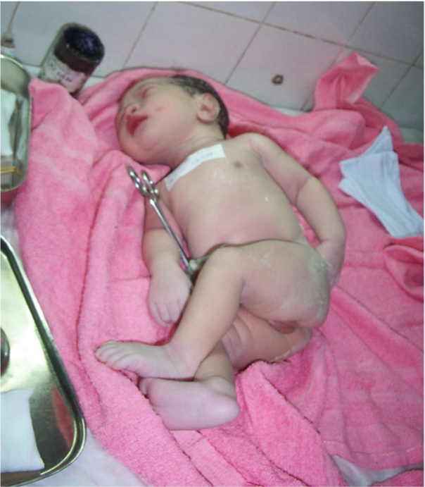
The situation
Ella has just been born.
The doctor will examine her now in the delivery room.
When and where would you examine Ella?
How can you provide respectful care to Ella and her mother
© WHO/Dr Helenlouise Taylor
Notes:
Ella is separated from her mother and left alone. She has an identity number taped on her chest.
In a 2021 study in Nepal, only 3% of more than 30,000 babies observed after vaginal delivery were placed skin-to-skin.
Mistreatment was more likely for female infants, those born to younger women, and those from disadvantaged groups.
What is the situation in your health facility?
Are newborns and mothers separated?
Why are they separated?
To learn more
KC A, et al. Mistreatment of newborns after childbirth in health facilities in Nepal PLoS One 2021; 16(2):e0246352
Sacks E et al. The first 2 hours after birth; prevalence and factors associated with neonatal care practices Lancet Global Health 2021; 9(1):E72-80.

Slide 6
Monitoring the newborn immediately after birth

Slide 7

Monitor a newborn at birth
Form groups (nurse, mother, companion)
Monitor and assess Moses with his mother.
Debrief with your team and facilitator.
Moses is 5 minutes old.
He is skin-to-skin with his mother.
You have just clamped and cut the cord.
He appears small but is pink and breathing well.
Notes:
Baseline simulation
Skills and performance – participants demonstrate monitoring and assessment for ongoing care in the first hour after birth.
1. Monitoring
Breathing/color (look, listen, and feel)
Temperature (feel tummy and toes)
Size/maturity/abnormalities (look for obvious signs)
2. Assessing to make a care plan
Continue skin-to-skin care.
Initiate breastfeeding.
Give special attention to warmth.
Communicate findings to the mother.
Debriefing – participants self-reflect and give feedback to one another in their roles.
Provision of care (performance objectives)
What was done well?
What could have been done better?
What will you change the next time?
Was data recorded and used?
Experience of care
Was the communication respectful and the language appropriate?
Was skin-to-skin contact maintained?
Was handling of the baby gentle with minimal interruption of initiation of breastfeeding?
Breathing - look for chest indrawing, fast or slow breathing; listen for extra sounds; feel breathing rate under blanket
Color – look for pink color of face and lips
Temperature – feel tummy and toes or forehead and hands
Rapid general assessment – look to see
Size – large or small
Maturity – term, preterm, or postmature
Birth trauma or anomalies – obvious differences from normal
Were infection prevention practices followed?

Slide 8
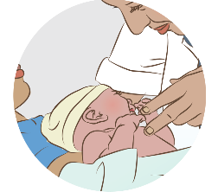
What are normal respiratory rate and breathing patterns?
30 to 60 breaths per minute
Easy movement of chest with each breath
No chest in-drawing
No grunting on breathing out
Small babies (< 2.5 kg at birth or < 37 weeks gestation) may:
    Have some mild chest in-drawing
    Periodically stop breathing for a few seconds
When assessing breathing, count the number of breaths for a full minute.
Babies may breathe irregularly (up to 80 breaths per minute) for short periods.
Repeat the count if <30 or >60 or unsure of breaths per minute.
Notes:
Newborns in the first minutes and hours may breathe faster and more irregularly than later in the first day.

Slide 9
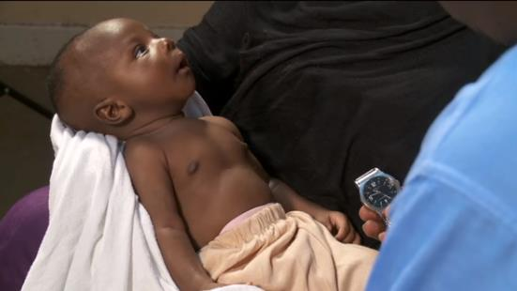


Check breathing
Breathing problems
Notes:
View video
What is new knowledge for you in this video?
Are there any skills or practices that differ from your current practice?
What provider behaviours differ from your current practice?
Does this video highlight a quality gaps in your facility?
If yes, note on the QI template for examination of the newborn.

Slide 10
Examination and complete assessment of the newborn

Slide 11

Prepare to assess a newborn after birth
Identify risk factors that affect care of the
newborn.
Keep the newborn skin-to-skin with mother after
early initiation of breastfeeding. Obtain consent
and explain what you are doing and observing.
Move equipment and supplies to the newborn,
rather than moving the newborn to equipment
and supplies.
Wash hands.
Measure temperature first, then begin the
examination as you weigh the baby.
Provide treatment to prevent disease and classify
the newborn for ongoing care after the examination.
Notes:
Prepare to perform a full physical examination and initial assessment while the newborn is in skin-to-skin contact with mother.
Wait until the baby has initiated breastfeeding in the first hour after birth.
Note the time scale (60 – 90 minutes after birth) on the Action Plan.
Assemble the equipment for measuring temperature, examination, and weighing. Gather the supplies for eye care, cord care, vitamin K administration.

Slide 12
What risk factors should be identified?
Review any risk factors identified before birth (antenatal
and intrapartum).
Identify new risk factors during birth and in the first hour
after birth.
    Signs of infection, bleeding, or hypertensive disorders
    in mother
    Difficult birth – vacuum or forceps (birth trauma), meconium
    in amniotic fluid, need for help to breathe
    Signs of concern in baby’s first hour – low temperature,
    fast or difficult breathing, no latch or breastfeeding
Where do you find this information in your facility?
Notes:
Risk factors from the antenatal and intrapartum periods should have been identified as part of preparation for birth.
New risk factors during birth and in the first hour may include:
Signs of infection (fever, uterine tenderness, foul-smelling discharge), bleeding, or hypertensive disorders (convulsions, blurry vision, high blood pressure) in mother. These may mean that mother needs extra help to care for her baby.
Signs of difficult birth, such as birth trauma, meconium in the amniotic fluid, or need for help to breathe.
Signs of concern in the first hour – low temperature, fast or difficult breathing, no initiation of breastfeeding.

Slide 13
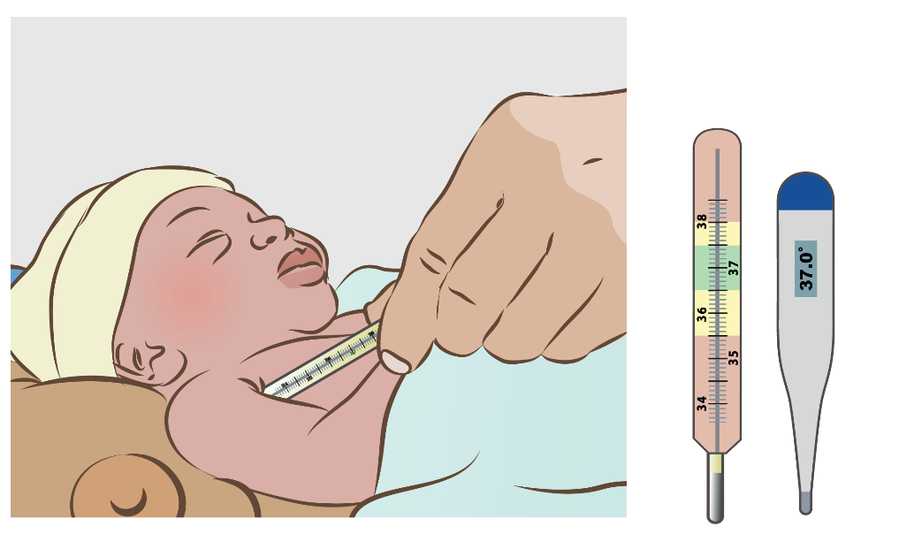
Measure temperature
Why is temperature important?
What is the normal range of temperature?
Where do you record the temperature?
Notes:
Measure temperature with a digital or mercury thermometer held under the baby’s arm.
Insert the tip of the thermometer deep into the armpit.
Keep it in place by holding the baby’s arm against the chest so the tip does not accidentally move.
Holding it parallel to the body will prevent the tip from slipping out the back of the armpit.
Check a baby’s temperature before beginning the physical examination.
If the baby is cold, warm the baby before continuing with the examination.
Identify the normal temperature range (in green), abnormally high and low temperatures (in yellow) and temperatures that are a Danger Sign (in red).
Record the temperature on the newborn record.

Slide 14
Weigh a newborn
Take the scale to the newborn and clean it.
Cover the pan with a clean cloth.
Set scale to zero.
Remove all clothing including the diaper.
Cover and wait until newborn stops moving
on scale.
Read and record the weight.
Return newborn to skin-to-skin contact with
mother and cover.
Why is the weight of a newborn important?
What is the normal range of weight?
Where do you record the weight?
Weigh the baby, 3:58-5:15
Notes:
Weigh all babies, even stillbirths.
Weight is important in classification and making a care plan.
Normal weight ranges from 2500 – 4000 grams. Babies below 2500 grams have low birth weight.
Protect babies from becoming cold during weighing.
Use a cloth large enough to cover the scale and the baby.
Warm the cloth before placing it on the scale if the baby is small.
Warm the room and avoid draughts where newborns are weighed.
Record the weight on the newborn record.
View video
What new knowledge is presented in this video?
Are there any skills or practices that differ from your current practice?
What provider behaviours differ from your current practice?
Does this video highlight any quality gaps in your facility?

Slide 15
Examine a newborn
Examine the newborn in a gentle and responsive way.
Begin by observing while the baby is quiet.
Look, listen and feel.
Then, undress the baby to inspect all parts of the body
from head to toe and front to back.
    Breathing (grunting or noisy breathing, chest
    in-drawing, fast or slow breathing)
    Posture, movement and tone, reflexes
    Colour (cyanosis – blue, pallor – pale, plethora- red,
    jaundice – yellow)
    Congenital malformations, unusual appearance
    Signs of trauma (birth injury), infection
Record the findings of the exam together with
temperature and weight.
Notes:
Examine the newborn in a gentle and responsive way.
Begin by observing while the baby is quiet – look and listen to breathing, note posture movement and tone, observe color and any obvious abnormalities.
Handle the baby gently and maintain skin-to-skin contact – feel the head and the abdomen first while the baby is quiet. Note the baby’s tone and movement as you undress the baby. Observe normal reflexes, such as rooting, sucking, grasp as you handle the baby.
Inspect all parts of the body from head to toe and front to back – Be opportunistic as you examine the baby. If the baby yawns, look at the palate and tongue. If the baby’s eyes are open, use that moment to check the red reflex* of the eyes. If you need to manipulate a body part or examine an area that may be painful, reserve that part of the examination until last. Then, help the mother comfort the baby with holding or breastfeeding.
Record the findings of the exam on the newborn record.
* Red reflex is assessed with a hand-held direct ophthalmoscope set to “0”. A red reflection from the retina (as viewed through the ophthalmoscope) signals that the focused light reaches the back of the eye without obstruction. The red reflex should be symmetric in both eyes. Tumors or cloudiness of the anterior parts of the eye interfere with the red reflex. A diminished, white, or asymmetrical reflex should prompt referral to an ophthalmologist.

Slide 16
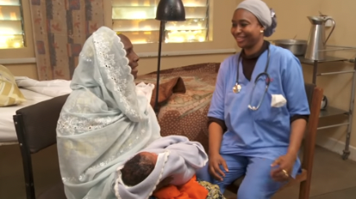
Newborn examination
Newborn physical exam
Notes:
View video
What new knowledge is presented in this video?
Are there any skills or practices that differ from your current practice?
What provider behaviours differ from your current practice?
Does this video highlight any quality gaps in your facility?
If yes, note on the QI template for examination of the newborn.

Slide 17
What are normal posture, movement, and tone?
Term newborn
  Loosely clenched fist
  Flexed arms, hips and knees
  Head lag mild-moderate
© Stanford Newborn Nursery Photo Gallery
Notes:
Normal posture, movement and tone vary depending upon whether a baby is term or preterm and the fetal position.

Slide 18
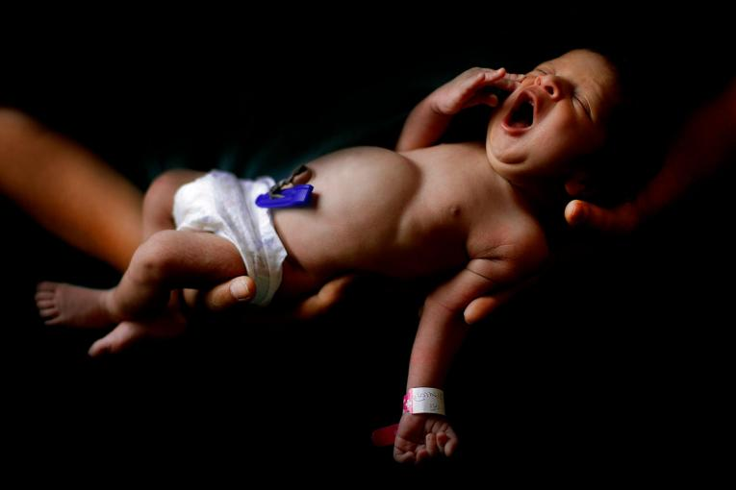
What are normal posture, movement, and tone?
Babies born in the breech position
Fully flexed hips and knees
Legs may even reach head or ears
Preterm newborn
  Limbs may be extended
  Head lag prominent
© UNICEF
Notes:
Normal posture, movement and tone vary depending upon whether a baby is term or preterm and the fetal position.

Slide 19
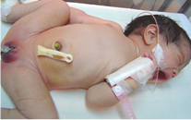
What are normal posture, movement, and tone?
Babies born in the breech position
Fully flexed hips and knees
Legs may even reach head or ears
©Jose Fabella Hospital
Normal movements
Abnormal movements
Notes:
Normal posture, movement and tone vary depending upon whether a baby is term or preterm and the fetal position.

Slide 20
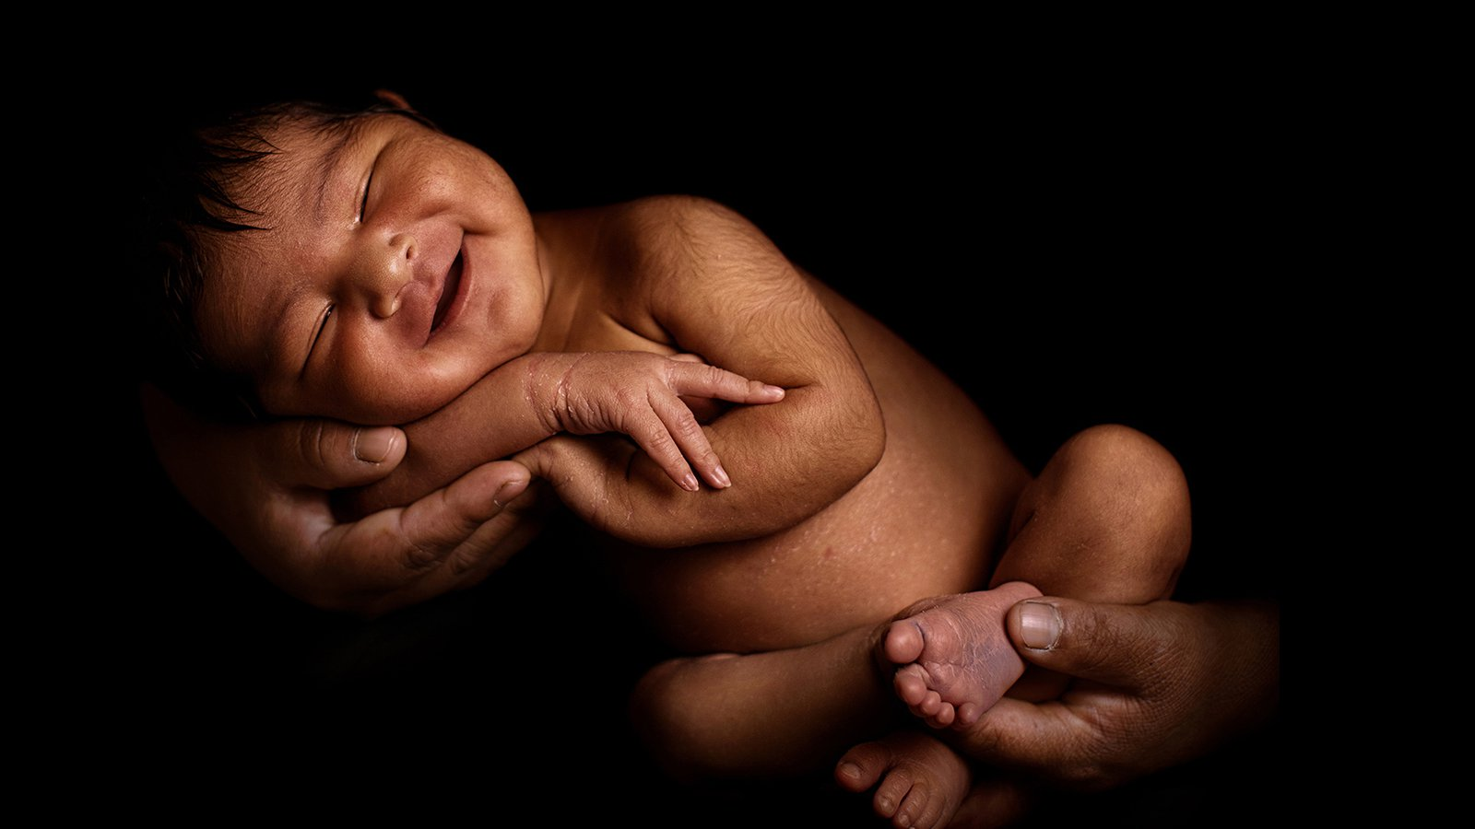
What is normal colour for a newborn?
© UNICEF /Ilvy Njiokiktjien
Notes:
The normal colour for a newborn is pink.
Pink color can be observed where pigmentation is lighter, for example on the inside of the lips, tongue, and palms/soles.
Newborns may have a bluish color of the palms or soles (as in this photo), called acrocyanosis.
If the hands and feet are warm and the rest of the body is pink, as well as the lips and tongue, this is generally a normal finding.

Slide 21
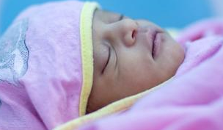
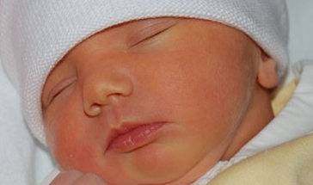
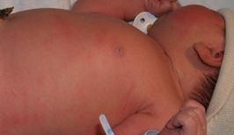
What is the significance of skin colour in a newborn?
© UNICEF/Sewunet
Pallor
Jaundice
Plethora
Cyanosis
© Stanford Newborn Medicine Photo Gallery
Notes:
Discuss the significance of skin colour.
Pallor (white) – low red blood cells (anaemia), low oxygen level, or shock/sepsis
Plethora (red) – high red blood cells (polycythaemia)
Jaundice (yellow) – high bilirubin (hyperbilirubinaemia)
Cyanosis (blue) – low oxygen level, possibly from lung or heart disease

Slide 22
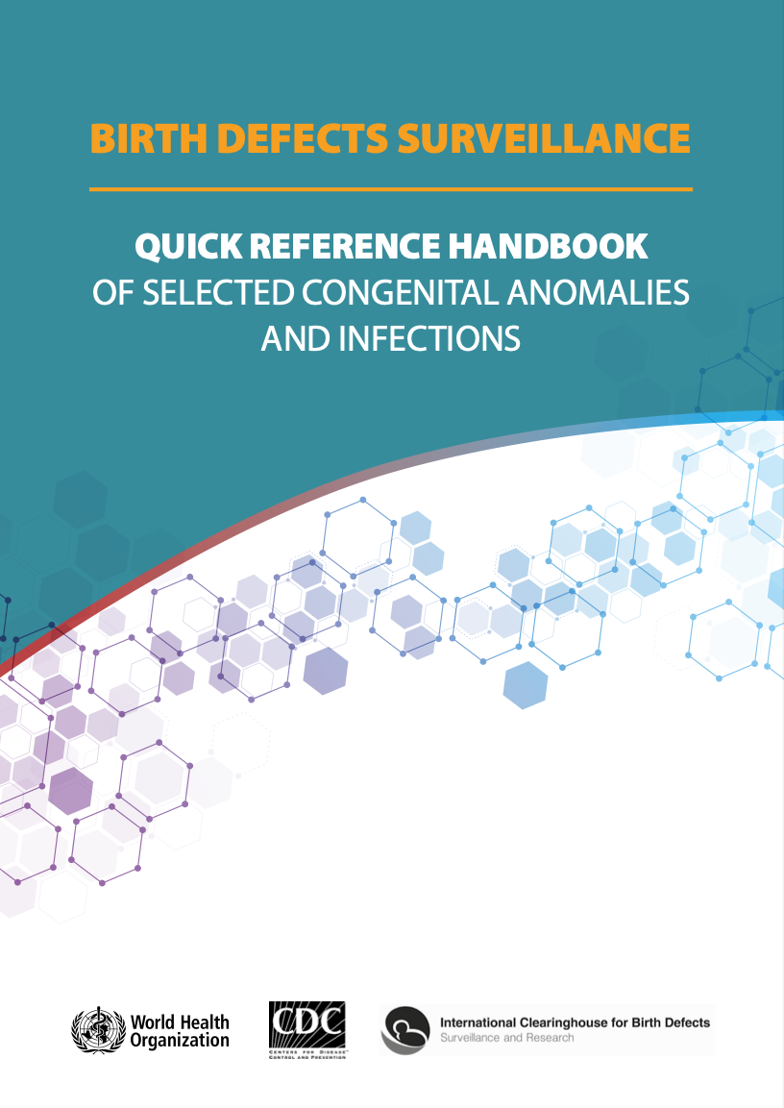
How to look for congenital anomalies?
Look for:
    Open tissue on head, back, abdomen, or pelvic area
    Abnormal head circumference (large or small)
    Cleft lip and/or palate
    Absent/abnormal red reflex
    No anal opening, abnormal urethral opening
    Extra or missing fingers or toes or other limb abnormalities
    Unusual appearance
Communicate findings to family.
Document and refer for investigation and management.
Report to national surveillance registry.
Notes:
The survey for visible congenital disorders includes the following:
Open tissue on head, back, abdomen, or pelvic area – neural tube defects, abdominal wall defects, genital anomalies
Abnormal head circumference (large or small) – macro/microcephaly (also abnormalities of ear size)
Cleft lip and/or palate – orofacial clefts
Absent/abnormal red reflex – cataract or tumour
No anal opening – imperforate anus; abnormal urethral opening – hypo/epispadias
Extra or missing fingers or toes or other limb abnormalities – musculoskeletal abnormalities
Unusual appearance – chromosomal abnormalities, infectious syndromes
Other congenital disorders may not have readily visible signs, but express functional abnormalities:
Congenital heart disease – cyanosis, respiratory distress
Digestive system disorders – oesophageal atresia, tracheoesophageal fistula, intestinal atresia
Urinary system disorders – renal agenesis or collecting system abnormalities
The presence of one congenital anomaly may be a clue to the possibility of others.
Midline defects and ear abnormalities are highly associated with other congenital problems.

Slide 23
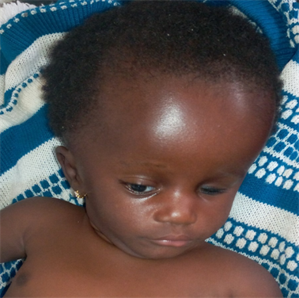
Abnormalities of head size
©Isikay S, Yilmaz K. Congenital cytomegalovirus infection and finger anomaly. Case Reports. 2013;2013bcr2013009486
Microcephaly
© Nagalo K et al. Congenital toxoplasmosis.
Open Journal of paediatrics 2022, 12:213.
Macrocephaly
Notes:
What do you see?
The infant on the left has microcephaly (small head circumference) as a result of congenital CMV infection.
The infant on the right has macrocephaly (large head circumference) as a result of congenital toxoplasmosis infection.
What do you do?
Often, abnormalities of head size are clues to underlying abnormalities of the brain.
The causes of abnormal head size are many and diagnostic studies are important to make a care plan.

Slide 24
Neural tube defects: cranial
Anencephaly
Encephalocele - occipital
Encephalocele
- nasofrontal
© CDC–Beijing Medical University collaborative project.
Notes:
What do you see?
Examination of the head may reveal significant malformations of brain tissue.
On the left, the skull and brain have failed to form completely, resulting in anencephaly, a lethal congenital anomaly.
In the middle, there is herniation of brain tissue outside the skull in the occipital region (encephalocele).
On the right is an example of herniation of neural tissue in the nasofrontal position.
What do you do?
Encephalocele can occur at the junction of any suture; it requires neurosurgical evaluation at a specialized centre.
Anencephaly is a lethal condition calling for palliative care.

Slide 25
Orofacial clefts
Bilateral cleft lip and palate
Unilateral cleft lip and palate
© Dr. Jaime Frías, Dr. Pedro Santiago, Dr. Miguel Yanez, EEUU
Notes:
What do you see?
Orofacial clefts are among the most common congenital abnormalities (1 of every 700 children is born with a cleft lip and/or palate). In some cases, cleft lip or cleft palate may occur alone. In about half of cases, cleft lip and palate occur together. The cleft may be on one side only (unilateral) or both sides (bilateral).
Cleft palate can be missed if the palate is not carefully examined by visualization or palpation of both anterior (hard) and posterior (soft) palate.
What do you do?
Support for alternative feeding methods to give breastmilk is an urgent priority to prevent malnutrition. Referral to a paediatric surgery centre should be made for evaluation and planning of repair, as well as counselling and support for the family.

Slide 26
Ear abnormalities
Normal
Normal
Ear tag
Ear pit
Microtia
© Stanford Newborn Nursery
Notes:
What do you see?
The ears of newborns show considerable normal variation in size, position, and configuration. However, certain abnormalities can signal underlying problems with the internal ear. Ear tags and pits are associated with other facial and kidney abnormalities. Microtia often signals abnormalities of the internal ear or a syndrome involving other organs.
What do you do?
Hearing screening is especially important for a newborn with an ear abnormality.
Look for other congenital abnormalities that may be part of an identifiable syndrome.

Slide 27
Eye abnormalities
© Stanford Newborn Nursery Photo Gallery
© Haseeb A et al. Down syndrome: a review of ocular manifestations. Ther Adv Ophthal 2022; 14:1
Cataract
Brushfield’s spots
Notes:
What do you see?
On the left, the cornea is cloudy, obscuring the color of the iris and the pupil in congenital cataract. Absence of the red reflex is a clue to abnormalities of the lens or cornea.
On the right, small white dots (Brushfield’s spots) are associated with trisomy 21.
What do you do?
Abnormalities of the eye often signal conditions that affect a baby’s development.
Some conditions (such as cataracts and tumors) call for surgical intervention, so evaluation by an ophthalmologist is important.
Absent red reflex is covered in the module “Discharge and follow-up”

Slide 28
Neural tube defects: spina bifida
Meningocele
– closed spina bifida
Myelomeningocele
– open spina bifida
© CDC–Beijing Medical University collaborative project
Notes:
What do you see?
The infant on the left has closed spina bifida, an opening in the spinal canal with herniation of the spinal cord and the membranes covering it, or the membranes only (meningocele). In the case of closed spina bifida, skin covers the herniation.
With open spina bifida, there is no skin covering the herniation. On the right the nerve tissue is visible (myelomeningocele); spinal fluid leakage from the sac is a risk for infection.
What do you do?
Both lesions require protection and referral to a paediatric neurosurgical centre.

Slide 29
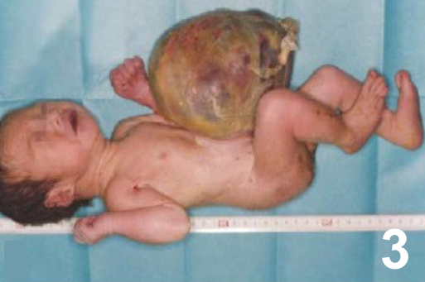
Abdominal wall defects
Omphalocele
Gastroschisis
© CDC–Beijing Medical University collaborative project.
Notes:
What do you see?
Omphalocele (on the left) is a defect of the anterior abdominal wall in the midline. There is a centrally located, membrane-covered herniation of gut and sometimes other organs such as liver, spleen, stomach.
Gastroschisis is a defect of the anterior abdominal wall to the right or left of the midline. The bowel is exposed (no covering membrane) to amniotic fluid during gestation.
What do you do?
Both conditions require protection of the bowel and urgent referral to a paediatric surgery centre.

Slide 30
Imperforate anus
Imperforate anus
Normal anus
© Stanford Newborn Nursery photo gallery
Notes:
What do you see?
On the left, the anal opening is absent (imperforate anus). The buttocks appear smooth without a defined muscular ring (sphincter).
This congenital malformation can be missed on physical examination unless specifically checked. An infant who does not pass meconium in the first 24 hours should be rechecked for imperforate anus.
What do you do?
Imperforate anus requires urgent referral to a paediatric surgery centre. With low imperforate anus, the intervention may be relatively simple. Malformation higher in the intestine involves more complex surgery.

Slide 31
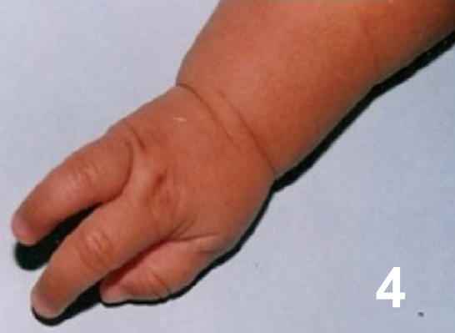
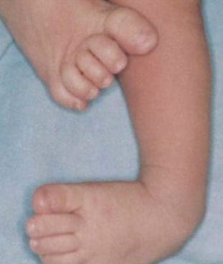
Musculoskeletal abnormalities
© ECLAMC
Congenital absence of digits (fourth and fifth fingers)
© Dr. Idalina Montes & Dr. Rafael Longo (PR)
Club foot talipes equinovarus
Notes:
What do you see?
Musculoskeletal abnormalities may take the form of absent structures, extra structures, malformations or deformations.
On the left, only the thumb and first two fingers are present; the fourth and fifth fingers are missing. Some babies may have extra fingers or toes (supernumerary digits) that may or may not contain bones.
On the right, the forefoot is deviated inward and the ankle joint is flexed downward in the position termed talipes equinovarus or clubfoot. This abnormality occurs with a wide range of severity, and it may accompany other congenital abnormalities.
What do you do?
Most cases of musculoskeletal abnormalities require orthopaedic or surgical treatment. Children often require rehabilitation services as they grow.
Deformations of the extremities are positional deformities that result from pressure in utero and may resolve spontaneously or with physiotherapy.

Slide 32
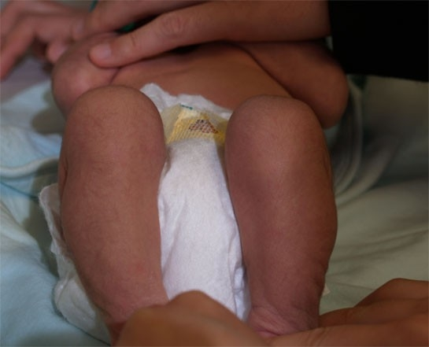
Musculoskeletal abnormalities
© Stanford Newborn Nursery photo gallery
Developmental dysplasia of the hip
Galeazzi sign – unequal knee height
Notes:
What do you see?
If the hip joint does not develop normally, there may be instability or even dislocation of the head of the femur bone.
Clues to this condition include unequal knee height when the newborn is lying supine.
What do you do?
If there are signs of abnormal hip development, manoeuvres that test the movement of the hips can be helpful (see Discharge and follow-up module).
Abnormal screening examinations should be followed up with hip ultrasound. Prompt diagnosis can lead to better treatment results.

Slide 33
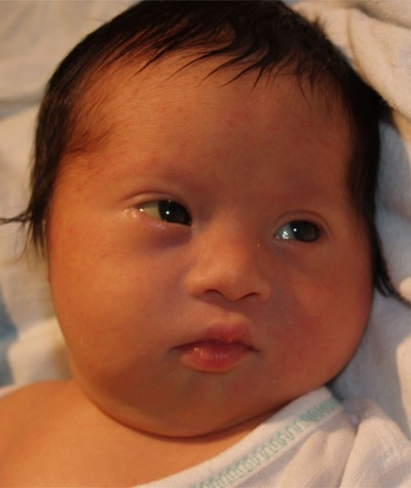
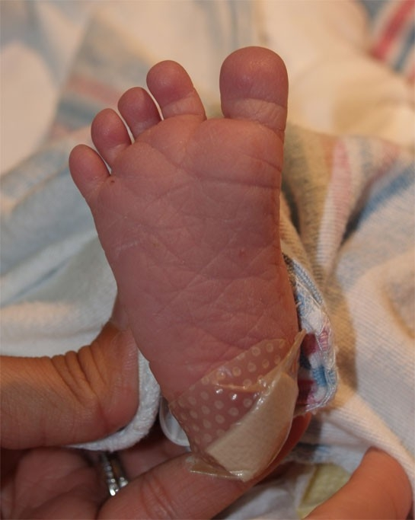
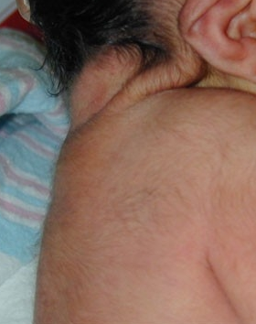
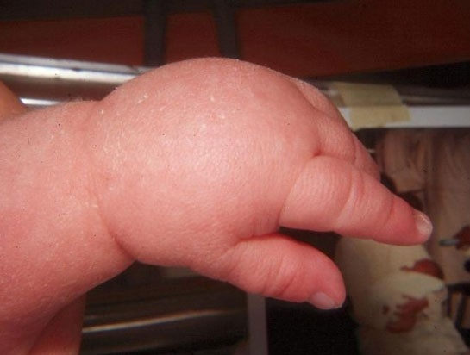
Chromosomal abnormalities – trisomy 21
Facial appearance
Toe gap
Nuchal folds
Dorsal edema
© Stanford Newborn Nursery Photo Gallery
Notes:
What do you see?
Trisomy 21 is one of the most common abnormalities of chromosome number. It can be recognized in the neonatal period by group of characteristic physical signs (syndrome) and confirmed by chromosomal analysis. The diagnosis is important because of associated major malformations (heart intestines, vertebrae) and medical problems during childhood (hypothyroidism, vision and hearing issues, varying intellectual impairment).
What do you do?
Newborns with trisomy 21 may have feeding difficulty and sometimes breathing difficulty as well.
Children will need special medical and developmental support.

Slide 34
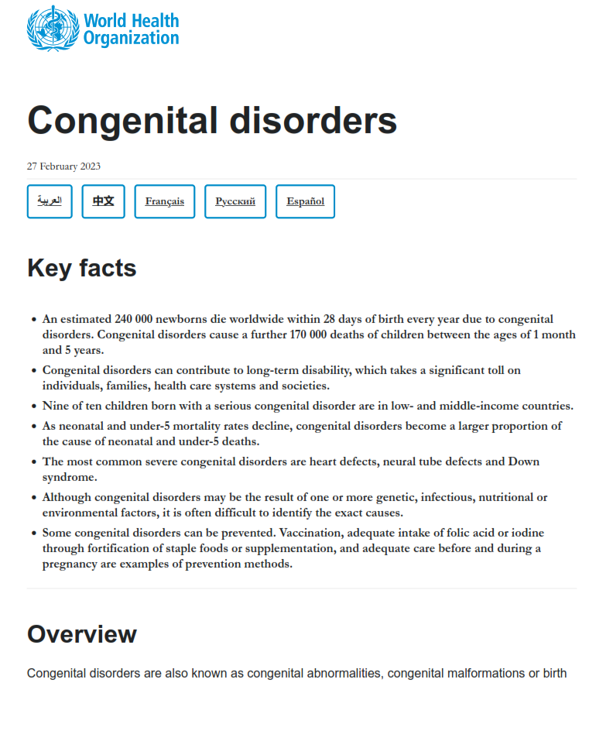
What preventive practices decrease the frequency of congenital disorders?
Find the recommendations on page 3.
Notes:
Use a printed or digital copy (pdf) of the document to find the recommendations.

Slide 35
Recommendations for adolescent girls and women to prevent congenital disorders
Maintaining a healthy diet and weight.
Consuming adequate folic acid, as well as other dietary vitamins and minerals.
Avoiding harmful substances, especially alcohol and tobacco.
Avoiding exposure to infections known to be associated with congenital
disorders.
Reducing environmental exposure to hazardous substances.
Controlling diabetes prior to and during pregnancy.
Vaccination against rubella virus.
Ensuring that any exposure of pregnant women to medications or medical
radiation is justified and based on careful analysis of risk and benefit.

Slide 36
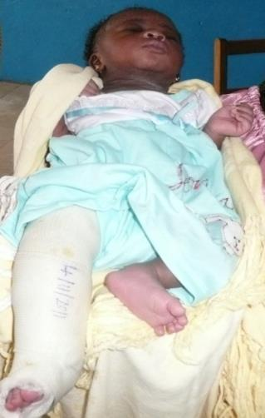
How to look for birth injuries?
Look for:
    Lumps or swelling on the head, body, limbs
    Bruises, cuts, or abrasions
    Abnormal position of legs, arms, hands/feet
    Asymmetrical limb movement or limb that does
    not move
    Signs of fractures, including swelling, redness,
    crepitus or crying when affected part touched
Communicate findings to the family and explain
their significance.
Refer for further management if necessary.
© WHO/Dr Helenlouise Taylor

Slide 37
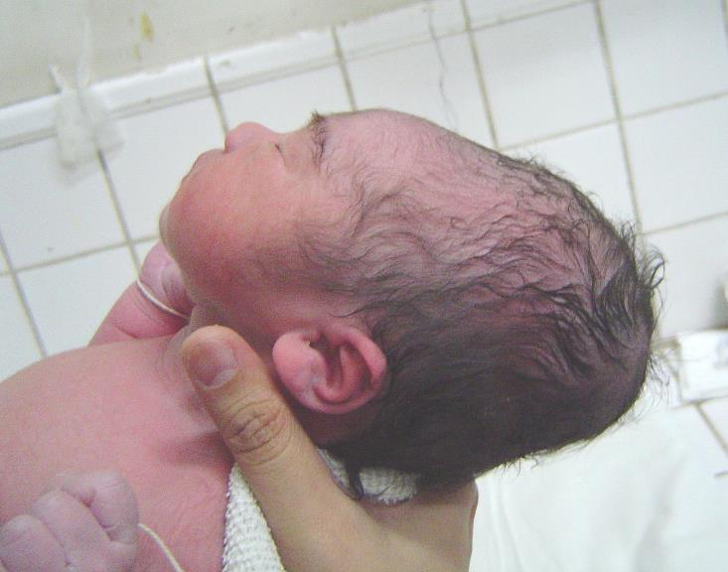
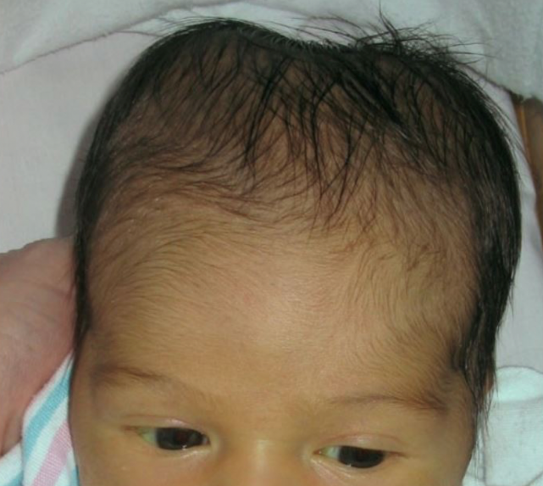
Birth trauma with soft tissue injury
Cephalohematoma
© Jose Fabella Hospital
© Janelle Aby
Caput succedaneum
Cephalohaematoma
Notes:
What do you see?
The infant on the left has moulding of the skull and swelling of the scalp from pressure while entering the birth canal as the presenting part. The swelling (subcutaneous oedema) extends over the midline of the skull. The bones of the skull may overlap one another.
The infant on the right has two distinct areas of swelling on either side of the skull. The areas may feel fluid-filled; they do not cross the suture line because the swelling represents a blood collection below the periosteum.
What do you do?
A caput resolves on its own over three to four days.
The blood collection in a cephalohaematoma resolves slowly on its own, but breakdown of the red cells may increase jaundice.

Slide 38
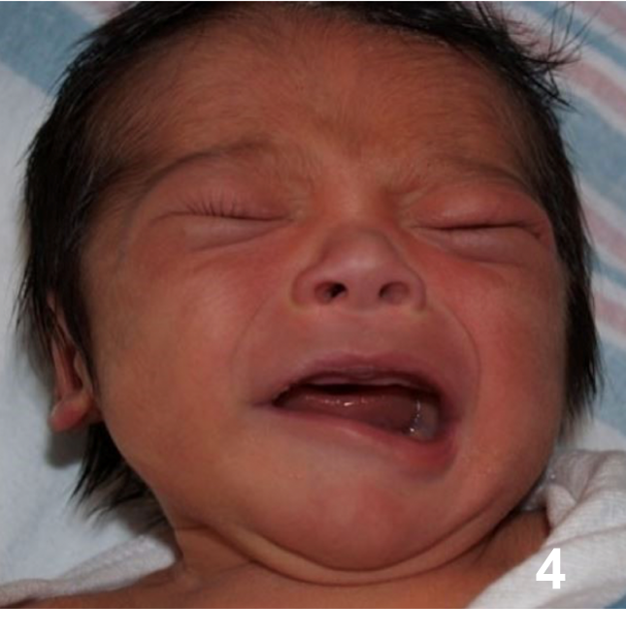
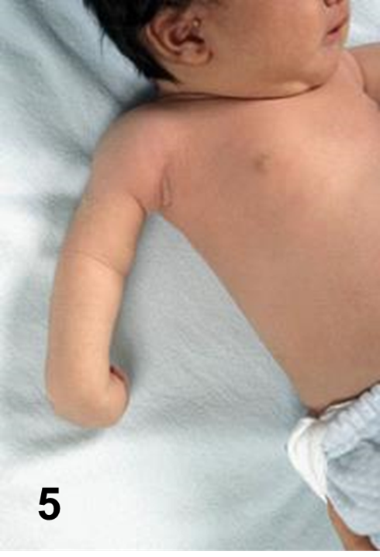
Birth trauma with nerve injury
Nerve damage: facial nerve palsy
Nerve damage: Erb’s palsy
© Jose Fabella Hospital
Notes:
What do you see?
The newborn on the left is crying, but the right side of the face is not moving. This baby was delivered by forceps; pressure from the forceps damaged the facial nerve.
On the right, the position of the arm and hand are abnormal. Damage to the nerves controlling the arm and hand can occur when an infant’s neck is stretched to one side during delivery.
What do you do?
Facial nerve palsy can resolve on its own over weeks or months. It may require referral if there are problems with feeding.
In Erb’s palsy the function usually returns over several weeks, but referral may be necessary if there is not improvement by 6 weeks.

Slide 39
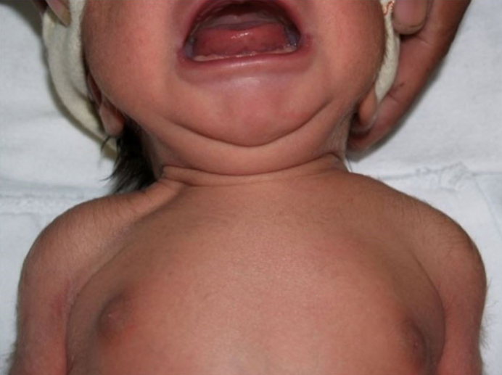
Birth trauma with fracture
© Jose Fabella Hospital
Clavicle fracture
Notes:
What do you see?
Note asymmetry and depression over the clavicle on the right.
What would you expect to find when gently feeling (palpating) the area? There may be a crunching sensation (crepitus), evident discomfort, and even movement (displacement) of the bone if the fracture is complete.
What do you do?
Newborns with a fracture need gentle handling and may need analgesia with acetaminophen/paracetamol.
Clavicle fractures generally heal on their own, but they may heal with a prominent lump at the site of the fracture.

Slide 40
Part 2
Assessment and re-assessment to make a care plan

Slide 41
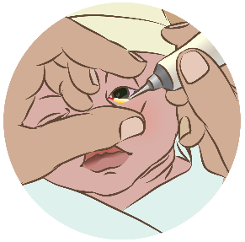
Provide eye care
Use the medication recommended in your national
guidelines
Pull down the lower lid of the eye
Apply a line of ointment along the inside of the lower lid,
from inner to outer side
Repeat for the other eye
Why is eye care important?
What will you do to prevent introducing infection
when providing eye care?
Notes:
As part of care with the initial complete assessment, all babies need preventive interventions.
Not all national guidelines recommend medication to prevent eye infections.
When screening for sexually transmitted diseases is strong, the risk of eye infections may be low.
Avoiding any contact with the eye or lid while applying the ointment helps prevent infection, as does using the ointment for a single patient only.

Slide 42
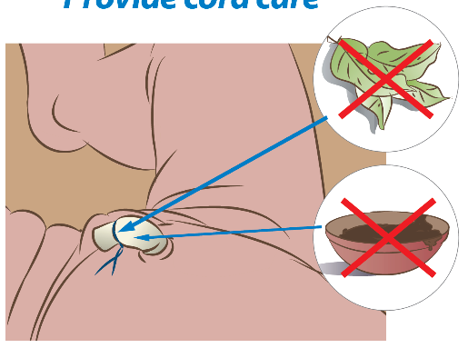
Provide cord care
Keep the cord exposed and dry.
Apply nothing to the cord unless a medication(for example, chlorhexidine) is recommended by your health authority.
If the stump is soiled, wash it with clean water and
dry with a clean cloth.
If bleeding, put an extra tie tightly around the cord.
Why is cord care important?
Is chlorhexidine recommended by the
Ministry of Health?
When should a baby be bathed for the first time?
Notes:
Correct cord care helps prevent serious infections.
Follow national guidelines for chlorhexidine use.
Chlorhexidine is recommended in areas where other potentially harmful substances may be applied to the cord.
Bathing should be delayed for at least 24 hours after birth. Keep the cord dry during bathing.

Slide 43
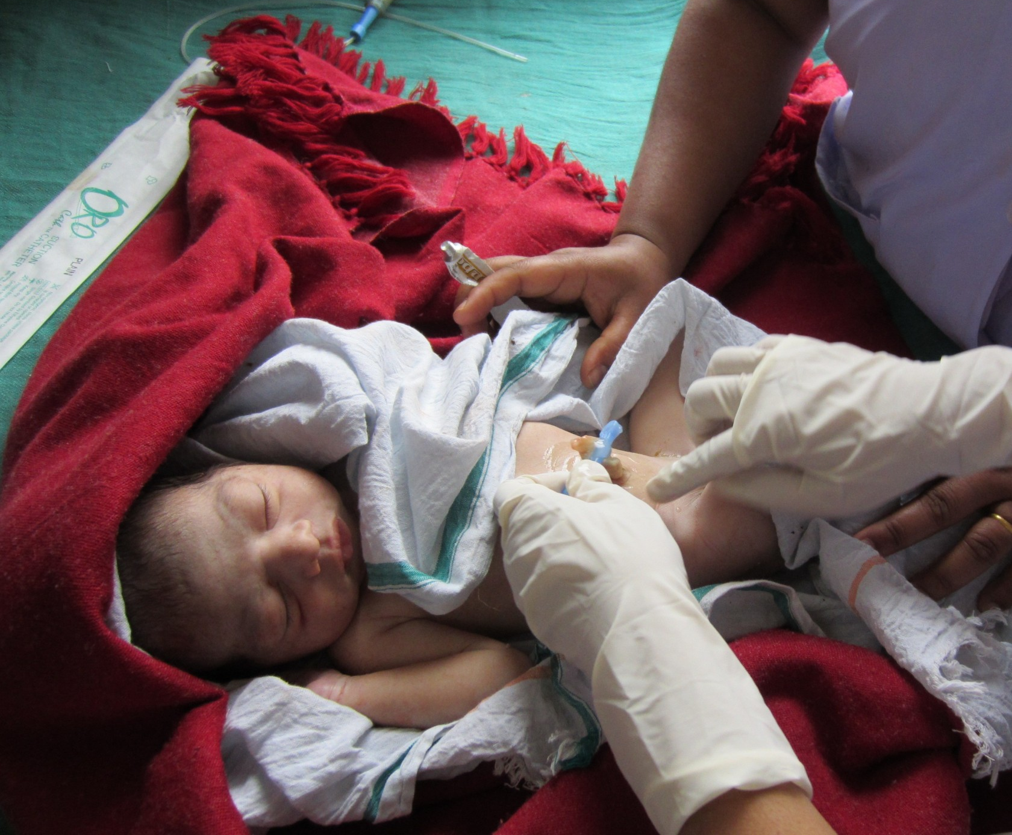
Apply chlorhexidine cord care
Use gloves if available
Apply 7.1% chlorhexidine
digluconate (solution or
gel) to the base of the cord
Repeat daily for the first
7 days
WARNING:
Application of chlorhexidine to the eye has resulted in blindness.
©Healthynewbornnetwork
Notes:
Follow national guidelines for chlorhexidine use.

Slide 44
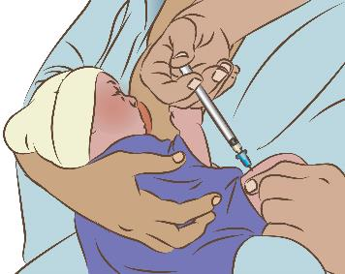
Give vitamin K
Encourage mother to breastfeed or hold the newborn
skin-to-skin.
Draw up 1 mg Vitamin K in 1mL syringe with 23-27
gauge needle.
Clean injection site on front outside of thigh with
isopropyl alcohol; allow to dry.
Inject medication quickly into muscle.
Dispose of syringe and needle correctly.
Why is vitamin K important?
Who needs vitamin K?
Notes:
Vitamin K protects babies from serious bleeding. All babies who are breastfed should receive vitamin K.
Some babies are at high risk of bleeding:
requiring surgical procedures
experienced birth trauma
preterm
exposed to maternal medication known to interfere with vitamin K (for example, some anticonvulsants)

Slide 45
How to classify for ongoing care?
ROUTINE care
Temperature 36.5 – 37.5°C
Weight > 2500 grams
Feeding well, normal exam, no risk factors
INTERMEDIATE care
Temperature 35.5-36.5 or 37.6-38°C
Weight 1500 - <2500 grams
Feeding difficulty, breathing difficulty that is
improving OR risk factors but newborn looks well
ADVANCED care
Danger Sign is present
Weight < 1500 grams
Malformation, birth injury or jaundice on exam
Risk factors and newborn looks unwell
Notes:
Classify the newborn by 90 minutes based on temperature, weight, examination, feeding, and risk factors to direct further care.
Are the same criteria for classification used in your health facility? If not, what is different?
How is the plan of care for a newborn recorded and communicated in your facility?

Slide 46
Assessment of the newborn
Form groups (nurse, mother, companion).
Assess, prevent disease, and classify Moses.
Communicate with mother as you perform
the actions.
Debrief with your team and facilitator.
Moses is 90 minutes old.
Pregnancy and birth were uncomplicated.
He breastfed in the first hour after birth.
His weight is 1920 grams and his temperature
is 36.8°C.
Notes:
Simulation
Skills and performance – participants demonstrate complete assessment, care to prevent disease, and classification for ongoing care.
1. Assessing
Review the risk factors from antenatal and intrapartum care and care of the newborn in the first hour after birth (initiation of breastfeeding).
Obtain temperature and weight.
Perform a complete physical examination (normal findings).
2. Preventing disease
Give eye care and cord care according to national guidelines
Administer vitamin K
3. Classifying
Based on the assessment data, classify as receiving intermediate care.
Debriefing – participants self-reflect and give feedback to one another in their roles.
Provision of care (performance objectives)
What was done well?
What could have been done better?
What will you change the next time?
Was data recorded and used?
Experience of care
Was the communication with mother and the companion effective and respectful?
Was the examination performed gently, moving from observation to palpation to more active handling?
Were national guidelines followed for disease prevention (cord care, eye care)?
How was discomfort reduced during procedures such an IM injection?
Were infection prevention practices followed?

Slide 47
Which newborns require assessment for infection at birth?
Prolonged rupture of membranes (>18 hours)
Foul-smelling amniotic fluid or pus
Maternal fever >38 °C
Maternal TB
Maternal HIV
Maternal syphilis, gonococcus
Maternal chlamydia
Maternal group B streptococcus
All require assessment and management.
Check guidelines for current recommended treatment.
Notes:
Which newborns are at highest risk of infection?
infants born to mothers with infection
infants who are very low birthweight or born prematurely
How do infants acquire infections?
In utero: syphilis, cytomegalovirus, rubella, chicken pox, toxoplasmosis, HIV, TB
In the birth canal: group B streptococcus, chlamydia E. coli, staphylococcus, gonococcus, Listeria, hepatitis B, HIV, herpes simplex
In the health facility: suboptimal cleaning, disinfection and sterilization practice; poor hand hygiene
In the home: home delivery with poor hygiene (no use of clean delivery kit); contamination of umbilical stump or feeding utensils, poor hand hygiene

Slide 48
Re-assess a newborn in the first hours after birth
Ask the mother about her baby and any concerns.
Check the notes of the mother and of the baby.
    Temperature
    Breathing
    Feeding
    Any conditions needing treatment
Examine the baby.
    Look and listen (breathing, cry) BEFORE touching
    Note changes (temperature, breathing)
    Identify Danger Signs
Assess a breastfeed.
    Especially if early initiation of breastfeeding in
    doubt due to small size or breathing difficulty.
Notes:
Practice the steps to re-assess a newborn in the first hours after birth.
The first 4-6 hours after birth represent a transition period when many of the newborn’s body systems are becoming established.
Frequent re-assessment is important to document both improved and worsening condition.
Review the Danger Signs:
temperature (too hot to cold), breathing (too fast, chest indrawing), not feeding, movement (lethargic or not moving, convulsions).

Slide 49
Re-assess the newborn
Form groups (nurse, mother, companion).
Re-assess Moses and communicate your
findings.
Debrief with your team and facilitator.
Moses is 4 hours old.
His mother tells you that he feels cold.
Notes:
Simulation
Skills and performance – participants demonstrate re-assessment of a newborn in the first hours after birth.
1. Re-assessing
Ask mother about her baby and her concerns.
Measure temperature – temperature is 35.9°C.
Check notes for feeding pattern and risk factors.
Perform a focused physical examination – normal findings except cold hands and feet.
Check breathing
Identify any Danger Signs
Change the care plan: Improve thermal care.
Communicate the findings and plan to the mother.
Re-check temperature.
Debriefing – participants self-reflect and give feedback to one another in their roles.
Provision of care (performance objectives)
What was done well?
What could have been done better?
What will you change the next time?
Was data recorded and used?
Experience of care
Were the mother’s concerns listened to and her questions answered?
Were the findings and plan explained to the mother?
Was handling of the baby gentle?
Were infection prevention practices followed?

Slide 50
Re-assess a newborn daily until discharge
Ask the mother about her baby and any concerns.
Check the notes of the mother and of the baby.
    Temperature
    Weight
    Intake and output
    Any conditions needing treatment
Examine the baby.
    Look and listen (breathing, cry) BEFORE touching
    Note changes (jaundice, infection)
    Identify Danger Signs
Assess growth (weight, length, head circumference)
and observe a breastfeeding
    In all newborns prior to discharge
    Throughout the facility stay in small babies
Notes:
Compare the daily re-assessment to that done in the first hours after birth.
What is the same?
What is different?
Practice organising the daily assessment of a newborn.

Slide 51
What else can be observed during the newborn examination?
How mother interacts with her baby gives clues to her mental health
and emotions.
A mother who is anxious, depressed or profoundly sad may have
    Increased difficulty breastfeeding
    Poorer nurturing care practices
Common perinatal mental disorders (CPMD) affect both women’s and
children’s outcomes.

Slide 52
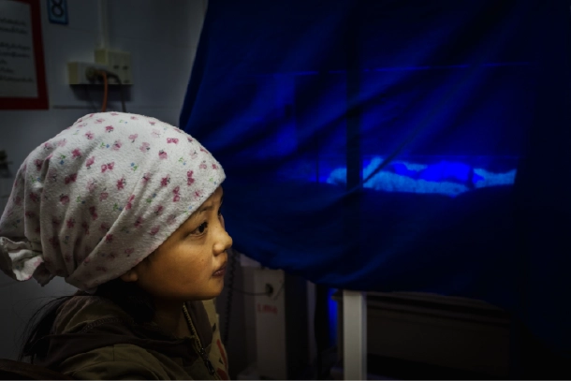
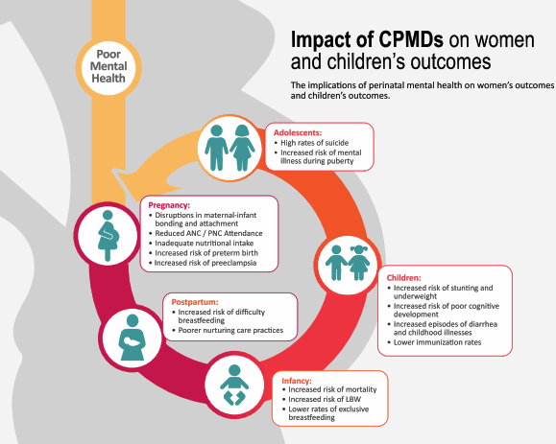
What else can be observed during the newborn examination?
© WHO/Yoshi Shimizu
©USAID Momentum.org
Notes:
What do you see?
How is this young adolescent mother interacting with her baby?
What do you do?
How would you assess her mood?

Slide 53
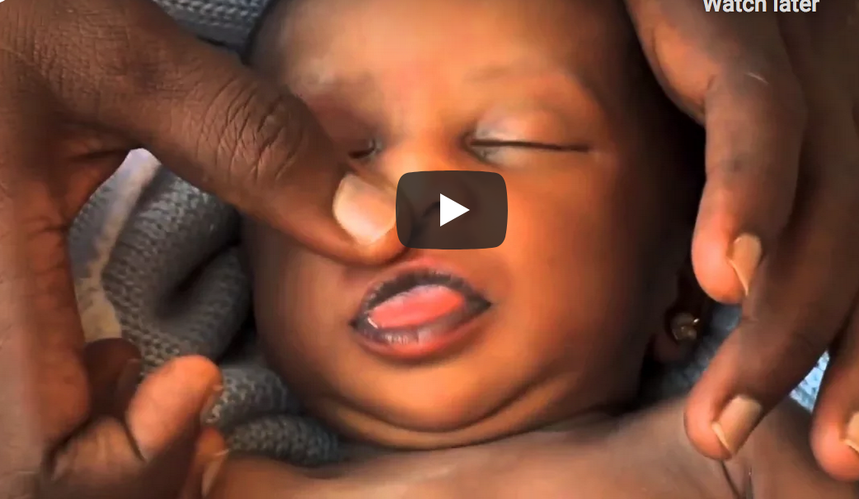
Check the colour for jaundice
Check for jaundice
Notes:
View video
What new knowledge is presented in this video?
Are there any skills or practices that differ from your current practice?
What provider behaviours differ from your current practice?
Does this video highlight any quality gaps in your facility?
What method is used to screen jaundice in your facility?
When does jaundice become dangerous?
Any jaundice that is visible on the day of birth or jaundice that reaches the palms and soles requires immediate treatment and may need referral.

Slide 54
What are signs of infection in a newborn?
Danger Signs
Fast breathing (> 60 breaths per minute)
Severe chest in-drawing or grunting
Slow breathing or gasping (< 30 breaths per minute)
High or low temperature
Not feeding well, stopped feeding, vomiting
Fits or convulsions
Floppy or stiff
Vital Signs
Fast heart rate, >180/minute
Cyanosis (blue color), grey or very pale
Physical Signs
Bulging fontanelle
Abdominal distension
Skin, eye, or umbilical redness, swelling, discharge
Notes:
What signs of infection do you look for in a newborn?

Slide 55
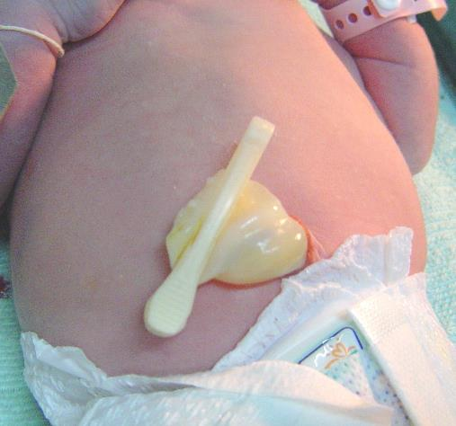
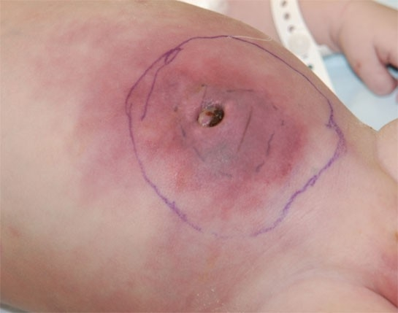
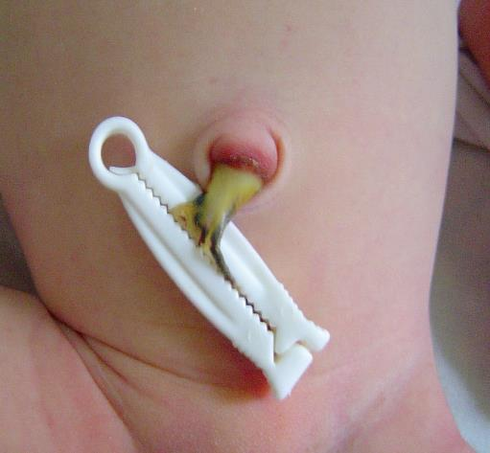
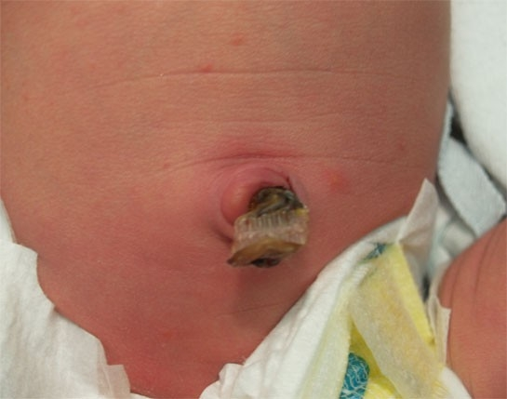
Which umbilicus is normal?
©Jose Fabella Hospital
© Stanford Newborn Nursery Photo Gallery
Notes:
What do you see?
The umbilicus in the upper left panel is normal.
Redness which spreads onto the skin at the base of the cord and the surrounding abdomen (upper right) may indicate an infection, termed omphalitis.
Redness can also result from irritation by the dried umbilical stump (lower right) or from skin of the cord adherent to the Wharton’s jelly (lower left).
What do you do?
A newborn with omphalitis requires IV antibiotics; the infection can spread to the bloodstream or cause destruction of tissue of the abdominal wall.
Localized redness may disappear with protection of the skin from irritation or making sure the base of the cord is dry.

Slide 56
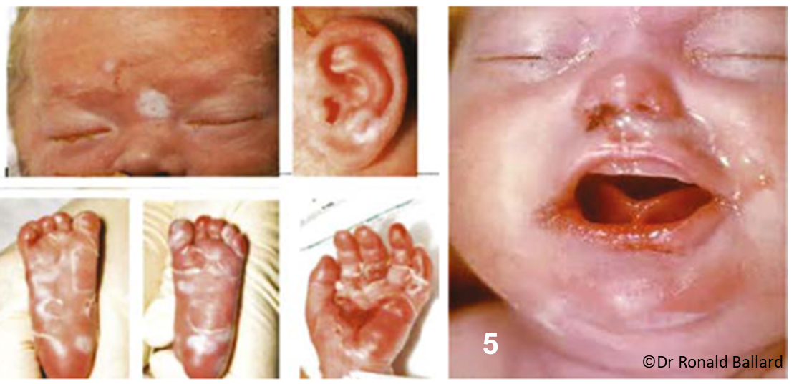
What congenital infection is present?
Notes:
Congenital syphilis may have visible signs of nasal discharge (mucopurulent rhinitis) and skin rash (peeling, jaundice).
In addition, physical findings include enlarged liver and spleen.
Eye findings may include cataracts and inflammation of the retina and optic nerve.
What congenital infections are common in your experience?

Slide 57
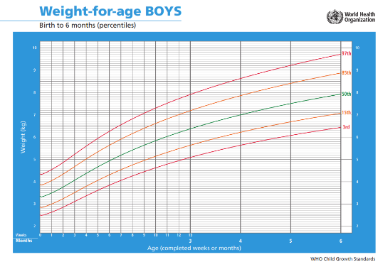
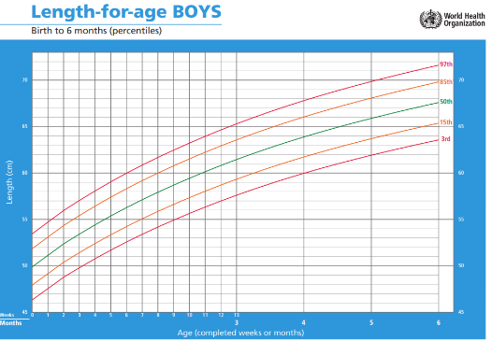
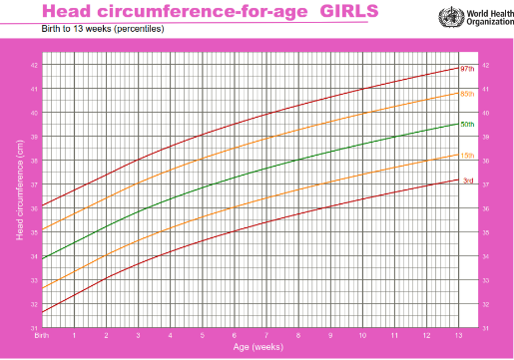
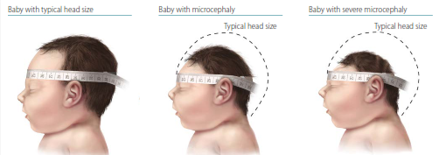
Document growth measurements
Weight
Length (crown to heel length)
Head circumference
Notes:
Practice measuring weight length and head circumference with locally available equipment and supplies.
To learn more
How to measure head circumference
How to measure length
How to weigh accurately
Are there any skills or practices that differ from your current practice?
Do these videos highlight any quality gaps in your facility?

Slide 58
Re-assess the newborn daily
Form groups (nurse, doctor, mother).
Re-assess Moses, update the care plan, and
communicate with mother.
Debrief with your team and facilitator.
Moses is 4 days old.
He is taking expressed breast milk by cup,
but he refused his last feed.
His abdomen is full and tense.
Notes:
Simulation
Skills and performance – participants demonstrate daily re-assessment of the newborn and updating of the care plan.
Asking the mother about her baby and any concerns – the baby is not feeding and his abdomen is distended
Checking the notes of the mother and of the baby.
Temperature – last temperature 36.5°C taken 4 hours ago
Weight – 1900 grams
Intake and output – normal wet diapers, no stool today
Any conditions needing treatment – none
Examining the baby
Look and listen (breathing, cry) BEFORE touching
Note changes (jaundice, infection) – full, tense abdomen with redness of abdominal wall
Identify Danger Signs – not feeding
Identifying the need for advanced care and antibiotics.
Communicating with the mother.
Debriefing – participants self-reflect and give feedback to one another in their roles.
Provision of care (performance objectives):
What was done well?
What could have been done better?
What will you change the next time?
Was data recorded and used?
Experience of care:
Did the health workers explain their actions and findings?
Was the mother’s understanding of the plan confirmed and her consent obtained?
Was handling of the baby gentle?
Were infection practices followed?

Slide 59
Summary:
Examination of the newborn
In this module, you have:
Assessed and re-assessed the newborn throughout the stay in the facility by identifying risk factors, measuring temperature, weighing, and
performing physical examination
    Monitoring during skin-to-skin care
    Assessment at 60-90 minutes after birth
    Re-assessment daily or with change in condition
Prevented disease by providing eye care, cord care, and giving
vitamin K to all newborns
Classified the newborn to determine further care and updated the care
plan based on re-assessment

Slide 60
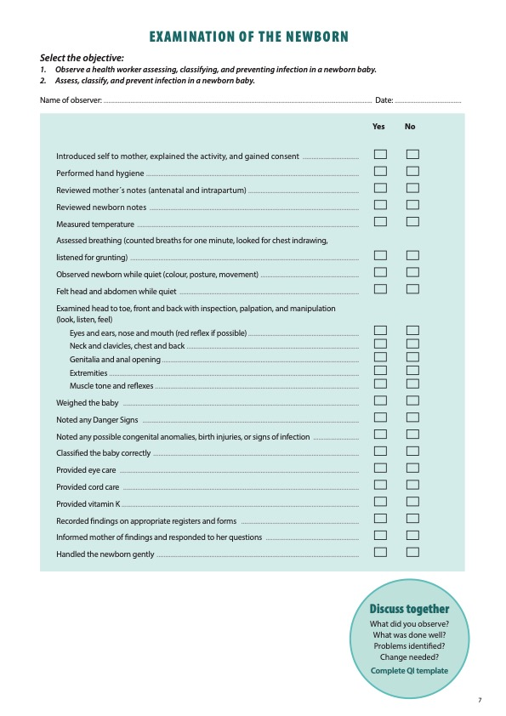
Notes:
Review the Clinical practice checklist before observing or practicing in the clinical area.

Slide 61
Notes:
After the clinical practice, discuss the observations made, possible reasons for practices, and changes needed to improve the quality of essential newborn care.
What new things will you do?
What old things will you not do?
How will you make a change?
Use your reflections to fill out the QI template.

Slide 62
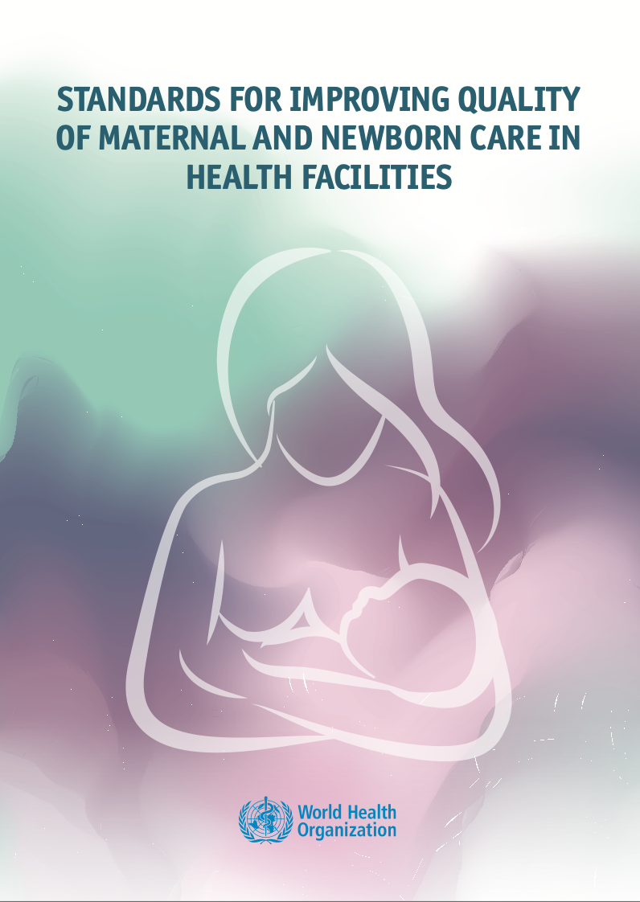
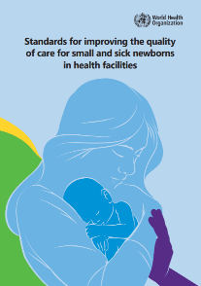






References and
additional resources
Examination of the newborn baby
Basic skills
Newborn examination

Slide 63

Additional simulations
Select simulations to build skills and performance
©WHO/
Dr Helenlouise Taylor

Slide 64
Examine Annie at 90 minutes of age
Form groups (mother, nurse, companion).
Carry out newborn examination.
Communicate with the family and document the findings.
Debrief with your team and facilitator.
Annie was born 90 minutes ago at term.
She just finished breastfeeding.
Notes:
Simulation
Skills and performance – participants demonstrate a systematic examination of a newborn and effective, respectful communication.
Obtaining consent and explain the procedure of physical examination
Carrying out examination of the newborn – normal findings
Breathing
Posture, movement, tone
Colour
Congenital malformations, unusual appearance
Signs of trauma, infection
3. Observing mother’s interaction
4. Communicating and documenting findings of the examination
Debriefing – participants self-reflect and give feedback to one another in their roles.
Provision of care (performance objectives)
What was done well?
What could have been done better?
What will you change the next time?
Was data recorded and used?
Experience of care
Was the communication respectful and the language appropriate?
Was handling of the baby gentle?
Were infection prevention practices followed?

Slide 65
Examine Petra who has a congenital malformation
Form groups (mother, doctor, companion).
Carry out a newborn examination.
Classify and make a care plan.
Communicate with family and document findings.
Debrief with your team and facilitator.
Petra was born 90 minutes ago.
You observe an open lesion on her back. Her mother has not yet noticed the lesion.
She is breastfeeding well.
Notes:
Simulation
Skills and performance – participants demonstrate examination of the newborn, classification and making a care plan, communication with the family.
Examining the newborn (complete physical assessment in skin‐to‐skin contact with the mother) – note spina bifida
Providing eye and umbilical cord care, Vitamin K according to national guidelines
Classifying Petra as needing advanced care and immediate protection from infection and hypothermia
Completing the newborn record and relevant surveillance documentation
Communicating with the family
Referring the newborn to a neurosurgical centre
Debriefing – participants self-reflect and give feedback to one another in their roles.
Provision of care (performance objectives)
What was done well?
What could have been done better?
What will you change the next time?
Was data recorded and used?
Experience of care
Was the congenital malformation explained with empathy and clarity, answering questions with simple language?
Were the findings of the examination, the support and treatment needed and referral of Petra explained fully.
Were cultural beliefs and stigma discussed?
Was Petra’s family connected with a parent support group?

Slide 66
Examine Roberto who has danger signs
Form groups (mother, doctor, companion).
Carry out a newborn examination.
Classify and make a care plan.
Communicate with the family.
Debrief with your team and facilitator.
Roberto was born at home with no support after a long, difficult labour.
His mother is concerned that he was making strange movements with his
mouth and eyes.
He is floppy and his mouth is twitching.
Notes:
Simulation
Skills and performance – participants demonstrate examination of the newborn, classification and making a care plan, communication with the family.
Examining the newborn (complete physical assessment in skin‐to‐skin contact with the mother) – note abnormal movements (convulsions)
Providing eye and umbilical cord care, Vitamin K according to national guidelines
Classifying Roberto as needing advanced care and make a plan for immediate management
Completing the newborn record
Communicating with the family
Referring the newborn to a centre providing specialized care
Debriefing – participants self-reflect and give feedback to one another in their roles.
Provision of care (performance objectives)
What was done well?
What could have been done better?
What will you change the next time?
Did you consider a serious bacterial infection or very serious disease?
Did you follow guidelines for managing newborn infection and give first dose of IM/IV antibiotics? Give anticonvulsant? Measure and treat low blood sugar?
Was data recorded and used?
Did you communicate urgent referral to the appropriate facility?
Experience of care
Was the language clear and appropriate?
Was the communication respectful?
Was consent obtained for referral?

Slide 67
Examine Ayesha who has congenital malformation
Form groups (mother, midwife, companion).
Carry out a newborn examination.
Classify and make a care plan.
Communicate with family and document findings.
Debrief with your team and facilitator.
Ayesha was born 60 minutes ago.
She is trying to breastfeed.
She coughs and splutters, then cries.
You observe a cleft in her palate.
Notes:
Simulation
Skills and performance – participants demonstrate examination of the newborn, classification and making a care plan, communication with the family.
Examining the newborn (complete physical assessment in skin‐to‐skin contact with the mother) – note cleft palate
Providing eye and umbilical cord care, Vitamin K according to national guidelines
Classifying Ayesha as needing referral to an experienced breastfeeding counsellor and make a plan for immediate management
Completing the newborn record and relevant surveillance documentation
Communicating with the family
Referring the newborn to a centre providing specialised care
Debriefing – participants self-reflect and give feedback to one another in their roles.
Provision of care (performance objectives)
What was done well?
What could have been done better?
What will you change the next time?
Was the baby examined for other associated anomalies – heart, eyes, jaw?
Was data recorded (newborn record and national surveillance reporting forms for congenital malformations)?
Experience of care
Was handling of the baby gentle?
Were cultural beliefs and stigma discussed?
Was Ayesha’s family connected with a parent support group?

Slide 68

Examine and classify twins Gloria and Joy
Form groups (mother, doctor, companion).
Carry out newborn examinations.
Classify and make care plans.
Communicate with family and document
findings.
Debrief with your team and facilitator.
Twins were born 90 minutes ago at
38 weeks gestation.
Both are breathing well.
Only Gloria (wrapped in the cloth) has breastfed.
©WHO/Dr Helenlouise Taylor
Notes:
Simulation
Skills and performance – participants demonstrate examination of the newborn, classification and making a care plan, communication with the family.
Performing systematic examinations of both newborns including weight, length, and head circumference – note discordant weights of 1900 and 4100 grams
Classifying both babies as needing intermediate care and make a management plan
Communicating the findings of the examinations and the care plan for the twins
Debriefing – participants self-reflect and give feedback to one another in their roles.
Provision of care (performance objectives)
What was done well?
What could have been done better?
What will you change the next time?
Did the care plan include breastfeeding support and assessment and management of hypoglycaemia?
Was data recorded and used?
Experience of care
Was the communication respectful and the language appropriate?
Was handling of the babies gentle?
Were infection prevention practices followed?

