Slide 1
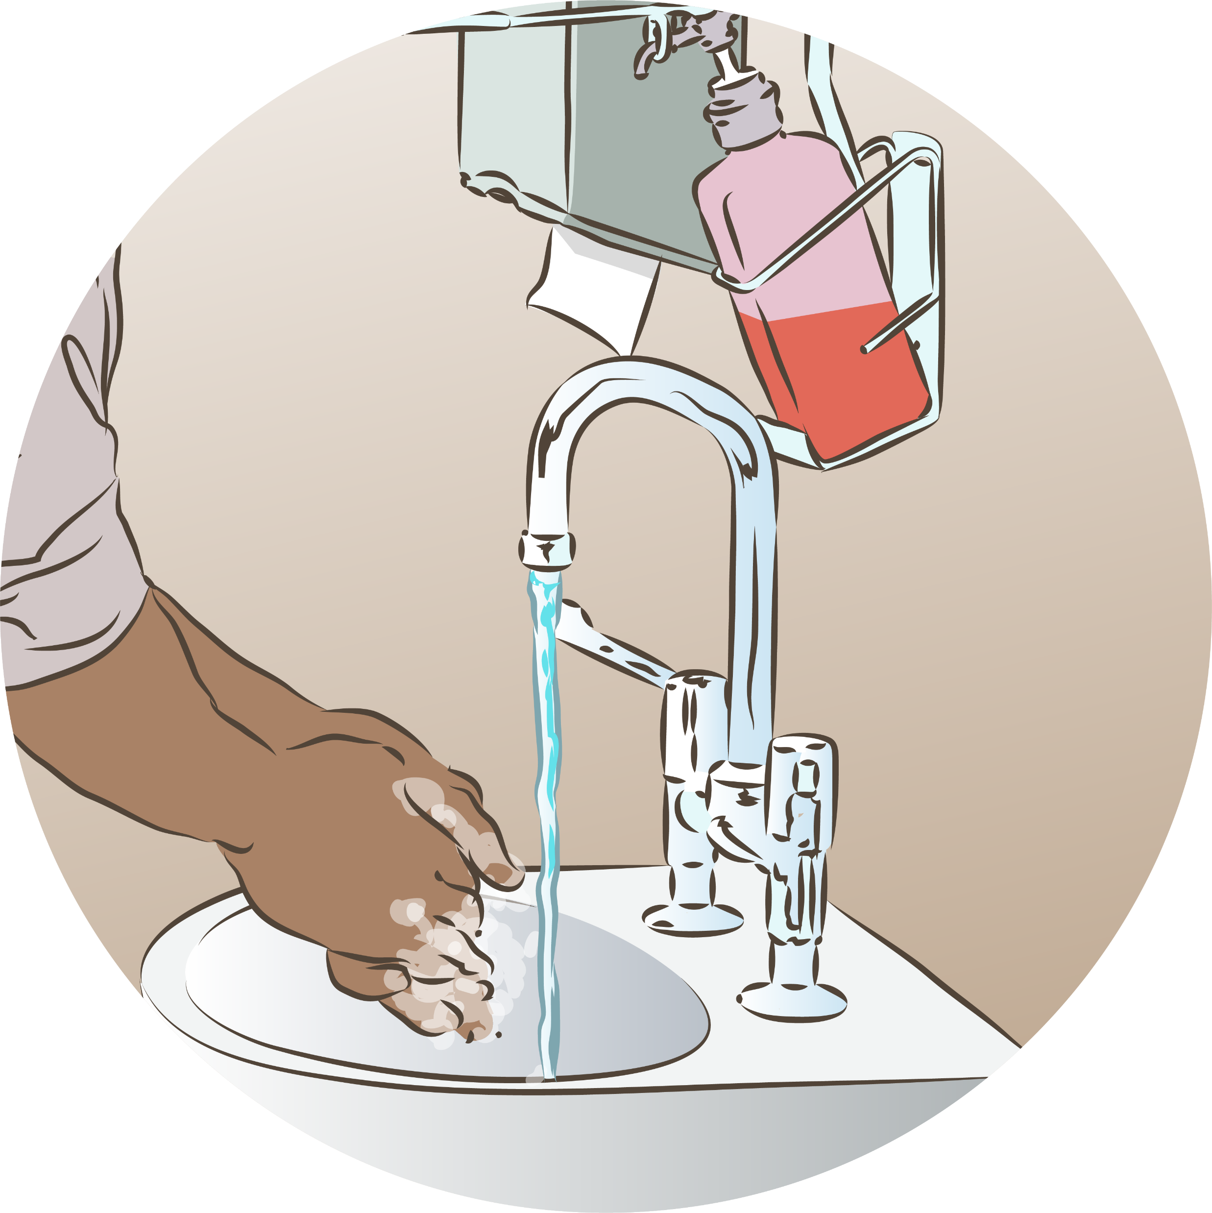

Infection prevention for newborns
Notes:
© World Health Organization 2024. All rights reserved.
Materials for demonstrations, practice, and simulations
Organize one set per group of 3 participants and a set for the facilitator as available.
Alcohol hand rub or basin with clean water, soap and towel
Personal protective equipment (as appropriate for midwifery or neonatal provider )
One set for facilitator demonstration.
Gloves (sterile, non-sterile and utility)
Colour-coded waste disposal containers, sharps boxes and recycling bins
Optional
Fluorescent gel
Ultraviolet detection light

Slide 2
Content
Goal and learning outcomes
The situation
Hand hygiene
Standard precautions
Environment
Summary
Clinical practice
Quality improvement
References and additional resources

Slide 3
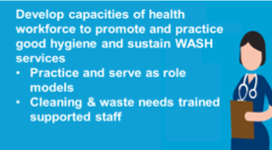
Goal and learning outcomes
Every newborn receives care that
integrates evidence-based infection
prevention and control.
Perform correct hand hygiene and
respiratory etiquette.
Use personal protective equipment
(PPE) correctly.
Ensure equipment and the environment
are clean and disinfected.
Dispose of waste safely.
Notes:
This module helps save the lives of mothers and newborns and prevent disabilities.
Mothers do not use services when they find the environment unclean or uncomfortable.
The same infection prevention practices protect newborns, mothers, and health workers.
Quality care includes a clean, safe environment for newborns, mothers, and health workers.
Care needs to be organized to prevent infection and to minimize the risk of acquiring infection in health care settings.
Sanitation facilities should be clean, functional and accessible.
To learn more
Standards-for-improving-quality-of-maternal-and-newborn-care-in-health-facilities_
Standard 8: The health facility has an appropriate physical environment, with adequate water, sanitation and energy supplies, medicines, supplies and equipment for routine maternal and newborn care and management of complications.
Quality statements
8.1: Water, energy, sanitation, hand hygiene and waste disposal facilities are functional, reliable, safe and sufficient to meet the needs of staff, women and their families.
8.2: Areas for labour, childbirth and postnatal care are designed, organized and maintained so that every woman and newborn can be cared for according to their needs in private, to facilitate the continuity of care.

Slide 4
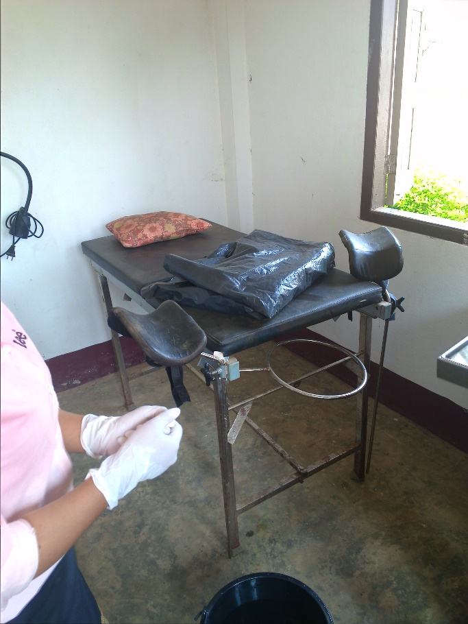
The situation
Lydia has decided to deliver
her second baby at home.
When she delivered her first
baby, she found the delivery
room was not very clean.
©WHO/Dr Helenlouise Taylor
Notes:
Throughout the world many mothers and newborns do not have access to clean water, sanitation and hygiene (WASH) in health facilities. This leads to infections, deaths and disabilities. It is estimated that up to 1 million women and newborns die each year from preventable infections.
To learn more
Blencowe H and Cousens S.
Addressing the challenge of neonatal mortality Trop Med Intern Health 2013; 18: 303-312

Slide 5
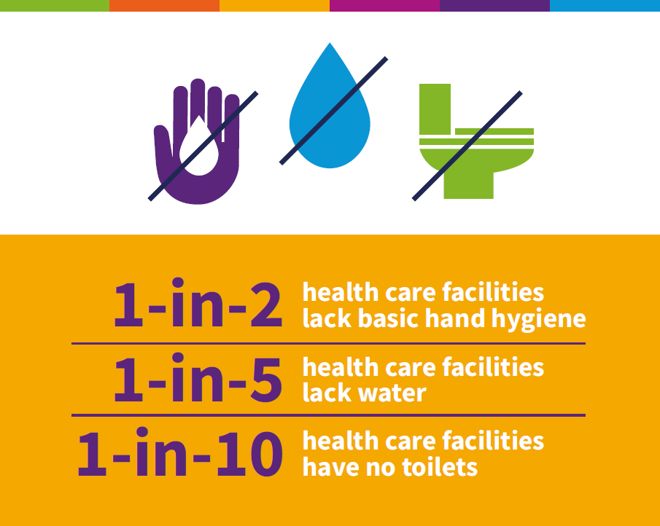
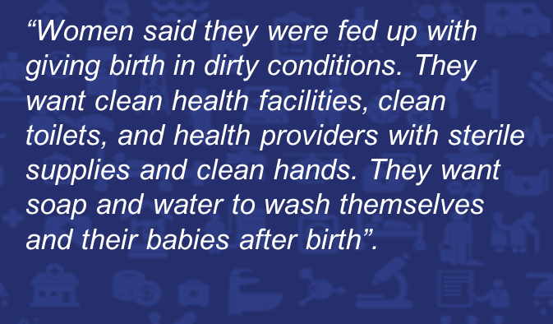
The situation
What Women Want survey: Demands for quality healthcare for women and girls (2019) 1.2 Million women surveyed
https://www.whatwomenwant.org/
Notes:
There are inequalities between and within countries.
What are the data for your country and subregion?
https://washdata.org/monitoring/health-care-facilities
https://washdata.org/data/healthcare#!/

Slide 6
Hand hygiene

Slide 7
Hand hygiene in labour
Form groups (midwife, Sarita and companion).
Help Sarita access hand hygiene facilities.
Debrief with your team and facilitator.
Sarita has spina bifida; she has been wheelchair bound since childhood.
Now Sarita is in labour and needs to wash her hands.
Notes:
Baseline simulation
Skills and performance – participants demonstrate practical solutions for accessing hand hygiene in labour.
Orienting Sarita and her companion to wheelchair-accessible handwashing and toilet facilities.
Providing alcohol hand rub or a basin with soap, clean water and towel at Sarita’s bedside.
Debriefing – participants self-reflect and give feedback to one another in their roles.
Provision of care (performance objectives)
What was done well?
What could have been done better?
What will you change the next time?
Experience of care
Was the language clear and appropriate?
Was the communication respectful?
To learn more WASH FIT Disability Inclusion

Slide 8


Practice hand hygiene
Wash-your-hands timed
Notes:
Practice correct hand hygiene in pairs.
Time each other in seconds.
Give feedback to one another.
How do you ensure correct duration of hand hygiene?
View video
or
If there is NO running water view
WHO handwashing with the tippy tap
What new knowledge is presented in this video?
Are there any skills or practices that differ from your current practice?
What provider behaviours differ from your current practice?
Does this video highlight any quality gaps in your facility?
To learn more
Importance of handwashing Newborn unit

Slide 9
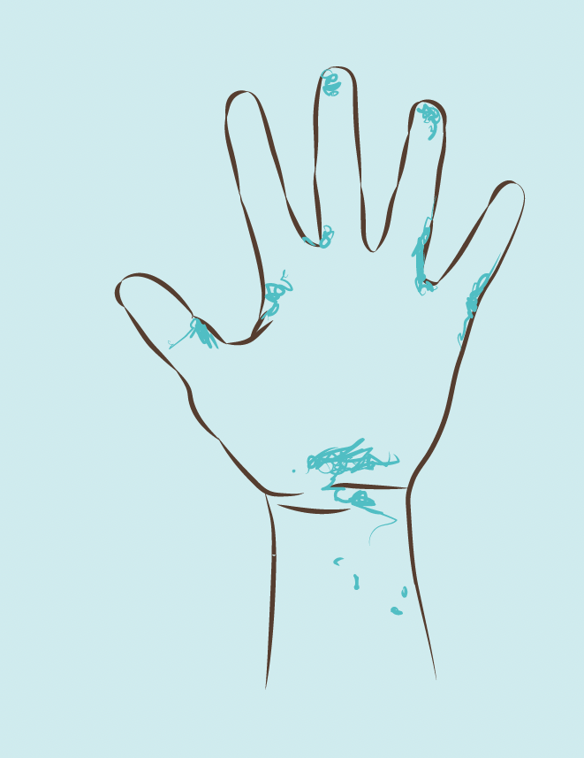
Check hand hygiene
Prepare a paper with outlines of your hands including the wrist (left and right, front and back).
Rub a small amount of fluorescent lotion all over your hands.
Wash your hands.
Shine the UV light onto washed hands, and with help from others, mark areas where the fluorescent lotion remains.
Hand hygiene using fluorescent gel
Notes:
What are 3 important points to remember about hand hygiene?
Correct hand hygiene is key to preventing infections.
Washing hands thoroughly is one element of correct hand hygiene.
Washing hands whenever it is indicated is another. Wearing gloves does not replace hand hygiene.
View video
Or
Optional practice
This practice session uses a special fluorescent gel, applied before hand washing, to show where microbes remain after inadequate washing. It reveals where hand hygiene technique has been ineffective. Examples of commercially available fluorescent gels include GloGerm™, Germ Juice™ and Glitter Bug™. Follow product instructions and use the UV light for detection of areas still contaminated.

Slide 10
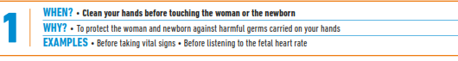
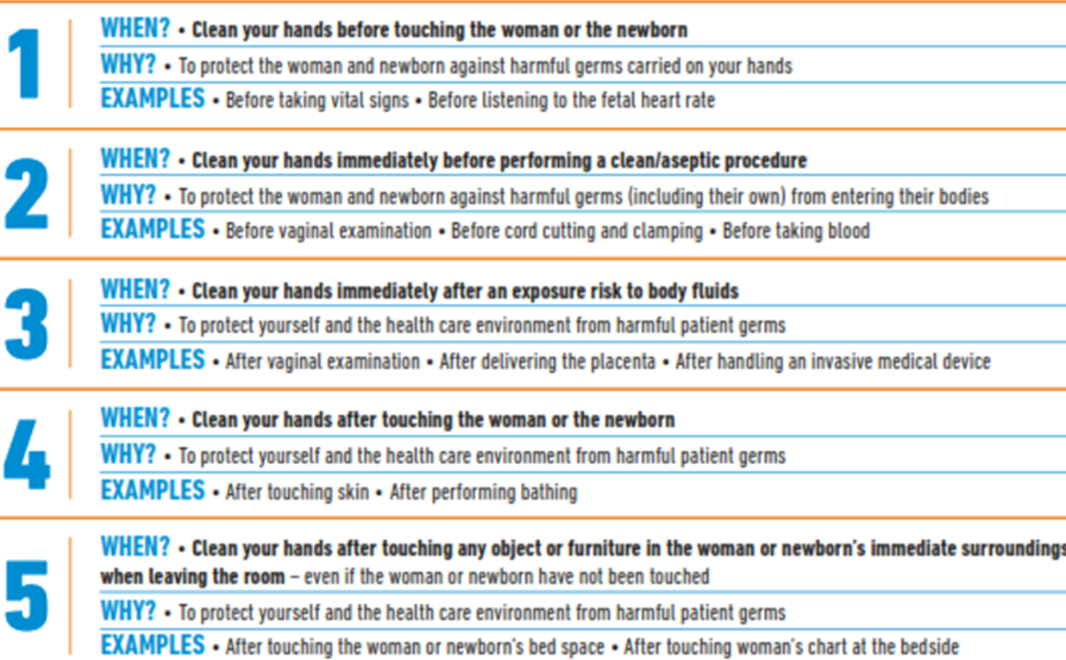
When are the 5 moments for hand hygiene?
Notes:
Hand hygiene before entering a perinatal unit (labour and delivery, postpartum, newborn or pediatric unit) is an effective way to reduce contamination from other areas within and outside the health facility.
Cleaning hands immediately before performing a clean/aseptic procedure means performing hand hygiene before putting on gloves. Hand hygiene also should be performed after removing gloves.
To learn more
WHO Guidelines on hand hygiene in health care.

Slide 11
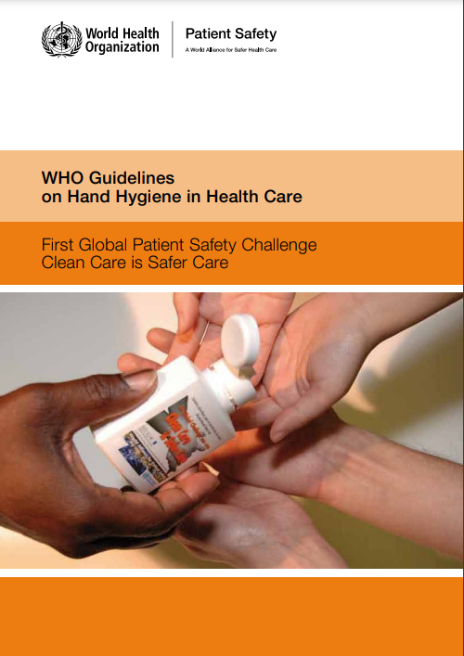
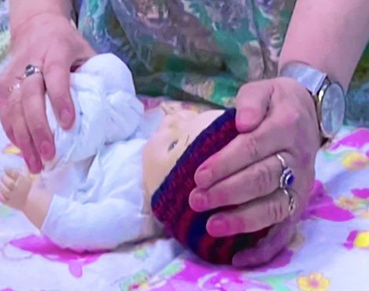
Do artificial nails and jewellery prevent effective hand hygiene?
Find the evidence on
pages 132 -133.
©UNICEF
Notes:
Use a printed or digital copy (pdf) of the document

Slide 12
Recommendation and reasons
Consensus recommendations: HCWs do not wear artificial fingernails
or extenders when having direct contact with patients and natural nails
should be kept short (≤ 0.5 cm long or approximately ¼ inch long).
Reasons:
Several studies have shown that skin underneath rings is more heavily
colonized than comparable areas of skin on fingers without rings.
Rings with sharp surfaces may puncture gloves and may also be a physical
danger to either patients or the HCW.
Long, sharp fingernails, either natural or artificial, including applying artificial
material to the nails for extensions; nail sculpturing; protecting nails by covering them
with a protective layer of artificial material; and nail jewellery, where decorations such as stones may be applied to the nails or the nails are pierced, can puncture gloves easily.

Slide 13
Standard precautions

Slide 14
What are the key elements of standard precautions?
Risk assessment
Hand hygiene
Respiratory hygiene and cough etiquette
Patient placement
Personal protective equipment and aseptic technique
Safe injections and sharps injury prevention
Environmental cleaning and handling of laundry and linen
Waste management
Decontamination and reprocessing of reusable patient care
items and equipment
Overview: preventing infection at birth 0:00–07:00
Notes:
Are all of these precautions practiced in your health care setting?
View video
What is new knowledge for you in this video?
Are there any skills or practices that are different from your current practice?
What provider behaviours differ from your current practice?
Does this video highlight any quality gaps in your facility?
To learn more
Standard precautions for the prevention and control of infections: aide-memoire

Slide 15
When do you put on and take off gloves?
When do you put ON gloves?
Before a sterile procedure
When anticipating contact with blood or another body fluid, regardless of the
existence of sterile conditions, including contact with non-intact skin or mucous
membrane
Before contact with a patient (and his/her immediate surroundings)
When do you take OFF gloves?
As soon as gloves are damaged (or loss of integrity is suspected)
When contact with blood, another body fluid, non-intact skin or mucous
membrane occurred and has now ended
When contact with a single patient and his/her surroundings or a patient’s
contaminated body site has ended
When there is an indication for hand hygiene
Notes:
In your place of work or in clinical practice sessions what incorrect glove use have you observed?
To learn more
WHO Glove use information leaflet

Slide 16

Which gloves would you select?
Sterile gloves
Examination gloves or hand hygiene
Examination gloves or hand hygiene
Examination gloves or hand hygiene
Sterile gloves
Sterile gloves
Examination gloves
Hand hygiene
Utility gloves
Hand hygiene
Vaginal delivery?
Placing nasogastric tube ?
Examining the newborn?
Changing a diaper?
Vaginal examination?
Clamping and cutting cord?
Emptying emesis basins?
Vaccinating the newborn?
Environmental cleaning?
Support mother to express
breast milk?
STERILE GLOVES INDICATED:
Any surgical procedure,vaginal delivery, cord cutting
Notes:
For each action, indicate whether sterile, examination, utility or no gloves should be used.
Summary of WHO recommendations on glove use:
Wear sterile gloves when performing vaginal examination, delivery, cord cutting, repair of episiotomy or tear.
Wear long sterile gloves for manual removal of placenta.
Wear examination gloves when:
Handling and cleaning instruments
Handling contaminated waste
Cleaning blood and body fluid spills
Drawing blood.
To learn more
WHO Glove use information leaflet

Slide 17
What are examples of unsafe glove use?
Using gloves to replace hand hygiene
Wearing the same pair of gloves between patients
Washing gloved hands
Reusing gloves
Incorrect glove use can result in infections and infections can kill.
Gloves do NOT protect against needle-stick or other puncture wounds.
Notes:
Have you observed unsafe glove use in your health facility?
Gloves prevent contamination of health care workers’ hands and so help reduce transmission of pathogens.
This depends, however, upon two critical factors:
They are used appropriately.
Timely hand hygiene is performed, using the method of hand rubbing or hand washing.
Summary of WHO recommendations on glove use:
Glove use does not modify hand hygiene indications or replace hand hygiene with an alcohol-based product or soap and water.
Remove gloves after caring for a patient. Do not wear the same pair of gloves for the care of more than one patient. Change gloves if moving from a contaminated body site to another body site (including a mucous membrane, non-intact skin or a medical device within the same patient or the environment).
The reuse of gloves after reprocessing or decontamination is not recommended. Alcohol can degrade glove material and reprocessing can result in small holes or tears that are not readily seen.

Slide 18
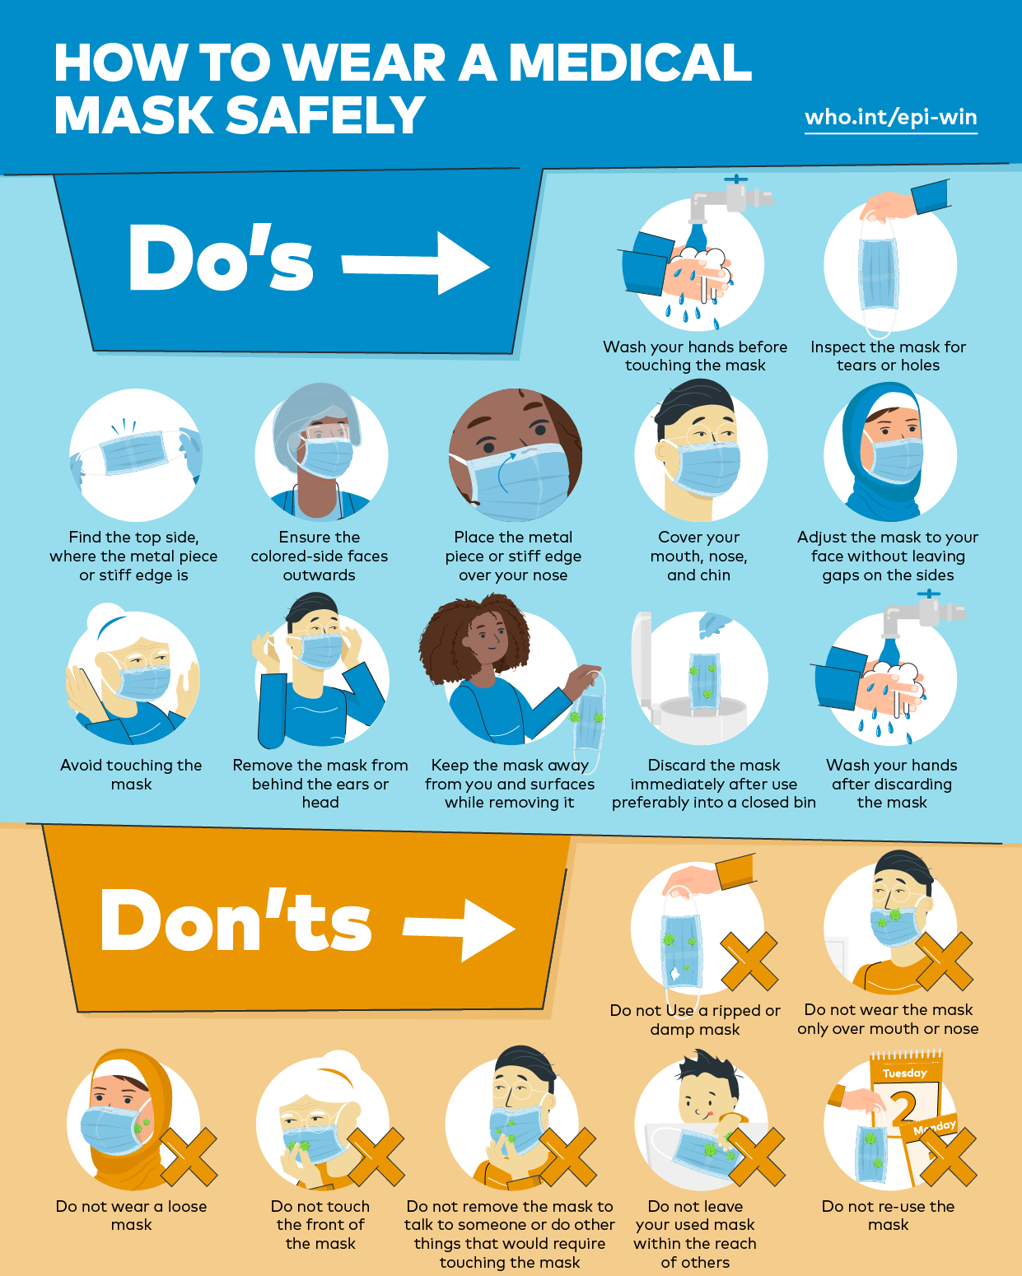
Use personal protective equipment (PPE) correctly
ASSESS THE RISK of exposure BEFORE
any health care activity.
Follow infection prevention guidelines.
Select PPE based on your assessment and
the task.
    Correct gloves
    Clean, non-sterile, fluid-resistant gown
    Mask and eye protection or face shield
Perform hand hygiene before putting on
and after taking off PPE.
Notes:
Practice putting on and taking off PPE according to your role in newborn care (midwife nurse doctor etc).
What are the common barriers or problems with correct use of PPE in your facility?
To learn more
PAHO/WHO correct use of PPE 00:00-04:00
How to wear a medical mask 0.25-2.10
Steps-to-put-on-personal-protective-equipment-(ppe)
Always protect yourself from infection by using PPE such as gloves, gowns, masks and eyewear to create barriers that protect skin, clothing, mucous membranes and respiratory tract. Correct use of PPE also protects mothers and babies from infections.
Facial protection (eyes, nose and mouth): Wear a surgical or procedure mask and eye protection (face shield, goggles) to protect mucous membranes of the eyes, nose and mouth during activities with possible splashes or sprays (blood, body fluids, secretions, etc).
Gown: Wear to protect skin and prevent soiling of clothing during activities with possible splashes or sprays. Remove soiled gown as soon as possible.

Slide 19
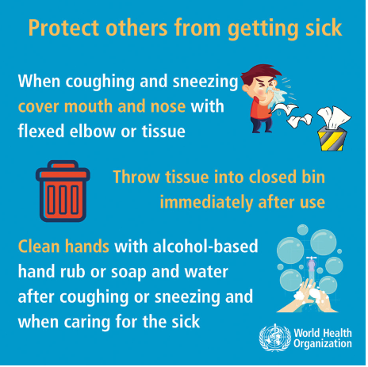
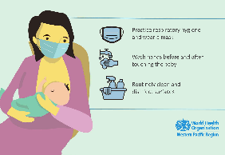
What measures protect against respiratory infections?
    Precautions for everyone everyday
    Coughing or sneezing into a bent elbow or
    a tissue and disposing of the tissue immediately
    Cleaning hands with alcohol-based hand rub or
    soap and water
    Precautions for patients with respiratory infections
    Good respiratory hygiene, including wearing
    a medical mask
    Prevention of droplet and/or aerosol transmission
    Routine cleaning and disinfection of surfaces
    in mother and baby’s zone
    Hand washing before and after breastfeeding
Notes:
What measures are in place in your health facility?

Slide 20
Advise a mother with a respiratory infection after birth
Form groups (nurse, mother and companion).
Advise Meena and her husband on actions to protect against infection.
Debrief with your team and facilitator.
Meena has developed a respiratory infection after the birth of
her term baby boy.
Her husband worries that the baby may become ill.
Notes:
Simulation
Skills and performance – participants demonstrate how to advise on protection against respiratory infections:
1. When coughing or sneezing, covering nose and mouth with tissue or mask.
2. Disposing of soiled tissue or mask into closed bin immediately after use.
3. Demonstrating how to use mask correctly.
4. Providing facilities for hygiene after contact with respiratory secretions and before breast feeding.
Debriefing – participants self-reflect and give feedback to one another in their roles.
Provision of care (performance objectives)
What was done well?
What could have been done better?
What will you change the next time?
Experience of care
Was the language clear and appropriate?
Was the communication respectful?

Slide 21
How do you ensure safe handling of sharps?
Use extreme caution when handling needles, scalpels and other sharp
instruments or devices or cleaning used instruments.
Dispose of sharps in a puncture-resistant, easily identifiable container
next to every point of care.
Drop all used needles, syringes and disposable blades directly into this
container, without passing to another person.
Do not recap, bend or break needles after giving an injection.
Do not reuse needles or syringes.
Process sharps boxes following local regulations.
Notes:
What problems have you observed with safe handling of sharps?
Sharps containers should be securely closed (when no more than three quarters filled) and transported to a safe storage area until collected for final disposal following institution policy and regulations.
What do the policies or regulations say in your health facility?

Slide 22
How should you safely handle the placenta, body fluids and clinical waste?
Handle waste contaminated with blood, body fluids, secretions and
excretions as clinical waste, in accordance with local regulations.
Handle human tissues and laboratory waste as clinical waste.
Segregate waste into correctly labelled bins less than 5 metres from point
of generation.
Treat and dispose of clinical waste safely by autoclaving, incineration
(850 °C to 1100 °C) and/or burial in a lined, protected pit.
Notes:
Are these steps applied in your health facility?
Functional waste collection containers must be in close proximity to all waste generation points for:
non-infectious (general) waste
infectious waste
sharps waste
recycling (plastic, paper etc)
A trained person should be responsible for the management of health care waste in the health care facility.
Waste should be correctly segregated at all waste generation points.
Functional burial pit/fenced waste dump or collection should be available for disposal of non-infectious (non-hazardous/general waste).
Incinerator or alternative treatment technology for the treatment of infectious and sharp waste should be functional and of a sufficient capacity.
There should be sufficient energy available for incineration or alternative treatment technologies.
Recycle according to local guidelines.
To learn more
Biomedical waste segregation and disposal 0:10-3:50

Slide 23
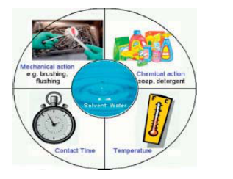
How should you manage equipment between each delivery?
Decontaminate, clean, disinfect and sterilize medical
devices between each patient use.
Follow facility guidelines for decontaminating and
reprocessing.
Mechanical actions, chemical actions, time and
temperature are all critical.
Dispose of single-use instruments safely.
Use 0.5% bleach for cleaning bowls, buckets, blood or
body fluid spills.
Notes:
After every delivery or procedure, what do you do with the equipment you have used?
Some routine practices can make equipment reprocessing easier and safer.
Wear PPE when handling equipment after use.
Discard or segregate sharps, such as knife blades and needles, that can cause injury.
Pre-clean (soak or spray) to prevent soil from drying on devices and make them easier to clean, but avoid prolonged soaking.
Use cleaning products that are appropriate for medical devices, approved by the device manufacturer, and mixed to the correct dilution.
Avoid prolonged soaking of devices.
Follow guidelines and manufacturer’s instructions for autoclaving to ensure adequate time and pressure so that instruments are sterile for the next delivery.

Slide 24
Environment

Slide 25
What are the components for a clean, safe environment for newborn care?
Clean facility (free from solid waste, visible dirt, stagnant water, insects,
animal and human faeces in or around the facility premises).
Lighting sufficiently powered and adequate to ensure safe provision of
health care including at night.
Clean work surfaces and equipment and adequate waste disposal.
Materials for cleaning (i.e. detergent, mops, buckets, cloths).
Cleaning staff who have adequate protection and can demonstrate
and apply the correct procedures for cleaning and disinfection.
Record of cleaning visible and signed by the cleaners each day.
Food preparation and laundry services meeting sanitary standards.
Adequate beds and space.
Notes:
What do you understand by CLEAN?
Does your health facility have all of these components?
Labour, childbirth and postnatal areas need to be clean, organized and maintained so that safe, high-quality care can be provided.

Slide 26
What needs to be supervised for clean, safe environment for newborn care?
At the beginning of each day:
All flat surfaces should be wiped with a clean, lint-free, moist cloth to remove
dust and dirt.
Start cleaning the cleanest areas first and work towards the dirty/contaminated
areas, for example, floors.
Damp-clean floors daily – and immediately if any spillage.
During the day:
Between patients: Using detergent, wipe clean all surfaces in contact with mother,
newborn or their body fluids. Then disinfect according to hospital policy and
allow to dry.
Clean toilets and sinks at the beginning of each shift or more often if needed.
The cleaning roster should be signed with date and time of each cleaning task
performed.
Notes:
Have you ever had training on what and how to clean so you can be an effective supervisor?
Teamwork is essential for clean safe newborn care. Cleaners and auxillary health staff are a critical part of the team.
Understanding the processes improves supervision and awareness of gaps in the facility routines.
Quality improvement cycles help make sustainable changes.
To learn more
WHO cleaning and disinfection environmental surfaces. 2020

Slide 27

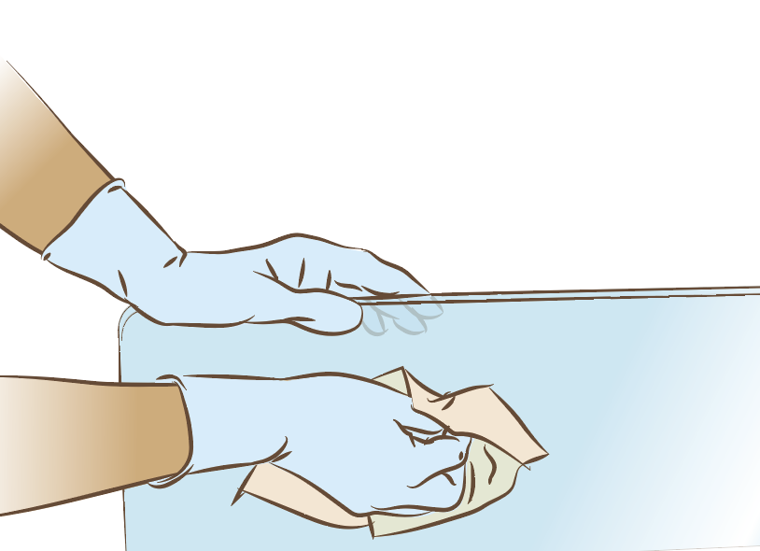
What areas need special attention for cleaning?
A total cleaning procedure should be carried out
whether or not room/area was used during the day:
Labour room
Postnatal wards
Surgical suite
Scrub sinks
Scrub or utility areas
How to clean floors, walls and other surfaces
Notes:
Does this happen in your health facility every day?
Who supervises the cleaners to ensure a clean safe environment?
View video

Slide 28
How do you ensure linen is handled safely?
Bed linen are changed and washed between patient use.
Clothing or sheets stained with blood or body fluids are collected
without touching (using gloves) and placed in a plastic bag separate
from other laundry.
Manage according to hospital policy.
Appropriate PPE is used in the laundry, and blood or other body
fluids are rinsed off before washing with soap.
Notes:
What is the system to handle linen contaminated with blood or body fluid in your facility?
To learn more
Environmental cleaning and infection prevention and control in health care facilities

Slide 29
What physical environment is essential for quality newborn care?
Organization of care and services to provide sufficient bed capacity
and staffing
Water, energy supply, sanitation, handwashing and waste-disposal facilities
At least one functioning hand hygiene station with soap and water
before entrance to the newborn ward
Easily accessible hand hygiene stations inside ward
Leak-proof, covered waste bins and impenetrable sharps containers
Improved sanitation facilities (toilets)
Measuring your performance against quality standards is critical for
improving care.
Notes:
Does your health facility have such a physical environment?
What can you do to improve the situation?
Why is organization of care so important?
Crowding and more than one patient per bed are associated with increased risk of health care acquired infections and the spread of antimicrobial-resistant organisms in health facilities. Inadequate health care worker staffing levels also can lead to disease transmission.

Slide 30
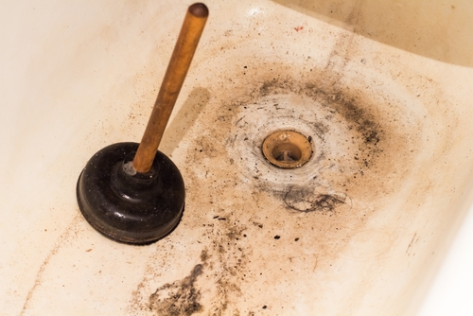
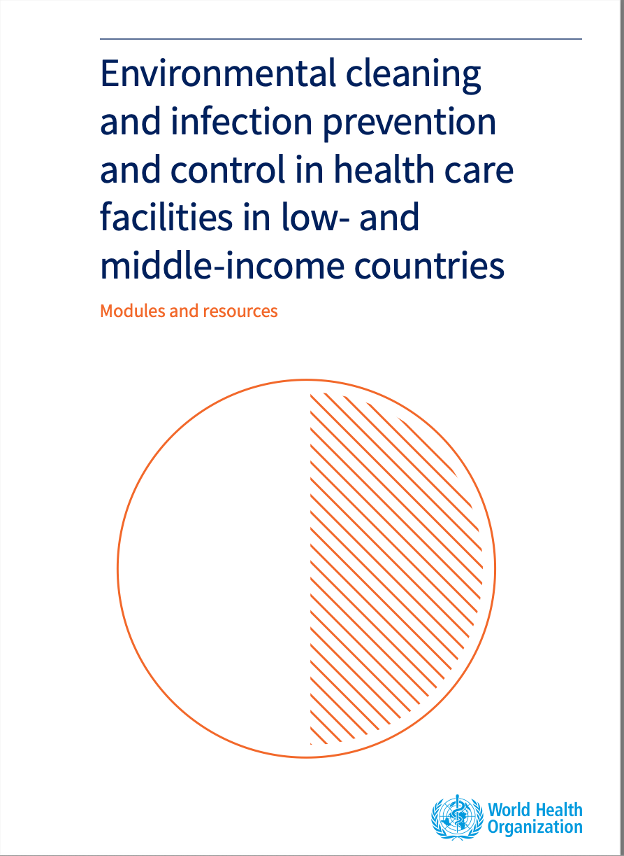
Supervise cleaning of sinks/handwashing stations
Form groups (nurse in charge, cleaner and nurse).
As part of your quality improvement activities,
demonstrate supervision of cleaning.
Debrief with your team and facilitator.
Dirty handwashing stations (sinks) are identified as
a priority problem for quality improvement in the
health facility.
Mothers are complaining or refusing to come to deliver in the facility.
Notes:
Simulation
Skills and performance – participants demonstrate supervision of cleaning:
Finding the graphic explanation of how to clean a handwashing basin (page 86)
Using the graphic to explain to nursing staff and cleaner the key actions for cleaning sinks/handwashing stations
Inviting the cleaner to ask any questions
Debriefing – participants self-reflect and give feedback to one another in their roles.
Provision of care (performance objectives)
What was done well?
What could have been done better?
What will you change the next time?
Was data recorded and used?
Experience of care
Was the language clear and appropriate?
Was the communication respectful?

Slide 31
Supervise safe handling of blood spill
Form groups (nurse in charge, cleaner and doctor).
Supervise the cleaner to safely handle the blood spill.
Debrief with your team and facilitator.
After an exchange transfusion the doctor accidentally
spilled blood on the floor of the treatment room.
You call the cleaner who is new.
Notes:
Simulation
Skills and performance – participants demonstrate how to supervise safe handling of a blood spill:
Finding the graphic explanation of how to clean a blood spill (page 78).
Using graphic to review with the staff the key actions for handling a blood spill.
Answering any questions from staff
Debriefing – participants self-reflect and give feedback to one another in their roles.
Provision of care (performance objectives)
What was done well?
What could have been done better?
What will you change the next time?
Was data recorded and used?
Experience of care
Was the language clear and appropriate?
Was the communication respectful?

Slide 32
Hand hygiene in labour
Form groups (midwife, Sarita and companion).
Help Sarita to access hand hygiene facilities.
Debrief with your team and facilitator.
Sarita has spina bifida; she has been wheelchair bound since childhood.
Now Sarita is in labour and needs to wash her hands.
Notes:
Repeat simulation
Skills and performance – participants demonstrate practical solutions for accessing hand hygiene in labour.
Orient Sarita and her companion to wheelchair-accessible handwashing and toilet facilities.
Provide alcohol hand rub or a basin with soap, clean water and towel at Sarita’s bedside.
Debriefing – participants self-reflect and give feedback to one another in their roles.
Provision of care (performance objectives)
What was done well?
What could have been done better?
What will you change the next time?
Experience of care
Was the language clear and appropriate?
Was the communication respectful?
Can mothers with disabilities access WASH facilities in your health facility?
Can mothers access toilets?
What are the WHO UNICEF standards for WASH in the delivery room?
A toilet can be considered to meet the needs of mothers with reduced mobility if it:
can be accessed without stairs or steps, handrails for support are attached either to the floor or sidewalls, the door is at least 80 cm wide, the toilet has a raised seat (between 40–48 cm from the floor), a backrest and the cubicle has space for circulation/manoeuvering (150 x 150 cm).
The sink, tap and water outside should also be accessible and the top of the sink 75 cm from the floor (with knee clearance). Switches for lights, where relevant, should also be at an accessible height (max 120 cm).
To learn more WASH FIT Disability Inclusion
Inclusion in WASH in health-care facilities

Slide 33
Summary:
Infection prevention for newborns
In this module, you have learned:
The importance of infection prevention to save lives and prevent disabilities.
How to perform correct hand hygiene, practice respiratory etiquette
and use appropriate PPE.
How equipment and the environment should be cleaned and disinfected.
Safe clinical waste disposal.
You will apply what you have learned about infection prevention measures throughout the course and whenever caring for women and newborns.
Notes:
To learn more
Health workers nurses and midwives wash hands save lives
Appropriate hand hygiene
The safe hands challenge
Overview preventing infection at birth

Slide 34
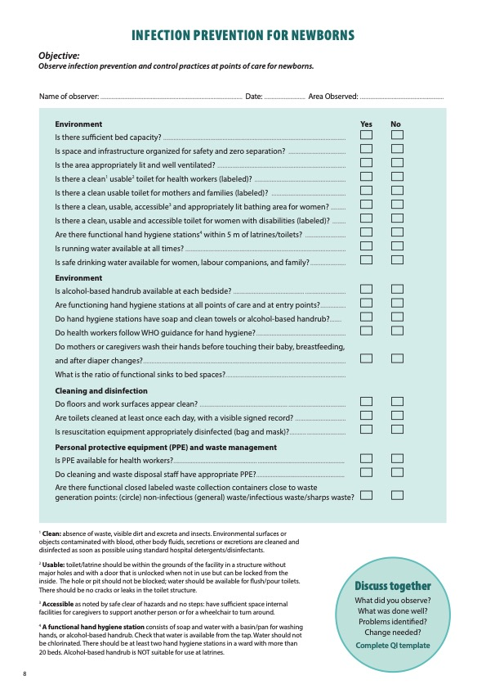
Notes:
Review the Clinical practice checklist before observing in the clinical area.

Slide 35
Notes:
After the clinical practice, discuss the observations made, possible reasons for practices, and changes needed to improve the quality of essential newborn care.
What new things will you do?
What old things will you not do?
How will you make a change?
Use your reflections to fill out the QI template.

Slide 36
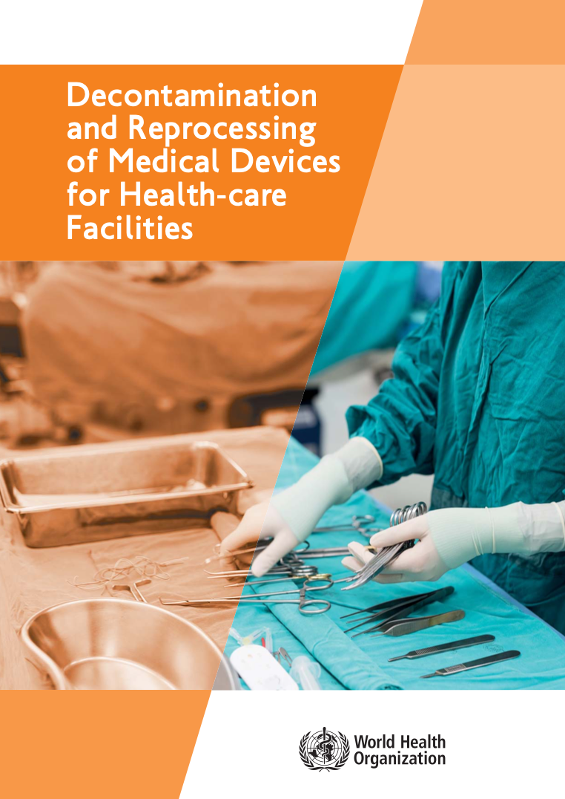
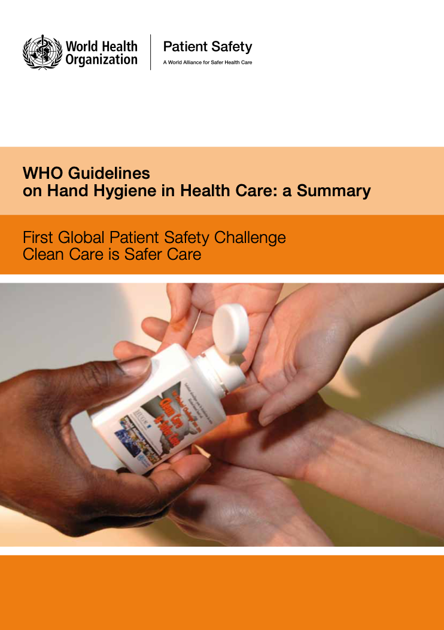
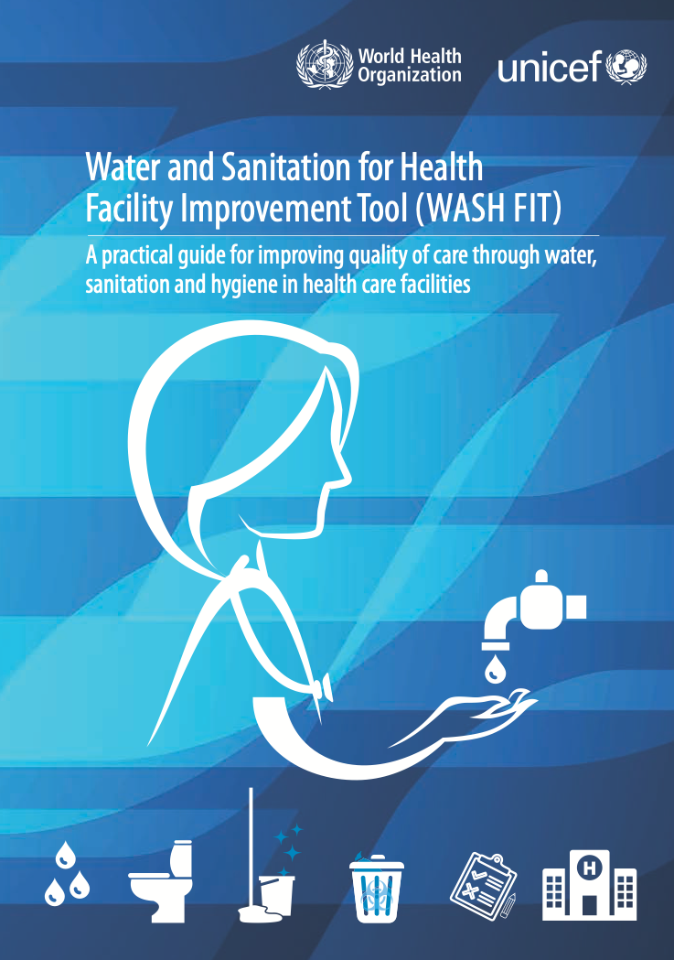
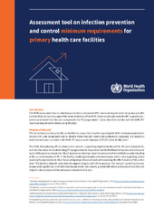
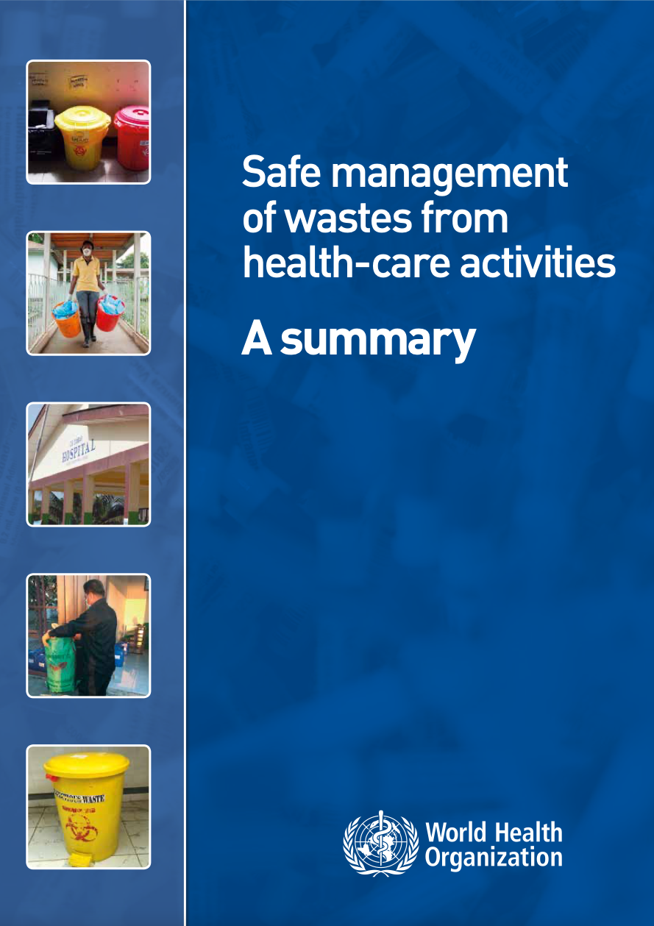
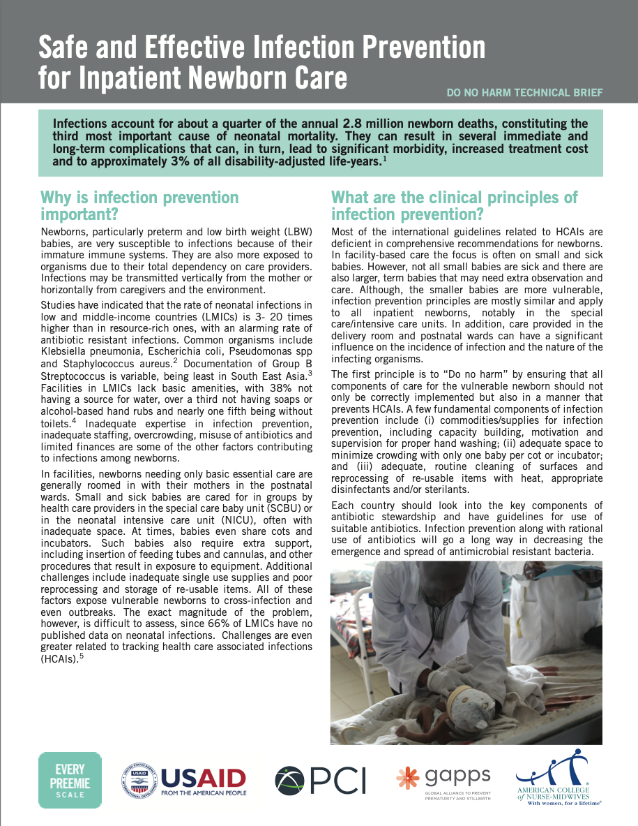
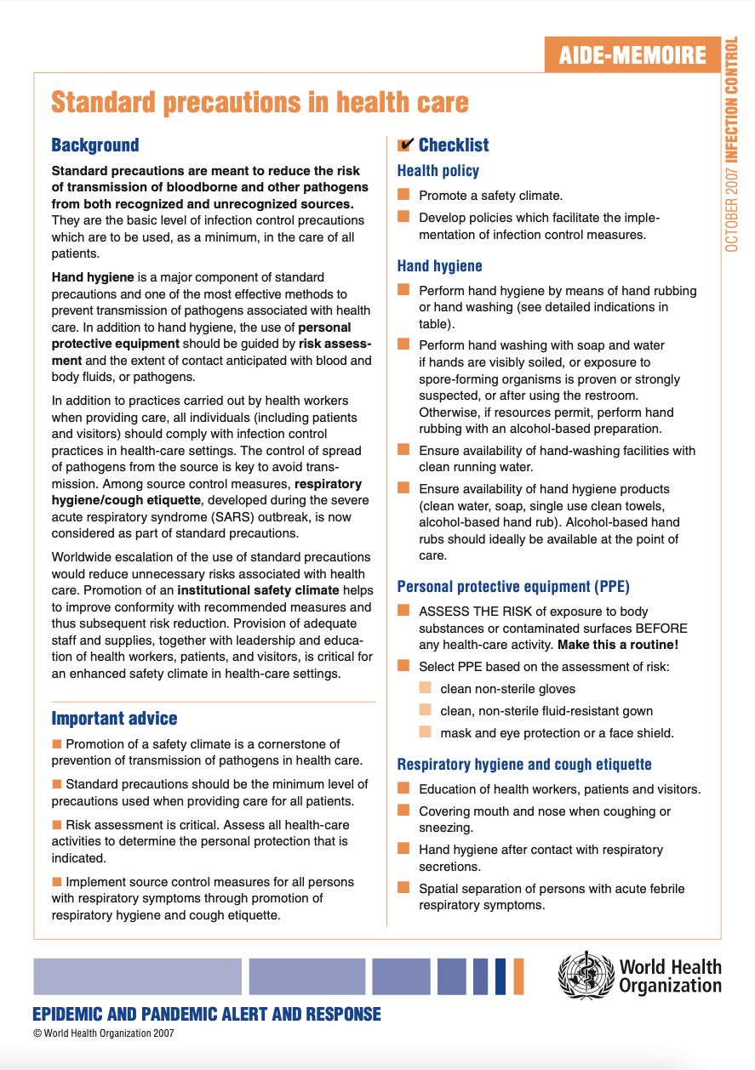
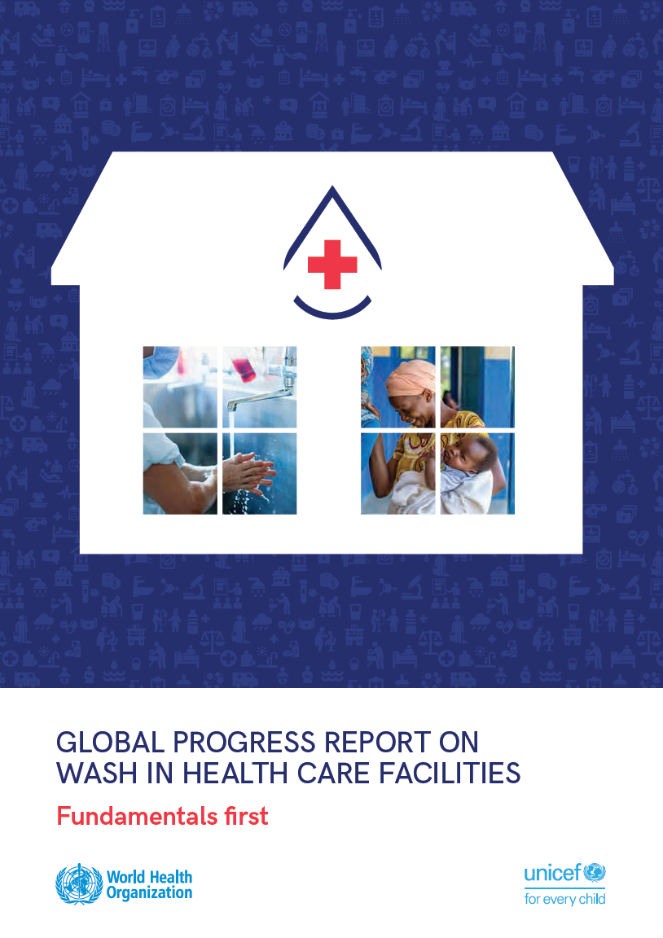
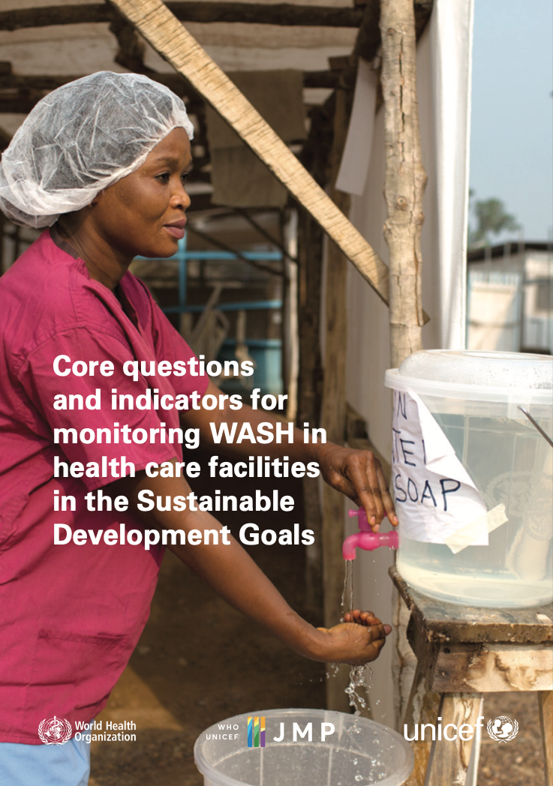
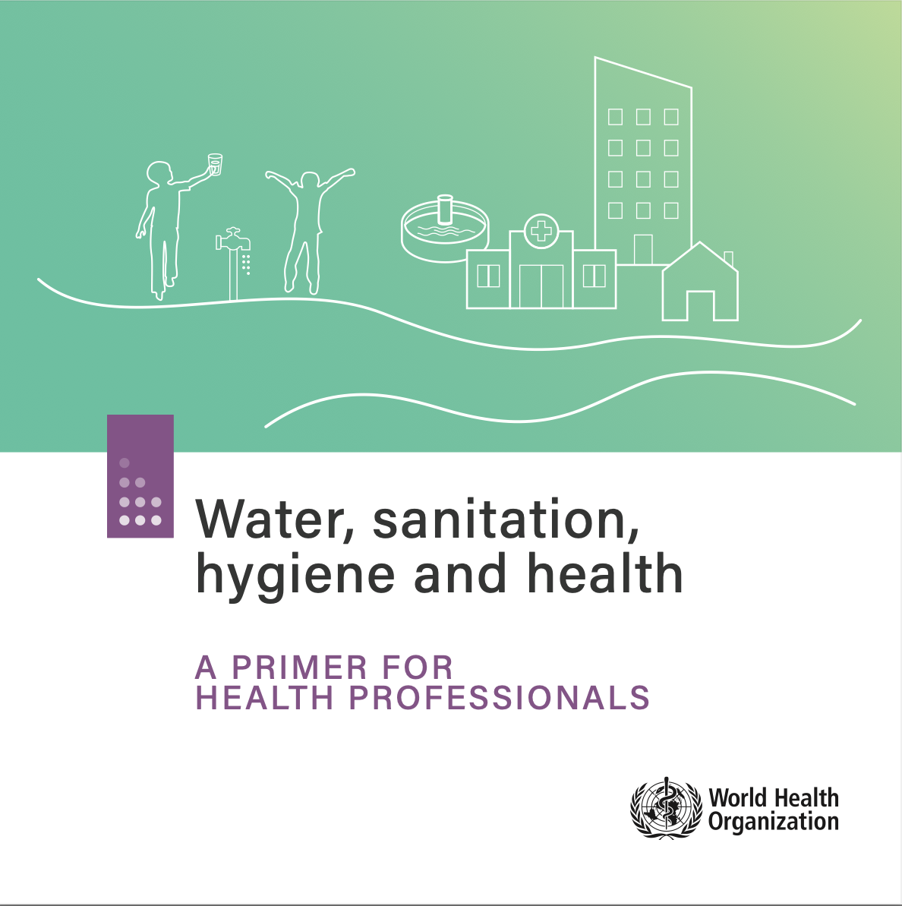
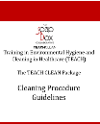
References and additional resources
Nurses and midwives, clean care is in your hands

