Slide 1
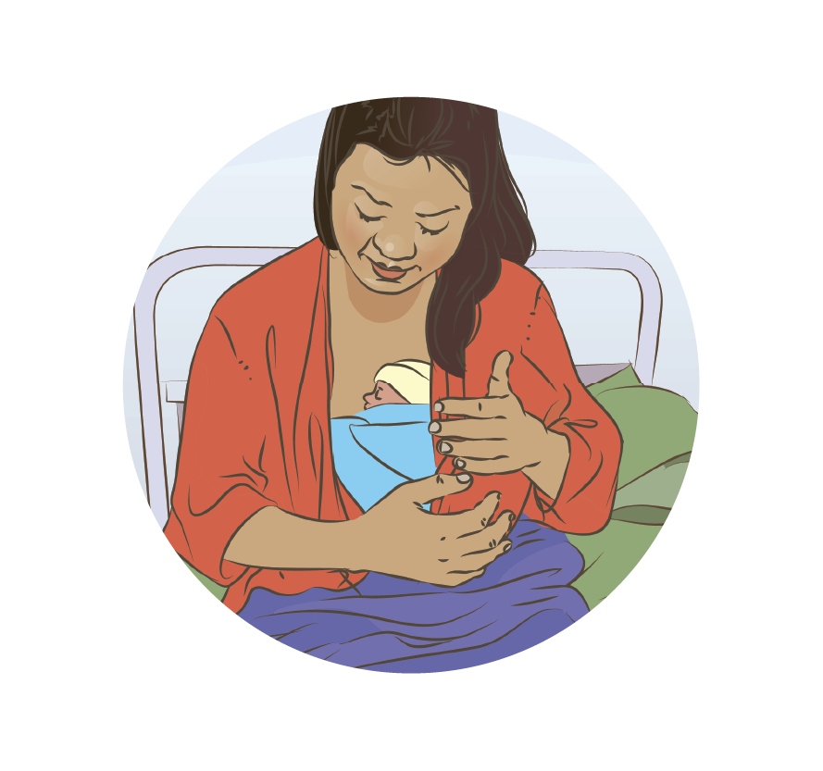

Kangaroo mother care
Notes:
© World Health Organization 2024. All rights reserved.
Materials for demonstrations, practice, and simulations
Organise one set per group of 3 participants and a set for the facilitator (as available).
Small newborn mannequin or doll
Model breasts or breast simulator (filled with water)
Preterm baby hat, socks, diaper/cloth
KMC binder or local wrap
Extra pillows for support when giving KMC
Large-size, open-front shirts for use when giving KMC
Blanket if cold climate
Alcohol hand gel or soap and water for hand hygiene

Slide 2
Content
Goal and learning outcomes
The situation
Special needs of the small baby
Principles of kangaroo mother care (KMC)
Practical issues in KMC
Organization of KMC
Summary
Clinical practice
Quality improvement
References and additional resources

Slide 3
Goal and learning outcomes
All low-birthweight or premature newborns
receive evidence-based care including
kangaroo mother care (KMC).
Recognize the special needs of a small baby.
Support mothers and families to practise KMC.
Organize the environment to provide
infant- and family-centred developmentally
supportive care.
Prepare for discharge, identify medical
and developmental follow-up and community
support.
© UNICEF/Zahara Abdul
Notes:
What is included in evidence-based newborn care for small newborns?
Exactly the same care as for term and normal-weight newborns and, in addition:
No separation of newborns and caregivers with rooming-in during hospitalisation
Continued re-assessment of additional needs for thermal support, feeding, and monitoring
Infant- and family-centred developmentally supportive care and follow-up
Emotional and psychosocial support for families that is sensitive to their needs and strengthens their capability
Early planning for follow-up and community support

Slide 4
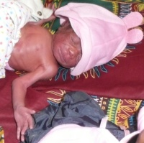
The situation
Amos weighs 1600 g. He was born at 33 weeks
gestation by spontaneous vaginal delivery.
He is 90 minutes old.
His mother Lydia has been practising skin-to-
skin care.
He is stable but unable to breastfeed.
The nurse suggests caring for him under an
overhead heater so that Lydia can go home after her postpartum check tomorrow.
How would you recommend caring for Amos?
© WHO/Dr Helenlouise Taylor
Notes:
How are small babies who are unable to feed cared for in your facility?
Amos should receive kangaroo mother care and breast milk by an alternative feeding method.
Support Lydia to start expressing breast milk as soon as possible.

Slide 5
Doris gives birth unexpectedly to a healthy preterm baby
Form groups (mother, midwife and husband).
Counsel Doris and her husband about Zeta’s care and initiating KMC.
Debrief with your team and facilitator.
Doris, a 24-year-old primigravida, arrives at the health facility in
advanced labour at 33 weeks gestation.
She delivers a healthy girl, Zeta, who breathes well.
Zeta is in skin-to-skin contact immediately after birth, and her parents
are adjusting to her unexpected arrival.
Notes:
Baseline simulation
Skills and performance – participants demonstrate counselling for initiation of KMC.
(Use local counselling checklist if available)
Communicating the newborn’s condition and care needed - thermal care and possible alternative methods of breast milk feeding
Counselling on KMC – including position, duration (hours and days), breast (milk) feeding, assessment, safe discharge and benefits to baby/mother/family
Answering questions – alternative providers (father, grandmother)
Debriefing – participants self-reflect and give feedback to one another in their roles.
Provision of care (performance objectives)
What was done well?
What could have been done better?
What will you change the next time?
Experience of care
Was the communication respectful and the language appropriate?
Did the health worker explain the benefits and address any doubts?
Did the health worker explain how many hours per day and until what age the baby will need KMC?
To learn more
Counselling for KMC

Slide 6
Special needs of the small baby

Slide 7

What does being small mean for a newborn?
Weight:
A small baby has a birth weight is between 1500 and 2500 g.
A very small baby has a birth weight less than 1500 g.
Gestation: a small baby may be term or preterm.
A small baby is term at 37 weeks and more.
A small baby is preterm between 32 and 36 weeks.
A small baby is very preterm at less than 32 weeks
Care needed: a small baby needs extra assessment and support.
Ensure adequate feeding, thermal care, infection protection and respiratory support.
Assess low birthweight and preterm newborns frequently, as they are at increased risk
of problems and poor outcomes.
Utilize a safe referral system to access additional urgent care.
Low birthweight neonates introduction
Notes:
View video
Were there any practices that differ from your health facility?
What is new knowledge for you in this video?
Are there any skills that differ from your current practice?
Does this video highlight a quality gap in your setting? If yes, note on the QI template.
To learn more
The lancet -small-vulnerable-newborns-series
Low birthweight management overview

Slide 8
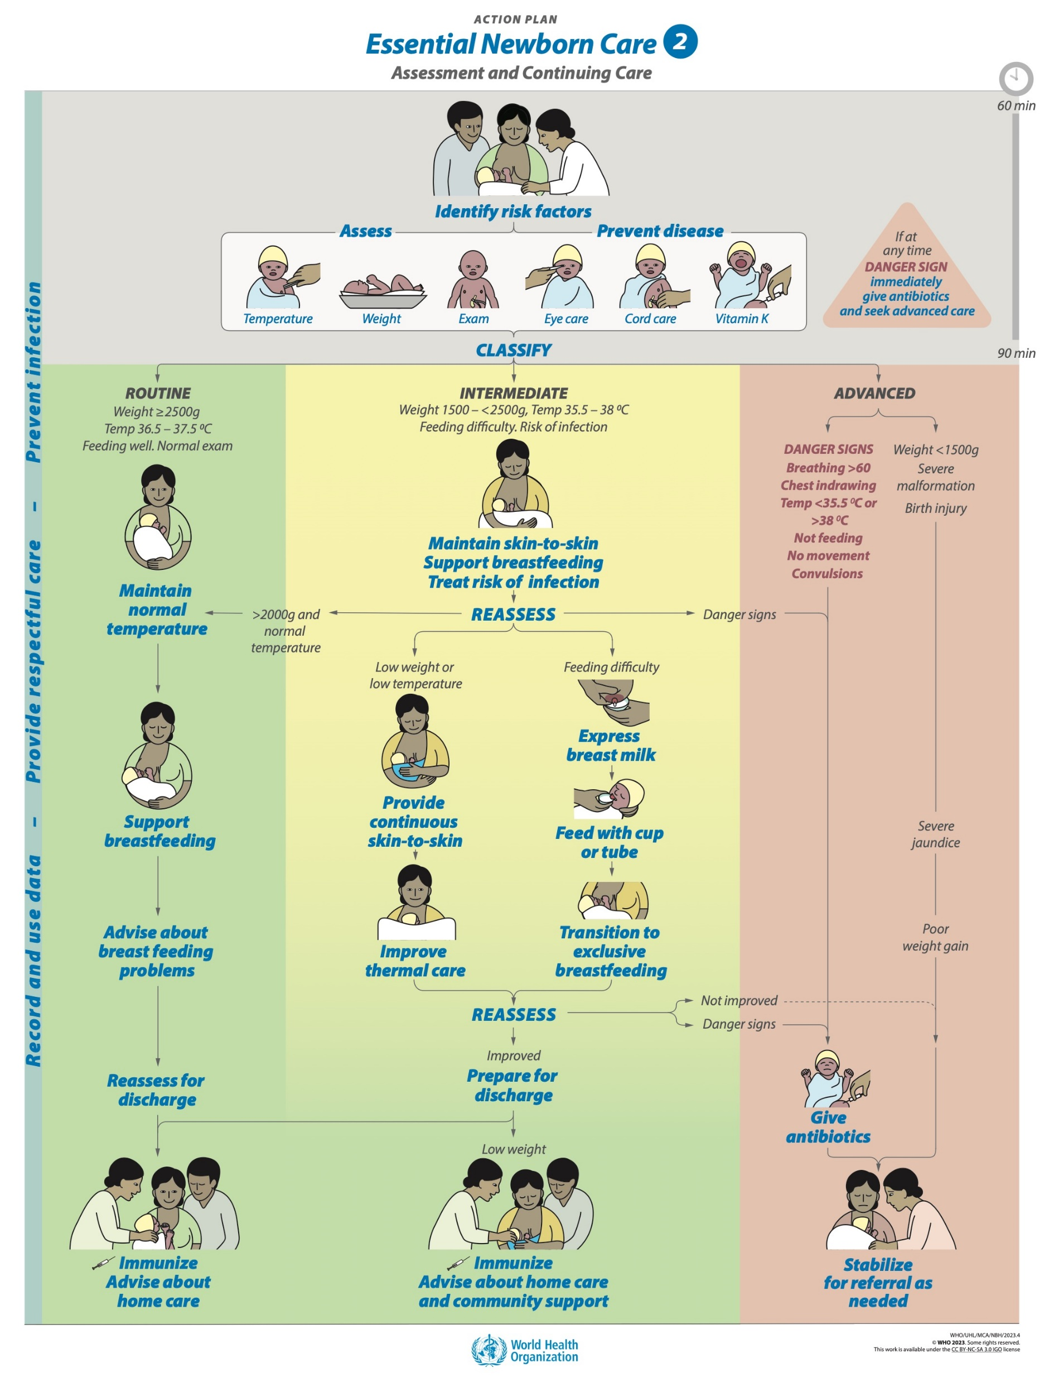
Re-assess a small newborn for problems in the first hours after birth
Ask the mother about her baby and any concerns.
Check the notes of the mother and of the baby.
    Temperature
    Breathing
    Feeding
    Any conditions needing treatment
Examine the baby
    Look and listen (breathing, cry) BEFORE touching
    Note changes (temperature, breathing)
    Identify Danger Signs
Assess a breastfeed
    Especially if early initiation of breastfeeding in
    doubt due to small size or breathing difficulty
Notes:
Practise the steps to re-assess a newborn in the first hours after birth.
The first 4-6 hours after birth represent a transition period when many of the newborn’s body systems are becoming established.
Frequent re-assessment is important to document both improved and worsening condition.
Review the Danger Signs – temperature (too hot to cold), breathing (too fast, chest indrawing), not feeding, movement (lethargic or not moving, convulsions).
To learn more
Danger signs in the small baby

Slide 9
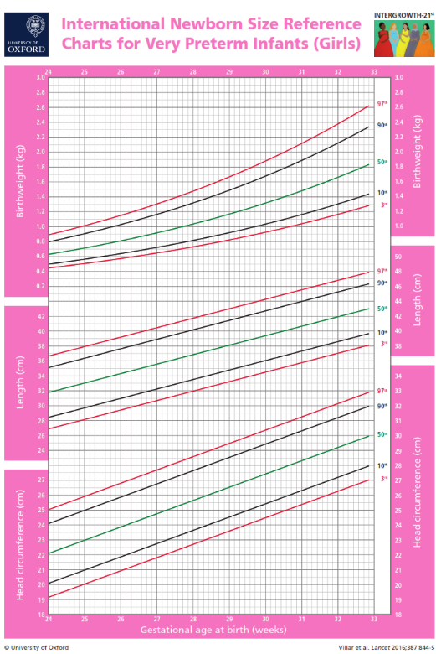
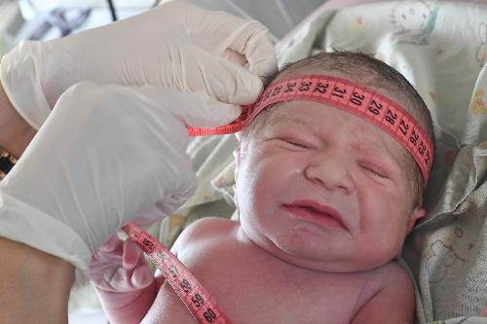
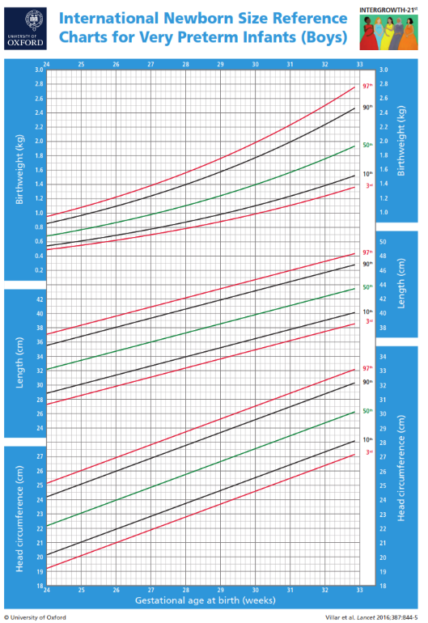

Measure and document growth
© WHO / Malin Bring
Weight
Head circumference
Length (crown-to-heel length)
Use appropriate growth charts for preterm baby
Anthropometry Newborn head circumference, weight, length
Notes:
Practise weighing and measuring the newborn mannequin with equipment used in your facility.
Growth is an important indicator of the general health of a small baby.
View video
What growth measurements do you record and where?
Measurement of weight, head circumference and length after birth of a small baby is especially important to establish a baseline for monitoring growth
Measure on examination, before discharge and at every follow-up visit..
Small babies should be weighed daily while in the facility to assess if feeding is adequate.
Measurements should be recorded in notes and on the relevant growth chart..
To learn more
intergrowth21

Slide 10
Principles of kangaroo mother care

Slide 11
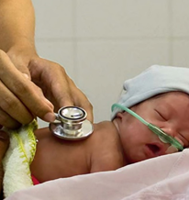
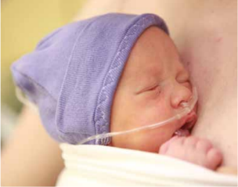
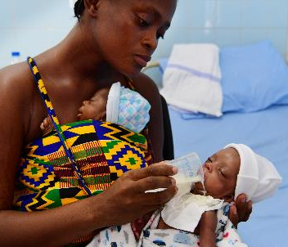
Is skin-to-skin care the same as Kangaroo Mother Care (KMC)?
Skin-to-skin contact is recommended for
all newborns after birth.
KMC includes:
    Early, continuous and prolonged skin-to-
    skin contact between the mother and her small baby in kangaroo position
    Exclusive breastfeeding or breast milk
    feeding
    Close monitoring and early discharge
    when adequate monitoring and special
    follow-up support can continue during
    postnatal care visits.
© Da Nang Hospital for Women and Children
© UNICEF / UN046134 / Kljajo
© UNICEF / UN046134 / Kljajo
Notes:
KMC refers to skin-to-skin contact that is:
for preterm or LBW infants, both well and sick
continuous and prolonged (8 -24 hours per day).
KMC should be started immediately after birth for all preterm or LBW infants, unless critically ill.
Mothers, parents and families should be supported to participate actively in the routine care of their infants while in the facility.
KMC should be provided at all levels of facility care starting immediately after birth and in the community for preterm or LBW newborns who do not need admission to a newborn care unit.
To learn more
Introduction to KMC
KMC essential care of small newborn
Note this video was made before guidelines were updated in 2022

Slide 12

When should kangaroo mother care begin for a low-birthweight or preterm newborn and why?
Find the recommendations on pages 12-16.
Notes:
Use a printed or digital copy (pdf) of the document.

Slide 13
Recommendations and reasons
Kangaroo mother care (KMC) for preterm or low-birthweight infants
should be started as soon as possible after birth.
Compared with later KMC, immediate KMC could:
decrease mortality
decrease hypothermia
decrease infections
increase weight gain
Notes:
Is this recommendation currently being applied in your place of work?
If yes, what enabling factors support the application of this recommendation?
If no, what are the barriers to applying this recommendation?

Slide 14
What is iKMC (immediate kangaroo mother care)?
iKMC for lowbirthweight babies
Immediate KMC after birth is
initiated immediately after birth wherever the baby is born, all levels of care,
in all settings, including at home
prolonged skin-to-skin contact (preferably for 24 h per day) with support for
exclusive breastfeeding or breastmilk feeding
the optimal standard of care, for all mothers and their preterm or low-birthweight
infants except if they are critically ill
suitable for babies requiring respiratory support and close monitoring of both
mother and newborn in the same space
SUPERIOR to current high-tech strategies.
Build experience and confidence with routine KMC before transition to iKMC.
Notes:
View video
What is new knowledge for you in this video?
KMC can be started for sick/unwell babies before they are clinically stable.
Only critically ill babies (danger signs) are excluded.
CPAP and nasogastric feeding can be given in KMC position.
Recommended duration of KMC is minimum 8 hours and preferably 24 hours per day.
In your health facility guidelines
How long a baby should be cared for in KMC position each day?
When and where is KMC started?
How are mothers and families engaged in care?
To transition to immediate KMC it is important that staff are confident in providing KMC routinely.
iKMC is the foundation of care for all preterm or LBW infants, nested within comprehensive small and/or sick newborn care.
Mother is central to the care of her infant, humanizing maternal and newborn care.
Combined maternal-newborn care is possible even when the mother or the newborn is sick.
Involvement of fathers/partners and families is important to support mothers in providing KMC in the facility and at home.
iKMC facilitates timely transition to lower levels of care within the health-care facility or to home with continued skin-to-skin contact and close monitoring.
To learn more
iKMC introduction
Immediate KMC all newborns 0:00-2:05

Slide 15
Practical issues in KMC

Slide 16
Counsel parents about kangaroo mother care
Form groups (mother, nurse and husband).
Counsel Lydia and her husband about KMC.
Debrief with your team and facilitator.
Amos is 1 hour old. He weighs 1900 g. He is skin-to-skin with
his mother, Lydia, who is 36 years old.
There are no danger signs. His temperature is 37.5 °C.
Lydia gave birth to two small babies in the past; both died.
She is anxious and scared to touch her baby.
Counselling for KMC
Notes:
Simulation
Skills and performance – participants demonstrate counseling for initiation of KMC.
Communicating the newborn’s condition and care needed - thermal care and possible alternative methods of breast milk feeding
Counselling on KMC – including position, duration (hours and days), breast (milk) feeding, assessment, safe discharge and benefits to baby/mother/family
Answering questions – alternative providers (father, grandmother)
Debriefing – participants self-reflect and give feedback to one another in their roles.
Provision of care (performance objectives)
What was done well?
What could have been done better?
What will you change the next time?
Did the health worker use a counselling checklist?
Experience of care
Was the communication respectful and the language appropriate?
Was communication sensitive to Lydia’s anxieties and loss?

Slide 17
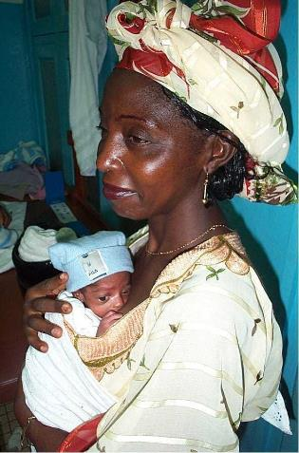
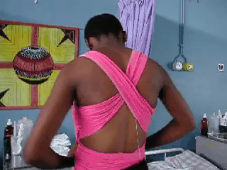
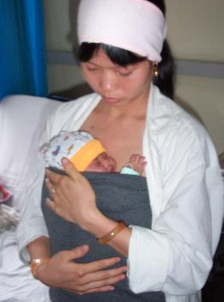
Wraps and binders
©WHO/Dr Ornella Lincetto
© WHO/Dr Helenlouise Taylor
Notes:
What type of wraps and binders are used in your health facility?
A KMC binder holds the baby firmly against the mother’s chest and increases her mobility by allowing her to stand and walk with the baby in place.
A binder allows the baby to be easily shifted for breastfeeding and expressing breast milk while keeping the baby in skin-to-skin contact.
Conventional wraps can make it more difficult to move the baby for feeding in the KMC position.
The use of only a shirt is less effective at maintaining the baby in skin-to-skin contact and may not provide enough support to allow the mother to move around with free hands.
To learn more
KMC wrap designs
Practise how different binders and wraps should be used.
Help a mother make a binder (optional)
Choose a locally available, reasonably priced fabric or cloth or clean recycled cloth from home.
The cloth should have some elasticity so that it will hold the baby snugly.
Cut the cloth into strips 0.8–0.9 metres long and 0.5 metres wide.
Sew the ends of each cloth strip together to form a loop.
Test the binders with mothers and preterm babies to establish correct average size. Adjust the fabric and length to ensure an adequate fit for the average mother.

Slide 18
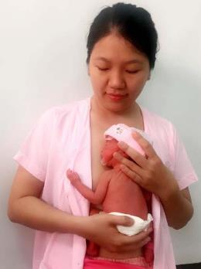
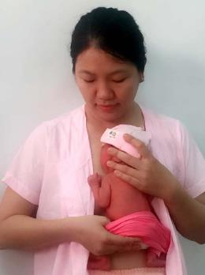
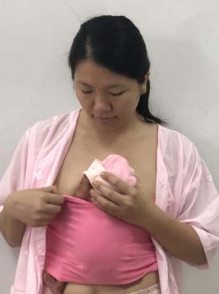
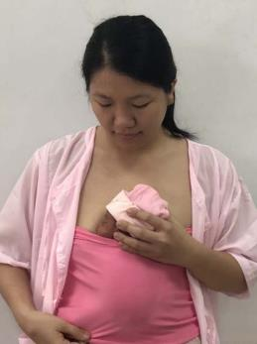
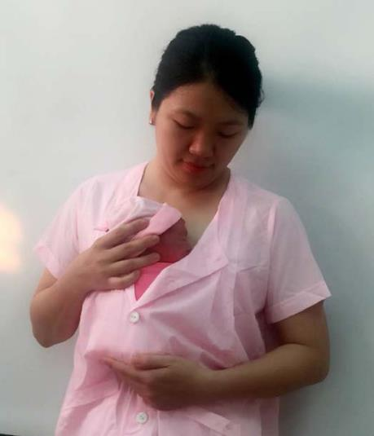
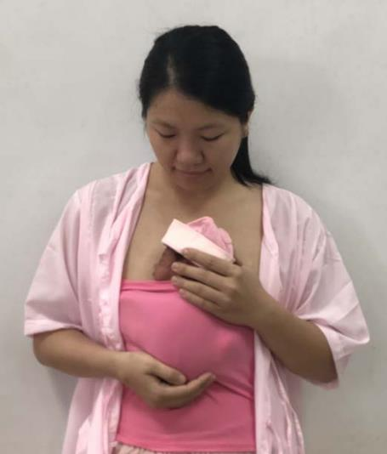
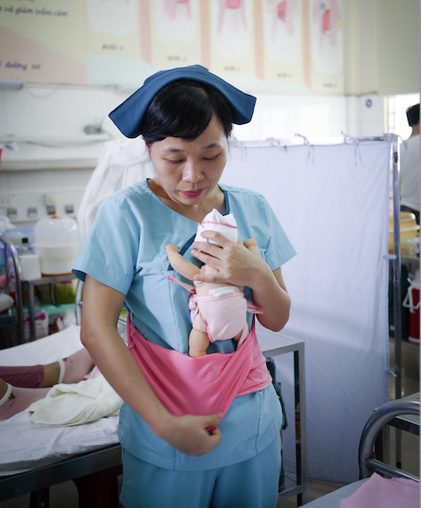

Help a mother place her newborn in kangaroo position
© Neonatal unit Da Nang hospital for women and children Vietnam
Preparing for KMC
Place the baby in KMC position
Notes:
Practise step-by-step using locally available materials.
Perform hand hygiene.
Cover the baby’s head and make sure the diaper is dry.
Gently hold the baby with one hand placed behind the neck and on the back and the other hand under the baby’s buttocks.
When the baby is in an upright position, lightly support the lower part of the jaw with your thumb and fingers to prevent the head from slipping down and blocking the airway.
Position the baby between mother’s breasts with legs spread and flexed at the knees; pull up the binder over the baby’s body to the level of the ear.
The baby’s head should be turned to one side and slightly extended. This slightly extended head position keeps the airway open and allows eye contact between the mother and baby.
Fasten mother’s garment over the binder or cover with a blanket for warmth. The garment and binder can be adjusted as needed to reposition the baby for breastfeeding.
View videos
What new knowledge is presented in this video?
Are there any skills or practices that differ from your current practice?
What provider behaviours differ from your current practice?
Does this video highlight any quality gaps in your facility?

Slide 19
Support Lydia for diaper change
Form groups (mother, midwife and companion).
Support Lydia to safely move Amos for a diaper change and counsel
her on monitoring her baby´s condition.
Debrief with your team and facilitator.
Amos is 3 hours old.
He is being cared for in KMC by his mother, Lydia, who is growing
in confidence.
There are no danger signs. His temperature is 37.6 °C.
KMC diaper change
Notes:
Simulation
Skills and performance – participants demonstrate moving a newborn out of and into KMC.
Explaining and demonstrating the process to the mother and her companion.
Supporting the mother to safely hold the newborn, change diaper and resecure the newborn in KMC position.
Head supported and airway protected, breathing easily, tight edge of the binder not over the chest
Binder adjusted to hold the baby securely when the mother moves around
Kept warm by buttoning or tying clothes over the baby and covering with a blanket
Performing hand hygiene and disposing of soiled diaper
Counselling mother to monitor colour, temperature, breathing (apnoeas) and activity.
Debriefing – participants self-reflect and give feedback to one another in their roles.
Provision of care (performance objectives)
What was done well?
What could have been done better?
What will you change the next time?
What did the health worker ask mother to monitor? And what should she do if she has concerns?
Experience of care
Was the communication respectful and the language appropriate?
Was handling of the baby gentle and baby safely secured?
View video

Slide 20
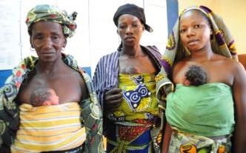
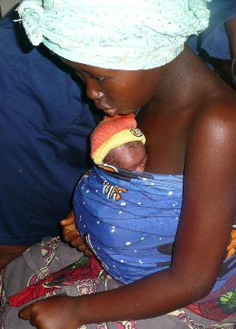
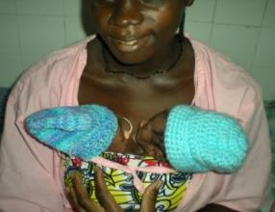
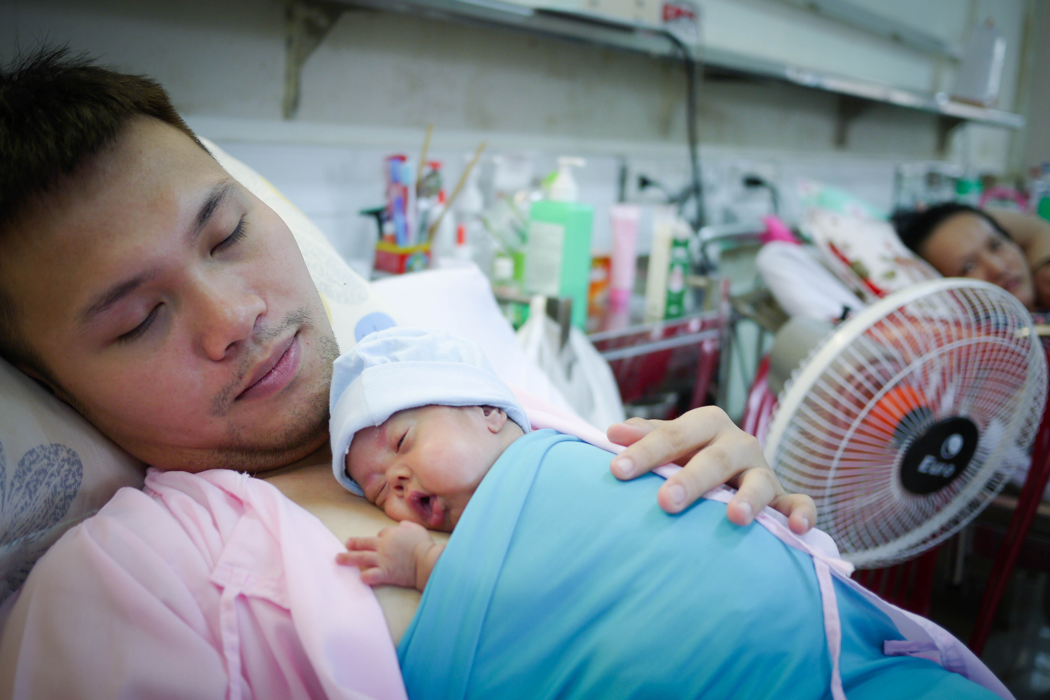
Who else can support mothers to provide KMC?
All family members can participate if they
are willing and available.
Age, number of children, education,
cultural background, religion and
social position should not be barriers.
© UNICEF Mali
© UNICEF Mali
© WHO/Dr Helenlouise Taylor
© Da Nang hospital Vietnam
Notes:
Are other family members allowed to provide KMC in your health facility?
Family members, including fathers and grandparents, can provide KMC. Exceptions are persons who have a cough, cold, fever, transmissible systemic infectious disease (for example, hepatitis A or E), skin infection on the chest or arms (boils, abscesses, furuncles) or some psychiatric illnesses, intoxication with alcohol or drugs.
In some contexts where family-centred care is routine, siblings are encouraged and supported to provide safe KMC.
Ensure that siblings are well supervised to ensure safety and good hand hygiene.
Twins and triplets can also be cared for in kangaroo position.

Slide 21
Should families be involved in care of preterm or low-birthweight infants in health facilities?
Find the recommendations on pages 83-85.
Notes:
Use a printed or digital copy (pdf) of the document.

Slide 22
Recommendations and reasons
Family involvement in the routine care of preterm or low-birth-weight
infants in health-care facilities is recommended.
Compared with usual hospital care, family involvement could:
decrease morbidity (infection, intraventricular haemorrhage, retinopathy
of prematurity, bronchopulmonary dysplasia)
increase weight and length
improve neurodevelopment
Notes:
Is this recommendation currently being applied in your place of work?
If yes, what enabling factors support the application of this recommendation?
If no, what are the barriers to applying this recommendation?
What neurodevelopmental benefits of KMC do you know?
KMC is associated with improved cognitive and motor development and functioning and improved longer-term social and behavioural outcomes.
Preterm infants who received KMC after birth had improved brain maturation (e.g. intelligence, attention, memory and coordination) compared with those who received incubator care; a longer duration of KMC strengthened this association.
To learn more
Charpak N, Tessier R, Ruiz JG, Hernandez JT, Uriza F, Villegas J et al. Twenty-year follow-up of kangaroo mother care versus traditional care. Pediatrics. 2017;139(1):e20162063. doi:10.1542/peds.2016-2063.
Ropars S, Tessier R, Charpak N, Uriza LF. The long-term effects of the kangaroo mother care intervention on cognitive functioning: results from a longitudinal study. Dev Neuropsychol. 2018;43(1):82–91. doi:10.1080/87565641.2017.1422 507.
Charpak N, Tessier R, Ruiz JG, Uriza F, Hernandez JT, Cortes D et. Kangaroo mother care had a protective effect on the volume of brain structures in young adults born preterm. Acta Paediatr. 2022;111(5):1004–14. doi:10.1111/apa.16265.

Slide 23
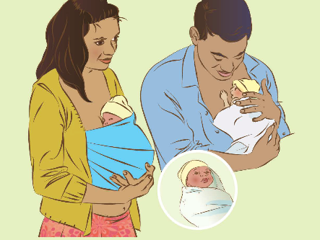
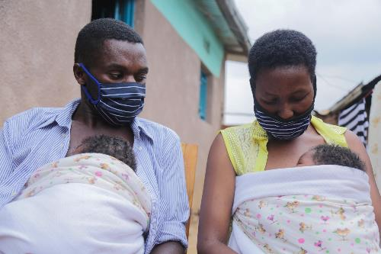
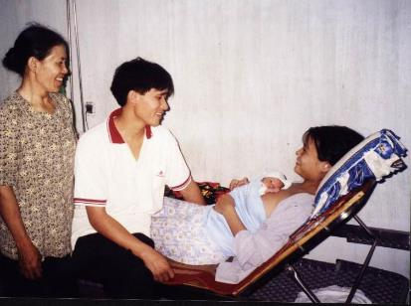
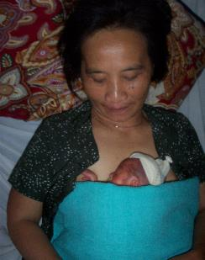
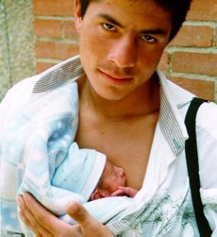
How do you counsel other family members?
© UNICEF/UNI356182/Kanobana
© WHO/Dr Helenlouise Taylor
© WHO/Dr Helenlouise Taylor
© WHO/Dr Helenlouise Taylor
Notes:
Do you have a checklist for topics to cover in counselling other family members?
Include:
Infection prevention, keeping the baby warm, recognizing danger signs, behavioural cues, and responsive nurturing care
Monitoring the baby
No smoking
Prioritising skin-to-skin time with mothers over other family members.
Good hand hygiene – no handling of the baby by anyone who has not washed hands
Linking with experienced families who can share experiences, successes and how they overcame the challenges with KMC
View video
To learn more
AIIMS role of family members
AIIMS monitoring in KMC
Monitoring in KMC position

Slide 24
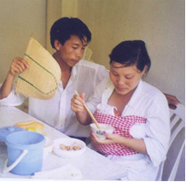
Support Lydia for activities of daily living
Form groups (mother, nurse and companion).
Support Lydia to put Amos safely in kangaroo position and give tips for activities of daily living with KMC.
Debrief with your team and facilitator.
Lydia is on her own with Amos.
Usually, her mother helps her place Amos in kangaroo position and move him around.
© WHO/Dr Helenlouise Taylor
KMC activities of daily living 6:05–7:45
Notes:
Simulation
Skills and performance – participants demonstrate supporting a mother to independently position her baby in KMC and perform activities of daily living.
Reviewing or demonstrating key steps in positioning with a mannequin.
Supporting Lydia to safely place Amos in KMC position
Counselling and supporting for sleeping in a reclined or semi-sitting position, hand hygiene after using toilet and before breastfeeding, walking and preparing food safely, talking/singing to the baby
Debriefing – participants self-reflect and give feedback to one another in their roles.
Provision of care (performance objectives)
What was done well?
What could have been done better?
What will you change the next time?
Experience of care
Was the communication respectful and the language appropriate?
Were infection prevention practices followed?
Was Amos securely positioned? Was the airway protected?
View video

Slide 25
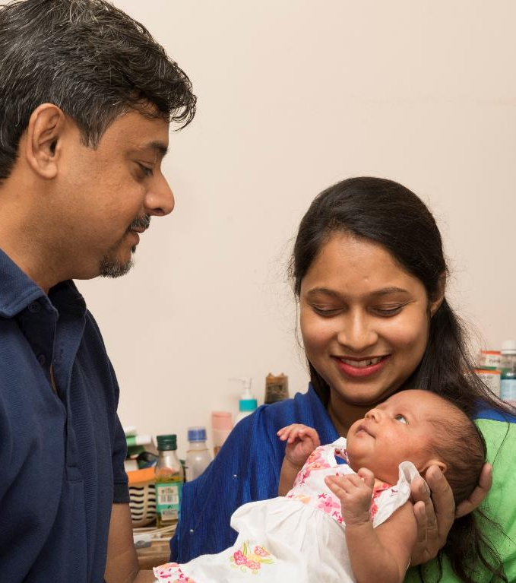
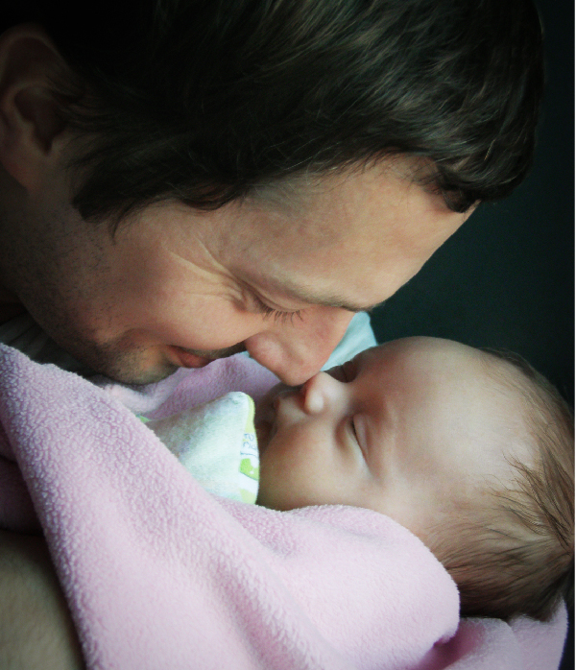
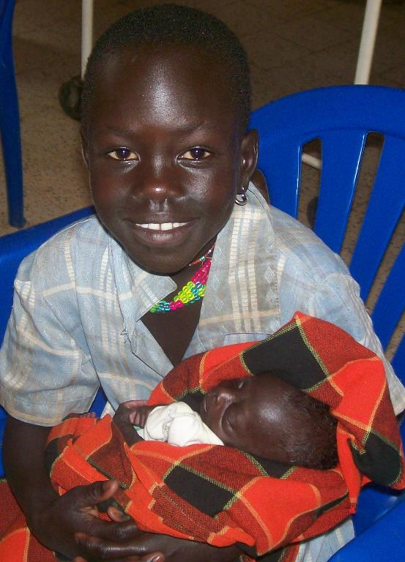
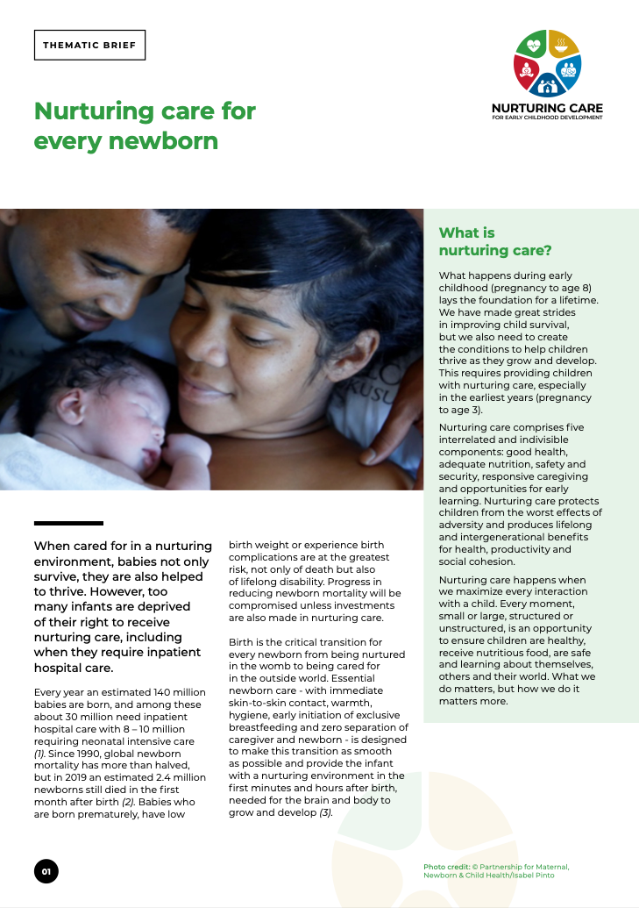
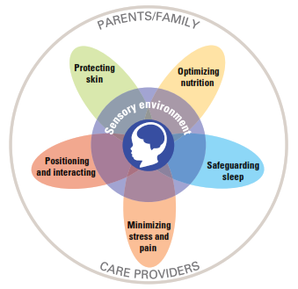
What additional care is essential for growth and development small newborns?
© WHO/Sergey Volkov
© UNICEF/Dr Helenlouise Taylor
© Chak
Notes:
Nurturing care
In the health facility, families must have access to their babies for breastfeeding, skin-to-skin care and nurturing care.
Families make unique contributions to the care and neurological development of their small newborns.
The consistent presence of parents provides familiar touch, sights, smells and sounds. Skin-to-skin care stimulates most of the senses.
Maternal breastmilk offers significant advantages for a newborn’s survival, growth and cognition (development of the brain).
In the first days, allow mother and baby to get to know each other, and make this nurturing relationship a priority.
With supervision, siblings also can stimulate and nurture their brothers and sisters. Under close supervision of health staff, this 10-year-old provided care for her preterm sister, including skin-to-skin and cup feeding after the death of her mother.
Grandparents also have a very important role to play.
To learn more
Infant and family-centred developmental care

Slide 26


What are the components of nurturing care for small newborns?
Preventing and managing illness, evidence-based high-quality
care for small newborns.
Optimising exclusive breastfeeding or breast milk feeding.
Warmth, practicing good hygiene, minimizing stress and enabling
the primary caregiver to be with the infant in a quiet environment.
Stimulating the baby’s brain gently, through touch, voice or
simply close contact.
Being aware of the newborn’s signals, which can indicate readiness
for a feed, pain or stress, and respond to them appropriately.
Notes:
Promote responsive care from pregnancy and birth;
Support parents and other caregivers to provide responsive care.
Ensure parents and other caregivers are aware of the newborn’s signals, such as indicate readiness to feed, pain or distress, and be able to respond to these signals appropriately.
Promote positive caregivers–infant interactions and strengthen the parent–infant relationship. Address the caregiver–infant dyad rather than the caregivers or the baby alone.
Support care that is prompt, consistent and contingent on and appropriate to the child’s cues, signals, behaviours and needs.
Start with play, communication and exclusive breastfeeding on demand.
To learn more:
Infant and family-centred developmental care

Slide 27
Counsel Lydia about responsive care
Form groups (mother, neonatal nurse and grandmother).
Counsel Lydia and her mother about responsive care and practice
with them after viewing the video to answer their questions.
Debrief with your team and facilitator.
Lydia is caring well for Amos and growing in confidence.
She is fully breastfeeding him without difficulties.
Caring for your small baby at home 0:00-6:54
Notes:
Simulation
Skills and performance – participants demonstrate counselling on and supporting responsive care.
Communicating to caregivers what is meant by responsive nurturing care (understanding and responding to the baby’s behavioural cues, stimulating all senses, and how it will enable the baby to grow and develop and will contribute to his reaching his full potential.)
Supporting mother and family to give responsive care.
Recognizing feeding cues, pain or discomfort, stress
Support the mother to talk or sing to and have eye contact with her baby, to gently stroke or massage the baby and to “serve and return”, mimicking the baby’s expressions, sounds and gestures.
Demonstrating culturally appropriate tips for stimulating the 5 senses.
Debriefing – participants self-reflect and give feedback to one another in their roles.
Provision of care (performance objectives)
What was done well?
What could have been done better?
What will you change the next time?
Experience of care:
Was the communication respectful and the language appropriate?
Was handling of the baby gentle?
View video
Massage in KMC position

Slide 28
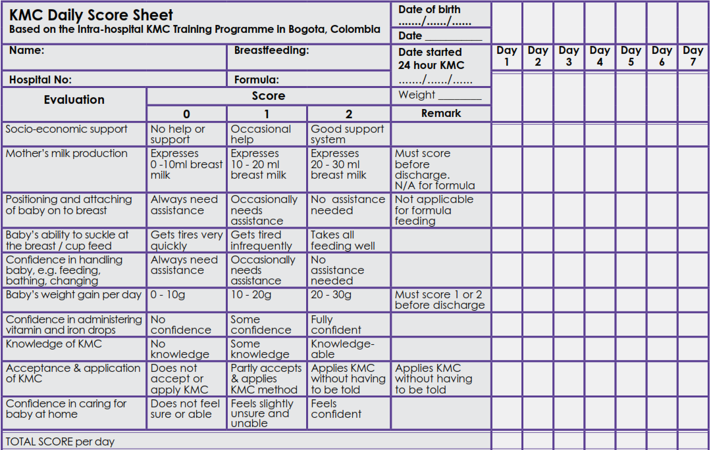
How will you decide if a small baby is ready for discharge?
Review your health facility discharge guidelines
Discharge criteria
Notes:
When do you plan for discharge of a small or preterm newborn?
Discharge planning should start as early as possible after birth in collaboration with families.
Families should understand the criteria used.
Do you use a discharge checklist in your health facility?
Decision-making for discharge:
Breathing: no apnoea, no fast breathing or chest indrawing.
Temperature: normal and stable (36.5–37.5 °C).
Weight gain: adequate over 3 consecutive days.
Fully breastfeeding or using an alternative method of feeding.
Baby is tolerating feeds well.
Mother is confident in providing KMC, understands the danger signs for seeking care and has adequate family support at home.
Mother has no health or psychosocial concerns.
Postnatal visits and follow up for mother–baby dyad are organized.
To learn more:
Planning discharge and follow-up KMC

Slide 29
Discharge readiness
Form groups (mother, doctor and companion).
Assess Amos for discharge and counsel Lydia about care at home
including KMC and follow-up.
Debrief with your team and facilitator.
Amos is growing well, gaining 20 g per day for the past 3 days.
He is now 35 weeks gestation.
Lydia is confident and is providing responsive nurturing care.
Amos is in kangaroo position all day and night. His grandfather and grandmother also help and enjoy time in kangaroo position with Amos.
He is stable and warm.
Notes:
Simulation
Skills and performance – participants demonstrate assessing for discharge and counselling for care at home.
Counselling Lydia about home care and follow-up using, written or digital materials or job aids.
Time, place and reason for follow-up visits
Community support
Examining in the KMC position (complete examination) and reviewing clinical record
Deciding whether the baby is ready for discharge using discharge checklist and local charts and forms
Debriefing – participants self-reflect and give feedback to one another in their roles.
Provision of care (performance objectives)
What was done well?
What could have been done better?
What will you change the next time?
Was data used in decision making ?
Experience of care:
Was the communication respectful and the language appropriate?
Was handling of the baby gentle?
Were infection prevention practices followed?
Did the health worker explain to Lydia and family that Amos is ready to go home?

Slide 30
Organisation of KMC

Slide 31
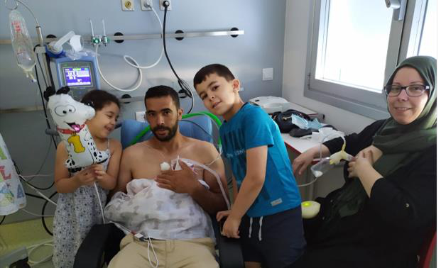
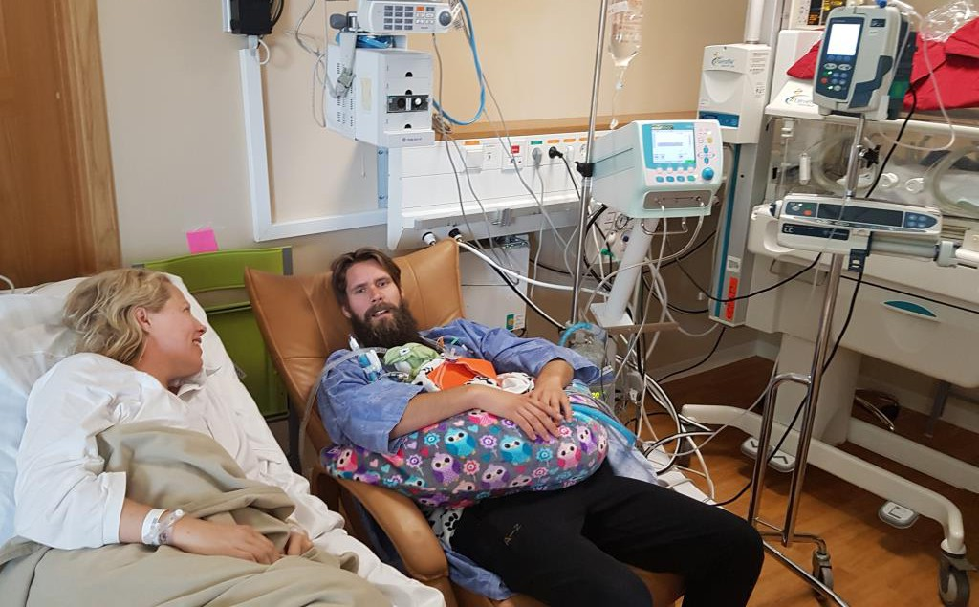
What changes promote KMC in health facilities?
Postnatal and KMC wards
Reorganise space for mothers
and babies, accommodating
fathers and other family members
to ensure KMC for ~24h per day.
Change layout of infrastructure
to enable mothers to be together
with low birthweight or preterm
infant.
Notes:
Do you need to make any changes where you work?
Do you need to reorganise space?
To learn more
Space-and-design for KMC

Slide 32
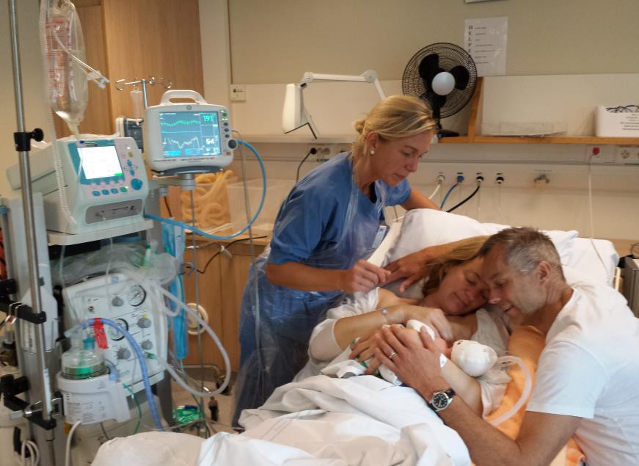
How can you improve access to KMC for small or preterm newborns?
Move away from obstetric and neonatal
services in distinct departments with different guidelines, providers, and locations.
Practise infant- and family-centred care with mothers and newborns together in one place, with families as key partners in the care of
their newborns.
Promote interdisciplinary teamwork among obstetricians, midwives, paediatricians, neonatal nurses and other cadres.
Implement policies and hold everyone accountable.
ZERO SEPARATION
Family-centred care
Notes:
What actions would ensure KMC for all preterm or low birthweight newborns where you work?
View video
What new knowledge is presented in this video?
Are there any skills or practices that differ from your current practice?
What provider behaviours differ from your current practice?
Does this video highlight any quality gaps in your facility?
To learn more
The neuroscience of birth and the case for Zero Separation
Calibo A et al. Scaling up kangaroo mother care in the Philippines using policy, regulatory and systems reform to drive changes in birth practices. BMJ. 2021.
https://gh.bmj.com/content/6/8/e006492

Slide 33
How do KMC and iKMC benefit the health system?
Lower capital investment and recurrent costs
Less need for incubators, which can be a source of
hospital-acquired infection and hypo- or hyperthermia
Less hospital-acquired infection
Families participate in care, freeing staff to take care of
critically ill newborns
Earlier discharge
Reduced readmission rates
Increased job satisfaction
Notes:
How can these points be used to advocate for more access to KMC?

Slide 34
Doris gives birth unexpectedly to a healthy preterm baby
Form groups (mother, midwife and husband).
Counsel Doris and her husband about Zeta’s care and initiating KMC.
Debrief with your team and facilitator.
Doris, a 24-year-old primigravida, arrives at the health facility in advanced labour at 33 weeks gestation.
She delivers a healthy girl, Zeta, who breathes well.
Zeta is in skin-to-skin contact immediately after birth, and her parents are adjusting to her unexpected arrival.
Notes:
Repeat simulation
Skills and performance – participants demonstrate counselling for initiation of KMC.
(Use local counselling checklist if available)
Communicating the newborn’s condition and care needed - thermal care and possible alternative methods of breast milk feeding
Counselling on KMC – including position, duration (hours and days), breast (milk) feeding, assessment, safe discharge and benefits to baby/mother/family
Answering questions – alternative providers (father, grandmother)
Debriefing – participants self-reflect and give feedback to one another in their roles.
Provision of care (performance objectives)
What was done well?
What could have been done better?
What will you change the next time?
Experience of care
Was the communication respectful and the language appropriate?
Did the health worker explain the benefits and address any doubts?
Did the health worker explain how many hours per day and until what age the baby will need KMC?
To learn more
KMC for preterm and low birthweight newborns

Slide 35
Summary
In this module, you have:
Examined the evidence why all low-birthweight and premature newborns should receive kangaroo mother care as soon after birth as possible, wherever they are born and whether sick or well.
Demonstrated how to counsel and give practical support to a mother and family members to safely practise kangaroo mother care.
Identified the importance of monitoring the baby for growth, apnoea and changes in condition and demonstrated how to assess for discharge readiness.
Identified organisational changes to improve access to kangaroo mother care.

Slide 36

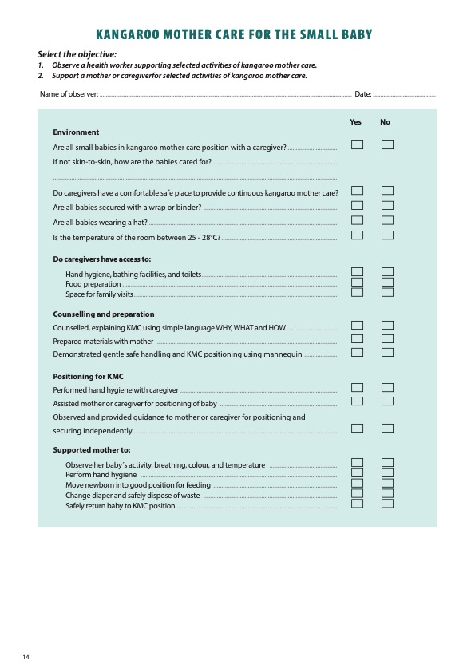
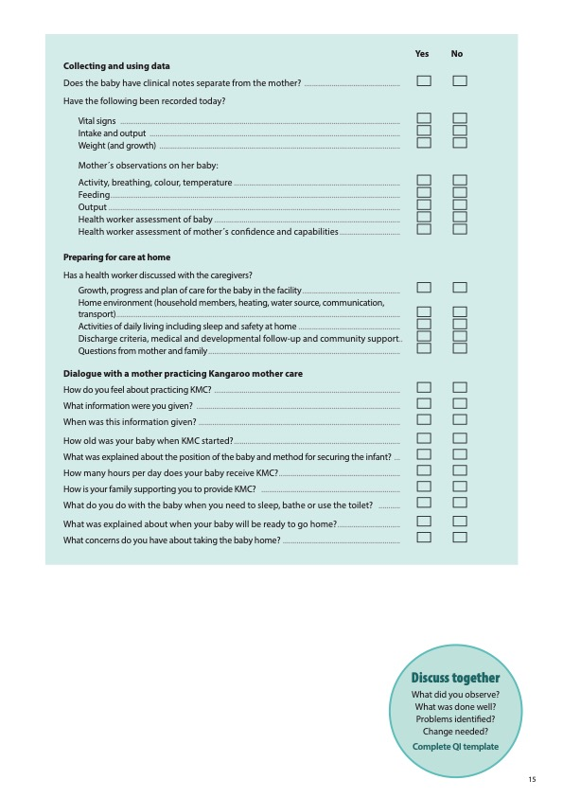
Clinical practice
Notes:
Review the Clinical practice checklist before observing or practicing in the clinical area.

Slide 37
  Example of QI KMC
Notes:
After the clinical practice, discuss the observations made, possible reasons for practices, and changes needed to improve the quality of essential newborn care.
What new things will you do?
What old things will you not do?
How will you make a change?
Use your reflections to fill out the QI template.
View video

Slide 38



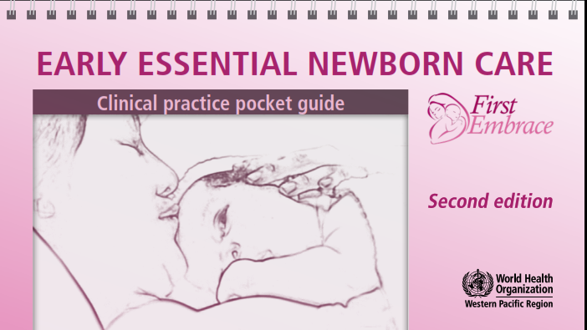



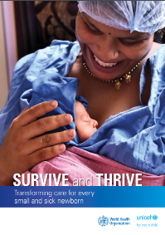


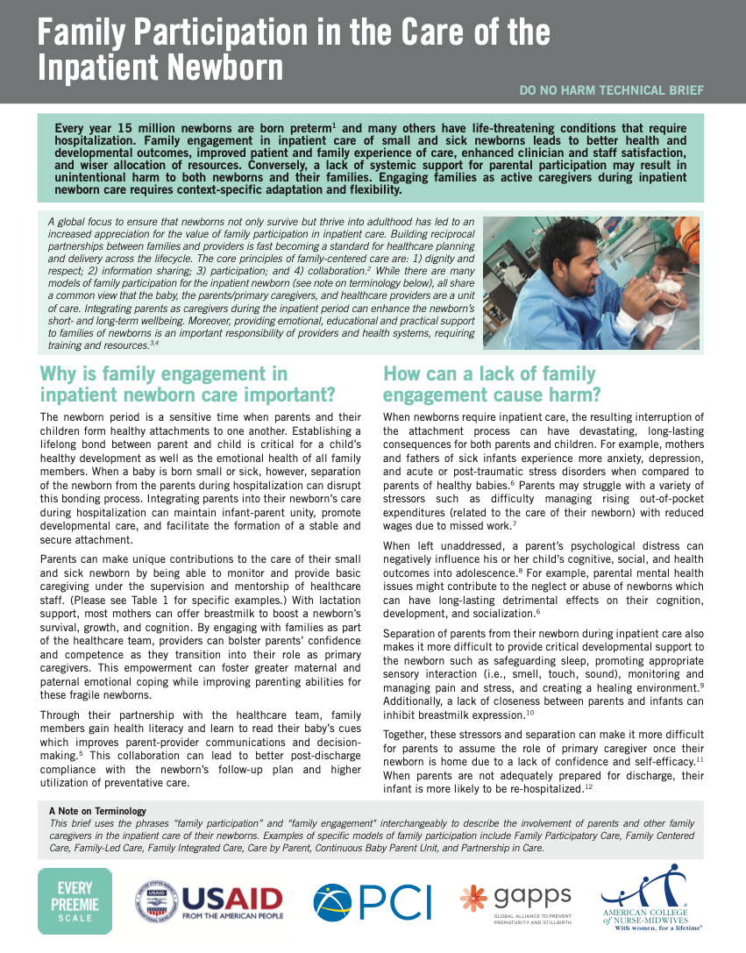
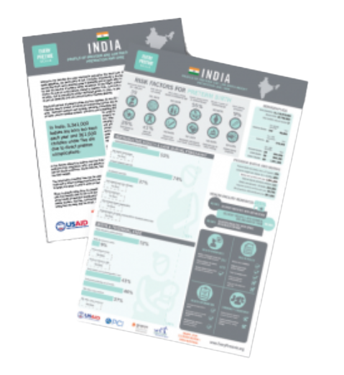
References and additional resources
KMC when phototherapy

Slide 39
Ensure safe skin-to-skin position
Form groups (mother Lydia, nurse and father).
Support Lydia and Amos for safe skin-to-skin positioning.
Debrief with your team and facilitator.
Amos is 40 minutes old and is lying skin-to-skin on Lydia’s chest.
His head is covered by a blanket.
You cannot see his face.
Notes:
Simulation
Skills and performance – participants demonstrate supporting a mother for safe skin-to-skin positioning
Communicating the safety aspects of skin-to-skin contact
Demonstrating safe positioning to mother and supporting her own positioning
Mother semi-recumbent (head of bed elevated 30 degrees or more)
Visual contact for recognition of the baby’s awakening and hunger cues
Support that allows infant to lift head at all times to facilitate breathing and suckling
Visual check of infant’s breathing, colour and responsiveness to
Mother responsive (not sedated)
How to get help if needed
Debriefing – participants self-reflect and give feedback to one another in their roles.
Provision of care (performance objectives)
What was done well?
What could have been done better?
What will you change the next time?
Experience of care
Was the communication respectful and the language appropriate?
Was handling of the baby gentle?
Were infection prevention practices followed?

Slide 40
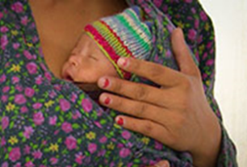
Samuel is cold: Counsel for thermal care
Form groups (mother Amy, midwife, grandmother).
Assess Samuel, then support Amy to keep her
small baby warm.
Debrief with your team and facilitator.
Amy wrapped Samuel after feeding him, placed him in a cot and took a shower.
Samuel is cold.
Amy returns from the shower.
© Global Health Media Project
Keeping the small baby warm
Notes:
Simulation
Skills and performance – participants demonstrate supporting a young mother to keep her small baby warm.
Assessing Samuel’s temperature and general condition – temperature 36 °C
Communicating to an adolescent mother the importance of continuous skin-to-skin care and need for rewarming
Supporting Amy for safe skin-to-skin care and improving thermal care
Semi-recumbent position with visual contact
Extra blankets, hat ,dry diaper
Visual check of breathing, colour and responsiveness to stimulation.
Repeat temperature check
Debriefing – participants self-reflect and give feedback to one another in their roles.
Provision of care (performance objectives)
What was done well?
What could have been done better?
What will you change the next time?
Experience of care:
Was the communication respectful and the language appropriate for a young adolescent mother, but effective in conveying not to leave the baby alone?
Was handling of the baby gentle?
Were infection prevention practices followed?
View video

Slide 41
Examine newborn in KMC position and counsel his mother
Form groups (mother Amy, doctor and grandmother).
Examine Samuel and counsel Amy (15 years old) about
kangaroo mother care.
Debrief with your team and facilitator.
Samuel took a small breastfeed at 20 minutes of age.
He is now 90 minutes old and stable, but small.
Routine assessment of the small baby
Notes:
Simulation
Skills and performance – participants demonstrate:
Explaining clearly the examination process to adolescent mother and gaining consent.
Examining systematically the stable small newborn whilst in skin to skin position ( see “Examination of the newborn” complete physical assessment, temperature , breathing, danger signs , including antenatal and perinatal and postnatal risk factors)
Debriefing – participants self-reflect and give feedback to one another in their roles.
Provision of care (performance objectives)
What was done well?
What could have been done better?
What will you change the next time?
Experience of care
Was the communication respectful and the language appropriate for adolescent mother? Were the findings communicated?
Was handling of the baby gentle?
Were infection prevention practices followed?
Was the baby kept warm?

Slide 42
Samuel is showing feeding cues
Form groups (mother Amy, midwife and grandmother).
Support Amy to position and attach her baby at the breast.
Debrief with your team and facilitator.
Samuel is showing feeding cues.
Breastfeeding the small baby
Notes:
Simulation
Skills and performance – participants demonstrate supporting a mother to breastfeed in KMC.
Pointing out feeding cues and demonstrating positioning for breast feeding a small baby
Positions which may be useful
Signs of good attachment
Supporting a mother to breastfeed her small baby in KMC position.
Debriefing – participants self-reflect and give feedback to one another in their roles.
Provision of care (performance objectives)
What was done well?
What could have been done better?
What will you change the next time?
Did the health worker demonstrate using a small newborn mannequin or doll?
Were head and neck well supported and appropriate positions for small newborns used ? (AVOID Cradle hold for small newborns)
Experience of care
Was the communication respectful and the language appropriate?
Did the health worker explain how often your baby will feed?
Was handling of the baby gentle?
Were infection prevention practices followed?
To learn more
Breastfeeding your small baby for mothers

Slide 43
Support Amy for responsive care
Form groups (mother, neonatal nurse and grandmother).
Counsel Amy and her mother on responsive care and support
them to practise.
Debrief with your team and facilitator.
Amy is caring well for Samuel in kangaroo position.
She is fully breastfeeding him without difficulties.
Caring for your small baby at home
Notes:
Simulation
Skills and performance – participants demonstrate supporting a family to provide responsive care.
Communicating for responsive nurturing care (understanding and responding to the baby’s behavioural cues, stimulating all senses, benefits for growth and development)
Supporting mother and family to recognize behavioural cues and give responsive care.
Responding to feeding cues
Talking or singing, having eye contact, stroking or massaging the baby and to
“Serve and return”, mimicking the baby’s expressions, sounds and gestures.
Debriefing – participants self-reflect and give feedback to one another in their roles.
Provision of care (performance objectives)
What was done well?
What could have been done better?
What will you change the next time?
Experience of care
Was the communication respectful and the language appropriate?
Was handling of the baby gentle?
Were infection prevention practices followed?
To learn more
Massage in KMC position

Slide 44
Refer Pierre
Form groups (referring doctor, midwife and mother).
Refer Pierre to the next level of care.
Debrief with your team and facilitator.
You are in a first-level health facility.
Pierre was born 10 minutes ago.
He weighs 1500g and he is skin-to-skin with his mother.
He is pink and warm.
Referring a small baby
Notes:
Simulation
Skills and performance – participants demonstrate referral of a very low birthweight newborn.
Communicating to the family the baby’s condition and need for referral
Safely referring a small newborn to next level of care - transport in KMC
Carrying out steps in safe referral including communication
gaining consent from parents
contacting referral centre
Documenting and filling out relevant forms
Debriefing – participants self-reflect and give feedback to one another in their roles.
Provision of care (performance objectives)
What was done well?
What could have been done better?
What will you change the next time?
Experience of care
Was the communication respectful and the language appropriate?
Was handling of the baby gentle?
Was safe thermal care addressed?
Were infection prevention practices followed?
View video

Slide 45
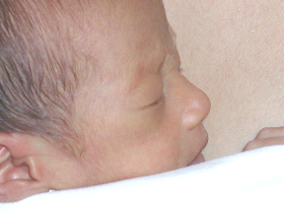
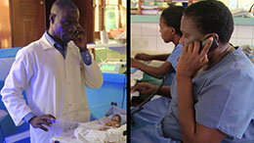
Assess and manage Fifi safely
Fifi was born 4 hours ago at 35 weeks gestation.
She required no resuscitation.
Her birth weight was 1900 g.
You ask how the baby is feeding. Fifi has never fed.
When you assess her breathing, you count 70 breaths
per minute and you hear grunting.
Fifi is very pale, she feels cool, and her temperature
is 35.4 °C.
How will you manage FiFi?
© Sandra Lang
Danger signs in the small baby
Referring a small baby
Notes:
Fifi has danger signs and needs to be referred urgently to the next level of care. This may be in the same hospital or in another hospital.
Explain to Fifi’s mother and companion what you have found and what actions need to be taken.
Gain consent of caregivers for referral.
View videos

Slide 46
Assess and manage Vishnu
Vishnu has just been born by spontaneous
vaginal delivery.
He was 29 weeks gestation.
He weighs 1200 g.
He received essential newborn care and is skin-to-skin
with his mother.
Classify Vishnu and decide on his management.
What are important steps when referring a newborn?
Referring a small baby
Notes:
Vishnu has very low weight and needs urgent safe referral.
Put the referral plan into action and follow all steps.
View video (optional)

