Slide 1
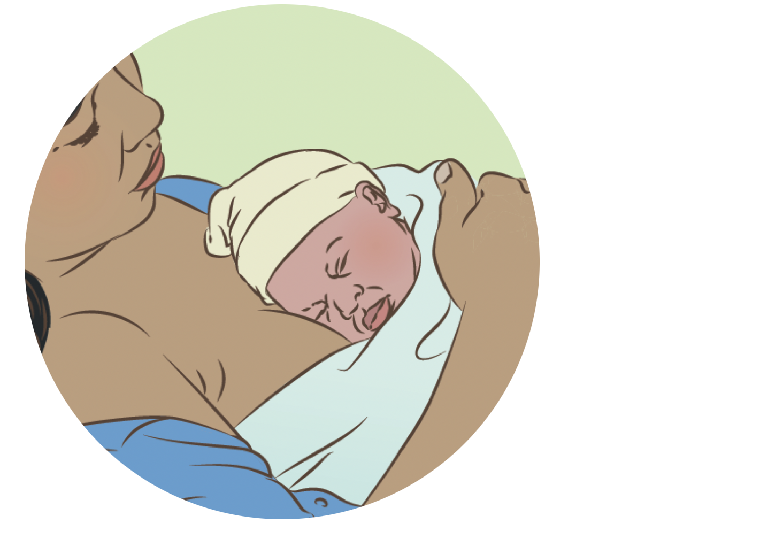

Keeping the newborn warm
Notes:
© World Health Organization 2024. All rights reserved.
Materials for demonstrations, practice, and simulations
Organise one set per group of 3 participants and a set for facilitator demonstration (as available).
Newborn mannequin
Towel for drying (at birth)
Cover or blanket for mother and newborn
Baby clothes and diapers, hat, blanket, socks
Kangaroo mother care wrap or binder
Thermometer (newborn)
Room thermometer
Newborn record

Slide 2
Content
Goal and learning outcomes
The situation
Keeping the newborn warm
Hypo- and hyperthermia
Alternative warming methods
Summary
Clinical practice
Quality improvement
References and additional resources

Slide 3
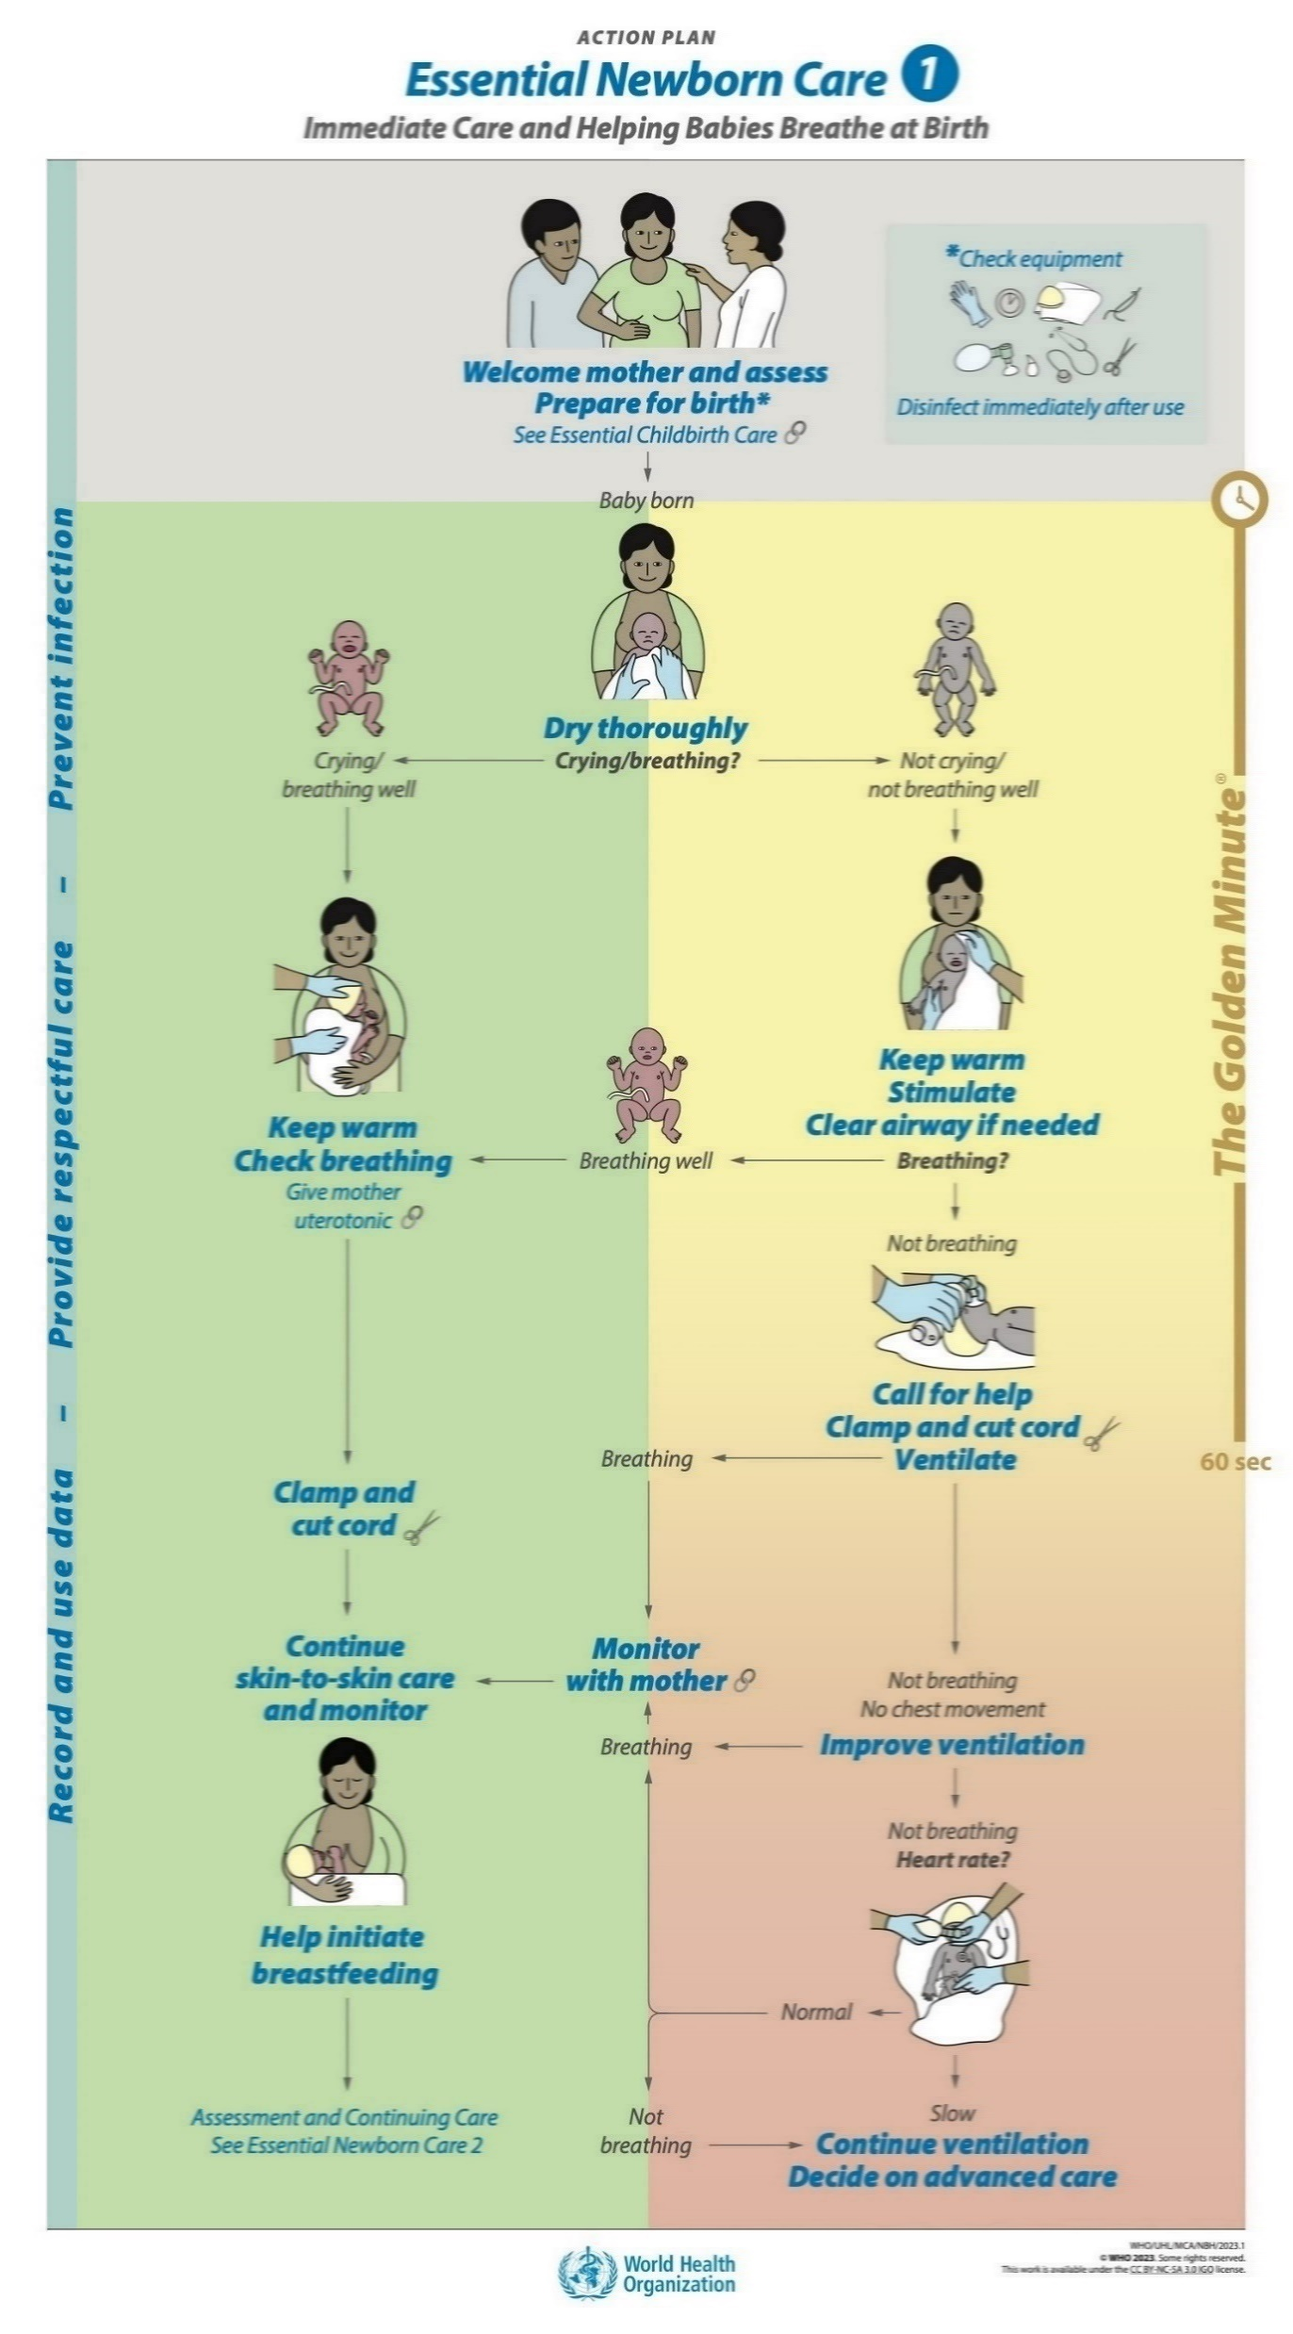
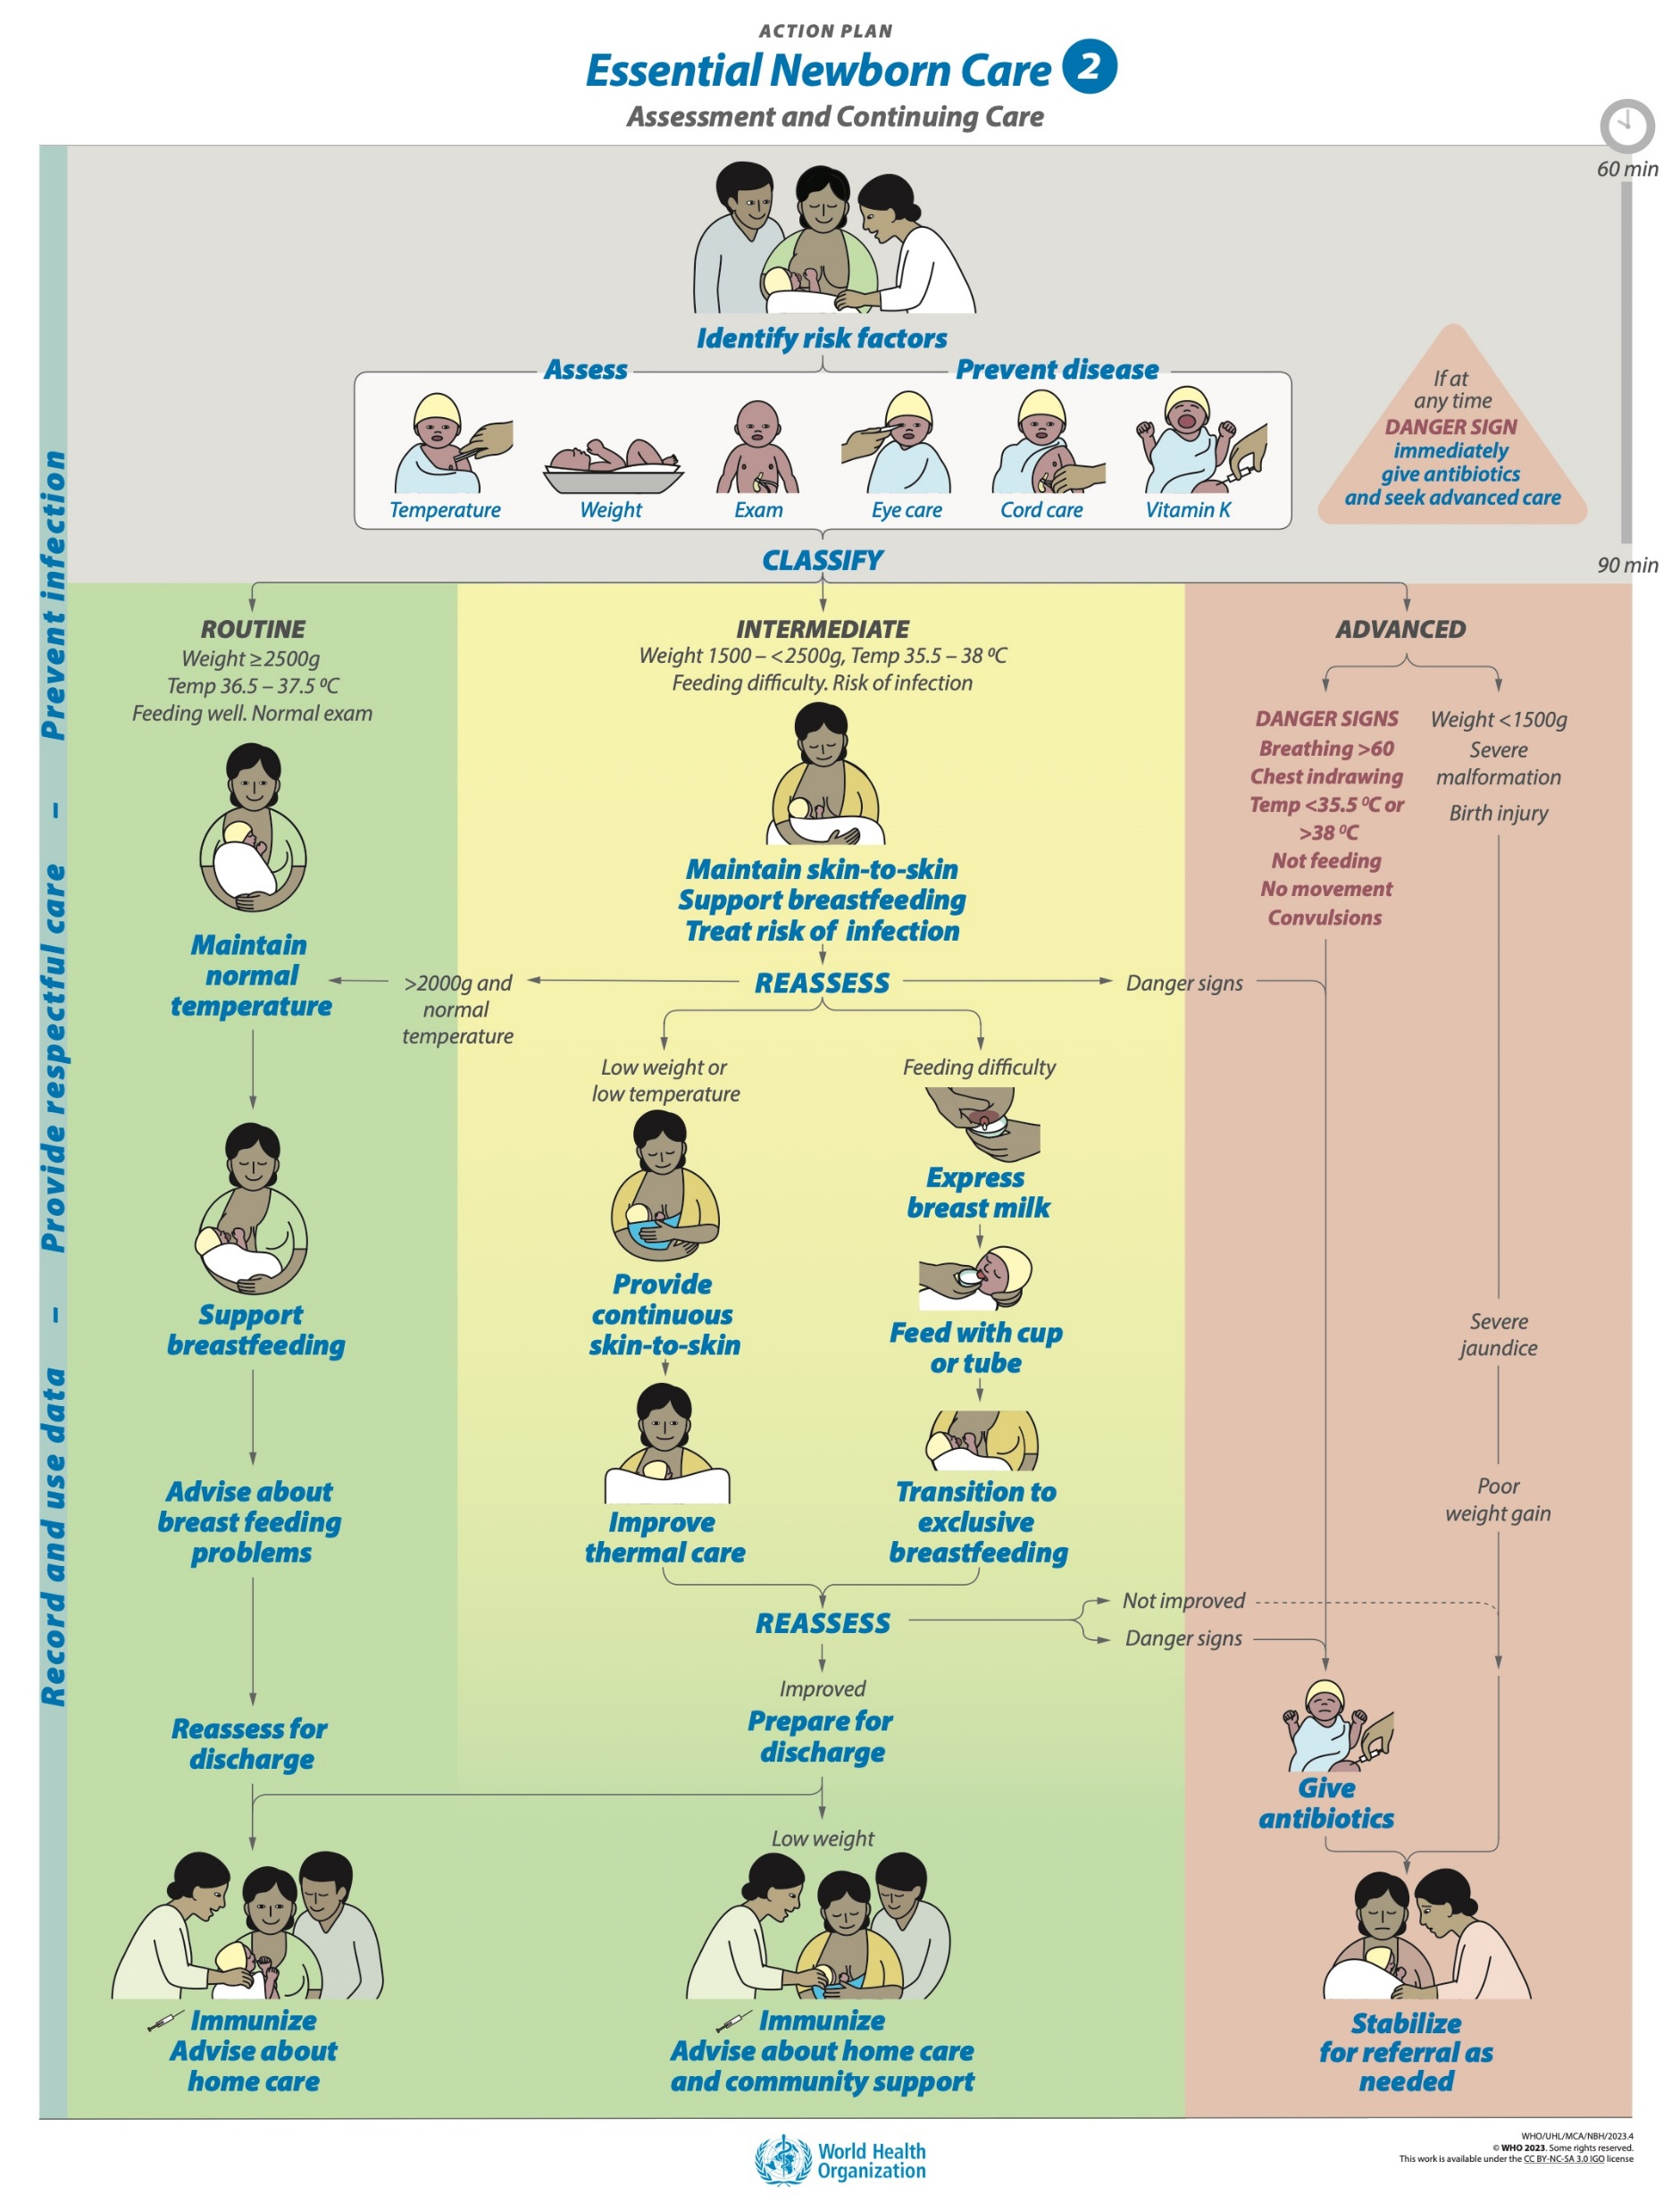
Goal and learning outcomes
All newborns are protected
from hypothermia and hyperthermia.
  Implement care that prevents heat
  loss and maintains warmth.
  Identify newborns with abnormal
  temperature and manage correctly.
  Use alternative warming methods
  safely when necessary.
  Communicate effectively to parents
  how they can keep the baby warm
  and when low or high temperature
  is a danger sign.

Slide 4
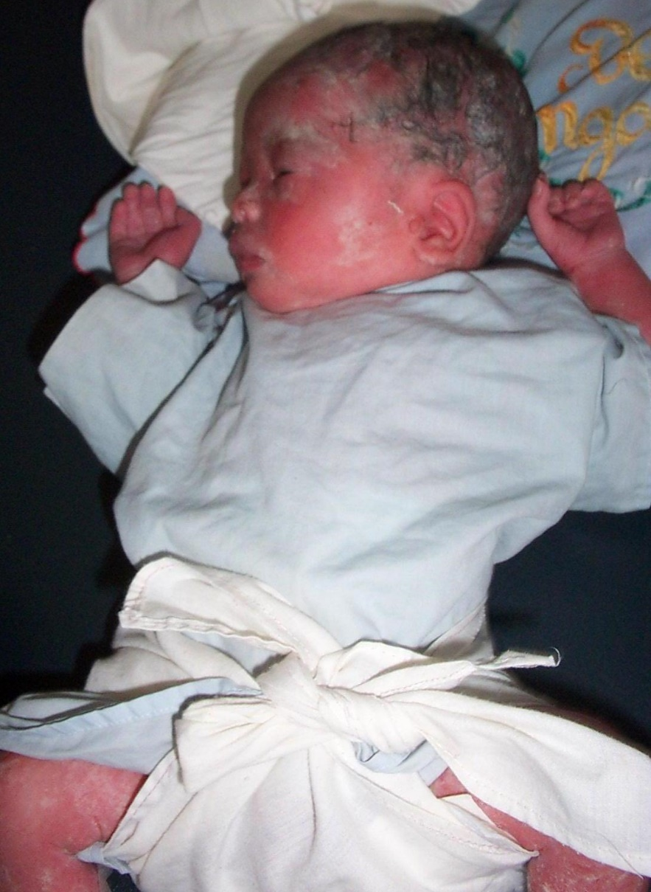
The situation
Budi was born at term one hour ago
by spontaneous vaginal delivery.
He is lying next to his mother.
When examining Budi
    His feet are cold to the touch.
    His temperature is 36.0 °C.
The nurse midwife suggests placing
Budi under a radiant warmer.
What would you do differently?
© WHO/Dr Helenlouise Taylor
Notes:
Keep the newborn and mother together skin-to-skin from birth.
Budi should not be separated and placed under a radiant warmer or in an incubator.
Explain to Budi’s mother that he is cold and needs skin-to-skin care and why it is important.
Support her to provide safe skin-to-skin care.
Change wet clothes or diaper.

Slide 5
Keep Ekta warm in the delivery room
Form groups (mother, midwife and companion).
Carry out immediate care to ensure that Ekta remains warm.
Debrief with your team and facilitator.
Leela just gave birth to Ekta by spontaneous vaginal delivery at term.
Ekta cried immediately at birth.
Notes:
Baseline Simulation
Skills and performance – participants demonstrate immediate care after birth to maintain warmth.
Drying head, body, arms and legs thoroughly and removing wet cloth
Positioning the newborn in skin-to-skin contact – no separation for assessment
Covering head and body with blanket and hat
Monitoring breathing, colour, temperature in skin-to-skin contact
Communicating clearly to mother and companion about thermal protection
Debriefing – participants self-reflect and give feedback in their roles.
Provision of care (performance objectives)
What was done well?
What could have been done better?
What will you change the next time?
Was assessment
Experience of care
Was the communication respectful and the language appropriate?
Was handling of the baby gentle?
Were infection prevention practices followed?

Slide 6
Keeping the newborn warm

Slide 7
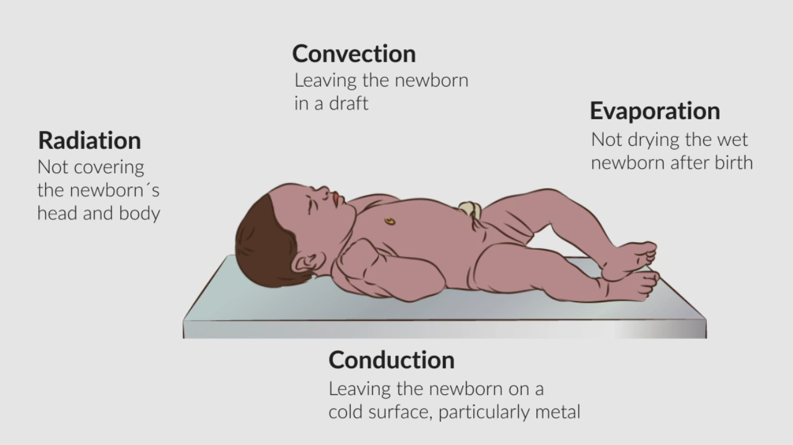


How will this newborn lose heat?
This baby is lying on
a metal surface.
This baby is not in skin-
to-skin contact with her
mother.
This baby is not covered.
This baby is exposed
if there is a draught.
This baby’s head is not
covered.
© WHO/ Sandra Lang
Thermal protection
Notes:
Low body temperature is a risk in the first hours after birth for ALL newborns.
A baby begins to lose heat immediately after birth because the environment is much colder than the woman’s uterus and the baby is wet with amniotic fluid.

Slide 8

What is the warm chain?
Warm delivery room temperature – at least 25 °C
Immediate thorough drying, within 5 seconds of birth
Prolonged skin-to-skin contact – 60-90 minutes
Early initiation of breastfeeding
Delayed bathing (24h) and weighing
Appropriate clothing and bedding
Zero separation: mother and baby together
Warm transportation (skin-to-skin)
Warm resuscitation (if required)
Awareness and education of health workers and
care givers
AIIMS Warm chain
Notes:
View video
What new knowledge is presented in this video?
Are there any skills or practices that differ from your current practice?
What provider behaviours differ from your current practice?
Does this video highlight any quality gaps in your facility?

Slide 9
Keep the newborn warm
In the delivery room
Ensure no air draughts. (Close windows and doors.)
Adjust delivery room temperature between 25 and 28 °C.
Deliver the newborn onto a dry cloth on the mother’s abdomen.
Dry the newborn immediately by wiping thoroughly.
Discard the wet cloth.
Start skin-to-skin contact with the mother.
Cover the baby’s body with dry cloth and head with hat/bonnet.
Maintain zero separation for at least 1 hour.
Notes:
Practise actions to keep a newborn warm in the delivery room.
Many normal babies become cold because they are not dried thoroughly, are left on wet cloths, or are separated from their mothers.
Skin-to-skin contact can be too easily forgotten in the delivery room, when midwives and obstetricians may be focusing on the mother and delivery of the placenta or on emergencies.
Separation from the mother may causes distress and hypothermia, exposure to infection and delayed initiation of breastfeeding.
Skin-to-skin care should be continued to stabilize the baby’s temperature and allow early initiation of breastfeeding and for as long as the mother desires.
If a mother is not well, other family members can provide skin-to-skin care.
To learn more
Improving thermal care

Slide 10
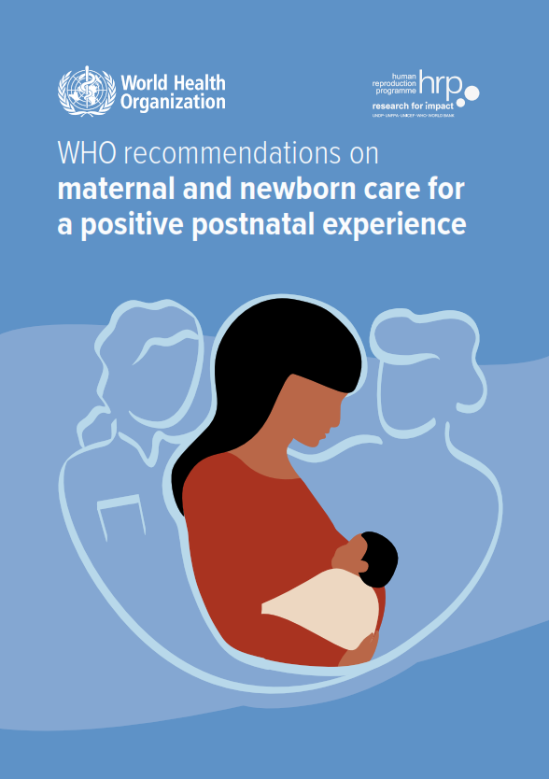
What is the evidence for delaying the first bath?
Find the recommendation and evidence on pages 114-116.
Notes:
Use a printed or digital copy (pdf) of the document.

Slide 11
Recommendation and reasons
The first bath of a term, healthy newborn should be delayed
for at least 24 hours after birth.
Reasons
A delayed first bath (after 24 hours) may:
    reduce infant all-cause mortality
    reduce neonatal hypothermia.
A delayed first bath (after 6 hours) may:
    reduce neonatal hypothermia
    reduce neonatal hypoglycaemia
    increase exclusive breastfeeding at discharge.
Notes:
Is this recommendation currently applied in your place of work?
If yes, what enabling factors support the application of this recommendation?
If no, what are the barriers to applying this recommendation?

Slide 12
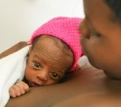
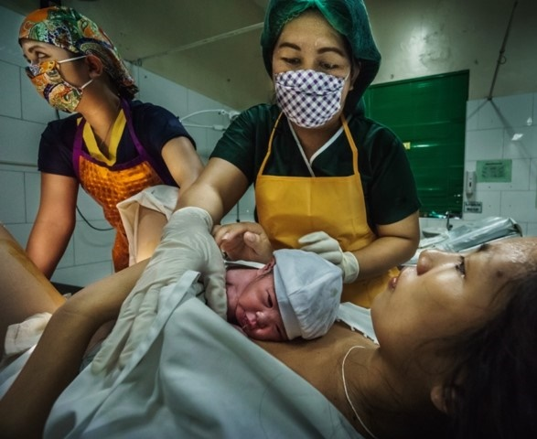
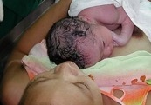
Why promote early and prolonged skin-to-skin contact for all newborns?
© UNICEF/UN0319780/Kanobana
© WHO/Yoshi Shimizu
© WHO/Yoshi Shimizu
Maintains warmth and prevents hypothermia
Lowers infection and mortality
Enables establishment of breastfeeding
Promotes bonding
Notes:
Does every newborn experience this where you work?

Slide 13
Practice immediate thorough drying
Deliver the newborn onto a dry cloth placed over the
mother’s abdomen.
Dry the newborn immediately by wiping face, head,
trunk, back, arms and legs thoroughly.
Dry the newborn by rubbing, not patting, but do not
remove the vernix.
Remove the wet cloth to start skin-to-skin contact.
Cover the baby’s body with a dry cloth and head with
a hat/bonnet.
Zero separation of mother and baby for 1 hour
prevents hypothermia.
Immediately drying the newborn 0:30-1:28
Notes:
View video
Did you notice that the hands were not dried?
Leaving amniotic fluid on the baby’s hands promote early initiation of breastfeeding by stimulating the baby’s olfactory (smell) response.
(Klaus and Kennel, 2001)
Practise immediate thorough drying with the newborn mannequin.

Slide 14

Why may newborns become hypothermic in the postnatal ward?
Cold environment (day$–$night variability)
Open windows and doors
Broken window glass, frames, handles
Ceiling fans
No heaters
No room thermometer to check temperature
Newborn left in wet diaper or cloth
Bathing the baby
Newborn separated from mother
Newborn not wearing enough clothing
Mother not prepared with clothing and wrap for baby
Transfer in open air from delivery room to another building
Inadequate monitoring of newborn temperature and response
Notes:
Do any of these apply in your health facility?

Slide 15

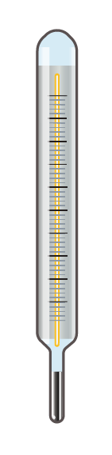
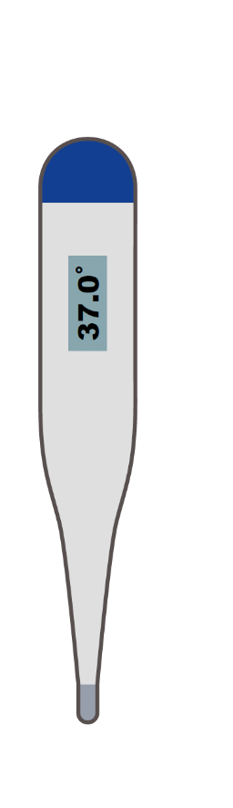
Take the temperature
Wash hands correctly and clean the thermometer.
Keep newborn in skin-to-skin contact.
Put the tip of the thermometer high in the armpit (axilla).
Hold the arm against the chest, 3–5 minutes for
a mercury thermometer before reading.
Digital thermometers can be read quickly.
Record the temperature in the newborn’s notes.
Clean the thermometer after use.
Taking the temperature 1:18–2:40
Notes:
Practise taking the temperature with the newborn mannequin.

Slide 16
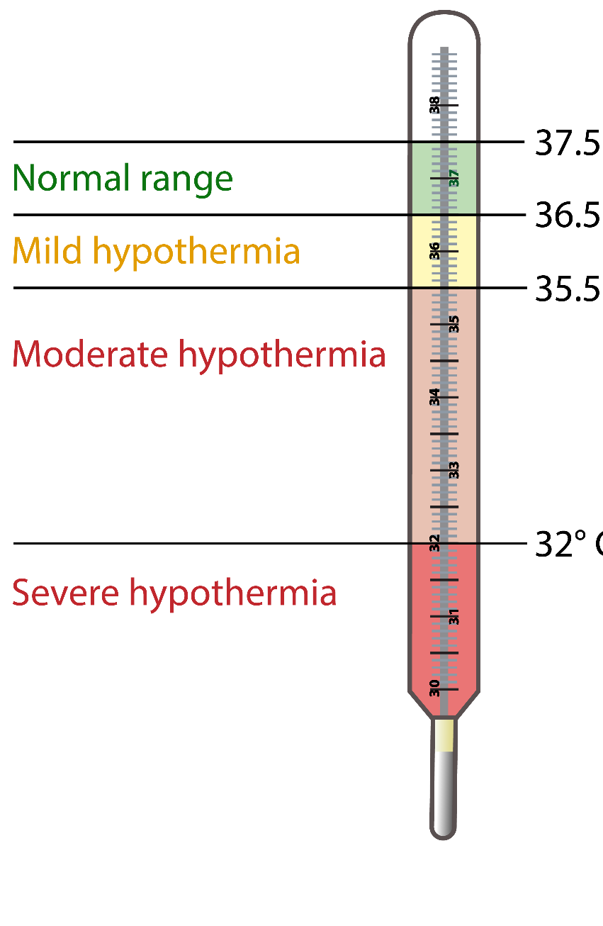
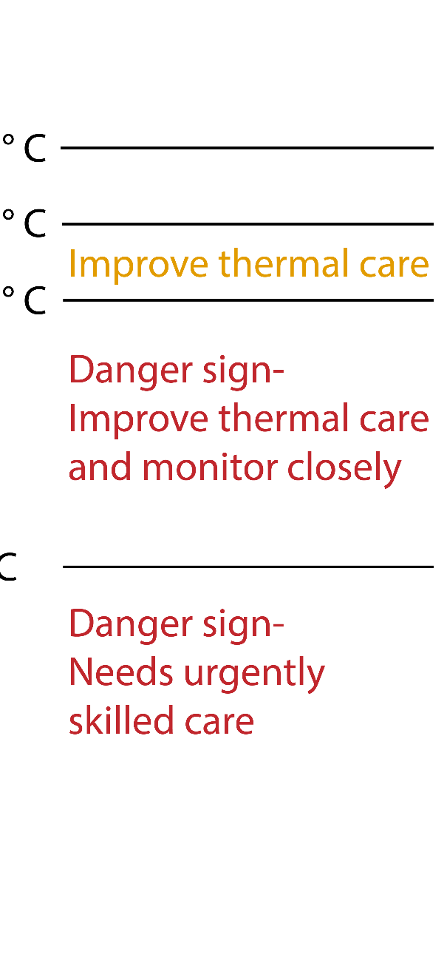

Check temperature ranges
Danger sign-Urgently needs skilled care
Notes:
What are the decision-making points and actions for mild, moderate, and severe hypothermia?

Slide 17
When do you monitor and record temperature?
All newborns: within 90 minutes after birth, at least twice in the first 24 hours, and
once per day until discharge
When a newborn is preterm/low birth weight, sick or has any danger sign
When a baby is admitted to hospital
When a newborn is suspected of being too cold (hypothermic) or too hot (hyperthermic)
When re-warming or cooling during management of hypo- and hyperthermia
How frequently do you measure temperature?
Measure axillary temperature using a thermometer and record it:
2–4 times per day for preterm or small baby (<2500 g), sick newborn or newborn
with a danger sign
More often when thermal environment varies day/night, when newborn cannot be
maintained in skin-to-skin contact, or when the newborn is unstable.
Check and use unit guidelines for specific conditions.
Notes:
What are your health facility protocols for frequency of temperature measurement?
In some environments a large difference between day and night temperatures requires frequent monitoring to avoid hypothermia.
The temperatures of small or sick newborns should be taken more frequently.
Record temperature in clinical notes.
Do NOT take a rectal temperature. It is not necessary and can cause harm.

Slide 18
Hypo- and hyperthermia

Slide 19
What is hypothermia?
If a newborn has a temperature of less than
36.5 °C, the newborn has hypothermia.
Hypothermia is a risk to newborns in all
climates.
Hypothermia is frequent where the temperature difference between day and night is large or
when transferring from delivery room to
postnatal ward.
Notes:
What percentage of newborns have an admission temperature 36.5-37.5 °C on initial assessment in your health facility?
What percentage have a temperature less than 36.5 °C ?

Slide 20
What signs indicate that a newborn may have mild hypothermia?
Activity decreased
Breastfeeding inadequate
Weak cry
Respiratory distress (fast or difficult breathing)
Cold feet and hands (may also have a cold body)
Hypoglycaemia
Notes:
When does mild hypothermia occur in your health facility?

Slide 21
What signs indicate severe hypothermia?
Face, hands and feet may develop a bright red colour (in all skin colours).
The skin over the back and limbs or over the whole body may become
hard, together with reddening and oedema.
Breathing becomes slow, shallow and irregular, with slow heartbeat.
Blood sugar falls (hypoglycaemia), with metabolic acidosis and possible
internal bleeding.
    Blood glucose levels must be checked in every newborn with hypothermia,
    and hypoglycaemia must be treated appropriately.
    Hypothermia may be a sign of serious bacterial infection in a newborn.
    Urgent referral for skilled care is needed.
  Hypothermia definitions and physiology
Notes:
Have you ever seen severe hypothermia in a newborn?
What did you observe?
View video
What new knowledge is presented in this video?
Are there any skills or practices that differ from your current practice?
What provider behaviours differ from your current practice?
Does this video highlight any quality gaps in your facility?

Slide 22
What actions do you take for hypothermic newborns?
Make sure the room is warm, at least 25 °C, no draughts.
Remove wet clothes, change nappy and put on warm
clothes, hat, mittens and socks.
Place baby in continuous skin-to-skin contact day and night.
Cover with the mother’s clothes and an additional
pre-warmed blanket.
Monitor temperature (axilla) every 15 minutes until normal,
then after two hours. Temperature should rise by 0.5 °C
per hour.
Assess the baby carefully for changes in condition, danger
signs and signs of infection.
If the newborn's temperature does not rise to 36.5 °C
or more after 2 hours of rewarming, reassess and refer
to a higher level of care.
Maintain zero separation.
Hypothermia management
Notes:
View video
What new knowledge is presented in this video?
Are there any skills or practices that differ from your current practice?
What provider behaviours differ from your current practice?
Does this video highlight any quality gaps in your facility?
To learn more
The cold baby

Slide 23
Recap: Refer if danger sign
Danger sign: A newborn has a temperature of less than 35.5 °C or greater than 38 °C or the newborn’s
temperature does not rise after improved thermal care.
This newborn might have a severe infection and needs to be referred urgently to higher level of care for treatment.
During referral, keep the newborn skin-to-skin with the
mother or family member accompanying the newborn.
Notes:
Practise the steps in referral of a newborn whose temperature is a danger sign.
Consider whether the newborn will be cared for in the same or another facility.
Decide what additional care is needed before and during referral (for example, antibiotics).
Describe how the newborn will be kept secure and warm during referral.

Slide 24
Why is thermal protection for small newborns important?
Each year more than 20 million newborns weighing less than 2500 g at
birth have
    Impaired ability to regulate temperature
    Vulnerability to hypo- or hyperthermia in facilities and at home.
Early temperature support is an important aspect of essential
newborn care.
Hypothermia and hyperthermia are associated with increased
mortality and poor outcomes.
Notes:
How do you provide thermal care for small newborns where you work?
Small newborns benefit from prolonged skin-to-skin contact and immediate kangaroo mother care to prevent hypothermia.

Slide 25
Keep Ekta warm in the delivery room
Form groups (mother, midwife, companion).
Carry out all steps to keep Ekta warm and maintain normal temperature.
Debrief with your team and facilitator.
Leela gives birth to Ekta at term. He is normal size.
Ekta cries immediately.
Notes:
Repeat simulation
Skills and performance – participants demonstrate immediate care after birth to maintain warmth.
Drying head, body, arms and legs thoroughly and removing wet cloth
Positioning the newborn in skin-to-skin contact – no separation for assessment
Covering head and body with blanket and hat
Monitoring breathing, colour, temperature in skin-to-skin contact
Communicating clearly to mother and companion about thermal protection
Debriefing – participants self-reflect and give feedback in their roles.
Provision of care (performance objectives)
What was done well?
What could have been done better?
What will you change the next time?
Was assessment
Experience of care
Was the communication respectful and the language appropriate?
Was handling of the baby gentle?
Were infection prevention practices followed?
To learn more
Thermal protection of newborn WHO CC AIIMS

Slide 26
Keep Ekta warm during transfer to postnatal ward
Form groups (mother, nurse, and companion).
Carry out all steps to keep Ekta warm and maintain normal temperature
during transfer.
Debrief with your team and facilitator.
The postnatal ward is in another building 150 m distant from the delivery room, on the other side of the car park.
You need to transfer Ekta and Leela to the postnatal ward.
Notes:
Simulation
Skills and performance – participants demonstrate steps to maintain normal temperature during transfer to the postnatal ward.
Removing any wet cloths, clothing or head covers and replacing with dry
Securing Ekta in skin-to-skin contact for transfer
Covering Ekta and Leela with a warmed blanket
Communicating the importance of skin-to-skin contact to maintain warmth
Debriefing – participants self-reflect and give feedback in their roles.
Provision of care (performance objectives)
What was done well?
What could have been done better?
What will you change the next time?
Was data recorded and used?
Experience of care
Was the communication respectful and the language appropriate?
Was handling of the baby gentle?
Did Leela feel that Ekta was secure in skin-to-skin contact?

Slide 27
Keep Ekta warm at night
Form groups (mother, nurse, and companion).
Counsel and support Leela to carry out all steps to keep Ekta warm and maintain normal temperature.
Debrief with your team and facilitator.
In the postnatal ward there is a variation of 15 °C between day and night.
Notes:
Simulation
Skills and performance – participants demonstrate steps to maintain normal temperature at night on the postnatal ward.
Removing any wet cloths, clothing or head covers and replacing with dry
Encouraging Leela to keep Ekta in skin-to-skin contact through the night
Securing Ekta in skin-to-skin contact with an appropriate binder or wrap
Covering Ekta and Leela with a warmed blanket
Communicating the importance of skin-to-skin contact to maintain warmth
Debriefing – participants self-reflect and give feedback in their roles.
Provision of care (performance objectives)
What was done well?
What could have been done better?
What will you change the next time?
Was data recorded and used?
Experience of care
Was the communication respectful and the language appropriate?
Was handling of the baby gentle?
Were infection prevention practices followed?

Slide 28
What is hyperthermia and what are its physical signs?
What is hyperthermia?
A temperature above 38.0 °C
What are the signs of hyperthermia?
Irritability
Agitation
Sweating
Convulsions
Notes:
Do newborns experience hyperthermia in your health facility?
Overheating can cause death, dehydration, apnoea or brain injury.

Slide 29
What are the causes and management of hyperthermia in a newborn?
What causes hyperthermia?
Too many wraps/clothes in hot weather
Placing the newborn next to a heater
An environment too hot for the newborn
Use of a mechanical warming device without servo-control
How do you manage the baby?
Move newborn away from the source of heat, for example, heater, direct sun.
Undress the newborn.
Give frequent breastfeeds.
Examine carefully for signs of infection.
Refer the baby if temperature above 38.0 °C. This is a danger sign.
  Manage hyperthermia (WHO CC AIIMS)
Notes:
Do any of these apply to your setting?
Referral depends on your setting
Refer can mean request a paediatrician or neonatologist to review, or
Refer internally if there are different levels of care in the hospital, or
Refer to another hospital.
View video
What new knowledge is presented in this video?
Are there any skills or practices that differ from your current practice?
What provider behaviours differ from your current practice?
Does this video highlight any quality gaps in your facility?

Slide 30
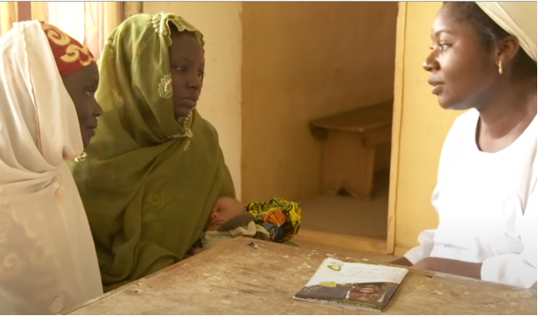
How do you keep a newborn warm during referral?
By skin-to-skin contact with the
mother or with another person
if the mother is not able to
accompany the newborn
By using a clean functioning
incubator accompanied by a health worker who is trained in its use
  Referring-a-sick-baby
Notes:
View video
What new knowledge is presented in this video?
Are there any skills or practices that differ from your current practice?
What provider behaviours differ from your current practice?
Does this video highlight any quality gaps in your facility?

Slide 31
Alternative warming methods

Slide 32
When and how to use alternative warming methods (radiant warmer and incubator)?
When
Skin-to-skin contact is not possible and other methods are available.
Staff are trained in the use of equipment. (Incorrect use can be
dangerous.)
How
Select a safe alternative warming method.
Follow the manufacturer’s instructions.
Monitor the newborn’s temperature using continuous monitoring and
functional neonatal temperature probes.
Thoroughly clean and disinfect warming devices to prevent health
facility-acquired infections.
Notes:
Is this the practice in your health facility?

Slide 33
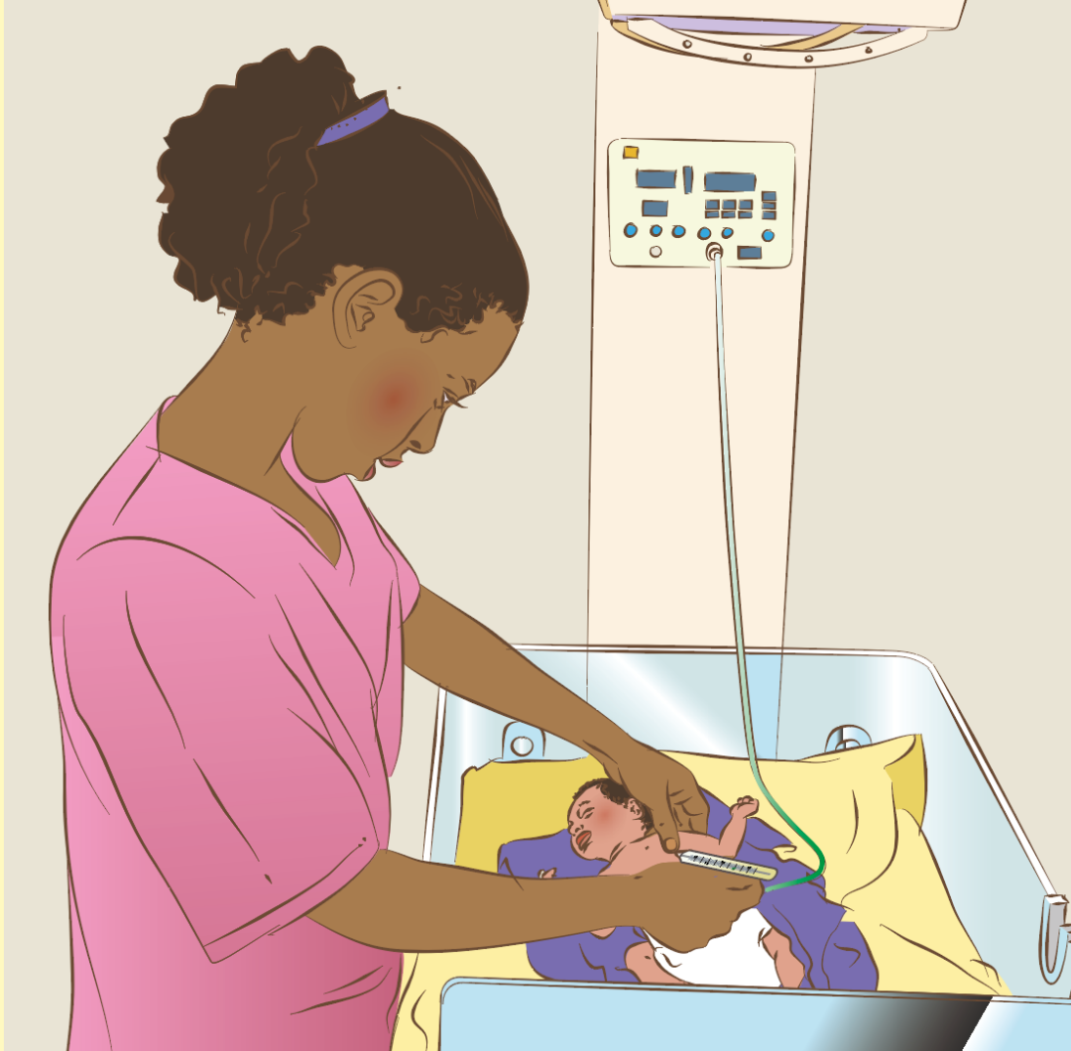
What is safe use of a radiant warmer?
Safe use includes
Preparation, cleaning, infection prevention
Policies and training for health workers
Indications for use: when and how to start
and stop if skin-to-skin contact is not
possible
Monitoring
Care and maintenance of equipment
Use radiant warmer safely (WHO CC AIIMS)
Notes:
View video
What new knowledge is presented in this video?
Are there any skills or practices that differ from your current practice?
What provider behaviours differ from your current practice?
Does this video highlight any quality gaps in your facility?
To learn more
Radiant-Warmer NEST 360
Introduction radiant warmer
Maintenance and troubleshooting radiant warmer

Slide 34
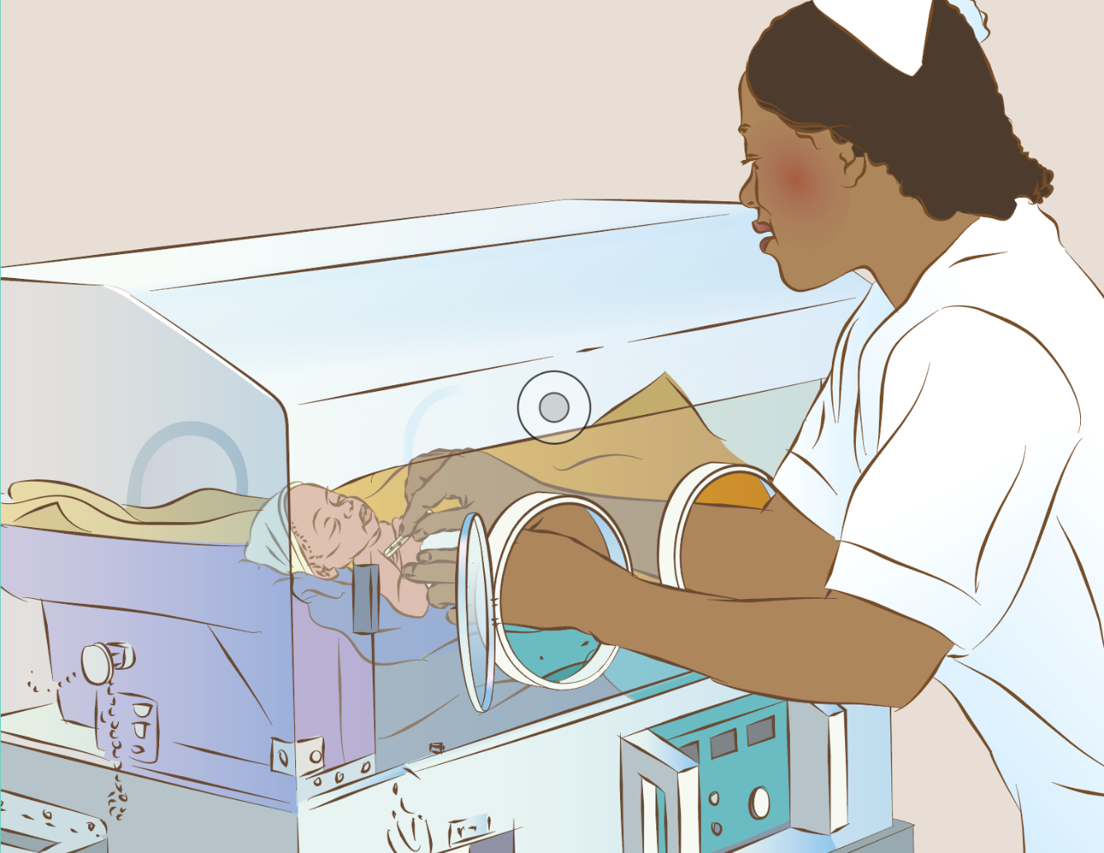
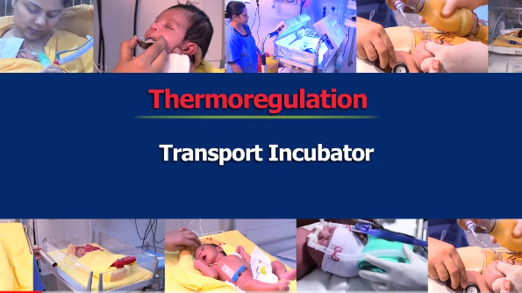
Overview: safe use of incubator if skin-to-skin contact not possible
Use incubator safely (WHO CC AIIMS)
Transport incubator (WHO CC AIIMS)
Notes:
Which babies are placed in incubators where you work?
What is safe use of incubators?
Safe use includes knowing:
when and how to use correctly
which babies cannot have skin-to-skin care
how to clean and prevent infection
how to care for and maintain the equipment
complications of using an incubator for the newborn and mother/family
how to troubleshoot if malfunctioning on the ward or during transport (simple technical difficulties).
View video/s
What new knowledge is presented in this video?
Are there any skills or practices that differ from your current practice?
What provider behaviours differ from your current practice?
Does this video highlight any quality gaps in your facility?

Slide 35

What actions can be taken to ensure safe thermal care for all newborns?
Involve and support parents and families directly in inpatient care (skin-to-skin).
Counsel for care at home.
Increase awareness of newborn hypo- and hyperthermia among
ALL staff, students and families.
Use clinical guidelines and apply the standards for newborn care.
Build the capacity of health workers for safe thermal care.
Ensure safe thermal care during referral or transfer.
Maintain infrastructure, equipment and supplies for thermal care.
Monitor and document equipment maintenance, cleaning and
staff training on safe use.
Measure and monitor standard indicators for thermal care.
© WHO/Dr Helenlouise Taylor
Notes:
What indicator/s do you use for monitoring thermal care in your health facility?

Slide 36
Summary
In this module, you have:
Demonstrated methods that prevent heat loss and maintain warmth for every newborn
Identified and correctly treated newborns with abnormal temperature (hypothermia and hyperthermia)
Identified when and how to use alternative warming methods
Demonstrated how to communicate effectively to support the mother and family to keep the baby warm.

Slide 37
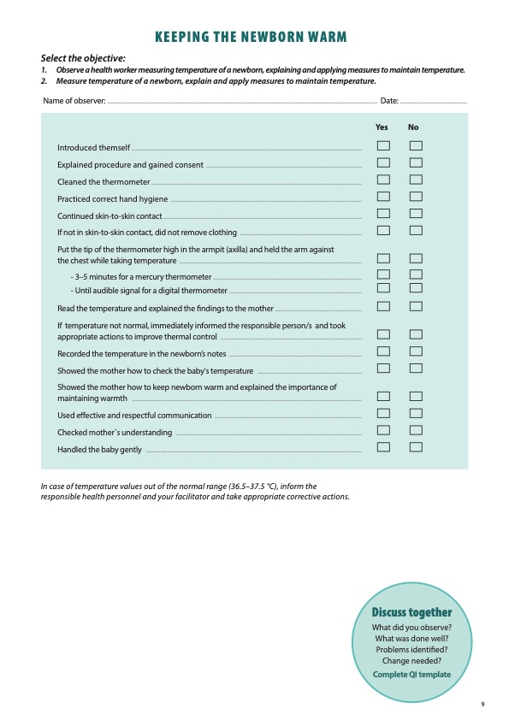
Notes:
Review the Clinical practice checklist before observing or practicing in the clinical area.

Slide 38
Notes:
After the clinical practice, discuss the observations made, possible reason for practices, and changes needed to improve the quality of essential newborn care.
What new things will you do?
What old things will you not do?
How will you make a change?
Use your reflections to fill out the QI template.

Slide 39
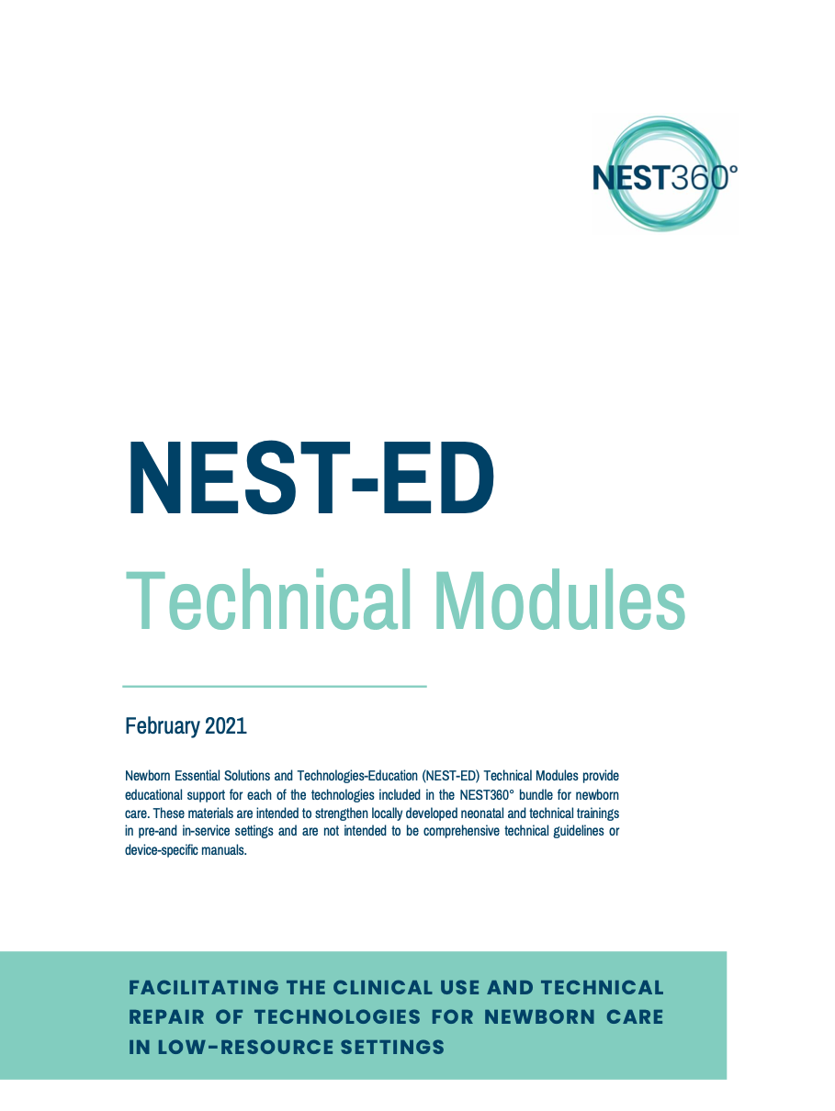
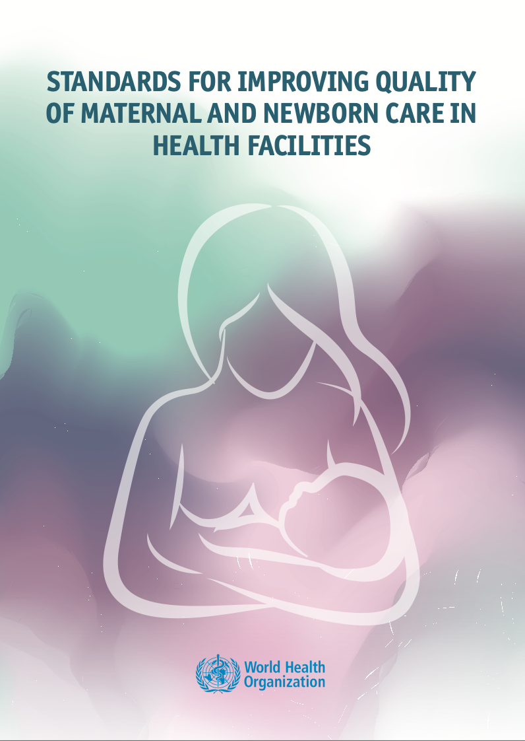
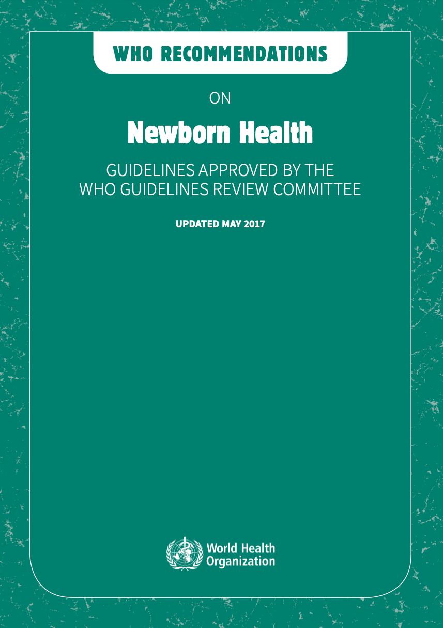
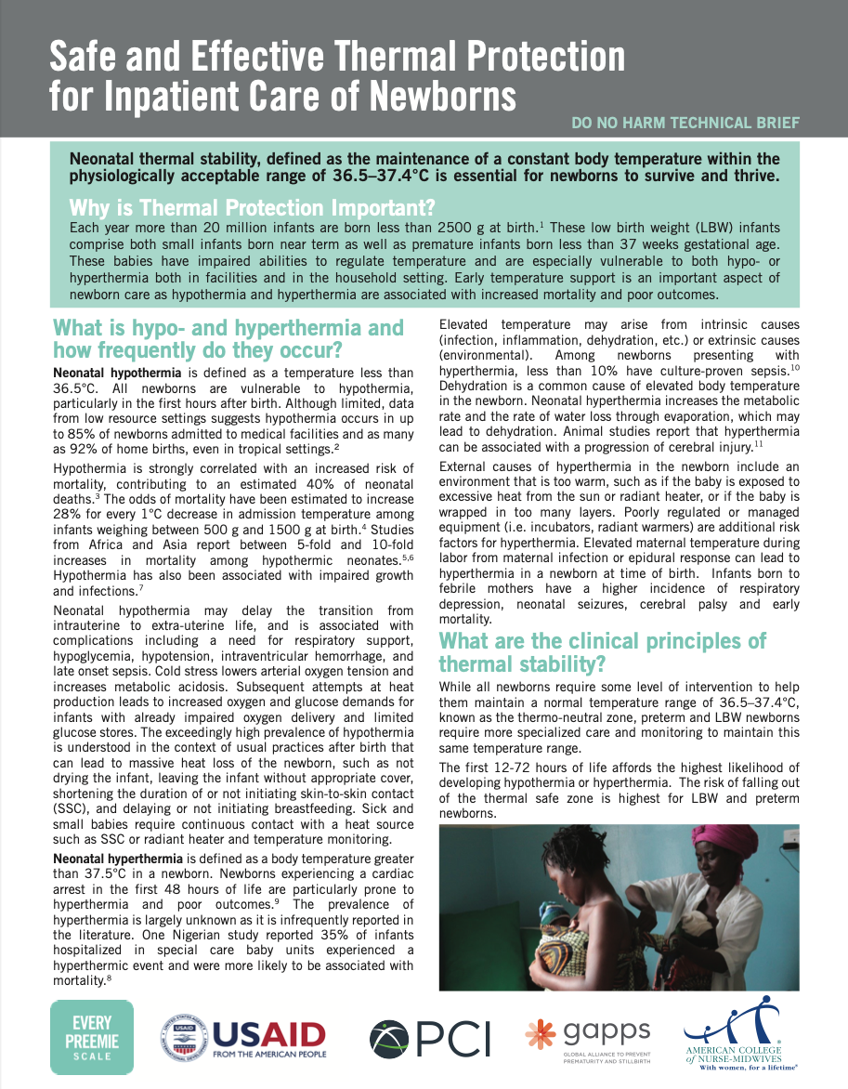
References and additional resources
Poster: Thermal protection (WHO CC AIIMS)

