Slide 1
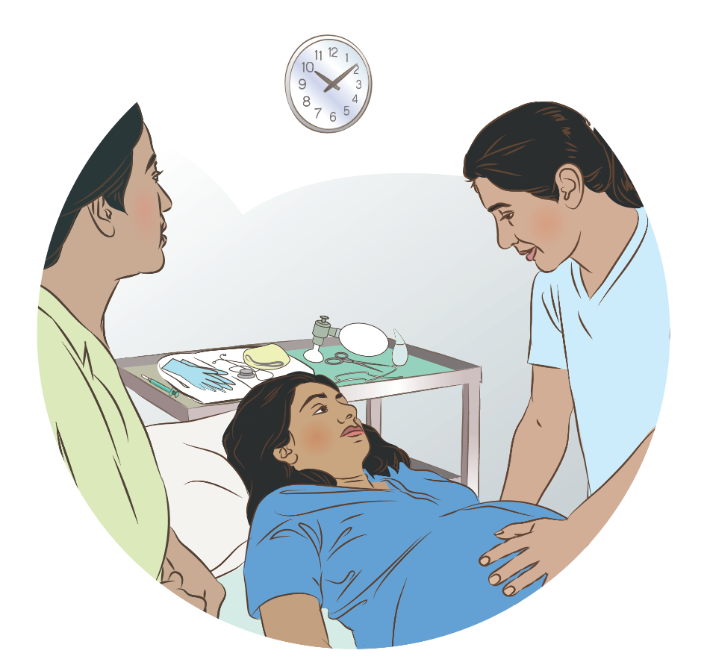

Preparation for birth
Notes:
© World Health Organization 2024. All rights reserved.
Materials for demonstrations, practice, and simulations
Organise one set per group of 3 participants and a set for the facilitator (as available).
If possible, use a vacant delivery area for simulations in this module.
Appropriate personal protective equipment (for context - apron, utility or sterile and non-sterile gloves, mask, eye protection)
Colour-coded clinical waste disposal containers; sharps boxes
Delivery set or clean delivery kit (for humanitarian or specific situations)
Uterotonic (for mother)
Clock with second hand
Room thermometer
Cord clamps/ties
Sterile scissors/blade
Two towels for drying
Head covering (for newborn)
Self-inflating bag (250–400 mL)
Two neonatal masks (sizes 0 and 1)
Suction device (reusable)
Stethoscope
Soft, warm cover (for mother and newborn)

Slide 2
Content
Goal and learning outcomes
The situation
Welcoming mother and assessing risk factors
Preparing for birth
Summary
Clinical practice
Quality improvement
References and additional resources

Slide 3
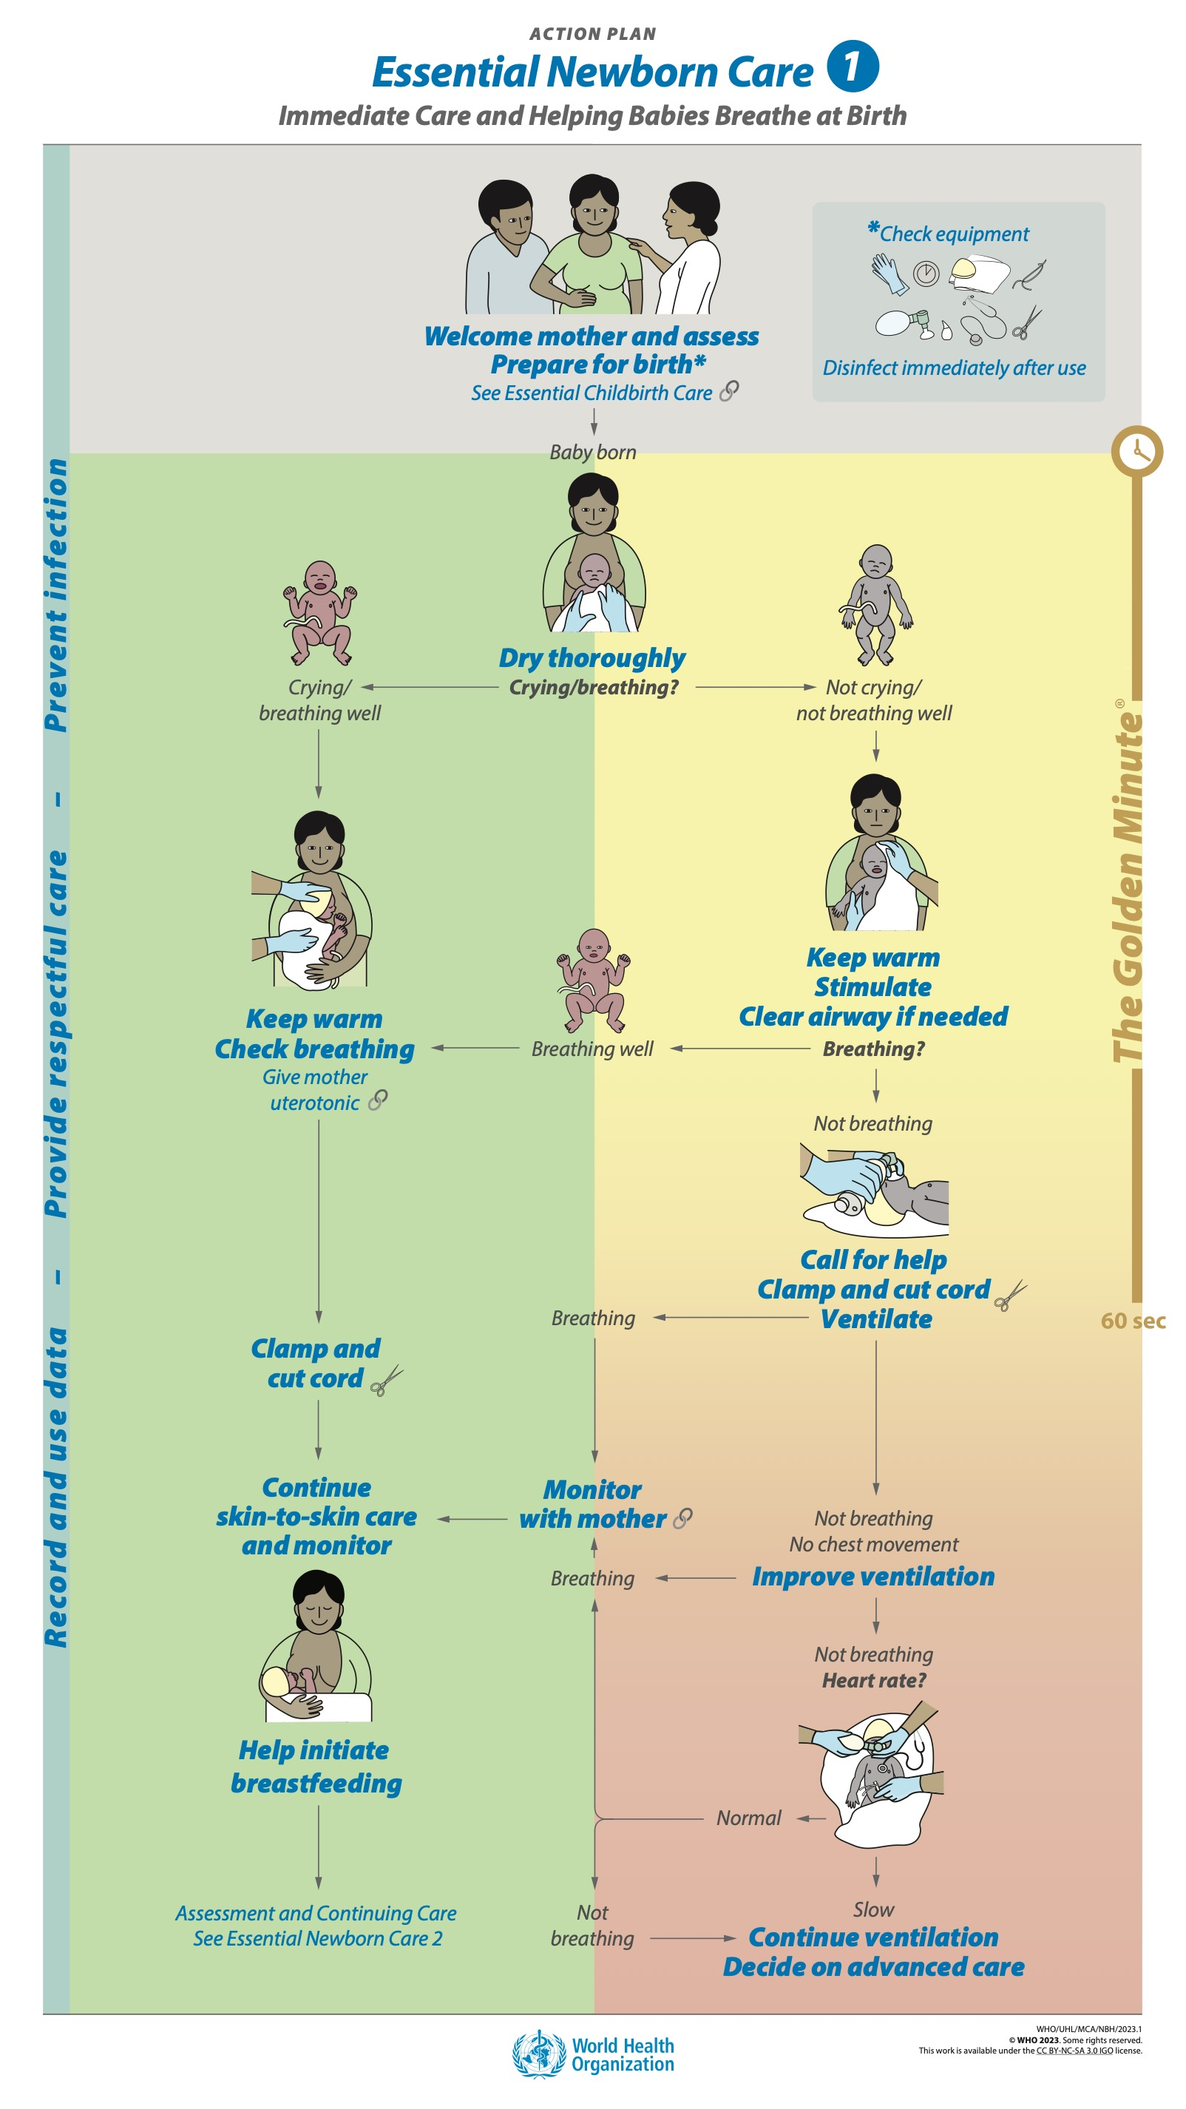
Goal and learning outcomes
Prepare a clean, safe, and welcoming
environment for birth.
  Welcome mother and assess risk
  factors that affect newborn care.
  Identify a helper and review the
  emergency plan.
  Prepare the delivery area to ensure
  privacy and safety.
  Organise equipment and supplies.

Slide 4
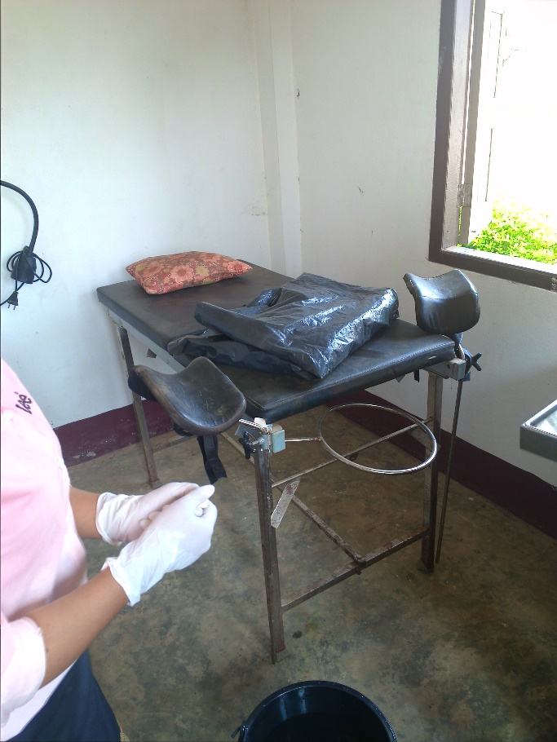
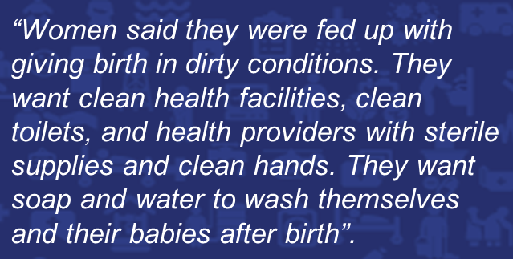
The situation
Lydia has decided to deliver her second baby
at home.
Why might she make that decision?
When she delivered her first baby, there were
no curtains and anyone passing could see
her in labour. She found the delivery room
was not very clean. The midwife was unfriendly.
© WHO/Dr Helenlouise Taylor
What Women Want survey:
Demands for quality health care for women and girls (2019).
https://www.whatwomenwant.org/ (1.2 million women surveyed)
Notes:
What prevents women from delivering their babies in your health facility?
What can be done to make a more clean, safe, and welcoming environment?

Slide 5
Welcoming mother and assessing risk factors

Slide 6
Prepare for birth
Form groups (midwife, mother, companion).
Welcome the mother and her companion and prepare for birth.
Debrief with your team and facilitator.
Madame Sylla arrives with her mother
This is her third baby, and delivery will occur very soon.
Notes:
Baseline simulation
Skills and performance – participants demonstrate welcoming the mother and preparing for birth.
Welcoming the mother
Encourage a companion in labour
Assess risk factors
2. Preparing for birth
Identify a helper and review the emergency plan
Prepare the area for birth
Wash hands
Prepare an area for ventilation
Assemble and test equipment
Check that a uterotonic is prepared
Debriefing – participants self-reflect and give feedback in their roles.
Provision of care (performance objectives)
What was done well?
What could have been done better?
What will you change the next time?
Experience of care
Was communication respectful and language appropriate?
Were infection prevention practices followed?
Was the equipment well organised to facilitate continued monitoring of mother and baby?

Slide 7
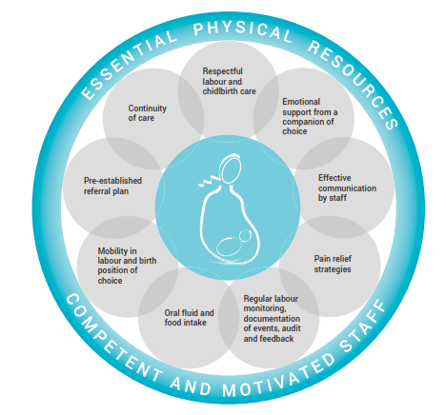
What makes a positive birth experience?
Notes:
What actions show respect and make a birth experience positive?
Respectful labour care means that no intervention should be implemented without a clear medical indication and consent from the woman.
Is care provided in this way in your facility?
To learn more
Intrapartum care for a positive childbirth experience

Slide 8
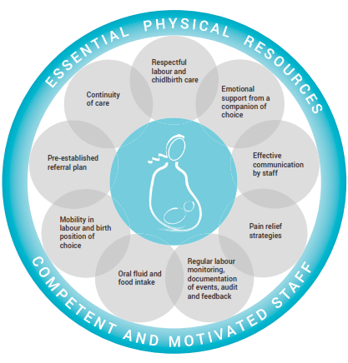
What will you encourage while a woman is in labour?
Encourage birth companion(s) to
  Stay with the woman
  Wash hands
  Encourage the woman to
Move around
Choose comfortable position(s)
Eat and drink
Use toilet to empty her bladder
Wash her hands
Notes:
Attention to physical and emotional needs improves the experience of birth for the mother.
Why are they also important for the baby?
Why is handwashing especially important for the woman and her companion?

Slide 9

Why is a companion during labour and childbirth recommended?
Find the recommendations on pages 29–30.
Notes:
Use a printed or digital copy (pdf) of the document to find the recommendations.

Slide 10
WHO recommendation and evidence
A companion of choice is recommended for all women throughout
labour and childbirth.
Companionship during labour and childbirth may:
  Increase spontaneous vaginal births.
  Reduce caesarean sections and instrumental vaginal births.
  Reduce low Apgar scores at 5 minutes.
Notes:
Women everywhere value feeling in control during labour and confident in their ability to give birth with a companion present.
Are there any concerns about implementing this recommendation?
Does this recommendation highlight any quality gaps in your setting?

Slide 11
Assess risk factors affecting newborn care
Review the mother’s records with her.
Pregnancy
    Gestational age
    Number of fetuses
    Growth of the fetus
    Chronic or pregnancy-related disease
    Infections
    Immunization status
Labour
    Danger Signs and vital signs in mother
    Rupture of membranes
    Progress of labour
    Fetal well-being
Notes:
Practise with the antenatal and labour/delivery/partograph forms from your facility.
With this information, you can explain the care planned for the newborn immediately after birth.
This is an opportunity to discuss skin-to-skin care and initiation of breastfeeding, as well as the emergency plan, with mother and her companion.
Do these forms provide all the information needed?

Slide 12
Preparing for birth

Slide 13
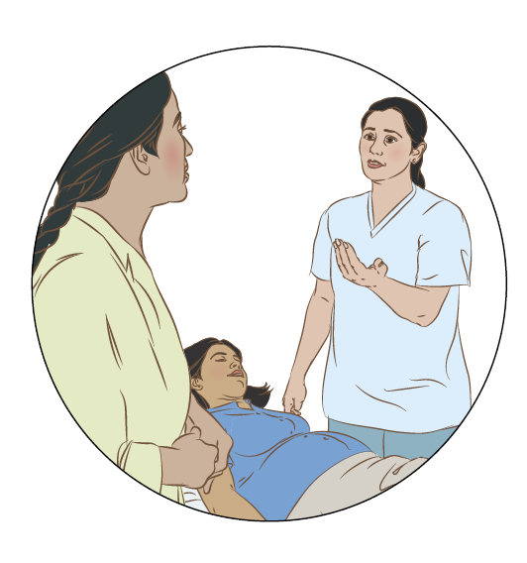
Identify a helper and review the emergency plan
Identify a second person to assist at birth
    another health worker
    mother’s companion to support her
Discuss the emergency plan with mother,
the helper, and companion
If referral for advanced care is needed,
define
    communication
    transportation
    finances
Notes:
Practise by discussing the emergency plan for your facility:
Who will provide skilled help?
Where will the mother and newborn be referred?
How will you communicate with the receiving facility?
How will the mother and newborn get there?
How much will it cost for transport and services?
Who will go along for support?
Who will care for the household and other children?
Is the emergency plan adequate in your facility?

Slide 14
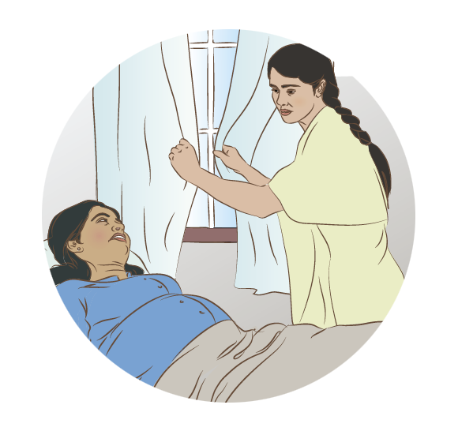
Prepare the area for delivery
  Draught-free, warm room – temperature
  between 25 and 28 °C.
  Good light for assessment and procedures.
  Privacy for mother.
  Space for family members or birth companion.
Notes:
What actions will you take to prepare the area for delivery in your facility?
Practise how you will make sure the area for delivery is warm, well-lighted, private but with space for a birth companion.

Slide 15
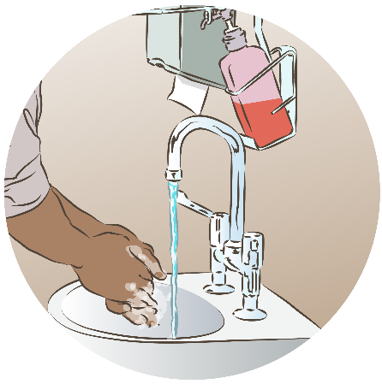

Who needs to wash hands and what personal protective equipment is needed?
Who needs to wash their hands?
  All persons who will be present at a birth should
  wash hands
    Mother
    Family members or companion
    Health worker(s) attending birth
What personal protective equipment (PPE) is needed?
  According to context and situation regarding outbreaks
  and epidemics
    Mask, eye protection or facial shield
    Gloves
    Gown, apron
Notes:
All persons who are present at a birth should wash their hands.
The mother and family members or birth companion will hold and touch the baby after birth.

Slide 16
Wash hands or use hand rub
Notes:
Practice the technique for using handrub.

Slide 17
Prepare an area for ventilation
Prepare a flat, firm, clean, dry surface
Organise all equipment within reach
Ensure adequate lighting for assessment of the newborn
Maintain visual contact with mother, her birth companion, and the newborn
Notes:
Practise the actions to prepare an area for ventilation.
What area in your facility has all the characteristics listed?

Slide 18
Prepare equipment for the newborn and delivery
Two clean, warm towels/cloths
Head covering for the newborn
Cord ties or cord clamp and sterile scissors or blade
Stethoscope
Suction device
Newborn-size self-inflating bag
Newborn masks: term and preterm
Gloves
Clock/timer
Additional equipment for delivery
Clean delivery kit
Uterotonic
Gloves, apron, mask, eye protection
Bucket or other receptacle with 0.5% chlorine solution for decontamination
Receptacle for placenta
Sharps box
Notes:
Practise organising the equipment for the newborn (along with that for the delivery).
What is the consequence of not having all the necessary equipment available and functioning?

Slide 19
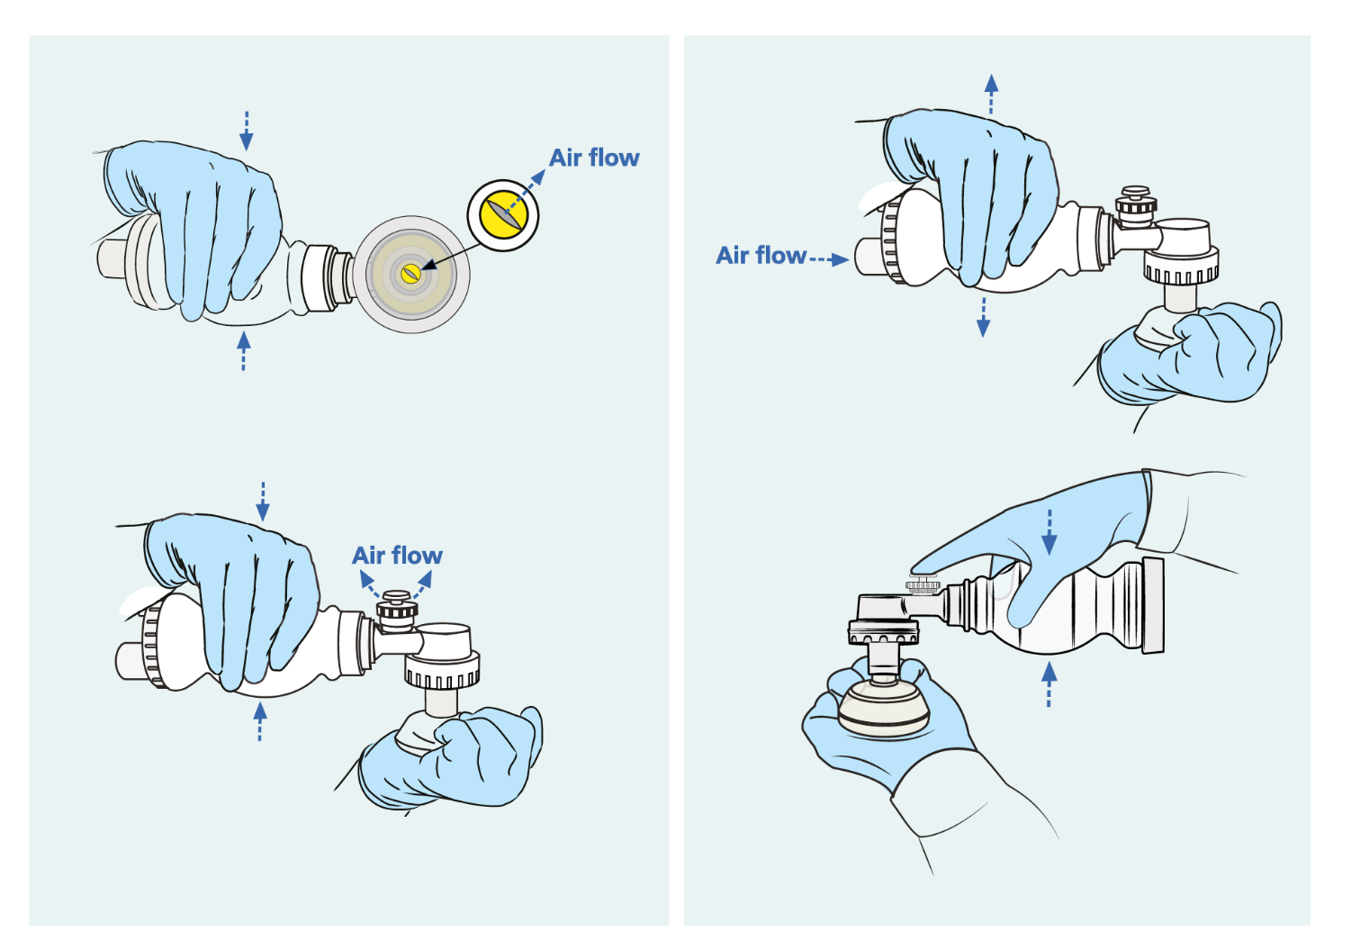

Check the self-inflating bag and suction device
Air flows through patient outlet
Air flow reinflates bag
Pressure-relief valve activates
Pressure-relief valve
by-passed
Device stays compressed
(no leak)
Check equipment (1:26-2:10)
Notes:
View video
Practise checking the self-inflating bag (4 steps) and the suction device.

Slide 20
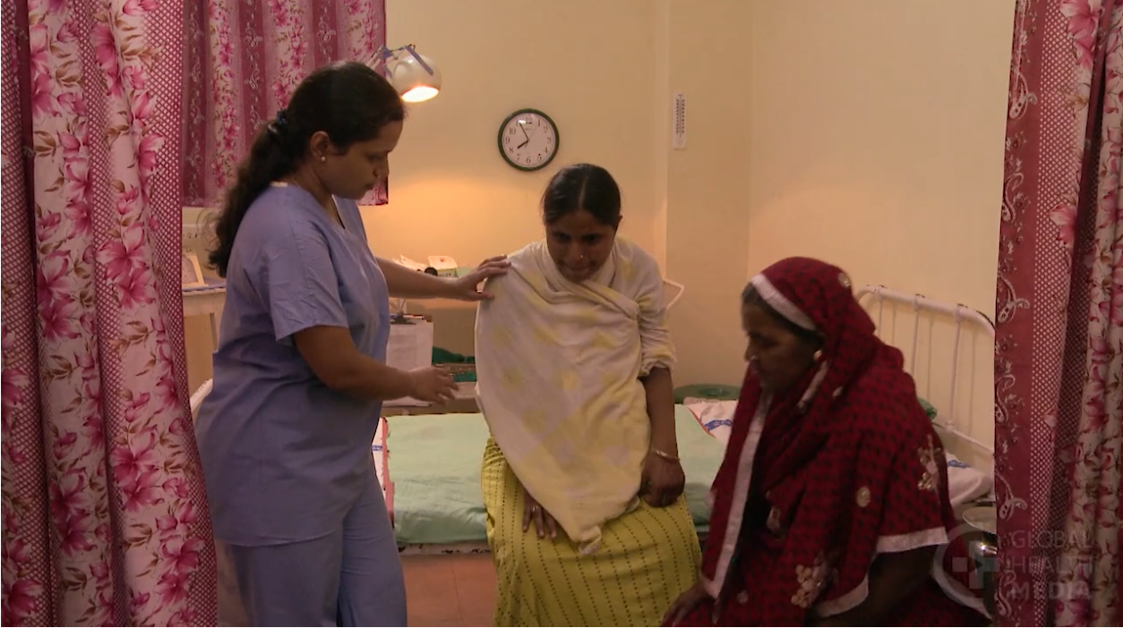


Prepare the area for delivery
Preparing the birth room (0:00-4.15)
Notes:
View video
What new knowledge is presented in this video?
Are there any skills or practices that differ from your current practice?
What provider behaviours differ from your current practice?
Does this video highlight any quality gaps in your facility?

Slide 21
Prepare for birth
Form groups (mother, companion, midwife).
Welcome the mother and her companion and prepare for birth.
Debrief with your team and facilitator.
Mrs. Ahmed arrives with her mother-in-law.
This is her first pregnancy.
She attended 6 ANC visits. She has had no complications.
Her expected date of delivery is today; delivery will occur very soon.
Notes:
Repeat simulation
Skills and performance – participants demonstrate welcoming the mother and preparing for birth.
Welcoming the mother
Encourage a companion in labour
Assess risk factors
2. Preparing for birth
Identify a helper and review the emergency plan
Prepare the area for birth
Wash hands
Prepare an area for ventilation
Assemble and test equipment
Check that a uterotonic is prepared
Debriefing – participant self-reflect and give feedback in their roles.
Provision of care (performance objectives)
What was done well?
What could have been done better?
What will you change the next time?
Experience of care
Was communication respectful and language appropriate?
Were infection prevention practices followed?
Was the equipment well organised to facilitate continued monitoring of mother and baby?

Slide 22
Summary:
Preparation for birth
In this module you have:
  Prepared a clean, safe, welcoming environment for every birth.
  Reviewed mother’s notes to assess for risk factors affecting the newborn.
  Demonstrated effective communication with mother, her companion and
  a helper, explaining what will happen to the newborn immediately after birth.
  Organised the delivery and resuscitation spaces, ensuring safety and maintaining dignity and privacy.
  Checked the equipment and supplies to make sure they are complete
  and function properly.

Slide 23
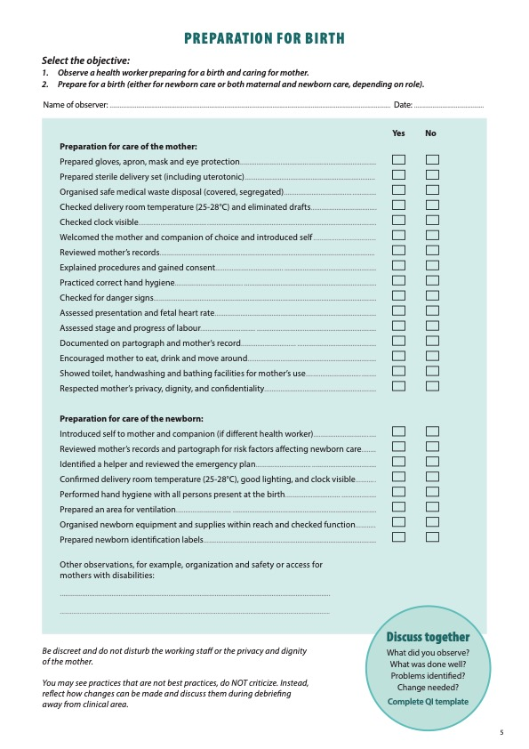
Notes:
Review the Clinical practice checklist before observing or practising in the clinical area.

Slide 24
Notes:
After the clinical practice, discuss the observations made, possible reasons for practices and changes needed to improve the quality of essential newborn care.
What new things will you do?
What old things will you not do?
How will you make a change?
Use your reflections to fill out the QI template.

Slide 25




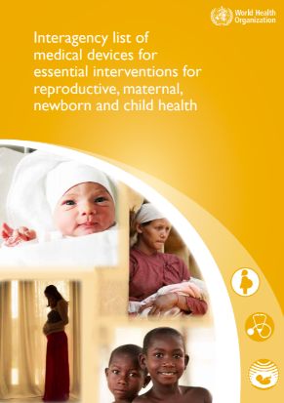

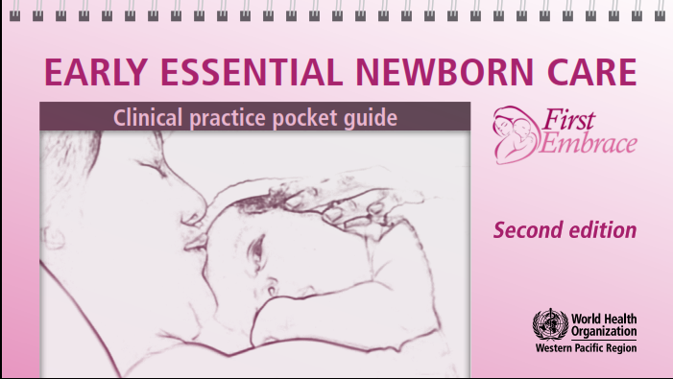
References and
additional resources
Preventing infection at birth
Respectful care during labour and birth

