Slide 1
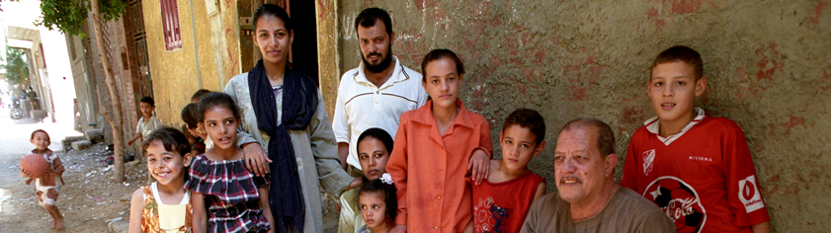


Course Slides
Human Rights
WHO/Heba Farid
WHO QualityRights Training: humanitarian edition
A training package on person-centred and human rights-based approaches to mental health and well-being.
QualityRights
Notes:
These training materials have been adapted from the WHO QualityRights materials for training, guidance and transformation to suit humanitarian assistance contexts.
https://www.who.int/publications/i/item/who-qualityrights-guidance-and-training-tools
Participants should have undertaken the WHO QualityRights e- training on mental health, recovery and community inclusion before attending this workshop.
https://www.who.int/teams/mental-health-and-substance-use/policy-law-rights/qr-e-training

Slide 2
Welcome!
First, some introductions, rationale and terminology
Notes:
Welcome, introductions, rationale and terminology 65 min (45 min rationale and terminology session with 15 slides, then 20 min plenary introductory discussion).
Welcome the participants. Introduce yourself and your co-facilitator(s).
Say that:
The first few slides will give an overview of the training, discussing terminology, what WHO QualityRights is for, and why a humanitarian edition has been developed.
At the end of this session there will be a chance for participants to introduce yourselves to each other.

Slide 3
What do we mean by MHPSS?
Definition
The composite term “mental health and psychosocial support (MHPSS)” is used to describe any type of local or outside support that aims to protect or promote psychosocial well-being and/or prevent or treat mental health conditions. The term was coined in the IASC MHPSS Guidelines of 2007.
Key elements:
  MHPSS overs the full spectrum of interventions from community and family supports to specialized clinical care.
  MHPSS recognizes that social conditions and psychological distress are interlinked, and both must be addressed together.
  MHPSS is implemented across sectors (health, protection, education, social services, etc.) as part of standard humanitarian response.
Notes:
Talk through the slide
Reference:
IASC Guidelines on Mental Health and Psychosocial Support in Emergency Settings, 2007 https://interagencystandingcommittee.org/iasc-task-force-mental-health-and-psychosocial-support-emergency-settings/iasc-guidelines-mental-health-and-psychosocial-support-emergency-settings-2007

Slide 4
Human rights are a foundational principle of all MHPSS in emergencies, not an optional add-on
This toolkit is grounded in the Convention on the Rights of Persons with Disabilities (CRPD), the International Covenant on Economic, Social and Cultural Rights (ICESCR), WHO QualityRights, and core humanitarian principles of the Universal Declaration of Human Rights. It intends to shape service design and delivery, not to create a separate rights project.
Rights-based MHPSS is clearly required by resolutions WHA 77.3 and UNGA 77/300 and is consistent with existing humanitarian guidance, including the IASC Guidelines on Mental Health and Psychosocial Support in Emergency Settings (2007) and the IASC MHPSS Minimum Service Package (in particular its General Principles on promoting human rights and equity).
The training should be used together with these and other IASC and WHO tools to embed a human-rights-based approach to service planning and provision across sectors and levels of care.
The training should not simply insert human rights language without changing practice. Instead, it should make person-centred, non-coercive support more available, accessible, acceptable and better quality for people with psychosocial, intellectual and cognitive disabilities, as well as for all people in distress.
    As long as there is no service or support, rights are not yet realized.
Notes:
Talk through these introductory remarks about human rights in MHPSS
References:
Convention on the Rights of Persons with Disabilities, (A/RES/61/106). New York: United Nations, General Assembly; 2006 https://www.un.org/development/desa/disabilities/convention-on-the-rights-of-persons-with-disabilities/convention-on-the-rights-of-persons-with-disabilities-2.html
International Covenant on Economic, Social and Cultural Rights (ICESCR) Adopted 16 December 1966 by General Assembly resolution 2200A (XXI) https://www.ohchr.org/en/instruments-mechanisms/instruments/international-covenant-economic-social-and-cultural-rights
WHO QualityRights materials for training, guidance and transformation. Geneva: World Health Organization; 2019. https://www.who.int/publications/i/item/who-qualityrights-guidance-and-training-tools
The Universal Declaration of Human Rights (UDHR), 10 December 1948, 217 A (III). New York (NY): United Nations; 1948. http://www.un.org/en/universal-declaration-human-rights/
Resolution WHA77.3. Strengthening mental health and psychosocial support before, during and after armed conflicts, natural and human-caused disasters and health and other emergencies. Adopted at World Health Assembly 77. Available in: Seventy-seventh World Health Assembly, Geneva, 27 May–1 June 2024. Resolutions and decisions, annexes (WHA77/2024/REC/1). Geneva: World Health Organization; 2024. https://apps.who.int/gb/ebwha/pdf_files/WHA77/A77_R3-en.pdfUNGA 77/300
UN General Assembly resolution 77/300 Mental health and psychosocial support. Addopted 26 June 2023. https://docs.un.org/en/A/RES/77/300
IASC Guidelines on Mental Health and Psychosocial Support in Emergency Settings, 2007 https://interagencystandingcommittee.org/iasc-task-force-mental-health-and-psychosocial-support-emergency-settings/iasc-guidelines-mental-health-and-psychosocial-support-emergency-settings-2007
Inter-Agency Standing Committee (IASC), The Mental Health and Psychosocial Support Minimum Service Package, IASC, Geneva, 2022 https://mhpsshub.org/wp-content/uploads/2022/01/IASC-MHPSS-Minimum-Service-Package.pdf

Slide 5
WHA77.3. Stronger MHPSS before, during and after emergencies
Resolution WHA77.3, adopted in 2024, embeds MHPSS in preparedness, response and recovery, and mandates WHO and Member States to integrate rights-based MHPSS across all emergencies.
Human-rights anchors
Reaffirmation of the right to health. The resolution reaffirms everyone’s right to the highest attainable standard of physical and mental health, grounding MHPSS in the right-to-health framework.
MHPSS is linked to enjoyment of human rights and freedoms. The resolution recognizes that mental health and psychosocial well-being are critical to survival, recovery, daily functioning, and to people’s enjoyment of human rights, fundamental freedoms, and access to protection and assistance.
    (continued on next slide)
Notes:
Talk through the slide.
Reference:
World Health Organization. Resolution WHA77.3, Strengthening mental health and psychosocial support before, during and after armed conflicts, natural and human-caused disasters and health and other emergencies. Adopted at WHA 77.3 and available in: Seventy-seventh World Health Assembly, Geneva, 27 May–1 June 2024. Resolutions and decisions, annexes (WHA77/2024/REC/1). Geneva: World Health Organization; 2024. Available at: https://apps.who.int/gb/ebwha/pdf_files/WHA77/A77_R3-en.pdf

Slide 6
WHA77.3. Stronger MHPSS before, during and after emergencies
(continued)
Explicit linkage to human-rights resolutions. WHA77.3 recalls UNGA resolution 77/300 and Human Rights Council resolution 52/12 on mental health and human rights, aligning the health-sector response with the wider UN human-rights architecture.
Focus on groups facing heightened rights risks. The resolution recognizes increased risks for children, women, caregivers, people with disabilities, survivors of violence and others in vulnerable or marginalized situations, underlining the need for protection, non-discrimination and targeted support.
An obligation to integrate safe, quality MHPSS in all stages of emergencies. WHA77.1 urges Member States to include MHPSS in preparedness, response and recovery across sectors and levels of care, consistent with rights-based principles of availability, accessibility, acceptability and quality (AAAQ).
Notes:
Talk through the slide

Slide 7
UNGA Resolution 77/300 – Mental health and psychosocial support
The first-ever standalone United Nations General Assembly resolution on MHPSS was adopted in June 2023. It positions MHPSS within the right to health, CRPD implementation and the 2030 Agenda, especially in emergencies and for groups at risk.
Human-rights anchors
CRPD as the foundation. Preambular paragraphs reaffirm the CRPD as a “landmark convention affirming the human rights and fundamental freedoms of persons with disabilities” and acknowledge it as the basis for a paradigm shift in mental health.
Right to the highest attainable standard of health. The resolution reaffirms the right of every human being, without distinction, to the enjoyment of the highest attainable standard of physical and mental health, linking this to sustainable development.
Dignity-based definition of mental health. The resolution acknowledges that good mental health and well-being cannot be defined by the absence of a condition but by an environment that respects inherent dignity, ensures full enjoyment of human rights and equitable pursuit of potential, and notes that discriminatory laws and practices undermine well-being
    and inclusion. (continued on next slide)
Notes:
Talk through the slide
Reference
UN General Assembly resolution 77/300 Mental health and psychosocial support. Addopted 26 June 2023. https://docs.un.org/en/A/RES/77/300

Slide 8
UNGA Resolution 77/300 – Mental health and psychosocial support
(continued)
Rights-based access to MHPSS services. The resolution emphasizes that everyone should have access to a range of mental health services and psychosocial support based on respect for human rights, including community and peer support, enabling autonomy, agency and equal participation with dignity.
Law reform and protection from abuse and coercion. The resolution calls on States to adopt, implement or strengthen laws to eradicate abuse, discrimination, stigma and violence (including hate speech, racism and xenophobia) in the context of mental health, and stresses that services must actively combat stigma, discrimination, social exclusion, coercion, over-medicalization and institutionalization.
Notes:
Talk through the slide

Slide 9
A few words about terminology in this training
People use language and terminology differently in varying contexts over time.
Psychosocial disability includes people who have received a mental health-related diagnosis or who self-identify with this term.
Cognitive disability and intellectual disability refer to people who have received a diagnosis related to their cognitive or intellectual function, including dementia and autism.
The term disability highlights the barriers to full participation in society facing people with actual or perceived impairments, and the fact that they are protected under the Convention on the Rights of Persons with Disabilities (UN CRPD). More on this later on the training!
Using disability in this context does not imply that people have an impairment or a disorder.
Notes:
Talk through the slide. Emphasize that:
Language and terminology evolves:
People must be able to decide on their vocabulary, idioms and descriptions of their experience.
For example, some people use terms such as “people with a psychiatric diagnosis”, “people with mental disorders” or “mental illnesses”, “people with mental health conditions”, “consumers”, “service users” or “psychiatric survivors”.
Others find some or all these stigmatizing or use different expressions to refer to their emotions, or experiences or distress.
Similarly, intellectual disability is referred to variously, for example, “learning disabilities” or “disorders of intellectual development” or “learning difficulties”.
We will use the term “psychosocial disability” to include people with a mental health-related diagnosis or who self-identify with this term.
“Cognitive disability” and “intellectual disability” cover people with a diagnosis including, but not limited to, dementia and autism.
The term “disability” highlights the significant barriers that hinder people’s full and effective participation in society and the fact that they are protected under the CRPD.
“Disability” does not imply that people have an impairment or a disorder.
Reference (for how disability is interpreted): Convention on the Rights of Persons with Disabilities, preamble, para. 5 (A/RES/61/106). New York: United Nations, General Assembly; 2006 https://social.desa.un.org/issues/disability/crpd/convention-on-the-rights-of-persons-with-disabilities-articles

Slide 10
A few words about terminology in this training
People who are using or who have previously used mental health and social services may not necessarily identify as experiencing a disability, but they have a variety of experiences applicable to this training.
The term mental health and social services refers to a wide range of services countries provide within public, private and nongovernmental sectors.
Terminology has been chosen for inclusiveness:
      It is a personal choice to self-identify with certain expressions or concepts, but human rights apply to everyone everywhere.
      A diagnosis or disability should never define a person.
      We are all individuals, with a unique social context, personality, goals, aspirations and relationships with others.
Notes:
Talk through the slide – here are some notes relating to the three bullet points.
It’s important to note that people who are using or who have previously used mental health and related services do not necessarily identify as having a disability. But they do have a variety of experiences applicable to this training.
In this training the term “mental health and social services” refers to a wide range of services, including for example: community mental health centres; primary care clinics; outpatient services; psychiatric hospitals; psychiatric wards in general hospitals; rehabilitation centres; traditional healers; day care centres; homes for older people; and other group homes; as well as home-based services and services and supports offering alternatives to traditional mental health or social services. These can be provided by a wide range of health and social care providers within public, private and nongovernmental sectors.
The terminology this training uses has been chosen for inclusiveness.
Read out the three sub bullet points.

Slide 11
A few words about terminology in this training
In humanitarian settings, using appropriate language allows MHPSS professionals to communicate effectively with communities without pathologizing very common, temporary or adaptive reactions to stressful situations. Language should focus on normalizing these reactions and emphasizing resilience and coping.
When communicating with communities or people with mental health conditions, avoid using clinical terms and emphasize people's strength, resilience and coping, while ensuring that those who need and wish to use mental health services can access them.
To understand populations' perceptions of MHPSS issues, it is essential to gather local terminology for mental health and psychosocial stressors.
Humanitarian settings have the potential for trauma and traumatic reactions, for acute stress and PTSD. A small but important number of people in such settings can have reactions, including mental health conditions, that can persist and cause significant challenges. It is important to protect access to quality services for those that need mental health care.
Notes:
Talk through the slide – here are some notes relating to the bullet points.
In humanitarian settings language is important, and words should let MHPSS professionals offer support without pathologizing natural reactions to stressful situations.
Avoid using clinical terms and emphasize their strength, resilience and coping, while ensuring that those who need and wish to use clinical services can access them.
To better understand populations' perceptions of MHPSS issues, it is essential to gather local terminology regarding mental health and psychosocial stressors.
Clearly, humanitarian situations can cause trauma and traumatic reactions. People may experience acute stress and PTSD, and a few people in humanitarian settings can present with reactions, including mental health conditions, that can persist and cause significant challenges. It is important to protect their access to quality mental health services.
Let participants know that we will return to terminology later on the training after some key concepts have been covered.

Slide 12
WHO QualityRights Initiative: goals and objectives
GOAL: Improve access to good quality mental health and social services and to promote the human rights of people with mental health conditions, psychosocial, intellectual or cognitive disabilities.
Build capacity to combat stigma and discrimination and promote human rights and recovery.
Improve the quality and human rights conditions in mental health and social services.
Create community-based services and recovery-oriented services that respect and promote human rights.
Support the development of a civil society movement to conduct advocacy and influence policy-making.
Reform national policies and legislation in line with the UN CRPD and other international human rights standards.
Notes:
Here is some text you could read to introduce the WHO QualityRights Initiative. This slide talks about the first two objectives. The others are covered on the next slide.
WHO QualityRights is WHOs global initiative to improve access to good quality mental health and social services and to promote the human rights of people with psychosocial, intellectual or cognitive disabilities.
It has 5 key objectives:
To build everyone’s capacity to understand and promote the rights of people with psychosocial, intellectual and cognitive disabilities. It is only through building knowledge and skills among people with disabilities, their families, practitioners, NGOs etc. that we will change attitudes and practices.
People need to understand what their rights are so that they can claim them.
Family members and carers need to understand these rights so that they too can respect them and also support their relatives in accessing rights.
Professionals need to be aware of the rights of people with psychosocial, intellectual and cognitive disabilities so that they can act with respect for these rights.
Humanitarian organizations and professionals, especially MHPSS responders, need to understand these rights so they can integrate them into emergency response.
QualityRights also work with countries to improve the quality and human rights conditions in mental health and related services.
QualityRights supports countries to assess their mental health and social care services to check how well these uphold rights.
QualityRights also supports countries to put in place plans to help transform services so that they promote human rights and recovery.
It is important to ensure that humanitarian support to countries is aligned with quality of care and human rights standards.

Slide 13
WHO QualityRights Initiative: goals and objectives
GOAL: Improve access to good quality mental health and social services and to promote the human rights of people with mental health conditions, psychosocial, intellectual or cognitive disabilities.
Build capacity to combat stigma and discrimination and promote human rights and recovery.
Improve the quality and human rights conditions in mental health and social services.
Create community-based services and recovery-oriented services that respect and promote human rights.
Support the development of a civil society movement to conduct advocacy and influence policy-making.
Reform national policies and legislation in line with the UN CRPD and other international human rights standards.
QualityRights uses a participatory approach involving all stakeholders in order to meet each of its objectives.
Notes:
This slide talks about the other three objectives.
Creating community-based services and supports that respect and promote human rights.
Institutionalization for mental health conditions needs to be replaced by community care and inclusion. Countries need a full range of services that meet people’s requirements, but many services are outdated.
QualityRights helps countries develop community-based services and supports that are people-centred, operate without coercion, respond to people’s needs and support recovery.
It is essential to promote MHPSS responses that can be delivered through basic services, safety, and at the community and family levels (the first two layers of the IASC MHPSS Pyramid). Safety here refers to ensuring that people’s basic and protection needs are met, and that they feel physically and emotionally secure. The approach relies on engaging and strengthening community-based MHPSS.
Helping develop civil society movements to conduct advocacy and influence policy making.
This is about supporting people with psychosocial, intellectual and cognitive disabilities and their organizations to have a central role and strong voice in all decision-making processes affecting them.
Advocacy is an essential element of MHPSS response, and it can't be achieved without engaging of civil society
Working with countries to reform policy and law in line with international human rights standards.
This provides an important mechanism in countries to stop violations, promote access to community mental health services, housing, education and employment and the full range of rights that people are entitled to.
Under the Triple Nexus that links humanitarian, development, and peace efforts, strong laws and policies help countries not just recover, but truly build back better and prepare for the future.
All of these actions are informed by the international human rights framework and in particular the UN Convention on the Rights of Persons with Disabilities. The full text is at
https://www.un.org/disabilities/documents/convention/convoptprot-e.pdf

Slide 14
WHO QualityRights Training: humanitarian edition
Why a humanitarian edition of the QualityRights training?
People with psychosocial, intellectual or cognitive disabilities face widespread discrimination.
Discrimination limits their ability to exercise basic human rights.
In humanitarian contexts, they are often at increased risk of rights violations, including:
  mistreatment and abuse by families, communities, and services;
  exclusion from humanitarian services;
  insufficient protection, such as interrupted access to psychotropic medication (e.g. due to displacement or supply chain issues) or being left in institutions without enough staff to meet basic needs or provide security.
New disabilities may arise during conflict or other crises, due to injury or trauma.
Notes:
Here is some text you could read to introduce the humanitarian edition. It largely reflects the slide. There are four slides in this brief overview.
Why was a humanitarian edition of the QualityRights training developed?
People with psychosocial, intellectual or cognitive disabilities face widespread discrimination
This prevents them from exercising their basic human rights.
This discrimination can be worse in humanitarian situations. The consequences include:
mistreatment and abuse by families, communities, and mental health and social services;
exclusion from humanitarian services;
insufficient protection for people with psychosocial, intellectual or cognitive disabilities, for example, their access to care or medication isn’t protected (perhaps because they are displaced, or supply chains are disrupted), or they are left in understaffed institutions because carers have been displaced.
In addition, situations like armed conflict can drive new disabilities, either due to injury or other difficulties.

Slide 15
WHO QualityRights Training: humanitarian edition
Goals
Highlight the challenges in protecting human rights standards, including the UN CRPD, in humanitarian interventions.
Identify attitudes and practices that contribute to stigma, discrimination and violations, and propose how to change them.
Contribute to making humanitarian action more inclusive and human rights-based for people with psychosocial, intellectual or cognitive disabilities, including by:
  implementing human rights-based and recovery-oriented MHPSS practices;
  enabling disability inclusion and protection of all people during humanitarian responses;
  protecting people from neglect, abuse, and other ill-treatment in all settings — including the community, community-based services, and institutions;
  promoting community-led mental health initiatives.
Notes:
Here is some text you could read to introduce the humanitarian edition. It largely reflects the slide.
The goals of this QualityRights humanitarian edition are to:
Highlight the challenges in protecting human rights standards, including the UN CRPD, in humanitarian interventions.
Identify beliefs, attitudes and practices that contribute to stigma, discrimination and human rights violations, and propose how these attitudes and practices can be changed.
Contribute to making humanitarian action more inclusive, human rights-based approach for people with psychosocial, intellectual or cognitive disabilities, including by:
implementing human rights-based and recovery-oriented MHPSS practices;
enabling disability inclusion and protection during humanitarian responses;
protecting people from neglect, abuse, and other forms of ill-treatment in all settings, including the community, community-based services, and institutions;
promoting community-led mental health initiatives.
Explain that:
This contribution adds to the MHPSS mandate, resources and guidelines that we will reference during the training, such as the Inter Agency Standing Committee (IASC) Guidelines on mental health and psychosocial support, the MHPSS Minimum Services Package (MSP) and the IASC Guidelines on the Inclusion of people with Disabilities. Many of these resources are applicable to people with cognitive disabilities (including dementia). Tomorrow’s training has more on this.
References
IASC Guidelines, support https://interagencystandingcommittee.org/iasc-task-force-mental-health-and-psychosocial-support-emergency-settings/iasc-guidelines-mental-health-and-psychosocial-support-emergency-settings-2007
MHPSS MSP https://www.mhpssmsp.org/en
IASC Guidelines, inclusion https://interagencystandingcommittee.org/sites/default/files/2024-01/IASC%20Information%20Note%20on%20Disability%20and%20Inclusion%20in%20MHPSS.pdf

Slide 16
WHO QualityRights Training: humanitarian edition
Training agenda
Day |  | Module
Day 1 |  | Module 1. Human rights
Day 2 |  | Module 2. Mental health, disability and human rights
 |  | Module 3. Legal capacity and the right to decide
Day 3 |  | Module 3. Legal capacity and the right to decide (cont.)
 |  | Module 4. Recovery and the right to health
Day 4 |  | Module 5. Freedom from coercion, violence and abuse
Day 5 |  | Planning QualityRights actions in humanitarian settings
Notes:
Preparation:
If you are not running full days, how will you adjust your plans and this slide?
For example, you may need different break times to those set out in the agenda and Facilitator’s Guide. You may also need flexible break times, for example for people who may need specific prayer times, might need to breast-feed or check on dependents etc.
Briefly outline the training, as it is spread over time.
Check that the participants received the training agenda in advance.
Give participants an overall sense of the content and structure of the training.
Ask participants:
Does anyone have any questions or comments about the agenda?
Be prepared to make reasonable adjustments.

Slide 17
WHO QualityRights Training: humanitarian edition
Each participant will develop a QualityRights Action Plan
Plans will have practical and feasible ideas for implementing change. Throughout the training there will be time to:
    reflect on how topics apply to your work situation;
    identify and develop ideas and actions for improvements.
  Day Five focuses on documenting and presenting:
    current practices/activities in your work that already align with human rights principles;
    a six-month action plan that highlights activities to drive improvements.
Notes:
Talk through the slide to introduce the QR Action Plan.

Slide 18

Introductions
Your Name
Your Organization
Briefly describe your work, activities, and how this training may be useful
Notes:
Preparation: You need enough flip chart paper ready, preferably with prompts for participant name, organization and work activities. You need a way to display the sheets around the training venue.
Tell participants they have five minutes to record their name, organization, and a brief description of their main activities on a sheet of flip chart paper.
Explain that they should describe their project activities, or which clusters in the humanitarian response they cover, whether they do advocacy etc.
Participants from the same organization, project, or department could prepare a joint sheet.
Display the sheets on the walls to help everyone learn about the work of all participating groups and individuals.
Run a plenary discussion where participants introduce themselves (or perhaps others) to the group (10-15 mins).
ALTERNATIVE: If everyone is from the same department or does similar work, one person can broadly describe the scope of the work and then the group can discuss how this training may be useful to them in their work.

Slide 19
Module 1.
Human rights
Notes:
Approximate time: 7 hrs 45 mins including two 15 min breaks and a 60 min lunch break.

Slide 20
Topics covered in Module 1 on human rights
Topic 1 What are human rights?
Topic 2 Examples of human rights violations
Topic 3 Groups of people at risk of human rights violations
Topic 4 Consequences of human rights violations
Topic 5 Respecting, protecting and fulfilling human rights
Topic 6 Empowering people to defend human rights
Topic 7 Human rights advocacy
Becoming a QualityRights changemaker
Notes:
Introduction to Day 1, 5 mins, 2 slides
Tell the participants that the training is now starting on Module 1, which has eight related topics – briefly talk through the slide.

Slide 21
At the end of the module, you should:
understand what human rights are;
understand the origins and content of the Universal Declaration of Human Rights and how it is relevant today;
be able to recognize violations, including in humanitarian contexts;
understand what makes groups of people at higher risk of violations;
identify who defends rights;
identify specific ways for humanitarian workers; people with psychosocial, intellectual or cognitive disabilities; families; care partners and other supporters to be QualityRights changemakers.
Notes:
Talk through the slide.

Slide 22
Topic 1. What are human rights?
Notes:
Time: 45 min for Topic 1

Slide 23
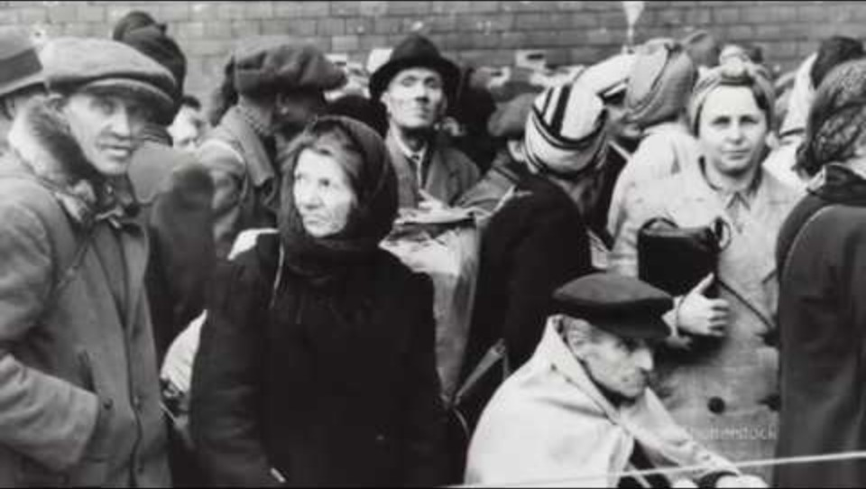

Introduction to the Universal Declaration of Human Rights
https://www.youtube.com/watch?v=d-UuB1lKzJ0&t=6s
Notes:
Run this video introduction to the Universal Declaration of Human Rights (UDHR) (4:34 min.)
https://www.youtube.com/watch?v=d-UuB1lKzJ0&t=6s

Slide 24
Exercise 1.1 We are all born free and equal
Plenary discussion
Do you agree or disagree with the following statement?
We are all born free and equal
Notes:
Exercise 1.1 We are all born free and equal (10 mins, 2 sides)
Gather participants in the centre of the room. Explain that you will ask people to move to their right if they agree with the statement you read out, or to the left if they disagree.
The statement is open to interpretation.
Remind the group: At this point there is no correct answer.
You might say “Respond according to your set of beliefs, and think how you will explain your opinion”. Be aware of the participants’ culture.
If participants have mobility difficulties, you can simply ask the whole group to raise their hands if they agree with the statement.
Do you agree or disagree with the following statement?
“We are all born free and equal”
Ask participants why they have chosen to agree or disagree.
Write down their responses on the flipchart.
Encourage participants to discuss their ideas directly with each other.
Prompts for discussion:
Yes, we are all born free and equal. It is society that may deny us this right.
No, a person born into slavery or poverty will never be free.
Characteristics such as race, ethnicity, colour, sex, sexual orientation, language, religion, political or other opinion, national or social origin, property, disability, birth or other status can contribute to many people not being treated equally.
No, many people lack freedom when they are born.

Slide 25
Exercise 1.1 We are all born free and equal
Discussion points
The statement “we are all born free and equal” is deliberately ambiguous.
On the one hand, by virtue of our humanity, we are all born free and equal.
On the other hand, in many cases government or society may deny many people their right to freedom and equality.
Human rights are about making sure that the freedom and equality of all people are respected.
Notes:
End this exercise by discussing the points on the slide.

Slide 26
Presentation. What are human rights?
“Human rights are what no one can take away from you”
- René Cassin, one of the drafters of the Universal Declaration of Human Rights (UDHR).
Human rights are not a gift or a privilege. They are not bestowed on us by others.
They are basic rights that we have simply because we are human. They are fundamental for living a good life and for flourishing.
Notes:
Presentation. What are human rights? (30 mins, 9 slides)
Read the slide to the group.
Provide participants with a copy of Handout M1.1 (on the UDHR, including a simplified version from Amnesty International). They could also scan the QR code on the next slide to access the UDHR online.
Different language versions of the UDHR can be found here: https://udhr.audio/
The UDHR in sign language can be found here:
http://www.ohchr.org/EN/UDHR/Pages/UDHRinsignlanguages.aspx (accessed 3 November 2025).
Amnesty International’s simplified version is here: http://www.amnesty.org.uk/sites/default/files/udhr_simplified.pdf
This module uses the UDHR as it provides a general introduction to human rights. The intention is not to provide in-depth knowledge and training on the international human rights framework, but to introduce participants to human rights issues and concepts in a way that is easy to understand. In subsequent modules, the Convention on the Rights of Person with Disabilities (CRPD) will be extensively discussed and examined.
Give participants a few minutes to read through the UDHR.

Slide 27
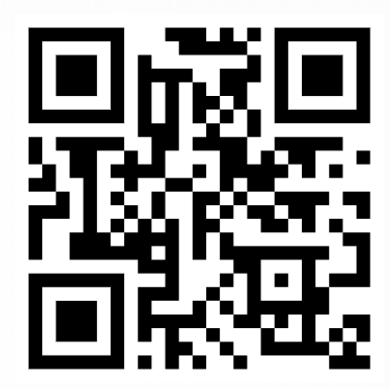
How the Universal Declaration of Human Rights came about
The UDHR was adopted by the United Nations General Assembly in 1948: 56 countries from all over the world adopted the core set of human rights.
The UDHR does not make legal requirements on governments. However, over the years it has become a binding customary international law, which means that governments must respect it.
It is important to note that the UDHR was adopted and endorsed by high-, middle- and low-income countries throughout the world.
The first group of drafters consisted in Eleanor Roosevelt (USA), Pen-Chun Chang (China) and Charles Malik (Lebanon).
Notes:
This slide and the next one can be adjusted based on the participants’ level of knowledge, understanding, and needs. They may be shortened or omitted if there are time constraints.
Talk through the slide: How did the Universal Declaration of Human Rights come about?
For the third bullet point, explain that:
Some people argue that human rights is a western concept or that they have only been agreed upon by high-income countries and are not realistic in low-resource settings. However, it is important to note that the UDHR was adopted and endorsed by high-, middle- and low-income countries throughout the world.

Slide 28
The United Nations and human rights
In 1966, Member States of the United Nations adopted:
    the International Covenant on Civil and Political Rights (ICCPR)
    the International Covenant on Economic, Social and Cultural Rights (ICESCR)
Thus, governments around the world have obligations to protect their citizens’ human rights.
Other treaties that protect the rights of certain people include:
    the Convention on the Rights of the Child (CRC)
    the Convention on the Elimination of All Forms of Discrimination Against Women (CEDAW)
    the Convention on the Rights of Persons with Disabilities (CRPD) – We explore this later.
Many countries specifically protect human rights in their national legislation (for example through a Bill of Rights or their national constitution).
Notes:
Read through the slide.
Explain that:
The ICCPR and the ICESCR have been ratified by the vast majority of countries around the world. As a consequence, governments around the world have obligations to protect their citizens’ human rights.
Read through the list of other treaties.
For the final bullet, you could say:
In addition to these international human rights instruments, many countries protect human rights in national legislation (e.g. through a Bill of Rights or their national constitution). In fact, many rights in national laws are inspired by and reflect international human rights instruments.
References
International Covenant on Civil and Political Rights, adopted and opened for signature, ratification and accession by General Assembly resolution 2200 (XXI) of 16 December 1966. Geneva: Office of the United Nations High Commissioner for Human Rights; 1976. (http://www.ohchr.org/en/professionalinterest/pages/ccpr.aspx)
International Covenant on Economic, Social and Cultural Rights, adopted and opened for signature, ratification and accession by General Assembly Resolution 2200 (XXI) of 16 December 1966. Geneva: Office of the United Nations High Commissioner for Human Rights; 1976. (http://www.ohchr.org/EN/ProfessionalInterest/Pages/CESCR.aspx).
Convention on the Rights of the Child (CRC), adopted and opened for signature, ratification and accession by General Assembly resolution 44/25 of 20 November 1989. Entry into force 2 September 1990. Geneva: Office of the United Nations High Commissioner for Human Rights / UN depositary.
Convention on the Elimination of All Forms of Discrimination Against Women (CEDAW), adopted and opened for signature, ratification and accession by General Assembly resolution 34/180 of 18 December 1979. Entry into force 3 September 1981. Geneva: Office of the United Nations High Commissioner for Human Rights / UN depositary.

Slide 29
We all have civil, political, economic, social and cultural rights
What parts of our lives does the UDHR talk about?
UDHR promotes and protects a range of rights, including civil, political, economic, social and cultural rights.
Civil and political rights include the rights: to liberty; to be recognized as a person before the law; to freedom from torture and other cruel inhuman or degrading treatment; to marry or enter into civil partnerships; to found a family; to freedom of thought, conscience and religion; to freedom of opinion and expression; to peaceful assembly; to vote and to take part in government.
Economic, social and cultural rights include the rights: to work; to an adequate standard of living; to health and to education; and to participate in the cultural rights of our communities.
These rights ensure that we can participate fully in society without discrimination.
Notes:
Talk through the slide.

Slide 30
Core principles of human rights
Fairness towards all human beings
Respect for others
Equality among all people
Dignity is to be preserved at all times
Freedom for all people
All rights are indivisible, interdependent and inter-related, whether they are civil, political, economic, social or cultural rights.
To enjoy one right people must be able to enjoy the other rights.
Similarly, denying one right adversely affects other rights.
Notes:
There are five core principles that underpin human rights.
Read through the bold bullets.
Then read through the bullets explaining how the rights are inter-related. Emphasize that:
These rights are included in the humanitarian principles and core guidelines, such as Sphere and IASC
Give participants the opportunity to express any concerns they may have about human rights, the UDHR and the practical usefulness of human rights.

Slide 31
Some rights (but only some) can be limited
For instance:
    if the exercise of that right by one person infringes the rights of another person
    certain rights can be limited or suspended in extreme situations.
But note that:
Any restrictions or limitations cannot be arbitrary.
Certain rights can never be limited or restricted:
          the right to life
          the right to be free from torture, cruel, inhuman or degrading treatment or punishment
          the right to be free from slavery
          the right to recognition everywhere as a person before the law
          freedom from discrimination.
Notes:
Talk through the slide, explaining that:
Not all human rights are absolute. Some rights can be restricted in specific situations. For instance:
A right can be subject to reasonable restrictions or limitations if the exercise of that right by one person infringes upon the rights of another person (e.g. the right to freedom of expression can sometimes be restricted if someone uses it to incite hatred towards a particular group).
Certain rights can be limited or suspended in certain extreme situations (for example during a public emergency).
But it is important to note that:
Any restrictions or limitations on a right cannot be arbitrary. There has to be a valid reason for it (e.g., because it infringes on the rights of others).
Certain rights that can never be limited or restricted. They are:
the right to life;
the right to be free from torture, cruel, inhuman or degrading treatment or punishment;
the right to be free from slavery;
the right to recognition everywhere as a person before the law;
freedom from discrimination - discrimination is not allowed even in humanitarian contexts.
Before showing the next slide, ask the participants how COVID 19 affected the rights of people with psychosocial, intellectual or cognitive disabilities. Were people’s rights restricted?

Slide 32
Human rights in emergencies and the humanitarian context
Example: limitations on rights during COVID 19
During emergencies, some rights are sometimes limited to protect health or safety.
Any limitations must be lawful, necessary, proportionate, and non-discriminatory.
COVID-19 measures, though protective, also led to discrimination and rights violations:
  Freedom of movement. Restricted in many countries
  Civil and political rights. Gatherings and demonstrations suspended.
  Social and cultural rights. Events and meetings cancelled.
  Economic rights. Many people lost jobs or income.
  Non-discrimination. Some measures were applied unfairly, for example:
  older people were prohibited from leaving home (age discrimination)
  people with disabilities were excluded when information wasn’t accessible
  there were reports of discriminatory triage protocols*
Key message:
Even in emergencies, human rights obligations remain.
Notes:
Talk through the slide
You might discuss the examples of discrimination a bit further:
Sometimes older people were told they couldn’t leave their homes for extended periods, even for essential needs — a form of age discrimination.
When COVID-19 safety information was not provided in accessible formats (for example sign language, easy-to-read materials), people with disabilities were excluded.
There were also reports of discriminatory triage protocols that meant people with disabilities were not given equal access to medical care. (The reference for this is https://pmc.ncbi.nlm.nih.gov/articles/PMC8193195/)
Emphasize the key message:
Even in emergencies, human rights obligations continue to apply. Measures to protect health or security must uphold the principles of equality, inclusion, and dignity for all.

Slide 33
International Human Rights Law, International Humanitarian Law and International Refugee Law
International human rights law applies at all times and in all circumstances while international humanitarian law applies in armed conflict.
All share common goals in safeguarding the well-being and dignity of individuals.
Many of their principles align, emphasizing importance of protecting human rights and dignity in various contexts.
Notes:
Talk through the slide, pointing out that:
International Human rights law (including the UDHR) applies at all times and in all circumstances while international humanitarian law (such as the Geneva Conventions) applies in armed conflict contexts.
However, both share common goals in safeguarding the well-being and dignity of individuals, albeit from different perspectives.
While their formulations differ, the essence of many of their principles align, emphasizing the fundamental importance of protecting human rights and dignity in various contexts.
The table on the next slide will help you highlight some of the similarities and differences.

Slide 34
Comparing international human rights, humanitarian and refugee law
Similarities
All three legal frameworks aim to protect individuals and uphold human dignity.
They are grounded in international treaties and conventions.
States are primary duty bearers under each framework.
They complement each other and may apply concurrently in certain situations (e.g., armed conflict and displacement).
Each has mechanisms for monitoring and enforcement, though effectiveness varies.
Differences
Aspect | International Human Rights Law (IHRL) | International Humanitarian Law (IHL) | International Refugee Law (IRL)
Purpose | Protect individuals from abuses by their own state | Protect individuals during armed conflict | Protect individuals fleeing persecution or serious harm
Scope of Application | Applies at all times, in peace and war | Applies only during armed conflicts | Applies to individuals outside their country due to persecution/conflict
Legal Instruments | UDHR, ICCPR, ICESCR, regional treaties | Geneva Conventions (1949), Additional Protocols (1977) | 1951 Refugee Convention, 1967 Protocol
Main Duty Bearers | States | States and parties to conflict | Host states, UNHCR
Key Principles | Universality, equality, non-discrimination | Distinction, proportionality, necessity, humanity | Non-refoulement, asylum, protection
Beneficiaries | All individuals under a State's jurisdiction | Civilians, wounded combatants, prisoners of war | Refugees and asylum seekers
Enforcement Mechanisms | UN treaty bodies, regional courts | ICRC monitoring, international tribunals | UNHCR, national asylum systems
Relationship to Other Laws | Complements IHL and IRL; applies concurrently during conflict | Complements IHRL; may override certain human rights norms | Draws from IHRL and IHL to enhance refugee protection
Limitations/Derogations | Some rights can be derogated in emergencies | No derogations; binding during conflict | Limited scope; excludes IDPs and climate migrants
Challenges | Enforcement gaps, political resistance | Compliance by non-state actors, access to conflict zones | Narrow definition of refugee, exclusion of certain displaced groups
Notes:
Talk through the table to highlight some of the similarities and differences.
For example,
International Human rights law (including the UDHR) applies at all times and in all circumstances while international humanitarian law (for example the Geneva Conventions) applies in contexts of armed conflict.
Refugee law protects individuals fleeing persecution or serious harm.
This website might be a useful resource. https://www.ohchr.org/sites/default/files/Documents/Publications/HR_in_armed_conflict.pdf
This is the last slide for Topic 1

Slide 35
Topic 2. Examples of human rights violations
Notes:
Time for this topic: 85 min plus 15 min break
Warning: Discussing human rights violations may provoke strong emotional responses from some people, leading to distress, arousing sad memories, and renewed distress in some cases.
Be mindful of this. Before this activity, let participants know that they should feel free to voice their emotions, or take a pause or step out of the training session until the end of the activity.
Also be mindful of any sign of distress shown by participants and be prepared to provide support.
The Facilitator’s Guide has more information on psychological first aid, how to set up ‘time off spaces’, or connect people with additional support.

Slide 36
Presentation. Human rights violations
Who violates human rights?
    Violations can be carried out by governments and officials, by organizations, by armed groups, by non-state actors such as and corporations, service providers (humanitarians, mental health workers etc.) or by individuals.
    Any of the 30 rights in the UDHR are at risk of being violated and this can, and does, occur all around the world.
When do human rights violations occur?
    Violations occur when a person or group of people do not have all their human rights respected by others.
    Can you name any events that constitute violations of human rights?
Notes:
Preparation: You might want to prepare examples of historical human rights violations that suit the context or country where the training is happening.
Presentation: Human rights violations (10 min 2 slides)
Introduce the topic of violations of human rights sensitively. Try to avoid highly political and controversial examples and instead focus on violations that are widely agreed upon.
Talk through the slide.
Then ask:
Can you name any historical events that constitute violations of human rights?
Explain that human rights violations often occur in humanitarian contexts. Encourage participants to suggest historical events from their own and other countries.
Also explain that human rights violations happen in all countries, in both the past and present, and that this topic focuses only on internationally well-known violations. More day-to-day examples will be discussed later.

Slide 37
Events leading to significant human rights violations
Forced displacement and refugee crises.
War and conflict – e.g. Afghanistan, Ukraine, Sudan, Gaza and Israel.
Guantanamo – USA’s extrajudicial detention camp.
The Rwandan genocide.
Apartheid in South Africa.
The Cambodian genocide.
The Holocaust.
The oppression of Māori people.
Slavery.
Notes:
If the participants have suggested many examples, only briefly show this slide.
If they do not have many examples, pick 2-3 from the slide and go into more detail.
It would be useful to focus on the more recent examples given (migration at international boarders, Ukraine and Afghanistan etc).

Slide 38
Presentation. Human rights violations in humanitarian contexts
The humanitarian context is high-risk for human rights violations:
Humanitarian contexts often lack functioning state structures and have diminished state power to enforce legal obligations and to protect human rights.
Armed conflicts are often characterized by violations (by state and non-state actors) of many or all articles of the UDHR, with the most marginalized people disproportionally affected.
What human rights violations are happening in the area where you live / work?
Notes:
Presentation: Human rights violations in humanitarian context (15 min, 4 slides)
Talk through the slide.
Ask participants:
What human rights violations are happening in the area where you live/work?
Collect 2-3 answers and continue.
38

Slide 39
Human rights violations in humanitarian contexts
Examples of violations:
violence, including sexual violence;
torture and ill-treatment;
killing and maiming;
forced recruitment;
detention in prisons, immigration settings or institutions without proper mental health and psychosocial support and no/limited humanitarian intervention;
denial of legal capacity (for example, for women, older people, people with psychosocial, intellectual or cognitive disabilities);
refugees or stateless people denied access to essential services on an equal basis with nationals;
refoulement – returning people to places where life or freedom is at risk.
Notes:
Talk through the slide.
39

Slide 40
Human rights violations in humanitarian contexts
Challenges in humanitarian response that may lead to violations:
power imbalances or weak accountability may lead to exploitation, neglect or discrimination;
limited access to people in institutions (for example, excluded from evacuation or rehabilitation);
unequal access to basic needs like food or non-food assistance;
institutions not included in safety plans, for example rooftop markings to protect against bombing, or omitted from evacuation plans.
Notes:
Talk through the slide.
40

Slide 41
Human rights violations in humanitarian contexts
Groups at risk of exclusion when accessing services
The following people are at heightened risk of exclusion from services, projects or programmes in humanitarian contexts:
  people with disabilities (including mobility, sensory, communication, cognitive, learning)
  people with mental health conditions and psychosocial disabilities
  people who use substances
  people who live in institutions.
Notes:
Talk through the slide.

Slide 42

Break
15 minutes
Notes:
42

Slide 43
Exercise 1.2 The meaning of human rights in humanitarian crisis and armed conflicts
Do you agree with following statement?
In a situation where nobody respects the human rights and there is no legal power to ensure them, human rights laws become meaningless.
Notes:
Exercise 1.2 (15 min, 2 slides)
This exercise lets participants discuss their thoughts about the reality of human rights violations they observe in their working/living circumstances. It should help them put into words why people may fight for rights in humanitarian contexts, and why people might not act.
Read out the question on the slide.
Alternating, ask one person who agrees and then one who disagrees to explain their view. Encourage the participants to consider the position from both perspectives. If somebody would like to reply to another person's explanation, allow this for one or two participants, then continue. If few people disagree with the statement, raise possible reasons yourself why human rights laws are important, especially in times of massive human rights violations.
Prompts:
For ‘Yes, I agree. In these situations, human rights laws become meaningless’
International laws have no relevance in local context.
Traditions and local norms are stronger than international laws.
Having rights is not useful, if nobody is able to execute and to protect them.
For ‘No, I disagree. Human rights laws are meaningful, regardless of context’
It is important to know your rights if you are to fight for your rights.
Services must know their potential users’ rights if they are to advocate for these rights.
Rights are the base for later legal consequences for perpetrators and a possibility for justice.
Human rights violations often occur when no one is watching. Human rights laws provide the foundation for defining these violations and bringing them to light.

Slide 44
Exercise 1.2 The meaning of human rights in humanitarian crises including armed conflicts
Plenary discussion
In humanitarian crises, what role might humanitarian organizations have to promote and protect human rights, especially the rights of people with psychosocial, intellectual or cognitive disabilities?
Notes:
Ask the question on the slide and write the answers on a flip chart.
Prompts for discussing possible roles:
testimony and advocacy;
collaborations with state actors, armed groups (those agencies with such mandate and capacity), civil society etc. to monitor human rights violations and find mechanisms of protection;
advocate for the rights within the CRPD;
ensure your own services and initiatives comply with the CRPD;
make sure collaborating partners are adhering to the CRPD.
It can be useful to tell participants:
There is no statute of limitations for serious crimes of violence under international law. This means that even when immediate justice is not possible, documenting violations and continued advocacy remain important to support future accountability and prevent recurrence.

Slide 45
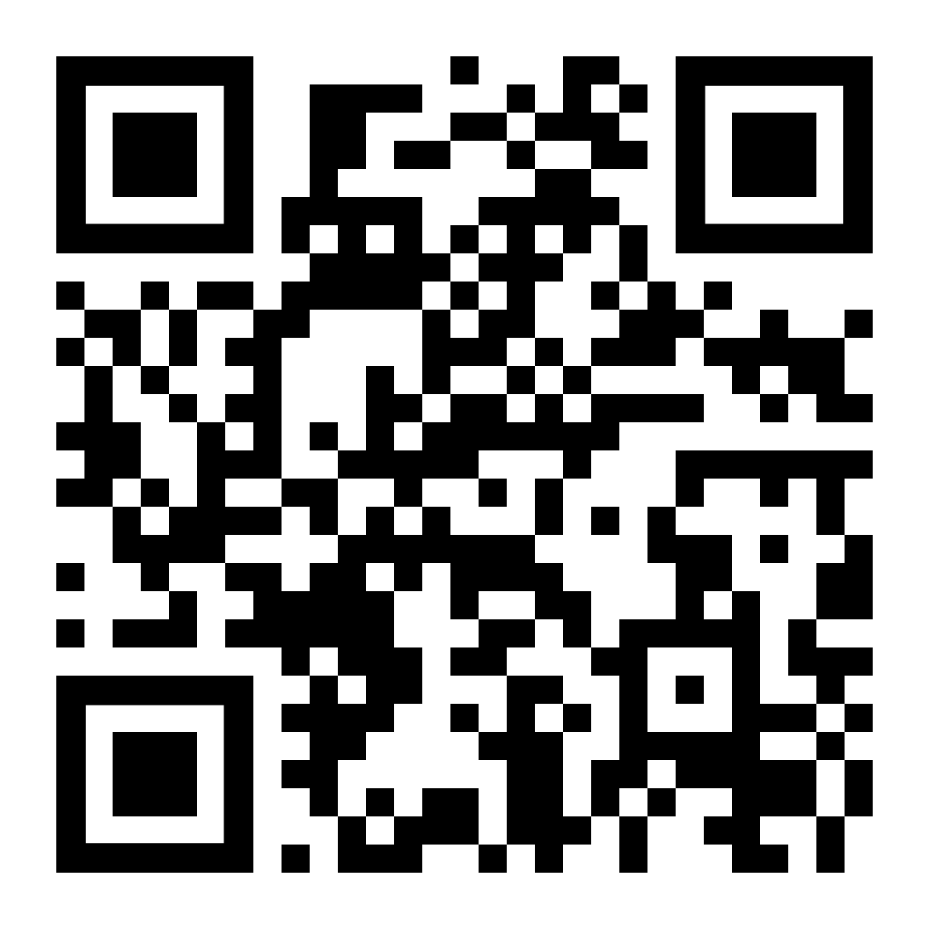
Exercise 1.3 Bodies at War
This is a MSF storytelling experience recounting the lives of Abu Wesam and of Joud, who are survivors of conflict in Yemen and Syria and are receiving care and support in a MSF hospital in Amman, Jordan.
  Watch your allocated video in groups and scroll down to read the stories (5 minutes).
  Discuss in groups which human rights have been violated (20 minutes).
  Use the copy of UDHR if needed.
  Appoint someone from each group to provide feedback in a 15-minute plenary discussion.
  We will note the relevant UDHR articles on a flip chart as each group gives their feedback.
https://bodiesatwar.msf.org/en/
Notes:
Exercise 1.3 Bodies at War (45 min, including 5 min to set up)
Divide participants into groups (perhaps with a facilitator in each) and allocate either the Abu Wesam or the Joud story from the Bodies at war video. Tell them to watch on a laptop or people’s mobile phones.
Background information:
Abu Wesam, and his children Wesam, Reda and Issa, were injured with severe burns in the war in Yemen. They face human rights violations under the UDHR, for example:
Article 3 (right to life, liberty and security). Abu Wesam and his family’s lives were seriously threatened by the war, violating many rights including access to ongoing, essential life saving treatment and care for their injuries.
Article 13 (the right to freedom of movement and residence within the borders of each state and the right to leave any country, including his own, and to return to his country). Abu Wesam and his children either could not cross borders or did so at great risk.
Article 19 (the right to freedom of opinion and expression). Abu Wesam was not safe due to his opinions/desire not to belong to a particular group.
Article 25 (Everyone has the right to a standard of living adequate for the health and well-being of himself and of his family, including food, clothing, housing and medical care and necessary social services, and the right to security in the event of unemployment, sickness, disability, widowhood, old age or other lack of livelihood in circumstances beyond his control) - the family could not access medical care for their injuries.
Article 26. (The right to education). Wesam was unable to go to school. Although a child, he had to work to make money for the family
Joud was injured and partially lost his vision in the war in Syria when he was 15 years old. He faced several violations, for example:
Article 3 (see above). Joud’s young life, safety and security, and his freedom were seriously impeded.
Article 5 (no torture, or cruel, inhuman, or degrading treatment). Joud was beaten and tortured by the police.
Article 9 (no arbitrary arrest). Joud was arrested and detained without trial for joining a protest.
Article 19 (see above) Joud was not able to express his views without real risk of arrest and assault.
Article 25 (see above). Joud could not access medical care for his injuries.

Slide 46
Topic 3. Groups/segments of the population at risk of human rights violations
Notes:
Time for this topic: 10 min.
There are four more slides in this topic.

Slide 47
Presentation. Groups/segments of the population at risk of human rights violations
Certain groups of people are more at risk of experiencing social exclusion, discrimination and other human rights violations.
The IASC MHPSS terminology is at risk groups, but they are sometimes called marginalized or vulnerable. Vulnerability in this context does not imply fragility, weakness or deficiency. It just means being at higher risk of exclusion and violations.
In a humanitarian context it is important not to hold preconceived ideas of who is marginalised/vulnerable, but rather to update the analysis.
What marginalised or vulnerable groups do you know of in your work or living context?
Notes:
There are 4 slides in this presentation.
Explain we will be looking at the human rights violations experienced by different groups of people.
Talk through the slide and pose the question.
Remind participants that the context can rapidly change from one day to the next in humanitarian settings (e.g. conflict, climate, COVID) and these changes can mean that there are changes in the groups at risk.
Ask the group
Can you give examples of where you have worked with people from these groups?

Slide 48
Groups/segments of the population at risk of human rights violations
Examples include:
    women;
    people who are lesbian, gay, bisexual, transgender, intersex or questioning (LGBTIQ+)
    children;
    people with HIV/AIDS;
    children and adults with disabilities (particularly those with psychosocial, intellectual or cognitive disabilities);
    older people;
    people who are undocumented migrants, asylum seekers or refugees;
    Indigenous People.
Notes:
Talk through the slide.
If time allows you can share the child-friendly versions of the Convention on the Rights of the Child with participants and flag the Six Grave Violations against Children in Armed Conflict
https://www.unicef.org/child-rights-convention/convention-text-childrens-version https://www.unicef.org/children-under-attack/six-grave-violations-against-children

Slide 49
Groups/segments of the population at risk of human rights violations
Sometimes groups subjected to human rights violations represent a significant part of the population (for example, women, children).
There can also be important differences between individuals within specific groups (gay and bisexual men may be at higher risk of suicide depending income, education and the living environment).
Groups that might be considered at risk of human rights violations can also experience advantage and can demonstrate resilience (for example, Indigenous communities may have strong resilience in the face of adversity and may maintain their cultural practices, languages, and identities despite external pressures).
Notes:
Talk through the slide.
For a reference on differences within groups you can point to
Ferlatte O, Salway T, Hankivsky O, Trussler T, Oliffe J, Marchand R. Recent suicide attempts across multiple social identities among gay and bisexual men: an intersectionality analysis. Homosex. 2017;65(11):1507–26. Epub 2017 Sep 27. doi: 10.1080/00918369.2017.1377489.
For a reference on resilience, you can point to
Caxaj CS, Berman H. Belonging among newcomer youths: intersecting experiences of inclusion and exclusion. ANS Adv Nurs Sci. 2010;33(4):E17–30. doi: 10.1097/ANS.0b013e3181fb2f0f.

Slide 50
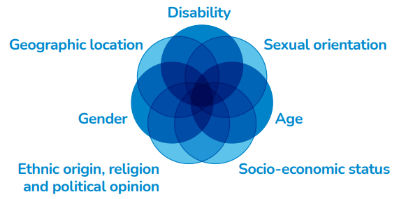
Groups/segments of the population at risk of human rights violations
Intersectionality: People may belong to more than one at-risk group, facing multiple and intersecting forms of discrimination (e.g. women with disabilities, displaced LGBTQ+ people, Indigenous People living with HIV/AIDS).
Key challenges that these groups may share:
discrimination in many areas of their lives;
violence, abuse and neglect;
restricted civil and political rights;
exclusion from participating fully in society;
reduced access to social services, including housing;
reduced access to health care and support;
reduced access to emergency relief services;
lack of educational opportunities;
exclusion from, or reduced access to, income-generation and employment opportunities;
increased rates of illness and premature death.
Notes:
Remind participants that:
At risk groups are not exclusive and can be intersectional. People may belong to more than one at-risk group or segment of the population which can expose them to even more human rights violations, including multiple and intersecting forms of discrimination. For example, women may have disabilities, people who are displaced due to war or violence may also identify as LGBTQ+, or Indigenous People may be living with HIV/AIDS.
Explain that the diagram visualizes some of these overlapping intersecting factors - but there can be many more.
Clearly highlight that:
People subjected to human rights violations, including multiple intersecting forms of discrimination, are very commonly encountered in the humanitarian context.
If you have time, talk through the list on the right of the slide.

Slide 51
Topic 4. Consequences of human rights violations
Notes:
Time for this topic: 65 min, with 20 of that after lunch (60 mins).

Slide 52
Exercise 1.4 Impacts of violations
What consequences do the violations of human rights discussed previously have for:
    individuals
    each group as a whole
    the wider community or society in which they live?
Notes:
Exercise 1.4 Impacts of violations (15 min.)
Ask participants the three questions and write down their ideas on the flipchart.
Discussion prompts:
For the individuals. This is an opportunity to reflect on the personal impacts of human rights violations. You can pose additional questions such as:
How might a violation affect the person’s mental health and well-being?
What about their family?
What about their future?
For each group as a whole.
Could this give rise to human rights violations in the future for the group?
Is their social / cultural / economic or political participation, or position in society, being affected?
For the wider community or society.
Could these violations give rise to negative consequences and further human rights violations affecting other at-risk groups or segments of the population?
Are societies that persecute groups/segments of society good places to live?
Do human rights violations result in a loss of diversity or culture?
At the end of the discussion, summarize what has been said based on the ideas written on the flipchart.

Slide 53
Exercise 1.5 Reflective exercise
An important step towards change is to reflect on how our own beliefs or actions may help or hinder other people’s enjoyment of human rights.
    Have you ever witnessed someone you know violating someone’s human rights?
    Has there ever been a time when you may have been responsible for not supporting and upholding someone’s human rights?
Notes:
Reflective exercise 1.5 (5 min.)
Warning: This reflective exercise is sensitive. Participants must feel secure and must understand that the point is not to judge them, but to encourage them to reflect on their own personal role in upholding or violating human rights. For some participants from certain contexts, this exercise may not be suitable.
Make sure to prepare in advance (see the facilitator’s guide) and decide whether to include it. Don’t hesitate to drop this activity where there is a recent history human rights violations that civilians are likely to have been involved in (directly or indirectly).
Read out the slide and pose the questions.
Given participants 3 minutes to jot down their thoughts. Tell them they will not have to share this exercise with others if they do not wish to.
Spend a couple of minutes in optional discussion. But tell those who want to share not to reveal the names of the people involved and not to give details that would identify individuals.
One alternative is for participants to write down their experience anonymously. The facilitator could read out some of the experiences at the next session.
A second less sensitive alternative is for participants to consider what factors might prevent them from taking action to uphold someone’s rights in a humanitarian context or a time of great stress.
Prompts.
Could the ‘someone’ be a friend/neighbour, colleague or community member?
If you were responsible for not upholding rights, it could have been something you realized only after a situation occurred. It may not have been intentional.

Slide 54
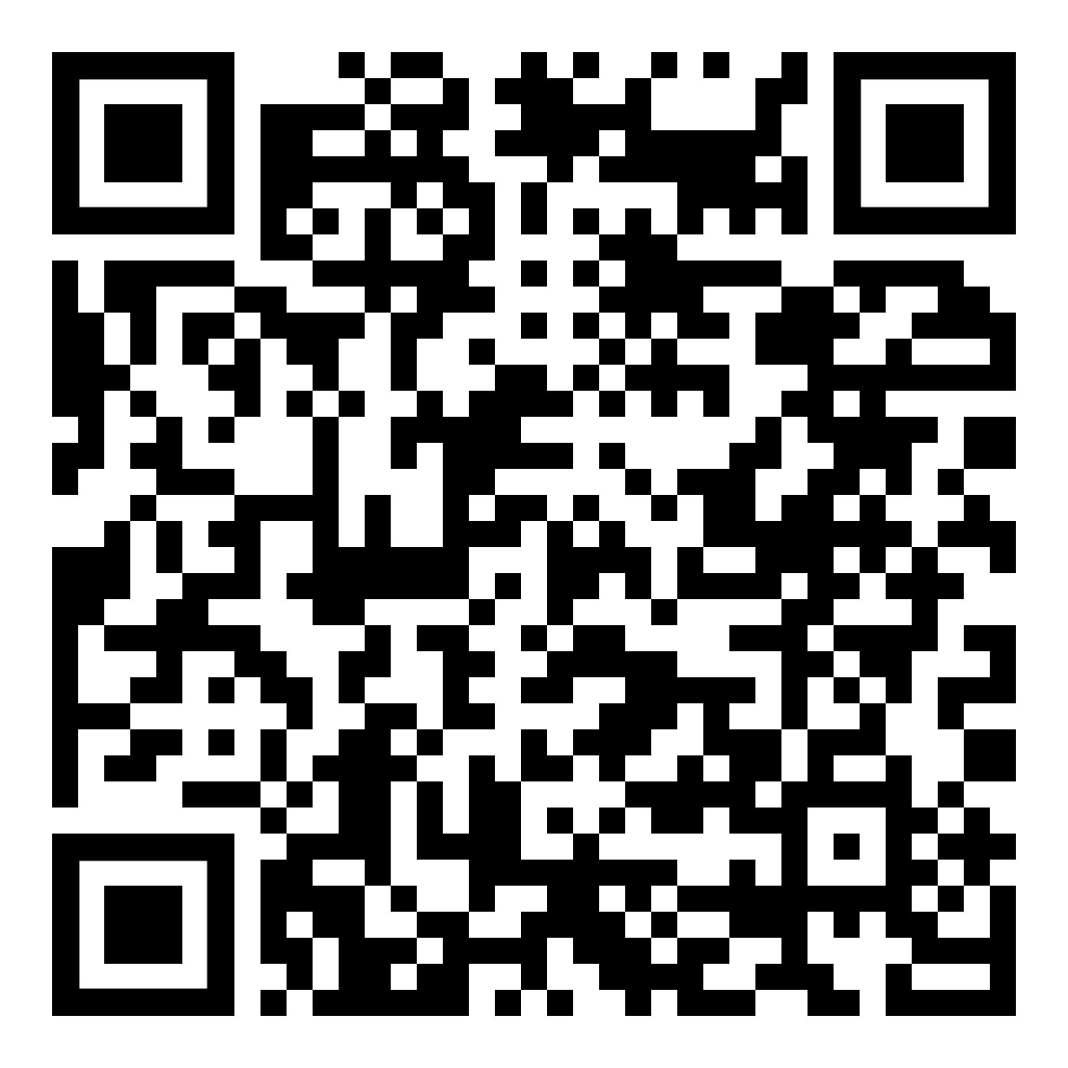
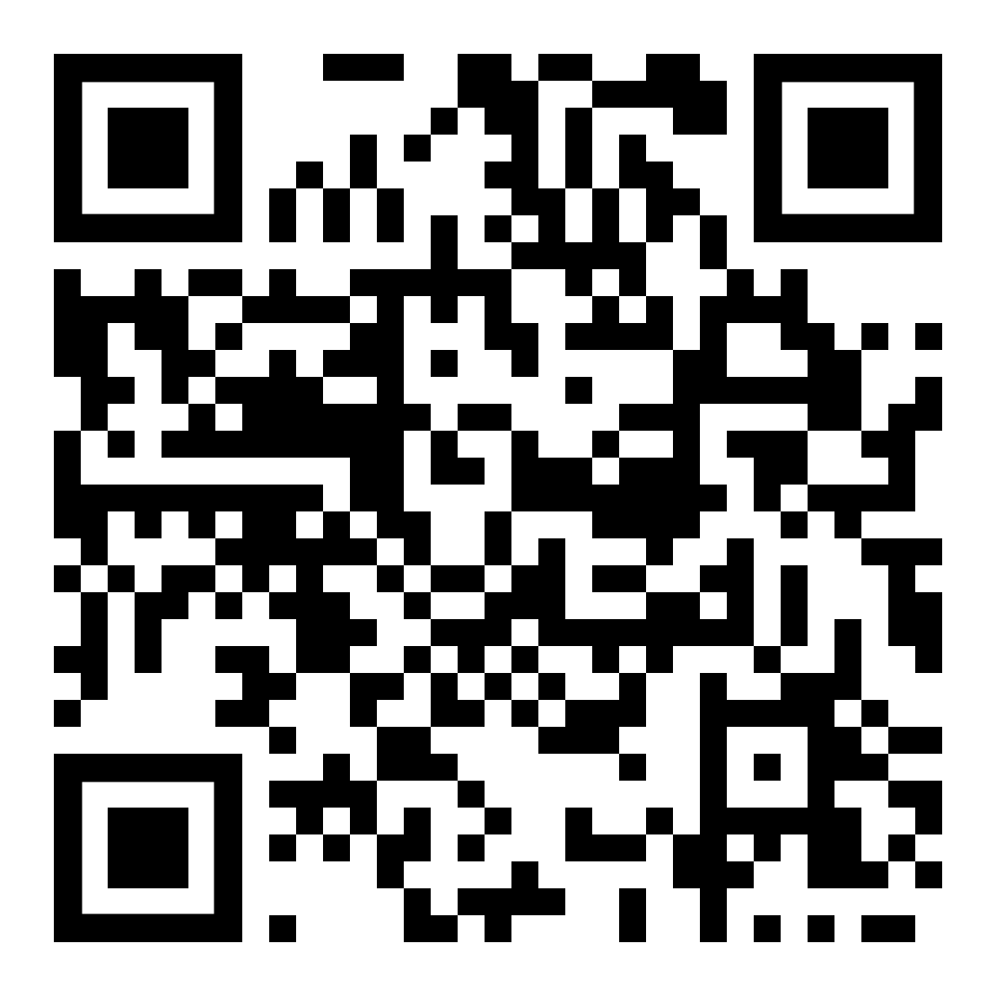
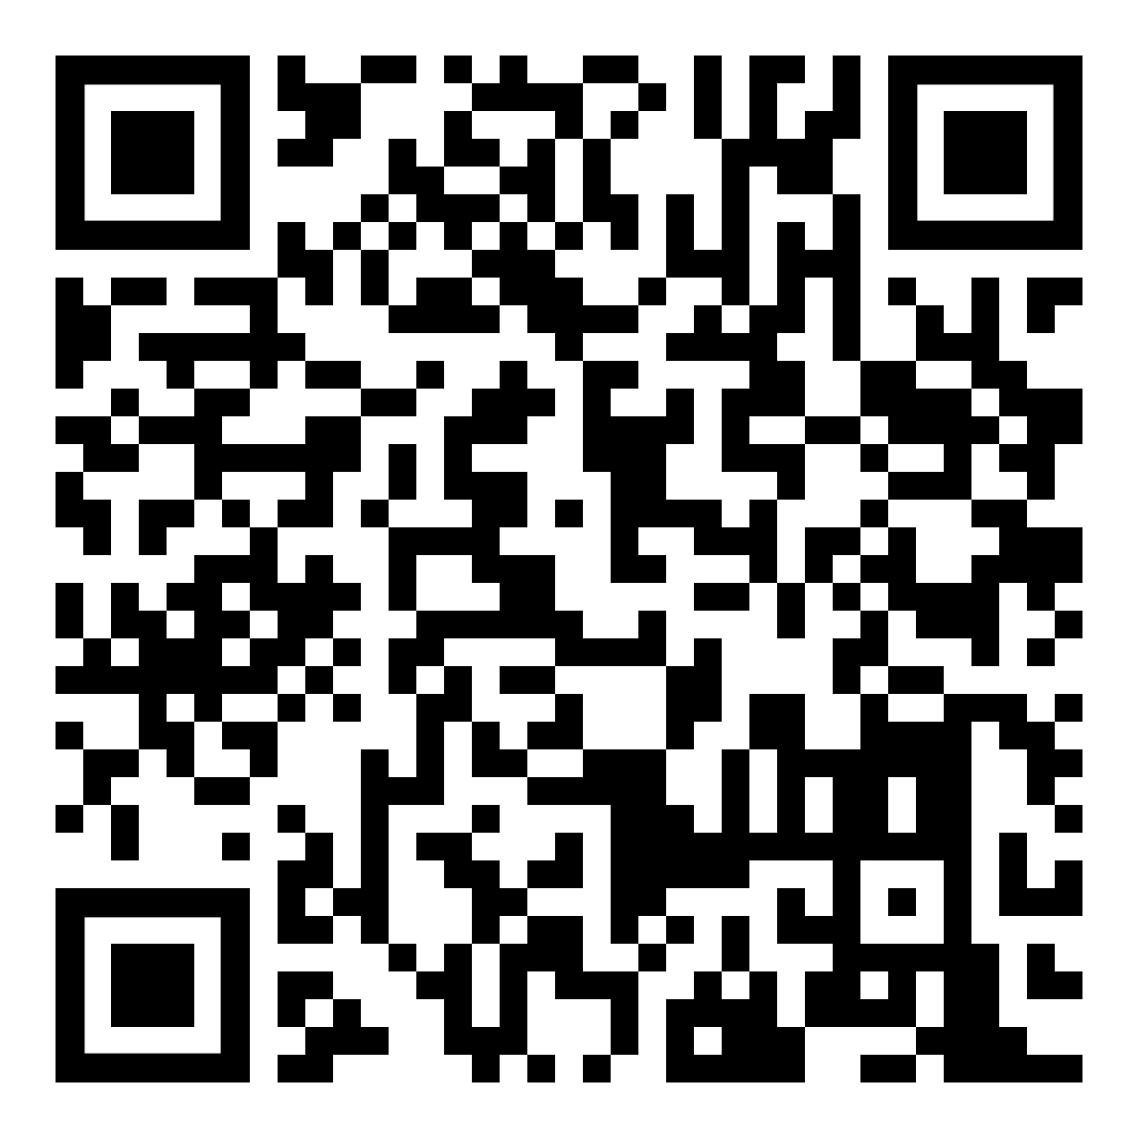
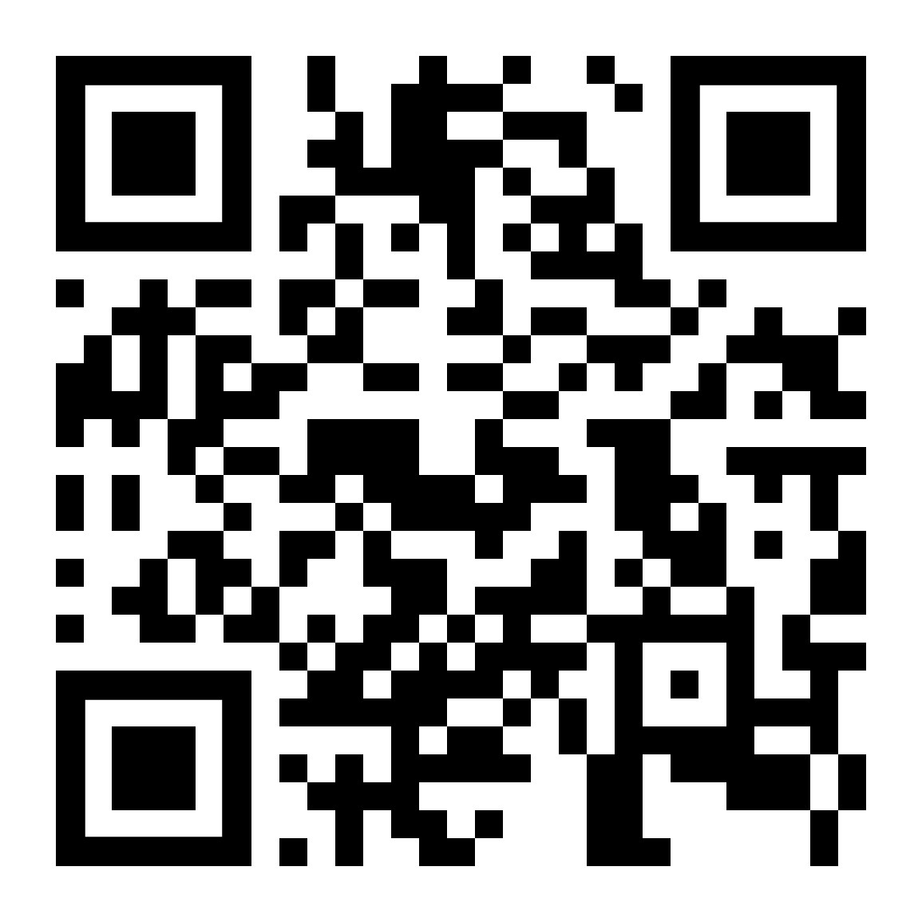
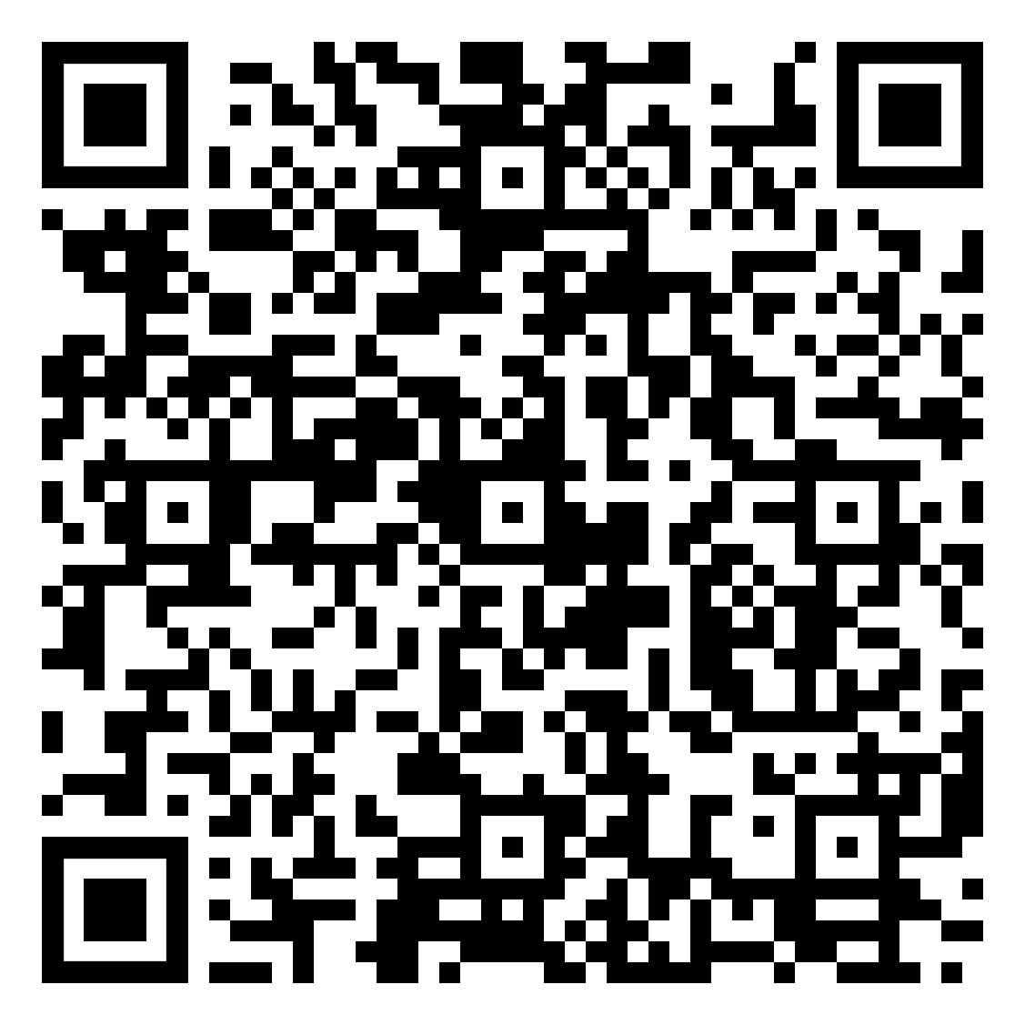
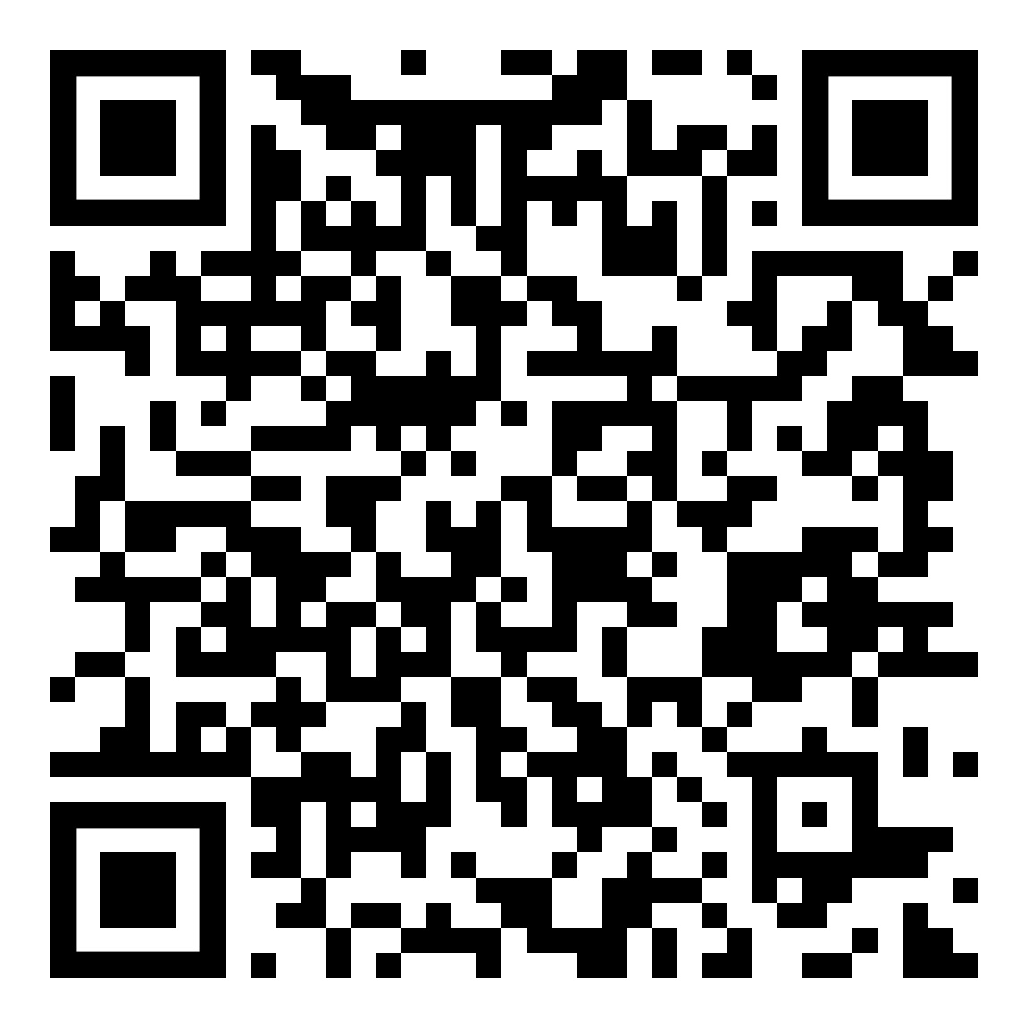
Exercise 1.6 High risk/vulnerable groups
  QUESTIONS:
  Which human rights violations did the person(s) face?
  What were the consequences of these violations?
  What could be done to mitigate these?
Ebola survivors, Liberia (6:40)
Refugees, Greece (1:22 + text)
Children with psychosocial, intellectual or cognitive disabilities, Ukraine (4:44 + text)
People with disability, Jordan (text)
Notes:
Exercise 1.6 High risk/vulnerable groups (50 minutes, 3 slides: 5 min explanation, 25 min group work, then 20 mins plenary after lunch)
This exercise uses video and text case studies of people from high risk/vulnerable groups or segments of the population. It poses questions on human rights violations, the consequences of violations and elicits suggestions for mitigation.
Divide participants into groups to look at one case study each.
Ask participants to use their paper or electronic copies of the UDHR for reference.
Ask participants to watch the video and read the text in their group and then discuss the questions posed on the slide (tell them they have 25 minutes).
Tell them there will be a group discussion after lunch.
Hyperlinks
Ebola survivors, Liberia.
Video: https://www.ohchr.org/en/video/2021/protecting-rights-humanitarian-crisis
Refugees, Lesvos
Video: https://www.youtube.com/watch?v=sQSEX3_MBuY
Article: https://www.msf.org/greek-police-enforce-unwarranted-and-cruel-quarantine-moria-camp (also available as HANDOUT M1.2)
People with disability, Jordan
Article: https://www.huffpost.com/entry/-helping-the-disabled-to_b_3094620 (or HANDOUT M1.3)
Children with psychosocial, intellectual or cognitive disabilities, Ukraine
Video: https://youtu.be/xor7IrwumSw
Article: https://www.driadvocacy.org/news/new-report-left-behind-war-dangers-facing-children-disabilities-ukraines-orphanages (also available HANDOUT M1.4)

Slide 55

Lunch breakchLun
Notes:
1 hour
55

Slide 56
Exercise 1.6 High risk/vulnerable groups
Plenary discussion
  QUESTIONS:
  Which human rights violations did the person(s) face?
  What were the consequences of these violations?
  What could be done to mitigate these?
Ebola survivors, Liberia.
The Ebola virus claimed more than four thousand lives in Liberia during the 2014 epidemic. The outbreak became a humanitarian crisis with emerging human rights violations.
Refugees, Lesvos, Greece
During COVID 19 the biggest refugee Camp in Lesvos, Moria, was completely locked down. Inhabitants could not leave – even after the lockdown was lifted for citizens. Evacuations, even of the most at-risk individuals, were not organized.
Notes:
Run a 10 minute discussion of the first two case studies investigated before lunch. Here is some background about the situations, and some prompts for the questions.
Ebola in Liberia
Prompts.
Which human rights violations did the person(s) face? Right to life (Article 3), right to health (Article 25), right to equality and non-discrimination (Article 2), and freedom of movement (Article 13).
What were the consequences of these violations? Stigma and discrimination, exclusion, worsening physical and mental health.
What could be done to mitigate these? Educate and build capacity on human rights including during a crisis, conduct anti-stigma campaigns, community reintegration, involve survivors in designing and implementing the response to the crisis.
Refugees, Lesvos
Prompts.
Which human rights violations did the person(s) face? Right to health (Article 25), freedom of movement (Article 13), right to dignity (Article 1), and non-discrimination (Article 2).
What were the consequences of these violations? Exclusion; Worsening physical and mental health; Heightened distress, fear, and insecurity; discriminatory treatment of refugees
What could be done to mitigate these? Ensure equal access to healthcare for refugees and host populations; Avoid discriminatory, blanket restrictions through proportionate and evidence-based measures; Improve living conditions, sanitation, and safety in camps; provide psychosocial and community support services.

Slide 57
Exercise 1.6 High risk/vulnerable groups
Plenary discussion
Refugees with disability, Jordan
In Zaatari, a Camp with over 150,000 refugees from Syria, life is hard, but especially for people with disabilities. Often, physical needs are not met in emergencies and during protracted displacement. People with disabilities are practically excluded from participating in many activities, leaving them isolated.
Children with disabilities, Ukraine
In April 2022, Disability Rights International visited facilities for children and babies in Ukraine, finding atrocious conditions that were entirely overlooked by major international relief agencies and that received little support from outside the country. Children with greater support needs were left behind in their institutions while those with fewer impairments or with no disabilities from the same institution were moved to Poland, Italy, and Germany.
  QUESTIONS:
  Which human rights violations did the person(s) face?
  What were the consequences of these violations?
  What could be done to mitigate these?
Notes:
Run a 10 minute discussion of the other two case studies investigated before lunch. Here is some background about the situations, and some prompts for the questions.
People with disability, Jordan
Prompts for discussing the questions.
Which human rights violations did the person(s) face? The right to life and security (Article 3), right to health (Article 25), right to dignity (Article 1), right to equality and non-discrimination (Article 2), right to education (Article 26), and freedom from cruel, inhuman or degrading treatment (Article 5), ), right to an adequate standard of living (Article 25).
What were the consequences of these violations? People with disabilities faced poor physical and mental health, sickness, poverty, social isolation, lack of opportunities, exclusion from education, and in some cases even death, leaving them highly vulnerable and marginalized within the camp.
What could be done to mitigate these? Ensure emergency responses address and respond to requirements of persons with disabilities, access to/provision of aids and supports such as wheelchairs, walkers and ramps, inclusive health and education services, implement actions to reduce isolation and enable full participation in camp life.
Children with psychosocial, intellectual or cognitive disabilities, Ukraine
Prompts for discussing the questions.
Which human rights violations did the person(s) face? Rright to health (Article 25), dignity (Article 1), freedom from cruel, inhuman or degrading treatment (Article 5), non-discrimination (Article 2), protection of family life (Article 12), right to an adequate standard of living (Article 25).
What were the consequences of these violations?: Children with disabilities were left behind, neglected, restrained, and denied medical care, leading to poor physical and mental health, isolation, emotional harm, and in some cases death.
What could be done to mitigate these? Close orphanages, invest in community-based supports, strengthen families, develop family-like alternatives (foster/kinship care), plan inclusive evacuations, enable families to flee with their children, and raise awareness among donors, policy-makers, institutions, and society to end discrimination against children with disabilities.

Slide 58
Topic 5. Respecting, protecting and fulfilling human rights
Notes:
Time for this topic: 5 min

Slide 59
Presentation: Respect/protect/fulfil
Upholding the human rights of others involves 3 main tasks
    Respecting - by not violating the human rights of another person.
    Protecting - by preventing others from violating a person’s human rights.
    Fulfilling - by taking positive steps to make sure that a particular person or group has the same human rights protections as everyone else.
Notes:
Presentation: Respect/protect/fulfil (5 min)
Talk through the slide point by point. Here are some examples using medicine preference and privacy that you could use to illustrate the three concepts.
Respecting. This is achieved by not violating the human rights of another person.
Listen to and respect a person’s preference concerning what treatment they would like or not like (for example, if someone says they don’t like a particular medicine because it makes them feel ill).
Respect a person’s right to privacy by not going into their private room without their permission.
Protecting. This is achieved by preventing others from violating a person’s human rights
Make sure others do not give the person treatment or medication that the person may not want.
Protect a person’s right to privacy by stopping others from going into their private room.
Fulfilling. This is achieved by taking positive steps to make sure that a particular person or group has the same human rights protections as everyone else.
Write in the person’s file or treatment plan what medication they dislike to make sure that they are not given it in the future.
Enable the person to have a lock on their door (or a Do not disturb sign) so that they may choose when they want to have visitors.
Educate others about the right to privacy.

Slide 60
Topic 6. Empowering people to defend human rights
Notes:
Time for this topic: approximately 45 minutes.

Slide 61
Exercise 1.7 Defending human rights in mental health
How can these people defend the human rights of individuals with psychosocial, intellectual or cognitive disabilities?:
    people with psychosocial, intellectual or cognitive disabilities themselves
    mental health and other practitioners
    humanitarian actors
    people with status or influence in the community
    family members and supporters
    humanitarian responders, including MHPSS actors.
Notes:
Exercise 1.7 Defending human rights in mental health (25 mins, 6 slides)
This exercise explores how various people might defend human rights. It is likely to bring up conflictual as well as cooperative situations.
Preparation
Familiarize yourself with the Minimum Service Package (MSP), and particularly with section 3, Activity 3.1 (Orient humanitarian actors and community members on MHPSS and advocate for MHPSS considerations and actions).
Instructions
Participants should discuss one of the five types of people in pairs. If there are more than 10 people, you can give two pairs the same topic. Ensure all five are discussed. Tell them they have 10 minutes for this before a group discussion.
Emphasize early on that people with psychosocial, intellectual, and cognitive disabilities have firsthand experience and valuable insights into how their rights can be protected and how others can best support them.
Allocate the roles to discuss according to the participants’ background, for example MHPSS workers can discuss humanitarian responders.
If you have participants who are MHPSS actors and are familiar with the Minimum Service Package you might tell them the following link is a good summary of things humanitarian responders can do. https://mhpsshub.org/resource/iasc-minimum-service-package-mental-health-and-psychosocial-support/.
The next five slides will help you run the plenary discussion. Allow 15 minutes, or around 3 minutes per role.

Slide 62
Exercise 1.7 Defending human rights in mental health
How can people with psychosocial, intellectual or cognitive disabilities themselves defend their human rights?
Notes:
Examples answers
They can:
know and understand their own rights;
speak out about human rights violations and organize actions to stop these violations;
support others in claiming their rights and form groups to come together and claim rights,
use the media to highlight problems and violations and to disseminate information about rights;
work with lawyers, human rights NGOs, institutions and mechanisms to enforce human rights;
build the knowledge and capacity of practitioners, families and others to understand and promote human rights;
develop their own capacities on human rights through legal and human rights training;
develop programmes for peer-run alternatives and community-based services and supports;
develop model laws and policies relevant to the human rights of people with psychosocial intellectual or cognitive disabilities;
develop in plain language some easy-to-read and accessible materials to help people with different needs to build their own capacities for human rights advocacy and engagement.

Slide 63
Exercise 1.7 Defending human rights in mental health
How can mental health and other practitioners defend the human rights of people with psychosocial, intellectual or cognitive disabilities?
Notes:
Example answers:
They can:
connect to people who can provide support, especially the protection sector and other supports (lawyers, NGOs, peer supporters, advocates, etc.) in order to help people defend their rights;
strengthen their own knowledge of the rights of people with psychosocial, intellectual and cognitive disabilities, including the rights of people using the services they work in;
identify and take responsibility for current practices (both personal and within services and society) that can violate people’s rights, and take action to change these;
speak out about human rights violations in the workplace and take action to stop them.
In some contexts, speaking up about rights can put individuals, responders, or communities at risk. Be sensitive to this by:
acknowledging that participants may have different levels of safety or ability to engage; and
adapting the discussion and examples to fit the realities of the participants’ contexts.

Slide 64
Exercise 1.7 Defending human rights in mental health
How can family members and supporters defend the human rights of people with psychosocial, intellectual or cognitive disabilities?
Notes:
Example answers
They can:
learn about the rights of people with disabilities;
support relatives or friends to claim and defend their rights;
provide people with the tools and information to exercise their autonomy and make decisions for themselves;
support development of peer support/ community-based services;
speak up about violations and the impact of poor-quality services (for example, speak to the services’ management);
act on the many different levels suggested across this training to make this sometimes-difficult task more possible.

Slide 65
Exercise 1.7 Defending human rights in mental health
How can people with status or influence in the community defend the human rights of people with psychosocial, intellectual or cognitive disabilities?
Notes:
Examples answers
Members of the police force can undergo training on human rights to ensure that they treat people with psychosocial, intellectual or cognitive disabilities with respect and dignity. They can make sure that they investigate complaints of abuse.
Teachers can educate about disability and can talk to students about the value in accepting and respecting diversity. In humanitarian contexts, the education sector and the several tools that MHPSS, Protection and Education share can be used in this regard.
Religious or community leaders can help raise awareness in communities about the need to respect people’s rights.
Local authorities or community members who oversee or work in reception or migration centres can receive training on human rights, so they can ensure that people with disabilities are treated with dignity and respect, and to help remove attitudinal, informational, communication, environmental and institutional barriers that hinder people’s participation and inclusion.

Slide 66
Exercise 1.7 Defending human rights in mental health
How can humanitarian actors defend the human rights of people with psychosocial, intellectual or cognitive disabilities?
Notes:
Example answers
Humanitarian responders and MHPSS professionals can:
contribute to all sectors of the humanitarian response (e.g. camp management, education, food security and nutrition, health, protection, shelter and water and sanitation) ensuring that people’s needs are met and upholding their rights (for example, the IASC MHPSS Minimum Service Package Activity 3.1. shows how to orient humanitarians and community members on MHPSS actions);
train people working alongside their project, activity or organization in human rights, for example using the QualityRights e-training;
include people with lived experience in programme planning, delivery and review;
prioritize community-based mental health activities;
advocate for rights during the recovery phase of the humanitarian response.
Mention that humanitarians have key obligations. Here there are some examples and resources.
United nations security council resolution 2475 (2019), the first-ever security council resolution on rights of persons with disabilities, calls on: “Member States and Parties to armed conflict to protect persons with disabilities in conflict situations and to ensure they have access to justice, basic services…and unimpeded humanitarian assistance [and] to prevent violence and abuses against civilians in situations of armed conflict… as well as rape and other forms of sexual violence in conflict”
World health assembly resolution eb148.R6, 74th 2021 requires achieving “the highest attainable standard of health for persons with disabilities” and prioritizes access to health services; protection during health emergencies; access to public health interventions; and disability data.
IASC guidelines on inclusion of people with disabilities in humanitarian action, requires:
identification and removal of barriers that people with disabilities face in accessing humanitarian action/ services;
meaningful participation of people with disabilities in the humanitarian programme cycle;
empowerment and capacity building of organizations of persons with disabilities;
Strengthen disability data disaggregation in planning, implementation, M&E
Charter on inclusion of persons with disabilities in humanitarian action World. Humanitarian Summit (2016) https://humanitariandisabilitycharter.org/
Six grave violations against children and the Monitoring and Reporting Mechanism for children in armed conflict. UN Security Council Resolution 1612. https://childrenandarmedconflict.un.org/tools-for-action/monitoring-and-reporting/

Slide 67
Topic 7. Human rights advocacy
Notes:
Time for this topic: 20 mins plus 30 mins for a guest speaker

Slide 68
Fighting for rights – human rights defenders
Plenary discussion
Can you think of any human rights defenders or advocacy groups working with your project?
Notes:
Presentation. Fighting for rights – human rights defenders. (20 mins. 6 slides before the optional guest speaker)
Take just a couple of minutes to ask the group:
Can you think of any human rights defenders, advocacy groups, or people with lived experience, working with your project or programme?
If they struggle to find examples, ask:
Can you think of any human rights defenders or advocacy groups in the region / country(ies) you work in?

Slide 69
Fighting for rights – human rights defenders
Who fights for human rights? Examples include:
    individuals
    communities
    governments
    organizations of people with disabilities, advocacy groups, NGOs and faith-based organizations
    the United Nations.
Notes:
The next few slides discuss who defends human rights.
Deliver this topic as a positive message. Participants should leave with a clear idea that defending human rights can improve the lives of individuals, groups and society as a whole.
Talk through the slide.

Slide 70
Fighting for rights – human rights defenders
Governments
Governments have the primary responsibility for protecting, respecting and fulfilling human rights
Governments have agreed to uphold the rights expressed in the UDHR and have ratified major human rights treaties, to varying degrees.
Despite governments’ roles, violations of human rights are still common within countries.
Notes:
Talk through the slide.
With the second bullet, mention that:
Many governments have also drafted their own human rights laws or have integrated human rights principles into their constitutions. This means that these principles are legally binding and can be used to protect the human rights of citizens. Yet, some governments have also not signed/ratified certain treaties, or have included limitations/reservations.

Slide 71
Fighting for rights – human rights defenders
Organizations
Organizations can be advocacy groups, groups of people with disabilities (OPDs), other NGOs or faith-based organizations. They can be international, national, or local.
Organizations of Persons with Disabilities (OPDs) include:
  International Disability Alliance (IDA)
  World Network of Users and Survivors of Psychiatry (WNUSP)
  Disability Rights International (DRI).
International organizations include:
  United Nations organizations and agencies including the World Health Organization
  Médecins Sans Frontières
  Humanity and Inclusion
  CBM Global Disability Inclusion
  Human Rights Watch
  Amnesty International
Notes:
Talk through the slide.
Emphasize:
Organizations of Persons with Disabilities (OPDs) defend human rights for people with disabilities, including psychosocial, intellectual and cognitive disabilities.
International organizations campaign to respect, protect and fulfil people’s human rights everywhere, including in humanitarian contexts.

Slide 72
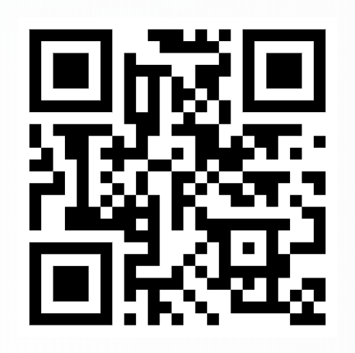
Fighting for rights – human rights defenders
The United Nations
A major purpose of the United Nations is to “develop friendly relations among nations based on respect for the principle of equal rights and self-determination of peoples”. The UN:
monitors, protects and promotes rights through the Office of the High Commissioner for Human Rights, the Human Rights Council and other agencies and mechanisms (www.ohchr.org/en/countries);
leads action to protect refugees and people forced to flee conflict and persecution through the United Nations High Commissioner for Refugees (UNHCR);
upholds the UNCRC through UNICEF.
Notes:
Talk through the slide.
For the monitors and protects point, explain (and show directly if appropriate):
You can easily see the human rights issues and obligations of the country you are working in through the OHCHR website www.ohchr.org/en/countries.
The homepage drop down menu has a Countries option, where you type in your country of interest to select a page devoted to it.
On the page you will see the latest statement and messages, news, calls for input, reports of OHCHR on the country, and closer to the end of the page you will see the ratification and reporting status of the country.
By clicking on each of the options you will be able to see which human rights treaties were signed and/or ratified by the country and when the reporting is due on each of the treaties.
If there is time and groups have internet access, they can look up the OHCHR website and explore it together. If demonstrating this process yourself, choose a relevant country.
For the leads action point you could direct participants to the United Nations High Commissioner for Refugees (UNHCR) website and the 1951 Convention. https://www.unhcr.org/about-unhcr/overview/1951-refugee-convention.
For the upholds the UNCRC point explain that the UNCRC refers to the UN Convention on the Rights of the Child, and that UNICEF is the United Nations Children’s Fund (previously called the United Nations International Children's Emergency Fund).

Slide 73
Fighting for rights – human rights defenders
YOU!
Core principles
Human rights and equity
Participation
Multi-layered supports
Integrated support systems
Building on available resources and capacities
Do no harm
IASC MHPSS Guidelines: Core principles
Principle 1. Human Rights and Equity
Humanitarian actors should promote the human rights of all affected persons and protect individuals and groups who are at heightened risk of human rights violations. Humanitarian actors should also promote equity and non-discrimination.
Notes:
Emphasize that everyone present should be a human rights defender.
Explain that:
The IASC Guidelines on MHPSS in Emergencies (2007) are key to establishing the essential principles of MHPSS in emergencies.
These guidelines establish six core principles for all MHPSS action, and the first one is Human Rights and Equity.
Ask a participant to read Principle 1 out loud.
Then explain:
This reminds us that as humanitarian actors we should promote the human rights of people we work with and protect the rights of those who may be at risk of their rights being violated.

Slide 74



Fighting for rights – human rights defenders
Guest speaker
Video
In person
Online
Notes:
There are 30 minutes in the schedule for this activity.
A guest speaker can inspire participants. They can provide insight into some of the issues covered in the training, for example a speaker might have lived experience of humanitarian crises, or might work in humanitarian contexts. The guest can be pre-recorded or can participate in person or remotely.
Having a guest speaker needs advance preparation.
Plan and test how you will reach the guest if they are joining remotely.
Link your video to the presentation if you have pre-recorded a speaker.
Plan how you will introduce the guest.
Agree in advance how they will share their experience, for example how long they will talk for and how you will guide that.
You may need to prepare a few prompt questions to guide discussion.
If using a live interaction, you might include a Q&A session where participants can ask the guest their own questions.

Slide 75
Break
15 minutes
Notes:
75

Slide 76
Topic 8. Becoming QualityRights Changemakers
Notes:
Time for this topic is 50 minutes overall: 10 minutes presentation (4 slides) then 40 mins for the action plan exercise.

Slide 77
Presentation. Becoming QualityRights changemakers with action planning
This training will help you become QualityRights Changemakers. The training will:
prepare you to develop and implement action plans that promote rights-based and recovery-oriented approaches;
reflect on and discuss specific problems, challenges, and barriers you face in your work;
exchange ideas for overcoming these obstacles;
give you time to develop your own action plan, tailored to your unique context, outlining concrete and realistic changes to be implemented over the next six months.
Notes:
Talk through the slide. There is one slide in this introduction (2 mins).
77

Slide 78
Presentation. Levels of change
Where QualityRights can be implemented within humanitarian response
Advocacy level. Global, national and local advocacy to integrate QualityRights in humanitarian responses and to improve mental health services
Organizational level. Setting operational priorities, adopting policies, and adapting human resource strategies to implement QualityRights training and align with human rights standards including the CRPD.
Project level. Integrating QualityRights in our projects, including all phases of the project cycle and within our diverse activities and services.
Organization
Project
Advocacy
Notes:
Presentation. Levels of change (8 mins, 3 slides)
Explain to the participants:
Within humanitarian responses, there are various levels where change can happen to improve the situation of people with psychosocial, intellectual or cognitive disabilities:
Advocacy level. There can be global and national advocacy to integrate QualityRights into humanitarian responses and to improve mental health services.
Organizational level. Our organizations can adopt policies, human resource strategies, operational priorities, etc. in order to implement knowledge acquired from this QualityRights training and align with human rights standards including the CRPD.
Project level. We can integrate QualityRights in our projects, including all phases of the project cycle.
This training focuses mostly on the actual project (or service) level, but it is important not to forget that change needs action at the other two as well.

Slide 79
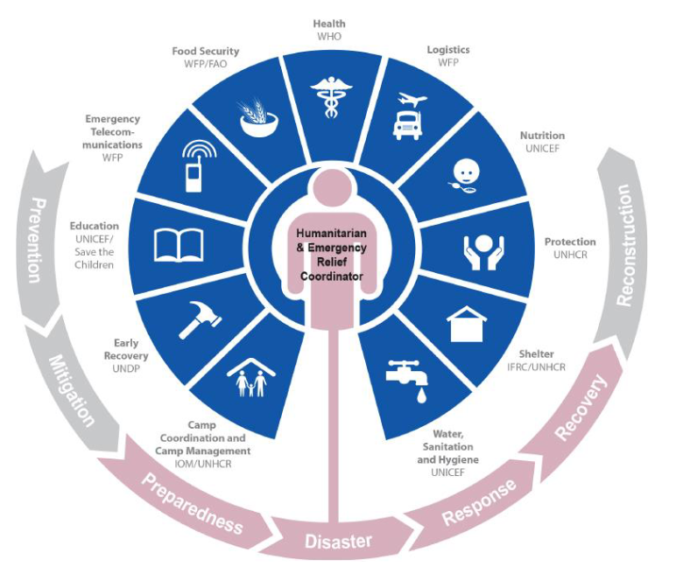
Levels of change: the programme cycle
Notes:
This and the next slide recap the activities and possibilities for implementing QualityRights-aligned changes.
Explain that:
The circular diagram represents the programme cycle. Change can happen at all stages, from prevention, through to mitigation, preparedness, during the disaster, then in response, recovery and reconstruction phases.
Reference for the image: OCHA (2015) Reference module for Cluster Coordination at country level: https://interagencystandingcommittee.org/iasc-transformative-agenda/documents-public/iasc-reference-module-cluster-coordination-country-level However, please note that this structure is under review and should be modified as the Humanitarian Reset is finalized.

Slide 80



Levels of change: the intervention pyramid and cross-sectoral working
Clinical
services
Focused psychosocial supports
Health sector
Protection sector
(with Child Protection, GBV, Mine Action AoRs)
Education Nutrition
Shelter CCCM and other sectors
Strengthening community and family supports
Social considerations in basic services and security
MHPSS Cross-sectoral Working Group
Notes:
….Explain that:
The pyramid diagram represents the MHPSS intervention pyramid. There are many opportunities to improve services at all of its levels, including within clinical services at the top of the pyramid, then within focused psychological support activities, and by strengthening community and family supports, and finally in providing basic services and security.
Reference for the image: IASC (2007) guidelines on mental health and psychosocial support in emergencies: https://interagencystandingcommittee.org/mental-health-and-psychosocial-support-emergency-settings-0/documents-public/iasc-guidelines-mental
The rectangular diagram reminds us that change can also be implemented across all sectors, for example within Health, Protection, Education, Shelter, Nutrition, Camp Coordination and Camp Management, and other sectors.
Reference for the image: IASC Handbook. Mental health and psychosocial support coordination. IASC (2022) https://interagencystandingcommittee.org/iasc-reference-group-mental-health-and-psychosocial-support-emergency-settings/iasc-handbook-mental-health-and-psychosocial-support-coordination
Remind participants:
You will be focusing on a level relevant to your position and function – you are not expected to work all levels. However, you should be able to see how your level fits within the others.
Ask participants:
Which level do you think you are working in?
Can you name some people or roles within your organizations with responsibility for other levels?

Slide 81
QualityRights Changemakers and Action Plans
Notes:
Time: 40 min

Slide 82
Exercise 1.8 Action plans: becoming QualityRights changemakers
In small groups, begin developing your individual QualityRights Action Plans.
  Part 1 (20 mins). Discuss what already exists in your work context, projects, or programmes that helps respect and promote the rights of people with psychosocial, intellectual or cognitive disabilities.
  Part 2 (20 mins). Identify new, realistic actions you could take in the next 1–6 months to further promote these rights (for example, advocacy, staff training, awareness-raising, policy change).
  Add your ideas to your individual Action Planner. Also summarize what your group came up with on your flipchart — you will continue using these summaries during the training.
Notes:
Exercise 1.8 Action plans. 40 mins.
Put participants into small groups of 3–5 people to begin developing ideas for individual Action Plans and creating a shared flipchart summary. They will continue to build their individual plans throughout the training. Clarify that each participant’s main Action Plan is individually developed day by day using the action planner, while the flipcharts serve as visual summaries of group discussions for sharing and continuity. These flipcharts can be displayed in the room and revisited in later exercises to reflect on progress and connect ideas across the week.
If participants are from different projects/professions/organizations, ask them to group by similar work/background so they can discuss practical barriers/solutions (for example, conflict rather than migration settings; or community services rather than institutional settings).
If all participants are from the same project, mix professions/roles (a person with lived experience, MHPSS professional, psychosocial worker, counsellor, coordinator, etc.) to ensure varied perspectives.
Or, group by one of: geographic region/project, service setting (refugee camp, community mental health, institution, survivors of torture/sexual violence), role, or idea of change (for example, Start a peer group / Train all staff / Revise policy).
Alternatively, if it makes more sense, let participants work individually on their action plans (for example, when participants come from different organizations or contexts), while still discussing their ideas with other participants before documenting them.
Give each person an Action Planner. Participants should complete both their individual Action Planner for Day 1 and a group flipchart.
82

Slide 83
Daily wrap up and rapid end of day evaluation
Please provide some quick first impressions on how you found this module. You'll have the opportunity to give more detailed feedback at the end of the entire course too.
What is/are the most important point(s) you learnt from today’s training?
Any remarks? Wishes for tomorrow?
Notes:
Daily wrap up and rapid end of day evaluation (15 min.)
Summary:
Ask a volunteer to briefly summarize the day’s training (5 minutes max.)
Alternatively, ask for one or two volunteers to do a 5 minute summary at the start of the next session.
Rapid evaluation:
Ask participants to answer the two questions in a couple of sentences each.
Alternatively, hand out sticky notes so people can leave comments on two flip charts allocated for the questions.
83

Slide 84
WHO/UCN/MSD/PLR/2025.2 © WHO 2025. Some rights reserved. This work is available under the CC BY-NC-SA 3.0 IGO licence.

