Slide 1
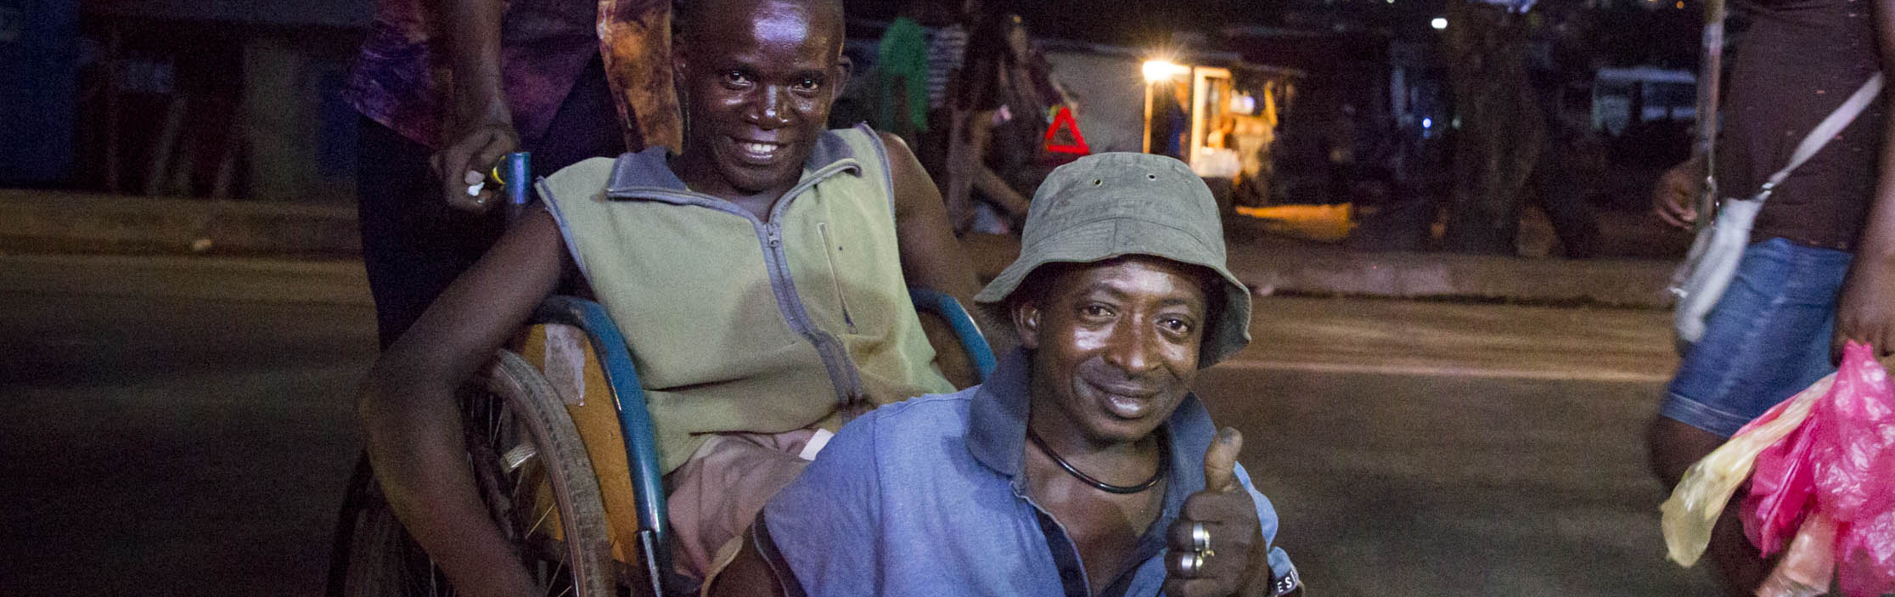



Course Slides
Mental health, disability and human rights
CBM/Sarah Isaacs
Legal capacity and the right to decide
WHO QualityRights training
– humanitarian edition
QualityRights
Notes:
These training materials have been adapted from the WHO QualityRights materials for training, guidance and transformation
https://www.who.int/publications/i/item/who-qualityrights-guidance-and-training-tools
To participate in the workshop QualityRights – humanitarian edition it is essential to have undertaken the WHO QualityRights e-training on mental health, recovery and community inclusion beforehand.
https://www.who.int/teams/mental-health-and-substance-use/policy-law-rights/qr-e-training

Slide 2
Topics covered in today’s training
Module 2. Mental health, disability and human rights
Topic 1. Understanding discrimination and denial of rights
Topic 2. Understanding disability from a human rights perspective
Topic 3. The Convention on the Rights of Persons with Disabilities (CRPD)
Topic 4. The link between MHPSS principles and the CRPD
Topic 5. Article 11 – Situations of risk and humanitarian emergencies
Topic 6. Article 19 – Living independently and being included in the community
Topic 7. Article 12 – Equal recognition before the law
Module 3. Legal capacity and the right to decide
Topic 1. Understanding the right to legal capacity (equal recognition before the law in practice)
Topic 2. Supported decision-making and advance planning
Becoming a QualityRights changemaker: working on our Action Plans
Notes:
Introduction (5 min for this and the next slide)
Give a brief welcome back
Summarize Day 1 if that has not yet been done.
Talk through the overview of Day 2.
Please ensure the Action Plan group flip charts from day 1 are displayed.

Slide 3
Learning outcomes
At the end of Day 2 you will understand:
the concepts of discrimination and denial of rights;
the concept of disability;
how the CRPD is central to respecting, protecting and fulfilling rights for people with disabilities;
how the principles of MHPSS work are closely linked to the CRPD;
how to apply CRPD knowledge to real-life scenarios and identify rights violations for people with disabilities, including in the humanitarian context;
how to respect and uphold people’s rights, including in the humanitarian context, and how to include people with disabilities in humanitarian project design and implementation;
supported decision-making and advance planning.
Notes:
Talk through the slide.

Slide 4
Module 2.
Mental health, disability and human rights
Notes:
Time: 230 min (3 hours 50 minutes) including a 15 min break, or 250 minutes (4 hours 10 minutes) with the final optional exercise.

Slide 5
Topic 1. Understanding discrimination and denial of rights
Notes:
Time of this topic is 55 min.

Slide 6
Exercise 2.1 Rights of people with psychosocial, intellectual or cognitive disabilities
Can everyone enjoy the same rights?
Do you think people with psychosocial, intellectual or cognitive disabilities are able to enjoy the rights in the UDHR?
Notes:
Exercise 2.1 Rights of people with psychosocial, intellectual or cognitive disabilities ( 3 slides, 20 min: a discussion, video, discussion)
Ask participants to look at their copy of the Universal Declaration of Human Rights (UDHR) (HANDOUT M1.1 but also see https://udhr.audio/ and http://www.ohchr.org/EN/UDHR/Pages/UDHRinsignlanguages.aspx.
(The CRPD will be introduced in the next topic.)
Ask participants the question on the slide. Encourage them to think about real-life experiences that might affect people and to link these with human rights issues.
The discussion may suggest that people with psychosocial, intellectual or cognitive disabilities are often denied nearly all of their rights within the UDHR. Highlight this fact.
For example, participants might answer that people with psychosocial, intellectual or cognitive disabilities cannot enjoy their rights under:
Article 5. They are subjected to forced treatment and other interventions against their will which cause severe pain and suffering and can amount to torture and ill-treatment.
Article 19. They are often denied the right to express themselves and to have their opinions heard.
Article 16. Their right to marry and start a family is often violated.
Article 13. They are often denied the right to freedom of movement (for example when detained by mental health or social services).
Article 23. Their right to work is not always respected; people with psychosocial, intellectual or cognitive disabilities are often discriminated against by being denied employment opportunities or being dismissed from their job.
Article 25. Many people with psychosocial, intellectual or cognitive disabilities do not have access to good-quality services for physical or mental health or to services or supports that they may require to achieve an adequate standard of living in the community.
Articles 9 and 10. The right not to be subjected to arbitrary arrest or detention is also often violated, as members of these groups are often detained in mental health or social services without their consent.

Slide 7
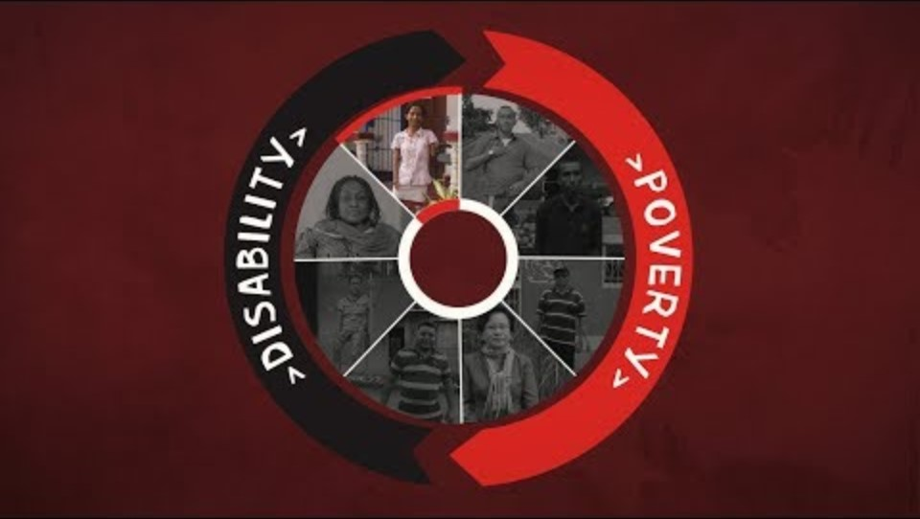

Mental Health, Disability and Human Rights
Video: The Cycle: EXPLAINED.
End the Cycle CBM / CBM Australia / CBM global
Watch this video
https://www.endthecycle.info
Notes:
Show the video The Cycle EXPLAINED to participants.
Tell them it shows the connection between the human rights of people with disabilities and a life lived in dignity and without discrimination.
https://www.youtube.com/watch?v=ca64-46rDm0 (3:27min)
Credit: The Cycle: EXPLAINED. End the Cycle CBM / CBM Australia / CBM global
Say to participants:
Before we dive into the UN Convention of Rights for People with Disabilities, we are going to zoom in on the existing discrimination and the different models of disability.

Slide 8
Exercise 2.1 Rights of people with psychosocial, intellectual or cognitive disabilities
What do you understand by the word “discrimination” ?
Exploring discrimination
Notes:
Exercise: 5 mins.
Ask the question, writing down some of participants’ key ideas on a flip chart/chalk board.
The presentation in the next two slides further explores the definition of discrimination. As you go through it, you will be able to talk briefly about similarities between what the group says now and the more formal definition.

Slide 9
Presentation. Defining discrimination
Discrimination means any distinction, exclusion or restriction on the basis of characteristics such as race, gender, sexual orientation, disability etc. which has the purpose or effect of impairing or nullifying the recognition, enjoyment of exercise, on an equal basis with others, of human rights and fundamental freedoms in political, economic, social, cultural, civil or any other fields
This definition is adapted from the Convention on the Rights of Persons with Disabilities (CRPD)
Simple definition of discrimination - when some people are treated differently from others because of one or more characteristics they have or are perceived to have and, as a consequence, are deprived of their human rights.
Notes:
Presentation: Defining discrimination (5 min for 2 slides.)
Talk through the slide.
Tell participants we will using the Convention on the Rights of Persons with Disabilities (CRPD) more later in the training,

Slide 10
Defining discrimination
Discrimination has complex causes at various levels. To fight discrimination:
    misinformation, prejudice and the fear of difference must be tackled;
    institutionalized discrimination or systemic discrimination must be addressed;
      Systemic discrimination includes discriminatory laws, policies, discrimination embedded in the health or social system, poverty and power inequalities in society.
Notes:
Here is some text you can read out to go with the slide.
Discrimination comes from complex causes that need to be addressed at various levels.
To fight discrimination, we have to address misinformation, prejudice and the fear of difference that some people may have. Sometimes people are not aware that their behaviour is discriminatory because they have internalized certain societal beliefs and norms all their lives.
Discrimination also needs to be addressed across our institutions and systems. This is often referred to as institutionalized discrimination or systemic discrimination.
Systemic discrimination can include discriminatory laws and policies; discrimination embedded in the health or social system. Poverty and power inequalities in society are also examples of factors that prevent people from enjoying their rights and may make people feel that efforts to change the situation and to obtain redress are hopeless. Although these systemic issues may seem hard to address, a lot can be done at this level.
Explain to participants:
This training focuses on discrimination rather than stigma. This approach encourages you to view the issue comprehensively and helps motivate action to challenge discriminatory laws, policies, and systemic barriers, as well as challenging negative attitudes.

Slide 11
Exercise 2.2 That’s not who I am!
How are people with psychosocial, intellectual or cognitive disabilities often perceived by society?
What are some common labels or stigmatizing words used in relation to people with psychosocial, intellectual or cognitive disabilities?
Notes:
Allow 15 minutes for this exercise, which has two questions on this slide, and some summary comments on the next.
Ask the first question and explore responses. Participants may offer negative views and stereotypes, such as ‘they are incapable of working / making decisions about themselves / should be medicated / kept in institutions’ etc. In some contexts, people are thought to be possessed by evil spirits and are seen as dangerous or bringing misfortune.
Then explain:
Health, social care and other professionals can have very limited views of people with disabilities. They may only see them at specific times (for example in distress or crisis) or in specific contexts (like residential services) where people can’t develop their potential. This gives a very limited view that does not reflect the whole person.
Ask the second question. Participants may give examples like “mad”, “manic”, “mental case”, “schizophrenic”, “retarded”, imbecile or “possessed” for example . Explore the language they think is acceptable in their own context and country.
Explain that:
Some people with psychosocial disabilities may find the term ‘people with a psychiatric diagnosis’ acceptable while others may prefer ‘people with mental health conditions’ or ‘people with psychosocial disabilities’. People with intellectual disabilities may prefer terms such as ‘learning disabilities’. Similarly, people with cognitive disabilities may, or may not, identify with diagnoses such as ‘people with dementia / Alzheimer’s / autism spectrum disorders’. Terms like disabled person, alcoholic, schizophrenic define the person as their condition. Many will prefer terminology such as ‘person with a disability’ or “person with schizophrenia” etc.
Some people who have used mental health or social services prefer terms such as ‘consumers’ or ‘survivors of psychiatry’ while others may prefer ‘people who use mental health services’.
Sometimes the same word may be considered unacceptable in one context but considered neutral or even positive in another. For example, the Mad Pride Movement challenges the stigma surrounding mental health by encouraging individuals to embrace and celebrate their identity.

Slide 12
Exercise 2.2 That’s not who I am!
Many people with psychosocial, intellectual or cognitive disabilities refuse to be defined or limited by a label or diagnosis. They achieve lives that are as fulfilling and successful as anyone else’s.
Others may internalize the negative views that society holds towards them; they may feel ashamed and blame themselves, and this can become a barrier to achieving their aspirations.
This can be called ‘internalized oppression’ or ‘self stigma’, and can prevent people from asserting their rights and obtaining redress for mistreatment and discrimination.
Notes:
Talk through the slide to finish the exercise.

Slide 13
Exercise 2.3 Understanding institutionalized discrimination
Plenary discussion
Can you give examples of laws, policies and other systemic issues in the humanitarian or low resource context where you work that prevent people with psychosocial, intellectual or cognitive disabilities from enjoying their rights?
Notes:
Exercise 2.3 Understanding institutionalized discrimination (10 mins, 1 slide)
This exercise asks the group to discuss examples of when people are unfairly treated on the basis of prejudices and power inequalities within laws, policies, health-care systems etc.
Ask the question on the slide.
IMPORTANT: If participants mention discriminatory old laws, such as Lunacy Acts, which still are present in several African contexts, you can highlight the colonial origin of these laws.
Prompts for the discussion:
During armed conflict and humanitarian crisis, state structures often break down. In this gap, those in control make “laws” and rules that may mean there is no legal protection for people with psychosocial disabilities at all.
In emergencies, mental health services and support is often deprioritized behind other health and support services.
Discriminatory laws may keep people out of employment. For instance, people can lose their disability benefits if they work. People may prefer to remain on benefits that they see as offering more financial security than employment options.
Discrimination in health insurance sometimes denies coverage for mental health services or limits people to options they find unacceptable, including institutional care and medication administered against their will.
Systemic discrimination in policy means that people with disabilities may be forced into institutions to get shelter and/or services that are not provided in the community.
Guardianship laws result in family members or appointed guardians making all decisions about a person’s life.
Humanitarian response may give insufficient systematic and structured consideration to the needs and rights of people with psychosocial, intellectual, or cognitive disabilities.
Governmental funding in health, education and social services may be insufficient to ensure people with psychosocial and other disabilities are considered and treated equitably.
Children may be excluded from education.

Slide 14
Topic 2. Understanding disability from a human rights perspective
Notes:
Time for this topic 100 minutes plus a 15 minute break.

Slide 15
Exercise 2.4 Understanding disability from a human rights perspective
Make a list of physical, attitudinal, communication, social or legal barriers facing people with disabilities, including people with psychosocial, intellectual or cognitive disabilities.
Think specifically about barriers in humanitarian and low resource settings.
Discuss what impact these barriers might have on individual people.
Notes:
Exercise 2.4 Understanding disability from a human rights perspective (25 mins 2 slides)
This exercise will help participants move from traditional charity and medical models of understanding disability to social and human rights models.
Preparation
Prepare 5 flipcharts for the types of barriers plus sticky notes or similar.
Discussion
Give pairs 10-15 minutes to discuss and write barrier on sticky notes. A few examples are given below. Remind participants that some of the barriers have already been mentioned.
Then ask each pair to put the barriers they find on the right flipcharts. Let participants walk around to read all the answers.
After a few minutes ask the participants, what they think/feel when they read all the barriers. Collect 3 or 4 answers.
Example barriers
Physical barriers: being locked up or restrained; being overmedicated; inaccessible shelters, transportation / evacuation, distribution points or shelter.
Attitudinal barriers: being ignored, disbelieved, treated as abnormal, as a burden, like an object, or as incapable; being left behind during emergencies or blamed for delays; facing hostility, distrust, fear, rejection, exclusion and abuse.
Communication barriers: exclusion from emergency communications; deliberately ‘kept in the dark’; not being ‘heard’; having nonverbal communication undervalued; condescension; having opinions dismissed as a symptom of illness.
Social barriers: isolation, neglect or full dependence on others; lack of services; labelled unable to contribute; being underpaid; missing school; being unwelcome at community activities; lack of resources and opportunities.
Legal barriers: being deprioritized in triage protocols; lip reading impossible through masks; requirements for self-isolation leave people unsupported; being disproportionately affected by limited access to justice in emergencies; guardianship laws that restricting legal capacity for decisions about aid, safety, and recovery.

Slide 16
Exercise 2.4 Understanding disability from a human rights perspective
People with disabilities, including people with psychosocial, intellectual or cognitive disabilities, face multiple barriers in their everyday life.
Facing all these barriers every day is what makes it difficult for many people with disabilities to live a fulfilled life. The problem is often the barriers, not the impairment or health condition itself.
This is why the human rights model of disabilities has been developed.
In humanitarian settings, people with disabilities, who are already disadvantaged, face heightened vulnerabilities and safety risks.
It is crucial to address their needs in humanitarian response activities.
Notes:
Link this slide and the previous one by saying:
What we see is that people with disabilities, already disadvantaged, face a dramatic increase in their vulnerabilities and risks to safety in humanitarian and lower resource settings.
Talk through the slide.
For the last bulleted point on the slide, also explain that:
Failure to design inclusive systems and responses can significantly heighten the risks and rights violations that people with disabilities face.
Humanitarian action needs to proactively identify and remove barriers and ensure that all people’s rights and needs are fully addressed.

Slide 17
Presentation. Different models of disability
The charity model of disability:
sees people with disabilities as helpless victims who depend on others;
relies on others’ goodwill and benevolence to 'care for' and 'protect' people with disabilities;
assumes people with disabilities lack capacity to participate in their communities by themselves, disempowering them.
Despite much change in MHPSS we must be alert to the charity model in humanitarian and MHPSS responses. International and local NGOs have a history, even if well-intentioned, of using the charity model in their fundraising and service delivery.
There is discussion, debate and action among international humanitarian and global health organizations to:
      acknowledge histories of racism, colonisation and past use of the charity model;
      reflect on previous versus current ways of working;
      restructure models to put the people they support first, with specific attention to their participation, inclusion and human rights.
Notes:
This presentation has 5 slides: one each for the charity, medical, social and human rights models of disabilities, and one comparing the models. Allow 15 minutes for the 5 slides.
Talk through the slide.

Slide 18
Different models of disability
The medical model of disability:
considers disability only as a health condition needing treatment;
sees people with disabilities as different from normal people;
and since the problem is believed to be with the person, the aim is to cure and make them normal again.
While many health interventions are important, desirable and helpful, relying solely on the medical model approach is problematic for many reasons.
In humanitarian and MHPSS settings, international and local NGOs have a history of focusing on people’s medical conditions or impairments.
In mental health, practitioners often refer to the biopsychosocial model.
      In practice, the bio strongly dominates the biopsychosocial model, and too much emphasis is put on the biological causes of mental health conditions.
      This approach often fails to place responsibility on society to remove social barriers.
      It also usually fails to adequately consider human rights.
Notes:
Talk through the slide.
Here is some background you could use to explain further.
Sometimes health professionals consider a person from various perspectives, yet focus heavily on their medical condition or impairment. It is important to take a more holistic perspective, which includes considering and responding to social barriers and human rights because these can be equally or more important factors.
The medical model does not refer to medical interventions themselves. Medical interventions can be helpful and appropriate, and are not the focus of the criticism. Rather, it is the excessive or exclusive focus on the medical, rather than a holistic interpretation.
The medical model is disempowering because it can leave social issues unresolved and implies that people with disabilities need to change, rather than that society should foster their diversity and inclusion.
The focus of this model is primarily on people’s perceived limitations, rather than on their strengths, passions and achievements.
For example, people with psychosocial disabilities are sometimes told by mental health and other practitioners that that they will never be able to “live a normal life” because of their condition. They may be told that they have a life-long condition from which they will not recover, that they will need medication for the rest of their life, and that they should give up on, or adjust, some of their goals (such as graduating from university, getting a job, having a family, etc.).
Certain experiences that mental health workers and other practitioners may consider symptoms of an illness (such as hearing voices) may be understood differently by the people experiencing them. People may see their experiences as reactions to fear, grief, injustice, despair, powerlessness, misunderstanding, panic, pain etc. They may also see these experiences as opportunities to learn about themselves and to grow.
People with psychosocial, intellectual or cognitive disabilities may not accept their medical labels. They may see themselves as part of the diversity of humanity rather than as having a condition or deficiency.
Challenging the model means always going beyond, to see and address the person and their caregivers with a broader consideration of what might be needed to address the challenges.
However, we must acknowledge that limited availability of other options for support and treatment is often a practical challenge.

Slide 19
Different models of disability
The social model of disability:
understands disability as resulting from the interaction between people with actual or perceived impairments and attitudinal and environmental barriers that hinder their full and effective participation in society on an equal basis with others (adapted from the preamble to the CRPD).
  Disability results when barriers prevent inclusion in the community.
  The problem originates from society rather than from the person’s actual or perceived impairment.
  It is up to society to remove barriers and to accommodate human diversity.
  Disability (as it is understood in the social model) can be overcome by enabling all people to participate equally in society.
Notes:
Talk through the slide.
If needed, explain a bit more about the role of medicine within the social model of disability:
The social model does not imply that health or social services are not useful; people may need and want medical interventions, for example to relieve pain or distress or to recover body functions.
However, the social model considers persons as a whole, including their interactions with their environment.
Within the social model, medical intervention is not an end in itself. Rather it is a way to support people to achieve the activities they want to do, if they find it helpful, and to participate in society.

Slide 20
Different models of disability
The human rights model of disability:
recognizes that disability is caused by barriers in society;
recognizes that people with disabilities are equal to others and are entitled to equal rights and opportunities;
recognizes that barriers that prevent people with disabilities from participating fully in society and from enjoying their rights are discriminatory;
states that people with disabilities have the right to have these barriers removed and can claim their rights (this is the main difference between the human rights and social models);
does not mean that health services are not useful;
does support people’s right to access quality health services on the basis of their free and informed consent.
Notes:
Explain that:
Like the social model, the human rights model recognizes that disability is caused by the many barriers that prevent people from participating in society on an equal basis with others.
But it goes further than this. The human rights model recognizes that people with disabilities are equal to others and, as such, they are entitled to equal rights and equal opportunities.
Talk through the slide.

Slide 21
Different models of disability
Different models in practice
Situation | Charity model | Medical model | Social model | Rights-based model
Young woman using a wheelchair | "What a pity, this woman is bound to a wheelchair, she'll never be able to marry, have children and care for her family. Maybe we can find her a nice care home where she can live and meet other people." | "Oh, this poor woman, she should go to a doctor and discuss if there is a therapy which could enable her to walk again, like everybody else." | "The community really should build ramps in front of public buildings, so that people like her can participate in social life." | "She has a right to take part in social activities, and the government should remove obstacles that make it difficult for her to be with other people in society.”
Notes:
Talk through the slide, or ask participants to read out the examples.

Slide 22
Exercise 2.5 The different models in practice
Situation | Charity model | Medical model | Social model | Rights-based model
Old man with a psychosocial disability, living in a care home in a town which is about to be evacuated due to war and violence approaching the town
Notes:
Exercise 2.5 (15 minutes, 3 slides)
Put the participants into 4 groups to discuss the scenario as though they worked for a humanitarian organization using a specific model of disability. Make sure each group uses a different model. Discuss first in groups, then in plenary.
How would they consider the man? How would they approach the situation?
Here are some prompts to use if needed.
Group using the charity model….
He is s a helpless victim, dependent on others.
He is someone who is vulnerable and to be pitied and 'cared for’.
He needs to be evacuated but there is no need to work out what he understands and wants.
He lacks the capacity to participate in his community or important decision-making as an independent person.
Group relying on the medical model….
He needs to depend on health system to keep him safe and to make decisions concerning his evacuation etc.
He has a medical problem primarily requiring health interventions
Group using the social model….
You work with him and his support workers to understand what is important to him, without making assumptions about his impairments.
You finding ways to communicate with him to explain the situation he faces, by working with the support of his chosen peers, family and care providers to listen and understand his needs, ensuring he has options and control over what happens to him, and seeing him as a member of his community.
Group using the rights-based model….
He has the right to make decisions on an equal basis to others, about whether he wants to leave, where he would like to move to, and how he would like to move.
You make meaningful efforts to implement supported decision-making processes so that he is given the support he may need in making his decisions (such as ensuring that he is given all relevant information, pros and cons of different options are discussed, that his point of view is communicated accurately and respected).
You speak out about the rights of people in his situation in local, national and international communities to ensure his rights.

Slide 23
Exercise 2.5 The different models in practice
Situation | Charity model | Medical model | Social model | Rights-based model
Old man with a psychosocial disability living in a care home in a town about to be evacuated due to war | "Look at this poor confused man; he seems to be mentally retarded; we’re going to move him to another part of the country where he can be cared for and kept safe." | "Perhaps we can give him some medicine or treatment to make him more calm and happier for his journey. If we sedate him he will feel better." | “Let’s work with him and the people he trusts (e.g. family and support workers) to support him to understand and decide about the evacuation, including where, with whom etc he should go.“ | "Where does he want to move to? Let's go and ask him!"
Notes:
Talk through the slide, which offers summaries of the different models in practice.
You may want to read out each of the descriptions above yourself, or ask the nominated leaders of each group to read out their respective model.

Slide 24
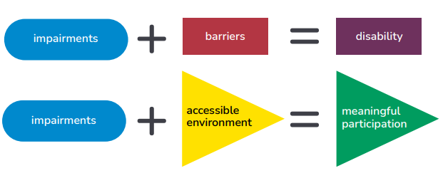
Exercise 2.5 The different models in practice
Summary
Notes:
Explain that:
The point here is that very often it is the barriers put up by society that cause problems. Instead, when people who experience impairment face an environment that is fully accessible (physically, socially, attitudinally, and legally), they are able to participate fully, meaningfully and equally in society.

Slide 25

Break
15 minutes
Notes:
Break – 15 mins

Slide 26
Exercise 2.6 Models of disability where you work
Plenary discussion
In the countries and communities where you work, what model is predominantly used to explain psychosocial, intellectual and cognitive disabilities? What do people think about people with these disabilities?
What model(s) are you using predominantly in your work? And what are the benefits/downfalls of using it?
Notes:
Exercise 2.6 Models of disability where you work (15 mins, 1 slide)
Run a plenary discussion of the questions on the slide.
Discussion prompts for question 1
In many countries, some mental health conditions and disabilities are explained by spirituality or witchcraft, spells etc.
In other contexts, explanations are ‘weakness of character’ ‘laziness’, ‘moral failures’ etc.
The medical model, seen as an alternative to supernatural explanations, aims to shield people with psychosocial disabilities from stigma and negative repercussions by viewing "illness" as needing treatment rather than punishment. However, this model can also be harmful, as it can be disempowering and may disregard individuals' will and preferences.
Discussion prompts for question 2
Humanitarian organizations might work from a medical / charity perspective, but within the MHPSS field, practitioners also consider psychosocial issues and human rights approaches.
Participants might highlight aspects of all models from their work.
Sometimes different groups of staff use different models in the same work settings. For example, medical staff may perhaps have a tendency to use the medical model whereas MHPSS counsellors might have a better understanding of the psychosocial and human rights issues and considerations.
Emphasize:
The model used where you work is not only important for MHPSS and social services. It will affect all services, including humanitarian services in all sectors and how people with disabilities are treated and included.

Slide 27
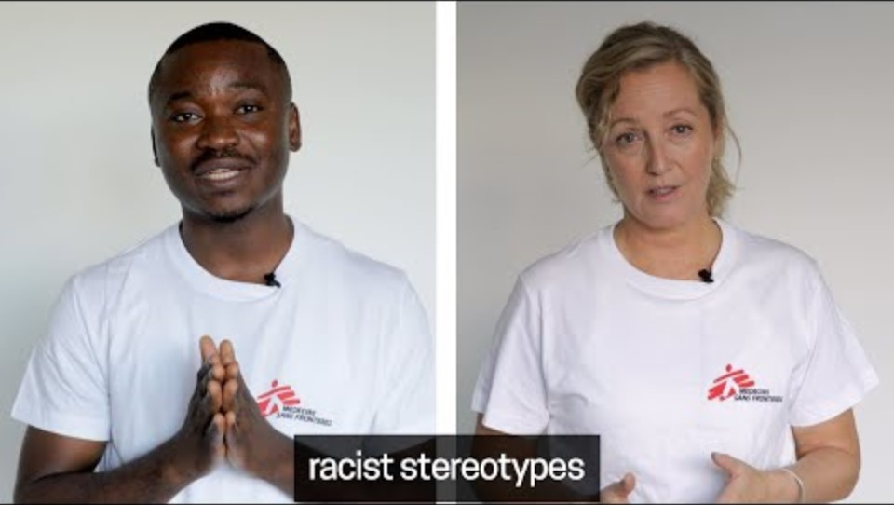
Exercise 2.7 Changing the model in the humanitarian sector
Anti-racism: When you picture Doctors Without Borders, what do you see?
Medecins Sans Frontieres
watch this video
Notes:
Exercise 2.7 (15 minutes) Changing the model in the humanitarian sector
Tell the group
This video was produced by MSF in 2022 to encourage discussion about its history and the need to transition to a new model.
As you watch, consider the models MSF and other organizations might be using. Prepare for the discussion by noting words and phrases that support your observations.
Reference
https://www.youtube.com/watch?v=8DFemg94ufU (3:54 min)
Credit: Anti-racism: When you picture Doctors Without Borders, what do you see? Medecins Sans Frontieres
After the video, run a discussion. Here are some prompts.
The video describes how MSF previously:
promoted the charity model in its communications;
used the concept of the ‘white saviour’ – a Western/European person delivering care to ‘victims’ who are passive objects of care, and who are non-white;
ignored the fact that the people they support are individuals who have families and lives in their community;
did not communicate that most of the care and support that people received was being provided by MSF team members from those same affected communities, who were more likely to understand the whole person.

Slide 28
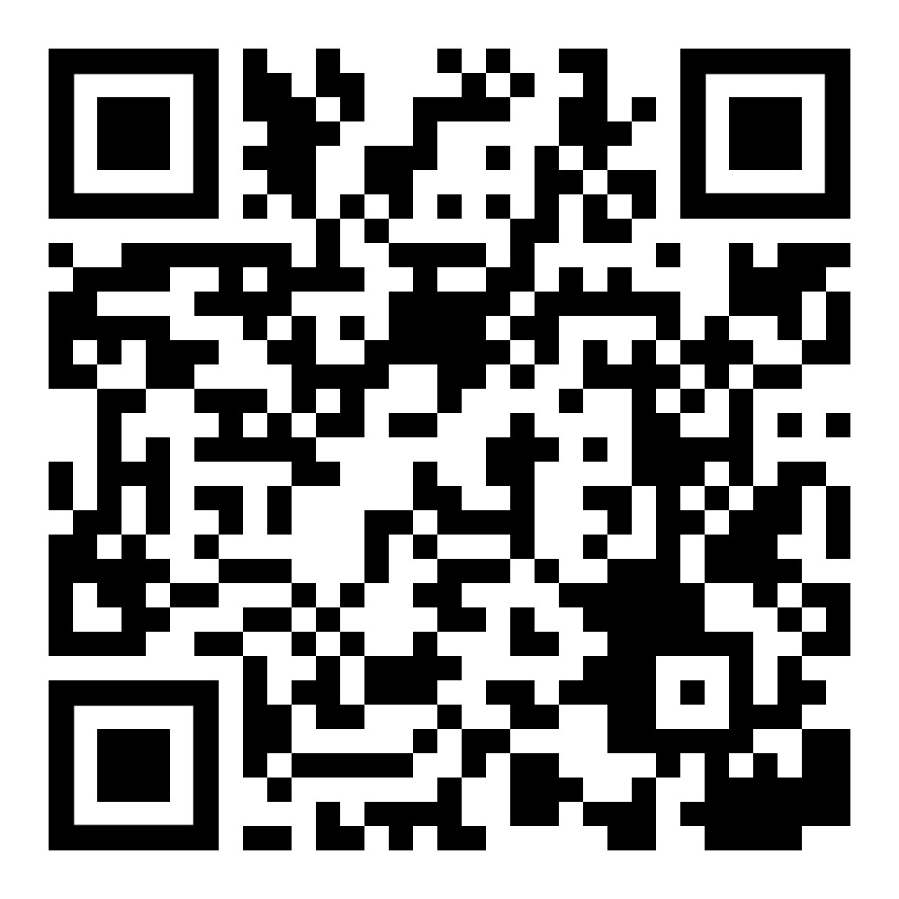
Exercise 2.8 Models of disability in the humanitarian sector – MHPSS response
Watch the video about Samar’s experience.
Where in the video could you identify the different models?
Do parts show the medical model perspective?
Imagine you are going to set up an MHPSS response in a displaced persons camp in Syria.
What aspects would you want to replicate, because they align with social and human rights models?
What additional components, aligned with the social and human rights models, could be included?
Video: Building sustainable mental health systems during and after emergencies. WHO: https://www.youtube.com/watch?v=R66xYAMh5P8&t=218s
Notes:
Exercise 2.8 (30 mins, 1 slide)
Put participants into groups of 4-6, then watch the video (on phones or in plenary). Give groups 10 mins to discuss the questions on the slide, then return to plenary and collect 3-5 answers for each question. Add from the prompts if necessary.
Reference: https://www.youtube.com/watch?v=R66xYAMh5P8&t=218s
Prompts for question 1
Psychosocial distress and related conditions underscore social barriers (human rights and the social models).
Healthcare centres are in the community, not institutions (social and human rights models).
There are community workers (social and human rights models).
The consultation is understandable and culturally acceptable and Samar agrees to proposed treatment (human rights model).
Prompts for question 2
Stigmatizing terminology like “being normal” is used.
There is no information about the social barriers Samar faced.
Prompts for question 3
MHPSS should work in primary health facilities and through community networks.
Clinicians and healthcare workers need training
Provide care in a multi-disciplinary team.
Include counselling - Samar said advice "helped me out”.
Medication can be prescribed by the doctor.
Prompts for question 4
Ask Samar what she would like support with.
If Samar agrees, talk together to her family/community about how they can support her.
Involve people with lived experiences when developing the MHPSS programme.
Assess barriers to accessing care and support, and try to overcome them.
Develop links with organizations that provide social, educational and occupational support
Strive to reach disadvantaged groups.
Develop peer approaches.
Note: you can mention that many of these components were indeed integrated in Syria, although this short video doesn’t show them.

Slide 29
Topic 3. The Convention on the Rights of Persons with Disabilities
Notes:
Time for this topic: 30 min

Slide 30
Exercise 2.9 What is the CRPD?
Quiz to recap learning from the WHO QualityRights emodule
Which key points of the CRPD do you know?
Notes:
Exercise 2.9 What is the CRPD? (10 min, 1 slide)
Ask the participants to name some of the key points they recall about the CRPD from the QualityRights e-training that they undertook before this in-person training.
Display the points on a flipchart.
Use the prompts if needed (or if your participants didn’t do this training).
Prompts:
Key points from the e-learning
The Convention on the Rights of Persons with Disabilities (CRPD) was adopted by the UN in 2006 in response to discrimination and human rights violations experienced by people with disability across the world.
The CRPD is a major step towards changing negative perceptions of disability and ensuring that countries recognize that people with disabilities must be provided with opportunities to live life to their fullest potential on an equal basis with others.
The Convention was not intended to create new rights but to show how existing rights apply to people with disabilities.
It contains 8 principles and, 50 human rights articles.
The CRPD is based on the social and human rights models of disability.

Slide 31
Exercise 2.10 The eight guiding principles of the CRPD
Identify the eight guiding principles from these twelve boxes
A. Respect for inherent dignity, individual autonomy
B. Guardianship
C. Non-discrimination
D. Sheltered workshops
E. Full and effective participation and inclusion in society
F. Respect for difference and diversity
G. Equality of opportunity
H. Special schools
I. Accessibility
J. Equality between men and women
L. Respect for the evolving capacities of children with disabilities
K. Institutionalisation
Notes:
Exercise 2.10 The eight guiding principles of the CRPD (5 mins, 1 slide)
Ask participants to identify the eight guiding principles of the CRPD from the 12 statements in the boxes.
If they give a wrong answer (boxes b, d, h, k), discuss why participants chose it, and why the choice is wrong.
Preparation
You can replace the boxes b, d, h and k with the following more challenging false statements if participants already have a very good knowledge of the CRPD:
B Recognition of priority of adequate healthcare
D Ensuring safe and stimulating environment
H Alleviation of criminal responsibility
K Adequate representation by legal guardians

Slide 32
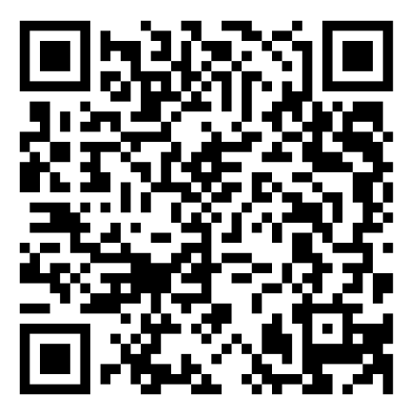
Exercise 2.11 Recap of the CRPD
ARCH Disability Law Centre.
https://archdisabilitylaw.ca/advancing-the-un-crpd/
Notes:
Exercise 2.11 Recap of the CRPD (10 min)
This exercise activates knowledge about certain CRPD articles and connects them to real life scenarios.
Use the QR code or link on the slide to access the colourful graphic on the website of ARCH Disability Law Centre. https://archdisabilitylaw.ca/advancing-the-un-crpd/
Ask the participants to explain some of the principles or rights on the poster and give an example from their work/project context.
At the end of the plenary discussion ask the participants:
Did you spot an article that might be missing? One that is essential for humanitarian work?
If the participants don´t know, tell them it is the Right to safety and protection in humanitarian emergencies (Article 11).

Slide 33
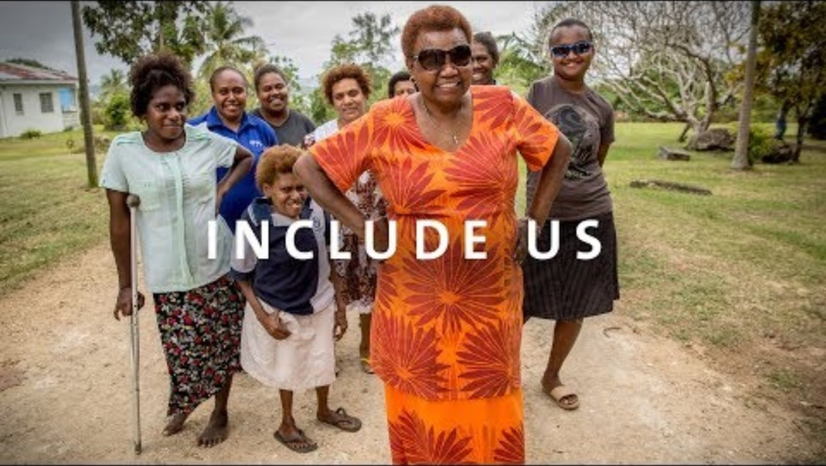
Mental Health, Disability and Human Rights
Credit: Include us! CBM Australia / CBM Global
Watch this video
https://cbm-global.org/video/include-us
Notes:
Presentation. Include us. Show the video as a summary of the CRPD’s meaning and impact
https://cbm-global.org/video/include-us
1:57 min. Credit: Include us! CBM Australia / CBM Global
Afterwards, ask the participants for their reactions.

Slide 34
Topic 4. The link between MHPSS principles and the CRPD
Notes:
Time for this topic: 15 min

Slide 35
Presentation. Guiding principles of MHPSS action and coordination
As we go through some of the key articles of the CRPD, think about how they align with the core principles of MHPSS coordination and action:
Promote human rights and equity.
Ensure participation of local affected people and communities
Do no harm.
Build on available resources and capacities.
Integrate with other services so that MHPSS is not a stand-alone programme.
Ensure multi-layered supports (as demonstrated by the MHPSS intervention pyramid)
… and make sure everything is accessible to everyone.
Notes:
Presentation. Guiding principles of MHPSS action and coordination (15 min, 2 slides)
Tell the participants:
As we learn more about the key articles of the CRPD, keep in mind the guiding principles of MHPSS action and coordination, so you see the links.
Talk through the core principles of MHPSS action and coordination, as set out in the IASC MHPSS Guidelines:
Human rights and equity should be promoted for everyone, including people at heightened risk of human rights violations.
We should be promoting participation of local affected populations, including children and young people, national authorities and other local actors in all aspects of humanitarian response.
The support we provide should do no harm.
We should build on available resources and capacities by engaging and working with local groups, supporting self-help and autonomy by building on existing resources.
We should integrate with other services such as general health, social care, education. This integration promotes considering people holistically, including all their support needs.
Multi-layered and appropriate supports across the life course are crucial. People affected by crises respond differently, needing different kinds of support (visualized in the MHPSS intervention pyramid).
Accessibility is not a core principle, but we should always bear it in mind.
References/resources
1. The IASC Handbook of Mental Health & Psychosocial (MHPSS) Interventions
https://interagencystandingcommittee.org/iasc-reference-group-mental-health-and-psychosocial-support-emergency-settings/iasc-handbook-mental-health-and-psychosocial-support-coordination
2. WHO’s Open course – Introducing mental health and psychosocial support in emergencies. This course is strongly advised to understand the MHPSS principles, framework and actions.
https://openwho.org/emergencymgmt/536361/Mental+health+and+psychosocial+support+in+emergencies
3. UNICEF’s MHPSS Operational Framework would help highlight child and adolescent specific considerations https://www.unicef.org/reports/global-multisectoral-operational-framework

Slide 36
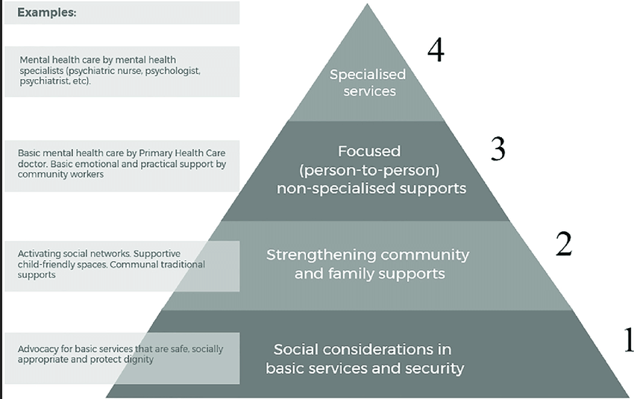
Guiding principles of MHPSS action and coordination
Ensure multi-layered support (the IASC intervention pyramid)
Image credit: Ubels et al. (2022). The social outcomes of psychosocial support: A grey literature scoping review. SSM – Mental Health, 2, Article 100074. doi.org/10.1016/j.ssmmh.2022.100074
Notes:
Here are some notes to help you talk through the IASC intervention pyramid.
Multi-layered supports are crucial and acknowledge that people affected by crises respond in different ways and require different kinds of support (the pyramid…). The model also acknowledges that the community has a very important role to play in providing MHPSS responses.
At the bottom of the pyramid are social considerations in basic services and security. Multi-layered support requires a solid foundation. This includes advocating for basic services that are safe, accessible, socially appropriate, and that protect people’s dignity (such as food, water, shelter, and safety). A core principle of MHPSS action is ensuring and advocating for these needs to be met as part of a holistic response.
The next layer focuses on strengthening community and family supports. Once basic services and safety are in place, social networks can be activated and supported, for example, through safe spaces for children and women, and strengthening community networks.
The third layer is focused (person-to-person or group) support. This includes basic mental health care provided by primary health care staff, and emotional or practical support offered by trained community workers, such as social workers, doctors, nurses and health professionals. These supports help individuals and families who need more focused attention.
At the top of the pyramid are specialized services, delivered by mental health and other specialized professionals.
References:
MHPSS MSP. The MSP and the MHPSS intervention pyramid. Geneva: MHPSS Minimum Services Package; 2022. https://www.mhpssmsp.org/sites/default/files/2022-10/THE%20MSP%20AND%20THE%20MHPSS%20INTERVENTION%20PYRAMID.pdf
Inter-Agency Standing Committee (IASC). IASC Guidelines on Mental Health and Psychosocial Support in Emergency Settings. Geneva: IASC; 2007. https://www.mhpssmsp.org/sites/default/files/2022-10/THE%20MSP%20AND%20THE%20MHPSS%20INTERVENTION%20PYRAMID.pdf
Ubels, T., Kinsbergen, S., Tolsma, J., and Koch, D.-J. (2022). The social outcomes of psychosocial support: A grey literature scoping review. SSM – Mental Health, 2, Article 100074. https://doi.org/10.1016/j.ssmmh.2022.100074

Slide 37
Topic 5. Zooming in on Article 11. Situations of risk and humanitarian emergencies
Notes:
Time: Presentation 15 mins, or 25 mins with addition of Exercise 2.12

Slide 38
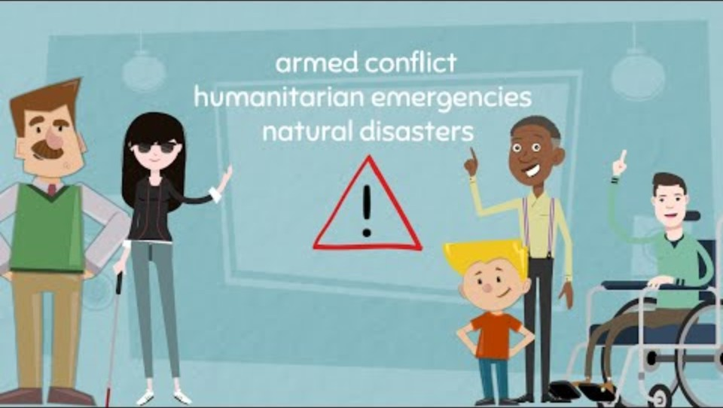
Presentation. Zooming in on article 11
https://www.youtube.com/watch?v=Nef5RbBpOB0
Notes:
Presentation. 15 mins. (4 slides: a video of 3:12 mins, 2 spoken slides, a further video 1:52 mins)
Play the video. Tell participant, that it explains UN CRPD: Article 11 - Situations of risk and humanitarian emergencies (MHE)
https://www.youtube.com/watch?v=Nef5RbBpOB0
Credit: UN CRPD: Article 11 - Situations of risk and humanitarian emergencies: Mental Health Europe.

Slide 39
Zooming in on Article 11
Situations of risk and humanitarian emergencies
The CRPD explicitly states that it applies in humanitarian emergencies:
“State Parties shall take, in accordance with their obligations under international law, including international humanitarian law and international human rights law, all necessary measures to ensure the protection and safety of persons with disabilities in situations of risk, including situations of armed conflict, humanitarian emergencies and the occurrence of natural disaster”
Notes:
Presentation: Zooming in on article 11 (5 min, 2 slides).
Ask a particpant to read out the text.
Tell the participants:
Additionally, other treaties/legislation/resolutions echo this article and complement its imperative. For example, the UN Security Council Resolution 2475 Disability Inclusive Humanitarian Action
Reference: UN Security Council Resolution 2475 Disability Inclusive Humanitarian Action https://docs.un.org/en/S/Res/2475(2019)

Slide 40
Presentation. Zooming in on Article 11
Situations of risk and humanitarian emergencies
Natural disasters, humanitarian crises, and armed conflict disproportionately impact people with disabilities.
Discrimination and a lack of consideration of their specific needs, including protection, can create barriers to food, shelter, health care and emergency evacuation.
This can lead to further disabilities for people already living with disabilities. It can also mean a further group of people with newly acquired disabilities.
Humanitarian aid must include disability-inclusive plans, policies, and procedures - considering needs of people with disabilities in emergency preparation, disaster management, and reconstruction.
MHPSS actors must include ALL people with disabilities in programming, advocate for their needs in humanitarian responses, and address discrimination.
Notes:
Talk through the slide (or ask a participant to read it out).
Explain that:
Of course, protection during emergencies is not the sole task of the MHPSS workers, however: because of all reasons discussed, people with psychosocial disabilities are often neglected so therefore MHPSS workers often need to advocate for their rights and collaborate with Protection actors for the integration of these persons in their activities.
We will go deeper into this topic about disability inclusion into disaster risk management on Day 4, when we look into how to prevent violence and abuse and protect people with psychosocial disabilities.

Slide 41
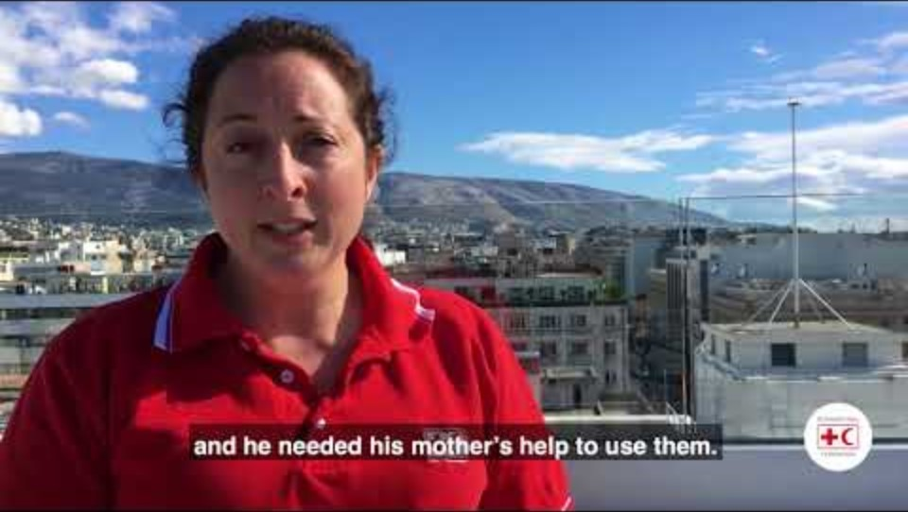
Zooming in on article 11 – 3
Water day 2018 - Disability inclusion Greece. The International Federation of Red Cross and Red Crescent Societies (IFRC)
We will watch this video, that shows the importance of article 11 with an example in Greece:
Disability Inclusion Greece
https://youtu.be/FZRfPsP6DAg
Notes:
Play the video from IFRC, explaining that it shows the importance of disability inclusion in humanitarian responses.
Reference: Water day 2018. Disability inclusion Greece. The International Federation of Red Cross and Red Crescent Societies (IFRC) (1:51 min.) https://youtu.be/FZRfPsP6DAg

Slide 42
Exercise 2.12 Barriers experienced by people with psychosocial disabilities in humanitarian emergencies
Plenary discussion
What violations of Article 11 (direct or indirect) have you witnessed or been told about during your work in humanitarian contexts?
Notes:
Exercise 2.12 (10 mins, 2 slides) Barriers experienced by people with psychosocial disabilities in humanitarian emergencies
Run a disucssion that explores barriers experienced specifically by people with psychosocial disabilities / mental health conditions. If needed, use the prompts.
Leave a minute or two to talk through the resource on the next slide.
Prompts
People may be chained or locked up to avoid them bringing shame to others, to enable control or to punish, or to prevent people from entering dangerous environments because of lack of other resources.
People with psychosocial disabilities may be excluded from livelihood programmes or during humanitarian evacuations.
Families might leave members with psychosocial disabilities behind during forced displacement. Sometimes they think their chance of successfully fleeing with the person is low.
People detained in mental health or social services are particularly at risk. Sometimes, residents may be abandoned by the staff that were caring for them. Their basic needs, medication, food, water etc. may no longer be met/provided. As they cannot leave, they cannot seek safety if fighting is reaching their facilities.
People may suffer disruption or lack of MHPSS services in emergencies.

Slide 43
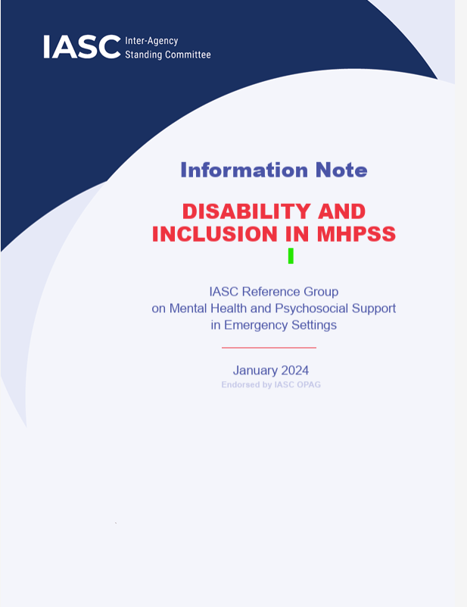
Exercise 2.12 Barriers experienced by people with psychosocial disabilities in humanitarian emergencies
Disability inclusion in MHPSS in emergencies
Including people with disabilities in preparedness and humanitarian response includes, of course, MHPSS.
The IASC MHPSS Reference Group has published a comprehensive Information Note on Disability and Inclusion in MHPSS.
Notes:
Talk through the slide to end the exercise with a resource.
Reference: IASC Information note. Disabilty and Inclusion in MHPSS https://interagencystandingcommittee.org/sites/default/files/2024-01/IASC%20Information%20Note%20on%20Disability%20and%20Inclusion%20in%20MHPSS.pdf
Background on the Information Note
IASC published the information note in 2024. It contains guidance for strengthening disability inclusiveness for MHPSS responses and programmes in emergency settings. It supplements the IASC Guidelines on Mental Health and Psychosocial Support in Emergency Settings (2007).
Overall objectives
To consider and address the mental health and psychosocial support (MHPSS) requirements of people living in emergency settings with all types of disabilities on an equal basis to the MHPSS requirements of all others, using a human rights-based approach and implementing social-ecological frameworks.
Specific objectives
Ensure that MHPSS programming in emergency settings is accessible to, and inclusive of, people with all types of disabilities.
Support the deinstitutionalization of people living in long-stay institutions and stand-alone hospitals.

Slide 44

Lunch
Notes:
Time: 60 minutes

Slide 45
Topic 6. Zooming in on Article 19 The right to live independently and be included in the community
Notes:
Time: 10 min
There are three slides in this topic. They are a refresher on Article 19, which all participants should already have covered in the QualityRights e-training.

Slide 46
Presentation: CRPD Article 19. Living independently and being included in the community
States Parties to this Convention recognize the equal right of all persons with disabilities to live in the community, with choices equal to others, and shall take effective and appropriate measures to facilitate full enjoyment by persons with disabilities of this right and their full inclusion and participation in the community
People with disabilities have the right to live like other people and to have the same choices in life.
Notes:
Presentation (10 mins, 3 slides, the last of which offers 2 videos)
Talk through the slide.

Slide 47
CRPD Article 19. Living independently and being included in the community
States who are Parties to this Convention recognize the equal right of all persons with disabilities to live in the community, with choices equal to others, and shall take effective and appropriate measures to facilitate full enjoyment by persons with disabilities of this right and their full inclusion and participation in the community. This is done by including by ensuring it’s three key dimensions:
Choice. Persons with disabilities have the opportunity to choose their place of residence and where and with whom they live on an equal basis with others and are not obliged to live in a particular living arrangement.
Support. Persons with disabilities have access to a range of in-home, residential and other community support services, including personal assistance necessary to support living and inclusion in the community, and to prevent isolation or segregation from the community.
Availability of community services and facilities. Community services and facilities for the general population are available on an equal basis to persons with disabilities and are responsive to their needs.
Notes:
Talk through the first part of the slide.
Then read out the three dimensions, and also give a simpler wording:
1. Choice. People can choose where to live and who they live with. They should not be forced to live somewhere if they do not want to.
2. Support. People should have access to a lot of different community services so they can live with others in the community. They should not live in places that isolate them or keep them away from their community.
3. Availability of community services and facilities. People with disabilities should have access to the same community services as all other people.

Slide 48
CRPD Article 19. Living independently and being included in the community
Article 19 and humanitarian emergencies
During disasters and emergencies, the right of every person to live independently and be included in the community is jeopardized by community disruption. Community services are often stretched further, leaving people with disabilities at even greater risk
Interventions in humanitarian settings must therefore crucially consider, plan and advocate ways to secure the three elements of Article 19.
Videos
South Sudan: people with disabilities left out of humanitarian assistance. Human Rights Watch. 2017 https://www.youtube.com/watch?v=WDRiNz3TYDE&t=2s
Ukraine: life of people with disabilities in war conditions. UATV English 2022 https://www.youtube.com/watch?v=DrQjhKmshPg
Notes:
Talk through the slide.
If there is time, show one or both of the videos.
South Sudan: people with disabilities left out of humanitarian assistance. Human Rights Watch. 2017
https://www.youtube.com/watch?v=WDRiNz3TYDE&t=2s
Ukraine: life of people with disabilities in war conditions. UATV English 2022
https://www.youtube.com/watch?v=DrQjhKmshPg

Slide 49
Topic 7. Zooming in on Article 12. Equal recognition before the law
Notes:
Time: 10 min
There are two further slides on this topic. They are a refresher on Article 12, which all participants should have already covered in the QualityRights e-training.
Tell participants we will come back to Article 12 in the module on legal capacity and the right to decide.

Slide 50
Presentation. Zooming in on Article 12. Equal recognition before the law
Summary of the article
The law must recognize that people with disabilities have rights and responsibilities like anyone else (they have legal capacity).
People with disabilities:
  have the same rights as everybody else and must be able to use them;
  must be able to act under the law, which means they can engage in transactions and create, modify or end legal relationships - they can make their own decisions and others must respect their decisions.
When it is hard for people to make decisions on their own, they have the right to receive support.
      The support should respect the rights of the person and what the person wants.
      It should not be in the interest of or benefit others.
      Supporters should not influence the person to make decisions they do not want to make.
      There should be the right amount of support for what the person needs.
      The support should be for as short a time as possible.
      It should be checked regularly by a trusted authority.
      Cont….
Notes:
Presentation. Zooming in on Article 12. (10 mins 2 slides)
Talk through the slide – the material continues on the next slide.
This topic will also come back in depth in the next module: legal capacity and the right to decide

Slide 51
Zooming in on Article 12 Equal recognition before the law
Cont…
Countries must protect the equal rights of people with disabilities:
  to have or be given property;
  to control their money;
  to borrow money;
  not to have their homes or money taken away from them.
Article 12 embodies the legal aspects of living independently, exercising autonomy and having the freedom to make one’s own choices.
A central paradigm shift is from substituted decision-making to supported decision making.
It is closely linked with Article 19 and the right to live independently.
In your region, can people with psychosocial disabilities decide important things in their life? Or are the decisions taken by their families/guardians etc.? What do you think is the impact of this?
Notes:
Talk through the slide.
When pointing out the shift from substituted to supported decision making, tell participants:
This will be discussed in depth in the next module. But in summary, substituted decision-making removes the right of people with disabilities to make their own choices, whereas supported decision-making ensures they receive any support needed to make and have their own choices respected.
Pose the question on the slide and run a plenary discussion.
Collect 3 or4 experiences, then summarize the discussion by noting that:
Around the world, the right to make decisions is still often denied to people with psychosocial disabilities. This has a significant impact on ensuring adherence to Article 19 on the right to live independently. While there are promising reforms taking place in various regions, much more progress is needed.
The next module will look more closely at the consequences of failing to uphold Article 19 and will explore ways this right can be realized in practice.

Slide 52
Module 3.
Legal capacity and the
right to decide
Notes:
Time: 90 min.
Explain to participants:
Now we are starting Module 3, which looks at the right to legal capacity in greater depth.

Slide 53
Topic 1. Understanding the right to legal capacity
(equal recognition before the law in practice)
Notes:
Time: 35 min.
Presentation

Slide 54
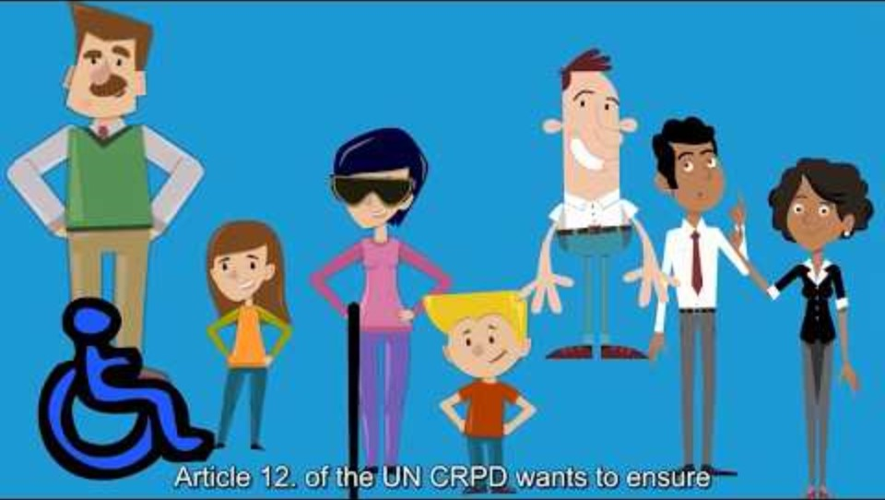
The right to legal capacity
Credit: What is Article 12 and Legal Capacity? Mental Health Europe​
Summary
Watch this video: What is Article 12 and Legal Capacity? MHE
https://youtu.be/8WhxKJtOXec
Notes:
Presentation. Video (this slide) then two slides – 15 minutes overall.
Tell the participants that:
Article 12, Equal recognition before the law, confirms the right of people with disabilities to have legal capacity on an equal basis with others in all aspects of life. This video will explain what that means, in practice.
Play the video.
Reference: What is Article 12 and Legal Capacity? https://youtu.be/8WhxKJtOXec (2:49 min) Mental Health Europe

Slide 55
Presentation. The right to legal capacity
Distinguishing between legal capacity and mental capacity
Legal capacity
It is a basic human right for everyone.
It means the right to make your own decisions.
It includes:
  legal standing – rights recognized
  legal agency – acting on those rights.
It is essential for enjoying all other rights.
Mental capacity
It means a person’s ability to make a specific decision.
It involves understanding, reasoning, and communication.
Mental capacity can change over time or by situation
Confusions and violations
Legal and mental capacity are often wrongly treated as the same thing.
People thought to have impaired decision-making may lose legal capacity.
Losing legal capacity leads to substituted decision-making.
Under the CRPD everyone keeps the right to decide:
support replaces substitution.
Notes:
Talk through this and the next slide (up to 5 minutes each). Here are some additional notes.
Legal capacity
Legal capacity is essential for enjoying all other human rights, for example for supporting children and young people to participate in decisions that affect them.
Legal standing might be demonstrated by having formal documentation, like a birth certificate, being on the electoral register etc. Legal agency is being able to act on those rights and have your actions recognized.
Mental capacity
If questions on mental capacity come up, draw on these points.
In mental health settings, mental capacity is often tested as being able to:
understand information about a decision
understand the possible consequences of that decision
communicate the decision.
These tests, part of the functional approach, are flawed for several reasons:
It is discriminatory to only test people with disabilities. For example, no one else is tested before signing a medical consent form or a bank contract.
They do not accurately assess the inner workings of someone’s mind, yet “failing” the test means losing a basic human right — the right to equal recognition before the law.
Under Article 12 of the CRPD, perceived or actual difficulties in mental capacity must never be used to deny legal capacity. People have the right to make their own decisions, even if others view them as risky. If necessary, supported decision-making should be offered.
People don’t always make decisions based purely on logic or reason. Emotions are important too, and difficulties with rational thinking do not mean a someone cannot decide what is best for themselves.
Denial of legal capacity
When someone is thought to have “impaired” decision-making skills, their legal capacity is sometimes denied in one of three ways:
Status approach – based on diagnosis.
Outcome approach – based on what is judged a “bad” or risky decision.
Functional approach – based on someone else assessing the person as lacking reasoning skills.
Reference: UN CRPD General Comment 1
https://documents-dds-ny.un.org/doc/UNDOC/GEN/G14/031/20/PDF/G1403120.pdf?OpenElement

Slide 56
The right to legal capacity
Settings where the right to legal capacity is denied
People are often denied the right to legal capacity:
    within communities
    at home
    within health, mental health and social services.
Notes:
Read out these notes, corresponding to the points on the slide.
Settings where the right to legal capacity is denied
People are denied their right to legal capacity in many settings: in communities, at home, in health, mental health, and social services, and in places where they are detained.
In communities:
People with disabilities, and often their families, face stigma and exclusion.
This may be linked to beliefs that disability is caused by curses or other supernatural forces, or to negative social attitudes.
People may be denied access to employment, education, and social life.
They may be excluded from community meetings or social events.
Their choices about treatment and care are often restricted or controlled by others.
At home:
Some people are denied the right to make decisions about their own lives.
Family members may take over decision-making, often with protective intentions.
Families may fear their relative will be harmed, fail, or be taken advantage of.
While well-intentioned, this overprotection limits autonomy and independence.
In health, mental health, and social services:
Legal capacity is often denied through involuntary admission and forced treatment.
Substitute decision-making by family members, guardians, or staff is common.
Staff may assume that people with psychosocial or intellectual disabilities cannot make decisions.
Consent procedures may be bypassed, and treatment provided without free and informed consent.
Health information is often not communicated in accessible formats.
Discriminatory attitudes and lack of training among professionals reinforce exclusion and unequal access to care.

Slide 57

Exercise 3.1 The right to legal capacity
Plenary discussion
What do the current laws say about legal capacity in the countries where you work?
In what settings are people’s right to legal capacity denied within the regions where you work?
Notes:
Exercise 3.1 The right to legal capacity (20 min)
Ask the participants the questions on the slide.
Give them 10 minutes to prepare, perhaps with internet research, and then collect answers during a plenary discussion.
Preparation
Depending on where you are delivering the training, you may need to prepare some examples, however, common examples include:
a guardianship law that deprives people of their legal capacity.
administrators being appointed to deal with the property and affairs of people with disabilities.

Slide 58
Presentation. The right to legal capacity in humanitarian contexts
The video at the beginning of this topic proposed supported decision-making as a way to uphold the right to legal capacity.
However, very few humanitarian projects facilitate supported decision-making for people with psychosocial, intellectual or cognitive disabilities. If they do, they are most likely to be in contexts that are stable or well resourced. Their approaches may not be easily applicable where we work.
Nonetheless, we can apply the underlying principles of supported decision-making. Next, we will think about new ways to implement supported decision-making and advanced planning in humanitarian services
Implementing practices that uphold the right to legal capacity are relevant in MHPSS services, but also in all sectors and all services across humanitarian responses, and are an important step in inclusion for people with disabilities.
Notes:
Talk through the slide. 5 mins.

Slide 59
Topic 2. Supported decision-making and advance planning
Notes:
Time: 55 minutes but with an additional 15 minute break making 70 mins overall
An exercise for 20 mins, a 10 min presentation, a 15 min break, then a 25 min exercise.

Slide 60


Exercise 3.1 Supported decision-making
Plenary discussion
Read the handouts provided on supported decision-making.
What do you understand about supported decision-making?
What are the main take-aways from your read?
Notes:
Exercise 3.1 Supported decision-making (20 min)
Provide all participants with:
Handout M3.1 Supported decision-making
Handout M3.2 Best practices in supported decision-making
Handout M3.3 Checklist for implementing supported decision-making
Give them time to read, then lead a discussion of the questions on the slide. Note the main points on a flipchart.

Slide 61
Presentation. Advance planning – content of advance plans
Advance planning is a form of supported decision-making. Advance plans, sometimes also called living wills or advance directives, can help ensure a person's will and preferences are respected.
In them, people give written directives about what they do or don’t want for future situations when they may find it difficult to make or communicate their will and preference. They might include:
        a description of desired support
        designated supporters and/or advocates
        recovery options and treatments, including refusal of healthcare options
        place of care or respite, including choosing to receive support at home
        directives concerning day-to-day life and obligations (for example, children, bills, pets etc.).
If the advance plan is intended as a legal document, it needs to state in which situation it comes into effect, and in which situation it ceases.
Notes:
Presentation: Advance planning (10 mins, three slides)
Talk through the slide on the content of advance plans:

Slide 62
Advance planning – uses
Advance planning can have two functions:
  If a person has difficulty in expressing themself, those providing support and care can refer to the advance plan as a communication tool find out the person’s wishes and preferences.
  In some countries, advance plans are used as a legal document in which the person authorizes or refuses certain actions/options in the future.
Advance planning may be useful to everyone, with or without a disability, especially during times when people may be having difficulties in making or communicating decisions.
Advance plans are not static. People’s views, will and preferences may evolve, and people can and do change their minds about things. Plans should be reviewed regularly.
Notes:
Talk through the slide.
When explaining that advance plans are not static, emphasize:
Supporters should engage with and consult with the person regularly to determine if their will and preferences have changed and if they still agree with the actions their plan proposes.

Slide 63
Advance planning – beyond medical choices
In humanitarian settings, advance plans can be used not only for routine and emergency mental health care but also for people to outline their needs and wishes during humanitarian responses (such as evacuations).
In urgent situations, people’s needs and wishes risk being deprioritized. Advance planning helps ensure they are recognized and respected.
WHO QualityRights Tool: Person-centred recovery planning for mental health and well-being has a template for an advanced plan (Part 4). https://www.who.int/publications/i/item/9789241516822
Notes:
Talk through the slide.
Explain:
In contexts where there is a sense of urgency, often the needs and wishes of people with psychosocial, intellectual or cognitive disability can be deprioritized. Managers or other people in authority may use the argument fthat there are 'higher level' needs that should be prioritized more, or that with a short amount of time that 'not everyone can be helped'. Advanced planning can be helpful in these situations to make sure that people's wishes are spelled out clearly and then respected, regardless of the situation.
If time allows, you can show participants the Advance Plan template in Part 4 of WHO QualityRights Tool: Person-centred recovery planning for mental health and well-being. https://www.who.int/publications/i/item/9789241516822

Slide 64
Break
15 minutes
Notes:
Duration: 15 minutes

Slide 65
Exercise 3.2 Supported decision-making and advance planning in humanitarian contexts
What could be challenging in introducing supported decision-making /advanced planning into humanitarian services, including MHPSS services?
Think about your project: how could you implement or advocate for supported decision-making in general (and advance planning specifically)?
Notes:
Time: 25 minutes
Form groups of 4-6 participants.
Explain:
As mentioned earlier, unfortunately, there are still very few projects that facilitate supported decision-making for people with psychosocial disabilities. Where such initiatives do exist, they are mostly found in stable contexts or high-resource settings. In unstable contexts and low-resource countries, supported decision-making is much more likely to be overlooked or neglected.
Give them 15 minutes to discuss the questions on the slide.
After 15 minutes let participants share a few overall reflections in a plenary discussion.
If you need prompts for the discussion, see below.
Where might it be challenging?
Decision-making structures in families (in some places heads of family or community leaders make decisions for individuals)
No funding for such projects and/or a lack of interest by senior managers or decision makers to develop projects for people with psychosocial disabilities (mental health services in general are often deprioritized).
Lack of understanding about concepts and rights related to legal capacity.
How could you implement supported decision-making and advanced planning?
Run an education/awareness campaign about decision-making rights and benefits aimed at communities and health staff.
Employ people with lived experience to support advocacy efforts explaining the need to respect the right to legal capacity.
Hold focus group discussions with people with lived experience.
Get families and others to discuss their role in supporting the supported decision-making approach.
Make sure the project guidelines include and promote the right to legal capacity and supported decision making approaches.

Slide 66
QualityRights Changemakers and Action Plans
Notes:
Time: 45 min

Slide 67
Presentation. QualityRights changemakers
Meet Cultivation for Users Hope - Liberia
One important practice to ensure the rights enshrined in the CRPD are protected, is to support and empower people with lived experience to advocate for themselves, and to include them in your organization, projects, programmes or services (for example as peer supporters or disability advisors).
We will show a video about Cultivation for Users Hope, a peer support network civil society organization in Liberia. CfUH was established and is run by mental health service users to support and advocate for people with lived experience of mental health conditions.
CfUH is working together with organizations such as MSF and the Ministry of Health in community-based health facilities to support other service users with advice, support groups and livelihood projects.
Notes:
Timing: Presentation 15 mins (intro 4 mins, video 6 mins, 1 further slide 5 mins)
Talk through the slide before running the video on the next slide.

Slide 68
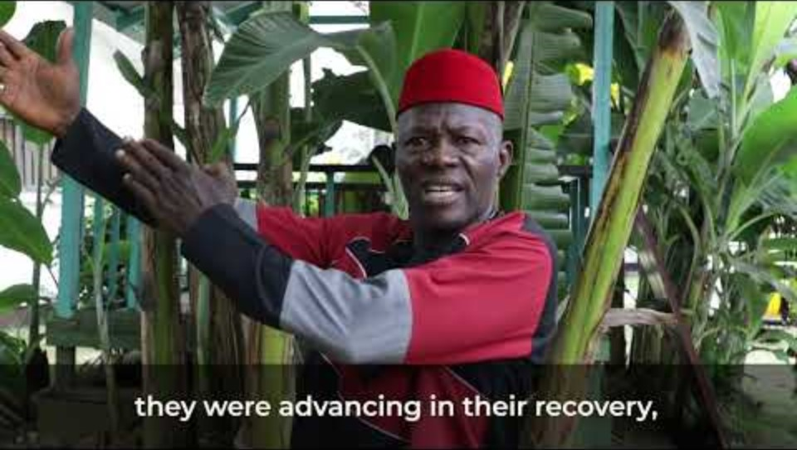
Cultivation for Users Hope. Medecins Sans Frontiers
Watch this video:
https://youtu.be/j202dkM4KwI
Notes:
Meet Bill Jallah and Cultivation for User’s Hope here: https://youtu.be/j202dkM4KwI
Credit: Cultivation for Users Hope. Medecins Sans Frontiers

Slide 69
QualityRights changemakers
(Additional information and future resources)
CfUH, and organizations like it, made up only of mental health service users, are sometimes known as organizations of persons with disabilities (OPDs).
OPDs are non-state organizations (civil society organizations) seeking change that advances their members’ interests. They are usually established to respond to unmet needs. Self-representation and leadership of and by people with disabilities is the most crucial aspect.
The members define the mission and activities, which might include:
  advocating for the rights of people with disabilities
  lobbying for law reform and human rights-based approaches to mental health
  providing peer support for members and others, individually or in groups.
If you are interested in supporting OPD development, WHO has developed training and guidance: https://www.who.int/publications/i/item/who-qualityrights-guidance-and-training-tools
Notes:
If time permits you can talk through this additional information.
For the final point, you may wish to follow the link and highlight the relevant tools – as examples of resources for the participants when they return to their normal work. Point out in particular the tools for Civil Society Organizations, individual and group peer approaches, and advocacy for mental health, disability and human rights.
https://www.who.int/publications/i/item/who-qualityrights-guidance-and-training-tools .
Alternatively, you could explore the link at the end the presentation, to limit distraction.

Slide 70
Exercise 3.3 People with lived experience where you work
Discussions in pairs
What mechanisms/spaces are available in your work setting for people with lived experience to be meaningfully included in activities, in improving the relevance and quality of the work and defending human rights according to the CRPD?
What other practices/mechanisms/guidelines/activities do you have to ensure the rights outlined in the CRPD are upheld inside or outside your services - including the right to decide?
Add the key points you develop in this exercise to the flip chart you developed as a group on Day 1, in collaboration with your colleagues).
Notes:
Time for this Exercise: 15 mins (10 mins discussion, 5 mins updating project presentation sheets).
Tell participants:
This exercise explores how people with lived experience can be meaningfully included and how CRPD rights — including the right to decide — can be upheld in your work.
Ensure the group flip charts from day 1 are displayed.
Organize the participants into pairs, preferably pairing people with someone from a different role or team. Ask them to discuss the questions on the slide (10 mins). Emphasize this is a discussion activity, not a presentation to the other person.
If they need prompts, you could suggest:
What spaces/ mechanisms already exist in your work for including participation by people with lived experience?
Are there opportunities for collaborating with disability advocates?
Could your setting employ people with lived experience? Can that be at all stages of a project?
How else would you ensure people with lived experience are meaningfully involved at all stages of the work/project life-cycle.
Then give participants 5 minutes to add the key points to their project presentation description (in collaboration with their colleagues).

Slide 71
Continue your QualityRights Action Plan
In groups of 3–5, discuss feasible actions your project could take in the next 6 months to promote the CRPD, with specific focus on disability inclusion and the right to decide (legal capacity).
    Think about the resources needed and possible challenges and ways to address these.
    When identifying actions, consider:
    how to involve people with lived experience and support their advocacy
    what levels of change (project, organizational, advocacy) are required
    what support or backing you might need at organizational and advocacy levels to deal with the legal context and implications of disability inclusion.
Record ideas on your Action Planner.
Optionally, share key points on your group flipchart.
Notes:
Timing: 15 mins
Ask participants to take out their Day 2 Action Planner.
Tell them they have 15 minutes for the discussion task on the slide.
Ask them to record their ideas on their Planner and add key points on a flipchart to display in the room.
Remind participants to keep their completed Action Planners. They will continue to build on them throughout the training.

Slide 72
Daily wrap up and rapid end of day evaluation
Please provide some quick first impressions on how you found module two on Mental health, disability and human rights, and the first part of module three on Legal capacity and the right to decide (we will continue this module in the next session). You'll have the opportunity to give more detailed feedback at the end of the entire course too.
What is/are the most important point(s) you learnt from today’s training?
Any remarks? Wishes for tomorrow?
Notes:
Daily wrap up and rapid end of day evaluation (10 min.)
Summary:
Ask a volunteer to briefly summarize the day’s training (5 minutes max.)
Alternatively, ask for one or two volunteers to do a 5 minute summary at the start of the next session.
Rapid evaluation:
Ask participants to answer the two questions in a couple of sentences each.
Alternatively, hand out sticky notes so people can leave comments on two flip charts allocated for the questions.
72

Slide 73
WHO/UCN/MSD/PLR/2025.3 © WHO 2025. Some rights reserved. This work is available under the CC BY-NC-SA 3.0 IGO licence.

