Slide 1
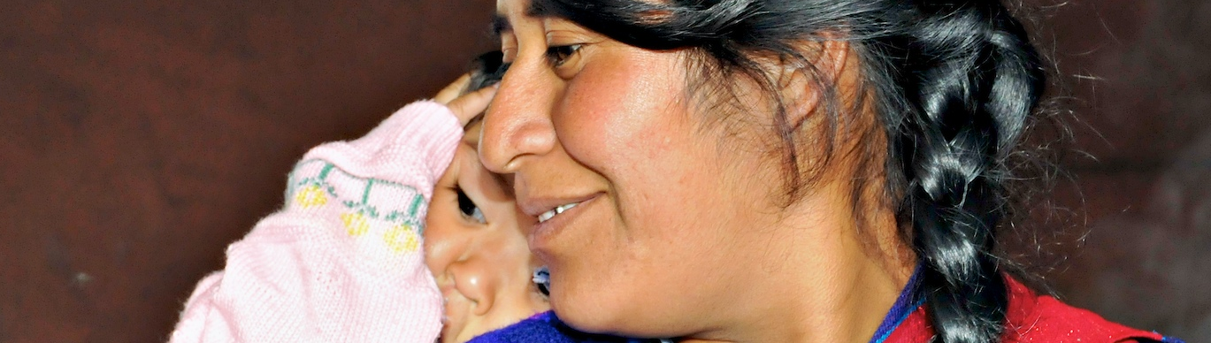
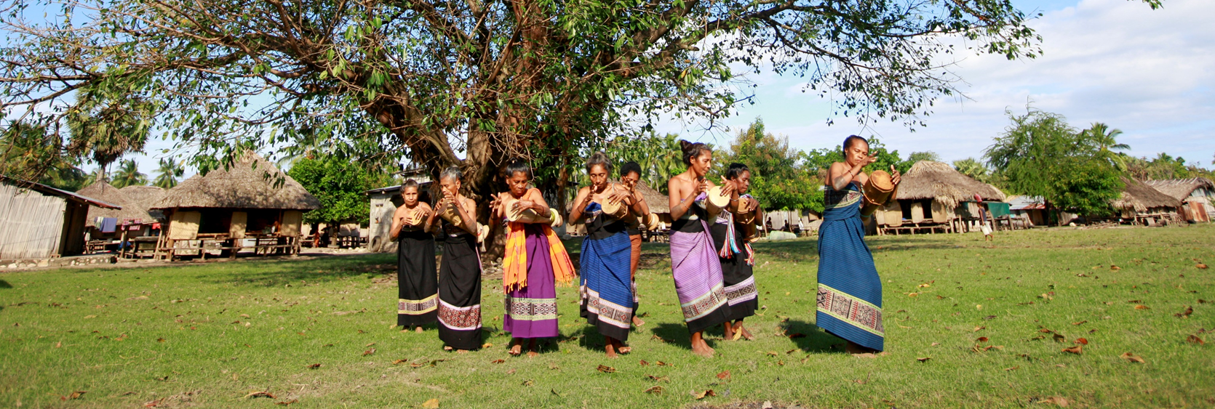


Course Slides
Legal capacity and
the right to decide (continued)
WHO/Harold Ruiz
Recovery and
the right to health
WHO QualityRights training – humanitarian edition
QualityRights
Notes:
These training materials have been adapted from the WHO QualityRights materials for training, guidance and transformation
https://www.who.int/publications/i/item/who-qualityrights-guidance-and-training-tools
To participate in the workshop QualityRights – humanitarian edition it is essential to have undertaken the WHO QualityRights e-training on mental health, recovery and community inclusion beforehand.
https://www.who.int/teams/mental-health-and-substance-use/policy-law-rights/qr-e-training

Slide 2
Topics covered in today’s training
Module 3. Legal capacity and the right to decide (continued)
Topic 3 Informed consent
Topic 4 Avoiding involuntary detention and treatment
Module 4. Recovery and the right to health
Topic 1 What is mental health?
Topic 2 Promoting the right to health in humanitarian setting: including the community
Topic 3 What is recovery?
Topic 4 Promoting recovery
Topic 5 The role of MHPSS services and staff promoting recovery
QualityRights changemakers and Action Plans
Notes:
Welcome the participants and outline today’s topics (5 mins).

Slide 3
Recap of Module 3 so far
Yesterday
Topic 1 Understanding the right to legal capacity – what are the key points?
Topic 2 Supported decision-making and advance planning – what are the key points?
Notes:
Run a quick recap (5 mins). You might say:
Before we restart Module 3 with topic three, let´s recap the first two topics. Please can one person highlight the key points from the right to legal capacity?
If needed, give others an opportunity to add something.
Can one person please highlight the key points from supported decision-making and advance planning?
If needed, give others an opportunity to add something.

Slide 4
Module 3.
Legal capacity and the right to decide (continued)
Notes:
Time for this module (day 3): 115 min.

Slide 5
Topic 3. Informed consent
Notes:
Time for this topic: approximately 35 minutes.
Explain to participants that this topic focuses specifically on the context of MHPSS services.
Explain how informed consent and person-led treatment and recovery plans are essential for respecting people’s right to legal capacity.

Slide 6
Presentation. What informed consent for treatment means
The person has enough information about proposed treatments to make an informed decision, including:
    possible benefits and negative effects/risks of the proposed treatment;
    possible alternatives to the proposed treatment;
    possible benefits and risks of not accepting the proposed treatment and/or of choosing one of the alternatives.
    information is given in a way the person can understand and is adapted to their needs;
    the information is given in a way that is culturally acceptable to the person.
The consent to treatment is given voluntarily:
    without threat or coercion or undue influence;
    without deception, fraud, manipulation or false reassurance.
    Obtaining informed consent to treatment is essential to respecting the right to legal capacity.
    The right to informed consent includes the right to refuse treatment!
Notes:
Timing: 5 min
Talk through the slide. These notes give a little more detail.
Informed consent means that:
The person is given enough information about the proposed treatment to make an informed decision, including:
the possible benefits and negative effects/risks of the proposed treatment;
possible alternatives to the proposed treatment;
the possible benefits and risks of not accepting the proposed treatment and/or of choosing one of the alternatives;
the information is given in a way that the person can understand, and is adapted to their needs, for example, the information avoids highly technical terms that the person may not understand and incorporates visual aids or sign language if the person is deaf or hard of hearing.
The consent to treatment is given voluntarily:
Consent is given without threat or coercion (for example, practitioners should not tell the person that they will be involuntarily admitted to a service if they refuse the treatment).
Consent is given without undue influence. For example, practitioners should not make the person think that there may be unpleasant consequences, such as withdrawal of privileges, if they refuse the treatment. It is important to be aware of the risk of undue influence due to the power imbalance in relationships between people and those trying the help them. There is sometimes a fine line between supporting people in making their decision and unduly influencing them.
Consent is given without deception, fraud, manipulation or false reassurance. For example, practitioners should not tell someone that a medication is ‘just a vitamin’ when it is actually a psychoactive medicine, or reassure someone that a treatment has no side effects when significant risks are known and should be discussed.
Obtaining informed consent to treatment is essential to respecting the right to legal capacity.
The right to give informed consent also includes the right to refuse treatment. If a person, after receiving information about treatment options, decides they do not want any kind of treatment, this is their right and it must be respected.

Slide 7
Exercise 3.4 Informed consent, Halima’s story
Halima
Halima is an 18-year-old young woman who had to flee her home city because it was bombed. She lost her father and her little brother in the bombings. She doesn´t know where her mother is. She sought shelter with her older sister, who is living with her family in an IDP camp. That was one year ago.
Since then, Halima has become tired of life. She is not speaking more than the necessary and refuses to go out of the tent, except when forced to do so by her family. She has stopped helping with the household, refuses to study – something she used to really enjoy – and she spends most of her time laying in her bed. The only things she likes to do is listen to music through her headphones and to play with her little cousins.
As Halima is not getting better, her sister is very worried and decides to bring her to the mental health services in the camp, where she meets a counsellor and a psychiatrist.
Notes:
Exercise 3.4 Informed consent, Halima’s story (15 min, three slides to read out, then a fourth to discuss)
Ask a participant to read out this slide.

Slide 8
Exercise 3.4 Informed consent, scenario A
After listening to her story (the sister does most the talking), the counsellor and psychiatrist explain that they can help Halima. Because Halima is not saying much, they explain to the sister that Halima should take medication, which they say will help to activate her - and they instruct her to come once per week to see the counsellor.
Halima looks hesitant and so they explain that it is very important that she follows the treatment recommendations very carefully if she wants to become better. They tell her sister that she is responsible for making sure Halima is taking her pills every morning and comes to the counselling sessions. Her sister agrees because she wants Halima to get better.
The counsellor takes an Informed Consent form and explains that Halima must sign it, to state that she understood everything, and that she agrees to the treatment being provided. The counsellor tells Halima and her sister that Informed Consent forms are required before the service can provide treatment. Her sister tells Halima to sign the form, which she does.
Notes:
Talk through the slide – or ask participants to read out paragraphs.

Slide 9
Exercise 3.4 Informed consent, scenario B
After the counsellor and psychiatrist hear the whole story (the sister does most of the talking), they explain they can help Halima, if she would like, and that normally it is necessary to talk with Halima alone first if she feels comfortable to do so. Halima agrees, and they explain to her sister that they will call her back in soon, if she would like.
After a few questions to get comfortable, they ask Halima what she thinks could help her. Halima is not sure. They explain that she could come and talk with a counsellor. They explain the counselling process and why they think it could be useful. And they explain why medication might also be useful.
Halima doesn´t know if she wants any of it and seems scared. The counsellor says this is completely fine and that she does not need to agree to anything she doesn't want. The counsellor suggests some ways to support Halima to feel more comfortable. If Halima would like, the counsellor and somebody from the community mental health team could come by next week to visit her at home and get to know her cousins and talk with her a bit more.
Alternatively, Halima could come to the weekly open women's café. After thinking a while, Halima asks if they could visit her at home, because she feels uncomfortable in new places. The psychiatrist asks Halima if it is ok to call her sister back in to explain to her the support that Halima would like to receive.
Notes:
Talk through the slide.
You can read it out, or get participants to read a paragraph each.

Slide 10
Exercise 3.4 Informed consent, discussion
If you were Halima, which scenario would feel better for you – and why?
Notes:
Use the remaining time to discuss the question on the slide.
After hearing responses from participants, emphasize, that:
Getting someone to sign a document does not mean you have their informed consent.
Consent can only occur when the person understands the information shared with them, and can make and communicate their choice freely, and without coercion.
MHPSS staff must support and accept each person's choice, even if they, or the person's family, disagree with that choice.

Slide 11
Exercise 3.5 Informed consent in humanitarian settings and MHPSS programmes
Plenary discussion
As a general rule, MHPSS and mental health treatment guidelines require informed consent before treatment.
In practice, however, this is not always done, or is not done in line with CRPD principles, or is not done systematically through established procedures with mechanisms to monitor the process.
  Have you implemented Informed Consent approaches in your project? How are you obtaining this?
  Do you have mechanisms to monitor the process of obtaining informed consent?
  What challenges, including safety, do you encounter in your efforts to obtain informed consent?
Notes:
Exercise 3.5 Informed consent in humanitarian settings and MHPSS programs (15 min, 2 slides.)
This exercise discusses informed consent in humanitarian settings, including challenges and facilitating factors. Guide participants to consider how they could promote informed consent in their work.
Talk through the slide.
If participants struggle to recall implementing informed consent processes, prompt them to think about other forms of consent, for example consent to take photos or do interviews for public communications strategies. Explain that informed consent for treatment is similar to this.
Prompts for the question on challenges:
People coming into treatment are often skeptical of signing forms.
In many humanitarian contexts, people may not want to sign their name for fear of significant security risks. For example, someone who is persecuted may not want others to know where they are. They may fear discrimination or targeting if someone else gets a hold of the documentation, as safety of files cannot be guaranteed in humanitarian settings. It’s important in these cases to find safe options to provide consent. For example, the service provider sometimes checks a box to document what was discussed and that consent was given.
Family, caregivers or guardians often push their relative to start treatment, even when the person may not themselves want to start.
Families, caregivers, guardians or health professionals think that they can give informed consent on behalf of the person.
Professionals may believe that it is enough to obtain the consent of relatives.
Varying beliefs about mental health can affect understanding of informed consent.
Language barriers (different languages and dialects) can hinder clear communication.
Low literacy rates can impede written access to information about informed consent.
Medical/mental health staff may explain the treatment in scientific or technical language that the person does not fully understand.
Medical/mental health staff may try to convince a person, or their family, to start treatment instead of giving neutral information (for example, on the risks and benefits, side effects etc.)
Perceived authority of medical/mental health staff might influence consent decisions (and people may appear to consent if they fear or believe that they do not really have the power to express their true decision.
Immediate and urgent needs may result in prioritizing rapid treatment over informed consent.
Limited staff and time can mean proper consent processes are not implemented.

Slide 12
Exercise 3.5 Informed consent in humanitarian settings and MHPSS programmes
Plenary discussion
  Guidelines for MHPSS in emergencies have always required informed consent in all activities. Informed consent is a tool to make sure we fulfil the right to decide. This right needs to be fulfilled during humanitarian emergencies, as well as during normal times.
  Whatever your scope of work is, think about how you can ensure that people (including people with disabilities) are informed about, understand, and can genuinely consent to treatment care and support.
  A signed form or a box that is ticked is not consent unless people coming to the service get the information they need, in a way they understand, and can make their own decision.
Notes:
Conclude the discussion by talking through the slide.
If needed, point participants to these resources:
The MHPSS Minimum Service Package section on informed consent https://www.mhpssmsp.org/en/lesson/ensure-informed-consentassent-and-safe-information-sharing-practices#page-1
The integration of informed consent in relevant tools, such as WHO’s mhGAP Humanitarian Intervention Guide and EQUIP, and training packages from other humanitarian organizations.

Slide 13
Topic 4. Avoiding involuntary detention and treatment
Notes:
Time for this topic: 80 min (15 mins on the experience of involuntary admission, 35 mins on case studies of involuntary admission, 15 mins on applicable Articles from the CRPD, 15 mins on avoiding coercive measures.
As you begin this topic, it is important to explain:
In many countries, laws and policies authorize people to be involuntarily admitted and treated in mental health and social services.
Furthermore, in many countries, including some experiencing a humanitarian crisis, people with psychosocial, intellectual or cognitive disabilities are often detained or even chained in their homes. Alternatively, they might be held in traditional/spiritual treatment facilities such as prayer camps, where they may also be subjected to forced treatment and detention.
Involuntary admission and treatment are contrary to the CRPD. However, legislative, administrative and other measures to end these discriminatory laws and policies may take time.
Meanwhile, there is a lot that can be done to end involuntary detention and treatment and to respect people’s right to legal capacity in these matters – even within existing legal or policy frameworks.

Slide 14
Exercise 3.6 The experience of involuntary admission and treatment
How would you feel if you were detained and treated against your will?
How did you feel when you were detained and treated against your will?
Notes:
Exercise 3.6 (15 min)
Encourage participants to express their views and feelings about involuntary detention and treatment.
It is important that people who have not experienced involuntary detention and/or treatment themselves should try to imagine how they would feel in this situation.

Slide 15
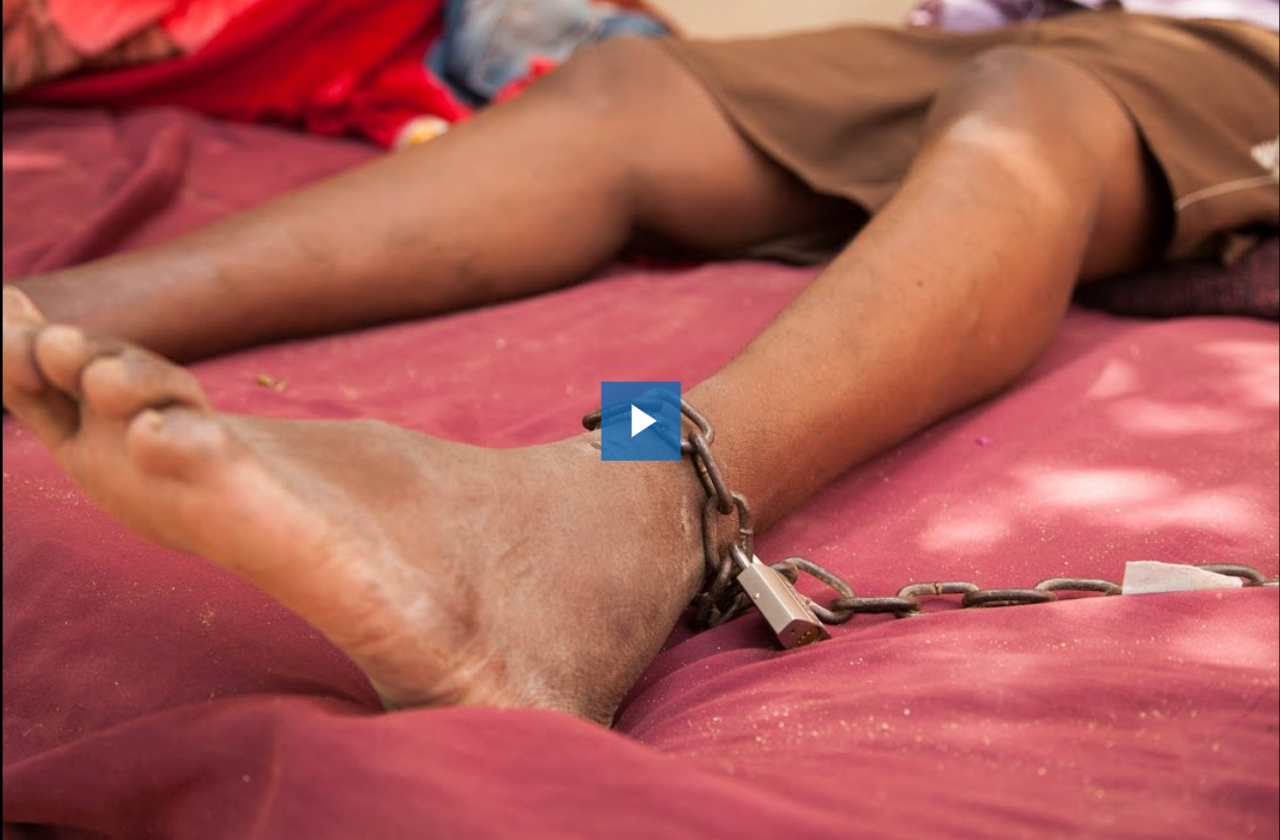
Exercise 3.7 Involuntary admission and treatment
Involuntary detention and treatment are often accompanied with terrible living conditions, violence and abuse, especially in situations where there is shortage of resources.
Watch this video on involuntary admission and treatment: Chained and locked up in Somaliland (Human Rights Watch)
https://www.hrw.org/video-photos/video/2015/10/25/chained-and-locked-somaliland
Notes:
Exercise 3.7 Involuntary admission and treatment (35 mins: a video of 3:05 min followed 1 slide, and a 20 min discussion)
Talk through the side and run the video
https://www.hrw.org/video-photos/video/2015/10/25/chained-and-locked-Somaliland
Chained and locked up in Somaliland.
Credit: Human Rights Watch

Slide 16
Exercise 3.7 Involuntary admission and treatment
People with psychosocial, intellectual or cognitive disabilities are often detained in mental health and social services against their wishes.
Sometimes, people may voluntarily enter mental health and social services because no alternatives are available.
Homeless people may be sent to services and institutions against their wishes because it is believed they are better off within a service.
People detained against their wishes are very often given forced treatment.
Involuntary detention and treatment can last for days, weeks, months and even years.
Due to prevalent stigma and inadequate support services, families often feel they have no choice but to shackle people with psychosocial disabilities, but it also happens as a form of punishment or “treatment”.
Involuntary admission and treatment also occurs in faith based or other private centres, where people may face punitive and prolonged chaining, confinement, seclusion, and severe restrictions on their movement.
Notes:
Read through the slide.
If you need more information on the topic of shackling in countries across the world, you can access the full report from Human Rights Watch:
https://www.hrw.org/report/2020/10/06/living-chains/shackling-people-psychosocial-disabilities-worldwide

Slide 17
Exercise 3.7 Involuntary admission and treatment
What might alternatives to involuntary admissions look like?
Notes:
Exercise 3.7 Involuntary admission and treatment (discussion, 20 mins)
Ask the participants to form pairs and spend about 10 minutes discussing the question on the slide.
Tell them they can use a working context of their own (past or present), instead of Somaliland, if they like.
Tell them to be ready to bring the main points they cover to a plenary discussion.
Spend the final 10 minutes of this exercise in a plenary discussion. Ask for contributions from the group, and share the main points on a flip chart or whiteboard.
Discussion prompts for alternatives to involuntary admission:
community based outpatient services
community mental health workers that follow up with people in their homes
teaching community and family about support strategies and de-escalation techniques
community recovery centers.

Slide 18
Presentation. What does the CRPD say about involuntary detention and treatment?
Article 5. Equality and non-discrimination (e.g., people treated for physical health conditions can not be detained in health services and treated without their informed consent)
Article 12. Equal recognition before the law (e.g. informed consent before involuntary admission or treatment)
Notes:
Presentation 15 mins. This slide, and the next three, discuss how the CRPD Articles relate to involuntary detention and treatment on the grounds of disability.
Talk through the following points.
Article 5. Equality and non-discrimination
According to article 5, people with disabilities should enjoy their rights on an equal basis with others.
People being treated for physical health conditions cannot generally be detained in health services and treated without their informed consent. The fact that, under national law, people with psychosocial, intellectual and cognitive disabilities often can be detained and treated against their wishes constitutes discrimination on the basis of a disability, violating Article 5.
Article 12. Equal recognition before the law
Article 12 underlies, and is indispensable to, all the other articles of the CRPD.
By protecting the right to legal capacity, the CRPD ensures that people have the right to make decisions on all aspects of their lives, including about their care and treatment.
This means that their informed consent must always be sought before admission or treatment in a mental health or related service.
Mental health and other practitioners should, above all, engage directly with the person and not only with the person’s family or supporters.
Practitioners should also try to ensure that the person is not unduly influenced by family, care partners or other supporters when making a decision on care or treatment.
Practitioners should make sure that people receive accommodation for their disability and any independent support that they need in order to make or communicate their decisions on care and treatment.

Slide 19
What does the CRPD say about involuntary detention and treatment?
Article 14. Liberty and security (“disability shall in no case justify a deprivation of liberty”)
Articles 15 and 16. Freedom from torture, violence, abuse
Notes:
….continue:
Article 14. Liberty and security
Article 14 guarantees the right to liberty and security. It makes clear that “disability shall in no case justify a deprivation of liberty”.
This means that disability can never be a basis for depriving someone of their liberty.
People with disabilities can only be detained on the same basis (or for the same reasons) as all other citizens (for example, following a criminal sentence).
Therefore, people with psychosocial, intellectual or cognitive disabilities should never be detained in mental health and social services or institutions because they have a disability (whether diagnosed or perceived), even when other additional criteria are involved (for example, danger to self or others, need for medical treatment, etc.).
Article 15. Freedom from torture or cruel, inhuman or degrading treatment or punishment, and Article 16. Freedom from exploitation, violence and abuse
Involuntary admission and treatment in mental health and social services often causes people severe pain and suffering and can have extremely negative consequences for their health and well-being.
Involuntary admission and treatment are experienced, and considered as, violent and abusive acts that can amount to torture and ill-treatment in violation of Articles 15 and 16 of the CRPD.

Slide 20
What does the CRPD say about involuntary detention and treatment?
Article 17. Protecting the integrity of the person
Article 19. Living independently and being included in the community
Notes:
…continue:
Article 17: Protecting the integrity of the person
Article 17 recognizes that people with disabilities have a right to respect for their physical and mental integrity on an equal basis with others.
Forced detention and treatment violates people’s physical and mental integrity and are therefore contrary to Article 17.
Article 19: Living independently and being included in the community
Article 19 states that people with disabilities have the right to live independently and to be included in the community.
They must be able to:
“choose their place of residence
and where and with whom they live on an equal basis with others”
and must not be “obliged to live in a particular living arrangement”.
Thus, the involuntary detention of people with psychosocial, intellectual and cognitive disabilities in mental health or social services is a direct violation of Article 19.

Slide 21
What does the CRPD say about involuntary detention and treatment?
Article 22. Respect for privacy
Article 25. Health (care on the basis of free and informed consent)
Notes:
…continue:
Article 22. Respect for privacy
Detention in mental health and social services can violate people’s right to privacy.
For example, when people are detained and treated against their will, often mental health and other practitioners are allowed to access personal information without the person’s consent.
People may share personal information with their mental health professional and then discover the information has been given to many other people – such as the person’s general practitioner, social worker, police, immigration authorities or even family members.
In addition, people often lack privacy because practitioners and others:
can access their room without their consent,
because they have no space to store their personal belongings, etc.
Article 25. Health
Article 25 explicitly requires that health professionals provide care on the basis of free and informed consent.
This means that treatment can be given to people only if they explicitly give their informed consent.
At the end of the presentation, encourage participants to ask for any clarification they may need.

Slide 22
Exercise 3.8 Avoiding coercive measures
Avoiding involuntary admission does not mean no action
The CRPD requires a shift away from coercion and towards support based on people’s will and preferences.
Avoiding involuntary practices does not mean abandoning people to their fate.
People should not be sent home by themselves without any offer of support.
They should be provided with options for support that respect their rights.
This might include support from someone they trust who can stay with/check on them.
It might mean listening and sometimes thinking creatively and “outside the box”.
Advance directives are useful to ensure people’s choices, will and preferences are respected in situations of high emotional distress.
Notes:
Exercise 3.8 Avoiding coercive measures (15 min: slide, a scenario slide and a discussion)
Talk through the slide.

Slide 23
Exercise 3.8 Avoiding coercive measures – a scenario
One night, George was feeling distressed, agitated and anxious, shouting and making wild gestures. He wanted to run out into the village. The family didn´t know what was happening and thought George was cursed. They wanted to stop him going out because they were afraid something might happen to him, but also because they didn´t want to bring shame on the family. So, his brother and father tackled him and tied him to a bed in a little room. George called out repeatedly that he wanted to be freed and to leave, but after a few hours he fell silent.
The next day, the family consulted a traditional healer, who confirmed their false belief that George had been cursed. He told the family to keep George locked up and away from others in order to prevent the curse from spreading. He also told the family to give George a certain herbal cure to eat to break the curse.
From that time on, George was forced against his will to stay inside the little room, tied by his feet to his bed. His parents brought him food and told him to eat his herbs to get better. George refused, so his father force-fed him twice a day. In the beginning George tried to resist, but after a week, he gave up. He stopped shouting and became increasingly sad and withdrawn, refused to talk to anybody and just lay on his bed. He showed no sign of improvement.
Notes:
Read out the scenario, or have participants read it to themselves.

Slide 24
Exercise 3.8 Avoiding coercive measures
Discussion
Which of George’s CRPD rights were violated?
As MHPSS worker, how could you intervene in this scenario?
How could you introduce supported decision making and advanced planning to support Georges rights in the future?
Notes:
Discussion
Discuss the questions on the slide. Here are some prompts.
Which of George’s CRPD rights were violated?
Legal capacity (CRPD Article 12)
Liberty and security of person (CRPD Article 14)
Freedom from torture and cruel, inhuman or degrading treatment or punishment (CRPD Article 15).
Freedom from exploitation, violence and abuse (CRPD Article 16)
Respect for the integrity of the person (Article 17)
Health (CRPD, Article 25).
As MHPSS worker, how could you intervene in this scenario?
Provide immediate psychosocial support and a person-centred assessment to understand George’s needs, distress, and preferences, and discuss voluntary options for care or treatment based on what he wants.
Give information about options for supported-decision making/advanced planning to the family.
Talk with George to find out what he wants and organize a family meeting.
Talk to the traditional healer about mental health and possible treatment methods, the negative consequences of detention, forced treatment etc. And alternative ways to provide care and support to George.
Share information about the rights of people with disabilities with George, his family and the traditional healer.
How could you introduce supported decision-making and advanced planning to support George’s rights in the future?
Work with George to identify people he trusts who can be called upon to provide supported decision-making.
Support him to develop an advanced plan.
Discuss what he wants to do if a similar situation arises again.

Slide 25

Break
15 minutes
Notes:
Duration: 15 minutes

Slide 26
Module 4.
Recovery and the right to health
Notes:
Approximate time: 250 min (4 hours 10 mins).

Slide 27
Topic 1. What is mental health?
Notes:
Time for this topic 25 mins overall. Time for this introductory slide 5 mins.
Write the words “Being OK” (or similar) in the center of a flipchart or whiteboard.
Ask participants:
What does the term mental health mean to you personally? When you check in with yourself and feel that you’re doing OK or feeling well, what are you aware of that allows you to feel that way?
Give participants a few minutes to reflect and discuss this as a group. List their answers on the flipchart. Take all answers in a brainstorm way and write as many things as possible around the “Being OK”. You can cluster the input around similar content (such as social networks, health, financial and other resources, leisure and arts…)
The idea is to get the participants to share their personal understanding of their own mental health, not to recite definitions.
Then say:
Looking at the wide range of responses, it’s clear that mental health is a multifaceted and rich concept that encompasses all these elements. Therefore, this broad scope should also be reflected in our mental health and psychosocial support efforts.

Slide 28
Presentation. What does mental health mean?
“Mental health is a state of mental well-being that enables people to cope with the stresses of life, realize their abilities, learn well and work well, and contribute to their community. It is an integral component of health and well-being that underpins our individual and collective abilities to make decisions, build relationships and shape the world we live in. Mental health is a basic human right. And it is crucial to personal, community and socio-economic development” World Health Organization
Having mental health is fundamentally personal and subjective. It might include:
  a sense of internal well-being
feeling in line with one’s own beliefs and values
feeling at peace with oneself
feeling positive and optimistic about life.
Notes:
Presentation. What does mental health mean? (5 mins, 1 slide)
Explain to the group that:
As we’ve seen, defining mental health and well-being is not simple. The answer to the question “What is mental health?” tends to be personal and subjective. However, we need a definition, and the WHO defines it as follows:
Read the definition from the slide.
Reference; https://www.who.int/news-room/fact-sheets/detail/mental-health-strengthening-our-response)
Explain that people should be able to define what mental health means for themselves. Talk through the points on the slide – do they match with what participants suggested on the flip chart?

Slide 29
Presentation. Factors affecting mental health and well-being
What can undermine mental health and well-being?
Poverty – not having enough income to provide for basic necessities is damaging.
Inequality – disparities and inequalities between different groups undermines mental health and well-being.
Social isolation and loneliness – people living in communities that are not inclusive experience marginalization and exclusion.
Low levels of education reduces opportunities for full and active participation in society.
Rapid social change – shifts in societal values, beliefs and behaviours can affect our well-being and the way we live.
A sudden change in circumstances – job loss, relationship break-ups, bereavement, displacement, or exposure to conflict and emergencies, can all cause distress and affect mental health and well-being. Even positive events (like having a child, starting a job), can strain mental health and well-being.
(…list continues on next slide)
Notes:
Presentation. Protecting and promoting mental health and well-being (10 min, 3 slides)
Ask the participants to think back to the flipchart, and explain:
If all of those things lead to people’s own mental health, not having them is a risk factor for poorer mental health. Mental health and well-being are influenced by many factors, both within our control and beyond it. It is very important to understand that social factors are crucial to mental health and well-being.
Talk through the slide. Here is some text you might use.
Poverty. Not having enough income for basic necessities gives rise to a wide range of social and psychosocial problems (stress, anxiety, anger, substance abuse, etc.) that damage mental health and well-being. Poverty can also prevent access – to nutritious food, specialized support, proper accommodation, and services and treatment for illness.
Inequality. Disparities and inequalities between groups in society may undermine mental health and well-being when people feel they have fewer resources and opportunities, and less security, than others. Experiencing disadvantage or barriers to participation (for example receiving unequal wages for equal work or poorer quality of health care) can be detrimental.
Social isolation and loneliness. People living in communities that are not inclusive experience a damaging sense of marginalization and exclusion. Not having a supportive network of family and friends also undermines mental health and well-being. Several studies have linked social isolation to higher risk of early death.
Low levels of education. Lacking good education reduces people’s opportunities for full and active participation in society, for accessing services and supports, and for employment.
Rapid social change. Rapid social changes (e.g. related to economics, politics, religion, family, education, science, technology etc.) can influence societal values, beliefs and behaviours, and can affect our well-being and the way we live.
A sudden change in circumstances. Job loss, break-ups, bereavement, forced displacement, or exposure to conflict, emergencies, or hazards that disrupt life seriously affect mental health and well-being. Even positive or expected life events (like starting a new job or becoming a parent) can bring strong emotions and strain mental health and well-being.

Slide 30
Factors affecting mental health and well-being
Continued…. What can negatively affect mental health and well-being?
Emergencies – crises like natural disasters, conflict, or pandemics can cause severe stress, loss, and uncertainty, with long-lasting effects on mental health and well-being.
Stressful work conditions – excessive demands, lack of support and encouragement, and health hazards can make a person feel vulnerable and unable to cope.
Discrimination and other human rights violations impact on a person’s feelings of self-worth, confidence, control over their life and hope for the future.
Violence and abuse have important damaging psychological impacts.
Physical health, intellectual, sensory conditions – these can present everyday barriers and challenges.
Non-existent or inadequate services or support may worsen these problems, and may cause human rights violations.
Notes:
Continue talking through the list.
Emergencies. Exposure to crises such as natural disasters, conflict, or pandemics can cause severe stress, loss, and uncertainty, with long-lasting effects on mental health and well-being.
Stressful work conditions. Excessive demands, lack of support and encouragement, safety concerns and health hazards at work can make people feel vulnerable, undervalued and unable to cope.
Discrimination and other human rights violations. Discrimination based on social factors (including gender, age, disability, migrant status), and being denied one’s rights, damages a person’s feelings of self-worth, confidence, control over life and hope for the future.
Violence and abuse. As well as the serious physical health impacts, violence and abuse bring can many important psychological impacts including trauma, fear, loneliness, anger, depression, anxiety, suicidal thoughts, withdrawal and loss of trust in the community. Gender-based violence is highly prevalent. Many women, girls, transgender and other people are being subject to physical, sexual and emotional abuse that has serious impacts on mental health and well-being.
Physical health, intellectual, sensory conditions. Physical health conditions and illnesses can present everyday barriers and challenges that can negatively impact on mental health.
Non-existent or inadequate services or support. Without access to adequate health or social services and support, people may be unable to address their challenges. Inadequate services may even worsen the problems and cause human rights violations that in turn further-damage mental health and well-being.

Slide 31
Factors affecting mental health and well-being
Humanitarian emergencies
Humanitarian crises, including armed conflict, forced displacement and disaster, inevitably result in suffering and high distress, with many barriers to good mental health.
As well as the stress of the events, situations like these disrupt families, communities, governmental and social support structures.
Emergencies almost always lead to a reduced personal safety and increased risk of personal threats and violence and human rights violations.
Emergencies frequently disrupt access to basic necessities, like food, clean water and shelter, and often separate people from employment, income or education.
The most marginalized in a society are often the most heavily affected.
Notes:
Ask participants:
Looking back at our flipchart… how many of these things are impacted or lost in an emergency?
Then talk through the slide.

Slide 32
Exercise 4.1 What is possible in humanitarian contexts?
Plenary discussion
      Humanitarian emergencies are so difficult, and so lacking in protective factors for mental health, that people sometimes think achieving mental health and well-being is simply not possible in these contexts.
      So, let’s challenge that:
      What can good mental health mean in humanitarian crisis?
      What are the possibilities for protecting and promoting mental health and well-being in humanitarian settings?
Notes:
Exercise 4.1 What is possible in humanitarian contexts? (10 min.)
Talk through the slide and run a plenary discussion. Here are some prompts.
What can good mental health mean in a humanitarian crisis?
Prompts:
Good mental health might involve:
resilience;
acceptance of loss;
finding meaning in the circumstance (for example, through religious, spiritual or cultural beliefs).
What are the possibilities for protecting and promoting mental health and well-being in humanitarian settings?
Prompts:
Foster protective factors on individual, family and community levels and within your services.
Understand mental health problems within the context of adversities that people are experiencing.
Include community resilience activities.
Link people to community resources and supports.
Promote solidarity and mutual support.
Participants could mention many of the activities highlighted in the MHPSS MSP (All Activities - MHPSS MSP https://www.mhpssmsp.org/en/all-activities).

Slide 33
Topic 2. Promoting the right to health in humanitarian settings: including the community
Notes:
Time 30 mins: a 15 minute presentation (4 slides) and a 15 minute discussion (1 slide).

Slide 34
Presentation. Community and its role in MHPSS
People should never have to live in institutions.
Mental health facilities that are isolated from, and unconnected to, the community should be phased out and replaced with mental health and social services provided in the community.
In humanitarian contexts, institutions and services might not be available and the community itself plays an important role as supporter, protector and sometimes healer.
Traditional and cultural healing and support practices that are not harmful, and that respect people's rights, should be incorporated into a holistic care approach.
After humanitarian emergencies it is necessary to think not only about people’s individual recovery, but also to include a community perspective and explore how to facilitate community resilience and healing.
Community plays a crucial part in a holistic MHPSS response, including: avoidance of institutionalisation; building community inclusion; and offering recovery-oriented support.
Notes:
Presentation: Community and its role in MHPSS (15 mins, 4 slides)
Talk through this first slide.
For the traditional healing point, you might add:
We should learn about these practices. Connecting with local and religious leaders and traditional healers can help us collaborate and learn about their positive impacts on people’s mental health and well-being, as well as making us more aware of any less positive impacts. Those practices that have positive outcomes should be incorporated into a holistic care approach.
Be sure to emphasize the idea that community plays a crucial role in a holistic MHPSS response.

Slide 35

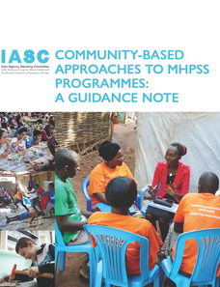
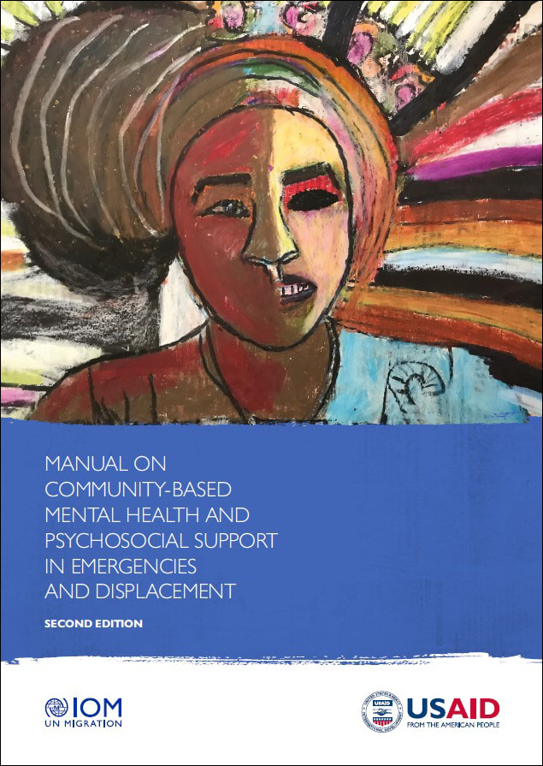
Community and its role in MHPSS
Key-elements of community approaches
Community inclusion, participation and outreach (including for people with lived experience) at all levels of the MHPSS pyramid is key for ownership, empowerment, engagement and community resilience.
Community has a key role in:
  developing and implementing protection activities;
  advocating for the rights of people with psychosocial, intellectual or cognitive disabilities;
  establishing a range of community-based mental health and other services and supports.
Notes:
Talk through the slide.
Introduce the following helpful and freely accessible tools:
An overview on how to integrate community-based activities can be found in the IASC MHPSS Minimum Service Package: Activity 3.4 Activity introduction - MHPSS MSP

Slide 36
Example 1 Friendship benches
The Friendship Bench initiative (created in Zimbabwe 2006) provides safe places in communities for people to talk.
Trained lay counsellors provide support to people experiencing emotional distress.
Most lay counsellors are older women as, in Zimbabwe, older people are seen as important guardians of the community and are respected.
The friendship bench approach has been adapted and implemented in Zanzibar (United Republic of Tanzania), in Malawi and in New York City, USA.
Notes:
Explain that:
We will look at two examples of mental health services within a community recovery approach.
Talk through the slide.
Source: Guidance on community mental health services: promoting person-centred and rights-based approaches. Geneva: World Health Organization; 2021 (Guidance and technical packages on community mental health services: promoting person-centred and rights-based approaches). Licence: CC BY-NC-SA 3.0 IGO. Guidance on community mental health services: Promoting person-centred and rights-based approaches

Slide 37
Example 2 The Green String Network
The Green String Network (GSN) is a multi-disciplinary team of peacebuilders, community workers, mental health staff and researchers who design trauma-informed interventions, and ways to evaluate them. Their work addresses trauma as a root cause of violent behaviour.
GSN is both a peacebuilding organization and a mental health organization
GSN’s approach to mental health is non-biomedical, non-Western, and linked to understanding the structural forces of violence, poverty, and power.
Key focus areas
Understanding stress and trauma. The framework examines historical injustices and their ongoing impact, recognizing how trauma can be transmitted across generations.
Breaking cycles of violence. The framework identifies the mechanisms, or "legacies and aftermaths," that perpetuate trauma responses, and seeks to break these cycles.
Empowerment and healing. The framework emphasizes fostering resilience and healing at individual and community levels.
For more information, see https://www.green-string.org/
Notes:
Talk through the slide, presenting the Green String Network as the second example of mental health services within a community recovery approach.

Slide 38
Exercise 4.2 Community based programmes and services
Sharing your experience with community engagement and community-based services
Do you provide, or know of, community-based services that can promote mental health and well-being? This might include mental health and other services (for example support groups, livelihood and income generating programmes, social and sports activities etc.)
What kind of support do these provide?
How do they promote mental health and well-being and respect the rights of people with psychosocial, intellectual or cognitive disabilities?
Notes:
Exercise 4.2 Community based programmes and services (15min)
Explain to participants that the goal of this exercise is an exchange of information about existing community approaches/programmes.
Ask the participants the questions on the slide, and encourage them to contribute to the discussion.
Conclude the discussion by highlighting that:
In humanitarian settings, community is even more important than it is in stable and high-income countries, where more services are available. Therefore, including the community into MHPSS is crucial for an effective response.

Slide 39
Topic 3. What is recovery?
Notes:
Time for this topic is 35 min: 10 mins silent exercise, 10 mins presentation on recovery (2 slides), 10 mins for the exercise, 5 minutes to optionally share recovery stories.

Slide 40
Exercise 4.3 Feeling better
Silent exercise
Think about a time when you had to recover from something – now or in the past. It can be anything you can think of, not necessarily related to mental health.
What helped you to get better?
Notes:
Exercise 4.3 Feeling better (10 min.)
Explain to participants:
Before we start with the topic Recovery, we will do a small self-reflection exercise.
Please think about a time when you had to recover from something yourself – recently or in the past. It can be anything you can think of, not necessarily related to mental health.
And then think about what helped you to get better.
Be as specific as possible.
Ensure that you explain to the participants that this exercise does not need to be shared.
If participants feel comfortable however, they are welcome to tell the group a few things that helped them. At the end of the exercise offer a minute or two for this in the plenary group.
Examples if prompts are needed:
Situation I had to recover from - breakup with partner, death of a family member, job loss, injury…..
Things that helped me to feel better - spending time with my children, talking things over with a friend, singing on my bicycle, going to my work….

Slide 41
Presentation. The meaning of recovery
Recovery can mean different things for each person. It can be about
  regaining control of identity and life
  having hope
  living a life that has meaning.
This understanding of recovery moves us away from the idea or goal of “being cured” or “being normal again”.
Recovery focuses on the whole person, addressing social, emotional, and physical aspects, including adversities like poverty, unemployment, discrimination etc.
Recovery focuses on (re)gaining new meaning and purpose in life, being empowered and able to live a self-directed life, despite what one may have lived through.
Notes:
Presentation. The meaning of recovery (10 mins, 2 slides or 20 mins if slide 3-6 are added)
Talk through the slide.
Explain that:
Recovery in action is not just treating or managing symptoms. It is an approach that looks at the whole person, extending to include social, emotional, physical and other aspects of life. This may involve addressing social adversities (such as poverty, unemployment, discrimination) that have a negative impact on people’s mental health.
Recovery focuses on gaining new meaning and purpose in life, being empowered and able to live a self-directed life, despite what one may have lived through.

Slide 42
The meaning of recovery
Recovery doesn’t have the same meaning as ‘cure’ (recovery is a journey not an end point).
Recovery refers to someone’s internal conditions (perhaps their hope, healing, empowerment etc) but also external conditions that help or hinder recovery (such as whether rights are upheld, recovery-orientated services are available, and a healing culture is established).
Notes:
Read out the text or ask a participant to read it out loud.

Slide 43
Exercise 4.4 Youssef’s recovery
Youssef has been experiencing deep and incapacitating sadness for several years and is not getting better. He has attempted suicide twice in the past 3 months. Youssef is seeing Dr Sharma.
Outcome 1. Upon arrival, Dr Sharma gives Youssef a prescription refill for his antidepressants. Youssef goes to the pharmacy to get his medication and leaves.
Outcome 2. Dr Sharma asks Youssef how he has been doing. When she hears he has been feeling worse in recent weeks, she asks why, and what might help. Dr Sharma also discusses Youssef’s goals for the future as well as goals he could focus on right now to feel better.
Youssef tells Dr Sharma that he feels very alone. He is estranged from his family and friends who do not understand his situation. He has not been performing well at work and has had to take time off. He tells Dr Sharma that he would feel a lot better if he could reconnect with his family and friends and go back to work.
Dr Sharma suggests that, if Youssef wishes, they could meet with close family and friends to discuss what he is experiencing and how they can all best support him. She offers him a referral to a psychologist and asks if he wants to get information about medical treatment. She also connects him with a social worker and local support NGOs. She gives him a list of local peer support groups to help rebuild his support network. Youssef and Dr Sharma agree to meet regularly to work towards his recovery goals.
.
Notes:
Exercise 4.4 Youssef’s recovery (10 min)
Give the participants time to read Youssef’s experience and the two potential outcomes.
Then lead a discussion on how each outcome does or doesn’t promote recover.
Prompts:
Outcome 1 does not put Youssef at the centre of his care. It does not focus on providing him with hope or supporting him to identify goals that he can work towards for his recovery or to find meaning in his life. The only focus is on treating the symptoms with medication.
Outcome 2 illustrates the recovery approach, where Youssef decides on his needs and objectives for recovery, while the health practitioner, by engaging in supportive dialogue, helps him to move forward in his recovery journey. This process takes longer than Outcome 1 but has more potential to support Youssef to be more effective in the long term.

Slide 44
Exercise 4.5 Recovery stories from your work
Plenary discussion
Do you have any recovery stories from your work?
Notes:
Recovery stories from your work (5 min.)
Ask the participants:
Do you have any recovery stories from your work?
If participant do not have examples, go to the next topic.

Slide 45

Lunch
Notes:
Duration: 60 minutes

Slide 46
Topic 4. Promoting recovery
Notes:
Time for this topic: 40 minutes (exercise 25 mins, presentation 15 mins 3 slides)
.

Slide 47
Exercise 4.6 How can we promote recovery?
How can people promote their own recovery?
How can families, caregivers and other supporters promote recovery?
How can communities promote recovery?
Notes:
Exercise: 4.6 How can we promote recovery? (25 min)
Split into 3 groups, and assign each a question. Tell participants to spend 10 minutes thinking about previous projects or their area of work. Ask each group to write their answers on a flip chart ready to give a 3 minutes presentation.
Prompts:
How can people promote their own recovery?
Identify and develop practices and strategies that make you feel better and promote well-being.
Seek out cultural and spiritual practices for growth and self-knowledge.
Foster relationships with peers and equals who value each other’s knowledge and autonomy, whether or not they share lived experience.
Stop blaming yourself for having been abused or for having been discriminated against.
Be clear with others that recovery is possible, that you are at the centre of your recovery, and that you drive all the decisions about your own life.
Develop your own plan for a recovery journey.
Explore opportunities to be more active and engaged in the community.
How can families and other supporters promote recovery?
Make sure that services and supporters respect the person’s opinions, decisions and choices on their treatment, care and other areas of life rather than making decisions on their behalf.
Acknowledge that opinions can differ, but that, ultimately, the person’s decisions should be respected.
Listen to others’ experiences and share your own story.
Find out more about the support options and strategies that the person finds helpful.
Support people to be actively engaged in their local community.
Include the person in family life and decisions on an equal basis with other family members.
Support the person to ensure that they are being treated fairly and without discrimination by health services and local agencies.
How can communities promote recovery?
Ensure that support is accessible and provided if needed.
Encourage individual recovery ideas in the community for example by facilitating meetings of people with lived experience.
In war and conflict, promote community healing through community recovery.

Slide 48
Presentation. What supports recovery?
Communication, trust and a shift of focus
Good communication and building a trusting relationship
  Using good communication skills (for example, active listening, using positive messages focusing on hope).
  Understanding that the person is an expert by experience and that this expertise is as valid as the expertise of practitioners.
A shift from What is the matter with you? to What matters to you?
  It is not up to mental health and other practitioners, families or others to decide what a person’s recovery will look like. This must be the decision of the person who is going through the recovery journey.
“Instead of telling people to be resilient, we must create environments where resilience is possible, if not inevitable” Green string Network
Notes:
Presentation: What supports recovery? (15 mins, 3 slides)
Talk through the slide.

Slide 49
What supports recovery?
Recovery and social inclusion
Taking part in social, educational, training, volunteering and employment can support individual recovery.
Services should empower people gain or establish their place in the community and to live a life that has meaning to them (institutional models of care, which isolate people from the community, are incompatible with a recovery approach).
We all have a role to play in fostering inclusion and openness that supports people in their recovery journey.
Notes:
Talk through the slide.

Slide 50
What supports recovery?
Recovery plans
A recovery plan can be a useful tool to:
  support someone to work out a direction and steps for moving forward in life
  help someone get the support of important people in their life, if they wish to do so.
A recovery plan outlines the person’s own goals in life.
The plan outlines how the person and their chosen support network will work to achieve these goals.
It may include a personal plan for dealing with acute distress.
A recovery plan may also include an advance directive about care and treatment.
Notes:
Talk through the slide.
Provide participants with a copy of WHO’s QualityRights recovery planning tool (Person-centred recovery planning for mental health and well-being: self-help tool: WHO QualityRights. WHO ‎2019). This is handout M4.1
If you don’t have paper copies, take a few minutes to look at the pdf version (available at https://www.who.int/europe/publications/i/item/9789241516822)

Slide 51
Topic 5. How MHPSS services and staff can promote recovery
Notes:
Time: 120 min plus 15 min break.
This topic is a multi-part exercise: 25 plenary discussion, 25 mins small group discussions, 15 min break, 20 min plenary discussion, 35 mins individual planning (could be set as homework if time is short), 15 min discussion around a video.

Slide 52
Exercise 4.7 Improving practices. What are you doing already?
Improving practices MHPSS services and staff use to promote recovery
Think about the MHPSS context where you work. How are you already promoting recovery?
(If you don’t work directly in implementing MHPSS, what do you do to create an environment for the people you help that supports hope, empowerment and inclusion…..?)
Notes:
Exercise 4.7 Improving practices to promote recovery in MHPSS Services and staff – What are you already doing? (25 min.)
Talk through the slide.
Then lead a plenary discussion.

Slide 53
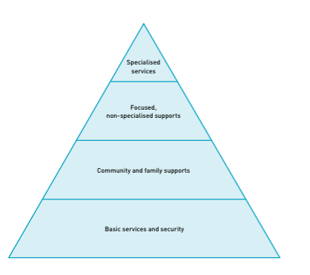
Exercise 4.8 Improving practices. What changes/improvements are needed?
Improving practices MHPSS services and staff use to promote recovery
Think about tangible measures that can be taken at the different levels of the pyramid to support recovery.
If you are not MHPSS staff, think about the scope of the work you do in your sector, and how you can support recovery.
Image: Inter-Agency Standing Committee (IASC). (2007). IASC guidelines on mental health and psychosocial support in emergency settings. Geneva: IASC.
Notes:
Exercise takes 25mins
Write one pyramid layer on each of 4 flipcharts.
Explain to participants:
For each of layer of the pyramid, actions to promote recovery are possible. We will think of practices we could improve in each layer. If you are non-MHPSS staff, think of your scope of work and where you could intervene.
Form participants into four groups. Nominate someone to stay with each flipchart for the whole exercise and write down the ideas. Use a timer to give participants 5 minutes at each flip chart in rotation. Alternatively, participants can walk around individually, recording ideas with moderation cards / sticky notes and discuss spontaneous with each other. When every participant has considered every flipchart, asking them to have a look at all four sheets. Do not ask them to explain their points yet.
Prompts:
End coercive, harmful or abusive practices at the person's home, in their community or in the healthcare setting.
Focus attention on how to support people to live and be included in the community.
Support each person to overcome social isolation and build social support networks, including by reconnecting with family and friends, peers or others, in line with the person’s wishes.
Link people to training and skills-building opportunities (such as vocational training, paid employment and any other relevant skills or educational training).
Promote and encourage peer support approaches.
Support access to spiritual, religious and cultural resources and experiences if requested (such as prayer rooms, religious scriptures, traditional cultural healing). This should include exploring and assessing potential harm.
Be open to learning from, and being changed by, people with psychosocial, intellectual or cognitive disabilities or any other person using the services.
Recognize people as experts by experience and involve them at all levels of the service, including service reform, management and governance.
Welcome involvement from family, care partners, friends and other supporters in planning and delivering care, in line with each persons’ wishes.

Slide 54
Break
15 minutes
Notes:
Duration: 15 minutes. Encourage participants to review the flipchart sheets.

Slide 55
Exercise 4.9 Improving practices. Plenary discussion
Improving practices MHPSS services and staff use to promote recovery
Was it difficult to find ideas? If yes, what made it difficult?
Was it easier to improve practices in some layers than others?
Were some recovery actions relevant to all the layers?
Notes:
Plenary discussion: 20 mins.
When participants have had a chance to review all four sheets, ask the questions on the slide.
Facilitate an open discussion about each point.
Some participants, in particular mental health and other practitioners, may express concern that they lack resources and time to carry out all the actions. Others might emphasize that it felt a bit generic. This should be all openly discussed.
Emphasize that:
Advocacy and lobbying are also key to making changes and moving in the right direction.
You might remind participants that simple reflection, such as this activity, is a crucial first step in bringing about change and improvements.
Conclude that:
It is important to not give up the challenge of transformation and improvement because of anticipated barriers or challenges. Instead, we should analyze the possible barriers realistically and then find ways to overcome them.

Slide 56
Presentation. Changing the narrative
We will watch a video about Little Amal’s journey: the larger-than-life puppet that travelled over 9000km from Syria across 13 countries in a project called The Walk, representing all children fleeing violence, conflict and persecution.
“….Yes, refugees need food and blankets, but they also need dignity and a voice. The purpose of The Walk is to highlight the potential of the refugee, not just their dire circumstances. Little Amal is 3.5 metres tall because we want the world to grow big enough to greet her. We want her to inspire us to think big and to act bigger.”
Amir Nizar Zuabi, Artistic Director of The Walk
Notes:
Video and discussion, 15 mins.
First introduce the video. Here is some text you could read.
We will watch a video about Little Amal’s journey: the larger-than-life puppet that travelled over 9000km from Syria across 13 countries in a project called The Walk, representing all children fleeing violence, conflict and persecution. On her journey, Amal was welcomed by more than a million people on the street, including hundreds of artists and civil society and faith leaders, as well as by tens of millions online. Her journeys have been festivals of art and hope (her name means ‘hope’ in Arabic) that draw attention to the huge numbers of children fleeing war, violence and persecution, each with their own story. Her urgent message to the world is “Don’t forget about us”.
We can understand the project as a kind of recovery story, perhaps a community recovery story. Throughout history, people’s movements have fuelled human progress, enriched culture and fostered knowledge. Often, personal recovery stories are the basis for such movements. But movements don’t have to be actual journeys. We use the same word to talk about important social change.
This video invites us to consider:
the dignity and voice of people in their recovery
their strengths and creativity in the recovery journey
the importance of community action and inclusion.
Ask one of the participants to read out the quote by the project’s director, Amir Nizar Zuabi.
Then move to the next slide to play the video (around 5 minutes).

Slide 57
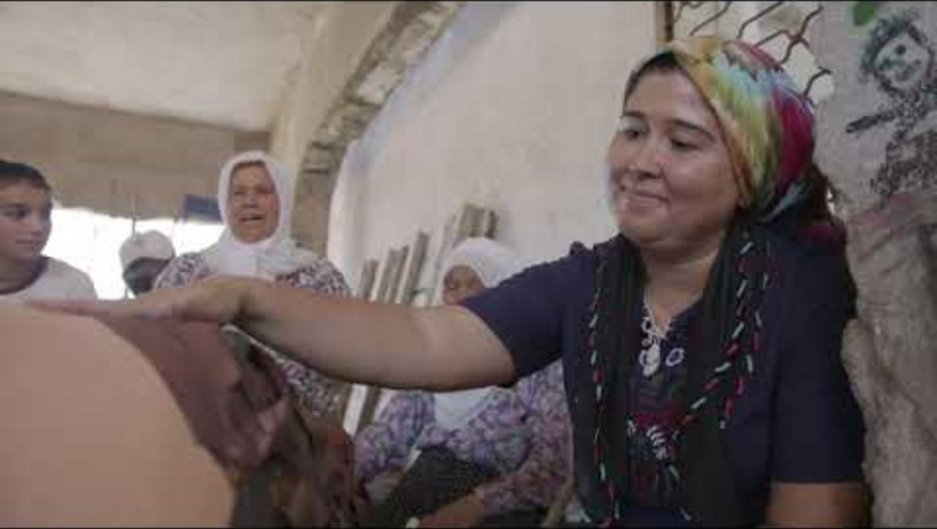
Notes:
Play the video, then ask a few participants to share some thoughts.
https://www.youtube.com/watch?v=5hZFktsc85s

Slide 58
QualityRights Changemakers and Action Plans
Notes:
Time: 35 mins

Slide 59
Exercise 4.10 Improving practices. Action planning
Improving practices MHPSS services and staff use to promote recovery
Continue building your QualityRights Action Plan.
Identify two to three concrete and realistic actions your project or organization could implement within the next six months to promote recovery-oriented practice.
  What specific changes in services or staff practices would support recovery?
  What resources will you need?
  What challenges might you face, and how can you address them?
Record your ideas in the Day 3 Action Planner (Recovery) section.
Notes:
Individual action planning: 35 mins
Ask participants to identify two to three specific and realistic actions their project or organization could implement within the next six months to promote recovery-oriented practice. Encourage participants to focus on feasible steps within their current work settings. They do not need to include different levels of the service system. Remind them to:
Think about specific changes in service or staff practices that could better support recovery-oriented approaches.
Consider the resources needed.
Consider potential challenges, and ways to address these.
Participants should record their key ideas directly in the Day 3 Action Planner (recovery section).
Remind participants that this forms part of their overall QualityRights Action Plan, which will continue to develop during Days 4 and 5.
If time is short, tell participants to complete the Day 3 Action Plan as homework and bring it back on Day 4 for sharing.

Slide 60
Daily wrap up and rapid end of day evaluation
Please provide some quick first impressions on how you found the second part of module three on Legal capacity and the right to decide, and module four on Recovery and the right to health. You'll have the opportunity to give more detailed feedback at the end of the entire course too.
What is/are the most important point(s) you learnt from today’s training?
Any remarks? Wishes for tomorrow?
Notes:
Daily wrap up and rapid end of day evaluation (10 min.)
Summary:
Ask a volunteer to briefly summarize the day’s training (5 minutes max.)
Alternatively, ask for one or two volunteers to do a 5 minute summary at the start of the next session.
Rapid evaluation:
Ask participants to answer the two questions in a couple of sentences each.
Alternatively, hand out sticky notes so people can leave comments on two flip charts allocated for the questions.

Slide 61
WHO/UCN/MSD/PLR/2025.4 © WHO 2025. Some rights reserved. This work is available under the CC BY-NC-SA 3.0 IGO licence.

