Slide 1
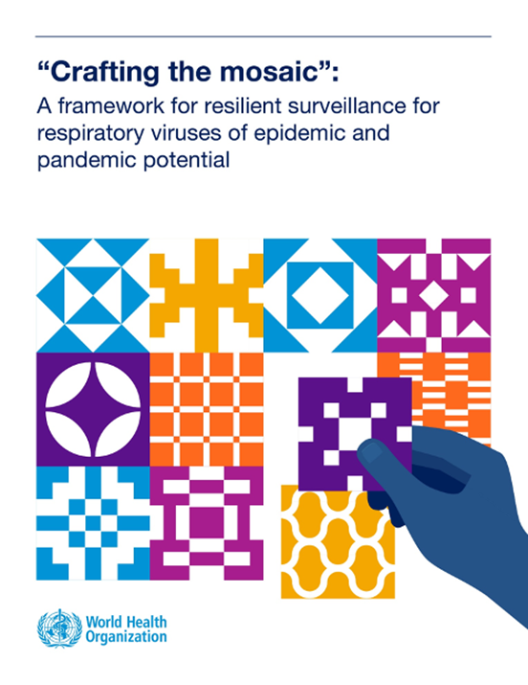
The Mosaic Respiratory
Surveillance Framework
  PRESENTER
  AFFILIATION
Generic e-mail: mosaic@who.int
Web page: https://www.who.int/initiatives/mosaic-respiratory-surveillance-framework/
Video: https://youtu.be/EOL6gaDRiEg
Notes:
[Welcome and introduction of self]
This is an introductory presentation on the Mosaic Respiratory Surveillance Framework. This WHO framework was published in 2023 and is being implemented globally to help develop sustainable national surveillance strategies to detect and monitor influenza, SARS-CoV-2, respiratory syncytial virus (RSV) and other respiratory viruses of epidemic and pandemic potential. Respiratory disease cause a substantial health and economic burden globally each year and are also the most urgent pandemic threat requiring strong IHR core capacities for surveillance (the next respiratory pandemic is not a question of "if" not "when). While the Mosaic Framework is intended to strengthen respiratory surveillance capacities, this "respiratory use case" applies to pathogens with other modes of transmission.
I will begin by describing the framework including its objectives, why it was created, it's development and contents. Then I will describe the aims and methodology of national Mosaic workshops. Finally, I will discuss how the framework can continue to be implemented over time.

Slide 2

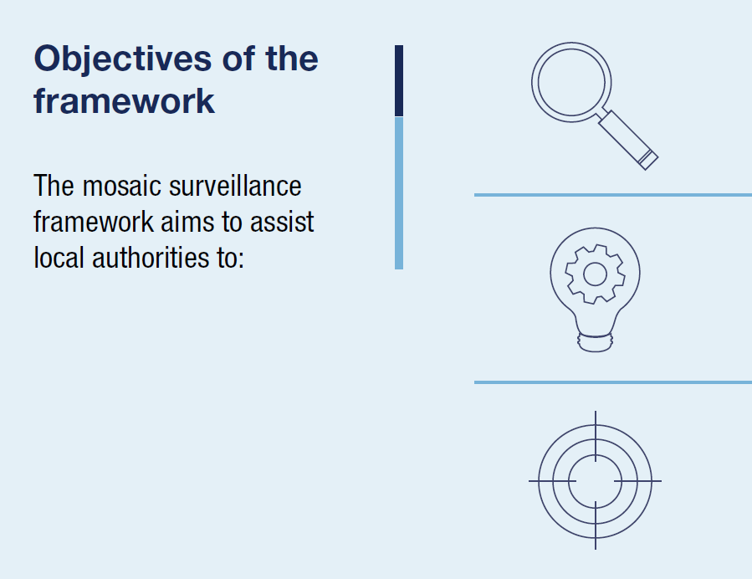
The Mosaic Respiratory Surveillance Framework:
An inter-pandemic organizational tool
Review priority respiratory surveillance objectives ​
and the best surveillance approaches to meet them
Prioritize and target technical assistance, financial​
investments, and partner focus to meet the ​
most pressing needs
Develop needs and actions to integrate into ​
surveillance work plans according to national​
context and resources
Notes:
The Mosaic Respiratory Surveillance Framework is an inter-pandemic organizational tool to focus on and strengthen surveillance to meet early warning and routine monitoring objectives each and every year. However, this informs pandemic preparedness in important ways as once a Mosaic is established, countries may then systematically assess how surveillance objectives may change in each pandemic period,and make specific plans for how existing systems would be used in that context.
The Mosaic Framework aims to assist national authorities to review surveillance objectives and then determine the best surveillance approaches that may be used to meet these objectives; including systematic identification of the required enhancements of existing surveillance.
The Mosaic Framework also helps national authorities target technical assistance, financial, investments, and partner focus to meet the most pressing needs. Mosaic workshops use scenario-driven discussion to systematically identify and prioritize surveillance needs and actions to integrate into surveillance work plans according to national context and resources.
This framework will also help national authorities extend partnerships for surveillance and collaborative analyses of data across partners and sectors. Doing so will improve data for decision-making during interpandemic periods and to help ensure that respiratory virus surveillance is both timely and scalable in emergencies.

Slide 3
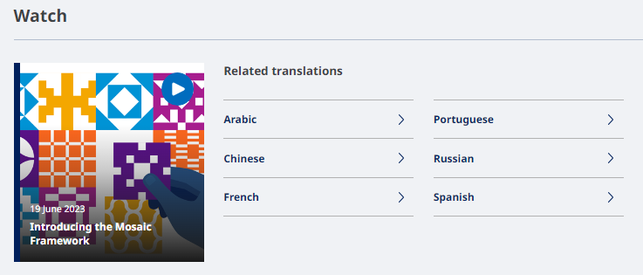
Introductory video (3 mins)
WATCH in English here: https://youtu.be/EOL6gaDRiEg
Languages and link for Mosaic video
English | https://youtu.be/EOL6gaDRiEg
Russian | https://youtu.be/tq0di5u7NR0
Portuguese | https://youtu.be/_Cs9CebAnCc
Spanish | https://youtu.be/HCX6RaDWz8g
French | https://youtu.be/wVsUY65yq2I
Chinese | https://youtu.be/dGd8FMB8BWg
Arabic | https://youtu.be/IHqU_TQnbx4
Notes:
Here is a 3-minute introductory video on the Mosaic Framework which gives a comprehensive and concise overview. The video is available in English, Arabic, Chinese, French, Portuguese, Russian, and Spanish.
[Note: Can choose to play the video as part of the webinar and/or workshop (recommend to download the file first). Can replace top line on the slide with most relevant language for workshop participants]

Slide 4




Why the Mosaic framework?
WHO Member States requested a coordinated approach for
sustainable surveillance of respiratory pathogens in 2022
  Multiple fit-for-purpose systems and complementary investigations & studies are needed
  The Mosaic Framework maps surveillance approaches to the objectives they are best intended to meet
  Considers gains made during the COVID-19 pandemic
→ Mosaic analogy: Different surveillance systems and studies must fit together as “tiles in a mosaic”, each providing a piece of the picture to contribute to a holistic understanding of respiratory viruses.
Notes:
Why was this framework named "the Mosaic Framework" and why was it created?
The Mosaic Framework demonstrates how surveillance approaches may be implemented as coordinated and collaborative systems, well-matched to specific priority objectives. During the COVID-19 pandemic, many countries established new surveillance systems to detect and monitor SARS-CoV-2 and COVID-19. While COVID-19 became a reportable condition globally, there was not a consistent approach to how countries leveraged existing respiratory disease surveillance systems (e.g. those used for influenza) to monitor COVID-19. This created a risk going forward - of multiple, parallel, laboratory and epidemiologic surveillance systems being used to monitor respiratory viruses of epidemic and pandemic potential.
As such, Member States requested WHO at the World Health Assembly in January 2022 to put into place a coordinated approach for sustainable surveillance of respiratory pathogens during the post-pandemic and inter-pandemic period.
As was emphasized in the recent pandemic it is impossible to address the many needs of respiratory virus surveillance with a single surveillance system. Rather, multiple systems and complementary investigations & specialized studies must each be fit-for-purpose to address priority objectives to which they are best suited.
Using global use cases, and experiences, the Mosaic Framework places surveillance systems, represented by existing guidance, into a context where they may best address the objectives for which they are best intended.
This is where the Mosaic analogy comes from. Different surveillance approaches must fit together as "tiles in a mosaic" to obtain the full "picture" of respiratory viruses in a country. Because each system meets a particular objective, any "missing tiles" will obscure the full picture.
Background info:
At the150th session of the Executive Board of the World Health Assembly in January 2022, Member States supported the sentinel surveillance platform (influenza) of the Global Influenza Surveillance and Response System or GISRS to be further leveraged to meet key monitoring needs, not only for influenza, but also for SARS-CoV-2 and other respiratory viruses. However, WHO was also specifically asked to:
provide a strategy to countries on how respiratory viruses of pandemic potential should be sustainably monitored, assessed, and new variants or novel viruses be detected, using existing surveillance platforms.
2. form a model for possible inter-connected surveillance for influenza, SARS-CoV-2 and other respiratory viruses moving forward and
3. help international partners and donor agencies focus technical and financial resources on the most essential surveillance needs.
This is precisely what the WHO Mosaic Respiratory Surveillance Framework is intended to be used for.

Slide 5
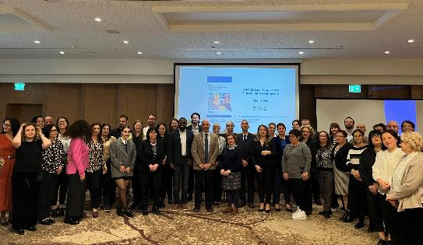
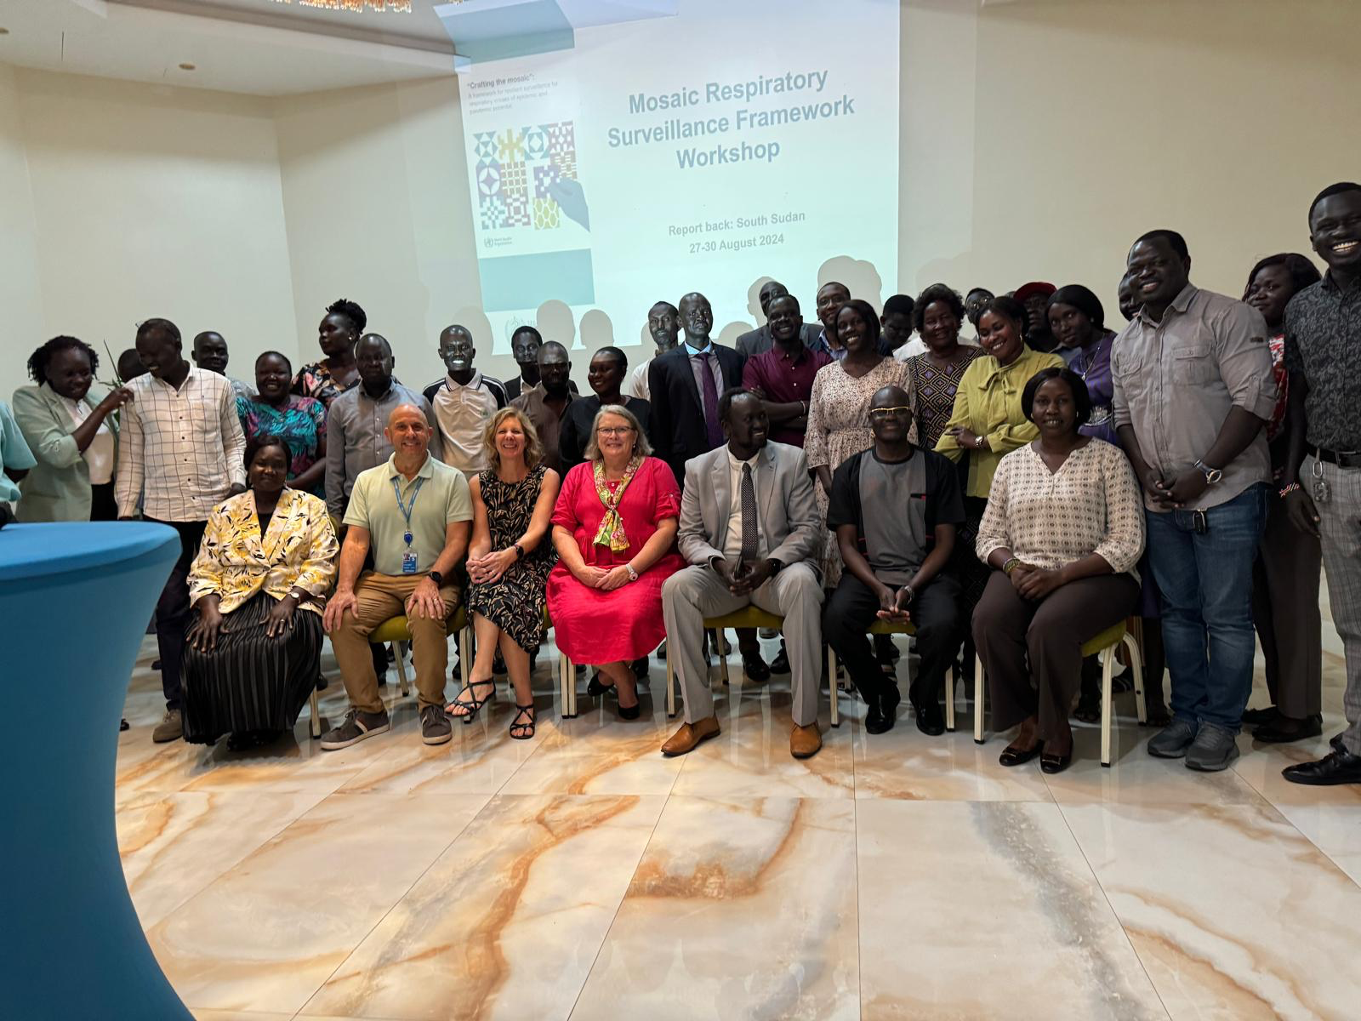
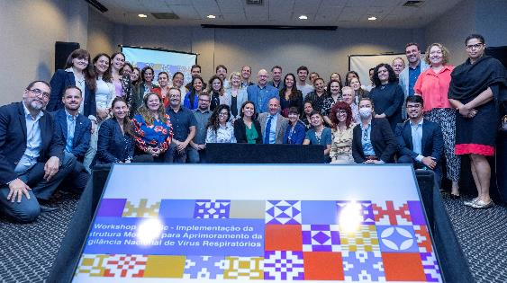
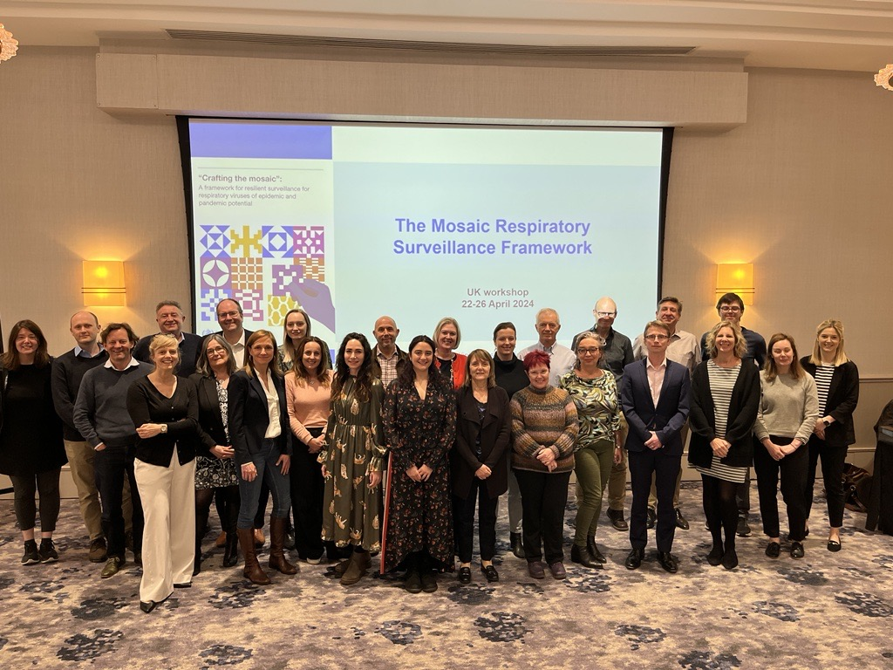
Mosaic Framework Development Timeline
Mid-late 2022
Mosaic Framework document drafted
by WHO HQ working group with review by wider WHO and external partners
Early 2022
Concept formulation for Mosaic Framework
through WHO country, regional and HQ consultations
2024
Pilot
workshops held in 10 countries
Early 2025
Final tools and “train-the-trainers” package finalized and made available
Mosaic Development
Mosaic Piloting
May 2022
Global consultation
In-person to finalize structure of Mosaic Framework
December 2024
Learnings from pilot workshops incorporated into implementation materials
March 2023
Mosaic Framework published
on WHO website
Notes:
Mosaic Framework development timeline
The Mosaic Framework development process involved all WHO regions and a large number of countries worldwide between 2022-2023 using a "bottom-up" approach.
First, in early 2022, country-level input was gathered using a number of different methods including online surveys (for countries and for regional office), informal country focused discussions and formal country consultations. The results were consolidated and served as the foundation for an in-person
WHO global consultation in May 2022. This was attended by national experts from a number of countries, the three levels of WHO, and external partners and donor organizations. During the consultation, working groups further developed the Mosaic Framework concepts and finalized the structure and content.
In mid and late 2022, the Mosaic Framework document was drafted through an internal WHO WG which addressed comments from a number of rounds of review by WHO and external partners and donors.
The Mosaic Framework document was published on WHO web in March 2023.
Pilot workshops were held in 10 countries in 4 regions throughout 2024.
In December 2024, learnings from the pilot workshops were incorporated into implementation materials. Final tools and a “train-the-trainers” package were finalized in early 2025 and made available to regions for their use.

Slide 6
Using the right tools for the right jobs!
Questions Surveillance approaches Domains
Early detection
Is there an emerging respiratory of virus of epidemic or pandemic potential in my country?
Who is at risk and what are the clinical characteristics of illness?
Event-based surveillance
Rapid risk assessment
Outbreak investigations
Immediately notifiable diseases
Are we beginning a respiratory epidemic period or season?
Are we seeing more respiratory disease than expected?
What viruses are currently circulating, who is affected?
Routine monitoring
Sentinel surveillance
High risk group monitoring
Hospital capacity monitoring
Lab networks
Informing intervention policy
Should we implement medical and non-medical interventions?
How well are they working?
How can we improve clinical care?
Are there adverse events to vaccines and therapeutics?
Data from national, regional, global platforms
Investigations and studies: partners and protocols
Clinical surveillance
Pharmacovigilance
Notes:
In conceptualizing and designing the Mosaic Surveillance Framework, it was considered how to best answer the policy-related questions that we are asked from senior stakeholders and the public. We have to use the right tools for the right jobs and it is important that we can answer these questions using the information (data) from the best suited surveillance approaches to enable timely action. When the Mosaic Framework was being conceptualized, such policy-related questions were compiled and thought was given to which national surveillance approaches can best generate the needed data to answer these questions. The different systems that have been used for decades in the past, and during the COVID-19 response, were considered: both existing systems and new and innovative approaches. These were then categorized into three key Domains: early detection, routine monitoring and informing intervention policy.
Starting with the top orange box, there are questions related to early detection of an emerging virus that is not yet widely circulating in a human population, and its associated investigations. Critical to our IHR core capacities is event-based surveillance. This means detecting individual cases or outbreaks (or other "events") of concern wherever they may occur in a country – this may be astute health workers identifying something that's unusual but also reporting from communities or populations that don't or can't access care. EBS also allows for rapid verification and assessment with the aim to stop an outbreak or epidemic from spreading further. At the animal human interface we need to watch for the emergence of novel viruses that may move from animal to human populations with pandemic potential; or even move from human populations back into animal populations where reassortment may occur. Outbreak investigations allow for the collection of further information and characterization of the event. In addition, routine national notifiable disease surveillance systems provide a comprehensiveness of surveillance for important diseases and conditions across a country in areas where sentinel surveillance systems may not reach. As such, these may also detect unusual events early if some respiratory diseases or conditions are immediately notifiable.
Going to the blue boxes, here are questions that would be asked relating to the routine monitoring of a respiratory virus that is already in circulation from year to year. For such routine monitoring of the epidemiological, virological and clinical characteristics, sentinel surveillance of influenza-like-illness and severe acute respiratory infection is critical. In these systems, because many cases may be expected each and every year, high quality virologic, epidemiologic, and clinical data is collected from a representative subset of cases seeking care in the population. In mature sentinel systems, the detection of pattern changes is also possible and baselines and thresholds can be applied for severity assessments. Sentinel systems to monitor respiratory viruses require a strong linkage between laboratories and epidemiologic data collection. Their connection to laboratory networks are required to understand how individual patient characteristics may be related to molecular diagnostic data, sequence data and other characterization of circulating viruses.
However, previous pandemics have taught us that there are other surveillance systems and specialized investigations and studies that are needed to meet additional objectives for comprehensive respiratory pathogen surveillance in a country. There may be high risk groups - these are country –specific and may be those in long term care facilities or others at higher risk of complications from infection - that are not typically reached by routine surveillance systems and that need targeted surveillance to address them. Other approaches may be used to monitor hospital capacity such as availability of beds, essential medicines, supplies, and even human resources.
Finally, in the purple boxes, are questions related to the information required to inform the implementation of specific interventions in the population, for example the use of vaccines, therapeutics, or non-medical interventions. Such questions often need to be addressed by time-limited specialized investigations and studies as the approach required is time-limited and too intensive to be sustained through routine surveillance. These may be detailed and standardized outbreak investigations with associated analytical studies, vaccine studies, transmission studies, studies to estimate population susceptibility/immunity as well population based burden studies.
[Note: in countries where sentinel ILI/SARI surveillance predominates and relied on heavily, it may be considered to state: "Sentinel ILI/ARI/SARI systems meet certain critical needs for respiratory disease surveillance but no one surveillance system or approach can be “everything to everyone". Sentinel systems must be complemented by other systems, investigations and studies to meet all needs."]

Slide 7

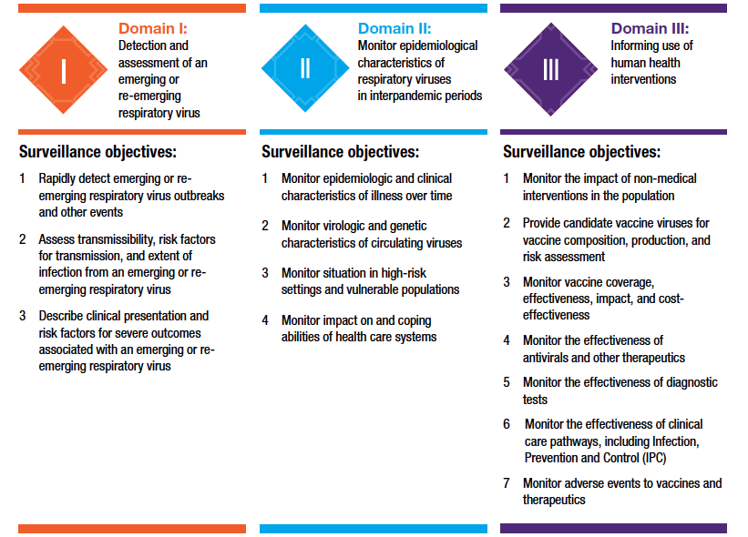
Mosaic Framework: an objective driven approach
Notes:
Through the consultative process used to develop the Mosaic Framework, the final names of the three key areas, the mosaic "Domains", and the priority objectives under each of the domains was also established. The implementation of the Mosaic Framework (including this workshop) very much focuses on organization of surveillance approaches within each of these domains through an objective driven approach. As such, I will go through these in some detail now.
For detection and assessment (early warning) in Domain I (orange), the first and key objective is to rapidly detect emerging or reemerging respiratory virus outbreaks and other events. The second and third objectives involve determining additional critical information to characterize the viruses, and cases associated with illness due to infection from those viruses – to assess transmissibility, risk factors for transmission and the extent of infection. Also, these investigation seek to describe clinical presentation and risk factors for severe outcomes.
As we move to domain 2 (blue), monitoring epidemiological and virological characteristics (routine monitoring), the objectives shift to those that we need to monitor the epidemiological, clinical, virological and genetic characteristics of the illnesses and viruses that regularly occur or circulate in human populations over time. We also need to monitor the situation in high risk groups to inform resource prioritization, as well as the impact on and coping abilities of our healthcare systems.
And then, in domain 3 (purple), the objectives are to use our surveillance data to inform the use of human health interventions. Not all these objectives may be a priority for every country but key objectives include: monitoring the impact of our non medical interventions in the population, helping to support global risk assessments and vaccine formulation, and to monitor vaccine coverage, effectiveness and impact in populations, among others. [note: speakers can mention other objectives in this list as they see relevant to the country].

Slide 8
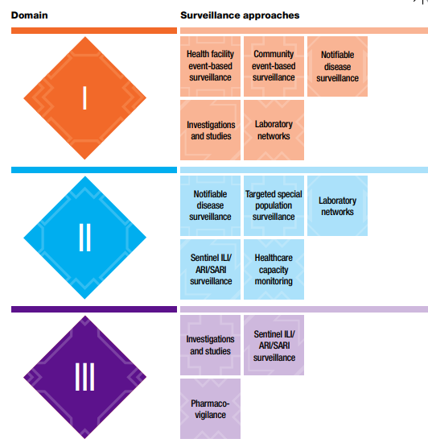
Mosaic core recommended surveillance approaches
Health
emergencies
programme
Notes:
During the consultative process, it was also determined which surveillance approaches are considered a priority globally, called "core" approaches in the framework, under each Mosaic Domain. This is shown in this figure and the names used for the surveillance approaches are globally agreed standardized terms, and intentionally generic to help standardize communication within the global community - to easily exchange best practices between countries and communicate with donors.
For detection and assessment, Domain I, the core surveillance approaches needed to meet this objective include those early warning approaches such as health facility and community event-based surveillance, notifiable disease surveillance and laboratory networks. Outbreak investigations and special studies to assess transmission, risk factors, and severity among other needs, are also essential.
As we move to domain 2, monitoring epidemiological characteristics, the core approaches shift away from early warning to those key to routine monitoring such as notifiable disease indicators for reporting, sentinel ILI/ARI/SARI surveillance and laboratory networks. It is also a priority to ensure any appropriate risk groups are well represented in surveillance, and to have sustainable monitoring of healthcare capacities.
In domain 3, informing the use of human health interventions, we rely mostly on investigations and studies to provide the data required for evidence-informed action, particularly when monitoring the impact and effectiveness of interventions. Sentinel ILI/ARI/SARI surveillance is also considered a priority to provide candidate vaccine viruses for vaccine composition, production and risk assessment. Additionally, pharmacovigilance is important to monitor adverse events. Enhanced clinical surveillance is also a priority in many countries, particularly to monitor the effectiveness of clinical care pathways.
[note: enhanced clinical surveillance is a missing tile here for the global model (as it was removed for LMIC): need new diagram from Lushomo, also with Domain names added].

Slide 9
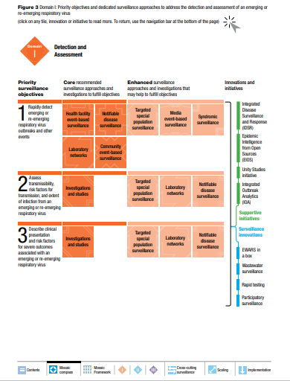
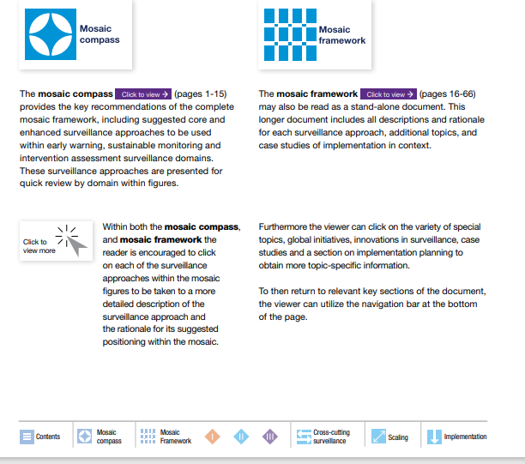
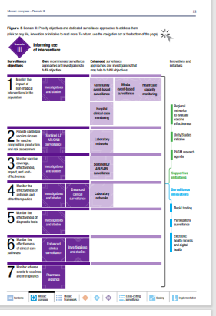
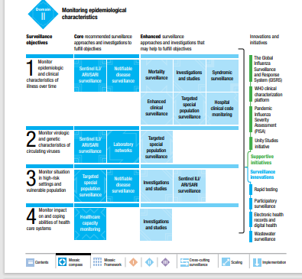
Web https://www.who.int/initiatives/mosaic-respiratory-surveillance-framework
Notes:
We want to briefly orientate you to the Mosaic Framework document that can be found on the WHO web site, and serves as an operational tool itself. It is an inter-active PDF document that needs to be downloaded for full functionality. The menu along the bottom of each page will to take the user to the key parts of the document.
The Framework document has a summary up-front called the “Mosaic Compass” – and it does just that, it points you in the right direction to design your own Mosaic of surveillance approaches and to further info that you may need in the main part of the document.
In the Compass there are three coloured diagrams (or tables) that form the backbone of the Mosaic Framework document – one for each of the three Mosaic Domains. These are shown on the right-hand side of the slide.
In the left column of each diagram, you have the objectives that we reviewed already. The mosaic tiles within each diagram represent the different recommended surveillance approaches or systems. In the dark colour are those surveillance approaches that are “core” (or priority) to fulfill that objective. The core systems or approaches are those that every country in the world should have to fulfill the said objective. In the pale colour are the “enhanced” (or “complementary”) approaches that may help to fulfill that objective. Depending on capacity, some countries may elect to make enhanced systems core in their own context. As said, this is a global representation and your national situation is likely to be unique to you, and that is perfectly fine . Some other core or enhanced systems may be present in your country but on the global level, they're not the approaches that we would expect every country to be using.
In the right hand column we have the innovations and initiatives that support surveillance approach implementation in each Domain. Some innovations in surveillance (e.g. wastewater surveillance or participatory surveillance) are not included as formal tiles in the mosaic but can be reviewed as innovations. Clicking on these may provide some evidence of how countries have used these approaches, and the pros and cons of doing so. If you need more info on any surveillance approach or initiative, click on the tile for more info – this will take you to a description in the main part of the document.
This compass allows busy national stakeholders such as yourselves to quickly look at what's being recommended to implement the Mosaic Framework.
In short, you can get a good understanding by just going to the Compass.

Slide 10


Enabling Structures of Surveillance
Strong governance and leadership
Sustainable financing
Trained, sustainable workforce
Effective coordination between sectors and levels
Appropriate digitalization and use of innovations
Ongoing monitoring and evaluation
Cross-cutting best practices
Notes:
The functionality of our surveillance systems, and therefore Mosaic Framework implementation, is dependent on an enabling environment. Important enabling structures that are listed on this slide including strong governance, sustainable financing and workforce, effective co-ordination, appropriate technology, and ongoing monitoring and evaluation. These are best practices that are relevant to, and therefore cut across, all three Mosaic surveillance domains. Strong enabling structures are not only critical to respiratory disease surveillance but to the sustainability and usefulness of all surveillance in general. The Mosaic workshops that we will discuss will helpto identify needs and actions for individual surveillance systems, but for these cross-cutting enabling structures as well.

Slide 11
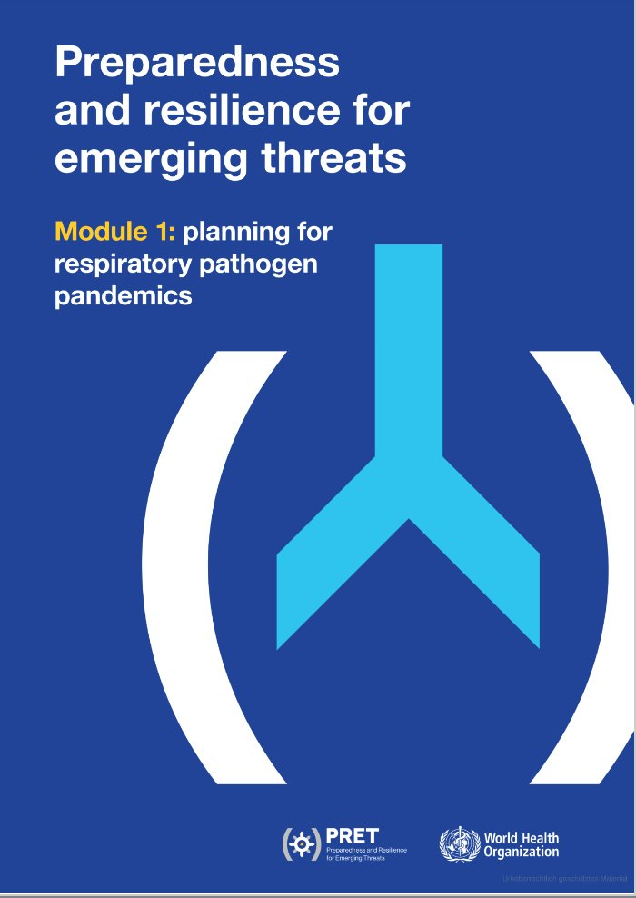



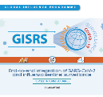

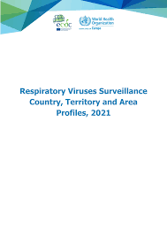









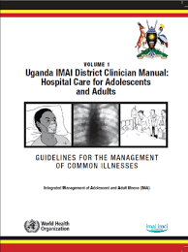

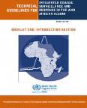


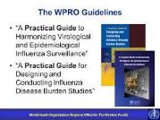


Mosaic Framework = Strategic framework
Supports tactical implementation of HEPR & PRET ‘Collaborative Surveillance’
Does not supersede other guidance, but provides context for their use
Global architecture
IHR, HEPR, PRET
Regional Guidance
Global Guidance
Mosaic Framework:
Respiratory "Use-Case" for their
implementation
Health
emergencies
programme
Notes:
The Mosaic framework is an organisational tool that is aligned with and supports tactical implementation of several WHO Initiatives. This includes the International Health Regulation's 2005, the Health Emergency Preparedness, Response and Resilience (HEPR) architecture's ‘Collaborative Surveillance’ subsystem, and The Preparedness and Resilience for Emerging Threats (PRET) initiative.
The Mosaic Framework is a respiratory use-case for the implementation of these broader initiatives. It is intended that Mosaic tools be developed for other modes of transmission (as is PRET) and the Mosaic Framework does not supersede other global, regional or national guidance, but provides context for their use.
No new guidance for respiratory disease surveillance was developed in the Mosaic Framework. Rather it provides links to salient existing guidance at the global or regional levels in the areas where that type of surveillance are recommended. As it can be difficult to find all of this guidance, the Mosaic Framework is a "one stop shop" for links to surveillance guidance, and country examples for how specific types of surveillance have been used to meet specific objectives.

Slide 12
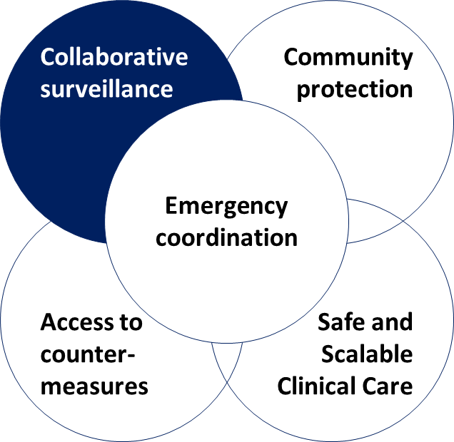
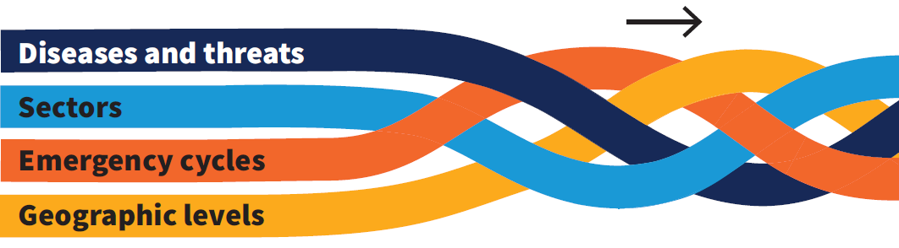
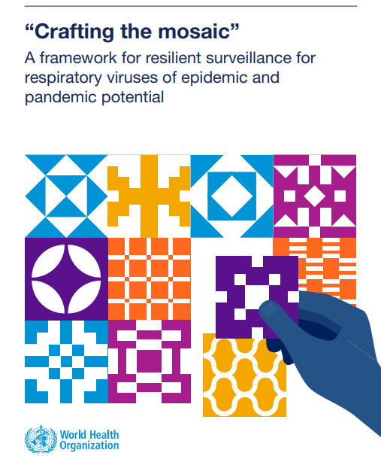

Collaborative surveillance calls for strengthening capacity and collaboration
Coverage, quality and collaboration across 4 dimensions
The “5Cs” of HEPR
Mosaic workshops identify specific national needs and actions at the national level to strengthen surveillance
Examples include improved stakeholder and multi-sectoral coordination, a sustained workforce, improved systems and tools, new data sources, or improving technology.
These and other needs can then be prioritized for strengthening through global HEPR implementation.
Notes:
Collaborative surveillance calls for increasing capacity (traditional) and strengthening collaboration
Collaborative surveillance: is the the systematic strengthening of capacity and collaboration among diverse stakeholders, both within and beyond the health sector, with the ultimate goal of enhancing public health intelligence and improving evidence for decision making
If each dimension of collaboration is strand, by building these across all activities and stages of surveillance where appropriate, we establish stronger surveillance architecture, stronger systems – a stronger rope – for the benefit of all stakeholders.
Mosaic workshops identify specific national needs and actions at the national level to strengthen surveillance

Slide 13

Mosaic Framework provides a "how to" for sustainable IHR 2005 implementation
States Parties must have the capacity to detect events through a
well-established national surveillance and response infrastructure
    To be able to notify events or respond to public health risks and emergencies
  Mosaic Framework provides:
      Fit-for-purposes surveillance approaches mapped to priority objectives
      A Monitoring and Evaluation Framework aligned with IHR MEF
      An implementation tool for the surveillance and response component of:
          National Action Plan for Health Security (NAPHS): all-hazard
          Respiratory pathogen pandemic preparedness plans: hazard-focused
Notes:
The Mosaic framework is a tool to support the implementation of the International Health Regulations (IHR) 2005, specifically the core capacity requirements for surveillance and response, and will be adapted if the ongoing discussion related to the revision of the IHR (2005) requires it
The Mosaic Framework does this by providing:
Fit-for-purposes surveillance approaches (with consideration of both event-based and indicator-based surveillance) mapped to priority objectives
A Monitoring and Evaluation Framework aligned with IHR MEF
An implementation tool for the surveillance and response component of:
National Action Plan for Health Security (NAPHS): all-hazard
Respiratory pathogen pandemic preparedness plans: hazard-focused
[Background:
The International Health Regulations (2005) (hereinafter "the IHR" or “the Regulations”) are an international agreement that is legally binding on 194 countries (States Parties), including all WHO Member States. The IHR define their "purpose and scope" as: "to prevent, protect against, control and provide a public health response to the international spread of disease in ways that are commensurate with and restricted to public health risks, and which avoid unnecessary interference with international traffic and trade". Since their entry into force on 15 June 2007, the IHR directs and governs particular WHO and States Parties activities aiming that protect the global community from public health risks and emergencies that cross international borders. The responsibility for implementing the IHR rests jointly with States Parties and WHO. ]

Slide 14
What the Mosaic Framework is and is not.....
Mosaic Framework IS an inter-pandemic organizational tool
Implemented through facilitated objective-driven exercises
To enable facilitated, safe, internal strategic surveillance decisions
To inform the content of existing work plans
Mosaic Framework is NOT:
An external evaluation (like JEE etc.)
A new surveillance system, software or dashboard
A new workplan
Notes:
We want to ensure that there isn't confusion regarding the implementation of this framework. The framework itself is an inter-pandemic organizational tool for which it's implementation involves a workshop with facilitated objective-driven exercises. This will enable internal strategic surveillance decisions and inform the content of existing national work plans. The Framework is not an external evaluation (like JEE), a new surveillance system, software or dashboard and does not involve the creation of a new workplan.

Slide 15

Aims of national workshops
Review priority surveillance objectives, and the systems that may be used to meet those objectives
Identify and prioritize context-appropriate surveillance needs and actions - integrate into existing work plans and proposals
Strengthen collaboration between surveillance systems and surveillance partners
Prioritize internal and external technical assistance and financial investments to strengthen surveillance and response
Notes:
The next few slides will now explain the content and methodology of national workshops. There are four aims for national workshops and these are to:
- Review priority surveillance objectives, and the systems that may be used to meet those objectives
Identify and prioritize context-appropriate surveillance needs and actions - integrate into existing work plans and proposals
Strengthen collaboration between surveillance systems and surveillance partners
Prioritize internal and external technical assistance and financial investments to strengthen surveillance and response

Slide 16
Mosaic Framework Workshop Agenda
Report Back
Pre-workshop
Call to Action
DI
(Detection)
DII
(Monitoring)
DIII
(Intervention Topics)
Overview &
Call to Action
Tabletop scenario for each Domain & national mosaic design
Orientation webinar & preparatory work
Final presentation: mosaic and “needs and actions”
Overall goal: inform content of existing surveillance plans
Notes:
This slide in about the workshop agenda.
Workshop materials and timing have been adapted from a global toolkit to country needs and can be found in the detailed agenda document [note: a hard copy agenda should be provided to participants at the workshop]. This slide is to give an overview of how a workshop and associated preparations can be planned and implemented.
Pre-workshop, there is/was a webinar to orientate all participants to the Mosaic Framework and there is preparatory work which is included a "pre-workshop tool" to map national surveillance approaches to priority objectives, design a draft national surveillance mosaic, and help ensure that all needed core and enhanced surveillance experts, and surveillance leadership, are represented at the workshop. The pre-workshop tool should be completed 1-2 months before the workshop to allow time to create mosaic visualizations and to facilitate timely invitations to attendees.
After having completed the pre-workshop tool the workshop itself then starts with an overview and a call to action – to hear from senior stakeholders and give those in the workshop the mandate from which to work. It is important all participants attend this session.
The plenary call-to-action is then followed by technical days which involve facilitated table-top scenarios and deeper technical discussions for each of the Mosaic Framework Domains – domain I, II, and III. These discussions will generate national needs and actions and are the core components of a workshop. The draft national mosaic design will also be updated each day from the outputs of these scenarios. Technical persons may choose to attend the sessions that are relevant to there are of work.
The workshop ends with a report back: which includes a presentation on the final national mosaic and prioritized “needs and actions” collected during the week. This session is to ensure partners are aligned & focused on supporting most important systems. Again, it is important that all participants and senior stakeholders attend this session.
There is a detailed Mosaic workshop implementation guide that provides much more detail on the specifics of implementation including technical content, facilitators guides, and even information about optimal room and audio v-visual needs etc..

Slide 17

Monitoring and Evaluation Tools
Functional Assessment (scenarios)
“What does the system do?
Examples…
Ability to detect outbreaks in remote areas
Ability to monitor start and end of season
Ability to identify risk groups
Provides clinical specimens for pathogen characterization
Reflects relative disease burden of different pathogens
Maturity Model (pre-workshop)
“How sustainable or mature is the system?”
Examples…
Funding is internal/national vs. external
Ongoing training program
Sufficient human resources for surge requirements
Overarching governance
Digitalization
Examples of existing performance indicators (resource)
“ How well does the system work?” Timeliness, Completeness, Quality etc.
WHO Benchmarks for surveillance
Global influenza surveillance standards
IHR (2005)
IDSR
etc...
Notes:
The Mosaic Framework provides some tools that can be used by national authorities to monitor the strengthening of their national surveillance systems over time, should they so desire.
During the workshop, table-top scenarios are used to conduct a functional assessment of national surveillance approaches. These scenarios help determine if national surveillance systems, and investigations and studies, have the ability to function in a way that meets the needs of the priority objectives.
There is also a maturity model that should be undertaken pre-workshop and is a self-assessment of the maturity, which indicates sustainability in-line with IHR core capacities, of national surveillance approaches. This may be revisited and updated at regular intervals after the workshop as part of the ongoing M&E process (optional). As a resource, key performance indicators are also proposed for use – these can help assess how well the system works. They help monitor aspects such as timeliness, completeness and quality. These are based on existing indicators used globally to reduce duplication/redundancy. It is suggested that a core team look through these indicators and pick those that are most suitable to country context. Some are likely to be in use already, and these indicators are not created new for the mosaic but drawn from existing sources including JEE, NAPHS, IHR, IDSR, Global Influenza Surveillance aand Response System (GISRS) guidance, and reginal event-based surveillance guidance among others.
There is no requirement to report on these M&E tools to WHO.

Slide 18
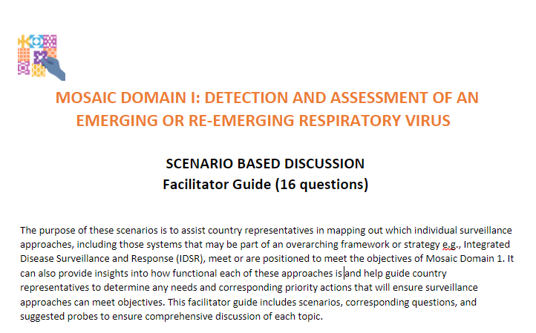
Scenario-based discussions to assess surveillance function, and identify needed actions
Immediate detection and reporting,
early warning, assessment, response operations, and information sharing
Defining epidemics and seasonality; monitoring viruses and epidemiology; and monitoring health care capacities in a high quality and representative manner
Planning to collect and use data to inform priority interventions and policies
Notes:
A scenario is a training tool that simulates real world public health situations in an informal environment It is an informal discussion-based session in which a team discusses their roles and responses, walking through one or more example stories with alerts to a changing situation or "injects". The atmosphere is collegial and exploratory, provides a “safe space” to identify needs and actions. The discussion is usually conducted by a trained facilitator who guides the team to determine where needs and actions exist.
Within the workshop, table-top scenarios are used to assess the surveillance function of national surveillance approaches under each Domain.
Under Domain I, injects focus discussion on immediate detection and reporting, rapid risk assessment, response operations, and information sharing
For Domain II, they are focus on defining an identifying epidemics and seasonality; monitoring viruses and epidemiology of illness in a high quality, timely, and representative manner; and monitoring health care capacities.
For Domain III, injects will generate discussion on planning to collect and use data to inform priority interventions and policies.

Slide 19
Mosaic Workshop Planning: Suggested Timeline
8 WEEKS PRIOR
Confirm workshop facilitators and planning meeting schedule
Share pre-workshop tool, maturity model, and agenda template with country stakeholders
4 WEEKS PRIOR
Country completes pre-workshop tool and maturity model and shares with facilitators
1-2 WEEKS PRIOR
Organizers and facilitators host pre-workshop webinar for participants
WORKSHOP
Host workshop
Finalize Mosaic and needs & actions
Pre-Workshop
Workshop
Post-Workshop
6 WEEKS PRIOR
Select and invite workshop participants using pre-workshop tool, issue concept note to leadership/stakeholders
Select date for pre-workshop webinar
Country partners begin adapting domain scenarios
3 WEEKS PRIOR
Organizers work with facilitators to assign workshop facilitation roles
Organizers and facilitators finalize agenda and country-adapted scenarios
Facilitators prepare pre-workshop webinar slides
1 DAY PRIOR
Organizers and facilitators meet for final pre-workshop planning meeting
4 WEEKS + POST
Finalize and share workshop report
Country incorporates actions into existing workplans for implementation
Notes:
This slide provides important information on how to plan a Mosaic workshop. The entire process begins two months before the scheduled workshop data to ensure completion of the pre-workshop tools, identification of a venue, and the systematic identification and invitation of key participants.
As the workshop approaches the facilitators are identified and the scenario tools are adapted to include examples appropriate to the local context. Webinars are then provided to orient participants to planned activities to ensure that the workshop proceeds efficiently.
Post-workshop activities are discussed further on the next slide.

Slide 20
Mosaic Post-Workshop Planning: Suggested Timeline
4 WEEKS POST
Workshop report drafted by organizers and facilitators
2+ MONTHS POST
Country incorporates actions into existing workplans, assigns tasks to country and partner stakeholders
Workshop
Finalize Mosaic and needs & actions
Post-Workshop
8 WEEKS POST
Country finalizes workshop report
Country shares final workshop report with relevant stakeholders and leadership
Notes:
This slide shows what can happen after a Mosaic workshop is completed. This is a suggested timeline for executing the workshop and key associated tasks
The workshop is an important event where the national Mosaic and the accompanying needs and actions will be finalized.
However, there are a number of activities that are essential post-workshop for Mosaic implementation.
4 weeks post-workshop, the workshop report should be drafted by organizers and facilitators (a draft template is available).
2 or more months post-workshop, the country incorporates actions into existing workplans, and assigns tasks to country and partner stakeholders
8 weeks post workshop, the workshop report should be finalized and shared with relevant stakeholders and leadership.
At one year after the workshop the maturity model should be re-visited, as well as any performance indicators being implemented for monitoring.

Slide 21


Join our Community of Practice!
Share Mosaic experiences
Contribute your best practices
Learn from others
Support with implementation and monitoring /evaluation
Regular opportunities through global partner engagement
Access to Mosaic “train the trainers” materials
Notes:
Although not yet existing as a platform, we encourage all those who have participated in a Mosaic Framework workshop to form a Community of Practice.
This will allow all countries to:
Share Mosaic experiences – between countries and regions
Contribute best practices
Learn from others
Receive support with implementation and monitoring /evaluation
Regular opportunities through global partner engagement
Access to Mosaic “train the trainers” and workshop implementation materials

Slide 22
Thank you!
WHO Mosaic Respiratory Surveillance Framework https://www.who.int/initiatives/mosaic-respiratory-surveillance-framework/
Contact: mosaic@who.int
Acknowledgements:
WHO Member States, Technical Working groups members, partners and donors involved in developing the framework
Watch: https://youtu.be/EOL6gaDRiEg
Notes:
Are there any questions?

Slide 23





Mosaic Framework: scope and surveillance domains
SCOPE
Surveillance domains
Domain I
DETECTION AND ASSESSMENT
A mosaic of effective and well-coordinated surveillance systems to detect and monitor respiratory viruses with epidemic & pandemic potential
Domain II
MONITORING EPIDEMIOLOGICAL CHARACTERISTICS
Domain III
INFORMING USE INTERVENTIONS
Notes:
Considering adding for stepwise intro?

