Slide 1

Welcome to the
Mosaic Workshop
Objective:
Using the pre-workshop activities and discussions, countries construct their own national mosaic of multiple
fit-for-purpose surveillance approaches that address priority surveillance objectives for respiratory viruses of epidemic and pandemic potential.
Follow the steps outlined in these slides to build your country-specific mosaic.

Slide 2


Mapping country approaches to Mosaic approaches
First, choose and add the relevant core (primary) and enhanced (secondary, complementary) surveillance approach tiles to the template based on the mapping completed in the pre-workshop activity. Examples of these approaches are below.
Please note: The white text boxes at the bottom of the tiles are spaces for you to type in your country-specific surveillance approach names (click in box to type).
Example of a core (primary)
surveillance approach tile:
Example of an enhanced (secondary)
surveillance approach tile:
Country specific name goes here
Country specific name goes here
To group the tile and textbox, so that both move as one item:
Select both the tile and text by pressing and holding CTRL while clicking on each one.
The "Shape Format" option will appear in the main menu. Select it.
Go to the "Arrange" menu
Select "Group."

Slide 3
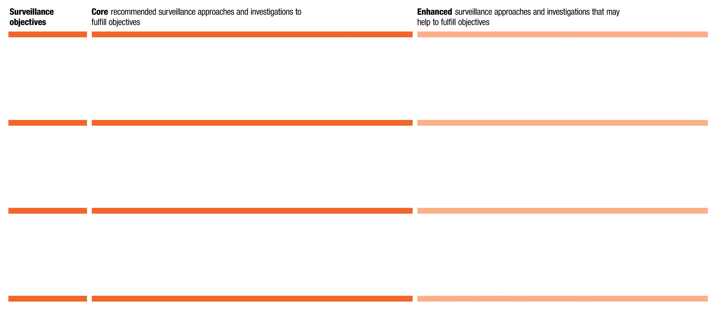
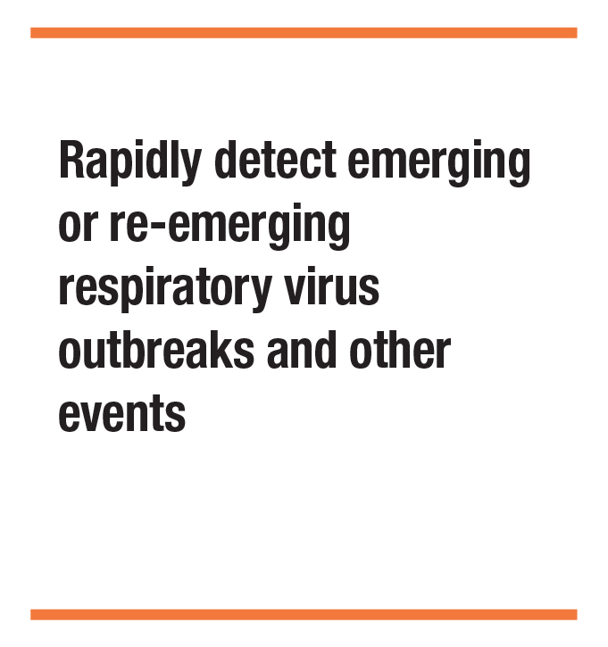
Example: Domain I, Objective 1
Example of a template outline with placed
surveillance objective, core and enhanced surveillance approach tiles
Country specific name
Country specific name

Slide 4
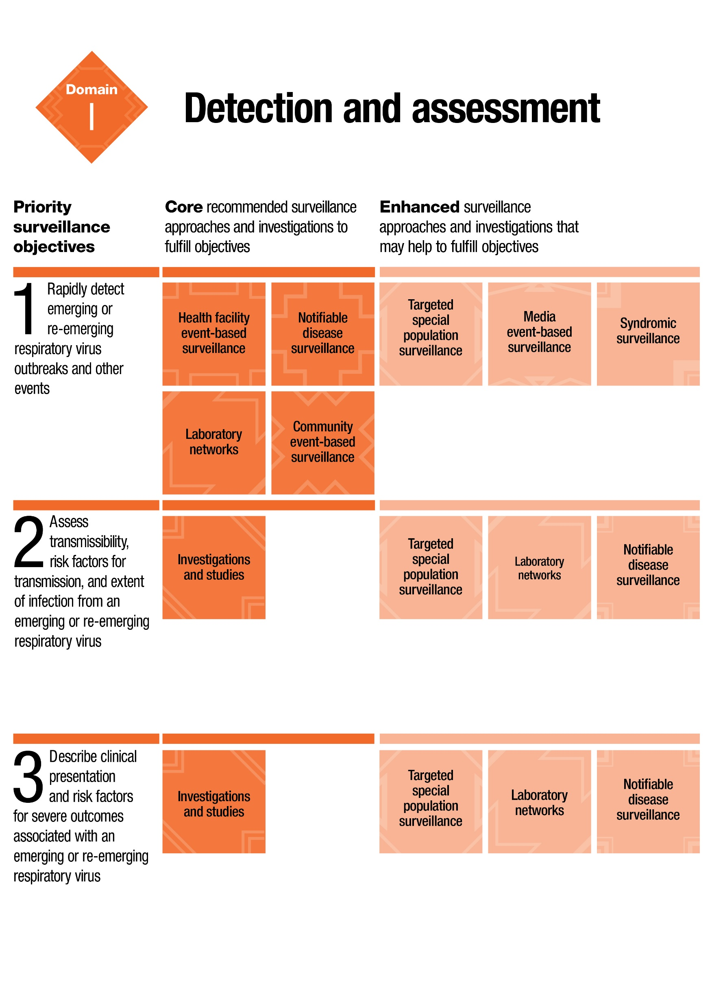
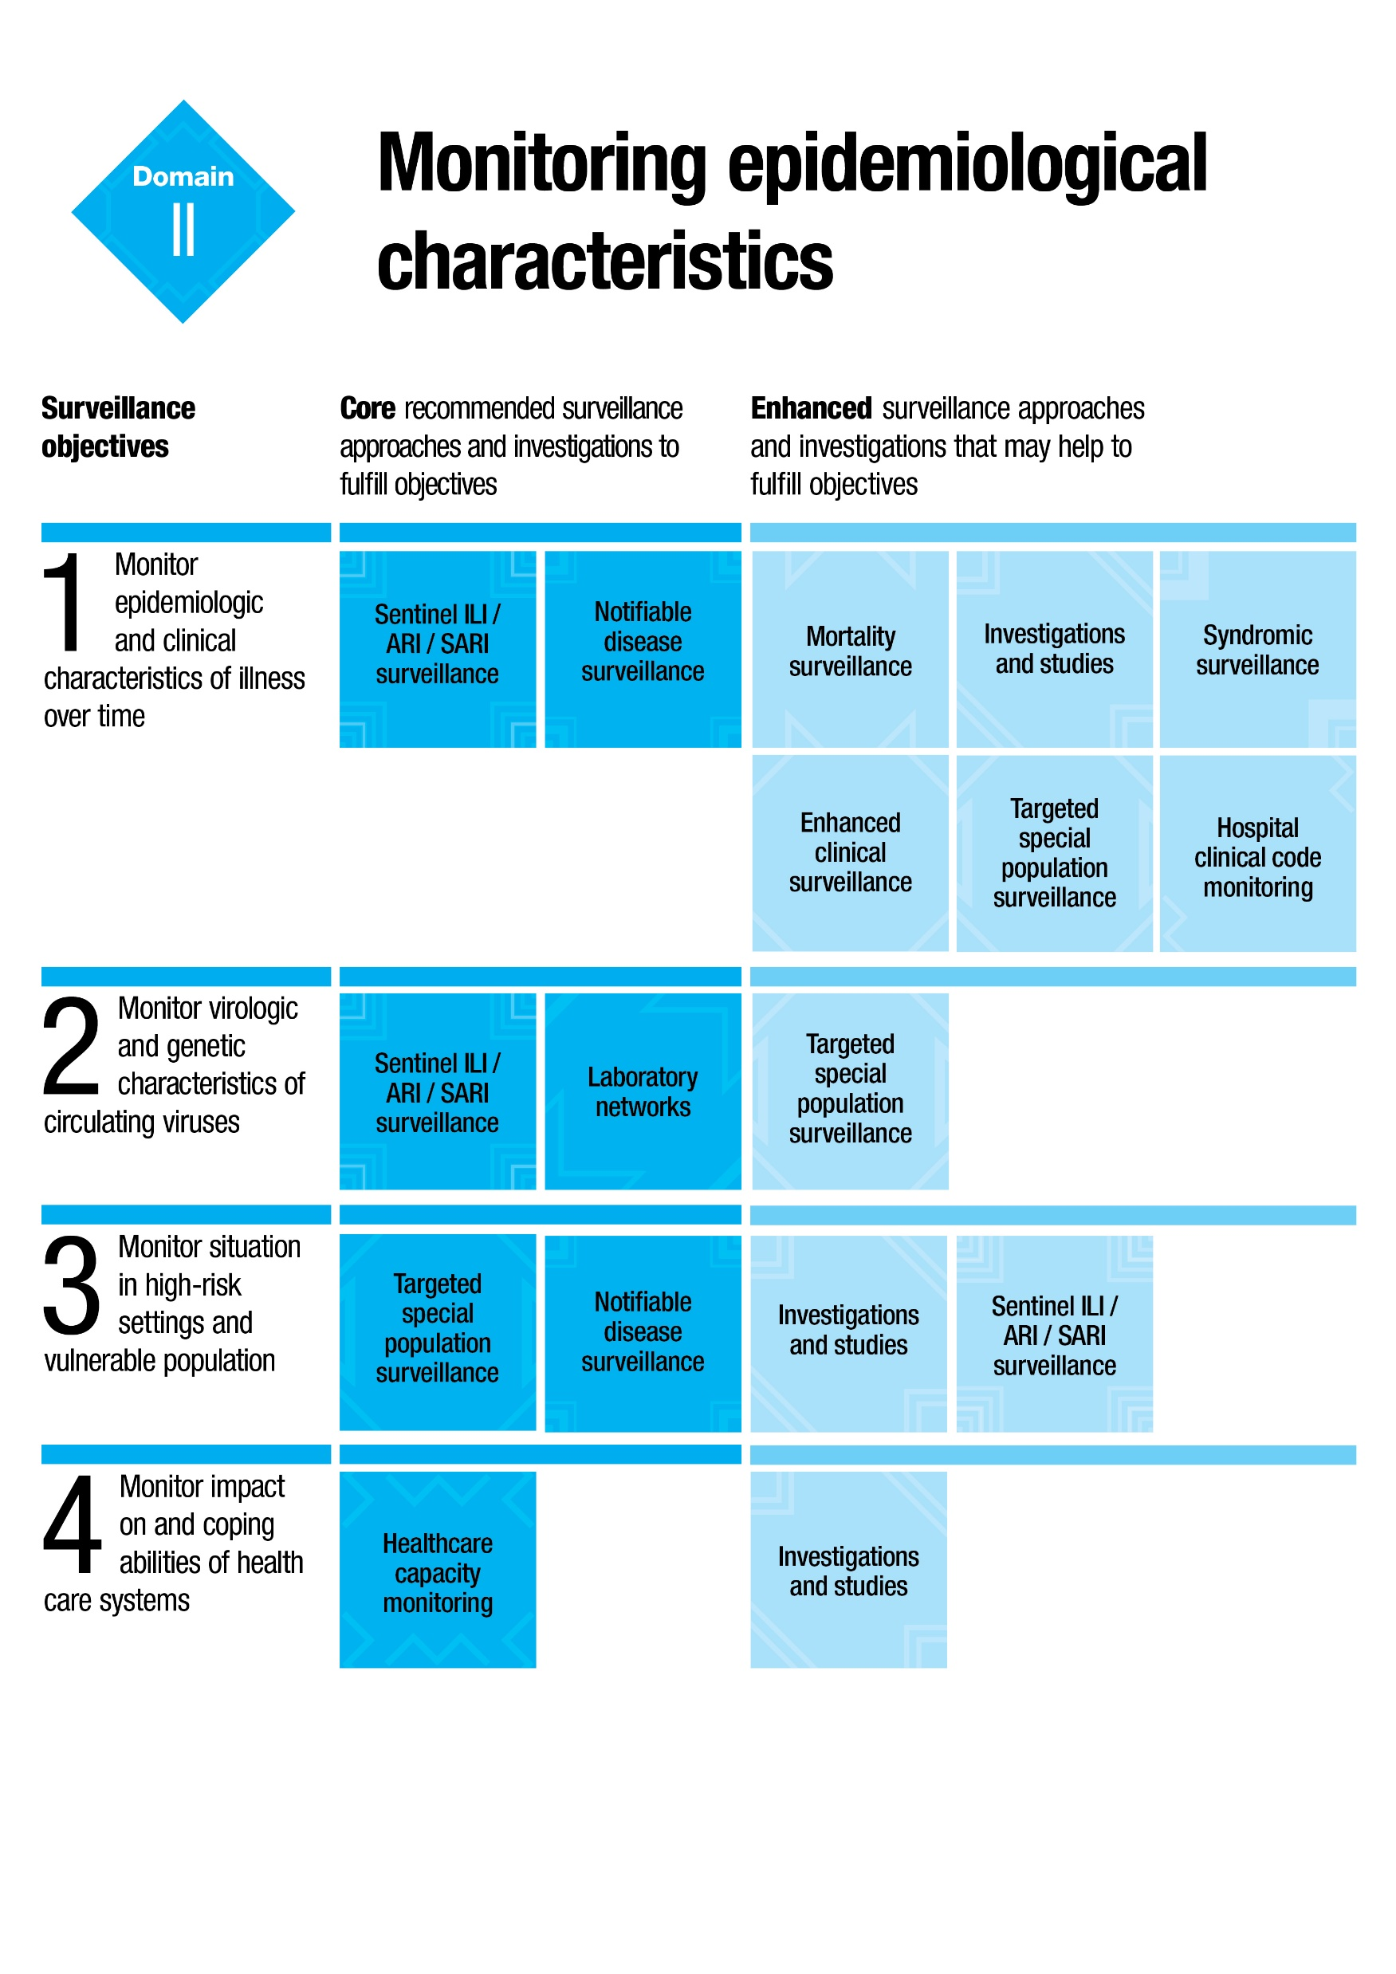
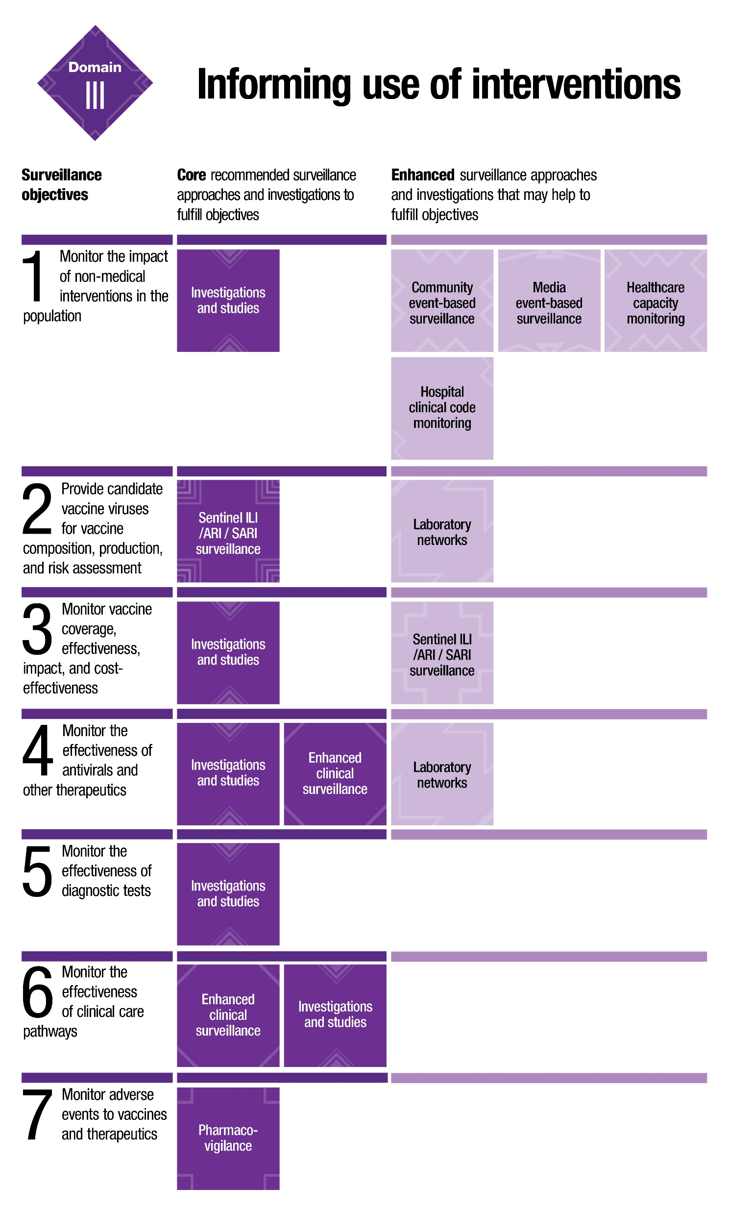
As a guide for recommended approaches for each Domain, please refer to the Best practice example references below.
Not all surveillance approaches need to be represented in a country.

Slide 5

Now it’s time to build your country-specific mosaic!
Note: You may find that your final domain mosaics and their text are difficult to read. When presenting, you can use the ‘Zoom’ function in PowerPoint to enlarge the Mosaic while presenting.
Zoom Function:
In presentation mode, select the magnifying glass icon in the lower-left corner of the screen. Note that the cursor is now a magnifying glass with a bright rectangle.
Move the magnification rectangle to the area of the slide you want to focus on, then click to magnify to 200%.The cursor becomes a hand symbol, indicating that you can click and drag to move to another part of the enlarged slide.
To exit zoom mode and return to standard view, press ‘Esc’, or click the magnifying glass icon again, located at the lower left margin of the screen.

Slide 6

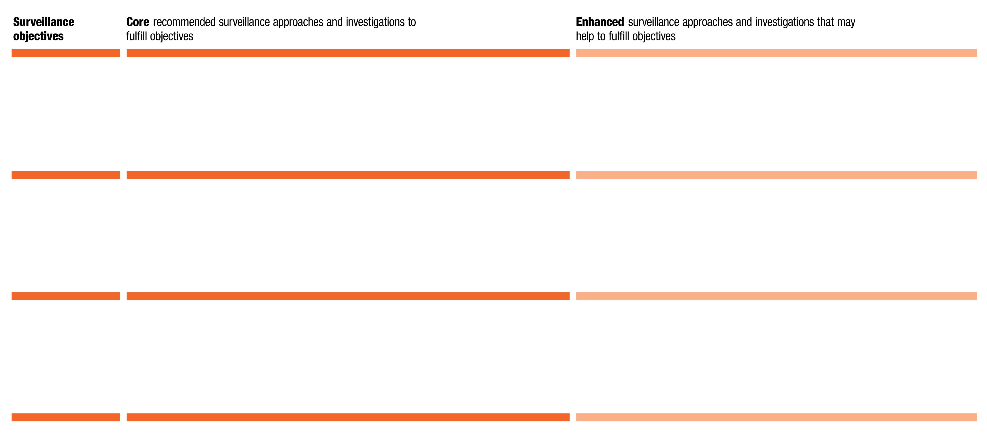
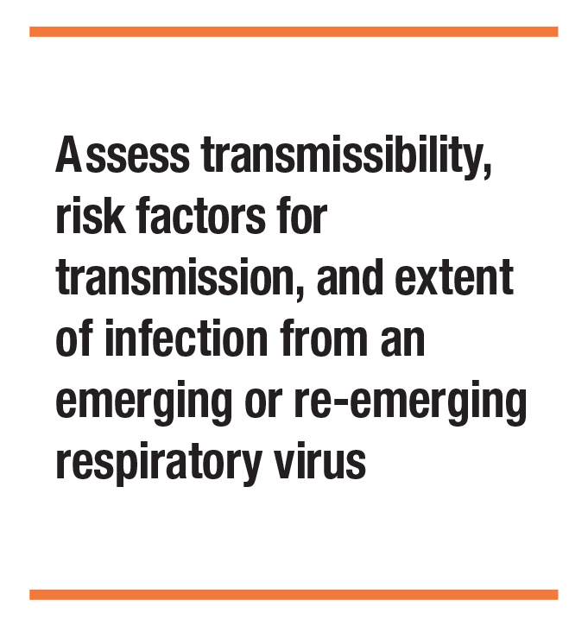

Detection & Assessment:

Slide 7

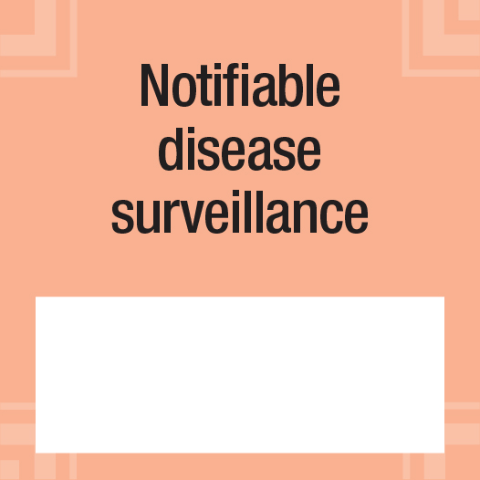


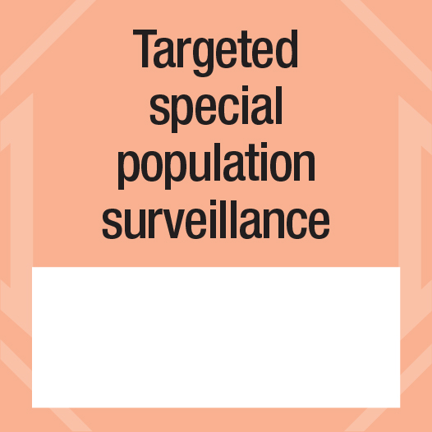

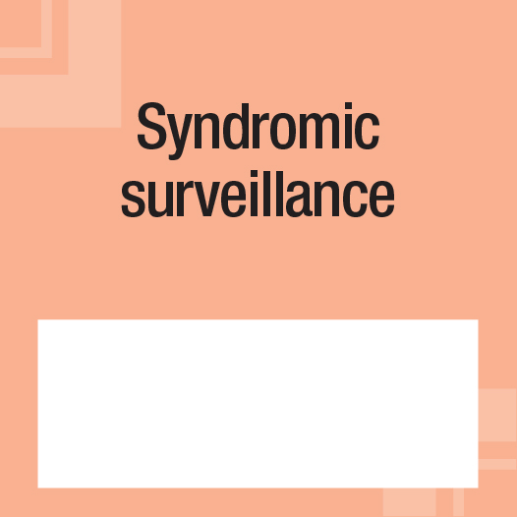



Surveillance
objective tiles
Core tiles
Enhanced tiles
…
…
…
…
…
…
…
…
…
…
…
…
Note: If needed, you can copy-paste any tile to generate more tiles for your mosaic framework.
…
…

Slide 8

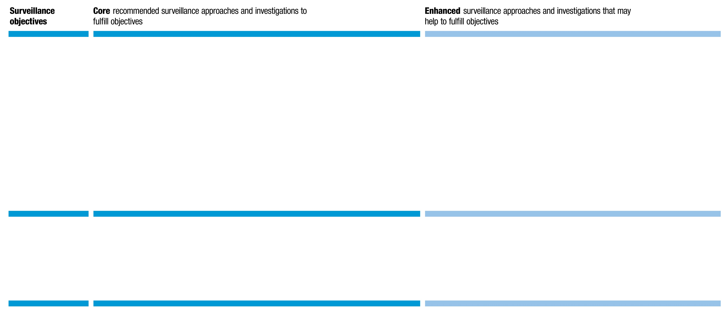
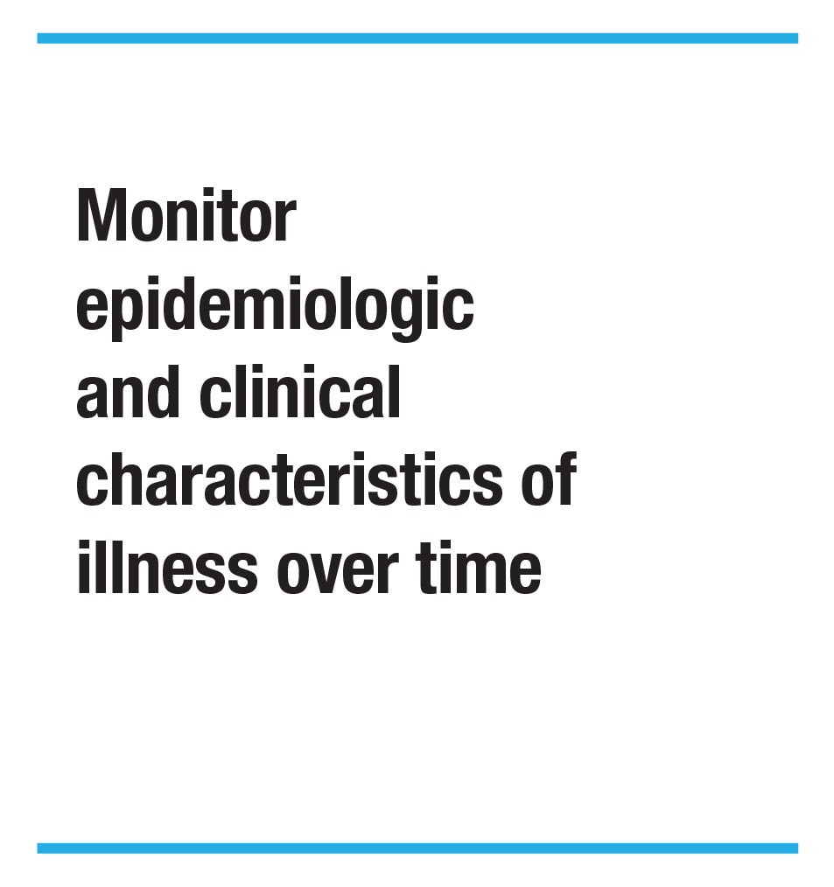

Monitoring epidemiological characteristics:

Slide 9
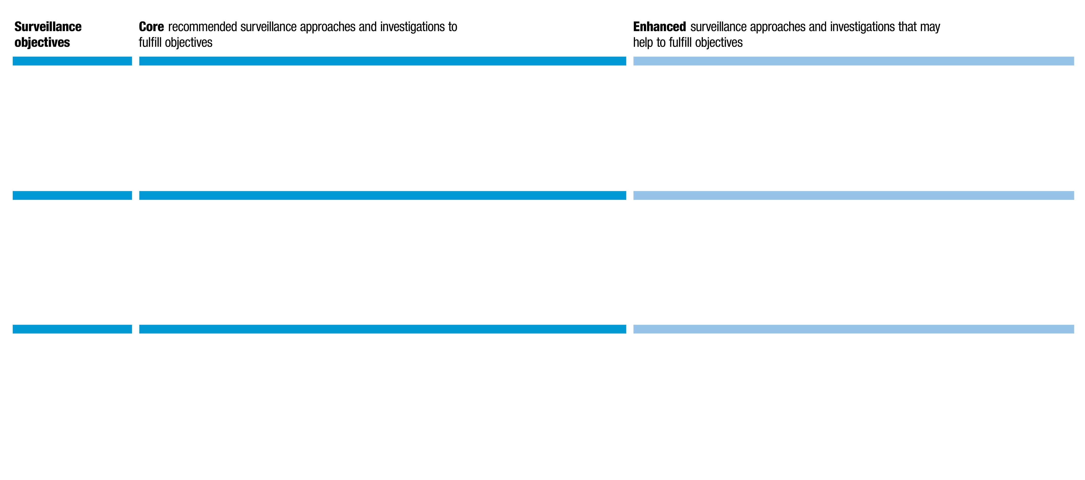
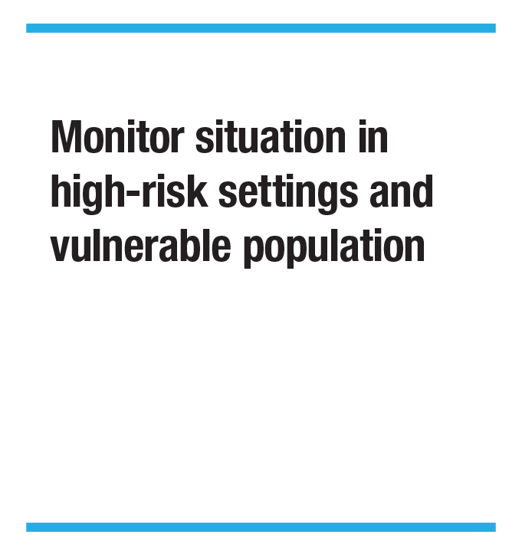

Monitoring epidemiological characteristics:
Surveillance objective tiles
Core tiles
Enhanced tiles

Slide 10
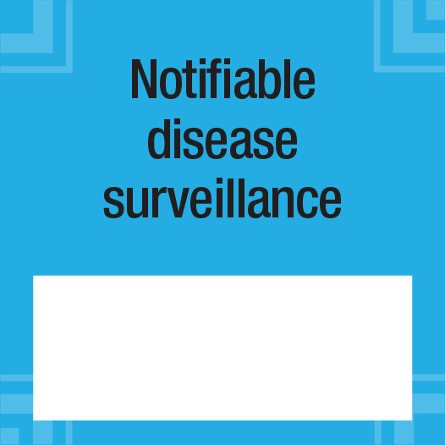

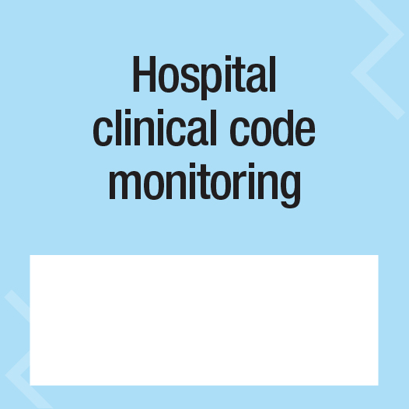

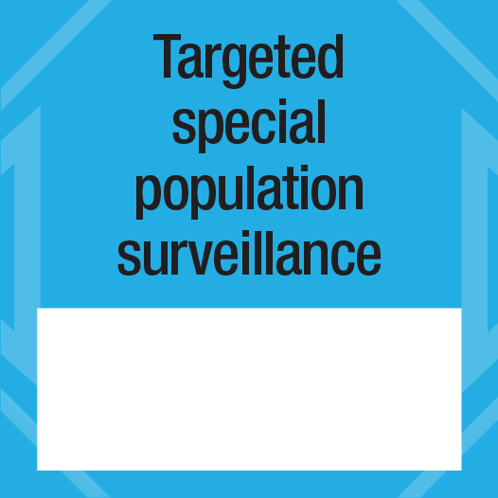

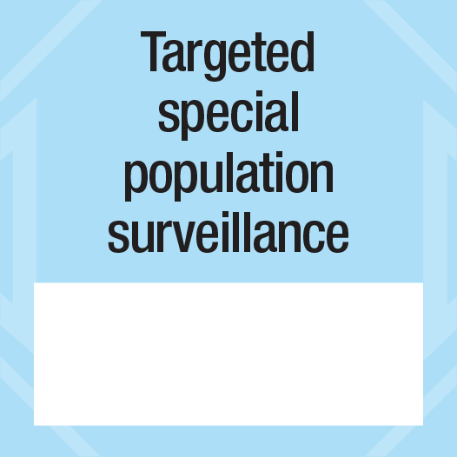
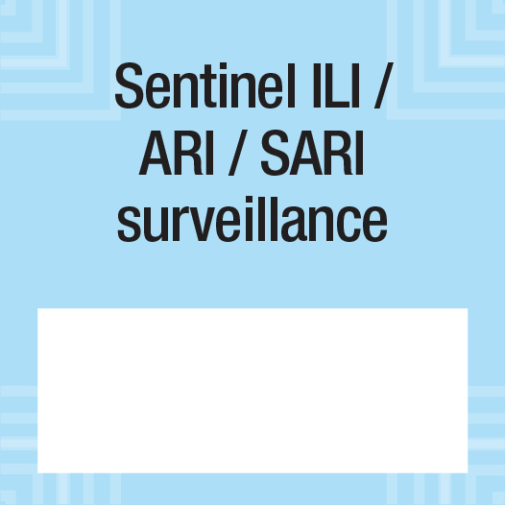
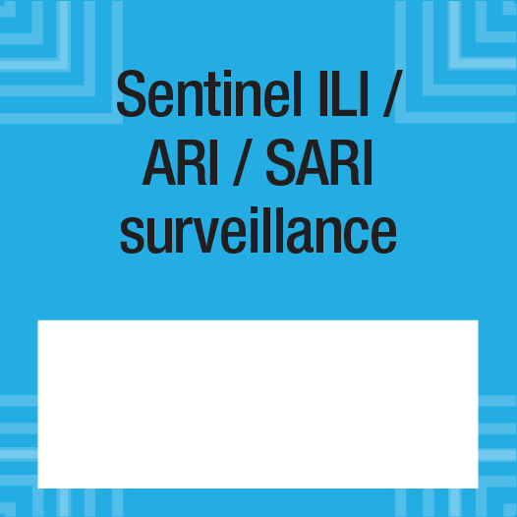

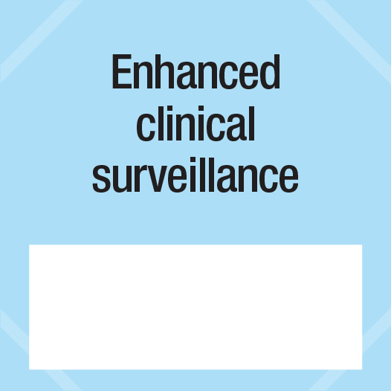
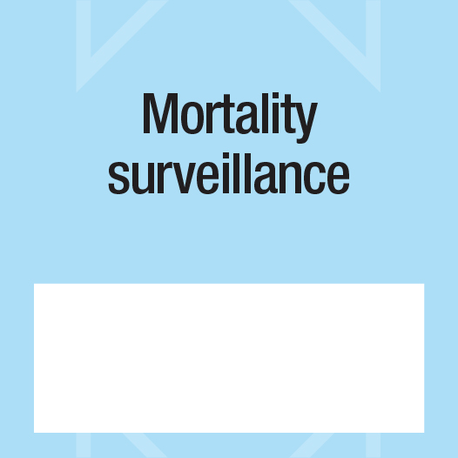
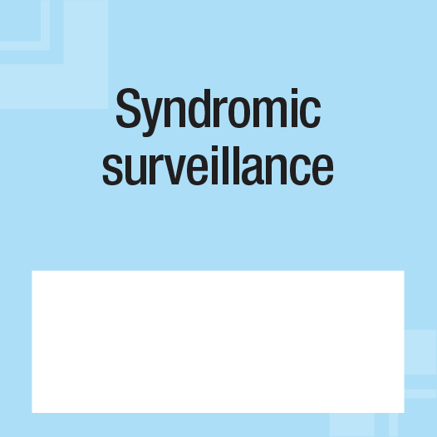

Surveillance
objective tiles
Core tiles
Enhanced tiles
…
…
…
…
…
…
…
…
…
…
…
…
Note: If needed, you can copy-paste any tile to generate more tiles for your mosaic framework.
…
…

Slide 11

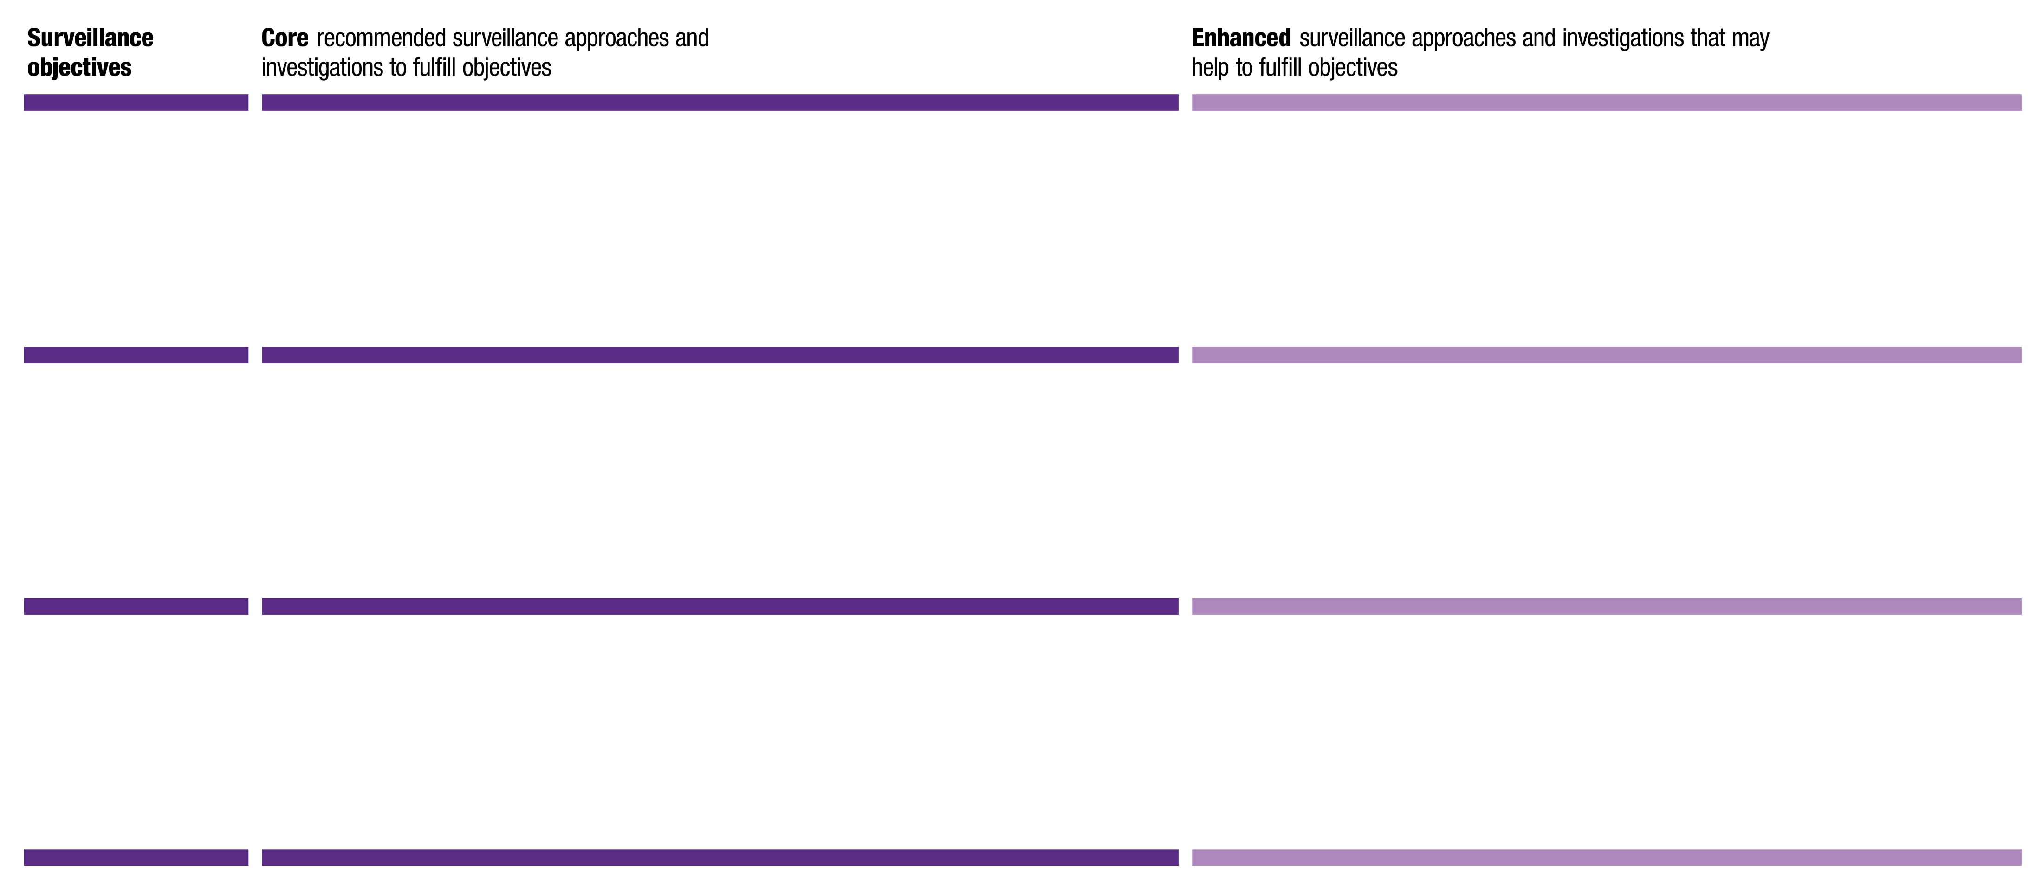
Informing use of interventions:

Slide 12






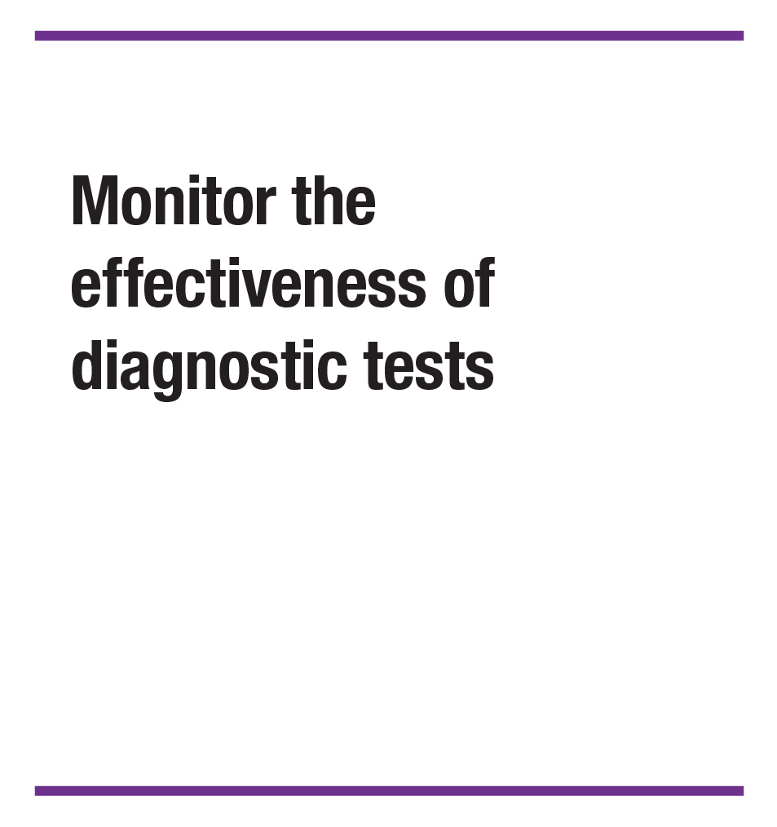


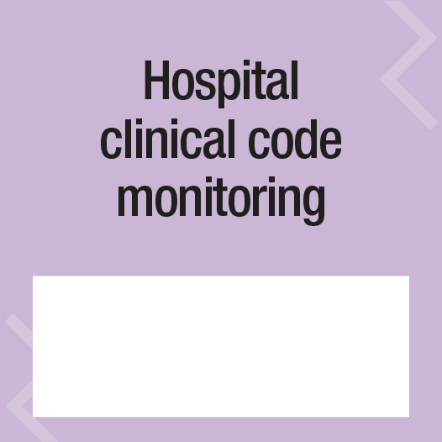





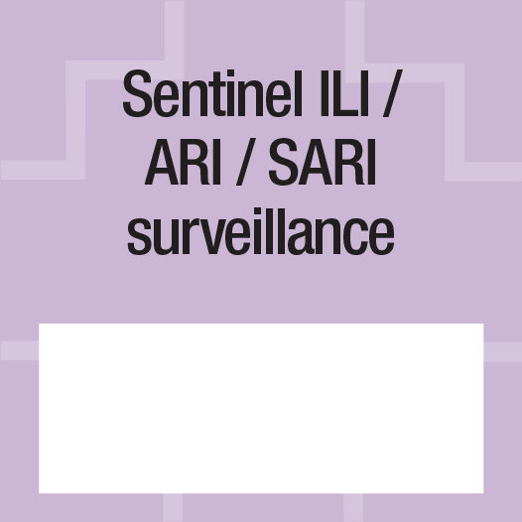
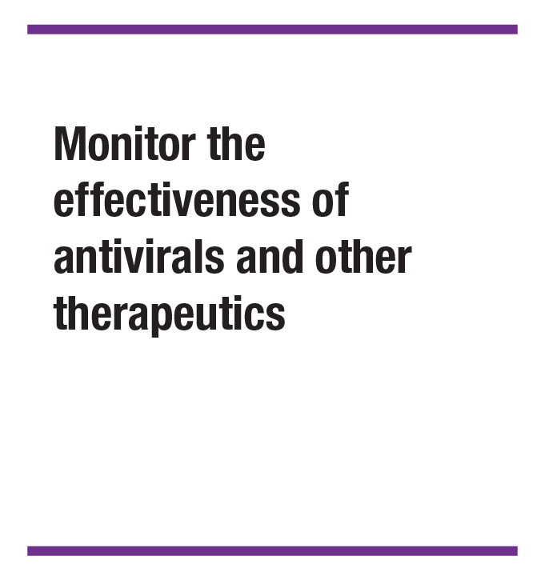


Surveillance
objective tiles
Core tiles
Enhanced tiles
…
…
…
…
…
…
…
…
…
…
…
…
…
Note: If needed, you can copy-paste any tile to generate more tiles for your mosaic framework.

Slide 13
Informing use of interventions:

Slide 14
Summary Mosaic
After the workshop, once all individual domain mosaics are finalized, countries are encouraged to create a summary mosaic representing all surveillance approaches in a country (across all three domains).
The tiles on the next slide may be used to fill in all the surveillance approaches currently in use in a country for early detection and response, monitoring epidemiological and virological characteristics, and

Slide 15















Summary mosaic

Slide 16
Thank you!

