Slide 1
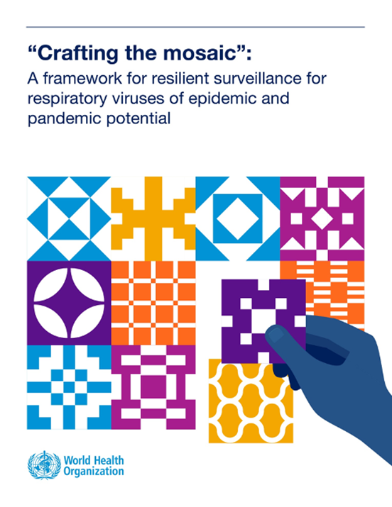
Mosaic Respiratory
Surveillance Framework Workshop
Domain I, II, & III
Scenarios and Questions
Country X workshop
DATES
Notes:
The slides included in this deck on the overview of different surveillance approches/systems (white background) are provided to ensure all participants have the same understaning of the surveillance systems being described. The slides are optional and could be removed due to time constraints or if the facilitators feel they are unnecessary for some/all approaches.

Slide 2
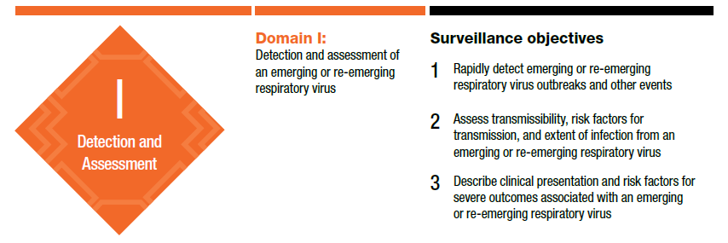
Domain I: Detection and assessment of an emerging or re-emerging respiratory virus

Slide 3

Event-based Surveillance (EBS): Overview
The organized and rapid capture of unstructured information about events that are a potential risk to public health; typically complement other systems that are focused on specific syndromes and conditions.
EBS is designed to be highly sensitive - optimized for early detection.
Example signals for respiratory events:
clusters of severe respiratory disease or pneumonia in families, workplaces, or social networks;
a change in the pattern of clinical presentation of respiratory illness;
persistent changes noted in the treatment response or outcome of severe lower respiratory illness;
a sudden surge in emergency department, hospital, or intensive care unit admissions;
severe, unexplained lower respiratory illness occurring in health workers who care for patients with respiratory disease.

Slide 4
Event-based Surveillance: Approaches
There are three core approaches to event-based surveillance, defined by the type and source of data. These approaches involve detection, reporting, and verification of signals from:
Sensitized health and care workers: Health facility event-based surveillance (HEBS)
    May involve health and care workers at all levels of care (e.g., tertiary to primary/health post).
Communities: Community event-based surveillance (CEBS)
    Community may be defined by geography (e.g., village), setting (schools, prisons, poultry breeding farms), or other affiliation (e.g., common workplace, ethnic or religious communities).
Media: Media event-based surveillance
    Systematic monitoring of traditional and digital media including specific social media sources, government and official web sites, news sites, blogs, and collaborating initiatives.
    Epidemic Intelligence from Open Sources (EIOS) is one example of an initiative and supporting technology to facilitate media monitoring.

Slide 5
National Notifiable Diseases and Conditions Surveillance (NNDS): Overview
Monitoring of data reported by all health facilities according to local laws and regulations that specify:
Which diseases and conditions (e.g., clinical case definitions; sometimes with laboratory criteria for confirmed cases) must be reported – commonly referred to as a ‘notifiable diseases list.’
Method of reporting (aggregate or case-based data, to whom)
Frequency (e.g., immediate, routine/weekly)
Typically includes both:
Immediate reporting of conditions of outbreak potential
Routine (weekly) reporting of conditions of public health importance
NNDS may be included within disease surveillance system frameworks such as the Integrated Disease Surveillance and Response (IDSR)

Slide 6
National Notifiable Diseases and Conditions Surveillance (NNDS): Best Practices
Ideally, only diseases and conditions that should trigger an immediate public health action (e.g., investigation) due to potential for outbreak/epidemic should be immediately notifiable.
Requiring immediate reporting of conditions that are too prevalent/commonly observed can overwhelm both those who report (i.e., healthcare workers) and verification and response infrastructure.
Established baselines and thresholds allow for the routine/weekly reporting of conditions of public health importance to serve as early warning by detecting sudden, unusual increases.
Inclusion of more prevalent, endemic diseases and conditions that overwhelm reporting capacity can result in lower quality baseline data (due to excessive “noise” and/or decreased reporting)– limiting utility of routine reporting for early warning.
More severe conditions may provide more useful data for monitoring (e.g., deaths associated with respiratory disease rather than all severe acute respiratory illness).

Slide 7
Laboratory Networks
Not a surveillance approach or system per se, however:
High-quality organized laboratory networks are essential to the assessment of signals as the clinical presentation of many novel/emergent and endemically circulating respiratory pathogens are indistinguishable.
Laboratory networks report results of specimens tested, with phenotypic and genomic characterization.
Laboratory networks aid in early warning where:
Available tests enable detection of immediately notifiable or rare pathogens
Monitoring of results can detect unexpected increases in detections (potentially using established baselines and thresholds)

Slide 8
Investigations and studies, including outbreak investigations: Overview
Outbreak investigations and transmission investigations involve standardized data collection during the early stages of virus emergence aimed at characterizing transmission and epidemiological parameters (i.e., etiologic agent, secondary attack rates, incubation period).
Example investigations for which standardized global protocols exist (Unity Studies):
Protocol to investigate outbreak of non-seasonal influenza and other emerging acute respiratory disease
‘First few X cases and contact’
‘Household transmission’
‘Closed setting transmission’
‘Health workers’ transmission and risk factor investigations

Slide 9
Investigations and studies, including outbreak investigations: Best Practices
Investigations aid in early warning where they can provide new data on risk factors and transmission dynamics, best achieved when there are:
Dedicated financial and human resources
Successful investigations involve a team of experts from multiple backgrounds, potentially including public health workforces trained through Field Epidemiology Training Programs (FETP).
Standard protocols
Ideally responders are trained on protocols that outline methods and data elements to collect during case investigations, active case-finding, contact tracing, a descriptive epidemiology of the outbreak, and generation of hypotheses on risk factors.

Slide 10
Enhanced/Complementary Approaches
Targeted special population surveillance
  Special populations are those with greater risk of exposure to a pathogen (e.g., health workers, animal health workers)
  May include data from a dedicated system or data from other systems enhanced (e.g., through inclusion of additional variables) for this purpose
  Depending on data collected, may provide early data on clinical characteristics, possible at-risk exposures, and phenotypic and genotypic characteristics
Syndromic surveillance without integrated laboratory testing
  Routine reporting by health facilities of cases meeting a defined syndromic case definition
  Since testing is not performed, geographic coverage may be greater than sentinel surveillance, enabling greater contribution to early warning
  Unusual increases in reporting can only be flagged for rapid verification and investigation where threshold values for ‘alert of an outbreak’ are set for each syndrome/case-definition

Slide 11
CASE 1, INJECT 1: Detection in Health Facilities
A small rural hospital in (insert district/town name) admits a 35-year-old farmer with an acute respiratory infection. The patient has a fever and needs oxygen support. The hospital performs a/an (insert relevant test(s) for context, e.g. malaria, influenza) test, which is negative. Broad-spectrum antibiotics are started based on a possible diagnosis of pneumonia of unknown origin. Overnight, the patient gets worse and is transferred to a referral hospital in (insert capital or other major city) where he is placed on a ventilator and given additional antibiotics.
The next day, a nurse from [original hospital (can insert hospital/district name)] calls the referral hospital to see if a diagnosis has been made for the young farmer because that same morning, the clinician and nurse who originally cared for the patient developed a cough and fever and were unable to come to work. The current diagnosis for the patient provided by the referral hospital is still pneumonia and no pathogen has been identified.

Slide 12
CASE 1, INJECT 1: Questions
1.1 Do your surveillance approaches have formal policies and/or procedures for immediate reporting of unusual, novel, or emerging respiratory cases or events in healthcare settings?
1.2 Do your surveillance approaches define clear roles, responsibilities, and mechanisms for staff to report these events from health facilities?
1.3 Where are such reports from a health facility received, and what happens after they are received?

Slide 13
CASE 1, INJECT 2: Investigation in Health Facilities
The next day, the clinician from [insert original facility name as above] who cared for the patient gets worse. He now has difficulty breathing and is admitted to the hospital for monitoring. More hospital staff, and even some patients, are getting sick with similar symptoms. By the end of the week, the small hospital has reached full bed capacity, is quickly becoming overwhelmed, and struggling to accommodate patients or contain further disease spread.

Slide 14
CASE 1, INJECT 2: Questions
1.4 Who is responsible for the initial investigation? Are risk assessments conducted and documented to ensure a proportionate response?
1.5 How would a reportable event be notified under the IHR (2005)?

Slide 15
CASE 2, INJECT 1: Detection & Assessment in the Community
Community members [specify e.g. neighbors, village head, NGO workers] have become concerned about several people from [X community e.g., remote village, religious community, informal settlement, refugees, Internally Displace Persons, unhoused] with severe respiratory symptoms. None of the sick individuals have gone to a health facility for care, since [insert reason e.g., no healthcare access, distrustful of health system, etc.] One person is rumored to have died.

Slide 16
CASE 2, INJECT 1: Questions
2.1 Can your early warning surveillance approaches capture this type of information from communities and/or community focal points (e.g., through a network of individuals in the community or in priority communities who detect and report event signals) in a timely way?
2.2 Can your early warning surveillance approaches reliably confirm or deny these informal reports or rumors from community members or key individuals?
2.3 Are outbreak investigations to characterize person, place, and time regularly conducted in response to verified events?

Slide 17
CASE 2, INJECT 1: Questions, cont.
2.4 Are epidemiological investigations conducted to further characterize events and outbreaks (e.g., outbreak investigation studies like cohort and case-control studies, or other risk factor or transmission studies)?
2.5 Are there mechanisms to coordinate and share information with other sectors or agencies (e.g., animal health partners, law enforcement, governance structures)?

Slide 18
CASE 2, INJECT 2: Detection by Laboratory Networks
You have confirmed that there were indeed multiple cases with respiratory symptoms in [X population or location, as above]. Staff from the regional [health office/rapid response team] are deployed to collect swabs from the sick individuals in their homes.

Slide 19
CASE 2, INJECT 2: Questions
2.6 Do you have mechanisms for immediate specimen collection and prioritized testing of respiratory samples from community outbreaks?
2.7 Which laboratories (private, public, academic etc.?), and at which levels, are designated to immediately test and report specimens from outbreaks of epidemic-prone diseases and other unusual respiratory disease events?
2.8 When laboratory results are reported from outbreak cases, to whom are they reported?

Slide 20
CASE 3: Detection & Assessment of Potential Zoonotic Events
A [large poultry slaughterhouse or other relevant location from which zoonotic transmission could occur (e.g., wet market)] is located on the outskirts of [insert town name]. One morning, managers noticed that multiple employees who work in the same area of the [above facility/location] were absent. They learn from staff who did come to work that several of the absent employees had told colleagues the day before that they felt sick with flu-like symptoms and therefore suspect that these employees stayed home. By the end of the week, 15 employees have become ill and are absent from the [above facility/location].

Slide 21
CASE 3: Questions
3.1 Do your early warning surveillance approaches include mechanisms for reporting illness or absences (or other “event” signals) from such settings where zoonotic transmission could occur?
3.2 Who is responsible for managing this potential cluster of zoonotic disease and implementing control measures to prevent more transmission within the setting and surrounding communities?

Slide 22
CASE 4: Media Event-based Surveillance
Users across various online media platforms (e.g. Facebook & Twitter/X) begin sharing information related to an apparently sudden spike in severe hospitalizations in children with respiratory symptoms in [insert region(s)/province(s) names]. You want to confirm whether this is true, and if so, whether these cases pose an immediate health risk to the population.

Slide 23
CASE 4: Questions
4.1 Do you have a structured approach for monitoring media for reports of unusual respiratory or other events?

Slide 24
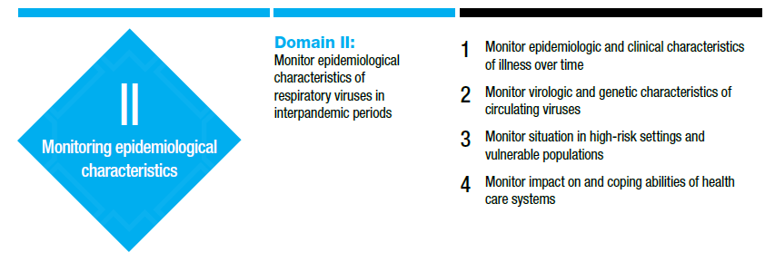
Domain II: Monitoring epidemiological, clinical and virological characteristics of respiratory viruses in interpandemic periods
groups

Slide 25

Sentinel ILI/ARI/SARI Surveillance: Overview
Representative enrollment of persons meeting standard case definitions (e.g., outpatient ARI or ILI, or inpatient SARI)
  Includes laboratory testing to support virological surveillance
  Only a small number of sites to allow for systematic, high-quality data (typically case-based reporting)
Where available, primary system for monitoring endemic viruses. Design optimized for monitoring trends as consistent reporting allows for more robust comparisons over time than other systems with larger sample sizes
  May evaluate trends in virus circulation, illness and severe illness, the relative circulation of different viruses under surveillance, and virological characteristics of circulating viruses.
Typically unable to robustly monitor trends in mortality given sample sizes
Supportive initiative: The Global Influenza Surveillance and Response System (GISRS)

Slide 26
National notifiable diseases and conditions surveillance (NNDS)
Optimized for early warning but can support monitoring trends in severe disease
Reporting is passive and sample sizes are large, therefore trends maybe more spurious compared to sentinel surveillance
  Reporting consistency should be determined before trends are interpreted
Where reporting is reliable over time, NNDS allows trend monitoring by place and time with greater geographic coverage than sentinel surveillance
  May provide more robust data on high risk settings and subpopulations

Slide 27
Sentinel surveillance complementing NNDS
Robust Mosaics leverage sentinel surveillance to monitor common illness caused by viruses widely in circulation in the population and use weekly reporting from NNDS (and syndromic surveillance) to provide data on severe disease in additional geographies and among subpopulations

Slide 28
Laboratory Networks
Laboratory networks ideally include testing of specimens from sentinel surveillance (with standardized sampling) as well as clinical specimens and other sources
  Reporting of phenotypic and genomic characterization of viruses undertaken from all sources can help enhance the detection and monitoring of changes in circulating viruses
Laboratory networks can be critical to evaluating things such as:
  Changes in the behavior of a virus
  Emergence of a new antigenic variant

Slide 29
Health care capacity monitoring
The routine and systematic monitoring of health care capacity and utilization.
Ideally achieved through comprehensive reporting from all hospitals.
Robust health care capacity monitoring includes regular monitoring of:
  Bed occupancy rates
  Availability of essential medications
  Availability of other hospital supplies
  Human resource monitoring

Slide 30
Targeted special population surveillance
Epidemiology of endemic pathogens may be different in select populations than in the general public – given differences in risk of infection and risk of severe disease associated with differences in biological factors or social networks/engagement
Different approaches can be used to ensure a robust sample to monitor disease trends among these populations, potentially including:
  Establishing sentinel sites in communities/settings of greater risk
  Routine monitoring of data from other sources by comorbidity and occupation
Example special populations
  Residents at long-term care facilities or facilities treating HIV- positive persons
  Health workers
  Persons with cardiovascular, disabilities, pregnant persons
  Disadvantaged and marginalized groups

Slide 31
Enhanced/Complementary Surveillance
Approaches (1 of 2)
Mortality and excess mortality surveillance – vital statistics reporting systems can help characterize trends and epidemic impact beyond (more limited) reporting of fatal cases from health facilities; typically lagging indicator of trends
Enhanced clinical surveillance linked to existing systems – standardized case-based reporting of clinical data to assess the quality of clinical care or evaluate clinical outcomes and sequelae; typically resource-intensive where clinical data is not recorded in electronic health records (EHR)
Hospital clinical code monitoring – Clinical coding data, such as the International Classification of Diseases (ICD) codes from outpatient and inpatient medical facilities can support routine trend monitoring

Slide 32
Enhanced/Complementary Surveillance
Approaches (2 of 2)
Investigations and studies – standardized data collection governed by a protocol
For Domain II objectives, consider:
    Case-control studies to evaluate risk factors for severe disease
    Population-based seroprevalence studies to estimate infection or exposure in the general population and by risk group (Unity studies protocol available)
    Cohorts to characterize transmission dynamics and clinical presentation in high-risk populations and closed settings (e.g., prison, school)

Slide 33
CASE 1
It is [month], and there are signs that respiratory disease activity is increasing in your country. Clinicians are concerned by the number of acute respiratory disease cases they are seeing in their healthcare facilities, which they feel are much higher this year than in recent years. Some prominent academic physicians have raised the alert of concurrent epidemics of influenza virus, SARS-CoV-2, and RSV, and the [Prime Minister’s/President’s (or other context-relevant government position/office)] office is being questioned by the media. Others have claimed that this is the beginning of a “very bad flu year.”
The [Ministry of Health’s Director (or other context-relevant government position)] wants to assess the situation and requests to review existing surveillance data.

Slide 34
CASE 1: Questions
1.1 What surveillance approaches do you use to monitor the weekly number of cases and severity of respiratory diseases?
1.2 Are epidemiologic data (e.g., demographic and clinical data collected through case report forms) linked with laboratory testing data in your routine surveillance approaches to assess the current respiratory disease situation?

Slide 35
CASE 1: Questions, cont.
1.3 Do you have stable surveillance approaches to monitor all-cause and respiratory mortality at the national or sub-national level?
1.4 How do you access and review your data (e.g., through reports, dashboards, or other tools)?

Slide 36
CASE 2
It is the beginning of the [winter (adapt to local context)] season and syndromic data has signaled that [outpatient facility (adapt to local context)] visits for influenza-like illness are increasing rapidly in [region (enter country-relevant region)]. A doctor’s WhatsApp group (i.e., informal clinical network) has also noted increased influenza hospital admissions among [school-aged children (or other context-relevant risk group)].

Slide 37
CASE 2: Questions
2.1 Can your respiratory disease surveillance data be stratified by age group and other priority risk groups to assess if this season is worse in certain groups?
2.2 This concern comes from a specific region. How well does your routine surveillance capture sub-national changes in disease activity?

Slide 38
CASE 2: Questions, cont.
2.3 Can you use your surveillance data to monitor if there have been changes in demographic or clinical characteristics of severe respiratory disease cases in your country?
2.4 Do you have enhanced clinical surveillance sites or national clinical networks (standing or ad hoc) that can help monitor clinical characteristics over time and identify changes?

Slide 39
CASE 3
There are reports that a study conducted by a university in a neighboring country [alternatively: a university/research institute in your country] has identified some genetic changes in the circulating coronaviruses that they feel may confer greater pathogenicity. These reports have raised concerns among clinicians and public health officials that this could be a new mutation that will cause increased caseloads and strained healthcare capacity.
You want to monitor for this potentially new strain of coronaviruses in your country.

Slide 40
CASE 3: Questions
3.1 What kind of tests does your national reference laboratory perform to characterize respiratory pathogens?
3.2 Can your national reference laboratory perform genetic sequencing? If your national reference lab does not conduct genetic sequencing, are there agreements with other reference labs to conduct timely genomic sequencing when needed?
3.3 Does your respiratory surveillance system allow linkage of genetic, clinical, and epidemiologic data to help interpret how genetic changes affect risk groups, treatment approaches, or virus spread?

Slide 41
CASE 4
It is the height of the [winter (adapt to local context)] season and there has been concurrent high activity of both influenza and COVID-19. Local public health officials report that hospital bed space and oxygen capacities are being challenged.
You need to determine if this is a localized problem or a broader healthcare capacity issue nationwide.

Slide 42
CASE 4: Questions
4.1 Do you routinely monitor healthcare capacity?
4.2 How often are healthcare capacity data reported and reviewed by Ministry of Health officials?

Slide 43
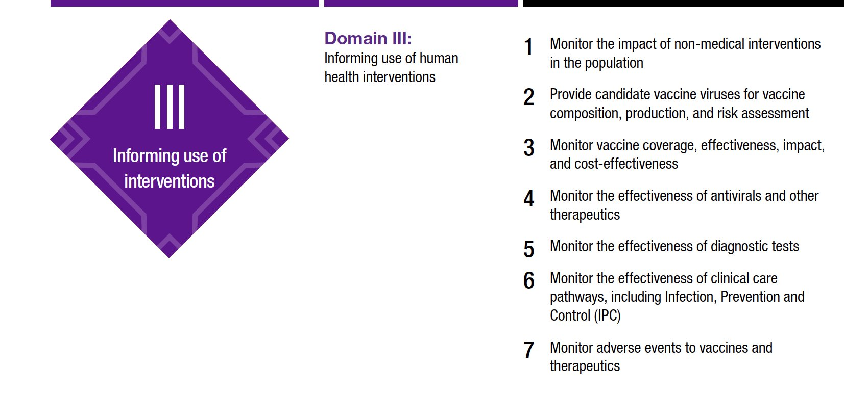
Domain III: Informing the use of human health interventions

Slide 44

Investigations and Studies
Investigations and Studies:
A variety of investigations and studies (standardized data collection governed by a protocol) are the primary methods to assess:
Impact of nonpharmaceutical public health and social measures (Objective 1);
Effectiveness of therapeutics and diagnostics (Objective 4 & 5);
Vaccine coverage, effectiveness, impact, and cost-effectiveness (Objective 3).
These objectives often require non-routine data that surveillance systems do not capture and may often be carried out by non-governmental actors such as academic institutions.

Slide 45
ILI/ARI/SARI Sentinel Surveillance
Sentinel ILI/ARI and SARI surveillance systems are a core surveillance approach that can be leveraged to support multiple Domain 3 objectives. If the country prioritizes these objectives by enabling certain factors, these systems can:
provide candidate vaccine viruses for vaccine composition, production, and risk assessment (Objective 2) if they agree to and actively share specimens with a WHO collaborating center.
serve as a source of specimens to monitor antiviral resistance (Objective 4) if there is sufficient case-based data for analysis, including use of antiviral medications.
be leveraged to provide platforms and data to monitor vaccine effectiveness using test-negative designs (Objective 3).

Slide 46
Enhanced Clinical Surveillance
Case-based clinical surveillance that collects detailed, case-based data (including treatment and outcome data) can contribute to:
Objective 4: monitoring effectiveness of antivirals / therapeutics, and
Objective 6: monitoring the effectiveness of clinical care pathways
Clinical networks designed to collect detailed clinical data are well-positioned to provide technical guidance on the detailed treatment and outcome data required to identify the optimal care process and timing of interventions to manage illness associated with respiratory viruses.

Slide 47
Adverse events and safety reporting systems (pharmacovigilance):
The monitoring of adverse events immediately following immunization is an essential activity for monitoring the safety of vaccines and adverse events to vaccines and therapeutics.
Providing a mechanism for vaccinated individuals to report adverse events for a longer time period following vaccination can enhance this approach further.
Adverse event and safety monitoring data are ideally addressed through integration into existing safety reporting systems.

Slide 48
Prioritizing Domain III Objectives
It may not be a priority for every country to collect national data to meet Domain III objectives.
For those objectives that are a priority, determine whether your country requires national data to support that objective, or if data generated from other investigations, studies, or systems in your region (or globally) are sufficient.
For example, national data are critical to assessing vaccine coverage but vaccine effectiveness estimates generated by a regional VE network of neighboring countries may be a sufficient and acceptable to inform stakeholders and policymakers.

Slide 49
Objective 1: Monitor the impact of non-medical interventions in the population
Questions:
Do you require national data to meet this objective, or are global or regional data sufficient?
Which level of data might you need for different intervention types (e.g., mask use in health facilities, triage and referral policies in care facilities, air filtration/ventilation public facilities, informing seasonal diagnostic practices, local school closures)?
If you require national data to monitor or assess an intervention, what data are needed (e.g. data from routine surveillance; data from existing studies)?
If there are data or systems available to support assessment of this objective, which institutes or groups are responsible for collecting and maintaining these data?

Slide 50
Objective 1: Monitor the impact of non-medical interventions in the population [continued]
Questions:
If national data do not exist or are not available, what approach might you implement to collect the necessary information?
Which institution(s) are responsible for reviewing data that would inform policies related to the use of this intervention?
Who is responsible for implementing this intervention (if different)
If you can rely on regional or global data to inform the use of an intervention, what is the process for gathering relevant data and evidence to inform the use of this intervention?

Slide 51
Objective 2: Provide candidate vaccine viruses for vaccine composition, production, and risk assessment
Questions:
Is your country currently submitting specimens to support global risk assessment and characterization?
  If yes, for which pathogens?
  If no, what challenges are you experiencing to submitting samples?

Slide 52
Objective 3a: Monitor vaccine coverage
Question:
What data are needed to monitor vaccine coverage? (e.g. vaccine registries; national immunization surveys, routine surveillance systems)
Are data available to support monitoring of vaccine coverage (e.g., doses administered, coverage estimates, demand/hesitancy and uptake)? Which organizations are responsible for collecting and maintaining these data?
If national data are not available, what approach might you implement to collect the necessary information?
Which institution is responsible for reviewing data that would inform policies related to vaccine coverage?
Who is responsible for implementing this intervention (if different from above)?

Slide 53
Objective 3b: Monitor vaccine effectiveness, impact, and cost effectiveness
Question:
Do you require national data to meet this objective, or are global or regional data sufficient?
How might your response differ for vaccine effectiveness vs. impact vs. cost-effectiveness?
If you require national data to monitor or assess an intervention, what data are needed to support this objective (e.g. data from routine surveillance; data from existing studies)?
If there are data or systems available to support monitoring or assessment of this objective, which institutes or groups are responsible for collecting and maintaining these data?
Vaccine Effectiveness can be described as how well as vaccine works to prevent specific outcomes in "real world" environment; Vaccine Impact can be described as the overall effect on public health that a vaccine (or vaccine program) has, including reduction in disease and death; Cost Effectiveness of vaccination can be described as comparing the costs of a vaccination program against its contributions to achieving a specific health goal (this is different from affordability).

Slide 54
Objective 3b: Monitor vaccine effectiveness, impact, and cost effectiveness [continued]
Question:
If national data do not exist or are not available, what approach might you implement to collect the necessary information?
Which institution is responsible for reviewing data that would inform policies related to the use of these interventions?
  Who is responsible for implementing these interventions (if different)?
If you can rely on regional or global data to inform use of this intervention, what is the process for gathering relevant data and evidence to inform the use of these interventions?

Slide 55
Objective 4: Monitor the effectiveness of antivirals (including resistance) and other therapeutics
Questions:
Do you require national data to monitor effectiveness of antivirals and therapeutics, or are global or regional data sufficient?
How might your response differ between prophylactic and therapeutic products?
If you require national data to evaluate a product, what data are needed (e.g. randomized controlled trial or other study)?
If there are data or systems available to support monitoring or assessment of this objective, which institutes or groups are responsible for collecting and maintaining these data?
Notes:
How confident are you that the approaches used to monitor effectiveness of anivirals and other therapeutics are optimal in your country (including antiviral resistance)?

Slide 56
Objective 4: Monitor the effectiveness of antivirals (including resistance) and other therapeutics [cont.]
Questions:
If national data do not exist or are not available, what approach might you implement to collect the necessary information?
Which institution is responsible for reviewing data that would inform policies related to the use of this intervention?
Who is responsible for implementing this intervention (if different)?
If you can rely on regional or global data to inform use of this intervention, what is the process for gathering relevant data and evidence to inform the use of this intervention?
Notes:
How confident are you that the approaches used to monitor effectiveness of anivirals and other therapeutics are optimal in your country (including antiviral resistance)?

Slide 57
Objective 5: Monitor the effectiveness of diagnostic tests
Questions:
How do you monitor availability and performance of rapid diagnostic tests for respiratory viruses that are currently on the market in your country?
Do you envision needing national data to evaluate performance of diagnostic tests (both rapid and laboratory-based), or are policy makers in your country comfortable relying on global or regional data?
If yes, what national data do you need to evaluate the performance characteristics of the diagnostics being used in your country?
If there are data or systems available to support evaluation of this objective, which institutes or groups are responsible for collecting and maintaining these data?
Notes:
How confident are you that the approaches used to monitor effectivness of dianostic tests are optimal in your country?

Slide 58
Objective 5: Monitor the effectiveness of diagnostic tests [continued]
Questions:
If national data do not exist or are not available, what approach might you implement to collect the necessary information?
Which institution is responsible for reviewing data that would inform policies related to the use of this intervention?
If you can rely on regional or global data to inform use of this intervention, what is the process for gathering relevant data and evidence to inform the use of this intervention?
Notes:
How confident are you that the approaches used to monitor effectiveness of diagnostic tests are optimal in your country?

Slide 59
Objective 6: Monitor the effectiveness of clinical care pathways including infection, prevention, and control
Question:
Are there sites or networks with established protocols to collect and analyze the data need to evaluate clinical care (e.g., detailed clinical care and outcome data like complication rates, readmission rates, mortality)?
If there are data or systems available to support monitoring or assessment of clinical care pathways, which institutions or networks are responsible for collecting and maintaining these data?
Do monitoring data sources differ between public and private health facilities?
Which institution is responsible for reviewing data that would inform policies related to clinical care pathways?
Notes:
If you quickly need to determine if the current clinical care pathways need improvement, what approach would you use to do that?

Slide 60
Objective 7: Monitor adverse events to vaccines and therapeutics
Question:
How do you capture national data to meet this objective (e.g., vaccine registries, adverse event monitoring systems)?
How might your response differ between populations receiving routine pediatric vaccines and other life course vaccines?
If there are data or systems available to support monitoring or assessment of adverse events, which organizations are responsible for collecting and maintaining these data?
If national data do not exist or are not available, what approach might you implement to collect the necessary information?

Slide 61
Objective 7: Monitor adverse events to vaccines and therapeutics [continued]
Question:
Which institution is responsible for reviewing adverse event data that would inform policies related to the use of vaccines and therapeutics?
If you also rely on regional or global data to inform use of this intervention, what is the process for gathering relevant data and evidence to inform best practice?

Slide 62
:

