Slide 1

Final Presentation to Leadership
& Stakeholders
Instructions
Mosaic workshop organizers and facilitators may use this template to develop the final presentation to senior leadership and other stakeholders delivered on the last day of the workshop.
Broadly, this template includes a brief introduction to the Mosaic Framework, the domain-specific mosaics finalized throughout the workshop (from the Mosaic Design Tool), summaries of the actions identified in each domain discussion (from the completed Needs and Action template), and an overview of next steps after the workshop. Remember that while in PowerPoint’s “presenter” mode, you can zoom in on the mosaics so they are easier to read. Please refer to the Mosaic Design Tool for more instructions.
There is also a final slide included as a placeholder for the Mosaic Framework Feedback Survey (draft available), which may be administered to participants via a QR code or online survey link.
While this is a suggested template and format, workshop organizers should edit the content and appearance of this resource as desired to fit country and stakeholder needs.

Slide 2

The Mosaic Respiratory
Surveillance Framework
Final Presentation to leadership and stakeholders:
COUNTRY X
DATE
Generic email: mosaic@who.int
Web page: https://www.who.int/initiatives/mosaic-respiratory-surveillance-framework/
Video: https://youtu.be/EOL6gaDRiEg

Slide 3
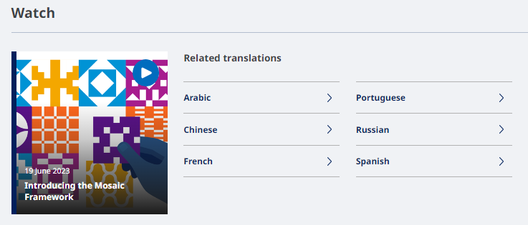
Introductory video (3 mins)
WATCH in English here: https://youtu.be/EOL6gaDRiEg
Languages and link for Mosaic video
English | https://youtu.be/EOL6gaDRiEg
Russian | https://youtu.be/tq0di5u7NR0
Portuguese | https://youtu.be/_Cs9CebAnCc
Spanish | https://youtu.be/HCX6RaDWz8g
French | https://youtu.be/wVsUY65yq2I
Chinese | https://youtu.be/dGd8FMB8BWg
Arabic | https://youtu.be/IHqU_TQnbx4
Notes:
Here is a 3-minute introductory video on the Mosaic Framework which gives a comprehensive and concise overview. The video is available in English, Arabic, Chinese, French, Portuguese, Russian, and Spanish.
[Note: Can choose to play the video as part of the webinar and/or workshop (recommend to download the file first). Can replace top line on the slide with most relevant language for workshop participants]

Slide 4




Why the Mosaic framework?
WHO Member States requested a coordinated approach for
sustainable surveillance of respiratory pathogens in 2022
  Multiple fit-for-purpose systems and complementary investigations & studies are needed
  The Mosaic Framework maps surveillance approaches to the objectives they are best intended to meet
  Considers gains made during the COVID-19 pandemic
→ Mosaic analogy: Different surveillance systems and studies must fit together as “tiles in a mosaic”, each providing a piece of the picture to contribute to a holistic understanding of respiratory viruses.
Notes:
Why was this framework named "the Mosaic Framework" and why was it created?
The Mosaic Framework demonstrates how surveillance approaches may be implemented as coordinated and collaborative systems, well-matched to specific priority objectives. During the COVID-19 pandemic, many countries established new surveillance systems to detect and monitor SARS-CoV-2 and COVID-19. While COVID-19 became a reportable condition globally, there was not a consistent approach to how countries leveraged existing respiratory disease surveillance systems (e.g. those used for influenza) to monitor COVID-19. This created a risk going forward - of multiple, parallel, laboratory and epidemiologic surveillance systems being used to monitor respiratory viruses of epidemic and pandemic potential. As such, Member States requested WHO at the World Health Assembly in January 2022 to put into place a coordinated approach for sustainable surveillance of respiratory pathogens during the post-pandemic and inter-pandemic period. As was emphasized in the recent pandemic it is impossible to address the many needs of respiratory virus surveillance with a single surveillance system. Rather, multiple systems and complementary investigations & specialized studies must each be fit-for-purpose to address priority objectives to which they are best suited. Using global use cases, and experiences, the Mosaic Framework places surveillance systems, represented by existing guidance, into a context where they may best address the objectives for which they are best intended. This is where the Mosaic analogy comes from. Different surveillance approaches must fit together as "tiles in a mosaic" to obtain the full "picture" of respiratory viruses in a country. Because each system meets a particular objective, any "missing tiles" will obscure the full picture.
Background info:
At the150th session of the Executive Board of the World Health Assembly in January 2022, Member States supported the sentinel surveillance platform (influenza) of the Global Influenza Surveillance and Response System or GISRS to be further leveraged to meet key monitoring needs, not only for influenza, but also for SARS-CoV-2 and other respiratory viruses. However, WHO was also specifically asked to:
provide a strategy to countries on how respiratory viruses of pandemic potential should be sustainably monitored, assessed, and new variants or novel viruses be detected, using existing surveillance platforms.
2. form a model for possible inter-connected surveillance for influenza, SARS-CoV-2 and other respiratory viruses moving forward and
3. help international partners and donor agencies focus technical and financial resources on the most essential surveillance needs.
This is precisely what the WHO Mosaic Respiratory Surveillance Framework is intended to be used for.

Slide 5

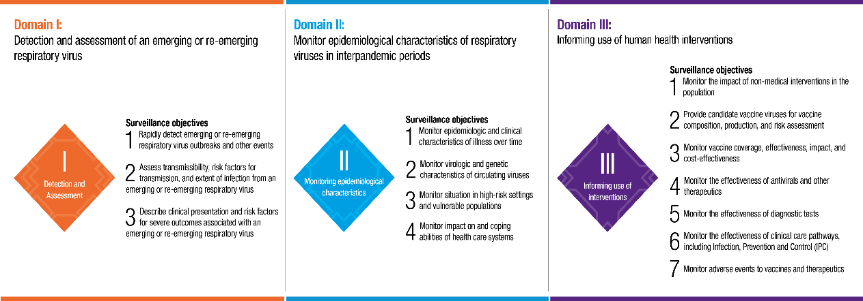
Mosaic Framework: an objective driven approach
Notes:
Through the consultative process used to develop the Mosaic Framework, the final names of the three key areas, the mosaic "Domains", and the priority objectives under each of the domains was also established. The implementation of the Mosaic Framework (including this workshop) very much focuses on organization of surveillance approaches within each of these domains through an objective driven approach. As such, I will go through these in some detail now.
For detection and assessment (early warning) in Domain I (orange), the first and key objective is to rapidly detect emerging or reemerging respiratory virus outbreaks and other events. The second and third objectives involve determining additional critical information to characterize the viruses, and cases associated with illness due to infection from those viruses – to assess transmissibility, risk factors for transmission and the extent of infection. Also, these investigation seek to describe clinical presentation and risk factors for severe outcomes.
As we move to domain 2 (blue), monitoring epidemiological characteristics (routine monitoring), the objectives shift to those that we need to monitor the epidemiological, clinical, virological and genetic characteristics of the illnesses and viruses that regularly occur or circulate in human populations over time. We also need to monitor the situation in high risk groups to inform resource prioritization, as well as the impact on and coping abilities of our healthcare systems.
And then, in domain 3 (purple), the objectives are to use our surveillance data to inform the use of human health interventions. Not all these objectives may be a priority for every country but key objectives include: monitoring the impact of our non medical interventions in the population, helping to support global risk assessments and vaccine formulation, and to monitor vaccine coverage, effectiveness and impact in populations, among others. [note: speakers can mention other objectives in this list as they see relevant to the country].

Slide 6
What the Mosaic Framework is and is not.....
Mosaic Framework IS an inter-pandemic organizational tool
Implemented through facilitated objective-driven exercises
To enable facilitated, safe, internal strategic surveillance decisions
To inform the content of existing work plans
Mosaic Framework is NOT:
An external evaluation (like JEE etc.)
A new surveillance system, software or dashboard
A new workplan
Notes:
We want to ensure that there isn't confusion regarding the implementation of this framework. The framework itself is an inter-pandemic organizational tool which is implemented involves a facilitated objective-driven exercise. This will enable internal strategic surveillance decisions and inform the content of existing national work plans. The Framework is not an external evaluation (like JEE), a new surveillance system, software or dashboard and does not involve the creation of a new workplan.

Slide 7

During this workshop we….
Participated in scenario- based discussions
Refined national mosaics for each domain
Identified and prioritized needs and actions
X number of days
X number of attendees in total, with active participation from all
Discussed X number of scenarios/questions in extensive detail
Challenged ways of working and clarification of roles & responsibilities
Developed X number needs and actions
Notes:
Participated in scenario- based discussions to test the functionality of national surveillance approaches
Revised national mosaic for each Domain which includes the core and enhanced surveillance approaches used to meet priority surveillance objectives
Identified and prioritized context-appropriate surveillance needs and actions – to integrate into existing work plans and proposals

Slide 8
Mosaic Workshop, Country X
Insert group photo from workshop

Slide 9
Best Practices
This slide may be used to summarize noteworthy “best practices” observed in COUNTRY X throughout the workshop. For example:
Pro-active leadership with interest in implementing collaborative surveillance
One Health Strategy formalised with plans to operationalise
Ongoing frontline and advanced FETP training with graduates contributing to the skilled workforce country-wide

Slide 10
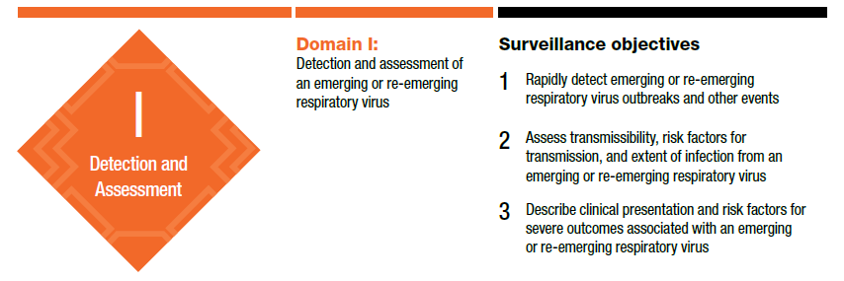
Domain I: Detection and assessment of an emerging or re-emerging respiratory virus

Slide 11

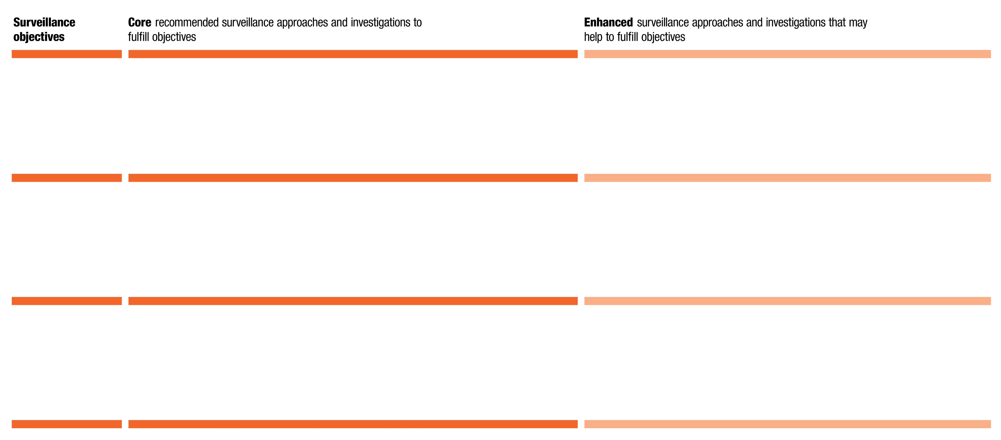
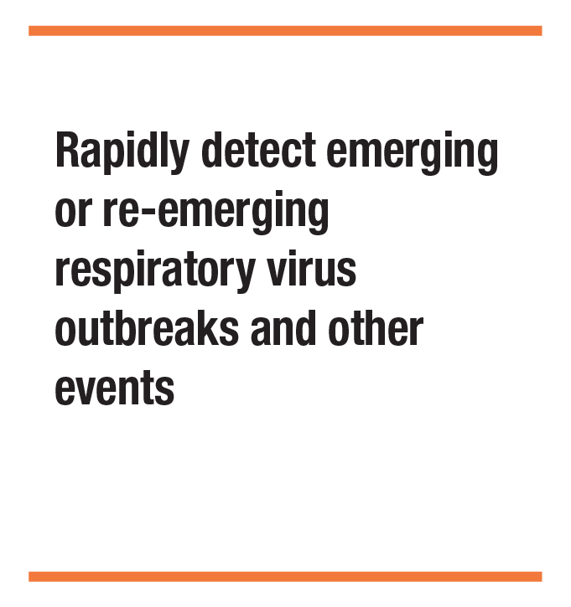
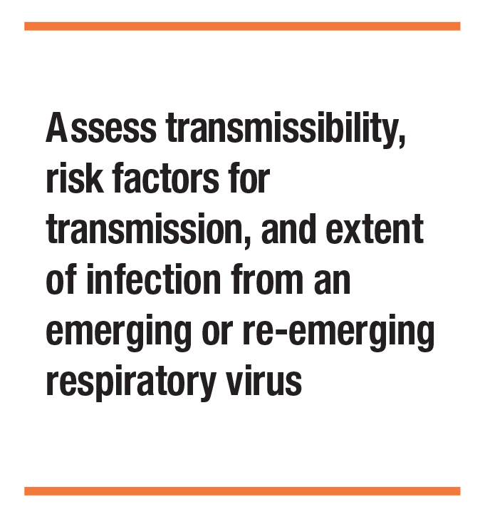
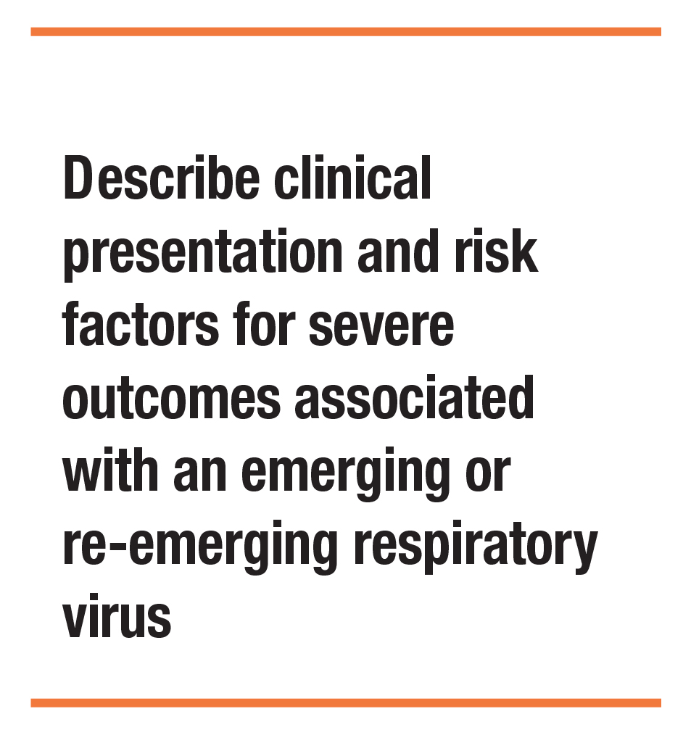
Detection & Assessment: Copy Domain I Mosaic here from Mosaic Design Tool

Slide 12
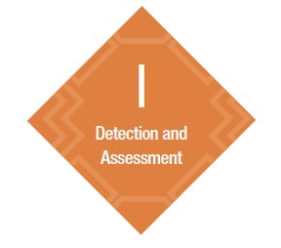

Domain I: Actions
  Surveillance Approach Name
  Summarize key actions for this approach identified in Domain I
  Surveillance Approach Name
  Summarize key actions for this approach identified in Domain I
Notes:
Presenter to verbally mention the distillation process of needs/actions over the course of the workshop and that more detail will be included in the final report.

Slide 13
Domain I: Actions
  Surveillance Approach Name
  Summarize key actions for this approach identified in Domain I
  Surveillance Approach Name
  Summarize key actions for this approach identified in Domain I
Notes:
I&S: also protocols for
PHEOC: handbook finalised and just needs to be implemented.

Slide 14
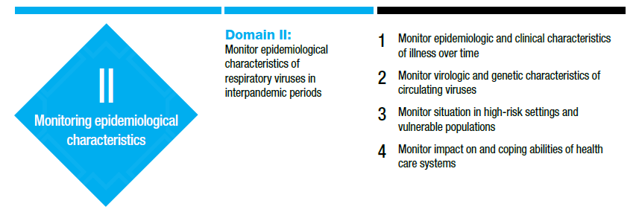
Domain II: Monitoring epidemiological, clinical and virological characteristics of respiratory viruses in interpandemic periods

Slide 15

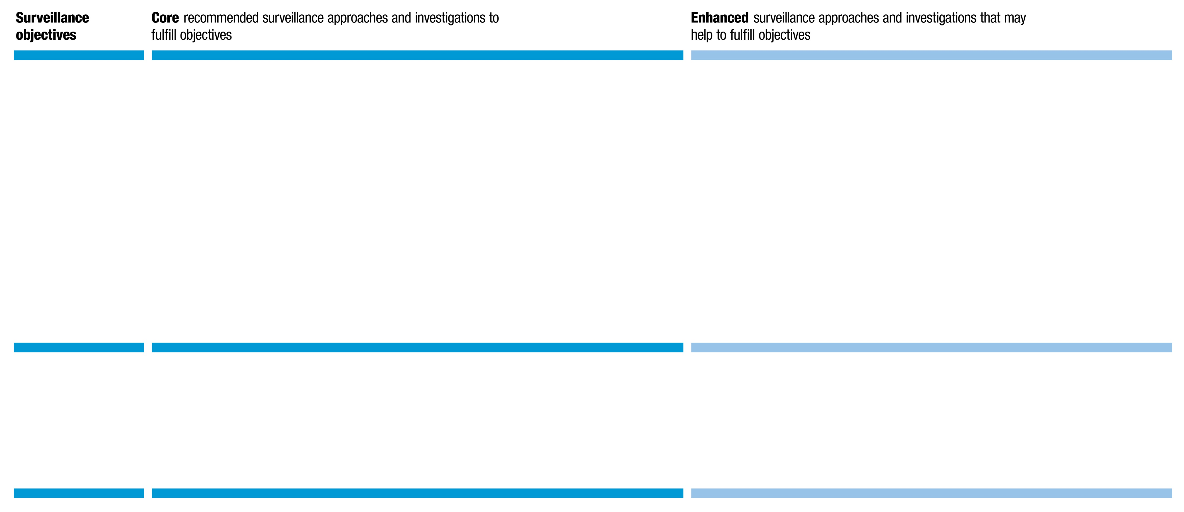
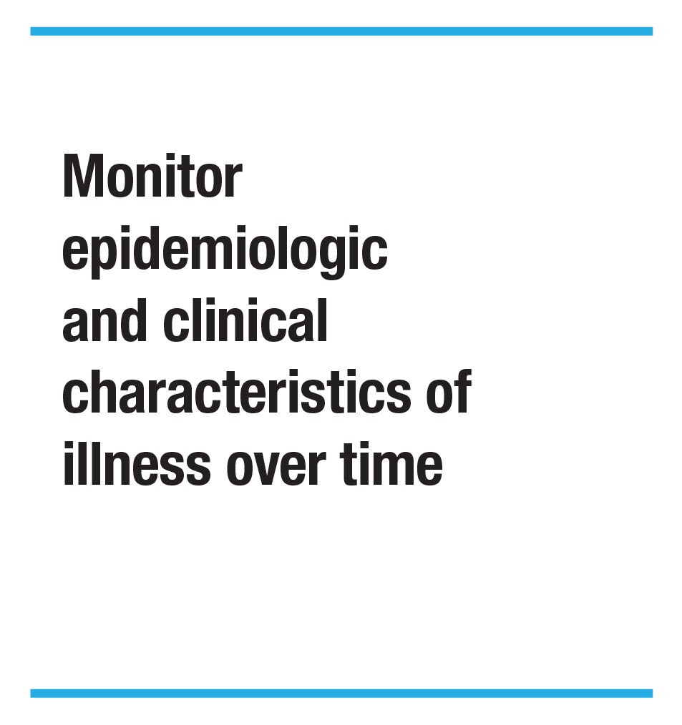


Monitoring epidemiological characteristics: Copy Domain II Mosaic here from Mosaic Design Tool
IDSR – Lab
Molecular and Genomic Surveillance

Slide 16
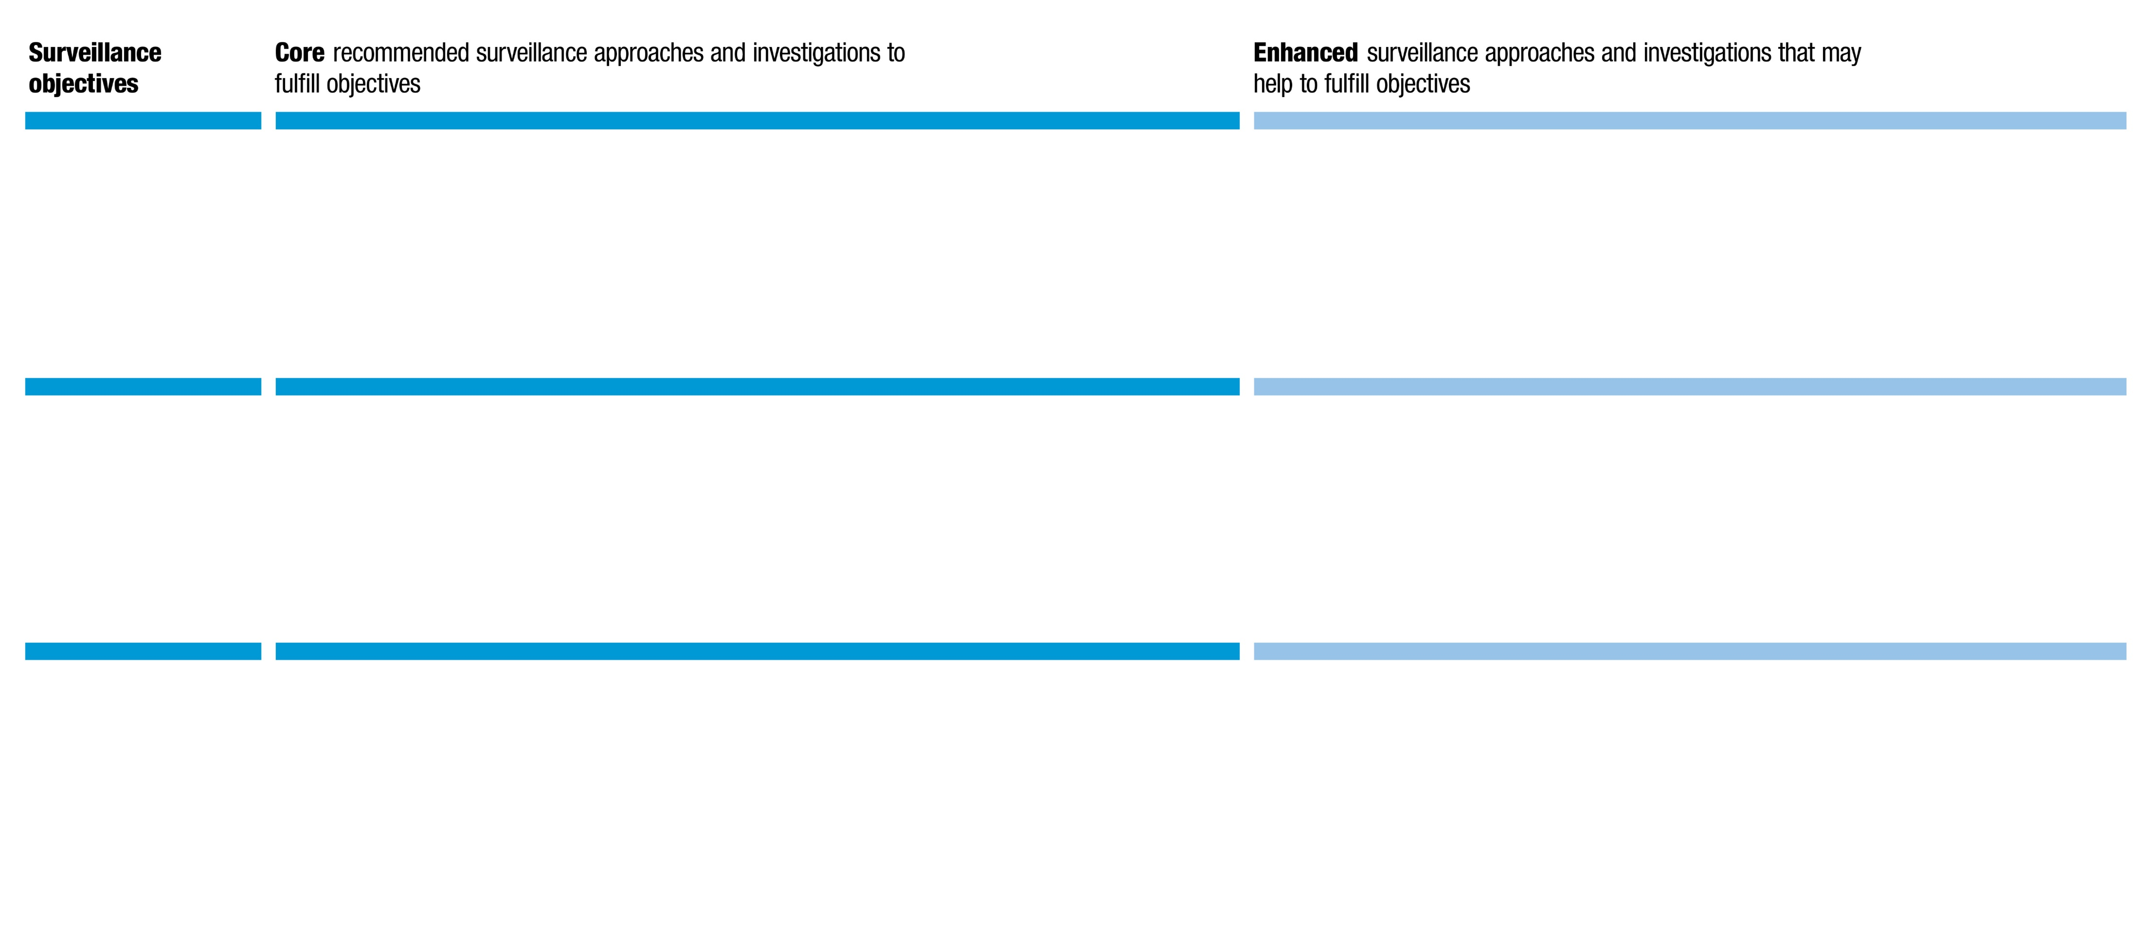
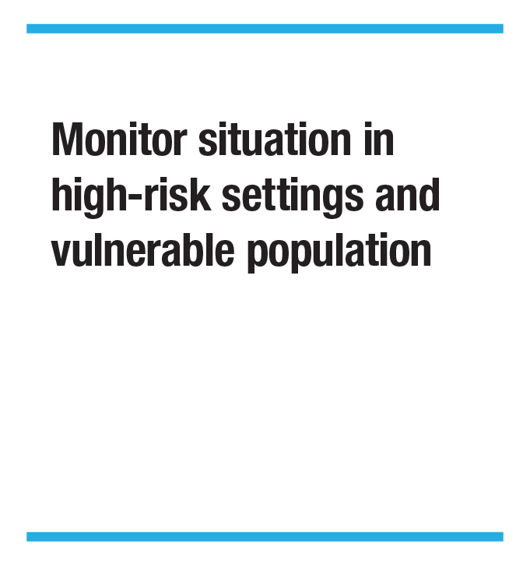
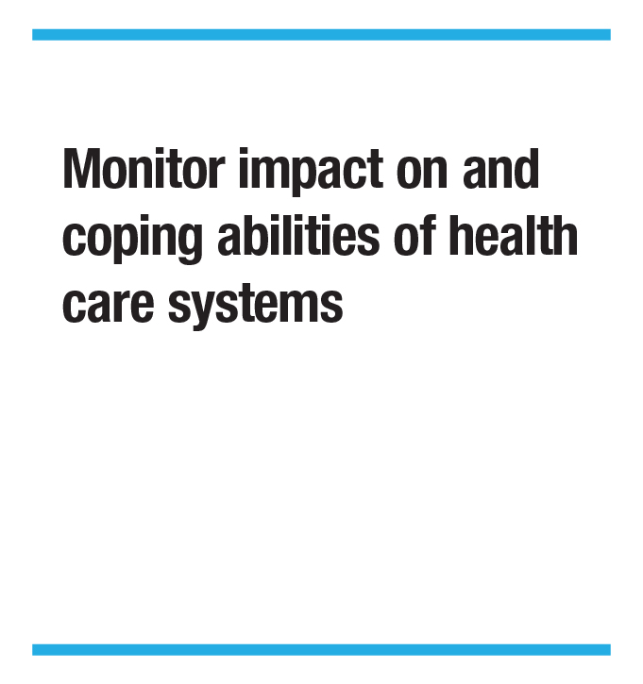
Monitoring epidemiological characteristics: Copy Domain II Mosaic here from Mosaic Design Tool

Slide 17
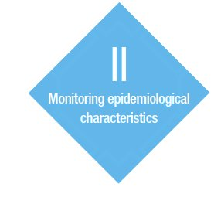

Domain II: Actions
  Surveillance Approach Name
  Summarize key actions for this approach identified in Domain II
  Surveillance Approach Name
  Summarize key actions for this approach identified in Domain II
…

Slide 18
Domain II: Actions
  Surveillance Approach Name
  Summarize key actions for this approach identified in Domain II
  Surveillance Approach Name
  Summarize key actions for this approach identified in Domain II
…

Slide 19
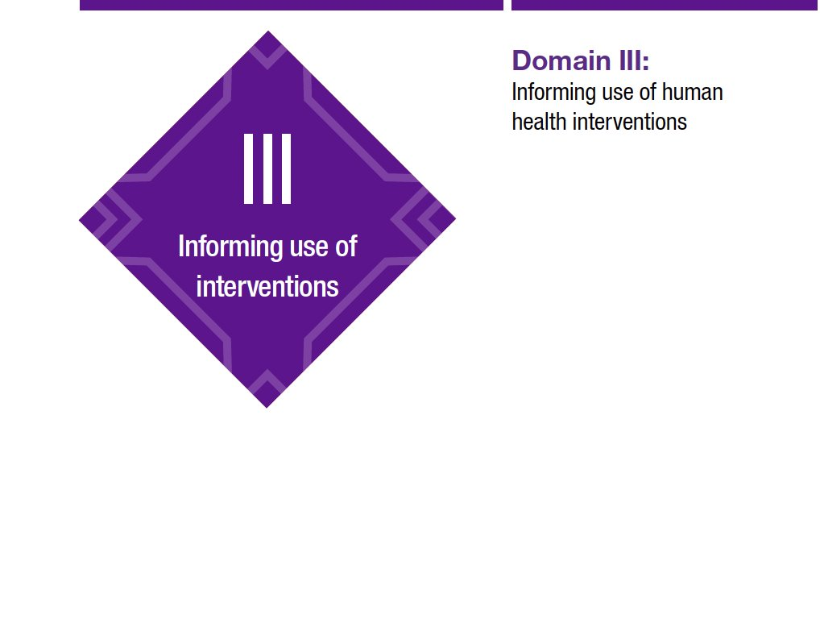
Domain III: Informing the use of human health interventions
Monitor the impact of non-medical interventions in the population
Provide candidate vaccine viruses for vaccine composition production, and risk assessment
Monitor vaccine coverage, effectiveness, impact, cost-effectiveness
Monitor the effectiveness of antivirals and other therapeutics
Monitor the effectiveness of diagnostic tests
Monitor the effectiveness of clinical care pathways, including IPC (Infection Prevention and control)
Monitor adverse events to vaccines and therapeutics
Notes:
NOTE: Presenters may wish to indicate here which objectives from this list were discussed during the workshop, e.g., by highlighting those objectives or deleting the objectives that were not discussed.

Slide 20

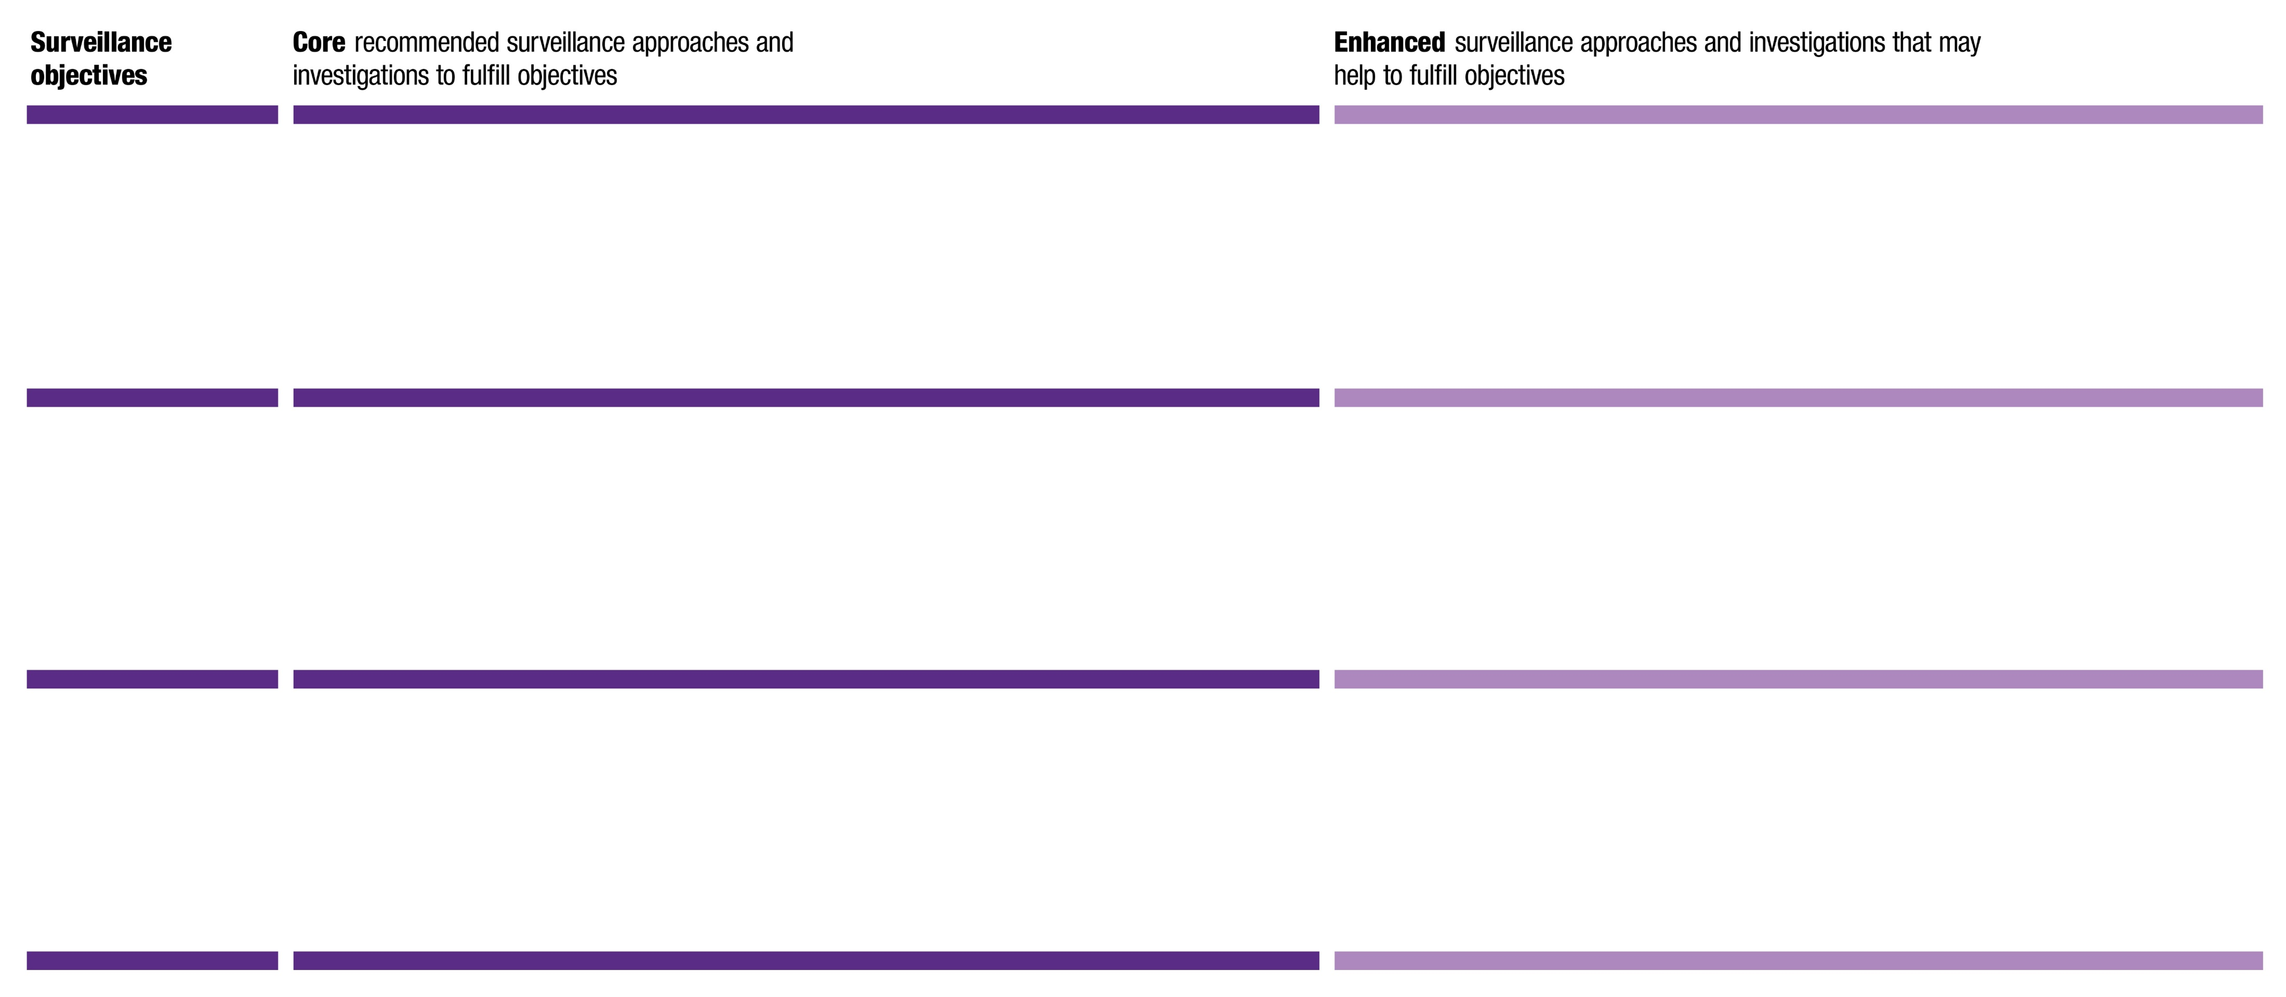

Informing use of interventions: Copy Domain III Mosaic here from Mosaic Design Tool
…
…
…

Slide 21

Domain III: Conclusions
Informing the use of interventions
  Surveillance Intervention/Approach Name
  Summarize key conclusions or actions identified in Domain III
  Surveillance intervention/Approach Name
  Summarize key conclusions or actions identified in Domain III

Slide 22
Domain III: Actions
Informing the use of interventions
  Surveillance Intervention/Approach Name
  Summarize key conclusions or actions identified in Domain III
  Surveillance intervention/Approach Name
  Summarize key conclusions or actions identified in Domain III

Slide 23

Cross-cutting Enabling Structures
  Enabler 1
  Summarize key actions identified
  Enabler 2
  Summarize key actions identified
Notes:
Enablers may include factors like governance, funding, staffing, training, etc.

Slide 24
Cross-cutting Enabling Structures
  Enabler 3
  Summarize key actions identified
  Enabler 4
  Summarize key actions identified

Slide 25
National Mosaic next steps
TIMELINE | DELIVERABLES
TODAY | Drafted "needs and actions“ and completed mosaics
4 WEEKS | Workshop report drafted by organizers and facilitators
8 WEEKS | Country finalizes workshop report Country shares final workshop report with relevant stakeholders and leadership
2+ MONTHS | Country incorporates actions into existing workplans, assigns tasks to country and partner stakeholders

Slide 26
Thank you!
WHO Mosaic Respiratory Surveillance Framework https://www.who.int/initiatives/mosaic-respiratory-surveillance-framework/
Contact: mosaic@who.int
Watch: https://youtu.be/EOL6gaDRiEg

Slide 27
Overall workshop reflections and Survey
ADD QR CODE or link to survey

