Slide 1
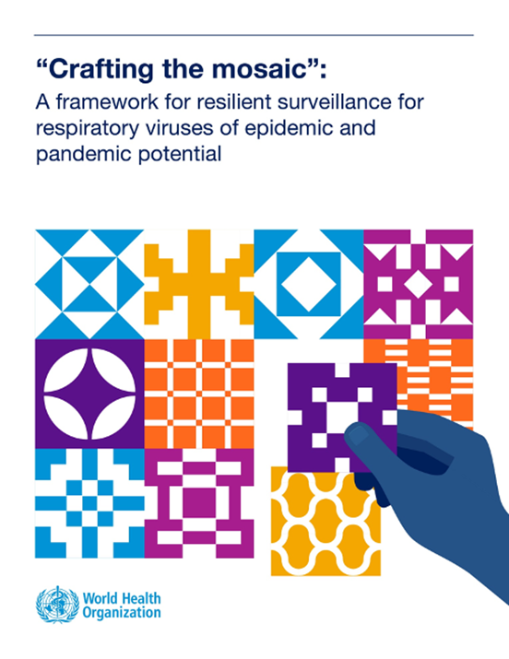
The Mosaic Respiratory
Surveillance Framework: Pandemic Preparedness
  PRESENTER
  AFFILIATION
Generic e-mail: mosaic@who.int
Web page: https://www.who.int/initiatives/mosaic-respiratory-surveillance-framework/
Video: https://youtu.be/EOL6gaDRiEg
Notes:
You should already have received and introduction to the Mosaic Respiratory Disease Framework and how it is used to strengthen early warning and routine monitoring surveillance on an ongoing basis. For countries that have developed their own national mosaics, this session is intended to help take the next step of using those mosaics to help pandemic surveillance planning.

Slide 2
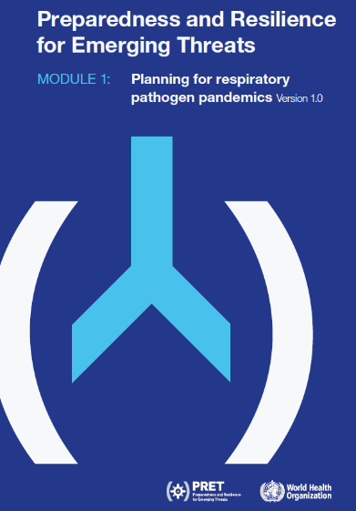



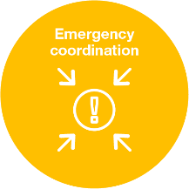

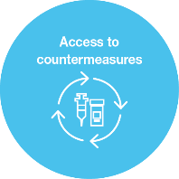

Get “PRET” (ready) for the next pandemic ?
Mosaic fits within pandemic preparedness planning PRET on Respiratory mode of transmission
The 5 “C” HEPR” subsystems and IHR core capacities:
Notes:
Mosaic fits within pandemic preparedness planning PRET on Respiratory mode of transmission and supports the implementation of the collaborative surveillance component of that initiative.

Slide 3
The Mosaic Framework and Pandemic Preparedness
The Problem: During past pandemics countries have often established parallel structures to address urgent data needs:
  not fully taking advantage of existing expertise/capacity
  creating additional parallel reporting streams, and,
  straining human and financial resources for existing, core systems
Notes:
In past pandemics countries have often established parallel structures to address urgent data needs. The absence of pandemic planning for surveillance has meant that they have not fully taken advantage of existing expertise/capacity, and at times created additional parallel reporting streams--straining human and financial resources for existing, core systems. Ideally countries have a mosaic of surveillance systems each targeted to objectives that they can address in a fit-for-purpose manner. The pandemic planning process then systematically helps them ask “how do objectives change in a pandemic?” and “how might I plan to enhance my existing systems to meet those pandemic objectives”? Only if gaps remain after that process should new additional systems or approaches need to be considered.

Slide 4
The Mosaic Framework and Pandemic Preparedness
Proposed solution: The Mosaic Framework can support pandemic planning by structuring discussions in advance:
  How will our surveillance objectives change in a pandemic?
  Based on their interpandemic use, what systems can we expect will best address anticipated objectives in a pandemic?
  What enhancements will be needed in the context of a pandemic?
    e.g. additional staffing, funding, reporting timelines/data elements
  What additional systems will need to be established to meet pandemic monitoring goals
    Document why needed, resources required, and initiate planning
Notes:
A pandemic surveillance planning discussion that builds upon a national mosaic of surveillance systems can therefore support pandemic planning by structuring discussions to identify needs and actions that must be included in national pandemic preparedness plans. These discussions may include asking:
How will our surveillance objectives change in a pandemic?
Based on their interpandemic use, what systems can we expect will best address anticipated objectives in a pandemic?
What enhancements will be needed in the context of a pandemic?
e.g. additional staffing, funding, reporting timelines/data elements
What additional systems will need to be established to meet pandemic monitoring goals
Document why needed, resources required, and initiate planning

Slide 5
Using Mosaic for Preparedness:
What approaches should be relied upon for specific needs the next pandemic?
How many cases and deaths today?
Lock-down?
Treatment failures?
Pathogen characteristics?
Are facilities coping?
Lift PHSM?
Rapid containment?
Vaccine effectiveness?
Human-to-human transmission?
New variant?
How to transition?
Is this a true outbreak?
Is it over?
*figure adapted from Dr M. Kato, Multi-source Surveillance, WHO SEARO
Notes:
Thank you to our colleagues in the WHO Southeast Asian Regional Office for this slide. What you can see here is that some objectives during a pandemic also exist in inter pandemic periods. These include objectives such as monitoring virus characteristics, risk groups, and illness associated with infections; treatment effectiveness; and the coping abilities of health care facilities However others such as implementation of community wide Public Health and Social measures such as lock downs, or the need to identify every case of death early in a pandemic may be pandemic-specific surveillance objectives. This is why we need to discuss how a national mosaic may change in a pandemic.

Slide 6
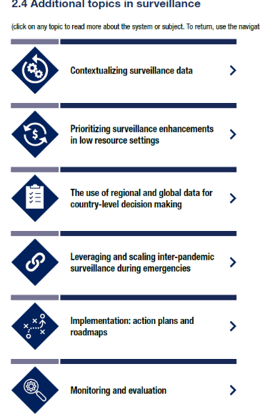
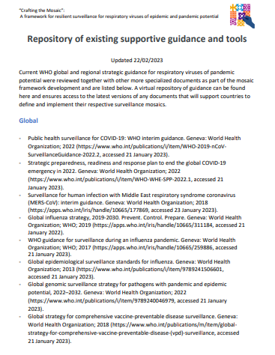
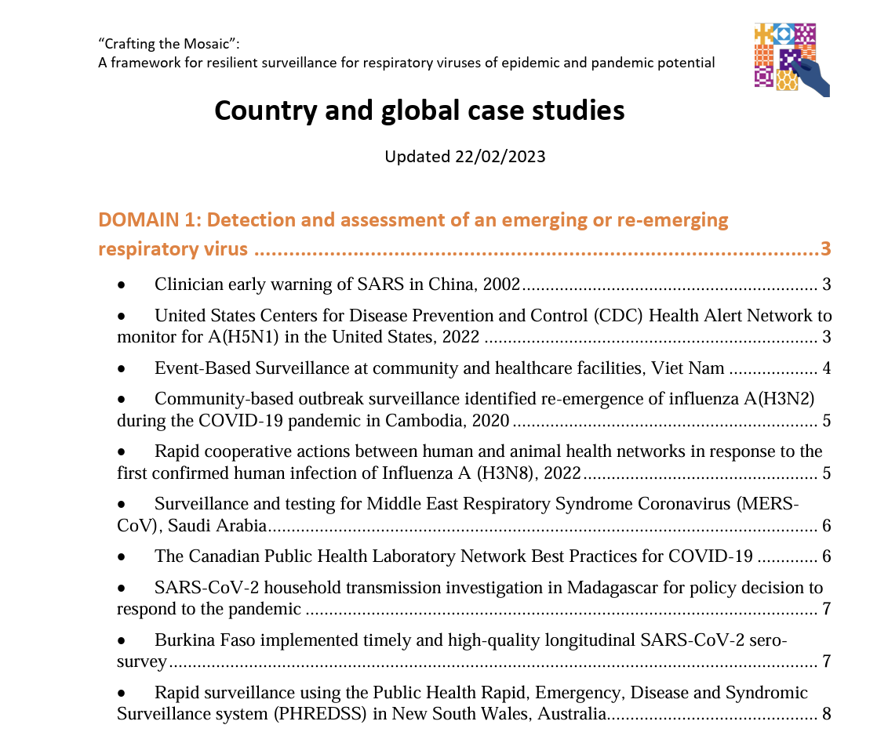
Added topics and resources
Also…
Brochures
Slide sets
Publications
Implementation tools
Notes:
As part of the main framework document, there are the following “additional topics in surveillance’ that can be read when needed.
The section on leveraging and scaling inter-pandemic surveillance during emergencies also informs discussion in these pandemic preparedness discussions.
Now we will use scenarios to ask ourselves how objectives may change in a pandemic, and if there are needs and actions to better address those objectives that should be included ir pandemic preparedness surveillance workplans.

Slide 7

Thank you
WHO Mosaic Respiratory Surveillance Framework https://www.who.int/initiatives/mosaic-respiratory-surveillance-framework/
Contact: mosaic@who.int
Acknowledgements:
WHO Member States, Technical Working groups members, partners and donors involved in developing the framework
Watch: https://youtu.be/EOL6gaDRiEg

