Slide 1
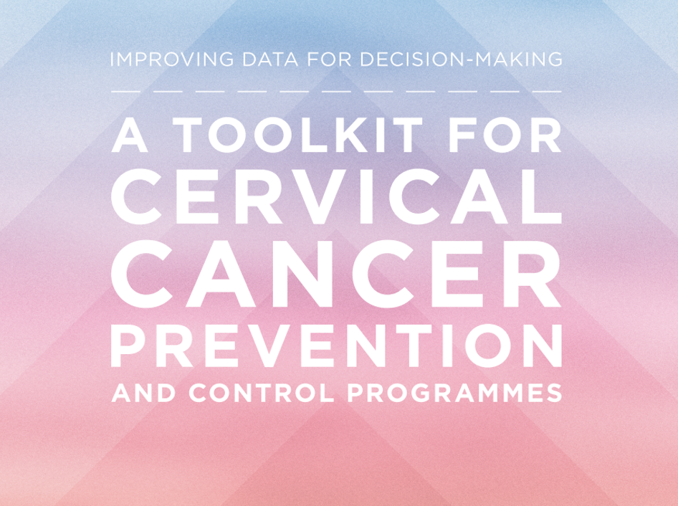


Slide 2

Introduction
Acknowledgments
Identified need
Project objective
Toolkit structure

Slide 3
ACKNOWLEDGEMENTS
The Improving Data for Decision Making in Global Cervical Cancer Programmes (IDCCP) project and the development of this toolkit were made possible through a grant from the Bill & Melinda Gates Foundation to the National Foundation for the U.S. Centers for Disease Control and Prevention (CDC Foundation). The project was implemented by a consortium of partners – the CDC Foundation, the U.S. Centers for Disease Control and Prevention (CDC), the George W. Bush Institute (Bush Institute), and the World Health Organization (WHO).

Slide 4
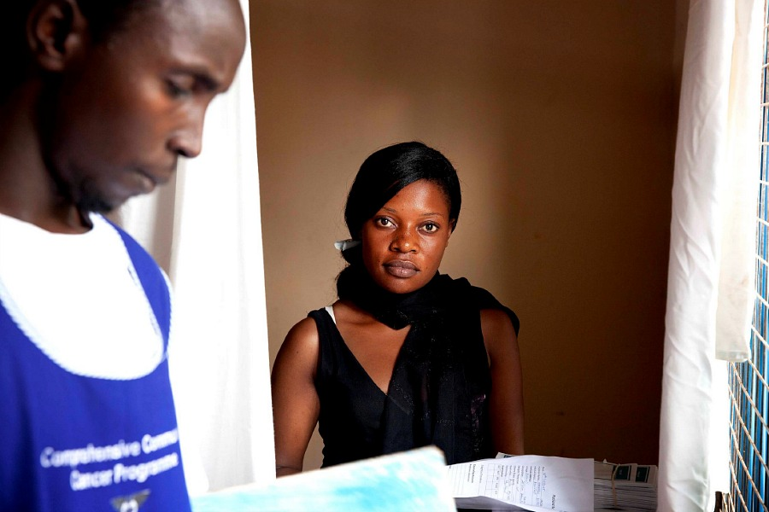
IDENTIFIED NEED
A global absence of standardised tools and guidance, technical expertise, and implementation support for countries that are seeking to collect and use high-quality data to monitor, evaluate, and improve their cervical cancer screening and treatment programs.
Photo: WHO/P Goldschmid

Slide 5

PROJECT OBJECTIVE
To improve and accelerate the availability of data for planning and improving global cervical cancer programmes by gathering information on data systems in select country contexts, and by developing global standards, tools, and guidance.
Photo: WHO/S Bones

Slide 6
TOOLKIT STRUCTURE
How to identify opportunities for strengthening country data and data systems?
SECTION 1: RAPID SITUATIONAL ASSESSMENT OF DATA AND DATA SYSTEMS
How to measure population coverage of cervical cancer screening and secondary prevention?
SECTION 2: POPULATION-BASED SURVEY MODULES
How to routinely monitor patients and programs?
SECTION 3: PATIENT AND PROGRAMME MONITORING
How to survey facilities for service readiness, service availability, service quality?
SECTION 4: FACILITY-BASED SURVEYS
How to estimate costs of cervical cancer screening & treatment programs?
SECTION 5: PREVENTION AND CONTROL COSTING

Slide 7
Rapid situational assessment of data and data systems
Purpose
Overview of components
01

Slide 8
Purpose
The Rapid Situational Assessment of Data and Data Systems supports countries to identify opportunities and challenges associated with implementing data systems for primary and secondary cervical cancer prevention and invasive cervical cancer treatment.
The goal of the data systems assessment is to contribute to the available evidence-base for planning and implementing cervical cancer monitoring and evaluation, surveillance, and information systems through documentation and analysis of country landscape, information systems, programmes, and services. This documentation and subsequent analysis leads to the development of actionable country-level recommendations.

Slide 9
Overview of components
The steps and processes presented in the Data Systems Assessment Field Guide should act as a core foundation and can be further adapted and expanded into Standard Operating Procedures (SOPs), data collection tools, job aids and other practical materials for assessment implementation.
The Field Guide includes:
Description of assessment approach
Field Guide for planning and conducting the Data Systems Assessment
Assessment Tool
  Checklists outlining the roles and responsibilities for each phase of the assessment
  Quick Reference Guides: Assessment Tool Field Definitions, and Steps in the Assessment Process
  Data Systems Assessment Survey Tool for all assessment Domains (includes embedded guides for the methods and timing of data collection, as well as the synthesis of outputs)
Example of an excel-based Assessment Data Synthesis and Analysis Tool

Slide 10
Population-based survey modules
Purpose
Overview of components
02

Slide 11
Purpose
Population-based surveys can be used to assess cervical cancer screening coverage, and to identify barriers to accessing screening and precancerous treatment services. They were developed to provide country stakeholders with standardized cervical cancer screening and treatment questions that can be incorporated into existing population-based surveys.
The use of standardized questions will help ensure that collected data are useful for programme planning and evaluation, and are comparable over time and across countries.
This component assists low-and middle-income countries in monitoring key indicators and measures of cervical cancer screening and treatment including:
Screening prevalence; Screening interval; Follow-up and treatment of precancer; Single Visit Approach; HPV vaccination; Knowledge and awareness; Facilitators to screening; and, Barriers to screening and treatment.

Slide 12
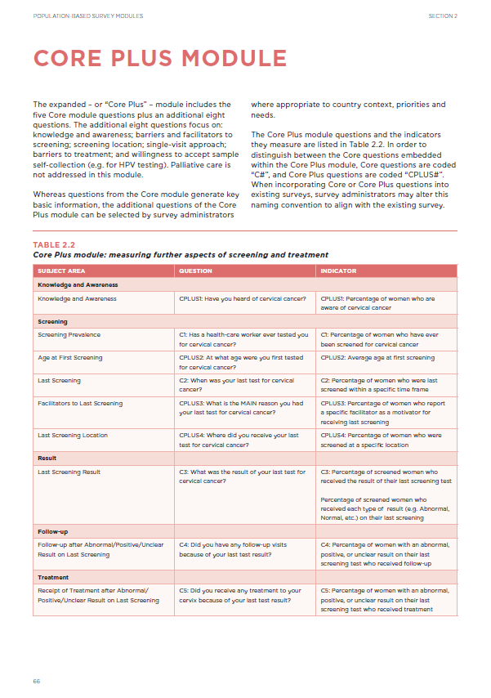
Overview of components
The Population-based Surveys component includes:
A core module including a probe and a set of survey questions related to cervical cancer screening and treatment of precancerous lesions
An expanded module that includes the core probe and questions as well as additional probes and survey questions
Instructions for administering all probes and questions
A cautionary statement on the inclusion of HPV DNA testing in population-based surveys
A discussion of methodological considerations for including PSCC questions in existing population-based surveys
Example table shells for use in analysis

Slide 13
Patient and programme monitoring
Purpose
Overview of components
03

Slide 14
Purpose
The Patient and Programme Monitoring component outlines a process for data collection, aggregation, analysis, and reporting for cervical cancer secondary prevention (screening and precancerous lesion treatment) programmes. It includes guiding information on indicator development, improvement of programme responsiveness and effectiveness, as well as sample data collection and management tools.
This component provides resources to assist health care providers, facility managers, subnational and national Ministry of Health staff and their partners to collect, systematically analyze and use data to:
• Better plan, target, tailor, and scale interventions;
• Assess whether programmes are being implemented with quality;
• Respond effectively when they are not implemented as planned; and,
• Report on standardized global indicators.

Slide 15
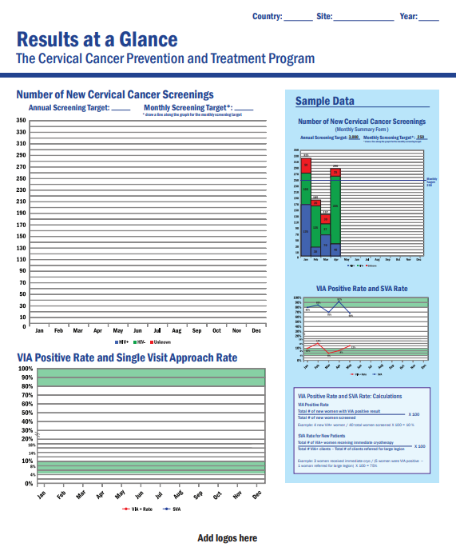
Overview of components
The Patient and Programme Monitoring component provides countries with the following essential resources:
Roles & Responsibilities for M&E;
A set of Core and Optional Indicators for Global, National, Sub-national, and Facility levels;
Client Screening Form Data Element Checklist and Sample Form;
Register Data Element Checklist and Sample Register;
Sample Monthly Summary Form for reporting;
Sample Annual Summary Form for reporting;
Data Visualization Graph and Table Tools; and
Data Quality and Training Tools.

Slide 16
Facility-based surveys
Purpose
Overview of components
04

Slide 17

Purpose
The Facility-based Surveys component provides Ministry of Health decision-makers, implementing partners, facility administrators, and service providers with the tools to gather and evaluate accurate, up-to-date information on the availability of cervical cancer secondary prevention services, the readiness and capacity to deliver services, and the quality of the services being delivered.
Photo: Christine McNab

Slide 18
Overview of components
The Facility-based Surveys component includes:
Service Availability Tool and Instructions for Use
Facility Readiness Assessment Planning Worksheet, Tool, and Instructions for Use
Supportive Supervision Planning Worksheet, Tool, Instructions for Use
Suggestions for Electronic Survey Administration
The Facility-based Surveys component is structured to be user-friendly and easy to understand, with detailed user instructions for each tool. The structure of this component allows countries to use each tool individually, or to use the package of three tools as part of a comprehensive approach to monitoring cervical cancer screening and precancerous lesion treatment service availability, capacity, and quality.

Slide 19
Prevention and control costing-analysis and planning module for screening and treatment
Purpose
Overview of components
05

Slide 20
PurposE
Policymakers and programme managers need information on the projected costs of introducing cervical cancer interventions in order to make decisions on the ‘when’ and the ‘where’ of service introduction and scale-up. Through a facilitated process, the MS Excel-based tool allows health programme planners and managers to estimate, synthesize and analyze programme and service costs including:
• Early detection of cervical cancer;
• Diagnosis;
• Treatment of precancerous lesions and invasive cancer;
• Palliative care for advanced disease;
• Community outreach and sensitization;
• Programme planning, monitoring and evaluation; and,
• Supportive supervision.

Slide 21
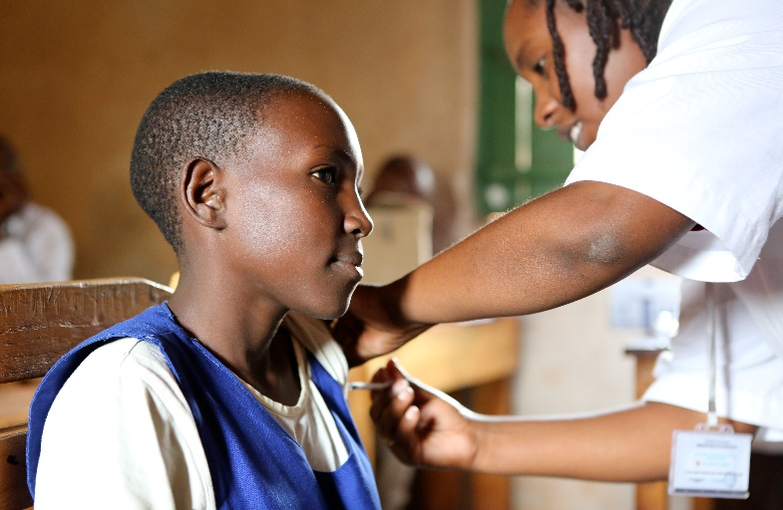
Overview of components
Trained facilitators will use this tool and the accompanying user manual to assist programme planners, managers and implementers to:
Estimate service costs and service coverage based on country-specific data and needs;
Estimate financial and economic costs, and start up and recurrent costs of cervical cancer programmes;
Photo: WHO/S Bones
Estimate service coverage rates based on cost, distribution, population need and predicted scale-up; and,
Explore cost/service access trade-offs based on different models of public service delivery.

Slide 22
Contact us
For further information, or to request the Cervical Cancer Prevention and Control Costing Tool (C4PST), please contact: ncdsurveillance@who.int
© World Health Organization 2018
The authors alone are responsible for the views expressed in this article and they do not necessarily represent the views, decisions or policies of the institutions with which they are affiliated.

