Slide 2
table of contents
01
The global burden of postpartum haemorrhage
04
What are the updated WHO recommendations?
02
Uterotonics for PPH prevention
05
So what’s new?
03
How were the WHO recommendations updated?
06
Implementing the WHO recommendations

Slide 3
What is postpartum haemorrhage?
1. the global burden of postpartum haemorrhage
Postpartum haemorrhage (PPH) is the leading cause of maternal death worldwide.
    Postpartum haemorrhage (PPH) is commonly defined as a blood loss of 500 ml or more within 24 hours after birth. It affects about 5% of all women giving birth around the world.
    Globally, nearly one quarter of all maternal deaths are associated with PPH. In most low-income countries, it is the main cause of maternal mortality.
    The majority of PPH-associated deaths could be avoided by the use of prophylactic uterotonics during the third stage of labour and appropriate treatment.
    Improving health care for women during childbirth to prevent and treat PPH is a necessary step towards achievement of the health targets of the Sustainable Development Goals (SDGs).
99% of all maternal deaths occur in low- and
middle-income countries (LMICs).
section 01

Slide 4
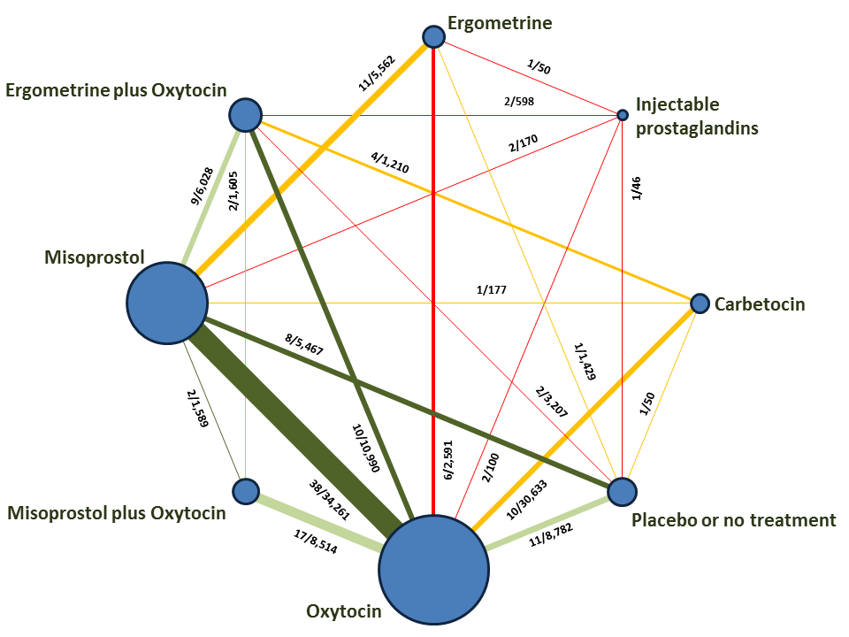
New findings on uterotonics for PPH prevention
2. Uterotonics for PPH prevention
A Cochrane systematic review and network meta-analysis compared uterotonic options with no uterotonic and other uterotonic options.
    196 trials (135 559 women) across 53 countries
    Any trial comparing a uterotonic vs placebo, no uterotonic or another uterotonic
    Single agents (oxytocin, carbetocin, misoprostol, ergometrine) or combination agents (oxytocin plus ergometrine, oxytocin plus misoprostol)
Gallos et al. Uterotonic agents for preventing postpartum haemorrhage: a network meta‐analysis. Cochrane Database Syst Rev. CD011689.
section 02

Slide 5
New findings on uterotonics for PPH prevention
2. Uterotonics for PPH prevention
A Cochrane systematic review and network meta-analysis compared all uterotonic options and placebo or no treatment.
In light of this new evidence, the WHO recommendations on uterotonics for PPH prevention have been updated
    The WHO PPH recommendations were first published in 2012.
    These updated recommendations (2018) supersede the previous recommendations on uterotonics for PPH prevention.
    196 trials (135 559 women) across 53 countries
    Any trial comparing a uterotonic vs placebo, no treatment or another uterotonic
    Single agents (oxytocin, carbetocin, misoprostol, ergometrine) or combination agents (oxytocin plus ergometrine, oxytocin plus misoprostol)
section 02

Slide 6
A systematic approach
3. how were the WHO recommendations updated?
The recommendations were updated according to the standards of the WHO handbook on guideline development
Retrieve, assess and synthesize evidence
GDG formulates the recommendations
Identify priority questions and outcomes
  Updating involves:
    WHO Steering Group
    Guideline Development Group (GDG)
    Executive Guideline Steering Group (GSG)
    External Review Group
    Systematic review team
    External partners and observers
section 03

Slide 7
GDG formulates the recommendations
3. how were the WHO recommendations updated?
The Guideline Development Group (GDG) convened in September & October 2018
    The GDG comprised 18 external experts and relevant stakeholders with expertise in research, guideline development, policy and programmes on PPH prevention and treatment.
    GDG members considered:
      Balance between desirable and undesirable effects
      Overall quality of supporting evidence
      Values and preferences of stakeholders
      Resource requirements
      Cost-effectiveness
      Acceptability
      Feasibility
      Equity
section 03

Slide 8
What works?
Efficacy and safety of uterotonics for PPH prevention uterotonic options vs placebo or no treatment
4. What are the updated WHO recommendations?
Which one?
Choice of uterotonics for PPH prevention
uterotonic options
vs
other uterotonic options
section 04

Slide 9
Recommendation 1. The use of an effective uterotonic for the prevention of PPH during the third stage of labour is recommended for all births.
4. What works: efficacy and safety of uterotonics for PPH prevention
To effectively prevent PPH, only one of the following uterotonics should be used:
  Oxytocin
  Carbetocin
  Misoprostol
  Ergometrine/methylergometrine
  Oxytocin and ergometrine fixed-dose combination
section 04

Slide 10
Recommendation 1. The use of an effective uterotonic for the prevention of PPH during the third stage of labour is recommended for all births.
4. What works: efficacy and safety of uterotonics for PPH prevention
    Recommendation 1.1
    The use of oxytocin (10 IU, IM/IV) is recommended for the prevention of PPH for all births.
    Vaginal birth or caesarean section
    Skilled health personnel required to administer
    At caesarean section: consider dividing doses and avoid a rapid IV bolus
To effectively prevent PPH, only one of the following uterotonics should be used:
  Oxytocin
  Carbetocin
  Misoprostol
  Ergometrine/methylergometrine
  Oxytocin and ergometrine fixed-dose combination
section 04

Slide 11
Recommendation 1. The use of an effective uterotonic for the prevention of PPH during the third stage of labour is recommended for all births.
4. What works: efficacy and safety of uterotonics for PPH prevention
    Recommendation 1.2
    The use of carbetocin (100 µg, IM/IV) is recommended for the prevention of PPH for all births in contexts where its cost is comparable to other effective uterotonics.
    Vaginal birth or caesarean section
    Skilled health personnel required to administer
    For PPH prevention only
To effectively prevent PPH, only one of the following uterotonics should be used:
  Oxytocin
  Carbetocin
  Misoprostol
  Ergometrine/methylergometrine
  Oxytocin and ergometrine fixed-dose combination
section 04

Slide 12
Recommendation 1. The use of an effective uterotonic for the prevention of PPH during the third stage of labour is recommended for all births.
4. What works: efficacy and safety of uterotonics for PPH prevention
    Recommendation 1.3
    The use of misoprostol (either 400 µg or 600 µg PO) is recommended for the prevention of PPH for all births.
    Alternative routes may be needed at caesarean section, but oral route is preferred by women
    No clear evidence of which dose is superior, but higher doses have more side effects
    Inform women of possible adverse effects
    Can be used in hospital or community
To effectively prevent PPH, only one of the following uterotonics should be used:
  Oxytocin
  Carbetocin
  Misoprostol
  Ergometrine/methylergometrine
  Oxytocin and ergometrine fixed-dose combination
section 04

Slide 13
Recommendation 1. The use of an effective uterotonic for the prevention of PPH during the third stage of labour is recommended for all births.
4. What works: efficacy and safety of uterotonics for PPH prevention
    Recommendation 1.4
    The use of ergometrine (200 µg, IM/IV) is recommended for the prevention of PPH in contexts where hypertensive disorders can be safely excluded prior to its use
    Vaginal birth or caesarean section
    Skilled health personnel are required
    Inform women of possible side effects - other options may have better side effect profile
To effectively prevent PPH, only one of the following uterotonics should be used:
  Oxytocin
  Carbetocin
  Misoprostol
  Ergometrine/methylergometrine
  Oxytocin and ergometrine fixed-dose combination
section 04

Slide 14
Recommendation 1. The use of an effective uterotonic for the prevention of PPH during the third stage of labour is recommended for all births.
4. What works: efficacy and safety of uterotonics for PPH prevention
    Recommendation 1.5
    The use of oxytocin and ergometrine fixed-dose combination (5 IU/500 µg IM) is recommended for the prevention of PPH in contexts where hypertensive disorders can be safely excluded prior to its use.
    Vaginal birth or caesarean section
    Skilled health personnel are required
To effectively prevent PPH, only one of the following uterotonics should be used:
  Oxytocin
  Carbetocin
  Misoprostol
  Ergometrine/methylergometrine
  Oxytocin and ergometrine fixed-dose combination
section 04

Slide 15
Recommendation 1. The use of an effective uterotonic for the prevention of PPH during the third stage of labour is recommended for all births.
4. What works: efficacy and safety of uterotonics for PPH prevention
    Recommendation 1.6
    Injectable prostaglandins (carboprost or sulprostone) are not recommended for the prevention of PPH
To effectively prevent PPH, only one of the following uterotonics should be used:
  Oxytocin
  Carbetocin
  Misoprostol
  Ergometrine/methylergometrine
  Oxytocin and ergometrine fixed-dose combination
  Injectable prostaglandins
section 04

Slide 16
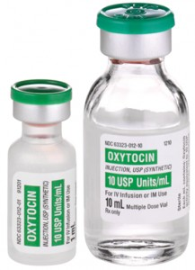
How do we compare uterotonics to one another?
4. Which one: identifying a uterotonic of choice
Carbetocin
Misoprostol
Ergometrine
Oxytocin + ergometrine
Placebo
Oxytocin + misoprostol
Comparing uterotonics through oxytocin as a common comparator
    Oxytocin is current standard of care
    Largest number of trials in the network meta-analysis
    The natural sequence for introducing a new uterotonic option is to evaluate efficacy with the “gold standard” option
Oxytocin
section 04
section 04

Slide 17
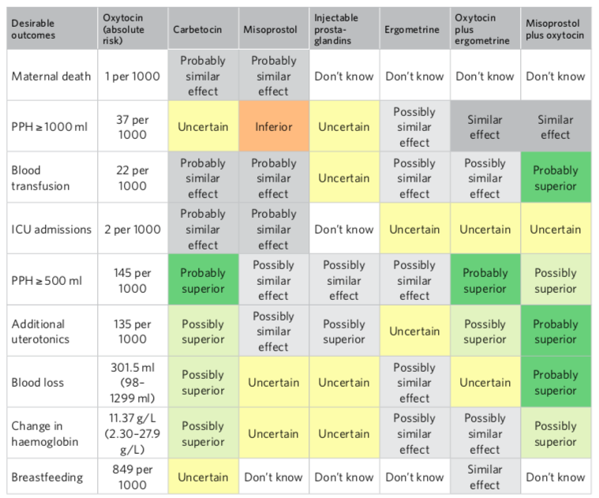
How do the effects of carbetocin compare to oxytocin for these outcomes?
Desirable outcomes

Slide 18
4. Which one: Summary of judgements comparing uterotonics to oxytocin (reference)
Desirable effects
Undesirable effects
Certainty of the evidence
Values
Balance of effects
Resources required
Certainty of the evidence
Cost-effectiveness
Equity
Acceptability
Feasibility
These criteria were considered by the GDG for each uterotonic option

Slide 19
4. Which one: Summary of judgements comparing uterotonics to oxytocin (reference)
Uterotonic options: | Oxytocin
Desirable effects | Reference
Undesirable effects | Reference
Certainty of the evidence | Reference
Values | Probably no important uncertainty or variability
Balance of effects | Reference
Resources required | Reference
Certainty of the evidence | Reference
Cost-effectiveness | Reference
Equity | Probably increased
Acceptability | Varies
Feasibility | Probably Yes
Oxytocin is the reference comparator

Slide 20
4. Which one: Summary of judgements comparing uterotonics to oxytocin (reference)
Uterotonic options: | Oxytocin | Carbetocin
Desirable effects | Reference | Small
Undesirable effects | Reference | None
Certainty of the evidence | Reference | Moderate
Values | Probably no important uncertainty or variability | Probably no important uncertainty or variability
Balance of effects | Reference | Probably favours carbetocin
Resources required | Reference | Moderate costs
Certainty of the evidence | Reference | Low
Cost-effectiveness | Reference | Probably favours oxytocin
Equity | Probably increased | Varies
Acceptability | Varies | Varies
Feasibility | Probably Yes | Probably Yes
Carbetocin compared to oxytocin
Similar desirable effects, and carbetocin likely superior in reducing PPH (≥ 500 ml) (41 fewer events per 1000 women), use of additional uterotonics (74 fewer per 1000) and blood loss after birth (81 ml less on average).
No clear difference in undesirable effects
While balance of effects probably favours carbetocin, the supply cost of carbetocin is approximately 20 times more than oxytocin
Uncertain whether the additional benefits justify the additional cost of routinely implementing carbetocin at the current unit price
Acceptability among stakeholders and impact on health equity would vary across settings compared with oxytocin.

Slide 21
4. Which one: Summary of judgements comparing uterotonics to oxytocin (reference)
Uterotonic options: | Oxytocin | Misoprostol
Desirable effects | Reference | None
Undesirable effects | Reference | Moderate
Certainty of the evidence | Reference | Moderate
Values | Probably no important uncertainty or variability | Probably no important uncertainty or variability
Balance of effects | Reference | Favours oxytocin
Resources required | Reference | Varies
Certainty of the evidence | Reference | Low
Cost-effectiveness | Reference | Varies
Equity | Probably increased | Probably increased
Acceptability | Varies | Probably Yes
Feasibility | Probably Yes | Probably Yes
Misoprostol compared to oxytocin
Misoprostol has similar desirable effects to oxytocin, but it is less effective for reducing severe PPH (≥ 1000 ml) (7 more events per 1000 women).
Causes more undesirable effects (including nausea, vomiting, shivering, fever and diarrhoea).
Misoprostol is cheaper, heat-stable, can be used orally, and is probably acceptable and feasible to use.
Lower effectiveness for severe PPH and greater undesirable effects may increase costs (these costs may vary according to the setting).
Can be task-shifted to lay health workers and community health workers.

Slide 22
4. Which one: Summary of judgements comparing uterotonics to oxytocin (reference)
Uterotonic options: | Oxytocin | Ergometrine
Desirable effects | Reference | None
Undesirable effects | Reference | Moderate
Certainty of the evidence | Reference | Low
Values | Probably no important uncertainty or variability | Probably no important uncertainty or variability
Balance of effects | Reference | Probably favours oxytocin
Resources required | Reference | Moderate costs
Certainty of the evidence | Reference | Low
Cost-effectiveness | Reference | Favours oxytocin
Equity | Probably increased | Probably reduced
Acceptability | Varies | Probably Yes
Feasibility | Probably Yes | Probably Yes
Ergometrine / methylergometrine compared to oxytocin
No clear evidence of difference in desirable effects.
However, women are more likely to experience nausea, vomiting, headache, hypertension and diarrhoea with ergometrine.
Costs associated with managing undesirable effects, as well as the need to screen for high blood pressure, implies that oxytocin is probably more cost-effective.
Ergometrine may have negative effects on health equity in settings with high rates of – or lack of screening for – hypertensive disorders.

Slide 23
4. Which one: Summary of judgements comparing uterotonics to oxytocin (reference)
Uterotonic options: | Oxytocin | Oxytocin plus ergometrine
Desirable effects | Reference | Small
Undesirable effects | Reference | Moderate
Certainty of the evidence | Reference | Moderate
Values | Probably no important uncertainty or variability | Probably no important uncertainty or variability
Balance of effects | Reference | Favours oxytocin
Resources required | Reference | Negligible costs or savings
Certainty of the evidence | Reference | Low
Cost-effectiveness | Reference | Probably favours oxytocin
Equity | Probably increased | Probably reduced
Acceptability | Varies | Probably Yes
Feasibility | Probably Yes | Varies
Oxytocin plus ergometrine compared to oxytocin
Similar to oxytocin in terms of desirable outcomes, though it is possibly more effective in preventing PPH (≥ 500 ml) (44 fewer events per 1000 women).
More undesirable effects than oxytocin, including nausea, vomiting and diarrhoea.
Balance of effects clearly favours oxytocin.
Costs related to undesirable effects, as well as the need to screen for women with hypertensive disorders, imply that oxytocin is probably more cost-effective.
May have a negative impact on health equity, particularly in settings with limited capacity and capability to routinely screening for hypertensive disorders of pregnancy.

Slide 24
4. Which one: Summary of judgements comparing uterotonics to oxytocin (reference)
Uterotonic options: | Oxytocin | Misoprostol plus oxytocin
Desirable effects | Reference | Moderate
Undesirable effects | Reference | Large
Certainty of the evidence | Reference | Moderate
Values | Probably no important uncertainty or variability | Probably no important uncertainty or variability
Balance of effects | Reference | Favours oxytocin
Resources required | Reference | Varies
Certainty of the evidence | Reference | Low
Cost-effectiveness | Reference | Varies
Equity | Probably increased | Probably increased
Acceptability | Varies | Probably Yes
Feasibility | Probably Yes | Probably No
Misoprostol plus oxytocin compared to oxytocin
Probably superior to oxytocin for blood transfusion (11 fewer events per 1000 women), additional uterotonic use (58 fewer per 1000) and blood loss (88 ml less on average). May possibly prevent more PPH (≥ 500 ml) (44 fewer per 1000) and result in a smaller mean change in haemoglobin level (before versus after birth).
Associated with more undesirable effects including nausea, vomiting, diarrhoea, shivering and fever.
Balance of effects favours oxytocin.
Cost-effectiveness may vary in different settings.
Feasibility is limited due to the complexity of using two separate medications through different routes of administration.

Slide 25
Recommendation 2. In settings where multiple uterotonic options are available, oxytocin (10 IU, IM/IV) is the recommended uterotonic agent for the prevention of PPH for all births.
4. Which one: Choice of uterotonics for PPH prevention
  Vaginal birth or caesarean section
  Skilled health personnel are required
Combination of misoprostol and oxytocin may be more effective than oxytocin alone for some priority outcomes, however:
    increases side effects
    not available as a fixed dose combination
    requires parenteral and oral administration
section 04
section 04

Slide 26
Recommendation 3. In settings where oxytocin is unavailable (or its quality cannot be guaranteed), the use of other injectable uterotonics (carbetocin, or if appropriate ergometrine/methylergometrine or oxytocin and ergometrine fixed-dose combination) or oral misoprostol is recommended.
4. Which one: Choice of uterotonics for PPH prevention
  Vaginal birth or caesarean section
  Skilled health personnel are required
section 04

Slide 27
Recommendation 4. In settings where skilled health personnel are not present to administer injectable uterotonics, the administration of misoprostol (either 400 µg or 600 µg PO) by community health care workers and lay health workers is recommended for the prevention of PPH.
4. Which one: Choice of uterotonics for PPH prevention
  If skilled health personnel are not present or have not been trained to administer injectable uterotonics, oral misoprostol is preferred
section 04

Slide 28
5. What’s new: wider scope, more evidence
 | 2012 recommendations | 2018 recommendations
Uterotonics considered | Oxytocin Misoprostol Ergometrine/ methylergometrine Oxytocin and ergometrine fixed-dose combination | Oxytocin Carbetocin Misoprostol Ergometrine/ methylergometrine Oxytocin and ergometrine fixed-dose combination Injectable prostaglandins Combination of misoprostol plus oxytocin
Evidence base | Individual Cochrane systematic reviews | Cochrane systematic review & network meta-analysis Individual Cochrane systematic reviews Qualitative evidence synthesis of women & providers perspectives Systematic review of cost-effectiveness studies
section 05

Slide 29
5. So what’s new: More recommendations, greater specificity
2012 | 2018
The use of uterotonics for the prevention of PPH during the third stage of labour is recommended for all births Oxytocin is recommended for prevention of PPH in CS. | The use of an effective uterotonic for the prevention of PPH during the third stage of labour is recommended for all births. To effectively prevent PPH, only one of the following uterotonics should be used: oxytocin, carbetocin*, misoprostol, Ergometrine/ methylergometrine* or fixed-dose combination of oxytocin and ergometrine*.
Oxytocin is the recommended uterotonic drug for the prevention of PPH. | In settings where multiple uterotonic options are available, oxytocin (10 IU, IM/IV) is the recommended uterotonic agent for the prevention of PPH for all births.
In settings where oxytocin is unavailable, the use of other injectable uterotonics (if appropriate ergometrine/methylergometrine or fixed-dose combination of oxytocin and ergometrine) or oral misoprostol is recommended. | In settings where oxytocin is unavailable (or its quality cannot be guaranteed), the use of other injectable uterotonics (carbetocin*, or if appropriate ergometrine/methylergometrine( or fixed-dose combination of oxytocin and ergometrine*) or oral misoprostol is recommended for the prevention of PPH.
In settings where skilled birth attendants are not present and oxytocin is unavailable, misoprostol is recommended. | In settings where skilled health personnel are not present to administer injectable uterotonics, the administration of misoprostol (400 µg or 600 µg PO) by community health care workers and lay health workers is recommended for the prevention of PPH.
section 05
* Context specific recommendation

Slide 30
6. implementing the updated WHO recommendations
Trained community health workers and lay health workers can administer misoprostol
(400 µg or 600 µg PO)
Are skilled health personnel who can administer injectable uterotonics available?
No
Heat-stable carbetocin (100 µg, IM/IV), in contexts where its cost is comparable to other effective uterotonics.
Yes
OR
Is oxytocin available?
No
Ergometrine / methylergometrine (200 µg, IM/IV), in contexts where hypertensive disorders can be safely excluded prior to its use.
Oxytocin is not available, or its quality cannot be guaranteed
Yes
Is oxytocin of sufficient quality?
No
OR
Yes
Fixed-dose combination of oxytocin and ergometrine, in contexts where hypertensive disorders can be safely excluded prior to its use.
Use oxytocin
(10 IU, IV or IM)
OR
Misoprostol
(400 µg or 600 µg PO)
section 06

Slide 31



Implementation considerations
6. implementing the updated WHO recommendations
Update clinical guidance
    Develop or revise existing clinical guidelines, protocols or job aids
Equip health facilities
    Ensure necessary supplies, equipment and staff to use uterotonics safely
Support behaviour change
    Obtain technical support for implementation, engage stakeholders and partners, and provide training
section 06

Slide 32



Implementation considerations
6. implementing the updated WHO recommendations
Quality-certified uterotonics
    Regulatory, procurement and logistics processes that work
Cold-chain transport & storage
    For heat-sensitive uterotonics (oxytocin, ergometrine)
Effective communication
    Ensure women are informed of risks, benefits and alternatives
section 06

Slide 33


Contact us
    Email: reproductivehealth@who.int
    Twitter:
    @HRPresearch
    Facebook:
    World Health Organization

