Slide 1




WHO recommendations
on maternal and
newborn care for
a positive postnatal
experience

Slide 2

Table of contents
Executive
summary
01
02
03
04
Introduction
Methods
Recommendations
Implementation
Pages vii-xvi
Pages 1-2
Pages 3-11
Pages 12-194
Pages 195-197
Postnatal care and the 2030 agenda for sustainable development
The postnatal period: a critical time for women and newborns
What is postnatal care?
Coverage and quality of postnatal care
Guideline scope
Contributors to the guideline
Priority questions
Confidence in the evidence
Developing the recommendations
Integration of recommendations
Maternal care
Newborn care
Health systems and health promotion interventions
The WHO postnatal care model
Putting the guideline into context
Who recommendations adaptation toolkit

Slide 3
Table of contents
05
06
07
08
Dissemination
Applicability
issues
Monitoring and evaluation
Updating the guideline
Page 198
Page 199
Page 200
Pages 201
Global launch with press release
WHO web story
Evidence briefs
Translations
Social media content
Blog
Potential barriers to implementation
Monitoring framework
Suggested indicators
Living guidelines approach
New guideline questions?
Connecting with WHO

Slide 4

Introduction
Postnatal care and the 2030 agenda for sustainable development
The postnatal period: a critical time for women and newborns
What is postnatal care?
Coverage and quality of postnatal care
Guideline scope: who & what?
01

Slide 5



Postnatal care and the 2030 agenda for sustainable development
Global agendas are expanding their focus to ensure that women and babies not only survive but also thrive and reach their full potential for health and well-being
And recognize the postnatal period as a critical time for women and newborns, partners, parents, caregivers and families.
Postnatal care services are a fundamental component of the continuum of maternal, newborn and child care.

Slide 6




Postnatal care and the 2030 agenda for sustainable development
The burden of maternal and neonatal mortality and morbidity remains unacceptably high, and opportunities to increase maternal well-being and to support nurturing newborn care have not been fully utilized
Up to 30% of maternal deaths occur postpartum
  17 in every 1000 liveborn babies will die in the first month after birth
Mariam Mahamame carries her baby son in a sling while walking to a health centre in Gao, Mali, in 2014. © UNICEF/UNI162675/Phelps

Slide 7
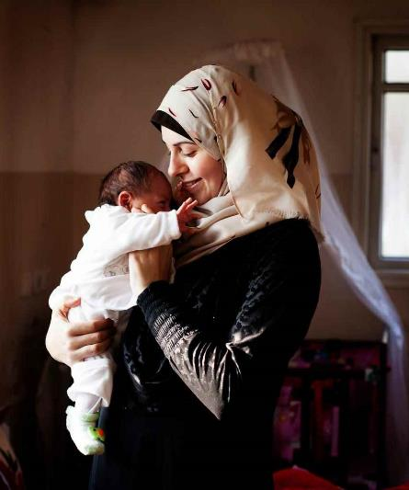
The postnatal period: a critical time for women and newborns
When is it?
The postnatal period is defined here as the period beginning immediately after the birth of the baby and lasting up to six weeks (42 days) after birth.
Immediate
(first 24hrs)
Early
(day 2 to day 7)
Late
(day 8 to day 42)
Safa Manasra with her first child Asil in Shejaiya, Palestine, in 2014. © UNICEF/UNI176354/d’Aki

Slide 8
What is postnatal care?
Objectives
Maintaining and promoting health and wellbeing
  Risk identification (assessments, screening)
  Prevention of complications
  Fostering support from the family & community
  Addressing health-related and social needs
Contents
Care of the mother
Care of the newborn
Health systems initiatives and policies to support the family unit and promote quality care provision

Slide 9
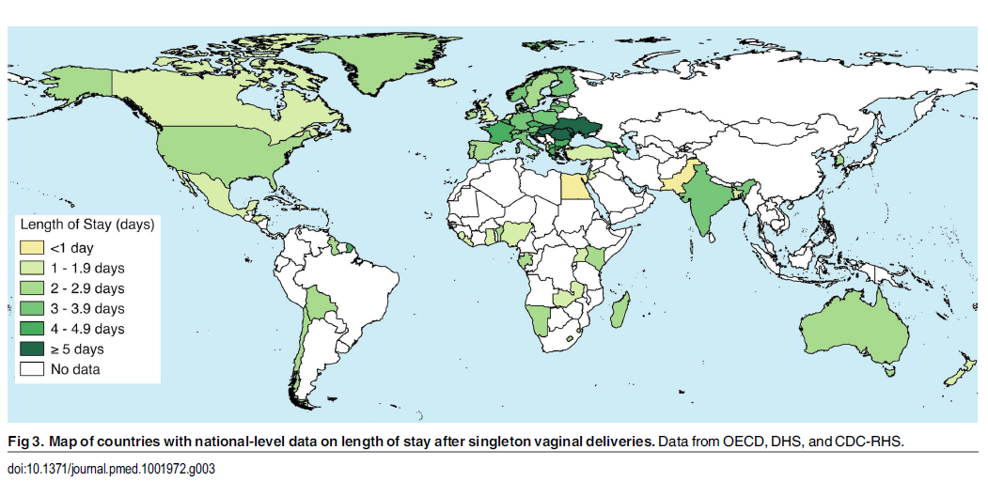
Coverage and quality lag behind global targets
Length of stay in the
health facility after birth varies widely across countries
Coverage and quality of postnatal care for women and newborns tend to be relatively poor, and opportunities to increase well-being and support nurturing newborn care are lost.
71 countries (DHS, OECD, CDC)
+ LINK: Campbell et al. 2016. Length of stay after childbirth in 92 countries and associated factors in 30 low- and middle-income countries: compilation of reported data and a cross-sectional analysis from nationally representative surveys

Slide 10
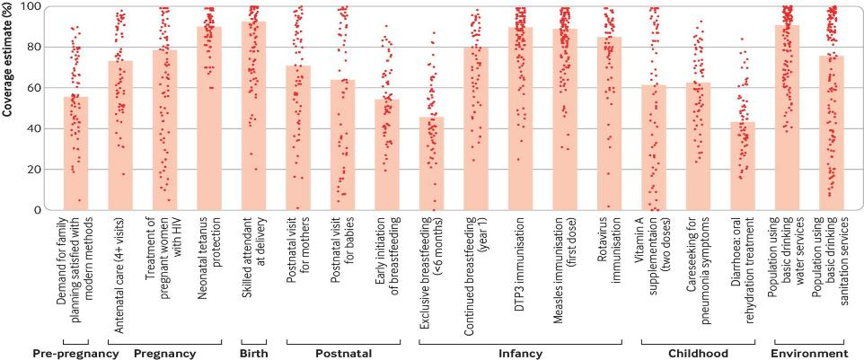
Coverage and quality lag behind global targets
PNC contacts have one of the lowest levels of coverage across the continuum of care for women and infants
Median coverage for routine postnatal care within two days after birth still lags behind global targets for 2025:
Figure indicates coverage for routine PNC within 2 days after birth (median)
+ LINK: Requejo et al., 2020. Assessing coverage of interventions for reproductive, maternal, newborn, child, and adolescent health and nutrition
Women = 71%
Newborns = 64%

Slide 11

Guideline scope: who?
This guideline is relevant for the care of all women and adolescent girls in the postpartum period, and newborns in any health-care facility or community-based setting, unless otherwise indicated in a specific recommendation.
Based on the premise that all women and newborns deserve high-quality care, the guideline focuses on the core, essential postnatal care package.
The term “healthy women and newborns” is used to describe women or adolescent girls after childbirth and their newborns who have no apparent risk factors or illness, and who otherwise appear to be healthy.
A mother holds a smiling baby, Kazakhstan. UNICEF Kazakhstan/2016/Kim

Slide 12
Guideline scope: who?
Some women and their newborns can have additional health and social needs that are not covered in this guideline, including in the case of death of the woman or baby.
This guideline is therefore complementary to existing WHO guidance on the immediate care of the woman and newborn after birth, management of complications during pregnancy, childbirth and the postnatal period and care of preterm and low birthweight infant
Individuals with additional needs may also include adolescent girls and those from priority groups, including, among others, those living in rural settings, those facing financial hardship, those from ethnic, religious and racial minorities, migrant and displaced or war-affected individuals, unmarried women and girls, survivors of sexual- and gender-based violence, surrogates, sex workers, transgender or nonbinary individuals, those with disabilities or mental health conditions, and those living with HIV.

Slide 13
Guideline scope: What? When and where?
By whom? How?
Delivery arrangements
Timing of discharge, time and place of contacts, discharge readiness
Individual interventions
Assessments, screening, preventive measures, interventions for common physiological symptoms, nutritional interventions, breastfeeding, immunization, responsive caregiving, security and safety;
self-care and family care practices
When
and where?
What?
Health systems and health promotion
Facility-based policies,
health promotion, support, education, workforce management, digital health
Competent and
motivated providers
Skilled personnel, CHWs
By
whom?
How to
Support?

Slide 14
Methods
Contributors to the guideline
Priority questions
Confidence in the evidence
Developing the recommendations
Integration of recommendations
02

Slide 15

Contributors to the guideline
    WHO Steering Group
    Staff members from the Departments of Maternal, Newborn, Child and Adolescent Health and Ageing (MCA), Mental Health and Substance Use (MSD), Nutrition and Food Safety (NFS), and Sexual and Reproductive Health and Research (SHR); who managed the guideline development process.
    Guideline Development Group
    A diverse group of 21 external experts and stakeholders from the six WHO regions with expertise in research, clinical practice, policy and programmes, guideline development methods relating to postnatal care practices and service delivery, and patient/consumer representatives.
    Members were identified in a way that ensures geographic representation and gender balance and had no important conflicts of interest.

Slide 16
Contributors to the guideline
    External Review Group
    Six technical experts and stakeholders with an interest in the provision and experience of evidence-based postnatal care. The External Review Group peer-reviewed the final document to identify any errors of fact and comment on clarity of the language, contextual issues and implications for implementation.
    Technical Working Group
    Guideline methodologists and systematic review team leads, who worked closely with the WHO Steering group to synthesize the evidence and other considerations for development of the recommendations.
    External partners and observers
    Representatives of Bill and Melinda Gates Foundation, FIGO, ICM, IPA, UNICEF, UNFPA, and USAID.

Slide 17
Priority questions
Women want to...
Focussing on what matters to women
adapt to their new self-identity
develop confidence and competence as a mother
    A qualitative evidence synthesis was conducted to understand what women want, need and value during the postnatal period. It found:
    The postnatal phase is a period of significant transition characterised by changes in self-identity, the redefinition of relationships, opportunities for personal growth, and alterations to sexual behaviour as women adjust to the new position both as parents and as individuals within their own cultural context, also marked by feelings of intense joy and happiness and love for their baby.
adjust to changes in intimate and family relationships (including with the baby)
have consistent, culturally appropriate, understandable support and information
navigate ordinary physical and emotional challenges

Slide 18


Priority questions
Focussing on what matters to women
    Altogether, women want a positive postnatal experience:
    A positive postnatal experience is defined as one in which women, partners, parents, caregivers and families receive information and reassurance in a consistent manner from motivated health workers. Both the women’s and babies’ health, social and developmental needs are recognized, within a resourced and flexible health system that respects their cultural context.
    Therefore, WHO used a consultative process to identify priority questions related to the effectiveness of clinical and non-clinical practices aimed at helping women achieve their expectations of the postnatal period.
Source: WHO

Slide 19





Confidence in the evidence
The GRADE approach
  Systematic reviews of
  quantitative evidence
  Resource implications, cost-effectiveness, and equity evidence
  Systematic reviews of
  quantitative evidence
    “What are the desirable and undesirable effects of the intervention?” and “What is the certainty of the evidence on effects?”
    “Is there important uncertainty or variability in how much women value the outcomes associated with the intervention?” and “Is the intervention acceptable and feasible to implement by women, health care providers, relevant stakeholders?”
    “What are the resources associated with the intervention?”, “Is the intervention/option cost-effective?”, What is the anticipated impact on health equity?”
  GRADE Evidence-to-Decision (EtD) frameworks
  These include explicit and systematic consideration of evidence on prioritized interventions in terms of effects, values, resources, equity, acceptability and feasibility.

Slide 20

Developing the recommendations
Adapting to the Covid-19 pandemic
Nine virtual GDG meetings were held each 1-2 months between September 2020 and June 2021.
Due to the need to accommodate various timezones, each GDG meeting lasted for a maximum of 3 hours.
Since virtual meetings were held over an extended period of time, the WHO Steering Group provided in batches the EtD frameworks, including evidence summaries, GRADE evidence profiles, and other documents related to each recommendation, to GDG members as soon as the documents were drafted in advance of the GDG meetings.
    Photo by Chris Montgomery on Unsplash

Slide 21


Developing the recommendations
Evidence synthesis
The GDG meetings were held to reach consensus on each recommendation, including its direction and in some instances the specific context, based on EtD frameworks, GRADE evidence profiles and evidence summaries.
+
+
Grade evidence profiles
EtD frameworks
Evidence summaries

Slide 22

Developing the recommendations
Recommended in specific contexts
Not recommended
Recommended with rigorous research
Reaching consensus
Recommended
Consensus was defined as the agreement by three quarters or more of the GDG, provided that those who disagreed did not feel strongly about their position.
In line with other recently published WHO guidelines using EtD frameworks, the GDG classified each recommendation into one of four categories.

Slide 23
Integration of recommendations
Existing WHO recommendations relevant to postnatal care
In order to harmonize and consolidate all recommendations that are relevant to the care of healthy women and healthy babies in the postnatal period into a single document, existing WHO recommendations that were within the scope of essential, routine postnatal care, and which were previously approved by the Guideline Review Committee, were identified, presented to the GDG and integrated into this guideline.
“Integrated from”
Recommendation taken from the associated guideline
without modification or revalidation.
“Adapted and integrated from”
Recommendation adapted for the purposes of the postnatal care guideline. Here, relevant WHO departments that produced the specific guidance were consulted to confirm that adaptations were feasible given the evidence base.

Slide 24
Recommendations
A Maternal care
B Newborn care
C Health systems and health promotion interventions
03

Slide 25

63 Recommendations included
31
new/updated
recommendations
32
integrated
recommendations
  Recommendations are grouped according to
  Further subcategories of recommendations are presented for maternal and newborn care (e.g. “preventative measures”, “nutritional interventions”, “breastfeeding”).
      The full guideline and the supporting GRADE evidence profiles
      are available at https://www.who.int/publications/i/item/9789240045989

Slide 26

Maternal health
Recommendations 1-24
A.1 Maternal assessment
A.2 Interventions for common physiological signs and symptoms
A.3 Preventive measures
A.4 Mental health interventions
A.5 Nutritional interventions and physical activity
A.6 Contraception
A

Slide 27

A.1 Maternal assessment
Integrated recommendation
1. Physiological assessment of the woman
All postpartum women should have regular assessment of vaginal bleeding, uterine tonus, fundal height, temperature and heart rate (pulse) routinely during the first 24 hours, starting from the first hour after birth. Blood pressure should be measured shortly after birth. If normal, the second blood pressure measurement should be taken within 6 hours. Urine void should be documented within 6 hours.
At each subsequent postnatal contact beyond 24 hours after birth, enquiries should continue to be made about general well-being and assessments made regarding the following: micturition and urinary incontinence, bowel function, healing of any perineal wound, headache, fatigue, back pain, perineal pain and perineal hygiene, breast pain and uterine tenderness and lochia.
Maternal Assessment

Slide 28
A.1 Maternal assessment
Integrated recommendations
2a & 2b. HIV catch-up testing
In high HIV burden settings, catch-up postpartum HIV testing is needed for women of HIV-negative or unknown status who missed early antenatal contact testing or retesting in late pregnancy at a third trimester visit.
In low HIV burden settings, catch-up postpartum HIV testing can be considered for women of HIV negative or unknown status who missed early antenatal contact testing or retesting in late pregnancy at a third trimester visit as part of the effort to eliminate mother-to-child transmission of HIV. Countries could consider this only for women who are in serodiscordant relationships, where the partner is not virally suppressed on ART, or who had other known ongoing HIV risks in late pregnancy at a third trimester visit.
Maternal Assessment

Slide 29
A.1 Maternal assessment
Integrated recommendations
3a-3c. Screening for tuberculosis disease
Systematic screening for tuberculosis (TB) disease may be conducted among the general population, including of women in the postpartum period, in areas with an estimated TB disease prevalence of 0.5% or higher.
In settings where the TB disease prevalence in the general population is 100/100 000 population or higher, systematic screening for TB disease may be conducted among women in the postpartum period.
Household contacts and other close contacts of individuals with TB disease, including women in the postpartum period and newborns, should be systematically screened for TB disease.
Maternal Assessment

Slide 30
A.2 Common physiological signs and symptoms
4-6. Postpartum pain relief
Acute pain from perineal trauma
Local cooling, such as with ice packs or cold pads, can be offered to women in the immediate postpartum period for the relief of acute pain from perineal trauma sustained during childbirth, based on a woman’s preferences and available options.
Postpartum perineal pain
Oral paracetamol is recommended as first-line choice when oral analgesia is required for the relief of postpartum perineal pain.
Uterine cramping/involution
Oral non-steroidal anti-inflammatory drugs (NSAIDs) can be used when analgesia is required for the relief of postpartum pain due to uterine cramping after childbirth, based on a woman’s preferences, the clinician’s experience with analgesics and availability.
Common physiological signs and symptoms

Slide 31
A.2 Common physiological signs and symptoms
4-6. Postpartum pain relief
Postpartum pain relief should be individualized, considering the presence of perineal trauma, intensity of the pain, multiple sources of postpartum pain (such as perineal, uterine, breast pain), and the use of other forms of pain relief.
All women should be asked about postpartum pain during their postpartum stay in health facilities and at each postnatal care contact.
Women should be advised on danger signs and symptoms, including any exacerbation of pain as manifestation of postpartum complications.
Common physiological signs and symptoms

Slide 32
A.2 Common physiological signs and symptoms
7. Pelvic floor muscle training for pelvic floor strengthening
For postpartum women, starting routine pelvic floor muscle training (PFMT) after childbirth for the prevention of postpartum urinary and faecal incontinence is not recommended.
While PFMT started after childbirth is not recommended as a preventive measure, women with involuntary loss of small volumes of urine (urinary stress incontinence) after childbirth should be advised of the potential benefits of PFMT for treatment of urinary incontinence. For these women, in the absence of stronger evidence, the GDG agreed that unsupervised pelvic floor exercises performed at home may be beneficial and are unlikely to cause harmful effects.
For postpartum women, starting routine pelvic floor muscle training after childbirth for the prevention of postpartum urinary and faecal incontinence is not recommended.
Common physiological signs and symptoms

Slide 33
A.2 Common physiological signs and symptoms
8 & 9. Interventions to treat postpartum breast engorgement
The use of pharmacological interventions such as subcutaneous oxytocin and proteolytic enzyme therapy for the treatment of breast engorgement in the postpartum period is not recommended.
For treatment of breast engorgement in the postpartum period, women should be counselled and supported to practice responsive breastfeeding, good positioning and attachment of the baby to the breast, expression of breastmilk, and the use of warm or cold compresses, based on a woman’s preferences.
Responsive breastfeeding
The mother responding to her baby’s cues, as well as her own desire to breastfeed. Responsive feeding is distinct from demand feeding, as it recognizes the reciprocal mother–baby relationship and benefits of breastfeeding beyond the alleviation of hunger.
Common physiological signs and symptoms

Slide 34
A.2 Common physiological signs and symptoms
10 & 11. Interventions to prevent postpartum mastitis
For the prevention of mastitis in the postpartum period, women should be counselled and supported to practise responsive breastfeeding, good positioning and attachment of the baby to the breast, hand expression of breastmilk, and the use of warm or cold compresses, based on a woman’s preferences.
Routine oral or topical antibiotic prophylaxis for the prevention of mastitis in the postpartum period is not recommended.
Why not?
The GDG emphasized the risk of adverse effects of antibiotics for the woman and the newborn, and the negative public health impact of routine antibiotic administration on the global efforts to contain antimicrobial resistance.
Common physiological signs and symptoms

Slide 35
A.3 Preventive measures
12 & 13. Prevention of postpartum constipation
Dietary advice and information on factors associated with constipation should be offered to women for the prevention of postpartum constipation.
Routine use of laxatives for the prevention of postpartum constipation is not recommended.
A stepwise approach
The GDG took into account a stepwise approach for the prevention and treatment of constipation in the adult population, where the use of laxatives is applied only if dietary modifications or fibre supplementation fail to relieve the constipation.
Preventive measures

Slide 36


A.3 Preventive measures
Integrated recommendation
14. Maternal peripartum infection
Routine antibiotic prophylaxis for women with uncomplicated vaginal birth is not recommended.
WHO /Sergey Volkov Illustration about child and maternal health in Russia
Preventive measures

Slide 37
A.3 Preventive measures
Integrated recommendations
15-16. Other maternal infections
Preventive chemotherapy (deworming) for soil-transmitted helminthiases and schistosomiasis
Preventive chemotherapy (deworming), using annual or biannuala single-dose albendazole (400 mg) or mebendazole (500 mg), is recommended as a public health intervention for all non-pregnant adolescent girls and women of reproductive age, including postpartum and/or lactating women, living in areas where the baseline prevalence of any soil-transmitted helminth infection is 20% or more among adolescent girls and women of reproductive age, in order to reduce the worm burden of soil-transmitted helminths.
In endemic communities with Schistosoma spp. prevalence of 10% or higher, WHO recommends annual preventive chemotherapy with praziquantel in a single dose for ≥ 75% up to 100% of pregnant women after the first trimester, and non-pregnant adolescent girls and women of reproductive age, including postpartum and/or lactating women, to control schistosomiasis morbidity and move towards eliminating the disease as a public health problem.
In endemic communities with Schistosoma spp. prevalence of less than 10%, WHO suggests one of two approaches based on the programmes’ objectives and resources: (i) where there has been a programme of regular preventive chemotherapy, continuing preventive chemotherapy at the same or a reduced frequency towards interruption of transmission; and (ii) where there has not been a programme of regular preventive chemotherapy, a clinical approach of test-and-treat, instead of preventive chemotherapy targeting a population.
Preventive measures

Slide 38

A.3 Preventive measures
Integrated recommendation
17. Other maternal infections
Oral pre-exposure prophylaxis (PrEP)
Oral pre-exposure prophylaxis (PrEP) containing tenofovir disoproxil fumarate (TDF) should be started or continued as an additional prevention choice for postpartum and/or lactating women at substantial risk of HIV infection as part of combination HIV prevention approaches.
A mother with her one day old baby in Port Moresby Hospital, Papua New Guinea © UNICEF/2014/Justine Nanking
Preventive measures

Slide 39
A.4 Mental health interventions
18. Screening for postpartum depression and anxiety
Screening for postpartum depression and anxiety using a validated instrument is recommended and should be accompanied by diagnostic and management services for women who screen positive.
Systems for referral, diagnosis and management of women should be established or strengthened to ensure adequate follow-up and management for those who screen positive.
Mental health interventions

Slide 40
A.4 Mental health interventions
19. Prevention of postpartum anxiety and depression
Psychosocial and/or psychological interventions during the antenatal and postnatal period are recommended to prevent postpartum depression and anxiety.
The provision of these interventions should be decided in a collaborative manner based on the woman’s preference and the care provider’s ability to deliver the intervention in terms of training, expertise and experience.
Mental health interventions

Slide 41
A.5 Nutritional interventions & physical activity
Integrated recommendations
20 & 21. Iron, folate and vitamin A supplementation
Oral iron supplementation
Oral iron supplementation, either alone or in combination with folic acid supplementation, may be provided to postpartum women for 6–12 weeks following childbirth for reducing the risk of anaemia in settings where gestational anaemia is of public health concern.
Vitamin A supplementation
Vitamin A supplementation in postpartum women for the prevention of maternal and infant morbidity and mortality is not recommended.
Nutritional interventions & physical activity

Slide 42
A.5 Nutritional interventions & physical activity
Integrated recommendations
22 & 23. Physical activity and sedentary behaviour
All postpartum women without contraindication should:
undertake regular physical activity throughout the postpartum period;
do at least 150 minutes of physical activity throughout the week for substantial health benefits; and
incorporate a variety of physical and muscle-strengthening activities; adding gentle stretching may also be beneficial.
Postpartum women should limit the amount of time spent being sedentary. Replacing sedentary time with physical activity of any intensity (including light intensity) provides health benefits.
Nutritional interventions & physical activity

Slide 43

A.6 Contraception
Integrated recommendation
24. Postpartum contraception
Provision of comprehensive contraceptive information and services during postnatal care is recommended.
All postpartum women and couples should be offered evidence-based, comprehensive contraceptive information, education and counselling to ensure informed choice for their own use of modern contraception without discrimination.
Contraception

Slide 44

Newborn health
Recommendations 25-43
B.1 Newborn assessment
B.2 Preventive measures
B.3 Nutritional interventions
B.4 Infant growth and development
B.5 Breastfeeding
B

Slide 45

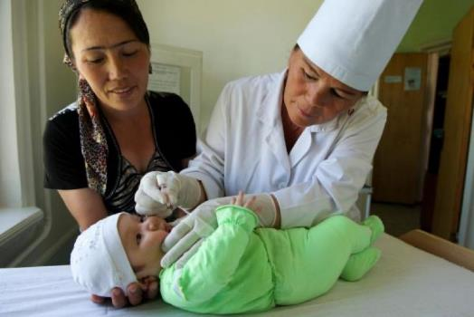
B.1 Newborn assessment
Integrated recommendation
25. Assessment of the newborn for danger signs
The following signs should be assessed during each postnatal care contact, and the newborn should be referred for further evaluation if any of the signs is present:
not feeding well
history of convulsions
fast breathing (breathing rate > 60 per minute)
severe chest in-drawing
no spontaneous movement
fever (temperature > 37.5 °C)
low body temperature (temperature < 35.5 °C)
any jaundice in first 24 hours after birth, or
yellow palms and soles at any age
The parents and family should be encouraged to seek health care early if they identify any of the above danger signs between postnatal care visits.
Source: UNICEF
Newborn assessment

Slide 46
B.1 Newborn assessment
26. Universal screening for abnormalities of the eye
Universal newborn screening for abnormalities of the eye is recommended and should be accompanied by diagnostic and management services for children identified with an abnormality.
When?
Screening should be done prior to discharge after a health-facility birth, or at the first postnatal care contact in an outpatient setting after a home birth. Ideally, the screening should be done within the first 6 weeks after birth.
Follow-up & management is critical
Systems for screening, referral, diagnosis and management should be established or strengthened to ensure adequate follow-up and management for those who screen positive.
Newborn assessment

Slide 47
B.1 Newborn assessment
27. Universal screening for hearing impairment
Universal newborn hearing screening (UNHS) with otoacoustic emissions (OAE) or automated auditory brain stem response (AABR) is recommended for early identification of permanent bilateral hearing loss (PBHL). UNHS should be accompanied by diagnostic and management services for children identified with hearing loss.
Follow-up & management is critical
The principles for screening programmes must be implemented throughout UNHS introduction and scale-up. In settings where principles for screening are not met, implementation of universal screening may be considered unethical.
Newborn assessment

Slide 48
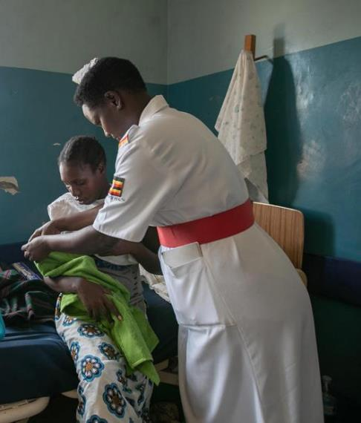
B.1 Newborn assessment
28 & 29. Universal screening for neonatal hyperbilirubinemia
Universal screening for neonatal hyperbilirubinemia by transcutaneous bilirubinometer (TcB) is recommended at health facility discharge.
There is insufficient evidence to recommend for or against universal screening by total serum bilirubin (TSB) at health facility discharge.
UNICEF/Abdul Maternity ward, Uganda
Newborn assessment

Slide 49
B.2 Preventive measures
30. Timing of first bath to prevent hypothermia and its sequelae
The GDG suggested that all measures should be taken to minimize heat loss during bathing, which include:
maintaining a neutral thermal environment,
immediate drying,
appropriate clothing of the newborn for the ambient temperature (1–2 layers of clothes more than adults, and use of hats/caps), and
allowing the mother and baby to remain together at all times
The first bath of a term, healthy newborn should be delayed for at least 24 hours after birth.
Preventive measures

Slide 50

B.2 Preventive measures
31. Use of emollients for the prevention of skin conditions
Routine application of topical emollients in term, healthy newborns for the prevention of skin conditions is not recommended.
What are topical emollients?
Creams, ointments, lotions, oils, gels, sprays and emulsions for skin care, applied routinely to whole or part of the body.
Why not?
The GDG agreed there was insufficient evidence on the benefits and harms, if any, of routine application of topical emollients in term, healthy newborns for either preventing skin conditions or atopic sensitization to allergens.
Preventive measures

Slide 51

B.2 Preventive measures
32a & 32b. Application of chlorhexidine to the umbilical cord stump for the prevention of neonatal infection
Clean, dry umbilical cord care is recommended.
Daily application of 4% chlorhexidine (7.1% chlorhexidine digluconate aqueous solution or gel, delivering 4% chlorhexidine) to the umbilical cord stump in the first week after birth is recommended only in settings where harmful traditional substances (e.g. animal dung) are commonly used on the umbilical cord.
Siphiwe with her daughter Lundiwe in South Africa in 2014.
© UNICEF/UNI182258/Schermbrucker
Preventive measures

Slide 52

B.2 Preventive measures
33. Sleeping position for the prevention of sudden infant death syndrome
Putting the baby to sleep in the supine position during the first year is recommended to prevent sudden infant death syndrome (SIDS) and sudden unexpected death in infancy (SUDI).
Saundy Sagui, an indigenous Mayan woman, cradles her newborn son in Cobán, Guatemala in 2012. © UNICEF/UNI139090/Markisz
Preventive measures

Slide 53

B.2 Preventive measures
Integrated recommendation
34. Immunization for the prevention of infections
Newborn immunization should be promoted as per the latest existing WHO recommendations for routine immunization.
Photo by Hollie Santos on Unsplash
Preventive measures

Slide 54
B.3 Nutritional interventions
35a & 35b. Neonatal supplementation of vitamin A
Routine neonatal vitamin A supplementation is not recommended to reduce neonatal and infant mortality.
In making this recommendation, the GDG emphasized the need to avoid harm, given the uncertainty of the evidence and the conflicting results of research studies, as well as implementation costs.
In settings with recent (within the last five years) and reliable data that indicate a high infant mortality rate (greater than 50 per 1000 live births) and a high prevalence of maternal vitamin A deficiency (> 10% of pregnant women with serum retinol concentrations < 0.70 µmol/L), providing newborns with a single oral dose of 50 000 IU of vitamin A within the first three days after birth may be considered to reduce infant mortality.
Nutritional interventions

Slide 55
B.3 Nutritional interventions
36. Neonatal supplementation of vitamin D
Vitamin D supplementation in breastfed, term infants is recommended for improving infant health outcomes only in the context of rigorous research.
Why?
There is insufficient evidence on the benefits and harms, if any, of routine vitamin D supplementation on health outcomes of term, breastfed infants.
What research?
Research in this context includes adequately powered studies on the effect of neonatal vitamin D supplementation on mortality, morbidity, growth and development, including clinically relevant outcomes, assessment of vitamin D status and cost effectiveness of this intervention in breastfed and non-breastfed infants.
Nutritional interventions

Slide 56
B.4 Infant growth and development
37. Whole-body massage
Gentle whole-body massage may be considered for term, healthy newborns for its possible benefits on growth and development.
Babies’ reactions to whole-body massage must be respected in line with the principles of responsive caregiving and respectful care. Massage should be used as an important opportunity to promote parent–infant interaction and stimulation for early childhood development.
Infant growth and development

Slide 57
B.4 Infant growth and development
Integrated recommendations
38-41. Improving early childhood development
All infants and children should receive responsive care between 0 and 3 years of age; parents and other caregivers should be supported to provide responsive care.
All infants and children should have early learning activities with their parents and other caregivers between 0 and 3 years of age; parents and other caregivers should be supported to engage in early learning with their infants and children.
Support for responsive care and early learning should be included as part of interventions for optimal nutrition of newborns, infants and young children.
Psychosocial interventions to support maternal mental health should be integrated into early childhood health and development services.
Infant growth and development

Slide 58
B.5 Breastfeeding
Integrated recommendations
42-43. Exclusive breastfeeding & supporting breastfeeding in health facilities
Exclusive breastfeeding
Supporting breastfeeding in health facilities
All babies should be exclusively breastfed from birth until 6 months of age. Mothers should be counselled and provided with support for exclusive breastfeeding at each postnatal contact.
Facilities providing maternity and newborn services should have a clearly written breastfeeding policy that is routinely communicated to staff and parents.
Health-facility staff who provide infant feeding services, including breastfeeding support, should have sufficient knowledge, competence and skills to support women to breastfeed.
Breastfeeding

Slide 59

Health systems and health promotion
Recommendations 44-55
C
C Health systems and health promotion interventions

Slide 60
C Health systems and health promotion
44. Schedules for postnatal care contacts
At every contact:
Women, newborns, parents and caregivers should receive respectful, individualized, person-centred care.
Care should include effective clinical practices, relevant and timely information, and psychosocial and emotional support.
Care should be provided by kind, competent and motivated health workers who are working within a well-functioning health system.
A minimum of four postnatal care contacts is recommended:
If birth is in a health facility, healthy women and newborns should receive postnatal care in the facility for at least 24 hours after birth. If birth is at home, the first postnatal contact should be as early as possible within 24 hours of birth. At least three additional postnatal contacts are recommended for healthy women and newborns, between 48 and 72 hours, between 7 and 14 days, and during week 6 after birth.
Health systems and health promotion interventions

Slide 61
C Health systems and health promotion
45. Length of stay in health facilities after birth
Care for healthy women and newborns in the health facility is recommended for at least 24 hours after vaginal birth.
Key considerations for timing of discharge
The time needed to complete the assessment of a comprehensive set of criteria to evaluate maternal and newborn well-being and needs.
The health system’s capacity to organize postnatal care contacts after discharge.
Avoidance of unnecessarily prolonged stays in health facilities.
Health systems and health promotion interventions

Slide 62
C Health systems and health promotion
46. Criteria to be assessed prior to discharge from the health facility after birth
Prior to discharging women and newborns after birth from the health facility to the home, health workers should assess the following criteria to improve maternal and newborn outcomes:
the woman’s and baby’s physical well-being and the woman’s emotional well-being;
the skills and confidence of the woman to care for herself and the skills and confidence of the parents and caregivers to care for the newborn; and
the home environment and other factors that may influence the ability to provide care for the woman and the newborn in the home, and care-seeking behaviour.
These criteria should be assessed to guide health workers to identify and manage problems before discharge, to provide information as per the individual woman, newborn and family needs, and to establish links to follow-up care and additional support that may be required.
Health systems and health promotion interventions

Slide 63


C Health systems and health promotion
47. Approaches to strengthen preparation for discharge from the health facility to home after birth
Information provision, educational interventions and counselling are recommended to prepare women, parents and caregivers for discharge from the health facility after birth to improve maternal and newborn health outcomes, and to facilitate the transition to the home. Educational materials, such as written/ digital education booklets, pictorials for semi-literate populations and job aids should be available.
Source: UNICEF
Health systems and health promotion interventions

Slide 64
C Health systems and health promotion
48. Home visits for postnatal care contacts
Home visits during the first week after birth by skilled health personnel or a trained community health worker are recommended for the postnatal care of healthy women and newborns. Where home visits are not feasible or not preferred, outpatient postnatal care contacts are recommended.
The capacity of the health system to provide postnatal care home visits should be assessed based on:
local availability of skilled and trained health work force
distribution of tasks among the health workforce and the competing responsibilities with other health programmes
capacity to provide initial and continuous training and supervision,
content of the postnatal care home visits
accessibility for hard to reach populations
coordination between facility- and community-based services
sustainability of the home visits programme and of the supply systems
Health systems and health promotion interventions

Slide 65
C Health systems and health promotion
Integrated recommendations
49-50. Workforce interventions
Midwife-led continuity-of-care
Task sharing the promotion of health-related behaviours
Midwife-led continuity-of-care (MLCC) models, in which a known midwife or small group of known midwives supports a woman throughout the antenatal, intrapartum and postnatal continuum, are recommended for women in settings with well-functioning midwifery programmes.
Task sharing the promotion of health-related behaviours for maternal and newborn health to a broad range of cadres, including lay health workers, auxiliary nurses, nurses, midwives and doctors, is recommended.
Task sharing the provision of recommended postpartum contraception methods to a broad range of cadres, including auxiliary nurses, nurses, midwives and doctors, is recommended.
Health systems and health promotion interventions

Slide 66
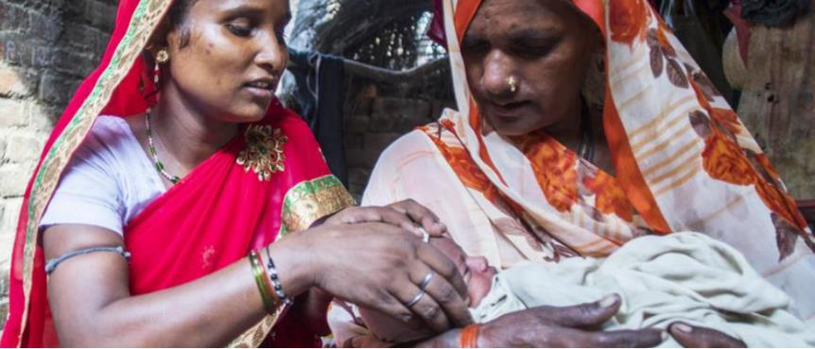
C Health systems and health promotion
Integrated recommendation
51. Workforce interventions
Health workforce in rural and remote areas
Policy-makers should consider a bundle of interventions covering education, regulation, incentives, and personal and professional support to improve health workforce development, attraction, recruitment and retention in rural and remote areas.
UNICEF/Vishwanathan
Health systems and health promotion interventions

Slide 67
C Health systems and health promotion
52. Involvement of men in postnatal care and maternal and newborn health
Interventions to promote the involvement of men during pregnancy, childbirth and after birth are recommended to facilitate and support improved self-care of women, home care practices for women and newborns, and use of skilled care for women and newborns during pregnancy, childbirth and the postnatal period, and to increase the timely use of facility care for obstetric and newborn complications.
These interventions are recommended, provided they are implemented in a way that respects, promotes and facilitates women’s choices and their autonomy in decision-making, and that supports women in taking care of themselves and their newborns.
Health systems and health promotion interventions

Slide 68
C Health systems and health promotion
Integrated recommendations
53-55. Information sharing & digital health interventions
The use of home-based records, as a complement to facility-based records, is recommended for the care of pregnant and postpartum women, newborns and children, to improve care-seeking behaviour, men’s involvement and support in the household, maternal and child home care practices, infant and child feeding, and communication between health workers and women, parents and caregivers.
WHO recommends digital targeted client communication for behaviour change regarding sexual, reproductive, maternal, newborn and child health, under the condition that concerns about sensitive content and data privacy are adequately addressed.
WHO recommends the use of digital birth notification under these conditions:
in settings where the notifications provide individual-level data to the health system and/or a civil registration and vital statistics (CRVS) system;
the health system and/or CRVS system has the capacity to respond to the notifications.
Health systems and health promotion interventions

Slide 69
Implementation
The WHO postnatal care model
General implementation considerations
Considerations specific to individual recommendations
04

Slide 70
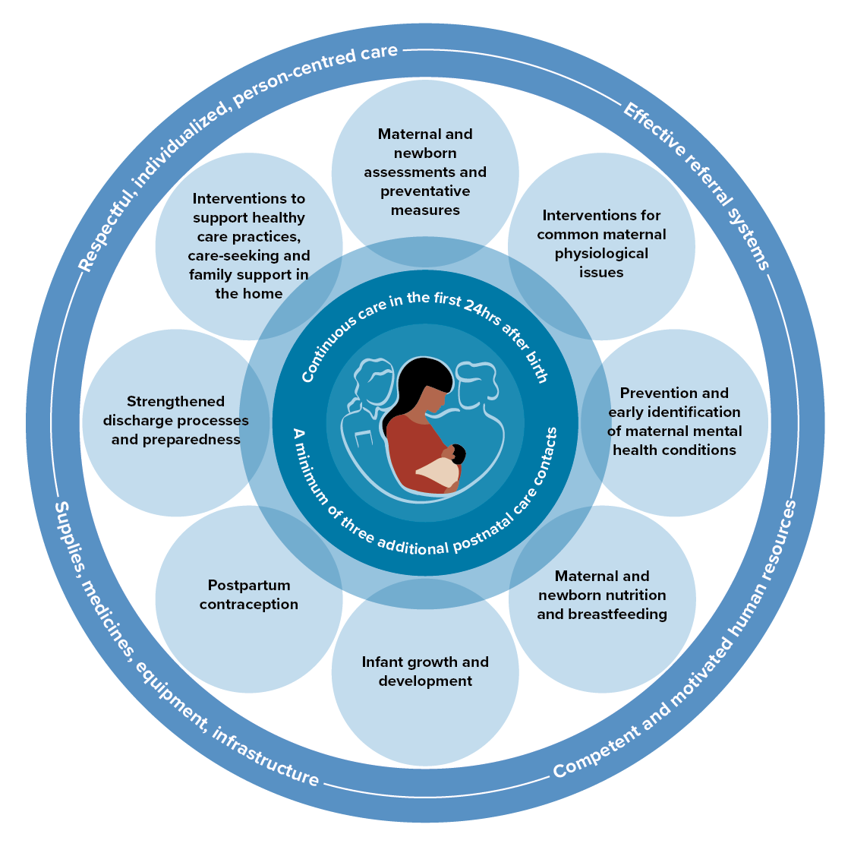
The WHO Postnatal Care Model
The WHO postnatal care model places the woman-newborn dyad at the centre of care, supported by quality care, family support, and continued support from health services.

Slide 71
Putting the guideline into context
General implementation considerations
Health policy considerations
for adoption and scale-up
Policy agenda-setting
Government buy-in and commitment
Public health funding & donors (e.g. in LMICs)
Situation-specific information on the expected impact on health services
Health system or organizational-level considerations for implementation
Updating national guidelines
Integration with existing national strategies
Training & supervision
Budgeting, resource acquisition and management
Quality improvement initiatives
User-level considerations for implementation
Quality improvement initiatives
Raising awareness of the importance of postnatal care
Promoting the notion of women’s and newborns’ fundamental human right to receive postnatal care for their health and well-being

Slide 72

Putting the guideline into context
Considerations specific to individual recommendations
In addition to the overarching WHO model of intrapartum care, implementation considerations specific to individual recommendations are presented as a Web Annex.
Source: UNICEF ROSA/2016/Nybo
The Web Annexes are available at https://www.who.int/publications/i/item/9789240045989

Slide 73

Who recommendations adaptation toolkit
To support implementation a WHO postnatal care recommendations adaptation toolkit will be available.
The toolkit will assist policy makers at the national level to adopt the WHO recommendations, by systematically adapting and effectively implementing the recommended interventions into routine practice.
UNICEF/UN0269343/Mukherjee AFP-Services

Slide 74
Dissemination
Global launch with press release
WHO web resources
Social media
Translations
Conferences and webinars
05

Slide 75
Dissemination
Press release | Commentary & blog | Infographics | Translations
Slidedoc | Conferences and webinars | FAQs | Evidence briefs
This guideline will be disseminated through WHO regional and country offices, ministries of health, professional organizations, WHO collaborating centres, other United Nations agencies and nongovernmental organizations and professional associations.
This guideline will be available on the WHO website and also as a printed publication.

Slide 76
Applicability issues
Potential barriers to implementation
06

Slide 77

Potential barriers to implementation
    Lack of human resources with the necessary expertise and skills to implement, supervise and support recommended practices.
    Lack of infrastructure to support interventions (e.g. lack of electricity for refrigeration; lack of access to clean water and sanitation; lack of physical space to conduct individual care and counselling).
    Difficulty accessing health services and health workers for women and newborns including lack of transport, geographical conditions, financial barriers.
    Lack of effective referral mechanisms and care pathways for women and newborns identified as needing additional care (e.g. subsequent newborn assessments).

Slide 78
Effective implementation of the recommendations
Reorganized postnatal care
Learning and professional development
Access to care
Resources Financial, physical, human, time
Infrastructure
Behaviour change
Health information systems
Resources
Effective implementation of the recommendations in this guideline may require reorganization of care and redistribution of health care resources.
A phased approach to adoption, adaptation and implementation may be prudent.
Infrastructure
Health information

Slide 79

Monitoring and evaluation
Monitoring framework
Suggested indicators
07

Slide 80

Monitoring framework
How do we track the performance and improve results?
    The implementation and impact of these recommendations should be monitored at the health service, sub-national and national levels.
    In collaboration with the monitoring and evaluation teams of the WHO Departments of MCA and SRH, data on country- and regional-level adoption of the recommendations will be collected and evaluated in the short to medium term across individual WHO Member States through the WHO Sexual, Reproductive, Maternal, Newborn, Child And Adolescent Health (SRMNCAH) Policy Survey.
    A full monitoring framework will be developed once the guidelines are finalized. In the meantime, the GDG suggested 4 indicators, adapted from current global recommended indicators.
UNI288585/Dejongh/2020

Slide 81
Suggested indicators
How do we track the performance and improve results?
Length of stay in health facilities after childbirth
Early routine postnatal care for women (within two days)
Early routine postnatal care for newborns (within two days)
Hepatitis B birth dose vaccination
    + LINK: Who maternal, newborn, child and adolescent health and ageing data porta

Slide 82
Updating the guideline
Living guidelines approach
New guideline questions?
Connecting with WHO
08

Slide 83
Living guidelines approach
    An Executive Guideline Steering Group (GSG) for maternal and newborn health recommendations will convene biannually to review WHO’s portfolio of maternal and newborn health recommendations, and to prioritize new and existing recommendations for development and updating, including where new recommendations or a change in the published recommendations may be warranted.
    WHO welcomes suggestions regarding additional questions for inclusion in future updates of this guideline; suggestions can be addressed by email to WHO MCA (mncah@who.int) and WHO SRH (srhmph@who.int).
A systematic and continuous process of surveillance, identification, and bridging of evidence gaps following guideline implementation will be employed.
Prioritize recommendation
Review evidence base
Update recommendation
  The living guidelines process

Slide 84


WHO’s vision for quality care of women and newborns is that every pregnant woman and newborn receives quality care throughout pregnancy, childbirth and the postnatal period.
Avalon and her young son Caleb hold newborn baby Tina in Fiji in 2016. ©UNICEF/UN012494/Sokhin

Slide 85
Many thanks to…
WHO Steering Group
Fernando Althabe, Rajiv Bahl, Mercedes Bonet, Neerja Chowdhary, Tarun Dua, Karen Edmond, Shuchita Gupta, Olufemi T Oladapo, Anayda Portela, Lisa Rogers, João Paulo Souza
  WHO Regional Advisors
  Jamela Al-Raiby, Bremen De Mucio, Pablo Duran, Karima Gholbzouri, Anoma Jayathilaka, Oleg Kuzmenko, Assumpta Muriithi, Triphonie Nkurunziza
  Guideline Development Group
  Shabina Ariff, Abdullah Baqui, Blami Dao, Louise Tina Day, Abiy Seifu Estifanos, Duncan Fisher, Jane Fisher, Zeele Hill, Caroline Homer, Tamar Kabakian-Khasholian, Mary Kinney, Tina Lavender, Pisake Lumbiganon, Adress Malata, Jim Neilson, Ibone Olza, Malvarappu Prakasamma, Siddarth Ramji, Parminder S Suchdev, Mark Tomlinson, Haifa Wahabi
External Review Group
  Rafat Jan, Silke Mader, Matthews Mathai, Linda Richter, Jane Sandall, Steve Wall
Technical Working Group
  Edgardo Abalos, Monica Chamillard, Virginia Diaz, Soo Downe, Kenneth Finlayson, Leanne Jones, Ani Movsisyan, Susan Munabi-Babigumura, Julia Pasquale, Yanina Sguassero, Aleena Wojcieszek
  External Partners and Observers
  Carlos Fuchtner (FIGO); Gagan Gupta, Tedbabe Degefie Hailegebriel (UNICEF); Petra Ten Hoope-Bender, Willibald Zeck (UNFPA); William Keenan (IPA); Smita Kumar, Rebecca Levine (USAID); Jeffrey Smith (Bill & Melinda Gates Foundation); Ann Yates (ICM)
  Funders
  USAID; HRP

Slide 86
Contact us
Getting in touch with WHO
    @HRPresearch
    World Health Organization
    Department of Sexual and Reproductive Health and Research
    srhmph@who.int
    Department of Maternal, Newborn, Child and Adolescent Health and Ageing
    mncah@who.int

