Slide 1
Challenges, Barriers and recommendations for Rehab work in COVID-19 Pandemic
Mathew Varghese
St Stephen’s Hospital
Delhi
July 2020

Slide 2
Challenges, Barriers and recommendations for Rehab work in COVID-19 Pandemic
Main Barriers
Closed or skeletal services
Access issues lack of public transport and taxies
Only persons with private vehicles could come
Need for interstate passes
FEAR factor about getting Corona infection from hospitals

Slide 3
Challenges, Barriers and recommendations for Rehab work in COVID-19 Pandemic
Initially anecdotal reports about PWDs
My admitted patients could not go back even though they were ready for discharge
Post operative patients could not get braces
Other colleagues also reported similar problems

Slide 4
Challenges, Barriers and recommendations for Rehab work in COVID-19 Pandemic
Decided to document the problems of persons with disabilities
Planned a project
On a multicentric study to look at problems faced by persons with disabilities during
Covid 19 pandemic

Slide 5
Project
Whose life is matters?
Challenges, Barriers and impact of Covid 19 Pandemic on persons with disabilities and their care givers

Slide 6
Challenges, Barriers and recommendations for Rehab work in COVID-19 Pandemic
Process
Development of a questionnaire
Consensus on the questionnaire
Consensus and approval on consent form
Translation of Consent form to some regional Languages
Telephonic survey started
14th April- May 8th 2020
Extended for Thallassemia and CMC Vellore

Slide 7
Rehab work in COVID-19 Pandemic
Institutions Involved
AADI, Delhi and Haryana
Arunodaya Eye Hospital, Haryana
CMC Vellore, Chittoor Campus, Andhra Pradesh
Children in India Trust, Delhi
Cure India International Trust, Delhi
Lady Hardinge Medical College, Delhi
Mobility India, Karnataka and Assam
National Institute of Speech and Hearing, Kerala
SDM Hospital, Jaipur
The Cradle, Delhi

Slide 8
Rehab work in COVID-19 Pandemic
Individuals Involved
Syamala Gidigu, AADI
Arun Seth, Arunodaya Eye Hospital
Suranjan Bhattacharji, CMC Vellore, Chittoor Campus
Santosh George, Children in India Trust
Santosh George, Cure India International Trust
Anil Gurtoo, Ritika Sood, Anupam Prakash,
Lady Hardinge Medical College
Albina Shankar, Mobility India
Shirly G, National Institute of Speech and Hearing
Anil Jain, SDM Hospital
Bipin B Choudhary, The Cradle
Mathew Varghese, St Stephen’s Hospital

Slide 9
Challenges, Barriers and recommendations for Rehab work in COVID-19 Pandemic
Condition/ Disability | Total Survey | Male / female
Cerebral Palsy | 687 | 457 / 230
Clubfoot | 3828 | 2495 / 1333
Thalassemia | 73 | 34/41
Autism | 29 | 20/9
Intellectual Disability | 28 | 22/6
Visual Challenge | 42 | 23/14
Hard of Hearing | 252 | 140/111
Deaf Adults | 77 | 43/34
Knee Amputation, Amputation, Trans Radial Amputation | 12 | 6 / 6
Hemiplegia, CVA, Stroke | 21 | 12 / 9
Polio | 19 | 11/8
Mental Illness | 31 | 20/11
Paraplegia, Paraplegia, MMC, Spinal Cord Injury | 14 | 2 / 12
Miscellaneous (Critical Neuropathy, SLE, Head Injury etc.) | 51 | 35/16
Total | 5165

Slide 10
Challenges, Barriers and recommendations for Rehab work in COVID-19 Pandemic
General - Common to all
No income
No food
> 90% - lost job
Spouse loosing job and no income
Lost job and can’t take family members for treatment

Slide 11
Challenges, Barriers and recommendations for Rehab work in COVID-19 Pandemic
General - Common to all
No shops nearby and no vehicle to reach shops
Three-wheeler accessibility was completely blocked during lock-down so poor could not go anywhere
Relatives could not bring regular food because of lock-down

Slide 12
Challenges, Barriers and recommendations for Rehab work in COVID-19 Pandemic
General - Common to all
Sleep cycle and pattern affected in most
Psychological Issues in most Not Admitted
Many Sad, Irritable
Anger, fear of uncertainty and loss
Feeling caged down
Privacy affected especially for most living in small houses

Slide 13
Cerebral Palsy
CIIT, Mobility India, AADI, Delhi
687 cases of cerebral palsy
457 Male 230 Females
45% had no disability Certificate
94% live with family
63% said they have no access to Medical/EMS

Slide 14
Cerebral Palsy
CIIT, Mobility India, AADI, Delhi
Access to rehab services- PT/OT/Speech Therapy
Counselling / Behaviour management
Special Education
Orthotics and assistive aids and devices ?
68% answered NO ACCESS

Slide 15
Cerebral Palsy
AADI, Delhi
55 Cases of CP
Finance issues
Procurement of Grocery as sales persons not allowed in colonies
42% Mood Swings and Irritated
33% admitted they were sad
Large number had issues with
Orthosis and Therapy

Slide 16
Cerebral Palsy
Urban and Rural
Meeting with peers, daily activities at AADI, cannot be replaced at home.
TV, Smart phone not there, so unable to cope with loneliness during lockdown.

Slide 17
Cerebral Palsy, Rural
Lack of a Disability certificate
This affects entitlement
Pension , scholarship money of People with disabilities are used for managing daily essentials for family

Slide 18
Cerebral Palsy, Rural
Repair of mobility aids, prosthetics, orthotics and adaptive assistive aids &
Glasses , hearing aids affected
Dignity & Privacy are now compromised for longer period of time

Slide 19
Intellectual Disability
AADI, Delhi
Intellectual Impairment
28 Persons interviewed
50 % received no support from any scheme
33% were worried with fears
Many upset with lack of routine

Slide 20
Intellectual Impairment, Rural
Persons with intellectual impairment have very little information about Covid19.
No information available in accessible and contextual format about Covid 19

Slide 21
Autism
AADI, Delhi
Autism
21 Cases Interviewed 9 Females
67% Irritated, sad
76% Sleep disturbance
41% Eating problems
Restless and start self-hitting
Do not smile and remain sad

Slide 22
Intellectual Impairment Urban
Autism
Find it difficult to be Confined with parents all day
Some cry, others scream, become aggressive
Parents have difficult time managing them
Finding it difficult to learn from online method of teaching

Slide 23
Mental Illness
AADI, Delhi and Haryana
Questions on Precautions for Covid 19 Prevention
41% unaware of Covid
39% admitted Mood Changes
26% admitted Change in food habits
42% had access issues with counselling
A majority had Financial, Job and food issues
Many reported Compatibility issues at home

Slide 24
Deaf and Hard of Hearing
National institute of Speech and Hearing
A Video questionnaire made with Sign Language First

Slide 25
Deaf and Hard of Hearing
National institute of Speech and Hearing
Deaf Adults 77
All the deaf adults answered questions themselves based on questionnaire put on Sign Language Video
Hard of Hearing Children 252
Answered by caregivers

Slide 26
Deaf Adults
National Institute of Speech and Hearing, Kerala
77 cases Deaf 252 Impaired Hearing
92% had disability Certificates
7% Irritated 16%
21% felt Sad 22%

Slide 27
Deaf Adults, Hard of Hearing
National Institute of Speech and Hearing, Kerala
Problem with Masks
Cannot Lip Read
Problem with Sign Language
Neither Radio Nor TV Could Help
TV No Subtitles for Messages on TV regarding Covid
No Sign Language

Slide 28
Deaf and Hard of Hearing
National institute of Speech and Hearing
Problems
Communication barrier
Helpline with SMS facility so deaf and hard of hearing can participate
Unable to attend online classes

Slide 29
Visually Impaired
Arunodaya Eye Hospital, Haryana &The Cradle, Delhi
30 Cases Visually Impaired
40% Sad
60% Irritated
70% Worried
40% had sleep Disturbance
27% Non availability of Optical Aid
53% had Replacement problems for aids

Slide 30
Hemeplegia, Stroke
CMC Vellore, Chittor Campus, Andhra Pradesh
Total of 21 cases
95% wanted food Support
62% wanted Financial Support
76% difficulties in Essential Supplies
76% No Psychological Issues
76-85% Sad and/or Irritated

Slide 31
Paraplegia, MMC
CMC Vellore, Chittor Campus, Andhra Pradesh
14 cases interviewed
86% problem of getting food
71% Financial problems
64% no Psychological issues
93% sad
79% Irritated

Slide 32
Children in India Trust
Children with Clubfeet/birth defects of foot
3828 cases interviewed pan India
12% were not aware of Pandemic
23% did not know where to go for fever
30% were Sad
25% were irritated

Slide 33
CURE India International Trust
Children with Clubfeet/birth defects of foot
27% Problems in Procuring Essential Supplies
40% children treatment discontinued
36% could not do follow up visits

Slide 34
Thalassemia
Lady Hardinge Medical College, Delhi
72 Cases of Thalassemia
36 Males and 36 Females
100% reported Mood Changes
64% felt Sad
43% felt Irritated

Slide 35
Thalassemia
Lady Hardinge Medical College, Delhi
Thalassemia Patients
All faced problem of availability of Bood
Arranging donor was also an issue
Social distancing,
Travel,
Fear of getting Corona

Slide 36
Lady Hardinge Medical College, Delhi
Thalassemia Patients
Availability of Blood Main Problem
No blood donation Camps
Colleges and offices closed
Whatsapp group messages for donors
Healthcare workers and their friends donated
Problem of transportation

Slide 37
Polio
SDM Hospital, Jaipur
19 cases interviewed
Male – 11 Female – 8
Admitted Patients stuck in the hospital
37% arrangements for travel Back from Hospital
26% wanted Helpline for PWDs

Slide 38
Polio
St Stephen’s Hospital, Delhi
16 cases interviewed
Male – 8 Female – 8
Admitted Patients stuck in the hospital
56% Sad
50% Irritated for being stuck
69% were anxious

Slide 39
NGO Contributions
CMC Vellore, Chittoor Campus
Most patients Rural
One patient walked 30 kilometers
Developed a trophic ulcer on diabetic foot

Slide 40
NGO Contributions
CMC Vellore, Chittoor Campus
Most patients in group Rural, some semi urban
ASHA Volunteers to busy
Rural patients lack of Smartphones EXPENSIVE
Find a neighbour with a smartphone
Donation for Broadband connection
Use a neighbours phone for Tele-therapy

Slide 41
NGO Contributions
Mobility India, Bangalore
Mostly Rural Patients
Parents trained on Physio therapy
Telemonitoring done using smartphone
CBR Guidelines during COVID being Followed

Slide 42
Need for Assistive Technologies
In times of Covid 19
Prescription
Availability
Training in use of Assistive Technologies
Repair
Resource Crunch
All need to be addressed

Slide 43
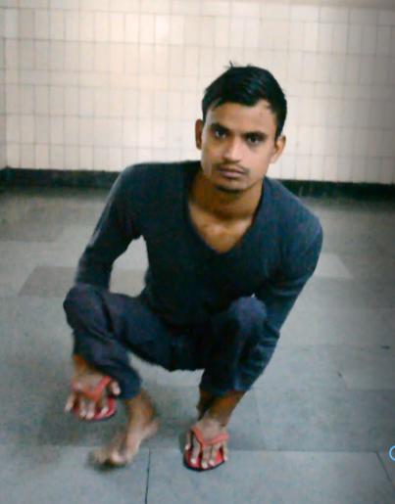
St Stephen’s Hospital, Delhi
Gufran crawling at arrival

Slide 44
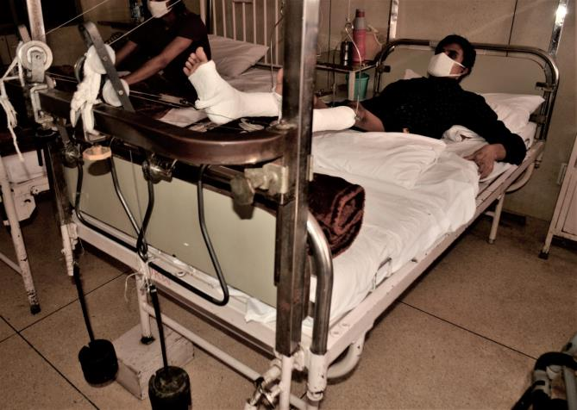
St Stephen’s Hospital, Delhi

Slide 45
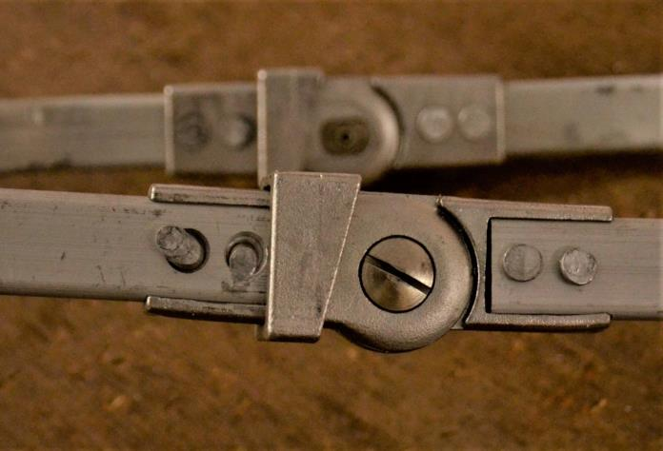
St Stephen’s Hospital, Delhi

Slide 46
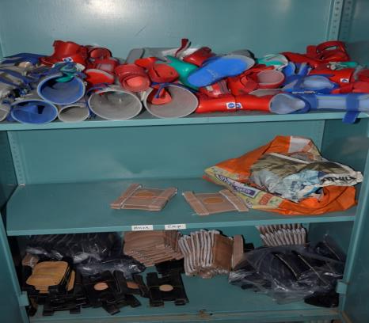
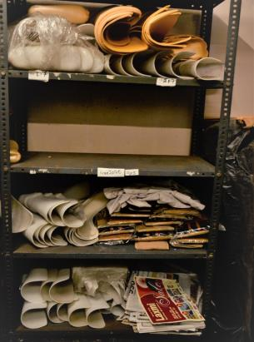
St Stephen’s Hospital, Delhi

Slide 47
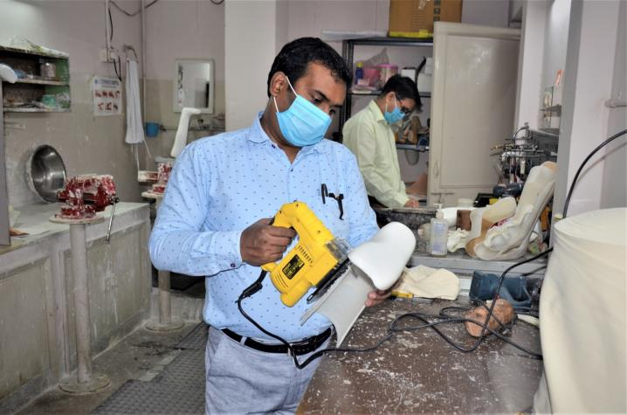
St Stephen’s Hospital, Delhi
Vivek Bisht
Died of Covid 19

Slide 48
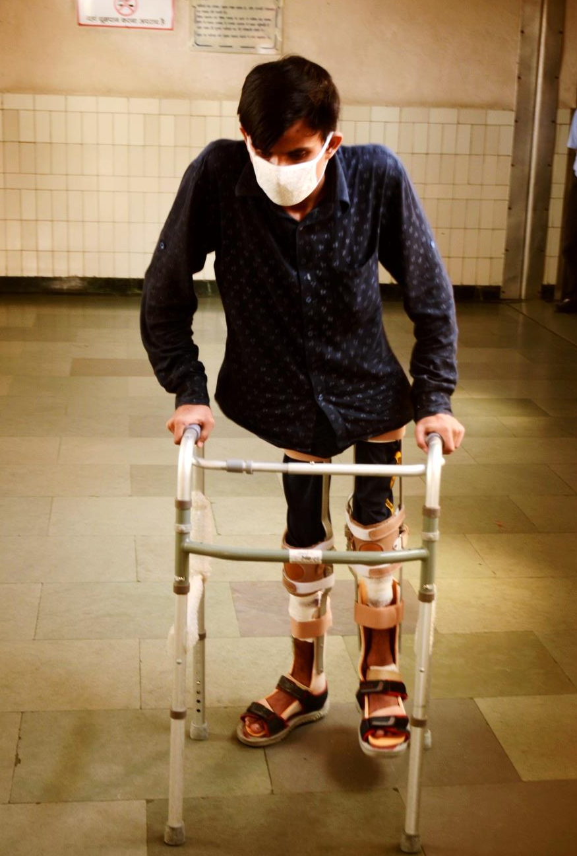
St Stephen’s Hospital, Delhi

Slide 49
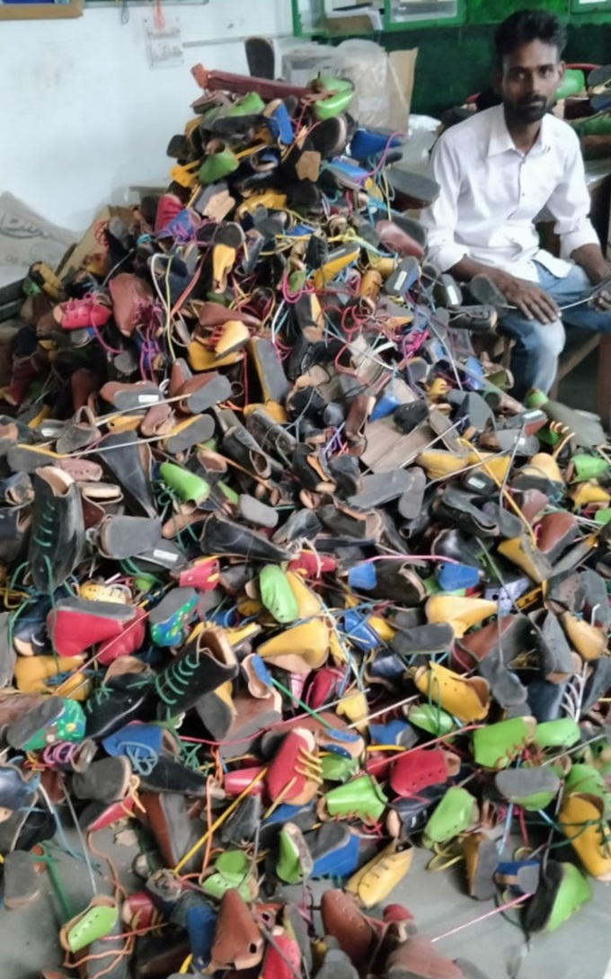
Recycling

Slide 50
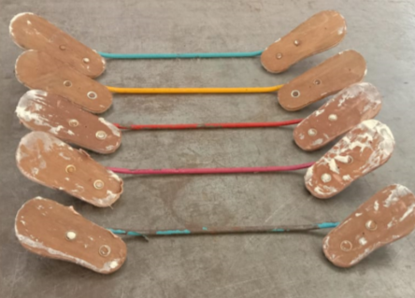
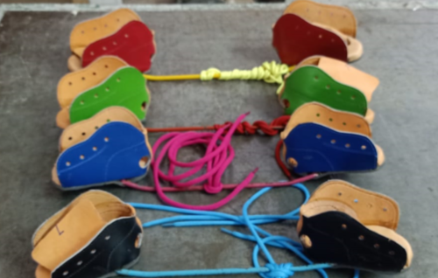
Recycling from Old Braces

Slide 51
Deaf and Hard of Hearing
National institute of Speech and Hearing
Transparent Masks
Why transparent mask?
Who should use it?
Who all can use it?
Sign language.
Speech reading.

Slide 52
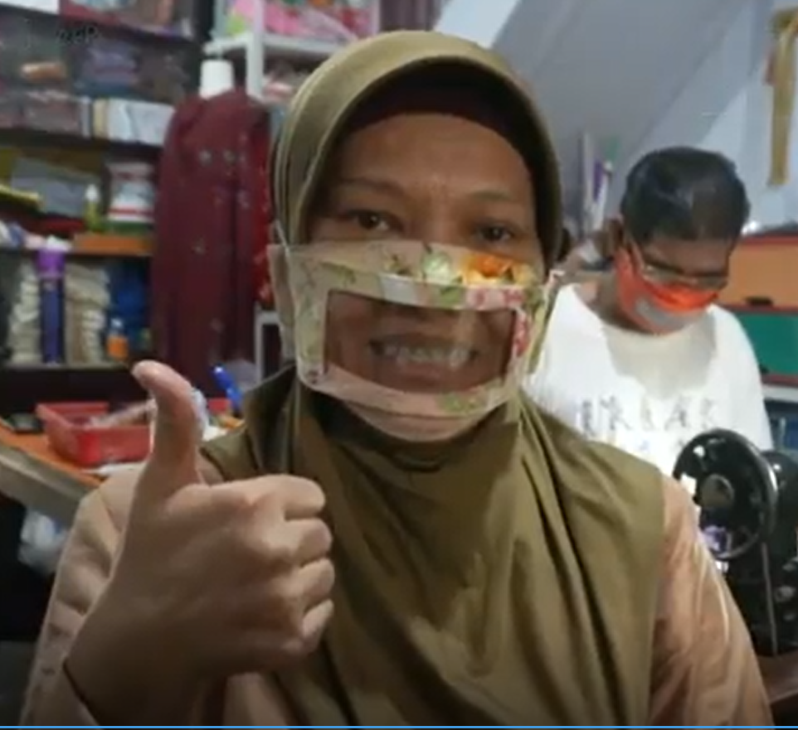
Transparent Mask

Slide 53
NGO Contributions
CIIT
Counselling
24x7 Helpline with Counselling Service
During call from Patients family If there are challenges, ask 3 more questions
How are you coping with the situation?
What are the Govt. supports you have availed?
What else you can look for?

Slide 54
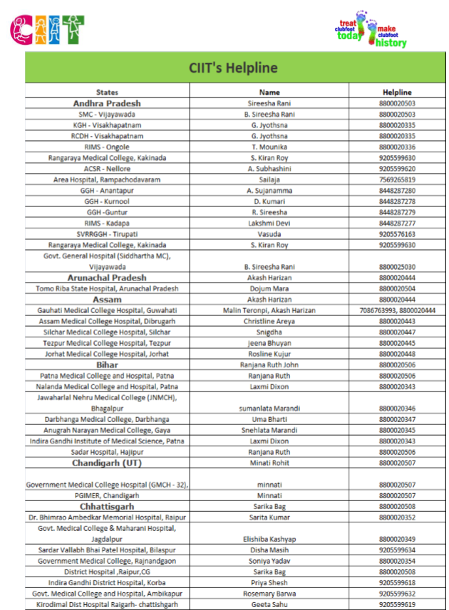
Challenges, Barriers and recommendations for Rehab work in COVID-19 Pandemic
196 Trained Counsellors with CIIT

Slide 55
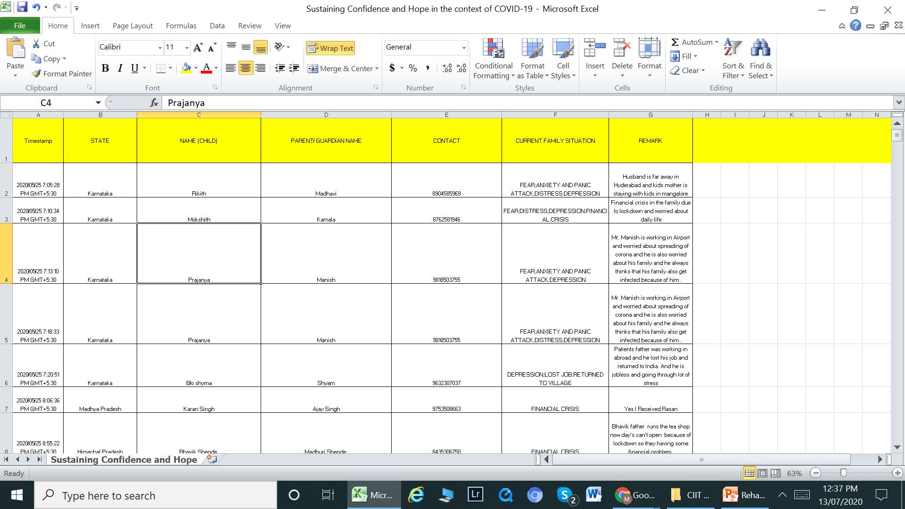
Format for recording Counselling sessions

Slide 56
NGO Contributions
CIIT
Government of India (GoI) Initiatives
National COVID 19 helpline – 011-23978046 or 1075 or 1800-112-545
Health &Family Welfare website – www.mohfw.gov.in
Available and existing and new Schemes
Help families of PWDs access that

Slide 57
NGO Contributions
CIIT
State Government Supports
Website – www. (find out your state’s official website that has all COVID 19 info)
Information on exams and competitive exams – dates, venue, precautions to note
Different forms available – for accessing support and services from Government
Help families Download and fill them

Slide 58
NGO Contributions
CSR Funds for Distribution of Dry Ration Kit :
Each kit worth Rs 800/-
1. Delhi - 945 kits
2. Dimapur - 300 kits
3. Jodhpur - 318 kits
4. Mumba i - 300 kits
5. Kolkata - 5248 kits
Total Kits - 7111

Slide 59
Recommendations
Loss of Jobs and financial crisis major issue
Able bodied persons can do Employment guarantee physical labour like in MNREGA
But PwDs cannot do this need to provide for
Non-physical Labour
Employment Guarantee
Or need for Social Security

Slide 60
Recommendations
Disability Certificates should be Easy access
to ensure access to entitlements for PWDs
Ration to be delivered home
Food distribution was at certain locations that is not accessible – Food for PwDs to be distributed at home
Access to medicines (Home delivery to be made possible)

Slide 61
Recommendations
Persons with Disabilities and their Caregivers Affected Severely
Main Problem Job Loss, Financial, Food Security
Need For Non Physical labour employment guarantee
Social security even with or without disbility certificate
Need to provide Continuous Services even during Lockdown
Need

Slide 62
Recommendations
Rehabilitation Services
Both Acute and Chronic Need to be Continued
Need to provide Continuous Services even during Lockdown
Need to take care of Protection of Health care workers with PPEs and Air changing work spaces

Slide 63
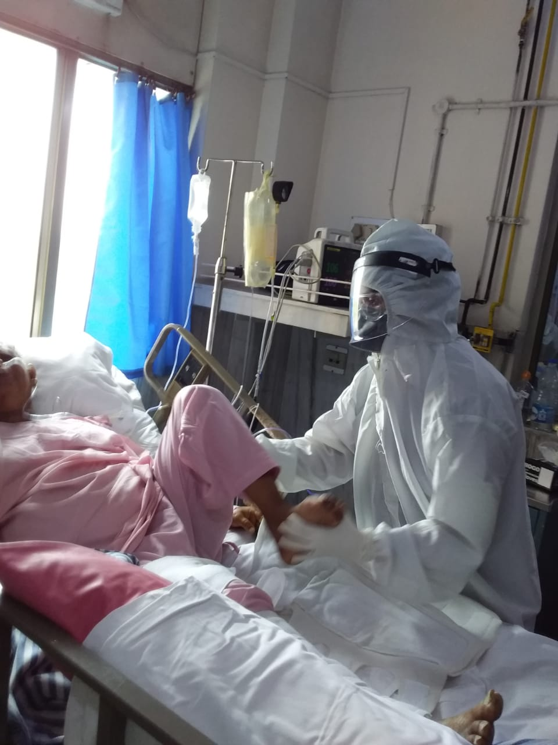
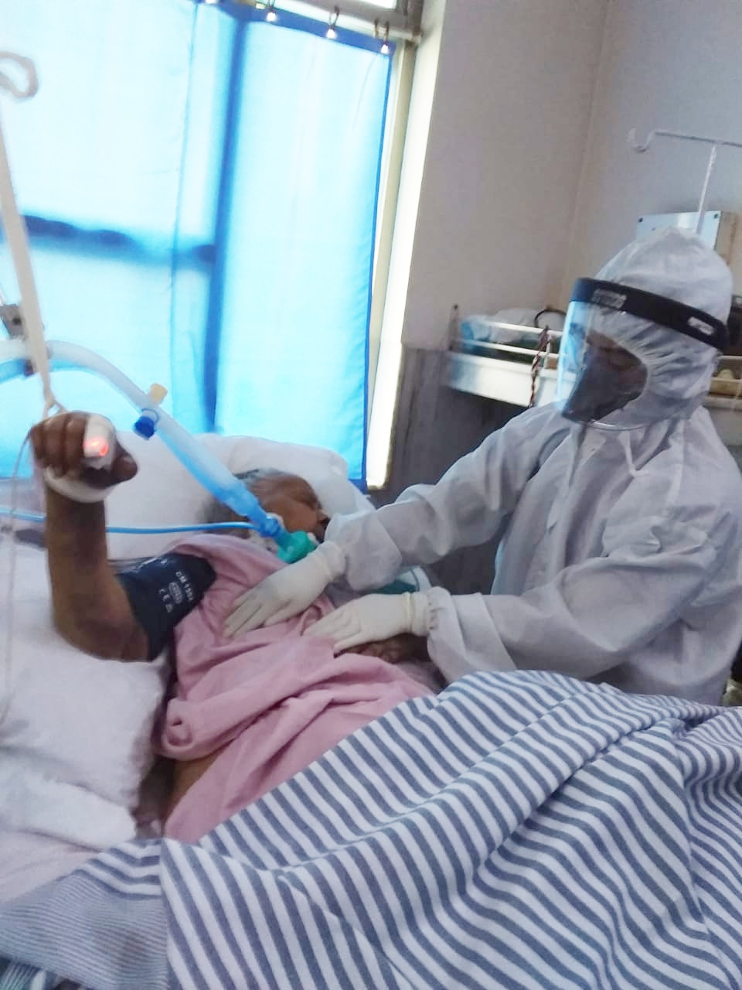
Physiotherapy session in The ICU
Aerosol area so full PPEs

Slide 64
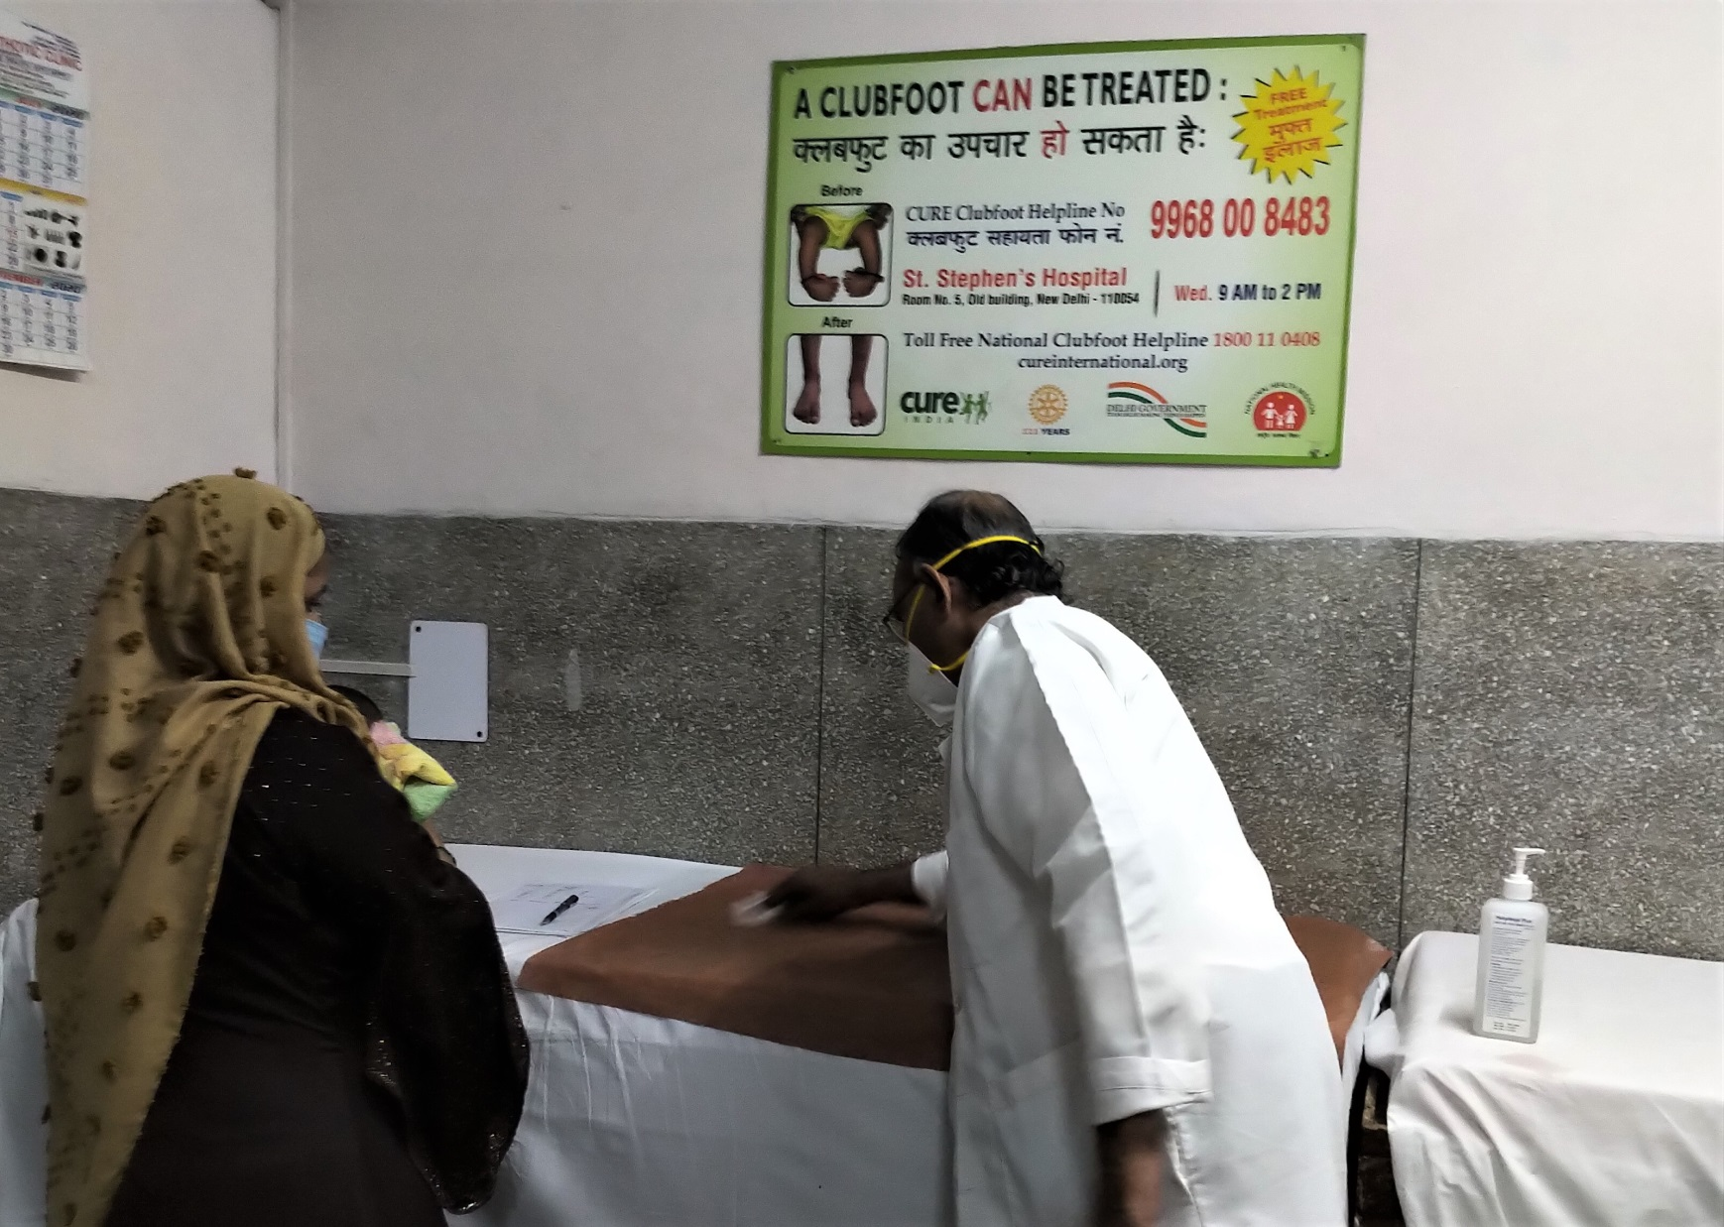
Continue to care for PwDs to prevent long term disability
Use PPEs all the time
Sanitiser Used to clean
Mackintosh before every child

Slide 65
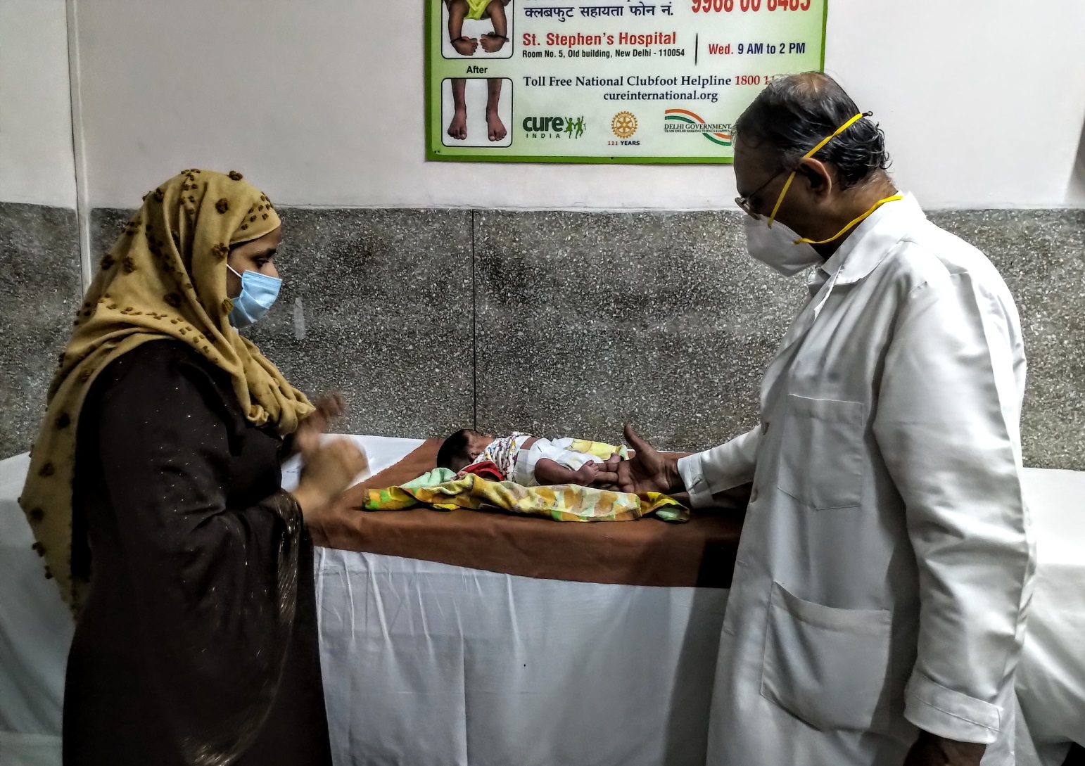
Continue to care for PwDs to prevent long term disability
Use PPEs all the time

Slide 66
Recommendations
Rehabilitation Services
Psychological Issues of Patients and Caregivers are critical and they need to be addressed
Difficult relationships worsened
Innovative methods of Reaching out are Important
Telemedicine with or without Smartphones

Slide 67
Recommendations
Rehabilitation Services
Physiotherapy
Occupational Therapy
Speech therapy
Psychological Counselling
must all be continued

Slide 68
Recommendations
Rehabilitation Services
Assistive Devices
Physical- Orthosis / Prosthesis
Mobility Aids/ ADL aids
Hearing Aids and Batteries
Visual Aids
Repair of all these
Speech therapy
Psychological Counselling
must all be continued

Slide 69
Recommendations
Rehabilitation Services
Public information for protection from Covid 19 should also include contextual messages and should be done so that those with
hearing and visual and other impairments
can also be reached
Subtitle or sign language in TV News

Slide 70
Recommendations
Rehabilitation Services
Need for 24 x 7 Helpline for PWDs

Slide 71
Challenges, Barriers and recommendations for Rehab work in COVID-19 Pandemic
Thank you
mathewvarghese.ms@gmail.com

