Slide 1
Delivery of palliative care in Nepal: a journey towards the community level care
Dr Yadu Chandra Ghimire
Director
National Health Training Centre, Nepal
16th July, 2020
Email: yadu2073ghimire@gmail.com
Website - www.nhtc.gov.np

Slide 2
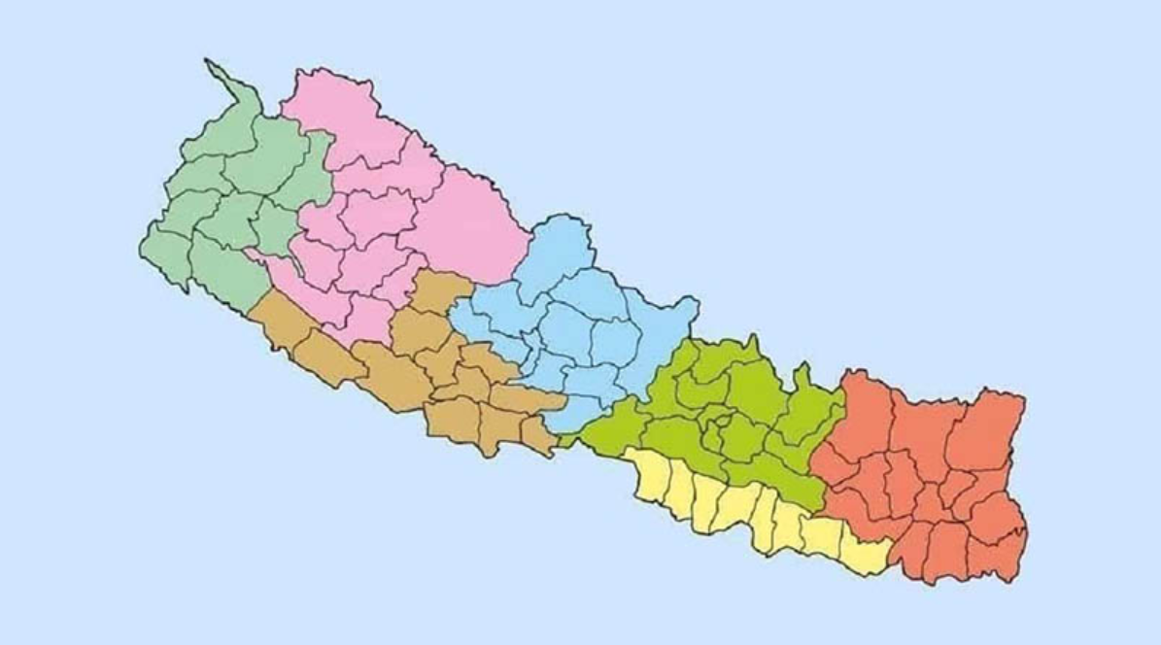

Kathmandu, Capital City of Nepal
Home-based program on palliative care is very appropriate in our cultural, social, and economic environment where a majority of people are living in rural areas.

Slide 3
Progress made so far in building palliative care services at the community level
National Strategy for Palliative Care: An appropriate care nationwide
A wide-range of pain relieving program (all provincial governments)
Programs are initiated collaborating with local governments’ ownership
Specific focus areas: Cancer, Chronic pulmonary disorders, Renal diseases, CVDs, HIV/AIDS and Progressive neurological conditions

Slide 4
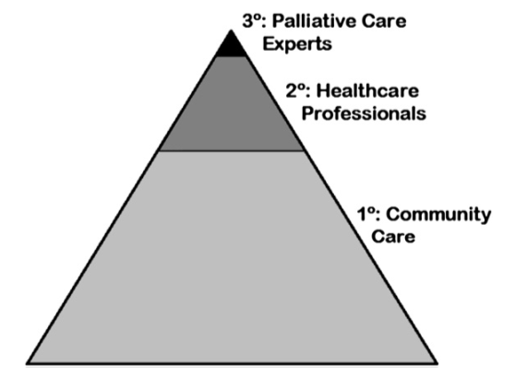
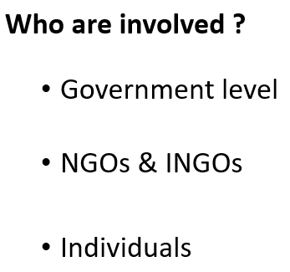
How many communities are covered?
Hospital
Hospice
Home care
about 80% population getting 20% services
A big space for the improvement

Slide 5
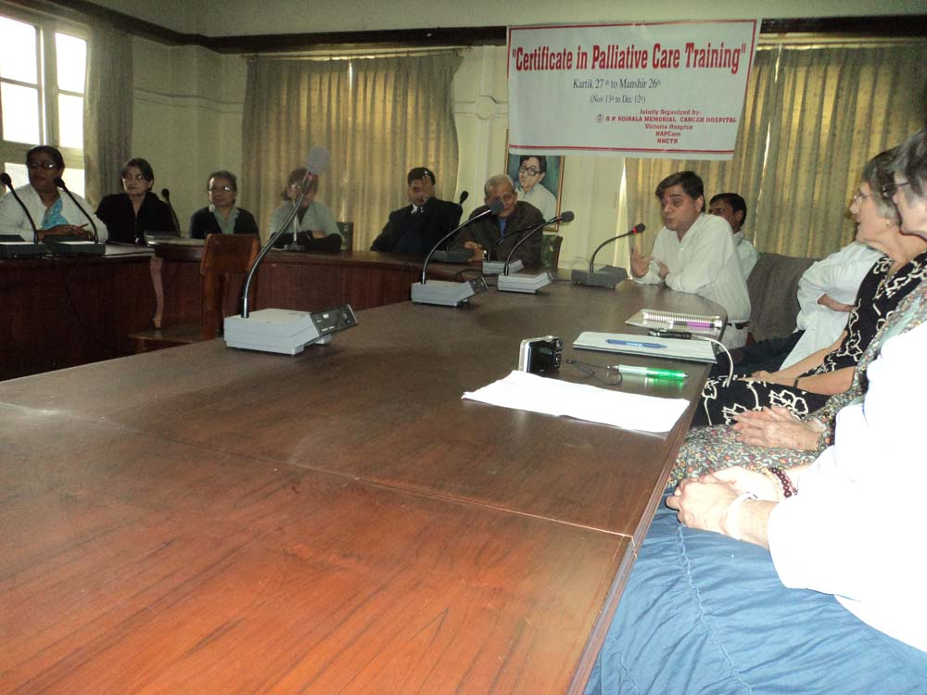
Government initiatives: Capacity Building and Services
National Health Training Center
  Palliative Care Trainings-NAPCARE
  Training on psychosocial counseling
  NCD program expanding etc.
Palliative care
  Hospital-based services and
  Community-based services in collaboration with social organizations

Slide 6
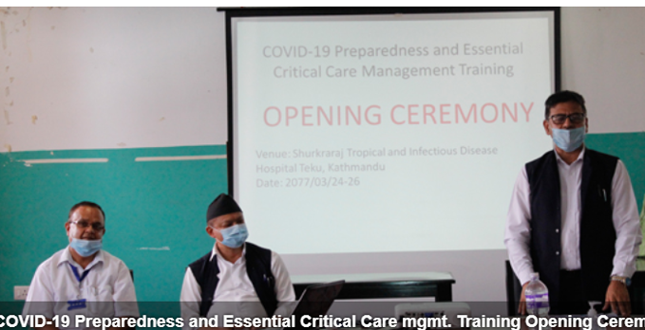
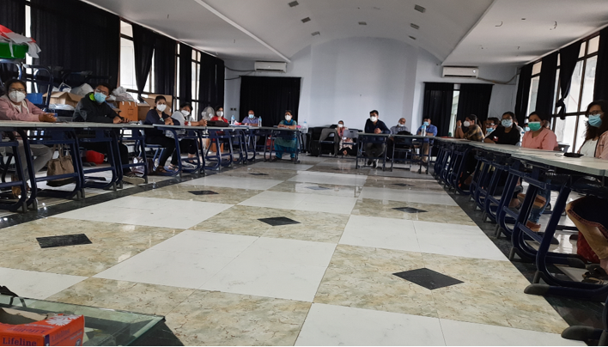
Training modality in the context of COVID-19
Virtual training
Mobile based training
In-person training
Blended training

Slide 7
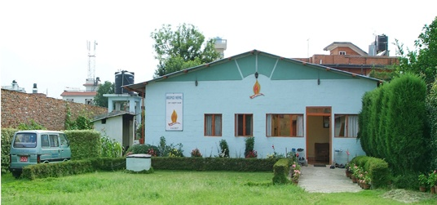
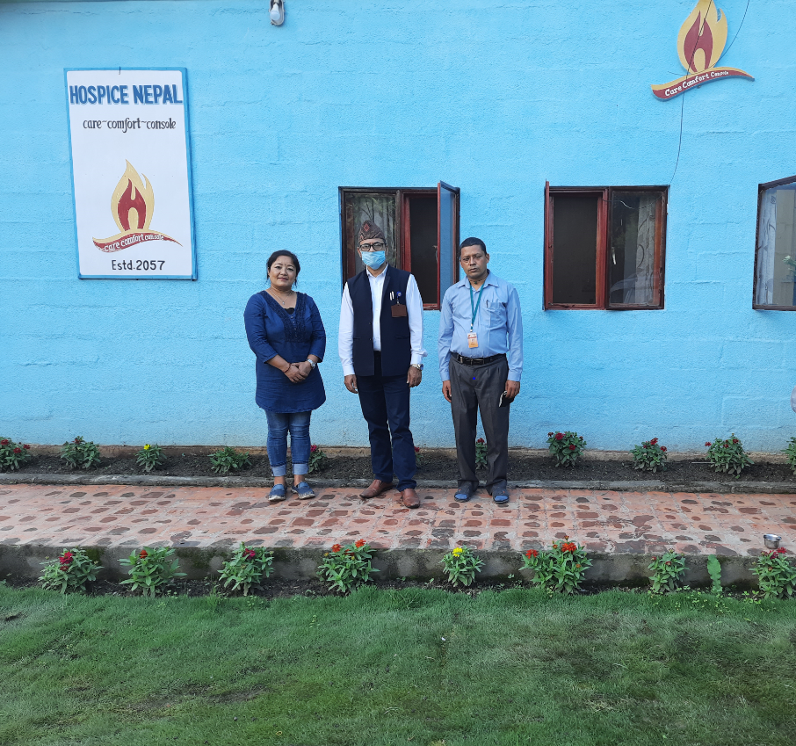
Hospice Nepal
Forefront of the palliative care initiative in Nepal and was established in the year 2000 and expanding Community level Palliative CARE
Rich on stories of difficulties faced and happiness gained during service delivery in hospice and community

Slide 8
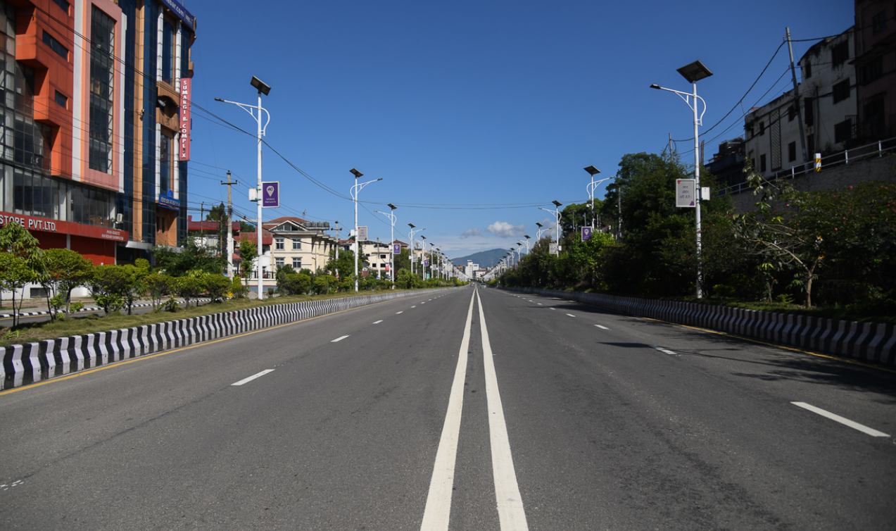
What are Challenges in COVID context?
Overshadowing of palliative care vs high risk (less priority to donors)
Transportation (even ambulances are reluctant)
Access to health care is compromised
Health Care Services are limited
COVID positive case - Stigmatized

Slide 9
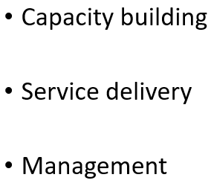

Over coming the Challenges and way forward on the delivery of palliative care in Nepal
Utilizing experiences,
Stream lining the resources
Working together
Prioritization
Research and development

Slide 10

Thank You for your kind Listening

