Slide 1






Rehabilitation considerations during the COVID-19 outbreak
16th July 2020
Pauline Kleinitz, Rehabilitation Programme, WHO Headquarters

Slide 2



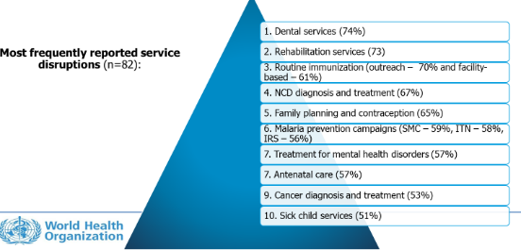
Why we need to consider rehabilitation?
Impact of COVID-19 on rehabilitation services
Rehabilitation in the context of the COVID-19 pandemic is required for:
  Continuation of rehabilitation services for people with essential needs
  Rehabilitation for optimizing outcomes of people who experience severe COVID-19
Survey Results of the WHO Rapid Assessment of Continuity of Essential Health Services

Slide 3
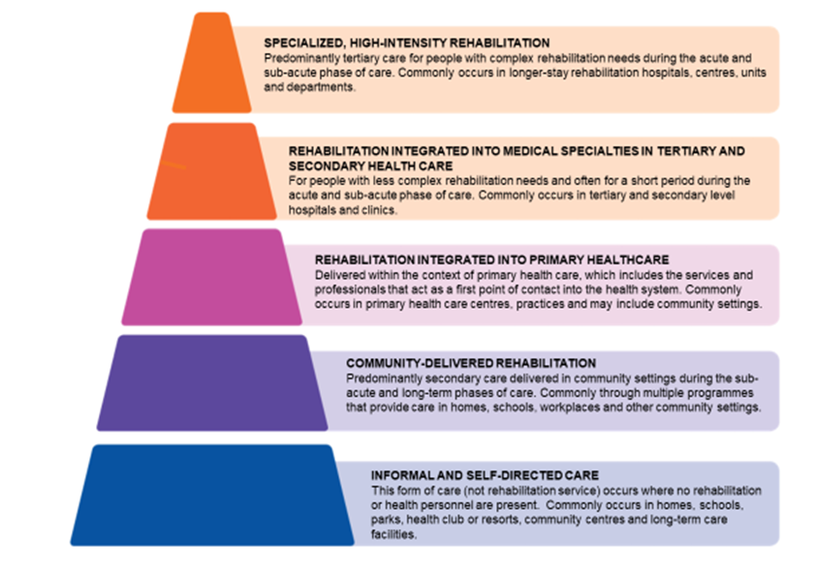
Consideration for Continuity of Non-COVID-19
Rehabilitation Services
Essential rehabilitation needs continue for:
Patients with new acute injuries, such as burns, amputations or spinal cord injuries who may develop serious preventable complications.
Patients recovering from surgery.
Patients with conditions who are at risk of suboptimal recovery, such as those recovering from stroke, myocardial infarction or perinatal complications.
Patient requiring long-term rehabilitation in hospitals, residential centres or community settings who may experience a loss of function or develop complications.
Patients who are unable to be discharged to a setting and be safe, or who may return to a setting that is a very long distance from the service and likely preclude them from future access.
Notes:
Rehabilitation needs do not stop during the pandemic.
A lack of access to rehabilitation can:
Compromise health and social outcomes
Extend inpatient stays
Result in preventable hospital admissions

Slide 4

Rehabilitation for Severe COVID-19
  Severe COVID-19 patients
  The illness may be complicated by respiratory failure and other forms of multi organ failure, resulting in ICU admission with likely invasive mechanical ventilation.
  Rehabilitation needs are typically related to the consequences of ventilatory support, and prolonged immobilization

Slide 5
Rehabilitation along the continuum of care in COVID-19
Acute
Objectives
- Optimize oxygenation
- Manage secretions
- Prevent complications
Input:
Specialist Respiratory physiotherapist /therapist and/or rehabilitation staff experienced with ICU/HDU setting
Setting: ICU/HDU
Long-term
Objectives
- Optimize functioning/ minimize impact of impairments on independence and quality of life
Input: Multidisciplinary
Setting: Home, outpatient facility, clinic
Post-acute
Objectives
- Identify and manage impairments for affected functioning domains
- Facilitate safe discharge and onward referral
Input: Multidisciplinary
Setting: Rehabilitation ward/unit, stepdown facility, home

Slide 6
Rehabilitation for severe COVID-19
Impairments most likely to encounter:
  Physical deconditioning and muscle weakness, fatigue
  Impaired lung function
  Delirium and other cognitive impairments
  Impaired swallow and communication
  Mental health disorders and psychosocial support needs.
Multi-disciplinary team approach is key
Still many unknowns related to the pathophysiology of COVID-19 and the long-term complications, many organs can be affected

Slide 7

Common country experiences
Rehabilitation services significantly reduced and often without full consideration of the consequences. Decisions made locally regarding continuation of rehabilitation services, limited national direction. Inadequate consideration of all four factors regarding service continuation :
  Risks associated with cessation or reduction of services for different patient groups
  Feasibility and appropriateness of alternative modes of service delivery e.g. telehealth, home outreach
  Access to PPE and robustness of IPC measures in different settings
  Capacity of the rehabilitation workforce, e.g. available for redistribution
COVID-19 related rehabilitation needs increased in tertiary settings and major urban areas, but less ‘new’ need in rural areas. Generally, reduced demand in line with reductions in elective surgery, transportation, lockdowns etc
Where face to face rehabilitation has not been an option a re-purposing workforce towards alternatives like tele-health, advice/help lines and developing self management plans has occurred, as has re-purposing for triage and other urgent needs

Slide 8
Common country experiences
PPE for rehabilitation personnel is essential but concerns repeatedly raised about limited access. Unmet rehabilitation needs & lack of resources reported to ministries of health, advocacy by professionals essential, value of involving rehabilitation workforce in service decisions highlighted
Telehealth (primarily phone calls) being utilised for service delivery for patients - important way forward
Online videos for patient rehabilitation and pre-developed pamphlets used for COVID-19 clients
Supply chains for assistive products interrupted
Greater task-sharing, upskilling and transdisciplinary teamwork occurring – but must be within scope of practice.
Rehabilitation professionals undertaking online training
Inadequate social support services for people with disabilities repeatedly highlighted as a concern

Slide 9
Rehabilitation sector reflections
No perfect response
Context vary, teams vary - need to adopt, adapt and evaluate approaches
Opportunity to highlight the value of rehabilitation
Opportunity to strengthen teams and efficiencies
Opportunity to harness telehealth for the long term
Importance of social sector support services for people with disabilities, and continuation of health and social sector collaboration
Opportunity to learn and link with international groups/ resources / training

Slide 10




THANK YOU

Slide 11


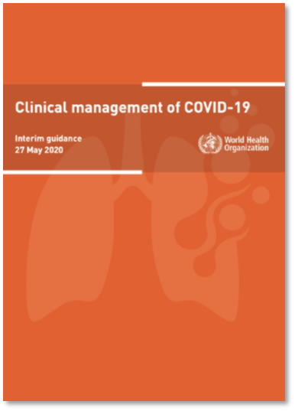
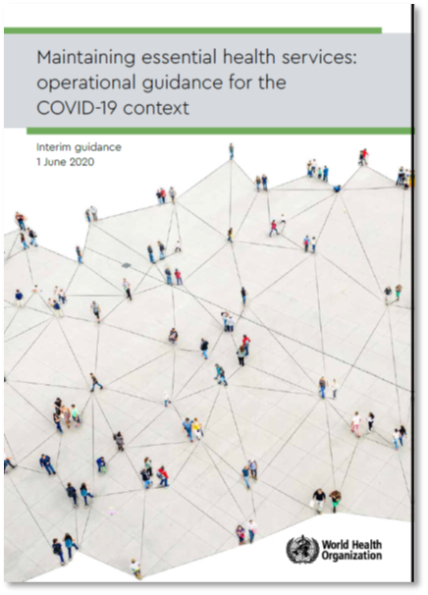
Key products
Rehabilitation integrated into WHO Products
Forthcoming:
WHO Community Facilities and Treatment Centres
Rehabilitation also being integrated into the WHO’s new OpenWHO platform for online courses
https://www.who.int/publications/i/item/clinical-management-of-covid-19
https://www.who.int/publications/i/item/10665-332240
Notes:
OpenWHO is WHO’s new, interactive, web-based platform that offers online courses to people preparing to work in epidemics, pandemics and health emergencies or already doing so.
The OpenWHO platform delivers WHO’s and partners’ expertise closer to where it is needed and provides information in user-friendly formats for frontline responders and decision-makers. The platform is managed by the Learning and Capacity Development unit in the WHO’s Health Emergencies Programme.

Slide 12
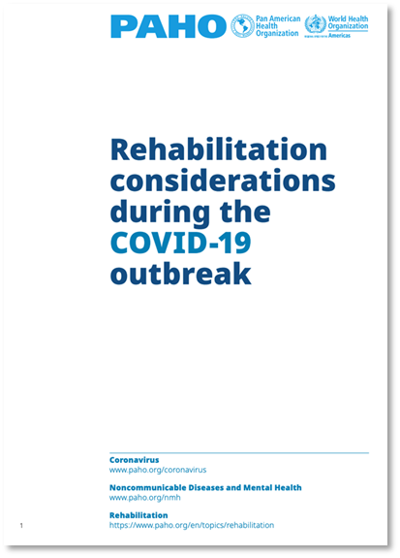
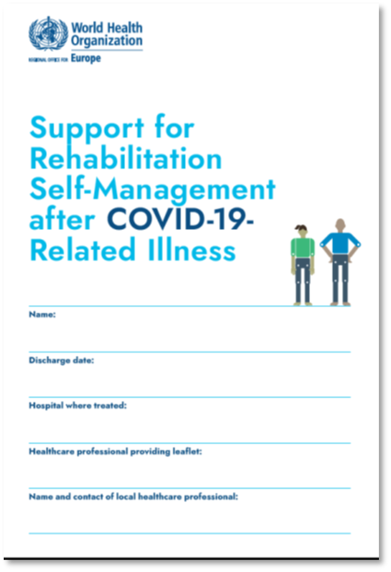
Key documents
WHO Rehabilitation Documents
https://www.euro.who.int/en/health-topics/Life-stages/disability-and-rehabilitation/publications/support-for-rehabilitation-self-management-after-covid-19-related-illness-2020
https://www.paho.org/en/documents/rehabilitation-considerations-during-covid-19-outbreak

Slide 13

Key documents
WHO Disability Document
https://www.who.int/publications/i/item/WHO-2019-nCoV-Disability-2020-1

Slide 14

THANK YOU

