Slide 1
Section D: Financement
Module 7: Vue d’ensemble des questions de la Section D
Cycle GLAAS 2018/2019

Slide 2
Vue d'ensemble
La Section D comprend 11 questions qui se rapportent au financement du secteur WASH.
Ce module passera chaque question en revue.
Veuillez vous référer également au guide d’orientation de l’enquête.

Slide 3
Questions
D1: Plan de financement
D2: Budgets du secteur WASH
D3: Rapports financiers
D4: Stratégies de recouvrement des coûts
D5: Equité
D6: Accessibilité financière
D7: Utilisation des fonds externes
D8: Utilisation des fonds nationaux
D9: Financement externe
D10: Financement suffisant pour atteindre les cibles
D11: Flux financiers

Slide 4
Question D1 – Plan de financement
D1
Cette question vise à évaluer :
  S’il existe un plan de financement lié au secteur WASH ou à des sous-secteurs spécifiques
  Le niveau de mise en oeuvre du plan.

Slide 5
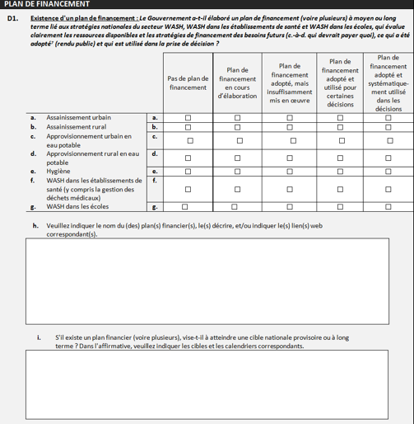
D1
Réponses possibles
Sous-secteurs couverts dans le plan
Notes:
In some countries there may be several plans each covering a specific area e.g. separate plans for drinking-water, sanitation and hygiene, separate plans for urban and rural areas, even sometimes different plans for urban differentiating according to utility boundaries and urban areas not covered by the national utility. Please include descriptions and/or web links to all agreed/publicly available plans.
Range of Responses:
No financing plan: There is no agreed financing plan that allocates funds to this particular WASH sub-sector/area. This sub-sector/area may be funded from a broader ministry budget or from other programmes, but no separate line items for this WASH sub-sector/area are identified and no finance plan is agreed.
Financing plan in development: Work is in progress to develop separate budget lines or a strategic financing plan for this WASH sub-sector/area.
Financing plan agreed, but insufficiently implemented: Budgets or finance plans for the WASH sub-sector/area are agreed, but allocation of funds is not forthcoming or only a small fraction of budget, and/or the capacity to implement these plans/projects has yet to be developed. ‘Agreed’ means agreed and publicly available.
Financing plan is agreed and used for some decisions: A strategic financing plan has been developed for the WASH sub-sector/area which establishes or identifies financial needs, budget allocations, sources of funds, and activities necessary to achieve plan goals. Budget allocations/expenditures and planned/implemented activities may be monitored according to planned activities, but only used sporadically in decision-making. Budgets and plan activities may or may not be adjusted based on assessments of capacity and progress. Financing gaps have been identified, but activities to reduce financing gaps may not be acted upon or monitored consistently.
Financing plan is agreed and consistently used in decisions: A strategic financing plan has been developed for the WASH sub-sector/area which establishes or identifies financial needs, budget allocations, sources of funds, and activities necessary to achieve plan goals. Budget allocations/expenditures and planned/implemented activities are monitored consistently, while adjustments in plan activities are made accordingly based on a periodic assessment of capacity and progress. Financing gaps have been identified and actions to reduce such gaps are planned and monitored.

Slide 6
D1
Lié aux cibles identifiées dans la Section A de l’enquête
Notes:
See responses provided in Question A7.

Slide 7
Question D2: Budgets du secteur WASH
D2
Cette question vise à:
  Analyser la répartition des budgets relatifs au secteur WASH entre les différents ministères et/ou institutions
  Suivre les tendances dans les budgets du secteur WASH (pour les pays ayant fourni des données budgétaires dans les cycles GLAAS précédents).
Notes:
Government budgets can be indicators of priority in national policy and action.

Slide 8
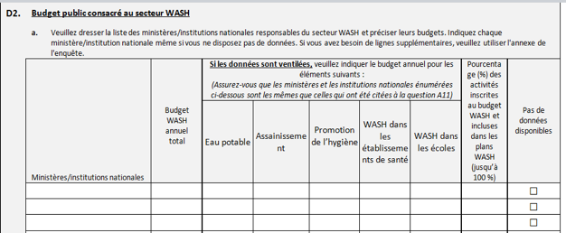
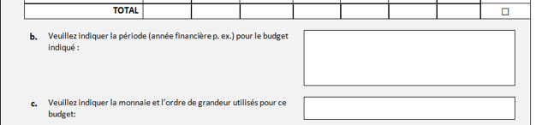
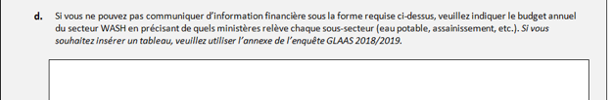
D2
Faites la liste des ministères responsables du secteur WASH (même si les budgets spécifiques ne sont pas disponibles).
Notes:
Line ministry WASH budgets for water, sanitation and hygiene are requested in a disaggregated format, however, it is acknowledged that only aggregated data may be available. If disaggregated data are available, please ensure that the ministries and national institutions listed here are the same as those listed in Question A11.

Slide 9
D2
Inscrivez le budget total annuel pour le secteur WASH.
Notes:
List the total WASH budget for the most recent fiscal year.

Slide 10
D2
Ventilez les budgets par sous-secteur si possible.
Notes:
Please provide disaggregated annual budget information for each listed ministry/national institution.
If the WASH budget cannot be disaggregated among drinking-water, sanitation, hygiene promotion, WASH in health care facilities, and WASH in schools, please list total budget for WASH in the most recent fiscal year.

Slide 11
D2
Estimez le % des activités inscrites au budget WASH, incluses dans les plans WASH, comme mentionné dans la Section A (question 5).
Notes:
Percentage (%) of WASH budget activities included in WASH plans: If there is a national WASH plan, please estimate the percentage of WASH-related (i.e. not all ministry/institution activities) activities planned by the ministry/national institution that are covered or aligned with the national WASH plan.
This is used in monitoring the SWA Collaborative Behaviours. More information on the Collaborative Behaviours can be found here: http://sanitationandwaterforall.org/news/how-are-37-countries-applying-the-collaborative-behaviours/

Slide 12
D2
Veuillez indiquer la période et la monnaie utilisée.

Slide 13
D2
Veuillez utiliser l’annexe de l’enquête si vous manquez d’espace.

Slide 14
Question D3: Rapports financiers
D3
Cette question vise à évaluer:
  S’il existe des rapports permettant de comparer les dépenses réelles aux fonds engagés
Les rapports peuvent provenir du Ministère des finances, des Ministères sectoriels, des rapports et états financiers.
Notes:
Financial reports may be available from the Ministry of Finance, line ministries responsible for WASH programmes, annual reports for specific programmes/areas, audited financial statements, donor or NGO reports or financial statements, etc. Expenditure reports for external funding may originate from donors and/or NGOs and content is not necessarily determined by the government.

Slide 15
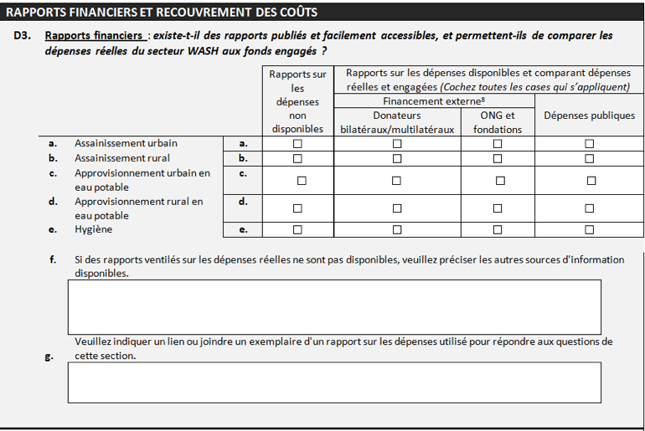
D3
’Publié et facilement accessible’ signifie que les rapports de dépenses peuvent être disponibles en ligne ou obtenus auprès du gouvernement.

Slide 16
D3
Les rapports sur les dépenses pour les financement externes peuvent provenir de donateurs et/ou ONGs et leur contenu n’est pas nécessairement déterminé par le gouvernement.
Notes:
Expenditure reports for external funding may originate from donors and/or NGOs and content is not necessarily determined by the government.

Slide 17
D3
Des rapports sont-ils disponibles pour les dépenses publiques?

Slide 18
D3
Fournissez toute autre information disponible.

Slide 19
Question D4: Stratégies de recouvrement des coûts
D4
Cette question vise à évaluer:
  si les frais de fonctionnement et d’entretien de base doivent être couverts en partie ou en totalité par les redevances/tarifs ou les contributions des ménages
  Si un plan de financement existe, quelle proportion des frais de fonctionnement et d’entretien de base est couverte par le tarif et les contributions des ménages.
Notes:
Cost recovery is considered to be important for the sustainability of services

Slide 20
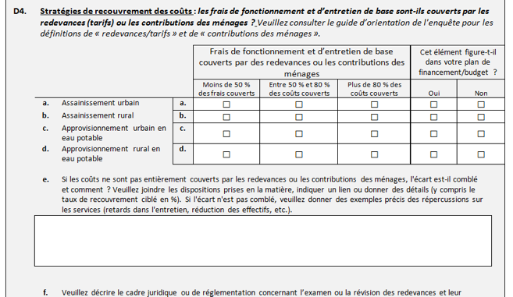
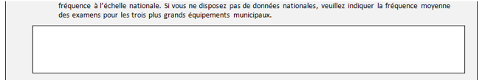
D4
Activités nécessaires pour maintenir les services , y compris le personnel, le carburant, les produits chimiques, les matériaux et l’entretien régulier.
Notes:
Operations and basic maintenance: Includes activities necessary to keep services running. Operating costs are recurrent (regular, ongoing) spending to provide WASH goods and services: labour, fuel, chemicals, materials, and purchases of any bulk water. Basic maintenance costs are the routine expenditures needed to keep systems running at design performance, but does not include major repairs or renewals.

Slide 21
D4
Quelle part de ces frais est couverte par les redevances ou les contributions des ménages?
Notes:
Tariffs are considered payments made by users to service providers for getting access to and for using the service.

Slide 22
D4
Si les tarifs ou les contributions des ménages ne couvrent pas ces coûts, comment l’écart est-il comblé?
Notes:
Provide information on cost recovery strategies where tariffs are insufficient to cover operations and basic maintenance.

Slide 23
D4
Description des cadres légaux ou réglementaires pour l’examen ou la révision des tarifs.
Notes:
Provide information on legal or regulatory frameworks for tariff review, including whether utility cost recovery is reviewed periodically and tariff adjustments made as necessary (i.e. by utility decision-making, by regulatory board, etc.).

Slide 24
Question D5: Equité
D5
Cette question vise à évaluer:
  quels groupes vulnérables sont au centre des mesures d’équité
  Si ces mesures sont financées et appliquées au moyen des ressources définies dans le plan/budget de financement .
Notes:
The 2030 Agenda for Sustainable Development includes a dedicated goal on water and sanitation (SDG 6) that sets out to “ensure availability and sustainable management of water and sanitation to all.” In line with this objective, many countries have already established policies and specific financing measures to reach vulnerable groups to ensure equal and non-discriminatory access to drinking-water and sanitation services.

Slide 25
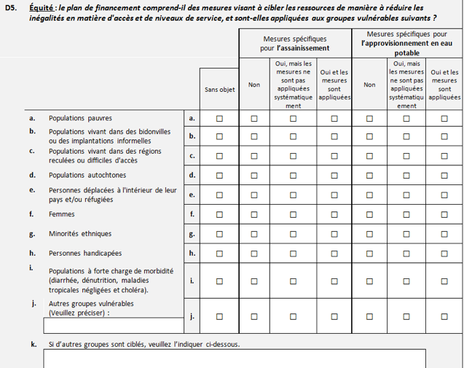
D5
Ces mesures spécifiques sont-elles incluses dans le plan de financement pour chaque groupe vulnérable?
Voir exemples dans le guide d’orientation de l’enquête.
Notes:
Examples of measures include:
Specific budgets for identified disparities (e.g. in rural, peri-urban or slum area with low access);
Grants for basic services that promote some service to all rather than all services for some;
Subsidized water tariffs, with lower rates for low consumption volumes that cover basic needs;
Geographic targeting of available funds (e.g. towards rural or interior areas with low access); and
Subsidies/grants targeted to specific vulnerable groups for water connections, or assistance in the construction of latrines.

Slide 26
D5
Groupes vulnérables

Slide 27
D5
Cochez ‘sans objet’ si le groupe vulnérable n’existe pas dans votre pays.
Notes:
If there is a vulnerable group listed that does not exist in your country, please mark the ‘not applicable’ column.

Slide 28
D5
D’autres groupes vulnérables peuvent être identifiés ici.
Notes:
If more than one vulnerable group are listed, please continue the answer in the Survey Annex.

Slide 29
Question D6: Accessibilité financière
D6
Cette question vise à déterminer:
  Si des mesures précises ont été prises en vue de rendre les services WASH financièrement plus abordables pour les groupes vulnérables
  Dans quelle mesure ces mesures sont mises en œuvre.
Notes:
Low-income populations, vulnerable population groups and rural communities commonly do not have the financial means to obtain or connect to existing water and sanitation services, let alone pay for the cost to sustain these services. This question aims to assess whether the government has defined affordability criteria and whether any specific measures have been made to make WASH more affordable for vulnerable groups, and how widely these are used.

Slide 30
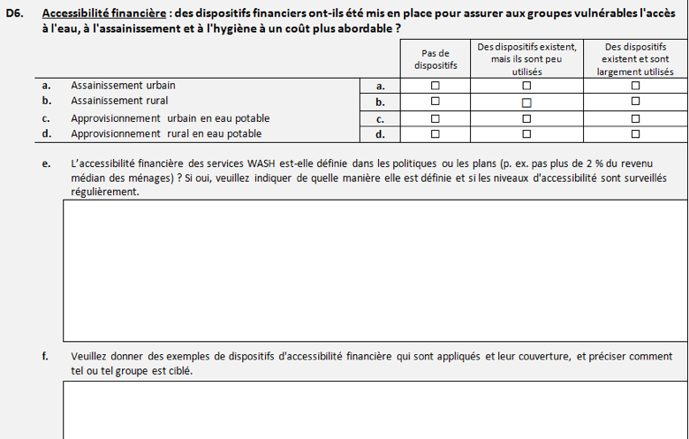
D6
Cochez la case appropriée. Voir les exemples de dispositifs dans le guide d’orientation de l’enquête.
Notes:
The affordability schemes can include any or all of the mentioned groups identified in question A9, B5, D5. The most commonly cited affordability scheme is that of a tiered or block tariff scheme based on water use and/or income levels – with a highly subsidized first block, (e.g. 0 to 7 cubic meters) designed to cover basic needs. Other examples of the affordability schemes cited by countries include:
Reduced or subsidized water connection fees
Vouchers (pre-paid)
Free water tanks for senior citizens and people living with disabilities
Goodwill of WASH committee
Microfinance, incentive credit (loan) for rural populations.
Other examples include subsidies to reduce costs of spare parts for water pumps or slabs for latrines.

Slide 31
D6
Décrivez comment l’accessibilité financière est définie dans les politiques et plans.
Notes:
In line with policies or plans mentioned in Section A (Question A5).

Slide 32
D6
Décrivez les dispositifs d’accessibilité financière, leur couverture et les groupes ciblés.
Notes:
The affordability schemes can include any or all of the mentioned groups identified in question A9, B5, D5. The most commonly cited affordability scheme is that of a tiered or block tariff scheme based on water use and/or income levels – with a highly subsidized first block, (e.g. 0 to 7 cubic meters) designed to cover basic needs. Other examples of the affordability schemes cited by countries include:
Reduced or subsidized water connection fees
Vouchers (pre-paid)
Free water tanks for senior citizens and people living with disabilities
Goodwill of WASH committee
Microfinance, incentive credit (loan) for rural populations.
Other examples include subsidies to reduce costs of spare parts for water pumps or slabs for latrines.

Slide 33
Question D7: Utilisation des fonds externes
D7
Cette question vise à évaluer:
  Le % des fonds externes utilisés (absorbés) pour financer les activités du secteur WASH
  S’il existe des variations entre les sous- secteurs du WASH.
Notes:
Improving the use of available external funds is one means to incrementally increase financing to the WASH sector.

Slide 34
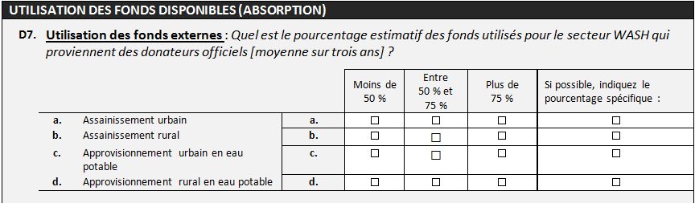
D7
L’engagement correspond à une obligation ferme, exprimée par écrit et accompagnée des fonds nécessaires, prise par un donateur officiel d’apporter l’aide spécifiée à un pays .
Taux d’absorption: le % des engagements des donateurs utilisés sur une période donnée

Slide 35
D7
Utilisation des fonds externes : le % des engagements financiers du donateur utilisés sur une période donnée.
Veuillez fournir une estimation ou une valeur précise.

Slide 36
Question D8: Utilisation des fonds nationaux
D8
Cette question vise à évaluer:
  Quel % des fonds nationaux engagés sont utilisés
  S’il existe des variations entre les sous- secteurs du WASH.

Slide 37
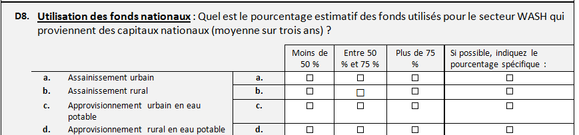
D8
Veuillez estimer ou fournir une estimation/valeur précise.
Notes:
In the previous GLAAS surveys, efficient and timely release of domestic financing for WASH was reported as an issue for a majority of countries. Most often issues concerning the absorption of national funds for WASH activities included:
Administrative/funding release procedures too lengthy or too complex;
Procurement delays (causing late fund release, i.e. too late to be spent within the financial year for which the funds have been allocated);
Inadequate project preparation, inaccurate estimates or terms of reference in procurement;
Low public or private sector capacity to respond to proposals and implement projects (e.g. limited drillers or suppliers, or lack of municipal capacity to perform supply chain management); and
Expropriation and land-ownership issues causing delays.
Previous trends showed improvements in the absorption of funds for WASH that were possibly linked to improvements in financial procedures or country implementation capacity. If there has been a recent increase in the absorption of domestic funds committed for WASH in the past three years, please describe what programmes or policies have aided this improvement.

Slide 38
Question D9: Financement externe
D9
Cette question vise à évaluer:
  Le volume de financement externe reçu
  Le niveau de coordination entre les financements externes et le gouvernement
  La répartition des financements externes entre les différents canaux
  Cette information est requise pour informer le suivi de la mise en oeuvre de la cible 6.a des ODD
Notes:
This question is used in monitoring SDG Target 6.a (http://www.sdg6monitoring.org/indicators/target-6a/). Donor activity and disbursement Information has been requested specifically for drinking-water and sanitation, and for the broader water sector. Countries may use information from OECD Creditor Reporting System to identify gross aid disbursements for those donors that do not channel funds through the national budget process if these amounts are unavailable in national budget or WASH sector planning or assessment documents (see http://stats.oecd.org/Index.aspx?DataSetCode=crs1).

Slide 39
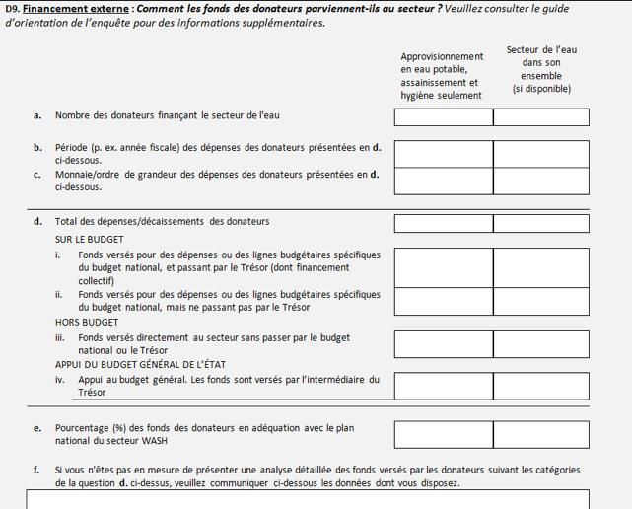
D9
Détails des engagements des donateurs
Notes:
This question is used in monitoring SDG Target 6.a (http://www.sdg6monitoring.org/indicators/target-6a/). Donor activity and disbursement Information has been requested specifically for drinking-water and sanitation, and for the broader water sector. Countries may use information from OECD Creditor Reporting System to identify gross aid disbursements for those donors that do not channel funds through the national budget process if these amounts are unavailable in national budget or WASH sector planning or assessment documents (see http://stats.oecd.org/Index.aspx?DataSetCode=crs1).

Slide 40
D9
Indiquez une réponse pour les deux colonnes. Voir le détail des codes OECD-CRS dans le guide d’orientation de l’enquête.
Notes:
The column for Drinking-water supply and sanitation only refers to water sector policy and administrative management, water supply and sanitation systems, waste disposal, and education and training in accordance to OECD-CRS codes: 14010, 14020 to 14032, 14050, and 14081. The column for Total water sector (if available) refers to any external funds channelled to the water sector, including drinking-water and sanitation systems, integrated water resources management, water conservation and rehabilitation, agricultural water use (CRS 361140), flood prevention/control (CRS 41050), and hydro-electric power plants (CRS 23220).

Slide 41
D9
Canaux de répartition des fonds. Voir le guide d’orientation de l’enquête pour plus de détails.
Notes:
With regard to D9.d.i on Funding provided for specific expenditures or lines in national budget, and are channelled through treasury (includes basket funding), targeted budget support involves the transfer of funds to the national treasury as ex-post “financing” of specific expenditures within the budget or of specific budget lines for the sector. Basket funding can be assimilated to this category.
With regard to D9.d.iv, general budget support is a transfer to the national treasury in support of a national development or reform policy and strategy to promote good governance across multiple sectors. Support may be conditional on certain eligibility criteria and meeting specific sector performance indicators (e.g. targets for health or other basic services). In the response, please estimate a proportion (in currency units, not as a percentage) of overall general budget support, that potentially benefited water sector programmes.

Slide 42
D9
Indiquez la proportion de fonds externes alloués aux programmes ou projets inscrits dans le plan national du secteur WASH.
Notes:
‘Per cent (%) of donor funds’ means what proportion of the donor funds identified for the water sector or for drinking-water and sanitation are channelled to programmes or projects in the national WASH plan. It does not mean the percentage of total donor funds provided for all sectors.

Slide 43
Question D10: Financement suffisant pour atteindre les cibles
D10
Cette question vise à évaluer:
  Si des fonds suffisants ont été alloués pour atteindre les cibles nationales pour le secteur WASH, tel que perçu par le pays
Les réponses doivent être basées sur les tendances de financement actuelles en prenant en compte toutes les sources (budgets nationaux et financement externe)

Slide 44
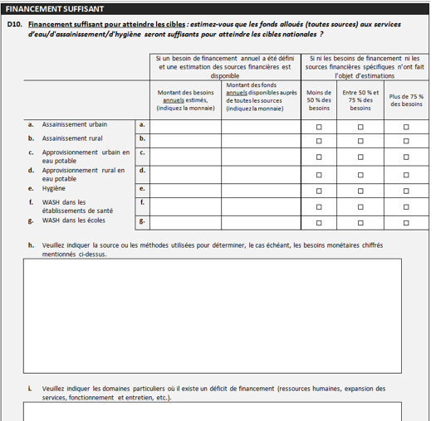
D10
Indiquez le montant et la monnaie.
Notes:
If need has been identified, please indicate monetary amount and currency.

Slide 45
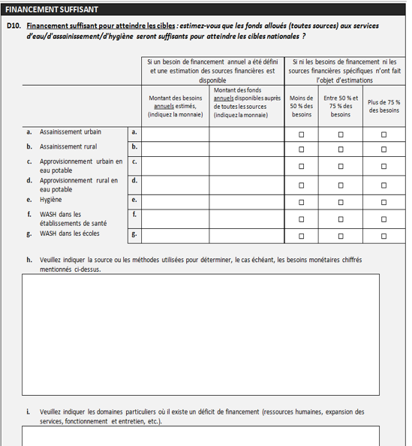
D10
Cochez une case par ligne.
Indiquez les sources ou les méthodes.
Fournissez plus d’information, si disponible.

Slide 46
Question D11: Flux financiers
D11
Cette question vise à déterminer:
  Quel est le total des dépenses dans le secteur ?
  Comment les fonds sont répartis entre les différents services et types de dépenses WASH ?
  Qui paie pour les services WASH, et dans quelle proportion ?
Notes:
Tracking of WASH financing is acknowledged as critical for policy development and implementation. However, prior studies have shown that this is a difficult and challenging task. Even where adequate data are available, an adequate level of disaggregation may not be possible. Despite these difficulties, GLAAS has requested information on WASH expenditures since 2010 and data received have steadily improved.

Slide 47
Étapes recommendées pour répondre à D11
Veuillez vous référer au guide d'orientation de l'enquête pour plus de détails
D11
Étape 1: Indiquer la monnaie, l’ordre de grandeur et l’année des données
Étape 2: Indiquer la personne à contacter
Étape 3: Indiquer les données disponibles
Étape 4: Délimiter le secteur WASH
Étape 5: Identifier les unités de financement (sources de recettes)
Étape 6: Éviter la double comptabilisation entre les unités de financement
Étape 7: Redevances (tarifs) pour les services fournis
Étape 8: Dépenses à la charge des ménages qui assurent eux-mêmes les services (Dépenses d’auto-approvisionnement des ménages)
Étape 9: Dépenses publiques
Étape 10: Transferts publics internationaux
Étape 11: Transferts volontaires (ONGs et fondations)
Étape 12: Fonds remboursables
Notes:
See the survey guidance for further details on these recommended steps.

Slide 48
Collecte des données
D11
Les sources d’informations possibles:
Documents de planification nationale
Systèmes d’information nationaux (enquêtes, données de recensement)
Documents de planification sectorielle et systèmes d’information
Bases de données internationales (IBNET, OECD CRS)
Études, revues et évaluations
Prestataires de service
Notes:
Countries should start by identifying relevant data already available through existing reports and information systems.
National planning documents
o Annual Development Plan
o Medium-Term Expenditure Framework
o National budgets and budget execution documents (public expenditures)
o Ministry budgets
o Poverty Reduction Strategy Paper (PRSP) documents and planned poverty reduction expenditure
o Local government budgets (for decentralized WASH sectors, for a sample of localities)
o Project-specific documentation
National information systems
o Household surveys, for example UNICEF’s Multi Indicator Cluster Surveys (MICS)
o National population estimates (breakdown of population urban/rural population estimates)
o Government financial management systems
o Information on the water sector from national statistics offices
Sector planning documents and information systems
o WASH sector reports / annual water sector review (expenditure data)
o Sector information systems
o Sector financing reports produced by the sector regulator (where these exist)
International databases
o IBNET (water and sewerage utilities performance, average annual water bill / utility revenues)
o OECD Creditor Reporting System (international public transfers, i.e. external funds)
Studies, reviews, and assessments
o Relevant studies of the United Nations Economic Commissions
o World Bank Water Sanitation Programme’s Country Status Overviews (sub-Saharan Africa only)
o UN-Water Country Briefs
o World Bank Public Expenditure Reviews (PERs)
o Africa Infrastructure Country Diagnostic studies
Utility information
o Utility financial statements or annual reports (tariff revenues / average cost per user)
o Benchmarking reports from utility associations, governments (for example Brazil or India) or regulators (for example Kenya or Mozambique).

Slide 49
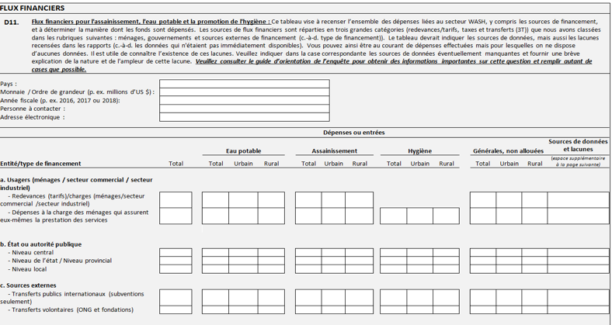

D11
Identifier la monnaie, l’année et la personne à contacter.
Notes:
Identify currency, units, and data year: It is expected that data could be obtained from several different sources, and it is possible that expenditures will be presented in different currencies other than the national currency (e.g. national vs. external aid reporting), different units, or for different timeframes. Please attempt to reconcile expenditure data in consistent units and timeframes, however, if this is not possible, please use/respond with as much data as possible and note where currencies or timeframes do not match.

Slide 50
D11
Les redevances et autres dépenses des ménages pour les les services fournis.
Notes:
Tariffs for services provided: For these flows, you will need to include an estimate of the total tariff revenues received by service providers. For example, this information might be obtained in IBNET, via the National Statistics Office, through individual service provider financial statements, with service regulators, or through associations of service providers. Some countries or organizations have gathered data on average tariffs in a given country or in different cities, while other organizations gather and present data on tariff structures at country level. However, few if any countries consistently and regularly collect data on the total amount of revenue generated through tariffs paid by users for services provided. In addition to collecting tariff revenue data from service providers, or if these data are not available, average tariffs could be combined with data on average water use and population estimates to derive very rough estimates of revenues from tariffs.
Households’ out of pocket expenditure for self-supply: Funding provided by households for investment in water self-supply solutions (private or community wells, small private water production systems, water tanks) and household level sanitation. In most countries, it is likely that these expenditures will need to be estimated based on estimated changes in water and sanitation coverage rates, and estimates of investments in self-provision by households. It would be preferable to at least provide an estimate of those expenses and to provide an explanation of the estimation method used below the table.

Slide 51
D11
Dépenses du gouvernement (ex. Transferts qui proviennent de taxes ou d’autres sources de revenu).
Notes:
Government or public authority expenditures: Funds contributed by the government or public authorities at central, provincial or local level to WASH. These funds are typically government transfers that come from taxes or other sources of revenues of the government. Such funds would typically be provided as subsidies for capital investment or operations. This category includes only “pure” grants and excludes repayable financing and concessionary loans, which should be included in the “repayable financing” row of this question.
Data on public transfers channeled to the WASH sector should be collected from a wide range of stakeholders and sources, including national and local governments or other public financing units. The latter may include common funding baskets, if a sector-wide approach to pool funding is adopted. In some cases, aggregated data at the national level can be found in established tools for tracking and planning financial resources. They can also be found in programme budget reporting systems.

Slide 52
D11
Transferts publics internationaux et autres transferts volontaires sous la forme de subventions.
Notes:
International public transfers: This category includes only voluntary donations from external public donors and multi-lateral agencies. These funds can be contributed in the form of grants or guarantees. Other forms of repayable financing from international donors, such as concessionary loans, are excluded from this category and should be shown in the “Repayable financing” row. Data on international public transfers can be sought from the following sources:
The OECD Creditor Reporting System (http://stats.oecd.org/Index.aspx?DataSetCode=crs1): This database tracks most transfers in the form of official development assistance (ODA) from donor countries and international organizations (bilateral and multilateral cooperation). This is a widely used source of international public transfer data and offers the possibility of tracking grants and (concessionary) loans separately.
National and local government financial accounts: These can be used to complement and refine data from OECD databases at the national level. In the event of conflicting information, however, it is essential to state which source has been given priority (which will depend on reliability). The Ministry of Finance should have aggregated reports on transfers from donors, but it may not differentiate between grants and concessionary loans.
Voluntary Transfers: Voluntary donations may come from international and national non-governmental donors, including from charitable foundations, non-governmental organizations (NGOs), civil society organizations and individuals (remittances). Only donations that are 100% pure grants are included in this category. All forms of repayable financing (including concessionary loans and guarantees) should be included in the “Repayable financing” row. In many developing countries, voluntary organizations frequently contribute to funding the water and sanitation sector both in cash and in kind (for example, by digging a well or providing equipment). Such transfers are often not reliably recorded, and therefore will likely be excluded from estimated voluntary donation amounts.

Slide 53
D11
Tous types de fonds remboursables, y compris les prêts et autres dettes.
Notes:
Repayable financing: This category includes all types of repayable financing, including concessionary loans or guarantees. Information on repayable financing to the sector is limited, but some can be found in existing databases:
The OECD-CRS database contains information on concessionary lending;
The International Financing Review compiles data on commercial loans or bonds; and
The World Bank Private Participation in Infrastructure database reports the amount of capital investment committed by private operators at the start of a public private partnership contract. It is commonly used to track private investment in infrastructure. Although private operators would not typically bring “new” financing to the sector as they are not financing types as such, they can temporarily bridge the financing gap.

Slide 54
D11
Indiquez la source d’information où des lacunes existent et l’étendue de ces lacunes. Un espace supplémentaire est disponible sur la page suivante.
Notes:
Please mention the source(s) of information for each financing type and indicate where data gaps exist (i.e. the respondent has attempted to locate the information, but the information is not available). Additionally, it is important to differentiate between what is not available at all and where insufficient data is available. Lastly, please feel free to include any comments on how much existing data/estimates reflect the actual overall sector spending

Slide 55
Notes supplémentaires
Veuillez utiliser le guide d'orientation de l'enquête pour plus de détails
D11
Fournir des détails sur les sources des données financières
Délimiter le secteur WASH
Éviter la double comptabilisation entre les unités financières et les sources de revenu
N’hésitez pas à inclure tout commentaire sur la proportion dans laquelle les données/estimations existantes prennent en compte les dépenses globales effectives du secteur.
Notes:
Establish WASH sector boundaries: For purposes of this question, the WASH sector boundary has been defined as services related to the provision of water, sanitation, and hygiene services. This would include support services to the WASH sector including policy-making processes, governance, and capacity-building activities, as well as water resources management (as it relates to water and sanitation services).
Avoid double counting between financing units: To establish overall expenditure in the WASH sector, financial flows should be computed at the level of the financing unit through which they enter the sector. A key principle is that one flow should only be recorded as one financing type. Donor funding channeled to local government through the national government, for example, should be recorded as international public transfers. Similarly, while network service providers (i.e. utilities), spend significant funds on infrastructure and operation and maintenance activities, these funds originate from user tariffs, grants, loans, ODA and should be recorded under these financing types where appropriate.

Slide 56
Utiliser TrackFin pour enrichir les réponses de la section D11
D11
Nous reconnaissons que les données demandées dans le tableau en D11 ne sont pas aisément disponibles dans certains pays. En vue d’améliorer l’information sur les flux financiers dans le secteur WASH, GLAAS a développé l’initiative TrackFin, une étude approfondie du financement du secteur WASH.
Notes:
Establish WASH sector boundaries: For purposes of this question, the WASH sector boundary has been defined as services related to the provision of water, sanitation, and hygiene services. This would include support services to the WASH sector including policy-making processes, governance, and capacity-building activities, as well as water resources management (as it relates to water and sanitation services).
Avoid double counting between financing units: To establish overall expenditure in the WASH sector, financial flows should be computed at the level of the financing unit through which they enter the sector. A key principle is that one flow should only be recorded as one financing type. Donor funding channeled to local government through the national government, for example, should be recorded as international public transfers. Similarly, while network service providers (i.e. utilities), spend significant funds on infrastructure and operation and maintenance activities, these funds originate from user tariffs, grants, loans, ODA and should be recorded under these financing types where appropriate.

Slide 57
TrackFin
D11
Cette initiative est une méthodologie standard mondiale qui permet d’assurer le suivi du financement dans le secteur de l’eau, de l’assainissement et de l’hygiène à l’échelle nationale.

Slide 58
Pour plus d’informations sur TrackFin
Si votre gouvernement souhaite participer à TrackFin, veuillez contacter: glaas@who.int
Pour plus d’information sur l’initiative TrackFin initiative et la méthodologie, merci de consulter ce lien: http://www.who.int/water_sanitation_health/monitoring/investments/trackfin-methodology/en/

Slide 59
Merci!
Pour plus d’information ou appui, veuillez contacter glaas@who.int

