Slide 1
Overview of how GLAAS and TrackFin fit into the SDGs and other monitoring initiatives
Module 4
GLAAS 2016/2017 cycle

Slide 2
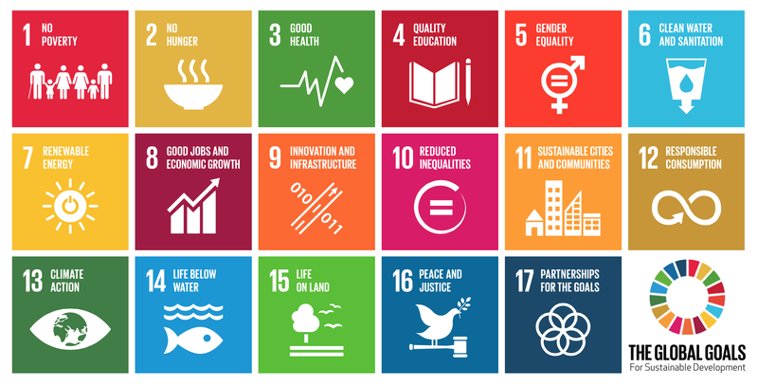
17 goals, 8 Water and Sanitation Targets, links to 6 other targets if not all….
Notes:
3.3 Water-borne diseases
No WASH indicator
3.8 Universal health coverage
WASH (domestic) as a tracer intervention
4.a Education facilities
Basic drinking-water and sanitation facilities in schools
6.3 Wastewater treatment
10.3 Reduce inequalities of outcome
11.1 Access for all (urban) to basic services

Slide 3
12 Indicators for Monitoring Goal 6
Indicator | Lead agencies | Indicator (brief title)
6.1.1 | WHO/UNICEF | Safely managed drinking water services
6.2.1 | WHO/UNICEF | Safely managed sanitation services
6.2.2 | WHO/UNICEF | Handwashing in the home
6.3.1 | WHO, Habitat | Safely treated wastewater
6.3.2 | UNEP | Ambient water quality in water bodies
6.4.1 | FAO | Level of water stress
6.4.2 | FAO | Change in water use-efficiency over time
6.5.1 | UNEP | Degree of integrated water resource management implementation
6.5.2 | UNECE, UNEP | Transboundary basin areas with operational arrangements for cooperation
6.6.1 | UNEP | Change in wetlands extent over time
6.a | OECD, WHO, UNEP | Water and sanitation ODA as part of coordinated spending plans
6.b | WHO, UNEP | Participation of local communities in water and sanitation management
Notes:
6.1 and 6.2. JMP
But there are twelve indicators proposed in all, and WHO is also involved in the monitoring of target 6.3, through the safely treated wastewater indicator regarding the treatment of domestic wastewater. (Other parts of this target track treatment of industrial waste, and surface water quality).
And GLAAS is a co-custodian (along with OECD and UNEP) for monitoring of the Means of Implementation indicators, 6.A and 6.B… (transition to GLAAS and AMCOW).

Slide 4

SDG 6 & Global monitoring initiatives
UN-Water
6.3
Water quality
6.4
Water scarcity
6.5
Water resource mgmt
6.6
Eco-systems
6.2
Sanitation and Hygiene
6.1
Drinking Water
Goal 6
JMP
Means of Implementation
6.A
International cooperation
and capacity development
6.B
Local participation
GEMI
GLAAS

Slide 5

JMP and the SDGs
What’s the same (mostly)?
  Basic services (similar to improved facilities)
  Data from household surveys
  Focus on inequalities (even more so)
What’s new?
  Higher levels of service (safely managed water, sanitation)
  Hygiene
  WASH in schools and health care facilities
Notes:
Monitoring SDG Targets 6.1 and 6.2
An important message for monitoring the SDGs on WASH is that their should be some continuity with the MDG period, and that for all of the limitations, the improved water and sanitation metrics have proved to be very useful. JMP will continue to report on a basic level of service, which is very much like the improved classification of the MDG period, drawing mainly on data from household surveys. The use of household surveys allows a strong focus on inequalities, as the same surveys also collect information on wealth, educational level, and location. Recent JMP reports have increasingly highlighted inequalities between different groups, and in the SDG period this focus will only intensify.
But the MDG indicators had some key gaps, and during a detailed consultation with many experts, in WASH and in human rights, from around the world, some new areas were identified that should be addressed in the SDGs.
First, there was a recognition that the improved water and sanitation indicators missed out on important aspects of service level, such as water quality, or wastewater management. As a result of the consultation, the JMP is proposing to add to the existing water and sanitation ladders, with a higher level of service that brings in aspects of management.
Second, the MDGs were silent on hygiene, but we know that the link between hygiene and health is critical – handwashing with soap is one of the most cost-effective public health interventions that exists. Finally, it was recognized that there was a need to move beyond the household, and consider WASH in other locations, and schools and health care facilities were identified as key areas where people are particularly vulnerable, and where there was already strong interest in ensuring safe WASH services.
So these are what the new SDG ladders might look like.
First, water and sanitation ladders that are much like the MDG ladders, but with a new higher level, called safely managed. Then a new ladder for handwashing, and
New ladders for water, sanitation, and hygiene – including menstrual hygiene – in institutional settings, with the focus at least initially on schools and health facilities.

Slide 6
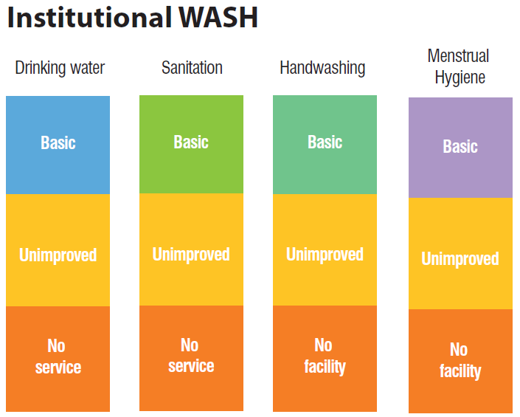
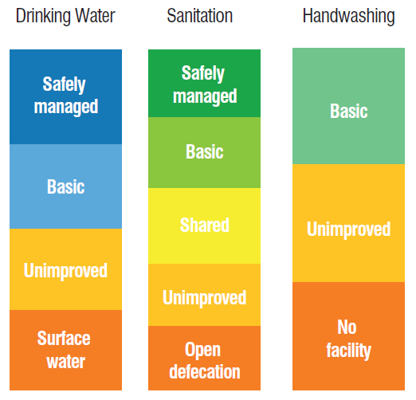
JMP and the SDGs
Household WASH

Slide 7
Target 6.1: Drinking water
By 2030, achieve universal and equitable access to safe and affordable drinking water for all
6.1.1: Population using safely managed drinking water services
Definition: Pop. using an improved drinking water source which is:
located on premises,
available when needed, and
free of faecal and priority chemical contamination
Accessibility
Availability
Quality

Slide 8
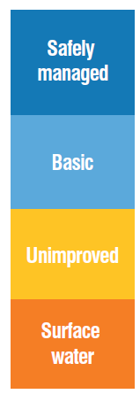
MDG/SDG | Service ladder | Progressive realization | Monitoring ladder
SDG 6.1 | Safely managed drinking water | On premises, available when needed and meets water quality standards | All developed countries, and some developing countries
MDG continuity | Basic water | Improved facility within 30 minutes round trip collection time | Most developing and some developed countries report
 | Unimproved water | Facility which does not protect against contamination | Most developing and some developed countries report
 | No service | Surface water | All countries report (applies to developing countries)
Developing Developed
Notes:
Safely-managed drinking water is the top level for the proposed service ladder, running from no service to safely managed.
This ladder aims to capture progressive realisation of the Human Rights to Water and Sanitation.
It is also a monitoring ladder, increasing sophistication of monitoring allows countries to track higher levels of service - in many cases these may happen in tandem.

Slide 9
Target 6.2: Sanitation and hygiene
By 2030, achieve access to adequate and equitable sanitation and hygiene for all, and end open defecation, paying special attention to the needs of women and girls and those in vulnerable situations
6.2.1: Population using safely managed sanitation services including a handwashing facility with soap and water
Definition: Pop. using an improved sanitation facility which is:
not shared with other households and where
excreta are safely disposed in situ or
transported and treated off-site
Accessibility
Quality

Slide 10
MDG/SDG | Service ladder | Progressive realization | Monitoring ladder
SDG 6.2 | Safely managed sanitation | Going beyond hygienic separation of excreta from human contact , including transport and treatment | All developed countries, some developing countries
MDG-type | Basic sanitation | Private basic sanitation | Most developing and some developed countries report
 | Shared sanitation | Improved sanitation | Most developing and some developed countries report
 | Unimproved sanitation | Fixed point defecation | All countries report (applies to developing countries)
 | No service | Open defecation | All countries report (applies to some countries)
Developing Developed

Slide 11
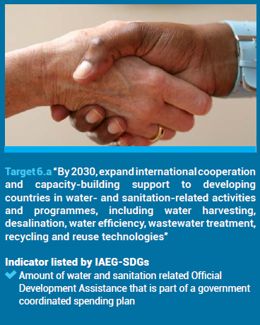
Data Sources:
GLAAS
2016 Survey Q D9 on how external funding channeled
Expanded to cover IWRM
TrackFin
If a country participates, data can complement GLAAS survey data
OECD
DAC data on ODA through CRS

Slide 12
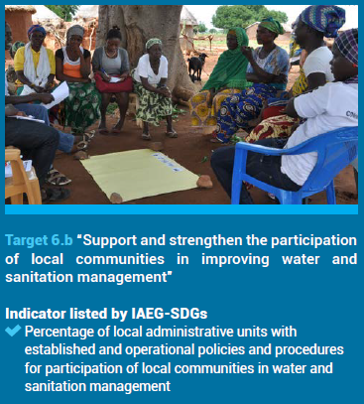
Data Sources:
GLAAS
2016 Survey Q A10
Expanded to cover IWRM
Added question on administrative units and number with participation policies/procedures
OECD
Potentially through Water Governance Indicators

Slide 13
GLAAS and SDG Monitoring
GLAAS has also expanded the country survey to include topics related to SDG 6 including:
  Wastewater
  Integrated water resource management
  Ambient water quality
  Regulation
Participating in GLAAS complements other SDG 6 monitoring initiatives
TrackFin data will also contribute to monitoring 6.a

Slide 14

Collaboration with AMCOW
GLAAS has aligned with AMCOW’s framework for monitoring the N’Gor commitments
  GLAAS and JMP are supporting further capacity in AMCOW for strengthening M&E at country ensuring regional comprehensiveness and alignment
  GLAAS 2016 survey has been mapped onto the N’Gor commitments and can contribute data, reducing the reporting burden on countries
GLAAS is a link with both N’Gor and SDG monitoring in addition to monitoring the global enabling environment feeding into Sanitation and Water for All (SWA) partnership

Slide 15

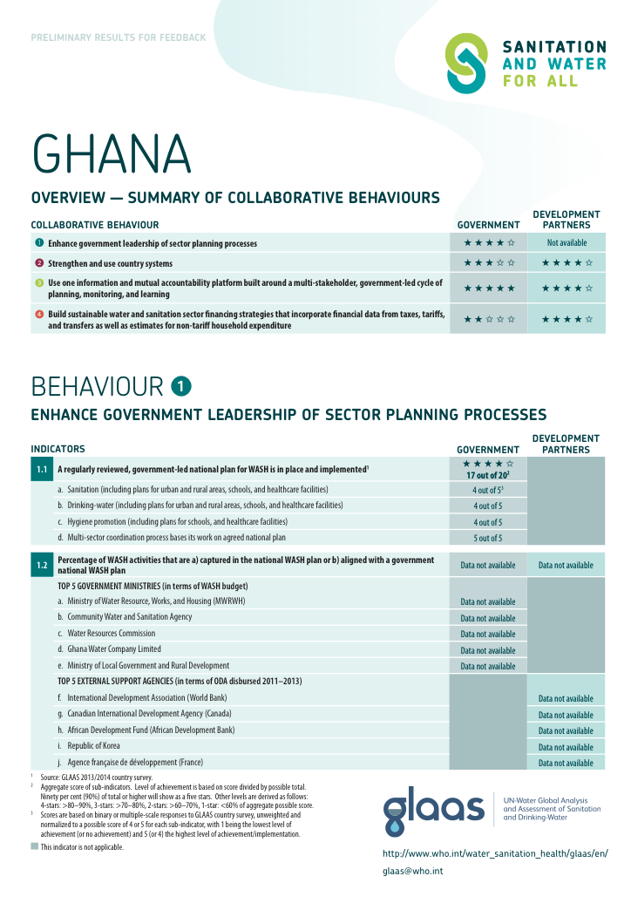
Collaboration with SWA
GLAAS is the evidence arm of SWA
GLAAS 2017 report on finance will be launched ahead of the High Level Meeting in April 2017
GLAAS is monitoring the four collaborative behaviors
  Country profiles will be available at the HLM
Participating in GLAAS will help with preparatory work for the 2017 HLM
Notes:
More information on the SWA Collaborative Behaviours can be found here: http://sanitationandwaterforall.org/about/the-four-swa-collaborative-behaviours/

Slide 16
Collaboration with WASH BATs
The two tools are complementary and ultimately serve different purposes.
If a country recently conducted a WASH BAT before a GLAAS data collection period, the WASH BAT can feed into the GLAAS survey.
If a country participates in GLAAS and wants to dive deeper into certain topics, it could conduct a WASH BAT.
GLAAS questions have been mapped onto the next version of the WASH BAT and GLAAS sections align with WASH BAT building blocks.
UNICEF and WHO are working together to continue to ensure alignment and cooperation.
Notes:
More information on WASH BATs can be found here: http://washbat.org

Slide 17
Collaboration with other regional initiatives
GLAAS findings are presented as evidence for regional conferences such as Latinosan in Latin America and SACOSAN in South Asia
In Europe, GLAAS synergy with the Protocol on Water and Health will support setting baselines and identifying national targets

Slide 18

Thank you!
For additional information or assistance please contact glaas@who.int

