Slide 1
Section D: Finance
Module 5: Overview of Questions
GLAAS 2016/2017 cycle

Slide 2
Why Finance?
Finance is the thematic focus for this cycle
Finance is one of the most critical aspects influencing sectoral planning
Finance is a strong driver of progress
Previous GLAAS cycles identified considerable data gaps in WASH finance, impeding sound decision-making and resource allocation

Slide 3
Overview
Section D consists of 11 questions covering WASH financing
Section D is the same for both the long and short versions of the survey
This module will go through each of the questions

Slide 4
Questions
D1: Financing Plan
D2: Government Budget
D3: Financial Reporting
D4: Cost recovery strategies
D4: Equity
D6: Affordability
D7: Utilisation (External)
D8: Utilisation (Domestic)
D9: External Financing
D10: Sufficiency of Financing
D11: Financial Flows

Slide 5
Question D1 – Financing Plan
D1
This question aims to assess :
  Whether there is a financing plan or budget for WASH or specific areas within WASH
  Whether there are links to a strategic financing planning process
  The extent of plan implementation
Notes:
Investment programmes help to define and prioritize capital needs, match expected resources with costs of infrastructure and programmes and improve intergovernmental coordination, predictability and transparency of budgeting and expenditure. These programmes can also be linked to a strategic financial planning process that answers questions such as who (e.g. users, taxpayers, donors) should pay for what (i.e. operating/capital expenses, water/sanitation, rural/urban/peri-urban areas) and what should be the future service level.

Slide 6
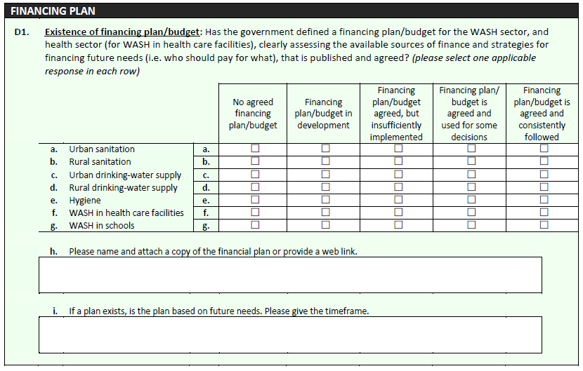
D1
Areas covered by plan
Notes:
In some countries there may be several plans each covering a specific area e.g. separate plans for drinking-water, sanitation and hygiene, separate plans for urban and rural areas, even sometimes different plans for urban differentiating according to utility boundaries and urban areas not covered by the national utility.

Slide 7
D1
Range of responses
Notes:
The range of responses for this question include (but is not limited to):
No agreed financing plan/budget – There is no agreed budget line(s) or finance plan that allocates funds to this particular WASH sub-sector/area. This sub-sector/area may be funded from a broader ministry budget or from other programmes, but no separate line items for this WASH sub-sector/area are identified and no finance plan is agreed.
Financing plan/budget in development – Work is in progress to develop separate budget lines or a strategic financing plan for this WASH sub-sector/area.
Financing plan/budget agreed, but insufficiently implemented – Budgets or finance plans for the WASH sub-sector/area are agreed, but allocation of funds is not forthcoming or only a small fraction of budget, and/or the capacity to implement these plans/projects has yet to be developed.

Slide 8
Question D2: Government WASH Budget
D2
This question aims to:
  Analyse the distribution of WASH budgets between different ministries and/or institutions
  Track trends in budgets for WASH
Notes:
Government budgets can be indicators of priority in national policy and action.

Slide 9
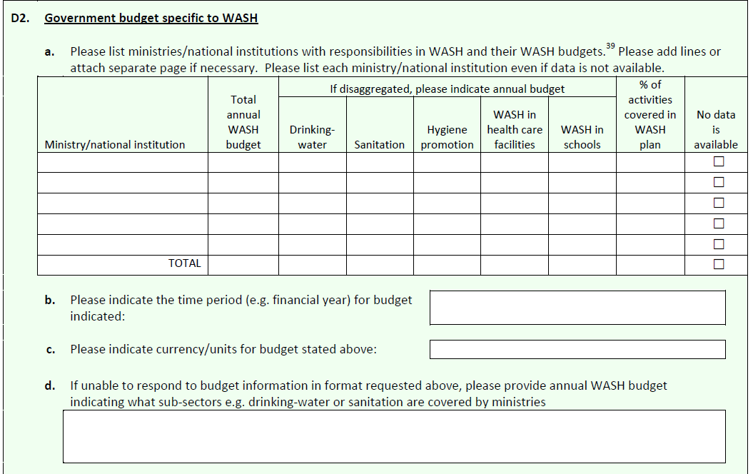
D2
List all ministries involved with WASH (even if specific budgets can’t be obtained)
Notes:
Line ministry WASH budgets for water, sanitation and hygiene are requested in a disaggregated format, however, it is acknowledged that only aggregate may be available.

Slide 10
D2
List disaggregated budget if possible
Notes:
Line ministry WASH budgets for water, sanitation and hygiene are requested in a disaggregated format, however, it is acknowledged that only aggregate may be available.

Slide 11
D2
List total WASH budget too
Notes:
If no data is available, check no available data column

Slide 12
D2
If there is a national WASH plan, estimate % of activities that align with the plan
Notes:
Line ministry WASH budgets for water, sanitation and hygiene are requested in a disaggregated format, however, it is acknowledged that only aggregate may be available.

Slide 13
D2
Please include time period and currency units
Notes:
If you cannot complete the table, estimate the annual WASH budget in the most convenient format in Section D.

Slide 14
Question D3: Financial Reporting
D3
This question aims to assess:
  Whether funds spent are reported against funds committed
Reports could come from the Ministry of Finance, line ministries, annual reports and financial statements

Slide 15
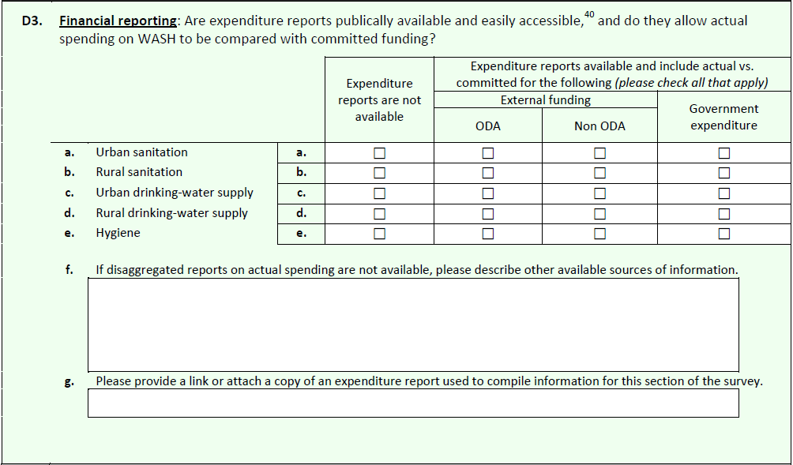
D3
Are reports available for external funds?

Slide 16
Explanatory Note – ODA vs. Non-ODA
D3
As a guide, the OECD definitions are:
Official Development Assistance (ODA): Financial flows provided by official government agencies and are concessional in character (at least a 25% grant element)
Non ODA: Official flows that are not concessional in nature (e.g. private flows at market terms), or funds from non-governmental donors such as NGOs and charities
Notes:
The difference between the two can be broadly defined but as a guide the OECD definitions are described here.

Slide 17
D3
Are reports available for government expenditure?

Slide 18
D3
List here any challenges in obtaining disaggregated WASH expenditure reports and describe what information is available

Slide 19
Question D4: Cost Recovery Strategies
D4
This question aims to assess:
  Whether operations and basic maintenance costs are covered by household contributions or tariffs
  How much of these costs are covered by household contributions, if such a plan exists

Slide 20
Cost Recovery for Operations
D4
Cost recovery is considered to be important for the sustainability of services
Operations and basic maintenance: activities necessary to keep services running. This includes labour, fuel, chemicals, materials and ongoing maintenance, but does not include major repairs or renewals.

Slide 21
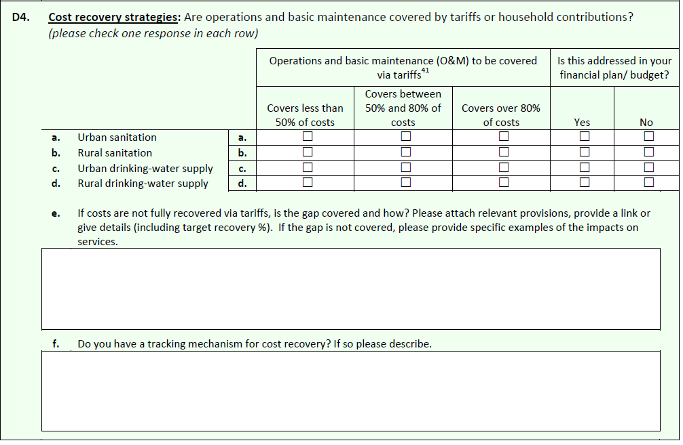
D4
How much of the costs do tariffs cover?

Slide 22
D4
If tariffs do not cover all the costs, how is this shortfall recovered?

Slide 23
D4
Is the cost recovery strategy reviewed and are adjustments made periodically?

Slide 24
Question D5: Equity
D5
This question aims to assess:
  Which vulnerable groups are the focus of equity measures
  Whether these measures are funded through resources identified in the financing plan
Notes:
The 2030 Agenda for Sustainable Development includes a dedicated goal on water and sanitation (SDG 6) that sets out to “ensure availability and sustainable management of water and sanitation to all.” In line with this objective, many countries have already established policies and specific financing measures to reach vulnerable groups to ensure equal and non-discriminatory access to drinking-water and sanitation services.

Slide 25
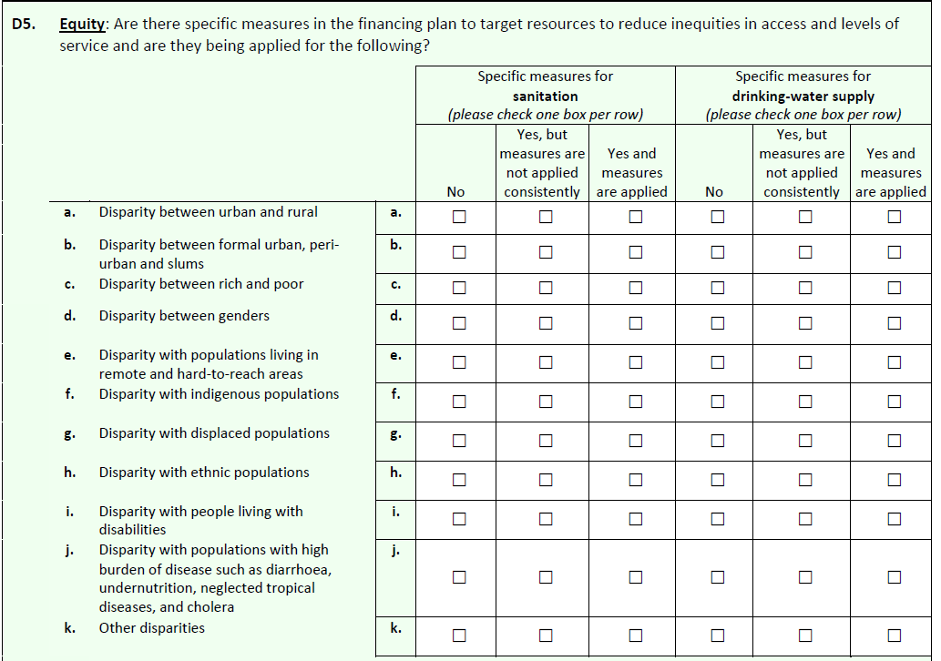
D5
Scope of equity measures
Notes:
Examples of measures include:
Specific budgets for identified disparities (e.g. in rural, peri-urban or slum area with low access);
Grants for basic services that promote some service to all rather than all services for some;
Subsidized water tariffs, with lower rates for low consumption volumes that cover basic needs;
Geographic targeting of available funds (e.g. towards rural or interior areas with low access); and
Subsidies/grants targeted to specific vulnerable groups for water connections, or assistance in the construction of latrines.

Slide 26
D5
Are these applied?

Slide 27
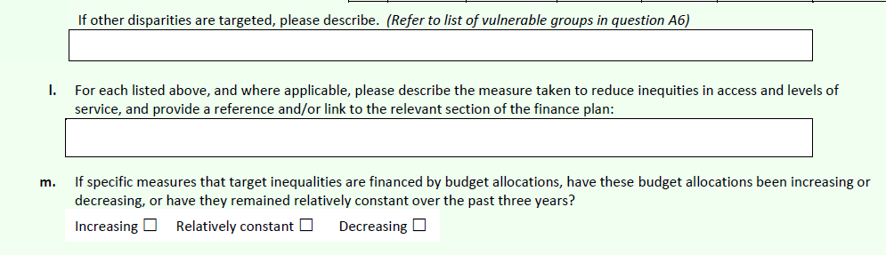
D5
Notes:
The last parts of the question request more detail. If needed, please attach further information to the survey results.

Slide 28
Question D6: Affordability
D6
This question aims to assess:
  Whether specific measures have been made to make WASH affordable for vulnerable groups
  How widely these measures are used
Notes:
Low-income populations, vulnerable population groups and rural communities commonly do not have the financial means to obtain or connect to existing water and sanitation services, let alone pay for the cost to sustain these services. In the GLAAS 2013/2014 survey, countries indicated that fees for connecting to services are often reduced or waived for the poor and vulnerable.

Slide 29
Examples of Vulnerable Groups
D6
Poor populations (both rural and urban)
Indigenous populations
Refugees and internally displaced persons
Women
Ethnic minorities
People living with disabilities
Notes:
These are identified in Question A6

Slide 30
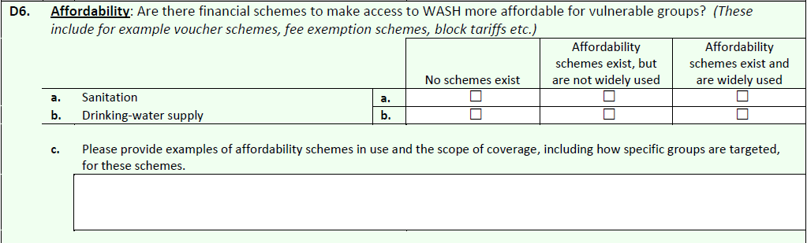
D6
Notes:
The most commonly cited affordability scheme is that of a tiered or block tariff scheme based on water use and/or income levels – with a highly subsidized first block, (e.g. 0 to 7 cubic meters) designed to cover basic needs. Other examples of the affordability schemes cited by countries include:
Reduced or subsidized water connection fees
Vouchers (pre-paid)
Free water tanks for senior citizens and people living with disabilities
Goodwill of WASH committee
Microfinance, incentive credit (loan) for rural populations.
Other examples include subsidies to reduce costs of spare parts for water pumps or slabs for latrines.

Slide 31
D6
Check appropriate box

Slide 32
Question D7: Utilisation of External Funds
D7
This question aims to assess:
  What % of external donor funds are utilised (absorbed) for WASH sector activities
  Whether there are differences between different WASH areas
  Reasons why commitments are under-utilised

Slide 33
Question D7: Definitions
D7
Absorption Rate: the % of donor commitments utilised over a given period
Commitment (donor): a firm obligation expressed in writing and backed by necessary funds, undertaken by an official donor to provide assistance to a recipient country

Slide 34
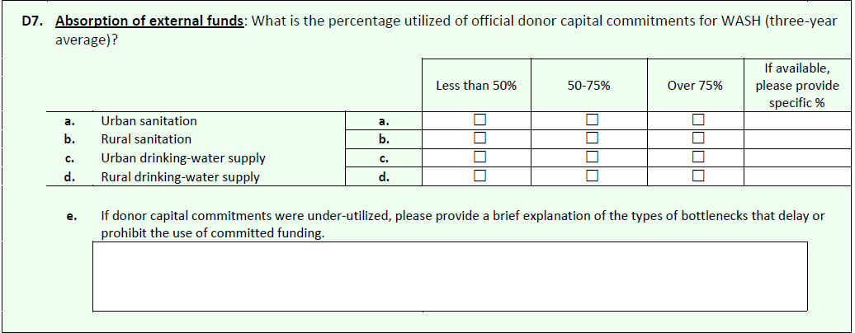
D7
Provide an estimate or specific value if possible

Slide 35
D7
Possible reasons could include:
Delays in procurement
Disbursement delays
Conflict or geographic inaccessibility
Notes:
Improving the use of available external funds is one means to incrementally increase financing to the WASH sector. In the GLAAS 2013/2014 survey, data indicated that only 40% of countries absorb a high percentage of donor capital commitments for sanitation. Problems reported by governments concerning the under-utilization of donor capital commitments included:
Procurement procedures are too complex, lengthy, or there are delays;
Disbursement delays or complex procedures;
Limited national institutional or contractor implementation strategy;
Land issues, geographic inaccessibility, and conflict;
Financial system complexity or limited financial administrative /control capacity; and
Contracting pre-requisites, budget readjustments, or multiplicity of rules and procedures specific for each donor.

Slide 36
Question D8: Utilisation of Domestic Funds
D8
This question aims to assess:
  What % of domestic WASH commitments are utilised (absorbed)
  Whether there are differences between different WASH areas
  Reasons why commitments may be underutilised

Slide 37
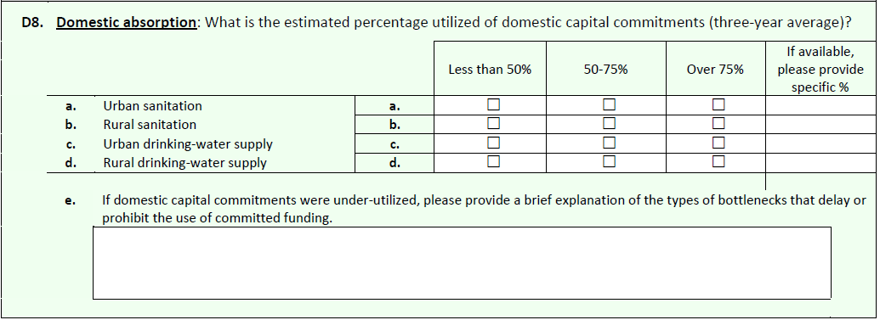
D8
Provide an estimate or specific value if possible
Notes:
In the GLAAS 2013/2014 survey, efficient and timely release of domestic financing for WASH was reported as an issue for a majority of countries. Survey data indicate that 60% of countries absorb a high percentage of their domestic commitments for both sanitation and drinking-water. Most often issues concerning the absorption of national funds for WASH activities included:
Administrative/funding release procedures too lengthy or too complex;
Procurement delays (causing late fund release, i.e. too late to be spent within the financial year for which the funds have been allocated);
Inadequate project preparation, inaccurate estimates or terms of reference in procurement;
Low public or private sector capacity to respond to proposals and implement projects (e.g. limited drillers or suppliers, or lack of municipal capacity to perform supply chain management); and
Expropriation and land-ownership issues causing delays.
Previous trends showed improvements in the absorption of funds for WASH that were possibly linked to improvements in financial procedures or country implementation capacity. If there has been a recent increase in the absorption of domestic funds committed for WASH in the past three years, please describe what programmes or policies have aided this improvement.

Slide 38
D8
And if the absorption rate has improved over the last 3 years, please described what policies might have aided this

Slide 39
Question D9: External Funding
D9
This question aims to assess:
  How much external funding is received
  The degree to which donors are coordinating funding with the government
  The distribution of external funding through different channels

Slide 40
Question D9: External Funding
D9
This question also includes questions on integrated water resources management and agricultural water use, in addition to water and sanitation
This information is requested to help inform monitoring efforts for SDG Target 6a

Slide 41
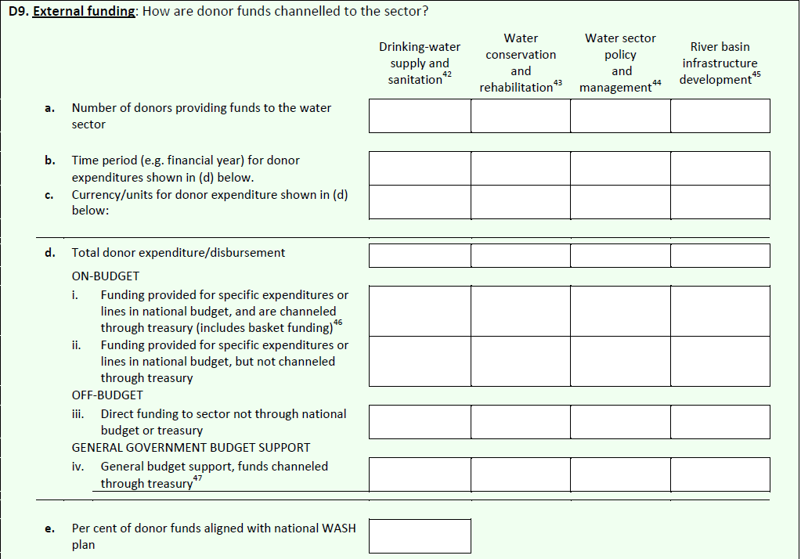
D9
Details of donor commitments
Notes:
Donor activity and disbursement Information has been requested according to OECD groupings found in its Creditor Reporting System. Countries may use information from OECD to identify gross aid disbursements for those donors that do not channel funds through the national budget process if these amounts are unavailable in national budget or WASH sector planning or assessment documents (see http://stats.oecd.org/Index.aspx? DataSetCode=crs1).

Slide 42
D9
Channels used for funds

Slide 43
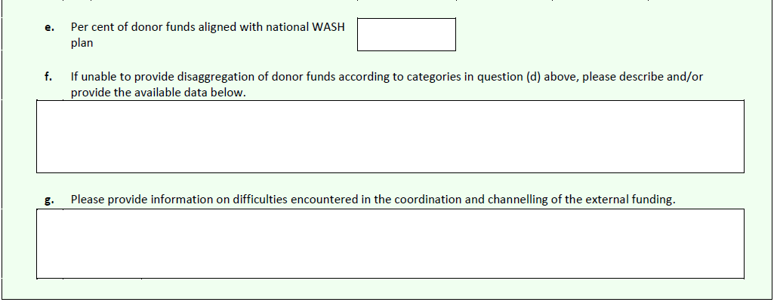
D9
Please describe if there were any challenges encountered in the coordination or channelling of external funds

Slide 44
Question D10: Sufficiency of Funding
D10
This question aims to assess:
  Whether sufficient funds were allocated to meet national targets for WASH, as perceived by the country
Responses should be based on current financing trends (both in national budgets and external assistance)

Slide 45
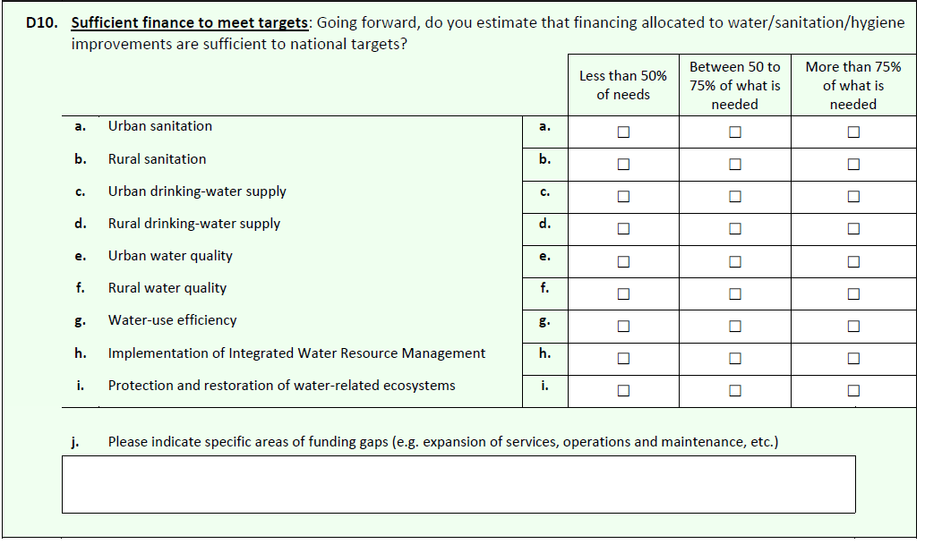
D10
Check the appropriate box

Slide 46
D10
These correspond to SDG6 targets

Slide 47
D10
Provide more information if available

Slide 48
Question D11: Financial Flows
D11
This question aims to assess:
  What is the total expenditure in the sector?
  How are funds distributed among different WASH services?
  Who pays for WASH services and how much?
Notes:
Tracking of WASH financing is acknowledged as critical for policy development and implementation. However, prior studies have shown that this is a difficult and challenging task. Even where adequate data are available, an adequate level of disaggregation may not be possible. Despite these difficulties, GLAAS has requested information on WASH expenditures since 2010 and data received have steadily improved.

Slide 49
Collection of Data
D11
Possible sources of information:
National planning documents
National information systems (surveys, census data)
Sector planning documents and information systems
International databases (IBNET, OECD CRS)
Studies, reviews and assessments
Utility information
Notes:
Countries should start by identifying relevant data already available through existing reports and information systems.
National planning documents
o Annual Development Plan
o Medium-Term Expenditure Framework
o National budgets and budget execution documents (public expenditures)
o Ministry budgets
o Poverty Reduction Strategy Paper (PRSP) documents and planned poverty reduction expenditure
o Local government budgets (for decentralized WASH sectors, for a sample of localities)
o Project-specific documentation
National information systems
o Household surveys, for example UNICEF’s Multi Indicator Cluster Surveys (MICS)
o National population estimates (breakdown of population urban/rural population estimates)
o Government financial management systems
o Information on the water sector from national statistics offices
Sector planning documents and information systems
o WASH sector reports / annual water sector review (expenditure data)
o Sector information systems
o Sector financing reports produced by the sector regulator (where these exist)
International databases
o IBNET (water and sewerage utilities performance, average annual water bill / utility revenues)
o OECD Creditor Reporting System (international public transfers, i.e. external funds)
Studies, reviews, and assessments
o Relevant studies of the United Nations Economic Commissions
o World Bank Water Sanitation Programme’s Country Status Overviews (sub-Saharan Africa only)
o UN-Water Country Briefs
o World Bank Public Expenditure Reviews (PERs)
o Africa Infrastructure Country Diagnostic studies
Utility information
o Utility financial statements or annual reports (tariff revenues / average cost per user)
o Benchmarking reports from utility associations, governments (for example Brazil or India) or regulators (for example Kenya or Mozambique).

Slide 50
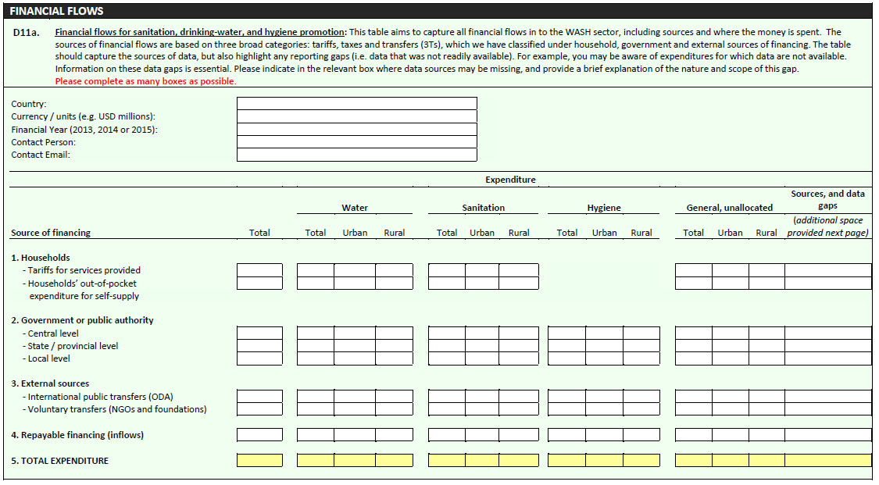
D11
Identify currency, year, and contact person
Notes:
This table is also available in Excel format online or upon request at glaas@who.int

Slide 51
D11
Tariffs and other household expenditures for services provided
Notes:
For these flows, you will need to include an estimate of the total tariff revenues received by service providers. This information might be obtained in IBNET, via the National Statistics Office, through individual service provider financial statements, with service regulators, or through associations of service providers for example. Some countries or organizations have gathered data on average tariffs in a given country or in different cities, while other organizations gather and present data on tariff structures at country level. However, few if any countries consistently and regularly collect data on the total amount of revenue generated through tariffs paid by users for services provided. In addition to collecting tariff revenue data from service providers, or if these data are not available, average tariffs could be combined with data on average water use and population estimates to derive very rough estimates of revenues from tariffs.
Households’ out of pocket expenditure for self-supply: Funding provided by households for investment in water self-supply solutions (private or community wells, small private water production systems, water tanks) and household level sanitation. In most countries, it is likely that these expenditures will need to be estimated based on estimates of investments by households and average unit costs. It would be preferable to at least provide an estimate of those expenses and to provide an explanation of the estimation method used below the table.

Slide 52
D11
Government expenditure
i.e. Government transfers that come from taxes or other revenue sources
Notes:
Government expenditures: Funds contributed by the government or public authorities at central, provincial or local level to WASH. These funds are typically government transfers that come from taxes or other sources of revenues of the government. Such funds would typically be provided as subsidies for capital investment or operations. This category includes only “pure” grants and excludes repayable financing and concessionary loans, which should be included in the “repayable financing” row of this question.
Data on public transfers channeled to the WASH sector should be collected from a wide range of stakeholders and sources, including national and local governments or other public financing units. The latter may include common funding baskets, if a sector-wide approach to pool funding is adopted. In some cases, aggregated data at the national level can be found in established tools for tracking and planning financial resources. They can also be found in programme budget reporting systems.

Slide 53
D11
International public transfers (ODA) and other voluntary donations (non ODA) that are pure grants
Notes:
International public transfers: This category includes only voluntary donations from external public donors and multi-lateral agencies. These funds can be contributed in the form of grants or guarantees. Other forms of repayable financing from international donors, such as concessionary loans, are excluded from this category and should be shown in the “Repayable financing” row. Data on international public transfers can be sought from the following sources:
The OECD Creditor Reporting System: This database tracks most transfers in the form of official development assistance (ODA) from donor countries and international organizations (bilateral and multilateral cooperation). This is the best source of international public transfer data and offers the possibility of tracking grants and (concessionary) loans separately.
National and local government financial accounts: These can be used to complement and refine data from OECD databases at the national level. In the event of conflicting information, however, it is essential to state which source has been given priority (which will depend on reliability). The Ministry of Finance should have aggregated reports on transfers from donors, but it may not differentiate between grants and concessionary loans.
Voluntary transfers: Voluntary donations may come from international and national non-governmental donors, including from charitable foundations, non-governmental organizations (NGOs), civil society organizations and individuals (remittances). Only donations that are 100% pure grants are included in this category. All forms of repayable financing (including concessionary loans and guarantees) should be included in the “Repayable financing” row. In many developing countries, voluntary organizations frequently contribute to funding the water and sanitation sector both in cash and in kind (for example, by digging a well or providing equipment). Such transfers are often not reliably recorded, and therefore will likely be excluded from estimated voluntary donation amounts.

Slide 54
D11
All types of repayable financing, including loans (concessionary or non concessionary)and guarantees.
Notes:
Repayable financing: This category includes all types of repayable financing, including concessionary loans or guarantees. Information on repayable financing to the sector is limited, but some can be found in existing databases:
The OECD-CRS database contains information on concessionary lending;
The International Financing Review compiles data on commercial loans or bonds; and
The World Bank Private Participation in Infrastructure database reports the amount of capital investment committed by private operators at the start of a public private partnership contract. It is commonly used to track private investment in infrastructure. Although private operators would not typically bring “new” financing to the sector as they are not financing types as such, they can temporarily bridge the financing gap.

Slide 55
D11
Indicate source of information, where data gaps exist and extent of the data gap
Notes:
Please mention the source(s) of information for each financing type and indicate where data gaps exist (i.e. the respondent has attempted to locate the information, but the information is not available). Additionally, it is important to differentiate between what is not available at all and where insufficient data is available.

Slide 56
Additional Notes
D11
Provide details on sources of financial data
Establish WASH sector boundaries
Avoid double counting between financing units/revenue sources
Feel free to include comments about how accurately the existing data or estimates reflect actual spending
Notes:
Establish WASH sector boundaries: For purposes of this question, the WASH sector boundary has been defined as services related to the provision of water, sanitation, and hygiene services. This would include support services to the WASH sector including policy-making processes, governance, and capacity-building activities, as well as water resources management (as it relates to water and sanitation services).
Avoid double counting between financing units: To establish overall expenditure in the WASH sector, financial flows should be computed at the level of the financing unit through which they enter the sector. A key principle is that one flow should only be recorded as one financing type. Donor funding channeled to local government through the national government, for example, should be recorded as international public transfers. Similarly, while network service providers (i.e. utilities), spend significant funds on infrastructure and operation and maintenance activities, these funds originate from user tariffs, grants, loans, ODA and should be recorded under these financing types where appropriate.

Slide 57
Thank you!
For additional information or assistance please contact glaas@who.int

