Slide 1
Introduction to GLAAS
Module 1
GLAAS 2018/2019 cycle

Slide 2
What is GLAAS?
GLAAS: UN-Water Global Analysis and Assessment of Sanitation and Drinking-Water
  Implemented by the World Health Organization on behalf of UN-Water
  A global, biennial update on the policy frameworks, institutional arrangements, monitoring systems, human resources base and finance streams in support of sanitation, drinking-water, hygiene sector
Notes:
GLAAS stands for the UN-Water Global Analysis and Assessment of Sanitation and Drinking-Water (GLAAS), which is implemented by the World Health Organization.

Slide 3
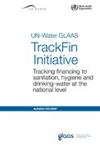
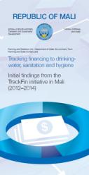
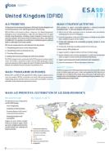
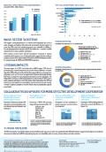





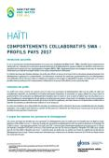
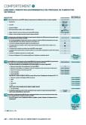
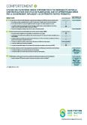





GLAAS areas of work
GLAAS data collection and reports
SDG monitoring
Collaboration and partnerships
TrackFin
UN-Water GLAAS
Notes:
In addition to the GLAAS country survey and report, SDG monitoring and TrackFin and also under the GLAAS umbrella.
For more information on SDG monitoring, see GLAAS informational module 3.
For more information on TrackFin see: http://www.who.int/water_sanitation_health/monitoring/investments/trackfin/en/

Slide 4
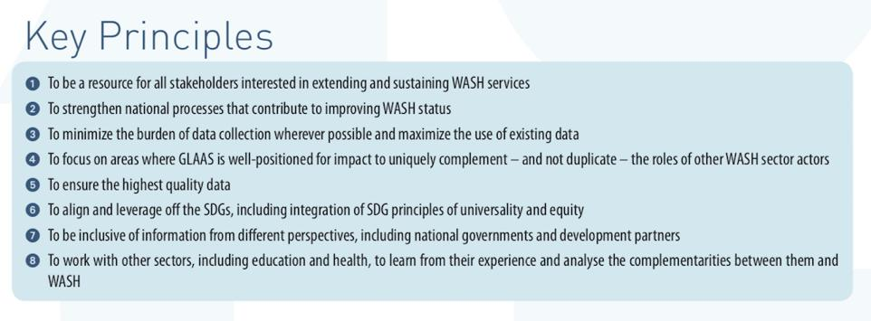
UN-Water GLAAS 2017-2020 strategy

Slide 5
GLAAS data collection and reports:
Purpose and objectives
Monitor the inputs required to extend and sustain WASH systems and services to all, especially the unserved and disadvantaged groups
Support country-led processes that bring together the many institutions and actors that are involved in delivering WASH services
Identify drivers and bottlenecks of progress, highlight knowledge gaps and assess strengths and challenges across countries
Collect data from countries and external support agencies
Notes:
The objectives of GLAAS is to monitor the inputs (human resources and finance) and the enabling environment (laws; plans and policies; institutional arrangements; monitoring; and feedback arrangements) required to extend and sustain WASH systems and services to all, especially the unserved and disadvantaged groups.
Importantly, GLAAS is a country-led process that helps to bring together the many institutions and actors that are involved in delivering WASH services. An equally challenging secondary goal is to analyze the factors associated with progress, or lack thereof, in order to identify drivers and bottlenecks, highlight knowledge gaps and assess strengths and challenges across countries.

Slide 6
Benefits of GLAAS to Countries
Provides a useful situation analysis of the WASH sector
Identifies information gaps
Helps decision-makers define priorities and devise plans
Brings different stakeholders together
Contributes to SDG monitoring
Notes:
Past countries have stressed that GLAAS provides a useful situation analysis for the water and sanitation sector and helps decision makers identify gaps, define priorities and devise sectoral plans. Its multisectoral approach also encourages different stakeholders to work together. GLAAS also contributes to SDG monitoring and helps to build bridges between global, regional, and national level actors within the sector.

Slide 7
GLAAS 2018/2019 cycle – What’s new?
Thematic focus: This cycle will focus on national WASH policies, plans and targets including:
  More comprehensive questions on national WASH policies and plans
  Focus on national targets to capture national target-setting processes and alignment with SDG 6.1 and 6.2 monitoring ladders
    GLAAS and JMP are working together to ensure the work is complementary
Questions for SDG monitoring have been incorporated into the survey
  Revised question on local participation (A14) for SDG 6.b
  Revised question on external funding (D9) for SDG 6.a
  The scope of these questions has been expanded to include integrated water resources management
Notes:
The thematic focus of policies, plans, and targets was selected as there currently is no global mechanism for monitoring progress towards national WASH targets under the SDGs or for how countries are considering and aligning with the ambitions of the SDGs in their national WASH enabling environments. A focus on national policies, plans and targets will contribute to filling this gap.
The survey has also been updated to align with the SDGs and specifically includes questions for monitoring SDG targets 6.a and 6.b. See the GLAAS informational module on SDG monitoring for additional information.

Slide 8
GLAAS 2018/2019 Cycle – What’s New? cont.
A revised survey guidance document
  Outlines the GLAAS process
  Gives general survey instructions
  Provides additional information for each question
GLAAS survey format is a fillable PDF
  User friendly with fillable text boxes and tick boxes
  To ensure functionality of the fillable PDF, please use an updated version of Adobe Acrobat Reader DC (https://get.adobe.com/reader/)
  Can save answers and return back to the PDF survey
GLAAS country survey annex is a separate word document for any text or tables that do not fit into the fillable PDF

Slide 9
UN-Water GLAAS 2019 Report
Information collected will be presented in the 2019 UN-Water GLAAS report
The GLAAS 2019 report will have a focus on national WASH policies, plans and targets
The GLAAS 2019 report is expected in Q2 2019

Slide 10
Overview of GLAAS 2019 report
Inputs to GLAAS 2019 report
Country survey
External Support Agency (ESA) survey
Other data sources
100+ countries
From all WHO regions
30+ ESAs
Bilateral donors
Multilateral donors
NGOs
WHO/UNICEF JMP
OECD data
World Bank data
Notes:
The GLAAS report draws from data from several existing sources such as the WHO/UNICEF Joint Monitoring Programme on Water Supply and Sanitation, the OECD creditor reporting system and World Bank development indicators.
To fill in key knowledge gaps, GLAAS utilises surveys at both country and ESA level.

Slide 11
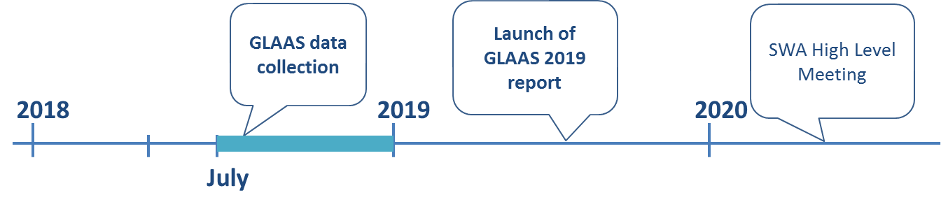
GLAAS 2018-2019 data collection
Data collection to be launched: July 2018
Deadline for submission: 15 December 2018

Slide 12
Thank you!
For additional information or assistance please contact glaas@who.int

Slide 13
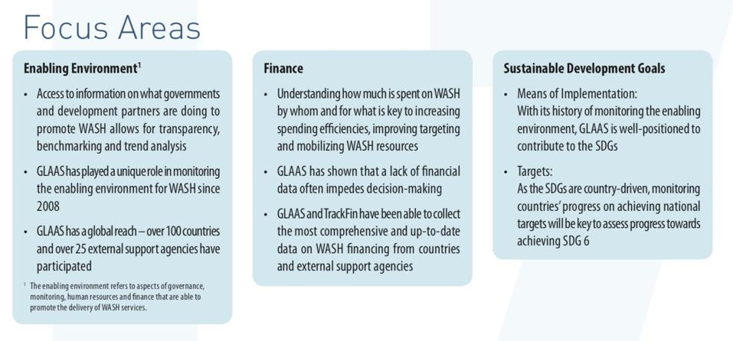
UN-Water GLAAS 2017-2020 strategy

Slide 14
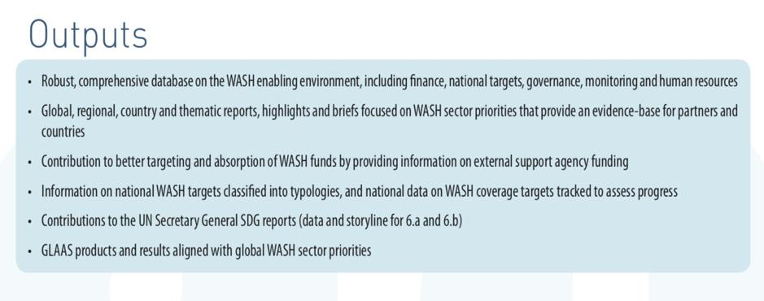
UN-Water GLAAS 2017-2020 strategy

