Slide 1
Section C: Human Resources
Module 6: Overview of questions in Section C
GLAAS 2018/2019 cycle

Slide 2
Overview
Section C consists of 3 questions covering human resources (HR).
Additional HR questions are included in Sections A, B and D.
This module will go through each of the questions. Please also reference the survey guidance.

Slide 3
Questions
C1: Human resources needs assessments
C2: WASH training institutions/programmes
C3: Human resources for WASH operations and development

Slide 4
Question C1 – Human resources needs assessments
C1
Understanding human resource needs is an essential foundation for a WASH enabling environment.
This question aims to gather information on needs assessments conducted for WASH human resources in your country.

Slide 5
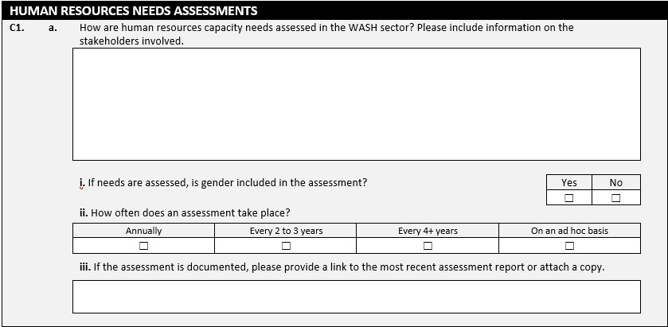
C1
Describe here how needs assessments for human resources in the WASH sector are conducted.

Slide 6
C1
Choose one option.

Slide 7
Question C2 – WASH training institutions and programmes
C2
Gaps in human resources are sometimes the source of too few trained or educated staff in specialized fields.
This question seeks information on the types of WASH training institutions or programmes available in your country.

Slide 8
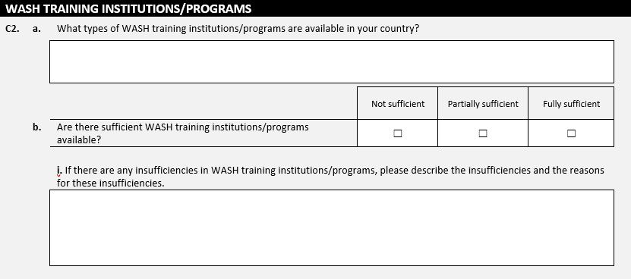
C2
Describe the types of training institutions or programmes related to WASH that are available in your country.
Notes:
e.g. programs for water engineering or trainings for hygiene promotion.

Slide 9
C2
Choose one option.

Slide 10
C2
Sufficiency in regards to the number and quality of programmes

Slide 11
C2
Describe here the insufficiencies in WASH training institutions and programmes and the reasons for these insufficiencies.
Notes:
If more space is required to answer this question, please use the survey annex.

Slide 12
Question C3 – Human resources for WASH operations and development
C3
This question aims to understand the extent to which there are sufficient human resources for:
  WASH operations and maintenance
  Management of design and construction of WASH facilities and networks

Slide 13
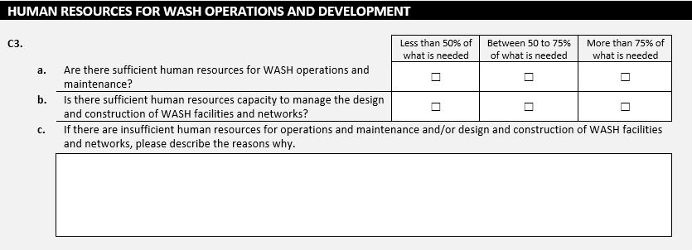
C3
Range of options

Slide 14
C3
Choose one option per row.
Notes:
Operations and maintenance (O&M) includes activities necessary to keep WASH services running.

Slide 15
C3
Describe here the primary reasons for insufficient human resources for operations and maintenance and/or design and construction.

Slide 16
Thank you!
For additional information or assistance please contact glaas@who.int

