Slide 1
GLAAS information module 1
Introduction to GLAAS
GLAAS 2021/2022 country survey

Slide 2
What is GLAAS?
GLAAS: UN-Water Global Analysis and Assessment of Sanitation and Drinking-Water
Implemented by the World Health Organization on behalf of UN-Water.
A global update on WASH systems, including policy frameworks, institutional arrangements, monitoring systems, regulation, human resources and finance.

Slide 3
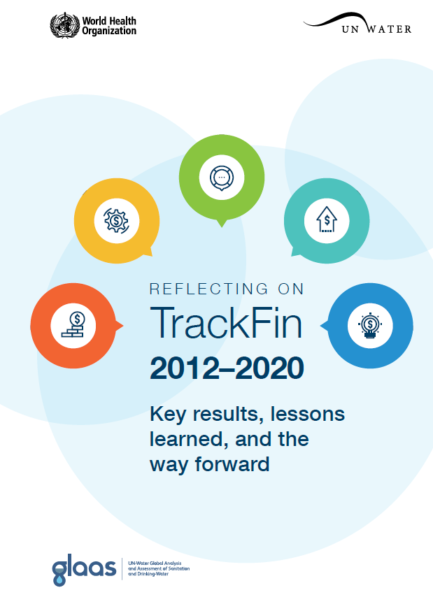


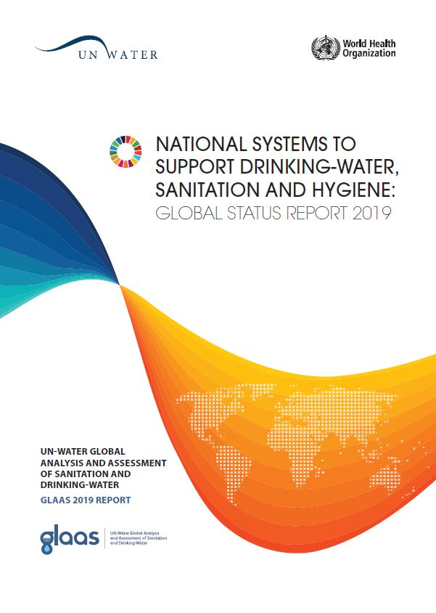

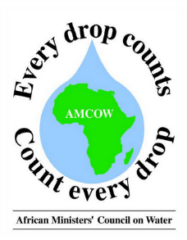




GLAAS areas of work
WASH accounts using the TrackFin methodology
SDG monitoring
PMAT: Policy monitoring and assessment tool
pmat
policy monitoring
& assessment tool
UN-Water GLAAS
GLAAS data collection, reports and data portal
Collaboration and partnerships

Slide 4
GLAAS data collection and reports: Purpose and objectives
Monitor the inputs required to extend and sustain WASH systems and services to all, especially unserved and disadvantaged groups
Support country-led processes that bring together the many institutions and actors that are involved in WASH
Identify drivers and bottlenecks of progress, highlight knowledge gaps and assess strengths and challenges across countries
Analyze and highlight data from countries and external support agencies in reports, highlights and on the GLAAS data portal

Slide 5
Benefits of GLAAS to Countries
Provides a useful situation analysis of the WASH sector
Identifies information gaps
Helps decision-makers define priorities and devise plans
Brings different stakeholders together
Contributes to SDG monitoring and regional monitoring initiatives

Slide 6
GLAAS 2021/2022 cycle - Updates
Updates to the GLAAS country survey:
  More comprehensive questions on hand hygiene
  New question on WASH in COVID-19 preparedness and response plans
  Revised Section C on human resources for WASH
  As in 2018, the GLAAS survey format is a fillable PDF
Streamlined and refined survey guidance document
  Outlines the GLAAS process and general survey instructions
  Provides additional information for some key questions
eGLAAS: Piloting an online version of the GLAAS country survey
  Based on feedback from the 2018/2019 cycle, GLAAS is preparing a pilot for online data collection for the country survey
  Select countries will complete the GLAAS survey via the online data collection tool in English and in Spanish, providing feedback on the experience
  For further information, please contact glaas@who.int

Slide 7
UN-Water GLAAS 2022 Report
Information collected through the GLAAS country survey will be presented in the UN-Water GLAAS 2022 report.
The GLAAS 2022 Report is expected in Q4 2022.
The GLAAS 2019 Report featured data from 115 countries and 29 external support agencies (ESAs).

Slide 8
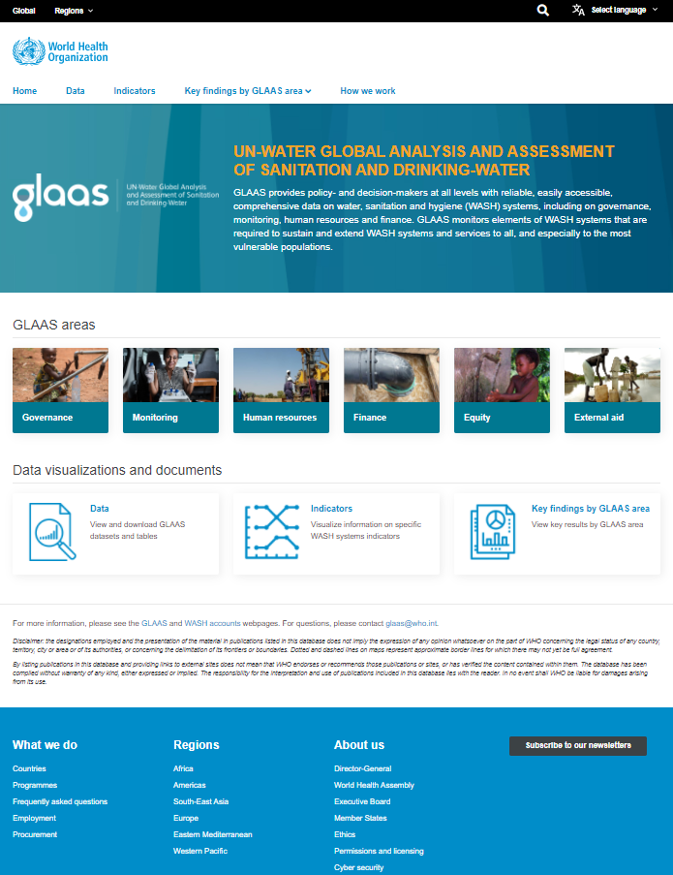
GLAAS data portal
Will allow users to interactively explore and download datasets by topic area, visualize key indicators, and search for GLAAS and national documents (such as national WASH policies and plans).
Automated generation of GLAAS country highlights.
Initially the data portal will focus on data from GLAAS country surveys from the past three cycles (2013/2014, 2016/2017, 2018/2019).
Data from external support agency surveys and WASH accounts results to be added progressively over time.
The first phase of the GLAAS data portal will be launched Q3 2021 and the full GLAAS data portal will be launched by the end of 2021.

Slide 9
GLAAS 2021/2022 cycle timeline
GLAAS 2022 Report and data available on the GLAAS data portal
PDF survey and package online in EN
Final deadline for GLAAS survey package:
April 1st, 2022
PDF survey and package online in six languages
2021
2022
Aug
Sept
Oct
Dec
Jan
Apr
Jun
Dec
Regional GLAAS trainings
Data management including quality assurance

