Slide 1
GLAAS information module 5
Section A Governance questions in the GLAAS 2021/2022 country survey

Slide 2
Overview
Section A has 11 questions on WASH governance.
This module will present key information on specific questions in Section A.
Please also reference the survey guidance.

Slide 3
Questions in Section A
A1: Human rights to water and sanitation
A2: National regulations and standards
A3: Existence of risk management approaches
A4: Risk management approaches
A5: National WASH policies and plans
A6: WASH in COVID-19 preparedness and response plans
A7: National WASH targets
A8I-A8II: Equity measures in national policies and plans
A9 – A10: Institutional roles and coordination
A11: Community and user participation
Questions covered in this module

Slide 4
A2: National regulations and standards
A1
A2
A2
A3
A4
A5
A6
A7
A8
A9
A10
A11
Key definitions for question A2:
  Standard: The term “standard” is commonly used to describe a mandatory numerical value in a table of parameters and limits (such as 10 μg/L of arsenic). However, it is also used to describe technical standards and policy documents designed to help achieve improved water quality.
  Regulation (or regulatory instruments): Rules created by an administrative agency or body that typically include tangible measures that are necessary to implement and/or enforce the general requirements prescribed in the broader legislation. Regulations may cover water quality standards, service-level/service delivery standards, required monitoring frequencies requirements for risk management, surveillance requirements and/or audit guidance, etc.

Slide 5
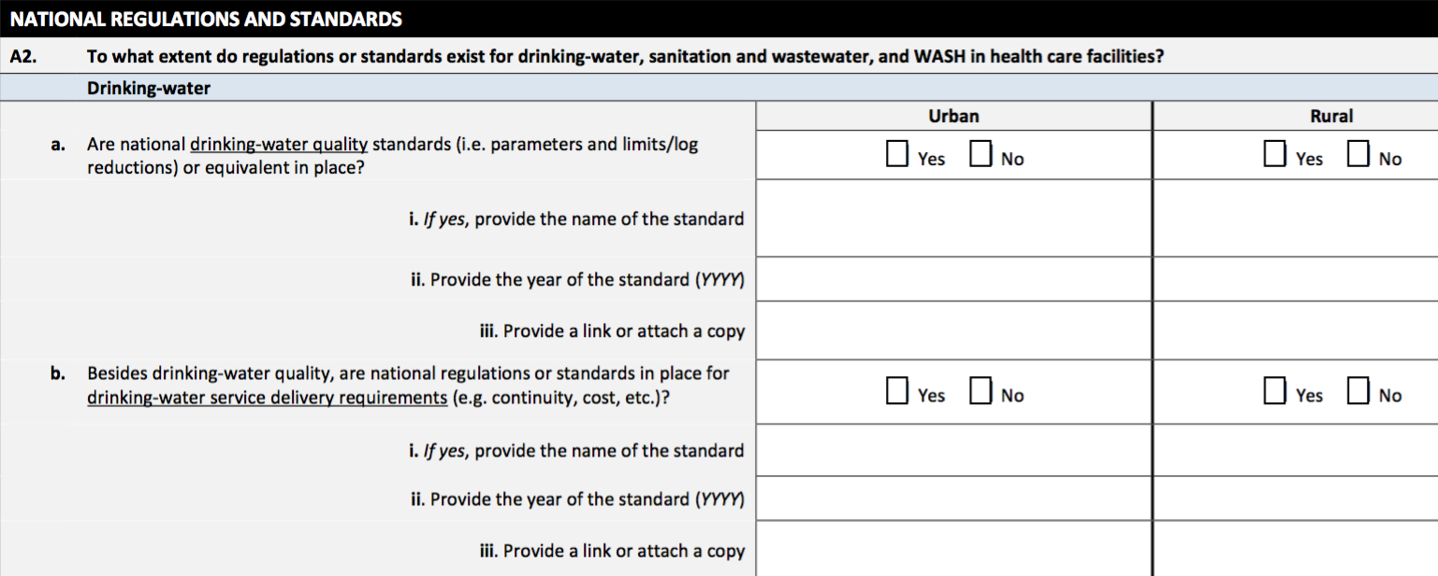
A1
A2
A2
A3
A4
A5
A6
A7
A8
A9
A10
A11
If your country has the same standards and/or regulations for both urban and rural drinking-water, please respond in both the urban and rural columns, answering the same for both columns.

Slide 6
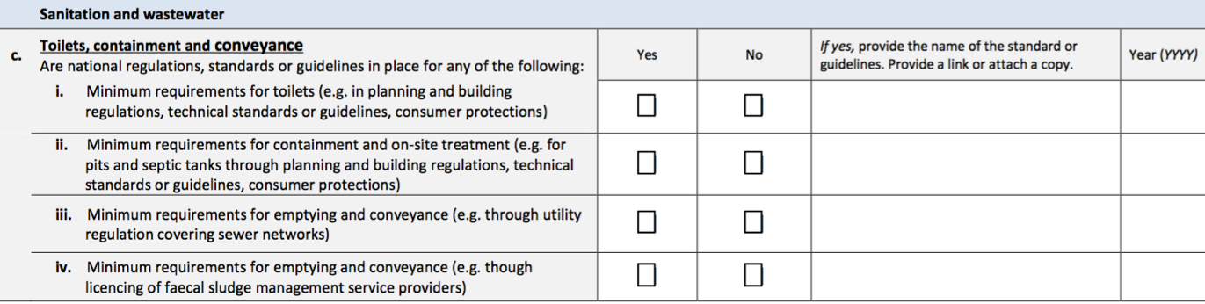
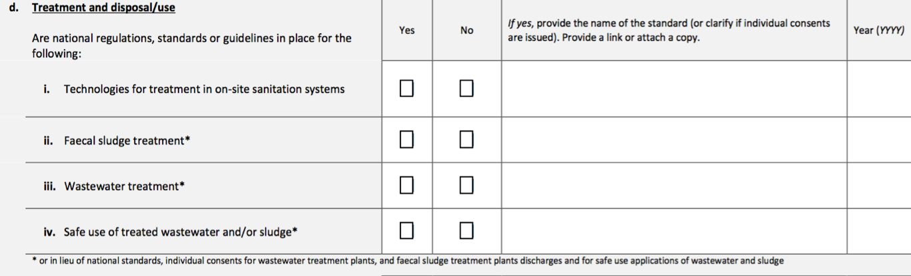
A1
A2
A2
A3
A4
A5
A6
A7
A8
A9
A10
A11
The questions on sanitation and wastewater are aligned with the sanitation service chain.
For more information on sanitation service chain regulatory mechanism options, please see Figure 4.4. in the WHO Guidelines on Sanitation and Health: https://apps.who.int/iris/bitstream/handle/10665/274939/9789241514705-eng.pdf
Notes:
Sanitation wastewater standards could be technology-based (i.e. specified technologies, such as minimum treatment process designs, that are known to achieve a certain level of performance under normal operating conditions) and/or performance-based (i.e. standards expressed at effluent quality (e.g. biological oxygen demand, nitrogen, phosphorus, E.coli)).

Slide 7
A3: Existence of risk management approaches
A1
A2
A3
A3
A4
A5
A6
A7
A8
A9
A10
A11
Key definitions for question A3:
  Promoted: Means that water safety plans or other risk management approaches are addressed in policies or regulations but are not mandated to be implemented.
  Required: Means that water safety plans or other risk management approaches are addressed in policies or regulations and that the policies or regulations mandate that the approaches be implemented.
  Sanitation safety plan (SSP): A step-by-step risk-based approach to assist in the implementation of the 2006 WHO Guidelines for Safe Use of Wastewater, Excreta and Greywater. The approach can also be applied to all sanitary systems to ensure the system is managed to meet health objectives.
  Water safety plan (WSP): A comprehensive risk assessment and risk management approach that includes all steps in the water supply chain, from catchment to consumer.

Slide 8
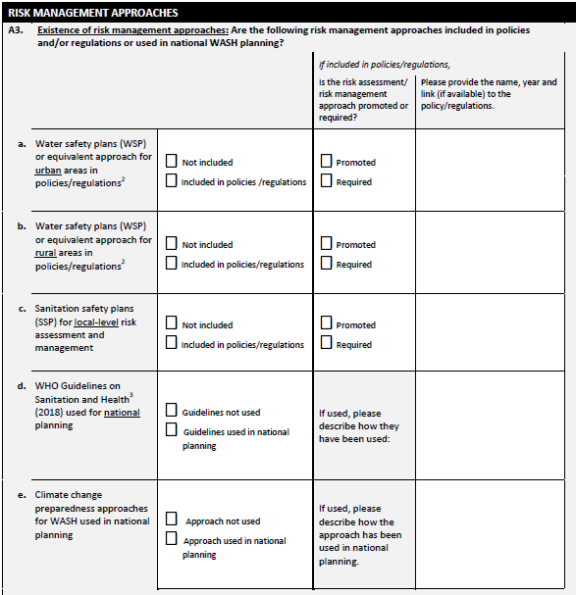
A1
A2
A3
A3
A4
A5
A6
A7
A8
A9
A10
A11
Questions a–c focus on if water safety plans, sanitation safety plans or equivalent approaches are included in policies or regulations.
Questions d and e focus on if risk management approaches outlined in the WHO Guidelines on Sanitation and Health and climate change preparedness approaches are used in national planning.
Unlike a – c, these approaches do not need to be included in policies or regulations in order to be used in national planning.

Slide 9
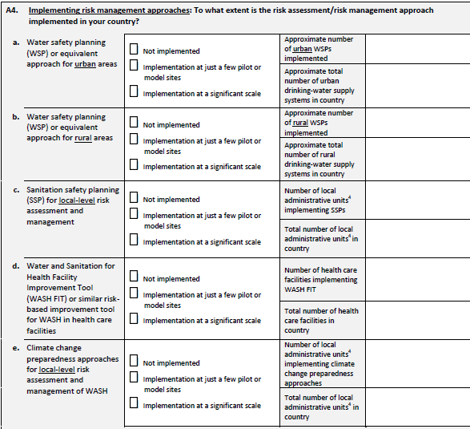
A4: Implementing risk management approaches
A1
A2
A3
A4
A4
A5
A6
A7
A8
A9
A10
A11
Risk management approaches can be implemented even if they have not been included in policies or plans (as answered in A3).
A4 includes a question on the implementation of WASH FIT or similar. More information about WASH FIT: https://washfit.org/.

Slide 10
A1
A2
A3
A4
A4
A5
A6
A7
A8
A9
A10
A11
You can only type numbers as answers to these questions. The PDF will not allow you to enter symbols or letters.
These responses should be based on local administrative units, which are determined by the government.
Local administrative units are institutional units whose fiscal, legislative and executive authority extends over the smallest geographical areas distinguished for administrative and political purposes
(OECD: https://stats.oecd.org/glossary/detail.asp?ID=1550).

Slide 11
A5: National WASH policies and plans
A1
A2
A3
A4
A5
A5
A6
A7
A8
A9
A10
A11
It is important to understand the distinction between policy and plan/strategy for this question.
  Plans/Strategies: A plan gives effect to decisions based on policy. In some contexts, a plan may be called a ‘strategy’ or ‘road map’. Plans outline implementable actions achieve policy objectives and provide details on implementing policy. Plans can assign responsibilities, and indicate how the responsible entities will respond to requirements set forth by policy, law and regulation, the type of training and development that will be provided, and how financial and human resources will be allocated.
  Policies: A policy is a key guiding instrument for present and future decisions. Policies are the principle guides to action taken by the government to achieve national, sector and/or industry-wide goals.
This question should not be used to report regulations, guidelines or laws.

Slide 12
A1
A2
A3
A4
A5
A5
A6
A7
A8
A9
A10
A11
A5: National WASH policies and plans
A5 is presented by sub-sector:
  Urban sanitation
  Rural sanitation
  Urban drinking-water
  Rural drinking-water
  WASH in Schools
  WASH in health care facilities
If there is not a specific urban or rural policy or plan/strategy, answer for both urban and rural with the name of the overarching policy or plan/strategy.
If a single policy or plan/strategy addresses more than one of the WASH areas, respond to each of the questions in A5 for the WASH areas covered by the combined policy or plan.
For example, if your country has an overarching National WASH Policy, respond to all sub-questions in A5 and cite the name of the National WASH Policy for each of the areas covered by the policy.
If there is more than one policy, plan/strategy choose the one that is most relevant to the question.

Slide 13
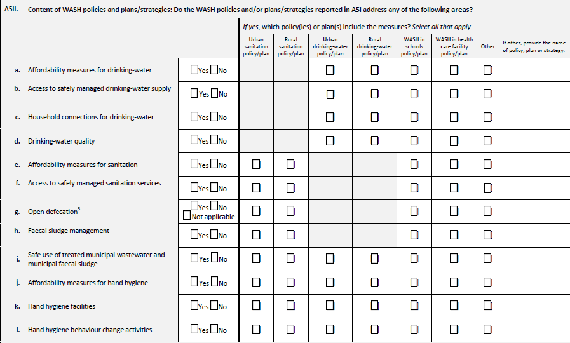
A1
A2
A3
A4
A5
A5
A6
A7
A8
A9
A10
A11
A5II is about the content of the WASH policies and plans/strategies that were reported in A5I.
Carefully consider each element and if it is included or addressed in the specific policy/plan per sub-sector.

Slide 14
The Sanitation Policy Monitoring and Assessment Tool
GLAAS developed the PMAT to support governments to dive deeper into the content of their sanitation policies, plans and strategies.
The PMAT is based on the WHO Guidelines on Sanitation and Health and the African Sanitation Policy Guidelines.
The PMAT objectives are:
  to monitor alignment with recommendations in the WHO Guidelines on Sanitation and Health;
  to provide evidence for governments and development partners on where sanitation policies can be strengthened; and
  to track the evolution of sanitation policies over time.
If your country would like to complete the PMAT, please contact GLAAS at glaas@who.int.

Slide 15
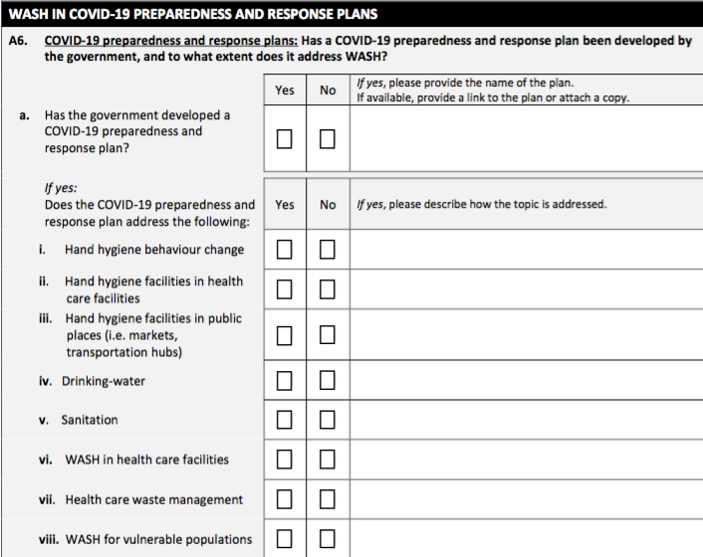
A6: WASH in COVID-19 preparedness and response plans
A1
A2
A3
A4
A5
A6
A6
A7
A8
A9
A10
A11
This is a new question in the 2021/2022 country survey.
Many governments developed COVID-19 preparedness and response plans to address the COVID-19 pandemic.
As WASH, specifically hand hygiene, is a front line of defence against infectious disease outbreaks, this question asks about WASH in COVID-19 preparedness and response plans.

Slide 16
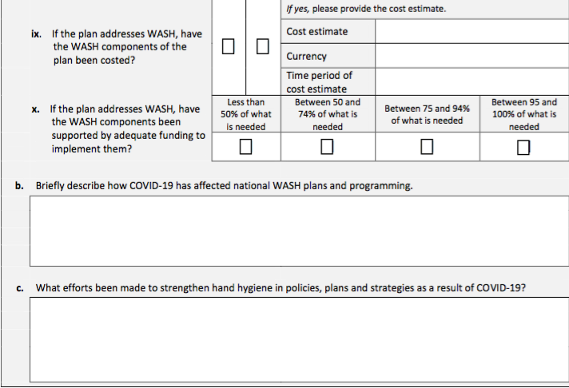
A1
A2
A3
A4
A5
A6
A6
A7
A8
A9
A10
A11
A6.b and A6.c should be answered by all countries
(even if your country does not have a COVID-19 preparedness and response plan).

Slide 17
A7: National WASH targets
A1
A2
A3
A4
A5
A6
A7
A7
A8
A9
A10
A11
Many countries have established national targets using SDG criteria, so it may be useful to review the following definitions:
Improved drinking-water: Improved drinking-water sources are those that have the potential to deliver safe water by nature of their design and construction, and include: piped water, boreholes or tubewells, protected dug wells, protected springs, rainwater, and packaged or delivered water.
Improved sanitation facilities: Improved sanitation facilities are those designed to hygienically separate excreta from human contact and include: flush/pour flush to piped sewer system, septic tanks or pit latrines, ventilated improved pit latrines, composting toilets or pit latrines with slabs.
Safely managed drinking-water: Drinking-water is considered safely managed when people use an improved source of drinking-water that is accessible on premises, available when needed, and free from contamination.
Safely managed sanitation: Sanitation is considered safely managed when people use improved sanitation facilities that are not shared with other households, and the excreta produced should either be: treated and disposed of in situ, stored temporarily and then emptied and transported to treatment off-site, or transported through a sewer with wastewater and then treated off-site.

Slide 18
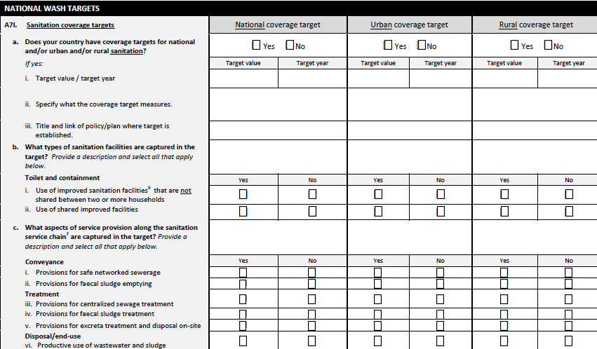
A1
A2
A3
A4
A5
A6
A7
A7
A8
A9
A10
A11
National targets are those that cover the entire country/territory and do not distinguish between urban or rural settings.
The urban target and rural target columns can be used to report specific targets for urban and/or rural settings.
Do not report the same target more than once.
For each reported target, carefully detail and describe the types of facilities/services/sources or other qualities that are acceptable for an area, population or household to be considered covered under the target criteria and definition.

Slide 19
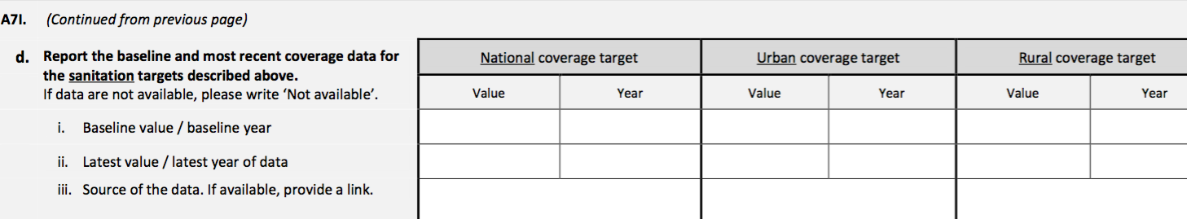
A1
A2
A3
A4
A5
A6
A7
A7
A8
A9
A10
A11
The last section for each question in A7 asks you to report progress towards the targets reported.
Baseline data is the first measurement or ‘starting point’ for tracking progress towards reaching your target.
Latest value is the most recent measurement for tracking progress towards reaching your target.

Slide 20
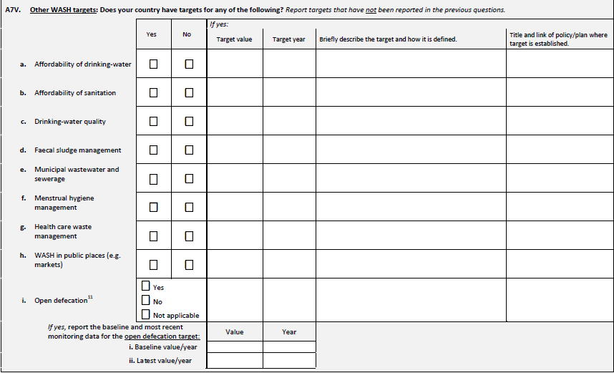
A1
A2
A3
A4
A5
A6
A7
A7
A8
A9
A10
A11
Other WASH targets should be reported in A7V.
Use A7V to report only targets that have not been reported in the previous questions.
Do not report the same target more than once.

Slide 21
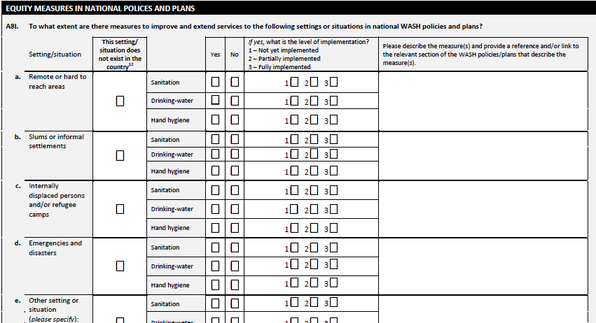
A8: Equity measures in national policies and plans
A1
A2
A3
A4
A5
A6
A7
A8
A8
A9
A10
A11
The settings where you checked the box indicating “does not exist in the country” in questions B3 and D4 should also be checked for this question.
Each setting or population are defined in accordance with definitions followed by your country.
Notes:
Each population and setting are defined in accordance with definitions followed by your country. For example, in some countries, ‘poor populations’ are considered those in the poorest quintile, while others may have a different definition for ‘poor’ or ‘indigent’ people.

Slide 22
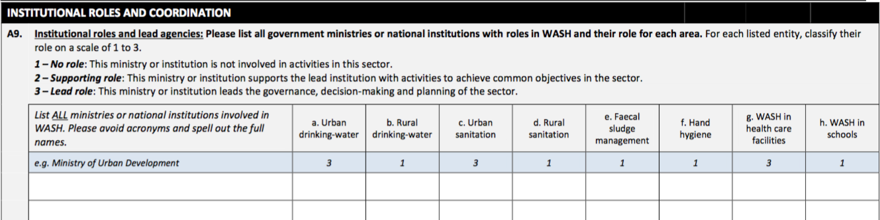
A9: Institutional roles and lead agencies
A1
A2
A3
A4
A5
A6
A7
A8
A9
A9
A10
A11
List of ALL government ministries or national institutions with any role.
This question is complemented by question D2 identifying annual budgets for each entity.
Not all ministries or national institutions will have a role in every sector listed in the columns. In this case, write 1 in the column to indicate that the ministry or national is not involved in the sector listed.

Slide 23
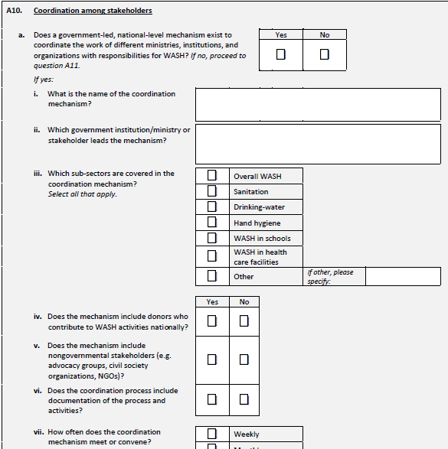
A10: Coordination among stakeholders
A1
A2
A3
A4
A5
A6
A7
A8
A9
A10
A10
A11
Types of coordination mechanisms include: a country compact, Memorandum of Understanding (MoU), a sector wide approach (SWAP), WASH clusters or other working groups.
If no coordination mechanism exists, then indicate ‘No’ on question A10.a and move to question A11.

Slide 24
A11: Participation procedures established at the national level
A1
A2
A3
A4
A5
A6
A7
A8
A9
A10
A11
A11
This question is used for monitoring SDG Target 6.b on local community participation.
Target 6.b aims to:
  Support and strengthen the participation of local communities in improving water and sanitation management

Slide 25
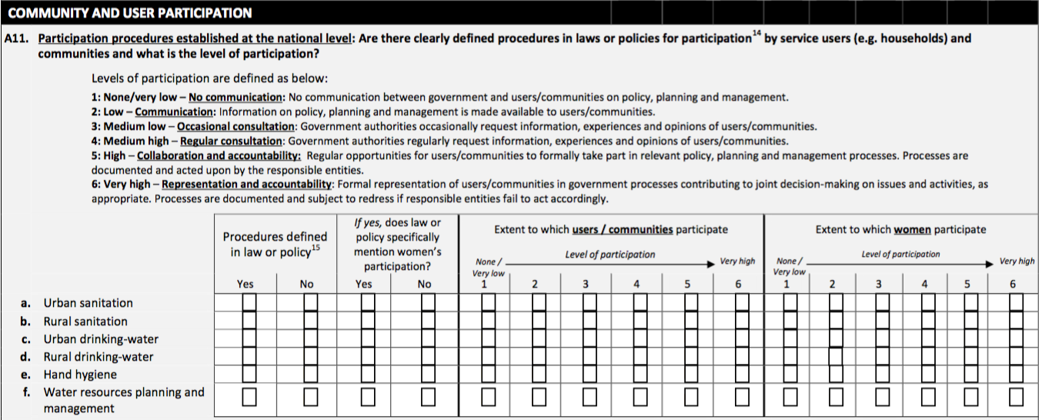
A1
A2
A3
A4
A5
A6
A7
A8
A9
A10
A11
A11
Carefully read the definitions for the levels of participation and note the distinctions to adequately classify the levels of participation for each sector.
Respond to these questions even if you do not have procedures defined in law or policy.
Notes:
In particular, low (2), medium-low (3) and medium high (4) levels of participation require only one-way communication without dialogue or accountability.
High (5) and very high (6) levels of participation require some form of collaboration, dialogue and accountability between communities / users and government / service providers.

Slide 26
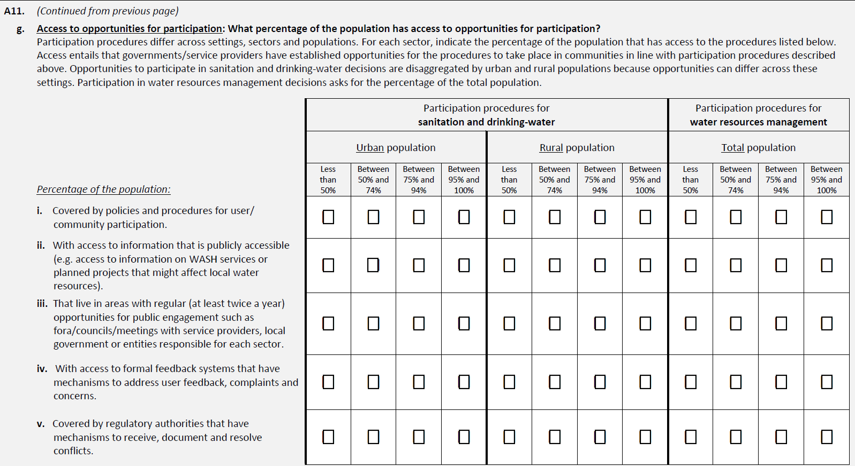
A1
A2
A3
A4
A5
A6
A7
A8
A9
A10
A11
A11
Access to participation procedures means that governments/ service providers have established opportunities for participation to take place.

Slide 27
A1
A2
A3
A4
A5
A6
A7
A8
A9
A10
A11
A11
The column for participation procedures in water and sanitation is split into urban and rural populations.
The column for water resources management asks only for percentage of the total population.

Slide 28
A1
A2
A3
A4
A5
A6
A7
A8
A9
A10
A11
A11
Estimate the percentage of the urban/rural or total population that has access to each of the opportunities for participation listed
‘Regular fora/councils/meetings’ are those that occur at least twice a year
A ‘formal feedback system’ is one that is set up by a service provider or government institution to collect and address feedback/complaint

