Slide 1
GLAAS information module 8
Section D Finance questions in the GLAAS 2021/2022 country survey

Slide 2
Overview
Section D consists of 11 questions covering WASH finance.
This module will present key information about specific questions in Section D.
Please also reference the survey guidance.

Slide 3
Questions
D1: Financial plans
D2: Budgets for WASH
D3: Cost recovery
D4 – D5: Financing for equity measures
D6: Affordability
D7 – D8: Utilization of available funds (absorption)
D9: External financing
D10: Sufficiency of funding
D11: Financial flows
Questions covered in this module

Slide 4
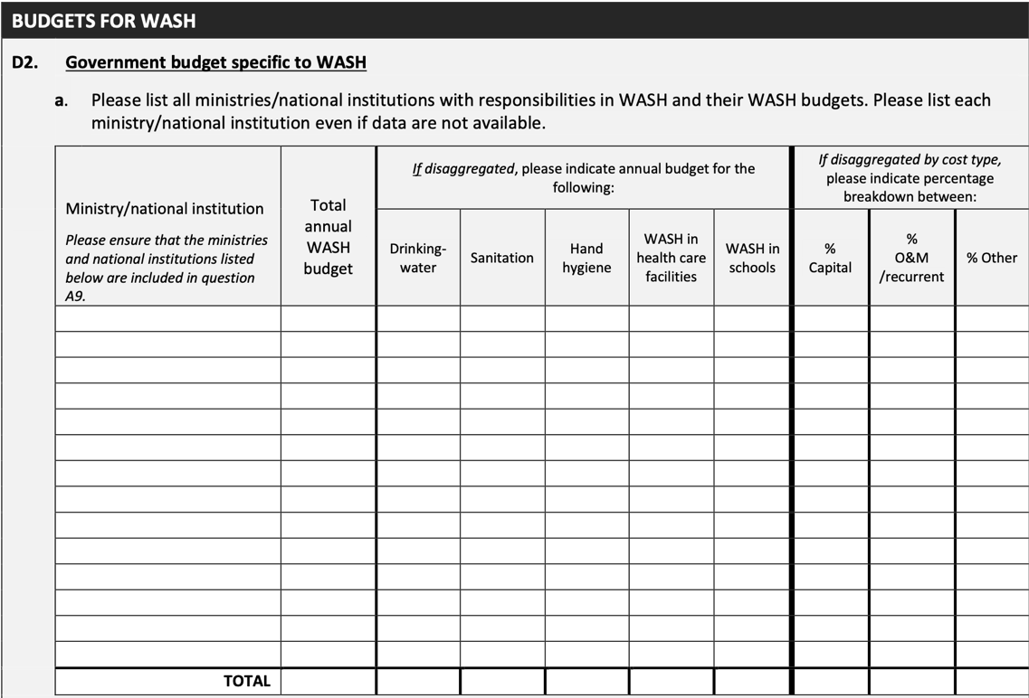
D2: Budgets for WASH
D1
D2
D2
D3
D4
D5
D6
D7
D8
D9
D10
D11
These three columns are new to the survey. The total across the three columns should add up to 100% in each row.
The answers should be numbers between 0 and 100.
List all ministries involved with WASH (even if specific budgets cannot be obtained). The ministries/national institutions should be the same as those listed in A9.

Slide 5
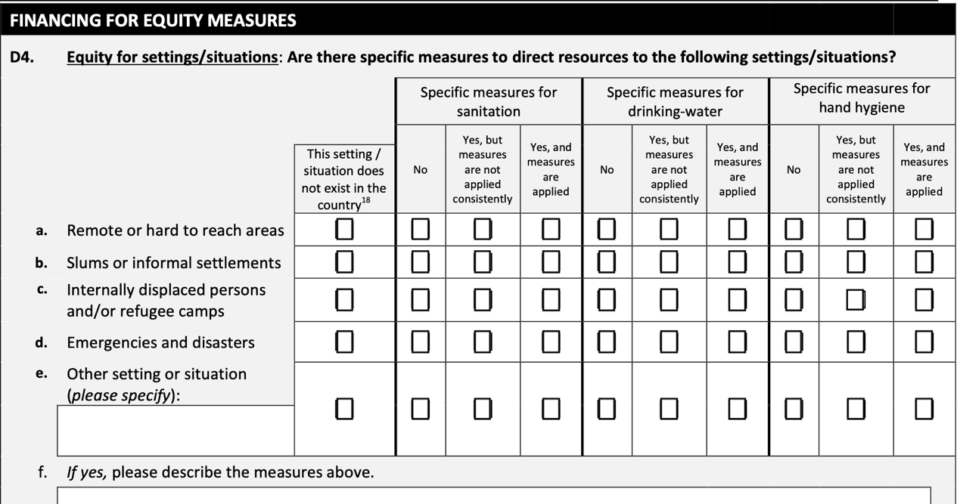
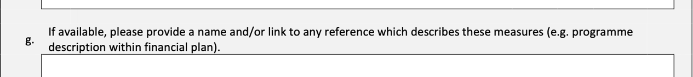
D4: Financing for equity measures
D1
D2
D3
D4
D4
D5
D6
D7
D8
D9
D10
D11
The settings where you checked the box indicating “does not exist in the country” in questions A8I and B3I should also be checked for this question.

Slide 6
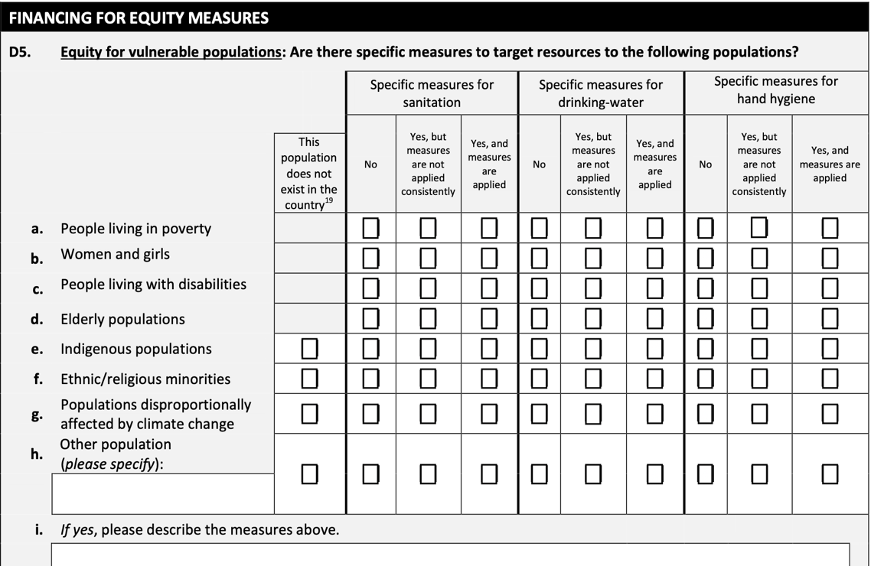
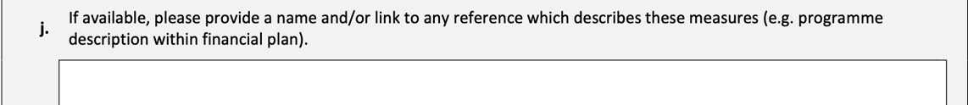
D5: Financing for equity measures
D1
D2
D3
D4
D5
D5
D6
D7
D8
D9
D10
D11
The populations where you checked the box indicating “does not exist in the country” in questions A8II and B3II should also be checked for this question.

Slide 7
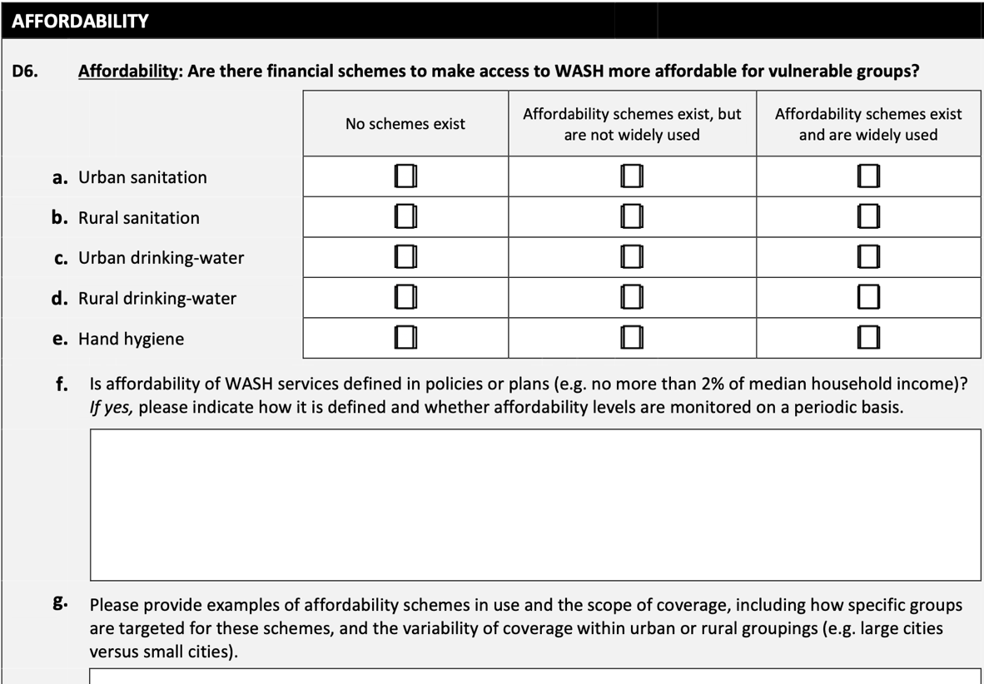
D6: Affordability
D1
D2
D3
D4
D5
D6
D6
D7
D8
D9
D10
D11
Different countries have different definitions for affordability. Please use the definition used in your country to answer this question.

Slide 8
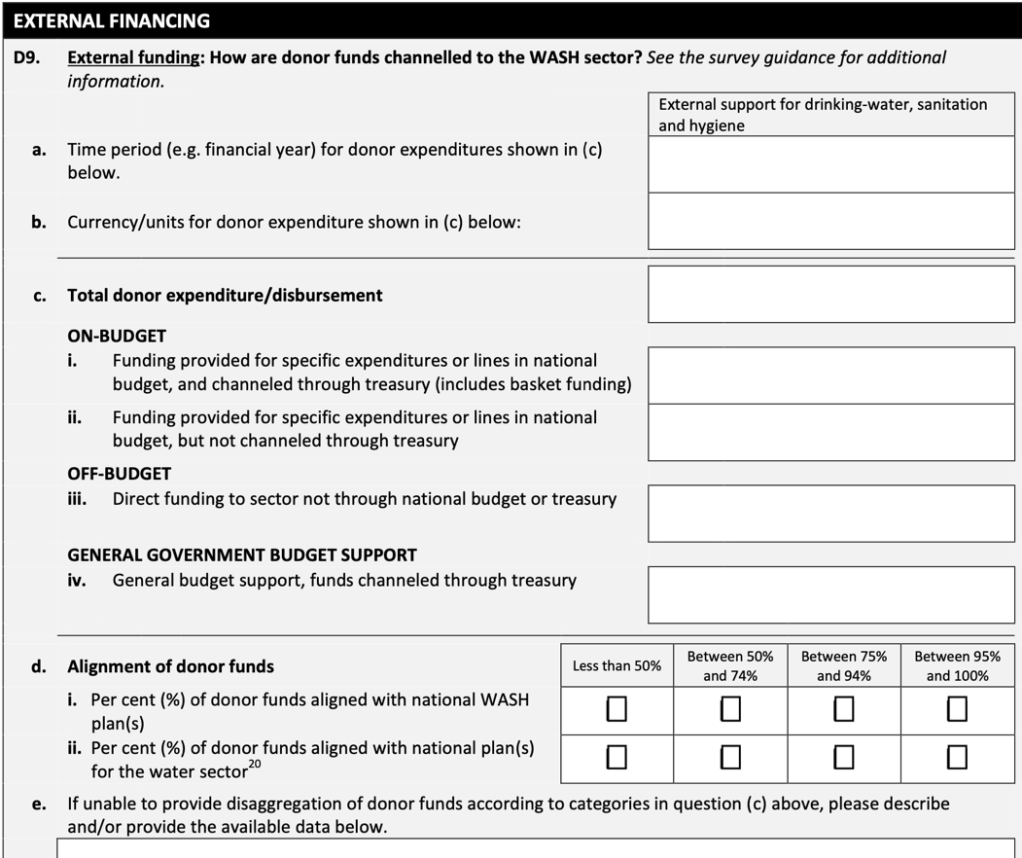
D9: External funding
D1
D2
D3
D4
D5
D6
D7
D8
D9
D9
D10
D11
To answer this question see detailed OECD-CRS codes in the survey guidance document.
This questions is used for monitoring SDG 6.a on international cooperation.
This question is asked in a new format compared to previous cycles.

Slide 9
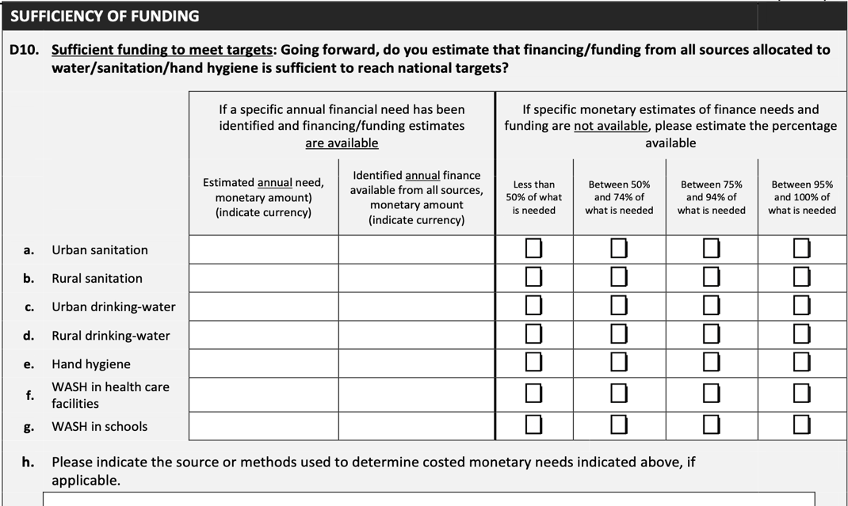
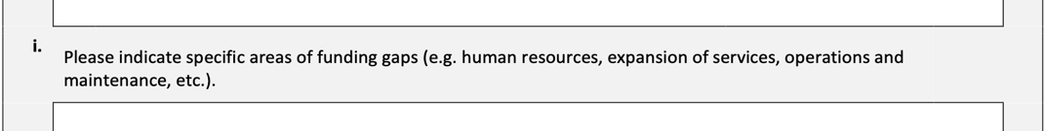
D10: Sufficiency of funding
D1
D2
D3
D4
D5
D6
D7
D8
D9
D10
D10
D11
Indicate amount and currency.
Only fill out this part of the question if specific financial needs are not available.

Slide 10
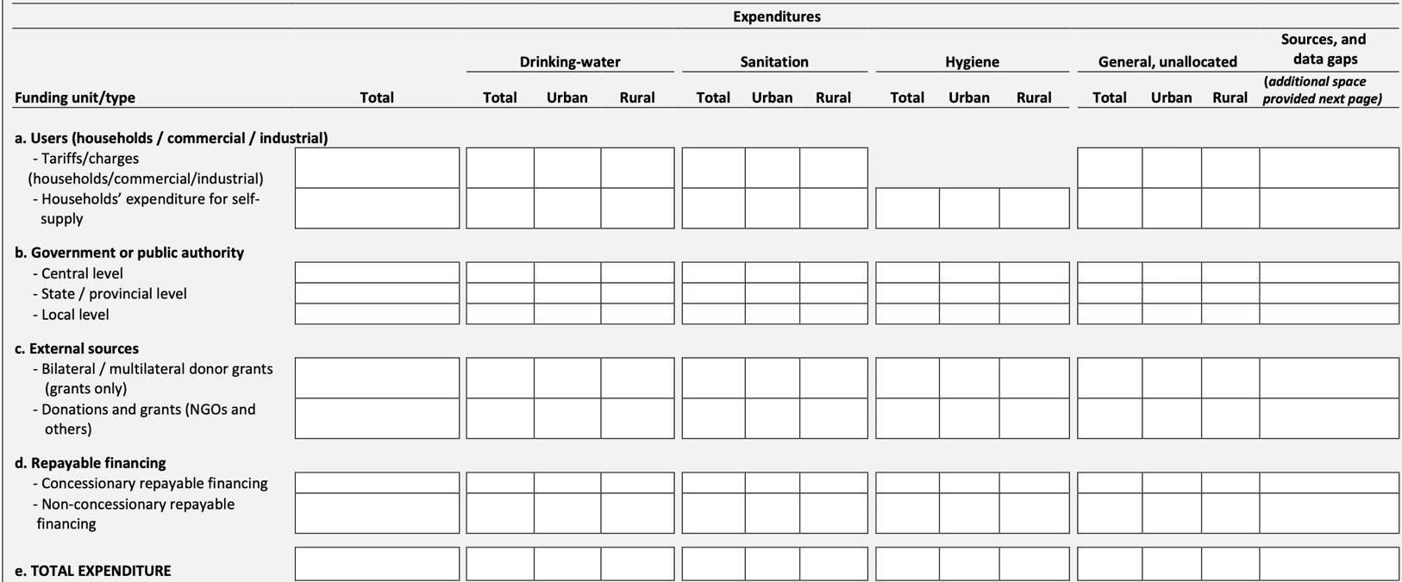
D1
D2
D3
D4
D5
D6
D7
D8
D9
D10
D11
D11
Indicate source of information, where data gaps exist and extent of the data gap. More space is provided on next survey page.
Please use one currency when answering this question. Detailed information on completing this question is available in the survey guidance document.

Slide 11
Using WASH accounts to improve answers to D11
It is acknowledged that the data requested in D11 may not be readily available.
To improve information on WASH financial flows, GLAAS has developed the TrackFin methodology, which results in WASH accounts, to improve information on financial flows and expenditures in WASH.
For countries that have developed WASH accounts recently, the D11 table can be extracted from module 6.4 of the WASH accounts production tool.

Slide 12

More information on WASH accounts
If your government is interested in developing WASH accounts using the TrackFin methodology, please contact: glaas@who.int
For more information on WASH accounts, please see: https://www.who.int/teams/environment-climate-change-and-health/water-sanitation-and-health/monitoring-and-evidence/wash-systems-monitoring/un-water-global-analysis-and-assessment-of-sanitation-and-drinking-water/wash-accounts

