Slide 1
GLAAS information module 1:
Introduction to GLAAS
GLAAS 2024/2025 cycle

Slide 2
What is GLAAS?
GLAAS: UN-Water Global Analysis and Assessment of Sanitation and Drinking-Water
Implemented by the World Health Organization in collaboration with UNICEF on behalf of UN-Water.
A global update on WASH systems, including policy frameworks, institutional arrangements, monitoring systems, regulation, human resources and finance.

Slide 3

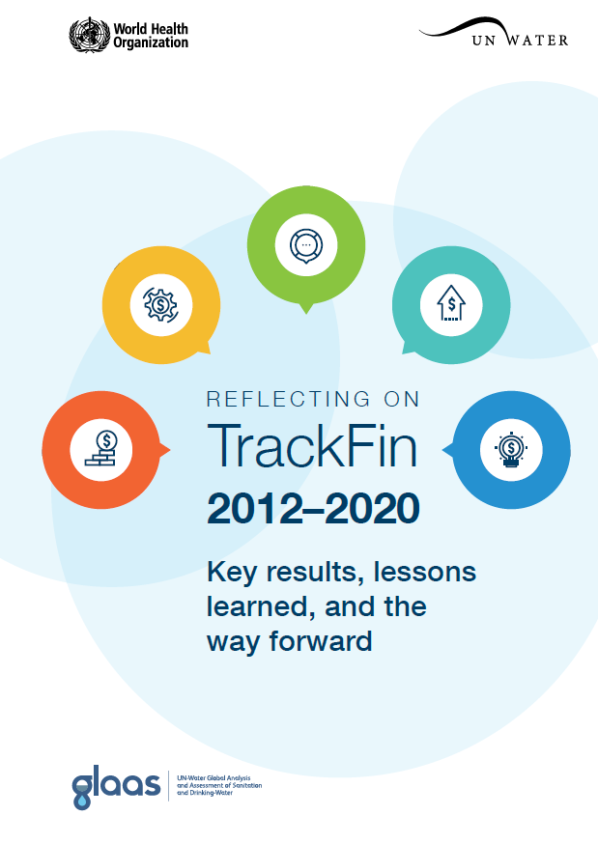


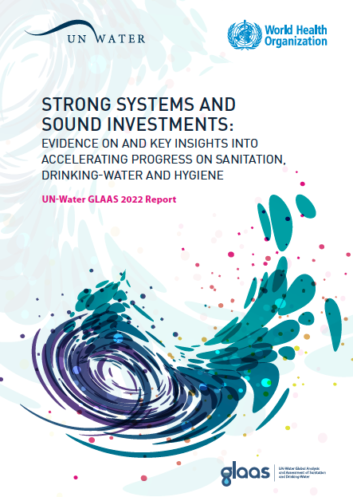

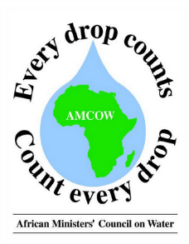
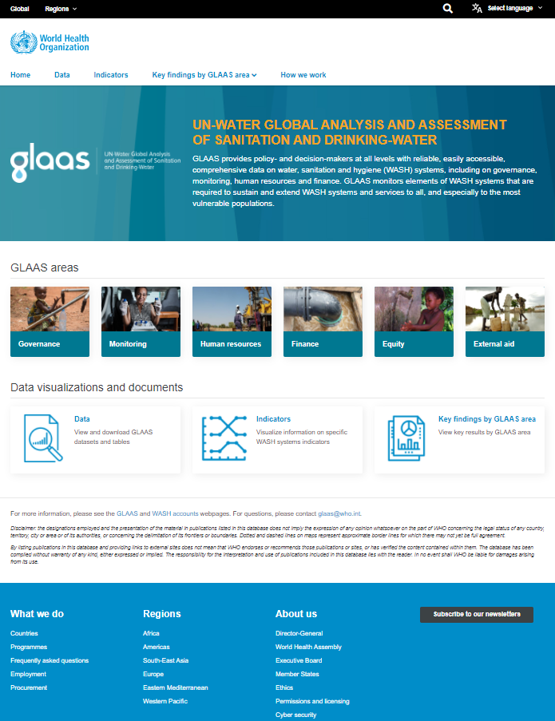







GLAAS areas of work
SDG monitoring
WASH accounts using the TrackFin methodology
UN-Water GLAAS
GLAAS data collection, reports and data portal
Collaboration and partnerships

Slide 4
GLAAS data collection and reports: Purpose and objectives
Monitor the inputs required to extend and sustain WASH systems and services to all, especially unserved and disadvantaged groups
Support country-led processes that bring together the many institutions and actors that are involved in WASH
Identify drivers and bottlenecks of progress, highlight knowledge gaps and assess strengths and challenges across countries
Analyze and highlight data from countries and development partners in reports, highlights and on the GLAAS data portal

Slide 5
Benefits of GLAAS to Countries
Provides a useful situation analysis of WASH systems
Identifies information gaps
Helps decision-makers define priorities and devise plans
Brings different stakeholders together
Contributes to SDG monitoring and regional monitoring initiatives
Countries have reported that the GLAAS process and data collected through GLAAS have contributed to:
    Improved sector coordination
    Development of policies and plans/strategies
    Stronger national monitoring and review systems
    Advocacy for funding/financing
    International and regional reporting

Slide 6
Examples of countries using data from the GLAAS process
In Azerbaijan, data collected through GLAAS contributed to the development of a national drinking-water quality standard.
In Bangladesh, data from the GLAAS survey were used in developing strategic WASH documents such as the National Strategy for Water supply and Sanitation 2021.
In Ecuador, based on the information obtained, proposals for guidelines and technical instruments aimed at strengthening WASH in the country were prepared.
In Fiji, data generated through the GLAAS process is used for monitoring progress towards the Sustainable Development Goals and the National Development Plan
In Guinea, the GLAAS process created an opportunity to advocate for a budget line from the government for financing rural sanitation.
In Tunisia, GLAAS results along with other national monitoring data highlighted a critical policy gap for regulating WASH in schools.

Slide 7
GLAAS 2024/2025 cycle - Updates
Updates to the GLAAS 2024 country survey:
  New questions on climate resilient WASH
  New questions on human resources
  New monitoring questions on national indicators and management information systems
Streamlined and refined survey guidance document
  Outlines the GLAAS process and general survey instructions
  Provides additional information on some key questions
eGLAAS: The online version of the GLAAS country survey package is available in English, French and Spanish
  More information on eGLAAS can be found in Module 4 as well as in the GLAAS country survey guidance
  To complete the GLAAS 2024 country survey using eGLAAS, please contact glaas@who.int
Data portal: All data from the GLAAS 2024 country survey will be available on the GLAAS data portal, including country highlights for the GLAAS 2024/2025 cycle.

Slide 8
GLAAS 2024/2025 cycle timeline
Country highlights on the GLAAS data portal
Country survey available
April 2024
GLAAS 2025 report and data available on the GLAAS data portal
Final deadline for GLAAS country survey:
15 October 2024
2024
Apr
Jun
Aug
Oct
Dec
2025
Regional
GLAAS trainings
Data management including quality assurance
Use of GLAAS data in country processes & SDG reporting

Slide 9
GLAAS data portal
Allows users to interactively explore and download datasets by topic area and visualize key indicators.
Includes data collected through GLAAS since the 2013/2014 cycle, allowing for trend analyses.
Possible to analyse data at the global, regional or country level.
Data from the GLAAS 2024 country survey will be featured on the GLAAS data portal as GLAAS country highlights.
Countries will have the opportunity to review their country highlights on the GLAAS data portal before they are published.
Visit the GLAAS data portal at:
https://glaas.who.int

Slide 10
UN-Water GLAAS 2025 Report
Information collected through the GLAAS country survey will be presented in the UN-Water GLAAS 2025 report as well as featured on the GLAAS data portal.
The GLAAS 2025 Report is expected in Q3 2025.
The GLAAS 2022 Report

