Slide 1
Information module eGLAAS 2024 country survey
GLAAS team
Water, Sanitation, Hygiene & Health
World Health Organization (WHO)

Slide 2
Overview of module
Introduction to eGLAAS
Registering and accessing the eGLAAS platform
eGLAAS demonstration and terminology
The eGLAAS process
Additional tips on eGLAAS
Final reminders

Slide 3
Introduction to eGLAAS

Slide 4
UN-Water GLAAS and the 2024 country survey
GLAAS: UN-Water Global Analysis and Assessment of Sanitation and Drinking-Water
Implemented by the World Health Organization on behalf of UN-Water.
A global update on WASH systems, including policy frameworks, institutional arrangements, monitoring systems, regulation, human resources and finance.
GLAAS collects information directly from national governments through the GLAAS country survey administered every 2-3 years by WHO reaching 100+ countries.

Slide 5
The GLAAS 2024 country survey
In the 2024/2025 GLAAS cycle, countries can complete the GLAAS 2024 country either as
  Fillable PDF; or
  eGLAAS (online)
The data collection in 2024 will begin April 1st with a deadline of October 15th, 2024.

Slide 6
User feedback on the eGLAAS pilot
In the GLAAS 2021/2022 cycle, 11 countries successfully piloted eGLAAS to complete the country survey.
Both experienced and first-time GLAAS contributors found the online survey to be user-friendly.
Teams found it especially useful that multiple survey contributors could access the platform and contribute responses to survey questions, which saved time and made the process more efficient.
The process of checking errors and communicating them through eGLAAS platform was excellent. It allowed the reviewers time to consult the country team virtually until a consensus was reached.
In general, eGLAAS is user-friendly and facilitates the data collection process
Notes:
Note:
The feedback received from the 2021/2022 country survey pilot was taken into account in 2024 to improve this years survey.
Countries in the pilot included

Slide 7
eGLAAS on the REDCap platform
The eGLAAS 2024 country survey is available in English, French and Spanish.
eGLAAS is hosted on the REDCap platform.
  REDCap is a secure online platform for online survey design, data collection and database management that is administered by Vanderbilt University (USA).
  WHO has a unique instance of the platform called EDCRC (Electronic Data Capture REDCap).
Submission of the eGLAAS country survey, country feedback form and additional documents can be done on the REDCap platform.
To access the platform, focal points and survey contributors must be registered by contacting the WHO regional advisor and glaas@who.int.

Slide 8
Registering and accessing the eGLAAS platform

Slide 9
Flowchart for registering and accessing the eGLAAS platform
GLAAS Focal Point provides email addresses of eGLAAS users/survey contributors to WHO
WHO sends an invitation to each user
Steps 1 - 3:
Each user accepts the invitation and follows the process to register their email address in WHO system
Users who are already registered in WHO system skip this step
Step 4 - 5:
User registers for eGLAAS platform (REDCap) and verifies their email address
Users who are already registered in the eGLAAS platform/REDCap can skip this step
Action needed by GLAAS country focal point
Action needed by WHO
Action needed by each survey contributor/eGLAAS user
User accesses eGLAAS 2024 country survey at https://extranet.who.int/edcrc

Slide 10
Registering and accessing the eGLAAS platform
To access the eGLAAS country survey, every user will need to be registered by WHO.
To register, the GLAAS focal point must contact the WHO regional advisor and GLAAS (glaas@who.int) with a list of email addresses of survey contributors as soon as possible.
The steps outlined on the next slides are those each contributor must take to access to the eGLAAS survey.
  Note: The screens that appear will vary depending on your primary email provider and the verification requirements from each provider.
If you have followed the steps on the following slides and are still having issues accessing the eGLAAS platform, please contact glaas@who.int.
Notes:
Note that more users can be registered at a later date, but to limit the number of emails sent we recommend compiling a complete list of users as soon as possible.
Make sure there are no spelling errors to the email addresses sent.
Setting up access to eGLAAS can take up to a few days.

Slide 11
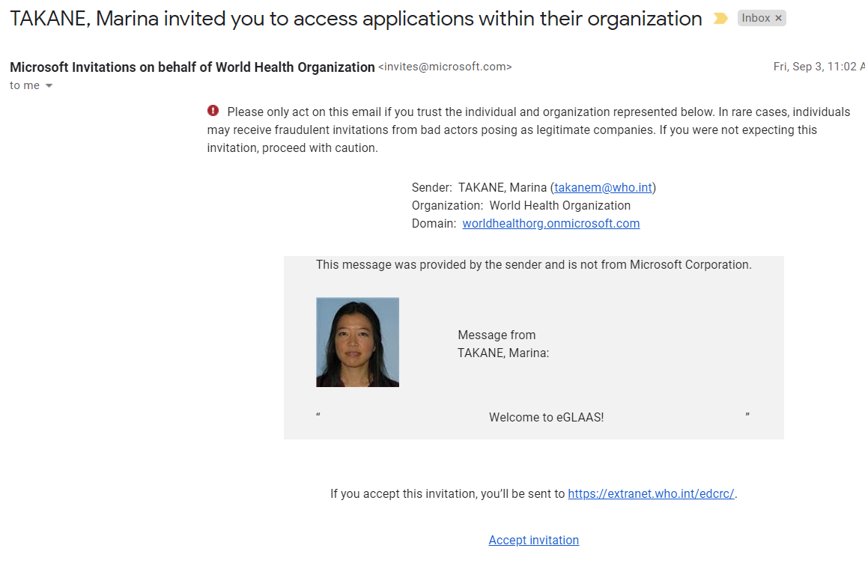
Step 1. Accept the email invitation from WHO
To begin your registration with WHO, you will receive an email like the one on this page.
If you did NOT receive an email:
Check your Spam/Junk folder in your email inbox. It is possible that the email has been automatically sorted as junk by your email provider.
You may already be registered in the WHO system. Skip to step 4 (slide 14) and follow the instructions in the pink box.
Once you access the email, click ‘Accept invitation’ to be redirected to the WHO registration page where you will be prompted to follow steps to log-in.
The message will look like this from Marina Takane welcoming you to eGLAAS.
Clicking ‘Accept invitation’ will redirect you to the WHO registration page.
Notes:
Note: The message will be received in English, click accept regardless of the language you prefer.

Slide 12

Step 2. Follow the link and log-in using your email credentials
Clicking ‘Accept invitation’ in the email will redirect you to a log-in page.
For External (non-WHO) users: Click on External Partner. Follow the instructions to log-in using the password for your email account.
For Internal (WHO email) users: Log-in using your WIMS account with your authenticator.
Only for WHO or PAHO Staff
For non-WHO, external users (personal accounts)
If you’re using a Gmail or Microsoft Outlook account, then you use your log-in credentials for those accounts. If you have another type of email account, the procedure might be slightly different.
Notes:
Note: These pages will appear in English only.

Slide 13
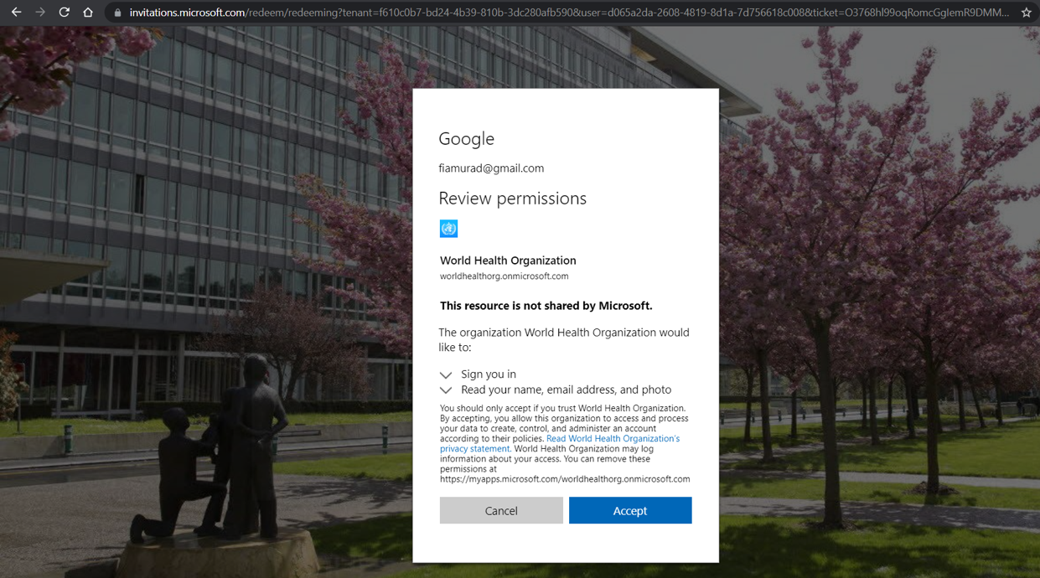
Step 3. Verify your email in the WHO system by clicking ‘Accept’
Follow the instructions to verify your email address using your email address and password in the WHO system.
You will need to accept the WHO terms and permissions.
Click ‘Accept’ when prompted.
Your email will appear here
Accept the terms to continue.

Slide 14
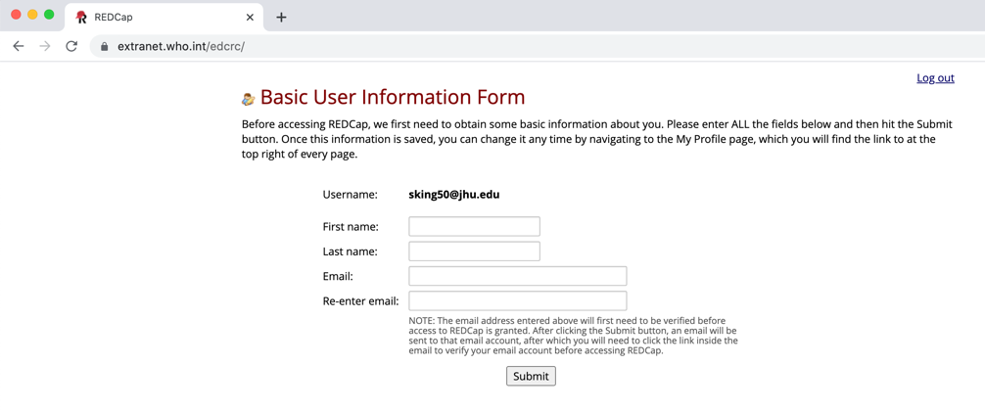
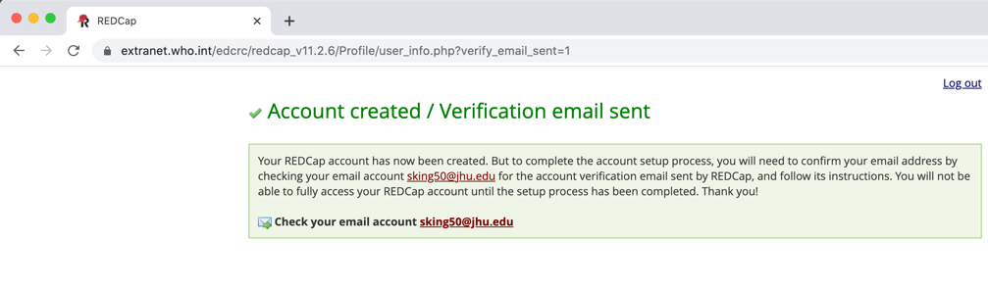
Step 4. Register on the eGLAAS platform
After verifying your email in the WHO system, go to the webpage: http://extranet.who.int/edcrc
Follow the instructions on REDCap to register on the eGLAAS platform.
Use the same email address where you received the initial email from Marina Takane.
Click ’Submit’.
You will receive an email to verify your account (go to Step 5).
Your email will appear here
Click ‘Submit’.
This window will appear when you click ‘Submit’
Your email
If you have skipped to this step from Step 1, you can access the eGLAAS platform immediately by going to: http://extranet.who.int/edcrc and follow the steps on this slide.
Your email will appear here
Notes:
Note: These pages may only be in English.

Slide 15
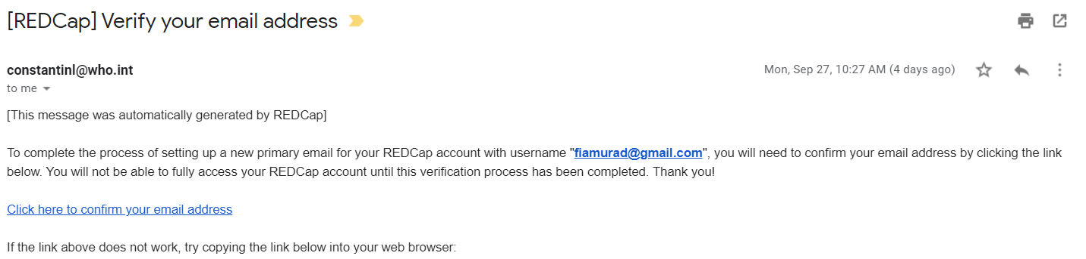
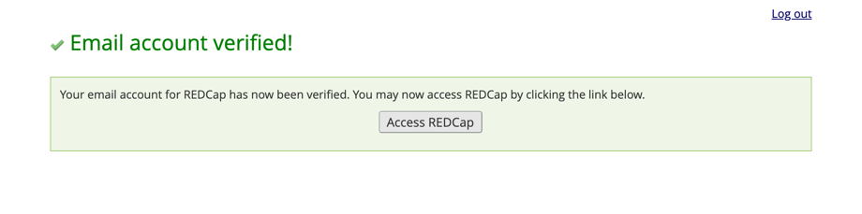
Step 5. Go to your email account and verify your email address
Find the email subject ‘[REDCap] Verify your email address.’
Click ‘Click here to confirm your email address’.
You should be redirected to REDCap/ the eGLAAS platform.
Your email here
Once registered, access the platform anytime by going to: https://extranet.who.int/edcrc/

Slide 16
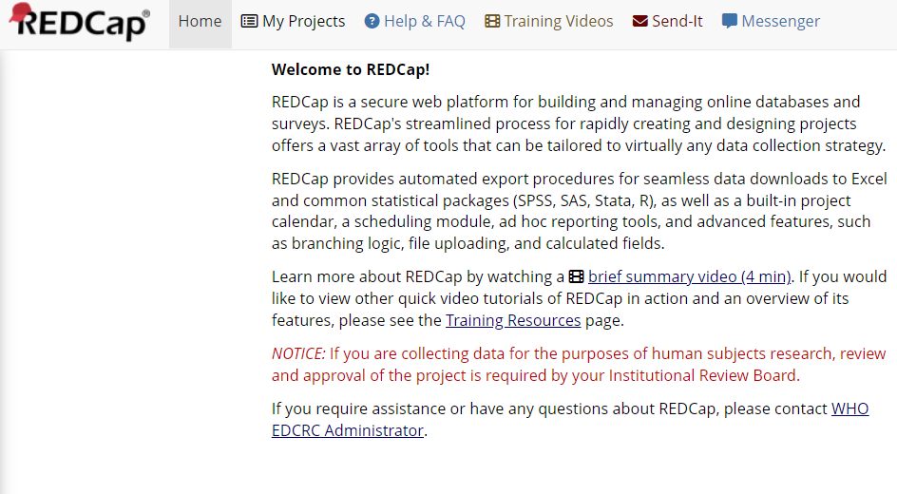
Access the eGLAAS platform anytime
Once you have registered by completing the outlined steps, you can access the eGLAAS platform with your email and password through this link:
https://extranet.who.int/edcrc/
It is recommended to access the platform using a desktop or laptop computer, rather than a mobile device.
Please contact glaas@who.int if you have any issues registering or accessing the eGLAAS platform.

Slide 17
eGLAAS terminology and demonstration of features

Slide 18
Terminology used in eGLAAS
Project: A data collection tool. In our case, this is the eGLAAS 2024 country survey.
Record: The individual electronic copy of the survey that is completed by each country. In our case, each country/territory has its own record.
  For example in eGLAAS, there is one eGLAAS survey for Serbia and all members of the Serbia data access group can access the Serbia record.
Instrument: Within a project, there are many instruments that collect data on different topics. Sometimes an instrument is called a ‘form’.
  For eGLAAS, each question in the GLAAS country survey is an instrument. For example, question A1 on the human rights to water and sanitation is one instrument. Question A2 on national regulations and standards is another instrument.
Data access group: The group of individuals that have access to the same record.
  For example, the Serbia data access group is made up of individual users that have access to the Serbia eGLAAS record.
Data resolution workflow: Allows users to leave comments on any given question on a data entry form by clicking the balloon icon next to the question.

Slide 19
Demonstration of eGLAAS

Slide 20
Overview of features on eGLAAS

Slide 21
Overview of features on eGLAAS
My projects: Shows the current projects you have access to including the eGLAAS 2024 country survey (If you do not see ‘eGLAAS 2024 country survey’, please contact glaas@who.int).
Project Home: The landing page provides an overview of the eGLAAS project.
Record Status Dashboard: This shows the status of each question in the eGLAAS country survey. You can access your country survey from this page.
View / Edit Records: This is where you access your eGLAAS country survey.
Data Exports, Reports and Stats: This is where you can export your data to Excel.
Resolve Issues: Add or read queries/comments from other users about responses to your eGLAAS survey questions.
Project Bookmarks: Find links to important information and resources about the GLAAS 2024/2025 cycle.
Notes:
If presenting this module, it is recommended to demonstrate these features on the eGLAAS platform, rather than presenting this slide.

Slide 22
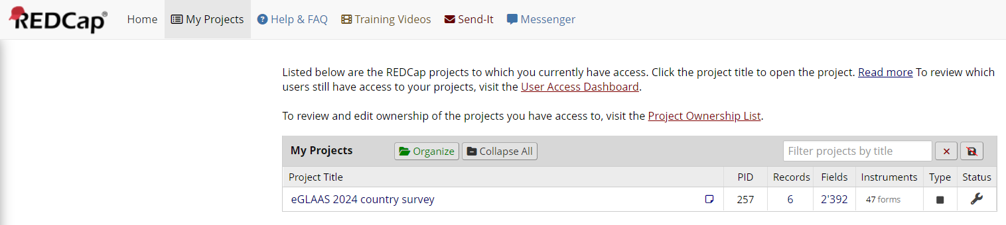
My Projects
When you log into the eGLAAS platform, click on My Projects at the top.
This page shows the current projects you have access to in the eGLAAS platform (REDCap).
Click on eGLAAS 2024 country survey to access the GLAAS survey.

Slide 23
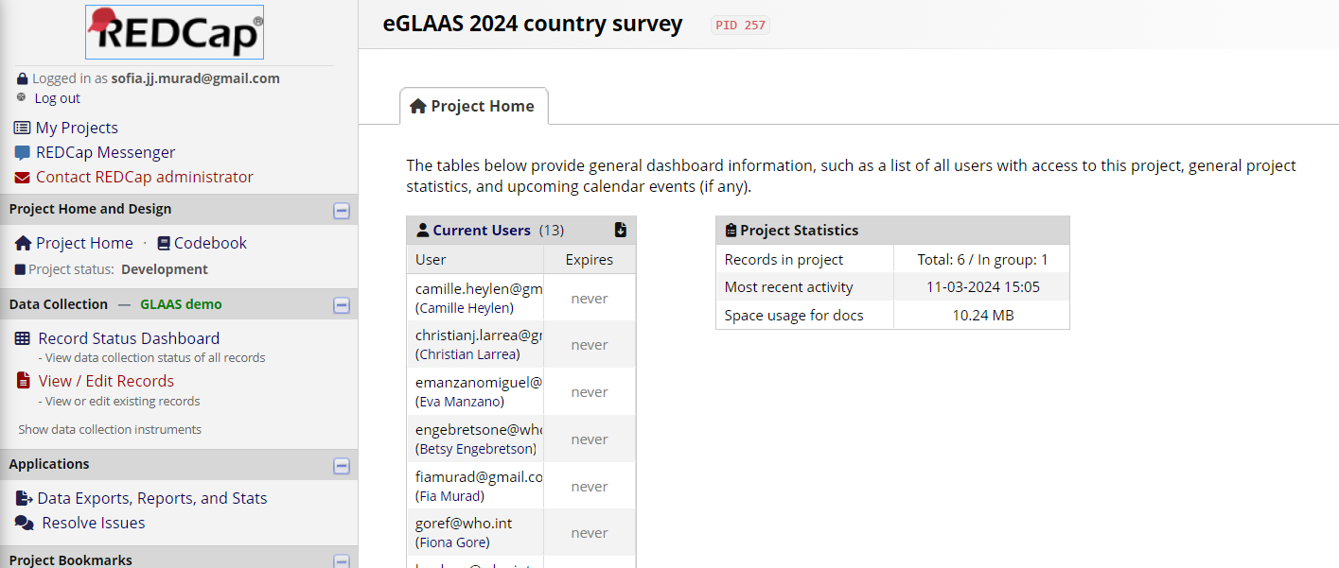
Project Home
This is the landing page of the eGLAAS 2024 country survey with an overview of the eGLAAS project.
The options on the left allow you to access the other features presented on the slides that follow.

Slide 24
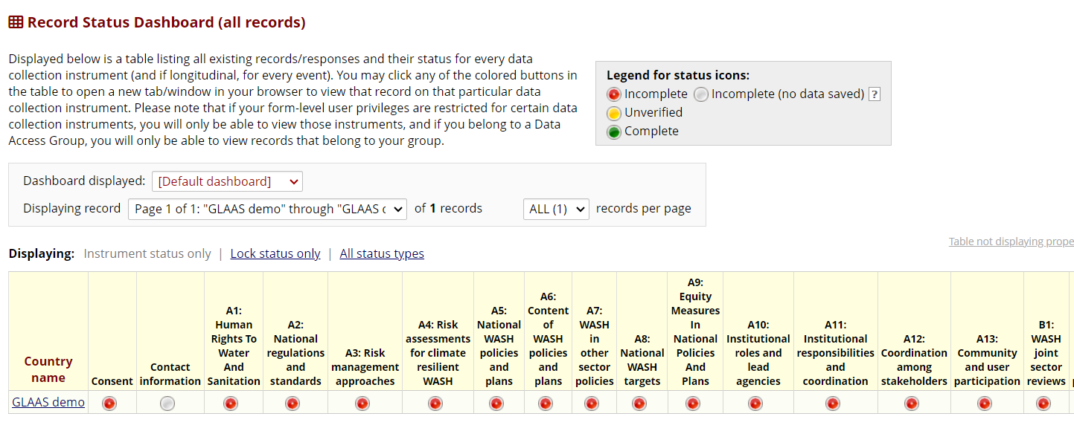
Record Status Dashboard – Accessing your country survey
Use this to access your country survey.
When you click on Record Status Dashboard from the Project Home page you will see the status of each question in your eGLAAS country survey.
You can access your country survey from this page by:
  Clicking on the country name (e.g. ‘GLAAS demo’ in the screenshot below); or
  Clicking on the status icon button underneath a specific question to complete data entry (e.g. to access question A1, click on the dot beneath A1.)

Slide 25
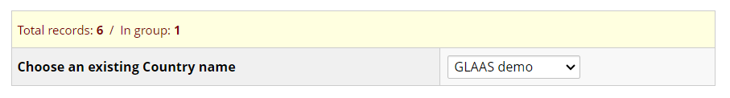
View / Edit Records
Another way to access your eGLAAS country survey is through View / Edit Records from the Project Home page.
When you click on View / Edit Records, select the Country name of your survey from the dropdown menu that reads ‘Choose an existing Country name’.

Slide 26
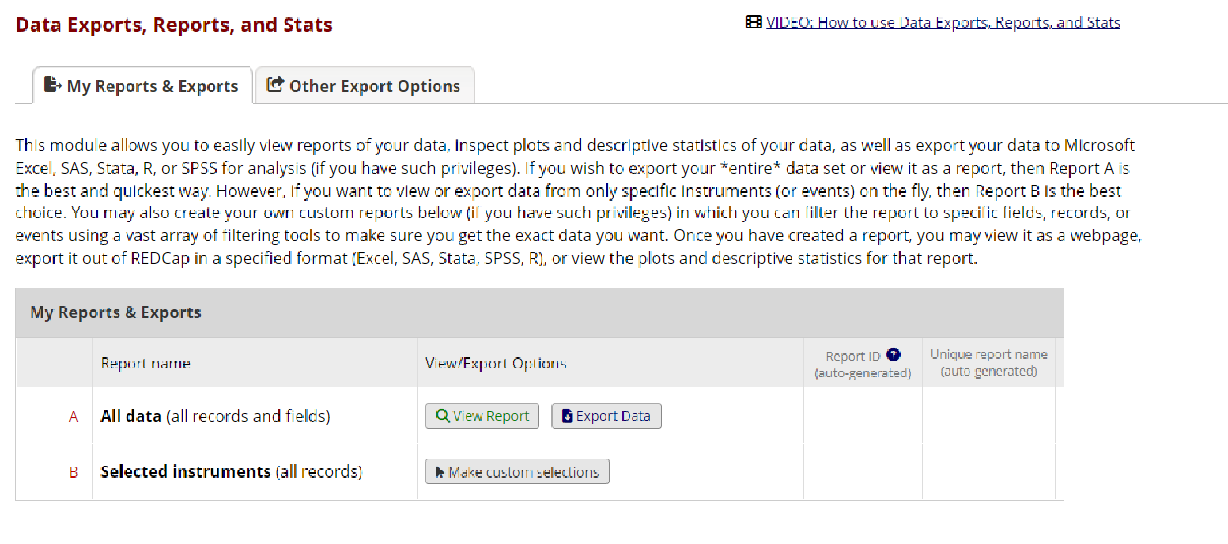
Data Exports, Reports, and Stats
This is where you can export raw data from your GLAAS 2024 country survey.
Select ‘Export data’ followed by the export format.
  Data can be exported to Excel, SPSS, SAS, R, STATA.

Slide 27
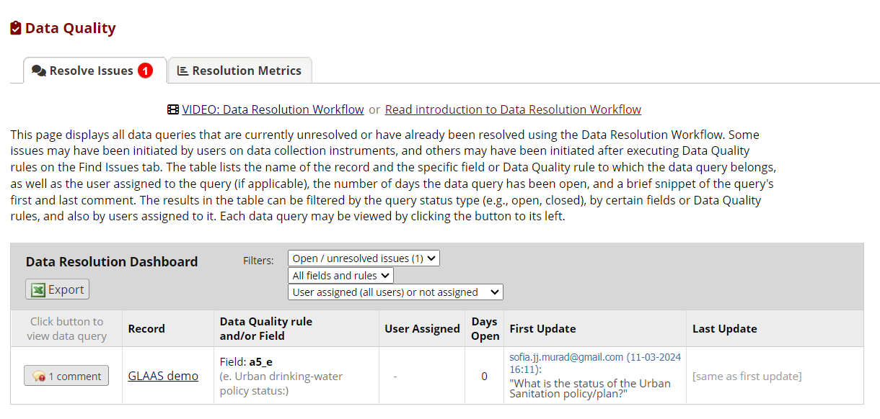
Resolve issues – Add or read queries
On this page you can add or read queries (comments) from other users about responses to your eGLAAS survey questions.
Click on the ‘Comment’ button to read and respond to the query.
Click on the ‘Record’ name (e.g. GLAAS demo) to see the comment in the context of the survey.

Slide 28
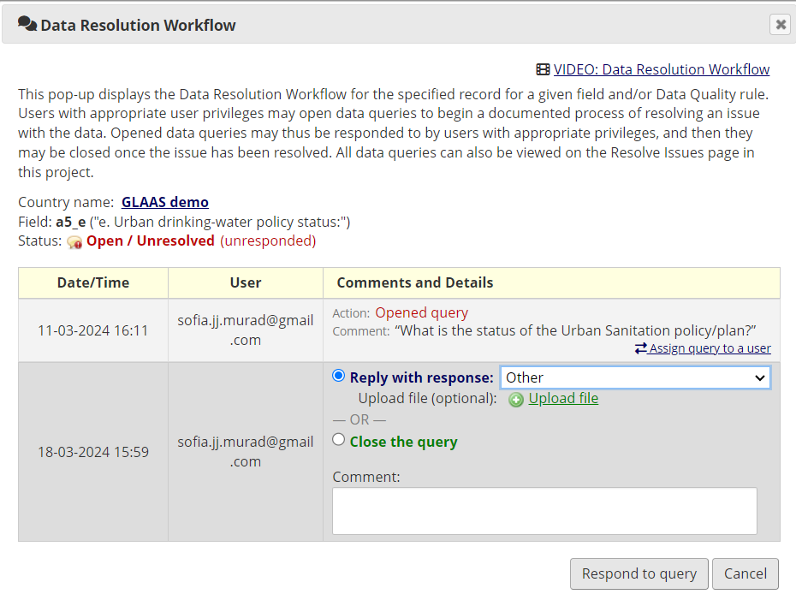
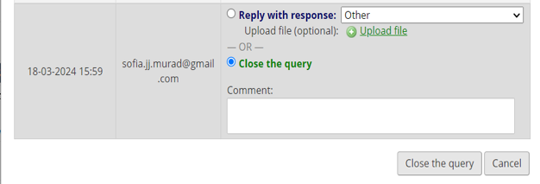
Resolve issues – Respond and resolve queries
Through the Resolve Issues page or in the eGLAAS country survey, queries can be responded to and resolved.
Click on ‘Comment’ on the Resolve issues page or Click on the comment symbol in the eGLAAS country survey.
To respond to a query:
  Choose ‘Reply with a response’ and select a response option. And add a comment.
  Click on ‘Respond to query’ at the bottom of the window to post a response.
To close a query:
  Make any necessary changes in the country survey before closing a comment.
  Choose ‘Close the query’ and add a comment describe why the query is being closed.
  Click on ‘Close the query’ at the bottom of the window.

Slide 29

Project Bookmarks
Access links to important information and resources about the GLAAS 2024/2025 cycle including the survey guidance document and GLAAS data portal.

Slide 30
The eGLAAS process
How to complete and submit the eGLAAS country survey

Slide 31
eGLAAS process on eGLAAS platform (REDCap)
You will be able to access your eGLAAS country record when
  your country has confirmed participation in eGLAAS with the WHO regional advisor and/or GLAAS team; and
  you and all contributors have registered on the eGLAAS platform.
Multiple users, including the GLAAS focal point, from your country team will be able to access and work on different questions within the country record simultaneously.
It is up to each country team to determine their approach for completing the eGLAAS survey.

Slide 32
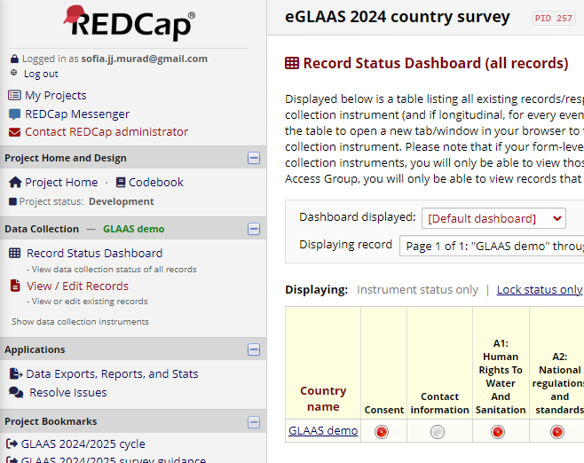
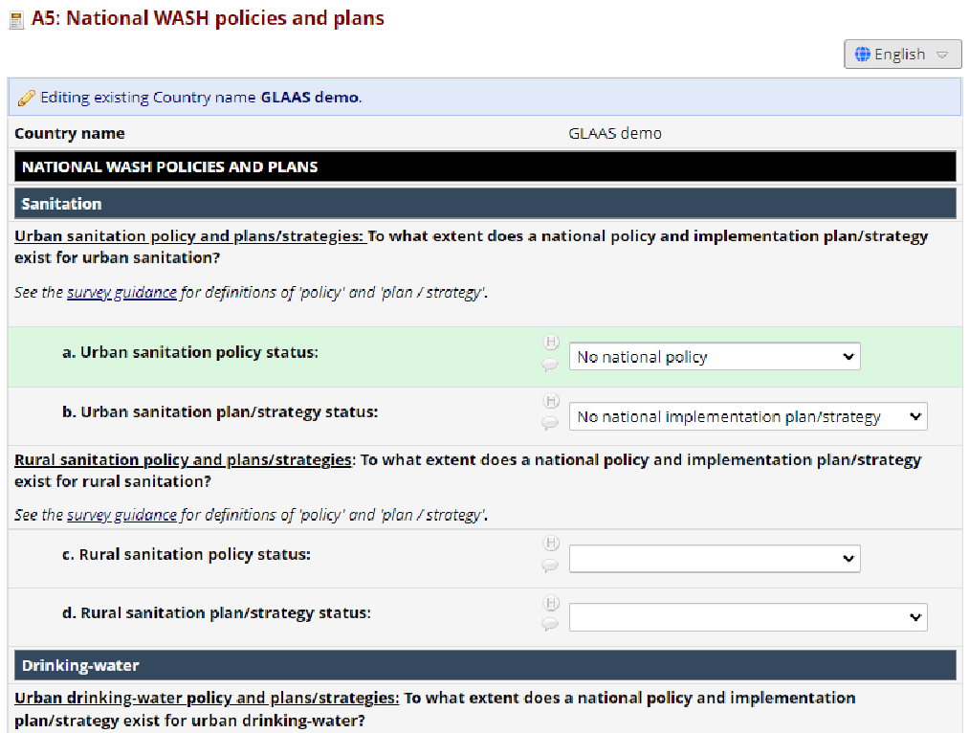
Completing the country survey on eGLAAS
Open your country survey on the eGLAAS platform through Record Status Dashboard or View / Edit Records.
Select the instrument (question) that you want to complete (e.g. A5).
To enter data, use the dropdown menus, radio buttons and text fields to complete the survey.
Remember to save the survey at regular intervals (see slide 34).

Slide 33
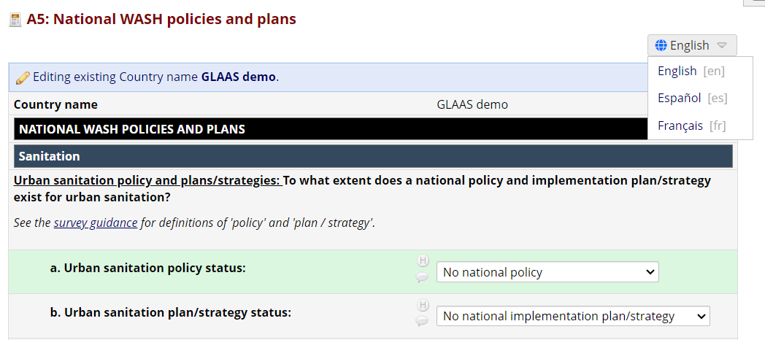
Selecting the language of the country survey
Once you have selected the instrument, the survey will appear in the default language of your country – either English, French or Spanish.
If the questions are not appearing in your preferred language, you can change the language through the dropdown menu at the top of each instrument.

Slide 34
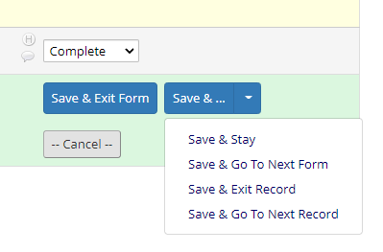
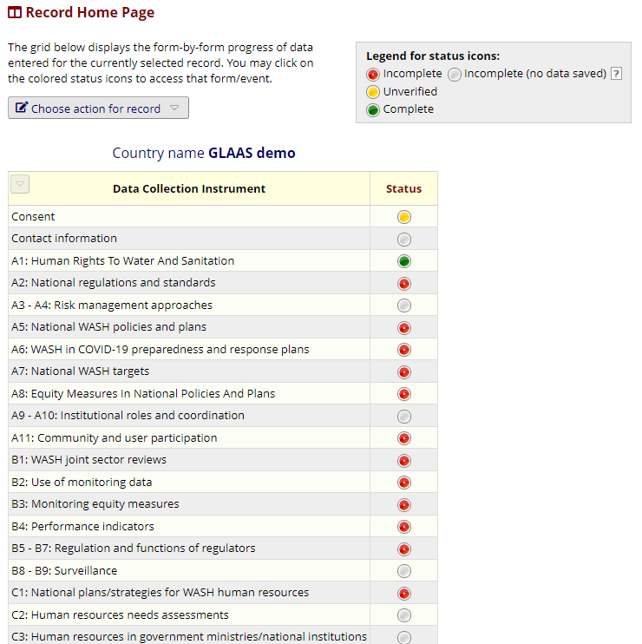
Saving each instrument
At the top right and bottom of each instrument there are various save options.
Remember to save the instrument at regular intervals while working.
If you lose internet connection while working on a question, data may be lost if not saved regularly.
‘Save and Stay’: Saves the instrument and keeps you on the instrument.
‘Save and Exit Form’: Saves the instrument and brings you back to the Record Home Page where you will see an overview of the status of each instrument.
‘Save and Go To Next Form’: Saves the instrument and continues to the next instrument in the record.

Slide 35
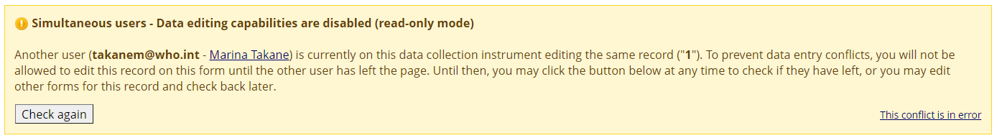
Alerts – Simultaneous users
If another user is actively editing a specific instrument, for example instrument A1, other users will be unable to edit that instrument at the same time.
This feature prevents conflicts in data entry on the form.
The alert will appear at the top of your screen when you open the instrument.
Click ‘Check again’ to refresh the page and see if your colleague has finished editing.
When you are not actively working on eGLAAS, we encourage you to save and close REDCap. Otherwise, you may be blocking your colleagues from continuing their work.

Slide 36
Planning teamwork in country eGLAAS processes
There are three main discussions specific to eGLAAS for country teams to have in planning their process:
How to work together and share responsibilities on eGLAAS?
How to use the ‘Record status’ function in eGLAAS?
How to use the ‘Data Resolution Workflow’ function in eGLAAS?

Slide 37
Planning teamwork in country eGLAAS processes
How to work together and share responsibilities on eGLAAS?
Some teams may only want one team member to enter data into the electronic country survey.
Other teams may choose to assign different eGLAAS questions to different team members to share data entry. Multiple team members can work simultaneously on the same record on the eGLAAS platform, but cannot have the same instrument (question) open at the same time.

Slide 38
Reminder: The GLAAS process is collaborative
Regardless of the format of the country survey (PDF or online), the GLAAS process for gathering data and compiling responses should be collaborative, participatory and multistakeholder.
With multiple stakeholders involved in completing the GLAAS survey, it is important to have a final government validation meeting with everyone involved in GLAAS to ensure that everyone agrees with the information in the survey.
The lead government ministry/agency reviews the data and signs off on the results before submission.
Several features of eGLAAS support and enhance the ability of teams to work collaboratively to complete the eGLAAS country survey such as record status dashboards, data resolution workflows and printing capabilities.
Notes:
Notes: Reminder – it is important to have clear internal communication between collaborators regarding roles and responsibilities.

Slide 39
Planning teamwork in country eGLAAS processes
How to use the ‘Record status’ function in eGLAAS?
If you are multiple team members working on eGLAAS, you should carefully consider how you want to use:
  Record Status: The record status shows the status of each question in the eGLAAS survey (e.g., Incomplete or Complete).
  See next slide for details

Slide 40
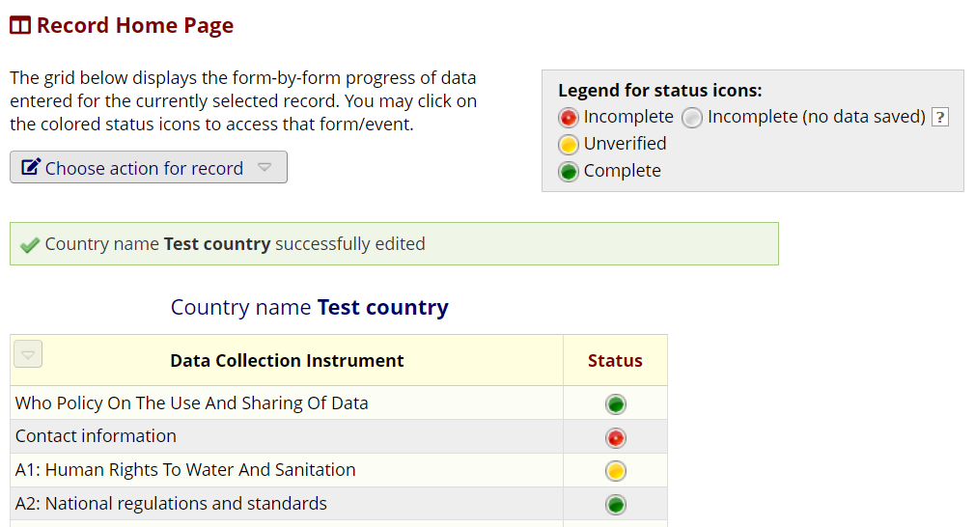
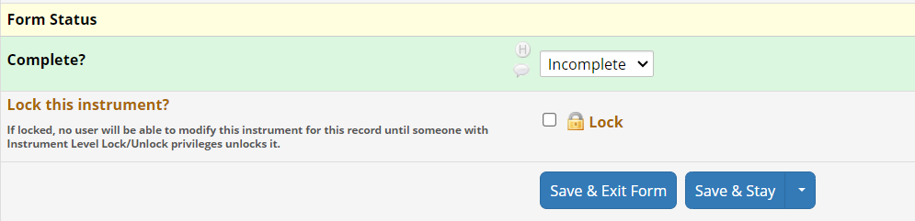
Determine how to use the ‘Record status’
Decide how to use the ‘Record status’ to manage the survey process.
The available record status icons are:
  Incomplete (no data saved) indicates that the instrument has not been started.
  Incomplete indicates that there is saved data in the instrument, but it is not complete.
  Unverified indicates there is saved data in the instrument, but it requires verification.
  Complete indicates that the instrument is ready to submit to WHO.
See each status by clicking ‘Record Status Dashboard’ or ‘View / Edit Records’ on the eGLAAS platform.
Change the record status in the dropdown menu at the bottom of each instrument (question).
Notes:
Notes: Make sure to be consistent on the way record status is classified for all the survey in order to ensure clear internal workflow.

Slide 41
Planning teamwork in country eGLAAS processes
How to use the ‘Data Resolution Workflow’ function in eGLAAS?
If you are multiple team members working on eGLAAS, you should carefully consider how you want to use:
  Data Resolution Workflow: To add or read queries/comments from other users about responses to your eGLAAS survey questions. Comments can be assigned to other team members, the WHO regional advisor or members of the GLAAS team for follow-up.
  See next slides for details

Slide 42
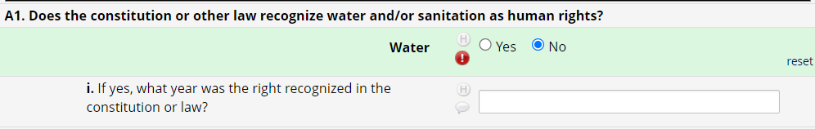
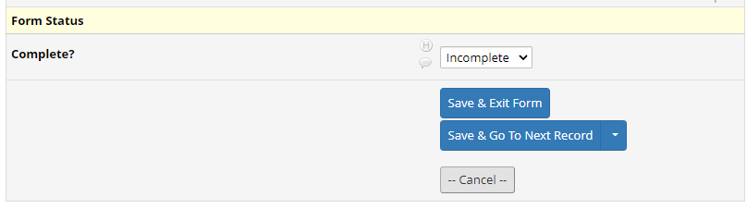
How to leave comments using ‘Data Resolution Workflow’
There are two places where you can add a comment on an instrument:
In most instruments, the comment icon is found directly next to the eGLAAS question.
  The comment icon allows you leave and assign comments for follow-up.
  The H shows you the data entry history.
In some instruments, the comment field will only appear at the bottom of the instrument under ‘Form status’.
  Note: Specify the question number that you are referring to in any comments left at the bottom of the instrument.

Slide 43
How to respond and resolve queries/comments
Through the Resolve Issues page or in the eGLAAS country survey, queries can be responded to and resolved.
Click on ‘Comment’ on the Resolve issues page or Click on the comment symbol in the eGLAAS country survey.
To respond to a query:
  Choose ‘Reply with a response’ and select a response option. And add a comment.
  Click on ‘Respond to query’ at the bottom of the window to post a response.
To close a query:
  Make any necessary changes in the country survey before closing a comment.
  Choose ‘Close the query’ and add a comment describe why the query is being closed.
  Click on ‘Close the query’ at the bottom of the window.

Slide 44
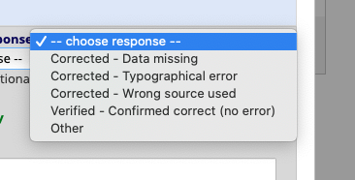
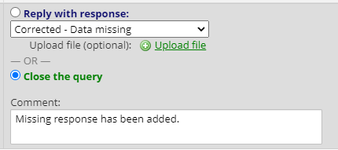
Notes on using Data Resolution Workflow
It is good practice to regularly check for open queries on the ‘Resolve issues’ page.
  Do not rely on the messenger or email function. If you send ‘email’ via queries be aware that it may end up in your spam folder.
There are several options when responding to a query. If unsure which to use, select ‘Other’.
‘Close the query’ when a comment has been addressed.

Slide 45
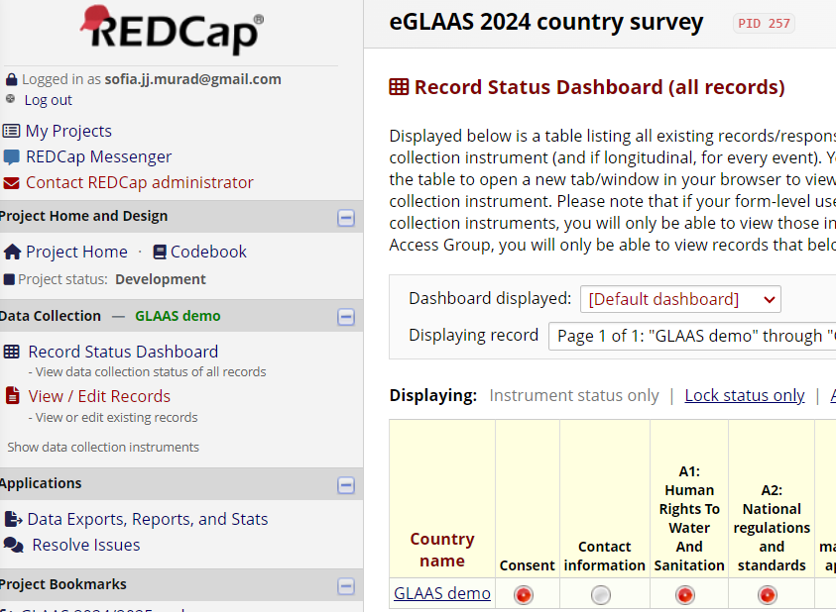
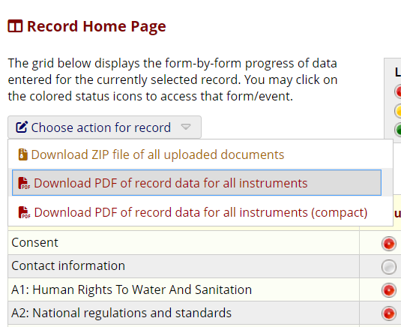
PDF / Printing eGLAAS record
To validate responses with multiple stakeholders, it can be useful to print the eGLAAS instruments as a PDF with the responses.
To generate a PDF of your eGLAAS survey with responses:
  Go to the eGLAAS platform and click on Record status dashboard.
  Click on your country name (e.g. GLAAS demo).
  In the new window, click on the dropdown menu ‘Choose action for record’ and select Download PDF of record data for all instruments.

Slide 46
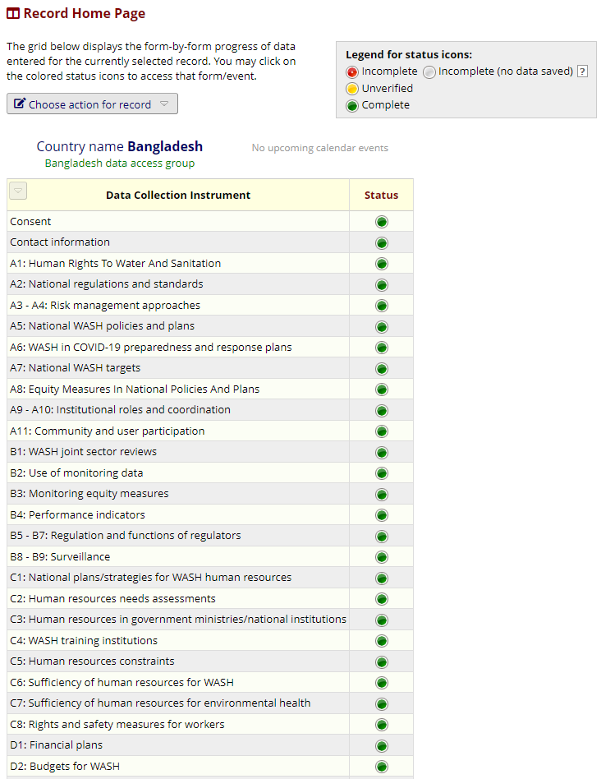
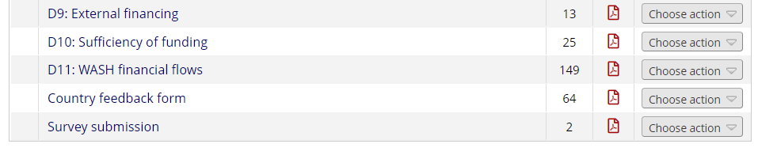
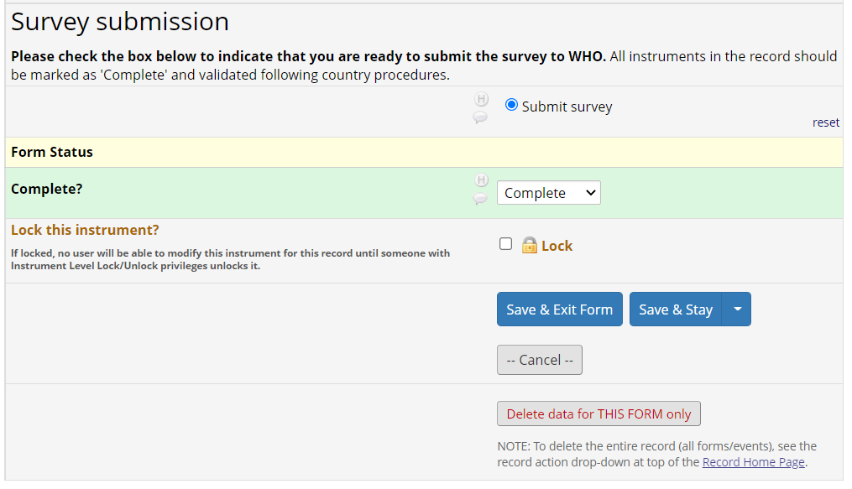
Submitting the eGLAAS survey
When the eGLAAS survey is ready for submission, we request that country teams:
Mark ALL instruments as ‘Complete’ (green) and
Complete the instrument called ‘Survey submission’.
This will notify the WHO regional advisors and WHO GLAAS team that the survey has been submitted.
The deadline for submitting the eGLAAS country survey is 15 October 2024.

Slide 47
Quality assurance through WHO regional office and HQ team
The WHO regional advisor and GLAAS team will have access to your record in order to conduct Quality Assurance once the survey has been submitted.
The WHO regional advisor and GLAAS team will use the Data Resolution Workflow (comments) to communicate with country teams about responses to the eGLAAS country survey.
WHO regional advisor and GLAAS team will send an email when review of entire eGLAAS country survey is complete.

Slide 48
Additional tips on eGLAAS
Notes:
If presenting this module to users, it is suggested that the ‘Additional tips on eGLAAS’ should only be presented as time allows, otherwise it can be skipped and indicated to users that these slides contain further information that can be useful when using the platform.

Slide 49
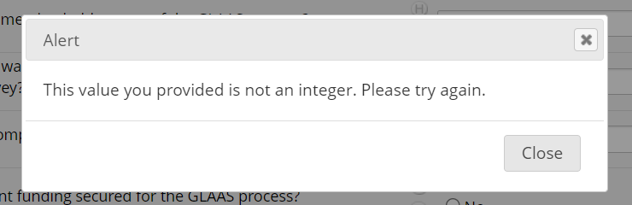
Alerts – Invalid response
Alerts will appear when a response is invalid.
  Note: These are similar to the alerts that appear in the fillable PDF of the GLAAS survey.
For example, some questions require:
  Integers (whole numbers) such as 1, 2, 45, 110.
  A year within a specific range such as between the year 1900 and 2023.
  A percentage between 0 and 100.
Notes:
Note – The alerts are the same as those presented in the fillable PDF of the GLAAS country survey.

Slide 50
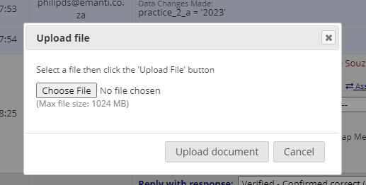
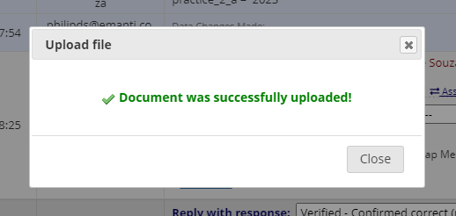
Uploading documents
Some questions will ask you to upload a supporting document or evidence.
Documents can be uploaded as PDF or Word files.
To ensure you do not face any connectivity and upload issues, it is recommended that you do not upload documents larger than 50 MB.

Slide 51
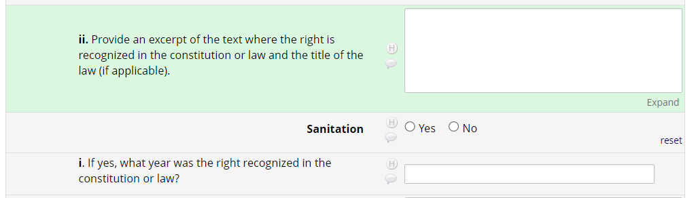
Extra notes on visibility and response fields
The eGLAAS country survey is optimally viewed on a larger screen. If you are opening the survey on a small screen, some of the response fields will be smaller and questions in tables may be narrow.
It is possible to expand some, but not all, response fields.
  Cells will turn green when clicking on ‘Expand’. Sometimes they expand, sometimes they will not.
  Cells will turn green when clicking on ‘Upload’ to upload a document to the form.

Slide 52
Final reminders

Slide 53
Final reminders
To register, the GLAAS focal point must contact the WHO regional advisor and GLAAS (glaas@who.int) as soon as possible with a list of email addresses of survey contributors.
As with the GLAAS PDF country survey, the eGLAAS process should be collaborative, inviting multiple stakeholders to contribute to the responses in the country survey.
To submit the eGLAAS survey, mark ALL instruments as ‘Complete’ (green) on the ‘Record status home’ page AND complete the instrument called ‘Survey submission’.
  This will notify the WHO regional advisors and WHO GLAAS team that the survey has been submitted.
The deadline for submission is 15 October 2024.
Contact glaas@who.int for any support or additional information on eGLAAS.

