Slide 1
Section B: Monitoring
Module 5: Overview of questions in Section B
GLAAS 2018/2019 cycle

Slide 2
Overview
Section B consists of 11 questions covering monitoring, including data availability and use, performance indicators and regulators.
This module will go through each of the questions.
Please also reference the survey guidance for additional information.

Slide 3
Questions
B1: National assessments and joint sector reviews (JSRs)
B2: Use of monitoring data
B3: Management information systems
B4: Monitoring national targets
B5: Monitoring vulnerable populations
B6: Performance indicators
B7: Regulation of drinking-water and sanitation/wastewater services
B8: Functions of drinking-water regulators
B9: Functions of sanitation/wastewater regulators
B10: Drinking-water quality surveillance
B11: Wastewater effluent surveillance

Slide 4
Question B1 – National assessments and JSRs
B1
Key definitions for answering this question:
  National assessment: National assessments may refer to government-led periodic reviews such as joint sector reviews (JSRs), as well as partner-led or -initiated assessments such as WASH BATs, GLAAS, CSOs, JMP coverage estimates, and Health Scorecards, etc.
  Joint sector review (JSR): A joint sector review is a government-led periodic process that brings different stakeholders in a particular sector together to engage in dialogue, review status, progress and performance, and take decisions on priority actions. Note that alternative names for joint sector reviews include: Annual water sector conference, Joint water sector review, Multi-stakeholder forum, Joint annual review, WASH conference, Revue annuelle conjointe and Revue annuelle sectorielle conjointe.
Notes:
The difference between national assessments and joint sector reviews is key when answering this question

Slide 5
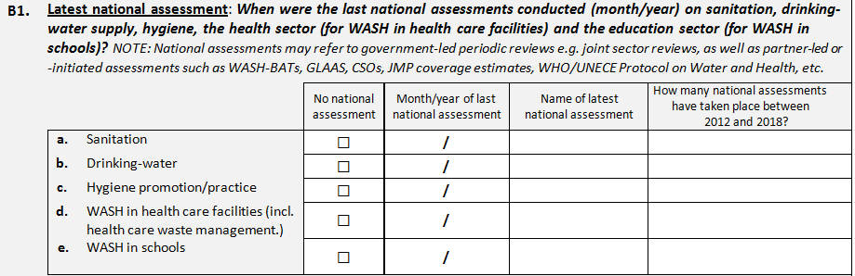
B1
For these columns, answer for the most recent national assessment.
Here list the number of national assessments between 2012 and 2018.

Slide 6
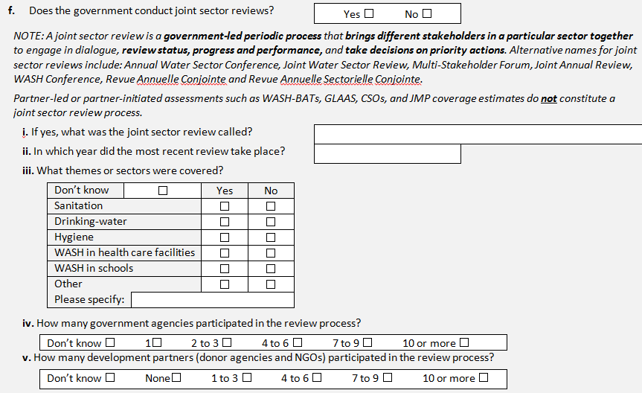
B1
JSR definition included in the question.
Only answer parts i-v if your country conducts JSRs. They refer to your country’s most recent JSR.

Slide 7
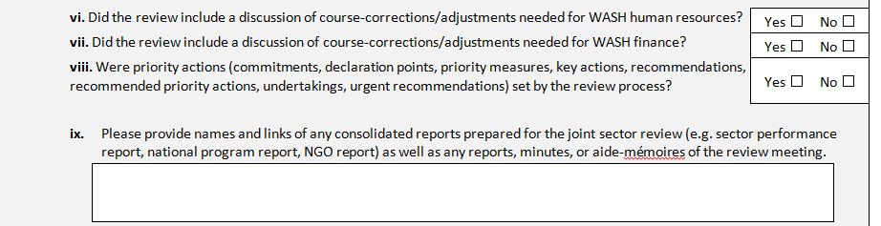
B1
Questions on JSRs continued. Only answer if your country conducts JSRs.
These questions focus on outcomes of the JSR.
This question focuses on documents used for and those prepared after the JSR.

Slide 8
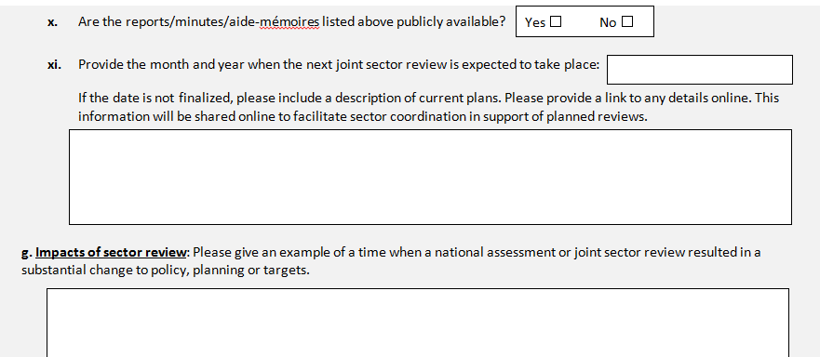
B1
Questions on JSRs continued. Only answer if your country conducts JSRs.
'Publicly available'means that information has been published or broadcast for public consumption and may be obtained through government offices or is available online.
Provide an example(s) when either a national assessment or JSR had an impact on governance in the WASH sector.

Slide 9
Question B2 – Use of monitoring data
B2
This question focuses on the extent that data are used for decision-making.
Data in this question could refer to data such as coverage levels, population growth, financial data, etc.
Data may be sourced from national surveillance agencies, management information systems (MIS)—a link with question B3—household surveys, etc.

Slide 10
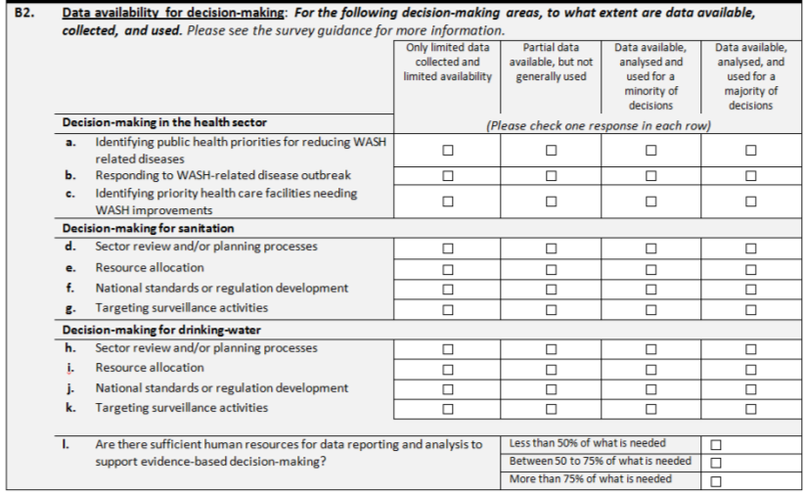
B2
This also includes targeting of services.
A human resources question.
Notes:
B2.e and B2.i refer to Resource allocation. Data for resource allocation decision-making could include data on coverage levels, planned population growth, asset status, etc.

Slide 11
Question B3 – Management information system
B3
This question refers to management information systems (MIS) that hold key WASH data.
A MIS is a computer-based or digital system where relevant stakeholders can upload data as per requirements. MIS are updated regularly and often form the basis for a variety of management reports.

Slide 12
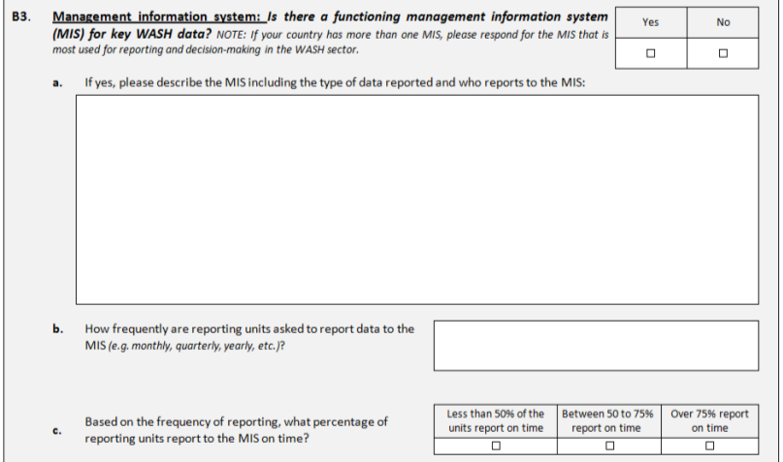
B3
Respond to this question for the MIS that is most used for reporting and decision-making in the WASH sector.
In part a be sure to include the type of data reported and who reports them.
Include the reporting units here.

Slide 13
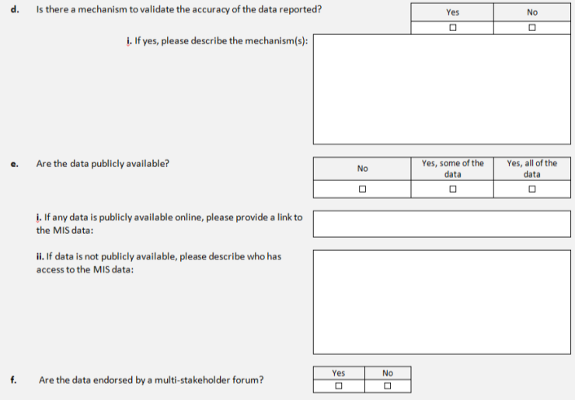
B3
If your description of the mechanism doesn’t fit in the text box, use the survey annex.
If the answer to part e is no, state who has access to the MIS data here.
‘Publicly available’ means that information has been published or broadcast for public consumption and may be obtained through government offices or is available online.

Slide 14
Question B4 – Monitoring national targets
B4
This questions relates to the focus of this GLAAS cycle: national policies, plans and targets.
When answering this question, refer to your answers on national targets in A7.

Slide 15
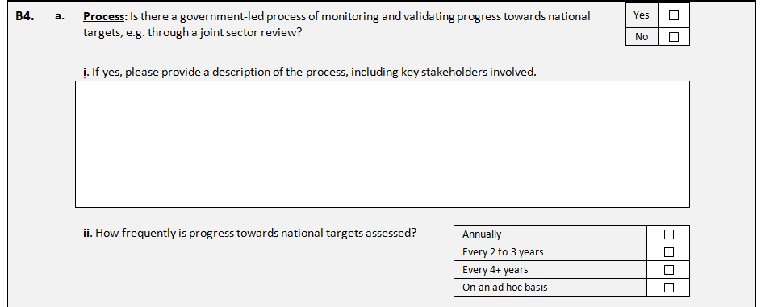
B4
To answer yes, the process should be government led.
If the answer to part a is yes, describe the process here. If additional space is needed, use the survey annex.

Slide 16
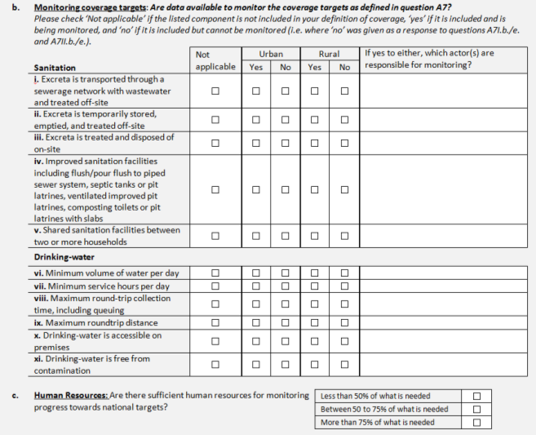
B4
Only answer these columns if the elements are included in your coverage definitions as answered in questions A7I.b, A7I.e, A7II.b and A7II.e.
Yes refers to included and being monitored.
No refers to included, but not monitored.
If the element is not included in your definition for coverage, mark 'not applicable'.

Slide 17
Question B5 – Tracking progress among vulnerable groups
B5
The question extends from A9 to understand if measures to reach vulnerable populations are monitored.

Slide 18
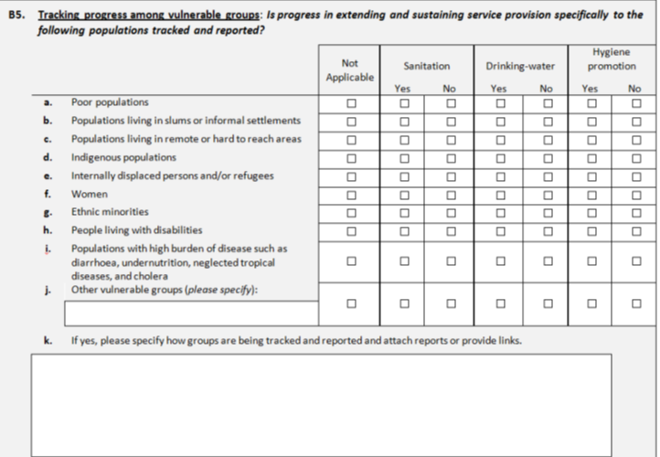
B5
If the vulnerable population does not reside in your country, mark not applicable.
Add other vulnerable population(s) if applicable.
In as much detail as possible, describe how measures to reach vulnerable populations are being monitored. Include or attach any reports.
Notes:
If you would like to include more than one additional vulnerable group, please include a response for these groups in the survey annex.

Slide 19
Question B6 – Performance indicators
B6
This question asks about select performance indicators for tracking progress for drinking-water and sanitation.
If more space is needed for answering this question, please use the survey annex.

Slide 20
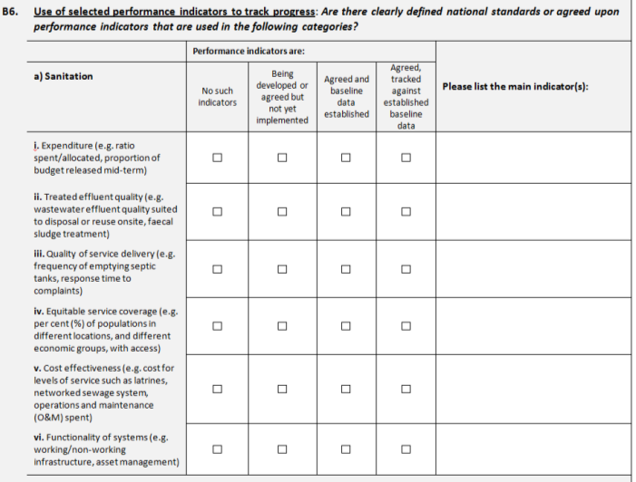
B6
Part a refers to sanitation.
Please list the main indicator(s) for each category. Use the survey annex if more space is needed.
Check one box per row.
Notes:
For B6.a and B6.b, please list the main indicator(s) for each category in the last column. For example, main indicators relating to “quality of service delivery” (B6.a.iii) may be the frequency of septic tank emptying or response time for addressing complaints.

Slide 21
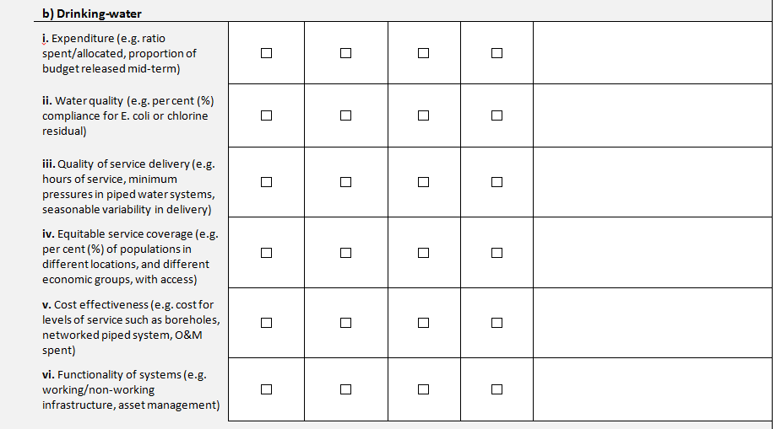
B6
Part b refers to drinking-water.
Please list the main indicator(s) for each category.
Check one box per row.
Notes:
The labels for the columns for part b are carried over from part a.

Slide 22
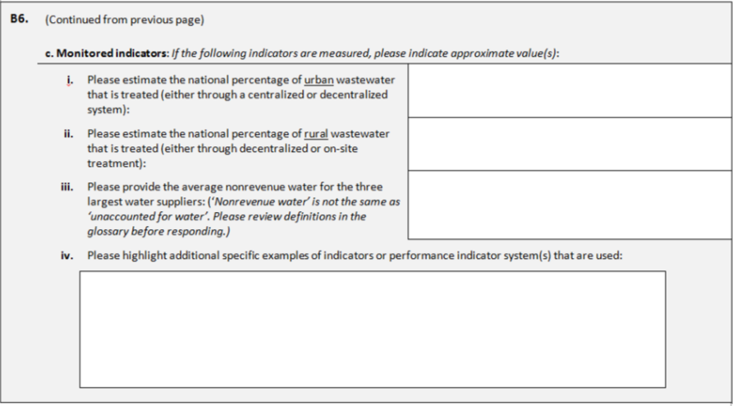
B6
List approximate values if the indicators are measured for i – iii.
'Nonrevenue water' does not equal 'unaccounted for water'.
If additional space is needed for indicators, use the survey annex.
Notes:
For B6.c.iii, please note that nonrevenue water is not to be used interchangeably with unaccounted for water. Nonrevenue water represents water that has been produced and is “lost” before it reaches the customer (either through leaks, through theft, or through legal usage for which no payment is made). It should not be used interchangeably with unaccounted for water (UFW or UAW), which is a component of nonrevenue water. Nonrevenue water (NRW) includes authorized unbilled consumption (such as water used for firefighting), whereas unaccounted for water excludes authorized unbilled consumption. See the glossary for more information.

Slide 23
Question B7 –
B7
This question focuses on types of regulatory authorities for drinking-water and sanitation.
A regulatory authority is an agency or body responsible for oversight and authority over regulations.
Notes:
Regulations (or regulatory instruments): Rules created by an administrative agency or body that typically include tangible measures that are necessary to implement and/or enforce the general requirements prescribed in the broader legislation. Regulations may cover water quality standards, service-level standards, required monitoring frequencies, requirements for risk management, surveillance requirements and/or audit guidance, etc.
Examples of regulatory authorities are the National Water Supply and Sanitation Council (NWASCO) in Zambia, and the Water Services Regulatory Board (WASREB) in Kenya.

Slide 24
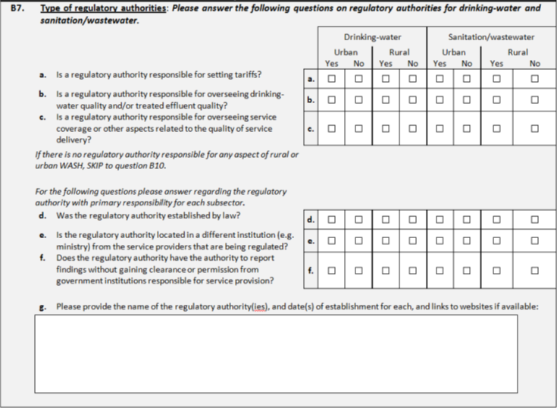
B7
Sanitation/
wastewater includes sewered services connected to a wastewater treatment plant as well as planning, emptying and disposal services for on-site sanitation such as septic tanks and latrines.
Answer these questions if there is a regulatory authority for urban/rural drinking-water or sanitation/wastewater. Answers should correspond to the regulatory authority with primary responsibility in each subsector.

Slide 25
Question B8 – Functions of drinking-water regulatory authorities
B8
This question focuses on drinking-water regulators.
The aim of the question is to understand what actions drinking-water regulators are taking in urban and rural areas.
Answer this question only if there is a regulatory authority with responsibilities for urban and/or rural drinking-water.

Slide 26
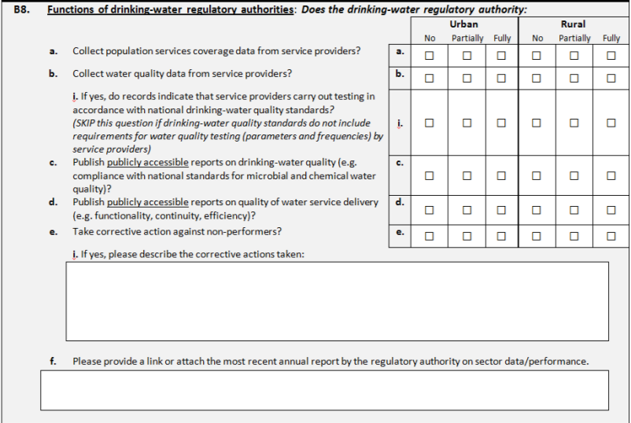
B8
Check two boxes per row—one for urban, one for rural.
Here, please describe the consequences of non-performance and the corrective actions that are taken.
Be sure to include a link of the most recent report or attach a copy.

Slide 27
Question B9 – Functions of sanitation/wastewater regulatory authorities
B9
This question focuses on sanitation/wastewater regulators.
The aim of the question is to understand what actions sanitation/wastewater regulators are taking in urban and rural areas.
Answer this question only if there is a regulatory authority with some responsibilities for urban and/or rural sanitation/wastewater.

Slide 28
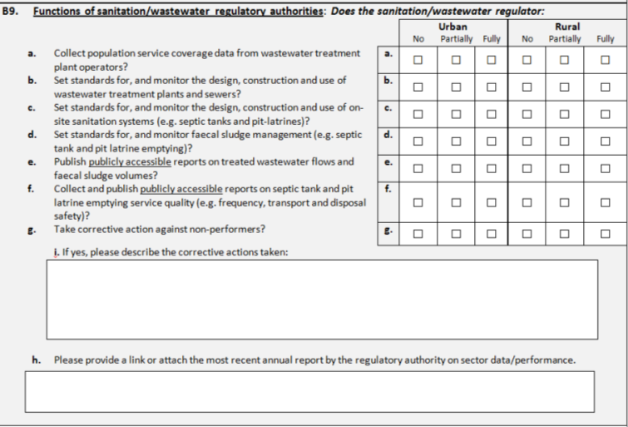
B9
Check two boxes per row—one for urban, one for rural.
Here describe the consequences of non-performance and the corrective actions that are taken.
Be sure to include a link of the most recent report or attach a copy.
Notes:
Note that parts a-g are different for drinking-water and sanitation/wastewater regulators.

Slide 29
Question B10 – Independent drinking-water quality surveillance
B10
This question aims to understand drinking-water surveillance activities.
Drinking-water supply surveillance is the continuous and vigilant public health assessment and periodic review of the safety and acceptability of drinking-water supplies. Drinking-water surveillance consists of sanitary inspections, auditing of preventive risk management approaches/water safety plans (WSPs), reviewing water suppliers’ internal water quality monitoring results, and/or independent testing of water supplies.
Surveillance should be performed by an agency that is independent (e.g. Ministry of Health) from the service provider.

Slide 30
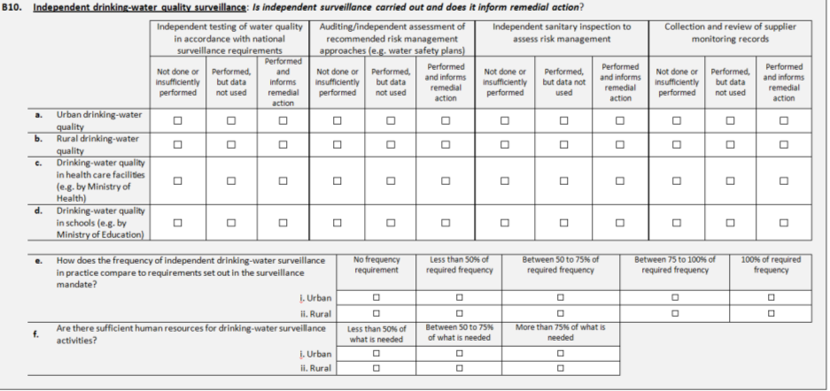
B10
Provide one answer for each column. Each row should have four answers.
A human resources question.

Slide 31
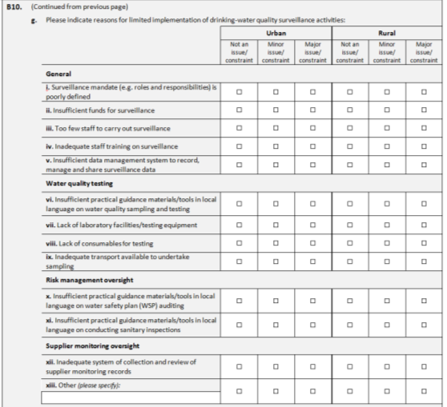
B10
Part g asks for specific reasons for limited implementation of drinking-water quality surveillance.
Two boxes per row should be checked—one for urban, one for rural.
Other can be for any additional constraint/limitation not listed. Additional constraints/limitations can be listed in part xiv, which is an open ended question.

Slide 32
Question B11 – Independent wastewater effluent surveillance
B11
This question focuses on the independent surveillance of wastewater effluent.
Surveillance should be conducted by an agency that is independent from the service provider.

Slide 33
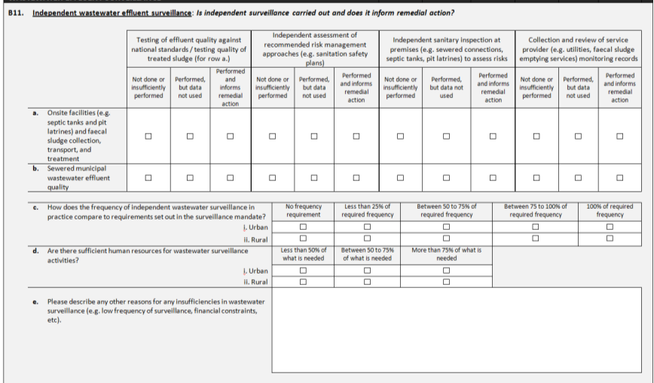
B11
Provide one answer for each column. Each row should have four answers.
A human resources question.
If extra space is needed to describe insufficiencies, use the survey annex.

Slide 34
Thank you!
For additional information or assistance please contact glaas@who.int

