Slide 1


These slides are available for adaptation and use by WSP stakeholders who wish to integrate equity messages into WSP training events.
These slides are as published in A guide to equitable water safety planning (WHO, 2019).
This work is available under the Creative Commons Attribution-NonCommercial-ShareAlike 3.0 IGO licence (CC BY-NC-SA 3.0 IGO). ¹
¹ Under the terms of this licence, you may copy, redistribute and adapt the work for non-commercial purposes, provided the work is appropriately cited, as indicated below. In any use of this work, there should be no suggestion that WHO endorses any specific organization, products or services. The use of the WHO logo is not permitted. Refer to the copyright page of the publication for further information.

Slide 2
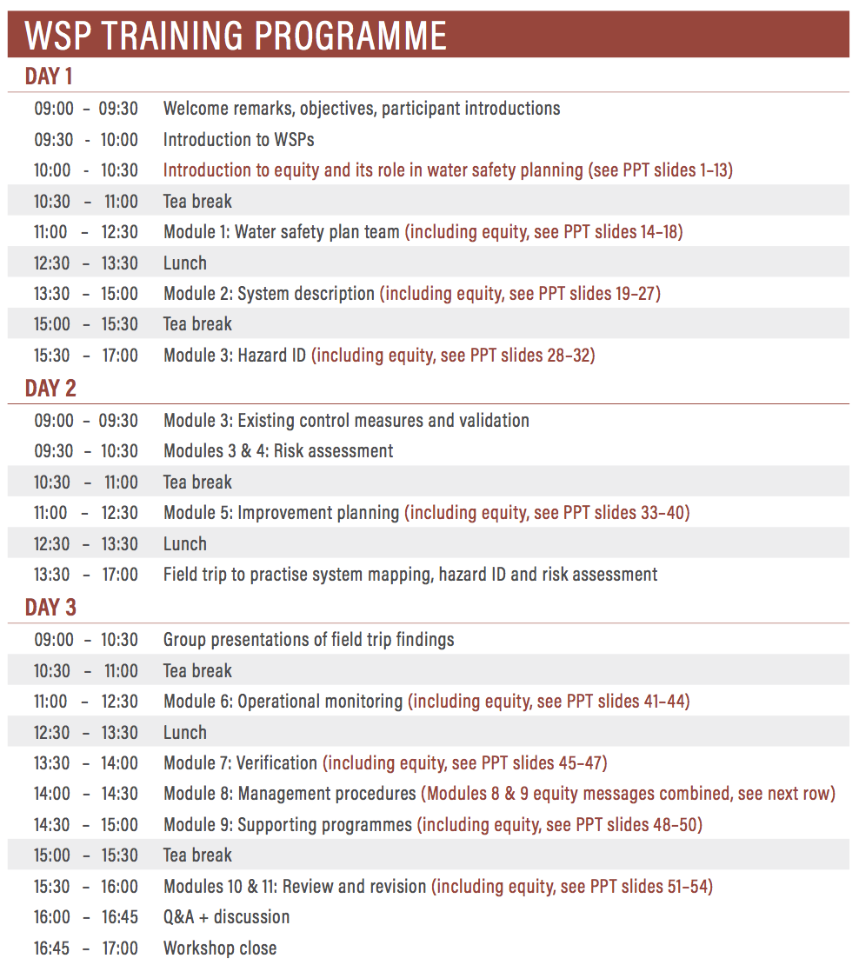
These slides focus on equity specifically and are designed to be integrated into a standard WSP training programme, i.e. general WSP training slides are not included here. ¹
These slides correspond to the three-day WSP training programme shown here, with particular points of equity integration flagged.
¹ For broader WSP training materials into which these equity slides could be incorporated, please refer to Capacity training on urban water safety planning – training modules (WHO SEARO, 2016) and the WSP training package (WHO/IWA, 2012). Note also that an updated standardized WSP training package is anticipated for publication by WHO and IWA in 2020.

Slide 3
AN INTRODUCTION TO
EQUITABLE WATER SAFETY PLANNING

Slide 4
Objective:
This introduction aims to explain what is meant by equitable water safety planning and why it is important.

Slide 5
Who experiences water?
A community is made up of different people with different life experiences and different experiences with water.

Slide 6
Thinking about your own community or a community where you work…
Who are the different types of water users?
Activity: Discuss in table groups, and write down all different types of water users that come to mind.

Slide 7
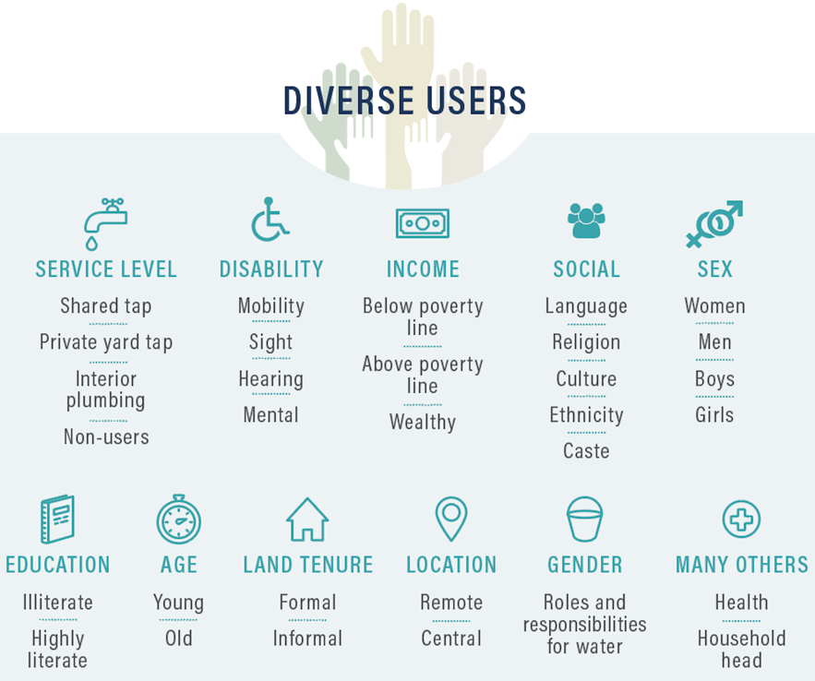
How many of these different user groups did you write down?
A community is made up of a range of diverse water users.

Slide 8
Thinking about diverse water user groups…
Who do you think are the most disadvantaged?
Activity: Discuss in table groups, and write down who you would consider to be the most disadvantaged.

Slide 9
Vulnerability: indicates traits or characteristics that put people at special risk to harm, e.g. babies are especially vulnerable to unsafe water
What contributes to disadvantage?
Marginalization: indicates a lack of access to safe water due to explicit or implicit discrimination, e.g. as experienced by the poor or remote

Slide 10

Who might experience vulnerability? Or marginalization?
Activity: Discuss who is likely to experience vulnerability. Why? And marginalization? Why?

Slide 11
“Equity” includes gender considerations
EQUITY
Gender equality
The absence of avoidable or remediable differences among groups of people
People’s rights and opportunities do not depend on gender

Slide 12
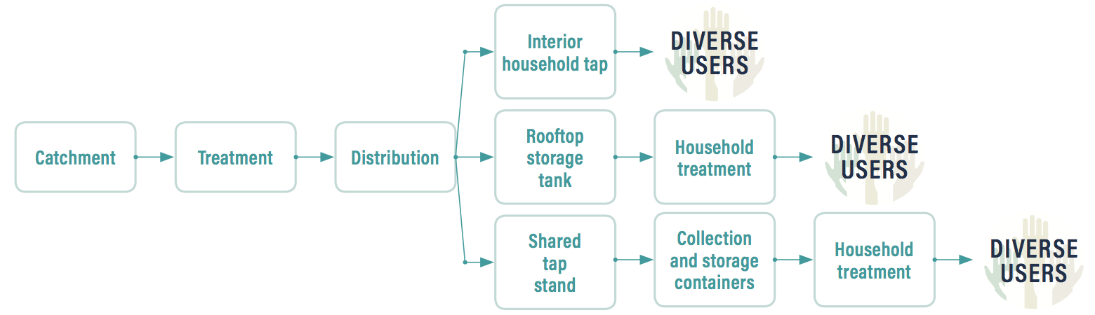
WSPs go from catchment to consumer
WSPs should consider diverse experiences with water along the water supply chain, especially at the catchment and user levels.
How are different users interacting with water at/near the point of use?
How are different groups interacting with water in the catchment?

Slide 13
Inputs to an equitable WSP
Risks experienced by all groups are identified
All groups are given the opportunity to participate
Improvement
and management plans target benefits for all
Equitable WSP

Slide 14
Outcomes of an equitable WSP
Equitable WSP
Equitable realization of WSP benefits
No one is made worse off in the process of managing risk
WSP is made more effective through an inclusive approach
All WASH initiatives have equity outcomes, whether intentional or not. Let us contribute to positive outcomes!

Slide 15
Can you identify any examples of how discrimination may result from a WSP?
Any examples of how a WSP can contribute to positive equity outcomes?
Activity: Discuss these questions in table groups, and write down the examples identified.

Slide 16
CONSIDERING EQUITY IN
MODULE 1:
ASSEMBLING THE WSP TEAM

Slide 17
Considering equity here means:
Seeking meaningful participation of diverse groups in the WSP team

Slide 18
Thinking about the diverse range of water user groups…
Who should participate in the WSP team? How can the different groups contribute?
Activity: Discuss these questions in table groups, and write down different groups’ contributions.

Slide 19
Equitable participation
(representation of women, men and disadvantaged groups in the WSP team)
Experiences and interests of diverse groups are taken into account during risk assessment and management planning
WSPs can be communicated and shared with different parts of the community through WSP team members
Risks to water safety are better understood and controlled by understanding different perspectives within the community.

Slide 20
What are ways to support meaningful participation of diverse groups in the WSP team?
Activity: Discuss this question in table groups.

Slide 21
CONSIDERING EQUITY IN
MODULE 2:
DESCRIBING THE SYSTEM

Slide 22
Considering equity here means:
Identifying diverse user (and non-user) groups
Understanding different experiences with water

Slide 23
Who are the users?
Defining intended water uses and users is an important part of describing the water supply system.
A typical example:
Intended use | Intended users
Intended for consumption, food preparation, bathing and laundry. | General population. Intended consumers do not include those that are significantly immuno-compromised or industries with special water quality needs.
But what is meant by “general population”?
Do we need to be more specific to ensure equitable benefit?

Slide 24

User diversity
In a community, there may be wealth disparities, health inequities, gender inequalities and/or other forms of disadvantage that impact experiences with water.

Slide 25
Why is it important to understand user diversity for an equitable WSP?
Activity: Discuss this question in table groups, and write down reasons discussed.

Slide 26
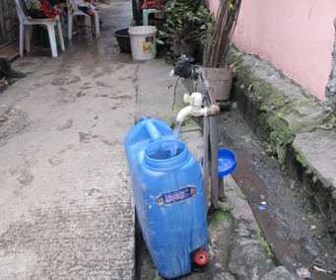
Diverse water experiences
If the diverse groups and their different experiences with water are not considered through the WSP process, the WSP may overlook important risks affecting some users.
EXAMPLE
Users of this public tap stand in an informal settlement face different risks than users with a household connection.

Slide 27
Why is it important to understand these experiences?
COLLECTION POINT INFRASTRUCTURE
Map all different collection point types and qualities.
WATER QUALITY AND SERVICE DELIVERY
Explore differences in water quality and service delivery.
WATER PRACTICES
Explore differences in how water is collected, managed and used.
PARTICIPATION
Identify practices and barriers related to participation.
Explore these topics for all user groups to identify different or inequitable experiences of water and water management.
Activity: In table groups, discuss how each of these points is relevant to a WSP.

Slide 28
Looking at the system map on the next slide, do you see…
Different types of collection points?
How water quality may differ by collection point?
Different water user practices?
Different opportunities for participation in decision-making relating to water management?
Activity: Discuss these questions in table groups, and write down differences identified.

Slide 29
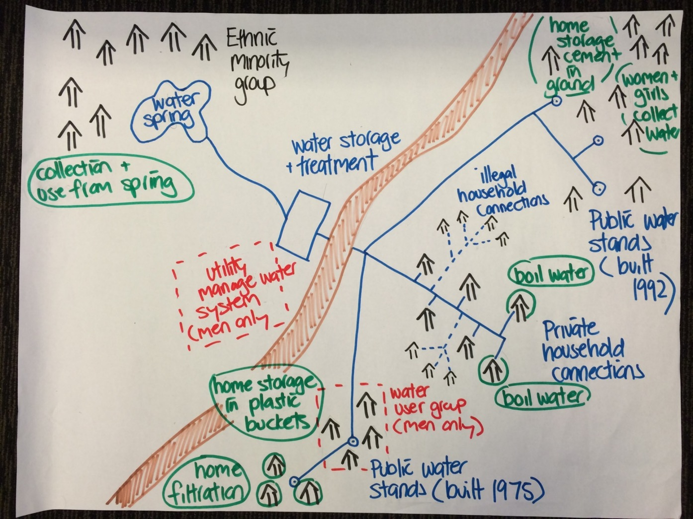
Spot differences in:
collection point
water quality
user practices
participation

Slide 30
CONSIDERING EQUITY IN
MODULE 3:
IDENTIFYING HAZARDS & ASSESSING RISK

Slide 31
Considering equity here means:
Bearing in mind diverse user experiences when identifying hazardous events

Slide 32
Looking at the system map on the next slide…
What different hazardous events do you see?
Activity: Discuss this question in table groups, and write down hazardous events identified.

Slide 33
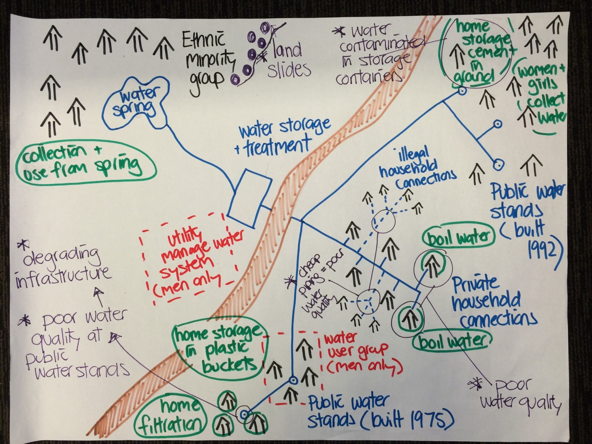
Spot the hazardous events

Slide 34
From the map, we can see…
LOCATION | HAZARDOUS EVENT
Catchment | Landslide in remote area threatens raw water quality/quantity
Distribution system | Contamination enters the pipe network due to low pressure
 | Illegal connections in informal settlements allow contaminants to enter the pipe network
 | Improper pipe materials used for illegal connections in the informal settlement leach chemicals into the water supply
Collection point | Degrading public tap stands threaten water quality/quality
 | Water collection from tap stands in open containers could allow contamination during collection and transport
Household | Household storage of water in underground tanks could allow contamination from surface runoff

Slide 35
CONSIDERING EQUITY IN
MODULE 5:
IMPROVEMENT PLANNING

Slide 36
Considering equity here means:
Prioritize improvements that benefit the disadvantaged
Ensure root causes are addressed
Identify positive and negative equity outcomes
Ensure equitable control measure participation and communication

Slide 37
Prioritizing disadvantaged groups
Hazardous events that disproportionately affect disadvantaged groups should be identified and prioritized (as appropriate) to ensure equity outcomes are achieved.
The WSP team should ask:
How might we be able to prioritize management of hazardous events affecting the most disadvantaged in the community?

Slide 38
Addressing root causes
Understanding systemic causes of hazardous events will increase control measure effectiveness and may address discrimination of the most disadvantaged.
To do this, the WSP team should:
Explore patterns of exposure to hazardous events across different groups to identify systemic causes
Identify control measures that address systemic causes, mitigating any embedded inequity or discrimination

Slide 39
Considering equity outcomes
Some control measures can directly impact people. Assessing human impact is important to avoid inadvertent discrimination and to maximize effectiveness.
To do this, the WSP team should assess each control measure to:
Determine if all groups will benefit equitably
Identify potentially negative impacts on any group
Identify alternatives or compensation measures in cases of potential harm or inequitable benefit
Determine if different solutions are needed for different groups based on their unique needs

Slide 40
Considering equity outcomes
Catchment
If restricting farming operations near a water intake is proposed, the following equity questions could be explored: How can disadvantage to farmers be avoided? Is there a form of compensation that could be offered to farmers? Can farming practices be changed to reduce hazards?
Consumer
If removal of illegal connections is proposed, an equity assessment could ask: What is driving the illegal connections? What will be the impact of removing the illegal connections on those who have connected illegally? Can solutions be found in which those needing water can still access water?
EXAMPLE
S

Slide 41
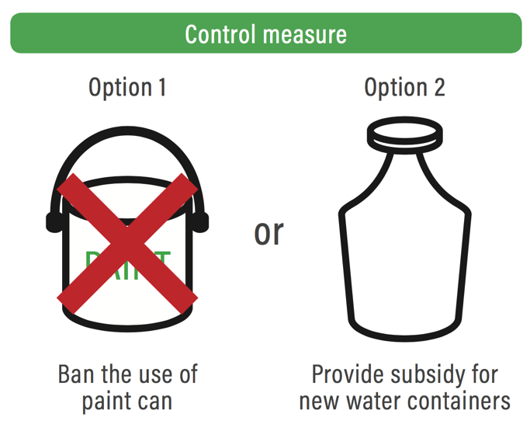
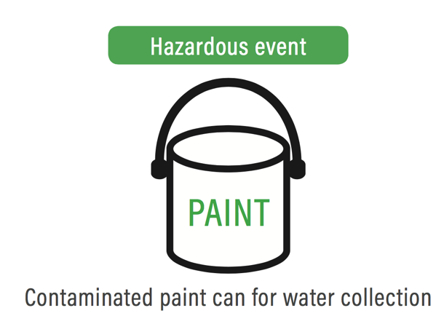
Considering equity outcomes
EXAMPLE
People are more likely to participate in control measures that do not contribute to disadvantage!

Slide 42
Ensuring equitable participation and communication
Some control measures depend on the awareness, support and/or participation of different groups. Appropriate communication and meaningful participation impact success.
For relevant control measures, the WSP team should consider:
Communication: Seek feedback on optimal control measures and ensure messages are delivered in ways accessible to all
Participation: Identify opportunities for diverse groups to participate in control measure implementation

Slide 43
CONSIDERING EQUITY IN
MODULE 6:
OPERATIONAL MONITORING

Slide 44
Considering equity here means:
Monitoring control measure effectiveness to ensure equitable benefit

Slide 45


Monitoring for equitable benefit
If the WSP team does not consider all user groups during control measure monitoring, some user groups may be excluded from benefits.
EXAMPLE
If Cl2 residual monitoring does not include remote households, it may fail to detect areas of inadequate protection.
Cl₂
WTP

Slide 46
Monitoring for equitable benefit
To do this, the WSP team should:
Note the intended beneficiaries of each control measure
Confirm that control measure benefits are experienced equitably by diverse users

Slide 47
CONSIDERING EQUITY IN
MODULE 7:
VERIFYING WSP EFFECTIVENESS

Slide 48
Considering equity here means:
Monitoring water quality and consumer satisfaction for all groups

Slide 49
Verifying WSP effectiveness for all
Compliance monitoring and consumer satisfaction monitoring should confirm that all groups receive safe water and are satisfied with their service.
To do this, the WSP team should:
Ensure compliance monitoring reflects all user experiences, e.g. different collection point types and user practices
Include all user groups in consumer satisfaction surveys
Review consumer satisfaction survey data for trends in user perceptions according to social stratifiers (e.g. level of wealth)

Slide 50
CONSIDERING EQUITY IN
MODULES 8 & 9:
DEVELOPING MANAGEMENT PROCEDURES & SUPPORTING PROGRAMMES

Slide 51
Considering equity here means:
Considering all groups when developing communication plans

Slide 52
Accessible communication plans
Diverse needs of different users must be considered when developing communication plans and programmes to ensure that important messages are accessible to all.
To do this, the WSP team should:
Ensure emergency response plans consider how to deliver critical messages to all diverse groups
Ensure communication and education programmes reflect the needs of diverse users, e.g. those with lower literacy levels or who speak a different language

Slide 53
CONSIDERING EQUITY IN
MODULES 10 & 11:
REVIEWING & REVISING
THE WSP

Slide 54
Considering equity here means:
Strengthening equity integration during ongoing review and revision of the WSP

Slide 55
Continuous equity strengthening
Each cycle of WSP review and revision provides an opportunity for the WSP team to strengthen equity consideration and outcomes.
To do this, the WSP team should:
Develop a simple equity checklist outlining opportunities for equity integration in each WSP module
Use the checklist to assess equity integration each time the WSP is reviewed and revised

Slide 56

CONGRATULATIONS!
You have just taken a first step toward equitable WSPs.

