Slide 1
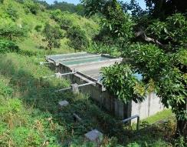
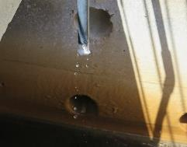
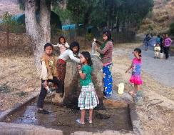

Principles and Practices of Drinking-water Chlorination
A guide to strengthening chlorination practices in
small- to medium-sized water supplies

Slide 2

NOTE TO TRAINER(S):
Delete this slide prior to delivering the presentation.
This PowerPoint presentation and the associated training materials have been developed by the World Health Organization (2017) for adaptation and use by those conducting training on this topic.
All reasonable precautions have been taken to verify the information contained in these materials. However, the material is being distributed without warranty of any kind, either expressed or implied. The responsibility for the interpretation and use of the material lies with the reader. In no event shall the World Health Organization be liable for damages arising from its use.
Notes:
2

Slide 3
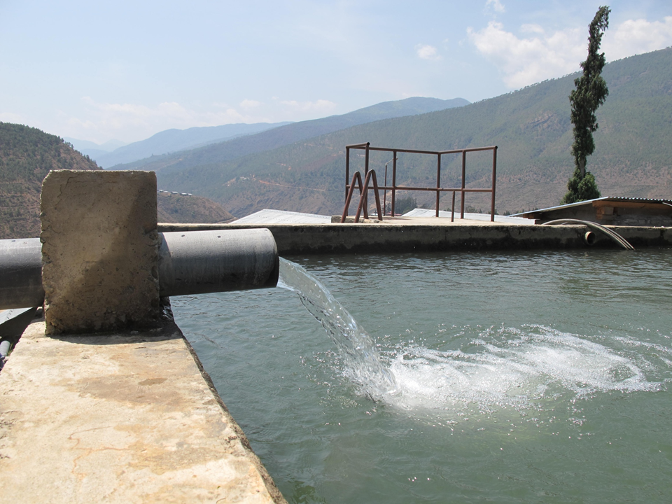
Contents
Part 1. Chlorination Principles
  What is chlorination?
  Properties of chlorine
  Principles of drinking-water chlorination
    - Chlorine dose
    - Types of chlorine present in drinking-water
    - Chlorine demand
    - Chlorine decay
    - Ct concept for disinfection
    - Aesthetic considerations for chlorination
    - Optimizing the chlorine concentration in a water supply system
    - Points of chlorine application
  Summary
Part 2. Practical Chlorination
  Safe handling and storage of chlorine
  Chlorine liquid dosing systems
  Chlorine dosing calculations
  Developing standard operating procedures
  Chlorine monitoring
General Summary

Slide 4
Aim of this training programme
Upon completion of this training course, you will be able to:
understand the key principles of drinking-water chlorination
apply these principles practically in the field
perform the basic calculations required to support effective drinking-water chlorination
develop standard procedures to correctly and consistently chlorinate drinking-water
store and handle chlorine safely

Slide 5
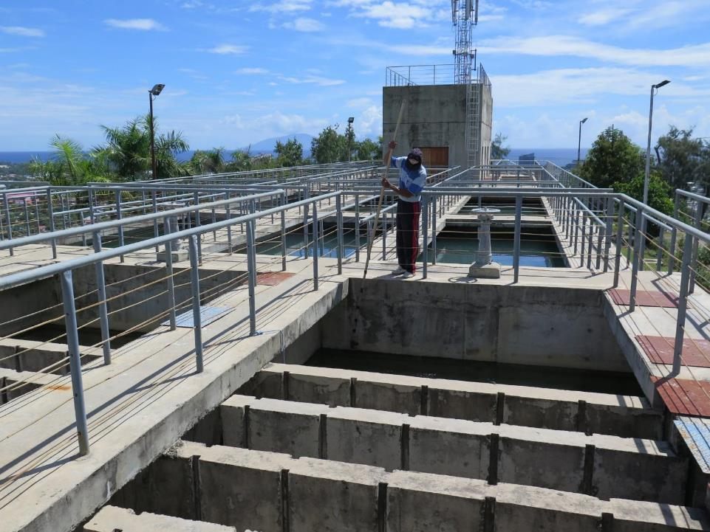
Part 1. Chlorination Principles
Describes the key chlorination concepts in a practical context to provide the necessary understanding for effective chlorination of drinking-water.

Slide 6

Contents
Part 1. Chlorination Principles
  What is chlorination?

Slide 7
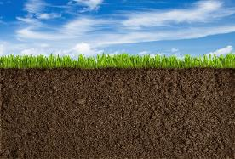
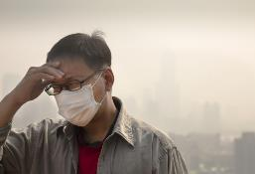

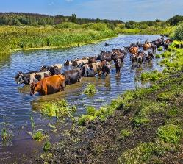
Microorganisms – Found in almost all environments
SOIL
AIR
Microorganisms
DOMESTIC/INDUSTRIAL WASTE
WATER
Photo credit: Shutterstock.com

Slide 8
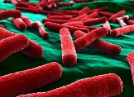
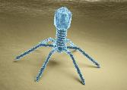
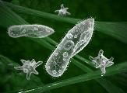
Microorganisms in drinking-water may cause illness
Microorganisms commonly associated with waterborne disease include:
• bacteria (e.g., Escherichia coli, Vibrio cholerae)
• viruses (e.g., Hepatitis A, poliovirus A)
• protozoa (e.g., Cryptosporidium, Giardia).
BACTERIA
VIRUSES
PROTOZOA
Photo credit: Shutterstock.com

Slide 9
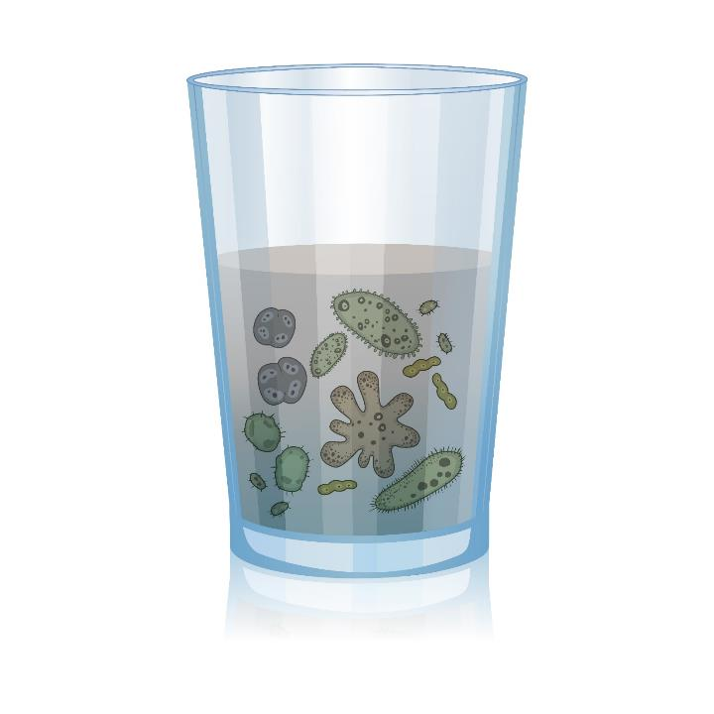
Chlorination
Addition of chlorine disinfectant to drinking-water to kill or inactivate microorganisms
Chlorine is a powerful disinfectant that kills most harmful microorganisms associated with waterborne disease
Chlorine does not kill all harmful microorganisms
Photo credit: Shutterstock.com

Slide 10
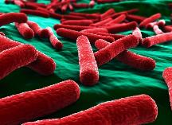
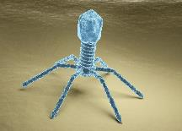
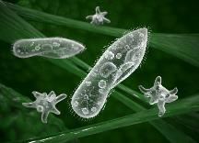
Relative effectiveness of chlorine
SOIL
AIR
BACTERIA
VIRUSES
PROTOZOA
Most effective Effectiveness of chlorine Least effective
SEWAGE
WATERWAYS
Photo credit: Shutterstock.com

Slide 11
Contents
Part 1. Chlorination Principles
  What is chlorination?
  Properties of chlorine

Slide 12
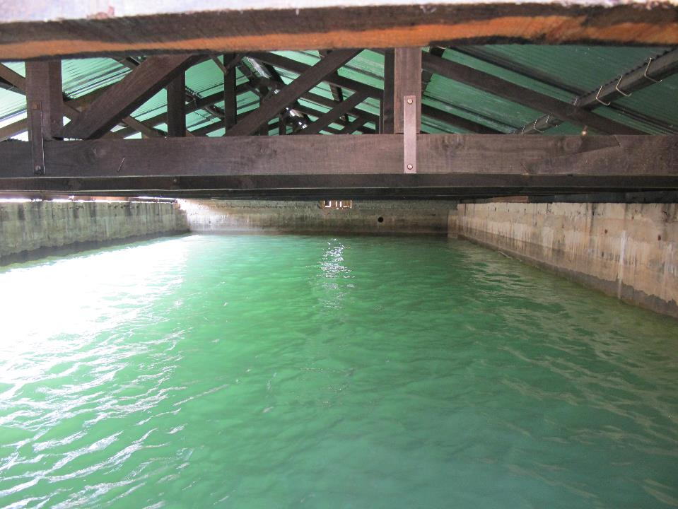
Properties of chlorine
Very reactive
Characteristic odour
Corrosive
May remain in the water after disinfection has occurred
Volatile once exposed to air
(i.e. escapes from water into the air)

Slide 13
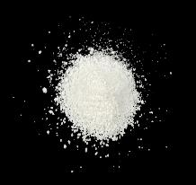
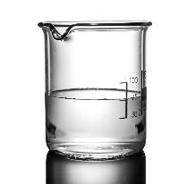
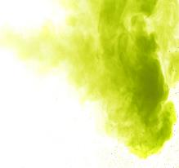
Properties of chlorine
Chlorine may be found in three forms
Powder
Liquid
Gas
Photo credit: Shutterstock.com

Slide 14
How to express the strength of chlorine
Chlorine gas typically contains pure chlorine
Chlorine powder and liquid do not contain pure chlorine
  are mixed with other substances (e.g., calcium, sodium or water)
The strength of chlorine in chlorine powder or chlorine liquid is referred to as the ‘concentration’ of chlorine in that substance
Typically, this is expressed as the percentage (%) of active chlorine present

Slide 15
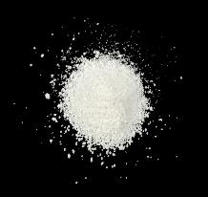
Properties of chlorine: Powder
Appearance: White powder, granules or tablet
Strength: Typically 30 to 70 % active chlorine
Requires mixing with water to make a liquid solution before use (see ‘Chlorine liquid’ below)
Stability: May lose strength over time; more stable than chlorine liquid
Application: Typically used for small-sized water treatment plants (< 5 000 cubic meters per day)
Examples: => Bleaching powder (approx. 35 % active chlorine)
=> High test hypochlorite (approx. 70 % active chlorine)
Powder
Photo credit: Shutterstock.com

Slide 16

Properties of chlorine: Liquid
Appearance: Pale yellow to clear liquid
Strength: Typically 1 to 15 % active chlorine
Stability: May lose strength over time; less stable than chlorine powder
Application: Typically used for small- to medium-sized water treatment plants (i.e., <10 000 cubic meters per day)
Examples: => Sodium hypochlorite (10 to 15 % active chlorine)
=> Domestic bleach (5 to 10 % active chlorine)
=> Chlorine liquid solution prepared from chlorine powder (typically 1 to 5 % active chlorine)
Liquid
Photo credit: Shutterstock.com

Slide 17

Properties of chlorine: Gas
Appearance: Green-yellow gas
Strength: Approx. 100 % active chlorine
Stability: Most stable
Application: Typically used for medium- to large-sized water treatment plants (i.e., >10, 000 cubic meters per day)
Example: Chlorine gas (liquefied)
Gas
Photo credit: Shutterstock.com

Slide 18
Contents
Part 1. Chlorination Principles
  What is chlorination?
  Properties of chlorine
  Principles of drinking-water chlorination
    - Chlorine dose

Slide 19
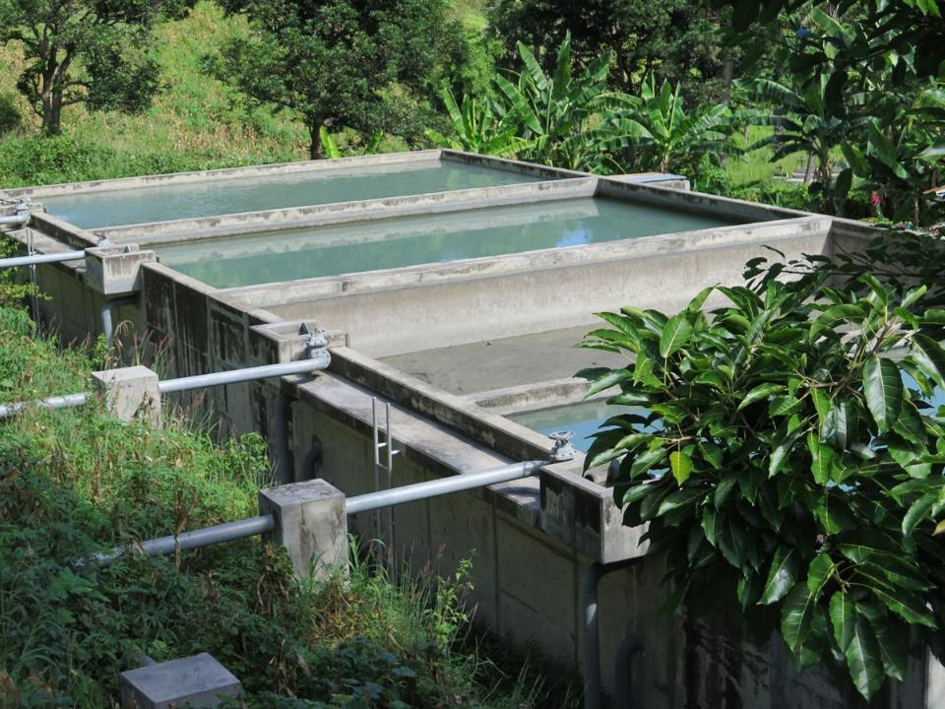
Chlorine dose
How much chlorine is added to the drinking-water (or, the concentration of chlorine in the drinking-water)
Usually expressed as milligrams per litre (mg/L).
  for example, if drinking-water has a chlorine concentration of 1 mg/L, this means that there is 1 milligram of chlorine present in 1 litre of water

Slide 20
Contents
Part 1. Chlorination Principles
  What is chlorination?
  Properties of chlorine
  Principles of drinking-water chlorination
    - Chlorine dose
    - Types of chlorine present in drinking-water

Slide 21
Chlorine reactions in drinking-water
Chlorine Dose
Amount of chlorine added to the water
Chlorine Demand
Chlorine consumed during reaction with organic and inorganic material present
Total Chlorine
Chlorine remaining after chlorine demand has been satisfied and disinfection has occurred
Residual Chlorine
Free chlorine available for disinfection (may prevent recontamination of water)
Combined chlorine
Chlorine bound to organic and nitrogen compounds (weak disinfection capacity)
SEWAGE
WATERWAYS

Slide 22
Residual chlorine (or free chlorine, or free available chlorine)
Chlorine remaining after disinfection has taken place
An effective disinfectant
Presence of residual chlorine indicates that:
    disinfection has occurred
    the disinfected water has a degree of residual protection from microbial recontamination (e.g., during storage and distribution)
  WHO recommends that a minimum residual chlorine concentration of 0.2 mg/L is maintained to the point of delivery to the consumer¹.
¹ World Health Organization (2011). Guidelines for Drinking-water Quality. 4th Edn. Geneva, Switzerland.

Slide 23
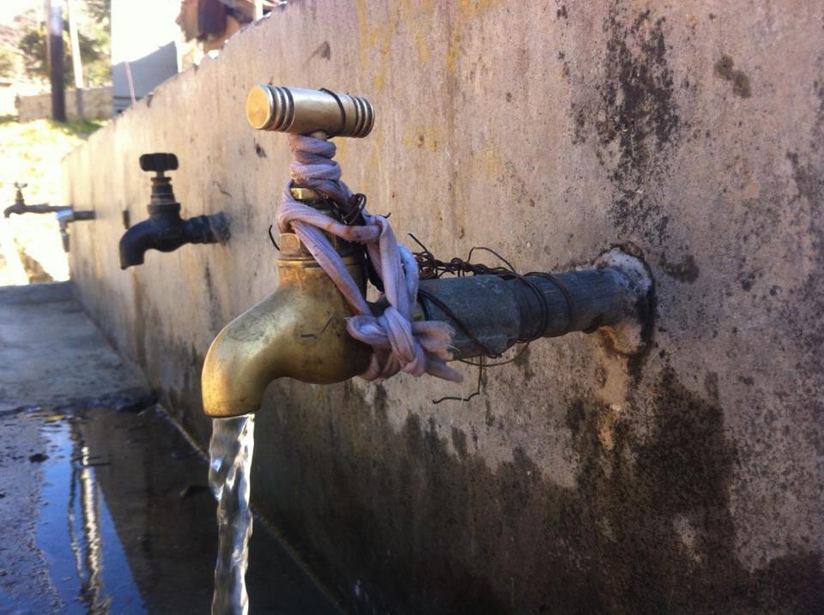
Chlorine demand
When chlorine is added to water, it reacts with any organic and inorganic material (chlorine reactive substances)
  during these reactions, chlorine is consumed
    referred to as the ‘chlorine demand’
  as chorine is consumed during these reactions, the concentration of chlorine decreases

Slide 24
Chlorine demand
It is important to understand how much chlorine will be consumed during the disinfection process:
  This allows you to estimate how much chlorine you need to add to the drinking-water at the water treatment plant to ensure there will be sufficient residual chlorine present in the water to protect the water during storage and distribution

Slide 25
Chlorine demand
Understanding the chlorine demand of the raw water is important for effective disinfection
  if the water has a higher concentration of chlorine reactive substances, the chlorine demand will be higher
  if the water has a lower concertation of chlorine reactive substances, the chlorine demand will be lower

Slide 26
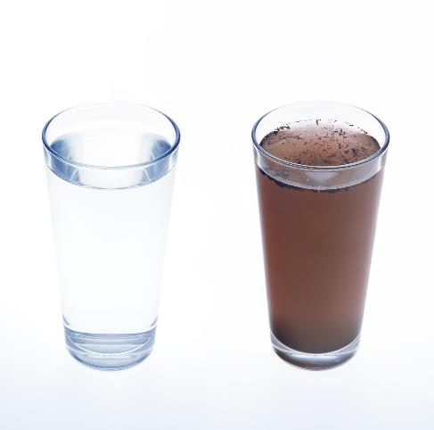
Relationship between chlorine demand & chlorine dose
DIRTY WATER
CLEAN WATER
High concentration of organic & inorganic material
Low concentration of organic & inorganic material
High chlorine demand
(i.e. high chlorine consumption)
Low chlorine demand
(i.e. low chlorine consumption)
WATERWAYS
Photo credit: Shutterstock.com

Slide 27
Chlorine demand
Chlorine demand of water is constantly changing
  Changes as water quality changes
Examples of events that influence the chlorine demand include….

Slide 28
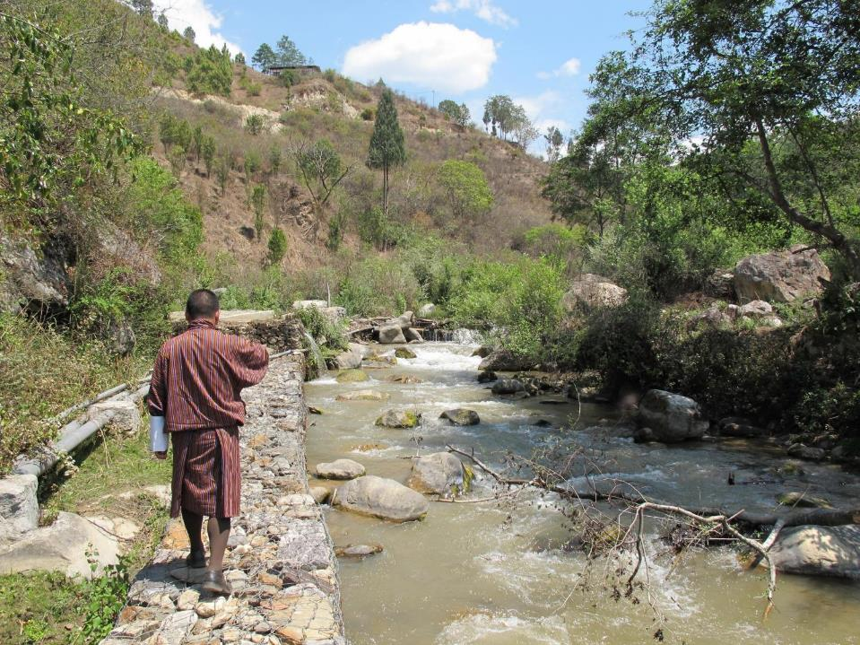
Seasonal changes in the raw water quality (e.g. dry/wet season, algal blooms, floods, landslides, bushfires)

Slide 29
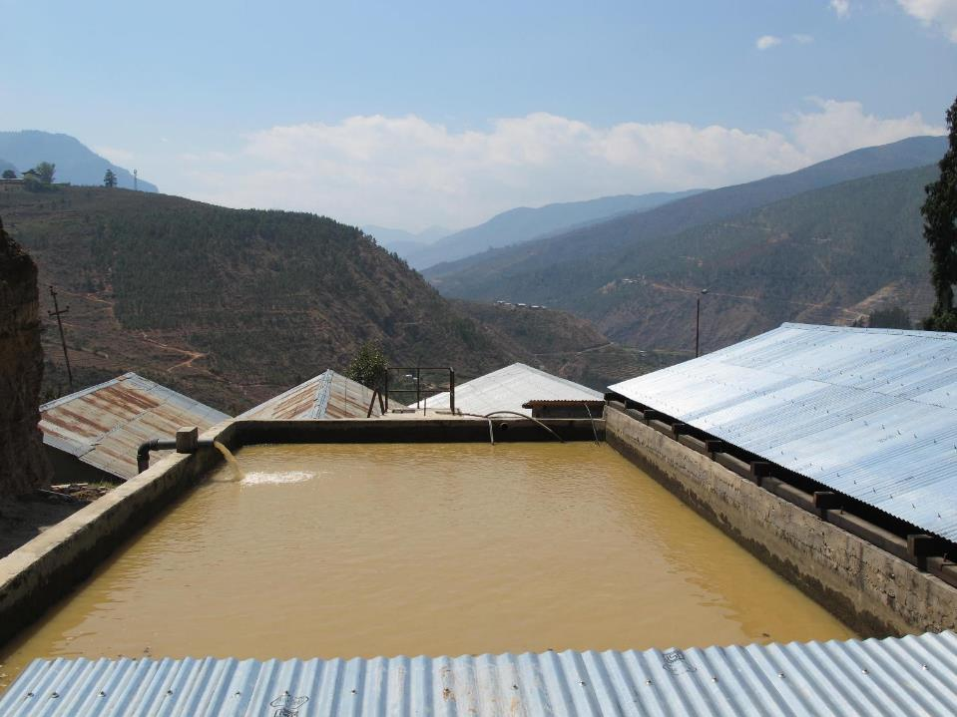
Failure of a water treatment process (e.g. sedimentation, filtration)

Slide 30
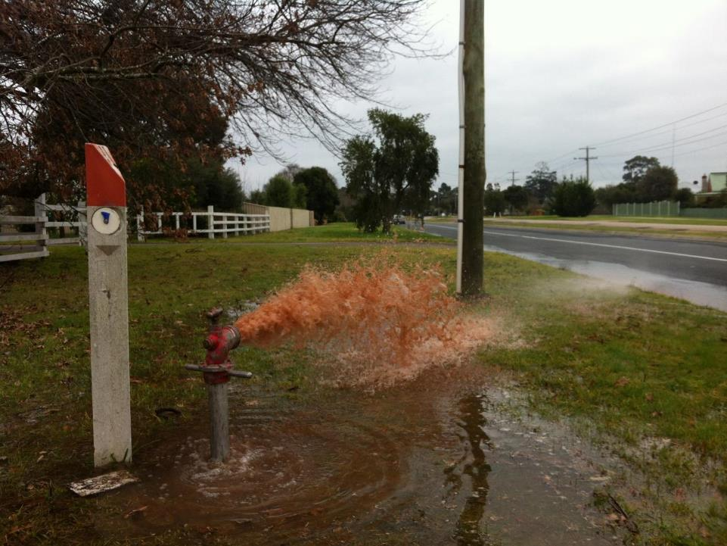
Introduction of contamination post treatment (e.g. leaking/bust water main, accumulation of sediment or microbial biofilm within water mains)

Slide 31
Chlorine demand
Consideration of the chlorine demand is most important at the water treatment plant, immediately prior to the addition of chlorine
Where practical, chlorine demand is a useful parameter to monitor
Where routine monitoring is not practical, you should be aware of the impact of changing raw water quality (i.e. changing chlorine demand) on the required chlorine dose
E.g. poorer water quality => higher chlorine demand => higher chlorine dose required

Slide 32
Contents
Part 1. Chlorination Principles
  What is chlorination?
  Properties of chlorine
  Principles of drinking-water chlorination
    - Chlorine dose
    - Types of chlorine present in drinking-water
    - Chlorine demand
    - Chlorine decay

Slide 33
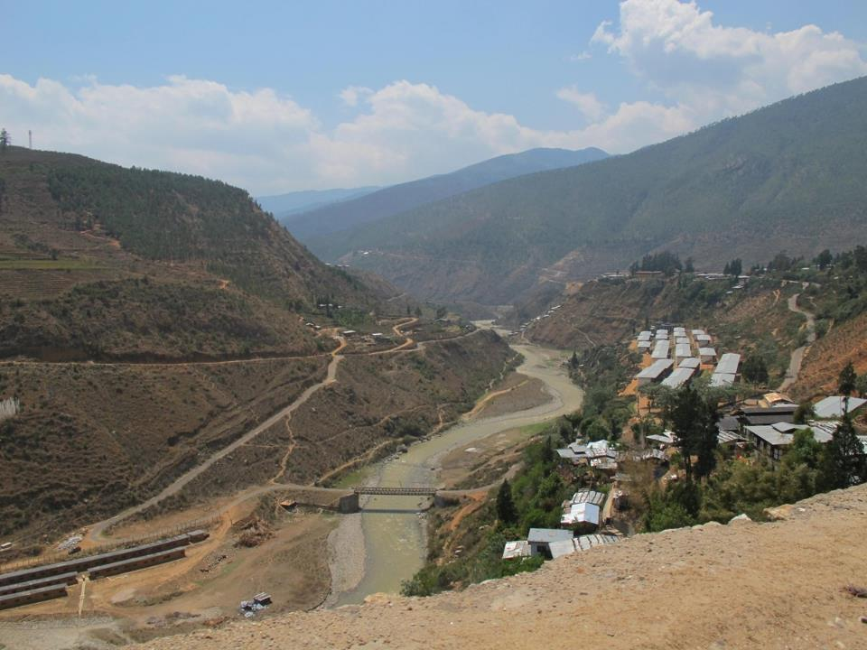
Chlorine decay
=> The decrease (or reduction) in the concentration of chlorine in drinking-water as it passes from the water treatment plant, through the distribution system, to the point of consumer delivery
Due to chlorine decay, the concentration of chlorine at the end of the distribution system will usually be less then the concentration at the water treatment plant

Slide 34
Chlorine decay
The rate and extent of chlorine decay may be influenced by:
  the level of chlorine reactive substances that are present in the treated water as well as the distribution tanks and pipes (i.e., organic and inorganic material)
  the type of material used in the distribution network tanks, pipes and fittings
  how long the water remains in the distribution system (or the ‘water age’)

Slide 35
Chlorine decay
Sediment accumulation
CHLORINE CONCENTRATION:
1.0 mg/L
Water Treatment Plant
Intermediate Storage Tank
FILTRATION
CHLORINATION
CHLORINE CONCENTRATION:
0.7 mg/L
SOURCE WATER
DISTRIBUTION SYSTEM
CHLORINE CONCENTRATION:
0.5 mg/L
BRANCH C
BRANCH A
BRANCH B
Unclean pipes/
Biofilm
BRANCH D
CHLORINE CONCENTRATION:
0.0 mg/L
Low usage area
CHLORINE CONCENTRATION:
0.2 mg/L
WATERWAYS
CHLORINE CONCENTRATION:
0.0 mg/L

Slide 36
Understanding the chlorine demand and chlorine decay of your water supply system is important:
    helps you to determine the correct chlorine dose at the water treatment plant
Remember, must dose enough chlorine at the water treatment plant to ensure you have ≥ 0.2 mg/L at the point of consumer delivery.

Slide 37
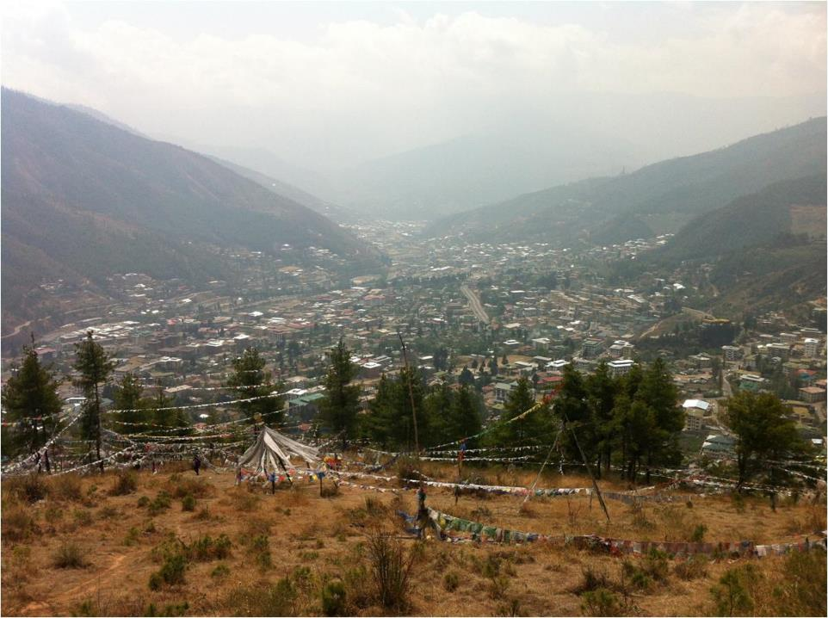
Strategies to minimize chlorine decay in a water supply system
Optimize water treatment process to ensure high quality treated water (i.e., water entering the distribution system has a low chlorine demand)
Maintain intermediate storages and distribution pipes (e.g., for removal of accumulated sediment and microbial biofilms)
Optimize the hydraulic regime during distribution (i.e., minimise water age and low-flow/stagnant areas)
Minimize unaccounted water (i.e., leaks, illegal connections) which may be vulnerable points for entry of contamination
Aim for 24 hours supply (where feasible) to maintain positive pressure in the system to minimize risks of contamination entry

Slide 38
Contents
Part 1. Chlorination Principles
  What is chlorination?
  Properties of chlorine
  Principles of drinking-water chlorination
    - Chlorine dose
    - Types of chlorine present in drinking-water
    - Chlorine demand
    - Chlorine decay
    - Ct concept for disinfection

Slide 39
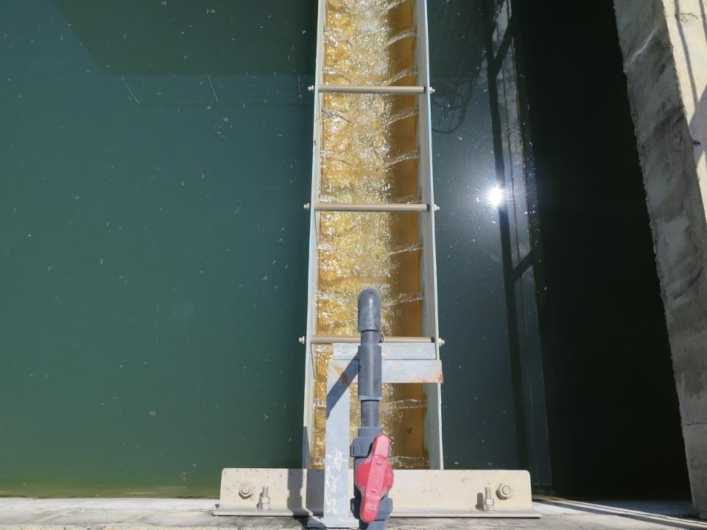
Ct concept for disinfection
Chlorine requires time to kill or inactive microorganisms during disinfection
this is referred to as ‘contact time’
The contact time must be considered in conjunction with the chlorine concentration and other factors, to ensure that effective disinfection of drinking-water occurs
    this is referred to as the ‘Ct’ concept for disinfection
  The Ct value is the product of disinfectant concentration and contact time with the drinking-water
  Ct = Residual Chlorine Concentration (mg/L) x Time of Contact (min)

Slide 40
Factors influencing the Ct value
1. Chlorine concentration
3. pH of water
2. Temperature of water
Ct value

Slide 41
Influence of chlorine concentration on disinfection
MORE contact time needed
LESS
contact time needed
Low
(<0.4 mg/L)
RESIDUAL CHLORINE
High
(>3 mg/L)

Slide 42
Influence of water temperature on disinfection
MORE
contact time or higher chlorine concentration needed
LESS
contact time or lower chlorine concentration needed
Cooler
(<5 ºC)
WATER TEMPERATURE
Warmer
(>20 ºC)

Slide 43

Influence of pH on disinfection
pH measures if the water is acid or alkaline (or basic)
  measured on a scale of pH 0 to pH 14
  pH 7 considered neutral, pH <7 considered acidic and pH >7 considered alkali
pH Scale
LESS
contact time or lower chlorine concentration needed
ACIDIC
NEUTRAL
ALKALI
MORE
contact time or higher chlorine concentration needed
Optimum pH for drinking-water

Slide 44
Influence of pH on disinfection
For effective chlorination, the pH of the water should be < pH 8.0
However
To balance water quality considerations, including chlorination, the optimum pH of drinking-water is generally between pH 6.5 and pH 8.5
  Where water is >pH 8.0, higher chlorine concentrations or more contact time will be required!

Slide 45
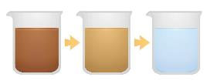
Turbidity may also indirectly impact contact time
Suspended organic/inorganic particles in water
  gives water an opaque (or cloudy) appearance
Turbidity may influence the effectiveness of chlorine disinfection
  indicates the presence of chlorine reactive substances, which may react with and consume chlorine, thereby increasing the chorine demand
  May also ‘shields’ microorganisms from the lethal/inactivating effects of chlorine
MORE
contact time or higher chlorine concentration needed
LESS
contact time or lower chlorine concentration needed
TURBIDITY
Low
High
1000 NTU
1 NTU
Photo credit: Shutterstock.com

Slide 46
Type of microorganism and chlorine disinfection
SOIL
AIR
BACTERIA
VIRUSES
PROTOZOA
LESS
contact time or lower chlorine concentration needed
MORE
contact time or higher chlorine concentration needed
Most effective Least effective
SEWAGE
WATERWAYS
Photo credit: Shutterstock.com

Slide 47
Minimum required contact time for effective disinfection
How much contact time is needed for effective disinfection?
  For effective disinfection, the WHO¹ recommends at least 30 minutes contact time, where the residual chlorine concentration is ≥0.5 mg/L and the pH of the water is <pH 8.
Minimum recommendation only – should determined on a site-specific basis (more to follow on this in Part 2…)
¹ World Health Organization (2011). Guidelines for Drinking-water Quality. 4th Edn. Geneva, Switzerland.

Slide 48
Contents
Part 1. Chlorination Principles
  What is chlorination?
  Properties of chlorine
  Principles of drinking-water chlorination
    - Chlorine dose
    - Types of chlorine present in drinking-water
    - Chlorine demand
    - Chlorine decay
    - Ct concept for disinfection
    - Aesthetic considerations for chlorination

Slide 49
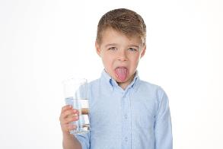
Aesthetic considerations (i.e. relating to taste or odour)
Chlorine may result in a distinctive taste & odour in drinking-water
  different individuals vary in their ability to detect chlorine taste/odour
  in general, chlorine has a taste/odour threshold >0.3 mg/L
If chlorine is present in drinking-water at concentrations that are unacceptable to consumers:
  may result in an individual using alternative, less safe, water sources
Photo credit: Shutterstock.com

Slide 50
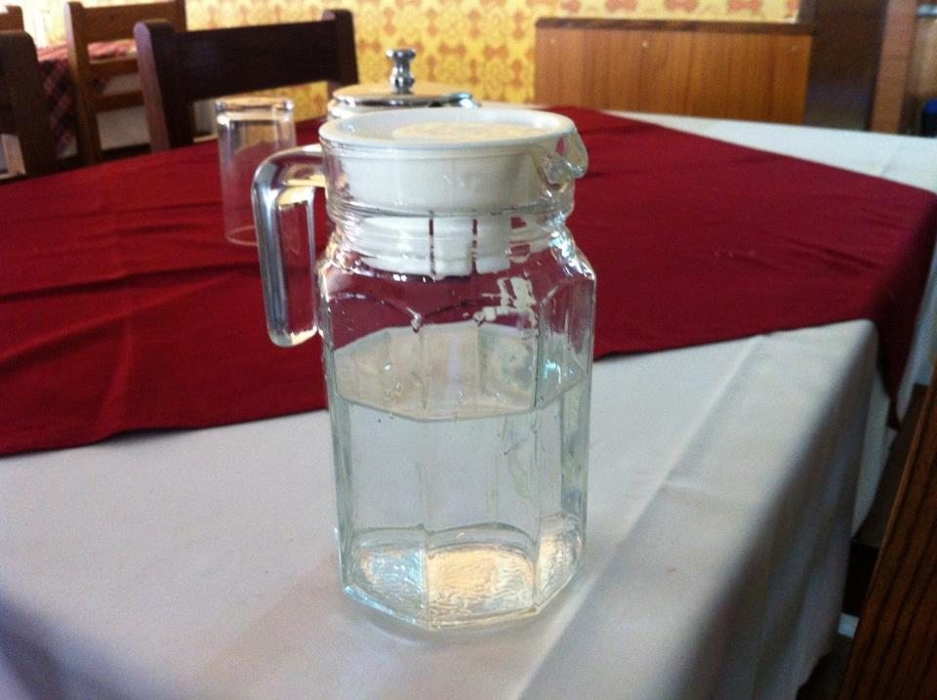
Aesthetic considerations (i.e. relating to taste, odour, appearance)
For this reason the aesthetic impact of chlorine on drinking-water should be considered when optimizing the chlorine dose
HOWEVER…
Disinfection should always be prioritized over aesthetic considerations!!!

Slide 51
Aesthetic considerations
To balance effective disinfection against aesthetic considerations:
  a residual chlorine concentration of between 0.2 to 0.5 mg/L should be targeted at all points in the distribution network
However, this may need to be higher in certain circumstances, to ensure a minimum residual chlorine concentration of 0.2 mg/L is maintained to the point of consumer delivery
  discussed further in next section…

Slide 52
Contents
Part 1. Chlorination Principles
  What is chlorination?
  Properties of chlorine
  Principles of drinking-water chlorination
    - Chlorine dose
    - Types of chlorine present in drinking-water
    - Chlorine demand
    - Chlorine decay
    - Ct concept for disinfection
    - Aesthetic considerations for chlorination
    - Optimizing the chlorine concentration in a water supply system

Slide 53
Optimizing the chlorine dose
Requires balancing the following key considerations…
OPTIMUM CHLORINE DOSE
Adequate Disinfection at the Water Treatment Plant
Adequate Residual Disinfection Capacity during Storage & Distribution
Customer Acceptability

Slide 54
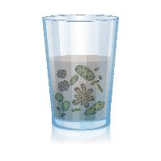

Optimizing the chlorine dose
Too low
(<0.2 mg/L)
RESIDUAL CHLORINE CONCENTRATION
Too high
(e.g. >1.5 mg/L)
Risk of microbial contamination
Aesthetically unacceptable
Photo credit: Shutterstock.com

Slide 55

Optimizing the chlorine dose
Priority must always be to add sufficient chlorine such that:
  The minimum required contact time for effective disinfection is achieved
  The residual chlorine concentration at all points in distribution system is ≥0.2 mg/L
To balance effective disinfection against consumer acceptability considerations:
  a residual chlorine concentration of between 0.2 to 0.5 mg/L in the distribution network should be targeted
Effective disinfection and residual protection should always be prioritized over aesthetic considerations

Slide 56
Optimizing the chlorine dose
May need to maintain a higher residual chlorine concentration in some parts of the distribution system to ensure a minimum residual chlorine concentration of 0.2 mg/L is achieved throughout the entire system
  for example, having a higher residual chlorine earlier in the system
  this may be needed to maintain an adequate residual chlorine concentration at the very end of the distribution system

Slide 57
Optimizing the chlorine dose
CHLORINE CONCENTRATION:
1.2 mg/L
CHLORINE CONCENTRATION:
1.0 mg/L
Water Treatment Plant
Intermediate Storage Tank
FILTRATION
CHLORINATION
CHLORINE CONCENTRATION:
0.9 mg/L
CHLORINE CONCENTRATION:
0.7 mg/L
CHLORINE CONCENTRATION:
0.7 mg/L
SOURCE WATER
DISTRIBUTION SYSTEM
CHLORINE CONCENTRATION:
0.5 mg/L
BRANCH C
BRANCH A
BRANCH B
BRANCH D
CHLORINE CONCENTRATION:
0.2 mg/L
CHLORINE CONCENTRATION:
0.0 mg/L
CHLORINE CONCENTRATION:
0.4 mg/L
CHLORINE CONCENTRATION:
0.2 mg/L
Current chlorine dose at the water treatment plant is too low to maintain >0.2 mg/L at all points in the distribution system
Increased chlorine dose at the water treatment plant ensures >0.2 mg/L is maintained at all points in the distribution system
CHLORINE CONCENTRATION:
0.2 mg/L
WATERWAYS
CHLORINE CONCENTRATION:
0.0 mg/L

Slide 58
Contents
Part 1. Chlorination Principles
  What is chlorination?
  Properties of chlorine
  Principles of drinking-water chlorination
    - Chlorine dose
    - Types of chlorine present in drinking-water
    - Chlorine demand
    - Chlorine decay
    - Ct concept for disinfection
    - Aesthetic considerations for chlorination
    - Optimizing the chlorine concentration in a water supply system
    - Points of chlorine application

Slide 59
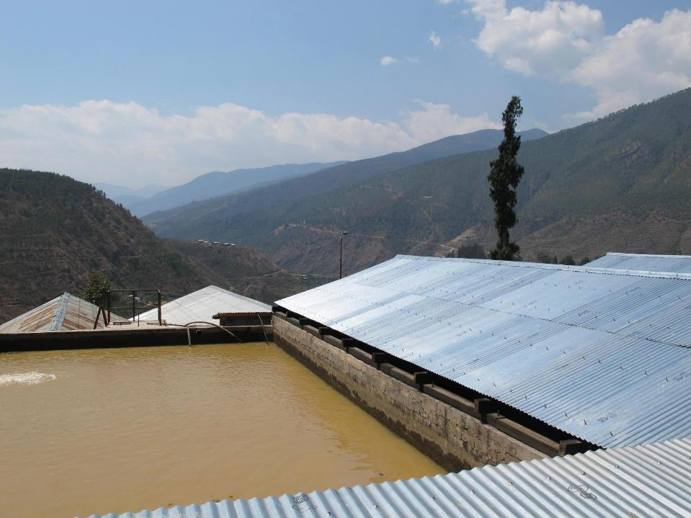
Points of chlorine dosing
Chlorine may be added:
Pre-chlorination (before water treatment plant)
Primary chlorination (after water treatment process)
Secondary chlorination (during distribution)
1. Pre-chlorination
2. Primary chlorination
3. Secondary chlorination
Water Treatment Plant
Distribution Network

Slide 60
Points of chlorine dosing
Pre-chlorination (before water treatment plant)
  used to remove minerals (e.g. Iron, manganese)
  chlorine makes them insoluble (particulate)
  can be removed during water treatment (filtration)
  can also remove taste/odour
Potential issues:
  raw water may have a high chlorine demand which requires high chlorine dose (high operational cost)
  formation of disinfection by-products in high organic waters
Pre-chlorination
Water Treatment Plant
Distribution Network

Slide 61
Points of chlorine dosing
2. Primary chlorination (after water treatment)
  used for disinfection; most common & effective point of application
  most effective to add chlorine when turbidity is as low as possible – ideally <1 NTU (i.e., after clarification, filtration)
  clean, filtered water so lower chlorine demand
    use less chlorine
    less risk of disinfection by-product formation
      Disinfection should not be compromised in attempting to control disinfection by-products
Primary chlorination
Water Treatment Plant
Distribution Network
4/01/2024
61

Slide 62
Points of chlorine dosing
3. Secondary (‘booster’) chlorination
  used to maintain sufficient chlorine concentration during distribution to protect the water from recontamination i.e. ≥0.2 mg/L
  ‘booster station’ adds more chlorine to the water at strategic points during distribution when the chlorine concentration is too low i.e. <0.2 mg/L
  helps keep the water safe to the very end of the distribution system
  common in large distribution networks
Secondary chlorination
Water Treatment Plant
Distribution Network

Slide 63
Contents
Part 1. Chlorination Principles
  What is chlorination?
  Properties of chlorine
  Principles of drinking-water chlorination
    - Chlorine dose
    - Types of chlorine present in drinking-water
    - Chlorine demand
    - Chlorine decay
    - Ct concept for disinfection
    - Aesthetic considerations for chlorination
    - Optimizing the chlorine concentration in a water supply system
    - Points of chlorine application
  Summary

Slide 64
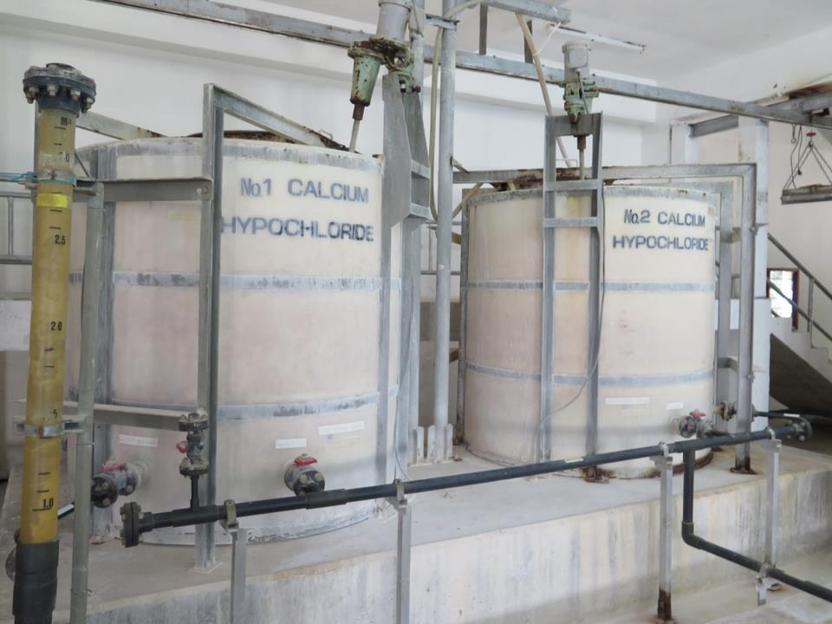
Summary of the optimal conditions required for effective chlorination
Turbidity: <1 NTU (lower where possible)
(where < 1 NTU is not possible, <5 NTU should be the aim; above 5 NTU, disinfection should still be practised, but higher chlorine doses or contact times will be required to inactivate harmful microorganisms)
pH: <pH 8.0
(Above pH 8.0, chlorination should still be practised but higher chlorine doses or contact times will be required to inactivate harmful microorganisms)
Minimum contact time: 30 minutes contact time with a minimum residual chlorine concentration of 0.5 mg/L, where the pH of the water is <pH 8.

Slide 65
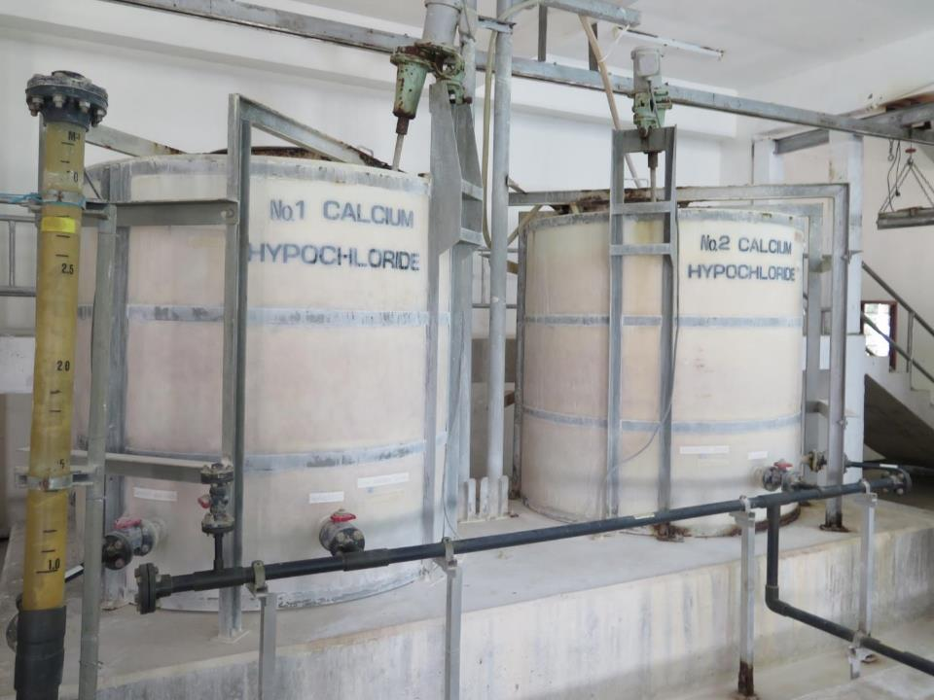
Summary of the optimal conditions required for effective chlorination
A minimum residual chlorine concentration of 0.2 mg/L must always be maintained to the point of consumer delivery
The residual chlorine concentration during distribution to the point of delivery should aim to be between 0.2 to 0.5 mg/L
    may need to be higher than 0.5 mg/L in particular circumstances to ensure that a minimum residual chlorine concentration of 0.2 mg/L is always maintained
The concentration of chlorine in water supplied to consumers should always be <5 mg/L

Slide 66
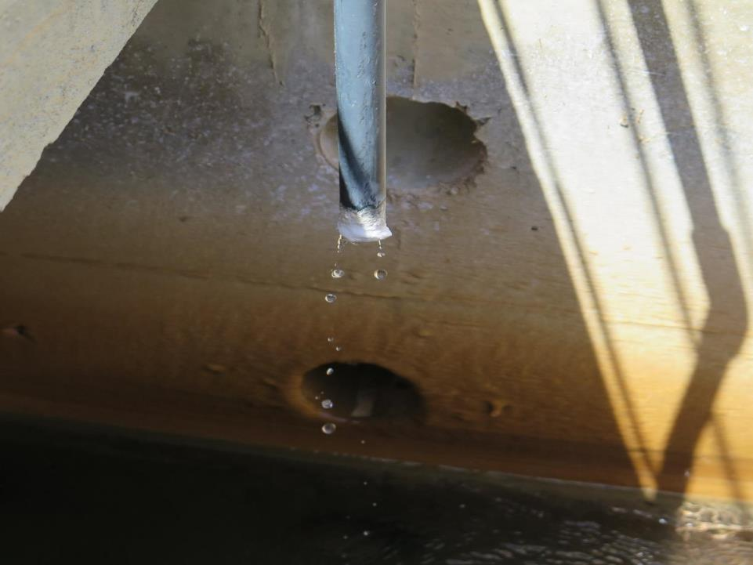
Part 2. Practical Chlorination
Applies key chlorination principles into practice, describing safe and effective procedures for drinking-water chlorination.

Slide 67
Contents
Part 2. Practical Chlorination
  Safe handling and storage of chlorine
  Chlorine liquid dosing systems
  Chlorine dosing calculations
    How to calculate the chlorine demand
    How to calculate the Ct value
    How to calculate the required chlorine dose
    How to calculate the amount of chlorine powder required to make a chlorine liquid solution
    How to calculate the chlorine dose rate
  Developing standard operating procedures
  Chlorine monitoring
General Summary

Slide 68
Contents
Part 2. Practical Chlorination
  Safe handling and storage of chlorine

Slide 69
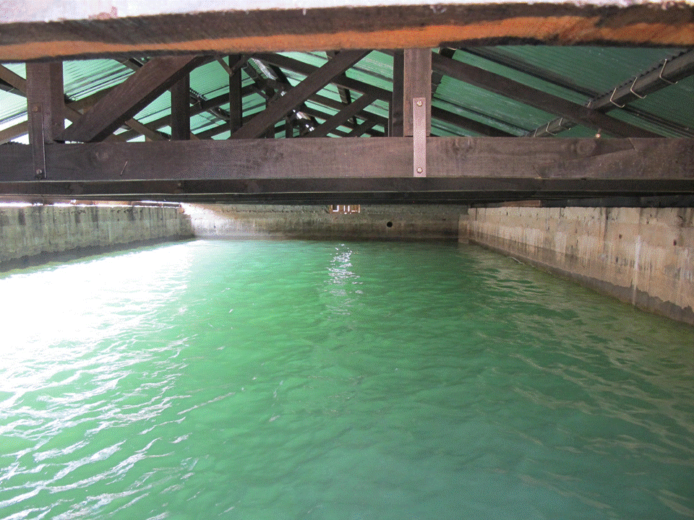
Remember…Properties of chlorine
Very reactive
Characteristic odour
Corrosive
May remain in the water after disinfection has occurred (i.e. residual protection)
Volatile once exposed to air

Slide 70
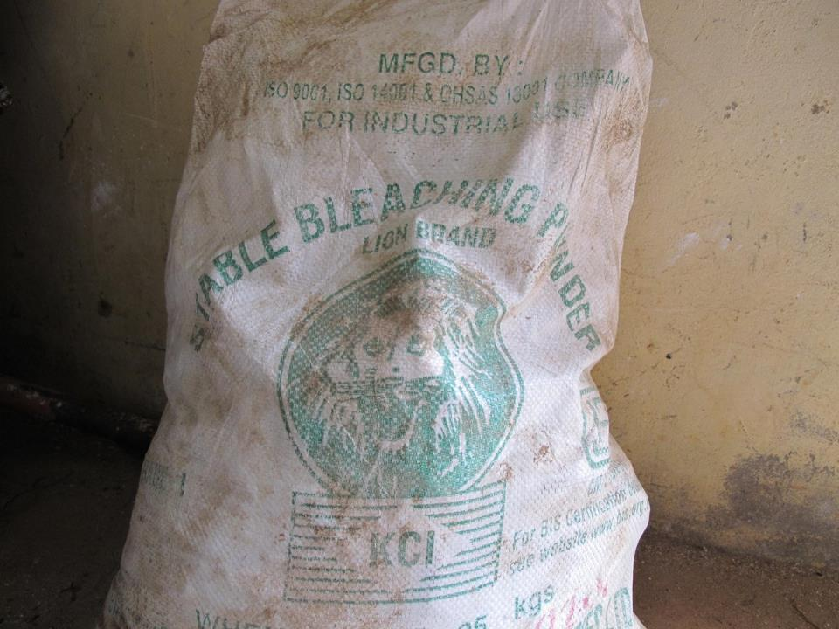
Safe handling and storage of chlorine powder & liquid
Contact with concentrated forms of chlorine may result in irritation, chemical burns and even death
  => contact includes clothes, skin, eyes, mouth and inhalation into the lungs
=> Protecting the health and safety of staff is critical
All staff in contact with chlorine must receive basic training in:
  the required personal protective equipment (PPE)
  precautions to be exercised when handling and storing different forms of chlorine, alongside
  basic first-aid measures in the event of accidental contact

Slide 71


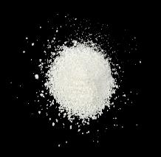


Chlorine powder: Protective personal equipment required for handling
Wear gloves
Wear overalls
Wear a dust mask
Wear safety glasses
GLOVES
OVERALLS
DUST MASK
SAFETY GLASSES
Photo credit: Shutterstock.com

Slide 72

Chlorine liquid: Protective personal equipment required for handling
Wear gloves
Wear overalls
Wear a face shield
GLOVES
OVERALLS
FACE SHIELD
Any enclosed building used for storage or preparation of chlorine should always be well ventilated.
If chlorine aerosols, mists, vapours or dust are not adequately controlled by ventilation, appropriate respiratory protection should be considered.
Photo credit: Shutterstock.com

Slide 73

Powder & liquid chlorine may lose strength over time
For example…
0
months
12
months
New bag
35 % chlorine
Old bag
e.g. 30 % chlorine

Slide 74
Powder & liquid chlorine may lose strength over time
Chlorine liquid solutions are generally less stable than chlorine powder (i.e., lose strength more quickly)
Type of chlorine (approx. % active chlorine concentration) |  | Loss of initial active chlorine concentration (%)^{1, 2, 3}
Chlorine powder | Bleaching powder (35 %) | 5 to 18 % after 40 days
 | High test hypochlorite (70 %)
Chlorine liquid | Sodium hypochlorite (15 %) | 50 % after 100 days
 | Sodium hypochlorite (10 %) | 50 % after 220 days
 | Sodium hypochlorite (5 %) | 50 % after 790 days
Source:
¹World Health Organisation. Calcium hypochlorite. Fact Sheet 2.19. http://www.who.int/water_sanitation_health/hygiene/emergencies/fs2_19.pdf?ua=1 visited on 13 July, 2015.
²World Health Organisation. Sodium hypochlorite. Fact Sheet 2.20. http://www.who.int/water_sanitation_health/hygiene/emergencies/fs2_20.pdf?ua=1 visited on 13 July, 2015.
³American Water Works Association (2006). Chlorination/chloramination practices and principles. AWWA Manual M20. 2nd Edn. Colorado, United States of America.

Slide 75
Powder & liquid chlorine may lose strength over time
May have important implications for water quality:
  if the chlorine powder or liquid is less concentrated, the risk of chlorine under-dosing may exist (i.e., not adding enough chlorine for effective disinfection)
      may present a microbiological water quality risk
Appropriate chlorine storage practices must be in place to:
  minimize the rate and extent of chorine degradation during storage, and
  protect staff safety

Slide 76
Chlorine powder and liquid: Appropriate storage practices
Store in a cool, dry, well ventilated place in air-tight containers
Store away from sunlight
Do not store for excessive periods of time (i.e., many months, years)
Store in chlorine resistant containers
Keep containers closed/sealed when not in use
Check for container leaks/spills regularly
Avoid contact and breathing in chlorine powder dust or chlorine liquid splashes/mists/aerosols
Always mark and date new chlorine stock individually
Use ‘First In First Out’ stock management principles

Slide 77
Contents
Part 2. Practical Chlorination
  Safe handling and storage of chlorine
  Chlorine liquid dosing systems

Slide 78
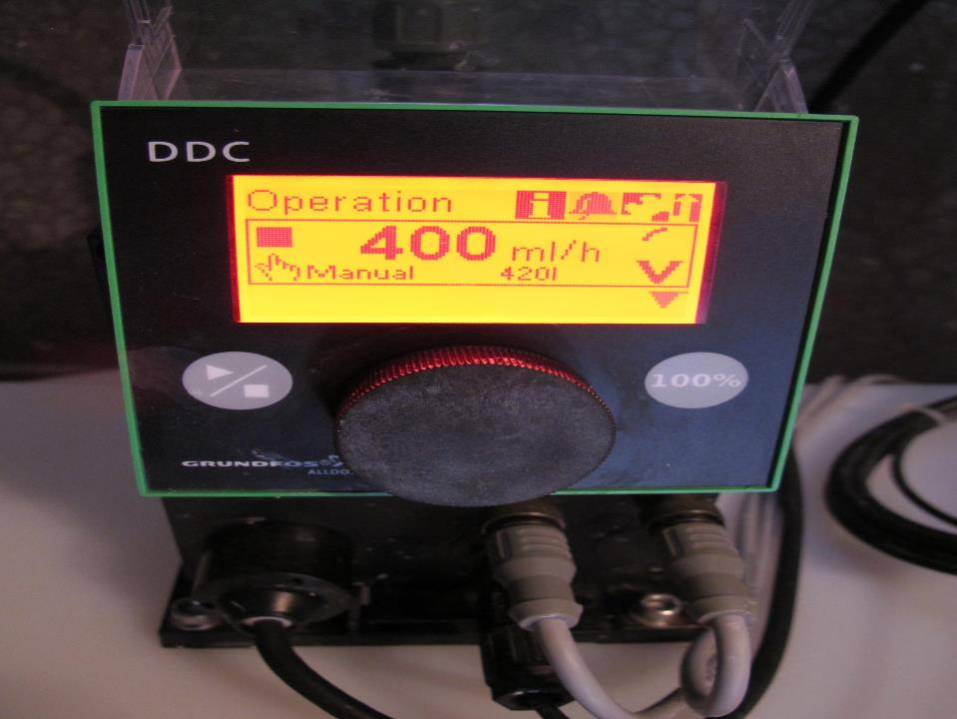
Chlorine liquid dosing systems
Used to dose chlorine liquid into the drinking-water
Two options:
Non-pump-based systems (e.g., gravity)
Pump-based systems

Slide 79
1. Non-pump based dosing systems
System¹ | Basis | Comments
Drip-feed chlorinators | Feeds a constant rate of drops of chlorine liquid solution using a constant head device to maintain the drip feed | Assume constant water flow rate (inaccurate dosing if flow rate changes) Suitable for small supplies Risk of siphoning must be managed
¹World Health Organisation. Dosing hypochlorite solutions. Fact Sheet 2.22. http://www.who.int/water_sanitation_health/hygiene/emergencies/fs2_22.pdf?ua=1 visited on 12 August, 2015.
Credit: World Health Organization

Slide 80
1. Non-pump based dosing systems
System¹ | Basis | Comments
Constant head aspirator | Drips a constant rate of chlorine liquid solution using an aspirator and glass tube | Simple, robust device Durable if given appropriate basic maintenance Easy installation Coarse and fine drip-rate control possible Assume constant water flow rate (inaccurate dosing if flow rate changes)
Chlorine tank
¹World Health Organisation. Dosing hypochlorite solutions. Fact Sheet 2.22. http://www.who.int/water_sanitation_health/hygiene/emergencies/fs2_22.pdf?ua=1 visited on 12 August, 2015.
Credit: World Health Organization

Slide 81
1. Non-pump based dosing systems
System¹ | Basis | Comments
Gravity feeder | Relies on gravity and a metering orifice/valve to control the flow of chlorine liquid solution | Requires a second tank and ball valve to maintain constant head pressure
¹World Health Organisation. Dosing hypochlorite solutions. Fact Sheet 2.22. http://www.who.int/water_sanitation_health/hygiene/emergencies/fs2_22.pdf?ua=1 visited on 12 August, 2015.
Credit: World Health Organization

Slide 82

1. Non-pump based dosing systems
Lower cost
Simple to operate and maintain (no mechanical parts, servicing)
Not suitable for larger capacity water supply systems
Less accurate and less operational control
=> greater risk of chlorine under-/over-dosing
Suitable for small supplies, limited resource settings

Slide 83
2. Pump-based dosing systems
Vary in their complexity and design….

Slide 84
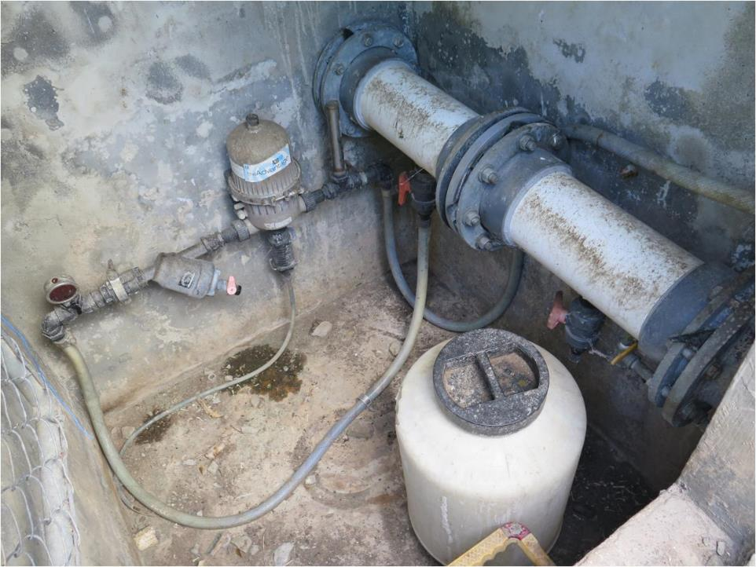
2. Pump-based dosing systems: More basic
Pulsation dampner
Filtered water flow
Dosing pump
Pressure gauge
Carry water
Strainer
Injection point
Chlorine feed line
Chlorine tank
84

Slide 85
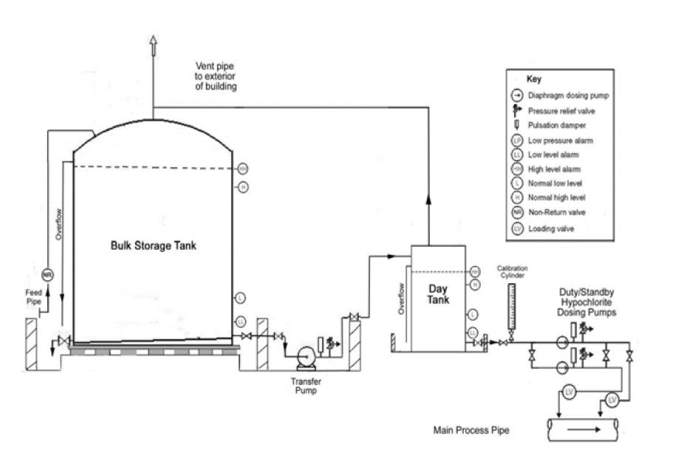
2. Pump-based dosing systems: More advanced
Vent
Vent
Inlet
Inlet
HH
High level alarms
High level alarms
H
Overflow
Bulk Storage Tank
Bulk storage tank
Calibration
Column
HH
Calibration
Column
Day
Tank
Day
tank
Dose Pump (Duty/Standby)
Feed pipe
Overflow
H
Dose Pump (Duty/Standby)
L
Low level alarms
Low level alarms
Sloped Floor
L
Sloped floor
LL
LL
Pressure relief valve
Pressure relief valve
Drain
Drain
Transfer Pump
Transfer pump
Pulsation dampner
Pulsation dampner
LV
Injection Points
LV
Filtered water flow
Load valves
Filtered water flow
Main process pipe
Adapted from: Environment Protection Agency (2011). Water treatment manual: Disinfection. Wexford, Ireland.
Load valves
Credit: Environment Protection Agency, Ireland
85

Slide 86
2. Pump-based dosing systems
Allow much greater accuracy and operational control
  may be linked to control signals (e.g. flow-paced, residual trim and associated alarming)
  less risk of chlorine under-/over-dosing
More costly
Require maintenance, servicing and parts
  may require specialised technician and supply chain for parts
Recommended where resources permit

Slide 87
Contents
Part 2. Practical Chlorination
  Safe handling and storage of chlorine
  Chlorine liquid dosing systems
  Chlorine dosing calculations
    How to calculate the chlorine demand

Slide 88
Remember….Chlorine demand
Reaction between chlorine and any organic and inorganic material (chlorine reactive substances) present in the water
  During these reactions, chlorine is consumed
  Residual chlorine in the water decreases
Important to understand the chlorine demand of the raw (untreated) water to optimise the chlorine dose

Slide 89
How to calculate the chlorine demand (Eq. 1)
Chlorine Demand (mg/L) = Actual Chlorine Dose (mg/L) - Total Residual Chlorine (mg/L)
Example:
If the actual chlorine dose is 3 mg/L
The total residual chlorine is 1 mg/L (after 30 minutes contact time), then using Eq. 1:
Chlorine Demand (mg/L) = 3 mg/L - 1 mg/L
= 2 mg/L

Slide 90
Contents
Part 2. Practical Chlorination
  Safe handling and storage of chlorine
  Chlorine liquid dosing systems
  Chlorine dosing calculations
    How to calculate the chlorine demand
    How to calculate the Ct value

Slide 91
Remember…. Ct value
Ct is calculated as follows:
Residual chlorine concentration (C) x Contact time (t)
Where:
Residual chlorine: Concentration of residual chlorine (in mg/L)
Contact time: Amount of time (in minutes) there is contact between the chlorine and the water (e.g. detention time in a storage tank, reservoir, or pipe)

Slide 92
How to calculate the detention time for a storage
Detention time (min) = Storage volume (m³) ÷ Flow (m³/min)
Tank volume = 200 m³
Flow = 5 m³/min
Detention time = 200 m³ ÷ 5 m³/min
= 40 min

Slide 93
How to calculate the Ct value (Eq. 2)
Ct (min.mg/L) = Residual chlorine concentration (mg/L) x Contact time (min)
Example:
Residual chlorine concentration is 0.5 mg/L
Tank has a detention time of 40 minutes, then using Eq. 2:
Ct (min.mg/L) = 0.5 mg/L x 40 min
= 20 min.mg/L

Slide 94
Minimum recommended Ct value
WHO¹ recommends a minimum contact time of 30 minutes where the residual chlorine is 0.5 mg/L and the pH is <8
(i.e., 15 min.mg/L)
However, Ct values should be determined on a site specific basis, considering:
  the temperature of the water
  the pH of the water
  turbidity of the water
  ‘short-circuiting’ within the storage (that is, the potential for preferential flow and reduced mixing/detention time)
A more detailed example for accurately determining the minimum required Ct value using Ct tables is presented in Toolbox C of the accompanying guide
¹ World Health Organization (2011). Guidelines for Drinking-water Quality. 4th Edn. Geneva, Switzerland.

Slide 95
Contents
Part 2. Practical Chlorination
  Safe handling and storage of chlorine
  Chlorine liquid dosing systems
  Chlorine dosing calculations
    How to calculate the chlorine demand
    How to calculate the Ct value
    How to calculate the required chlorine dose

Slide 96
How to calculate the required chlorine dose (Eq. 3)
Required Chlorine Dose (mg/L) = Chlorine Demand (mg/L) + Desired Residual Chlorine (mg/L)
Example:
The chlorine demand is known to be 2 mg/L
The desired residual chlorine is 1 mg/L, then using Eq. 3:
Required chlorine dose (mg/L) = 2 mg/L + 1 mg/L
= 3 mg/L

Slide 97
Contents
Part 2. Practical Chlorination
  Safe handling and storage of chlorine
  Chlorine liquid dosing systems
  Chlorine dosing calculations
    How to calculate the chlorine demand
    How to calculate the required chlorine dose
    How to calculate the amount of chlorine powder required to make a chlorine liquid solution

Slide 98
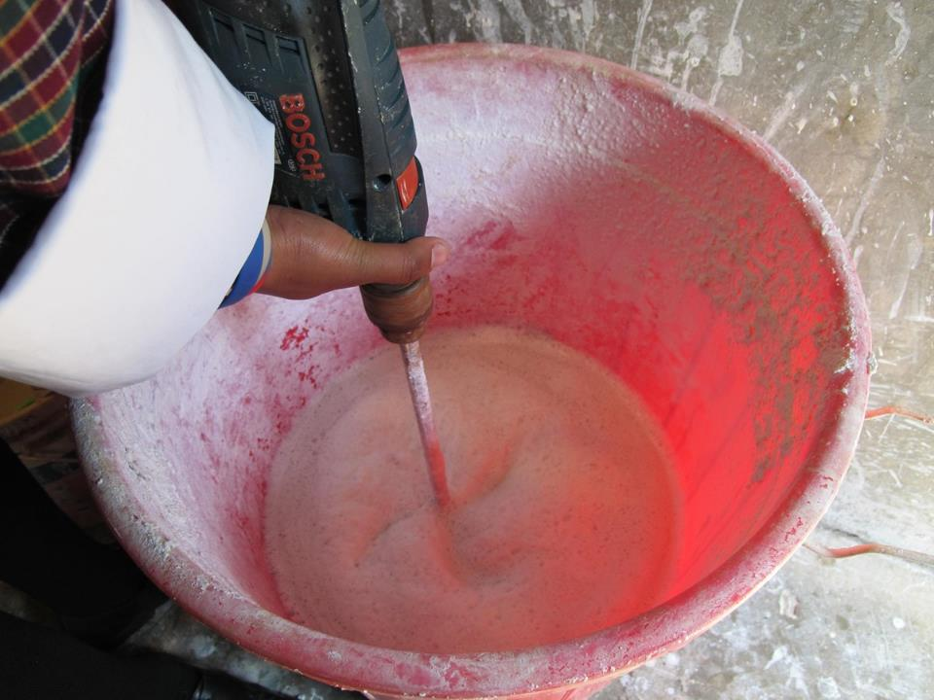
Preparing chlorine liquid from chlorine powder
Establish which type of chlorine powder is in use:
  bleaching powder – typically 35 % active chlorine, or
  high test hypochlorite typically 70 % active chlorine
=> if unsure, contact supplier or manufacturer
Consider the age and storage conditions of the chlorine powder
concentration of active chlorine in the chlorine powder may be less than expected if old stock is in use and/or stock has been stored inappropriately

Slide 99
Preparing chlorine liquid from chlorine powder
Determine what concentration you wish to prepare the chlorine liquid solution:
  typically chlorine liquid solutions are made between 1 and 5 % active chlorine
  higher concentrations of liquid solutions may be prepared in certain circumstances (e.g., pump or bulk storage capacity limitations)
    may result in accumulation of undissolved sediment (or ‘sludge’) from inert material present in the powder (risk of blockages)
    requires appropriate settling time for undissolved sediment and decanting
Appropriate concentration and volume of chlorine liquid solution to be prepared must be determined on a specific basis

Slide 100
How to calculate the required amount of chlorine powder (Eq. 4)
Weight of chlorine powder (mg/L) =
1 000 x Volume of chlorine liquid required (L) x Desired chlorine liquid concentration (%) Active chlorine concentration in the chlorine powder (%)
Example:
Require 500 L of chlorine liquid solution
Require chlorine liquid concentration to be 2 % active chlorine
Using bleaching powder (35 % active chlorine), then using Eq. 4:
Weight of chlorine powder (mg/L) = 1 000 x 500 L x 2 %
35%
= 28 571 g (or 28.6 kg) per 500 L of water

Slide 101
Preparing chlorine liquid from chlorine powder
Generally require two containers:
One for mixing and settling of undissolved sediment (e.g., up to 24 hours settling time)
One for decanting settled solution into for storage and dosing
World Health Organisation. Calcium hypochlorite. Fact Sheet 2.19. http://www.who.int/water_sanitation_health/hygiene/emergencies/fs2_19.pdf?ua=1 visited on 13 July, 2015.
Credit: World Health Organization

Slide 102
Summary of Steps for Preparing Chlorine Liquid from Chlorine Powder
1. Determine what strength chlorine powder you are using
2. Determine the concentration you want the chlorine liquid solution to be
Typically liquid chlorine solutions between 1 to 5 % active chlorine is used
3. Determine how much chlorine powder must be added to prepare the desired chlorine solution
Determine the total volume of liquid chlorine solution required
4. Mix chlorine powder in the desired volume of water in an appropriate container
Bleaching powder ~35 % active chlorine, or
Allow sufficient time for the undissolved powder to settle
High test hypochlorite ~ 70 % active chlorine
May be higher in certain situations
Calculate amount of chlorine powder required for this volume using Equation 4
Pour off (decant) the liquid chlorine solution
Ready to use ☺

Slide 103
Contents
Part 2. Practical Chlorination
  Safe handling and storage of chlorine
  Chlorine liquid dosing systems
  Chlorine dosing calculations
    How to calculate the chlorine demand
    How to calculate the Ct value
    How to calculate the required chlorine dose
    How to calculate the amount of chlorine powder required to make a chlorine liquid solution
    How to calculate the chlorine dose rate

Slide 104
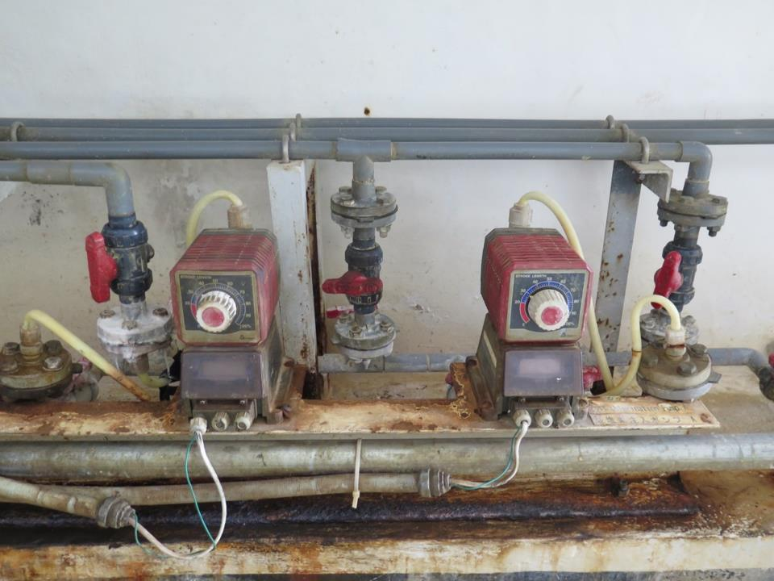
Chlorine dose rate
‘Chlorine dose rate’ means how much chlorine liquid solution you are adding to the water over time
May be measured in various ways
  mL per second
  mL per minute
  L per hour

Slide 105
How to calculate the chlorine dose rate (Eq. 5)
Chlorine Dose Rate (mL/h) = Required chlorine dose (mg/L) x Treated water flow rate (m³/h) Chlorine liquid concentration (%) ÷ 100
Example:
Require 3 mg/L chlorine dose (see Eq. 3)
Flow rate at the water treatment plant is 100 cubic meters per hour (100 m³/h)
Chlorine liquid concentration is 2 % (see Eq. 4), then using Eq. 5:
Chlorine Dose Rate (mL/h) = 3 mg/L x 100 m³/h
2 % ÷ 100
= 15 000 mL/h (or 250 mL/min)

Slide 106
How to calculate the actual chlorine dose (Eq. 6)
May rearrange Eq. 5 to determine actual chlorine dose; useful for determining chlorine demand (Eq. 1)
Actual Chlorine Dose (mg/L) =
[Chlorine dose rate (mL/h) x Chlorine liquid concentration (%)] ÷ 100 Flow rate (m³/h)
Example:
Chlorine dose rate is 6 000 mL/h
Chlorine liquid concentration is 2 % (see Eq. 4)
Flow rate at the water treatment plant is 100 cubic meters per hour (100 m³/h) then using Eq. 6:
Actual Chlorine Dose (mg/L) = (6 000 mL/h x 2 %) ÷ 100
100 m³/h
= 1.2 mg/L

Slide 107
Adjusting the chlorine dose
Always adjust stepwise (i.e., in small increments)
    do not make large adjustments all at once or you risk over-/under-dosing
Always consider time taken for water to turn-over in the tank or pipe before additional adjustments are made
    e.g. may take 2 days for higher chlorinated water to reach a particular monitoring point in the distribution system
    make sure the tank/pipe/section of network is completely replenished with ‘new’ water with the adjusted chlorine dose
Increase the frequency of chlorine monitoring following:
    changes in the chlorine dose
    preparation/delivery of a new batch of chlorine liquid
4/01/2024
107

Slide 108
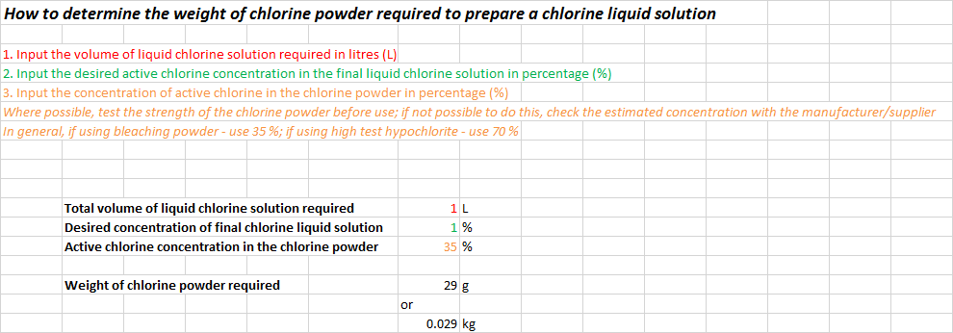
Chlorine Dosing Cheat Sheet
For a quick and easy way to perform chlorine dosing calculations, see the ‘Chlorine Dosing Cheat Sheet’ described in Toolbox B
  prompts you to input the required information
  automatically performs the calculation
Example:
108

Slide 109
Contents
Part 2. Practical Chlorination
  Safe handling and storage of chlorine
  Chlorine liquid dosing systems
  Chlorine dosing calculations
    How to calculate the chlorine demand
    How to calculate the Ct value
    How to calculate the required chlorine dose
    How to calculate the amount of chlorine powder required to make a chlorine liquid solution
    How to calculate the chlorine dose rate
  Developing standard operating procedures

Slide 110
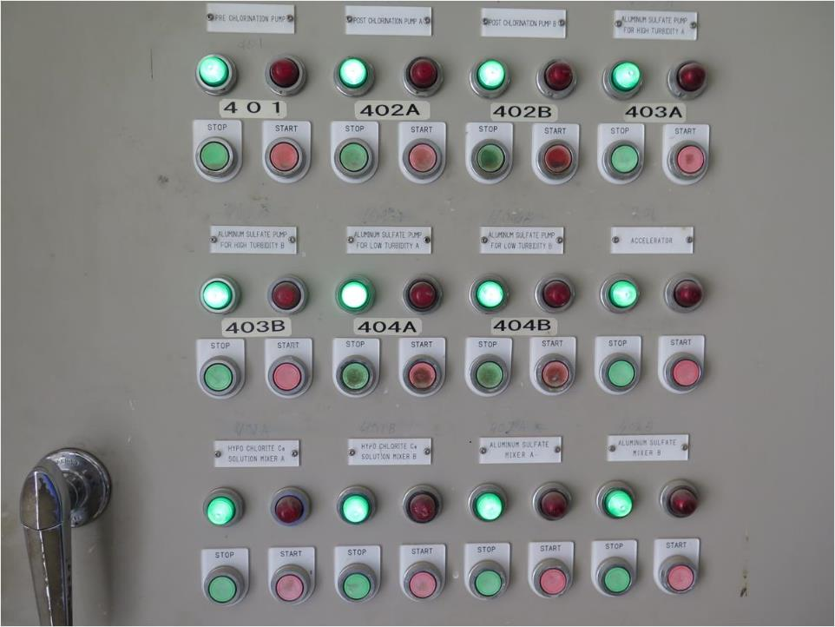
Standard operating procedures (SOPs)
To be developed for any operational tasks that are performed routinely, including chlorination
Help operational staff perform duties safely, correctly and with consistency
Include important safety information
Examples of information that should be included within SOPs for chlorination….

Slide 111
Suggested SOPs for chlorination
Calculating the weight of chlorine powder required to make a chlorine liquid batch
Preparing a batch of chlorine liquid from chlorine powder
Calculating the chlorine dose
=> suggested content for each of this is presented on the following slides…

Slide 112
SOP: Calculating the weight of chlorine powder required to make a chlorine liquid batch
PPE required for safe completion of the task
The type of chlorine powder to be used (e.g., bleaching powder or high test hypochlorite)
The desired solution strength of the chlorine liquid being prepared (e.g., 1 % chlorine liquid solution)
The volume of chlorine liquid solution to be prepared
The calculation used to determine the weight of chlorine powder required
=> For an example see Generic SOP 1 and 2 (Toolbox A)

Slide 113
SOP: Preparing a batch of chlorine liquid from chlorine powder
PPE required for safe completion of the task
The unit weight of chlorine powder required to prepare a batch of liquid chlorine (e.g., 35 g of bleaching powder per litre of water)
The receptacle that the solution will be mixed in (e.g., dedicated concrete tank or a plastic container)
The means by which the powder will be mixed with the water (e.g., a dedicated mixing device)
The amount of settling time required following mixing and before use
The appropriate chlorine storage conditions
=> For an example see Generic SOP 3 (Toolbox A)

Slide 114
SOP: Calculating the chlorine dose
PPE required for safe completion of the task
The calculation used to determine the chlorine dose rate based on the strength of the chlorine liquid solution and the water treatment plant flow rate
Precautions to be taken when adjusting the dose rate (including increased monitoring of the chlorine concentration in the drinking-water following adjustment)
=> For an example see Generic SOP 4 (Toolbox A)

Slide 115
Other chlorination SOPs may include…
Chlorine stock management
Operation and maintenance of chlorine dose pumps
Emergency response procedure in the event of accidental human contact or release to the environment
Emergency response procedure in the event of accidental human contact or release to the environment

Slide 116
Contents
Part 2. Practical Chlorination
  Safe handling and storage of chlorine
  Chlorine liquid dosing systems
  Chlorine dosing calculations
    How to calculate the chlorine demand
    How to calculate the Ct value
    How to calculate the required chlorine dose
    How to calculate the amount of chlorine powder required to make a chlorine liquid solution
    How to calculate the chlorine dose rate
  Developing standard operating procedures
  Chlorine monitoring (operational monitoring)

Slide 117
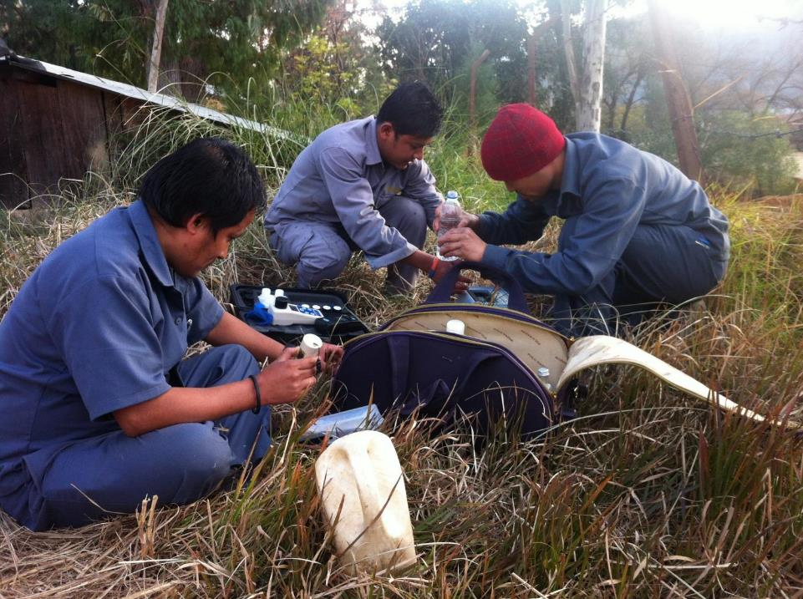
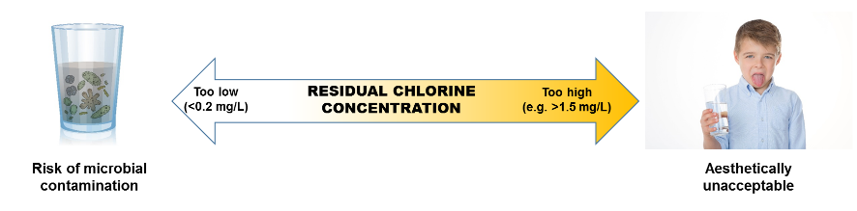
Chorine monitoring (operational monitoring)
Careful monitoring and optimization of the chlorine concentration through the water supply system is critical:
  ensures that sufficient chlorine is added to the water for adequate disinfection and residual protection from recontamination
  minimizing risks of consumer acceptability issues (i.e., taste, odour)
Photo credit: Shutterstock.com

Slide 118
Chorine monitoring
Should be performed as part of Operational Monitoring
  simple, routine checks to confirm that the measures in place to manage water quality risk are operating effectively (i.e., control measures)
  critical limits determine the point at which the control measures is no longer working within an acceptable range
  corrective actions are then required to restore correction functioning of the control measure and minimise the risk of unsafe water supply

Slide 119
Operational monitoring is different to verification monitoring
WSP monitoring
Operational monitoring
Asks: Is the control measure effectively working now?
Observations (e.g. visual inspection)
Water sampling and testing
(by the supplier to inform operational decisions)
Verification
Asks: Is the WSP, as a whole, working effectively to deliver safe and acceptable drinking water?
Compliance monitoring
(to confirm compliance with standards; by supplier and surveillance agency)
Audits
consumer surveys
SOIL
AIR
SEWAGE
WATERWAYS
Acknowledgement: Darryl Jackson; Angella Rinehold

Slide 120
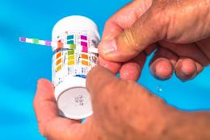


Examples of equipment for chorine monitoring
Chlorine test strips
Chlorine comparator
Chlorine meter
ACCURACY/RESOLOUTION
$$$$$$$$$$$$
Photo credit: Shutterstock.com

Slide 121
Chorine testing equipment
Test Equipment | Cost | Accuracy/ Resolution | Advantages | Disadvantages
Chlorine test strips | M | L | Easy to use, disposable No calibration/servicing required | Poor degree of resolution (e.g., may only measure in 0.5 mg/L increments) Visual measurement (colour change); open to user interpretation Requires supply chain for replacement strips
Chlorine comparator test kit | M | M | Easy to use Durable for field use No calibration/servicing required | Visual measurement (colour change); open to user interpretation Requires reagents (DPD powder), supply chain
Chlorine meter | H | H | High degree of resolution over a wide range (0.05 to 10 mg/L in 0.01 mg/L increments) Easy to use | Less durable for field use Calibration/servicing required Requires reagents, replacement parts (bulb), supply chain
L - Low; M - Medium; H - High.

Slide 122
Chorine monitoring
Chlorine monitoring locations in the distribution system should include:
  the start, middle and end of the distribution network
  known water quality trouble spots (that is, where poor water quality has been historically found, such as the end-points of the network, low-flow areas and dead legs)
Number of sample points and the frequency of sampling will differ depending on the specific circumstances of the water supply system
  should be sufficient to manage the risk of sub-optimal chlorination

Slide 123
Chorine monitoring
Chlorine monitoring should generally occur (for sample point reference, see next slide):
  immediately after chlorine has been added to the water (dosed water; SP1)
  after contact time has elapsed (SP2)
  at the point of entry to the distribution system (SP3)
  throughout the distribution system to the point of consumer delivery (including storage tanks, reservoirs; for example, SP4 to 10; Note - number of sample points will differ depending on the specific circumstances of the water supply system)
  at a frequency that is appropriate to manage the risk of sub-optimal chlorine concentration in the particular drinking-water supply

Slide 124
Example chorine monitoring locations in a water supply system
Source
WATER TREATMENT PLANT
CLARIFICATION
FILTRATION
CONTACT
TANK (30 min)
TREATED WATER STORAGE
SP1
SP2
SP3
CHLORINE
DISTRIBUTION SYSTEM
INTERMEDIATE STORAGE TANK
SP4
SP9
SP5
SP7
SP10
SP8
SP6

Slide 125
Chorine monitoring
Feedback of data from chlorine operational monitoring is essential to ensure that the chlorine dose is being optimized
  Chlorine operational monitoring data will indicate if:
    Chlorine dose at the water treatment plant needs to be optimized
    Potential changes in raw/treated water quality
    Potential presence of contamination in storage or distribution
    Likelihood of recontamination during delivery to consumer

Slide 126
Contents
Part 2. Practical Chlorination
  Safe handling and storage of chlorine
  Chlorine liquid dosing systems
  Chlorine dosing calculations
    How to calculate the chlorine demand
    How to calculate the Ct value
    How to calculate the required chlorine dose
    How to calculate the amount of chlorine powder required to make a chlorine liquid solution
    How to calculate the chlorine dose rate
  Developing standard operating procedures
  Chlorine monitoring
General Summary

Slide 127

Chlorine summary…
Chlorine is added to water to kill microorganisms
=> kills most microorganisms in a short time
=> not all microorganisms will be killed by chlorine
4/01/2024
www.egwater.vic.gov.au
127

Slide 128
Chlorine summary…
Chlorine is very reactive
reacts with microorganisms, organic material, sediment, pipe material
4/01/2024
www.egwater.vic.gov.au

Slide 129
Chlorine summary…
Chlorine decay is the decrease in the concentration of chlorine in a water supply system
for this reason, the chlorine concentration decreases in the distribution system
4/01/2024
www.egwater.vic.gov.au
129

Slide 130
Chlorine summary…
Chlorine demand indicates how much chlorine will be consumed during chlorine reactions
helps inform what chlorine dose is required for effective disinfection
if water has high chlorine demand it consumes more chlorine and needs a high chlorine dose
if water has low chlorine demand it consumes less chlorine and needs a low chlorine dose
4/01/2024
www.egwater.vic.gov.au
130

Slide 131
Chlorine summary…
Chlorine residual is the concentration of free chlorine remaining after the chlorine demand has been satisfied and disinfection has taken place
critically important water quality parameter for public health
implies that there is residual protection from recontamination from microorganisms during storage/distribution
residual chlorine concentration should always be ≥0.2 mg/L at the point of delivery to the consumer
4/01/2024
www.egwater.vic.gov.au
131

Slide 132
Chlorine summary…
Chlorine contact time is the amount of time required for effective disinfection to take place
a minimum Ct value of 15 min.mg/L (where pH <8.0) is required in all cases
this is 30 minutes contact time with a residual chlorine concentration of 0.5 mg/L
minimum required Ct value should be determined on a case-by-case basis (see Appendix C of the accompanying manual)
4/01/2024
www.egwater.vic.gov.au
132

Slide 133
Chlorine summary…
Ct value is influenced by:
pH
temperature
chlorine concentration
turbidity
4/01/2024
www.egwater.vic.gov.au
133

Slide 134
Chlorine summary…
All forms of chlorine are dangerous to handle
must be handled safely
Powder: Overalls, gloves, safety glasses, dust mask
Liquid: Overalls, gloves and face shield
4/01/2024
www.egwater.vic.gov.au
134

Slide 135
Chlorine summary…
Chlorine will lose strength over time during storage
chlorine must be stored appropriately
good stock management principles should be applied
4/01/2024
www.egwater.vic.gov.au
135

Slide 136
Chlorine summary…
Conditions required for effective disinfection
Turbidity: <1 NTU (lower where possible)
(where < 1 NTU is not possible, <5 NTU should be the aim; above 5 NTU, disinfection should still be practised, but higher chlorine doses or contact times will be required to inactivate harmful microorganisms)
pH: <pH 8.0
(Above pH 8.0, chlorination should still be practised but higher chlorine doses or contact times will be required to inactivate harmful microorganisms)
Minimum contact time: 30 minutes contact time with a minimum residual chlorine concentration of 0.5 mg/L, where the pH of the water is <pH 8.

Slide 137
Chlorine summary…
Once chlorination at the water treatment plant is complete, the residual chlorine concentration during distribution to the point of delivery should aim to be between 0.2 to 0.5 mg/L.
a minimum residual chlorine concentration of 0.2 mg/L must always be maintained at the point of delivery
The concentration of chlorine in water supplied to consumers should always be <5 mg/L

Slide 138

Summary…
For sections references, please refer to the accompanying guide

Slide 139

any
questions...
Photo credit: Shutterstock.com

Slide 140
Quiz
Multiple choice…..
4/01/2024
140

Slide 141
Quiz
Q.1) Chlorine is added to water to:
Make it taste better
Kill/inactivate harmful microorganisms
Improve the pH
Remove turbidity
4/01/2024
141

Slide 142
Quiz
Q.1) Chlorine is added to water to:
Make it taste better
Kill/inactivate harmful microorganisms
Improve the pH
Remove turbidity
4/01/2024
142

Slide 143
Quiz
Q.2) Microorganisms may be found in:
Soil
Water
Sewage
All of the above
4/01/2024
143

Slide 144
Quiz
Q.2) Microorganisms may be found in:
Soil
Water
Sewage
All of the above
4/01/2024
144

Slide 145
Quiz
Q.3) Chlorine will kill/inactivate:
All microorganisms
Some microorganisms
Only bacteria
No microorganisms
4/01/2024
145

Slide 146
Chlorination Theory and Practice: Assessment
Q.3) Chlorine will kill/inactivate:
All microorganisms
Some microorganisms
Only bacteria
No microorganisms
4/01/2024
146

Slide 147
Quiz
Q.4) Over time, chlorine powder and liquid will:
Never lose strength
lose strength
Gain strength
Combine to give chlorine gas
4/01/2024
147

Slide 148
Quiz
Q.4) Over time, chlorine powder and liquid will:
Never lose strength
lose strength
Gain strength
Combine to give chlorine gas
4/01/2024
148

Slide 149
Quiz
Q.5) Chlorine will react with:
Microorganisms
Other organic material
Inorganic material
All of the above
4/01/2024
149

Slide 150
Quiz
Q.5) Chlorine will react with:
Microorganisms
Other organic material
Inorganic material
All of the above
4/01/2024
150

Slide 151
Quiz
Q.6) Due to chlorine decay, the concentration of chlorine during distribution will:
Increase
Decrease
Stay the same
Fluctuate up and down
4/01/2024
151

Slide 152
Quiz
Q.6) Due to chlorine decay, the concentration of chlorine during distribution will:
Increase
Decrease
Stay the same
Fluctuate up and down
4/01/2024
152

Slide 153
Quiz
Q.7) If water has high chlorine demand, it will:
Consume more chlorine
Consume very little chlorine
Consume no chlorine
Produce chlorine
4/01/2024
153

Slide 154
Quiz
Q.7) If water has high chlorine demand, it will:
Consume more chlorine
Consume very little chlorine
Consume no chlorine
Produce chlorine
4/01/2024
154

Slide 155
Quiz
Q.8) Chlorine residual is the concentration of chlorine:
Before chlorine demand has been satisfied
After chlorine demand has been satisfied
Equal to the total chlorine
4/01/2024
155

Slide 156
Quiz
Q.8) Chlorine residual is the concentration of chlorine:
Before chlorine demand has been satisfied
After chlorine demand has been satisfied
Equal to the total chlorine
4/01/2024
156

Slide 157
Quiz
Q.9) Chlorine contact time is the amount of time needed for:
Effective disinfection to occur
For chlorine concentration to decrease to zero
For chlorine to burn your skin
All of the above
4/01/2024
157

Slide 158
Quiz
Q.9) Chlorine contact time is the amount of time needed for:
Effective disinfection to occur
For chlorine concentration to decrease to zero
For chlorine to burn your skin
All of the above
4/01/2024
158

Slide 159
Quiz
Q.10) Chlorine contact time depends on the:
pH of the water
Temperature of the water
Chlorine concentration in the water
All of the above
4/01/2024
159

Slide 160
Quiz
Q.10) Chlorine contact time depends on the:
pH of the water
Temperature of the water
Chlorine concentration in the water
All of the above
4/01/2024
160

Slide 161
Quiz
Q.11) Chlorine disinfection works best when turbidity is:
>1 NTU
<1 NTU
>5 NTU
Turbidity does not impact disinfection
4/01/2024
161

Slide 162
Quiz
Q.11) Chlorine disinfection works best when turbidity is:
>1 NTU
<1 NTU
>5 NTU
Turbidity does not impact disinfection
4/01/2024
162

Slide 163
Quiz
Q.12) The residual chlorine concentration in the distribution network should always be:
Undetectable
<0.2 mg/L
≥0.2 mg/L
>5 mg/L
4/01/2024
163

Slide 164
Quiz
Q.12) The residual chlorine concentration in the distribution network should always be:
Undetectable
<0.2 mg/L
≥0.2 mg/L
>5 mg/L
4/01/2024
164

Slide 165
Quiz
Q.13) If the residual chlorine concentration is <0.2 mg/L in distribution samples, the water is:
Safe from recontamination by microorganisms
At risk from recontamination by microorganisms
Unpleasant taste and odor
None of the above
4/01/2024
165

Slide 166
Quiz
Q.13) If the residual chlorine dose is <0.2 mg/L in the distribution network, the water is:
Safe from recontamination by microorganisms
At risk from recontamination by microorganisms
Unpleasant taste and odor
None of the above
4/01/2024
166

Slide 167
Quiz
Q.14) The chlorine dose at the water treatment plant should always be:
1 mg/L
<0.2 mg/L
5 mg/L
Sufficient to ensure effective disinfection and a chlorine concentration ≥0.2 mg/L to the point of consumer delivery
4/01/2024
167

Slide 168
Quiz
Q.14) The chlorine dose at the water treatment plant should always be:
1 mg/L
<0.2 mg/L
5 mg/L
Sufficient to ensure effective disinfection and a chlorine concentration ≥0.2 mg/L to the point of consumer delivery
4/01/2024
168

Slide 169
Quiz
Q.15) For effective chlorination, the pH of the water should always be:
>pH 8.5
<pH 8.5
pH does not impact chlorination
4/01/2024
169

Slide 170
Quiz
Q.15) For effective chlorination, the pH of the water should always be:
>pH 8.5
<pH 8.5
pH does not impact chlorination
4/01/2024
170

