Slide 1
Water safety plan
Step-by-step risk management for drinking-water suppliers
Training package
Notes:
1
Cover slide

Slide 2
NOTE to trainer(s)
Delete this slide prior to delivering the presentation
This presentation and the associated training materials have been developed by the World Health Organization and International Water Association (2025) for adaptation and use by those conducting water safety planning training workshops.
Under the terms of this licence, you may copy, redistribute and adapt the work for non-commercial purposes, provided the work is appropriately cited, as indicated below. In any use of this work, there should be no suggestion that WHO endorses any specific organization, products or services. The use of the WHO logo is not permitted. If you adapt the work, then you must license your work under the same or equivalent Creative Commons licence
All reasonable precautions have been taken to verify the information contained in these materials. However, the material is being distributed without warranty of any kind, either expressed or implied. The responsibility for the interpretation and use of the material lies with the reader. In no event shall the World Health Organization or International Water Association be liable for damages arising from its use.
© World Health Organization 2025. Some rights reserved. This work is available under the CC BY-NC-SA 3.0 IGO licence.
Suggested citation. Water safety plan: step-by-step risk management for drinking-water suppliers. Training package: powerpoint slides. Geneva: World Health Organization; 2025 (WHO/HEP/ECH/WSH/2025.58).

Slide 3
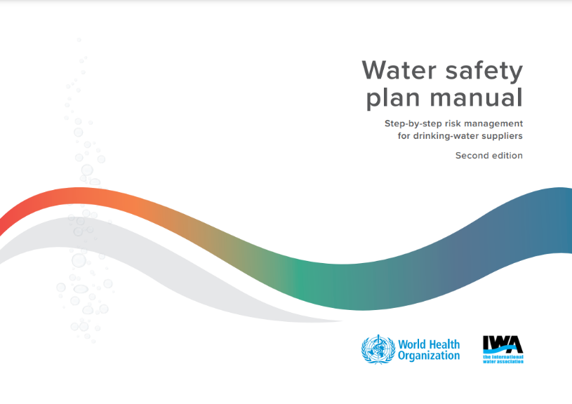

NOTE to trainer(s)
Delete this slide prior to delivering the presentation
These training materials are based on Water safety plan manual, 2nd edition (WHO & IWA, 2023).
These materials have been developed for a 4-day training event incorporating a partial-day field visit, but they can be adapted to accommodate other training durations and approaches, as preferred.
Customization of these training materials to reflect the local context will contribute greatly to positive outcomes and is highly recommended.

Slide 4
TRAINER introductions
Insert
trainer
photo
Trainer name(s)
Affiliation

Slide 5
WORKSHOP objectives
By the end of this workshop, all participants should 
Appreciate the value of water safety planning
Understand water safety plan (WSP) principles and steps
Understand how WSPs provide a framework to strengthen equitable access to safe drinking-water supplies that are more resilient to climate change
Have sufficient knowledge and confidence to begin to develop and
implement WSPs
This workshop is an introduction to WSP principles and practices

Slide 6
WORKSHOP approach
This workshop will be 
PRACTICAL
PARTICIPATORY
INTENSIVE
Practice the theory introduced in both classroom and field
Often a 5+ day training!
Engage with activities, share ideas, ask questions

Slide 7

WORKSHOP overview
DAY 1
WSP introduction, modules 2-3
DAY 2
Modules 4-7, field trip briefing
DAY 3
Field trip
DAY 4
Field trip sharing, modules 8-10 and module 1, wrap-up, next steps

Slide 8


RESOURCE review
Resources at your tables 
Workshop
program
Participant
Workbook

Slide 9

PARTICIPANT introductions
Who’s who in the room?
Tell us about yourself in max. 10 seconds
What is your name?
What is your organization and job title?
What is your WSP experience?
Answer either: new to WSPs, some experience, or a lot of experience
What is one fun fact about yourself?
e.g. hobby, favourite movie, favourite food, phobia, languages you speak…

Slide 10

WSP introduction
WSP background
What is a WSP?
Why do we need WSPs?
WSP drivers
Benefits of WSPs
Global WSP uptake

Slide 11
WSP background
WSPs introduced by WHO in Guidelines for drinking-water quality (3rd Edition, 2004)
“The most effective means of consistently ensuring the safety of a drinking water supply.”

Slide 12
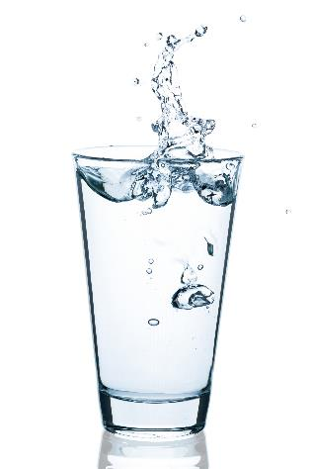
WHAT is a WSP?
WATER SAFETY PLAN 
A proactive risk assessment and risk management approach to help ensure drinking-water safety, encompassing the entire drinking-water supply, from catchment to consumer
Notes:
12

Slide 13
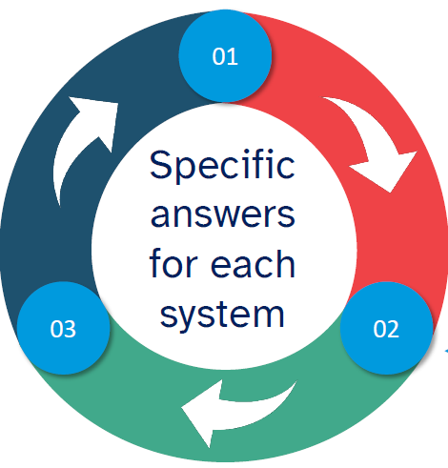
Water safety planning asks three questions
What are the priority risks?
01
03
How can we confirm the ongoing effectiveness of the WSP?
How can we better manage the risks?
Notes:
13

Slide 14
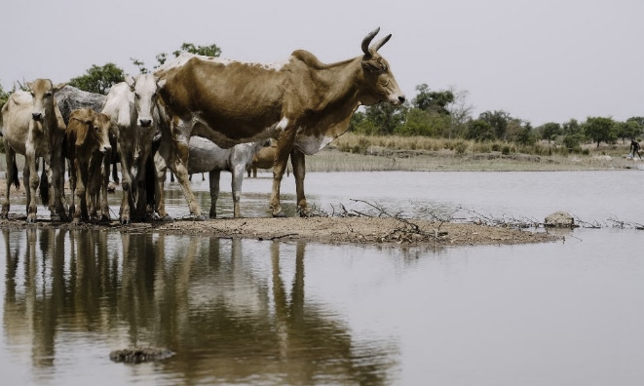
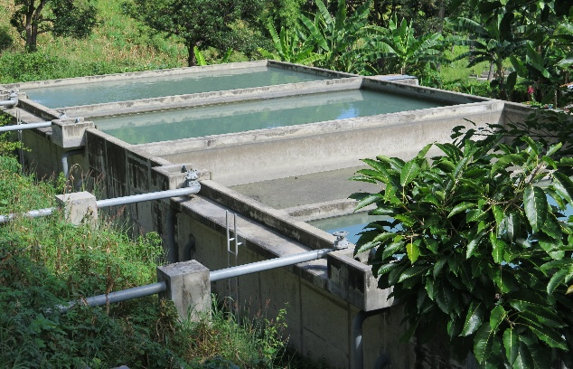
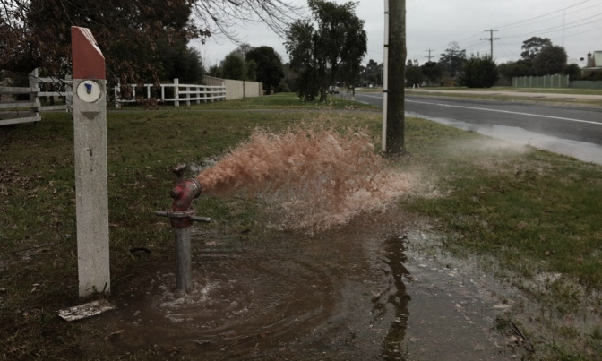
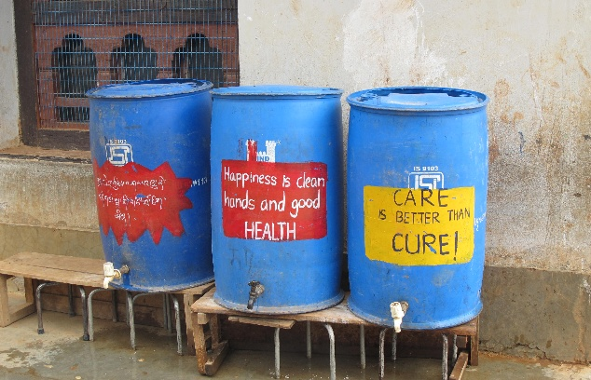
WSPs involve…
Preventing contamination at the source
Removing/ reducing contamination by water treatment
Preventing
recontamination
in storage and distribution
Preventing recontamination at the household
Picture 1: Ollivier Girard/CIFOR via flickr.com (CC BY-NC-ND 2.0)
Credit: Ollivier Girard/CIFOR via flickr.com (CC BY-NC-ND 2.0)
Pictures 2-4: WHO/Rory Moses McKeown

Slide 15






WHAT is a WSP?
A proactive management system to ensure safe drinking-water by 
5
Putting barriers and management systems in place to proactively manage these risks
Identifying where and how the problems could arise
Involving all stakeholders
Understanding the complete water supply system
Focusing initially on priority risks
Monitoring to make sure all parts of the system continue to work properly
After Water safety planning for urban water supply systems an introduction (WHO, 2024)

Slide 16






WSPs use a “multi-barrier approach”
Multiple-barriers in action to prevent microbial contamination 
1
Example: Sand filtration & disinfection at a water treatment plant
Example:
Household treatment and safe storage practices
Example: Restrictions on land use in catchment
Example: Maintaining residual disinfection during distribution
After Water safety planning for urban water supply systems an introduction (WHO, 2024)
Notes:
Central to water safety planning is the “multiple-barrier” approach.
As illustrated in this diagram, this is across the entire system from catchment …..to …….the user (or consumer).
Here we see if one barrier fails, e.g. source protection measures [CLICK], there are other barriers in place downstream to minimize the risk of microbial contamination e.g. filtration, disinfection and household treatment.

Slide 17

WHY do we need WSPs?
Without a risk management approach, water suppliers must rely only on END-PRODUCT TESTING to confirm water safety
Notes:
17

Slide 18
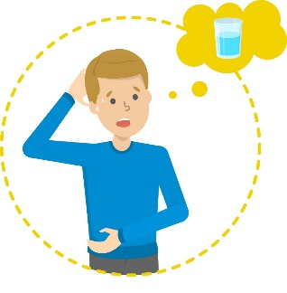
WHY do we need WSPs?
End-product testing scenario
4
Contaminated water consumed
Water microbially contaminated
Boil water advisory issued to consumers
Day 0
Day 7
Day 9
Day 10
TIME
Water sampled & tested
Test results
* E. coli *
Notes:
18

Slide 19


EXERCISE:
Limitations of end-product testing
10 minutes
(5 to complete; 5 to discuss)
Working in groups, make a list of the problems with relying on end-product testing to ensure water safety.
After exercise, review examples on following slide…

Slide 20
WHY do we need WSPs?
1
Limitations of end-product testing include 
  Reactive approach
  (problem has already occurred)
  Test results provide a “spot check” only
  (problems can be missed in space and time)
  Limited laboratory/equipment capacity
  Testing can be very expensive
  May not be clear what went wrong, where and when
  (supplier may not know how to correct problem)
TOO LITTLE, TOO LATE!
Notes:
20
Too little – does not give you the information needed to identify the source of the problem, pr prevent it from happening again.
Too late – unsafe water has already been delivered.

Slide 21



WHY do we need WSPs?
Water quality testing is an important component of water supply system management…
…but it is not enough to ensure water safety.
Need a proactive approach to ensure water safety through good management of the complete water supply system → WSP
Notes:
21

Slide 22
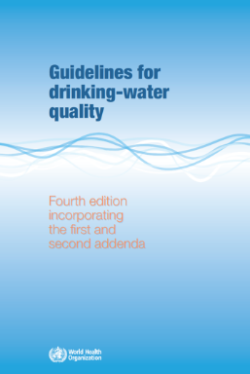
WSPs play a key role in delivering safe drinking-water
Framework for safe drinking-water 
Drinking-water quality targets
established based on health considerations
WSPs are one of three functions recommended by WHO to ensure drinking-water safety
can help water suppliers to achieve drinking-water quality targets
Water supply managed by a
Water safety plan
Verified by
Independent surveillance
After Guidelines for drinking-water quality (WHO, 2022)

Slide 23
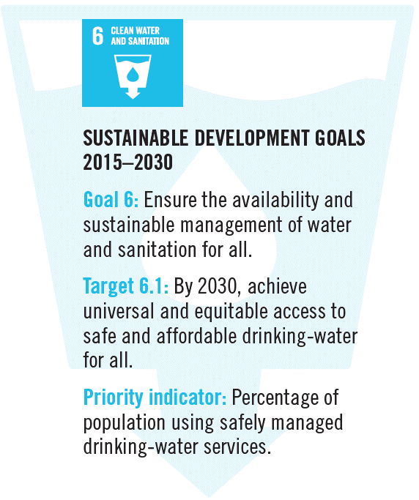
WSPs and the Sustainable Development Goals (SDGs)
Increased focus on proactive management
to ensure safe delivery of drinking-water services
Notes:
WSPs are a tool to help achieve the SDGs
SDG is central to achieving the SDG agenda as a whole.
Beyond 2030, WSPs will continue to play a central role as part of the future development agenda.

Slide 24

WSP drivers
Regional or national drivers, such as drinking-water quality policies and legal instruments, for example:
National standards requiring WSPs in Lao People’s Democratic Republic
European Union Drinking Water Directive
Sri Lanka national policy on drinking-water safety
WSP policies or regulations have been formally approved in over 60 countries*
*WHO global tracking database (as at 2022)
Notes:
24

Slide 25

BENEFITS of WSPs
WSP OUTCOMES
Improved system understanding
Improved stakeholder collaboration
Prioritized improvement needs
Improved operations and management
Cost savings via improved operational efficiencies
Reductions in non-revenue water
Improved infrastructure
Leveraged financial support
WSP IMPACTS
Improved water quality
Improved service delivery
Improved health
Leading to
Suppliers Consumers Health authorities
Notes:
25

Slide 26




MANY WSP benefits, however GIGO principle applies…
Garbage
In
Garbage
Out
We get out of WSPs what we put into them.
Attitude is key!
=
Notes:
26

Slide 27

WSPs provide resilience to future shocks and uncertainty
WSPs support future planning for foreseen and unforeseen events
WSPs can strengthen the resilience of the water supply e.g.
Support business continuity planning
Strengthen emergency preparedness and response planning
Help ensure robust supply chains (e.g. treatment additives, consumable reagents for testing)
Notes:
27
Future and unforeseen events can include natural disasters, conflict, epidemics/pandemics, migration, urbanization

Slide 28

WSPs and building climate resilience
Example climate impacts | Hazardous event | Example improvement measures needed
Increased temperature Reduced precipitation Increased drought | Reduced water quantity due to reduced rainfall and increased demand | Catchment/source Provision of additional boreholes to supplement existing water source
 |  | Treatment Backwash water recovery program to minimize water wastage
 |  | Distribution/storage Leak detection Mains repair/replacement programme
 |  | Household User education on water conservation during drought periods
WSPs can help to prioritize and manage current and future climate threats
Considers the implications of climate change at each stage of the water supply

Slide 29
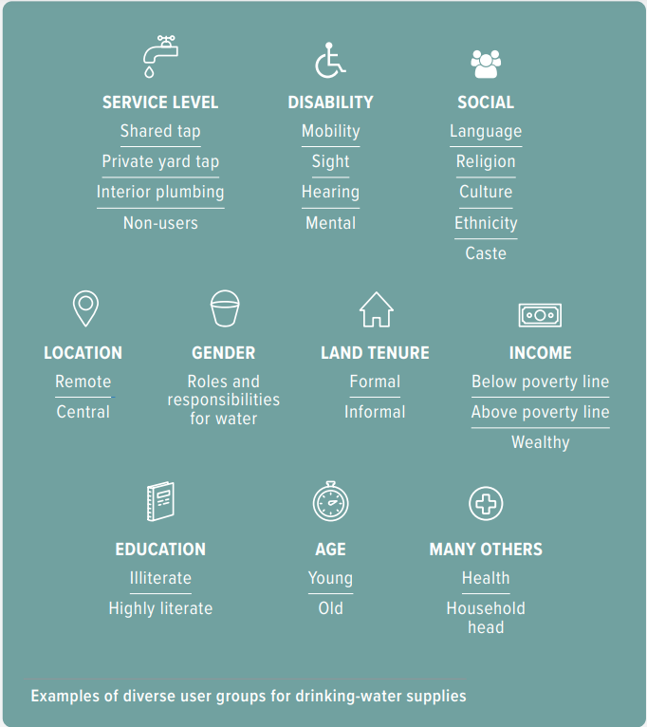
WSPs and enhancing equitable access to safe drinking-water
Vulnerable and disadvantaged groups can be explicitly considered in WSPs to help reduce inequalities e.g.
Considering users in informal settlements when assessing risks
Including all users in monitoring programmes
Developing emergency response plans that consider the needs of different groups
Notes:
This figure illustrates the diversity of user groups that may be encountered in a water supply system.

Slide 30


GLOBAL WSP uptake
?
How many countries
have implemented WSPs?
Notes:
30

Slide 31
GLOBAL WSP uptake
>90
countries have implemented WSPs*
*
* Or equivalent risk assessment and risk management approaches.
WHO/IWA (2017) Global status report on water safety plans. Geneva, Switzerland.
Notes:
31

Slide 32

ACTIVITY 1:
Water quality and health
Activity 1 – Workbook page 3
15 minutes
(10 to complete; 5 to review)
Working in groups, and as a team, read the instructions in the Participant Workbook (page 3).
Choosing from the list provided, complete the table by matching each water-related hazard with the signs and source of the hazard. Review answers together.
Example on next slide…

Slide 33
EXERCISE:
Water quality and health
1
EXAMPLE:
Potential signs | Possible hazard | Possible contamination source (or hazardous event)
Acute health issues
Diarrhoea and dysentery (including occasional outbreaks of cholera and typhoid fever) and other waterborne infections such as hepatitis are widespread within the community, particularly affecting the young, old and health compromised |  | Open defecation or nearby sanitation facilities; agriculture (use of manure) or wildlife; dirty water with suspended particles such as silt, clay or organic matter (often from flood waters or following rainstorms)
Microbial pathogens
After exercise, review answers on following slides…

Slide 34
Potential signs | Possible hazard | Possible contamination source (or hazardous event)
Acute health issues
Diarrhoea and dysentery (including occasional outbreaks of cholera and typhoid fever) and other waterborne infections such as hepatitis are widespread within the community, particularly affecting the young, old and health compromised | Microbial pathogens | Open defecation or nearby sanitation facilities; agriculture (use of manure) or wildlife; dirty water with suspended particles such as silt, clay or organic matter (often from flood waters or following rainstorms)
Methaemoglobinaemia in bottle-fed infants (or "blue baby syndrome") | High levels of nitrates/nitrites | Sewage discharges; poorly maintained septic tank; animal manure and runoff from agriculture
1

Slide 35
Potential signs | Possible hazard | Possible contamination source (or hazardous event)
Chronic health issues
Mottling and staining of teeth in young children and teenagers; brittle bones and crippling | High fluoride levels | Naturally occurring in some groundwaters
Pigmentation changes (melanosis) and thickening of the skin (hyperkeratosis), increased rates of cancers | High arsenic levels | Naturally occurring in some groundwaters
Skin irritation (skin rash, hives, itchy eyes and throat); tingling around the mouth and fingertips; slurred speech; animals who drink the water may die | Algae and algal toxins | High nutrient levels in warm and stagnant surface water (ponds, tanks)
3

Slide 36
Potential signs | Possible hazard | Possible contamination source (or hazardous event)
Acceptability issues
Stains on fixtures or laundry; coloured water with metallic taste | High metal concentrations | Naturally occurring in some groundwaters; may result from corroding pipes in the distribution system or from "overturning" of reservoirs
Unpleasantly salty taste (may pose health concern to those on sodium-restricted diets) | High sodium chloride levels | Naturally occurring in some groundwaters; may be from seawater (coastal areas) or caused by evaporation residue in irrigated areas (hot climates)
Rotten egg odour and taste; corrosive black spots in pipes | High sulfide levels | Naturally occurring in some groundwaters; could indicate industrial waste, oil, coal or stagnant water
3

Slide 37
Potential signs | Possible hazard | Possible contamination source (or hazardous event)
Acceptability issues
Brown-coloured water without particles (not direct harmful to health but could result in high levels of disinfection by-products if water is chlorinated) | High levels of natural organic matter | Naturally occurring in some surface waters from lakes or rivers with submerged vegetation
Soap does not lather; white scale builds up on pots or kettles when water is heated (not harmful to health, but may make water difficult to treat and use) | High hardness (calcium and magnesium) | Usually from limestone or chalk aquifers
2

Slide 38

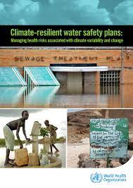

BASIS of this WSP training
WHO/IWA (2023)
Reflects over 15 years of practical experience since the first edition (2009)
Streamlined integration of enhancing climate resilience and equity in WSPs
Notes:
38

Slide 39
10 WSP modules
DAY 1
Mod 2: Describing the system
Mod 3: Identifying hazards and hazardous events
DAY 2
Mod 4: Validating existing control measures and assessing risks
Mod 5: Planning for improvement
Mod 6: Monitoring control measures
Mod 7: Verifying the effectiveness of water safety planning
DAY 4
Mod 8: Strengthening management procedures
Mod 9: Strengthening WSP supporting programmes
Mod 10: Reviewing and updating the WSP
Mod 1: Assembling the WSP team

Slide 40

MODULE
I
Assembling the
WSP team
Notes:
40
Module slide 1

Slide 41
MODULE 1
Will discuss on Day 4
Outlines roles and responsibilities for the team, and stakeholder engagement.
Participants first need to understand the full WSP process.
Only then can you fully appreciate who needs to be involved, when, and why, to ensure the overall undertaking is effective.
Notes:
41

Slide 42

MODULE
2
Describing the
system
How does the system deliver drinking-water from catchment to consumer?
Notes:
42
Module slide 1

Slide 43
MODULE 2 overview
1
2
3
WHAT WE DO:
Develop an accurate,
up-to-date description
of the complete water supply system
WHY WE DO IT:
To contribute to system understanding and to facilitate identification of system vulnerabilities in subsequent steps
HOW WE DO IT:
Gather, document and update system information (in words and supporting diagrams)
Confirm the accuracy of the system description

Slide 44

KEY ACTION 1:
Gather, document and update system information
Describe the complete water supply system
List water quality targets / standards
Include known / suspected problems or vulnerabilities
Catchment/ source
Storage & distribution
Treatment
User
?
What should we describe at each step?

Slide 45
INCLUDE summarized information to help identify vulnerabilities
3
Catchment/ source
Treatment
Storage & distribution
User
Water source(s), yields, catchment land use, source water quality/issues, abstraction details, climate information/ projections, etc.
Treatment processes, chemicals used, treatment capacity (versus production), treated water quality/issues, etc.
Storage tanks
(number, capacity, age, material), pipeline information (age, material), tapstands, delivery tankers, kiosks, etc.
Consumer practices (collection, storage, treatment, handling), including vulnerable and disadvantaged groups, etc.

Slide 46
INCLUDE information on the “use” and “users” of the water
1
EXAMPLE:
Intended use | Intended users
The water supplied is intended for consumption, food preparation, bathing and laundry. | GENERAL POPULATION. The intended users do not include those that are significantly immuno-compromised or industries with special water quality needs. These groups are advised to provide additional point-of-use treatment.
What is meant by “general population”?
Do we need to be more specific to ensure equitable benefit?

Slide 47
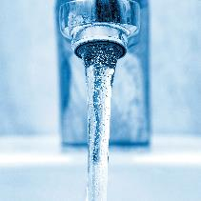
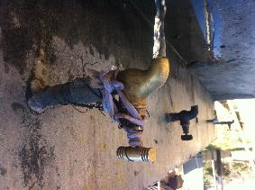
WHY it is important to consider all users
1
If the diverse water experiences of different user groups are not considered through the WSP process, the WSP may overlook important risks affecting some users
EXAMPLE
Household tap (most residents)
Public tap
(informal settlements)
Credit: WHO/RM McKeown
Remember to consider all users, including vulnerable & disadvantaged groups

Slide 48


DEVELOP a system diagram
A great deal of information can be presented on a diagram
1
Steel Covered
Built 2000
Elevated treated water storage tank
Distribution system
Well #1
Duty/standby
Pumps
75 m
15 L/s
500 KL
600 KL
Ground-level raw water storage
UV
5 000 customers, Household connections
Well #2
80 m
20 L/s
Concrete Uncovered
Built 1980
Treated Water
Raw Water
Treated Water
Raw Water
Notes:
Discuss this diagram in detail, including:
Why is it valuable to record upstream activities or conditions on the diagram? (Example answer: to understand threats to source water quality.)
Why is it valuable to show the number of pumps and specify duty or standby? (Example answer: to facilitate hazard identification and risk assessment by prompting consideration of what might happen in the event of a pump failure.)
Why is it valuable to record system details (tank size/material, year constructed, etc.) on the diagrams? (Example answer: it is a clear and simple way to record and display system details important for water quality; important for hazard identification; lends itself to easy review and update.)

Slide 49
DEVELOP a system diagram
Consider climate and equity information
700 users in informal settlements rely on tapstands
Often low chlorine residual
Projected to be subject to flooding by 2035
Steel Covered
Built 2000
Elevated treated water storage tank
Distribution system
Well #1
Duty/standby
Pumps
Annual rainfall:
2035 – 1750 mm
75 m
15 L/s
500 KL
600 KL
Ground-level raw water storage
UV
5 000 customers, Household connections
Use surface water during flood-related supply outages
Well #2
80 m
20 L/s
Concrete Uncovered
Built 1980
60 m
20 L/s
Well #3
Future water source
(high fluoride)
Raw Water
Treated Water

Slide 50
SYSTEM DIAGRAMS are an important part of the system description
System diagrams help to:
strengthen conceptual understanding of the complete system
clarify water flow, linkages, responsibilities and vulnerabilities
!
Create system diagrams with sufficient detail to help identify problems or potential problems
If needed, consider creating diagrams at two levels:
Level 1: system overview (catchment to consumer)
Level 2: water treatment plant details

Slide 51

LEVEL 1:
System overview
Cattle farm
High-level area,
20 000 customers, Household connections
See detailed drawing of WTP
Village
Treated water storage, steel, 1990
Blue River
WTP
Blue River
5 ML/d
500 KL
Duty/
standby
pump
Duty/ standby pump
1 ML
Low-level area, 10 000 customers, 50% household connections, 50% public tap stands
Raw water storage reservoir for irrigation, 1990
Raw Water
Treated Water
Treated Water

Slide 52
LEVEL 2:
Water treatment plant details
Blue River Water Treatment Plant (WTP)
(5 ML/day, built 2014)
Alum
Clarification
Clear water storage tank
5 ML
Rapid mix
1 ML
Raw water storage reservoir
Duty/ standby pumps
Flocculation
Filtration
Chlorine
Raw Water
Treated Water
Notes:
Flag that additional details such as control points (e.g. turbidity meters at individual filters), sample points, and the number of unit processes (e.g. rapid sand filters x 6) would also be advantageous.

Slide 53
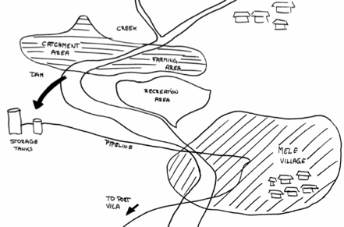
KEY ACTION 2:
Confirm the accuracy of the system description
Follow the flow of water and field verify that the description is thorough and accurate.
  Interview relevant field staff, operators or stakeholders to confirm accuracy of information
  Ensure that the system description is consistent with accurate data and reports
  Update the system description based on the outcomes of these activities
Walk the system!
Don’t rely on a desktop review only

Slide 54
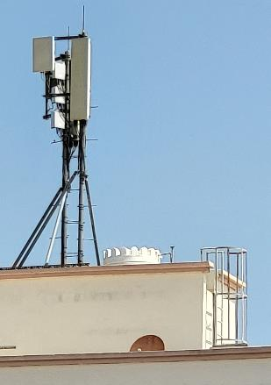
EXERCISE:
Where does the WSP end?
10 minutes
(5 in groups; 5 in plenary)
Consider this water supply scenario:
Intermittent supply is standard operation
Consumers generally receiving water once every one or two weeks
Household rooftop tanks are part of the supply chain
Credit: WHO/RM McKeown
Notes:
Ask participants to consider:
The fact that intermittent supply is standard operation, with consumers generally receiving water once every one or two weeks
Rooftop tanks are part of the supply chain.

Slide 55
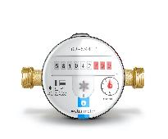
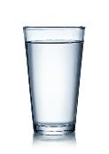

EXERCISE:
Where does the WSP end?
10 minutes
(5 in groups; 5 in plenary)
Working in groups, consider where the WSP should end:
At the tap?
(after rooftop storage)
At the point
of consumption?
(after household treatment)
At the
water meter?
(before rooftop storage)
Notes:
Get participants to self organize into three areas of the room according to their answer i.e. one corner for “water meter”; opposite corner for “point of consumption”; middle of the room for “tap”.
Get each group to discuss their reasons and to nominate a spokesperson to defend the groups decision.

Slide 56

ACTIVITY 2:
System diagram
Activity 2 – Workbook page 5
50 minutes
(40 to complete; 10 to review)
Part I: Working in groups, create system diagrams as described in the Participant Workbook (page 5).
Part II: Review diagrams in table group pairs assigned by the trainer.

Slide 57
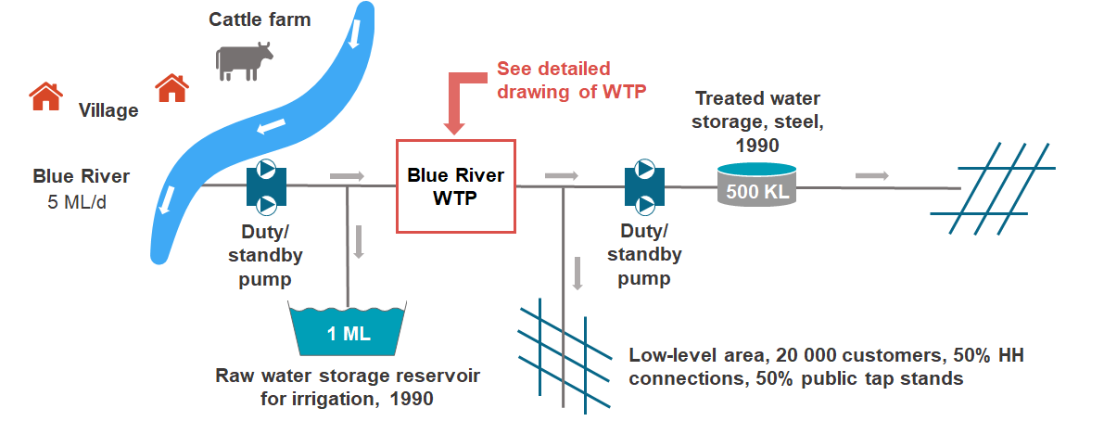
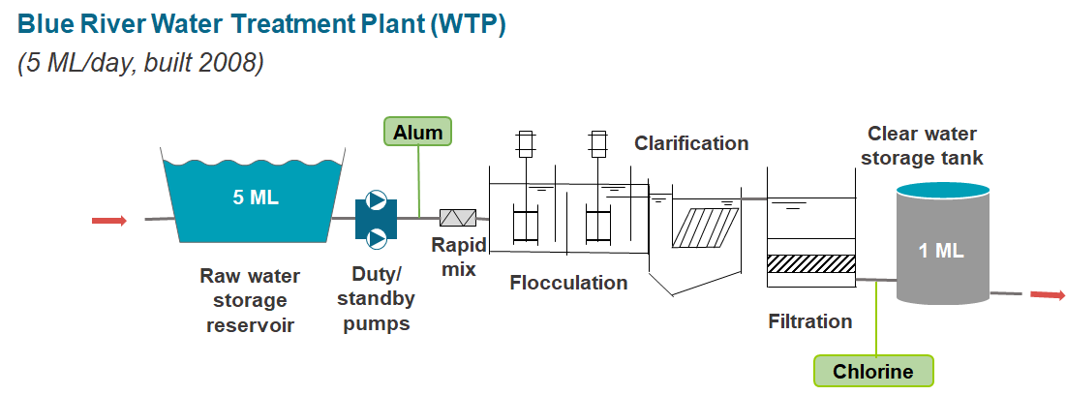
ACTIVITY 2:
System diagram – hints & tips
Reminder: system diagrams should include sufficient detail to help identify problems or potential problems
Level 1: system overview (catchment to consumer)
Level 2: water treatment plant details

Slide 58

MODULE
3
Identifying hazards and hazardous events
What could go wrong?
Notes:
58
Module slide 1

Slide 59
MODULE 3 overview
1
2
3
WHAT WE DO:
List the issues that may threaten the safety and adequacy of the water supply
WHY WE DO IT:
To understand what could go wrong in the entire system to ensure important risks can be identified and managed
HOW WE DO IT:
For each step in the water supply chain, identify hazards and hazardous events that could contaminate or compromise the water supply

Slide 60

DEFINITIONS
HAZARD
A contaminant or condition that may adversely affect the supply of safe drinking-water
HAZARDOUS EVENT
An event that results in a hazard being introduced to, or inadequately removed from, the water supply

Slide 61

HAZARD vs. hazardous event
2
HAZARDOUS EVENT
The houses are damaged because of heavy rains that destabilize the hillside, releasing the boulder
HAZARD
Large boulder

Slide 62
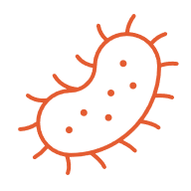



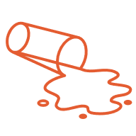
HAZARD types
Generally classify hazard types as υ
Microbial
e.g. pathogens such as E. coli, Legionella, Cryptosporidium, norovirus, enterovirus
Chemical
e.g. arsenic, fluoride, lead, manganese, nitrate, iron, synthetic chemicals, pesticides
Radiological
e.g. radionuclides, radium, uranium, tritium
Acceptability
e.g. taste/odour, colour, turbidity, hardness
Quantity-related
e.g. insufficient water for hydration, hygiene, domestic needs

Slide 63
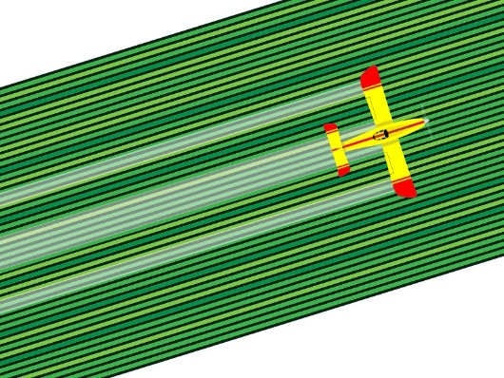

HAZARDS and hazardous events
2
HAZARDOUS EVENT  Source water is faecally contaminated because of faecal run-off into the source water from cattle grazing
HAZARD TYPE  Microbial
HAZARDOUS EVENT  Source water is chemically contaminated because of pesticide run-off into source water
HAZARD TYPE Chemical
Notes:
Ask participants the answer, one row at a time, before clicking the animation.

Slide 64
EXAMPLES of possible problems
3
Catchment/ source | Animal waste in runoff; industrial discharges; onsite-sanitation overflow during flood; agricultural chemicals in runoff; natural chemicals in groundwater; sediment from bushfires
Treatment | Inadequate coagulation; filter clogging/ breakthrough; inadequate disinfection (underdose or insufficient contact time); chemical overdose; power failure; pump failure
?
What are possible problems at each step?
Storage & distribution | Birds/animals entering the storage; flooding of pump stations; leaky pipes; poor pipeline repair practices; backflow
Consumer practices | Transport from tapstand in open/unsafe vessels; unsafe storage practices; poor hygiene practices; improper household treatment practices

Slide 65

DESCRIBING hazardous events
When describing hazardous events, BE SPECIFIC!
Clearly indicate what hazard could be introduced, and how.
TIP
A good hazardous event reads like this:
X happens (to the water supply)
because of Y

Slide 66
DESCRIBING hazardous events
X happens (to the water supply) because of Y
EXAMPLES:
Source water becomes faecally contaminated (X)
because of discharge of untreated domestic waste from households (Y)
Water in the pipe network becomes contaminated (X)
because of unsanitary pipeline repair practices (Y)
Water is over- or under-dosed with chlorine (X)
because of insufficient operator training (Y)
X = What can happen to the water supply
Y = How it can happen (i.e. cause)

Slide 67

DESCRIBING hazardous events
2
WEAK EXAMPLE
Hazardous event: Agriculture in the catchment
X = What can happen to the water supply
Y = How it can happen (i.e. cause)
Are these clear enough?
STRONGER EXAMPLES
Hazardous event: The source water is faecally contaminated (X) due to use of animal waste on crops and runoff during heavy rains (Y)
Hazardous event: The source water is chemically contaminated (X) due to use of pesticides on crops and runoff during rains (Y)
Notes:
Make clear the point that if you do not define clearly in module 3 – this affects the risk assessment in Module 4, and subsequent modules.

Slide 68
DESCRIBING hazardous events
1
WEAK EXAMPLE
Hazardous event: Old pipes
X = What can happen to the water supply
Y = How it can happen (i.e. cause)
Not clear enough
STRONGER EXAMPLES
Hazardous event: Acceptability and microbial contaminants enter the pipe network (X) due to leaks in old pipes (Y)
Hazardous event: The water supply is chemically contaminated (X) due to leaching of lead from old pipes (Y)

Slide 69
IDENTIFYING hazardous events
When identifying hazardous events, consider each step in the water supply chain and ask:
  What could potentially go wrong at this location?
  What is wrong now, what has gone wrong in the past, and what could possibly go wrong in the future?
  Consider climate information & projections!
Identifying hazardous events should involve:
  Field visits/site inspections (incl. discussions with field staff, stakeholders)
  Desktop review of Module 2 system diagrams (detailed and accurate!)
  Consideration of all user groups

Slide 70

EXERCISE:
Hazard brainstorm
EXAMPLE
15 minutes
Working all together in plenary, make a bullet list of some potential problems in the pictures on the next slide.
Then, translate these into clearly-defined hazardous events/hazard types.
Hazardous event The source water is faecally contaminated (X) due to the animals defecating in the river at the abstraction point (Y)
Hazard Microbial (M)
Picture 1: Ollivier Girard/CIFOR via flickr.com (CC BY-NC-ND 2.0)

Slide 71
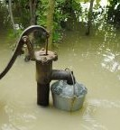
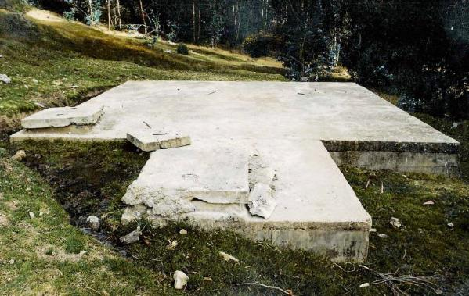
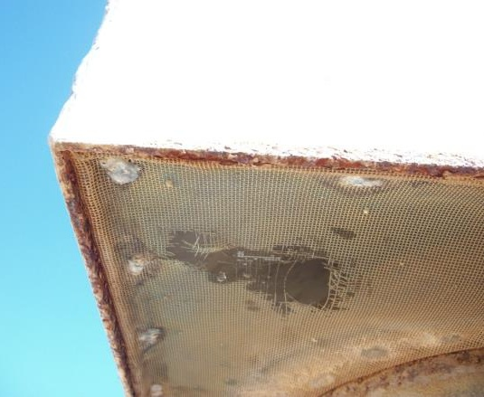
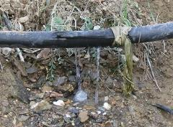
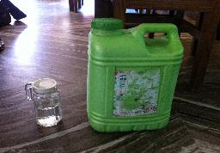
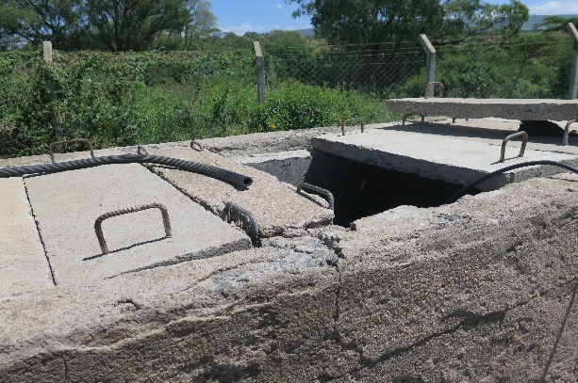
EXERCISE:
Dug well hazard brainstorm
6
Hazardous event:
Household well water microbiologically contaminated during collection because of flooding
Hazard:
Microbial
Hazardous event:
Ingress of contaminated surface
runoff because of broken spring box
Hazard:
Microbial
Hazardous event:
Microbial contamination from insects or rodents accessing the reservoir because of damaged screens
Hazard:
Microbial
Hazardous event:
Water losses because of pipe
leaks
Hazard:
Quantity
Hazardous event:
Chemical contamination of water because of use of a chemical container to store household water
Hazard:
Chemical Acceptability
Hazardous event:
Contamination of stored water because of missing tank cover
Hazard:
Microbial
Photo credit:
Photos 1, 5, 6 - WHO/RMK
Photos 2, 3 and 4 - WHO/Oliver Schmoll
After Strengthening drinking-water surveillance using risk-based approaches – training package (WHO EURO, 2025)

Slide 72
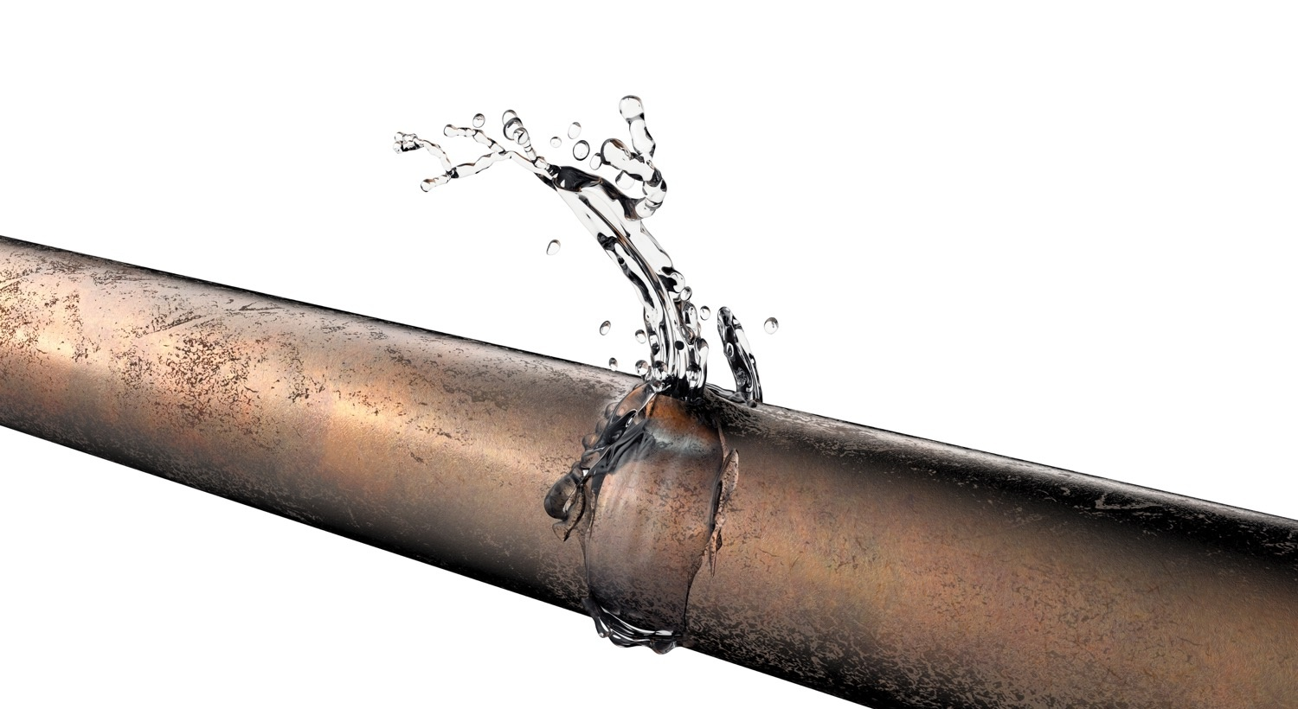
ACTIVITY 3:
Hazard identification
Workbook Activity 3 (page 7)
50 minutes
(40 to complete; 10 to review)
Working in groups, carry out Activity 3 in the Participant Workbook (page 7).

Slide 73


CASE EXAMPLES:
Identifying hazards/hazardous events
Consider these real-world examples that highlight the importance of detailed and accurate system diagrams…..

Slide 74
WHAT is the problem?
AUSTRALIA: Hazard detected by field verifying system diagram
1
Alum
Clarification
Clear water storage tank
5 ML
Rapid mix
1 ML
Raw water storage reservoir
Duty/ standby pumps
Flocculation
Filtration
Cl₂
Cl₂
!
Raw Water
Treated Water
Notes:
This story provides a good of example of why it is important to field verify the system diagrams. For this system in Australia, the operators believed that the chlorine was added at the INLET of the clearwater storage tank. However, during the process of field verifying the system diagram, they discovered that the chlorine was actually added at the tank outlet due to a plumbing error. Ask participants what is the associated hazard.
The hazard here is that chlorine requires “contact time” with the water to kill microorganisms, and that “contact time” should be provided in the clearwater storage tank.
When the chlorine is injected into the line AFTER clearwater storage (rather than before), the water may reach the first consumers before chlorine has had time to kill the microbes. After making this discovery, the operators changed the chlorine addition point from the tank outlet to the tank inlet.
This story provides a good of example of why it is important to develop detailed and accurate system drawings. (Without the detailed diagram, this supplier would not have identified and resolved this important system hazard.)

Slide 75
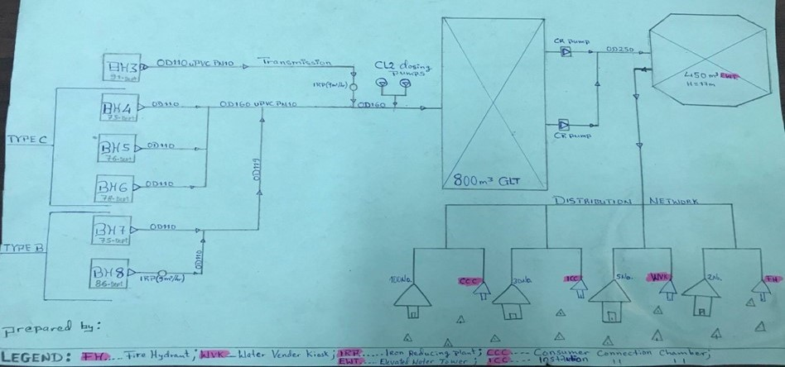
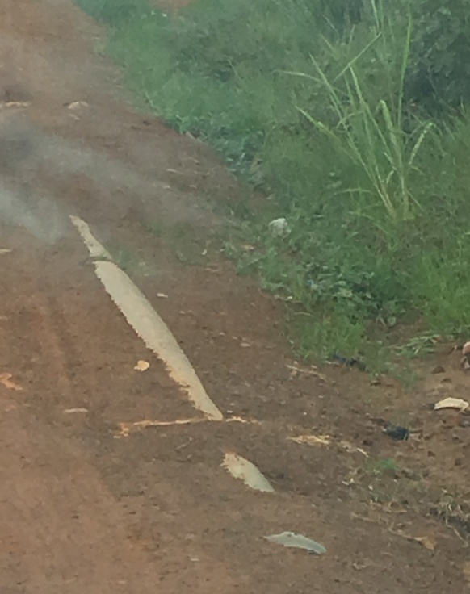
WHAT is the problem?
LIBERIA: Hazard detected by field inspection
1
Treated water
Boreholes
Elevated
storage
Chlorine
Main supply
pipeline
Credit: WHO/RM McKeown
Users
Notes:
During a field visit as part of Module 3, the main supply pipeline – that is, the water transmission line between the treated water storage tank and the distribution system – was found to be exposed because surface water following heavy rainfall had washed away the ground cover. The pipe was beside a main road that was subject to heavy vehicular traffic.
If the pipe had been damaged, the water supply to the town would have to be shut off for an extended period to allow repair work. This would lead to a prolonged supply outage, as well as microbial and acceptability risks associated with depressurizing the water main and repairing the pipeline.

Slide 76

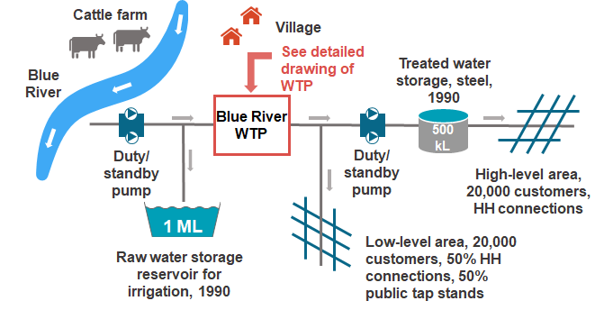
SYSTEM DIAGRAMS
support hazard identification
MORAL OF THE STORIES:
Detailed and accurate system diagrams (Module 2) play an important role in hazard identification (Module 3)
Desk-top identification of hazards/hazardous events alone is insufficient to detect all threats within a system → field visits are required!

Slide 77
10 WSP modules
DAY 1
Mod 2: Describing the system
Mod 3: Identifying hazards and hazardous events
DAY 2
Mod 4: Validating existing control measures and assessing risks
Mod 5: Planning for improvement
Mod 6: Monitoring control measures
Mod 7: Verifying the effectiveness of water safety planning
DAY 4
Mod 8: Strengthening management procedures
Mod 9: Strengthening WSP supporting programmes
Mod 10: Reviewing and updating the WSP
Mod 1: Assembling the WSP team
Notes:
Flag that Day 1 is complete
Note to facilitator – if there is still time left on day 1; Module 4 could be started (e.g. Module 4 key actions 1 and possibly 2), and the programme adjusted accordingly.

Slide 78

DISCUSSION and questions?
Notes:
78

Slide 79
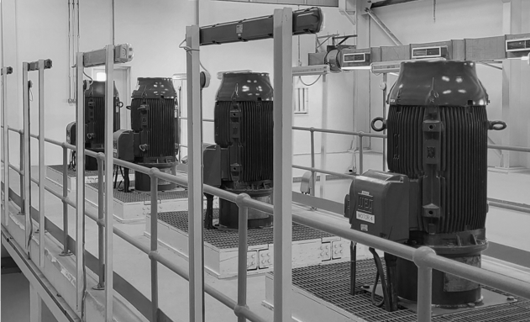
Credit: WHO/RM McKeown
That’s all for today!

