Slide 1
Water safety plan
Step-by-step risk management for drinking-water suppliers
TRAINING PACKAGE
Workshop Day 2
Notes:
1
Cover slide

Slide 2
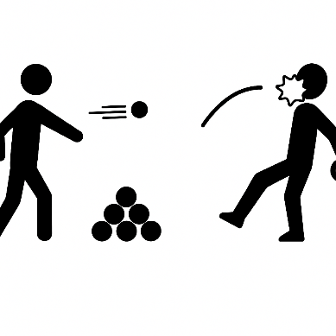
Day 1 RECAP:
Snowball fight
Take a piece of paper
Write down one key take away message from Day 1
Roll it up in a ball
Throw it at your colleagues anywhere in the room
  NO head shots
Keep going, and when we say stop, open it up and share it with the group when asked
Notes:
Allow a minute or so for people to throw their snowballs so the messages are well dispersed.

Slide 3
10 WSP modules
DAY 1
Mod 2: Describing the system
Mod 3: Identifying hazards and hazardous events
DAY 2
Mod 4: Validating existing control measures and assessing risks
Mod 5: Planning for improvement
Mod 6: Monitoring control measures
Mod 7: Verifying the effectiveness of water safety planning
DAY 4
Mod 8: Strengthening management procedures
Mod 9: Strengthening WSP supporting programmes
Mod 10: Reviewing and updating the WSP
Mod 1: Assembling the WSP team
Notes:
Flag that Modules 4-7 are to be covered on Day 2

Slide 4

MODULE
4
Validating existing control measures and assessing risks
How effective are the control measures and how important are the risks?
Notes:
4
Module slide 1

Slide 5
MODULE 4 overview
1
2
3
WHAT WE DO:
Evaluate control measures that are already in place to protect the water supply, and assess risk
WHY WE DO IT:
To understand how well the hazardous events are already controlled, to prioritize improvement needs
HOW WE DO IT:
  1. Identify existing control measures
  2. Validate their effectiveness
  3. Assess the risks

Slide 6

KEY ACTION 1:
Identify existing control measures
Identify existing control measures for all hazardous events identified in Module 3.
CONTROL MEASURE
An activity or process to prevent, eliminate or reduce the risk of a hazardous event to an acceptable level
Module 4 focuses on identifying and validating EXISTING control measures already in place.
ADDITIONAL control measures that are needed are addressed in Module 5

Slide 7
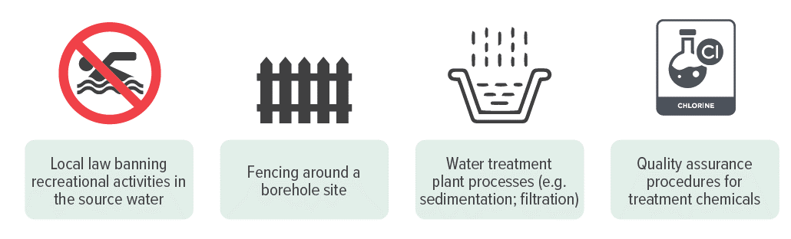
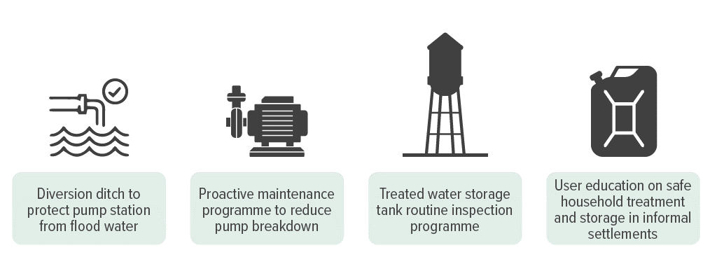

CONTROL measures
1
EXAMPLES
Monitoring is not a control measure
Notes:
7
Red box - Monitoring provides information about the performance of control measures but does not itself directly prevent, eliminate or reduce the risk of a hazardous event to an acceptable level.

Slide 8

EXERCISE:
Control measures - spot the difference
5 minutes
Working all together in plenary, discuss the control measures shown in the picture on the next slide.

Slide 9
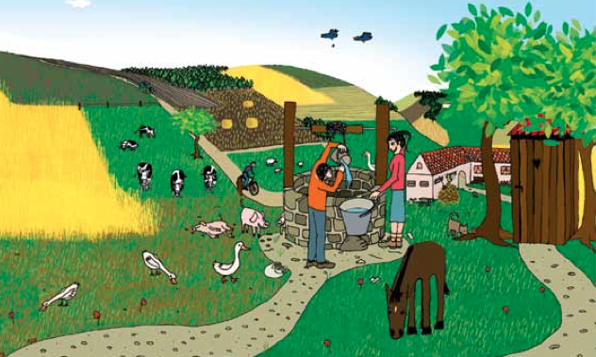
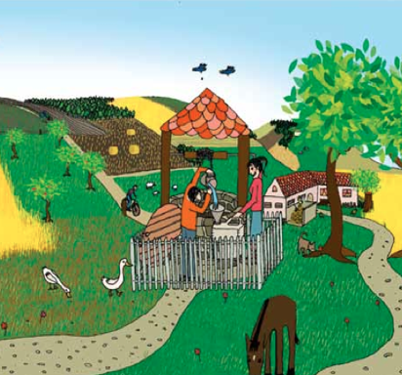
EXERCISE:
Control measures - spot the difference
?
What control measures have been added to the second picture?
Notes:
Examples of control measures put in place:
Fence constructed around well
Roof constructed over well
Well cover added
Latrine removed (and relocated out of view)
Cattle/pigs no longer grazing in area (restrictions applied)
More trees planted uphill from well (natural buffer to control surface water runoff)
Water user collecting in a safer / narrow-mouthed container
Animal dung near house confined to an impermeable bund

Slide 10

ACTIVITY 4:
Hazard-control match-up
Workbook Activity 4 (page 8)
15 minutes
(10 to complete; 5 to review)
Working in groups, refer to Activity 4 in the Participant Workbook (page 8) and match up the hazardous events with the related control measures.
Solution on next slides…

Slide 11
HAZARDOUS EVENT | CONTROL MEASURE
Raw water is contaminated runoff (X) because of cattle grazing near surface water intake (Y) | Controlled grazing in exclusion zone: permits, fencing, regular inspections
Contaminated water is consumed (X) because informal settlements do not have access to the piped water supply (Y) | Settlement dweller education programme on safe household treatment and storage practices
Contaminated water from customer’s storage tanks is back-siphoned into distribution pipes (X) because of low pressure in distribution network (Y) | Regulations requiring check valves (backflow prevention valves) at customer connections
The water supply is or over- or under-dosed with chlorine (X) because of operator error (Y) | SOPs and thorough operator training and competency testing in chlorination procedures
Water supply outages (X) because of power loss at the network pump station following severe storm (Y) | Back-up mobile power generator
Raw water is contaminated (X) because of direct discharge of industrial pollutants upstream of the intake (Y) | Enforced industrial effluent standards
5

Slide 12


KEY ACTION 2:
Validate the effectiveness of existing control measures
“Validation” can mean different things in different contexts.
In the context of a WSP, it has this very specific meaning...

Slide 13

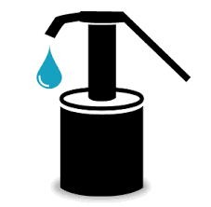
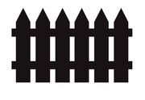

KEY ACTION 2:
Validate the effectiveness of existing control measures
2
VALIDATION - how do I know that the control measure is adequate and effective at managing the risk?
VALIDATION:
Obtaining evidence that the control measure can effectively control the corresponding hazardous event
Notes:
Before the first click, ask if the fence is adequate to prevent the entry of animal into the well area?

Slide 14

KEY ACTION 2:
Validate control measures
Sources of validation information include:
Existing water quality monitoring data
Water quality investigations
Visual inspections
Scientific literature (be careful comparing situations)

Slide 15
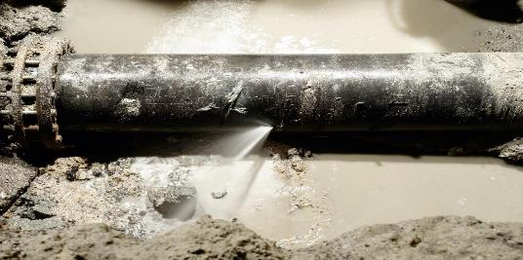
KEY ACTION 2:
Validate control measures
HAZARDOUS EVENT
The water supply becomes microbially contaminated when dirty water enters the pipeline (X) because of unsanitary pipeline repair practices (Y)
WORKED EXAMPLE:
HAZARD
Microbial
CONTROL MEASURE
Visual inspection of reinstated pipe water (i.e. sample of water in a white bucket to visually check for turbidity).
It is very important to ask:
IS THIS CONTROL
MEASURE EFFECTIVE?
Notes:
Please flag that this “Worked Example” will be built on and explored in subsequent WSP modules.
Note that this will be denoted by the yellow box stating “Worked Example”.

Slide 16
KEY ACTION 2:
Validate control measures
 |  |  |  | Are the existing controls effective?
Process Step | Hazardous Event | Hazard Type | Existing control measure description | Validation notes (basis of effectiveness assessment) | Yes | No | Somewhat
Distribution | The water supply becomes microbially contaminated when dirty water enters the pipeline (X) because of unsanitary pipeline repair practices (Y) | Microbial | Visual inspection of reinstated pipe water by operator | Supervisor oversight reports that the visual inspection is not always carried out in practice; water quality testing indicates problems with microbial contamination; occasional dirty water reports from customers occasionally following pipe repairs |  |  | ✓
Existing control measures are only somewhat effective at controlling the hazard/hazardous event

Slide 17

KEY ACTION 2:
Validate control measures
The approach to validation can be tailored to suit WSP experience and resource constraints.
Two validation approaches can be considered
Informal, judgment-based: simpler approach that considers the evidence and observations, then assigning Yes/No/Somewhat based on WSP Team judgement.
Data-based validation: more sophisticated approach that considers e.g. historical operational data, and/or technical data from the scientific literature and/or data from studies at pilot drinking-water treatment plants.
Notes:
In the early stages of water safety planning, informal judgment-based validation is often enough for most control measures.
As the plan develops and more data is collected, the team can shift to a more data-driven approach for validating key control measures, especially those addressing major risks.

Slide 18

ACTIVITY 5:
Hazard-control-validation match-up
Workbook Activity 5 (page 9)
15 minutes
(10 to complete; 5 to review)
Working in groups, refer to Activity 5 in the Participant Workbook (page 9). Use the boxes provided to complete the blanks in the table, matching up associated process steps, hazardous events, hazards, control measures and validation notes.
Solution on following slide…

Slide 19
SOLUTION:
5
Process step | Hazardous event | Hazard | Existing Control Measures | Validation Notes
Catchment | Raw water turbidity spikes can occur (X) due to logging activity near the river and soil erosion during heavy rains (Y) | 3 Microbial Acceptability | The Catchment Management Authority prohibits logging within 300 m of the river bank | 6 A review of relevant literature indicates that a 300m vegetated buffer zone is sufficient to control sediment transport at grades typical within the catchment
Water Treatment Plant | Water is under- or over-chlorinated (X) due to an operator error (Y) | Chemical & Microbial | 4 Operator training and regular refresher courses | 1 Operator competency testing indicates effective learning, and water quality monitoring confirms that chlorine levels are consistently within the target range
Distribution System | 2 Water in the storage tank becomes contaminated (X) due to bird access to tank through the vent pipe and overflow pipe (Y) | Microbial | Wire mesh installed around vent pipe and overflow pipe to prevent bird and insect access | 5 Visual inspection confirms that the wire mesh is robust and finely woven, and water quality testing results indicate high microbiological compliance
?
?
?
?
?

Slide 20
EXERCISE:
Control measure ID & validation
Workbook Activity 6 (page 11)
40 minutes
Catchment
(30 to complete;
10 to review)
Treatment
Distribution
Working in groups, refer to Activity 6 in the Participant Workbook (page 11). Carry out the control measure ID and validation in the Participant Workbook.
User
Read workbook instructions together,
then review next three explanatory slides…

Slide 21
FOR HALF of the hazardous events:
Assume NO existing control measures are in place (NA – not applicable).
 |  |  |  | Are the existing controls effective?
Process Step | Hazardous Event | Hazard Type | Existing control measure description | Validation notes (basis of effectiveness assessment) | Yes | No | Somewhat
Source | Source water becomes contaminated (X) because of animals in the abstraction area (Y) | Microbial | None | NA | NA | NA | NA

Slide 22

FOR THE OTHER HALF of the hazardous events:
Imagination required!
(See example on next slide.)
 |  |  |  | Are the existing controls effective?
Process Step | Hazardous Event | Hazard Type | Existing control measure description | Validation notes (basis of effectiveness assessment) | Yes | No | Somewhat
Source | Source water becomes contaminated (X) because of animals in the abstraction area (Y) | Microbial | What (imaginary) control measure is already in place? | What evidence have you have gathered to gauge control measure effectiveness and what did you find? | ? | ? | ?

Slide 23
DESCRIBING of imaginative answer:
 |  |  |  | Are the existing controls effective?
Process Step | Hazardous Event | Hazard Type | Existing control measure description | Validation notes (basis of effectiveness assessment) | Yes | No | Somewhat
Source | Source water becomes contaminated (X) because of animals in the abstraction area (Y) | Microbial | The abstraction area has a stock exclusion fence | Visual inspection shows that the fence is in poor condition and cattle are occasionally in the abstraction area; water quality testing indicates occasional problems with microbial contamination |  |  | ✓

Slide 24
KEY ACTION 3:
Assess the risks
Key actions:
  Identify existing control measures
  Validate control measures
  Assess the risk
1
2
3
RISK:
The product of the likelihood of occurrence of a hazardous event and its severity (or consequences)

Slide 25
RISK assessment (3x3 matrix)
Semi-quantitative approach
 |  |  | SEVERITY
 |  |  | No/minor impact | Moderate impact | Major impact
 |  |  | 1 | 2 | 3
LIKELIHOOD | Unlikely | 1 | 1 | 2 | 3
 | Likely | 2 | 2 | 4 | 6
 | Most likely | 3 | 3 | 6 | 9
 | Risk score: |  | ≤ 2 | 3 - 5 | ≥ 6
 | Risk level: |  | Low | Medium | High
Allows you to prioritize the risks
Clearly not a priority
Medium- or long-term priority; requires some attention
Clearly a priority; requires urgent attention

Slide 26
RISK assessment
6
Risk = Likelihood x Severity
Example 1:
Likelihood = 1 Severity = 2
Example 2:
Likelihood = 2 Severity = 3
 |  |  | SEVERITY
 |  |  | No/minor impact | Moderate impact | Major impact
 |  |  | 1 | 2 | 3
LIKELIHOOD | Unlikely | 1
 | Likely | 2
 | Most likely | 3
 | Risk score: |  | ≤ 2 | 3 - 5 | ≥ 6
 | Risk level: |  | Low | Medium | High
2
6

Slide 27
LIKELIHOOD and SEVERITY
Defining LIKELIHOOD and SEVERITY:
What exactly is meant by unlikely or likely?
How do we distinguish between a minor and major severity (consequence)?
Example definitions for likelihood and severity are provided, but WSP TEAMS SHOULD ADOPT THEIR OWN DEFINITIONS to suit their own situation.
Note: in practice, it can be challenging to choose suitable definitions, but this step is essential to meaningful risk assessment results.

Slide 28
LIKELIHOOD and severity
Likelihood level |  | Definition
1 | Unlikely | Could occur at some time but has not been observed; may occur only in exceptional circumstances
2 | Likely | Might occur at some time; has been observed occasionally
3 | Most likely | Will probably occur in most circumstances; has been observed regularly
EXAMPLE DEFINITIONS
Severity level |  | Definition
1 | No/minor impact | Minor or negligible impact on water quality, acceptability or quantity (not health related) for a small percentage of customers; some manageable disruptions to operation; rise in complaints not significant.
2 | Moderate impact | Minor impact water quality, acceptability or quantity (not health related) for a large percentage of customers; clear rise in complaints; community annoyance; minor breach of regulatory requirement.
3 | Major impact | Major impact; potential illness or death in community associated with the water supply; large number of complaints; significant level of customer concern; significant breach of regulatory requirement.

Slide 29
EXAMPLE
HAZARDOUS EVENT
The water supply becomes microbially contaminated when dirty water enters the pipeline (X) because of unsanitary pipeline repair practices (Y)
HAZARD
Microbial
CONTROL MEASURES
Visual inspection of reinstated pipe water (i.e. sample of water in a white bucket to visually check for turbidity). Validation outcome - somewhat effective
LIKELIHOOD
2 (Likely - might occur at some time;
has been observed occasionally)
SEVERITY
3 (Major impact – possible illness in the community)
WORKED EXAMPLE:
Notes:
29
Please flag that this “Worked Example” will be built on and explored in subsequent WSP modules.
Note that this will be denoted by the yellow box stating “Worked Example”.

Slide 30
RISK assessment
3
Likelihood = 2; Severity = 3
Risk = Likelihood x Severity
 |  |  | SEVERITY
 |  |  | No/minor impact | Moderate impact | Major impact
 |  |  | 1 | 2 | 3
LIKELIHOOD | Unlikely | 1
 | Likely | 2
 | Most likely | 3
 | Risk score: |  | ≤ 2 | 3 - 5 | ≥ 6
 | Risk level: |  | Low | Medium | High
6

Slide 31
RISK assessment
WORKED EXAMPLE:
Documenting the risk assessment
Process Step | Hazardous Event | Hazard | Existing control measure description | Are the existing controls effective? |  |  |  | Risk assessment
 |  |  |  | Validation notes (basis of control measure effectiveness decision) | Yes | No | Somewhat | Likelihood | Severity | Risk score | Risk level
Distribution | The water supply becomes microbially contaminated when dirty water enters the pipeline (X) because of unsanitary pipeline repair practices (Y) | Microbial | Visual inspection of reinstated pipe water by operator | Supervisor oversight reports that the visual inspection is not always carried out in practice; water quality testing indicates problems with microbial contamination; occasional dirty water reports from customers occasionally following pipe repairs |  |  | ✓ | 2 | 3 | 6 | H
Notes:
Flag that this worked example will be developed during the subsequent modules

Slide 32
RISK assessment
This “one stage” risk assessment is the risk in light of existing control, or “residual risk”. BUT…can also assess “raw risk”….
Process Step | Hazardous Event | Hazard | Existing control measure description | Are these controls effective? |  |  |  | Risk assessment
 |  |  |  | Validation notes (basis of control measure effectiveness decision) | Yes | No | Somewhat | Likelihood | Severity | Risk score | Risk level
Distribution | The water supply becomes microbially contaminated when dirty water enters the pipeline (X) because of unsanitary pipeline repair practices (Y) | Microbial | Visual inspection of reinstated pipe water by operator) | Supervisor oversight reports that the visual inspection is not always carried out in practice; water quality testing indicates problems with microbial contamination; occasional dirty water reports from customers occasionally following pipe repairs |  |  | ✓ | 2 | 3 | 6 | H

Slide 33
ONE STAGE risk assessment (residual only)
Residual risk
Hazardous Event | Hazard type | Existing control measures | Are these controls effective? |  |  |  | Risk assessment
 |  |  | Validation notes (basis of control measure effectiveness decision) | Yes | No | Somewhat | Likelihood | Severity | Risk score | Risk level
Water supply is chemically over- or under-dosed (X) due to operator error (Y) | Microbial (under dosed). Chemical, acceptability (over-dosed) | Operator training; SOPs for dosing | Up-to-date SOPs are posted and followed; water quality results and incident records (5 years) indicate tight control is maintained | ✓ |  |  | 1 | 3 | 3 | M
Notes:
Flag this is a new example

Slide 34
TWO STAGE risk assessment (raw + residual risk)
1
Raw risk
Residual risk
Hazardous Event | Hazard type | Risk (raw) |  |  |  | Existing control measure description | Are these controls effective? |  |  |  | Risk (residual)
 |  | Likelihood | Severity | Risk score | Risk level |  | Validation notes (basis of control measure effectiveness decision) | Yes | No | Somewhat | Likelihood | Severity | Risk score | Risk level
Water supply is chemically over- or under-dosed (X) due to operator error (Y) | Microbial (under dosed). Chemical, acceptability (over-dosed). | 3 | 3 | 9 | H | Operator training; SOPs for dosing | Up-to-date SOPs are posted and followed; water quality results and incident records (5 years) indicate tight control is maintained | ✓ |  |  | 1 | 3 | 3 | M
Risk reduction through applied control

Slide 35
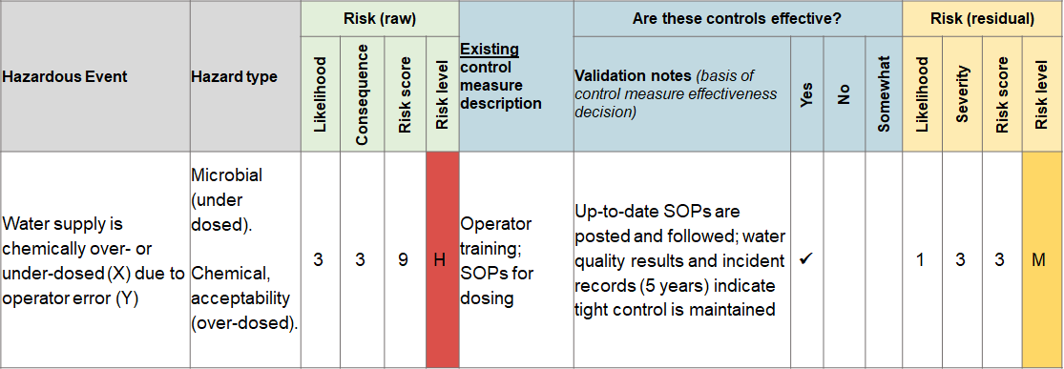
TWO STAGE risk assessment (raw + residual)
Raw risk
is always
Residual
risk
?
When does raw risk equal residual risk?
Notes:
Answer – where there is no control measure in place.

Slide 36

ONE STAGE vs. TWO STAGE risk assessment
One stage risk assessment = residual risk only = essential
Two stage risk assessment = residual + raw = optional
?
Why assess raw risk?
Notes:
Raw risk identifies the significance of the control measure (i.e. if the control measure did not exist, or fails)
Helps identify weaknesses in existing control measures
Identifies the need to ensure ongoing maintenance of existing control measures to ensure they remain functional
Emphasizes the importance of controlling each hazard at its source, especially when events have high raw risk but low residual risk.

Slide 37

DEALING with uncertainties in the risk assessment
WSP team will often have information gaps when validating control measures and assessing risks – this should not be a barrier to progress!
Document the information gaps, and any assumptions made in the validation or risk assessment
Revisit once the necessary information becomes available, and update the risk assessment

Slide 38
ACTIVITY 7:
Risk assessment
Workbook Activity 7 (page 12)
40 minutes
 |  |  | SEVERITY
 |  |  | No/minor impact | Moderate impact | Major impact
 |  |  | 1 | 2 | 3
LIKELIHOOD | Unlikely | 1 | 1 | 2 | 3
 | Likely | 2 | 2 | 4 | 6
 | Most likely | 3 | 3 | 6 | 9
 | Risk score: |  | ≤ 2 | 3 - 5 | ≥ 6
 | Risk level: |  | Low | Medium | High
(30 to complete;
10 to discuss)
Working in groups, refer to Activity 7 in the Participant Workbook (page 12) and carry out the risk assessment exercise.

Slide 39
RISK assessment (5x5 matrix)
ALTERNATIVE
 |  |  | SEVERITY
 |  |  | Insignificant | Minor | Moderate | Major | Catastrophic
 |  |  | 1 | 2 | 3 | 4 | 5
LIKELIHOOD | Most unlikely | 1 | 1 | 2 | 3 | 4 | 5
 | Unlikely | 2 | 2 | 4 | 6 | 8 | 10
 | Likely | 3 | 3 | 6 | 9 | 12 | 15
 | Very likely | 4 | 4 | 8 | 12 | 16 | 20
 | Almost certain | 5 | 5 | 10 | 15 | 20 | 25
 | Risk score: |  | ≤ 5 | 6 - 14 | ≥ 15
 | Risk level: |  | Low | Medium | High
Clearly not a priority
Medium- or long-term priority; requires some attention
Clearly a priority; requires urgent attention

Slide 40
RISK assessment (5x5 matrix)
Likelihood level |  | Definition
1 | Very unlikely | Has not occurred in the past, and it is highly improbable that it will happen in the future
2 | Unlikely | Is possible and cannot be ruled out completely
3 | Likely | Is possible and under certain circumstances could happen
4 | Very likely | Has occurred in the past and has the potential to happen again
5 | Almost certain | Has occurred in the past and is expected to happen again
EXAMPLE DEFINITIONS
Severity level |  | Definition
1 | Insignificant | Negligible impact on water quality, acceptability or quantity
2 | Minor | Short-term or localized non-compliance, quantity or acceptability issue (not health related)
3 | Moderate | Long-term or widespread non-compliance, quantity or acceptability issue (not health related)
4 | Major | Potential long-term health effects
5 | Catastrophic | Potential illness or death

Slide 41
3x3 MATRIX versus 5x5 matrix
Consideration | 3x3 matrix | 5x5 matrix
Simplicity | ☺☺ | ☺
Resolution of risk score/level | ☺ | ☺☺
Choose level of complexity that suits
WSP team experience/resources
=> Start simple and incrementally improve

Slide 42


EXERCISE:
Pop quiz
10 minutes
Working in plenary, complete the pop quiz.
Raise your hand if you know the right answer…

Slide 43
EXERCISE:
Pop quiz
The WSP approach consists of how many modules?
Q1

Slide 44
ANSWER:10 WSP MODULES
Mod 1: Assembling the WSP team
Mod 2: Describing the system
Mod 3: Identifying hazards and hazardous events
Mod 4: Validating existing control measures and assessing risks
Mod 5: Planning for improvement
Mod 6: Monitoring control measures
Mod 7: Verifying the effectiveness of water safety planning
Mod 8: Strengthening management procedures
Mod 9: Strengthening WSP supporting programmes
Q1
Mod 10: Reviewing and updating the WSP

Slide 45
EXERCISE:
Pop quiz
Name 2 limitations of relying on end-product testing to ensure water safety.
  Water quality testing for all relevant parameters can be cost prohibitive
  ?
  ?
Q2

Slide 46
ANSWER
Limitations of end-product testing include:
  Testing can be very expensive
  Reactive approach (problem has already occurred)
  Test results provide a “spot check” only
  (problems can be missed in space and time)
  Limited laboratory/equipment capacity
  May not be clear what went wrong, where and when
  (supplier may not know how to correct problem)
Q2
Notes:
46

Slide 47
EXERCISE:
Pop quiz
Key WSP objectives are:
  ?
  Removing or reducing contamination by water treatment
  Preventing recontamination during storage and distribution
  Preventing recontamination at the household
Q3

Slide 48
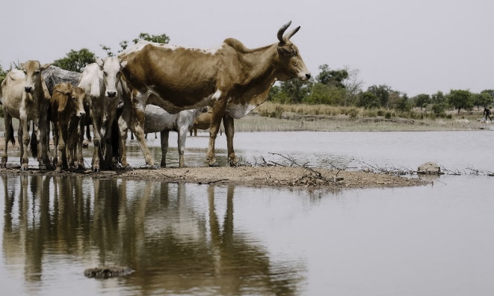
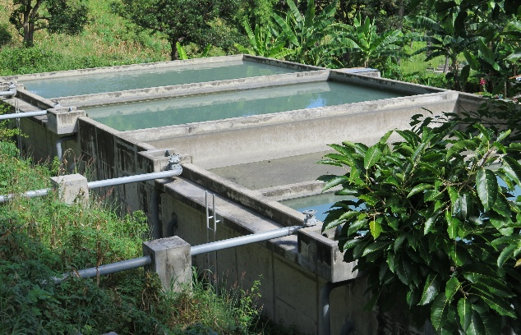
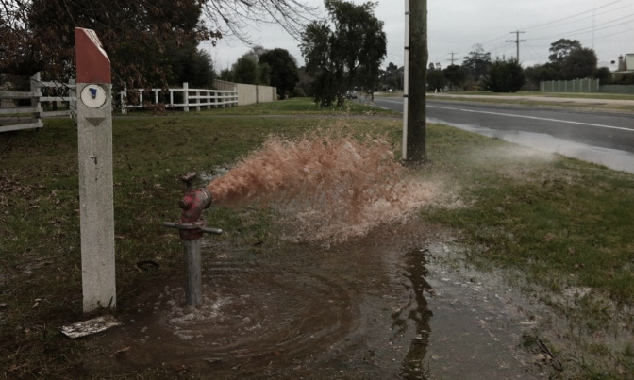
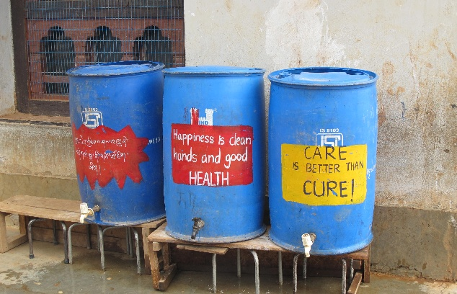
ANSWER
Q3
Preventing contamination at the source
Removing/ reducing contamination by water treatment
Preventing
recontamination
in storage and distribution
Preventing recontamination at the household
Picture 1: Ollivier Girard/CIFOR via flickr.com (CC BY-NC-ND 2.0)
Pictures 2-4: WHO/Rory Moses McKeown
Notes:
48

Slide 49
EXERCISE:
Pop quiz
Explain the difference between a hazard and a hazardous event?
Q4

Slide 50
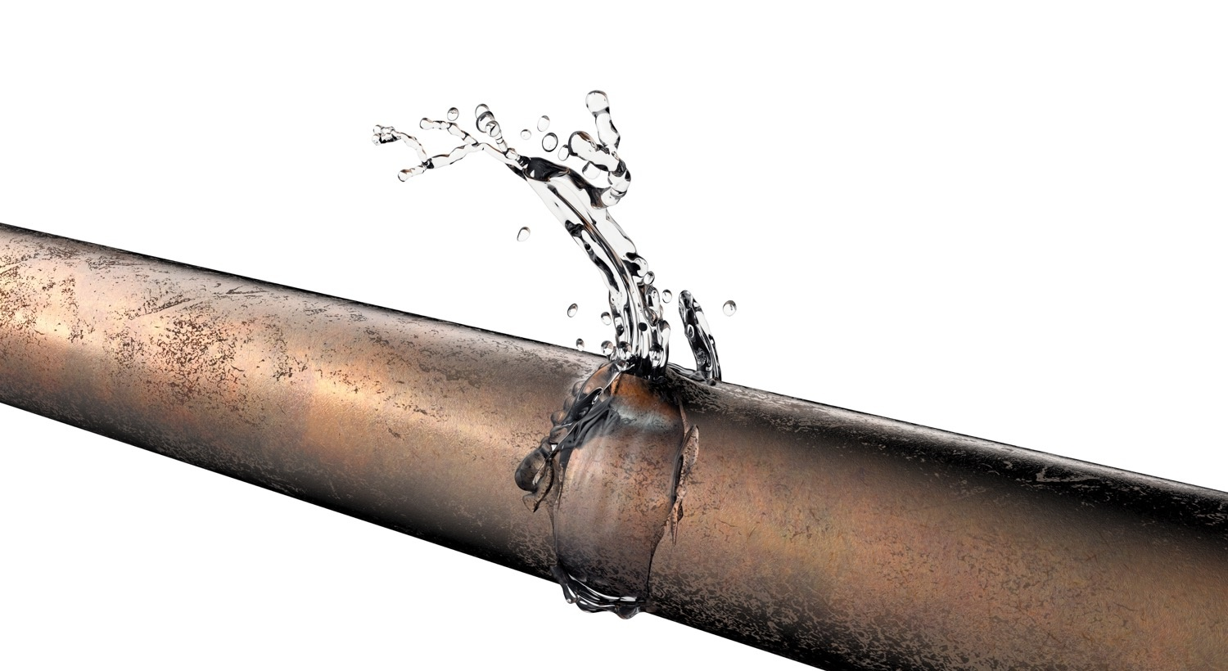
ANSWER
HAZARD
A contaminant or condition that may adversely affect the supply of safe drinking-water
HAZARDOUS EVENT
An event that results in a hazard being introduced to, or inadequately removed from, the water supply
Q4

Slide 51
EXERCISE:
Pop quiz
What is the “formula” for describing a hazardous event?
Q5

Slide 52

ANSWER
When identifying hazardous events, BE SPECIFIC!
Clearly indicate what hazard could be introduced, and how.
TIP: A good hazardous event reads like this:
X happens (to the water supply) because of Y
Q5

Slide 53
EXERCISE:
Pop quiz
What is a “control measure”?
Q6

Slide 54
ANSWER
CONTROL MEASURES
An activity or process to prevent, eliminate or reduce the risk of a hazardous event to an acceptable level
Module 4 focuses on identifying and validating EXISTING control measures already in place.
ADDITIONAL control measures that are needed are addressed in Module 5
Q6

Slide 55
EXERCISE:
Pop quiz
What does it mean to “validate” a control measure?
Q7

Slide 56
ANSWER
Key actions:
  Identify existing control measures
  Validate control measures
1
2
“Validation” can mean different things in different contexts.
In the context of a WSP, it has this very specific meaning.
VALIDATION
Obtaining evidence that the control measure can effectively control the corresponding hazardous event
Q7

Slide 57
EXERCISE:
Pop quiz
Complete this sentence:
The risk associated with a hazardous event depends on the combination of ____________________ and _____________________.
Q8

Slide 58
ANSWER
Key actions:
  Identify existing control measures
  Validate control measures
  Assess the risks
1
2
3
RISK
The product of the likelihood of occurrence of a hazardous event and its severity (or consequences)
Q8

Slide 59

MODULE
5
Planning for improvement
What needs to be improved to ensure the supply of safe drinking-water, and how?
Notes:
59
Module slide 1

Slide 60
MODULE 5 overview
1
2
3
WHAT WE DO:
Develop a detailed improvement plan to address all significant risks requiring additional control
WHY WE DO IT:
To ensure stepwise system improvement
HOW WE DO IT:
  Select the hazardous events needing additional control
  Develop a plan for progressive improvement
  Implement the improvement plan

Slide 61
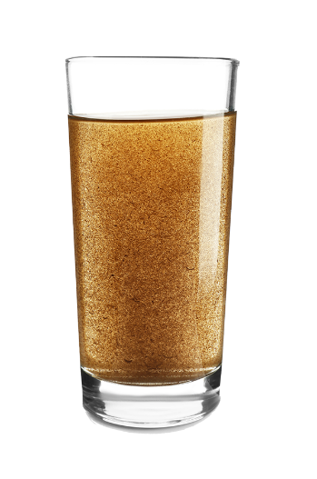
DEFINITIONS
IMPROVEMENT PLAN
An action plan for improving the level of control for a hazardous event, thereby reducing the level of risk

Slide 62
IMPROVEMENT PLANNING:
logic flow
MODULE 3
What are the hazardous events and hazards that threaten water safety?
MODULE 4
What existing controls are in place, are they effective? What are the risks, and what needs more control?
MODULE 5
What will be done to address the risks that require additional control?

Slide 63
3
What could go wrong?
(Module 3)
What are we doing about it and is it effective?
(Module 4)
What is the risk?
(Module 4)
WORKED EXAMPLE:
Process Step | Hazardous Event | Hazard | Existing control measure description | Are the existing controls effective? |  |  |  | Risk assessment
 |  |  |  | Validation notes (basis of control measure effectiveness decision) | Yes | No | Somewhat | Likelihood | Severity | Risk score | Risk level
Distribution | The water supply becomes microbially contaminated when dirty water enters the pipeline (X) because of unsanitary pipeline repair practices (Y) | Microbial | Visual inspection of reinstated pipe water by operator (i.e. sample of water in a white bucket) | Supervisor oversight reports that procedures are not always followed in practice; water quality testing indicates problems with microbial contamination and high turbidity occasionally following pipe repairs |  |  | ✓ | 2 | 3 | 6 | H
Detailed improvement plan needed where the risk level is unacceptable (Module 5)
Notes:
Make the link that we are continuing here with the same worked example that was introduced in Module 4

Slide 64

KEY ACTION 1:
Select the hazardous events needing additional control
Based on the outcomes from the risk assessment in Module 4, determine which hazardous events require an improvement plan.
How to do this? Consider one of the following approaches.
  Relying on the expert judgement of the WSP team
  Or, use a risk score cut-off point
  e.g. a risk score greater than 6 requires additional control; below this, the risk is kept under review
The approach taken to selecting hazardous events that require additional control should be agreed by the WSP team and documented in the WSP

Slide 65
KEY ACTION 2:
Develop a plan for improvement
A detailed improvement plan should consider:
  Specific action to be undertaken
  Responsible party
  Due date
  Budget
  Resource constraints (financial, human)
  Short-, medium- and long-term priorities
BE REALISTIC!
Notes:
Flag that early stage WSP teams often over promise and under deliver with improvements. In particular, be realistic that the timeframes are achievable, and adequate resources are available.

Slide 66

Hazardous event: The water supply becomes microbially contaminated when dirty water enters the pipeline (X) because of unsanitary pipeline repair practices (Y)
Hazard: Microbial
Control Measures: Visual inspection of reinstated pipe water by operator
WORKED EXAMPLE:
Likelihood = 2
Might occur at some time; has been observed occasionally
Severity = 3
Major impact; potential illness or death in community associated with the water supply

Slide 67
IMPROVEMENT planning
WORKED EXAMPLE:
Process Step | Hazardous Event | Hazard | Existing control measure description | Are the existing controls effective? |  |  |  | Risk assessment
 |  |  |  | Validation notes (basis of control measure effectiveness decision) | Yes | No | Somewhat | Likelihood | Severity | Risk score | Risk level
Distribution | The water supply becomes microbially contaminated when dirty water enters the pipeline (X) because of unsanitary pipeline repair practices (Y) | Microbial | Operator training on sanitary pipeline repair practices | Supervisor oversight reports that procedures are not always followed in practice; water quality testing indicates problems with microbial contamination; occasional dirty water reports from customers occasionally following pipe repairs |  |  | ✓ | 2 | 3 | 6 | H
What specific action
will be taken?

Slide 68
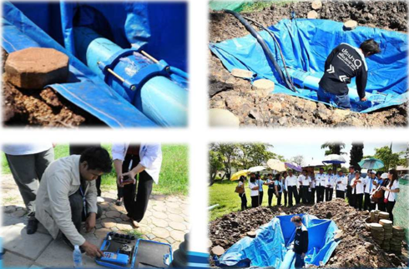
OPTION 1 (Thailand)
Credit: WHO/Angella Rinehold
Keep the trench as clean as possible
Notes:
Flag that this is one possible option for improvement planning for the Worked Example risk presented in Module 4

Slide 69
OPTION 1 (Thailand)
WORKED EXAMPLE:
 | Specific improvement action | Arising from (relevant hazardous event) | Responsible party(ies) | Estimated cost ($) | Source of funding | Due date | Status (not yet started, actions undertaken to date, etc.)
1 | Purchase 10 specialized plastic trench liners and 5 trench dewatering pumps, develop new SOPs and train staff on new procedures, with ongoing refresher training and field supervision | Risk of contamination from pipeline repair practices | Head of operations | 5 000 | Capital budget Operational budget | May 20XX | Not yet started
2
3

Slide 70
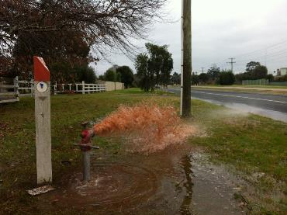
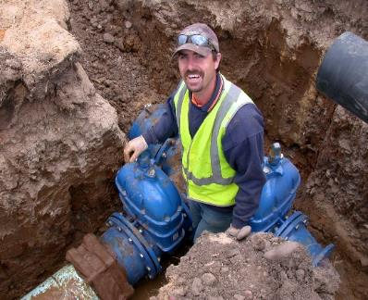
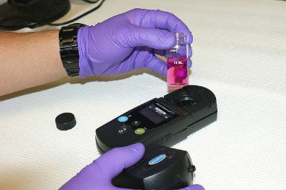
OPTION 2 (Australia)
Take reasonable precautions to keep pipeline clean
Use dedicated water (vs sewer) repair gear (e.g. boots, shovels)
SOP to flush pipeline after repair with confirmation of free chlorine residual
WHO/R M McKeown
NAVAC via flickr.com (CC BY-NC-ND 2.0)
Notes:
Flag that this is another possible approach for improvement planning for the Worked Example risk presented in Module 4

Slide 71
OPTION 2 (Australia)
WORKED EXAMPLE:
 | Specific improvement action | Arising from (relevant hazardous event) | Responsible party(ies) | Estimated cost ($) | Source of funding | Due date | Status (not yet started, actions undertaken to date, etc.)
1 | Purchase separate repair gear for water and sewer maintenance staff, develop new SOP on pipeline flushing following repair and train staff on new procedures, with ongoing refresher training and field supervision | Risk of contamination during pipeline repair | Field manager (purchasing) Operations team leader (SOP development and training) | 900 | Capital budget Operational budget | May 20XX | Repair gear purchased March 20XX. SOP development and training not yet stared.
2
3

Slide 72
PROGRESSIVE improvement planning
Sometimes a stepwise approach to full implementation of an optimal solution is needed due to resource constraints e.g. strengthening chlorine monitoring at water treatment plant…
Example: stepwise improvement to address cows at source
 | Specific improvement action | Arising from (relevant hazardous event) | Responsible party(ies) | Estimated cost ($) | Source of funding | Due date | Status (not yet started, actions undertaken to date, etc.)
1 | Operator manually checks the free chlorine residual concentration at exit of the water treatment plant 3 times per day. | Risk of inadequate free chlorine residual in treated water leaving the plant | Operational staff on-duty | 100 | Operational budget | Within 1 week | Completed
2 | Installation of online free chlorine residual monitor with alarm that sounds at the water treatment plant in the event of an exceedance. |  | Operations manager | 10 000 | Capital budget | Within 12 months | Installation underway May 20XX
Notes:
Flag that this is a new example.
It shows how progressive improvement is applied in practice.
Here we have a stepwise approach with two actions (see next slide).

Slide 73
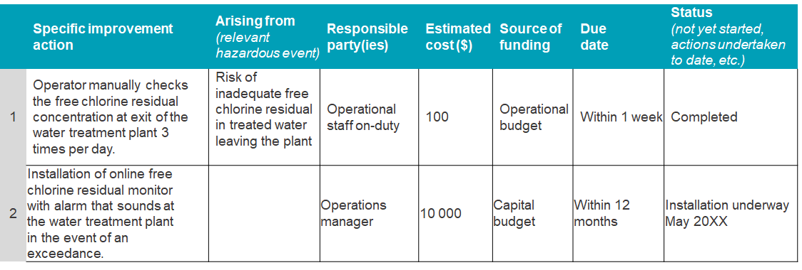
PROGRESSIVE improvement planning
2
Get started, improve over time!
Step 1: Lower risk reduction, lower cost, but faster to implement
Step 2: Higher cost, longer to implement, but greater risk reduction ultimately

Slide 74
KEY ACTION 3:
Implement the improvement plan
Implement the improvement plan according to the assigned timelines
  Monitor the implementation of the improvement plan to ensure progress, and report regularly to management.
  Once an improvement is to be put in place, update the corresponding section of the risk assessment table (discussed in Module 10)
Notes:
Bullet 1 - If delays occur, document the reasons and revised timelines in the improvement plan. Report on progress regularly to senior management.
Bullet 2 - Reassess the risk, taking into account the effectiveness of the new or strengthened control measures.

Slide 75
VALIDATING the effectiveness of proposed improvements
Important to consider validation of proposed control measures in addition to existing control measures (Module 4)
Question: How can we validate a proposed control measure to ensure it is capable of controlling a particular hazard?
Cannot rely on existing water quality data or visual inspections!
Strategies could include:
Scientific literature (again, be careful comparing situations)
Factory validation of equipment by manufacturer e.g. UV system (ensuring validation conditions are similar to operational conditions in practice)

Slide 76


FINANCING improvement plans
Generally, some improvements can be implemented immediately at little or no cost, while other improvements may require significant resources.
The improvement plan can be an excellent tool to attract funding from government and external donors/banks who understand that WSPs help to:
Systematically identify priority needs
Sustain improvements through strengthened
operations and management

Slide 77


IMPROVEMENT planning for enhanced resilience
  Consider control measures that provide benefit under multiple climate scenarios e.g. “low/no-regret” improvements like source protection measures, strengthening chlorination practices.
  Such actions provide immediate benefit now, and over a broad range of future and uncertain climate projections.
Notes:
Improvement planning should flexible and adaptable to respond to new climate information or the emergence of new threats.

Slide 78


IMPROVEMENT planning for equity
For each relevant control measure proposed, the WSP team should ask:
Are there any potential negative consequences of the control measure to any stakeholder group?
Are there alternatives, modifications or compensation measures for any control measure that is expected to cause harm or inequitable benefit?
Are different control measures needed for different users based on their unique needs?

Slide 79

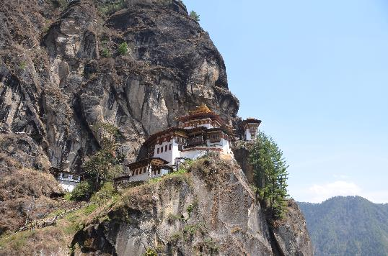
CASE EXAMPLE:
Improvement planning in Bhutan
This true story highlights the importance of looking beyond physical/infrastructural issues to fully understand improvement needs…
WHO/R M McKeown

Slide 80

WTP OPERATIONS theory vs practice
S. River
IN THEORY According to WSP documentation, the WTP needed a new Cl₂ dosing system and new slow sand filter media.
WTP improvement needs identified in the WSP were purely physical.
Funds were to be provided (government + donor) following a WSP audit.
Coag./floc.
Sedimentation
Slow sand filters (SSFs)
To customers
Clearwater
2 chlorine (Cl₂) units
(pressurized + gravity backup)
Notes:
A WSP team in Bhutan had been through the WSP process and identified these improvement needs at a WTP:
1. Chlorine dosing system to be replaced
2. Slow sand filter media to be replaced
According to WSP documentation, the WTP employed the treatment processes shown on the diagram.
The improvement works were to be funded by an international donor and the government of Bhutan following a WSP audit.

Slide 81
WTP OPERATIONS theory vs practice
S. River
Coag./floc.
Sedimentation
IN PRACTICE WSP audit team found entire WTP was being bypassed due to problems largely related to poor operations and maintenance (O&M).
Bypass line
SSFs
To customers
Clearwater
2 Cl₂ units
(pressurized + gravity backup)
Notes:
When the WSP audit team visited the site to investigate the improvement needs proposed, they found that the entire WTP was in fact being bypassed for reasons largely related to poor O&M.

Slide 82
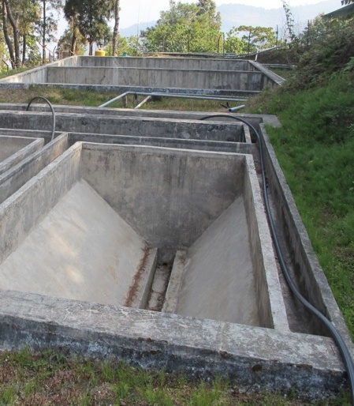
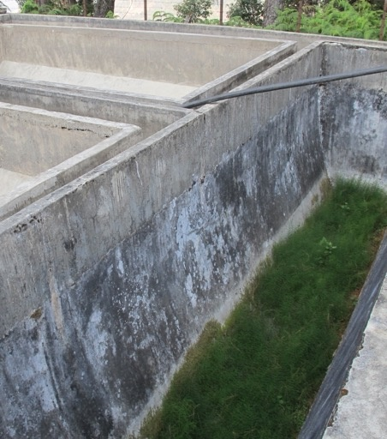
The actual situation encountered
by the WSP audit team:
Grass growing in process basins
Credit: WHO/Angella Rinehold
Not a drop of water in the treatment plant

Slide 83
Many issues at this WTP were O&M-related.
Addressing “hard” improvements only will not be effective.
S. River
Coag./
floc.
No chemicals on site/
design poorly understood
Sedimentation
Clogged lines/
design poorly understood
1 Cl₂ unit broken
Poor quality media
Poor O&M of SSF
SSFs
2 Cl₂ units
(pressurized + gravity backup)
One Cl₂ unit functional; no clear reason for non-use.
Also no way to know dose due to lack of Cl₂ testing equipment
Notes:
The key message here is that although one Cl2 unit was broken and the SSF media did need to be replaced, most of the issues at the WTP were related to poor O&M. Addressing the physical needs without addressing the need to strengthen O&M would not have been effective.
Following the WSP audit and before funds were released for the physical improvements, the WSP was revised to assess and manage the O&M issues as well.

Slide 84

#1 moral of the story
2
WSPs should address both “hard” (physical) and “soft” (O&M) needs e.g.
Flood defense ditch
Establishing buffer zones for source protection
Fire sprinkler system for treatment plant in bushfire area
“Hard” solutions
“Soft” solutions
Operator training on SOPs
User education programme on safe household practices
Chlorine booster station in distal part of network
Proactive mains cleaning programme
Construction of tapstands in informal settlements
User education programme on water conservation during drought

Slide 85
#2 moral of the story
1
DON’T SHOW THIS
IN THE WSP…
S. River
Coag./floc.
Sedimentation
SSFs
To customers
S. River
Clearwater
Coag/floc
Sedimentation
2 Cl₂ units
(pressurized +
gravity backup)
Bypass line
SSFs
… when the real situation is THIS!
Let the WSP reflect the REAL situation and explore the issues.
Clearwater
To customers
2 Cl₂ units
(pressurized +
gravity backup)

Slide 86
EXERCISE
Improvement planning
Workbook Activity 8 (page 18)
25 minutes
(15 to complete;
10 to discuss)
Working in groups, refer to Activity 8 in the Participant Workbook (page 18) carry out the improvement planning exercise.

Slide 87

MODULE
6
Monitoring control measures (operational monitoring)
Are the control measures operating as intended?
Notes:
87
Module slide 1

Slide 88
MODULE 6 overview
1
2
3
WHAT WE DO:
Define an operational monitoring plan for important control measures, and implement the plan
HOW WE DO IT:
  Identify the control measures to be monitored
  Develop an operational monitoring plan for the control measures
  Implement the operational monitoring plan
WHY WE DO IT:
To ensure that the control measures continue to work as intended and to allow for timely action to be taken to prevent problems from occurring

Slide 89
DEFINITIONS
2
OPERATIONAL MONITORING PLAN
A plan to monitor control measures to ensure that they work as intended, and that proper and timely corrective action is taken when predefined limits are not met
CRITICAL LIMIT
An operational limit that separates acceptable performance from unacceptable performance of the control measure, triggering corrective action
CORRECTIVE ACTION
Action taken when operational monitoring indicates that the control measure is not working as intended

Slide 90
OPERATIONAL monitoring
MODULE 4
Through validation, we confirm that a control measure is fundamentally capable of addressing the hazard
MODULE 6
Through routine operational monitoring, we ensure that the control measure continues to function correctly (i.e. within acceptable limits)
Routine monitoring of control measures is one of the most important WSP activities and is central to proactive risk management

Slide 91
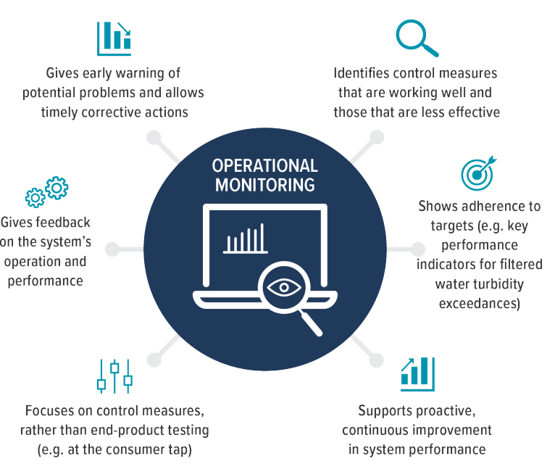
BENEFITS of operational monitoring

Slide 92
KEY ACTION 1:
Select the control measures to be monitored
2
Which control measures should be monitored?
Look at each existing control measure in your risk table and the hazardous event it is designed to manage
Is the control measure critical to keeping the risk to an acceptable level?
Monitoring plan not needed
No
Yes
Monitoring plan needed
Notes:
Flag that this is where a two-stage risk assessment is beneficial e.g. raw risk high, and residual risk low, would indicate that the control measure is critical.

Slide 93
KEY ACTION 2:
Develop an operational monitoring plan
Operational monitoring
should be:
  Simple: easy to perform
  Rapid: quick to carry out and with
  fast, reliable results
  Routine: easy to incorporate into normal operations

Slide 94
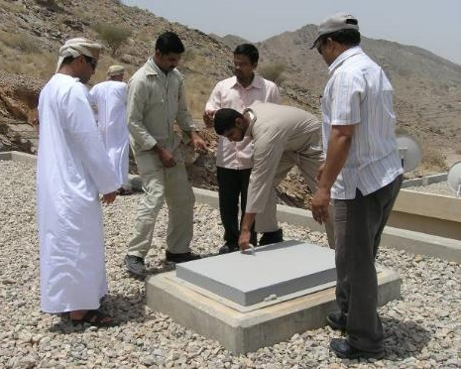
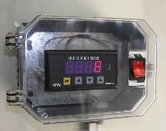
METHODS of operational monitoring
Observe
  Integrity of fence
  Tank hatch (if open/closed; locked/unlocked)
  Water level (head) in filter
  Formation of floc
  Household storage/handling practices
Credit: WHO/Oliver Schmoll
Measure
  Raw water turbidity
  Filtered water turbidity
  Filtered water pH
  Flow rate through water treatment plant
  Free chlorine concentration in distribution system
WHO/R M McKeown

Slide 95



CRITICAL limits and corrective actions
2
What to
monitor
Target condition/ critical limit
Fence intact,
no damage
Fence around abstraction point
Remove animals and repair/
replace fence
Critical limit breached
Corrective action

Slide 96
DEVELOP an operational monitoring plan
WORKED EXAMPLE:
Process step | Control measure | What to monitor? | Where? | When? | How? | Who? | Critical limit (or target condition) | Corrective action
Distribution | Sanitary pipe repair practices | Free chlorine residual and turbidity of reinstated pipe water | First sample point in the network downstream of the repair location | Following every pipe repair | Free chlorine residual meter Turbidity meter | Network maintenance operator | Free chlorine residual: ≥0.2 mg/L and ≤0.7 mg/L Turbidity: <0.5 NTU | Repeat pipe flushing until target conditions are met
Notes:
Flag that this is a continuation of the Worked Example risk identified in Module 4

Slide 97
DEVELOP an operational monitoring
OTHER EXAMPLES:
Process step | Control measure | What to monitor? | Where? | When? | How? | Who? | Critical limit (or target condition) | Corrective action
Catchment | Fence around abstraction point | Fence condition | At abstraction point | Weekly | Visual inspection | Maintenance lead | Fence structurally sound and the gate secured | Secure gate or repair fence
Water treatment plant | Chlorination | Chlorine residual | At entry point to the distribution system | 4 x daily | Collect sample from tank outlet tap & field test | Analyst | ≥0.9 mg/L and ≤1.2 mg/L | Follow chlorine non-compliance SOP
Notes:
Flag that these examples are separate to the Worked Example

Slide 98


KEY ACTION 3:
Implement the operational monitoring plan
2
OPERATIONAL MONITORING:
What to monitor, where, when, how, who? What is critical limit or target condition?
MONITORING RESULTS:
Is the control measure performing as intended (within critical limits)?
CORRECTIVE ACTIONS:
What corrective actions need to be taken if critical limits are breached?
No
Yes
Continue monitoring as per operational monitoring plan

Slide 99
IMPLEMENTING operational monitoring
  EMBED into routine operations
  ASSESS monitoring data frequently to gain operational insights and identify where optimization or improvement needed
  PAY ATTENTION to deviations from established trends => may indicate an issue is about to occur
  USE operational monitoring data to inform control measure validation (Module 4) and during WSP reviews (Module 10)
Operational monitoring plans often omit vulnerable users.
For example, monitoring may detect adequate chlorine in the main network, but informal settlements may receive water that is not sufficiently chlorinated.
Consider the full diversity of users in Module 6.

Slide 100
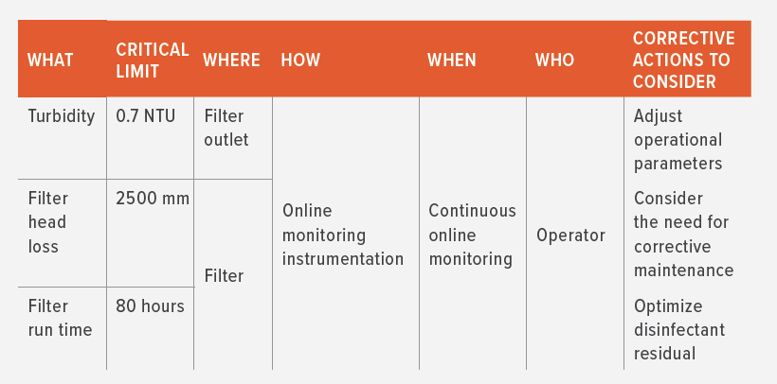
CASE EXAMPLE:
Operational monitoring (Uruguay)
National regulations specify operational monitoring requirements for control measures that are significant for drinking-water safety.
Water supplies can set more stringent critical limits as appropriate

Slide 101
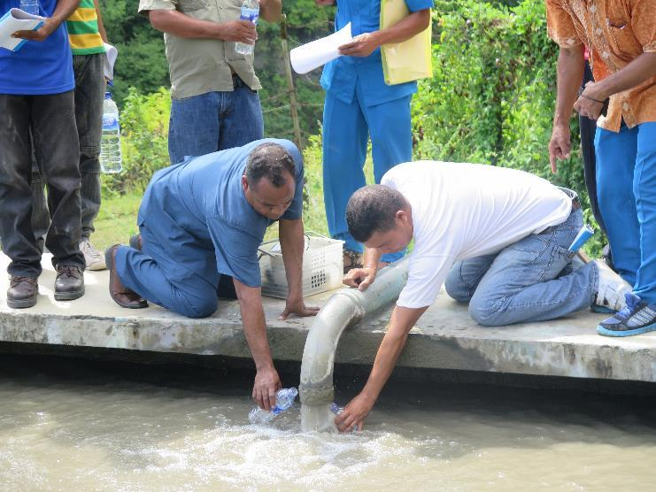
CASE EXAMPLE:
Operational monitoring in Timor-Leste
WHO/R M McKeown

Slide 102
FROM Timor-Leste:
Process Step | Control Measure | Where? | What? | How? | When? | Who? | Critical Limit | Corrective Action
Treated water storage tank | Maintain target free chlorine residual (FCR) concentration | Tank outlet (SP-IST-01) | FCR | Chlorine analyser | Once per week | Technician | Should be ≥0.2 mg/L and ≤1.0 mg/L | Immediately review chlorination at water treatment facility and adjust as needed If low chlorine levels detected, also: assess the need to clean tank assess tank detention
 | Tank cleaning program | Tank outlet (SP-IS-01) | Turbidity | Turbidity tube | Once per week | Technician | Should be ≤5 NTU | Investigate upstream water quality trends to determine source of elevated turbidity, and clean tank if it is the suspected source
 | Security fencing and gate locks | Tank compound | Integrity of security fencing and lock | Visual inspection | Once per week | Technician | Should be free of damage / intact | Repair fencing and/or lock as required

Slide 103
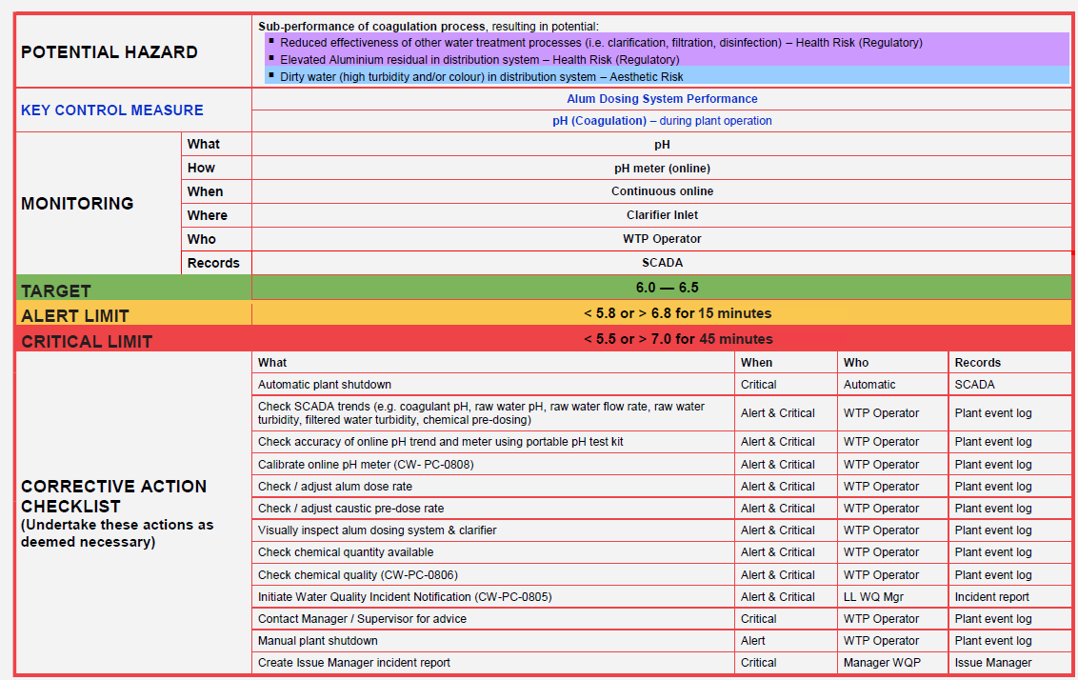
CASE EXAMPLE:
Operational monitoring plan extract, Australia
Courtesy of Coliban Water, Australia
Notes:
This highlights a more detailed approach from a mature WSP highlighting:
A target value (or range): represents optimal control of the process.
An adjustment limit (or alert limit): indicates the point where adjustment is needed to restore control and avoid the alarm limit being reached.
A critical limit: indicates control of the process is lost and drinking-water safety is not guaranteed.
Flag also that the limits are “time-based” – this is particularly desirable for online instrumentation to differentiate where there could be an instantaneous spike/potential instrument error vs. prolonged out of range value.

Slide 104
EXERCISE:
Operational monitoring
Working together in plenary, let’s discuss options for completing the table below for operational monitoring of rapid sand filter performance.
5 minutes
Process step | Control measure | What to monitor? | Where? | When? | How? | Who? | Critical limit (or target condition) | Corrective action
Water treatment plant | Rapid sand filter | ? | ? | ? | ? | ? | ? | ?
After exercise, review examples on following slide…

Slide 105
EXERCISE:
Operational monitoring
Example solutions (visual inspection and water quality testing):
Process step | Control measure | What to monitor? | Where? | When? | How? | Who? | Critical limit (or target condition) | Corrective action
Water treatment plant | Rapid sand filter | Water level | In filter | 1x daily (dry season); 2x daily (rainy season) | Visual inspection | Operator | <0.5 m below top of filter basin | Filter backwash as per SOP
 |  | Turbidity | At filter outlet | 1x daily (dry season); 2x daily (rainy season) | Sampling and on-site lab testing | Operator | <1 NTU | Filter backwash as per SOP

Slide 106


Energizer:
True or false
5 minutes
ENERGIZER ACTIVITY!
We will designate a “true” and a “false” area of the room.
As we read the following statements, please walk to the “true” or “false” area to express your view.
For each statement, a VOLUNTEER should explain why it is true or false.

Slide 107
Energizer:
True or false
Water safety can be assured by water quality testing alone, as assessing risks is subjective.
Water safety planning can result in more targeted use of limited resources.
Operational monitoring is typically conducted by the surveillance authority.
The WSP approach should be followed exactly as the WHO WSP Manual prescribes it – it should never be tailored to a particular context.
Water safety planning should be undertaken in a progressive way – starting simple, and improving progressively over time as capacity and resources permit.
Notes:
False
True
False
False
True

Slide 108

MODULE
7
Verifying the effectiveness of water safety planning
How do we know that the WSP is working and effective?
Notes:
108
Module slide 1

Slide 109
MODULE 7 overview
1
2
3
WHAT WE DO:
Confirm that drinking-water quality standards are being met, consumers are satisfied and the WSP is complete, up-to-date and effective
WHY WE DO IT:
To verify that the WSP as a whole is working effectively to deliver safe drinking-water
HOW WE DO IT:
Develop and implement verification programmes to confirm that:
regulations for drinking-water quality are being met
users are satisfied
the WSP is complete, adequately implemented and effective

Slide 110
VERIFICATION
VERIFICATION
The process of obtaining evidence that the WSP, as a whole, is working effectively to deliver safe drinking-water
Verification is a key part of the continuous WSP improvement cycle

Slide 111
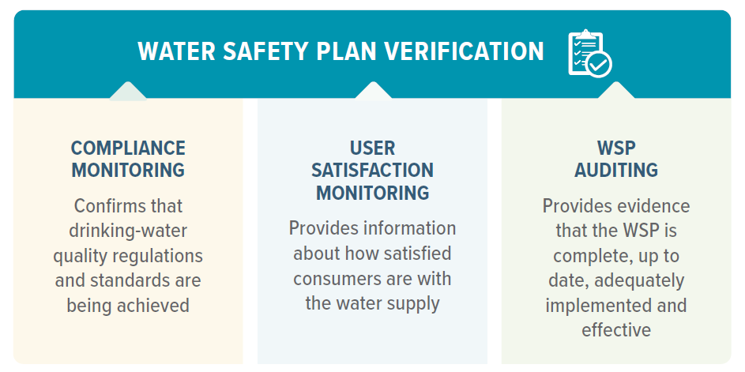
THREE pillars of verification

Slide 112
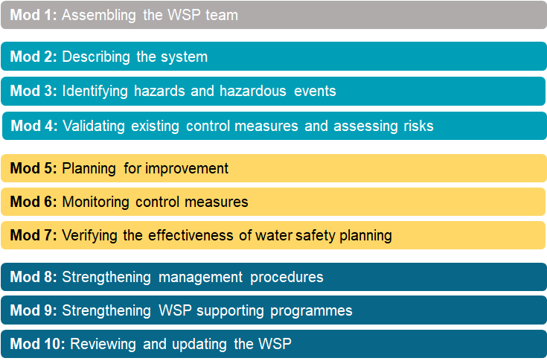
KEY ACTION 1:
Conduct compliance monitoring
Develop and implement a system-specific compliance monitoring programme to determine if regulations and standards for drinking-water quality are being achieved.
Monitoring
Notes:
Flag that monitoring associated with WSPs occurs in both Modules 6 and 7.

Slide 113
MONITORING as part of WSPs
Water quality testing in both modules 6 and 7
MODULE 6
MODULE 7
OPERATIONAL
MONITORING
To ensure that a control measure works effectively
VERIFICATION
To confirm that the WSP as
a whole works effectively
to deliver safe water
Observations
Compliance monitoring
(for health authority to confirm compliance with DWQS)
Measurements
(e.g. water quality testing)
(by the supplier to inform operational decisions)
WSP audits
User satisfaction surveys

Slide 114
MODULE 6 or module 7?
?
Turbidity testing (T) by the supplier at water treatment plant (WTP) filter inlet and outlet to measure filter performance.
Operational monitoring or compliance monitoring?
T
T
Alum
Clarification
Clear water storage tank
5 ML
Rapid mix
1 ML
Raw water storage reservoir
Duty/ standby pumps
Flocculation
Filtration
Cl₂

Slide 115
MODULE 6 or module 7?
?
Faecal coliform (FC) testing by the health authority at household taps.
Operational monitoring or compliance monitoring?
FC
FC
WTP

Slide 116
MODULE 6 or module 7?
?
Free chlorine residual (FCR) testing by the supplier at household taps to confirm compliance with DWQS (results submitted to MoH).
Operational monitoring or compliance monitoring?
FCR
WTP

Slide 117
MODULE 6 or module 7?
?
Free chlorine residual (FCR) testing by the supplier at the WTP and throughout the distribution system to understand chlorine loss and to determine the appropriate chlorine dose.
Operational monitoring or compliance monitoring?
FCR
FCR
FCR
FCR
WTP

Slide 118
THREE pillars of verification

Slide 119
USER satisfaction monitoring
  Develop a user satisfaction monitoring programme to check that users are satisfied with, and are using, the water supply, including:
  a system for managing day-to-day user notifications or complaints
  a routine programme for actively seeking user feedback (e.g. user satisfaction survey).
Ensure that there is equitable investigation of all complaints and notifications.
Design the user satisfaction survey to collect demographic data on all users.
Disaggregate survey responses by gender and other social stratifiers to help identify any differences in user satisfaction between the diverse user groups.

Slide 120

USER satisfaction monitoring
  Always investigate user complaints, especially clusters or patterns
Although subjective, user feedback can give an early indication of water quality problems e.g.
Dirty water ➔ Broken network pipe, abnormal flow, backflow, cross connection?
Milky water ➔ Air in the network?
“Chemical” taste/odour ➔ Chemical overdose at treatment plant, backflow, cross connection, sabotage?

Slide 121
THREE pillars of verification

Slide 122
WSP auditing
WSP AUDIT
An independent and systematic check to confirm that the WSP is complete, adequately implemented and effective
  Audits can support:
  CONFIRMATION that WSPs are compliant with any regulatory requirements
  SUSTAINABLE implementation of the WSP e.g. by providing accountability, motivation
  CONTINUOUS improvement of the WSP

Slide 123
WSP auditing
Audits should always be carried out by someone independent of the WSP team
INTERNAL
AUDIT
EXTERNAL
AUDIT
Someone employed or contracted by the water supplier
Government body or other entity not employed or contracted by the water supplier

Slide 124
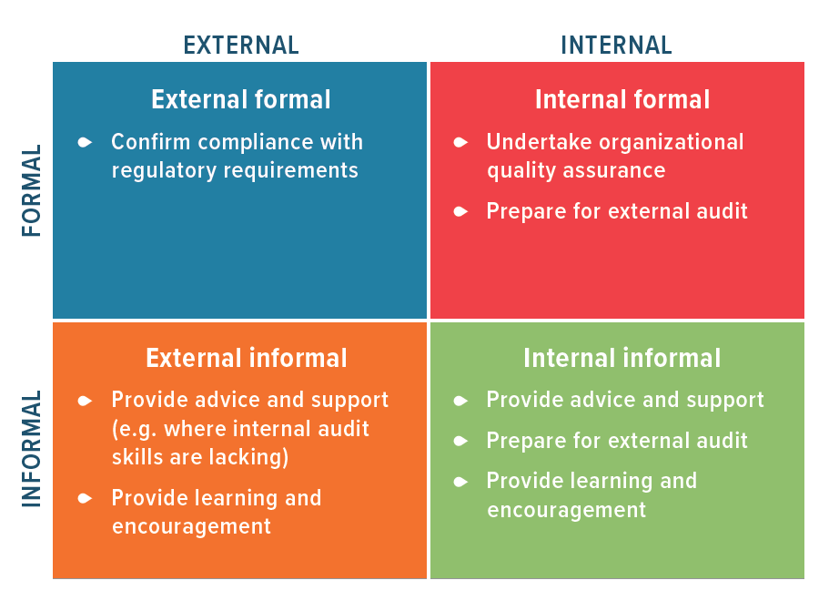
WSP auditing aims

Slide 125
CASE EXAMPLE:
Progressive improvement of WSP auditing in Jordan
SITUATION
WSP auditing was not mandated by national drinking-water quality regulations
Existing verification gap – but the water supplier recognized the importance of auditing for continuous WSP improvement
Basic internal informal auditing undertaken via “water supply field inspections”
  to identify sanitary hazards throughout the water supply
  improve risk management
  These interim activities were implemented in parallel with the development of a customized auditing programme for the water supplier

Slide 126
IMPORTANT note!
VALIDATION
≠
VERIFICATION
 | Are these controls effective?
Existing control measures | Yes | No | Somewhat | Validation notes (basis of effectiveness assessment)
The well has a cover |  |  | ✓ | Visual inspection shows that the well cover is corroded and has holes where animal excreta can be washed into well when it is raining
Part of Module 4: Identify and validate control measures, assess and prioritize risk
Answers the question:
Can the control measure effectively control the hazard?

Slide 127
IMPORTANT note!
VALIDATION
≠
VERIFICATION
Module 7: Verify the effectiveness of a WSP
Answers the question:
Is the WSP as a whole working effectively to deliver safe water?

Slide 128

ANY questions?
Notes:
128

Slide 129
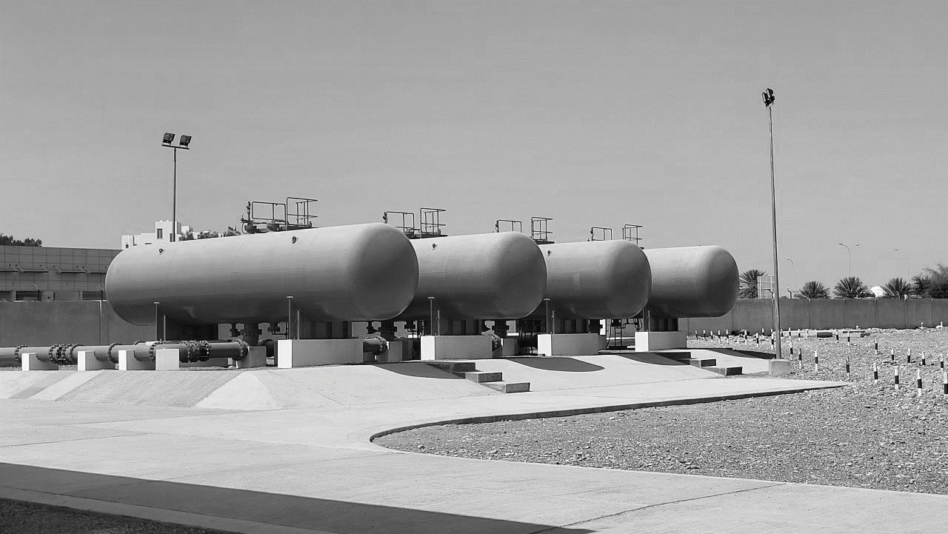
WHO/R M McKeown
FIELD TRIP briefing

Slide 130


FIELD trip briefing
TOMORROW:
All day field trip
Work in your table groups
Wear comfortable clothes/shoes
Expect a briefing by a water supply representative
Notes:
130

Slide 131
ACTIVITY 9 – field trip instructions:
Part I – risk assessment
Refer to Activity 9: Field Visit in your Participant Workbook (page 20).
Bring your workbook with you to the field!
For each major process step visited (e.g. catchment/source, treatment works, storage/distribution and household), make observations and ask questions of staff to:
Identify at least two hazardous events at each major process step (“X happens because of Y”)
Document any existing control measures for each hazardous event
Validate the effectiveness of those controls (may require imagination!)
Assess the risk of each hazardous event identified
Catchment
Treatment
Distribution
User

Slide 132
ACTIVITY 9 – field trip instructions:
Part I – risk assessment
In other words, complete the risk assessment table…
Process Step (catchment, source, treatment plant, etc.) | Hazardous Event (“X happens because of Y”) | Hazard | Existing control measures (measures already in place to address hazard) | Are these controls effective? |  |  |  | Risk assessment
 |  |  |  | Yes | No | Somewhat | Validation notes (basis of control measure effectiveness decision) | Likelihood | Severity | Risk score | Risk level

Slide 133

ACTIVITY 9 – field trip instructions:
Part I – risk assessment
TIPS
Refer to your list of possible hazardous events for ideas while in the field (Participant Workbook page 29)
Ask questions of yourselves and of supplier staff, for example:
  What could go wrong here?
  What steps are currently taken to stop that from happening?
  What evidence is there that those measures do (or do not) work?
Be a WSP detective!

Slide 134
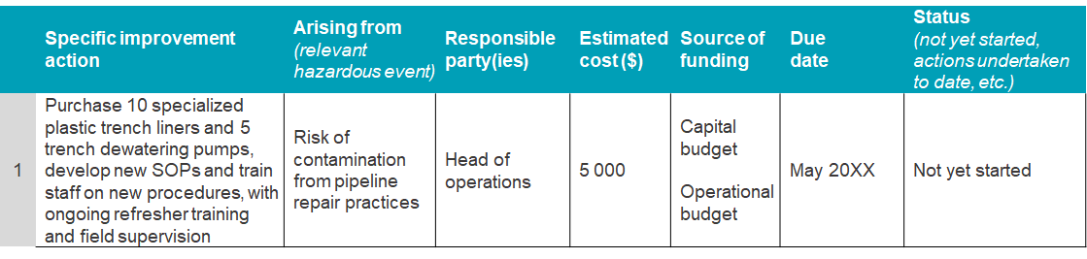
ACTIVITY 9 – field trip instructions:
Part II – improvement plan
Develop an improvement plan where the need for additional control has been identified
From the field-trip risk assessment table (Part I), choose at least two hazardous event that represent a significant risk and require additional control, and complete the improvement plan table.
Consider a two-stage improvement plan i.e. document one simple improvement that could be done in the short term, and in the next row document a more thorough improvement that may require additional funding or expertise.

Slide 135
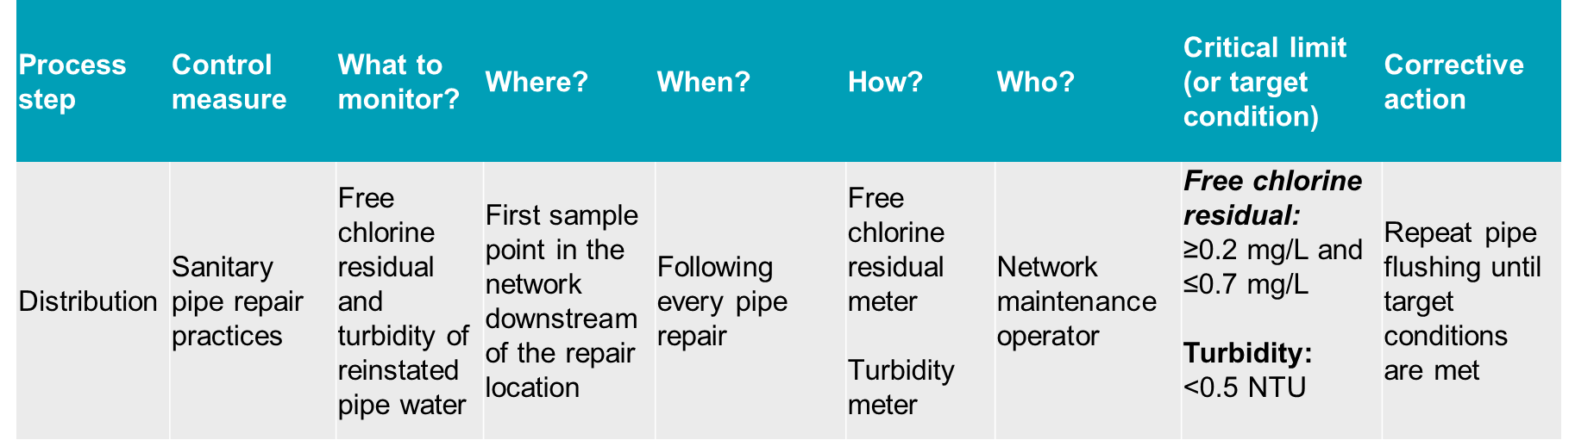
ACTIVITY 9 – field trip instructions:
Part III – operational monitoring
At the process steps visited, e.g. the water treatment plant (WTP), ask questions of staff to determine:
Where are the operational monitoring points? What is monitored, how, how often and by whom? What are the critical limits? What action is taken if critical limits are breached? Where is monitoring data recorded?
For at least two control measures, record the information collected in the form of an operational monitoring plan.

Slide 136
ACTIVITY 9 – field trip instructions:
Part IV – WTP schematic review
Where the field trip includes a WTP visit and a WTP diagram/schematic is provided:
  Study the WTP schematic provided and, while on site, field verify the accuracy of the schematic. Can you spot any significant errors or omissions? If so, make a note on your copy of the schematic.
Alum
Clarification
Clear water storage tank
5 ML
Rapid mix
1 ML
Raw water storage reservoir
Duty/ standby pumps
Flocculation
Filtration
Cl₂
Notes:
Note if a diagram/schematic is not provided, participants may consider sketching a basic one themselves.

Slide 137


ACTIVITY 9 – field trip instructions:
Debrief
On Day 4, groups will prepare a summary of their field trip findings.
Groups will then pair up and share their findings with another table group.

Slide 138
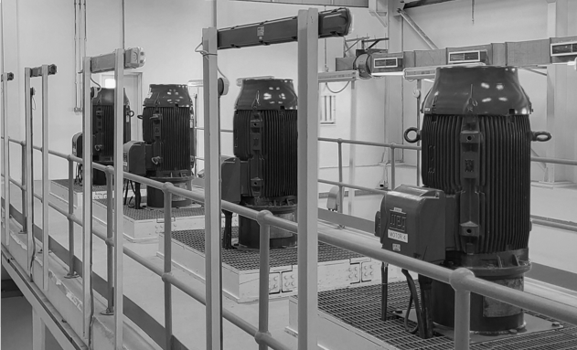
Credit: WHO/RM McKeown
That’s all for today!

