Slide 1
Water safety plan
Step-by-step risk management for drinking-water suppliers
TRAINING PACKAGE
Workshop Day 3
Notes:
1
Cover slide

Slide 2
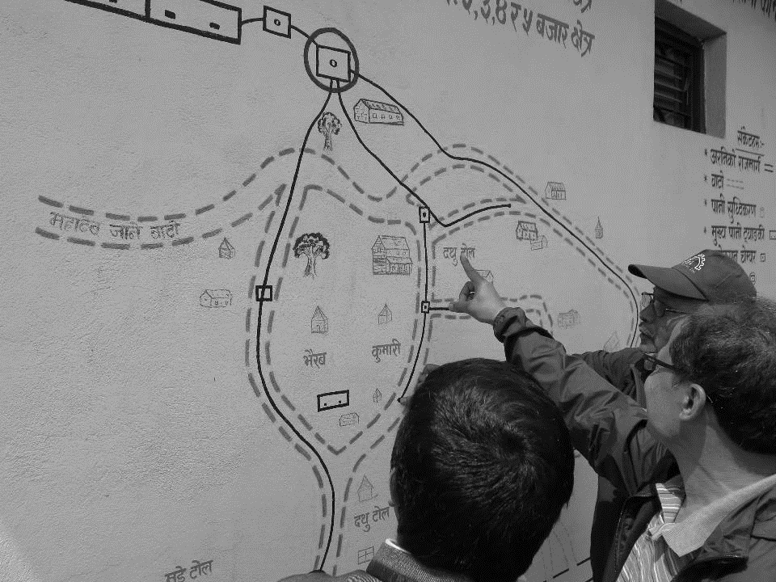
WATER SUPPLIER BRIEFING ON FIELD VISIT
(separate presentation delivered by a water supply representative)
WHO/R M McKeown
Notes:
2

Slide 3
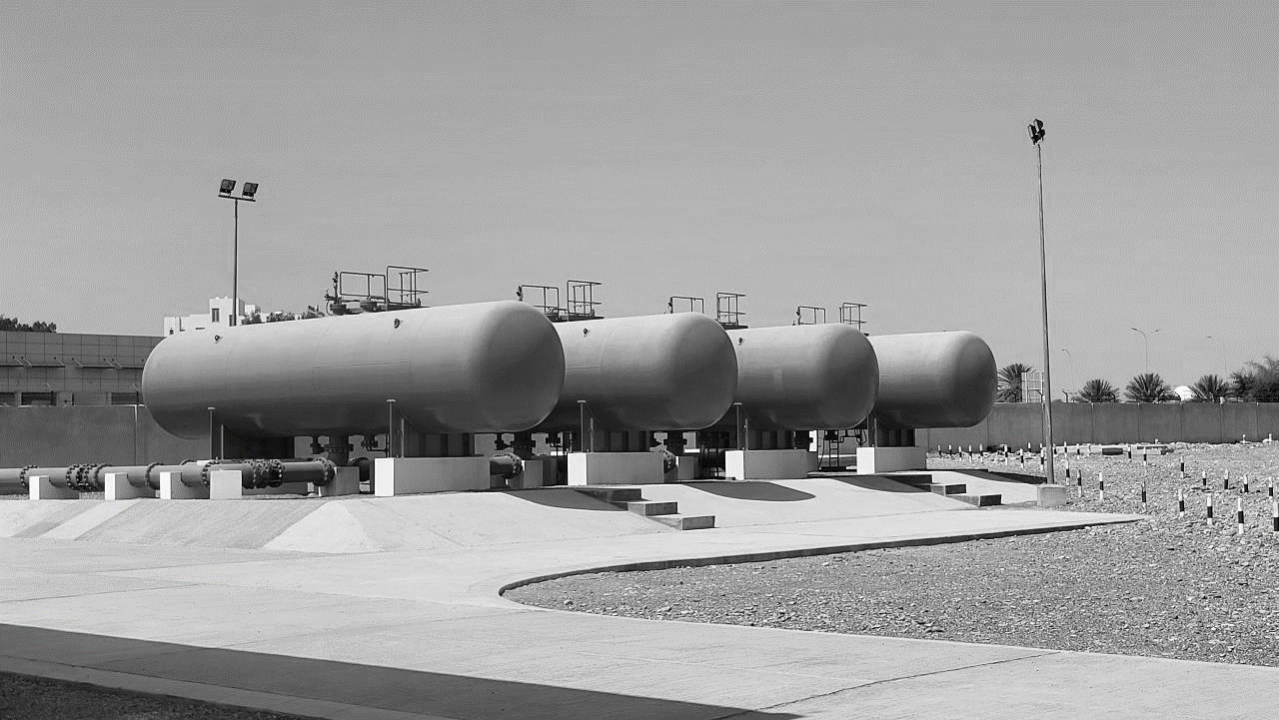
WHO/R M McKeown
Let’s go the field!

