Slide 1
Water safety plan
Step-by-step risk management for drinking-water suppliers
TRAINING PACKAGE
Workshop Day 4
Notes:
1
Cover slide

Slide 2



ACTIVITY 9:
Field trip debrief
60 minutes
(30 minutes to prepare;
10 minutes per group to share;
10 minutes to discuss after sharing)
PART A: Working in your table groups, prepare to share your field trip findings.
PART B: Share findings in table group pairs assigned by the trainer.

Slide 3
10 WSP modules
DAY 1
Mod 2: Describing the system
Mod 3: Identifying hazards and hazardous events
DAY 2
Mod 4: Validating existing control measures and assessing risks
Mod 5: Planning for improvement
Mod 6: Monitoring control measures
Mod 7: Verifying the effectiveness of water safety planning
DAY 4
Mod 8: Strengthening management procedures
Mod 9: Strengthening WSP supporting programmes
Mod 10: Reviewing and updating the WSP
Mod 1: Assembling the WSP team
Notes:
Flag that Modules 8-10 and 1 are to be covered on Day 4

Slide 4

MODULE
8
Strengthening management procedures
What management procedures should be used for normal and abnormal conditions?
Notes:
4
Module slide 1

Slide 5
MODULE 8 overview
1
2
3
WHAT WE DO:
Document management procedures to be followed during normal conditions and in incident or emergency situations
WHY WE DO IT:
To ensure that all staff clearly understand what to do and when
HOW WE DO IT:
Develop standard operating procedures (SOPs)
Prepare emergency response plans (ERPs)

Slide 6
MANAGEMENT procedures
All systems require instructions on how to operate.
It is important to have relevant management procedures clearly defined and accessible for use.
Management procedures
Standard operating procedures (SOPs)
Emergency response plans (ERPs)

Slide 7


KEY ACTION 1:
Develop or strengthen SOPs, and implement
Standard operating procedures (SOPs) should document steps to follow during:
normal operations and
incident situations.
SOPs
Steps to follow during normal operations
Steps to follow during an incident (corrective actions)
e.g. Weekly storage tank inspection
e.g. Response to a high filtered water turbidity alarm

Slide 8

EXAMPLE SOP content
Filter backwashing SOP:
SOP for chlorine critical limit breach:
Backwash triggers (effluent turbidity, pressure head, filter run time)
Who is qualified to run backwash
How to run backwash
(valve adjustments, etc.)
How to return filter to service
(filter to waste)
Etc…
Who is qualified to respond
Protocol for investigating and
correcting issue
How to stop flow of unsafe water to distribution system (when necessary)
How to communicate with health
officials and consumers (when necessary)
Etc…

Slide 9
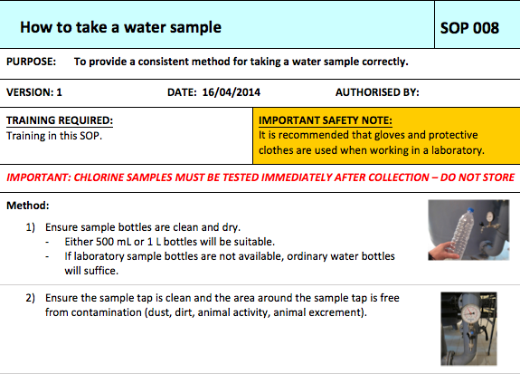
EXAMPLE SOP

Slide 10
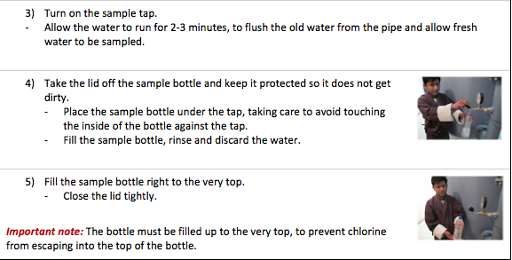
EXAMPLE SOP

Slide 11
EXAMPLE SOP content
Filter backwashing SOP:
SOP for chlorine critical limit breach:
Backwash triggers (effluent turbidity, pressure head, filter run time)
Who is qualified to run backwash
How to run backwash
(valve adjustments, etc.)
How to return filter to service
(filter to waste)
Etc…
Who is qualified to respond
Protocol for investigating and
correcting issue
How to stop flow of unsafe water to distribution system (when necessary)
How to communicate with health
officials and consumers (when necessary)
Etc…

Slide 12

KEY ACTION 1:
Develop or strengthen SOPs, and implement
  SOPs are important tools to:
  Build operator confidence that they know what to do and when
  Help ensure that important tasks are done right
  Prevent valuable knowledge and experience from being lost
  Serve as training tools for new staff

Slide 13
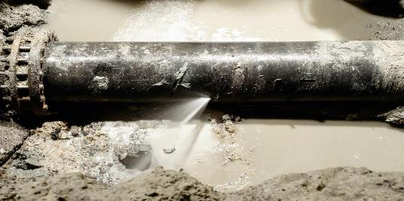
EXERCISE:
SOP brainstorm for the worked example
5 minutes
WORKED EXAMPLE:
Working in your table groups, make a quick list of the key information that should be included in the new SOP for the Worked Example risk identified in Module 4 i.e. SOP for Sanitary pipe repair procedures
Notes:
Example answers given on the next slide. Do not show until the exercise is complete.
Note only a high-level list of important information is being sought, not a full SOP!

Slide 14

EXERCISE:
SOP brainstorm for the worked example
Example of key considerations for an SOP for Sanitary pipe repair practices
Purpose and responsibilities: Define clearly what activity the SOP covers and who is responsible, and any reporting/communication requirements.
Preparation: Describe any preparations needed before the work starts e.g. assess the site, isolate the section, and assemble clean tools and approved materials.
Sanitary work practices: Describe the steps to be taken for sanitary conditions to be maintained e.g. prevent soil or debris entry, keep pipe interiors clean, maintain positive pressure.
Flushing and disinfection: What chemical disinfections steps are needed e.g. to clean and disinfect new or repaired sections before reconnection; How long the pipe should be flushed with clean water post-reinstatement of the pipe; How to verify chlorine residuals and turbidity in the flushed water.
Verification and documentation: Record actions, test results, and sanitary return-to-service confirmation.
Health and safety: What is needed to safely complete the job e.g. ensure PPE use and safe handling of disinfectants.

Slide 15

KEY ACTION 2:
Develop or strengthen ERPs, and implement
!
Emergency response plans (ERPs) should be developed to cover emergencies for which there is no specific SOP
Emergency response plan may include:
Triggers for activating emergency response
Steps to protect water quality/consumer health
General roles and responsibilities within utility
Communication protocols (internal and external)
Alternative/emergency water supplies

Slide 16

KEY ACTION 2:
Develop or strengthen ERPs, and implement
  Consider communication with:
  Consumers
  Health authorities
  Regulators
  Within supplier
  Environmental agencies
Communication protocols should detail contact information during business hours and outside of business hours

Slide 17
EXERCISE:
Emergency response planning
15 minutes
!
Working in your table groups, outline an emergency response plan for the emergency described on the next slide.
Record on chart paper.
See next slides for example elements of an emergency response plan for you to consider…

Slide 18

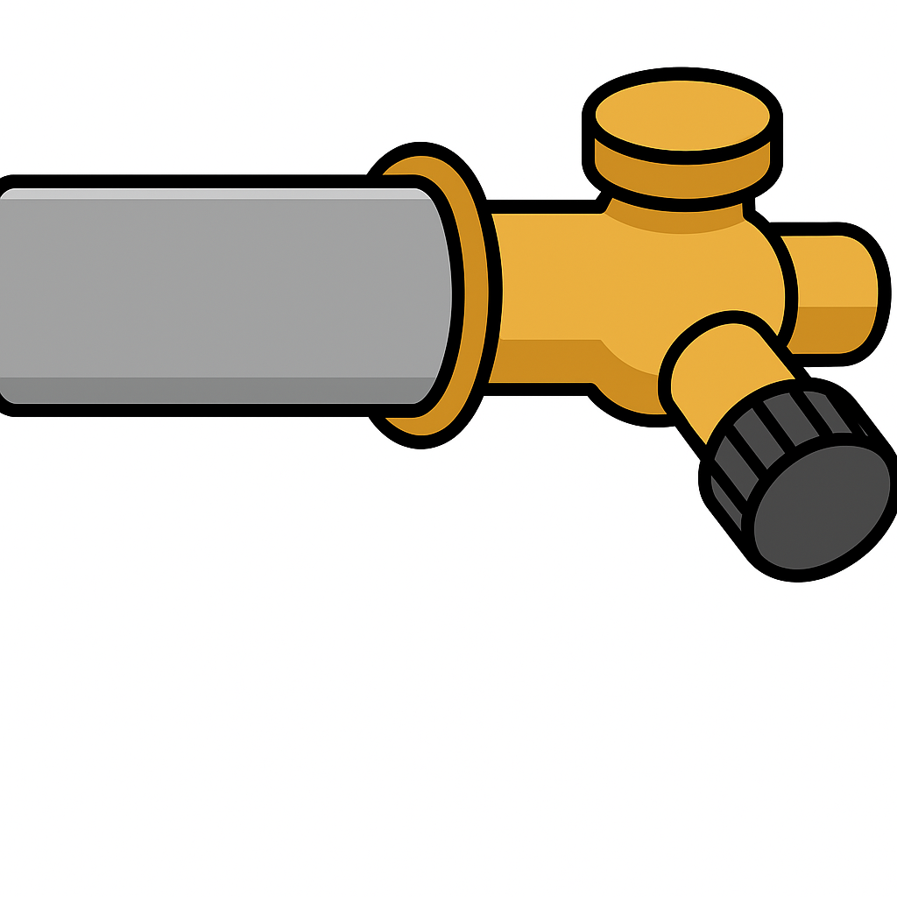
Real life case example:
Extensive supply disruption due to network failure
Scenario
A Swedish water utility had their system overrun by frogs
Frogs ended up in the distribution pipes, causing extensive blockages and prolonged water supply disruptions, outages
Even the most prepared water utility does not have an SOP for such an occurrence!
Prepare a generic emergency response plan that could be applied in such a situation i.e. Major disruption to network and prolonged loss of supply

Slide 19

EXERCISE:
Consider the following in your outline
Emergency response plan may include:
Triggers for activating emergency response
Steps to protect water quality/consumer health
General roles and responsibilities within utility
Communication protocols (internal and external)
Alternative/emergency water supplies
Criteria for emergency “stand-down” i.e. when the emergency is over
  Consider communication with:
  Consumers
  Health authorities
  Regulators
  Internally within the water supply organization
  Environmental agencies
  During and after business hours

Slide 20
KEY LESSON:
Importance of emergency preparedness
Basic preparedness can support responses to a broad range of emergency situations, including unforeseen events
Basic emergency preparedness includes consideration of:
  back-up power supply
  ample stocks of consumables & essential equipment
  redundancy of suppliers & supply routes
  multiple operators trained on critical tasks
  remote monitoring and control of key assets & robust cybersecurity
  alternative water sources, modes of distribution, water carts, packaged water supplies….
!
Bushfires Floods Droughts Natural disasters Epidemics/pandemics Major contamination
Notes:
Bullet 2 e.g. testing kits/reagents, treatment chemical, fuel) (e.g. pipes, valves)

Slide 21

EQUITABLE emergency response planning
Critical emergency actions & messages must reach all users, including vulnerable groups.
How will critical messages be delivered to users during the emergency?
Will any user group be excluded from this communication method? How could they be reached?
Which users are the most vulnerable to emergencies? What is the best way to communicate with them?
Can proposed remedial actions be implemented by all user groups (e.g. boiling, chlorine tablets)?
If alternative water supplies will be provided, will they be accessible to all user groups?

Slide 22

MODULE
9
Strengthening WSP supporting programmes
What is the best way to support the implementation of water safety planning?
Notes:
22
Module slide 1

Slide 23
MODULE 9 overview
1
2
3
WHAT WE DO:
Strengthen supporting programs to help ensure the effective implementation of water safety planning
WHY WE DO IT:
To contribute to the safe and adequate supply of acceptable drinking-water
HOW WE DO IT:
Develop or strengthen supporting programs, and implement

Slide 24

SUPPORTING programs
SUPPORTING PROGRAMS
Activities that improve management of drinking-water supplies that are consistent with the implementation of water safety planning.
Supporting programs can…
Develop skills and knowledge
(e.g. operator training)
Strengthen relationships
(e.g. consumer outreach)
Create enthusiasm & improve attitudes
(e.g. develop WSP culture)

Slide 25
EXAMPLES of supporting programs
Safer drinking-water
Quality assurance & control
Operator training
Equipment calibration & maintenance
Consumer education
Creating WSP awareness & buy-in
Stakeholder outreach
Research & development

Slide 26


ENHANCING climate resilience through supporting programmes
  Examples of supporting programmes to strengthen resilience
  Aquifer recharge rate modelling under different drought scenarios
  Flow tracer study on reservoir mixing during different precipitation/flow scenarios
  Investigating impact of increasing water temperature on chlorine stability in the network
  Assessment of flood vulnerability for critical assets
  Incentive programmes for household leak repair
  Strengthening planning and communication for disaster management between stakeholders

Slide 27


CASE EXAMPLE:
Tool for early warning for water quality changes, Urguay
Context: 90% of potable water is from surface sources, managed by 60+ treatment plants.
Objective: Improve data integration and water safety planning for shared catchments.
Key actions:
Developed app for managing water quality data.
Set up real-time data transmission.
Trained staff.
Outcomes: Enhanced risk management through real-time data for chemical dosing; better communication and coordination across plants; motivated adoption of proactive decision-making.

Slide 28
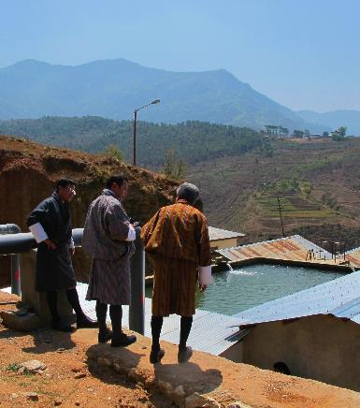
CASE EXAMPLE:
Strengthening operations and management, Bhutan
This case study highlights a WSP supporting programme that delivered improvements in planning and practice of operations and management.
WHO/R M McKeown

Slide 29
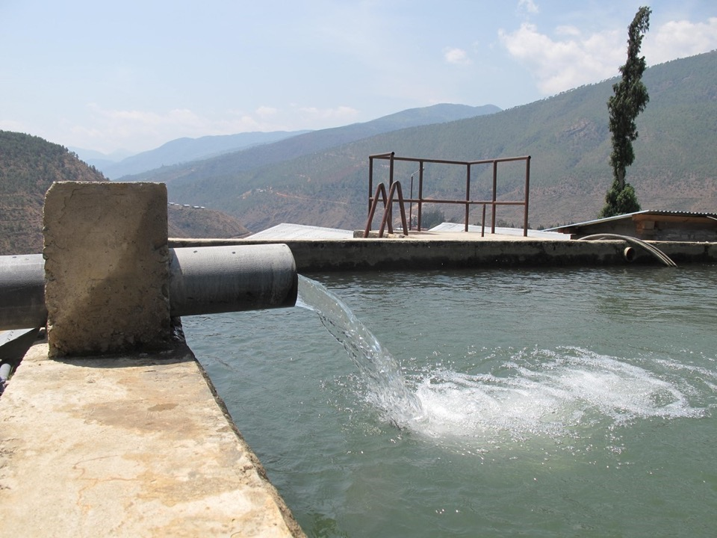
WATER treatment plant:
2 MLD, sedimentation, pressure filtration, chlorination
WSP IDENTIFIED:
No operational monitoring (Module 6)
No WQ testing equipment (Module 6-7)
No SOPs for chlorination (Module 8)
Operator training needed (Module 9)
WHO/R M McKeown

Slide 30
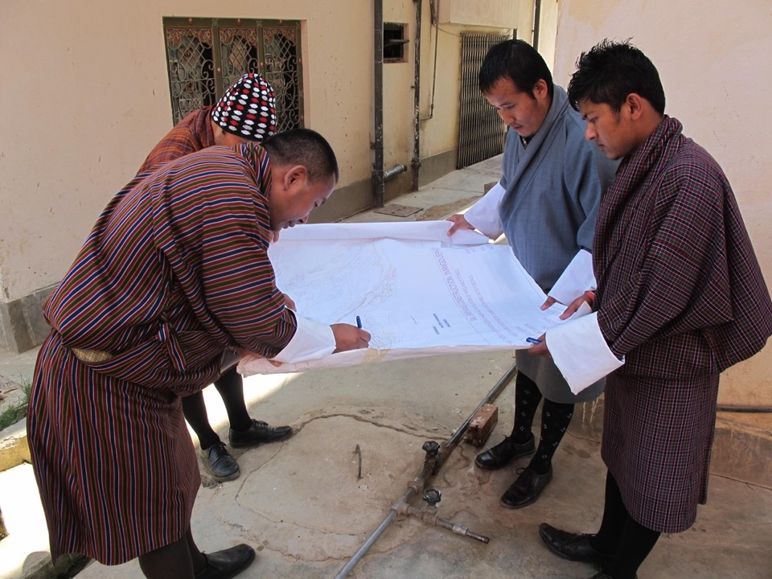
Operational monitoring plan developed
Credit: WHO/R M McKeown

Slide 31
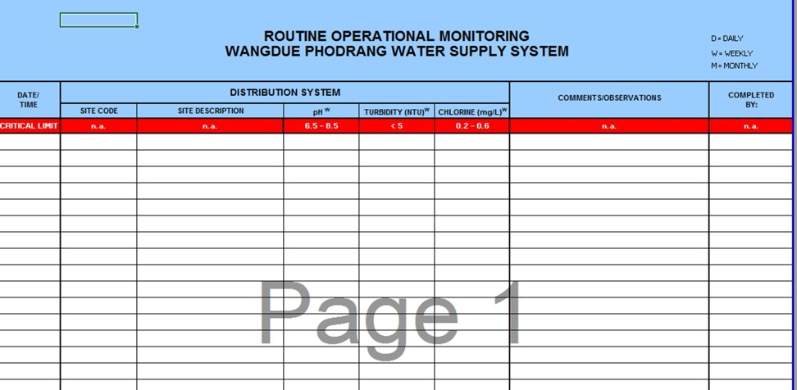
OPERATIONAL monitoring record sheets developed

Slide 32
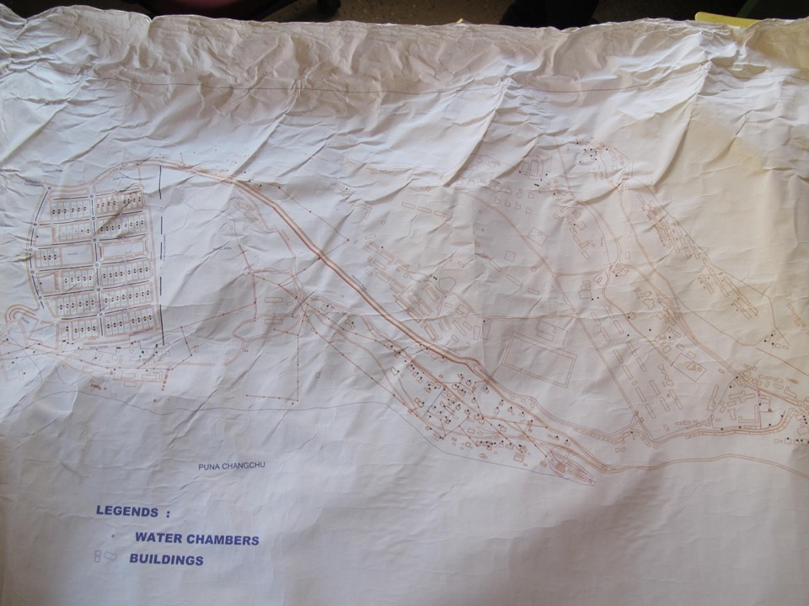
SAMPLING sites established
SP-D-001
WTP
SP-D-002
SP-WTP-005
SP-D-003
SP-D-04
SP-D-10
SP-D-09
SP-D-05
SP-D-08
SP-D-06
SP-D-07
SP-D-011
WHO/R M McKeown
SP-D-012

Slide 33
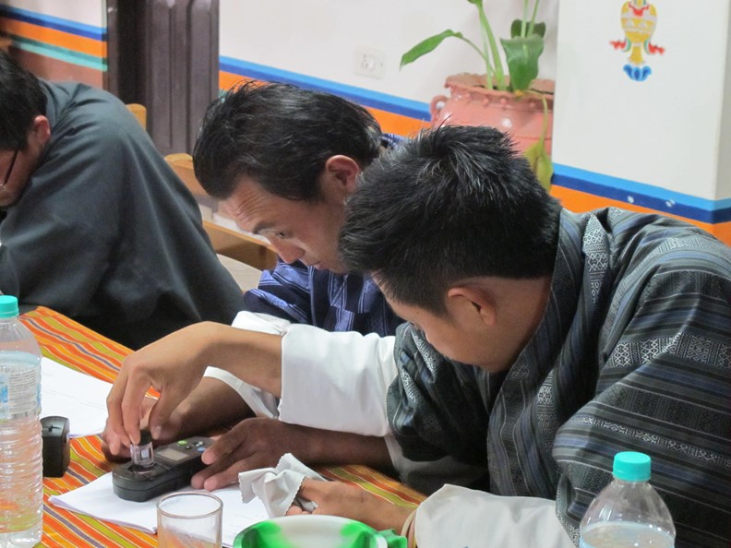
Water quality testing training: In the classroom…
WHO/R M McKeown

Slide 34
…and the field.
WHO/R M McKeown

Slide 35
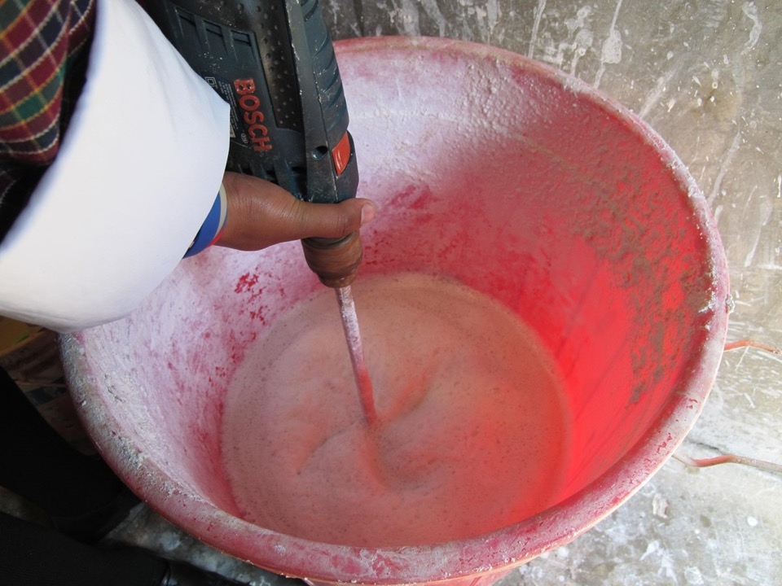
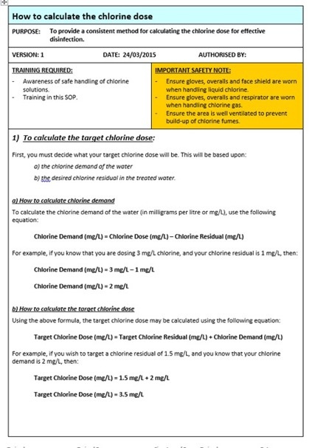
Chlorination SOPs developed and training provided
2
WHO/R M McKeown

Slide 36

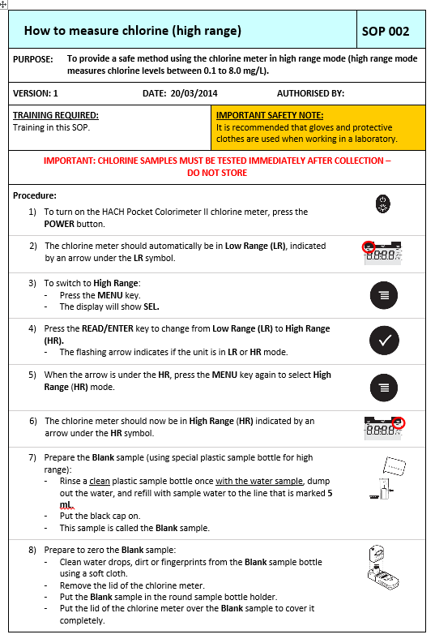
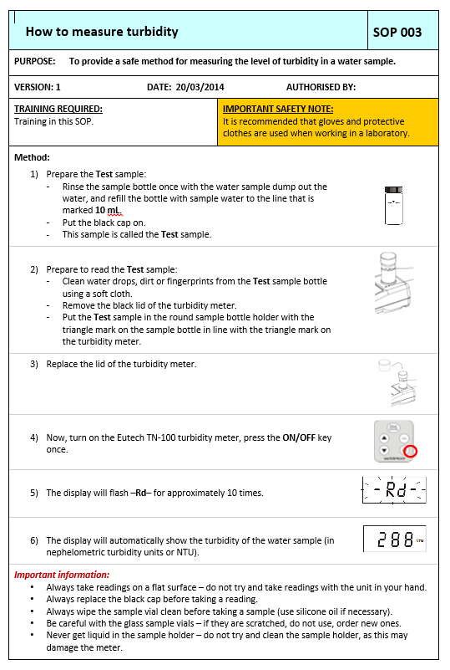
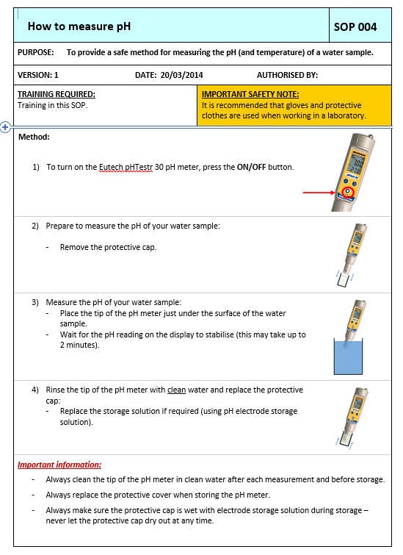
WQ TESTING SOPS DEVELOPED
& training provided
3

Slide 37

EARLY FINDINGS SHOWED
clear water quality improvements
FAECAL COLIFORM TEST RESULTS (from health authority records)
Year | # samples | % of complying samples
1 | 36 | 0%
2 | 58 | 0%
3 | 37 | 41%
4 | 67 | 66%
Before WSP
After early WSP interventions
Such gains will be lost if careful attention is not given to sustaining supporting programmes.
How will it be financed? How will equipment be calibrated/maintained? Who will pay for consumables? How will capacity building be institutionalized? How will the data be communicated & actioned?...

Slide 38
LESSON:
Give due attention to the “back end” of the WSP
WSP team
System description
Risk assessment
Improvement plan
Often the focus of WSP efforts
☐
Operational monitoring
Verification
Management procedures
Supporting programs
☐
Also critical to WSP success and often given too little attention
☐
☐

Slide 39
EXERCISE:
Developing a supporting programme for the worked example
5 minutes
WORKED EXAMPLE:
Working in your table groups, make a quick list of the possible elements that could be considered in a new supporting programme for the Worked Example risk identified in Module 4 i.e. supporting programme for Operator competency training for sanitary network maintenance practices
Notes:
Make clear this is linked to the Worked Example risk identified in Module 4.
Example answers given on the next slide. Do not show until the exercise is complete.

Slide 40
EXERCISE:
Developing a supporting programme for the worked example
Example of possible considerations for a training programme for sanitary network maintenance practices
Clear objectives: State what the training should achieve e.g. ensure safe, hygienic repair and maintenance of water networks.
Defined competencies: Specify the essential knowledge and skills required e.g. contamination prevention, disinfection, and safe work practices.
Practical training for relevant SOPs: Include hands-on demonstrations, simulations, and supervised field practice to reinforce correct techniques.
Certification and refresher system: Establish a mechanism to assess, certify, and periodically re-train operators.
Monitoring and evaluation: Track implementation, assess competency retention, and identify areas for improvement.
Supporting materials: Provide visual guides, job aids, checklists, and communication tools to promote good practice in daily work.

Slide 41

MODULE
10
Reviewing and updating the WSP
How will the WSP be kept up to date?
Notes:
41
Module slide 1

Slide 42
MODULE 10 overview
1
2
3
WHAT WE DO:
Review and revise the WSP regularly and after a significant event
WHY WE DO IT:
To ensure that the WSP is up to date and reflects lessons learned from WSP operational experiences
HOW WE DO IT:
  Conduct regular WSP reviews to make sure the WSP is kept up to date
  Review the WSP after a significant incident, near miss or emergency, and update as needed

Slide 43

KEY ACTION 1:
Conduct regular planned WSP reviews
WSP team should plan to meet regularly to review all aspects of the WSP to ensure that the WSP is:
Up-to-date
Effective
A WSP is a “living” document that must be updated regularly
to remain relevant, useful and effective
May include incorporating new information,
new processes and procedures, lessons from experiences, analysis of monitoring data, audit findings, user feedback…

Slide 44
REGULARLY review the WSP
1
Each of these changes requires revisions to the WSP:
Revise WSP
New treatment infrastructure
Improvement plan implemented
WSP team changes
New informal settlement
Operator training program changes
New activity in the catchment
New climate information
For example…
Notes:
Ask participants can they think of other examples?
For example – changes in national regulations and standards.
Any others?

Slide 45
UPDATING the WSP after improvements
As the improvement plan is implemented, the following should be updated:
  The risk assessment table
  Add new controls to the risk assessment table (including control measure validation and risk reassessment)
WORKED EXAMPLE:
1
Notes:
Make clear this is linked to the Worked Example risk identified in Module 4.

Slide 46
NEW controls in risk assessment table
WORKED EXAMPLE:
Process Step | Hazardous Event | Hazard | Existing control measure description | Are the existing controls effective? |  |  |  | Risk assessment
 |  |  |  | Validation notes (basis of control measure effectiveness decision) | Yes | No | Somewhat | Likelihood | Severity | Risk score | Risk level
Distribution | The water supply becomes microbially contaminated when dirty water enters the pipeline (X) because of unsanitary pipeline repair practices (Y) | Microbial Acceptability (turbidity) | Visual inspection of reinstated pipe water by operator | Supervisor oversight reports that procedures are not always followed in practice; water quality testing indicates problems with microbial contamination and high turbidity occasionally following pipe repairs |  |  | ✓ | 2 | 3 | 6 | H
Update to reflect new improvements after they are implemented

Slide 47
NEW controls in risk assessment table
 |  |  |  | Are controls effective? |  |  |  | Risk assessment
Hazardous Event |  | Hazard Type | Existing control measures | Validation notes (basis of effectiveness assessment) | Yes | No | Somewhat | Likelihood | Severity | Risk score | Risk level
BEFORE IMPROVEMENT WORKS
The water supply becomes microbially contaminated when dirty water enters the pipeline (X) because of unsanitary pipeline repair practices (Y) |  | Microbial Acceptability (turbidity) | Visual inspection of reinstated pipe water by operator | Supervisor oversight reports that procedures are not always followed in practice; water quality testing indicates problems with microbial contamination and high turbidity occasionally following pipe repairs |  |  | ✓ | 2 | 3 | 6 | H
AFTER IMPROVEMENT WORKS
The water supply becomes microbially contaminated when dirty water enters the pipeline (X) because of unsanitary pipeline repair practices (Y) |  | Microbial Acceptability (turbidity) | Trench dewatering equipment, sanitary pipe repair SOP, and associated training on sanitary pipe repair practices | Supervisor oversight reports that procedures are always followed in practice; water quality testing indicates consistently good water quality following pipe repairs | ✓ |  |  | 1 | 3 | 3 | M
WORKED EXAMPLE:

Slide 48
UPDATING the WSP after improvements
As the improvement plan is implemented, the following should
be updated:
  The risk assessment table
  Add new controls to the risk assessment table (including control measure validation and risk reassessment)
  Consider any new hazards introduced by the new control
1

Slide 49
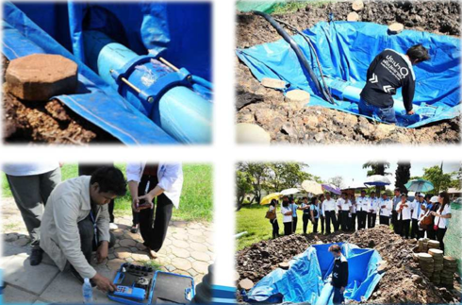
NEW hazards in risk assessment table
New controls could introduce new hazards
Credit: WHO/Angella Rinehold
?
What new hazards could be introduced when trench dewatering equipment is introduced (e.g. dewatering pumps, trench liner)?
Notes:
Microbial contamination from dewatering equipment being used for sewer jobs.
Chemical contamination from fuel/oil leaks from dewatering pumps.

Slide 50
UPDATING the WSP after improvements
As the improvement plan is implemented, the following should be updated:
  The risk assessment table
  Add new controls to the risk assessment table
  (including control measure validation and risk reassessment)
  Consider any new hazards introduced by the new control
  The improvement plan
  Update the improvement plan to make clear the status
1
2

Slide 51
IMPROVEMENT status updates
WORKED EXAMPLE:
 | Specific improvement action | Arising from (relevant hazardous event) | Responsible party(ies) | Estimated cost ($) | Source of funding | Due date | Status (not yet started, actions undertaken to date, etc.)
1 | Purchase 10 specialized plastic trench liners and 5 trench dewatering pumps, develop new SOPs and train staff on new procedures, with ongoing refresher training and field supervision | Risk of contamination from pipeline repair practices | Head of operations | 5 000 | Capital budget Operational budget | May 20XX | Not yet started
2
3
Requires updating upon improvement completion

Slide 52
IMPROVEMENT status updates
 | Specific improvement action | Arising from (relevant hazardous event) | Responsible party(ies) | Estimated cost ($) | Source of funding | Due date | Status (not yet started, actions undertaken to date, etc.)
1 | Purchase 10 specialized plastic trench liners and 5 trench dewatering pumps, develop new SOPs and train staff on new procedures, with ongoing refresher training and field supervision | Risk of contamination from pipeline repair practices | Head of operations | 5 000 | Capital budget Operational budget | May 20XX | Project fully completed as of November 20XX.
2
3
Updated upon improvement completion

Slide 53
CASE EXAMPLE:
Planned WSP reviews in Portugal
Example of a typical agenda for planned WSP review meetings:
Follow-up action from previous WSP audit
Progress in implementation of improvement plans
Actions from significant changes in the organization
Actions from occurrence of events that affect hazards or hazardous events
Evaluation of the effectiveness of corrective actions
Progress with implementation of supporting programmes

Slide 54
USING reviews to strengthen climate resilience and ensure more equitable WSPs
1
A WSP review is an opportune time to consider key questions to build resilience and enhance equity
  Examples of equity questions
  Is there meaningful participation of women, girls as well as and disadvantaged groups as members of, or advisers to, the WSP team?
  Have experiences with water been investigated for all user groups?
  Have improvements considered how disadvantaged groups can be assisted?
  Do emergency response plans reflect the needs of all users?
  Examples of climate resilience questions
  What climate expertise is needed to support the WSP team?
  What are the climate-related threats to the water supply?
  What new/strengthened control measures are needed to manage climate risks?
  What supporting programmes are in place to raise awareness of WSP for enhanced climate resilience?

Slide 55
KEY ACTION 2:
Review the WSP after a significant incident, near miss or emergency
1
Why review the WSP after a significant “event” (i.e. an incident, near miss or emergency)?
TO IMPROVE
To reduce the likelihood that it will happen again and/or to improve the response to minimize impact.
?

Slide 56
KEY ACTION 2:
Review the WSP after a significant incident, near miss or emergency
Following a significant incident, near miss or emergency:
Conduct an investigation with relevant staff and stakeholders to review performance and key lessons learned.
Assess the adequacy of current procedures.
Address any identified issues or concerns.
Make sure the level of detail and depth of the review matches the significance of the event → more significant events require a more thorough review

Slide 57
EXERCISE:
WSP revision
15 minutes
(brief explanation;
10 minutes to complete;
few minutes to share)
Working in your table groups, list which WSP modules are affected by the events shown in the figure on the next slide.
See next three slides for further explanation…

Slide 58

EXAMPLE
Revise WSP
New treatment infrastructure
Improvement plan implemented
WSP team changes
SOPs added and/or updated
Operator training program changes
New activity in the catchment
Which modules are affected?

Slide 59

REMINDER
(from a previous slide)
3
As the improvement plan is implemented, the following should be updated:
  The risks assessment table
  Add new controls to the risk assessment table (including control measure validation and risk reassessment)
  Consider any new hazards introduced by the new control (e.g. chlorine)
  The improvement plan
  Update the improvement plan to make clear the status
1
Module 4
Module 3
2
Module 5
?
Which modules are affected?

Slide 60
EXAMPLE
2
?
?
Revise WSP
New treatment infrastructure
Improvement plan implemented
WSP team changes
SOPs added and/or updated
Operator training program changes
New activity in the catchment
?
?
?
Modules 3, 4 & 5

Slide 61

MODULE
I
Assembling the
WSP team
Who will lead WSP development and implementation?
Notes:
61
Module slide 1

Slide 62
MODULE 1 overview
1
2
3
WHAT WE DO:
Form an experienced, multidisciplinary team to lead the development and ongoing implementation of the WSP
WHY WE DO IT:
To establish a body responsible for development and ongoing implementation
of the WSP
HOW WE DO IT:
  Identify the required expertise and establish the WSP team
  Define the roles and responsibilities of team members

Slide 63

Key action: 1
Identify the required expertise and establish the team
WSP team should include those with:
Knowledge of the complete water supply system
(catchment to consumer)
Authority to make decisions (e.g. allocating human and financial resources, approving system changes)
Responsibility for, and capacity to, help manage and prevent risks

Slide 64
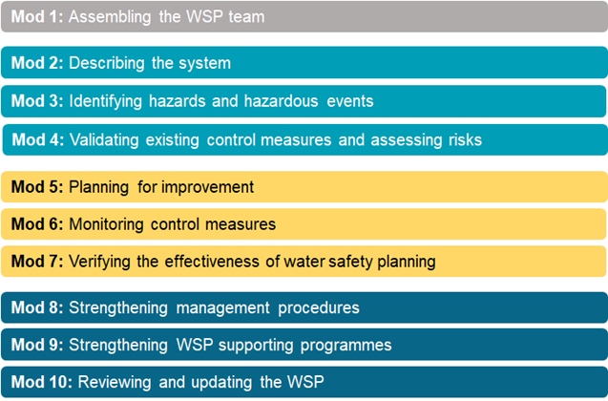
EXERCISE:
WSP team member brainstorm
10 minutes
Working together in plenary, brainstorm who should be involved in the various WSP activities.

Slide 65

TYPICAL team members
Typically, the team might include:
  Managers
  Engineers
  Staff involved in water sampling and testing
  Technical staff involved in day-to-day system operations and maintenance
  Representatives of relevant catchment-level agencies
  Representatives of the public health agency

Slide 66
CONSIDER stakeholders that can support the WSP
Stakeholders can be any individual, group, or organization that has responsibility for, an interest in, or is affected, by decisions, operations and outcomes related to the WSP
Stakeholders can be internal to the water supplier organization
e.g. customer services, IT, procurement (e.g. chemicals), finance, asset management, system design and construction…
…or external
e.g. catchment land use, catchment management, environmental protection, public health, regulation, independent testing, user groups and civil society
Consider conducting a stakeholder mapping exercise to determine who the key stakeholders are, & how they can support the WSP

Slide 67
Key action: 2
Define the roles and responsibilities of team members
Name, job title & organisation | Skills, knowledge and expertise relevant to the WSP | Role on the WSP team | Contact details
Operations manager | Operations, including water treatment | Team Leader Stakeholder coordination Emergency response coordinator | …….
Water treatment manager | Water treatment plant O&M | Water treatment plant risk assessment and O&M Review of monitoring trends | …….
Network maintenance staff / plumber | Day to day water network operation Customer in-house practices Materials safe for contact with water | Network plant risk assessment and O&M | …….
Health officer | Health (especially water related diseases in the context of climate change) | Health liaison, e.g. compliance monitoring, emergency response planning, capacity building | …….
Environmental protection officer | Catchment management | Source water protection Communication/outreach to land users | …….
NGO representative | Water user experiences for disadvantaged groups | Liaison with user groups in informal settlements User education & awareness raising | …….
EXTRACT

Slide 68
SUPPLEMENTAL support for more resilient & equitable WSPs
Consider what additional expertise may be required to ensure climate & equity considerations are adequately integrated.
  Equity stakeholders may include representatives from:
  NGOs
  Women’s groups
  Youth groups
  Elderly groups
  Disability groups
  Ethnic groups…
  Climate-related stakeholders may include representatives from
  Climatology / meteorology
  Hydro(geo)ology
  Emergency response/Disaster risk reduction agencies
  Epidemiologists (focus on climate and health)
  Adaptation / Civil protection agencies…
Consider if these should be full WSP Team members, or only provide support to the WSP Team “as needed”

Slide 69
CHALLENGE: Excessively large WSP teams can hamper decision-making & progress
Consider if individuals should be
CORE
TEAM MEMBERS
EXTENDED
TEAM MEMBERS
Involved in day-to-day implementation of the WSP and typically attend all WSP team meetings
Less involved in day-to-day WSP implementation and may only be consulted at select stages/activities
e.g. WSP team members representing water supply operations and lower management
e.g. catchment-level agencies, climate-related experts, higher-level management, community group representatives

Slide 70

APPOINT a team leader
Strong and active WSP team leadership is essential.
The team leader will play a critical role in driving WSP development and implementation.

Slide 71

MAINTAINING long-term WSP Team engagement
Success factors:
Emphasize the long-term nature of the WSP
Establish appropriate WSP Team meeting intervals to discuss WSP implementation
Consider how to manage staff turnover issues e.g. developing an organization-wide WSP policy, prepare a WSP induction/training kit for new staff

Slide 72
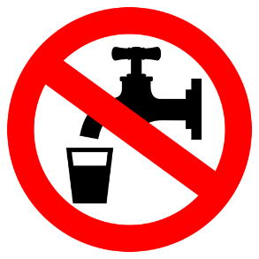
ACTIVITY 10:
Walkerton (Canada) case study
Workbook Activity 10 (page 27)
40 minutes
(30 to complete; 10 to discuss)
Working in groups, answer the questions presented in the Participant Workbook (page 27).
Be prepared to share your findings.
Notes:
Note to facilitator – this exercise is optional depending on the time available.

Slide 73

CONGRATULATIONS!
You’ve learned all 10 WSP modules

Slide 74
RECAP: what is a WSP?
A PROACTIVE MANAGEMENT SYSTEM to ensure safe drinking water by:
understanding the complete water supply system
identifying where and how problems could arise
putting barriers and management systems in place to stop the problems before they happen
making sure all parts of the system work properly

Slide 75

WATER SAFETY PLANNING
KEY TAKEAWAY
WSPs are NOT a one-off exercise

Slide 76




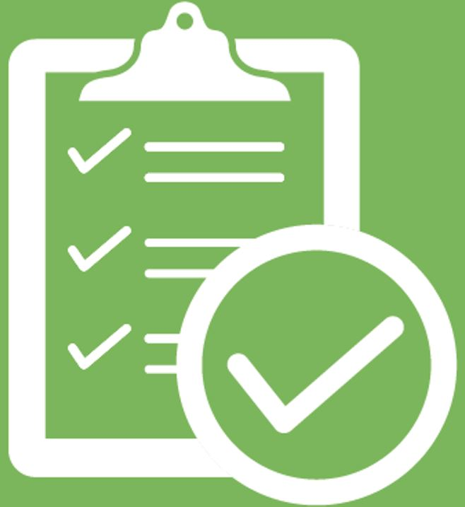
WATER SAFETY PLANNING in action
WSP Development
The WSP is established.
All 10 WSP steps are planned, developed and documented
If the work stops here, the undertaking will be ineffective!
3

Slide 77
WATER SAFETY PLANNING in action
WSP Development
The WSP is routinely applied, in activities that are conducted daily, weekly, and so on
WSP
Operation
Examples:
Regular WSP team meetings undertaken
Improvement plans implemented
Regular operational monitoring conducted
Management procedures and supporting programmes applied
3

Slide 78
WATER SAFETY PLANNING in action
WSP Development
The WSP is verified, ensuring that the WSP is working effectively
WSP
Operation
Examples:
Checking water quality compliance
Consumer satisfaction surveys
WSP auditing
WSP
Verification
3

Slide 79
WATER SAFETY PLANNING in action
WSP Development
The WSP is periodically reviewed and, if needed, updated.
WSP
Review &
Update
WSP
Operation
This ensures that the WSP is up to date and strengthened as needed
supports the process beyond initial WSP development
WSP
Verification
3

Slide 80

WATER SAFETY PLANNING in action
WSP Development
Water safety planning is a continuous cycle of improvement
WSP
Review and Update
WSP
Operation
Continuous
cycle
Developing the WSP is just the first step!
Failure to operationalize, verify, and review/update the WSP on an ongoing basis will result in poor WSP outcomes
WSP
Verification
3

Slide 81

SUCCESSFUL WSP practices
Example tips for sustainable and effective WSPs
Get commitment from all organizational levels (e.g. senior, executive, board management)
See water safety planning as core work – NOT additional work
Build on existing practices – a WSP does not replace existing systems (e.g. ISO, HACCP)
Adapt the WSP approach to suit local the context (e.g. capacity, resources, system complexity)
Aim for early gains and improve progressively, over time
Visit the field – a WSP is not just a desk-top exercise
For more tips see the WSP Manual (2023)…

Slide 82

START SIMPLE and improve over time
“Rapid cycling” approach to WSPs
Start simple with easily manageable issues (“quick wins”) to:
build WSP Team confidence
demonstrate the value of WSPs
This can then be progressively built on during iterative cycles of WSP strengthening

Slide 83
STARTING SIMPLE in action
Where capacity, resources or experience are constrained 
Focus initially on known significant threats, before broadening to include all possible threats during successive cycles of WSP development
Develop the WSP for only specific stages of the water supply initially
Document assumptions and “unknowns” in the risk assessment, and return to these and fill information gaps in subsequent cycles
Initially target low/no cost improvement actions in the shorter term, allowing time for resources to be secured for more costly longer-term improvements
Notes:
Bullet 2:
e.g. WTP or distribution only, where the water supplier has more knowledge/control, and less stakeholders are involved
take a “lighter touch” approach to the other stages, before addressing all stages in detail in later cycles

Slide 84

EXERCISE:
Reflections on value added by WSPs
5 minutes
Working in groups, list one WSP activity or area that is already a priority for your organization, and list one activity or area where the WSP could add value.

Slide 85

ANY questions from the last 4 days?
Notes:
85

Slide 86
WORKSHOP objectives: check-in
We said “By the end of this workshop, participants should:”
1
2
3
4
Appreciate the value of water safety planning
Understand WSP principles and steps
Understand how WSPs provide a framework for equitable and resilient access to safe drinking-water
Have sufficient knowledge to begin to develop and implement WSPs
?
Have we met our objectives?

Slide 87

RESOURCES
TO SUPPORT
WATER
SAFETY
PLANNING

Slide 88
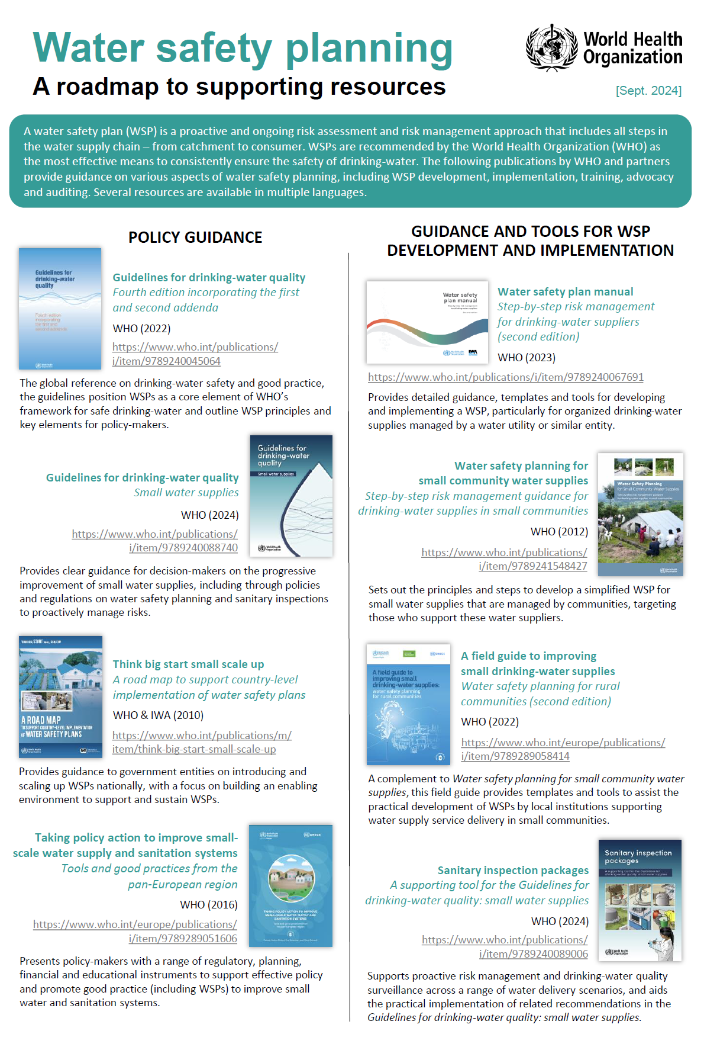
WSP resource roadmap
Information on all WHO global guidance resources on WSPs…
Technical guidance manuals
Case studies
Training packages
https://www.who.int/publications/m/item/water-safety-planning-a-roadmap-to-supporting-resources

Slide 89

WSP Manual (second edition)
Provides detailed guidance for practitioners on developing and implementing a WSP
Global case examples provided
Highlights common challenges & practical solutions
Guidance on starting simple, and strengthening the WSP through successive cycles of progressive improvement
https://www.who.int/publications/i/item/9789240067691

Slide 90
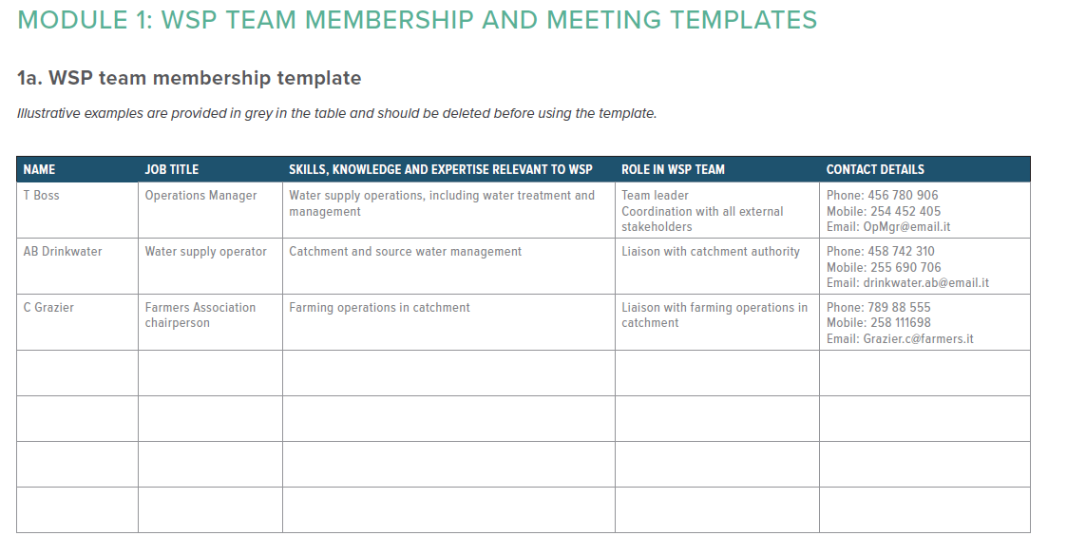
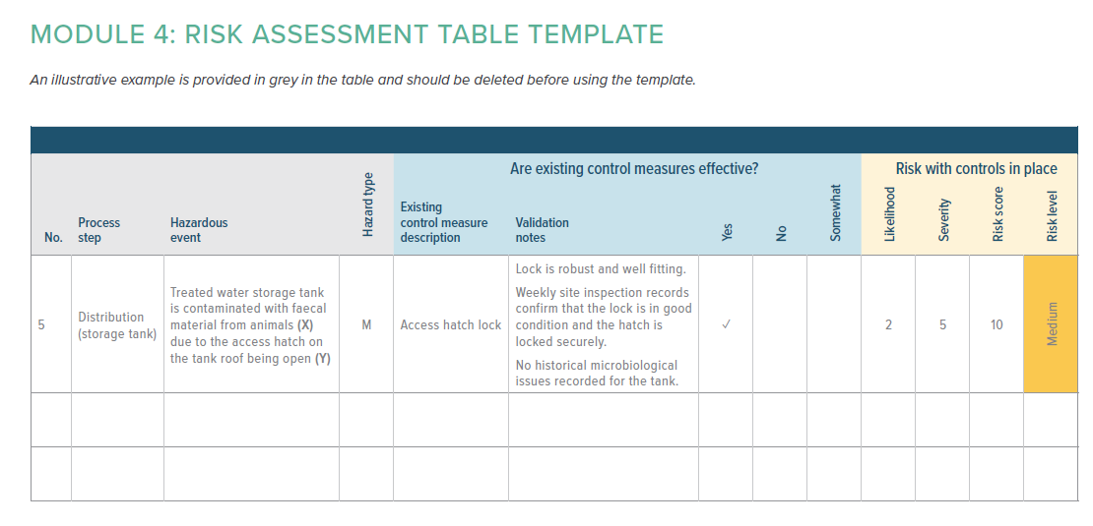
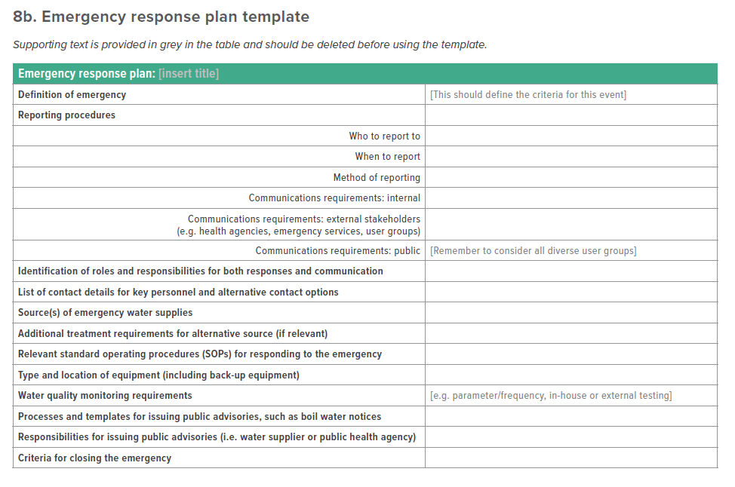
WSP Manual (second edition)
Templates for select modules
Includes basic WSP templates to support early-stage WSP teams to get started
Module 1: WSP team membership and meeting templates
Module 4: Risk assessment table template
Module 5: Improvement plan template
Module 6: Operational monitoring templates
Module 7: Compliance monitoring template
Module 8: Management procedure templates

Slide 91
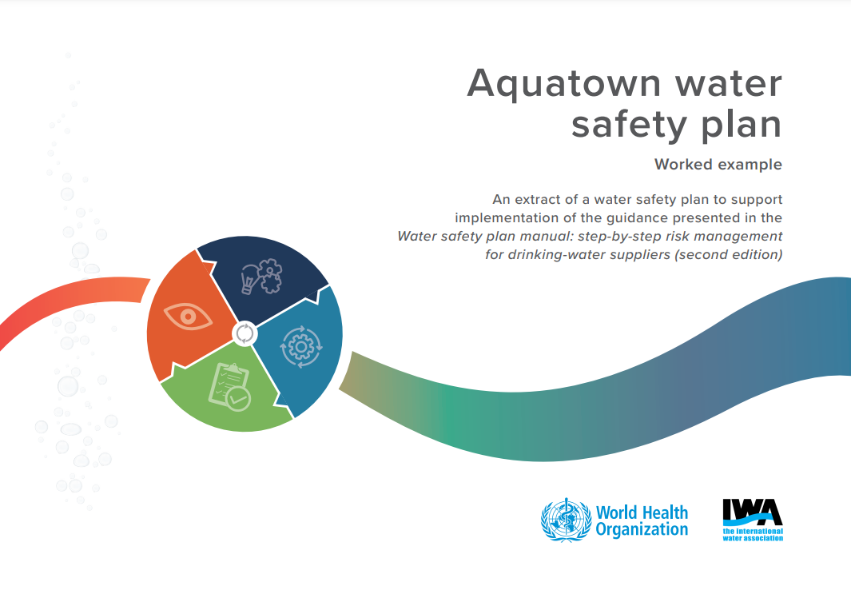
WSP Manual (second edition)
Toolbox
Links to supporting tools are provided
Aquatown water safety plan: worked example
Module 2: System description checklist
Module 3: Possible threats to the supply of safe drinking-water
Module 4: Examples of risk assessment matrices
Module 8: General checklist for emergency preparedness
Module 10: Checklists for WSP reviews

Slide 92
WSP guidance at key stages
in water supply chain
https://iris.who.int/handle/10665/246196
https://iris.who.int/handle/10665/76145
https://iris.who.int/handle/10665/43186
https://iris.who.int/handle/10665/204422
Source protection
Distribution/buildings

Slide 93
A PRACTICAL guide to auditing
water safety plans
Provides practical guidance for water suppliers and surveillance authorities on WSP auditing schemes
Support the continuous improvement and sustainability of WSPs
Accompanying training package available to download
https://www.who.int/publications/i/item/9789241509527

Slide 94

RESOURCES to support the integration
of climate resilience into WSPs
Stepwise consideration of the integration of climate-related risks
Includes practical guidance on identification of hazards, risk impacts and control measures for various climate scenarios
https://www.who.int/publications/i/item/9789241512794

Slide 95

EQUITY in water safety planning
Provides guidance to support the improvement of equity outcomes through the explicit and systematic inclusion of equity considerations through the WSP process.
Include a supporting training package.
https://www.who.int/publications/i/item/9789241515313

Slide 96
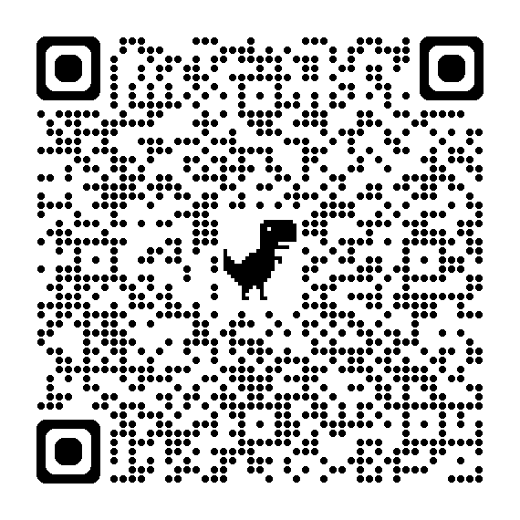
RESOURCES
All of these resources and more are available from:
https://www.who.int/teams/environment-climate-change-and-health/water-sanitation-and-health/water-safety-and-quality/water-safety-planning
Scan the QR code

Slide 97
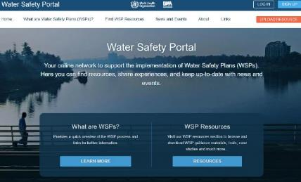

WATER SAFETY PORTAL (WHO and IWA)
Online WSP support network to find resources, share experiences and keep up-to-date on WSP news and events
Peer-reviewed resources to support all aspects of WSP development and implementation
Examples - WSP advocacy, auditing, training packages, tools, templates, literature, case studies, policy, regulations and many more….
SIGN UP ON www.wsportal.org

