Slide 2
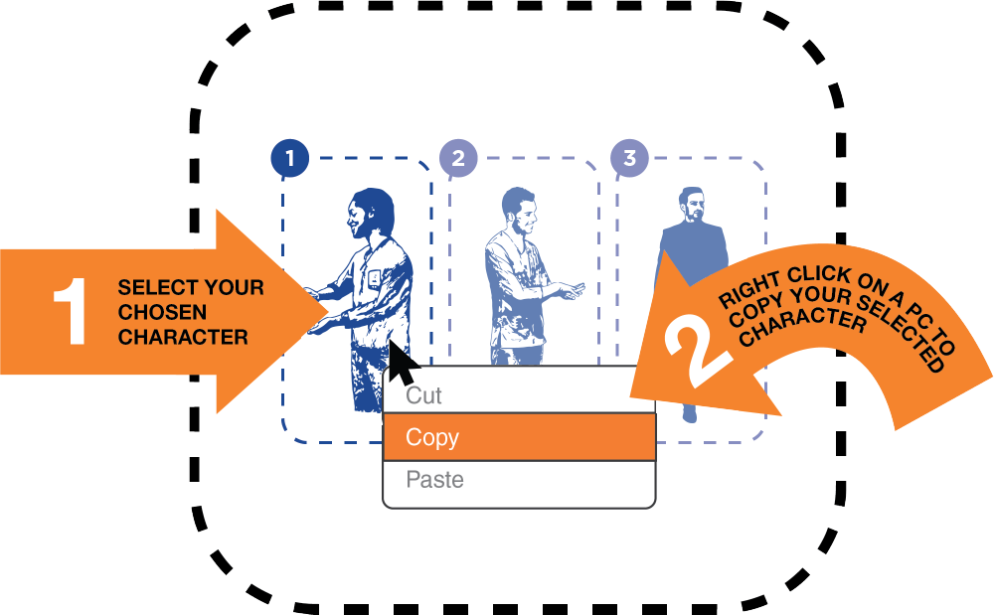

Step 1. Select scenes, characters and objects from pages 5-10
COPYING THE CHARACTER
Right click on your selected character to copy or use this keyboard shortcut

Slide 3
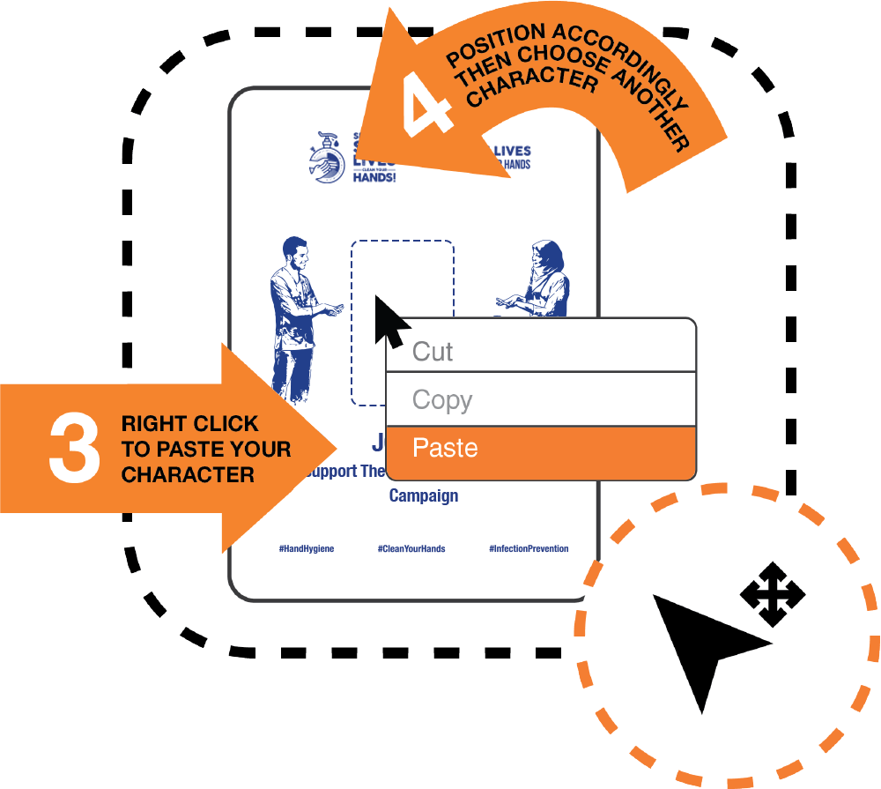
Step 2. Paste your selection on top of the text on page 11 for solo creations
or page 12 if you’re working with a team
SCALING THE ELEMENTS
Don’t forget that you can ‘scale’ a scene, character or object to give it a sense of perspective.
Make sure to add your name

Slide 4

Step 3. Promote the Campaign
SHARE SOCIALLY
Choose FILE and then EXPORT to save your image as a picture and then share on all Social Media
Make sure to use the following #Hashtags
Or share it simply on
www.cleanhandssavelives.org/
#HandHygiene #CleanYourHands #InfectionPrevention

Slide 5
SELECT A SCENE

Slide 6
SELECT CHARACTERS

Slide 7
SELECT CHARACTERS

Slide 8
SELECT OBJECTS

Slide 9
SELECT OBJECTS

Slide 10
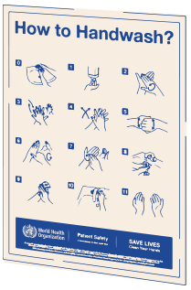
SELECT OBJECTS

Slide 11
JOHN DOE
I support the
Save Lives, Clean Your Hands Campaign.

Slide 12
TEAM NAME
We support the
Save Lives, Clean Your Hands Campaign.

Slide 13
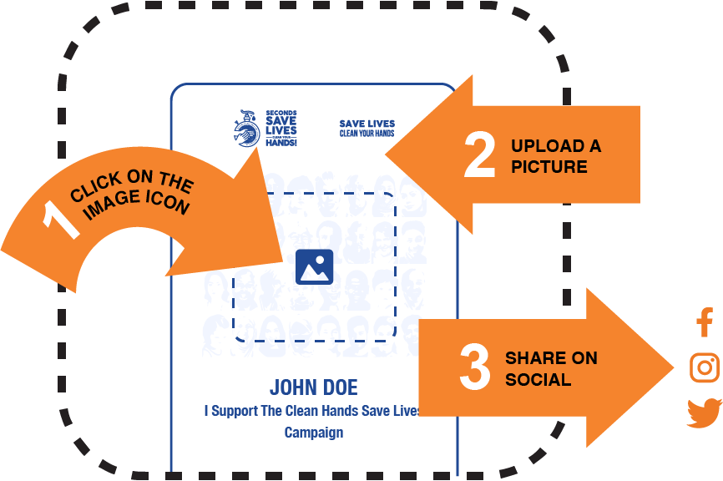
Too busy?
Quickly upload a photo of yourself
or even your team
UPLOAD YOUR PHOTO
Click the ICON then SELECT your image
and finally enter in your name.
Make sure to use page 14 for a solo image
and page 15 for a team photo

Slide 14
JOHN DOE
I support the
Save Lives, Clean Your Hands Campaign.

Slide 15
TEAM NAME
We support the
Save Lives, Clean Your Hands Campaign.

