Slide 1


Charting a path to healthier societies
From loneliness
to social connection
Report of the WHO Commission on Social Connection
Notes:
We are pleased to share the report of the WHO Commission on Social Connection – From loneliness to social connection: charting a path to healthier societies.
This presentation will highlight some key findings from the report.

Slide 2
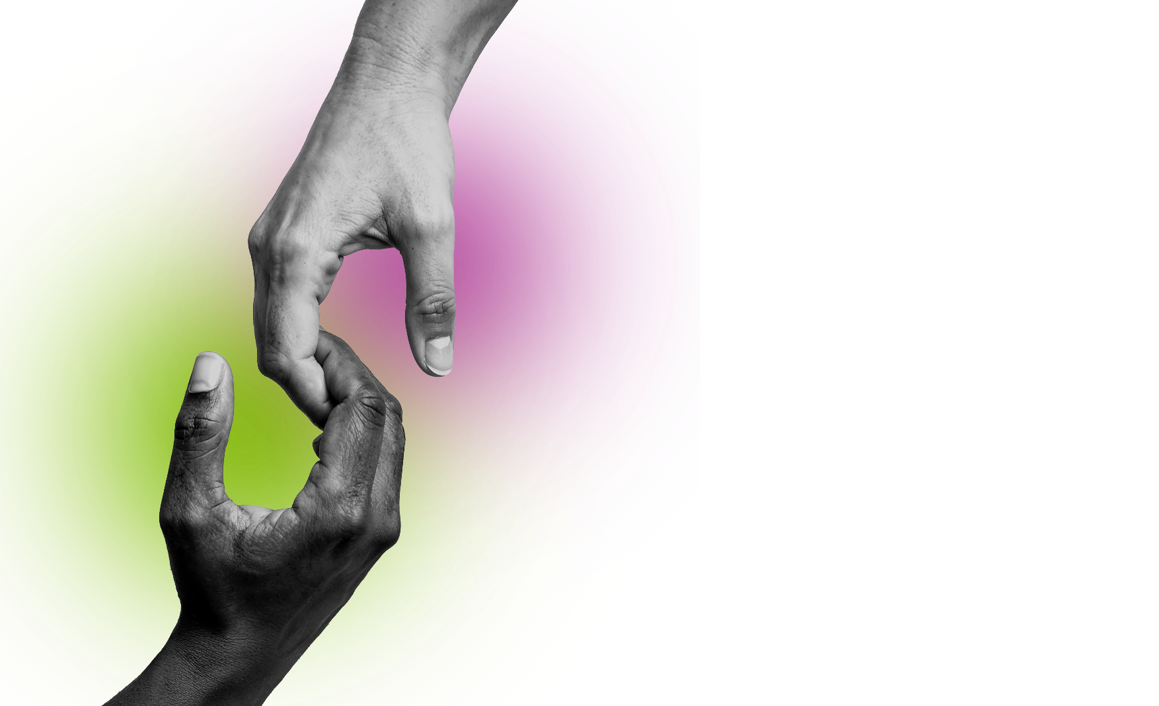

Charting a path to healthier societies
From loneliness
to social connection
Report of the WHO Commission on Social Connection
Notes:
We are pleased to share the report of the WHO Commission on Social Connection – From loneliness to social connection: charting a path to healthier societies.
This presentation will highlight some key findings from the report.

Slide 3


SOCIAL HEALTH: THE MISSING PILLAR
HEALTH
Health is a state of complete physical, mental, and social well-being and not just the absence of disease or infirmity (WHO Constitution, 1948).
PHYSICAL
well-being
MENTAL
well-being
SOCIAL
well-being
Notes:
Social health is the missing pillar of health.
WHO defines health as a state of complete physical, mental, and social well-being – not merely the absence of disease or infirmity.
Yet social health has long been overlooked.
At its core is social connection.

Slide 4









Is how we relate to and interact with others.
STRUCTURE
FUNCTION
QUALITY
SOCIAL CONNECTION
(numbers)
(support, e.g. information, emotional)
1
2
Hurts and happens when your relationships do not match what you want or need.
LONELINESS
Is having very few relationships
or not seeing people often enough.
SOCIAL ISOLATION
Notes:
Social connection describes how people relate to and interact with each other. It has three main dimensions:
Structure: the number and types of relationships and roles, and how often and how long people interact.
Function: the type and amount of support exchanged — whether practical, financial, emotional, informational, etc.
Quality: whether interactions are positive (loving, satisfying) or negative (strained, conflictual, or violent).
Loneliness – a form of social disconnection – is a painful, subjective feeling that happens when your relationships do not match what you want or need.
Social isolation – another form of disconnection — is the objective state of having few relationships or interactions.

Slide 5




LONELINESS IS
A GLOBAL PROBLEM
Rates are highest among
YOUNG PEOPLE
Loneliness affects
and in
1 IN 6
LOW-INCOME COUNTRIES
people worldwide
Notes:
Loneliness is a global problem, which affects 1 in 6 people worldwide.
It affects people of all ages and in all regions.
However, rates are highest among young people (13–29 year-olds), especially among adolescents (13–17 year olds), where they reaches 21%.
Rates are also highest in low-income countries:
Where, at 24%, they are over twice as high as in high income countries, where rates are 11%.

Slide 6




Harm physical and mental health
SOCIAL ISOLATION AND LONELINESS HAVE SERIOUS IMPACTS
Reduce life expectancy.
Loneliness causes
870 000
DEATHS A YEAR
Cost society billions in terms
of health care, education
and employment
Notes:
Social isolation and loneliness have serious impacts:
They harm physical and mental health
Increasing the risk, for instance, of cardiovascular disease and diabetes, and depression and anxiety.
They reduce life expectancy, with loneliness causing 870,000 deaths a year.
They cost society billions in healthcare, poorer education outcomes, and employment problems.

Slide 7

















Poor health
THE DRIVERS OF SOCIAL ISOLATION AND LONELINESS:
Unhealthy
use of digital technologies
Marginalization
SOCIAL ISOLATION AND LONELINESS
Life
transitions
Low income / education
Weak
community
infrastructure
Living alone
Notes:
Many factors drive loneliness and social isolation, for instance:
Poor physical or mental health (e.g., chronic illness, anxiety, depression).
The marginalization experienced by, for instance, people with disabilities, LGBTIQ+ individuals, migrants, and refugees.
Low education and income.
Living alone or without a partner.
Life changes, such as moving, job loss, breakups, retirement, widowhood.
Excessive or harmful use of digital media, especially among youth.

Slide 8

SOLUTIONS EXIST
TO STRENGTHEN SOCIAL CONNECTION:
ADVOCACY, CAMPAIGNS, NETWORKS AND COALITIONS
1
POLICIES
2
COMMUNITY STRATEGIES
3
4
INDIVIDUAL AND RELATIONSHIP STRATEGIES
Notes:
But we are not powerless the face of this issue.
A whole range of solutions exist to strengthen social connection.
These fall into four main categories:
Advocacy, campaigns, networks and coalition
Policies
Community strategies
Individual and relationship strategies
I’ll briefly describe each.

Slide 9

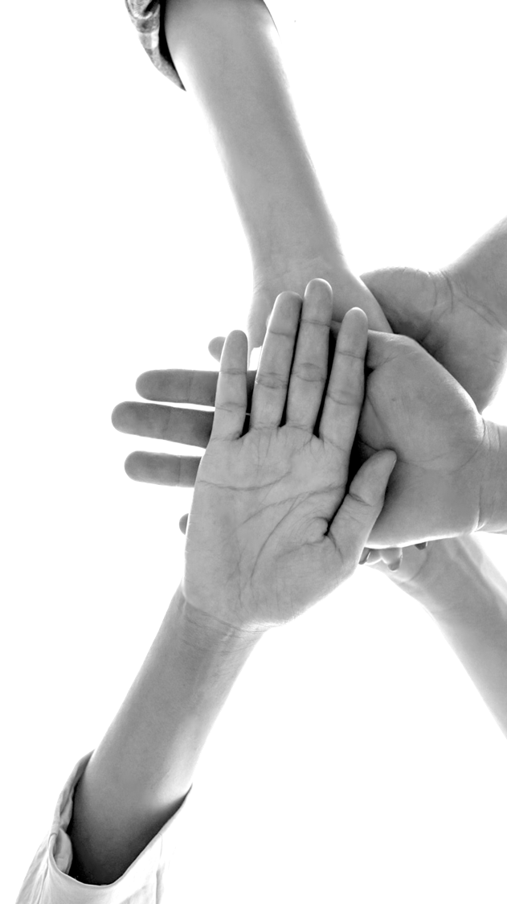
ADVOCACY, CAMPAIGNS,
NETWORKS AND COALITIONS
Notes:
Advocacy, campaigns, networks and coalition help raise awareness, shift social norms, and build networks to coordinate efforts and push for change at the level of whole societies.

Slide 10

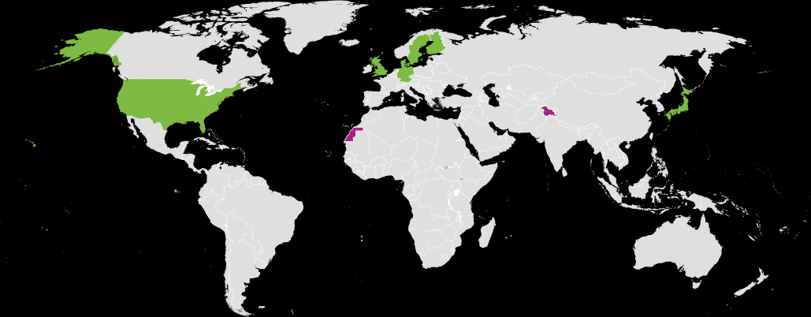

POLICIES
National policies*
No national policies
Not applicable
8 Member States with policies, strategies, action plans,
laws and advisories
Common recommendations:
  Whole-of-society approach
  Strengthening knowledge
  Reducing stigma
  Fostering cross-sectoral collaboration
*In the United Kingdom, only England, Scotland and Wales have policies.
Notes:
Policies are important because they help integrate social connection into government systems and funding.
In recent years, 8 WHO Member States have adopted policies, strategies, actions plans, laws, or advisories addressing the issue.
These are: Denmark, Finland, Germany, Japan, the Netherlands, Sweden, the United Kingdom (England, Scotland and Wales only, not Northern Ireland), and the United States of America.
Many of these have recommended:
“Whole of society approaches” where governments work together with all sectors , including, for instance, schools, healthcare systems, housing, transport, communities, and businesses;
Strengthening knowledge through the funding of more research; and
Public awareness campaigns, particularly to reduce the stigma associated with loneliness.

Slide 11



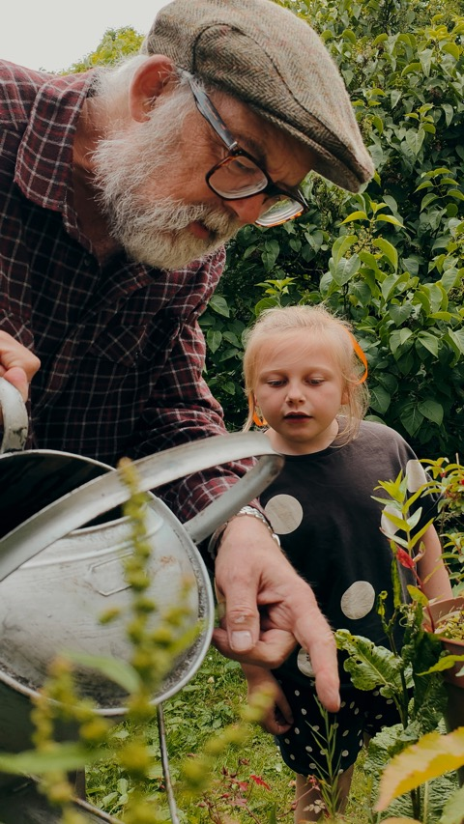

COMMUNITY STRATEGIES
SOCIAL PRESCRIBING
COMMUNITY GROUPS
SOCIAL INFRASTRUCTURE
Notes:
Communities are where people live, work, learn, play, and age — and where connection happens.
That's why community-level strategies are important for helping people feel more connected and less lonely.
One of the best ways to improve social connection is by making community spaces and services – also known as “social infrastructure” – stronger and more welcoming. This includes places like parks, libraries, cafés, public transportation, schools, and healthcare centres.
Other strategies include supporting community groups and connecting people to local non-clinical services through “social prescribing”.

Slide 12

INDIVIDUAL AND RELATIONSHIP STRATEGIES
  Social skills training
  Internet and computer training
SKILLS TRAINING
SOCIAL ENGAGEMENT FACILITATION
  Social support
  Non-human companionship
THERAPEUTIC AND PSYCHOLOGICAL
INTERVENTIONS
  Psychological interventions
  Psychoeducation
Notes:
Individual and relationship strategies have the strongest evidence of effectiveness. Examples include:
Skills training: teaching social and communication skills or how to use digital tools.
Social engagement opportunities: regular, meaningful interactions through befriending programs, peer-support groups, or animal and robot companions.
Therapeutic and psychological support: interventions like cognitive behavioural therapy (CBT) to change thought patterns, and psychoeducation to help people understand and manage loneliness and social connection.

Slide 13










THE WAY FORWARD ON SOCIAL CONNECTION
POLICY
National strategies, cross-sector leadership
RESEARCH
Fill gaps, fund properties, Grand Challenges
INTERVENTIONS
Develop and
scale effective solutions
MEASUREMENT
Better data, global Social Connection Index
ENGAGEMENT
Build public support, shift norms, global movement
Notes:
As a way forward, the report proposes five areas for action, with several concrete suggestions for each:
Policy, e.g., create and fund a national policy promoting social connection.
Research, e.g., launch a Grand Challenge in Social Connection to address the most important problems in this areas
Interventions, develop and scale up effective programs through an “intervention accelerator” .
Measurement and data, e.g., develop a “Global Social Connection Index” monitor the issue better and track progress.
Engagement, build public support through awareness campaigns.

Slide 14



The costs of inaction are
HIGH
THE OPPORTUNITY AHEAD:
The benefits of connection are
FAR REACHING
The time to prioritise social connection is
NOW
Notes:
This report makes clear that:
The costs of inaction are high
The benefits of connection are far-reaching
And the time to prioritise social connection is now.
The Commissioners believe that we have a unique opportunity ahead.
If these actions are widely put into practice, they can improve lives, help communities, and benefit entire societies.
These actions can boost mental and physical health, save lives, support learning and jobs, and lower the costs of social disconnection.
By building stronger social connections, we can create a healthier, more productive, and more fulfilling future for everyone.

Slide 15

#PowerOfConnection #NotAlone
Notes:
Thank you.

