Slide 1
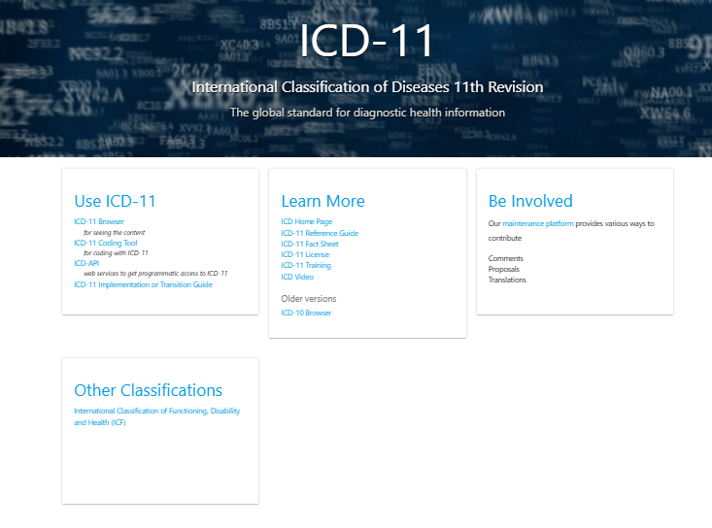
RFP 008-2026
Supporting ICD-11 Transition Planning and Readiness in Indonesia
Pre-bidding meeting
15 March 2026
https://icd.who.int/en/

Slide 2
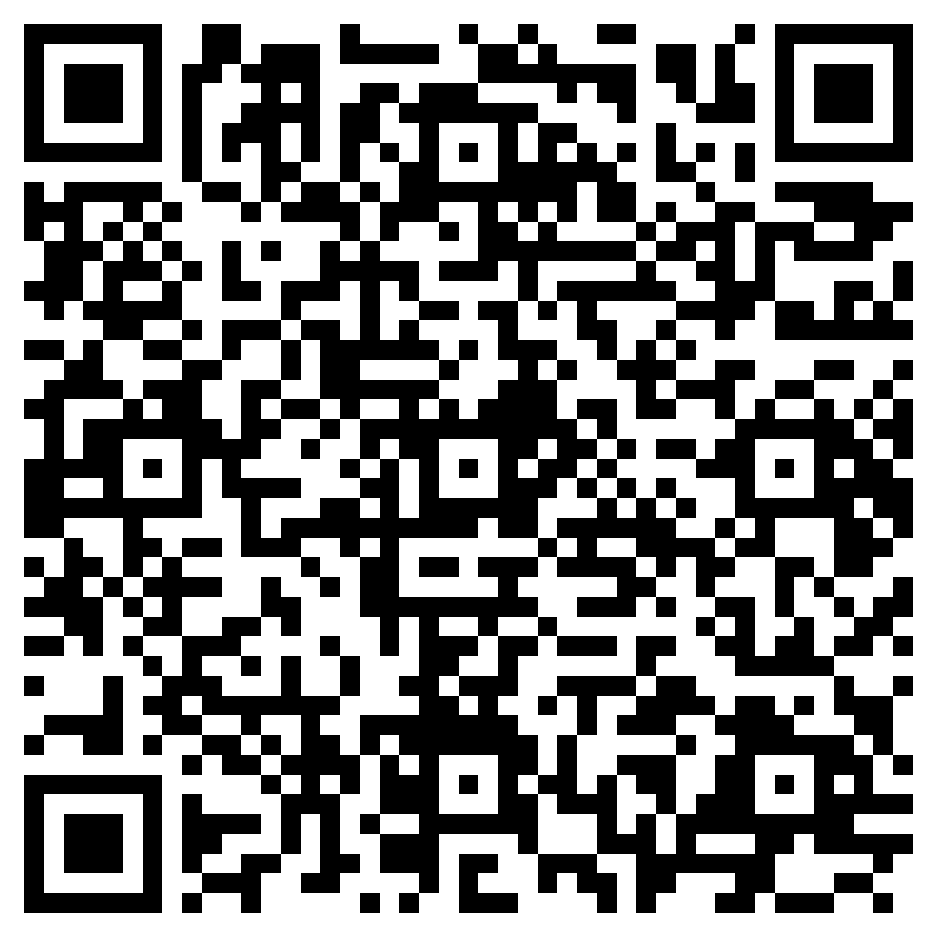
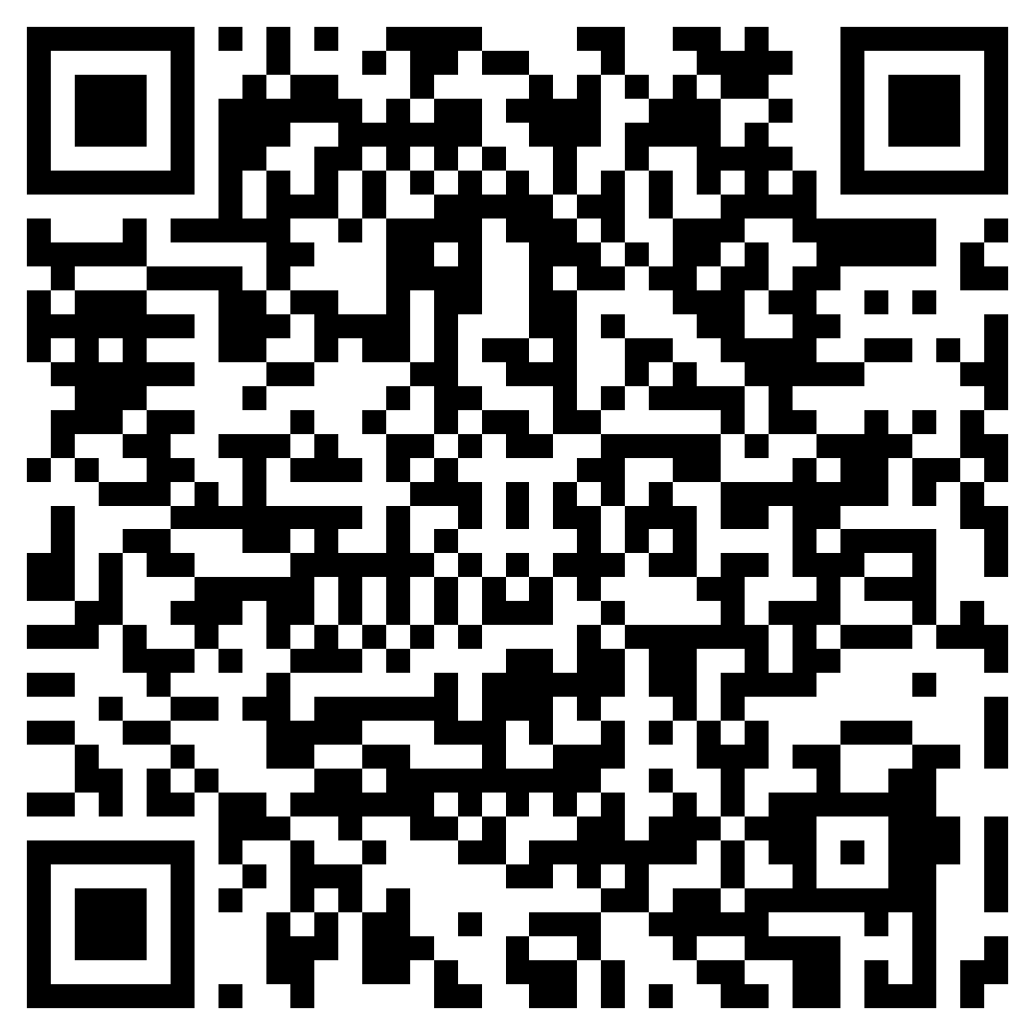
Before we begin
Sebelum kita mulai
Code of Conduct
Please note that this event adheres to the
Code of Conduct to prevent harassment,
including sexual harassment, at WHO events.
Zero tolerance to sexual misconduct
Harap diperhatikan bahwa kegiatan ini mematuhi
Tata Perilaku untuk mencegah pelecehan, termasuk pelecehan seksual, pada kegiatan WHO.
Nol toleransi terhadap pelanggaran seksual
Tata Perilaku

Slide 3
Agenda
Background
Purpose of RFP
Timeline, Scope of Work, and Deliverables
Characteristic of Provider
The proposal and Evaluation Criteria
The Suggestive Budget Detail Template

Slide 4
Background
Indonesia has been strengthening its Civil Registration and Vital Statistics (CRVS) system, including through the establishment of the Health Sector CRVS Working Group (PS2H) within the Ministry of Health in 2023, chaired by Pusdatin.
The Working Group has developed a Health Sector CRVS Roadmap, which identifies the introduction of ICD-11 as an important milestone for improving the quality and use of health data.
Role of the International Classification of Diseases (ICD)
The ICD is the global standard used for recording morbidity and mortality data, supporting functions such as:
  Clinical documentation and morbidity/disease coding
  Cause of death certification and mortality statistics
  Health service reporting and monitoring
  Health financing and claims management
  Public health research and analysis
The 11th Revision of ICD (ICD-11), endorsed by the World Health Assembly in 2019 and effective since 2022, introduces more detailed and structured health data and a fully digital classification system designed to support interoperability and improved use of health data across systems.

Slide 5
Background (continued)
Why Indonesia needs to begin preparing for ICD-11 transition
Indonesia has used ICD-10 for more than two decades under Ministerial Decree No. 50/MENKES/SK/I/1998.
While ICD-10 has supported national health reporting and statistics, several developments highlight the need to begin preparing for a future transition to ICD-11, including:
  Increasing demand for timely and internationally comparable health data
  Ongoing digital health transformation, including SATUSEHAT
  Evolving clinical practice and health service delivery
  The need to strengthen mortality statistics and CRVS systems
Recent initiatives also highlight the importance of preparing for ICD-11 transition, including:
  Strengthening Medical Certification of Cause of Death (MCCD) for mortality coding
  Development of ICD-10 Indonesian Modification (ICD-10-IM) for morbidity reporting
At present, Indonesia does not yet have a national direction or transition framework for ICD-11 adoption, and levels of awareness and readiness vary across institutions.
Therefore, the Ministry of Health, with support from WHO and partners, will initiate a structured process of policy dialogue and technical consultation to develop an initial ICD-11 Transition Framework for Indonesia.

Slide 6
Purpose of the RFP 017
The primary objective :
To support the development of an initial ICD-11 Transition Framework for Indonesia to guide future adoption.
Include:
Readiness mapping for ICD-11 transition across MoH and stakeholders
Policy dialogue to define key transition directions and priorities
Development of a draft ICD-11 Transition Framework
Technical workshops and consultations to refine the framework
WHO Indonesia seeks to engage a consultant to support Pusdatin, Ministry of Health in preparing for the transition to ICD-11 in Indonesia.
Deliverables
Important note:
This assignment does not focus on immediate implementation of ICD-11, but on supporting early policy and transition framework/planning.

Slide 7
Scope of Work and Deliverables (continued)
Estimated Start date: May/June 2024 End date: Oct/Nov 2024
The total timeline for this project is 5 months
DELIVERABLES
1. Preparatory Work and Coordination
Activities include:
Desk review of relevant references and current practices related to disease classification and ICD-11 transition in Indonesia
Preparation of background notes, discussion materials, and tools for policy and technical workshops
Preparatory and technical coordination meetings with Pusdatin and MoH to support planning and implementation
A short background note (1–2 pages) to support the Policy Forum and Technical Workshops.
Discussion materials for the Policy Forum and Technical Workshops
Short records of preparatory and coordination meetings, as appropriate.
Note:
Preparatory/technical coordination meetings at Pusdatin office will be conducted up to four (4) times of one-day hybrid meeting, held at different stages of the assignment, including prior to and in preparation for key activities.

Slide 8
Scope of Work and Deliverables (continued)
DELIVERABLES
2. Policy Forum on ICD-11 Transition (2 days)
Activities include:
Agenda setting and coordination of the in-person policy forum
Facilitation and moderation of policy dialogue sessions•
Documentation and synthesis of key discussions and agreed inputs
A short background note (1–2 pages) to support the Policy Forum and Technical Workshops.
Discussion materials for the Policy Forum and Technical Workshops
Short records of preparatory and coordination meetings, as appropriate.
Policy Forum discussions will focus on:
Building a shared understanding of the rationale and policy implications of ICD-11 transition in Indonesia
Identifying key policy questions, priorities, and considerations• Exploring transition options, sequencing, and institutional roles
Discussing implications for regulation, health financing, workforce capacity, and digital health systems, including SATUSEHAT and BPJS Kesehatan
Participants: Representatives from MoH units, other ministries/agencies, professional associations, academia, health facilities, and other key stakeholders (same participants for both days).
Note:
2-day in-person forum, maximum 60 participants, held in Jakarta (government venue)
Technical inputs from WHO HQ and WHO Regional Office
Consultant responsible for facilitation and synthesis of forum outcomes.

Slide 9
Scope of Work and Deliverables (continued)
3. Targeted Technical Workshop and Consultations (3 days)
The consultant will organize and facilitate one targeted technical workshop to provide practical, role-based exposure to ICD-11 and build a shared understanding of its implications for different functions and workflows, as input to the ICD-11 transition planning process.
DELIVERABLES
Activities include:
Planning and coordination of the targeted technical workshop
Facilitation of workshop sessions and group discussions
Documentation and synthesis of key technical discussions and inputs
Follow-up technical consultations, as needed, to clarify and consolidate inputs
A technical workshop report summarizing key discussions, practical insights, and issues identified during the workshop.
A consolidated list of technical, system, and capacity needs to support future ICD-11 transition.
Key focus areas:
• Introduction to ICD-11 concepts, structure, and tools, including key differences from ICD-10
• Discussion and exercises on implications for workflows, data use, reporting, claims, and systems
• Identification of feasibility issues, capacity needs, and technical considerations for ICD-11 transition
Participants: Selected technical participants, including coders, clinicians, claims verifiers, health information and IT staff, and health statisticians, with discussions conducted in smaller groups as appropriate.).

Slide 10
Scope of Work and Deliverables (continued)
3. Targeted Technical Workshop and Consultations (3 days)
Note:
3-day in-person workshop, maximum 60 participants, held in Bogor (government venue)
Learning materials and participant records managed through Pelataran Sehat (lms.kemkes.go.id)
Technical inputs may be supported by WHO HQ and WHO Regional Office experts
The consultant is responsible for overall facilitation and consolidation of outputs.

Slide 11
Scope of Work and Deliverables (continued)
4. Adaptation of ICD-11 Technical Training Materials
The consultant will adapt existing WHO ICD-11 technical training materials for the Indonesian context to support reuse beyond this assignment.
Materials should be prepared in a format suitable for online delivery and reuse.
DELIVERABLES
Adapted ICD-11 technical training materials in Bahasa Indonesia, contextualized for Indonesia and suitable for online learning platforms (e.g. Pelataran Sehat)
Note:
The adapted materials will undergo WHO technical review prior to finalization..
https://icd.who.int/en/
https://www.who.int/standards/classifications/frequently-asked- questions/icd-11-implementation
https://apps.who.int/gb/ebwha/pdf_files/WHA72/A72_29-en.pdf

Slide 12
Scope of Work and Deliverables (continued)
IN THE END OF PROJECT
DELIVERABLES
Draft ICD-11 Transition Framework for Indonesia, documenting the agreed direction and key considerations for ICD-11 transition in Indonesia and English languages
Adapted ICD-11 Technical Training Materials, based on WHO ICD-11 training content, contextualized for the Indonesian context and prepared in a format suitable for online delivery and reuse through Pelataran Sehat or other designated MoH learning platforms.
Comprehensive activity (technical and financial) final report in Indonesia and English languages

Slide 13

Characteristic of Provider
The team
The team must come from the company or institution that have a strong capacity and previous experience in the similar project.
Mandatory:
experience in assignments related to disease classification systems and their use in health reporting, statistics, and related health system functions, or comparable technical-policy work in the health sector
experience in supporting policy dialogue, technical consultation, and multi-stakeholder processes with government institutions, including facilitating policy or technical workshops
familiarity with the institutional and operational context of health data and statistics in Indonesia
familiarity with international disease classification systems and related health data standards
Desirable:
Prior experience working with government institutions, experience working with WHO or other international organizations is an advantage
Experience in developing or adapting technical training materials for health professionals

Slide 14
To achieve the maximum results, the team should consist of possess a team leader and members who have expertise and/or experience in:
Characteristic of Provider
Project manager/team leader (1 person)
  At least a Master’s degree (S2) in public health, medicine, health information, health policy, or a related field.
  Minimum 5 years of relevant professional experience in disease classification, health statistics, health policy, or related areas.
  Demonstrated experience leading technical-policy assignments or similar projects with government institutions.
  Strong facilitation and analytical skills, including the ability to synthesize technical discussions into policy-relevant outputs.
  Prior experience working with UN agencies or international organizations is an advantage
Technical team member (1 person)
At least a Bachelor’s degree (S1) in public health, medicine, statistics, health informatics, or a related field.
Minimum 3 years of relevant professional experience related to disease classification, health statistics, health reporting, or similar work
Experience supporting technical discussions, workshops, or consultations in the health sector.
Ability to document and synthesize technical inputs clearly and accurately
Ability to support the preparation and adaptation of technical training materials, including organizing content in a format suitable for online delivery and reuse
Administration and finance staff for handling the administration and finance issue, including organizing the meeting (1 person)
  Background in business, administration, or related subject
  At least 2 years experiences of administrative support (including arrange the travel and meeting venue) for government, UN agency, or NGO activity

Slide 15

The Proposal
Refer to Invitation RFP 008-2026 for the structure of proposal (section 4.12) and the detailed of evaluation criteria (section 5.3 and Appendix 4).
Technical Evaluation Criteria
Organizational Capacity
Quality of the Technical Proposal
Resources and Key Personnel
Institutional profile demonstrating relevant experience in disease classification, health information or health statistics, or similar technical/policy work with government institutions in Indonesia, including a list of relevant assignments (e.g. policy dialogue, technical consultation, transition planning).
Clarity of the institution’s rationale for undertaking this assignment and alignment of its background with the objectives of ICD-11 transition in Indonesia
Clear understanding of the objectives and scope of the assignment, including ICD-11 transition as a policy and planning process and the role of disease classification in health reporting and statistics.
Proposed approach and methodology for implementing the scope of work, including stakeholder identification, structure of the Policy Forum and Technical Workshop, and the approach to developing the ICD-11 Transition Framework.
Implementation timeline (Gantt chart), including key tasks and human resource allocation for each phase.
Project risks and mitigation measures and quality assurance
Full Cvs of proposed team members’ qualifications and experience directly relevant to this assignment, including the team organogram and delegation tasks/responsibilities according to timeline as described at Gantt chart
Institutional existing resources (that can be utilized for this project
Approach for facilitating policy dialogue and technical discussions, including managing different perspectives and generating meaningful inputs.
Previous experience working with UN agency or other international organizations is preferable.

Slide 16
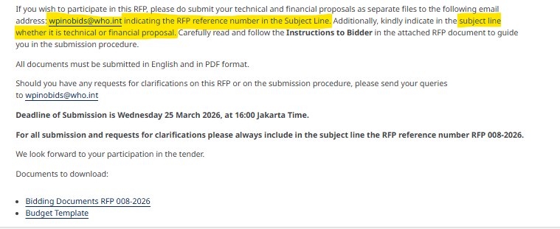

The Suggestive Budget Detail Template
Refer to Invitation RFP -08-2026 Appendix 4
Note:
Scoring – Technical proposal : Budget proposal is 70:30
With minimum passing points for technical proposal is 50

Slide 17


