Slide 1
RFP 007-2026
SATU SEHAT Logistics Roadmap 2026-2029
Pre-bidding meeting
17 March 2026
https://icd.who.int/en/

Slide 2


Before we begin
Sebelum kita mulai
Code of Conduct
Please note that this event adheres to the
Code of Conduct to prevent harassment,
including sexual harassment, at WHO events.
Zero tolerance to sexual misconduct
Harap diperhatikan bahwa kegiatan ini mematuhi
Tata Perilaku untuk mencegah pelecehan, termasuk pelecehan seksual, pada kegiatan WHO.
Nol toleransi terhadap pelanggaran seksual
Tata Perilaku

Slide 3
Agenda
Background
Purpose of RFP
Timeline, Scope of Work, and Deliverables
Characteristic of Provider
The proposal and Evaluation Criteria
The Suggestive Budget Detail Template

Slide 4

Background
As part of Pillar 6 – Health Technology Transformation, the Ministry of Health has launched the Indonesia Health Services (IHS) Platform – SATUSEHAT to enable data exchange and interoperability across health information systems.
One key priority is strengthening SATUSEHAT Logistics to support the management and availability of health commodities across the health system.
Availability and appropriate use of health commodities
Efficient supply chain management
Better planning, monitoring, and decision-making
Effective logistics
management
Essential for
Fragmented logistics information systems across units and facilities
Limited capacity and understanding among personnel
Suboptimal use of logistics data for decision-making
In the context of rapid digital and technological developments, strengthening SATUSEHAT Logistics is essential to support integrated supply chain management.
To ensure coherent and sustainable development, MoH plans to develop a SATUSEHAT Logistics Roadmap 2026–2029, supported by benchmarking and knowledge-sharing activities to strengthen stakeholder understanding and guide future implementation.

Slide 5
Purpose of the RFP 007-2026 - Development of the SATUSEHAT Logistics Roadmap 2026–2029
Supporting Pusdatin and Ditjen Farmalkes
to develop a strategic roadmap to strengthen SATUSEHAT Logistics as part of Indonesia’s health digital transformation,
enabling coordinated and phased implementation of logistics information systems across the health system
Key Objectives:
assess the current situation of SATUSEHAT Logistics, identify key gaps and opportunities in logistics information system
define short-, medium-, and long-term priorities for SATUSEHAT Logistics based on analysis and benchmarking
develop SATUSEHAT Logistics Roadmap 2026–2029 with phased implementation and monitoring indicators
strengthen stakeholder understanding of supply chain management and logistics data use
benchmark national and international good practices and assess their relevance to Indonesia
Situation
Analysis
Stakeholder Understanding
Benchmarking and Good Practices
Strategic
Priorities
Develop SATUSEHAT Logistics Roadmap

Slide 6
Scope of Work and Deliverables
Estimated Start date: May/June 2026 End date: Nov/Dec 2026
The total timeline for this project is 6months
Activities | Deliverables | Notes
Preparatory Coordination and Activity Planning
Initial coordination (kick-off) meeting with Pusdatin, Farmalkes, and stakeholders to align on scope, activity sequencing, coordination arrangements, and current SATUSEHAT Logistics status Follow-up coordination meeting to review and confirm scope, sequencing, and coordination arrangements | An agreed detailed activity plan, including timeline and coordination arrangements | 2 separate hybrid meetings at the Pusdatin office, with a maximum of 35 participants per meeting
Situation Analysis and Initial Assessment
Desk review of policies and documents on SATUSEHAT Logistics and logistics information systems Assessment of current implementation, including key gaps and opportunities Technical meetings to validate findings Stakeholder workshop to discuss findings and proposed directions | Situation analysis summary (including key gaps and opportunities) Initial outline of strategic issues for the roadmap Documentation of knowledge-sharing activities | 3 hybrid technical meetings at the Pusdatin office, with a maximum 35 participants per meeting 1 in-person workshop in Jakarta – gov owned venue (max 65 participants)

Slide 7
Scope of Work and Deliverables
Activities | Deliverables | Notes
Stakeholder Consultation, Benchmarking, and Development of Roadmap
FGDs, interviews, and meetings to gather inputs and refine the draft roadmap• Benchmarking of relevant national and international good practices Stakeholder discussions on adapting good practices to the Indonesian context | Draft SATUSEHAT Logistics Roadmap incorporating consultation and benchmarking inputs Documentation of consultation and benchmarking activities | 1 hybrid technical meeting at the Pusdatin office, max 35 participants 1 in-person workshop in Jakarta – gov owned venue (max 65 participants)
Finalization of the SATUSEHAT Logistics Roadmap
Finalize the roadmap by consolidating inputs from consultations, benchmarking, and internal reviews Review and confirm strategic directions, priorities, and sequencing Refine phased implementation approach and monitoring indicators Conduct final review meetings and validation workshop | Final SATUSEHAT Logistics Roadmap 2026–2029, prepared and ready for internal endorsement within the MoH | 3 hybrid finalization meetings at the Pusdatin office, max 35 participants per meeting 1 in-person validation workshop in Jakarta – gov owned venue (max 65 participants)

Slide 8
Scope of Work and Deliverables
Activities | Deliverables | Notes
Dissemination of the SATUSEHAT Logistics Roadmap
Organize dissemination workshop to present the roadmap to stakeholders Present key directions, priorities, and implementation phases outlined in the roadmap, and facilitating discussion to support understanding and uptake. Prepare dissemination materials (slides and summaries) Conduct online dissemination (webinar) | Disseminated SATUSEHAT Logistics Roadmap (print and PDF Documentation of dissemination activities (workshop and webinar) | 1 in-person workshop in Jakarta - gov owned venue (±65 participants 1 webinar session (max 54 participants)
Deliverables in the end of project:
➡️ SATUSEHAT Logistics Roadmap 2026–2029
➡️ Comprehensive activity (technical and financial) final report in Indonesia and
English language

Slide 9
Requirements of Provider
Technical Requirements
The consultant should demonstrate: • Strong understanding of health logistics and logistics information systems in Indonesia • Experience in health supply chain management (including pharmaceuticals and medical devices) • Familiarity with logistics information systems and its data use for planning, monitoring, and decision-making • Understanding of standards, interoperability, governance, and regulatory aspects (incl. SATUSEHAT) • Experience facilitating multi-stakeholder consultations and technical discussions
Provider Profile
Eligibility | Mandatory Experience | Desirable
Legally registered institution in Indonesia with relevant capacity and experience | Experience in roadmap development, strategic planning, or system strengthening Experience in logistics information systems or supply chain management Understanding of interoperability, governance, and regulatory context | Experience with government, WHO, or international organizations Familiarity with good practices in logistics systems Experience facilitating consultations, FGDs, or workshops
Team Requirements
• Multidisciplinary team with technical and operational capacity • Combination of academic/research and hands-on implementation experience → At least one team member with academic/research experience and one with hands-on implementation experience

Slide 10
Characteristic of Provider
Project manager/team leader (1) 👤
  Overall coordination, technical leadership, and quality assurance
  Master’s degree in public health, health informatics, health policy, pharmacy, supply chain management, information systems, or a related field
  ≥5 years experience in HIS, logistics, supply chain, or digital health
  Experience leading roadmap/strategic planning developmentwith government institutions.
  Good understanding of standards, interoperability, governance, and regulatory context.
  Strong facilitation and analytical skills.
  Ability to integrate academic inputs with practical implementation considerations into clear policy and implementation recommendations
  Experience with UN/ international organizations (advantage)
Technical Pharmaceutical Logistics (1) 💊
Provide inputs on pharmaceutical logistics and data use
Bachelor’s (Master’s preferred) in pharmacy, public health, health informatics, or a related field
≥3 years experience in pharmaceutical supply chain/health logistics systems
Familiar with national regulations and operational processes related to pharmaceutical logistics in Indonesia.
Experience in technical discussions/workshops
Ability to document and synthesize technical inputs clearly and accurately.
Technical – Logistics & Medical Devices (1) 📦
Provide inputs on logistics systems for medical devices and other health commodities
Bachelor’s (Master’s preferred) in public health, engineering, supply chain management, health informatics, or a related field
≥3 years experience in health logistics/medical device supply chains
Familiar with logistics workflows, data reporting, and across different levels of the health system, including national and subnational contexts
Experience in stakeholder consultations

Slide 11

Characteristic of Provider
Technical– System Architecture and Interoperability (1 person) ⚙️
Provide inputs on system architecture, interoperability, and data integration relevant to SATUSEHAT Logistics
Bachelor’s in IT/computer science/health informatics or related field
≥3 years experience in HIS/interoperability/system architecture/data integration
Understanding of data interoperability frameworks, and system integration, particularly in digital health or logistics information systems
Ability to translate technical design into practical roadmap inputs
Administration and finance staff for handling the administration and finance issue, including organizing the meeting (1 person) 📊
  Background in business, administration, or related subject
  At least 2 years experiences of administrative support (including arrange the travel and meeting venue) for government, UN agency, or NGO activity
Combination of academic/research and hands-on implementation experience → At least one team member with academic/research experience and one with hands-on implementation experience

Slide 12

The Proposal
Refer to Invitation RFP 007-2026 for the structure of proposal (section 4.12) and the detailed of evaluation criteria
(section 5.3 and Appendix 2).
Technical Evaluation Criteria
Organizational Capacity
Quality of the Technical Proposal
Resources and Key Personnel
Institutional profile demonstrating relevant experience to roadmap development, health logistics, logistics information systems, supply chain management, digital health, or similar technical or policy-related work with government institutions in Indonesia, including a list of relevant assignments (e.g. policy dialogue, technical consultation, transition planning).
Clear understanding of the objectives and scope of the assignment, including the purpose of developing the SATUSEHAT Logistics Roadmap and its role in supporting national health digital transformation priorities.
Proposed approach and methodology for implementing the activity, including preparatory coordination, situation analysis, stakeholder consultation, benchmarking, roadmap development, finalization, and dissemination.
Implementation timeline (Gantt chart), including key tasks and human resource allocation for each phase.
Project risks and mitigation measures and quality assurance
Full Cvs of proposed team members’ qualifications and experience directly relevant to this assignment, including the team organogram and delegation tasks/responsibilities according to timeline as described at Gantt chart
Institutional existing resources (that can be utilized for this project
Approach for engaging relevant stakeholders, including government units and other key actors, through meetings, FGDs, and workshops, and for ensuring meaningful inputs into the roadmap development process.
Previous experience working with UN agency or other international organizations is advantage.
Clarity of the institution’s rationale for undertaking this assignment and alignment of its background with the objectives of the SATUSEHAT Logistics Roadmap development

Slide 13
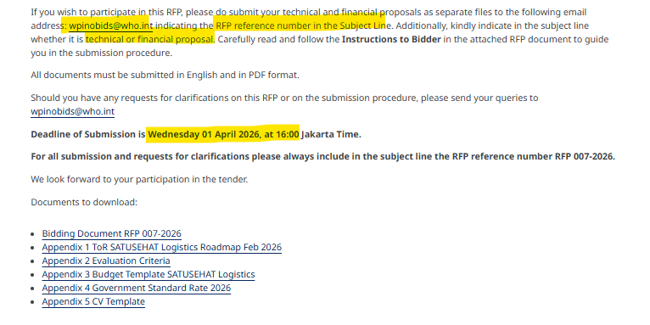
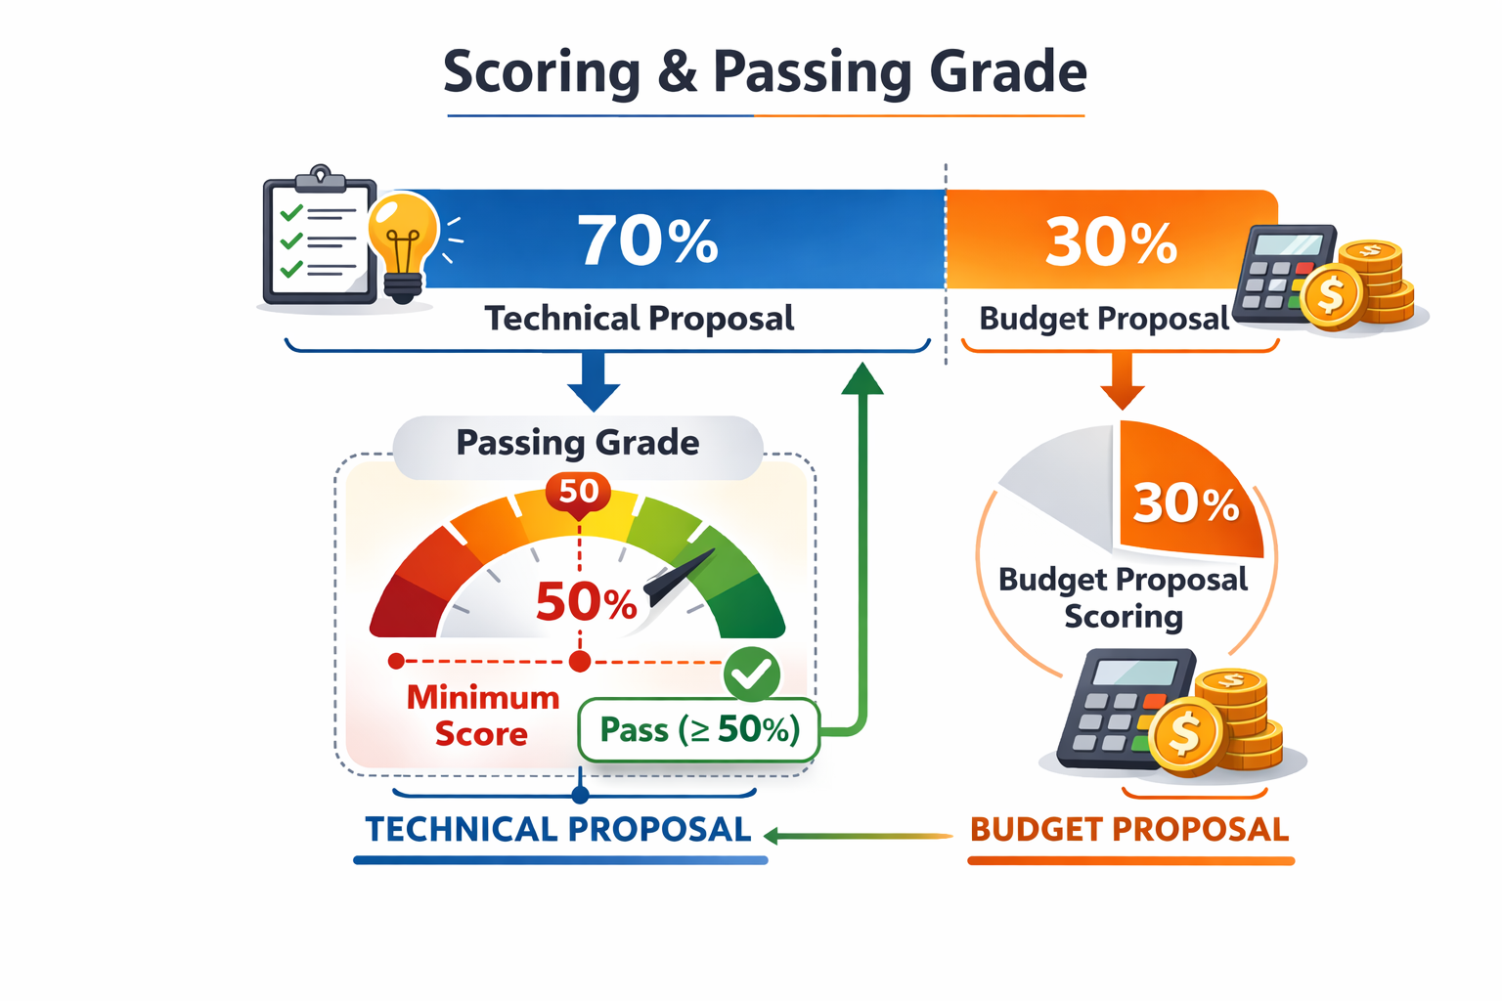

The Suggestive Budget Detail Template
Refer to Invitation RFP -07-2026 Appendix 3

Slide 14


