Slide 1
RFP 011-2026
Development Fellowship Information System Integrated to Support Transparent and Accountable Fellowship Management
who.int/RFP-011-2026-Fellowship
Pre-bidding Meeting
14 April 2026

Slide 2


Before we begin
Sebelum kita mulai
Code of Conduct
Please note that this event adheres to the
Code of Conduct to prevent harassment,
including sexual harassment, at WHO events.
Zero tolerance to sexual misconduct
Harap diperhatikan bahwa kegiatan ini mematuhi
Tata Perilaku untuk mencegah pelecehan, termasuk pelecehan seksual, pada kegiatan WHO.
Nol toleransi terhadap pelanggaran seksual
Tata Perilaku

Slide 3
Agenda
1. Background
2. Purpose of RFP
3. Timeline, Scope of Work, and Deliverables
4. Characteristic of Provider
5. The proposal and Evaluation Criteria
6. The Suggestive Budget Detail Template

Slide 4
Background
What is the current situation and mandate?
MoH has a mandate to improve quality and equitable distribution of health workforce
Fellowship programs are a key mechanism to strengthen subspecialist expertise and referral services
Improve access to specialist care across regions
What is the gap?
1,747 specialists deployed, but ~1,300 more still needed
Fellowship system is fragmented and only partially digitalized
Registration partially in SATUSEHAT SDMK, while other processes remain manual
Results in inefficiency, limited transparency, and data inconsistency

Slide 5
Background (continued)
What is the solution?
Strengthening an integrated Fellowship Information System within SATUSEHAT SDMK ecosystem
Functions as a digital gateway for end-to-end fellowship management
Enables structured, transparent, and auditable processes
What are the expected benefits?
Provides reliable data on candidates, training capacity, placement, and outcomes
Supports monitoring of specialist competency development
Enables evidence-based health workforce planning
Helps identify gaps and align training with national needs
Strengthens referral services and expands access, especially in underserved and remote areas

Slide 6
Purpose of the RFP
WHO Indonesia seeks to engage a vendor to support Directorate of Health Workforce Quality, Ministry of Health in the design, development, integration, and implementation of the Fellowship Information System as part of the SATUSEHAT SDMK ecosystem.
The key objectives include:
Develop fellowship information system that support the end-to-end implementation of medical specialist fellowship programs, including registration, selection process, monitoring, and management of fellowship seats.
Ensure interoperability of the Fellowship Information System with national digital health and health workforce platforms, including SATUSEHAT SDMK and related systems.
Deliverables
Important Note
This assignment focuses on strengthening governance and digitalization of fellowship program management, including integration within the national health information ecosystem – SATUSEHAT SDMK, rather than standalone system development.

Slide 7
Scope of Work and Deliverables (continued)
Estimated Start Date: May 2026 End Date: April 2027
The total project duration is 12 months, consisting of approximately 4 months for system development and implementation by the contracted provider, followed by server hand over to Centre of Data and Information Technology (Pusdatin) MoH, and warranty and technical support period.
1. Preparatory Coordination and Activity Planning
Activities include:
Coordination meetings with the Directorate of Health workforce quality, the Directorate General of Health workforce, Pusdatin, MoH and other relevant stakeholders to discuss activity preparation, implementation, and alignment with the SATUSEHAT SDMK ecosystem.
Discussions to clarify the scope of work, sequencing of activities, and coordination arrangements for the assignment.
Deliverables:
An agreed detailed activity plan, including timeline and coordination arrangements.
Note:
The preparatory coordination and activity planning will be supported by up to 2 hybrid meetings at the Directorate of Health workforce quality office, with a maximum of 15 participants per meeting.

Slide 8
Scope of Work and Deliverables (continued)
2. Requirements Analysis and System Design
Activities include:
Map current fellowship business processes and workflows and identify digitalization needs
Define user roles, access hierarchy, and authorization protocols.
Develop functional requirement specifications and system architecture design.
Define interoperability requirements with SATUSEHAT APIs and HRH datasets.
Define data governance and cybersecurity requirements aligned with national standards.
Prepare a system implementation approach and risk mitigation plan.
Deliverables:
Approved Functional Requirements Specification (FRS).
Validated workflow diagrams and user journey maps.
System Architecture and Technical Design Document.
Note:
Desk Work (internal preparation, system development, and technical coordination) with technical consultations with relevant stakeholder as needed

Slide 9
Scope of Work and Deliverables (continued)
3. System Development and Configuration
This phase focuses on the development and configuration of the Fellowship Information System based on approved specifications. The contractor shall develop modular system components enabling end-to-end digital management of fellowship program within a secure and scalable environment.
Activities include:
Develop and configure system modules based on the approved Functional Requirements Specification.
Configure user roles, access control, and system workflows.
Develop system interfaces and integration components with relevant platforms.
Conduct internal system testing and configuration adjustments during development
Deliverables:
Developed and configured Fellowship Information System modules as described above.
Audit trail functionality enabling complete logging of user activities, approvals and data changes within the system.
System configuration documentation and technical setup.
System ready for integration and testing.
Note:
Desk Work (internal preparation, system development, and technical coordination) with technical consultations with relevant stakeholder as needed

Slide 10
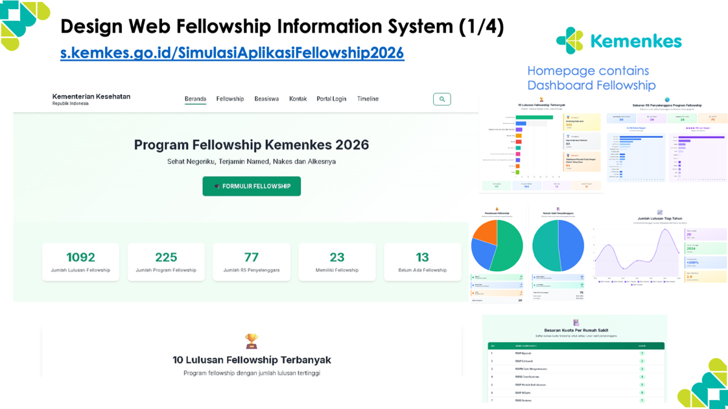
System Module & Prototype
No | System module | Description
1 | Dashboard | Displays real-time fellowship program status (available quota, number of participants)
2 | Registration | Manages participant application and admission process both in-country and abroad, queues, and timelines
3 | Integration (SATUSEHAT SDMK, LMS, SIBK/Sistem Informasi Beasiswa Kemenkes | Merges separate apps into one integrated system. enables interoperability and data exchange between the Fellowship Information System and relevant national platforms.
4 | Fellowship Lifecycle Tracking | Tracks participants from registration to completion of fellowship and place of posting
5 | College and Host Hospital | Allows colleges and host hospitals to conduct assessments and issue recommendation in one platform
6 | Letter of Acceptance issuance | Allows host hospitals to issue LoA (Letters of Acceptance) directly through the app.
7 | Payment Monitoring | supports monitoring of scholarship payments managed through to SIBK (payments incl. tuition fee, living allowance, transport)
8 | Participant Activity | Fellowship participants log activities in the app.
9 | Fellowship management | Enables the fellowship management team to monitors all processes and issues decisions within the app.
A prototype of the fellowship information system developed by MoH can be accessed at https://s.kemkes.go.id/SimulasiAplikasiFellowship2026

Slide 11
Scope of Work and Deliverables (continued)
4. Integration and Testing
Activities include:
Configure and operationalize system interoperability between the Fellowship Information System, SATUSEHAT SDMK, and SIBK through API integration, data mapping, authentication setup, and alignment with national digital health interoperability standards
Conduct end-to-end integration testing to ensure secure, accurate, and real-time data exchange across systems, including performance testing and coordination with relevant MoH system owners.
Facilitate User Acceptance Testing (UAT) through relevant stakeholders' validation sessions to confirm system functionality and readiness prior to deployment.
Address technical issues identified during integration testing, UAT, and perform necessary system adjustments.
Deliverables:
Fully functional and validated system integration between the Fellowship Information System, SATUSEHAT SDMK, and SIBK.
Integration and User Acceptance Testing (UAT) Report, including testing results and issue resolution.
Note:
The testing will be supported by dissemination meetings at the Directorate of Health workforce quality office, with a maximum of 30 participants.

Slide 12
Scope of Work and Deliverables (continued)
5. System Implementation and Data Migration
Activities include:
Plan and execute secure system deployment within the MoH digital infrastructure.
Conduct secure data migration to ensure all existing fellowship participant data are accurately transferred to the new system.
Validate migrated data to ensure data completeness, accuracy, and integrity during the transition to the new Fellowship Information System.
Deliverables:
Data Migration and System Implementation Report, confirming successful deployment and data migration with validated data integrity.
Note:
Migration activities shall be coordinated with MoH system administrators to ensure continuity of services. Desk Work (internal preparation, system development), with technical consultations with relevant stakeholder as needed

Slide 13
Scope of Work and Deliverables (continued)
6. Training and User Support
This phase strengthens institutional capacity to ensure effective adoption and sustainable use of the system by national and subnational stakeholders. Training shall focus on operational competency, system administration, and troubleshooting to enable independent system management by MoH.
Activities include:
Conduct user and administrator training sessions for MoH teams, professional collegiums, and partner hospitals, including hands-on system operation and troubleshooting.
Establish a user support mechanism during the initial operational period, including issue tracking and system usage monitoring.
Provide technical guidance and documentation to support system administration and operational management.
Provide post-deployment technical support during the initial operational period to address system issues and minor system adjustments following system launch up to three months after system launch.
Deliverables:
Technical Documentation Package, including system architecture documentation, user manuals, and administrator guides aligned with the deployed Fellowship Information System.
Training completion report, including training materials and participant records.
Note: The training will be supported by 1 dissemination meetings at the Directorate of Health workforce quality office, with a maximum of 30 participants.

Slide 14
Scope of Work and Deliverables (continued)
7. Handover
This phase formalizes the transfer of the Fellowship Information System to MoH and ensures operational readiness/sustainability through complete documentation, knowledge transfer, and system acceptance. The contractor shall ensure MoH ownership and long-term maintainability of the system.
Activities include:
Conduct final system verification and acceptance review covering all system modules, integrations, and platform functionalities.
Transfer system source code, configuration files, and other technical assets to MoH.
Conduct knowledge transfer sessions for relevant MoH technical teams to support future system maintenance and management.
Deliver final project documentation and support the system acceptance and project closure process.
Deliverables:
System Handover Package including server, source code, system configuration files, and related technical assets from the provider to Pusdatin, MoH.
Final Project Completion and Acceptance Report, confirming system handover and operational readiness.
Note: The project closure will be supported by meeting at the Directorate of Health Workforce, with a maximum of 40 participants.

Slide 15
Scope of Work and Deliverables (continued)
IN THE END OF PROJECT
DELIVERABLES
A fully functional Fellowship Information System containing the modules, deployed within the MoH digital infrastructure, and compliant with national interoperability standards and data governance requirements.

Slide 16
Characteristic of Provider
Mandatory:
Familiarity with health workforce regulations, management systems, or program related to fellowship, scholarship or professional training of health workers.
Proven experience in the design and implementation of government-scale web-based information systems, preferably in the health sector.
Demonstrated experience in developing integrated digital platforms covering end-to-end workflows such as registration, selection, monitoring, reporting, and financial management.
Proven experience in system integration and interoperability, preferably with national digital health platforms such as SATUSEHAT or comparable systems.
Demonstrated understanding of digital governance, data protection, audit trail mechanisms, and compliance with SPBE or relevant regulatory standards.
Desirable:
Prior experience working with the Ministry of Health, other government institutions, or international organizations.
Experience facilitating stakeholder consultations, system validation workshops, or multi-institutional coordination processes.
Ability to work with multidisciplinary teams combining digital health, information systems, and public health or health workforce expertise.
The assignment shall be undertaken by a legally registered company or institution in Indonesia with demonstrated capacity and experience relevant to the scope of work.
The provider is expected to demonstrate both technical expertise in digital system development and an understanding of health system and workforce program contexts.

Slide 17
To achieve the maximum results, the team should consist of possess a team leader and members who have expertise and/or experience in:
Characteristic of Provider
1. Team Leader (1 person, allocated time: 4 months)
Task :
Provide overall technical and managerial leadership for the development of the Fellowship Information System, ensuring the system design, functionality, and outputs respond to the operational needs of the Directorate of Health Workforce Quality
Lead the planning, development, and implementation of the system architecture, ensuring integration with SATU SEHAT SDMK
Coordinate the multidisciplinary development team (Project Manager/Enterprise/ Solution Architect, Business/System Analyst, UI-UX Designer/Frontend Developer/DevOps, Backend Developer/Database Engineer/Integration Specialist/IT Security Specialist, Quality Assurance/Technical Writer/Change Management & Training Specialist, and Administration & Finance Staff) to ensure timely delivery of project milestones and system components.
Maintain regular coordination and communication with the Directorate of Health Workforce Quality, Pusdatin, and WHO Indonesia to ensure alignment with program objectives and technical requirements.
Qualification:
Education/training: At least a Master’s degree in Public Health, Health Informatics, Information Systems, Computer Science, or other relevant fields.
Strong understanding of health workforce development programs, particularly fellowship or competency development programs under the Directorate General of Health Workforce.
Experience: At least 5 years in MOH application development, with significant experience in working with Ditjen SDMK.

Slide 18
To achieve the maximum results, the team should consist of possess a team leader and members who have expertise and/or experience in:
Characteristic of Provider
2. Project Manager / Enterprise / Solution Architect (1 person, allocated time: 4 months)
Task :
Overall delivery of information system, stakeholder management, SPBE compliance, risk mitigation, MoH reporting
Microservices design, SATUSEHAT FHIR integration, PostgreSQL HA architecture, SPBE level 4
Qualification:
Education/Training: Bachelor in Information Technology, Management, or Enterprise Architecture.
Experience: Minimum 5 years of project management experience, health information systems, and enterprise systems experience.
Certifications: Project management or enterprise architecture certifications (e.g., PMP, PRINCE2, Scrum, TOGAF, or equivalent) is desirable.
3. Business / System Analyst (1 person, allocated time: 4 months)
Task :
Conduct requirements gathering and develop BPMN (Business Process Model and Notation) workflows, LoA process mapping, and GRB data specifications.
Develop use case design, ERD modelling, API specifications, and RBAC design.
Qualification:
Education/Training: Bachelor in Information Technology, Management, or Enterprise Architecture.
Experience: Minimum 5 years of project management experience, health information systems, and enterprise systems experience.
Certifications: Project management or enterprise architecture certifications (e.g., PMP, PRINCE2, Scrum, TOGAF, or equivalent) is desirable.

Slide 19
To achieve the maximum results, the team should consist of possess a team leader and members who have expertise and/or experience in:
Characteristic of Provider
4. UI-UX Designer / Frontend Developer / DevOps (1 person, allocated time: 4 months)
Task :
Develop role-based dashboards using a mobile-first PWA (Progressive Web App) approach, ensuring accessibility (WCAG 2.1) and appropriate health UX patterns.
Develop role-based dashboards with real-time updates, mobile PWA functionality, and health data visualization features.
Implement and manage cloud deployment and continuous integration pipelines to support reliable system deployment and monitoring.
Qualification:
Education/Training: Bachelor’s degree in Design Communication, Informatics, or related field.
Experience: Minimum 3 years of experience in health app design, PWA development, cloud health infra.
Certifications: Modern web frameworks (e.g., React, Vue, or equivalent) and cloud or DevOps platforms (e.g., Kubernetes, CI/CD tools, or equivalent) is desirable.
5. Backend Developer / Database Engineer / Integration Specialist / IT Security Specialist (1 person, allocated time: 4 months)
Task :
Develop microservices using Laravel/Node, implement REST APIs, workflow engine, and FHIR HL7 integration.
Set up and manage HA cluster configuration, database partitioning, materialized views for GRB, and performance tuning for high transaction volumes.
Implement FHIR Practitioner mapping, SIBK webhook, SATUSEHAT SDMK synchronization, and API gateway integration.
Implement and maintain database and application security mechanisms including RLS PostgreSQL, OWASP Top 10 compliance, WAF configuration, SPBE clearance audit, and MFA SSO.
Qualification:
Education/Training: Bachelor’s degree in Informatics, Computer Science, or related field.
Experience: Minimum 3 years of experience in backend health systems, PostgreSQL production, SATUSEHAT integration, health IT security
Certifications: Modern backend development frameworks (e.g., Laravel, Node.js, or equivalent), relational databases (e.g., PostgreSQL or equivalent), and API integration standards (e.g., FHIR HL7, OAuth2, or equivalent) is desirable..

Slide 20
To achieve the maximum results, the team should consist of possess a team leader and members who have expertise and/or experience in:
Characteristic of Provider
6. Quality Assurance / Technical Writer / Change Management & Training Specialist (1 person, allocated time: 4 months)
Task :
Conduct JavaScript-based testing framework used to verify the entire flow of a web application from the user's perspective, ensuring that all components and services work together as a cohesive whole (E2E testing using Cypress), load testing for 1000 concurrent users, FHIR validation, and security scanning.
Prepare SPBE tender documents, API documentation, user manuals, GRB reports, and as-built drawings.
Facilitate stakeholder training for MoH, hospitals, and collegiums, support UAT facilitation, SOP development, and post-go-live support.
Qualification:
Education/Training: Bachelor’s degree in Informatics, Information Systems, Management, or related field.
Experience: Minimum 3 years of experience in system testing, documentation, or training.
Certifications: Quality assurance, documentation, or change management certifications (e.g., ISTQB, Prosci, or equivalent) is desirable.
7. Administration and Finance Staff (1 person, allocated time: 4 months)
Task :
Handling the administration and finance issue, including organizing the meeting, financial report, project mid-term, and final report
Qualification:
Education/Training: Bachelor’s degree in Business, Administration, or related subject
Experience: At least 2 years experiences of administrative support (including arrange the meeting – e.g., invitation, travel, and meeting venue; logistics, document management, financial reporting) for government, UN, or NGO activity is desirable.

Slide 21
The Proposal
Refer to Invitation RFP 011-2026 for the structure of proposal (section 4.12) and the detailed of evaluation criteria (section 5.3 and Appendix 4).
Technical Evaluation Criteria
Organizational Capacity
Quality of the Technical Proposal
Resources and Key Personnel
Institutional profile demonstrating relevant experience related to digital health system development, health workforce information systems, fellowship or scholarship management systems, or comparable government-scale information systems in Indonesia, including a list of relevant previous assignments.
Clarity of the institution’s rationale for rationale for undertaking this assignment and alignment of its background with the objectives of developing the Fellowship Information System.
Understanding of the objectives, scope, and expected outputs of the assignment, including the purpose of developing Fellowship information system
Project risks and mitigation measures and quality assurance
Full Cvs of proposed team members’ qualifications and experience directly relevant to this assignment, including the team organogram and delegation tasks/responsibilities according to timeline as described at Gantt chart
Institutional existing resources (that can be utilized for this project
Previous experience working with UN agency or other international organizations is preferable.
Approach and methodology for implementing the assignment across all components
Implementation timeline, including alignment with the indicative sequencing outlined in this ToR, key task and specific allocation of human resources for each phase. Consider the feasibility and practicality of the proposed timeline and activities
Approach for engaging relevant stakeholders, including government units and other key actors, through meetings, FGDs, and workshops, and for ensuring meaningful inputs into the information system development process.

Slide 22
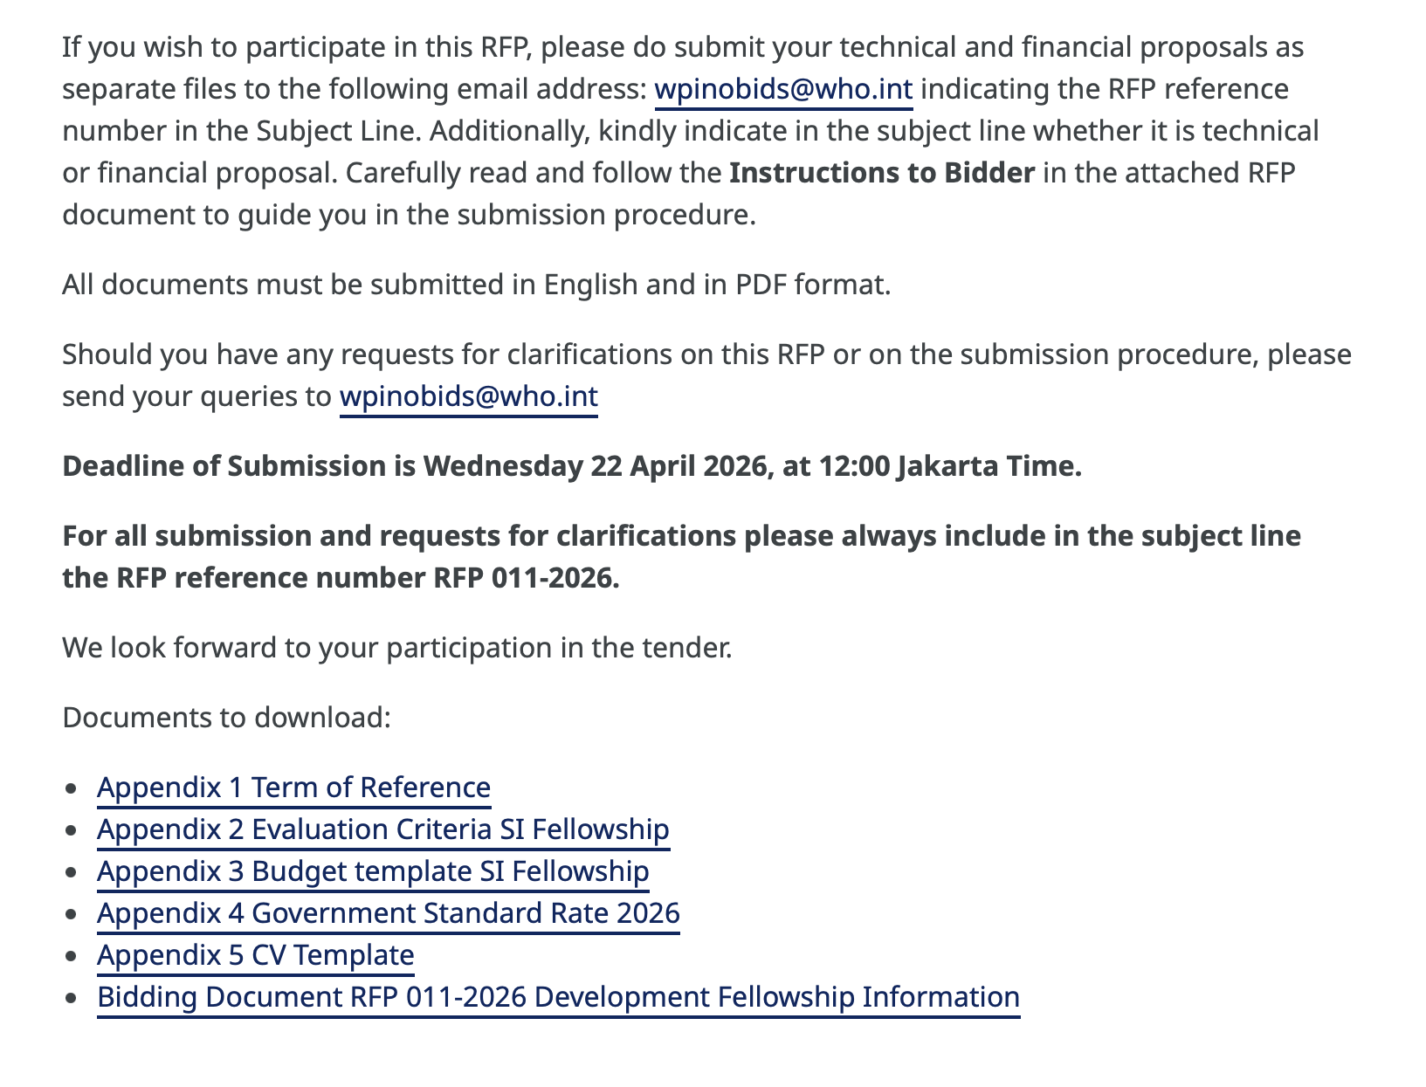
The Suggestive Budget Detail Template
Refer to Invitation RFP-011-2026 Appendix 3
who.int/RFP-011-2026-Fellowship
Note:
Scoring – Technical proposal : Budget proposal is 70:30
With minimum passing points for technical proposal is 50

Slide 23


